Slide 1
NIST Calibrations at X-Ray and Ultraviolet Wavelengths
Claire Cramer
IACHEC Meeting
25 March, 2013

Slide 2
Who am I and why am I here?

Slide 3
Outline
Introduction/Background Material
Flux/Detector Response Calibrations
Spectroscopy and Detector Development

Slide 4
What is NIST?
National Institute of Standards and Technology
USA’s National Metrological Institute (NMI)
Other examples:
Physikalisch-Technische Bundetanstalt (PTB)
Laboratoire national de metrologie st d’assais (LNE)
National Physical Laboratory (NPL)
National Metrology Institute of Japan (NIMJ)
National Institute of Metrology (NIM)
Umbrella Organization:
Bureau Internationale des Poids et Mesures (BIPM)

Slide 5
Function of an NMI
Maintain national standards of the
seven base SI units
meter
second
kilogram
ampere
Kelvin
mole
candela

Slide 6
SI Traceability
Any meaningful calibration of a quantity with units must have an unbroken chain of measurements tying it to primary standards.
Each link in the chain must have quantified uncertainties.

Slide 7
X-Ray and UV Flux Calibration
Synchrotron Ultraviolet Radiation Facility (SURF)
contact: Tom Lucatorto, Uwe Arp
Radiation Dosimetry
contact: Michael Mitch, Larry Hudson

Slide 8
Where do we put X24C?

Slide 9
Custom-Tailored Output Spectrum
Example Output Spectra
Notes:
Since we are a small facility with few simultaneous users, we have the freedom to change operating parameters as we please. For most calibrations based on broadband synchrotron radiation, it is useful to change the energy of the stored electrons, which will shift the output spectrum. That gives us a handle on higher orders.

Slide 10
Combined Relative Standard Uncertainty
Combined Relative Standard Uncertainty
E=380 MeV
B=1.5142 T
ν_{rf}=114 MHz
I_{B}=1 mA
d=10000 mm
ΔX=7.071 mm
Δ Y=7.071 mm
E=380 MeV
B=1.5142 T
ν_{rf}=114 MHz
I_{B}=300 mA
d=10538 mm
R = 6.5 mm

Slide 11
SURF III Beamlines
# | Wavelength range | Calibration | Accuracy
1a | 13 nm | Resist sensitivity (EUV)
1b | 5 nm – 20 nm | Photoresist prequalification testing (EUV) Optics lifetime (EUV)
2 | 0.3 nm - 400 nm | EUV/UV spectrometer calibrations | < 1.0 %
3 | 200 nm – 400 nm 200 nm – 2000 nm | Light sources (D₂ and other UV) Filtered radiometers (UV, VIS, NIR) | < 1.0 % < 0.5 %
4 | 140 nm - 320 nm (110 nm – 320 nm) | Detector calibrations (DUV, UV) Detector radiation damage (DUV, UV) Optical properties (DUV, UV) | < 0.5 % (AXUV) < 1.0 % < 1.0 %
5
6 |  | Beam Current Monitor | 0.2 %
7 | 7 nm - 35 nm | Reflectometry (EUV) Optical properties (EUV) Detector calibrations (EUV) | < 1 % < 1 % < 2 %
8 | 13 nm | Optics lifetime(EUV) EUV-induced surface chemistry
9 | 5 nm - 50 nm | Detector calibrations (EUV) | < 5 %
10 | 550 nm | Beam imaging | < 5 %

Slide 13
Absolute Radiometry with SURF
Source-based: calibration of standard sources, spectrometers
Detector-based: calibration of detectors, filter/detector packages
Storage Ring
Window
Monochromator
Detector Under Test DUT
Absolute Detector AD
MonitorDetector

Slide 14
Radiometry: Detector Calibrations
Radiometric Detector Calibrations:
5 nm
254 nm
Wavelength (nm)
Facilities
BL9 (5 – 50)
C-29 (50 nm – 254 nm)
7 - 33
ACR BL7
2%
33 - 50
IC
5%
50 – 92
IC x 2
8% (typ.)
92 – 116
Intrplte
NA
140 – 320
ACR BL4
1%
Range λ (nm)
Primary standard
Quoted uncertainty
Present:
ACR 2% calibrations only possible 7 – 33 nm on BL-7
ACR 1% calibrations only possible 140 – 320 nm on BL-4
Ionization chamber ≈ 8% calibrations used in range 33 – 92 nm
Rough interpolation used 92 – 116 nm
Photodiodes calibrated 5 – 50 nm on BL-9 and 50 – 254 nm on plasma discharge system
Planned with X24C:
ACR 1% or better from 4 nm – 400 nm
Photodiodes calibrated 4 nm – 400 nm on SURF III

Slide 15
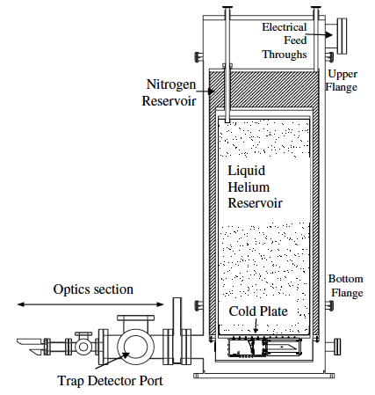
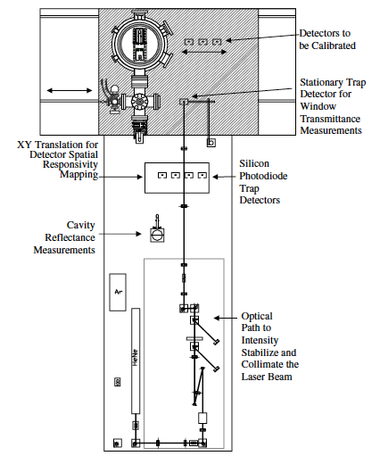
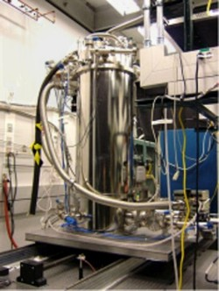
SI-Traceability for SURF Calibrations
Primary Optical Watt Radiometer: ties together units of electrical power (W), temperature (K), and luminous intensity (candela)
Allan Smith, Joe Rice

Slide 16
Radiation Dosimetry Group
Develop dosimetric standards for x rays, gamma rays, and electrons
based on the SI unit, the gray, 1 Gy ≡ 1 J / kg
keV x-rays: x-ray tubes, radioactive sources
MeV x-rays: linac
gamma rays: irradiators, e.g., ⁶⁰Co, ¹³⁷Cs
electrons: linac, Van de Graaf, radioactive sources
Applications: homeland security, medical, radiation processing, radiation protection

Slide 17
Radiation Dosimetry Measurement
Use a free-air ion chamber to measure air kerma:
energy released per unit mass of irradiated air (J/kg)
Electrometer
Attix free-air
chamber
Mo, Rh anode
x-ray tubes
filters
V
calibrate chamber with standard source
use calibrated chamber to measure other sources or calibrate other detectors

Slide 18
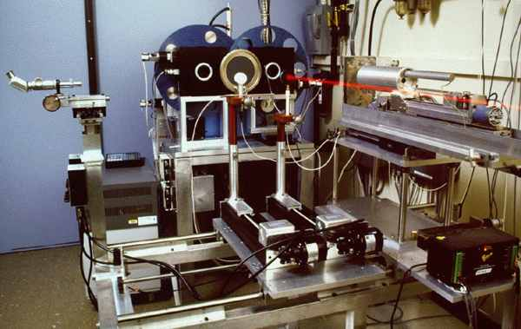

Slide 19
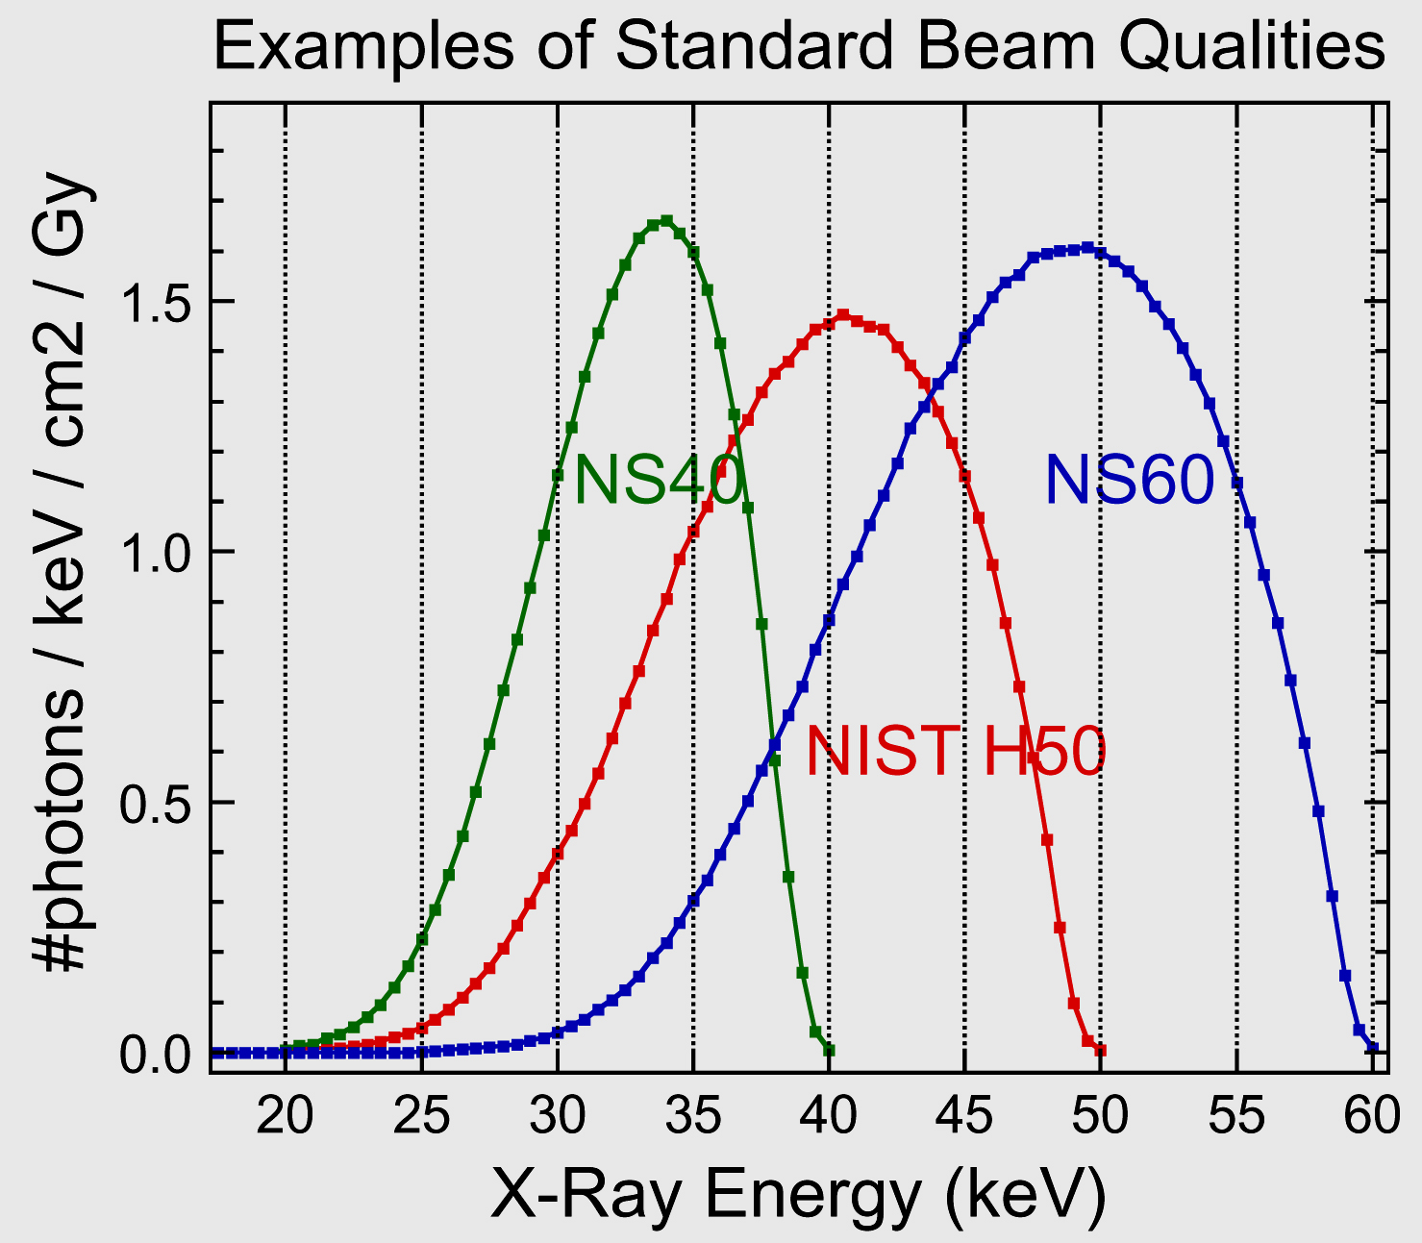
NIST x-ray calibration ranges produce standard beam qualities with absolute air-kerma rates at 1 %.
NS40
ISO Narrow Spectrum
W anode, 40 kV
filtration:
4.0 mm Al, 0.21 mm Cu

Slide 20
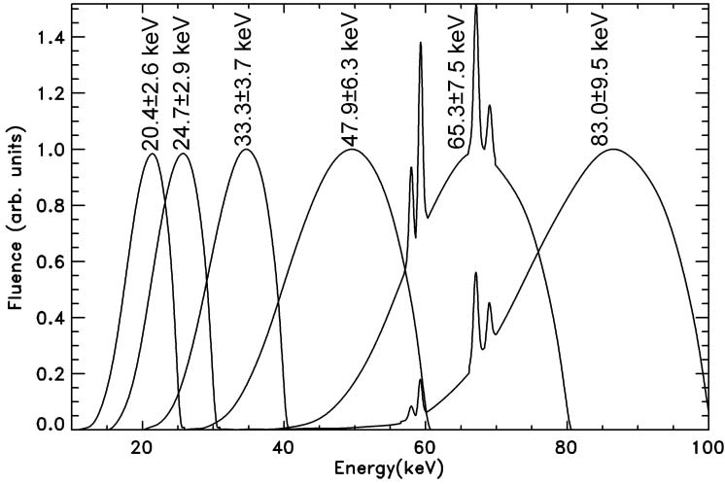
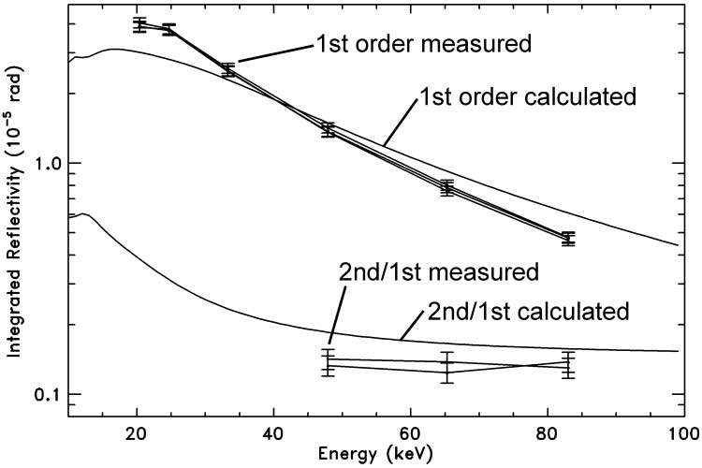
SI-Traceable Spectrometer Calibration
Calibrated double-crystal transmission spectrometer in bandpasses from 20-80 keV, compared with computational model.
Szabo, et al., Applied Optics, 36, 1335 (2011)
Absolute accuracy: 5%
10-300 keV

Slide 21
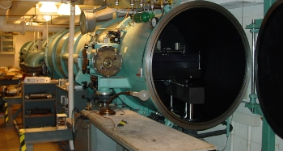
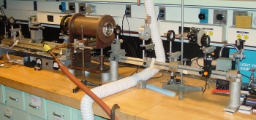
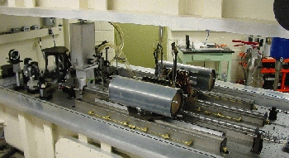
Atomic Spectroscopy
10.7 m Normal and Grazing Incidence Spectrographs
Czerny-Turner Spectrograph
Fourier Transform Spectrometer
SURF Beamline Instruments
contact: Joe Reader, Gillian Nave

Slide 22
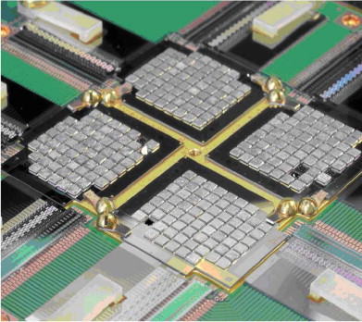
Transition-Edge Sensors
any wavelength
high spectral resolution
(53 eV @ 97 keV)
high temporal resolution
(1 photon, 10 us)
low temperature
(100 mK)
contact:
Joel Ullom, Terry Jach
Bennett, et al., Rev. Sci. Instruments, 83, 093113 (2012)
Rausch, et al., Proc. SPIE Vol 7011 70113T-1

Slide 23
Working With NIST
We have internal funding sources to start new “calibration services” and attempt high-risk innovations in measurement science
We can also partner with other agencies w/ MOU, contract, grants, etc.
We are always looking for interesting work to do – stay in touch, help us understand what you need

