Slide 1
XMM-Newton EPIC Cross-Calibration
Andy Read
With contributions from Matteo Guainazzi, Jukka Nevalainen, Steve Sembay and others

Slide 2
XMM: Different Samples & Methods
Galaxy Clusters (GC) – Jukka
  Pros : Constant, Spectrally simple
  Cons : Extended, diffuse
Very Bright RL AGN (XCAL) – Matteo, Martin
  Pros : Bright, point-source
  Cons : Piled-up, core-excised, variable
Bright clean point sources (2XMM) – AR
  Pros : Point-source, non-piled-up
  Cons : Spectrally complex/different, variable

Slide 3
2XMM Sample Selection
2XMM DR3 (up to Rev1600, Sep 2008)
Full-Frame (FF) mode and thin or medium filter in all of M1, M2 & pn
Point sources (zero extent)
Near on-axis (EP_OFFAX<2’)
Low column (|b|<15deg)
Large numbers of counts (>5000 in each MOS, 15000 in pn)
Below FF pile-up limit (rate<0.7 c/s [MOS], <6 c/s [pn])
87 sources
BG-flare cleaned, common GTIs applied, and visually inspected
Removed sources where:
  at least one instrument had ~zero time/counts
  confused sources close to other bright sources
  appearing extended, or point source within extended emission
  quadrant/chip loss
  bright sources in the BG extraction region
46 sources

Slide 4
2XMM Data Reduction
Standardized (where possible) across all EPIC cross-cal analyses, e.g. 2XMM (AR), GC (JN)
Public SASv12, standard data-reduction meta-tasks e[mp]proc/e[mp]chain, default parameters
Use data screening criteria as recommended to the users:
  PATTERN<=12 for MOS, PATTERN<=4 for pn
  #XMMEA_EM (MOS), FLAG==0 (pn)
  spectralbinsize=5 in evselect
Common GTIs for each source separately (2XMM)

Slide 5
2XMM Spectral Reduction
For each source and each instrument, produced:
  Source spectra 0-40” (also can do 0-60”, 5-40”, 15-40”, 5-60”, 15-60” etc)
  BG spectra 90-180”
  rmfs and arfs
For each instrument:
  Source spectra stacked together (exposure-weighting BACKSCAL)
  BG spectra stacked together (exposure-weighting BACKSCAL)
  Average exposure-weighted arf calculated
  Average exposure-weighted rmf calculated
Output is (for each of M1, M2 & pn) one source spectrum, one BG spectrum, one arf & one rmf

Slide 6
2XMM Spectral Analysis
Having stacked the data, we now fit – ‘Stack & Fit’
Multi-component (phenomenological) model constructed to closely fit the pn data
How M1/M2 varies wrt pn can then be inspected

Slide 7
2XMM
46 sources (SB12)
Black: pn, red: MOS1, green: MOS2

Slide 8
2XMM Spectral Analysis
Calculated and plotted is the ratio R : [MOS-data/(pn-)model] / [pn-data/pn-model]
This removes any differences between the pn data and the pn model prediction (tests using ‘good’ models of varying ‘goodness’ resulted in negligible changes to the R ratio)
Used e.g. also for GC for ACIS/Swift-XRT/Suzaku (and EPIC) (JN)
Most/all sources of possible error removed/minimized:
  Variability – Common GTI
  PSF – non-piled up sources and large extraction radius
  Complex/different spectra – stack into one spectrum, fit, calculate R ratio

Slide 9
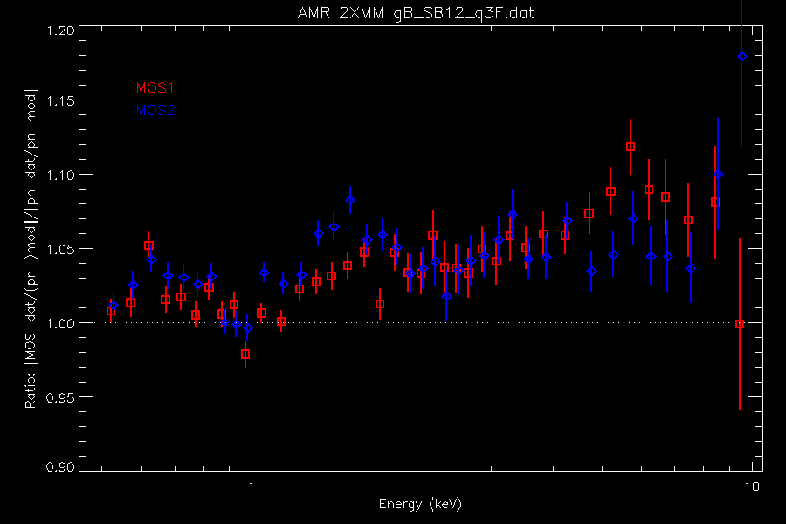
2XMM – MOS1/pn & MOS2/pn

Slide 10
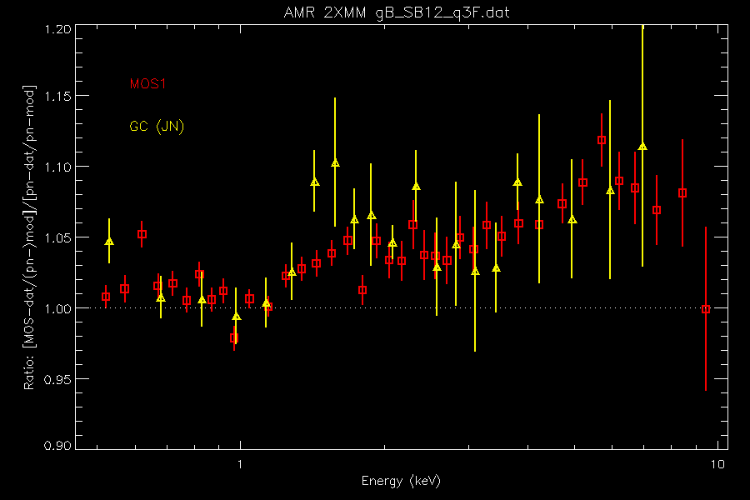
MOS1 – 2XMM v GC

Slide 11
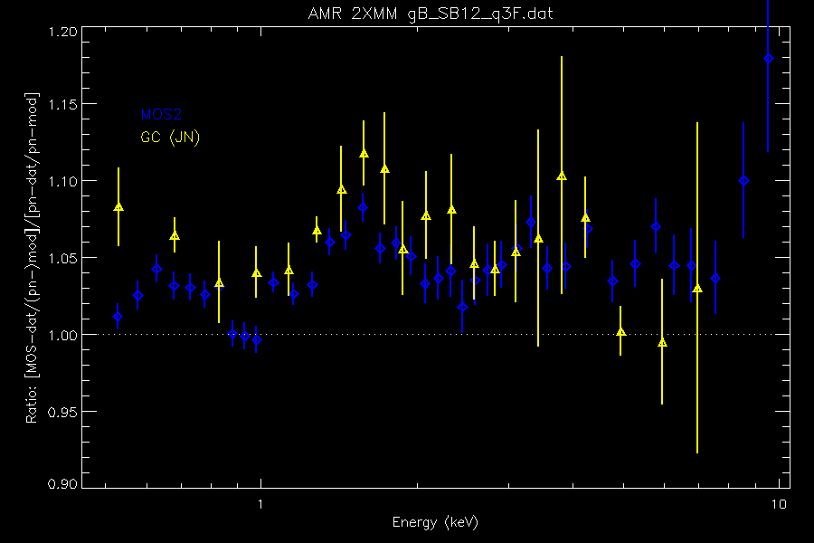
MOS2 – 2XMM v GC

Slide 12
Other (Jukka, Matteo) Stacked Residuals Method – ‘Fit & Stack’
For each source, pn spectrum is fit
Calculated model applied to spectrum of each camera – residuals (data/model) calculated and stored
For each camera, residuals obtained on all sources are averaged (median) together
Each MOS average residual spectrum divided by the pn average residual spectrum – removes features due to uncertainties in pn calibration (<~2%)

Slide 13
2XMM
‘Stack and Fit’ vs ‘Fit and Stack’ (MG)
Yield consistent results over E-range where number of channels with negative counts is small (might be explanation of JN’s GC MOS2/pn)
S&F method may be more robust

Slide 14
Main Results : Closing Remarks
Stack & Fit method, calculating stacked residuals R ratio seems stable and robust for non-piled-up on-axis point sources (common GTIs, weighted RMF, large extraction circle etc.)
Approaching a MOS/pn description that is (high-statistic and) consistent with other methods/samples (e.g. GC)
At >1.5keV, MOS(/pn) looks very similar to GC ACIS, Swift-XRT
At <1.5keV, MOS(/pn) larger than GC ACIS, XRT, also XIS1,XIS3. Similar to GC XIS0
Future plans include
  Extend to 3XMM
  applying to off-axis (& off-patch) regions
  investigating narrow annuli (PSF)

Slide 15
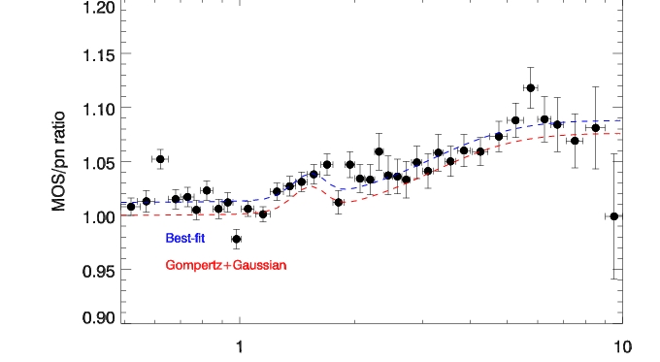
2XMM MOS1

Slide 16
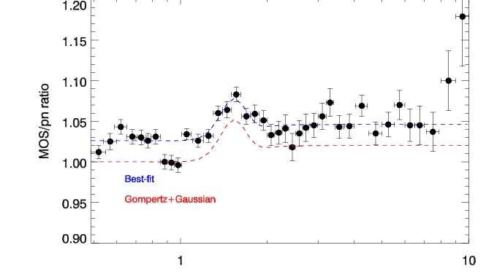
2XMM MOS2

