Slide 1
2015 IACHEC Possible venues in China

Slide 2
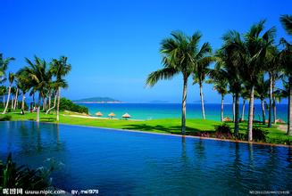
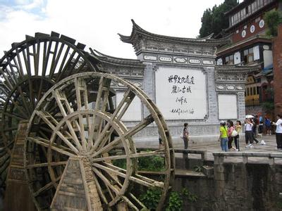
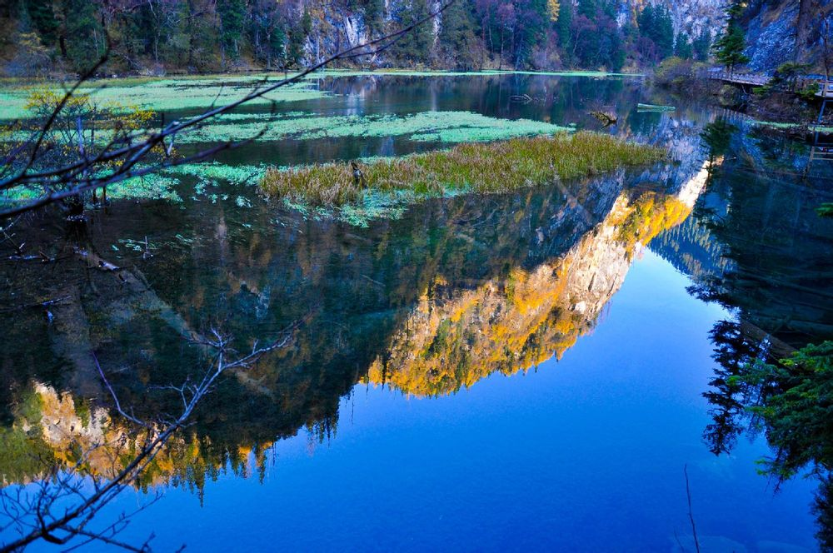
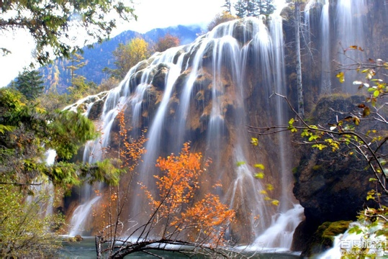
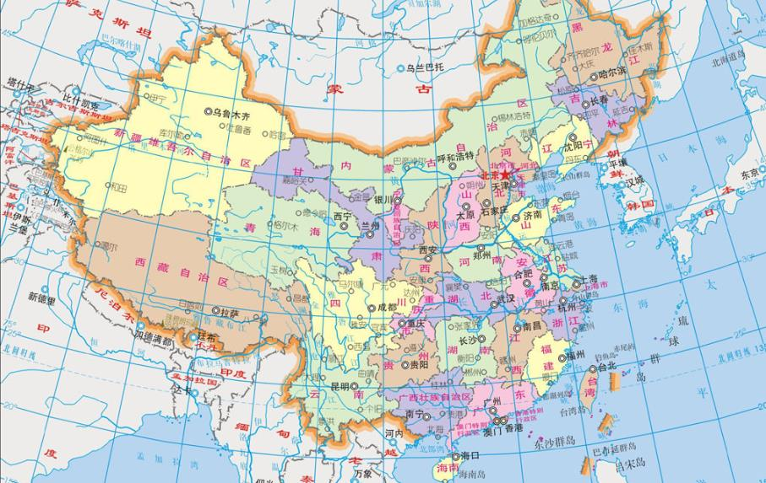

Slide 3
Venues for IACHEC: isolated convenient relatively nice be better typical at least locally
Sightseeing for tourist but not for IACHEC;
Serve as your possible backup vocation plan

Slide 4
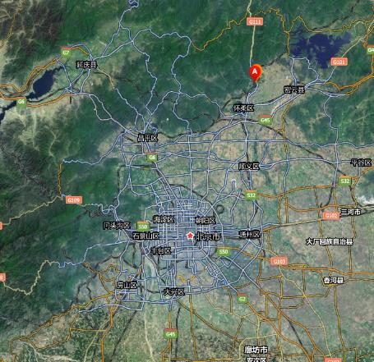
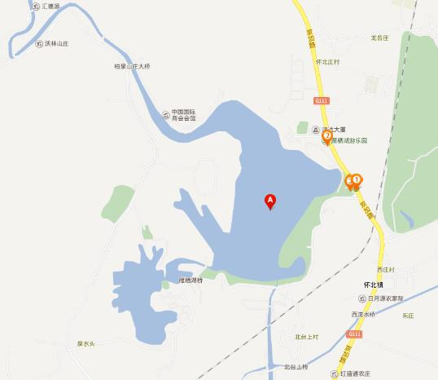

Slide 5
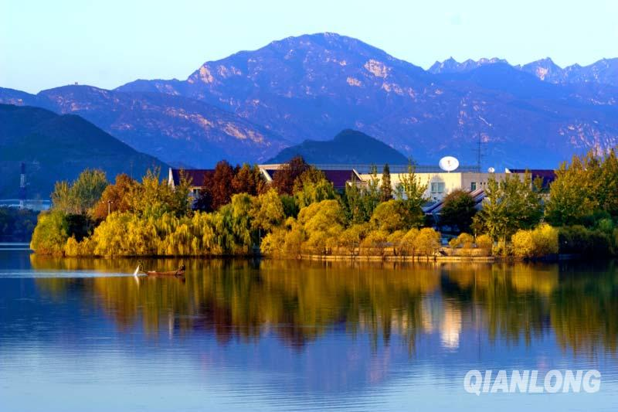
One choice for 2015 IACHEC venue: hotel around YanQi lake 62 km to downtown of BJ 36km to BJ international airport

Slide 6
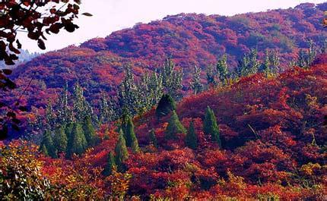
another choice for 2015 IACHEC venue: hotel in middle of the fragrance hill 20 km to downtown of BJ 60 km to BJ international airport

Slide 7
Welcome to China for 2015 IACHEC

