Slide 1
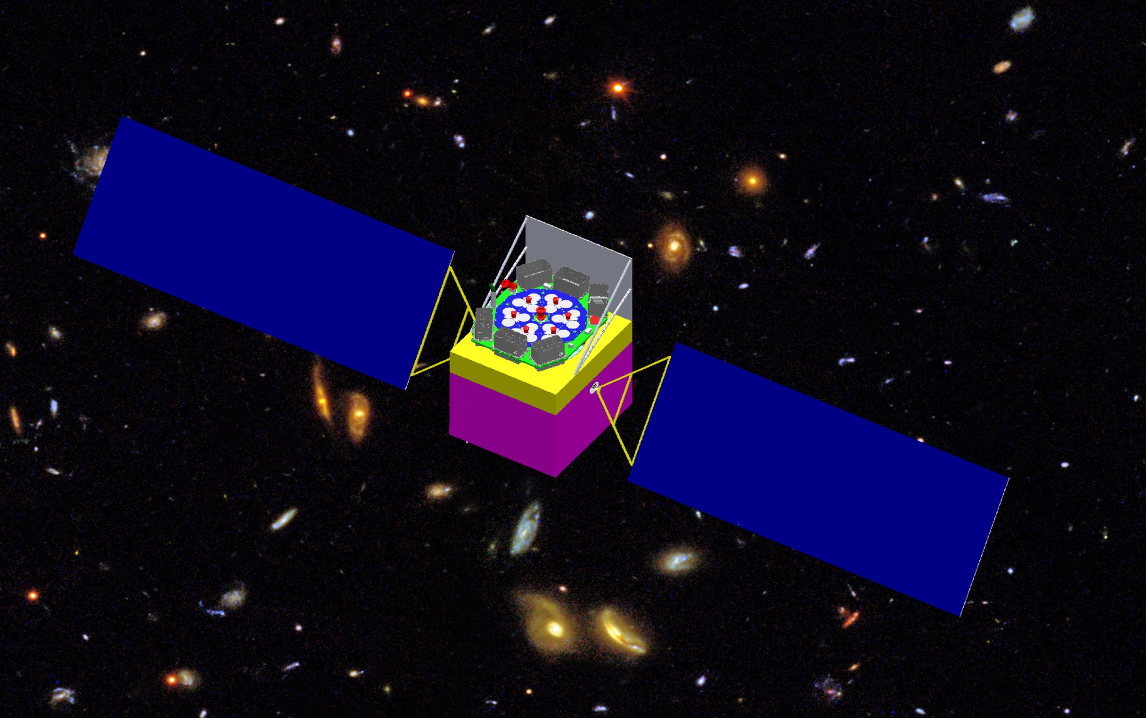
Progress of HXMT Science Ground Segment: Calibration and Background analysis
9th IACHEC
Zhang Juan，on behalf of HXMT SGS Institute of High Energy Physics, CAS

Slide 2
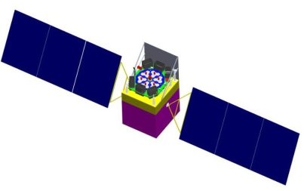
Outline
HXMT & Science Ground Segment(SGS)
SGS Calibration work and its current status
--- Li Xiaobo, lixb@ihep.ac.cn
HXMT background analysis
Summary
May 10-15, 2014 IACHEC @ Warrenton

Slide 3
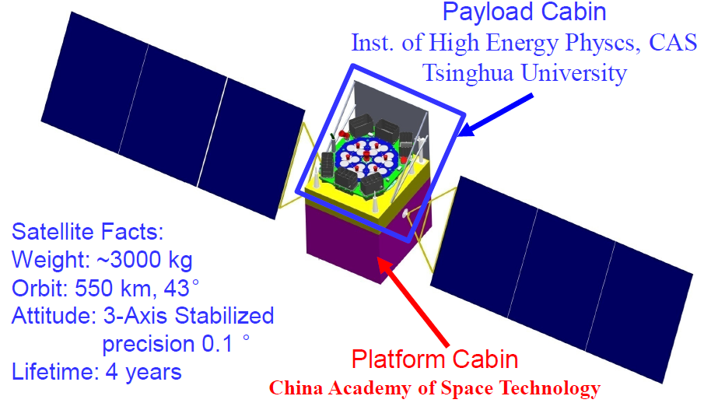
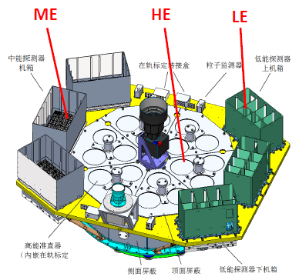
1. Introduction of HXMT & SGS
HXMT---
Hard X-ray Modulation Telescope
Orbit: ~550km,~43°
Collimated X-ray telescope
Payloads:
HE(NaI/CsI, 20-250keV)
ME(Si-Pin,5-30keV)
LE(SCD,1-15keV)
SEM(space environment monitor)

Slide 4
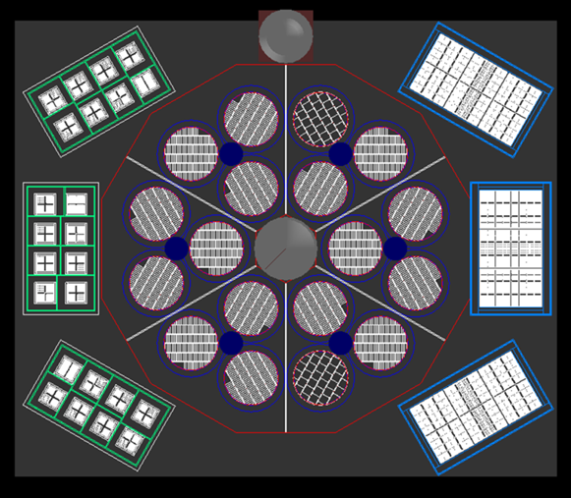
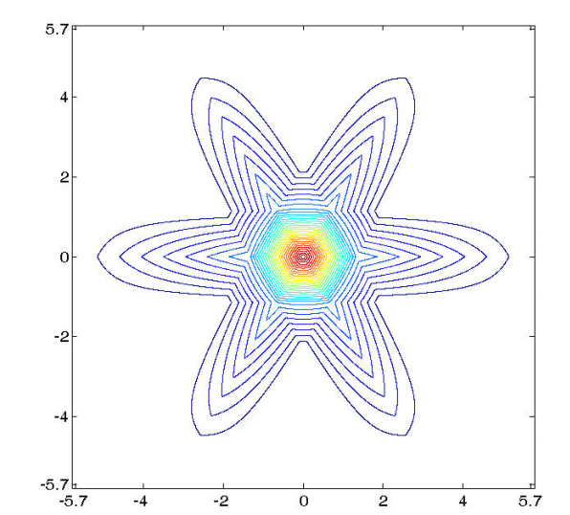
Special design
Different FOV detectors: large, small, covered
Collimator co-axis, but FOVs fall into 3 groups according to their major axis direction
Useful in background analysis
LE
ME
HE
Theoretical psf of HE-15 small FOV detectors

Slide 5
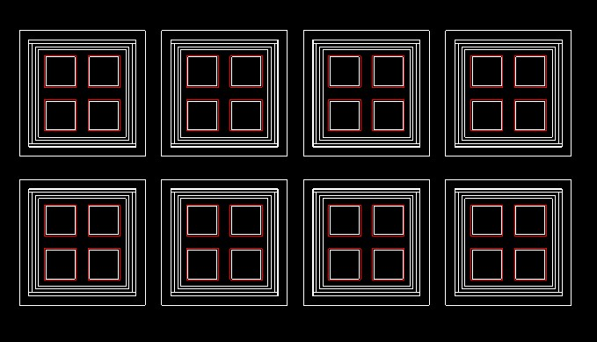
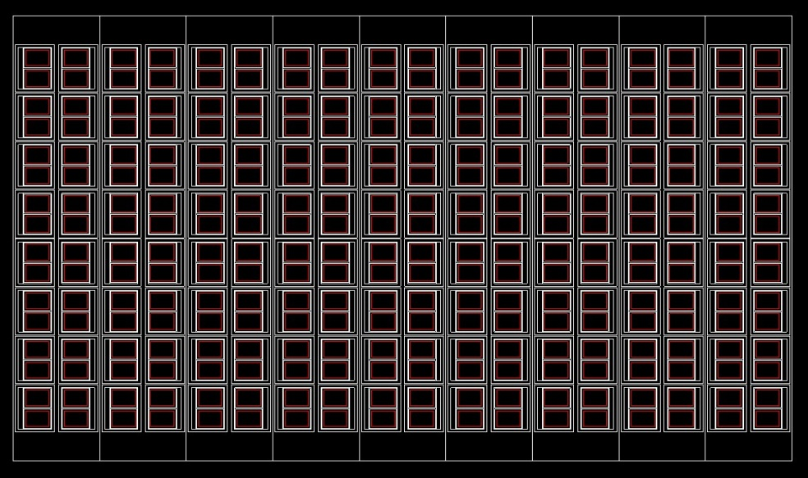
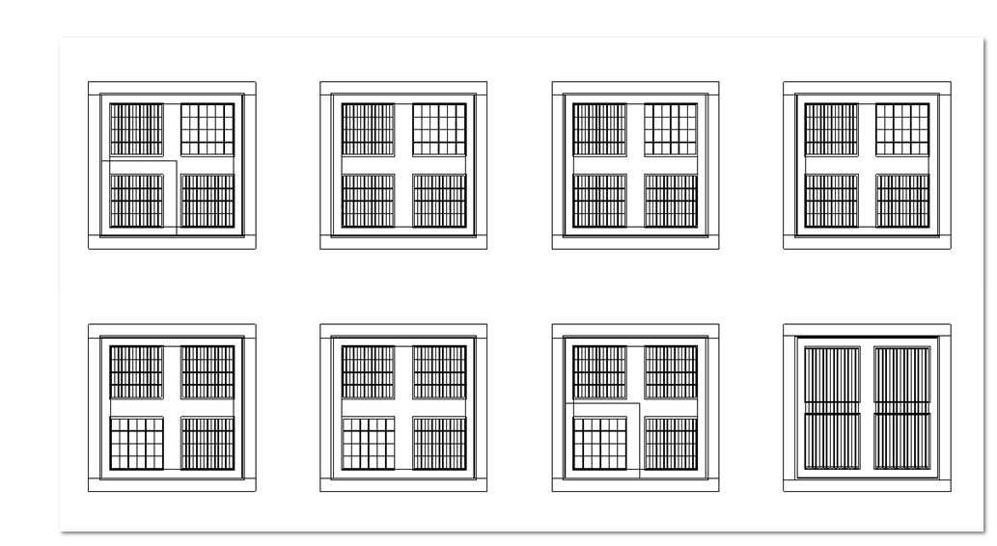
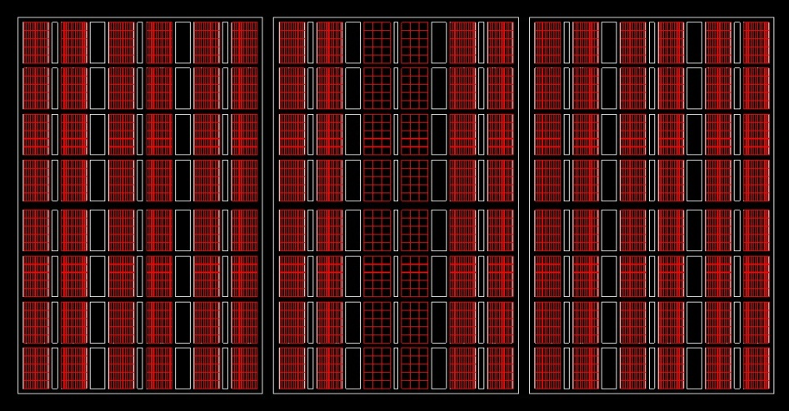
Visualization of HXMT detectors
SCD detectors of LE in one box:
Si-Pin detectors of ME in one box:
Collimators of LE:
Collimators of ME:

Slide 6
HXMT SGS

Slide 7
2. Calibration data flows in HEASARC

Slide 8
2. Flow of HXMT-SGS Calibration
Mass model
Cal. Params.
Raw Evt. data
rsp
db
Comds.
detSim
specSim
Spectrum,
efficiency
rspGen
Data Analysis
software
CALDB
detSim
Inputs:
Mass model of instrument and environment
Some commands to configure the simulation
Outputs:
Raw event files(ROOT files)
External dependencies:
GEANT4—toolkit for MC of particle interactions with matter from CERN
ROOT– Data analysis package from CERN.
May 10-15, 2014 IACHEC @ Warrenton

Slide 9
Continue:
specSim
Inputs:
Raw event root files
Calibration parameters from experiment data
Outputs:
Energy response curve and efficiency
FITS file, like rmf, arf.
External dependencies:
ROOT– Data analysis package from CERN.
CCFITS—FITS data file I/O
rspGen
Inputs:
FITS file from CALDB
Some FTOOLS to generate the RMF of observe ID.
Outputs:
Application RMF files
External dependencies:
CCFITS—FITS data file I/O
FTOOLS of CALDB related.
Incident Generator
All kinds of incident particles
Geant4
Mass Model,
Physical interaction model
Hit information
Deposit energy
Deposit position
Energy resolution and scale
Digitization
ADC spectrum,
Pulse width spectrum

Slide 10
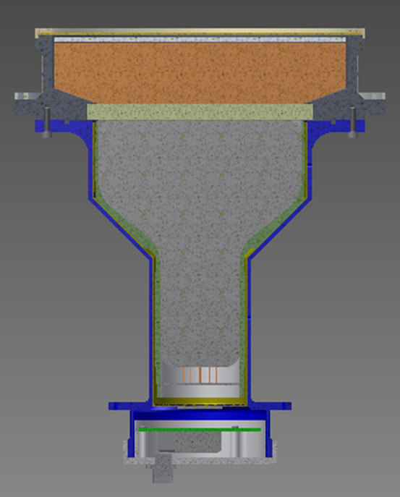
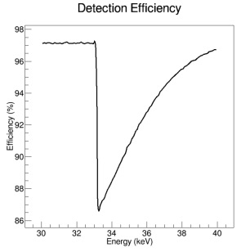
Current Status---HE
Rad Src. | E(keV) | chn | deltaE/E | Det eff.
Am241 | 59.5 | 50.1 | 15.5% | 100%
Co57 | 122.1 | 99.7 | 12.2% | 70%
Ba133 | 33.0 | 26.4 | 21.0% | 100%
 | 81.0 | 68.4 | 12.9% | 97%
Detector :thinkness*diameter
Be-window：1.5mm*212mm
NaI：3.5mm*190mm
CsI：40mm*190mm

Slide 11
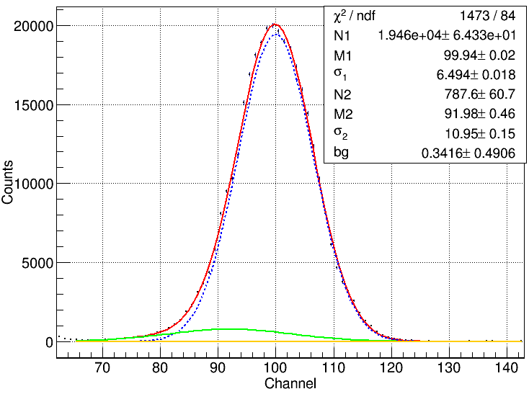
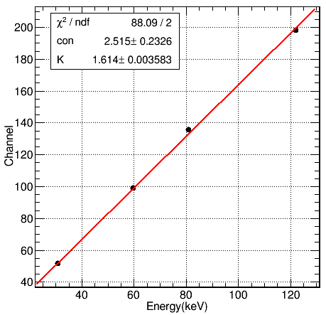
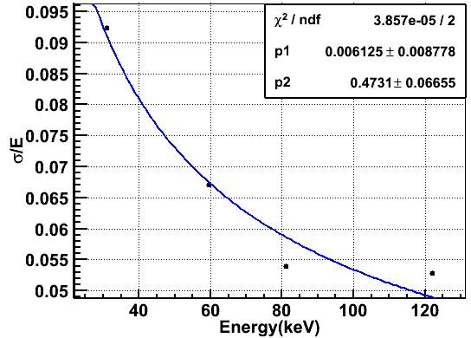
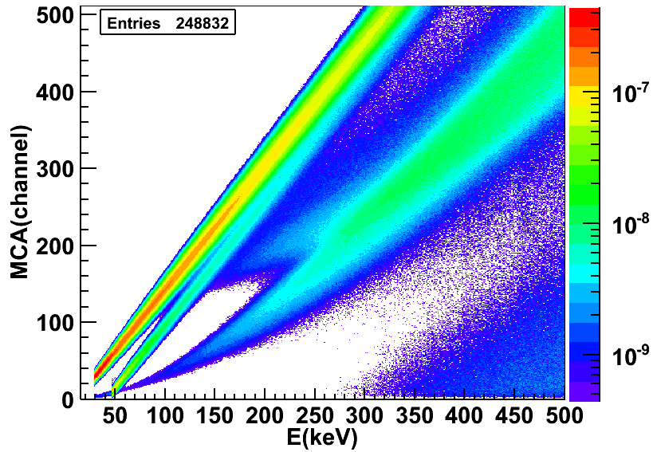
Current Status---HE
HE: Energy scale and resolution → rsp
²⁴¹Am@ HE
σ/E=0.006+0.47/sqrt(E)
C=2.515*E+1.614
Rad Src. | E(keV) | chn | deltaE/E | Det eff.
Am241 | 59.5 | 50.1 | 15.5% | 100%
Co57 | 122.1 | 99.7 | 12.2% | 70%
Ba133 | 33.0 | 26.4 | 21.0% | 100%
 | 81.0 | 68.4 | 12.9% | 97%
The difference between MC spectrum and data decides the precision of the energy response.
Experience to tune the MC parameters to reduce the difference .

Slide 12
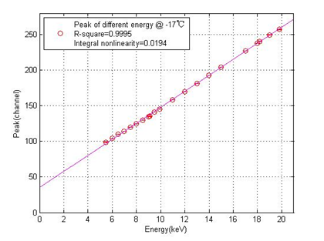
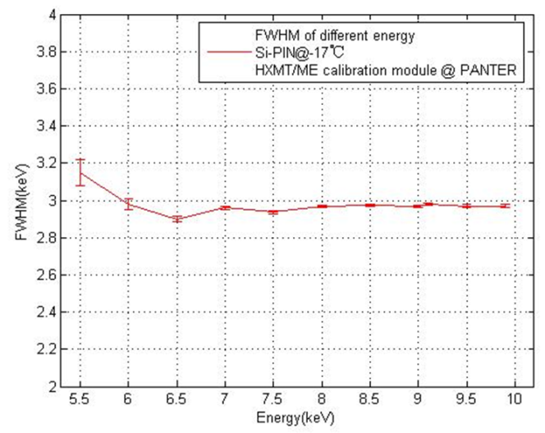
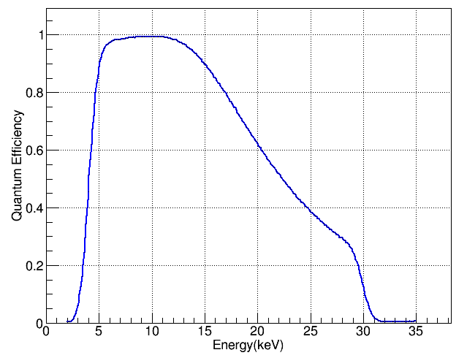
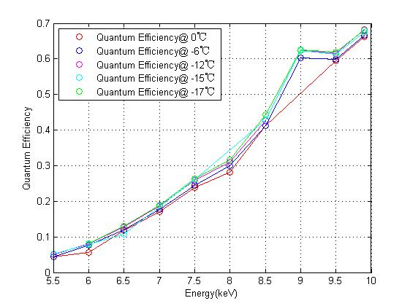
Current Status---ME (Si-PIN)
ME: Energy scale and resolution@Panter
ME: efficiency, MC vs exp. ：
E>4keV &&E<30keV

Slide 13
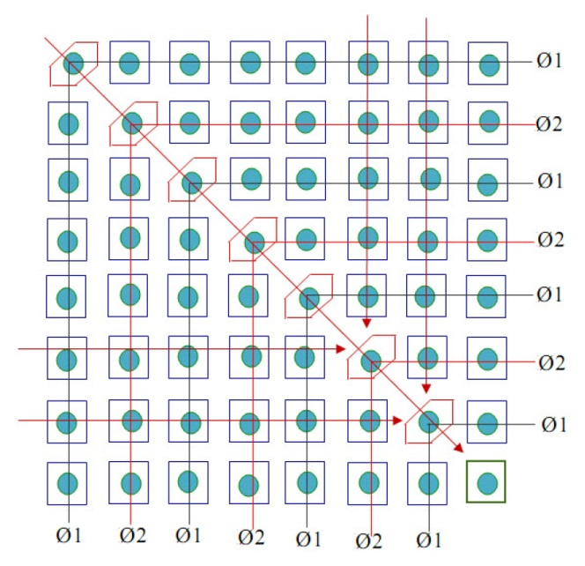
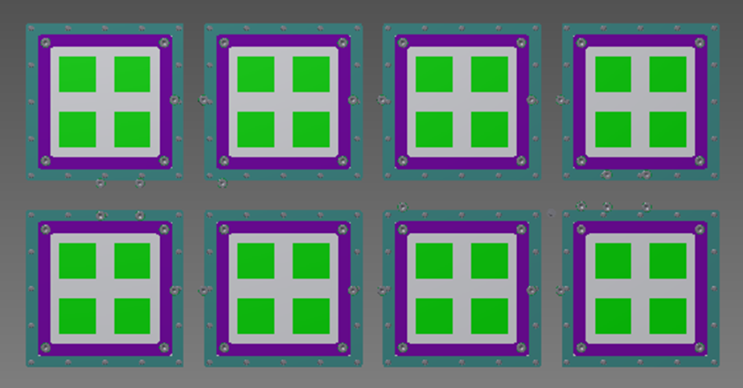
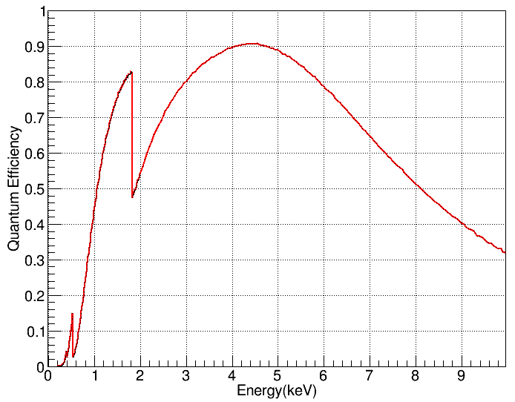
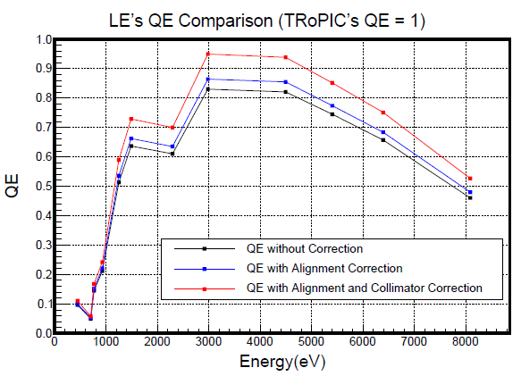
Current Status--- LE(SCD)
4 ×
100*100 pixels
L-shape readout mechanism
Efficiency @MC
Si-K：1.839keV

Slide 14
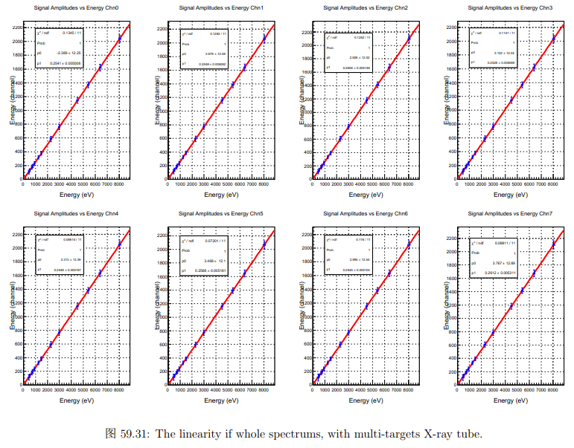
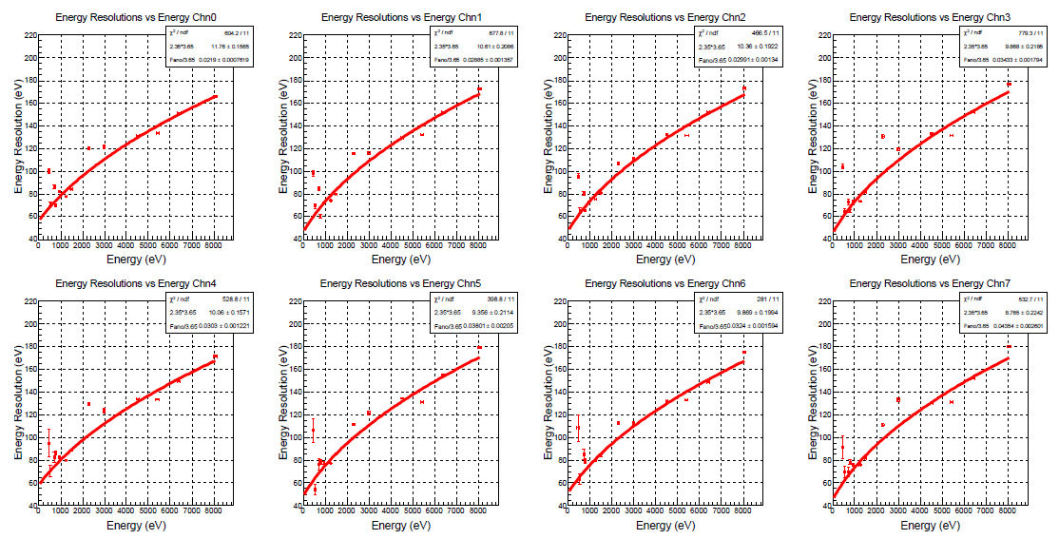
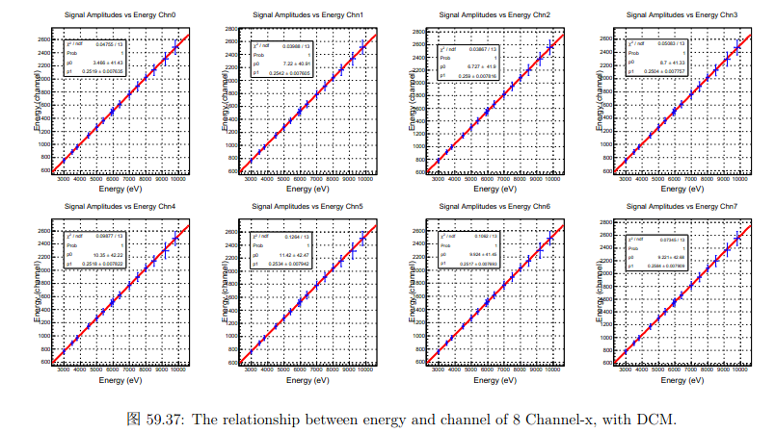
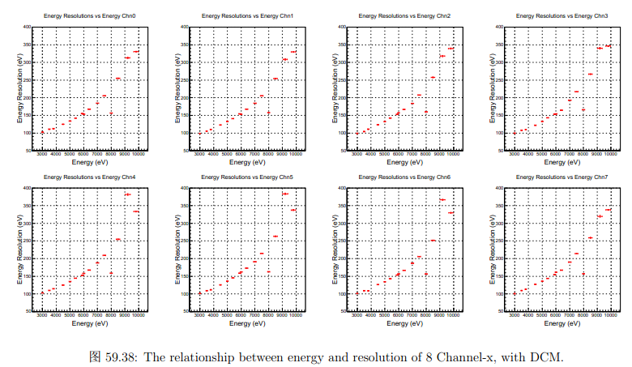
LE: energy scale and resolution@Panter

Slide 15
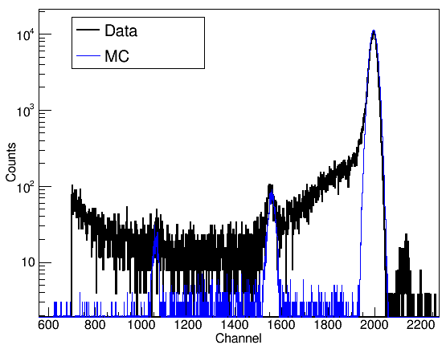
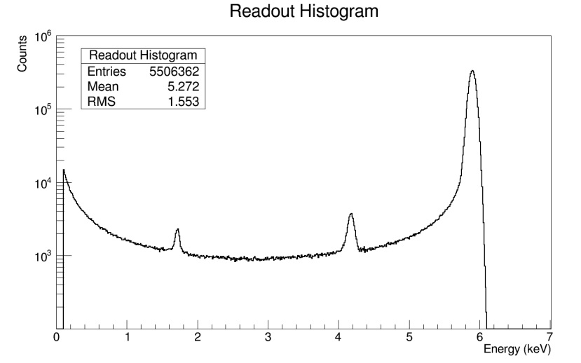
LE Simulation
only considering energy scale + resolution
production of rsp is on-going
Energy scale + resolution+
diffusion , drift and collection effects of charges

Slide 16
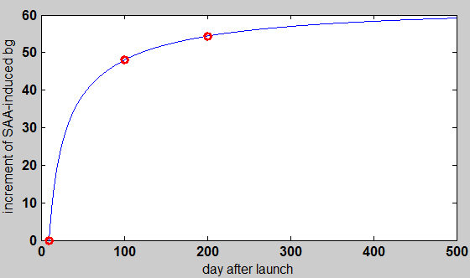
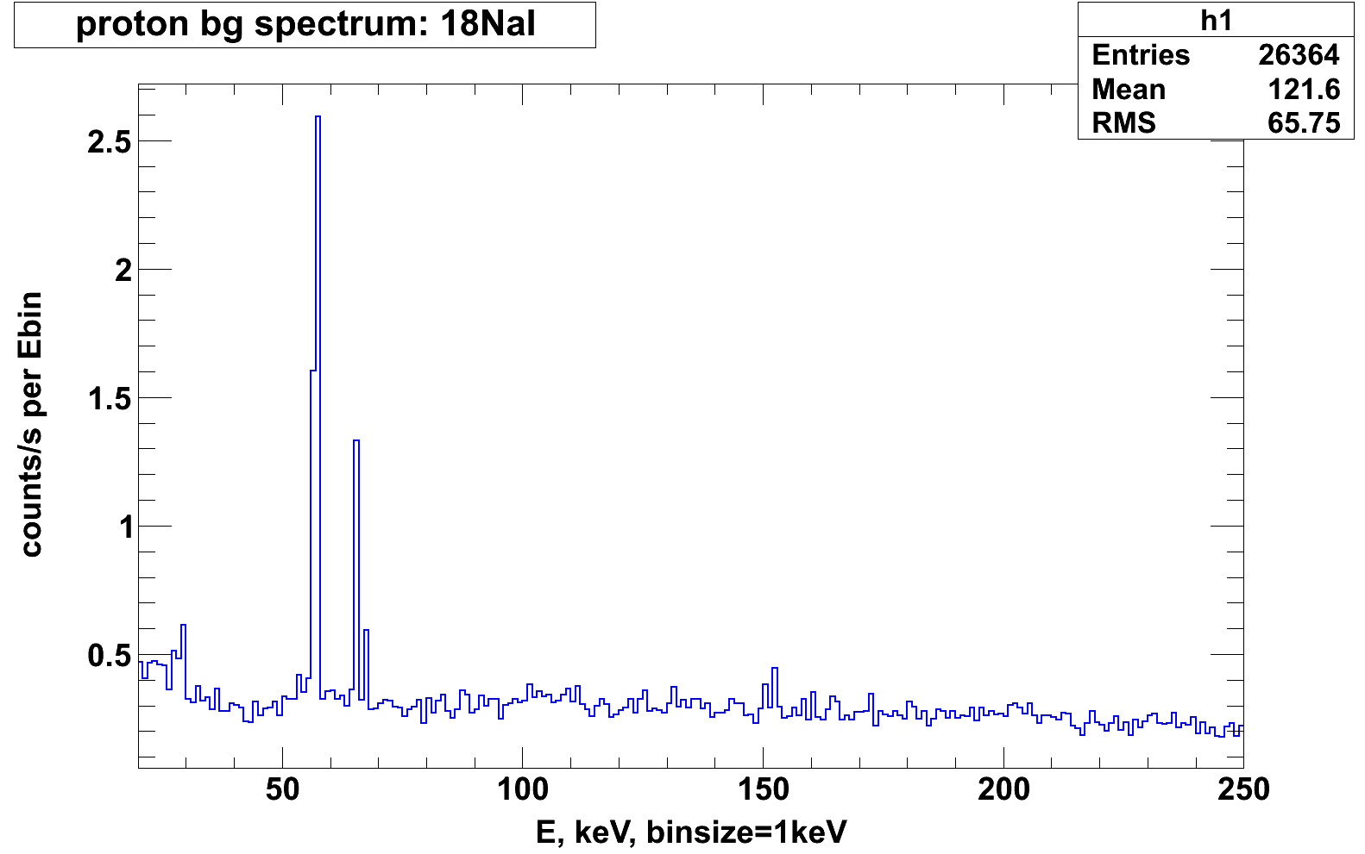
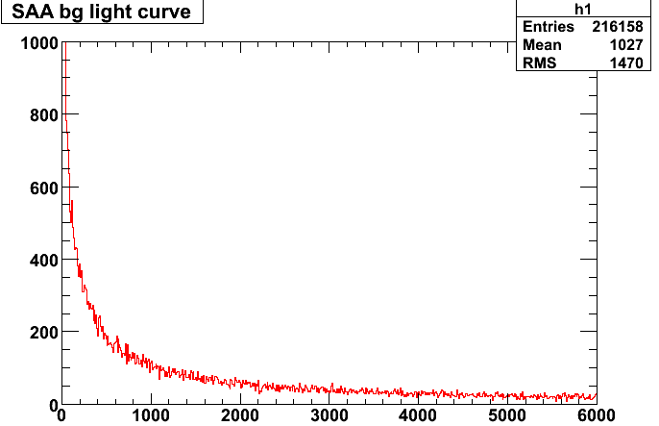
3. HXMT background simulation
Background rate
Take HE as an example, in the day of 100 after launch
CXB~48.0
CR-p：62.7 prompt
CR-p：116.3 delayed
SAA：339.2
Albedo gamma：75.5
HE total bg rate~650cnt/s
SAA-induced bg increase with days after launch due to the activation of long –lived nuclides
SAA induced bg decrease with time after per passage of SAA
RXTE/HEXTE~80-110cnt/s@each cluster(800cm²)
→ HE(5000cm²) 500-680cnt/s

Slide 17
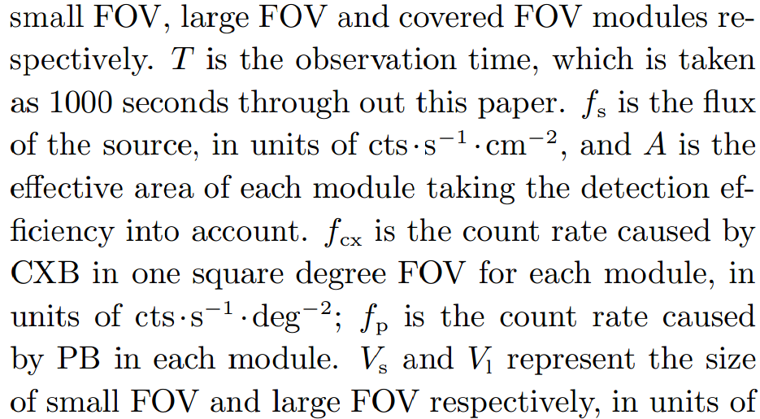
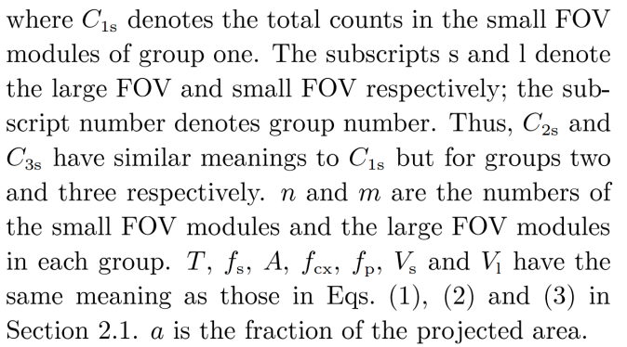
3. in-orbit BG subtraction method
Principle
L
Combined FOV method
Covered detector: Cc=nc*t*fp
Small detector: C­s=ns*t*(fs*A+fCXB*FOVs+fp)
Large detector: C_{­L}=n_{L}*t*(fs*A+fCXB*FOV_{L}+fp)
L
off-axis method
FOV direction-1: C­_{1s}=n_{1s}*t*(f_{s}*A*a_{1s}+f_{CXB}*FOV_{s}+f_{p})
FOV direction-2: C­_{2s}=n_{2s}*t*(f_{s}*A*a_{2s}+f_{CXB}*FOV_{s}+f_{p})
FOV direction-3: C­_{3s}=n_{3s}*t*(f_{s}*A*a_{3s}+f_{CXB}*FOV_{s}+f_{p})
These two methods are based on the condition that:
Aperture background is proportional to FOV size,
Non-aperture background is identical for each detector.

Slide 18
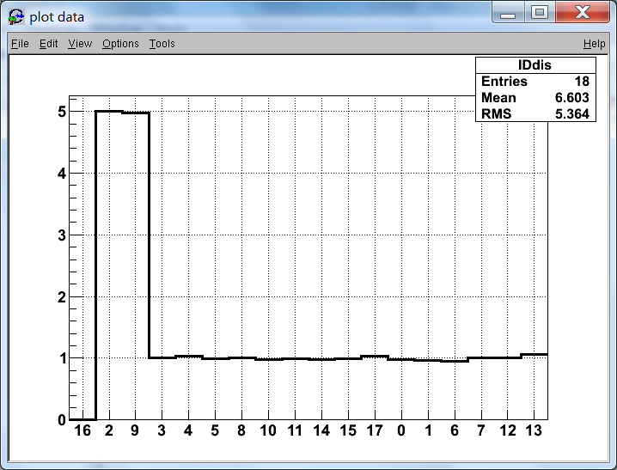
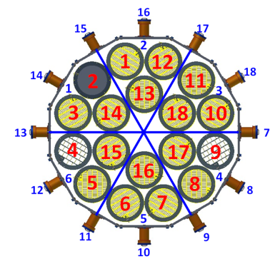
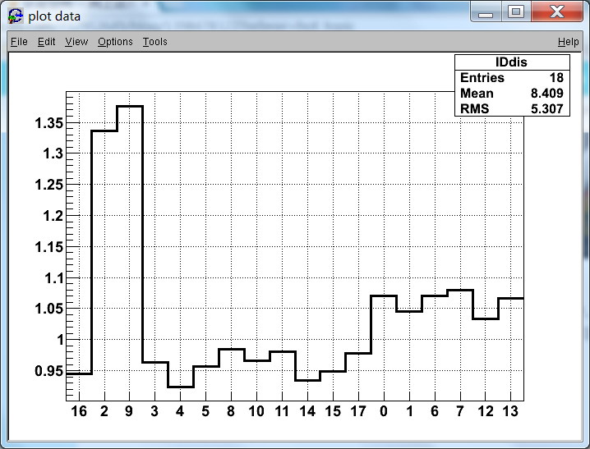
Preliminary bg simulation results
Aperture background of cxb:
Covered det. ~ 0
Large/small ~ 5
Non-FOV bg ratio of cxb:
large/covered ~ 1.44
Inner circle small/covered ~ 1.12
Outer circle small/covered ~ 1.02
Using in-orbit obs. data to determine these parameter, background analysis method and the uncertainties

Slide 19
4. Summary
Now we focus on the construction of caldb, based on MC simulation and ground exp. data
More experimental data are needed
Background: using MC data analysis the subtraction method
In-orbit backgournd subtraction would be more complicated
Thank you for you attention

