Slide 1
NuSTAR Calibration Status
Kristin Kruse Madsen
Caltech

Slide 2
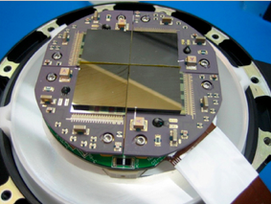
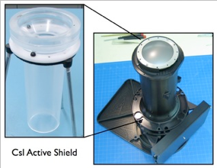
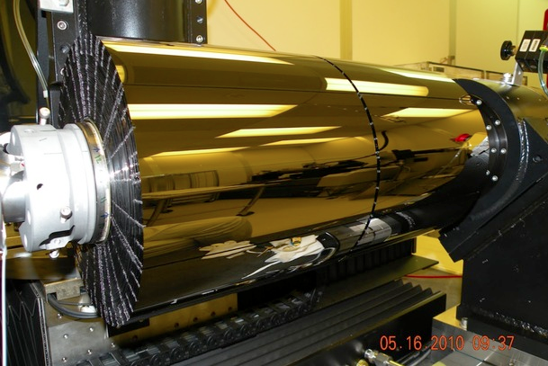
Launch: July 2012
Energy range: 3 – 78 keV
Detectors:
4x(32x32) CdZnTe
Optics:
Conical Wolter-I approximation
133 shells (43 W/Si, 90 Pt/C)

Slide 3
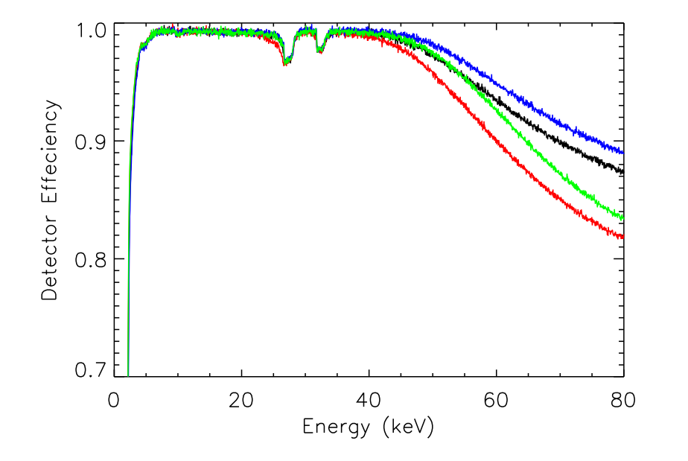
Detectors
Escape lines
Cd & Te
Detector 0
Detector 1
CdZnTe
Operated @15 cº
Photon counting
2.5ms dead time
Detector 2
Detector 3

Slide 4
Gain calibration:
On-board Eu-155 source
Future Gain calibration:
Cas-A
Tycho
Galactic center iron line
Internal bkg lines

Slide 5
Crab residuals - physics based response

Slide 6

NuSTAR effective area components
A₀ = on-axis effective area
  Physics based ray-trace
V = vignetting function
  Physics based ray-trace
GR = Ghost Ray component
  Function of extraction region size, off-axis angle and azimuthal source position
AS = Aperture Stop
  Function of off-axis angle and azimuthal source position
Detabs = low energy Pt, CZT dead-layer absorbent
C = correction function

Slide 7
NuSTAR effective area components
A₀ = on-axis effective area
  Physics based ray-trace
V = vignetting function
  Physics based ray-trace
GR = Ghost Ray component
  Function of extraction region size, off-axis angle and azimuthal source position
AS = Aperture Stop
  Function of off-axis angle and azimuthal source position
Detabs = low energy Pt, CZT dead-layer absorbent
C = correction function

Slide 8
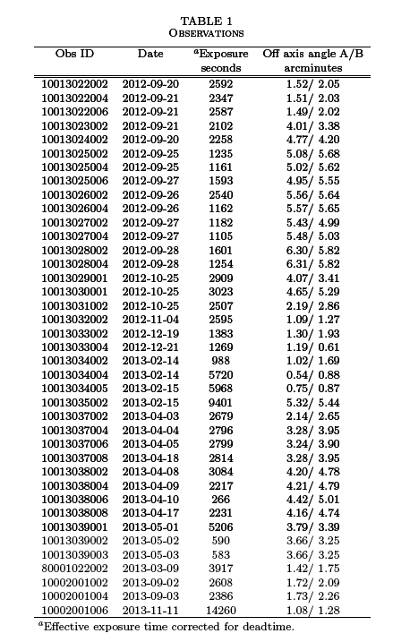
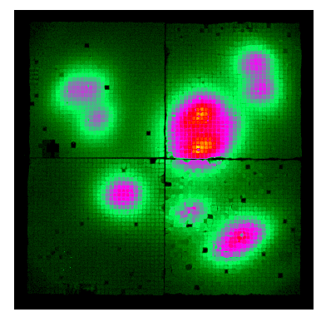
Crab calibration
Assumption:
Γ = 2.1
N = 10
N_{H} = 2.22e21 cm⁻²
(determined from 3c273)

Slide 10
Crab before

Slide 11
Crab after
A/B cross calibration 0 – 5%

Slide 12
Effective Area and Vignetting

Slide 13
Crab parameters v. Off-axis angle

Slide 14
Effective Area calibration Summary
Calibration is valid up to 78 keV (Pt K-edge is theoretically at 78.4 but could be shifted, hence 78 keV as the upper safe limit)
The error on the slope is +/- 0.01 . This is the smallest error you can have on absolute number – tied to the Crab calibration.
We know there is a small evolution in slope as a function of off-axis angle, but that is covered by the +/- 0.01
NuSTAR has calibrated our responses AGAINST the Crab. Slope changes between instruments may be expected.

Slide 15
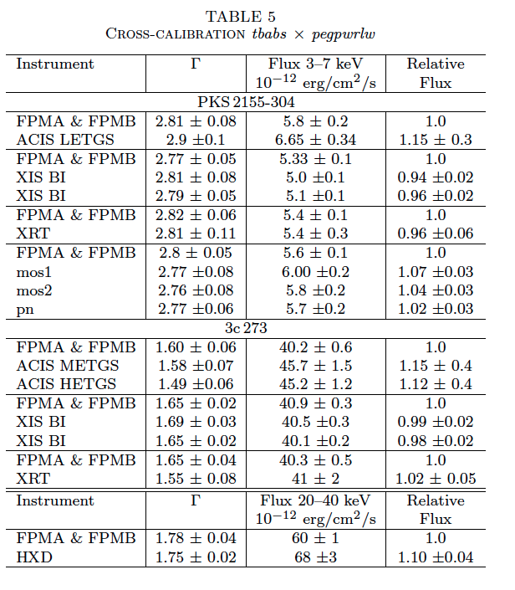
Cross-calibration with 3c273 & PKS2155
Matched START and STOP times of limiting observation

Slide 16
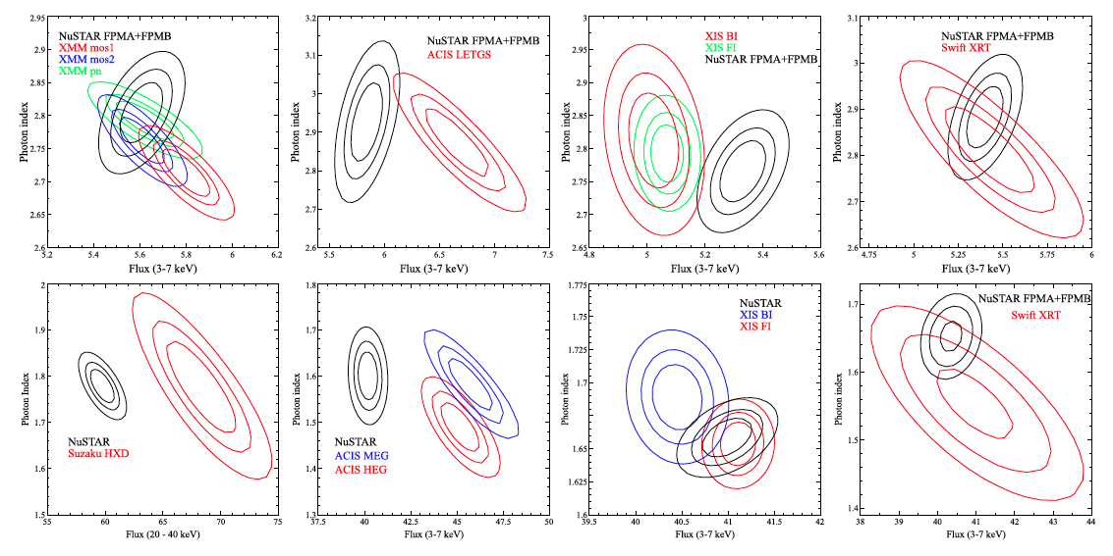
Confidence contours

Slide 17
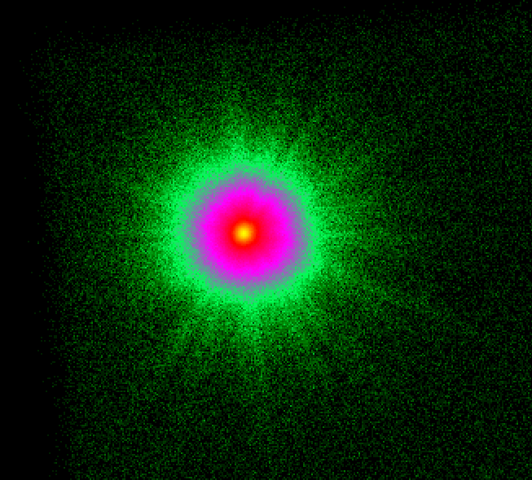
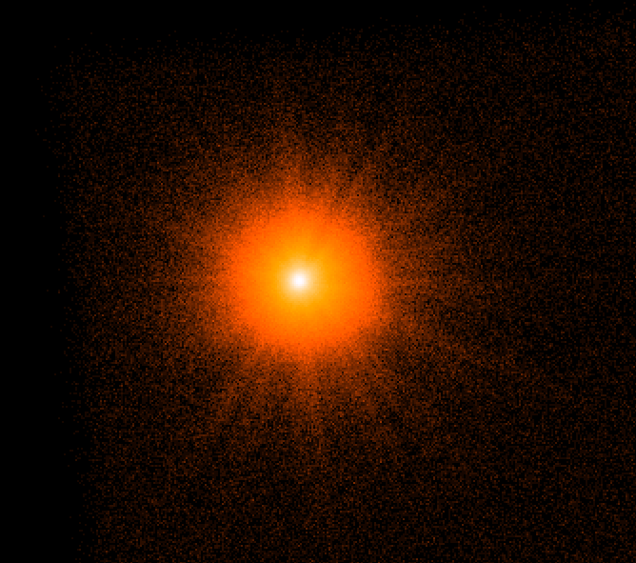
PSF – empirical model
Data
Model PSF
Ray trace
Wing
Background

Slide 18
PSF: Energy dependency
HPD of the PSF decreases with energy
EEF
Ratio (PSF_{X}/PSF_{4.5})

Slide 19
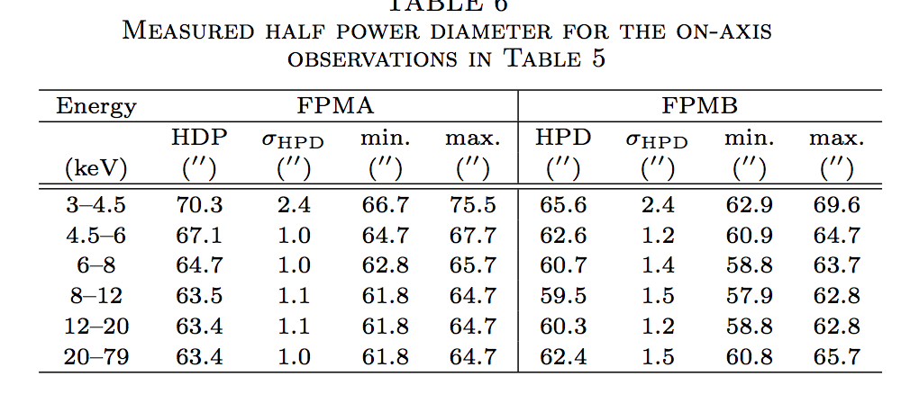
HPDs

Slide 20
Summary Calibration status
Detectors – Completed
ARF – Completed
  ARF revisions:
  (2013-08-14) CALDB version 20130509
    Crab calibration round 1 which changed the vignetting files to v005
  (2013-11-25) CALDB version 20131007
    Absolute normalization adjustment (+15% area, -15% flux) which changed the on-axis files to v006
    Energy dependent PSF
  (2014-01-17) CALDB version 20131223
    Crab high energy calibration round 2 which changed the vignetting files to v006
PSF – Completed
Background – Understood and managed, but improvement always needed.
Remaining calibration:
  Absolute aspect reconstruction ~ 8’’ (1 pixel = 2.45’’)
  Operations – pointing stability, planning
  Wish list: Better GR and AP corrections

Slide 21
Back up slides

Slide 22
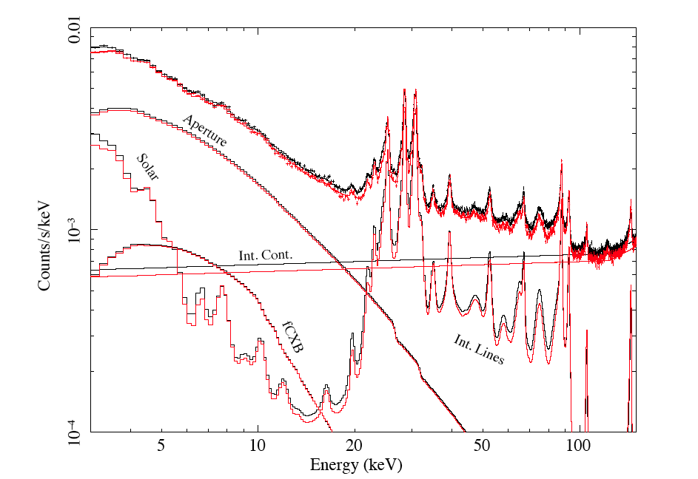
Background
Well understood!
From D. Wik et al

Slide 23
Variable background
Soft component :
  Clearly related to sun activity and present when the satellite is in sunshine: scattered solar X-rays
CXB also scattered:
  Clear signature in the power-law component seen in Dark Earth. Reflection off aperture backside.

Slide 24
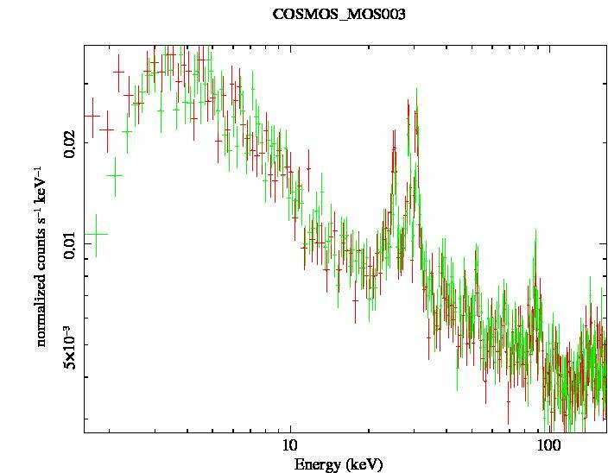
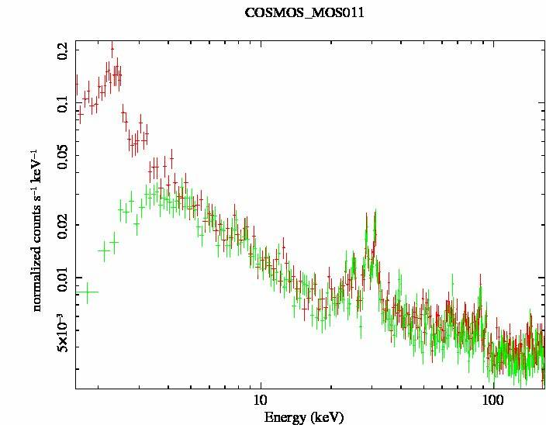
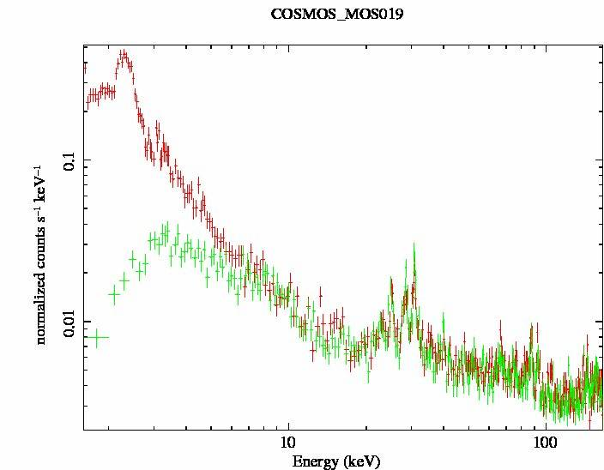
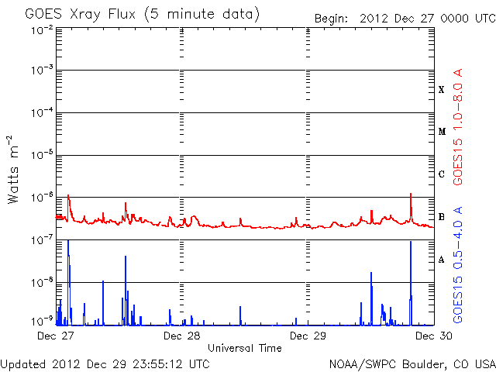
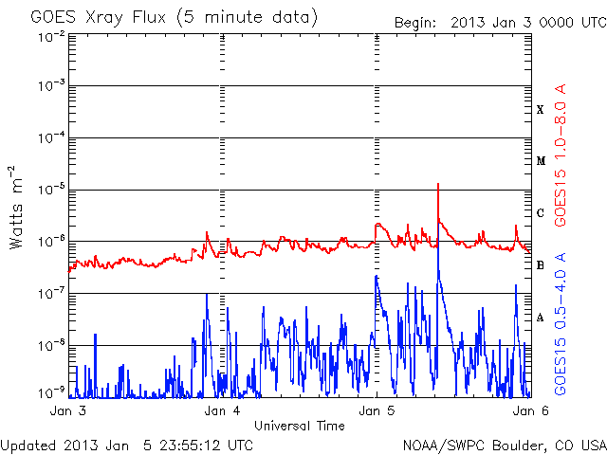
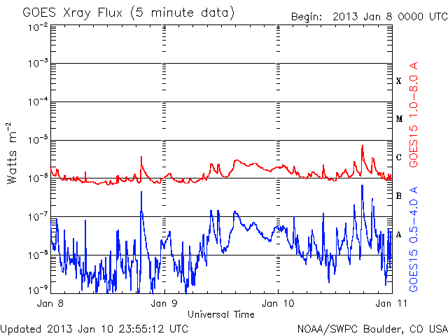
Variable Solar Background
Sunshine
No Sunshine

Slide 25
CALDB
ARF revisions.
  (2013-08-14) CALDB version 20130509
    Crab calibration round 1 which changed the vignetting files to v005
  (2013-11-25) CALDB version 20131007
    Absolute normalization adjustment (+15% area, -15% flux) which changed the on-axis files to v006
    Energy dependent PSF
  (2014-01-17) CALDB version 20131223
    Crab high energy calibration round 2 which changed the vignetting files to v006

