Slide 1
Status of the Astrosat mission
A R Rao
Tata Institute of Fundamental Research, India

Slide 2
Plan
Astrosat
Astrosat Instruments:
- Ultraviolet Imaging Telescope (UVIT)
- Large Area Xenon Proportional Counters
(LAXPC)
- Soft X-ray Telescope (SXT)
- Cadmium Zinc Telluride Imager (CZTI)
- Scanning Sky Monitor (SSM)
Calibration
- CZT – Imager
Conclusions

Slide 3
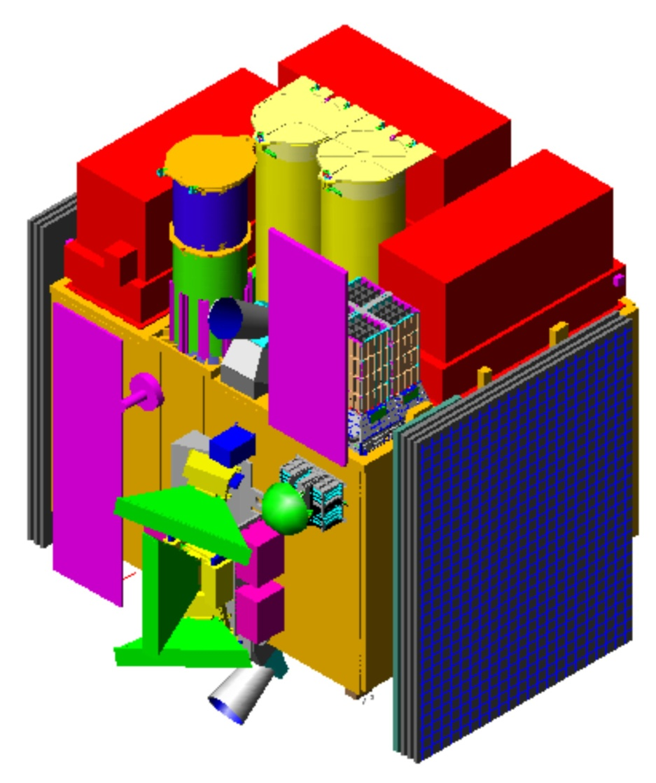
ASTROSAT
UVIT
LAXPC
SXT
CZTI
Star Sensors
SSM

Slide 4
Participating Institutes…
ISRO Centers
Satellite, rocket, T&E, Launch, Orbit, SSM,
Level 1&2 software + overall management
Research Institutes
Tata Institute of Fundamental Research
LAXPC, CZTI, SXT
Indian Institute of Astrophysics UVIT
IUCAA SSM, CZTI
RRI LAXPC
PRL, Universities,
Leicester Uty (SXT), Canadian Space Agency (UVIT)

Slide 5
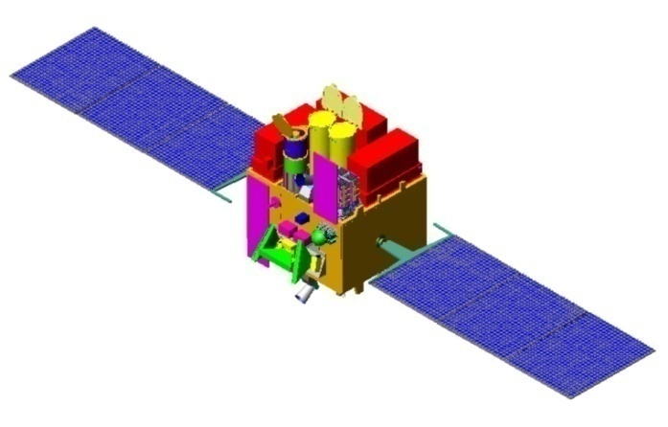
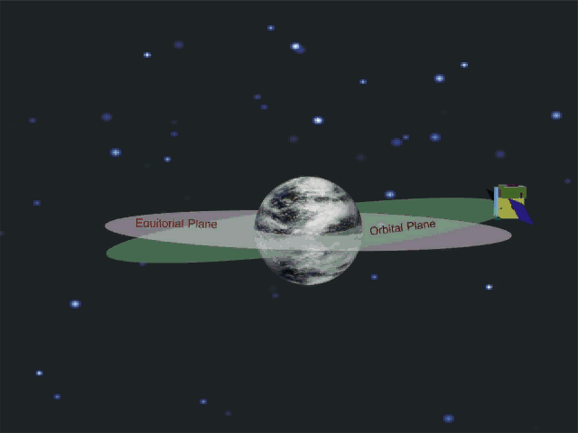
ASTROSAT
IRS (Indian Remote Sensing) Class
Launch PSLV from SHAR
Altitude : 650 km; Inclination : 6 deg.
Mass 1550 kg. (780 kg. Payloads)
Power : 2200 watts
200 Gb (210 Mb/sec)
Satellite Positioning System for orbit and time data
Payload pointing (3σ ): 0.05 degree
Slew rate : 0.6 deg/sec
Launch: Second quarter of 2015
Operational life > 5 years
Slide courtesy: K S Sarma

Slide 6
UVIT: Two Telescopes, Three Bands
f/12 RC Optics
Focal Length: 4756mm; Diameter: 38 cm
Simultaneous Wide Angle ( ~ 28’) images in FUV (130-180 nm) in one and NUV (180-300 nm) & VIS (320-530 nm) in the other
MCP based intensified CMOS detectors
Spatial Resolution : 1.8”
Sensitivity in FUV: mag. 20 in 1000 s
Temporal Resolution ~ 30 ms, full frame ( < 5 ms, small window )
Gratings for Slit-less spectroscopy in FUV & NUV (R ~ 100)
Getting ready for satellite integration (next 2 months).

Slide 7
Soft X-ray Telescope (SXT)
Telescope Length: 2465 mm (Telescope + camera + baffle + door)
Focal Length: 2000 mm
Epoxy Replicated Gold Mirrors on Al substrates in conical Approximation to Wolter I geometry.
Radii of mirrors: 65 - 130 mm; Reflector Length: 100 mm
No. of nested shells : 40
No. of reflectors: 320 (40 per quadrant)
Detector : E2V CCD-22 (Frame-Store) 600 x 600
Field of view : 41.3 x 41.3 arcmin PSF: ~ 2 arcmins
Sensitivity (expected): 15 μCrab (0.5 cps/mCrab)
Calibrated and Integrated with satellite
(next talk: A. Read)
Slide courtesy: K P Singh

Slide 8
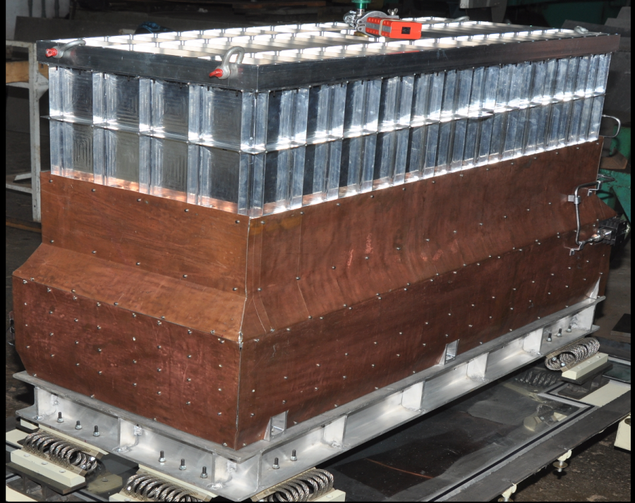
LAXPC:
Large area Xenon-filled
Proportional Counters
Energy range : 3 – 80 keV
Time Resolution: 10 μsec
Area : 6000 cm²
(7980)
E /ΔE ~ 3 - 7
Three identical xenon filled proportional counters. Multi layer and multi cell geometry with 60 anode cells and 28 anti cells
Xenon + methane mixture at a pressure 1500 mm of Hg.
50 micron thick aluminized Mylar window with a FOV of 1ºx1º
One Unit calibrated and delivered for satellite integration.
Slide courtesy: Ravi Manchanda

Slide 9
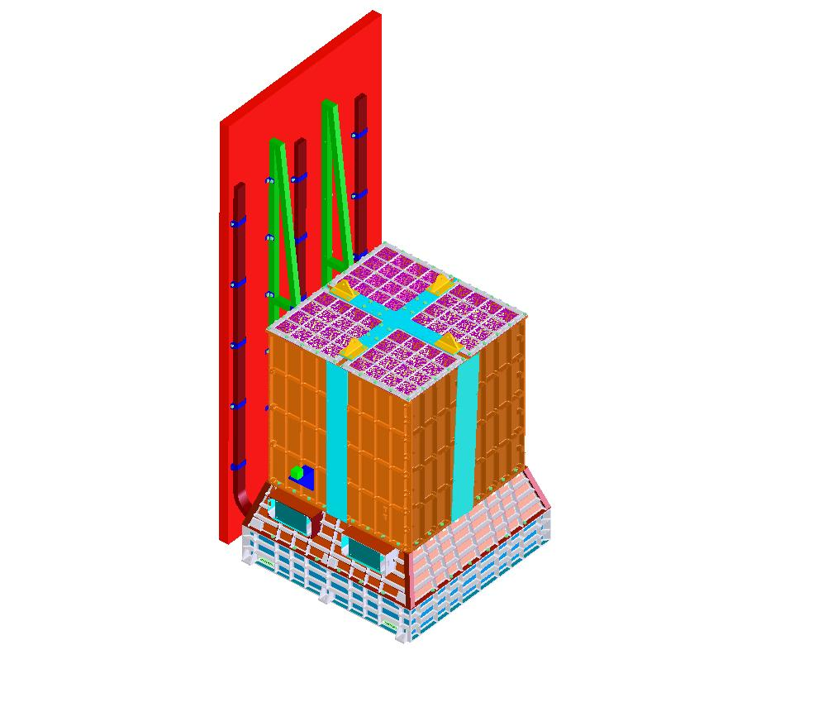
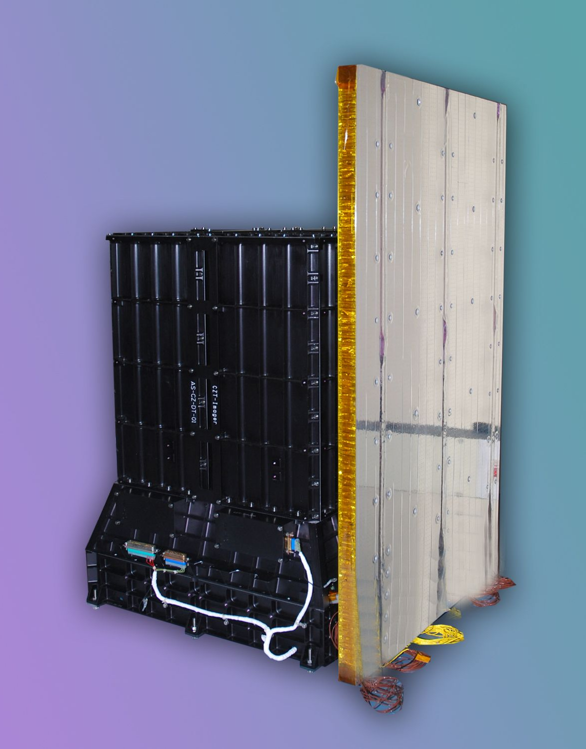
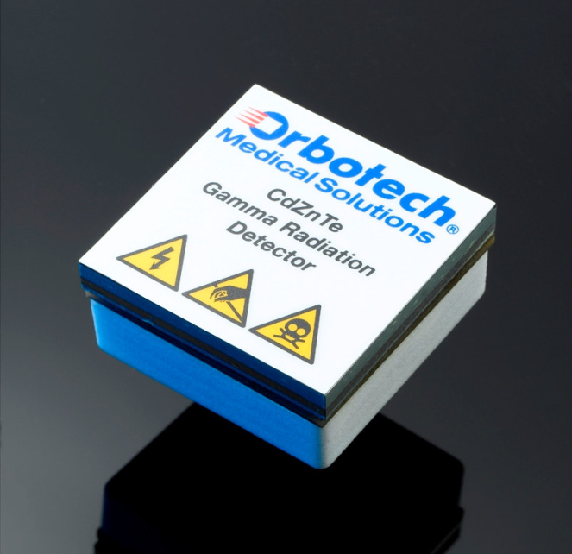
CZT-Imager
Heat pipes
Size: 482 x 458 x 603 mm
CFRP support
Weight - 50 kg
Handling brackets
Power – 60 Watts
CAM
Collimator: 6 x 6 Degree
17 x 17 Degree
Collimator
Side joining plates
CZT top hsg.
Radiator
Optical cube
Alpha tag source
CZT bottom hsg.

Slide 10
Area | 1024 cm ²
Pixels | 16384
Pixel size | 2.4 mm X 2.4 mm (5 mm thick)
Read-out | ASIC based (128 chips of 128 channels)
Imaging method | Coded Aperture Mask (CAM)
Field of View | 17 X 17 deg² (uncollimated) 6 X 6 (10 – 100 keV) – CAM
Angular resolution | 8 arcmin
Energy resolution | 5% @ 100 keV
Energy range | 10 – 100 keV - Up to 1 MeV (Photometric)
Sensitivity | 0.5 mCrab (5 sigma; 10⁴ s)
Calibrated; final testing going on (Satellite Integration in next 2 months)

Slide 11
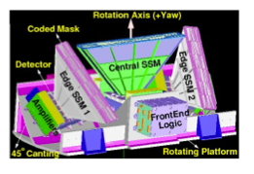
Scanning Sky Monitor (SSM)
3 PSPC; Area 60 cm² (5 keV); Ang res. : 2.5º & 12’
Energy Res 20%@ 6 keV
Flight Models are being tested
(Satellite Integration in next 2 months)

Slide 12
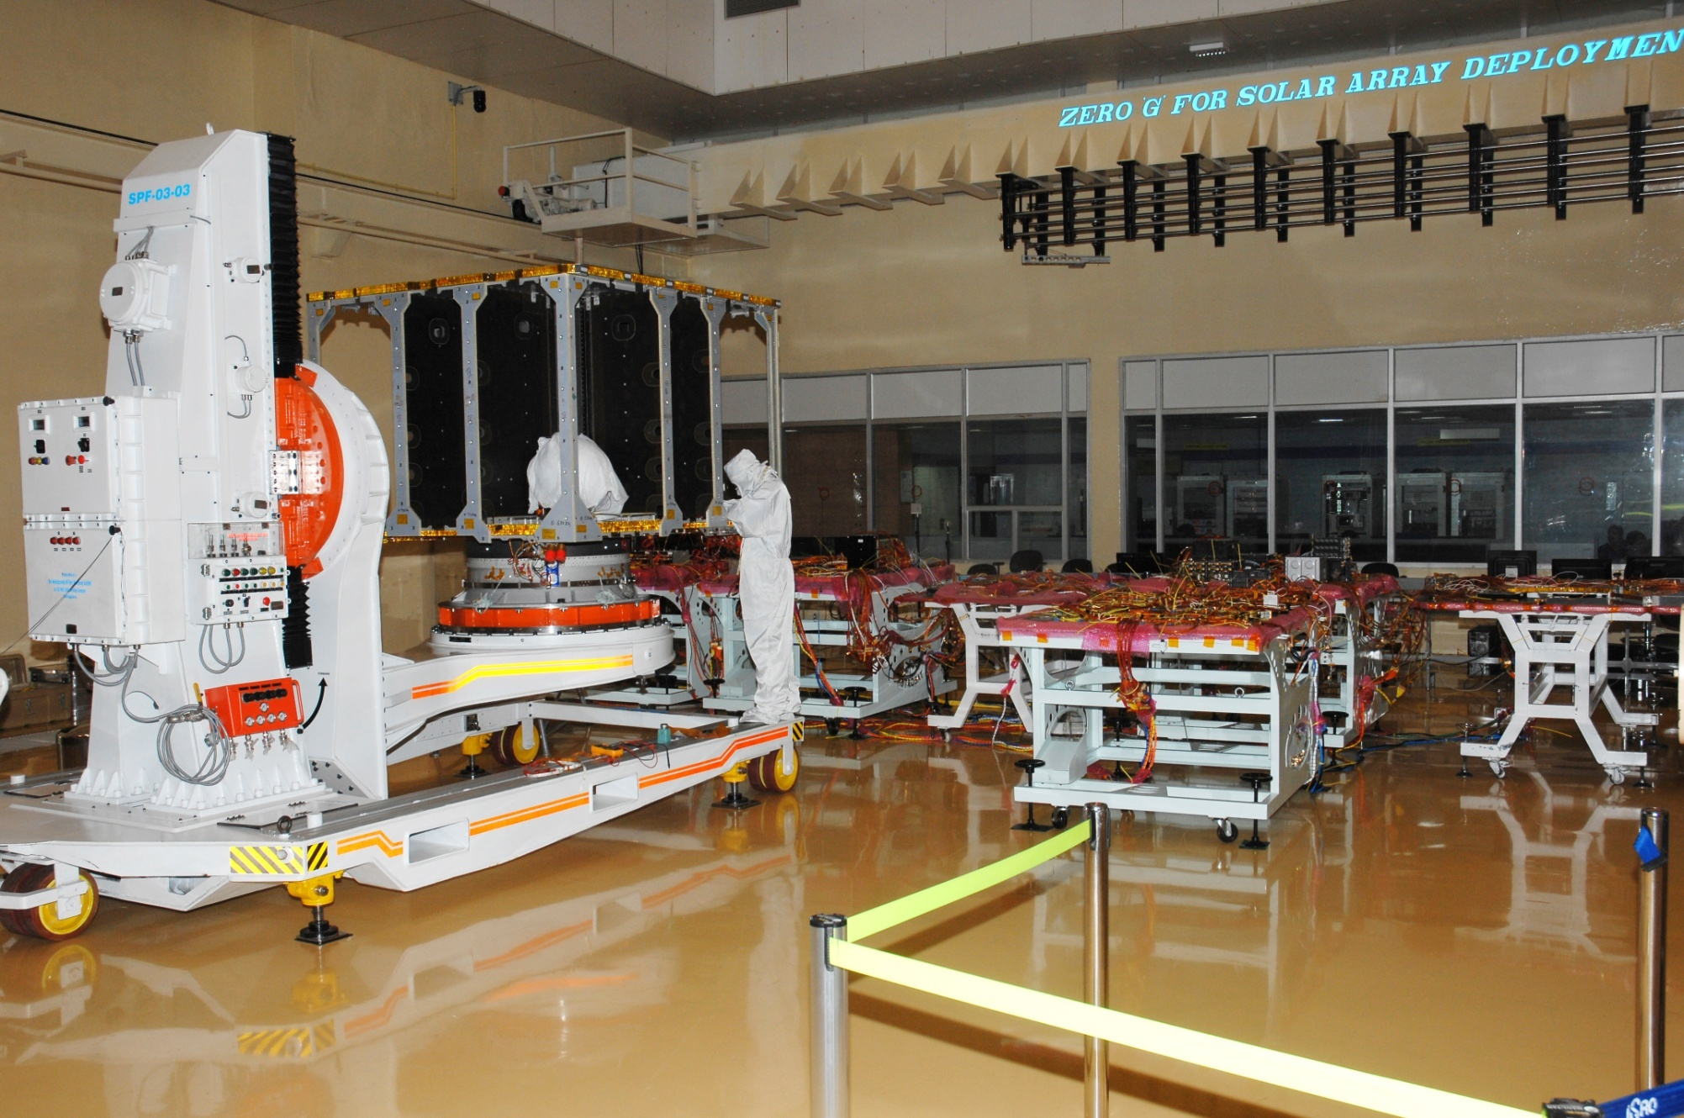
Payload integration, alignment & testing: December 2014; Launch: mid-2015
Slide courtesy: S S Sarma

Slide 13
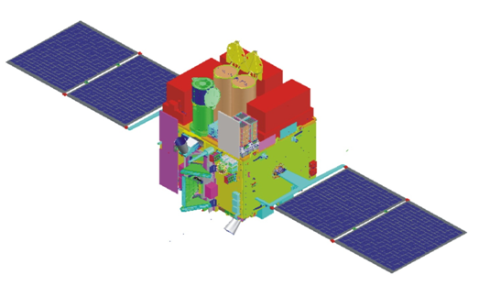
Astrosat: Special Features
Low Inclination
Continuous time-tagged individual photon data
(LAXPC & CZTI)
– a few tens of micro-second accuracy
Bright source observing capability of SXT
Facility to change/ adjust observation time of
SSM pointing.
Hard X-ray (above ~ 80 keV) monitoring capability.

Slide 14
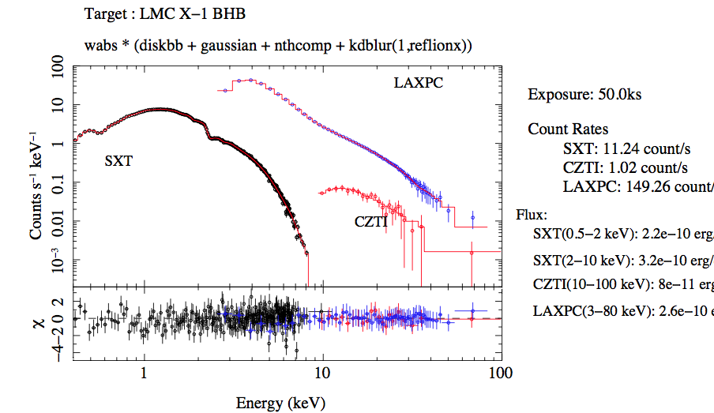
Astrosat calibration: ground & onboard
Slide courtesy: G C Dewangan

Slide 15
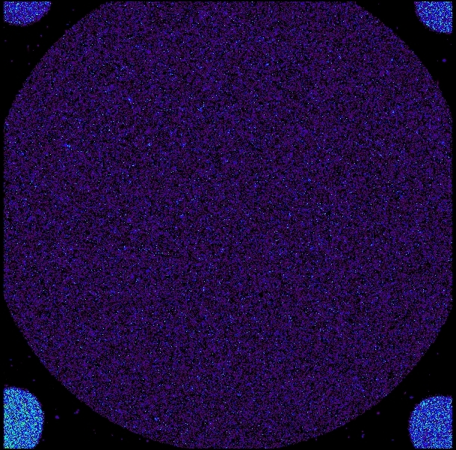
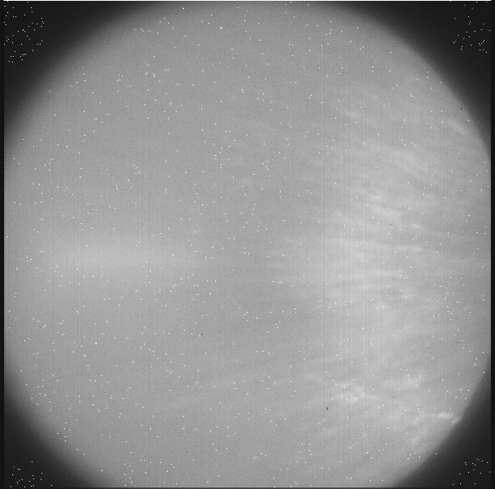
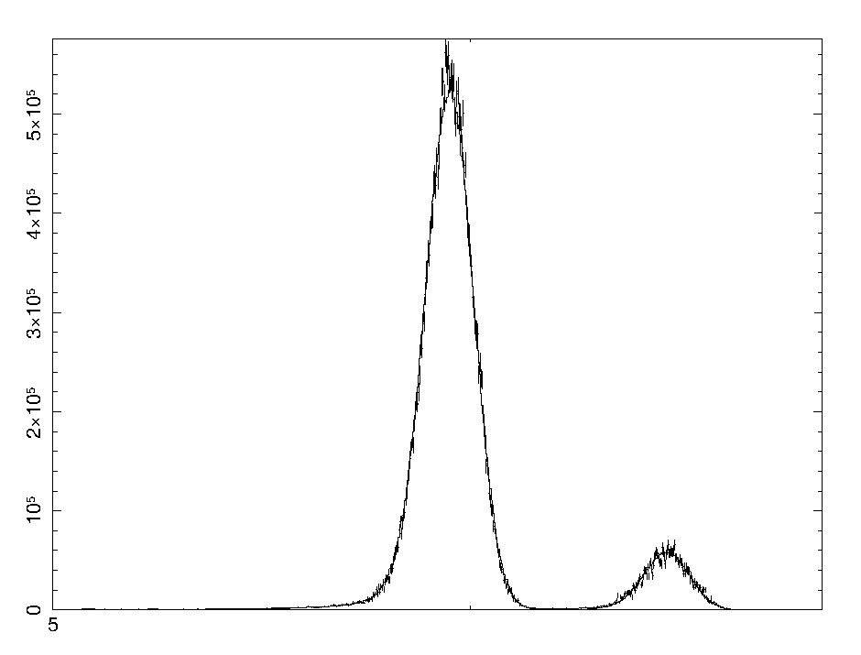
CCD: X-ray illumination
CCD: Optical illumination
Mn K_{α}, K_{β}
145 eV resn.
Slide courtesy: K P Singh

Slide 16
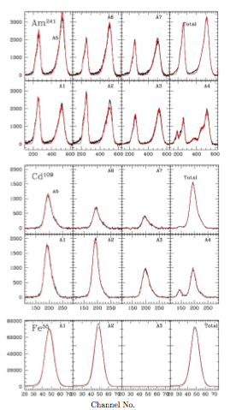
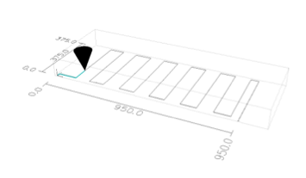
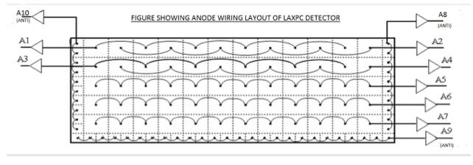
LAXPC Calibration
Radio-active sources for
Spectral Calibration.
GEANT4 simulation for background estimation

Slide 17
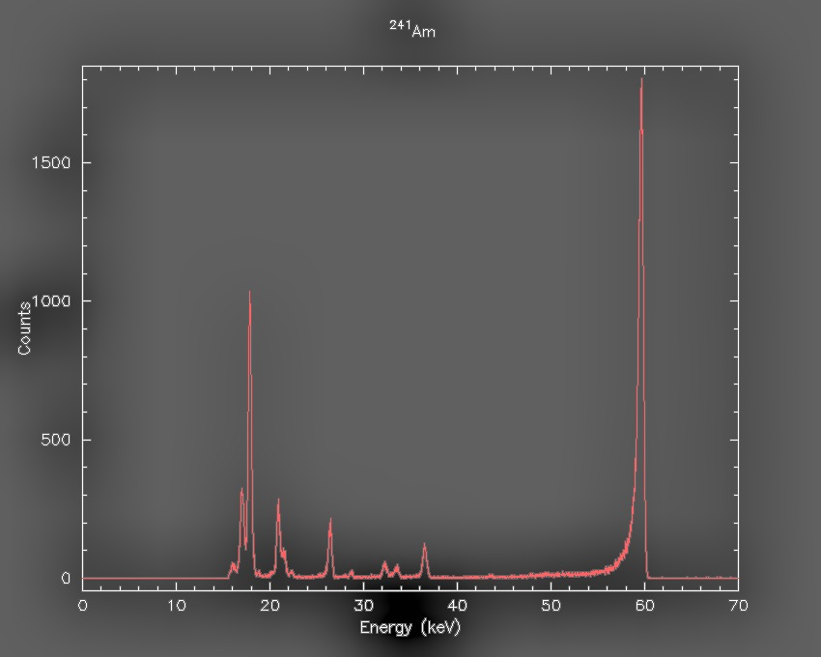
CZT Calibration
4 Quadrants
64 Detectors
16,000 pixels
Multi-temperature, multi-sources

Slide 18
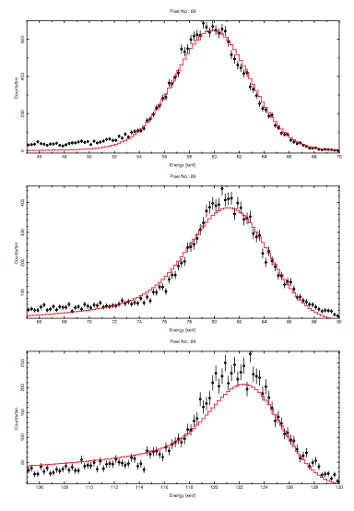
Physics based model and fraction of counts in tail
Mu-Tau based method:
Photo-peak Efficiency
59.54 keV 81 keV 122 keV
99% 87% 84%

Slide 19
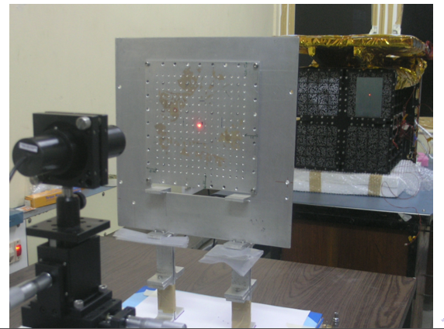
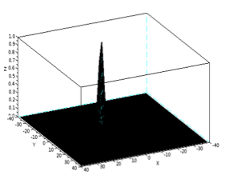
CAM calibration: 2m length
A few arc-seconds could be achieved.

Slide 20
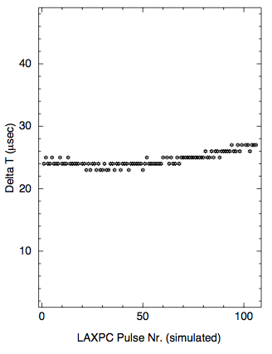
The time difference (Delta T) in units of micro-seconds, is well within the expected calibration for pulse from a normal (1 ppm) clock.

Slide 21
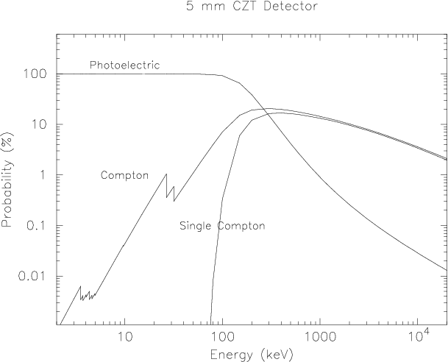

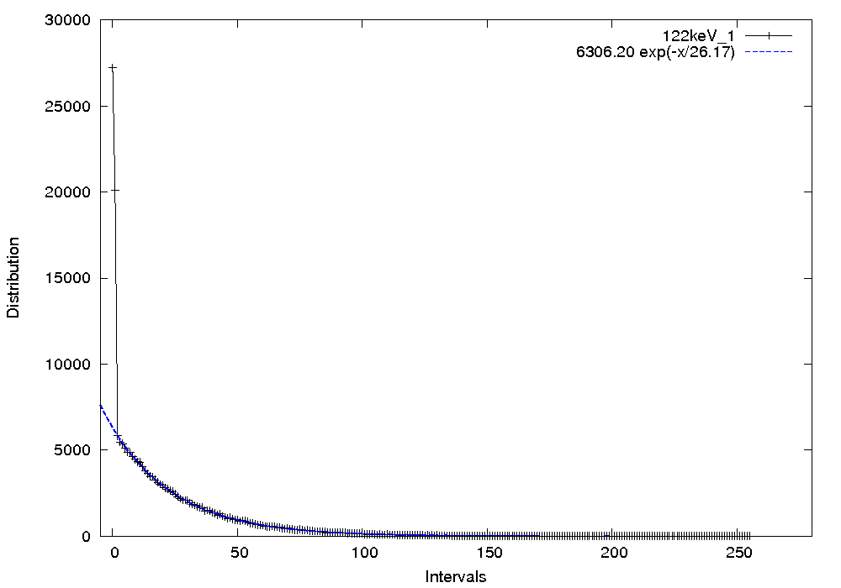
Polarization
Crab 3 sigma detection in < 1 day
 | Next (%) | 1:2 | 3:4 | 4:5
Obs | 2.4+0.1 | 4.3+0.2 | 0.8+0.1 | 8.0+2.0
Monte Carlo | 2.43 | 4.9 | 1.0 | 10.0

Slide 22
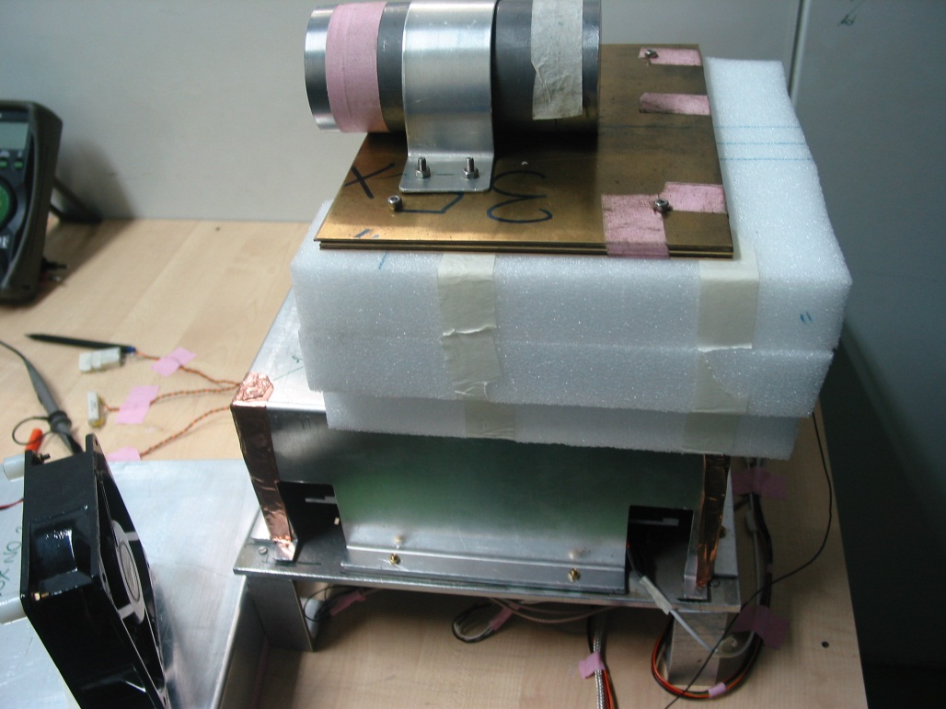
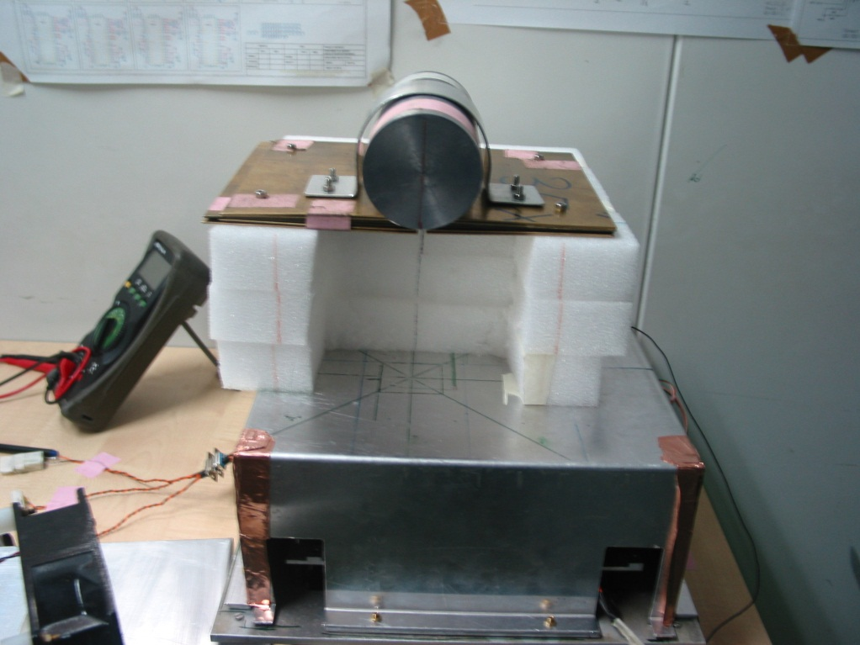
10.78 % edge modulation fator
4.8 % corner modulation factor
Modulation Curve at 0 degree
-7.802 % edge modulation fator
2.57 % corner modulation factor
Modulation Curve at 90 degree

Slide 23
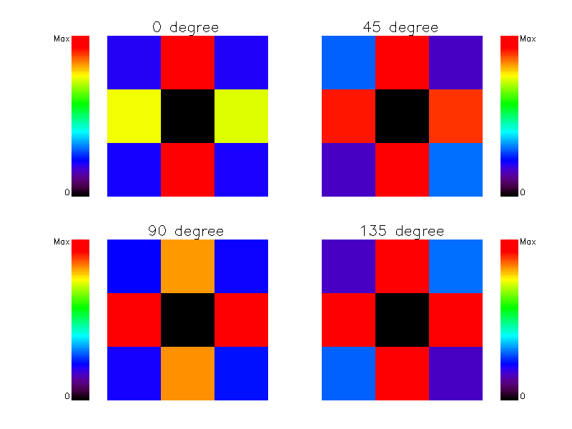
Polarization measurement capability of CZTI
Arrows represent incident polarization direction
Slide courtesy: Santosh Vadawale

Slide 24
Onboard Calibration
Low Energy: standard sources
High energy: Crab

Slide 25
ASTROSAT: Observation Phases and Data Policy
Slide courtesy: K S Sarma

Slide 26
Science Working Group and
Payload Science Teams
PI: S Seetha (seetha@isro.gov.in)
UVIT: S. Tandon (sntandon@iucaa.ernet.in)
LAXPC: J. S. Yadav (jsyadav@tifr.res.in)
SXT: K.P. Singh (singh@tifr.res.in)
CZTI: A. R. Rao (arrao@tifr.res.in)
SSM: M. C. Ramadevi (ramadevi@isac.gov.in)

Slide 27

`Hard X-ray Astronomy: Astrosat and Beyond’
A conference in Goa: September 24 - 26, 2014

Slide 28
Conclusions
Wide band X-ray spectroscopy is the strength of Astrosat.
Extensive ground calibrations completed. Results are as expected.
New features (individual photon counting and possibly polarization) will enhance the observation capabilities.
Onboard calibration will center around Crab observation for high energy instruments.

