Slide 1
Neutron Star Interior Composition ExploreR
NICER
Bev LaMarr (MIT) for the NICER team.

Slide 2
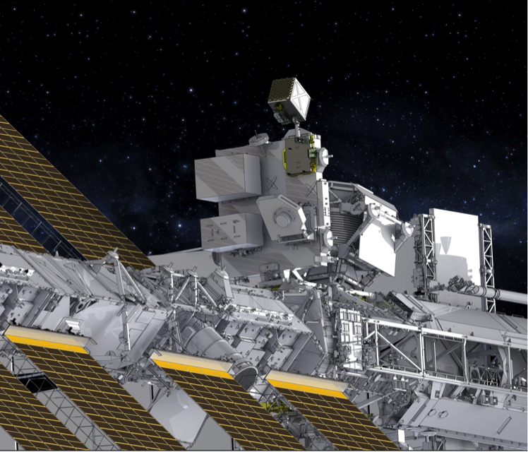
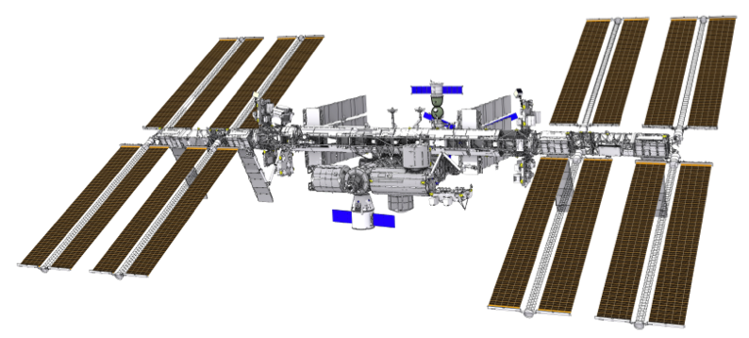
An Astrophysics Mission of Opportunity on the International Space Station
Science: Understanding ultra-dense matter through observations of neutron stars in the soft X-ray band
Launch: August 2016, SpaceX-12 resupply
Platform: ISS ExPRESS Logistics Carrier (ELC), with active pointing over nearly a full hemisphere
Duration: 24 months including Guest Observer program
Instrument: X-ray (0.2–12 keV) “concentrator” optics and silicon-drift detectors. GPS position & absolute time reference
Enhancements:
  Guest Investigator/Observer program
  Demonstration of pulsar-based
  spacecraft navigation
Status:
  Passed CDR, Sept 2014
  All critical ETUs in hand
  Significant flight hardware done

Slide 3
Science-enabling capabilities
An unprecedented combination of time resolution, energy resolution, and sensitivity
Spectral band: 0.2–12 keV
  Well matched to neutron stars
  Overlaps RXTE and XMM-Newton
Timing resolution: 100 nsec RMS absolute
  50x better than RXTE
  ~1000x better than XMM-Newton
Energy resolution: 2.5% @ 6 keV
  10x better than RXTE
Angular resolution: 6 arcmin (non-imaging)
  10x better than RXTE
Sensitivity, 5σ: 5.3 x 10^{–14} erg/s/cm²
  0.5–10 keV in 10 ksec (Crab-like spectrum)
  20x better than RXTE
  3x better than XMM-Newton’s timing
  capability

Slide 4
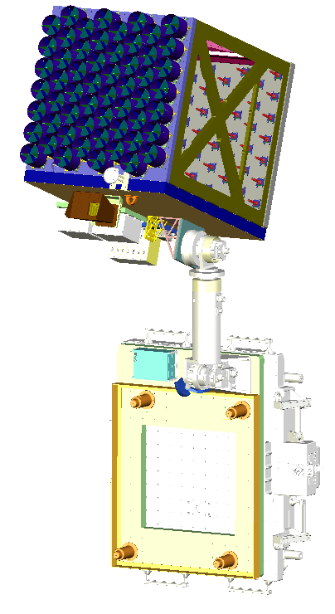
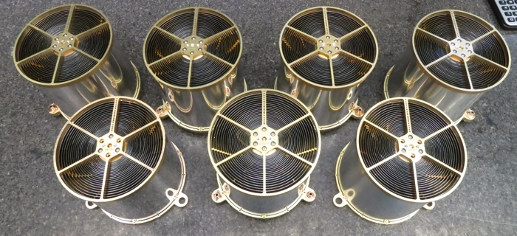
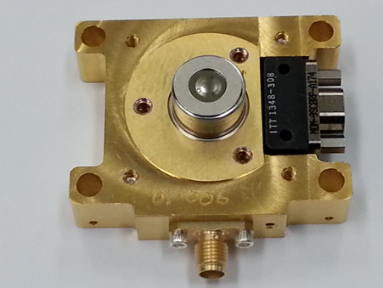
The NICER payload
An innovative combination of high-heritage components
y
X-ray Timing Instrument (XTI)
  Assembly of 56 X-ray concentrators and detectors
  Detects individual X-ray photons,
  returns energy and time of arrival
  Held together in the Instrument Optical Bench
Thermal system
  Maintains thermal-mechanical alignment
Pointing System
  Composed of high-heritage components
  Allows the XTI to track pulsars
  Slews XTI between targets
C&DH
  Digital interface to ISS for commands, data
  Supports pointing system
  Flight Releasable Attachment Mechanism
  Electrical & mechanical interface to ISS and transfer vehicle
  Provided by ISS program
Sunshades and X-Ray Concentrators (56)
XTI
Radiator surface
Focal Plane Modules (56)
GPS Antenna
Star Tracker
Connector Bracket
Electronics
Deploy & Pointing System — El over Az, deploy, and latching actuators with EVR/EVA fixtures
HiPos Box
Adapter Plate
Contamination shield
Launch-lock mounts
AFRAM

Slide 5
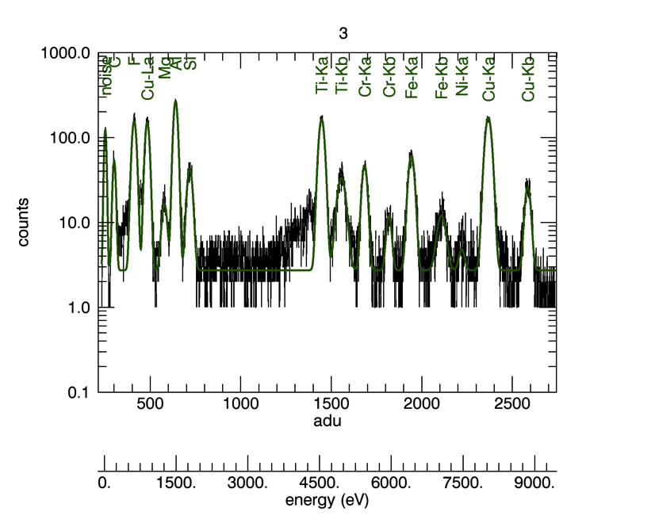
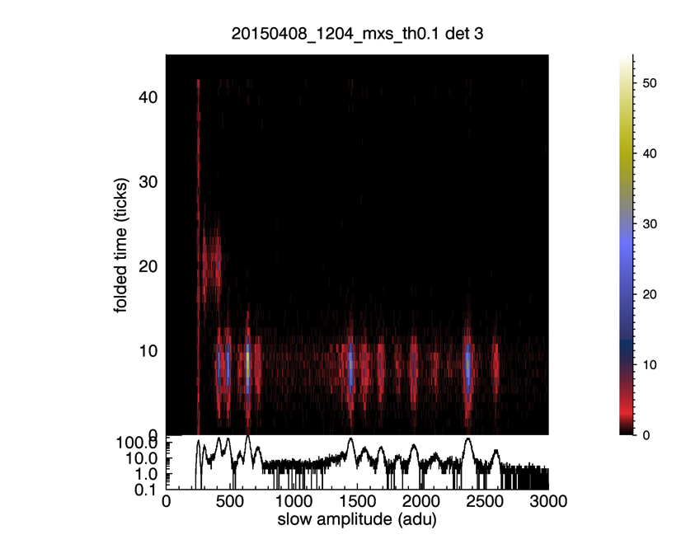
FPM Characterization at MIT
Modulate Xray Source provided by GSFC provides multiple lines at 600kHz

Slide 6
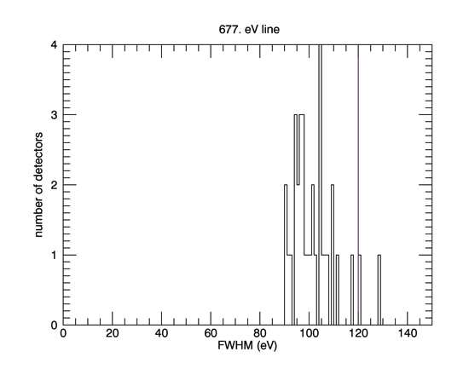
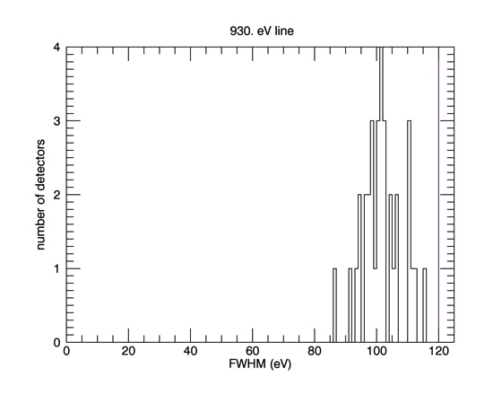
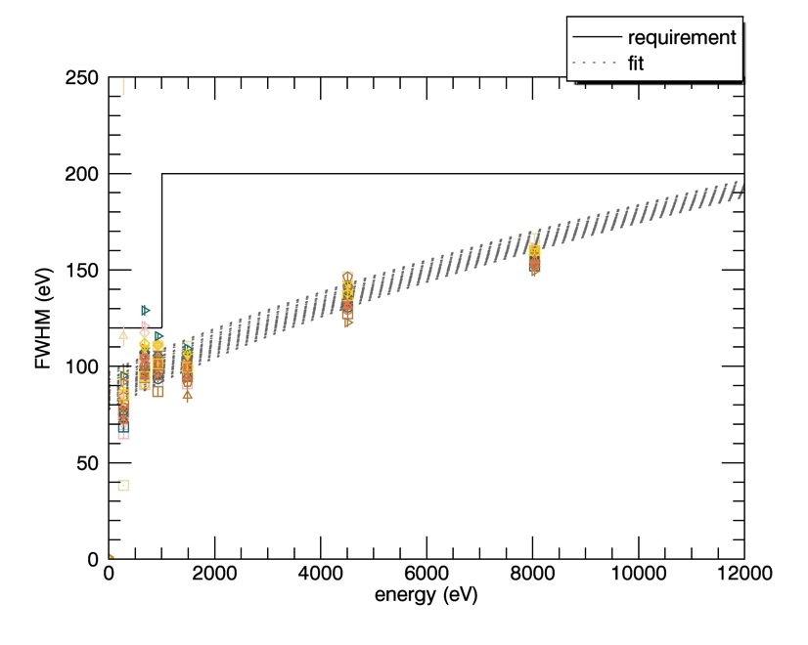
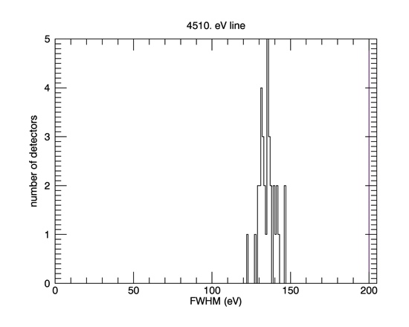
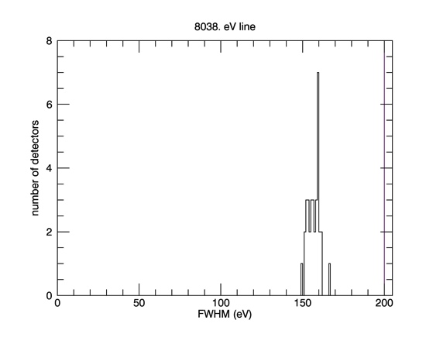
Spectral Resolution
All FPMs measured to date
EM model MPUs
Requirement is 120 eV below 1 keV, 200 eV above 1 keV

Slide 7
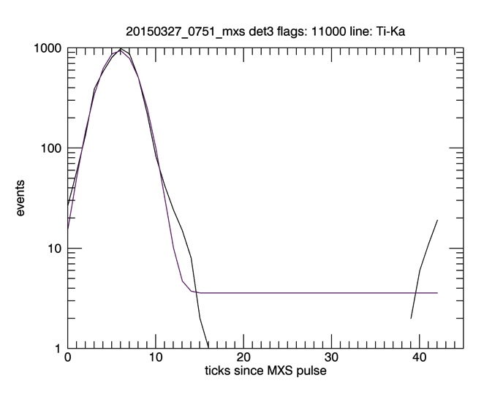
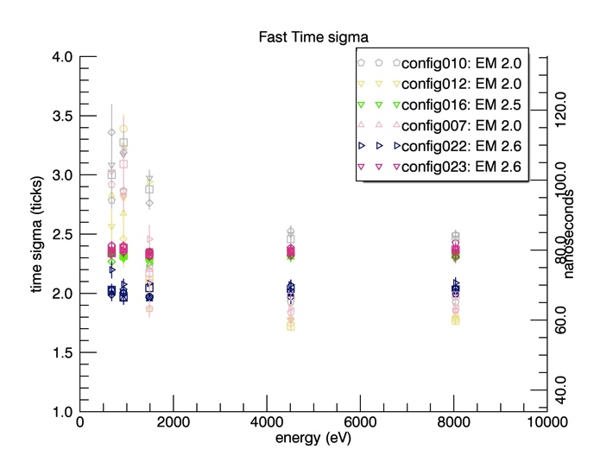
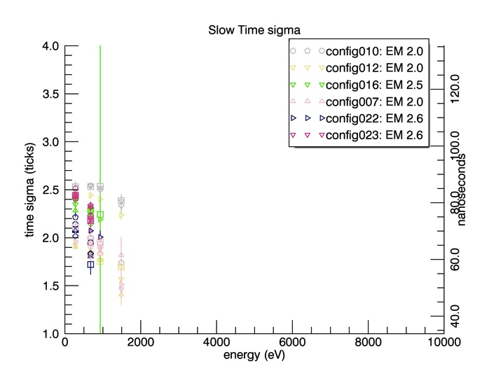
Timing Resolution
Select events by slow amplitude value, then histogram the ticks since MXS pulse.
Slow chain times are only available when the fast chain doesn’t trigger.

Slide 8
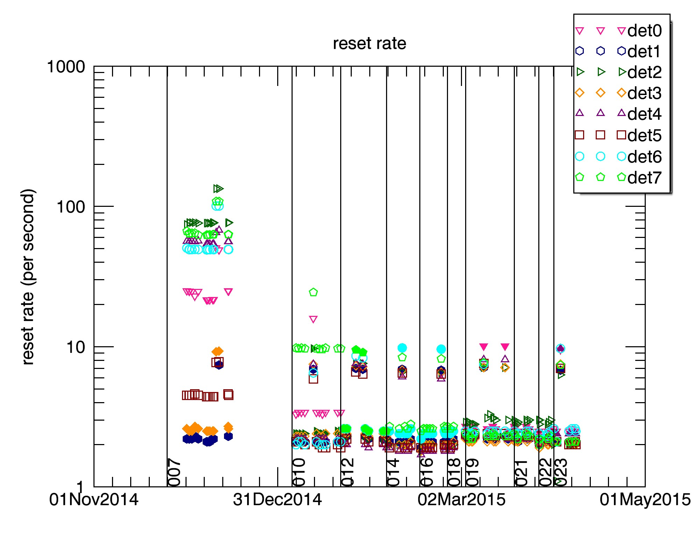
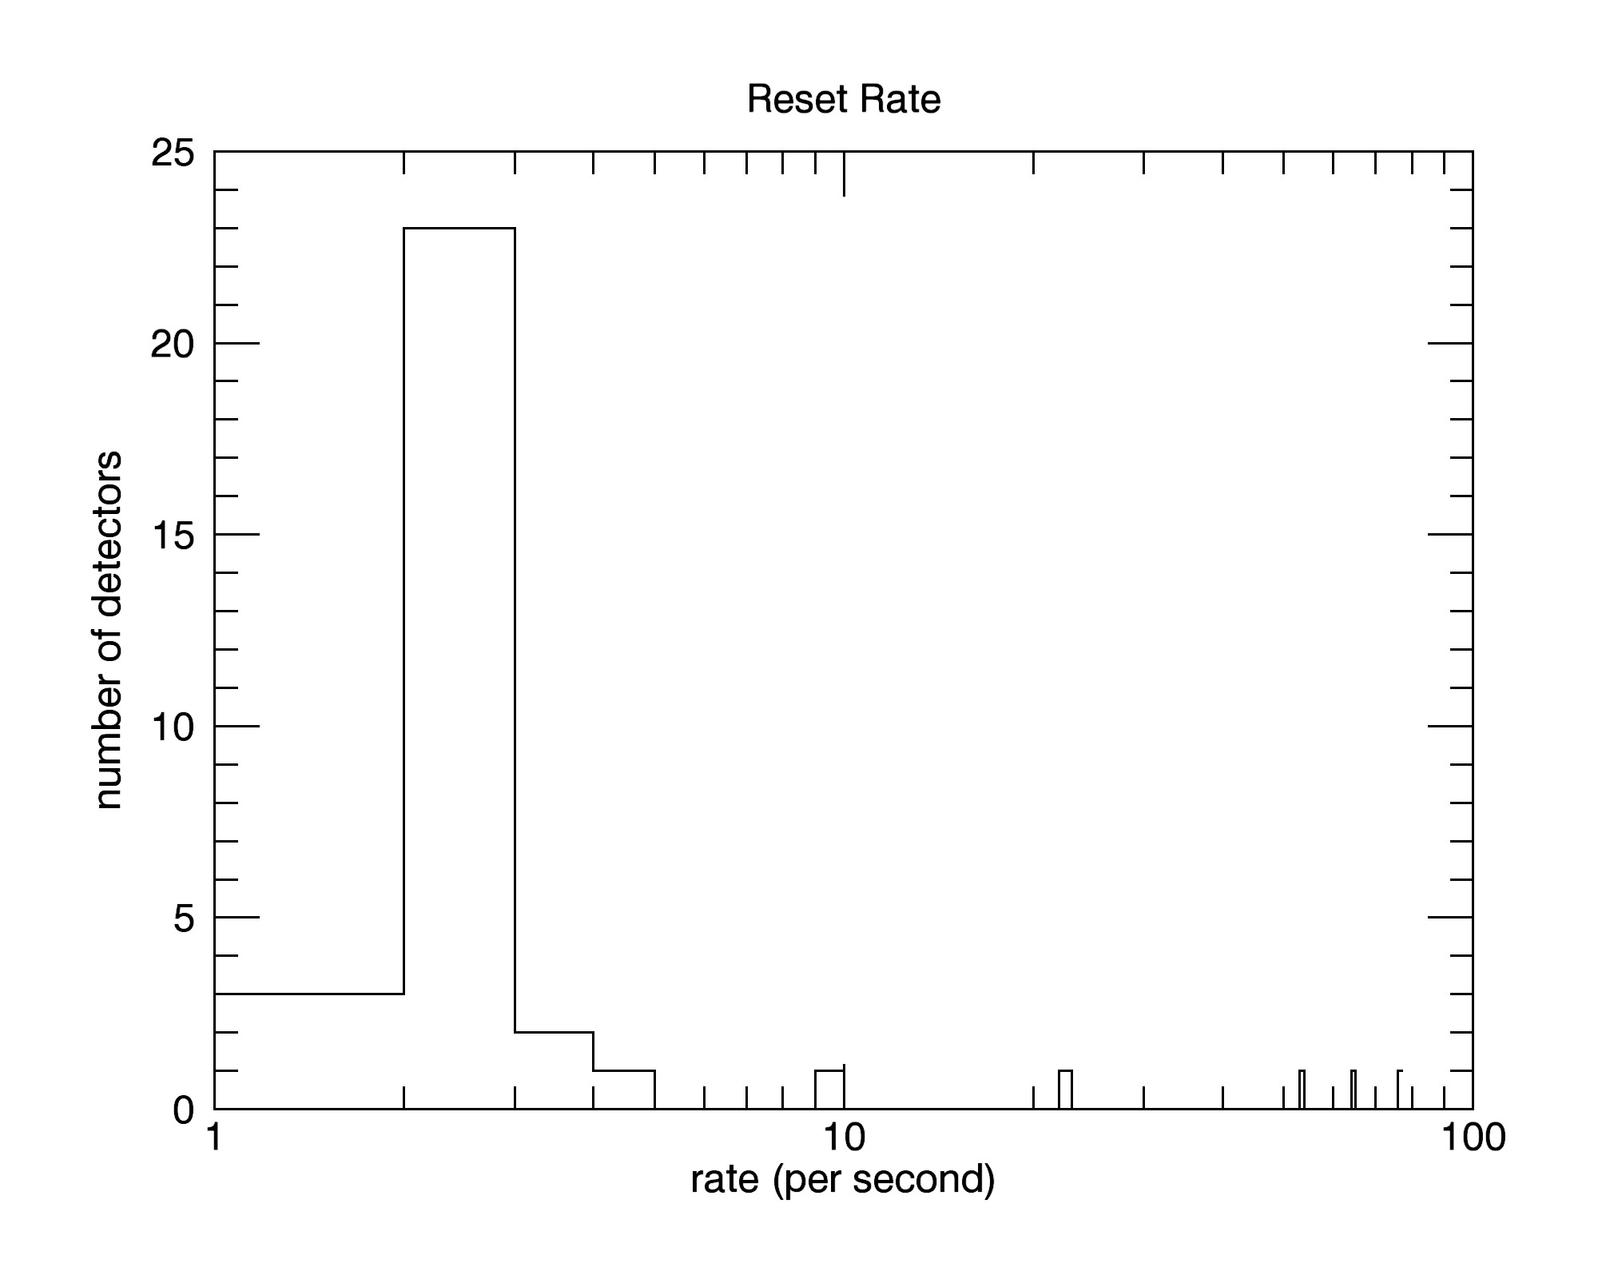
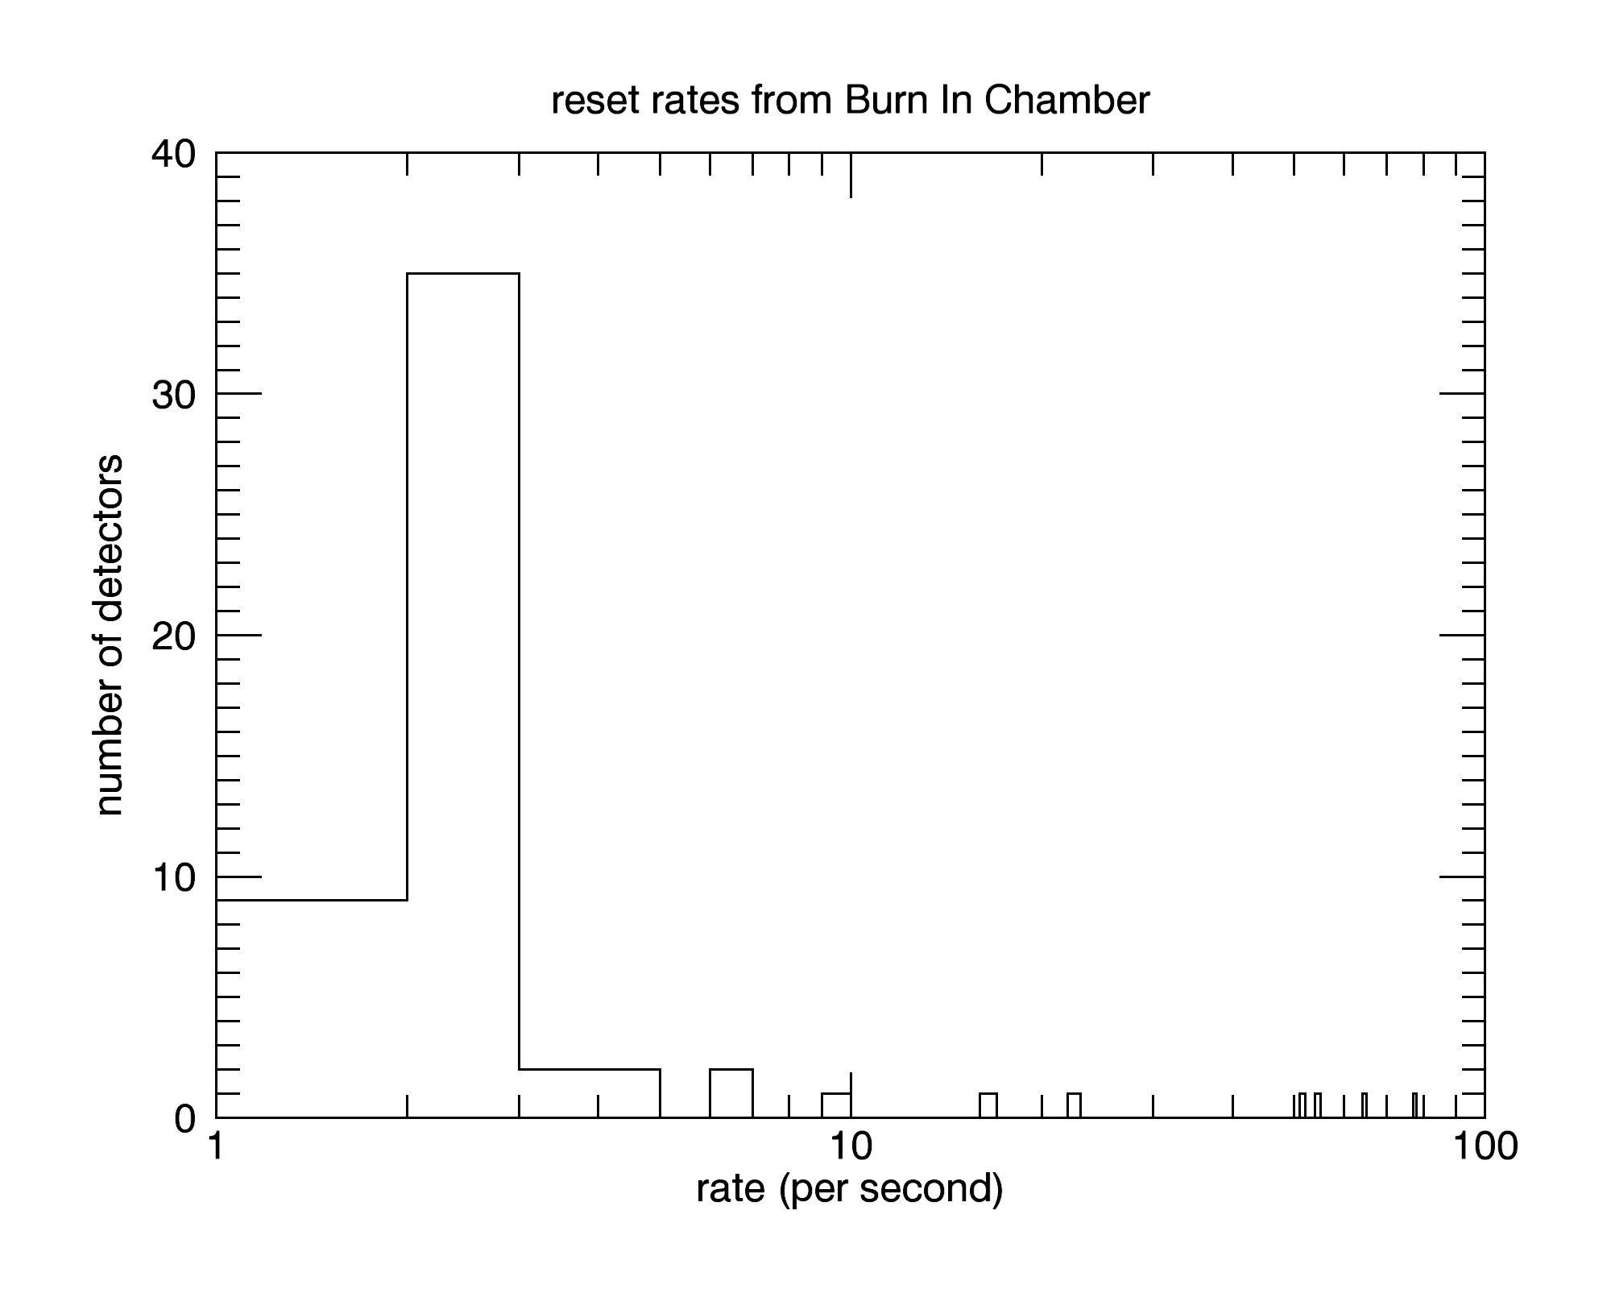
Reset Rates
Most flight candidate FPMs reset a few times per second with a few outliers
Reset rates in the cal chamber
34 measured
Reset rates in the burn in chamber
57 measured

Slide 9
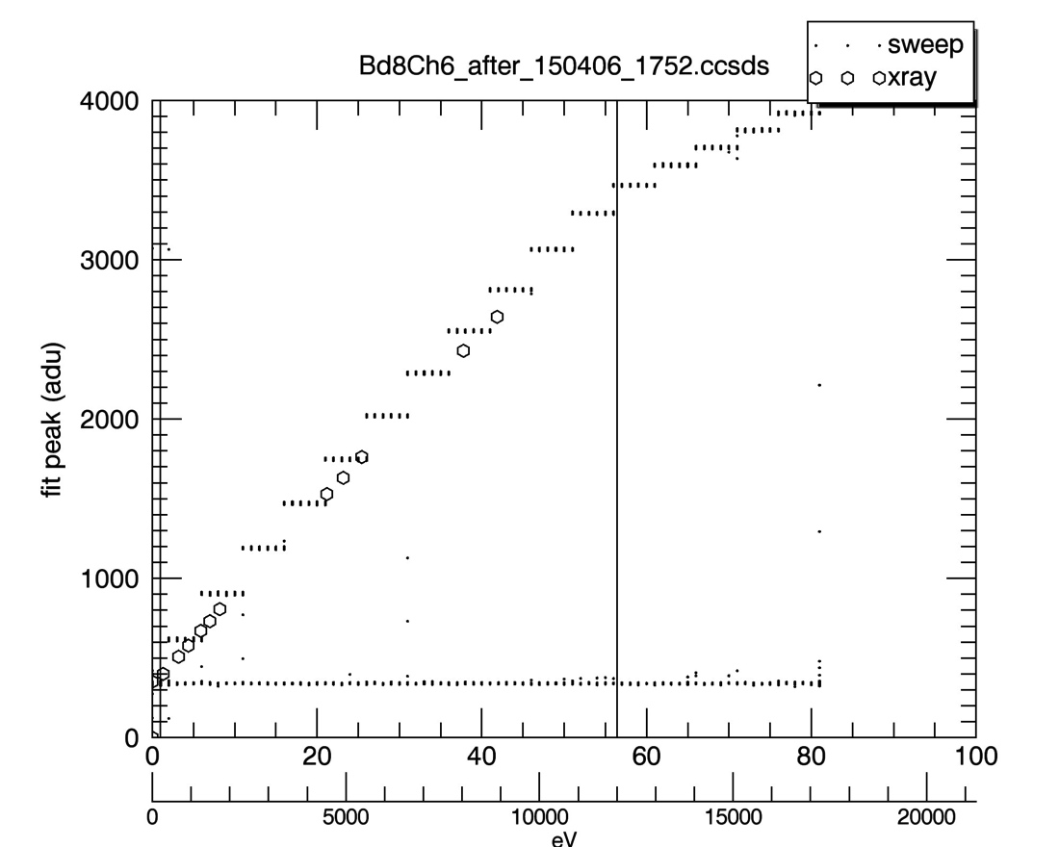
MPU Characterization
Replace the FPM with a pulse generator and step through multiple voltages
Dots are pulse heights for one channel on an engineering unit MPU
Open symbols are x-rays detected by a flight candidate FPM on the same channel of the MPU
Vertical lines are at 200 eV to 12 keV
Pulser sweeps allow us to quickly extend the gain characterization beyond the MXS range

Slide 10
Additional Characterization During Integration and Test at GSFC
MXS at Ti Ka & (one higher line) during integration
Selected fe55 during thermal vac
End to end timing
Forced trigger tests during thermal vac
Threshold tests during thermal vac

Slide 11
current schedule dates
Delivery of flight FPMs and MPUs from MIT to GSFC in July 2015
XTI integration and test August 2015
Payload thermal vac testing in January & February 2016
launch August 2016

Slide 12
Summary
Flight unit testing proceeding
Launch will be in August 2016
More information available at http://heasarc.gsfc.nasa.gov/docs/nicer
Guest observer program has been approved for 2017

