Slide 1
Charge transport model for Swept Charge Devices (SCD)
P. S. Athiray
Post Doctoral Research Fellow,
Manipal Centre for Natural Sciences,
Manipal University, Manipal
Collaborators : C1XS & CLASS team (ISRO Satellite Centre),
Dr. Jason Gow (The Open University, UK)
Dr. Sreekumar (Indian Institute of Astrophysics, Bangalore)

Slide 2
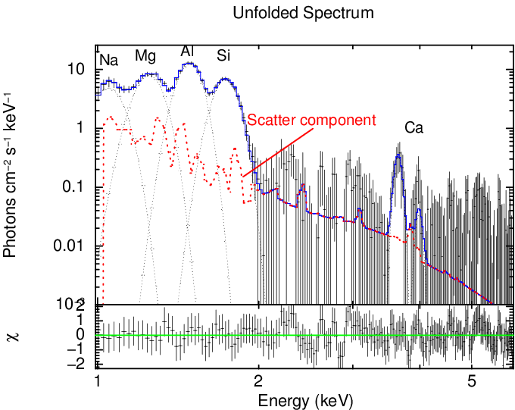
C1XS achievement - First detection of Na
1.04 keV
First direct measurement of enhanced Na abundances from the lunar surface
The best fit to one of the C1XS spectrum with all components
6th July 2009 (17:10:47 -17:13:59)

Slide 3
Swept Charge Device (SCD) (Developed by e2V technologies Ltd., UK)
1D X-ray CCD
Continuous diagonal clocking
Minimize surface generated
leakage current
High rate of periodic charge
clocking (100 kHz/sample)
High spectral performance
with minimal cooling
CCD-54 used in C1XS

Slide 4
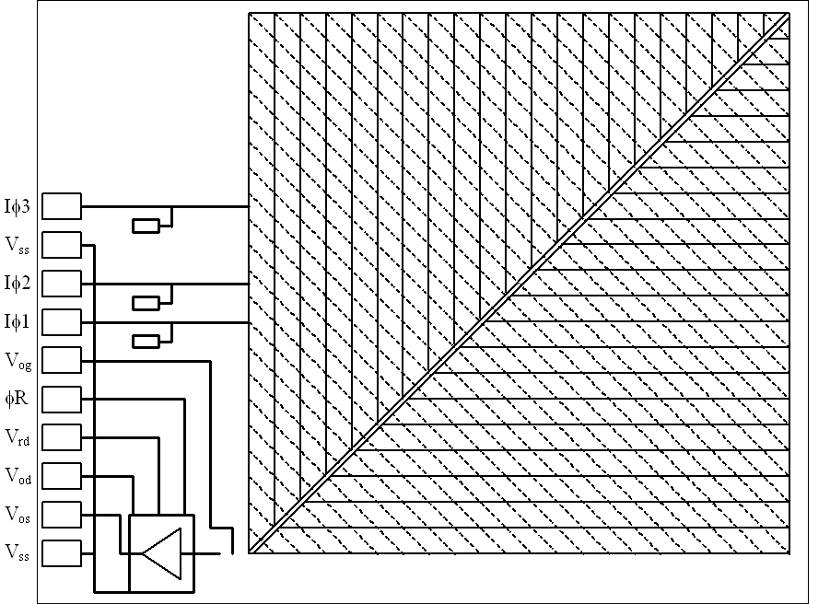
SCD (CCD-54) in C1XS
Depletion depth ~ 35 – 40 µm
On-board resolution ~ 153 eV @ 6keV with -10º C
Heritage
SMART-1 (DCIXS)
Chandrayaan-1 (C1XS)
Pitch - 25µm
Each unit area – 1.07 cm²
Measured X-ray charge
CCD-54 used in C1XS
Notes:
The SWD was developed by e2v technologies as an industrial X-ray spectrometer for the energy range of 0.5 keV to 10 keV, achieving near fano limited spectroscopy at -10oC.
The device has a three phase electrode structure, as depicted by the dashed lines (click mouse) the charge deposited by an X-ray event is clocked towards the central transport channel and towards the output amplifier to produce a linear output consisting of 575 pixel, unlike a conventional CCD it can not be used as an imager. There are two separate central channels for each side of the device which join just before the output.
The key technology of the SCD is the use of continuous clocking, similar to dither mode clocking and is used to minimise the surface generated leakage current. Through avoidance of an image integration period, the high rate periodic charge clocking (approximately 100 kHz/sample) produces a suppression of the surface leakage current due to maintaining the silicon surface inversion. The SCD is capable of providing similar performance at -20oC to a Si(Li) detector operating at -120oC.

Slide 5
Motivation for Charge Transport Model
Better understand Spectral Redistribution Function (SRF) - RMF
Reduce uncertainties in spectral response
Augment calibration
Improved global lunar elemental mapping using Chandrayaan-2 Large Area Soft x-ray Spectrometer (CLASS)

Slide 6
Spectral Redistribution Function (SRF) of SCD
Observed SRF of SCD CCD54 at 8 keV – C1XS calibration
Narendranath et al., 2010
Photopeak
Complex SRF
Physical model for photon interaction and charge propagation
LE rise
LE
shoulder
LE tail
Cutoff
Escape peak

Slide 7
Charge Transport Model (CTM) for SCD
Generic photon source input
Photons spectrum on top of CCD
Spatial distribution : Uniform source, Different geometry
Photon interaction, charge-cloud spreading, escape peaks, pixel mapping and charge collection
Simulate diagonal clocking and readout - output
Raw pseudo linear output, Event selection with thresholds

Slide 8
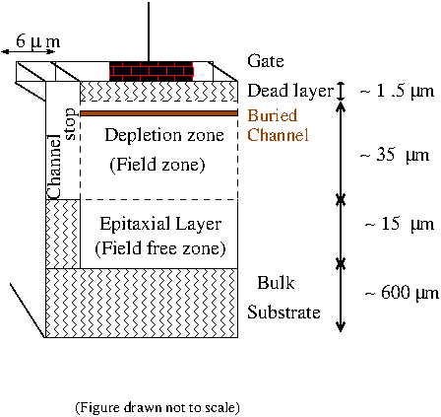
CTM for SCD
Monte Carlo simulation
Ideal Si based X-ray detector
Written in IDL with the aim to be generic
Interactions considered
Field zone, Field free zone, Channel stop
Photon loss
Dead layer & substrate

Slide 9
Interaction zones
&
Dominant physics
~1.5µm
V
Dead layer
(recombine)
Buried Channel
35µm
Field zone
(drift)
15µm
Field-free zone
(diffusion)
Substrate
(recombine)
600µm
Drawn not to scale

Slide 10
Equations governing CTM of SCD
Kurniawan & Ong 2007
Assumes Charge cloud distribution
is Gaussian – Pavlov & Nousek 1999
Hopkinson 1984;
Pavlov & Nousek 1999

Slide 11
Equations governing CTM of SCD
Townsley et al., 2002
Channel stop
Followed steps similar to ACIS modeling
Currently assumed energy independence for tuning parameters (α and χ)

Slide 12
Event selection in C1XS
Single Pixel event

Slide 13
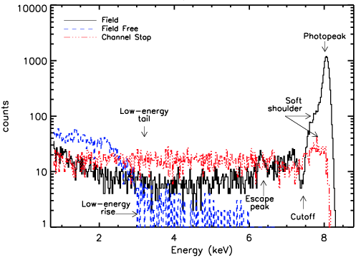
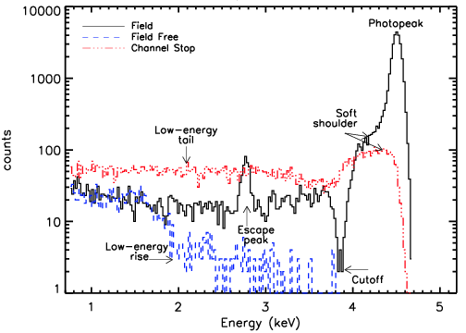
Spectral components of SCD
8.047 keV
Interaction zone | SRF components
Channel stop | LE shoulder, LE tail
Field-free zone | LE rise, LE tail
Field zone | Photopeak, LE shoulder, LE tail, cutoff, Escape peak
4.510 keV

Slide 14
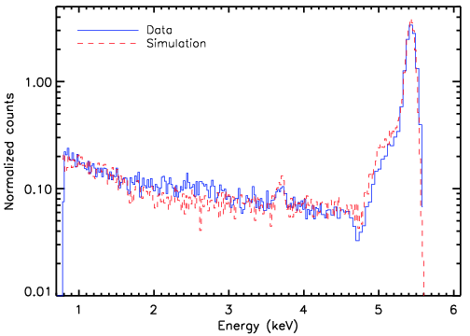
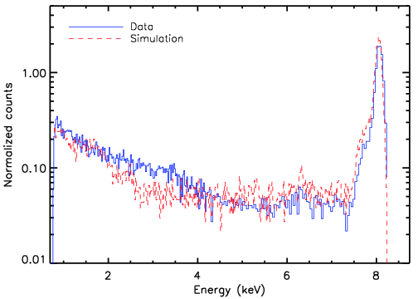
CTM results Vs C1XS ground calibration
5.414 keV
8.047 keV

Slide 15
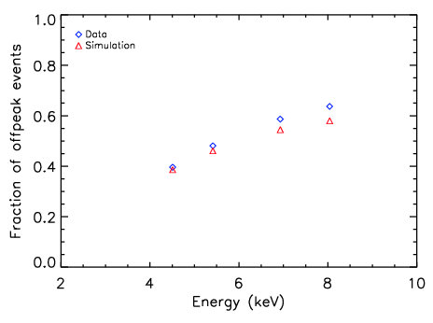
Energy dependence of SRF
Systematic variations
Channel stop interactions?
Concentration of dopants in the boundary?
Possible suggestions for further improvements!

Slide 16
Summary of CTM
Modeled photon interaction, charge generation & propagation in SCD
Identified major sources contributing to the observed SRF
CTM results matches well with C1XS ground calibration data
Studied Energy dependence of SRF
Fraction of off-peak events are underestimated in CTM
Fine tuning of channel stop interactions required

Slide 17
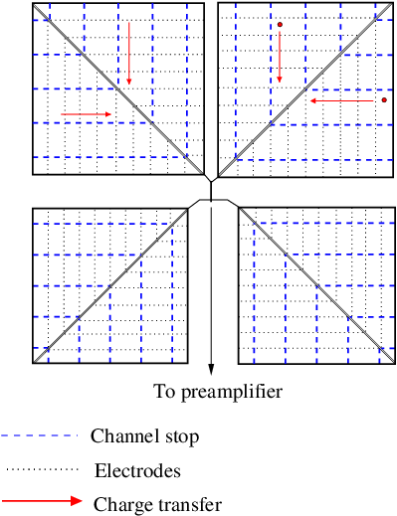
SCD (CCD 236) for CLASS
Each unit – 4 cm²
2phase clock
Pitch – 100 µm
Less split fraction
CLASS – 64cm²

Slide 18
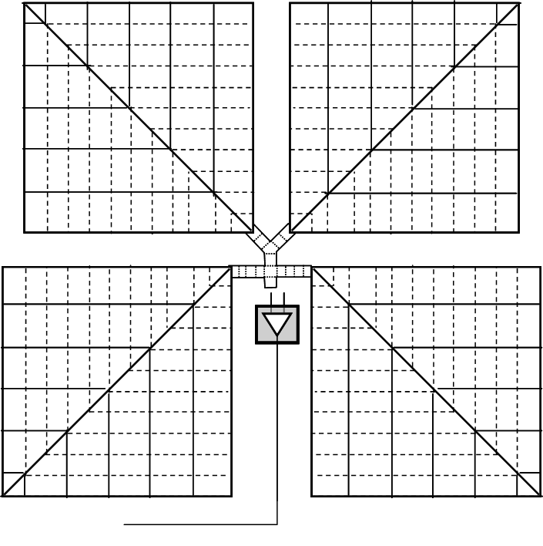
Measured X-ray charge
CCD-236 being used in CLASS

Slide 19
Data comparison
Courtesy - Dr. Jason, Dr. Phillipa, The Open University, UK

Slide 20
Future Work
Detailed study of dead layer interaction
Investigate dead layer interactions (Si – SiO₂ – Si₃N₄)
Investigation of Channel stop interactions
Energy dependence and SRF contribution
Testing and validation for Bulk SCDs
Optimizing event selection and split threshold

Slide 21
Thank You

Slide 22
Interaction zones
&
Dominant physics
~1.5µm
V
Dead layer
(recombine)
Buried Channel
35µm
Field zone
(drift)
15µm
Field-free zone
(diffusion)
Substrate
(recombine)
600µm

Slide 23
Single pixel
events
FF zone
Field zone
Substrate
Drawn not to scale – CCD 54

Slide 24
Multi pixel
events
FF zone
Field zone
Substrate
Drawn not to scale – CCD 54

Slide 25
Equations governing CTM of SCD

Slide 26
Remote sensing X-ray studies of the Moon
Apollo 15,16 (XRS); SMART-1 (DCIXS); KAGUYA (XRS)
CHANDRAYAAN-1 (C1XS)
First lunar bound XRF experiment to observe the Moon with a good spectral resolution

Slide 27
CTM for SCD
Written in IDL with the aim to be generic
Implementation of the SCD architecture
Diagonal charge transfer
Pseudo linear charge output
Event processing in SCD (adopted in C1XS)
Selection and optimization of event selection criteria
Optimize event and split threshold
Study the SRF and its dependencies

Slide 28
Motivation for Charge Transport Model
For accurate lunar surface composition
High sensitive and resolved measurement of major rock-forming elements (Na, Mg, Al, Si, Ca, Ti, Fe)
Reduce uncertainties in the derived XRF line fluxes
To better understand Spectral Redistribution Function
To reduce uncertainties in spectral response
Dependencies : Energy, Event selection criteria
Improved global lunar elemental mapping using
Chandrayaan-2 Large Area Soft x-ray Spectrometer (CLASS)

Slide 29
Spectral Redistribution Function (SRF) of SCD
E
Observed SRF of SCD CCD54 at 8 keV – C1XS calibration
Detector
Photopeak
LE rise
LE
shoulder
counts
LE tail
Cutoff
Energy
Escape peak
Physical model for photon interaction and charge transportation to understand the complex SRF of SCD
Narendranath et al., 2010

Slide 30
Outline of the talk
Chandrayaan-1 X-ray Spectrometer – An overview
Introduction to Swept Charge Devices
Need for a charge transport model
Algorithm development and implementation
Validation with ground calibration data
Application of model for the upcoming Chandrayaan-2 X-ray spectrometer (CLASS)

