Slide 1
Charged Particle Monitor onboard the ASTROSAT
Yash Bhargava
Tata Institute of Fundamental Research
On Behalf of CZTI/CPM team
1st March 2016

Slide 2
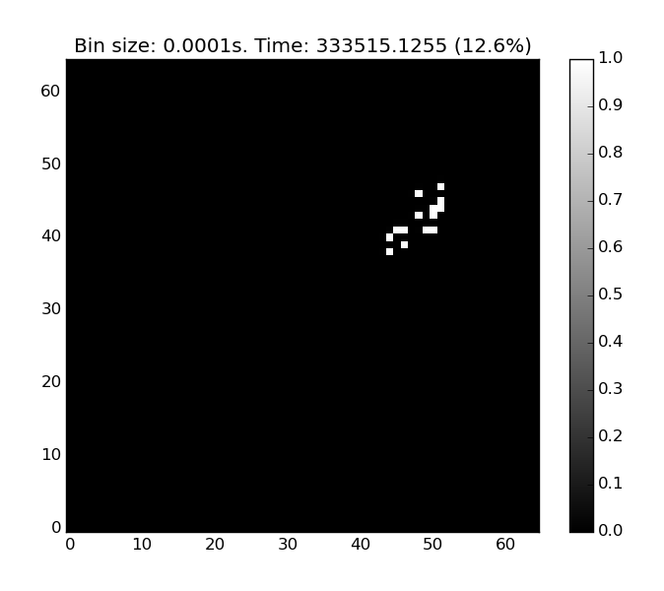
Motivation for CPM
South Atlantic Anomaly
Drifting
Solar flares
Effect of Charged particles on the detector
Notes:
Brief description of the SAA,
Effect of SAA on detector
Explain the czti plot

Slide 3
CPM design
Scintillating crystal detector – CsI(Tl)
Light detector – Photodiode with CSPA
Cost Effective
No gain change
Notes:
Contents of the circuit
Detector, Photodiode with pre amp
Processing electronics
Interface with the ground

Slide 4
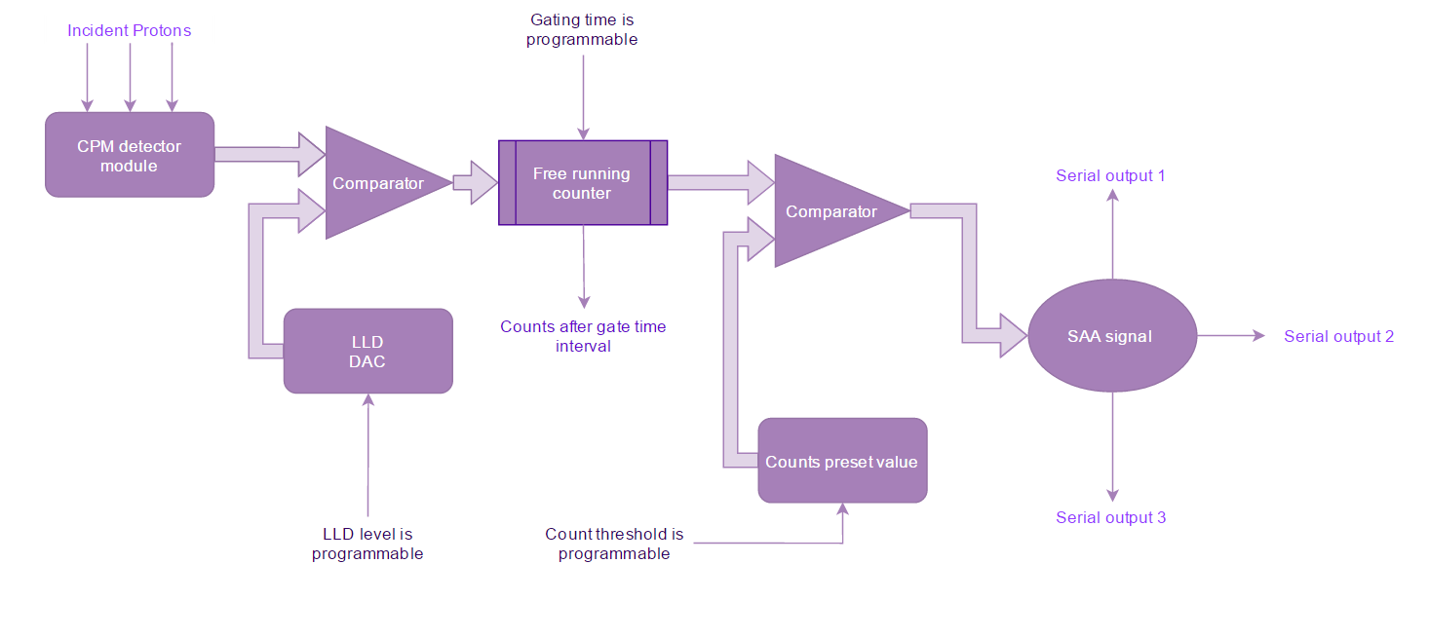
CPM logic
Notes:
Explain the logic of the CPM
Incident proton produces radiation
Radiation converted to the electrical signal with the diode and amplified by the cspa
The signal reaches comparator, (mention the programmable part of LLD)
Free running counter to count the signals
Concept of gating time
Count preset values to discriminate SAA
False trigger avoidance
SAA signal generation

Slide 5
Ground Calibration

Slide 6
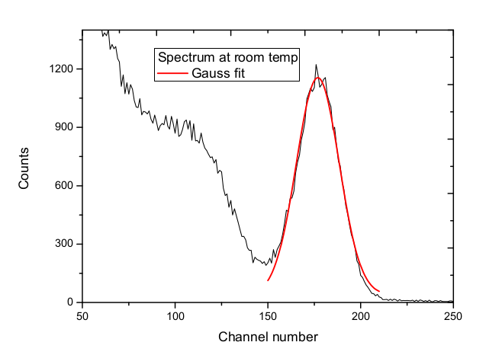
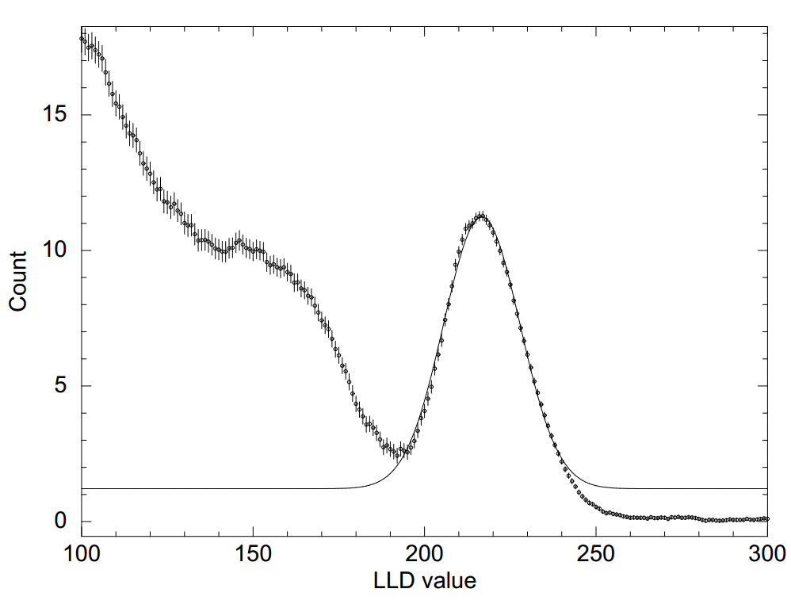
Spectral Fitting
Absence of direct energy information
Multi-Channel Analyser – used in engineering model
Integral spectrum using LLD
Gaussian fitting to determine the peak position
Notes:
Mention where mca can be used for the energy information
Explain the spectrum generation process from LLD
Mention the use of peak position

Slide 7
Testing with different sources
Radioactive sources – Ba¹³³, Cs¹³⁷ and Eu¹⁵²
Detector response 1.20 mV/keV
Source | Energy (in MeV) | Peak Channel number
Ba¹³³ | 356 | 43.1
Cs¹³⁷ | 662 | 85.2
Eu¹⁵² | 1112 | 131
Eu¹⁵² | 1408 | 173.6
Notes:
Mention why testing with gamma sources is done

Slide 8
Testing with particles
Tested in BARC-TIFR Pelletron facility
Protons of energy 15 MeV, 17 MeV and 18 MeV used
Attenuation observed due to air column, Teflon, Aluminum Mylar
Energy (MeV) | Peak channel number | Error in energy(MeV)
6.07 | 177.5 | 0.7
10.1 | 378 | 0.45
11.7 | 448.7 | 0.35
Notes:
Mention how the attenuated energy was computed
Mention that the fitting was done using the attenuated energy

Slide 9
Stability tests
Detector exposed to the source for varying time durations
Stability in Peak position and PWHM is observed
Notes:
Variation in peak- think of what can cause such variation
Mention the reason for the difference in the mean values

Slide 10
Stability with environment
Detector tested in Thermo-Vacuum chamber
-10ºC to 40ºC
Stable results in 10-30ºC
Notes:
Mention that commercial grade detector was used. Best performance in RT range

Slide 11
Onboard testing

Slide 12
Switching ON
Default values
Gating time 5 s
Count threshold 3 counts/s
Entry trigger criteria - 3
Notes:
Effect of precession
Deepest SAA counts
Detection of SAA in grazing orbits

Slide 13
Contour of SAA
Notes:
Plotting the path of satellite
Plotting the contour maps for defining the boundaries well

Slide 14
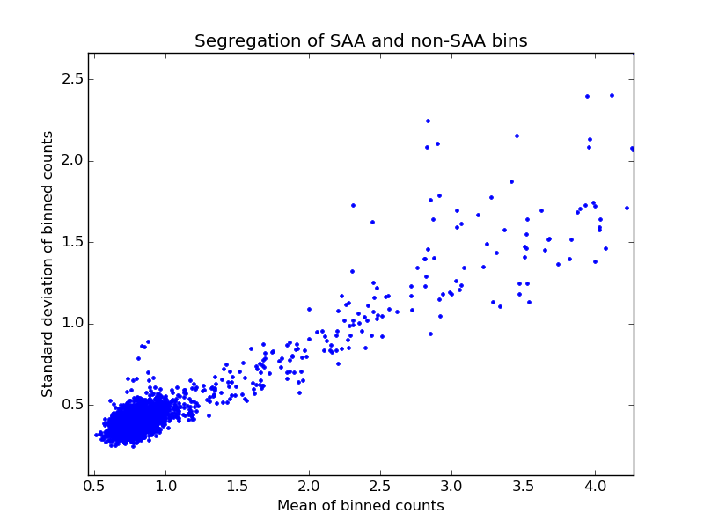
Onboard Stability of CPM
Mean and Variance of observed counts binned by square degree interval
Clear segregation between SAA and non SAA regions
Notes:
Mean of counts vs the std
Low counts in non-SAA region – low variance means high stability of non SAA
Clumping of the non SAA region
Tracks of SAA region
- High variability within the degree

Slide 15
Products from CPM
Monthly contour maps of SAA
Average counts in each square degree of Satellite path for ready reference
SAA window for Astrosat (in case CPM trigger fails)
Currently set at 100ºW to 0ºE for all possible latitudes
Trapezoidal window can be set for more data time
Notes:
Contour maps can be used for model generation

Slide 16
Thank you!

