Slide 1
A GUI for High Resolution X-ray Spectra
T. Kallman, L. Angelini, M. Witthoeft, F. Paerels, J. Kaastra

Slide 2
Background
Spectra contain large amounts of information, but deriving this information can be challenging both conceptually and procedurally
In the optical band science results are derived from ‘discrete diagnostics’, i.e. line ratios or equivalent, based on quantities which can be measured directly from an observed spectrum.
In the X-ray band finite spectral resolution and counting statistics mean this is often not possible.
General results depend on ‘modeling’, i.e. producing synthetic data from models and then iteratively correcting.
This procedure requires knowledge of fitting tools and may obscure the model physics.
It is familiar and straightforward for experts, but raises the barrier for entry to the field by outsiders.
For Hitomi (Astro-H) we have tried to build a tool which alleviates some of these problem.

Slide 3
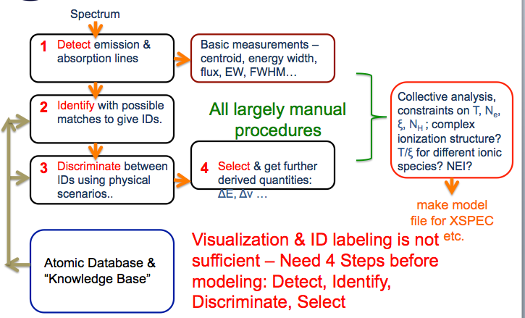
Overview
Procedure is outlined:

Slide 4
General list of features to include
  Spectra treated as optical data (without RMF)
  Graphical interface to display spectrum with several capabilities
  Show detector feature & abs edges & considering how to treat Redshift
  Binning capability
  X-axis ADC & keV ; Yaxis Count/s & flux
  Re-iterative Detection capability
  Line detected compared :
    With list of bright lines
    Line diagnostics to id for example line series
  Guess out the plasma type (Photoionized, Coronal, NEI etc ..)
  Outputs xspec style model with guess lines

Slide 5
Current development
Build in Python uses standard libraries numpy , matplotlib & astropy
View capability
  Read type I & II spectra
  Read ARF
  Compute photon flux
  Easy navigation
  Rebinning
  Save plot to file
  Automatic feature detection
    Choose criterion
    Display individual features
    correct
identify
  Load atomic line/edge list
  ID by energy
  Filter atomic set by ion or other
  Alternate feature shape
  Apply redshift/velocity
  Capability to load other list (instrument features)
  ID detected features
  Export line lists to file
Diagnostics
  Detect redshift/velocity
  Apply diagnostics
  Look for line series (Kα/Kβ)
  Prepare xspec/etc input
Software features:
  Logging
  Save/Load sessions
  Undo/redo
  Scripting

Slide 6
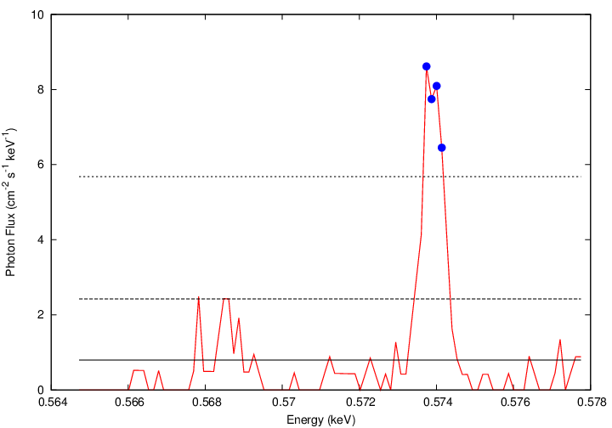
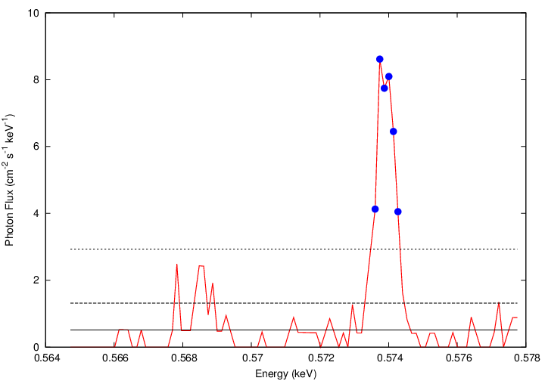
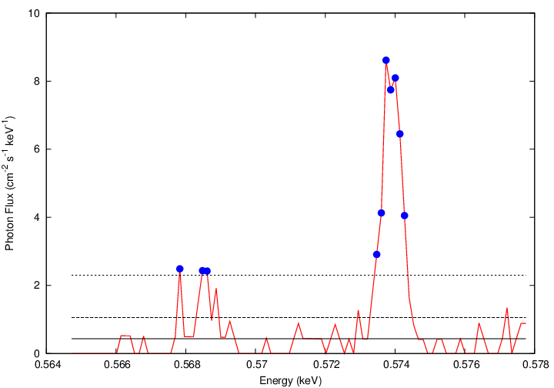
Detections
Iterative detection

Slide 7
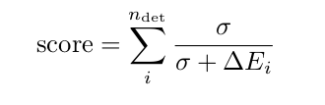


Velocity/redshift
2340 km/s
-400 km/s
Kaspi et al 2002
reported 2330 km/s
Miller et al. 2008

Slide 8
Atomic features
So far, taken from xstar database
  But use of other line lists and models is desired
Xstar database has ~10⁵ lines, 432 ions
Two lists:
  From grid of models: find lines from each ion which appear in top 10 in most model → top ~800 lines, a few from each ion for use in getting ids
  Include lines emitted and absorbed, and from fluorescence, recombination, EIE.
And physical list generated from physical scenario: photoionization, coronal, nei ….
  Used for evaluating physical scenario via ‘score’
Wavelengths for strongest lines are known with sufficient accuracy (NIST).
Rely on ab initio wavelengths for many inner shell lines; these have fractional errors ~1%, not ideal.
Strong lines are almost certainly the same across various line lists

Slide 9
Line identification
Using Gaussian fit, line list is searched for all features within either
  Prescribed energy shift
  Statistically significant region
Subsequent scoring uses sum of all identified model lines satisfying this criterion.
Does not pick winners, lets the model choose

Slide 10
Evaluating the physical model
Each physical model is very simple: uniform gas with given elemental abundances, ξ or T or age, emission measure
If so, line strength depends linearly on abundance, emission measure
Evaluate models using a score:
Where sum is over lines
  n is number of lines
  d_{i} is the area of of observed line from Gaussian fit
  a_{i} is the line strength from model table
  0 index is strongest line of each element
All the features for a given element are combined into one score → makes procedure valid independent of element abundances
Look for best score
  Allows testing of various scenarios
  Determination of best fit single parameter (ξ or T or age)

Slide 11
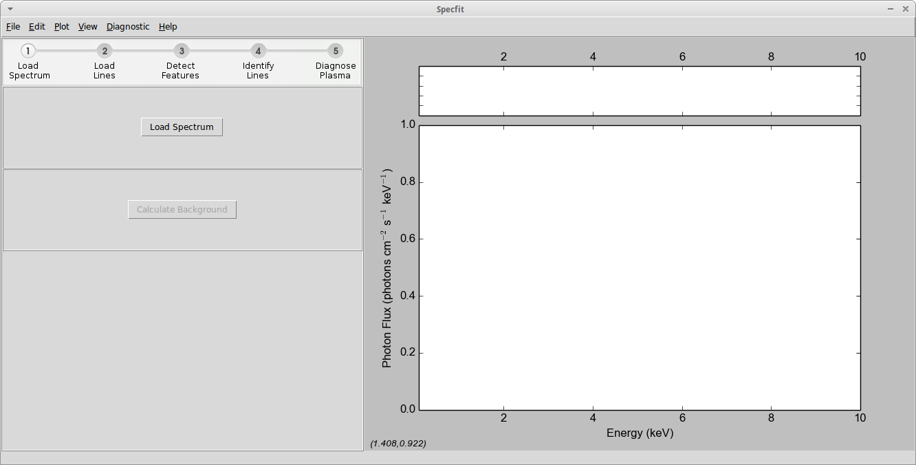
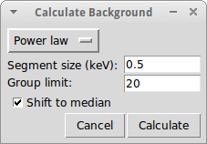
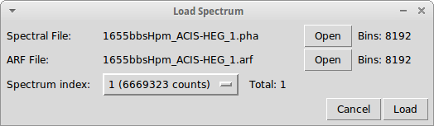
First step… load data and calculate continuum position

Slide 12
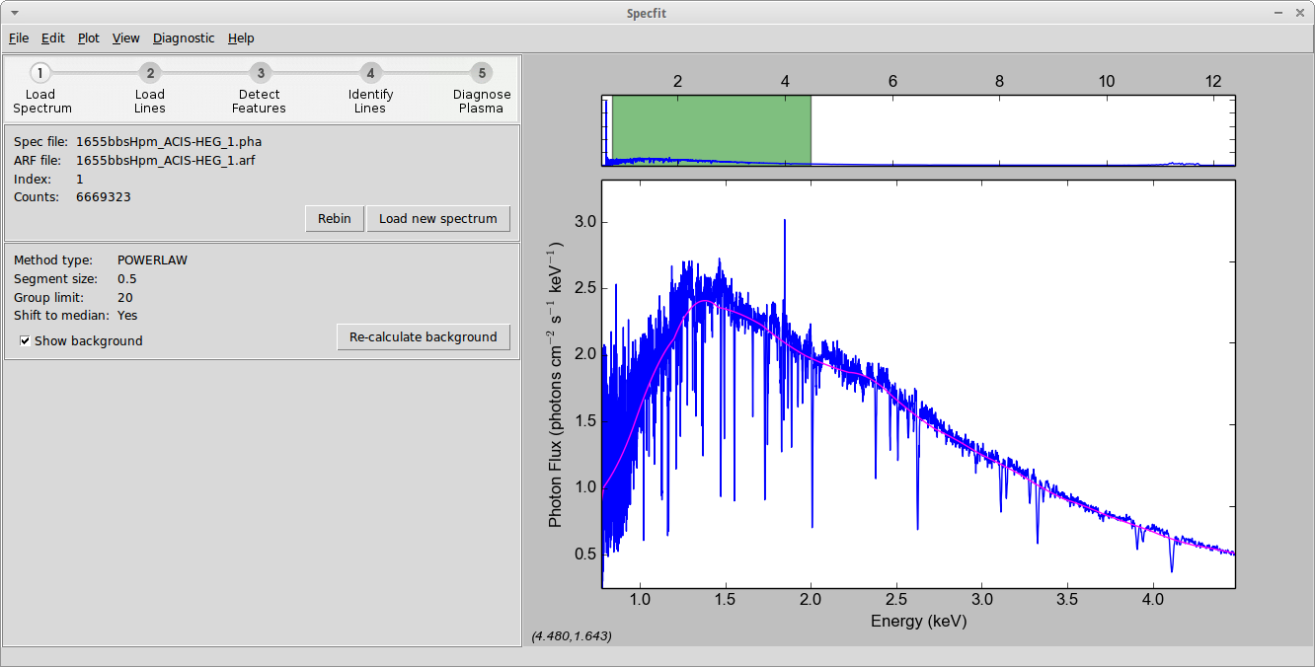
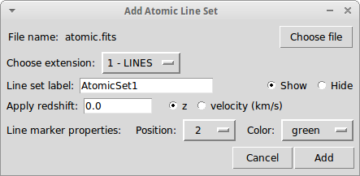
load line list

Slide 13
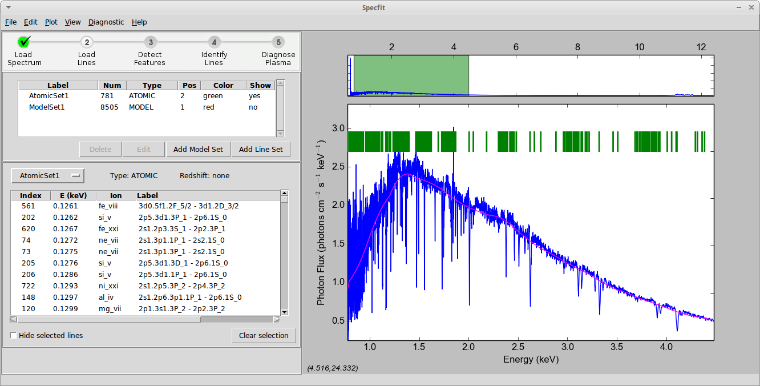
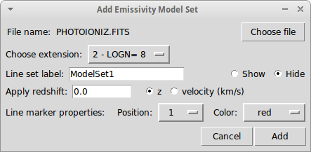
load line list with emissivities

Slide 14
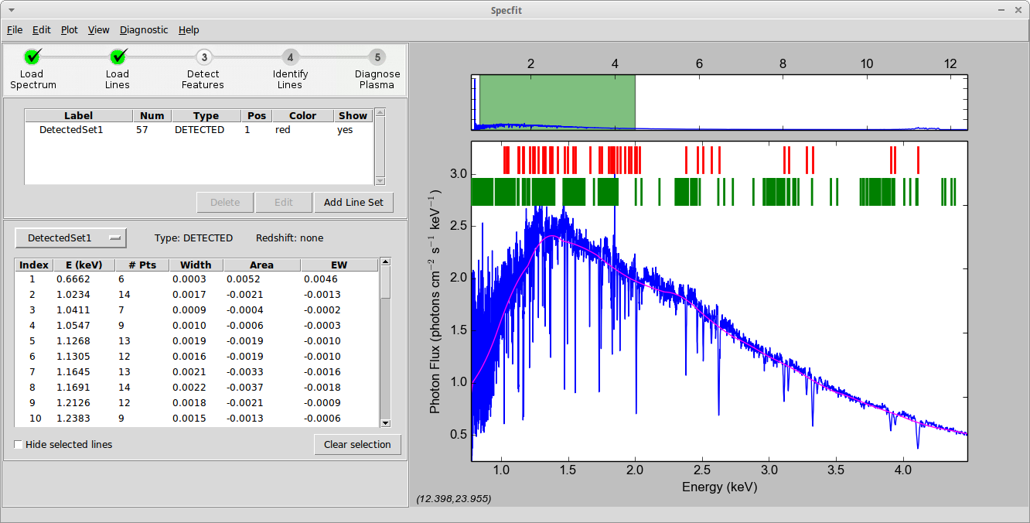
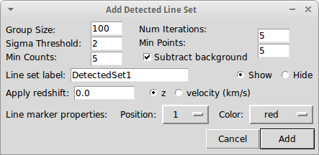
Criteria for line detection

Slide 15
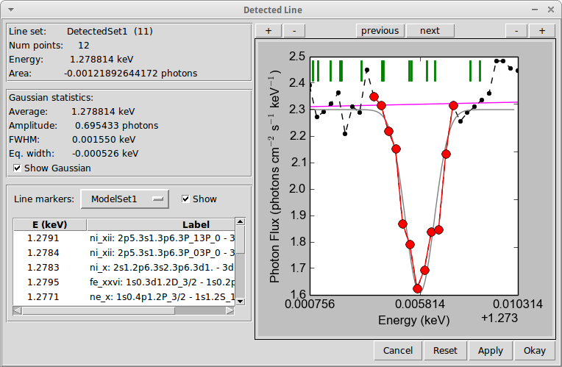
Adjust line detection criteria

Slide 16
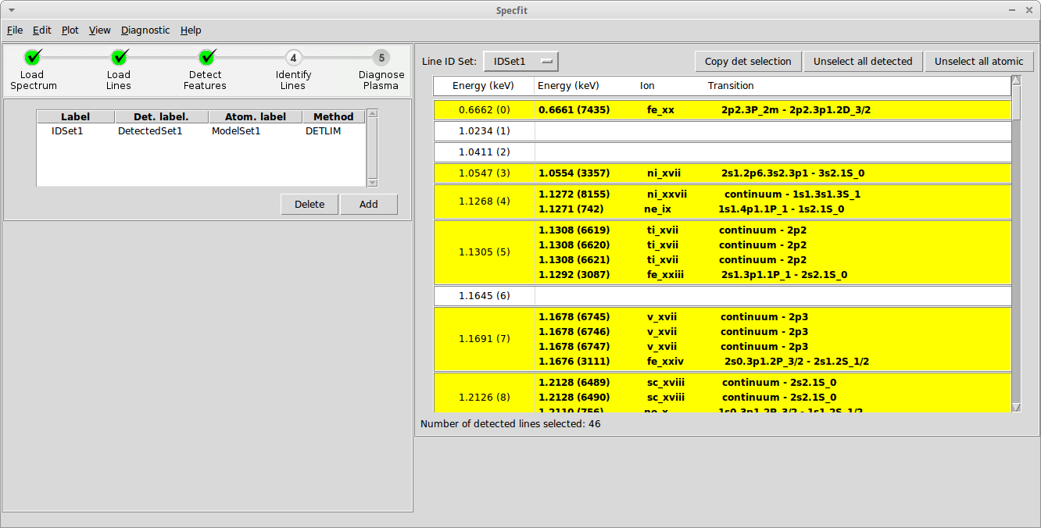
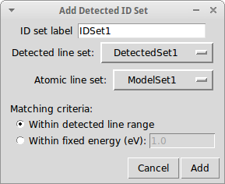
Choose which identified lines are used in plasma diagnostic

Slide 17
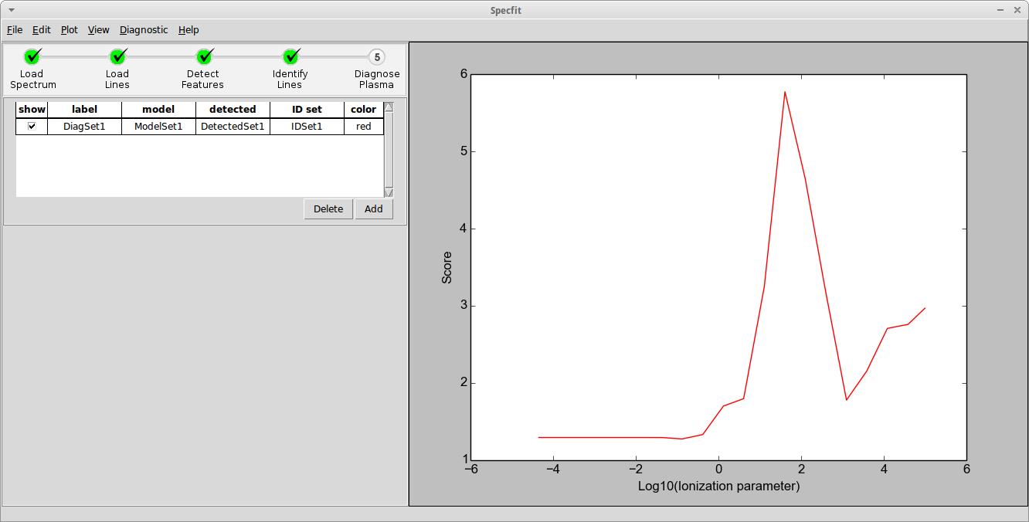
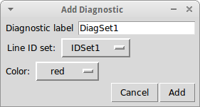
Evaluate plasma diagnostic via score

Slide 18
Possible future tool: Decision tree
Final remarks

Slide 19
Next steps
  Optimize algorithms
  Manually adding features
  Experiment with atomic data tailored to specific scenarios
  Experiment with other algorithms for identifying features.
  Be more selective according to conditions and atomic data → jelle’s tree
  Compare models for similar scenarios across developers
  Tool will be circulated simultaneously with Hitomi software, but not part of headas

