Slide 1
Cross-Cal paper
Kristin Kruse Madsen

Slide 2
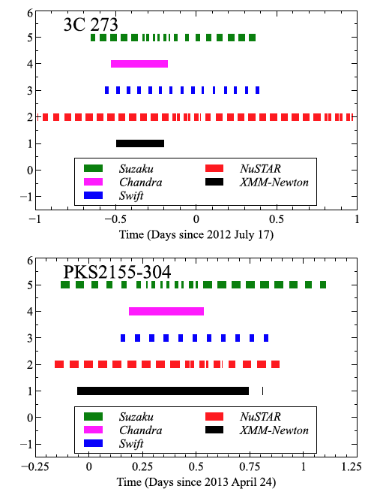
Observations

Slide 3
Light curves – 3C273

Slide 4
Light curves – PKS2155
Native observatory units (Request by A.B.)
No large variations, spikes due to SAA -> therefore quasi simultaneity OK

Slide 5
Analysis
Two energy bands:
1 – 5 keV for the soft instruments to increase statistics
3 – 7 keV when paired with NuSTAR
Fitting
Models Independent – calculate fluxes in the bands
Models ties – calculate fluxes in the bands
Plots
Contours
Independent v. tied
Flux ratios

Slide 6
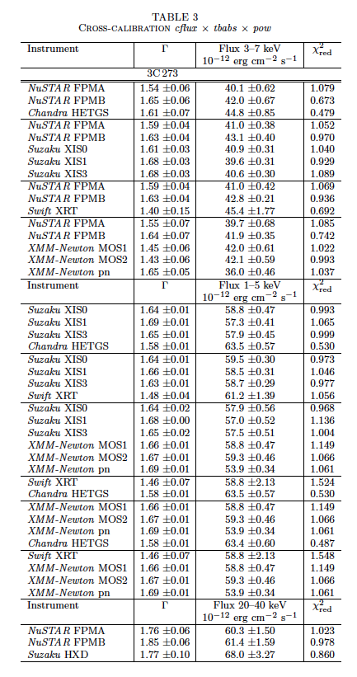
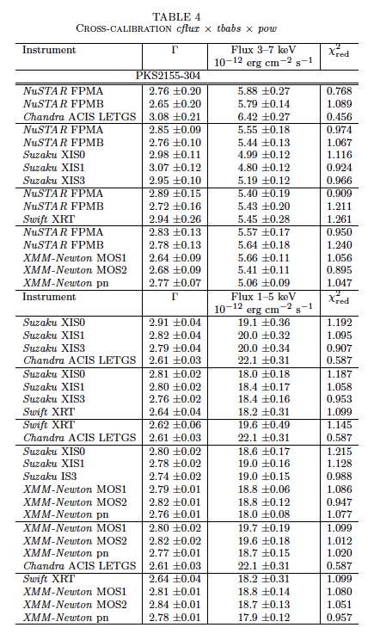
Independent fits

Slide 7
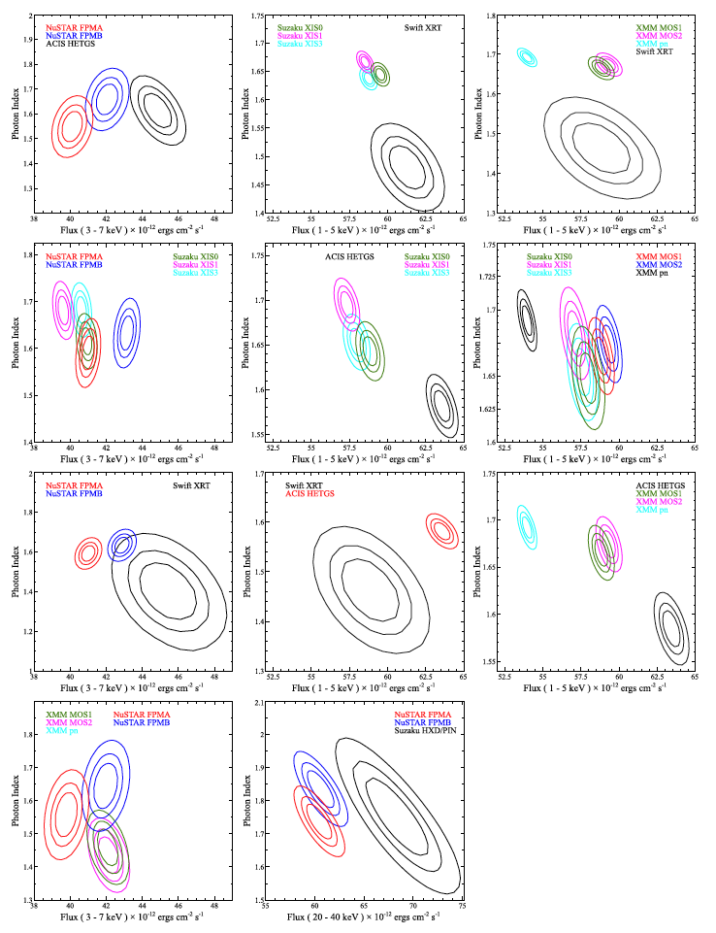
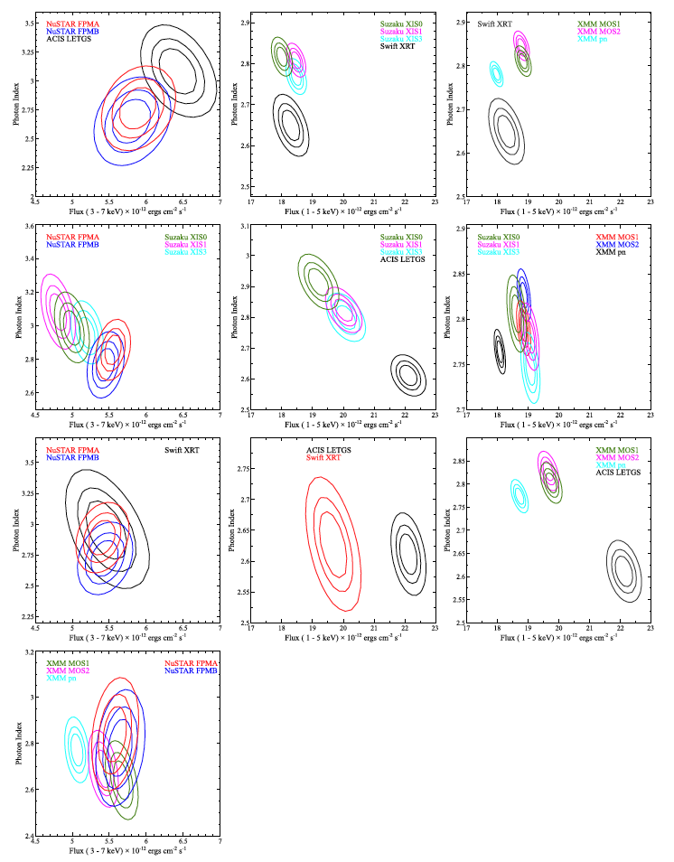
Plots for tables
3C273
PKS 2155

Slide 8
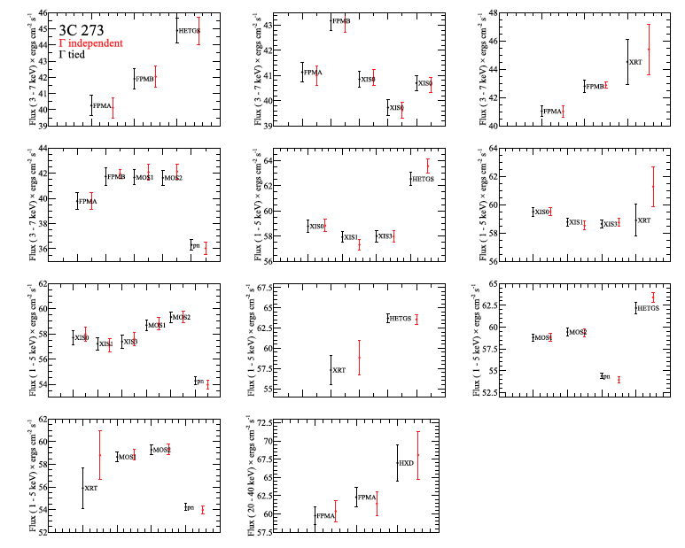
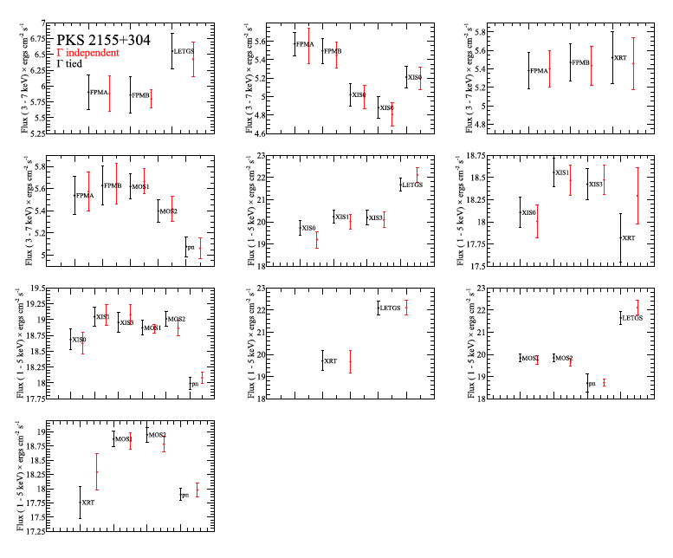
Tied fits

Slide 9
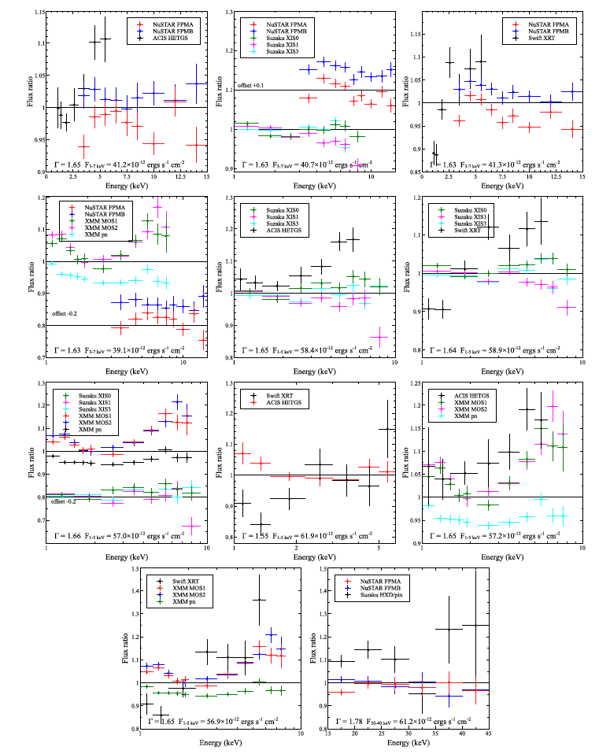
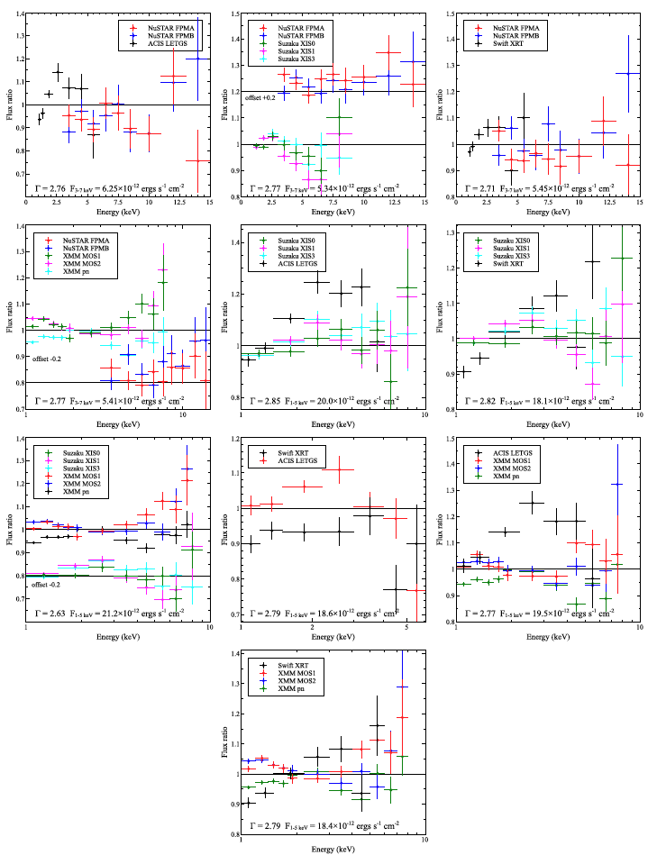
Flux plots

Slide 10
Decisions needed for finishing paper

Slide 11
Easy Decision Points
In section 3.1 it was commented upon that it was obvious the sections were written by different ppl.
My suggestion drop the detailed event selection for XMM if it is default. That makes the sections look more alike.
Section 5.1 addresses known calibration issues for each observatory.
Question: do people think this is a good idea?
We are missing XMM, Swift, and Suzaku text.

Slide 12
Rework table 5
Tab.5: I am not sure I agree with showing in this table the mean value obtained with the two sources, and adding the statistical errors in quadrature. This would be legitimate if the difference between the measurements obtained with the two sources would be purely statistical. However, we cannot rule out systematic effects (due to the different spectral shape, time, or whatever). I would argue that it would fairer to show the range of measurements obtained with the two campaigns
- Tab.5: I would split it by energy range in analogy to Tabs.3 and 4

Slide 13
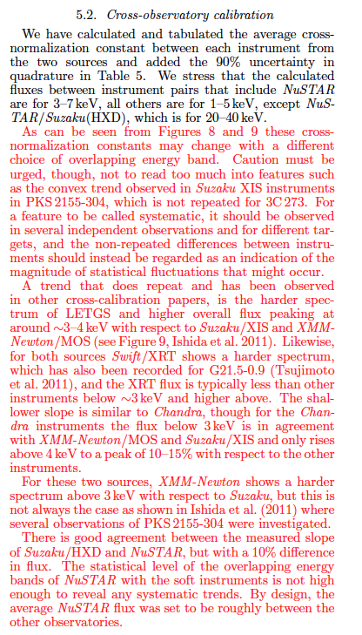
Reworking Section 5.2
add at the end of the first paragraph a short comment on the content of Tab.5, maybe stressing some typical feature such as the systematic low fluxes yielded by EPIC-pn, or the very good agreement between similar cameras as the EPIC-MOS and the XRT (despite the large differences in spectral shape!).
The title of this Section could be "Flux cross-calibration". I would then start a new section (whose title could be "Cross-observatory spectral discrepancies"), whose content could stay as it is now

Slide 14
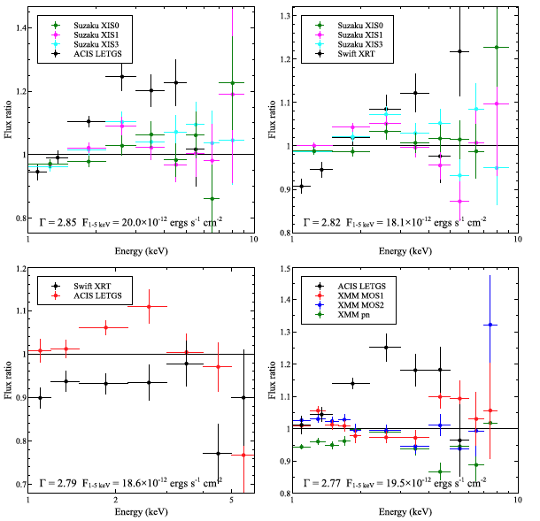
5.2 (5.3)
A trend that does repeat and has been observed in other cross-calibration papers, is the harder spectrum of LETGS and higher overall flux peaking at around 3-4 keV with respect to Suzaku/XIS and XMM-Newton/MOS (see Figure 9, Ishida et al. 2011).

Slide 15
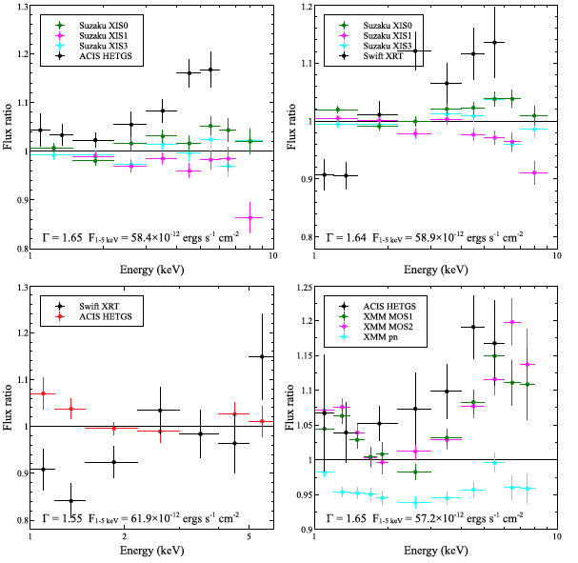
5.2 (5.3)
Likewise, for both sources Swift/XRT shows a harder spectrum, which has also been recorded for G21.5-0.9 (Tsujimoto et al. 2011), and the XRT flux is typically less than other instruments below 3 keV and higher above. The shallower slope is similar to Chandra, though for the Chandra instruments the flux below 3 keV is in agreement with XMM-Newton/MOS and Suzaku/XIS and only rises above 4 keV to a peak of 10-15% with respect to the other instruments.

Slide 16
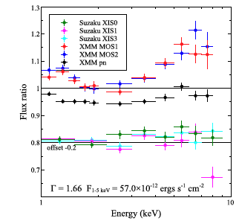
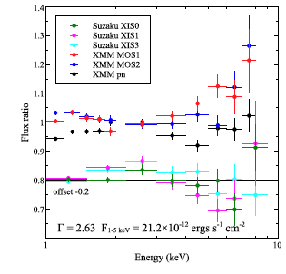
5.2 (5.3)
For these two sources, XMM-Newton shows a harder spectrum above 3 keV with respect to Suzaku, but this is not always the case as shown in Ishida et al. (2011) where several observations of PKS2155-304 were investigated.

