Slide 1
NuSTAR and PyBLOXCs
Kristin Kruse Madsen

Slide 2
Overview
Status of NuSTAR effective area
Sources of uncertainty
PyBLOCXS and NuSTAR

Slide 3
Status of the Effective Area

Slide 4
Cooking up a response file
RSP = RMF#ARF(on-axis*vignetting)*nuabs*PSF
RMF
  GEANT detector charge transport model calibrated and verified in the lab.
ARF
  On-axis is the pre-flight model
  vignetting contains all the corrections from the Crab calibration.
Nuabs
  detector dead-layer that has been measured against a control source (Crab)
PSF
  blurred(ray-trace model) * empirical correction

Slide 5
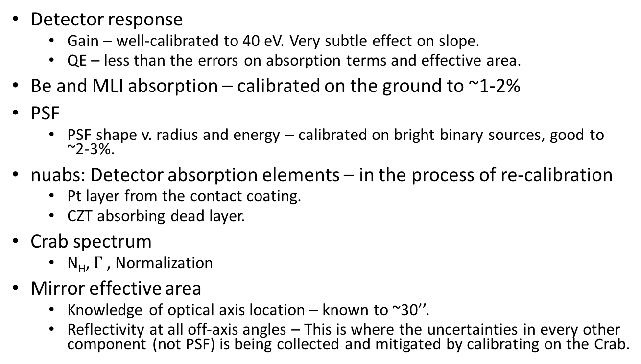
Status of Response File Components
Detector response
  Gain – well-calibrated to 40 eV. Very subtle effect on slope.
  QE – less than the errors on absorption terms and effective area.
Be and MLI absorption – calibrated on the ground to ~1-2%
PSF
  PSF shape v. radius and energy – calibrated on bright binary sources, good to ~2-3%.
nuabs: Detector absorption elements – in the process of re-calibration
  Pt layer from the contact coating.
  CZT absorbing dead layer.
Crab spectrum
  N_{H}, $Γ$, Normalization
Mirror effective area
  Knowledge of optical axis location – known to ~30’’.
  Reflectivity at all off-axis angles – This is where the uncertainties in every other component (not PSF) is being collected and mitigated by calibrating on the Crab.

Slide 6
Sources of Uncertainty

Slide 7
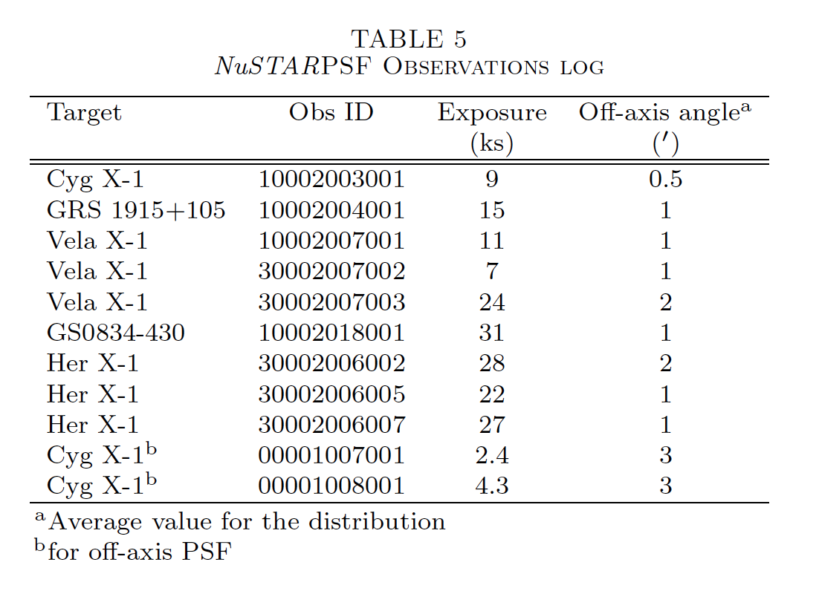
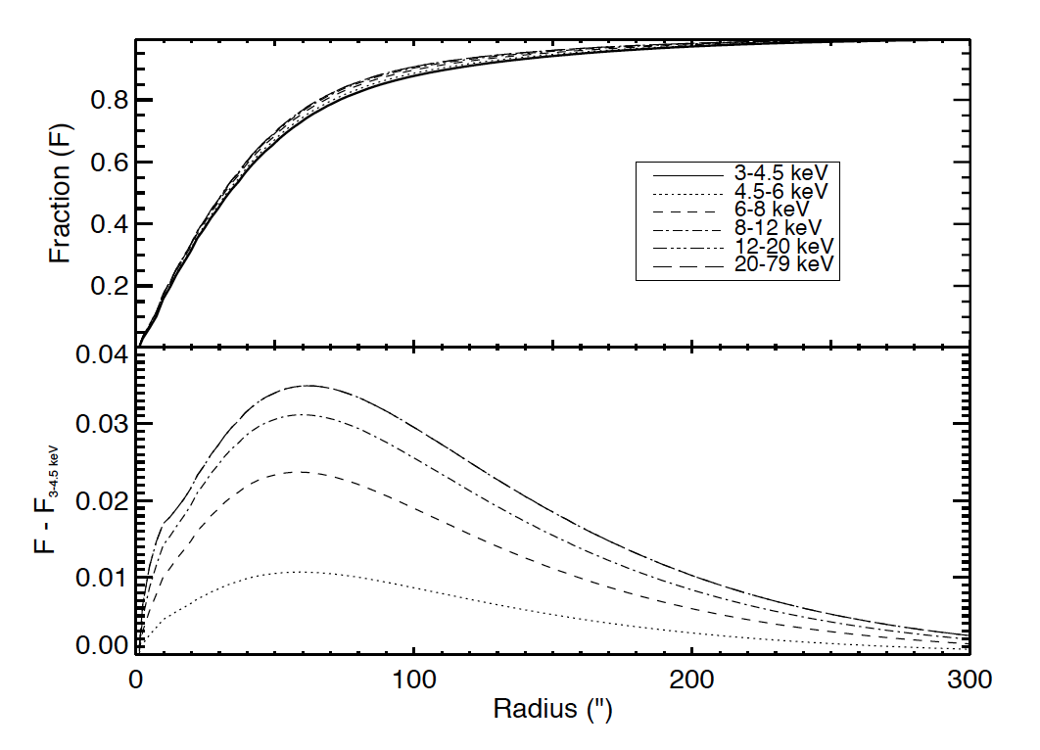
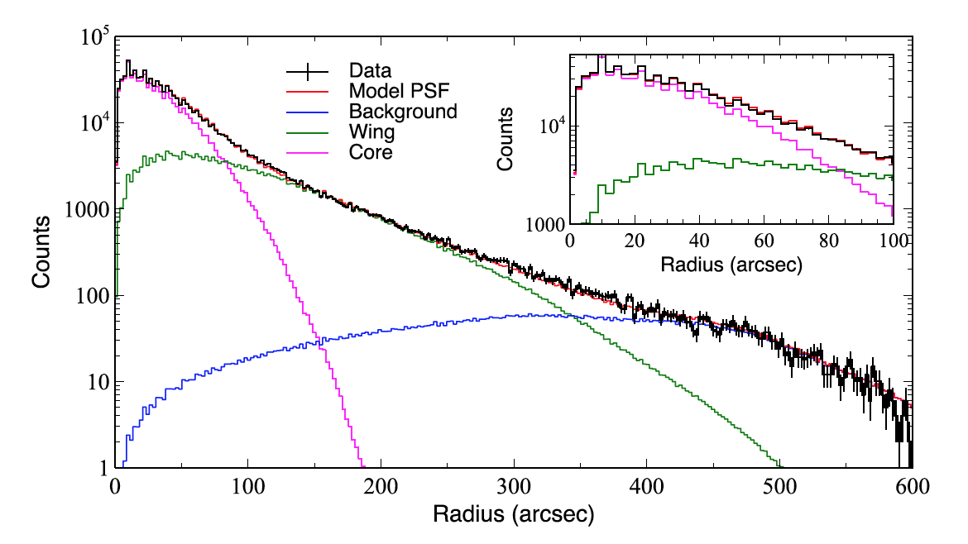
PSF calibration
The PSF shape as a function of radius and energy was calibrated on:

Slide 8
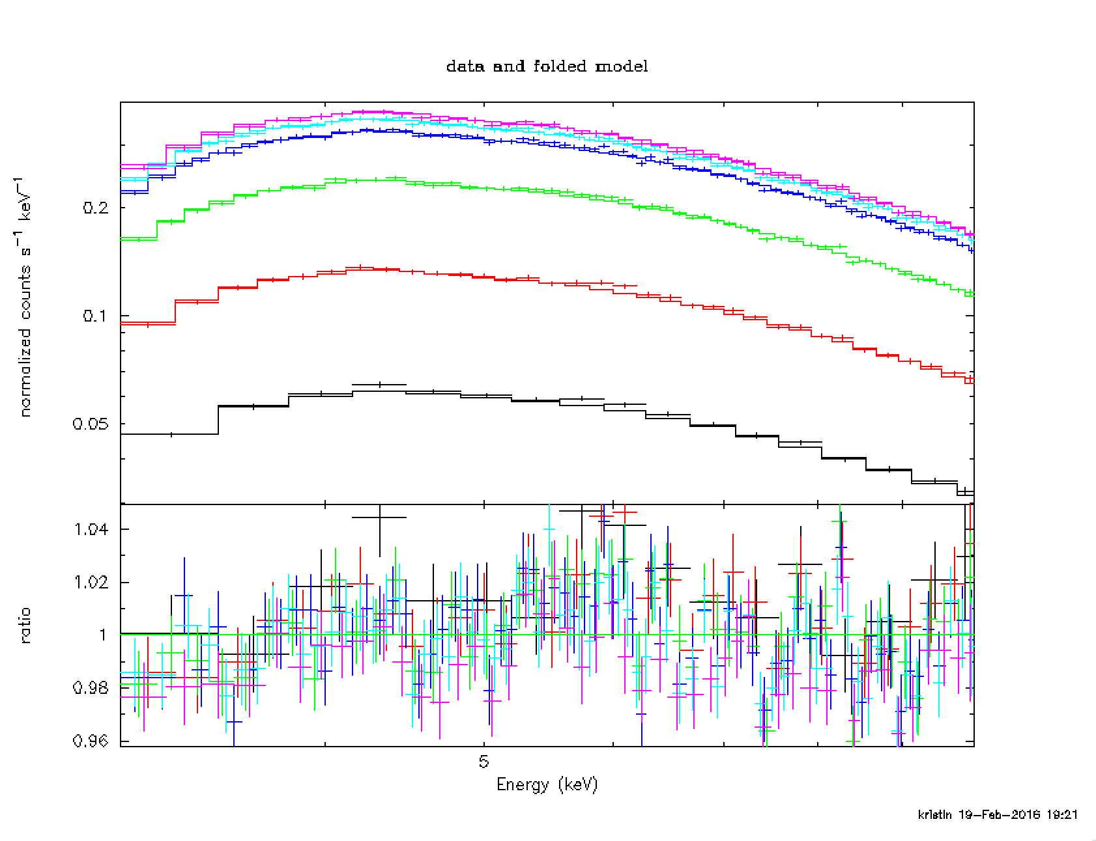
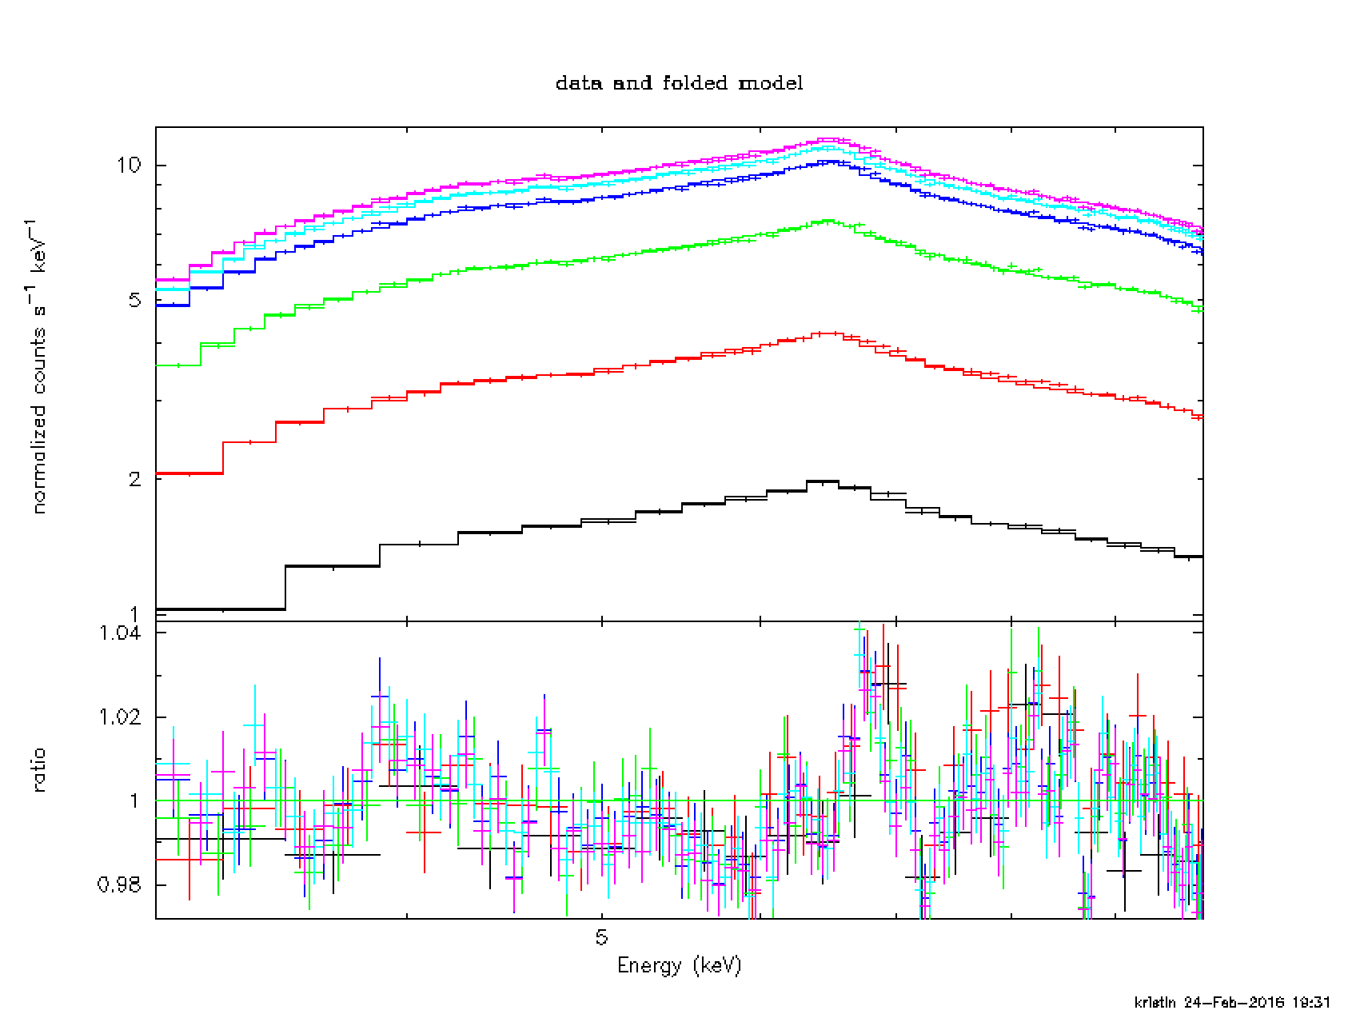
Radius v. energy
3C273
Her X-1

Slide 9
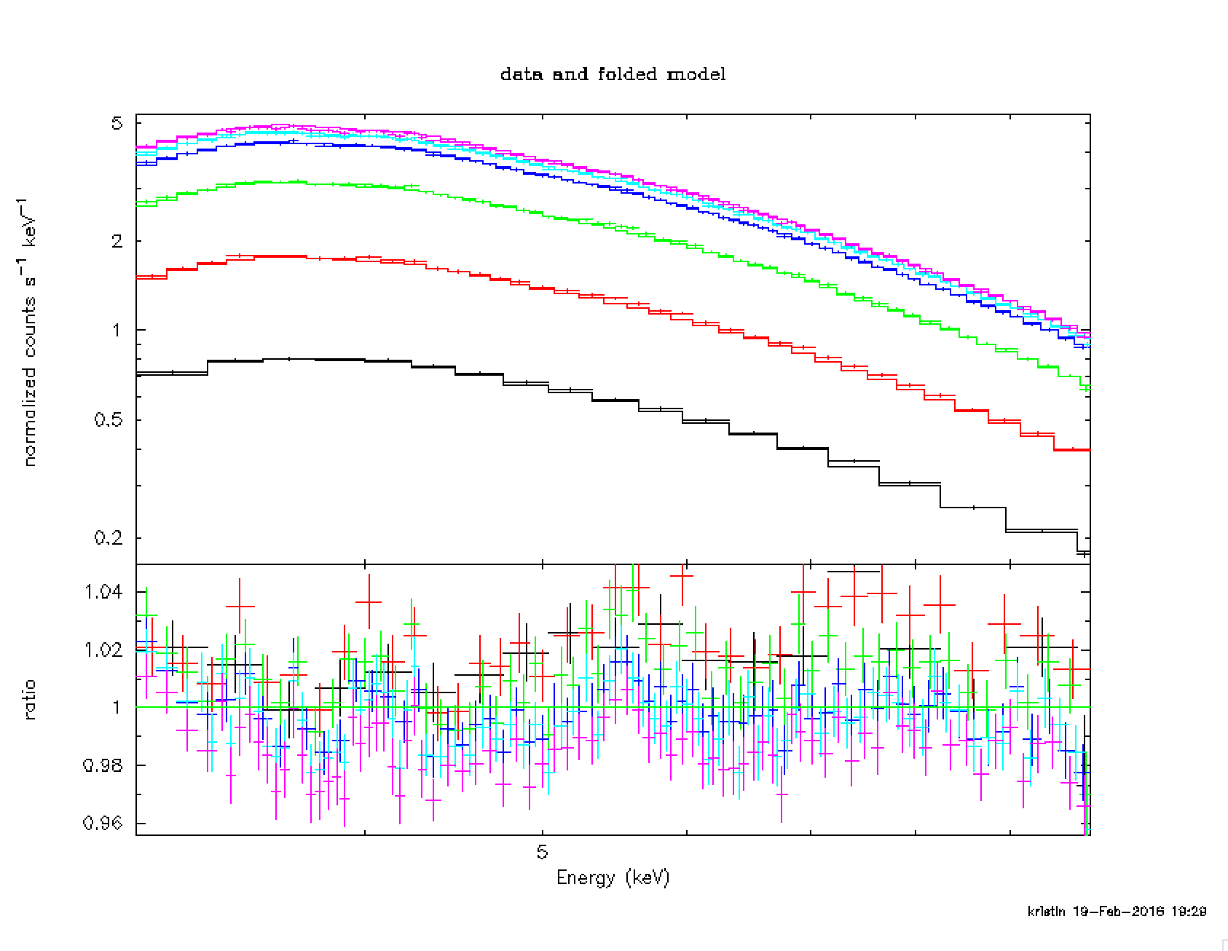
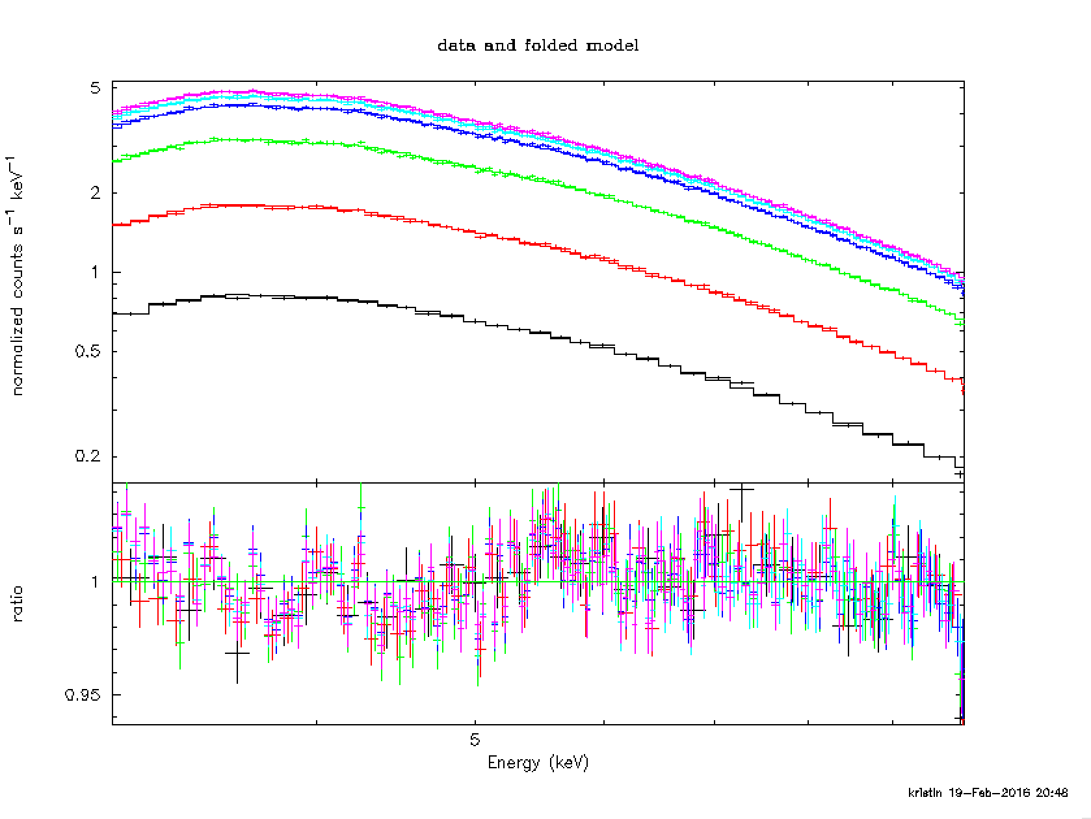
PSF uncertainties
Mkn 421
1 pixel = 2.45”
radius | 5 pixels | 10 pixels | 20 pixels | 40 pixels | 60 pixels | 100 pixels
constant | 1.000 | 1.006 | 0.996 | 0.983 | 0.973 | 0.971

Slide 10
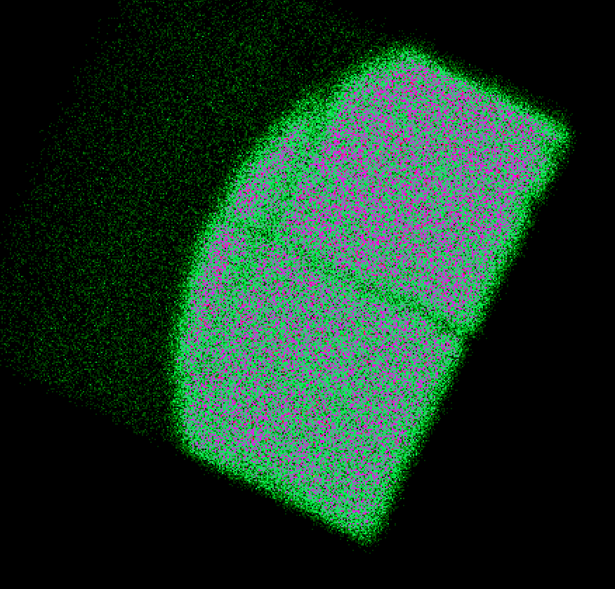
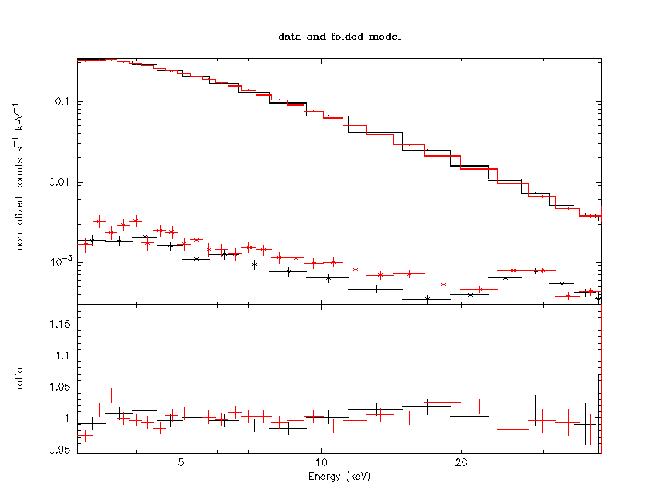
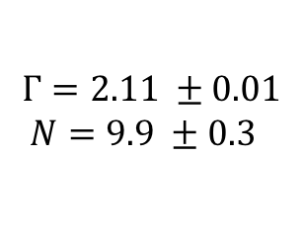
Nuabs
Explore the detector effects alone by using the Crab as a stray-light source. We place it 1.5 deg off-axis and observe the light that slips past the observatory and the aperture stop.
Only response is Be+MLI (<5 keV), and RMF (efficiency 99% up to 40 keV).
20 ksec
$$Γ=2.11 ±0.01$$
$$N=9.9 ±0.3$$
To be published as a in ApJL

Slide 11
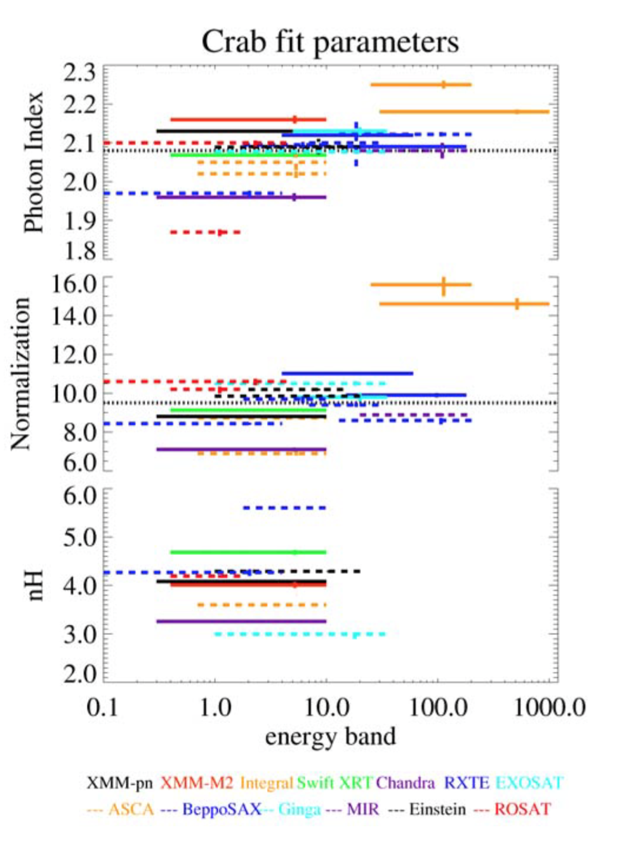
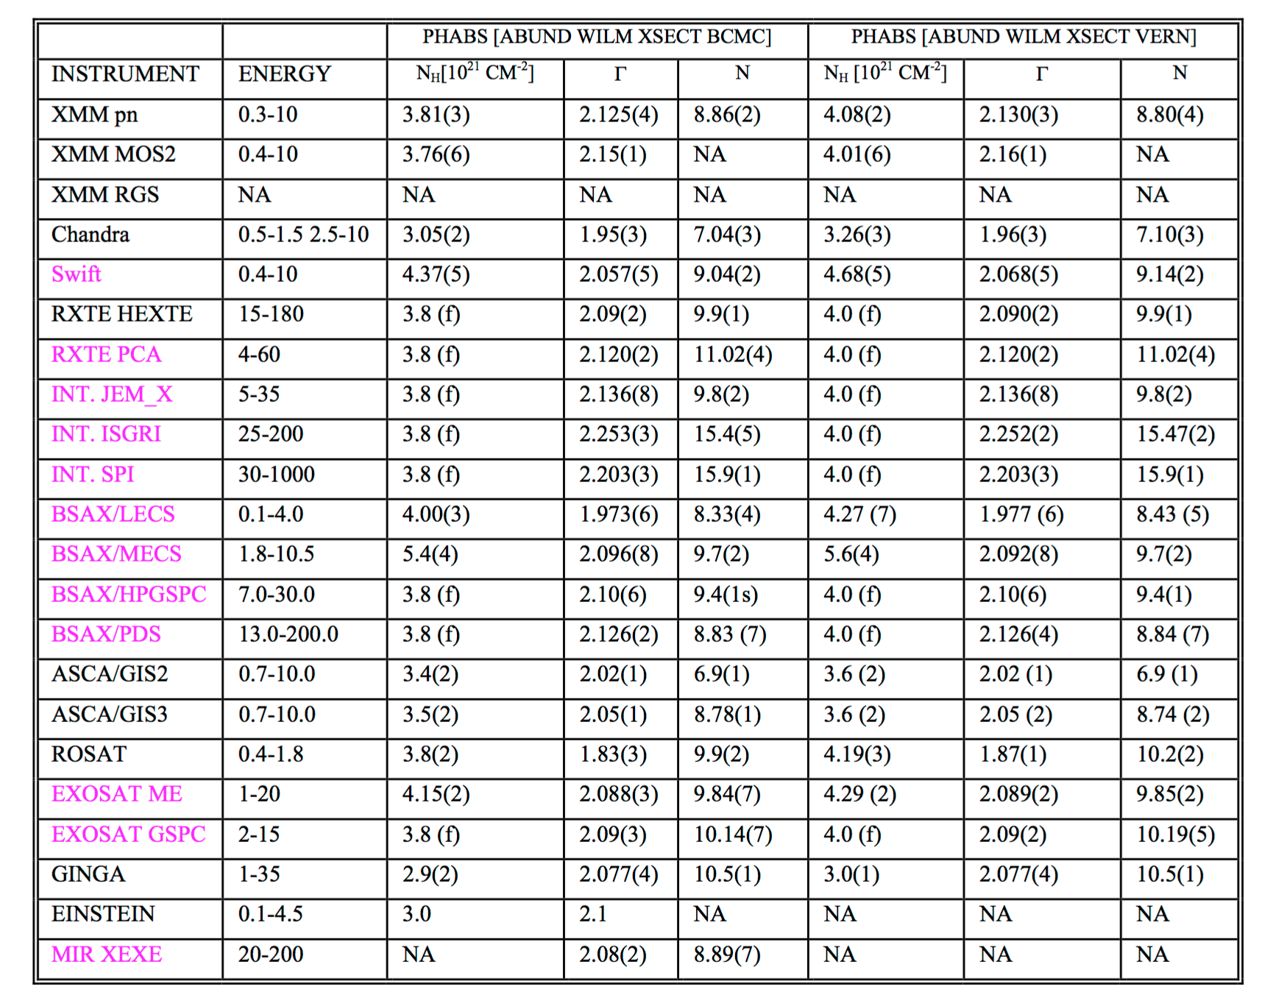
Crab spectrum
Kirsch et al (2005)

Slide 12
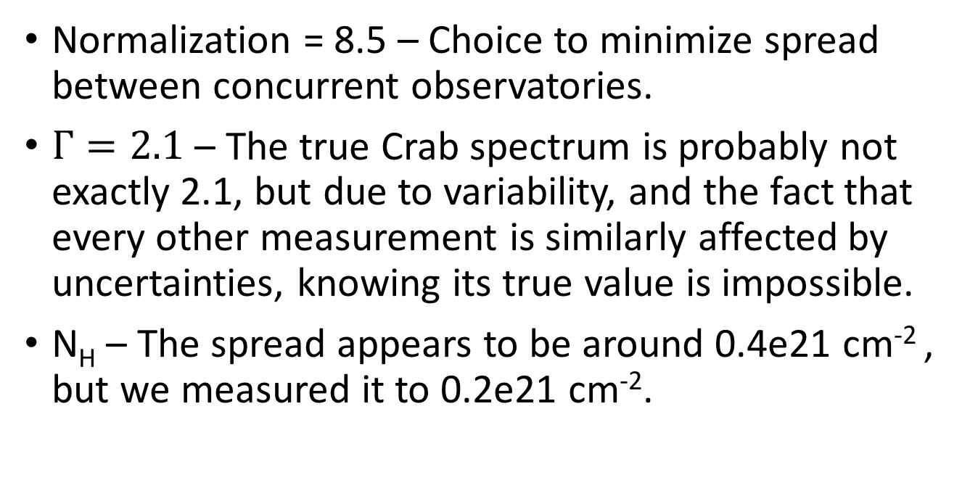
Choice of spectrum
Normalization = 8.5 – Choice to minimize spread between concurrent observatories.
$Γ=2.1$ – The true Crab spectrum is probably not exactly 2.1, but due to variability, and the fact that every other measurement is similarly affected by uncertainties, knowing its true value is impossible.
N_{H} – The spread appears to be around 0.4e21 cm⁻² , but we measured it to 0.2e21 cm⁻².

Slide 13
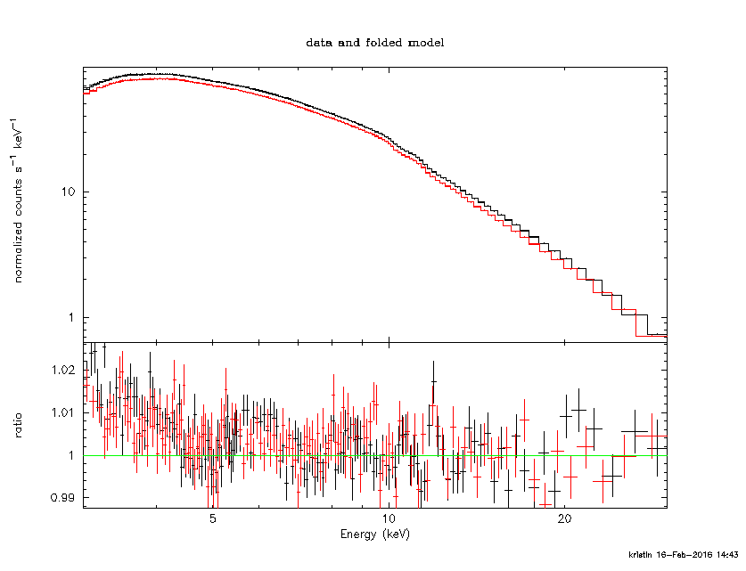
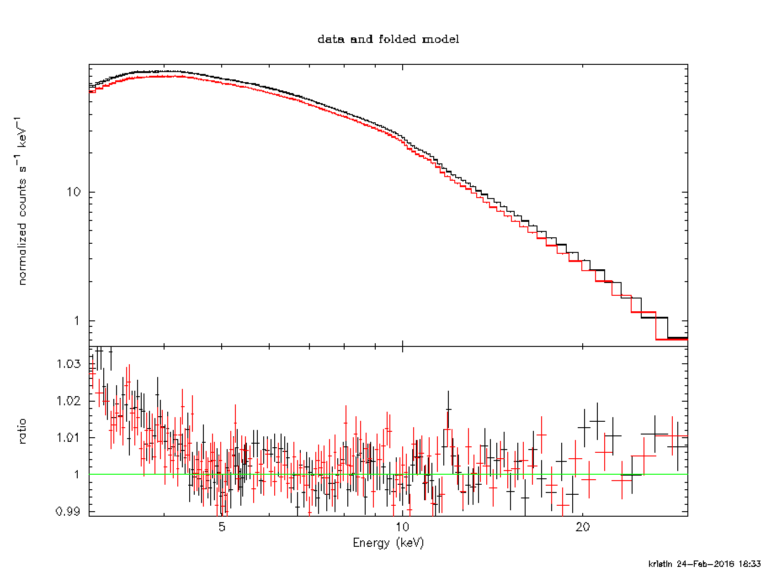
Effect of N_{H} on spectrum
0.4e21 cm⁻²
0.6e21 cm⁻²
The effect of this potentially wrong choice of N_{H} is 2-3% at 3 keV.

Slide 14
Mirror effective area
Vignetting (reflectivity)
  Because of the Crab calibration errors from the other components (minus PSF) gets mitigated by the effective area.
Optical axis location
  There is 0-5% difference between normalization from FPMA and FPMB. This points towards the possibility that we are probably don’t have the OA location quite correct. Thus potentially the vignetting could be +/- 30” off.

Slide 15
NuSTAR and PyBLOCXs

Slide 16
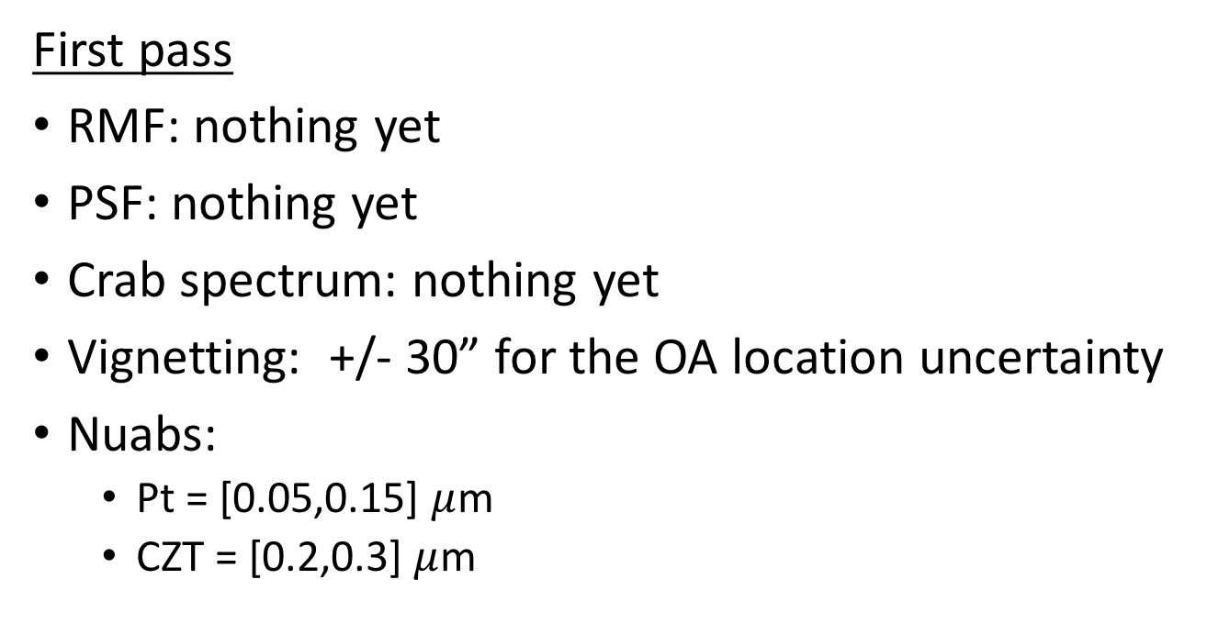
Perturbations for PyBLOCXs
First pass
RMF: nothing yet
PSF: nothing yet
Crab spectrum: nothing yet
Vignetting: +/- 30” for the OA location uncertainty
Nuabs:
  Pt = [0.05,0.15] $μ$m
  CZT = [0.2,0.3] $μ$m

Slide 17
Vignetting
Sampling of the vignetting curves around chosen off-axis angle by +/- 30”

Slide 18
nuabs

Slide 19
Results

Slide 20
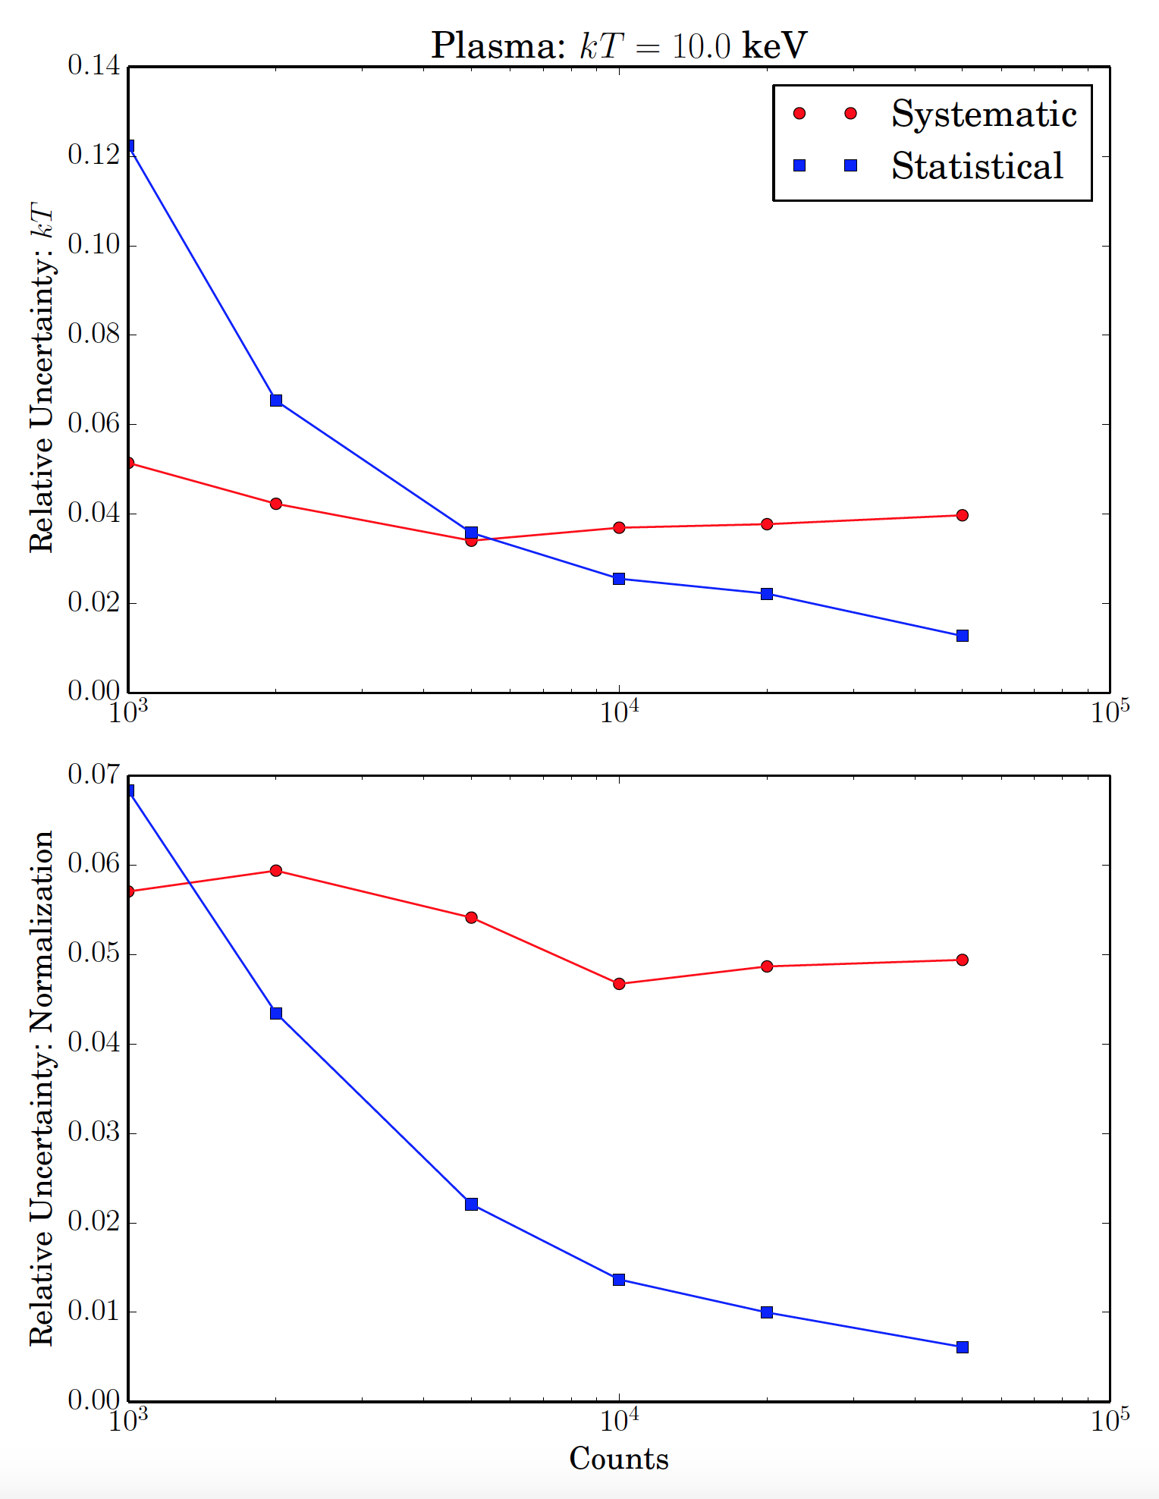
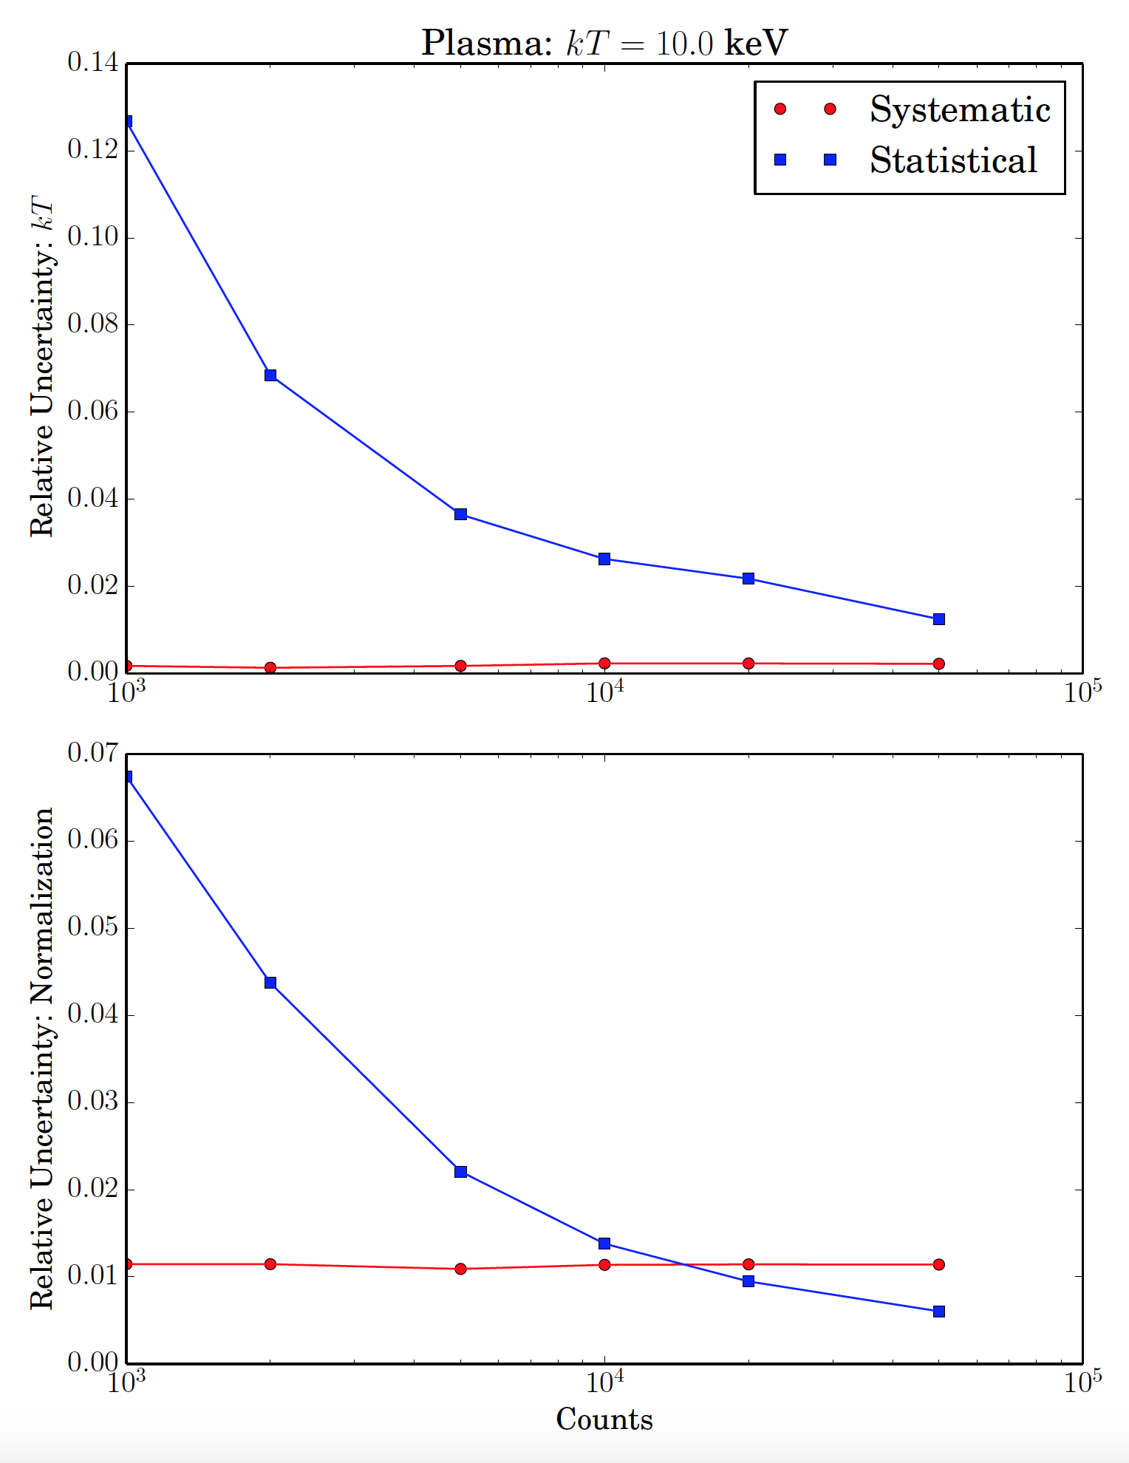
Plasma: kT = 10 keV
With nuabs
Without nuabs

Slide 21
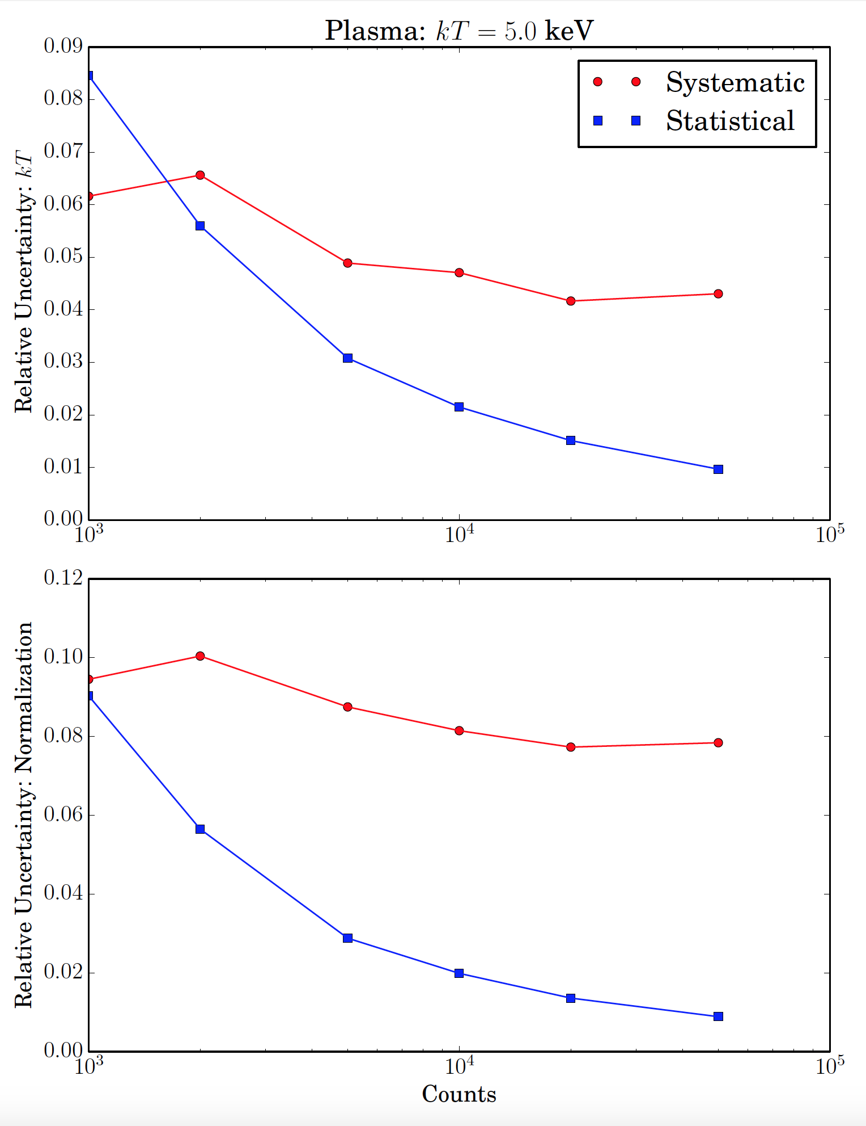
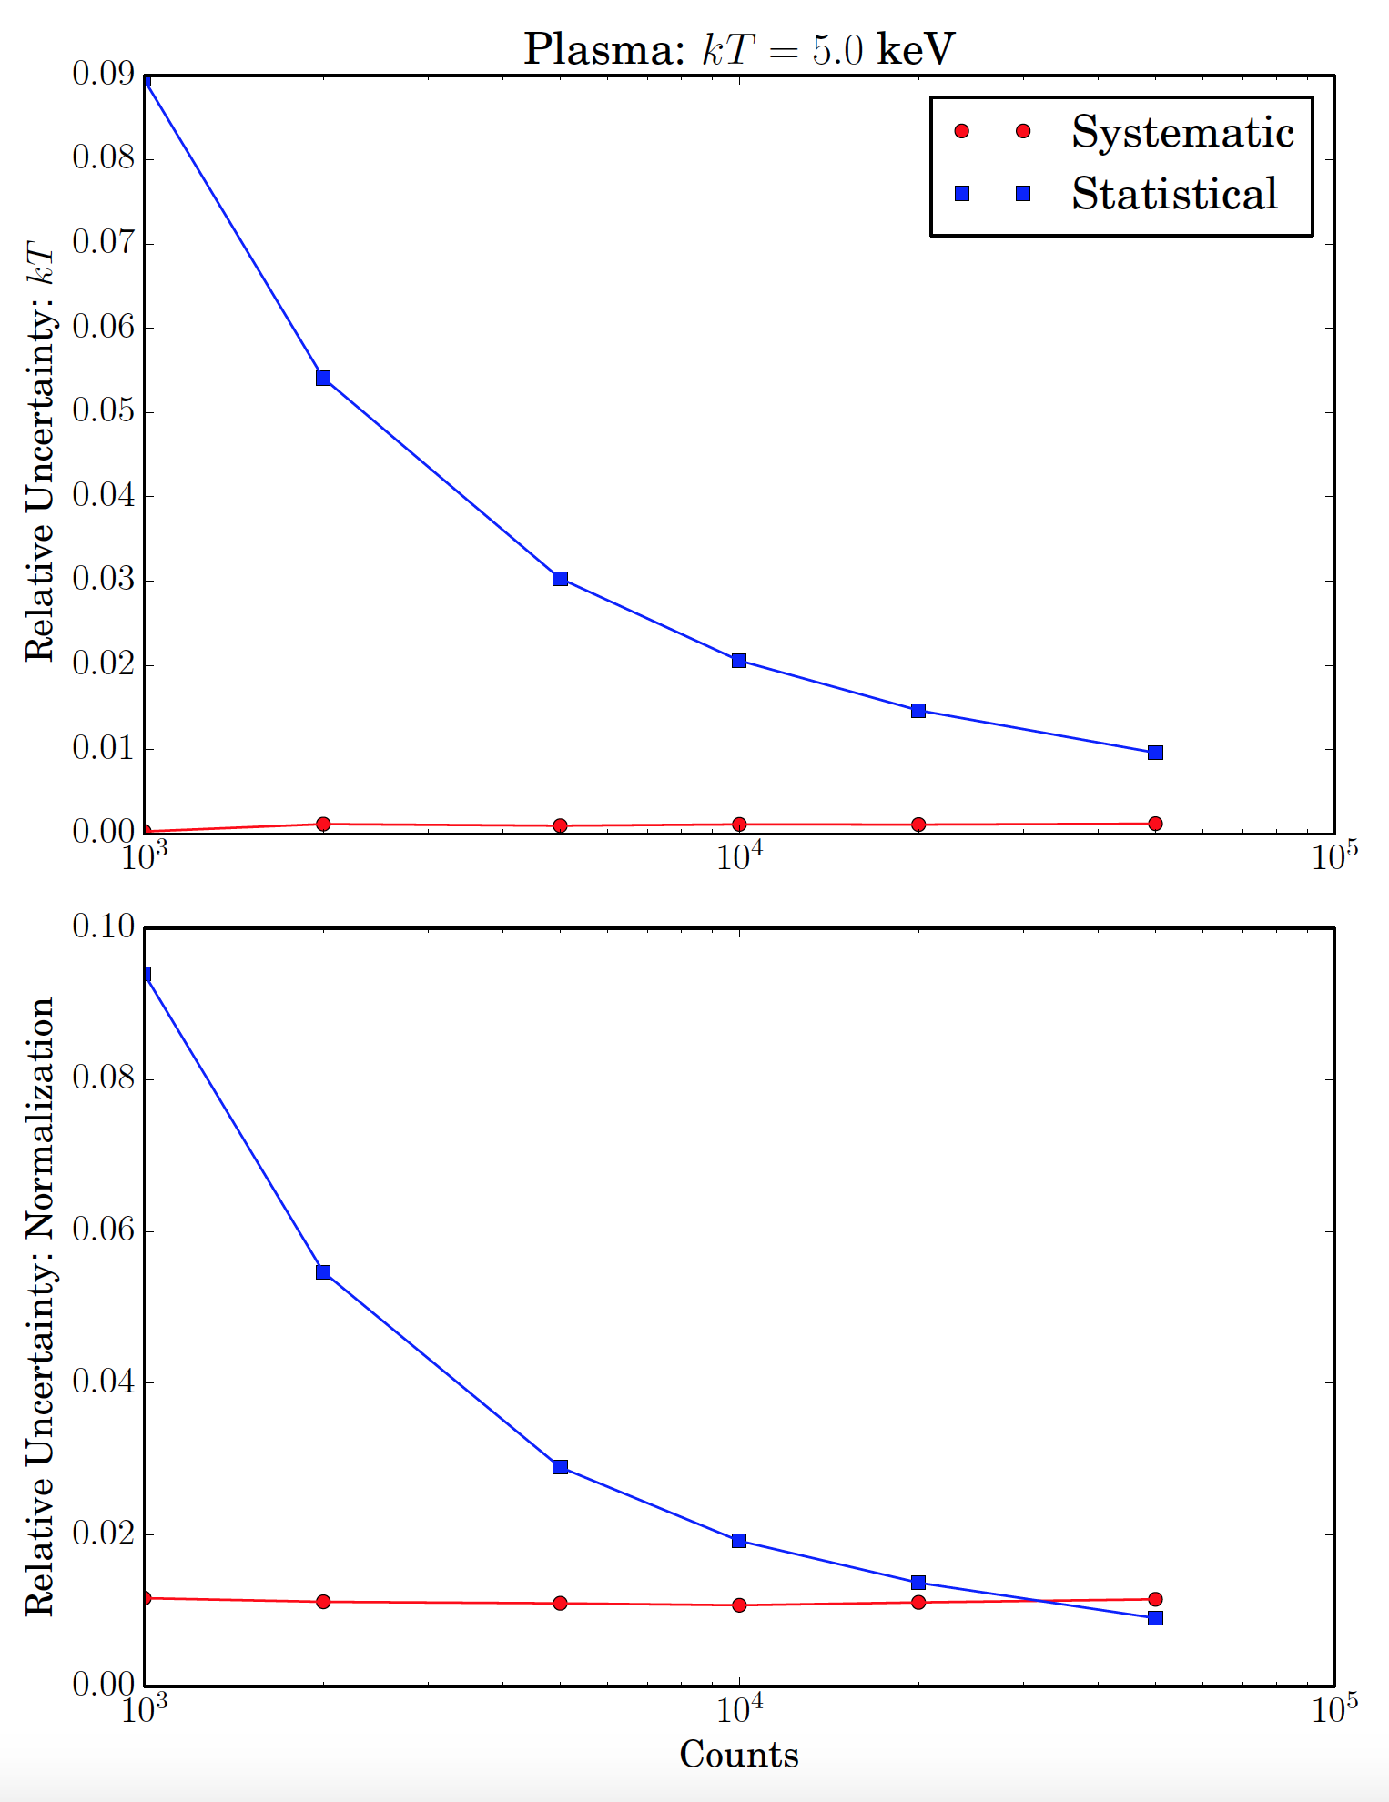
Plasma: kT = 5 keV
With nuabs
Without nuabs

Slide 22
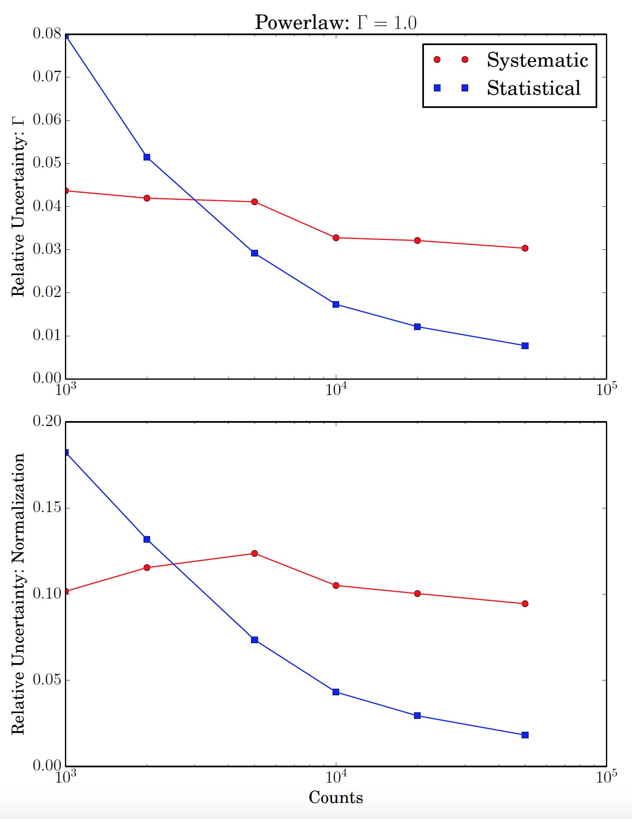
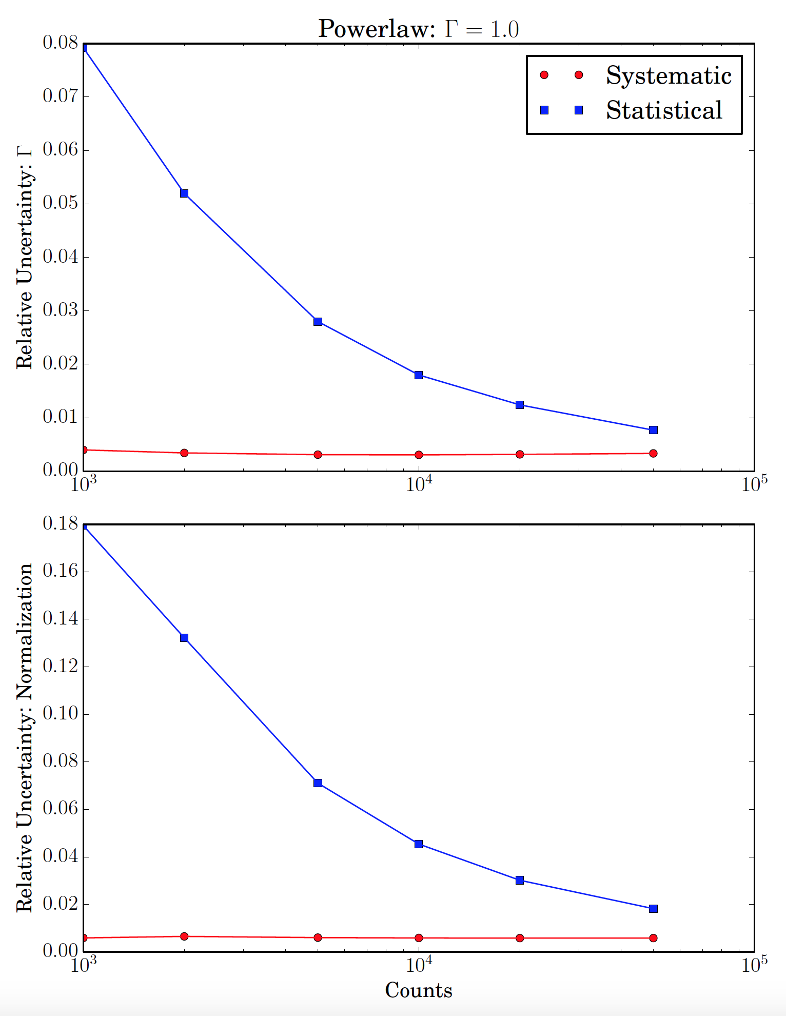
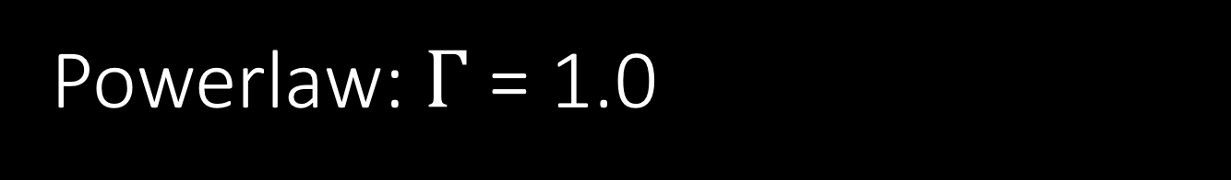
Powerlaw: $Γ$ = 1.0
With nuabs
Without nuabs

Slide 23
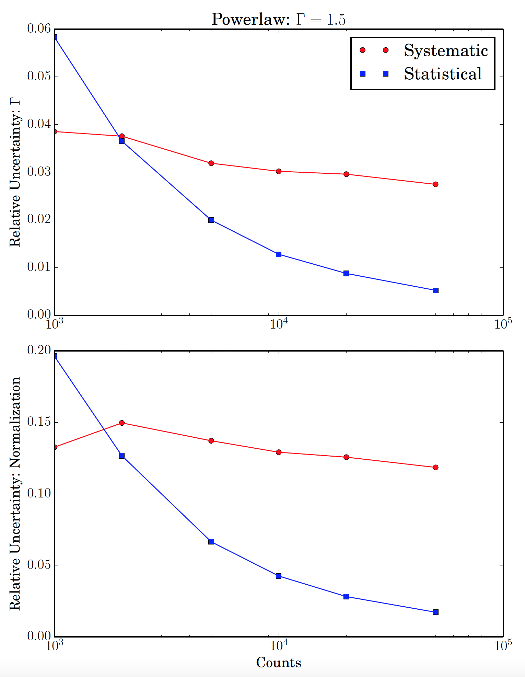
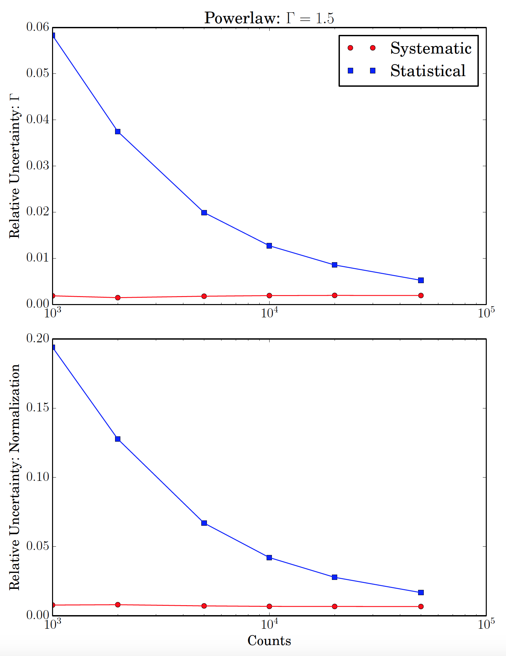
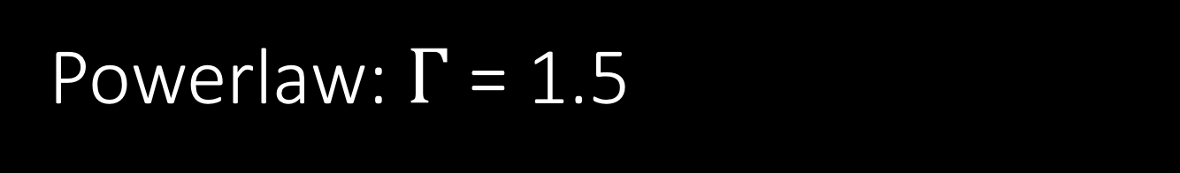
Powerlaw: $Γ$ = 1.5
With nuabs
Without nuabs

Slide 24
Conclusion
Achievements
Setup code to produce effective area realizations
First pass through
Lessons learned
Overdid the nuabs contribution
Future Achievements
Include the uncertainty in choice of Crab spectrum, in particular N_{H}
Check out the influence on other typical spectral models that NuSTAR uses:
  Cutoff power-law
  Reflection and Comptonizing models (pexrav, relxill, comptt)
Write paper!
Start using the results

