Slide 1

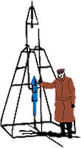






NICER Calibration: Ground-based Results and In-Flight Plans
Craig Markwardt & Bev LaMarr
GSFC

Slide 2
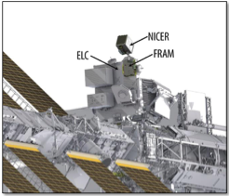
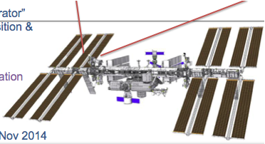
NICER: Astrophysics Mission of Opportunity on the International Space Station
PI: Keith Gendreau, NASA GSFC
Science: Understanding ultra-dense matter via soft X-ray timing spectroscopy of neutron stars
Platform: International Space Station ExPRESS Logistics Carrier external attached payload, with active pointing
Launch: NET January 2017, SpaceX-11 resupply
Duration: ≥ 24 months
Instrument: X-ray (0.2–12 keV) “concentrator” optics and silicon-drift detectors; GPS position & absolute time tagging
Enhancements:
  Demonstration of pulsar-based navigation
  Guest Observer program in Year 2+
Status:
  Ground-based calibration complete Fall 2015
  Passed PER, Winter 2015

Slide 3
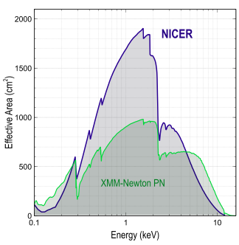
Unique Capabilities, New Discovery Space
An unprecedented combination of sensitivity, timing, and energy resolution
Spectral band: 0.2–12 keV
  Well matched to neutron star emissions
  Overlaps RXTE, XMM-Newton, and other missions
Energy resolution: < 150 eV @ 6 keV
  10x better than RXTE
Timing resolution: 100 nsec RMS absolute
  50x better than RXTE
  > 100x better than XMM-Newton
Non-imaging FOV: 6 arcmin diameter
  10x finer than RXTE
Sensitivity: 5.3 x 10^{–14} erg/s/cm² (5σ, Crab- like spectrum, 0.5–10 keV in 10 ksec)
  20x better than RXTE
  3x better than XMM-Newton’s timing capability (PN clocked mode)

Slide 4
NICER Calibration and Data Pipeline
Status of Ground Calibration as of Pre-Environmental Review
In-Flight Calibration

Slide 5
Objectives of XTI Calibration
Develop instrument model to properly interpret science data
Calibrate instrument model with key measurements of flight and ETU hardware
Gain experience with extended operation (search for rare behaviors)
In-Flight calibration plan to verify calibration and/or adjust for post-launch shifts, cross-calibrate with other X-ray missions
Team Members
  System: C. Markwardt, K. Gendreau, Z. Arzoumanian
  XRC: T. Okajima, E. Balsamo, T. Enoto, L. Jalota
  FPM: R. Remillard, B. Lamarr, G. Prigozhin, D. Malonis
  Timing: L. Winternitz, J. Mitchell, E. Rogstad

Slide 6
XTI Calibration Requirements
Component | Knowledge Requirement
Effective Area (Total @ 1-2 keV) | 10%
Energy Gain | 1%
Resolution (FWHM) | 10%
Background | 10%
Timing Uncertainty (Total, 1σ) | 100 ns

Slide 7
XTI Calibration & Alignment Flow
2 Reference FPMs
56 FPMs & Spares
56 XRCs & Spares
Relative Calibration @ MIT
  MXS Fluorescent Lines
  C-K, F-K, Al-K, Ti-K, Cu K
  Additional tests for selected sample
Sep 2014-
June 2015
July-Nov
2014
Effective Area & PSF Measurement @ GSFC Beamline
Selected sample: off-axis measurement
July-October 2015
Offline
Fall 2015
XRC Integration into XTI Optical Bench @ GSFC
Alignment in 1 m parallel optical beam, flux maximization
Relative alignment of XRC flats
“Absolute” Calibration @ BESSY
FPM Integration @ GSFC
Translation adjustment in 1 m parallel beam, flux maximization
Optics Response Model
Detector Response Model
XTI
Payload I&T Winter 2015/2016

Slide 8
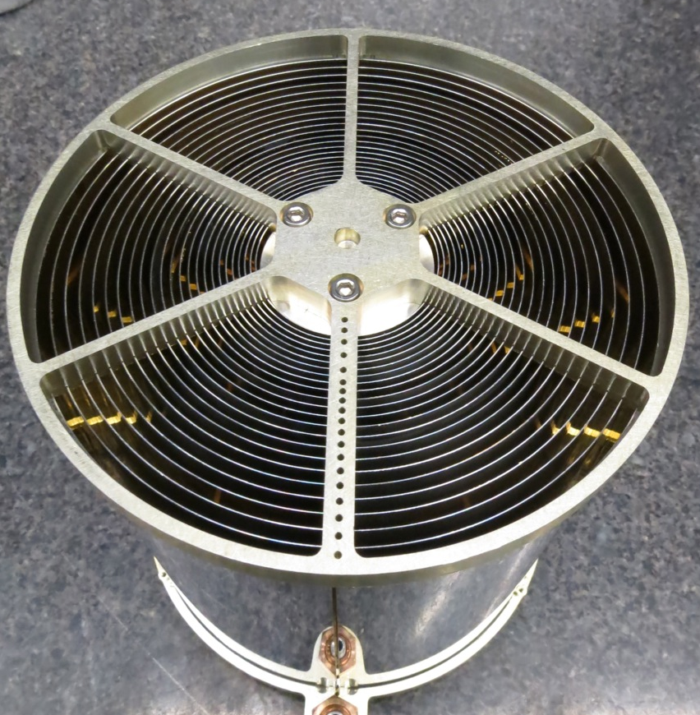
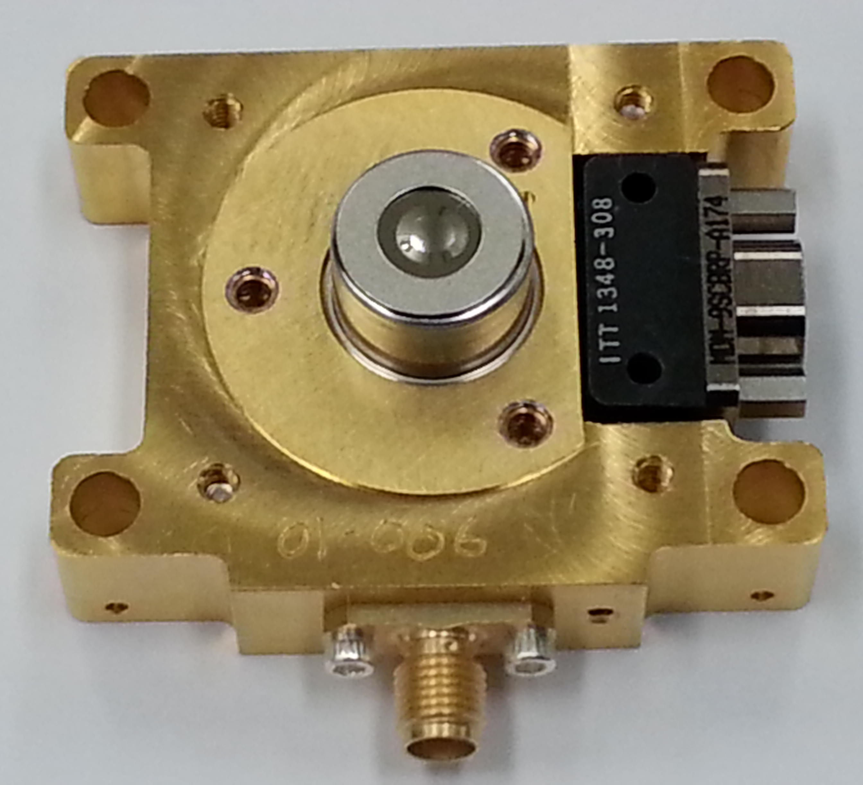
Optic and Detector Efficiency
X-rays
Thermal Film
MODEL: transmission model (thickness)
MEASUREMENT: BESSY transmission on window samples
ACHIEVED: <1% relative transmission ✔︎
X-ray Concentrator
MODEL: X-ray ray tracing (mirror area)
AREA
MEASUREMENT: X-ray beam, each optic
ACHIEVED: <4% uncertainty, >20% margin ✔︎
PSF
MEASUREMENT: X-ray beam, each optic
ACHIEVED: <4% uncertainty, >4% margin ✔︎
COALIGNMENENT
MEASUREMENT: optical vignetting, each optic
ACHIEVED: ~25” uncertainty ✔︎
Detector Window
MODEL: X-ray transmission model (thickness)
MEASUREMENT: BESSY transmission on window samples
ACHIEVED: < 1% relative transmission ✔︎
FPM Silicon Drift Detector
MODEL: Silicon / X-ray (Scholze & Procop 2009)
GAIN & RESOLUTION
MEASUREMENT: X-ray lines, each FPM and MPU
ACHIEVED: <1% gain uncertainty ✔︎ and meet resolution ✔︎
RESOLUTION
MEASUREMENT: relative area, gain, resolution with MXS & fluorescent line source

Slide 9
Energy Resolution of All 56
Detectors Over Wide Temperature Range During XTI TVAC
Gain and Resolution Requirements Met ✔︎

Slide 10
Energy Resolution Requirement Met
Red points: TVAC data with Fe55 source, all detectors and all temperatures combined (Cycle 3, T = –5 ºC to +70 ºC)
Blue points: FPM calibration data with multi-line modulated X-ray source @ MIT, all detectors combined, single temperature
(T ~ 30 ºC)
Red & blue curves:
Fits to Fano-limited readout noise performance curves demonstrate that XTI’s spectral resolution meets both the original and relaxed requirements.
Current requirement
Requirements Met ✔︎

Slide 11
BESSY Detector Filter Transmission Data
In September 2015, MIT brought all the reference SDDs used in calibration of the flight detectors to the BESSY synchrotron for absolute calibration.
In addition to the SDDs, MIT brought some detector windows and XRC thermal shields.
To the right is transmission data from one of the detector windows showing that it meets requirements.
On MIS, this data is at:
Doc #: EXP-NICER-FPMMPU-REF-0225
Title: MIT Filter KW37
Margin
Detector Spec (DS-023) requires detector efficiency >67% at 1.5 keV. This is dominated by the detector window, where we see a transmission of 89.73% ✔︎
DS-027 requires the detector window has transmission of >79% ✔︎
DET-08 requires >55% at 392 eV, >65% at 677 eV, and >=80% at all energies above 4.5 keV.
This data verifies all this ✔︎

Slide 12
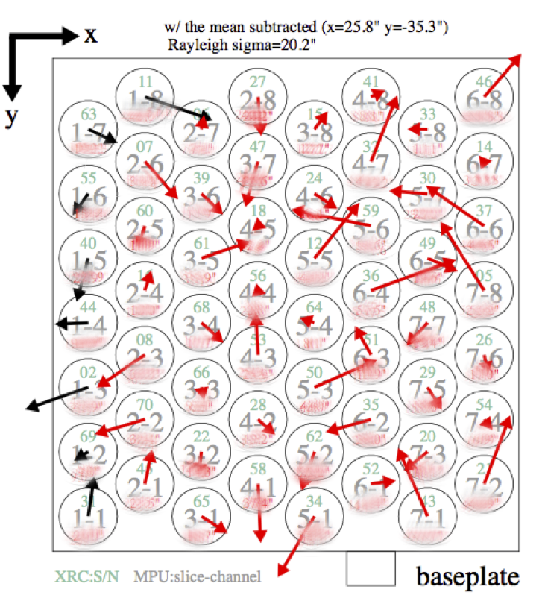
Module Co-Alignment
Module co-alignment was measured using optical vignetting scans
Final measurements (right) establish baseline co-alignment knowledge vector for each module
Uncertainty 20.2” ~25”requirement met ✔

Slide 13
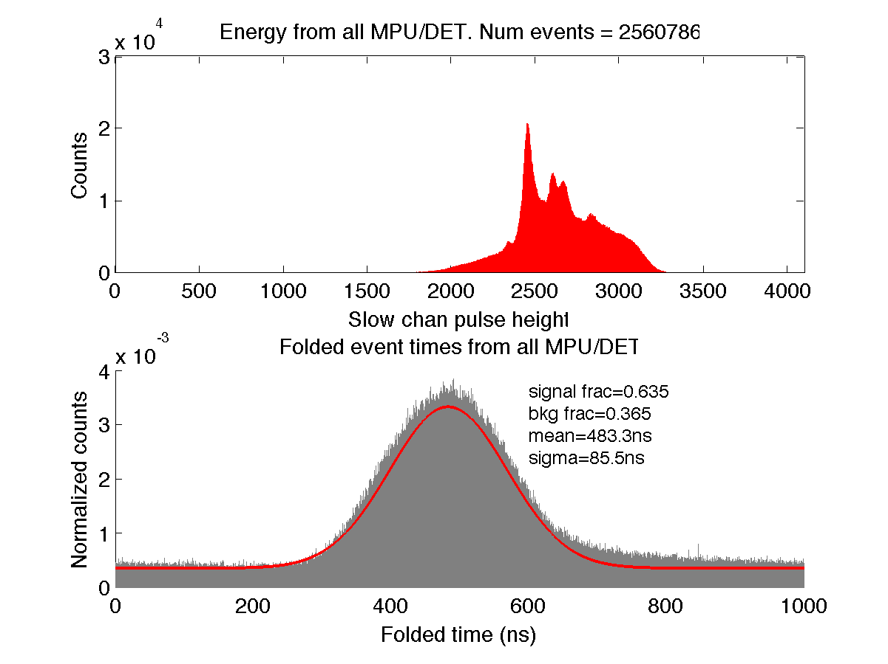
System Level Time Resolution Calibration Measurement
100 ns Requirement Met ✔︎
1σ = 85.5 ns
Notes:
----- Meeting Notes (11/30/15 09:38) -----
use Lukes data (see Zaven chart)

Slide 14
In-Flight Calibration
In-flight calibration verifies ground calibration and accounts for any post-launch shifts in performance
Combination of
  Initial checkout calibration observations
  Joint observations with other X-ray observatories, under cross-calibration working group IACHEC
    Swift XRT, XMM-Newton, Chandra
  Periodic calibration monitoring
Specific notes:
  Absolute time calibration: no absolute in-orbit X-ray timing references at the 100 nsec level
    Clear calibration and characterization of system on ground
  Absolute area calibration: no asolute flux calibrator
    Use cross-calibration with other missions
    Intercalibrate individual modules so NICER produces consistent results with minimal adjustment to ground-based caibration efficiencies

Slide 15
In-Flight Calibration Plan 1
Purpose | Target(s) | Method
XTI-to-Star Tracker Offset, PSF/Off-axis Performance | Crab | Initial Checkout. Multiple rasters/scans across Crab, X-ray centroid of count rate vs. known J2000 position of Crab. Expect ~arcsec centroid accuracy. Orbit night.
Threshold Scan | Stowed | Scan thresholds with no signal to determine optimal threshold level.
XTI-to-Star Tracker Offset, PSF/Off-axis Performance | Crab, Sco X-1 | Orbit day. Additional scans in different thermal configurations to verify thermal analysis. Maintenance observations every 1 month early on.

Slide 16
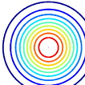
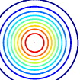
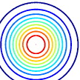
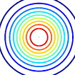
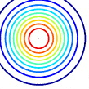
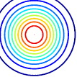
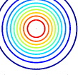

Alignment & Response of
56 Telescopes
+
+
+
+
+
+
+
+
Each individual optic tip/tilted w.r.t. observatory axis
For each realization of observatory-target offset, determine optic target offset angle and vignetting
+
+
+
+
+
+
+
+
+
+
+
+
+
+
+
+
+
+
+
+
+
+
+
+
+
+
+
+
+
+
+
+
+
+
+
+
+
+
+
+
Indiv. Optic vignetting in Observatory coord
+
+
+
+
+
+
+
+
Target in Obs. coord (one realization)

Slide 17
In-Flight Calibration Plan 2
Purpose | Target(s) | Method
Gain Scale, Energy Resolution | 1E 0102.2-7219 | Initial Checkout. Observe ~60 ksec; approx. 36000 ct/FPM. Lines < 2 keV
Gain Scale, Energy Resolution | Cas A (20 ksec) Cyg X-3 (10 ksec) Perseus Galaxy (60 ksec) SS 433 (20 ksec; X-CAL) GX 301-2? | Initial Checkout. Approx 100000 ct/FPM. Lines 2-6.4 keV
Contamination | 1E 0102.2-7219 | Periodic Monitoring. Observe 5-10 ksec/month; detect array-level gain shifts and contamination trends

Slide 18
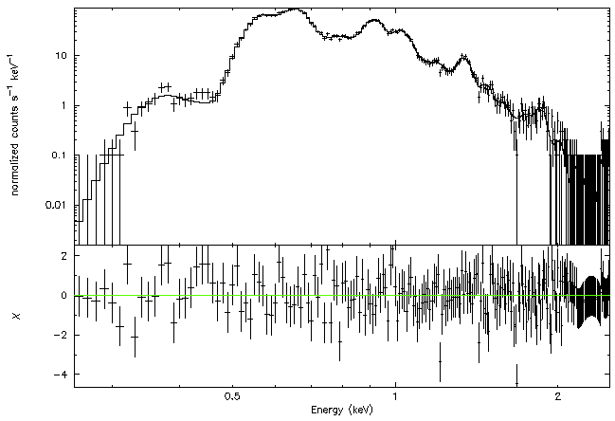
Low Energy Gain Scale:
E0102 Supernova Remnant
60 ksec
per FPM
Gain scale to <1%
IACHEC Continuum/Line Model courtesy E. Miller

Slide 19
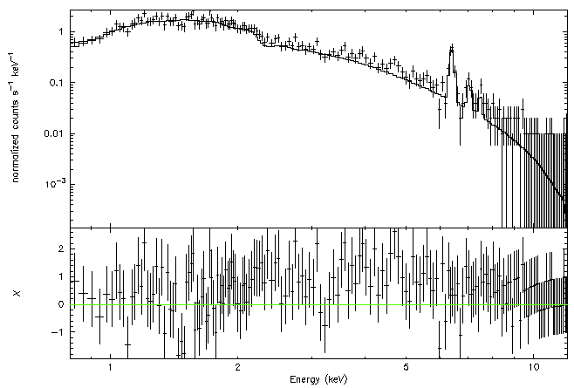
High Energy Gain Scale:
Circinus Galaxy
60 ksec
per FPM
Line Centroids
to 10 eV (<1%)
Molendi et al 2014 Model

Slide 20
In-Flight Calibration Plan 3
Purpose | Target(s) | Method
Broad Band Effective Area | PKS 2155-305 (X-CAL) 3C 273 | Initial Checkout. Observe 30 ksec, simultaneous with XMM-Newton or Chandra. Tie overall flux scale.
Broad Band Effective Area Pulse Timing FPM-to-FPM variation | Crab | Initial Checkout. Observe 10 ksec on-axis, broad band continuum source. Known intrinsic flux variability at ~5-10% level. Pulse folding at 33 msec period. Simultaneous with Swift for timing ~100 usec timing tie.

Slide 21
In-Flight Calibration Plan 4
Purpose | Target(s) | Method
Background | Blank Sky | Initial Checkout. Observe 100 ksec various blank sky targets. Verify and refine background model. RXTE background points. Chandra Deep Field or Lockman Hole ROSAT ¼ keV background map (hot & cold spots) For sensitive targets, offset points
Background | Blank Sky | Maintenance. Observe 20-60 ksec per month, blank sky targets, intensive after Soyuz configuration change

Slide 22
In-Flight Calibration Plan 5
Purpose | Target(s) | Method
UV Loading | Beta Car, Beta Leo, Vega | Initial check-out. On-off pointings. Measure detector response to UV loading
Threshold Throughput Efficiency | Crab | Initial check-out. Continuum source at low energies to verify throughtput at threshold edge.
Continuum shape and low energy threshold response | Crab | Maintenance. 5 ksec per month. Continuum response changes.

Slide 23
In-Flight Background Characterization
Post-launch background calibration observations
  Dedicated blank sky observations
  Data collected during slews between targets
  Dedicated off-pointed background observation before/after faintest targets
  Dark data in stowed configuration will be collected
Verify and refine ground-based background modeling approach
Deep 100 ksec observation of blank sky during initial checkout (~3 calendar days) to characterize background behavior w.r.t. orbit and pointing position w.r.t. Soyuz
  100 ksec @ (0.17 + 0.13) ct/s = 30000 ct (0.4-8 keV)
    Enough counts to detect 10% variations over 25 minute timescale (< 90 minute orbit)
    Also able to fold with orbital period, geomagnetic cut-off rigidity, etc. to build significance
  536 ct/FPM
    Enough counts for crude spectrum, and to detect ~5% FPM-to-FPM variations
    17000 ct 0.4-2 keV; 13000 ct 2-10 keV
Routine maintenance background calibration observations to continuously assess background environment (~monthly 20-60 ksec & off-target background points)
Compare to non-imaging RXTE Proportional Counter Array, able to ultimately achieve background model with 1% r.m.s. unmodeled component (Markwardt was PCA background modeling lead scientist from 2003-2012)

Slide 24
Response Matrix Calculation
ARF
(per XRC)
Thermal Film Transmission
✕
E
Vignetting Cube
XRC Transmission
✕
E
E,θ
Off-axis response
ARF Calculator (versus time)
Co-Alignment
=
E
Attitude Data
θ
RMF
(per XRC)
Window Transmission
SDD QE & Re-distribution
E
✕
E,PHA
FPM RMF
RMF Calculator
=
Threshold Setting
E,PHA
PHA
Sum Over Enabled FPMs

Slide 25
Calibration Products
Timing Calibration
Gain Calibration
Detector Response Model
Optics Response Model
nicertimecal (Time Correction)
nicerpi (Gain Correction)
Response Matrix File (56 FPMs)
Ancillary Response File (Effective Area) & Off-axis Algorithms
All files delivered to the HEASARC Calibration Database (CALDB) for use in standard HEASoft software
Algorithms coded in NICER-specific HEASoft tasks
  Effective Area calculator
  Adjustment of X-ray event times for time calibration

