Slide 1
POLAR status and beam test with ESRF in 2015
Bobing WU
Institute of High Energy Physics, CAS
On behalf of the POLAR collaboration

Slide 2
Outline
Introduction to POLAR
Progress and current status
Calibrations with ESRF beam in 2015
Summary and Outlook

Slide 3
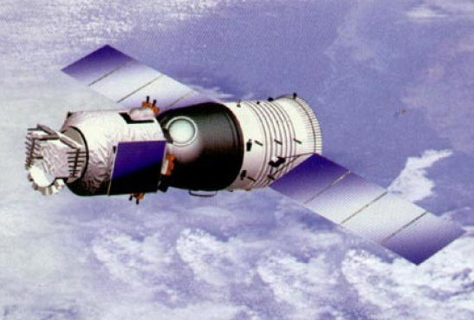
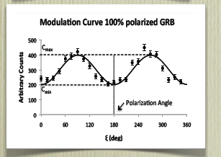
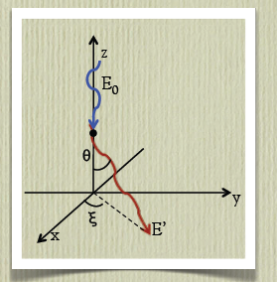
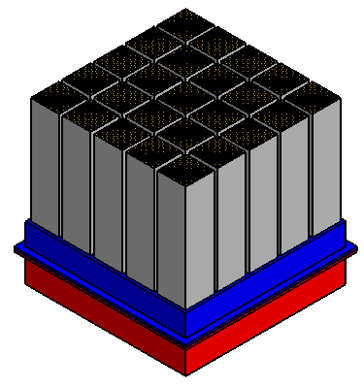
POLAR onboard China’s Spacelab
Onboard China’s spacelab TG-2: launch time ~2016.9
A China-led international collaboration (Switzerland, Poland)
FOV of POLAR: ~½ sky
PI: Shuangnan ZHANG
Tian-Gong 天宫
Palace in Heaven
Plastic
scintillator
stacks
Instrument concept proposed by N. Produit, et al., NIM (2005)
Notes:
The POLAR will be onboard China’s spacelab TG-2,and is scheduled for launch in September end of 2015. The POLAR collaboration includes Institutes from China, Switzerland, and Poland。The PI is professor Shuangnan Zhang. This is the artist’s image of TG. TianGong means Palace in Heaven. And the Instrument concept was proposed by Nicolas from Switzerland in 2005

Slide 4
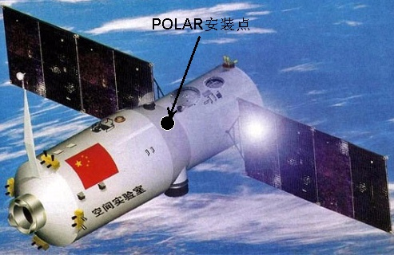
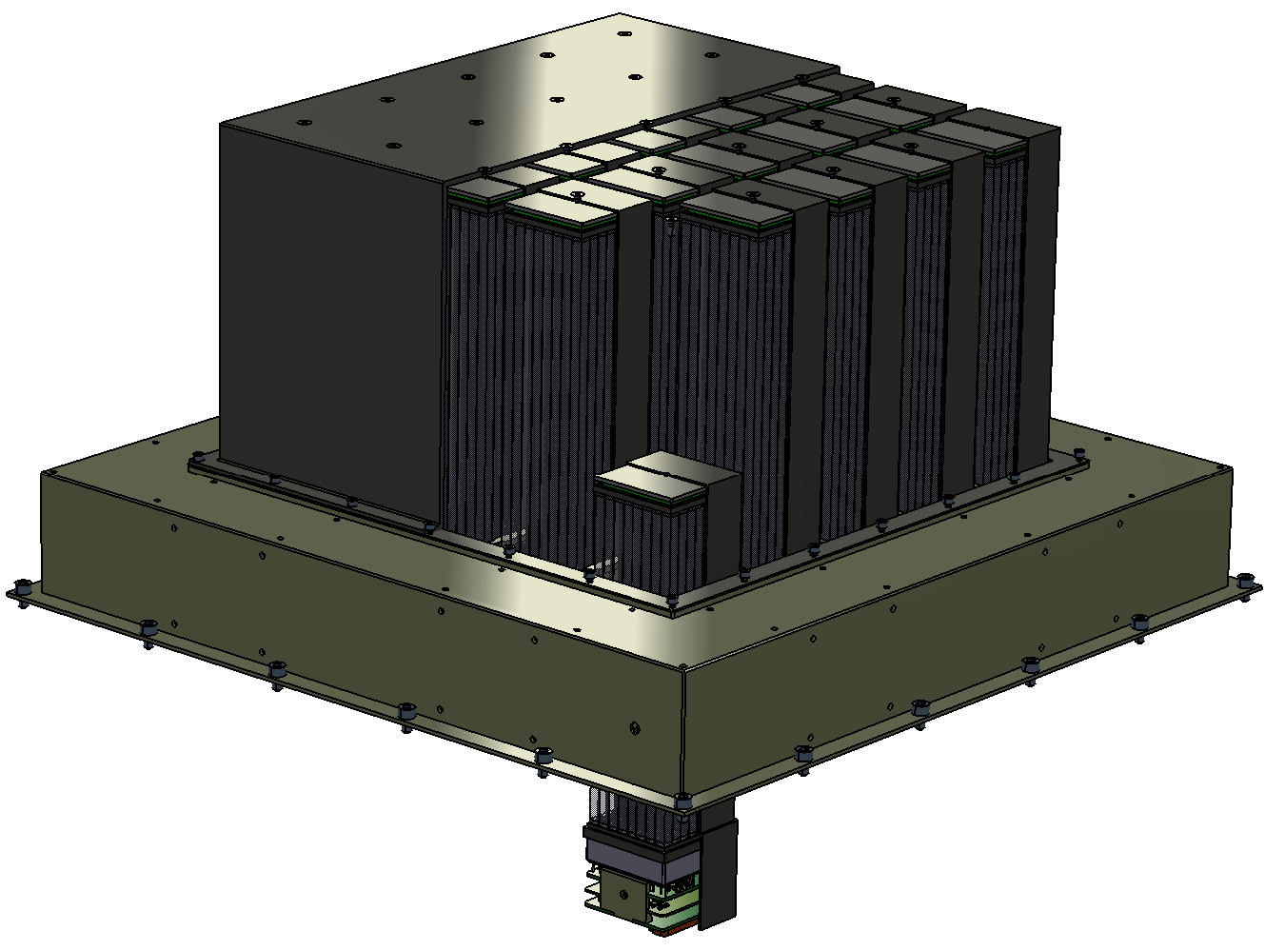
The Gamma-Ray Bursts Polarimeter-POLAR
Main scientific goals
  Measure the polarization of the GRB prompt emissions, to confirm or restrict the GRB radiation models
  In 2 years of operation, be able to measure ~ 100 GRBs, contributing to the largest GRB prompt emission polarization observation database
  For the GRBs with fluence higher than 10⁻⁵ erg cm⁻², the Minimum Detectable Polarization (MDP) of POLAR can reach down to < 10%
Imagined TG-2 model: installation position of POLAR

Slide 5
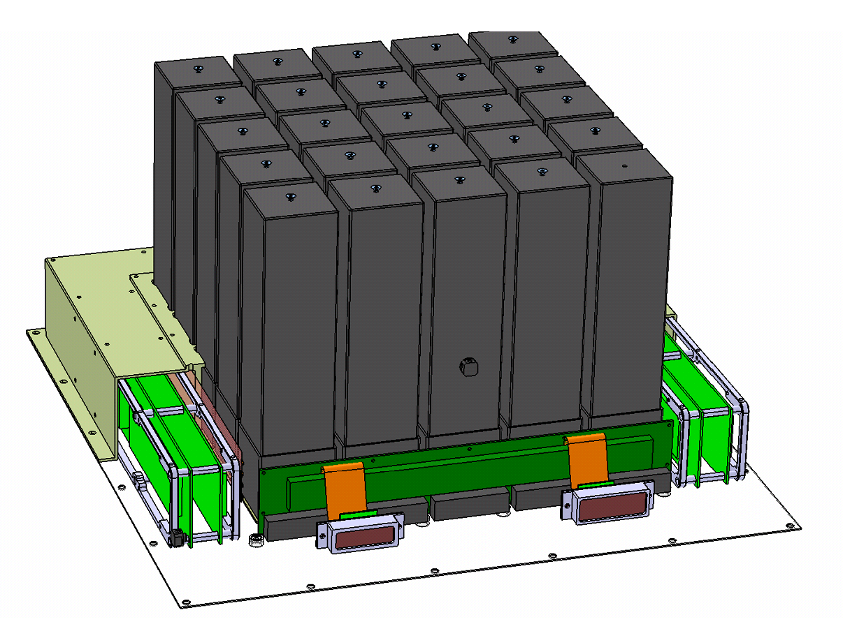
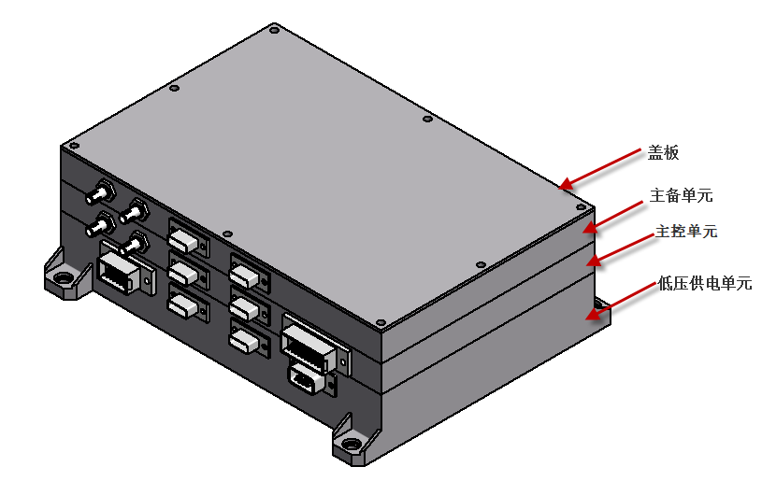
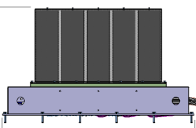
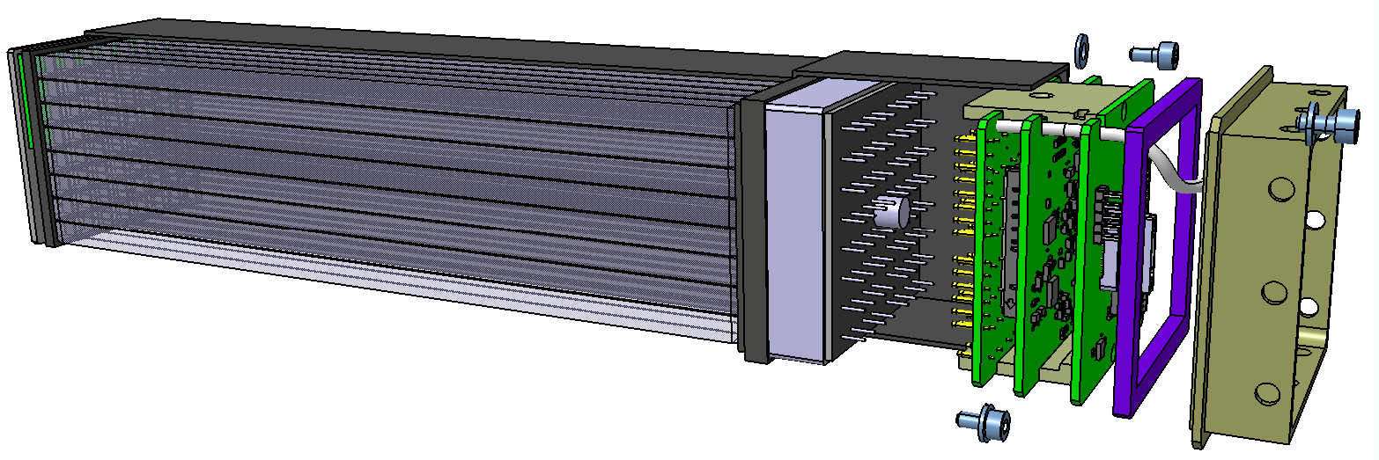
POLAR Instrument
POLAR: 25 modules
Each module: 64 bars (6x6x176mm), one multi-anode photomultiplier H8500 + ASIC readout electronics
Notes:
Now let me introduce you the POLAR Instrument. POLAR consists of 25 modules, each modules consisting 64bars,plus one multi-anode photomultiplier (PMT) 8500+ASIC read electronics (VA32+TA32)

Slide 6
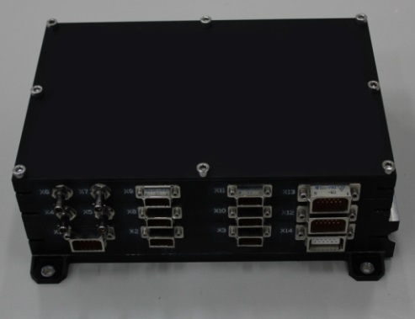
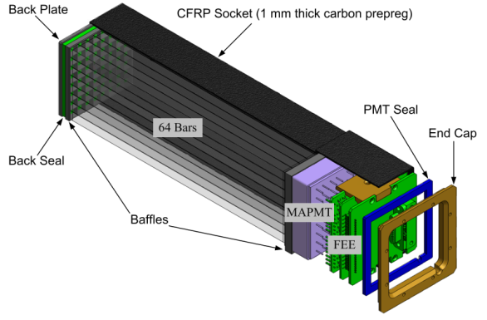
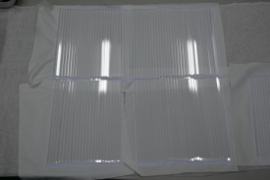
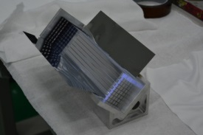
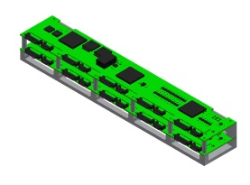
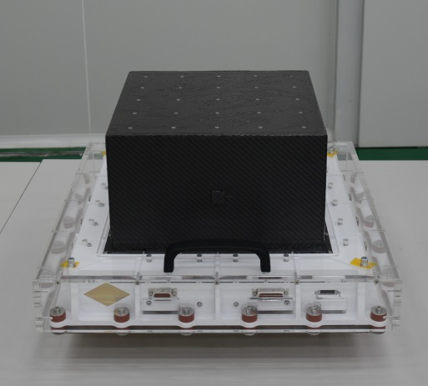
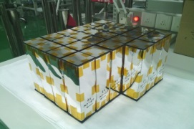
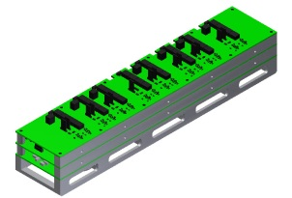
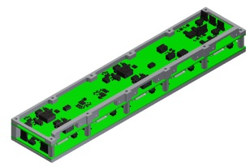
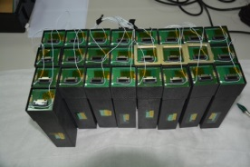
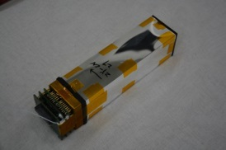
POLAR- composition and construction
Detector modular unit
Plastic scintillator bars
Electric cabinet—IBOX
POLAR
Assembly of the PS target
Central trigger
PS targets
Detector—OBOX
HVPS
LVPS
Assembled DMUs
Naked DMU

Slide 7
Detection principle of low Z material detector
Plastic scintillators
(low Z material)

Slide 8
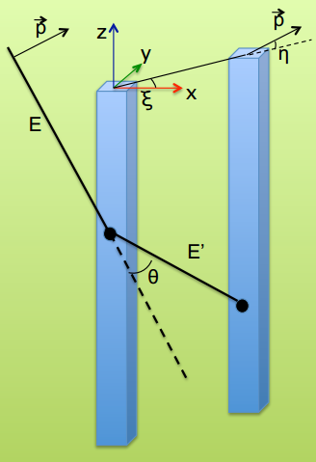
Polarization measurement: Compton scattering
z
Compton scattered photons
E’
θ
Distribution of Scattered photons in X-Y plane
y
η
Compton scattering
x
E₀
Polarization plane
Compton scattering is the dominant process in plastic scintillators in the energy range of interest
ξ
Incident photon
Notes:
This slide shows how the polarization is measured. Compton scattering is the dominant process in plastic scintillators in the energy range of interest.

Slide 9
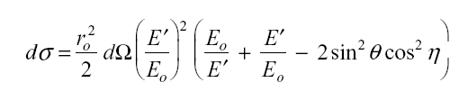
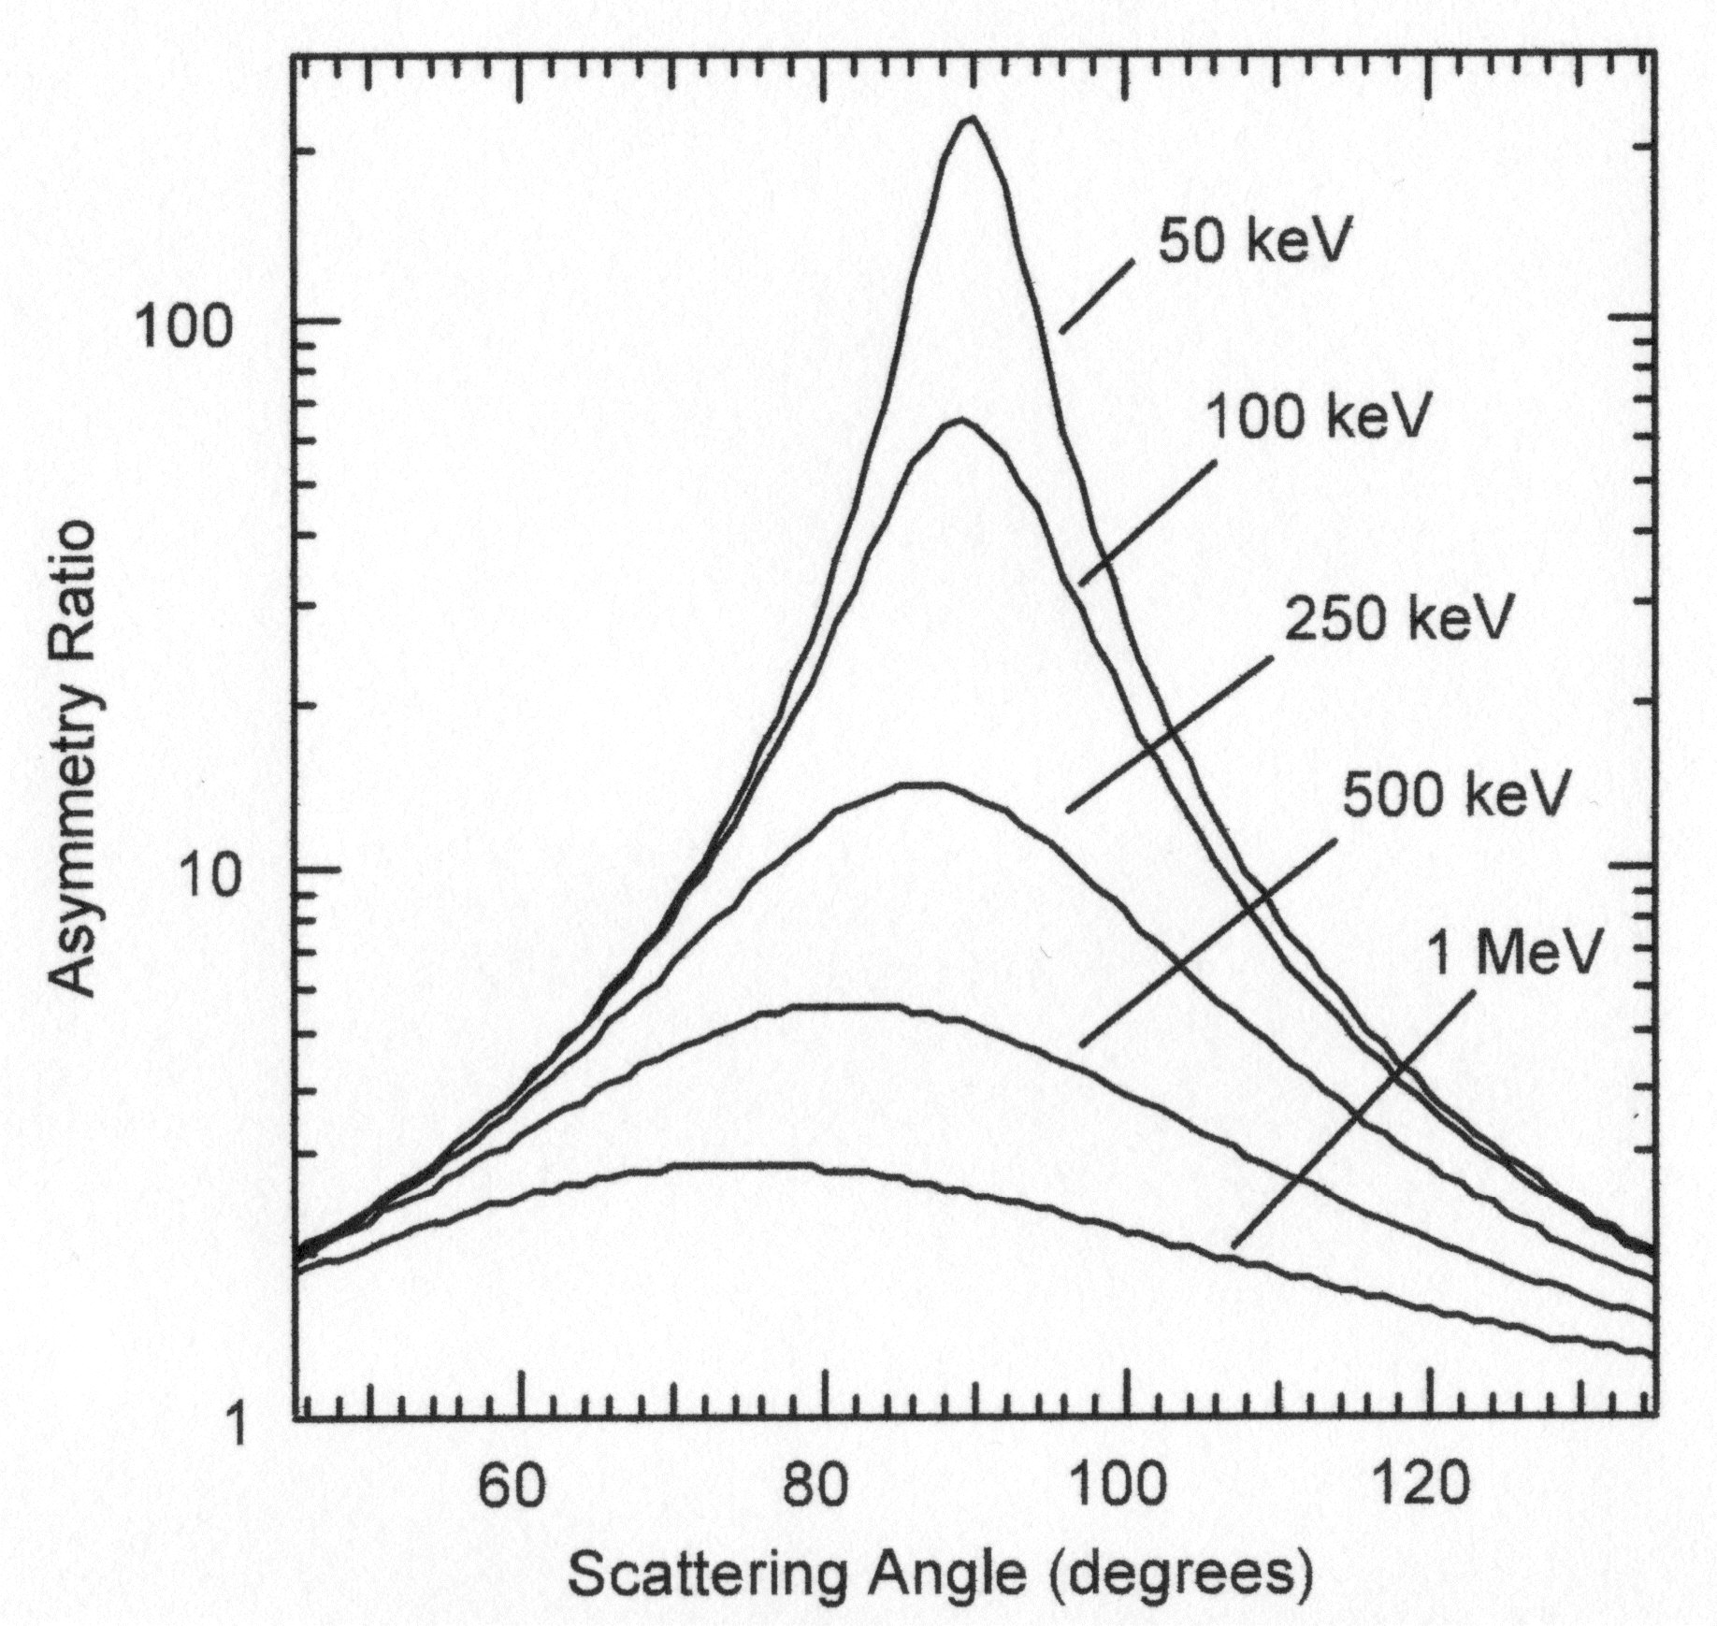
Position angle distribution of scattered photons
Compton scattering cross section is maximum for photons scattered at right angle to the direction of the incident electric vector ⇒ asymmetry in the azimuthal profile S of scattered events.
modulation
  a = modulation factor
  polar. fraction = PF = a/a₁₀₀
  a₁₀₀ = modulation for a 100 % polarized source.
  polar. angle = PA = ϕ₀ - π/2 + nπ
Notes:
Scattered photons are distributed preferentially in the plane normal to the polarization plane of incident photons, we will get a light curve some like cosine function curve. The modulation factor is defined as M=peak amplitude/mean value. And M100 is the modulation factor for 100% polarized photons .

Slide 10
Technical properties summary of POLAR
1 | Detector material | Plastic scintillator (EJ-248M)
2 | Yearly detectable GRBs | ~50
3 | GRB localization accuracy | ≤5°(Fluence≥10⁻⁵ erg cm⁻²)
4 | Detection energy range | ～50－500 keV
5 | Field of view | ±70°×±70°（~1/3 of the sky）
6 | Modulation factor | 40%@200 keV
8 | MDP | ～10％ （Fluence_{total} ≥ 3×10⁻⁵ erg cm⁻²）
9 | Detector geometry area | ~430 cm² (on-axis view)
10 | Mass | OBOX: 27.6 kg, IBOX: 3.52 kg
11 | Size | OOX: 462×462×268.5 mm³ IBOX: 247×160×85 mm³
12 | Maximum power consumption | ≤80 W
13 | Time accuracy(UTC) | ±1 ms
14 | Reliability | 0.90（in 2 years lifetime）
POLAR has limited capability in determining incident GRB directions and spectra.
  The observation to the same GRB by other payload will certainly improve GRB polarization measurement accuracy.
Notes:
instant

Slide 11
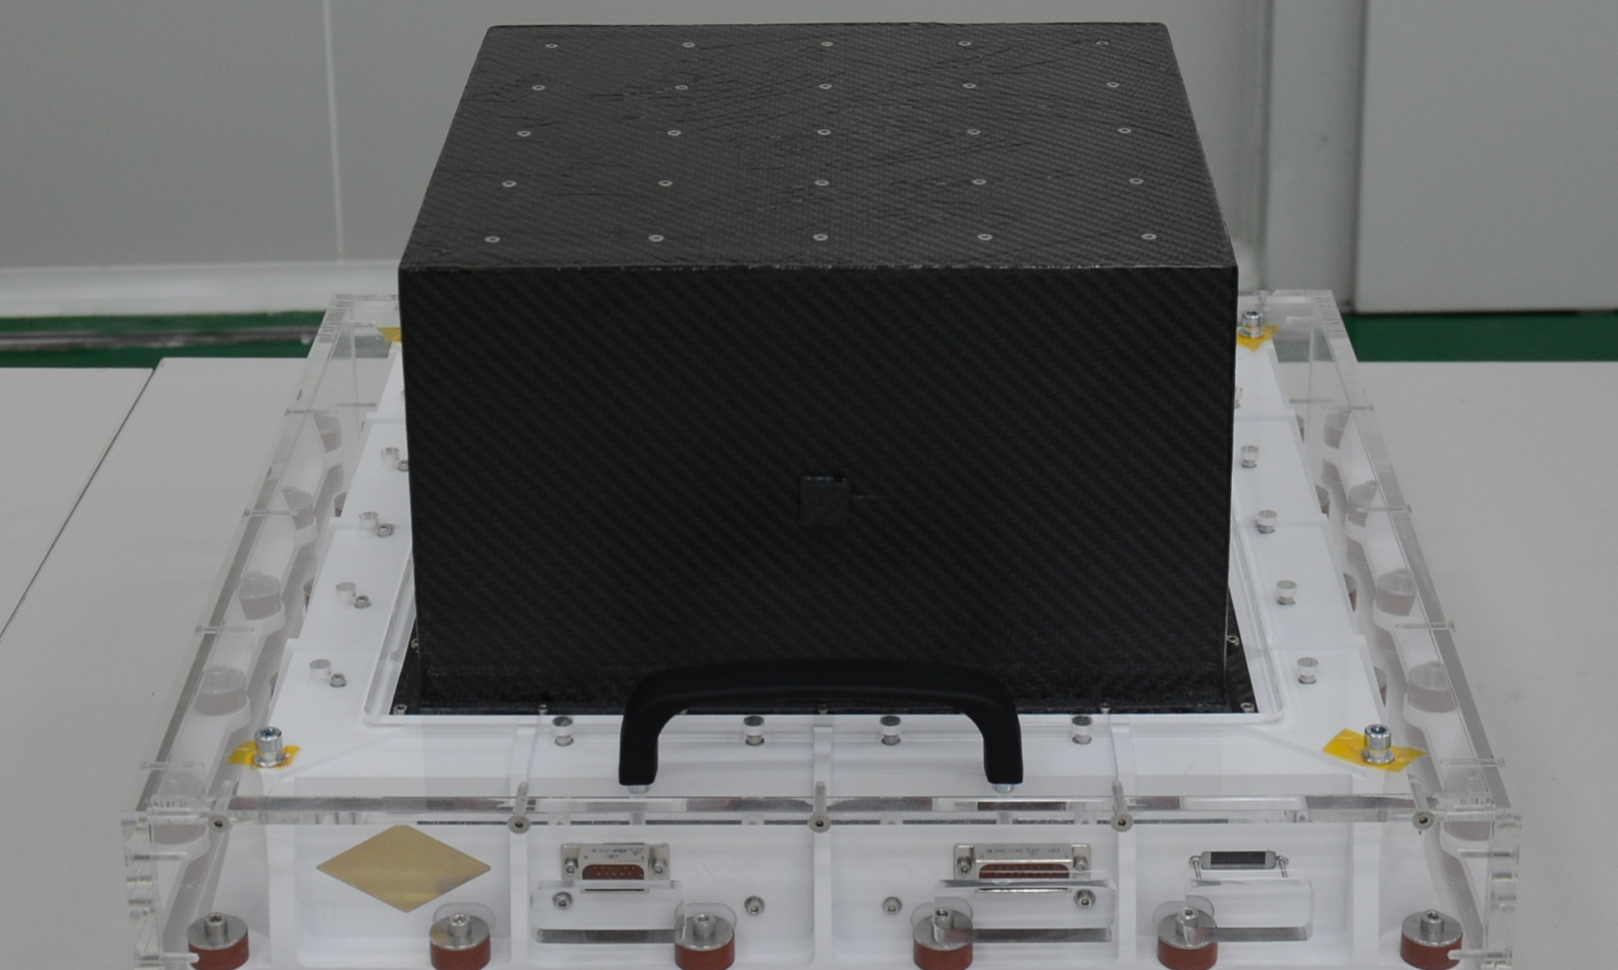
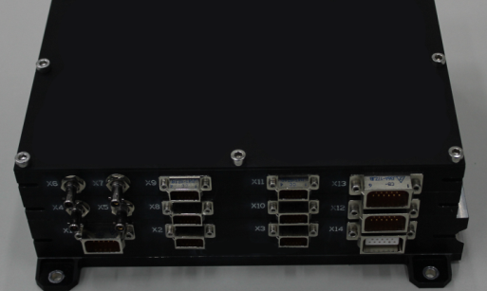
Progress and current status of the mission
The phases that POLAR has experienced：
  In 2006, POLAR was selected as one of the flight payload candidate for TG-2
  In 2008, POLAR passed the scheme and design review
  In 2011, enter qualification model construction phase
  In 2013, finish the qualification model phase and enter the flight model phase
  In 2015, finish the flight model phase and perform the calibration tests
  Currently POLAR FM was delivered to the upper system and integrated into TG－2 system
、
POLAR flight model: detector (OBOX)
POLAR flight model: electric cabinet (IBOX)

Slide 12
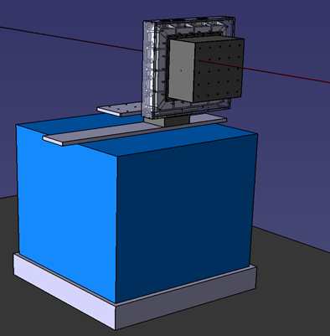
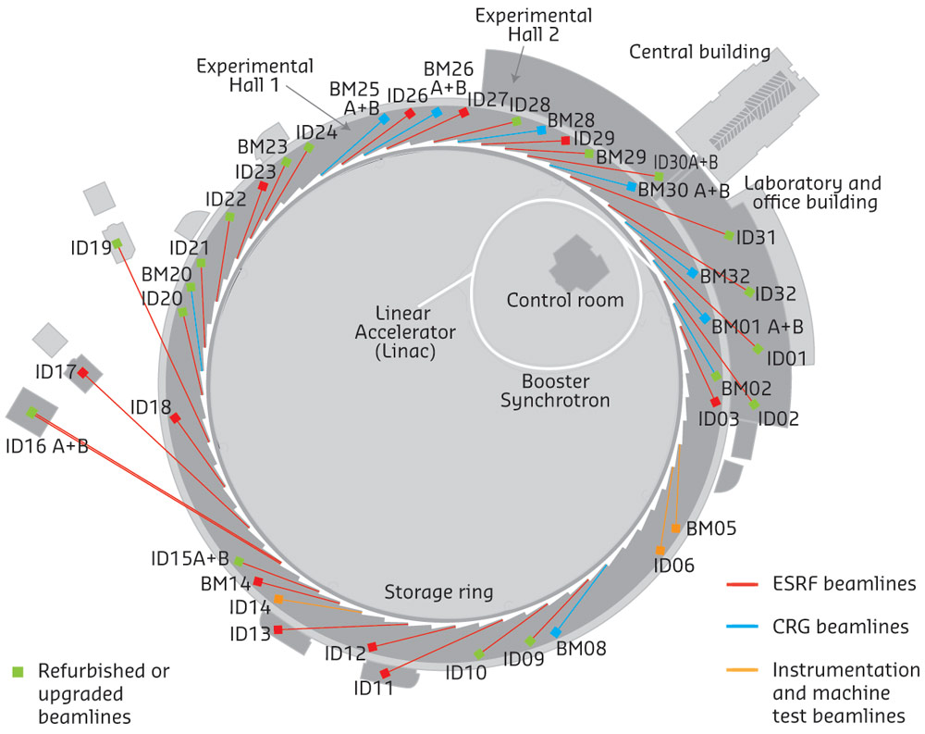
Calibration test of POLAR at ESRF in 2015
ESRF beam test in 2015
Facility introduction
    Beamline: ID11
    Polarization: 100%
    Pol direction: horizontal
    Energy range: 35 ~ 140 keV
    Beam size: minimum (H×V) 0.2×0.07 μm², maximum (H×V) 1200×1000 μm²
    Initila intensity：~10⁷ phs/s
Beamline: ID15A （Not Available in 2015
Energy range: 30~511 keV
Notes:
ESRF: European Synchrotron Radiation Facility, which is X-ray light source for Europe. it is located in Grenoble, France.

Slide 13
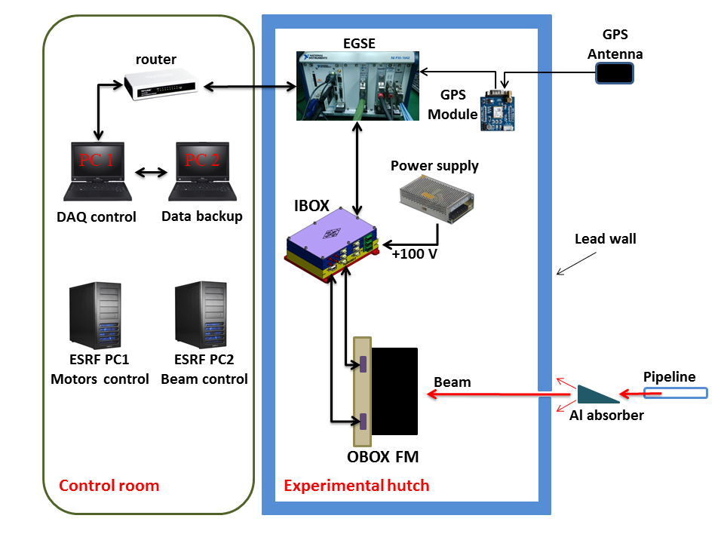
ESRF beam test scheme

Slide 14
ESRF beam test dataset
Energy | Incident angleθ | Polarization | Test status
140 keV | 0° | 100% | done
 | 30° | 100% | done
 | 60° | 100% | done
110 keV | 0° | 100% | done
 | 30° | 100% | done
 | 60° | 100% | done
80 keV | 0° | 100% | done
 | 30° | 100% | done
 | 60° | 100% | done
60 keV | 0° | 100% | done
 | 30° | 100% | done
 | 60° | 100% | done

Slide 15
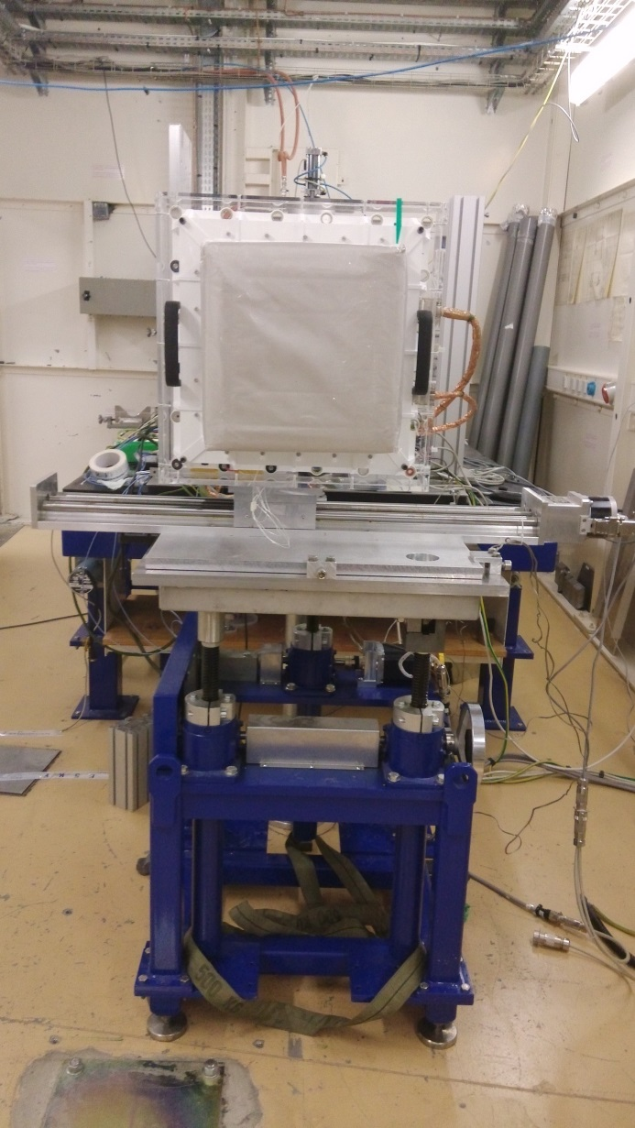
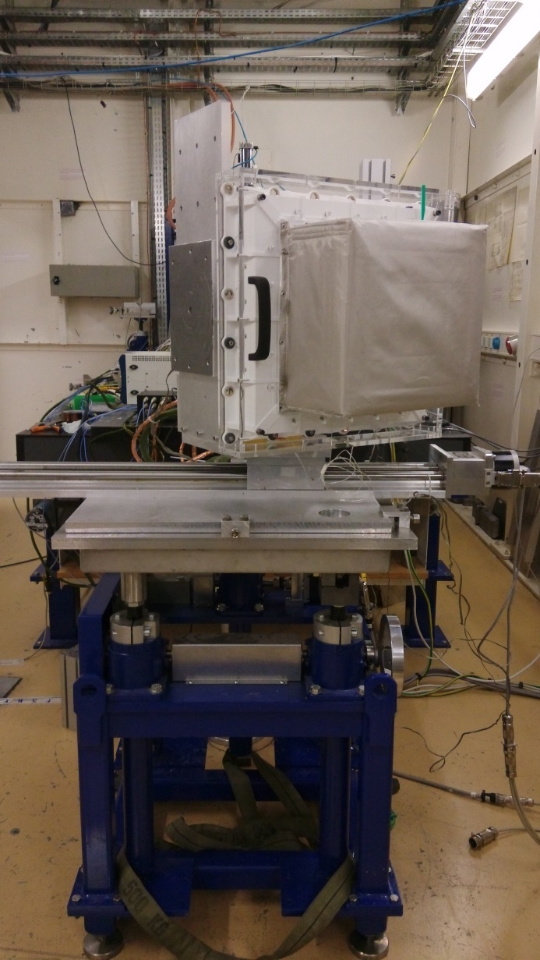
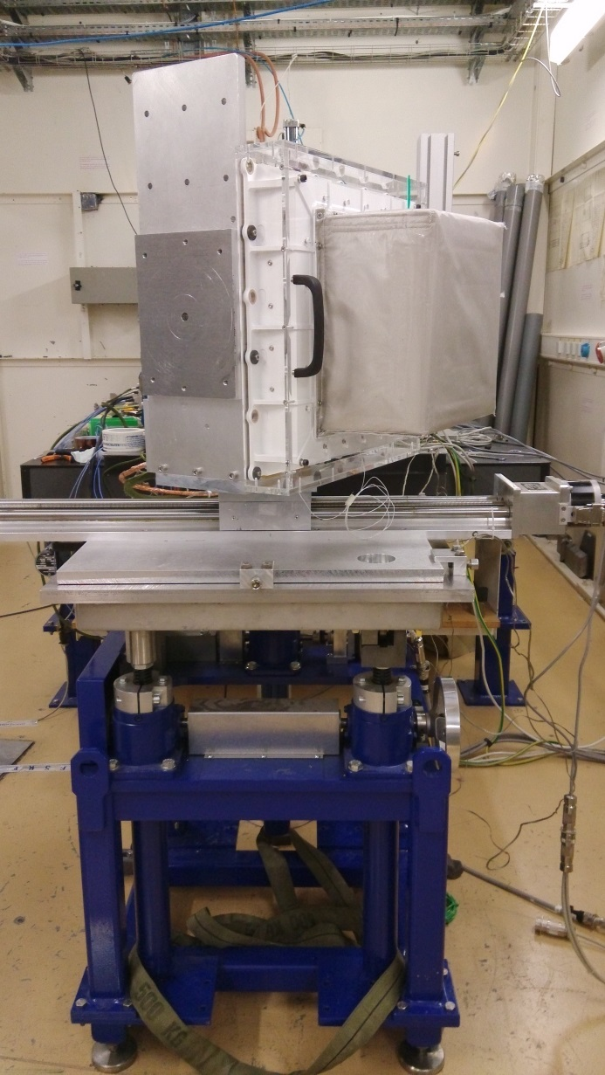
Detectors for different off-axis tests
On axis
30°off axis
60°off axis

Slide 16
Data reduction procedure
Data Analysis (in progress)
General data analysis procedure
  Cleaning and selecting of the data
  Integration of the data files
  Pedestal and common noise subtraction
  Crosstalk correction
  Energy calibration
  Timing synchronization
  Events selection and merge
  Modulation curve filling
  Geometric effect correction
  Modulation factor calculation
  Comparison with MC simulation results
  …

Slide 17
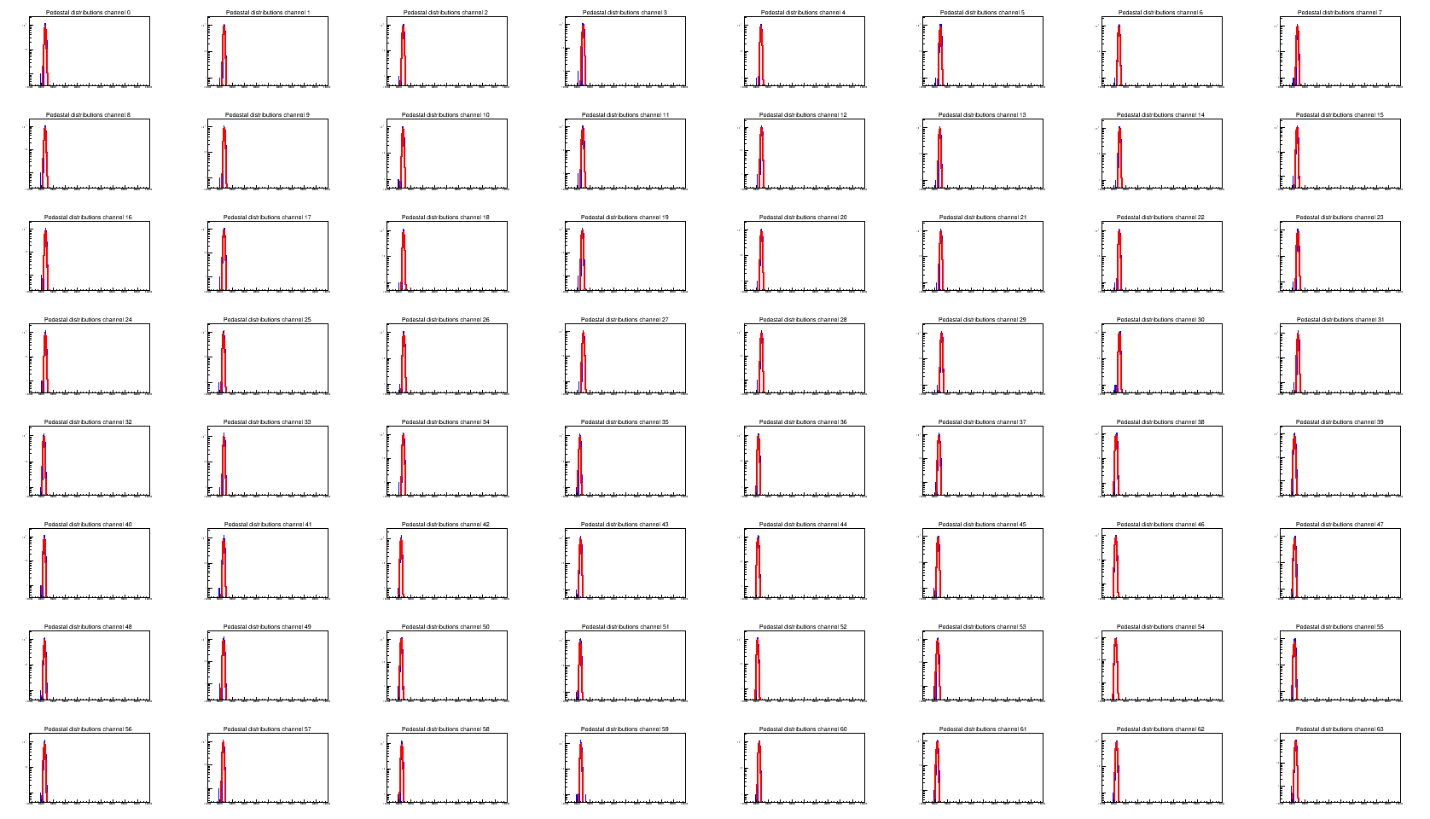
Data analysis and preliminary results – Pedestal fit
Pedestal fit, Module 405, 140 keV

Slide 18
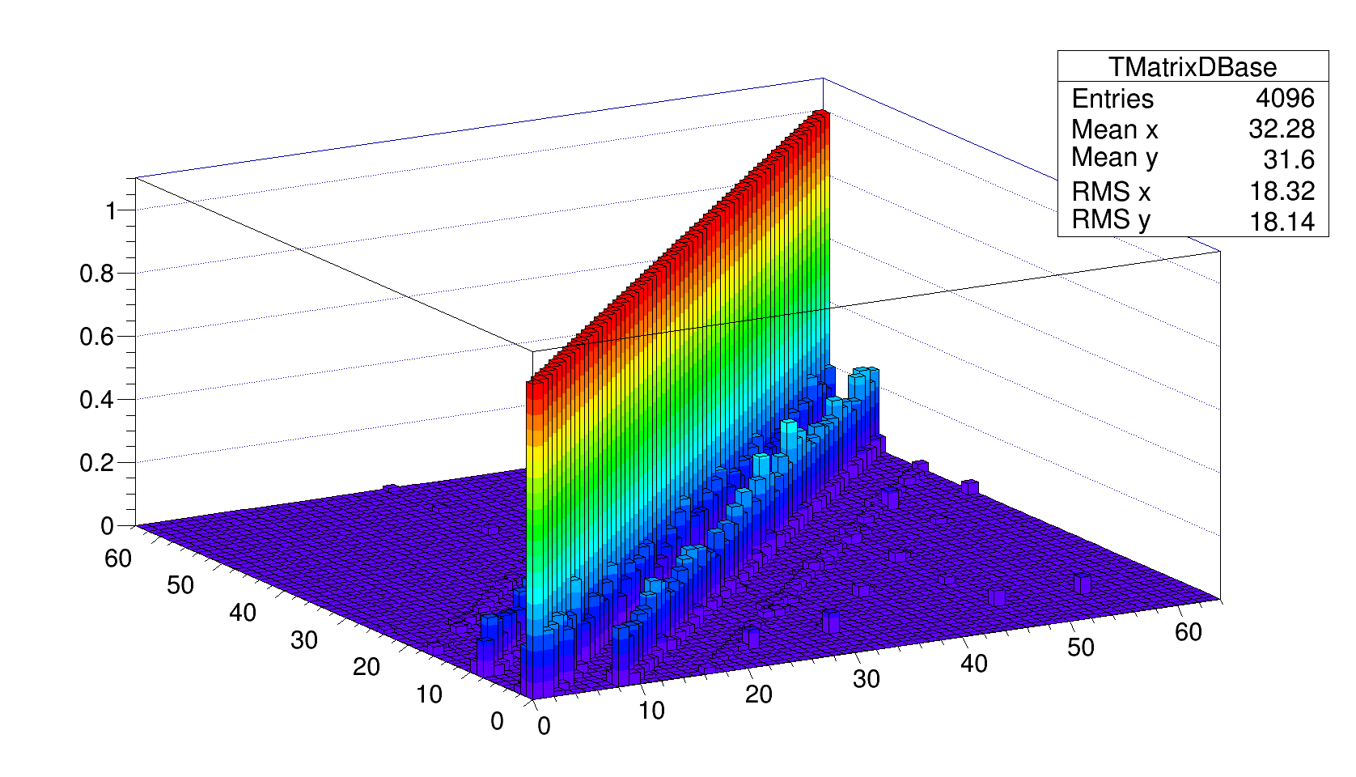
Data analysis and results – Xtalk calculation
Crosstalk matrix, Module 405
Notes:
Crosstalk matrix measured during the ESRF beam test. 64×64 elements for each matrix, and will be used for the data correction.

Slide 19
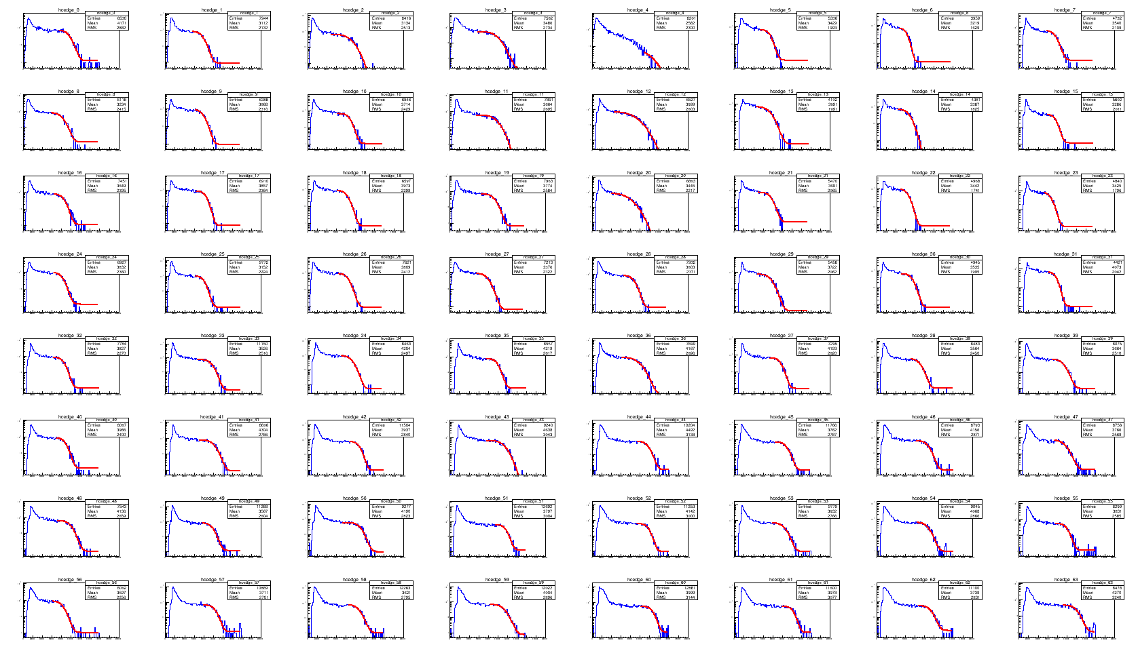
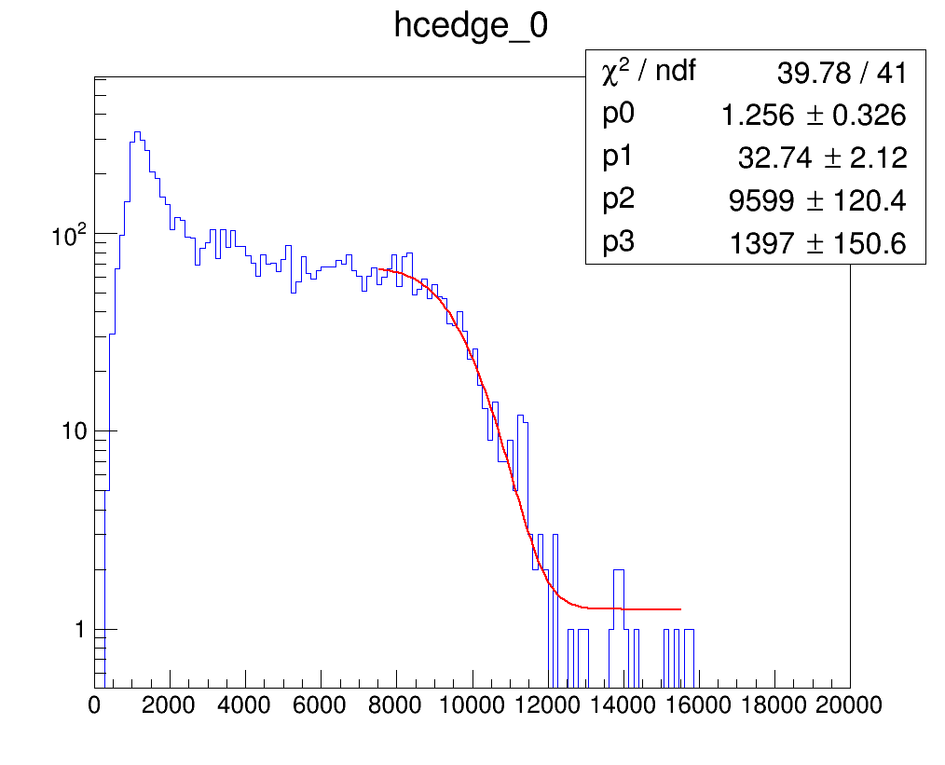
Data analysis and results – energy calibration
Compton edge fit, Module 405, HV=-650V

Slide 20
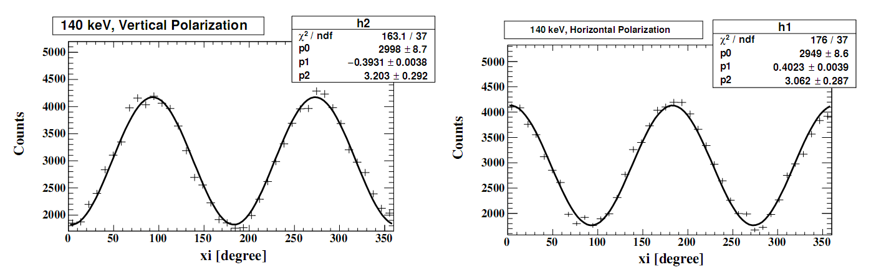
Data analysis and results – Modulation curve
Modulation curve, 140 keV
0°polarized
90°polarized
  140 keV，on-axis measurement
  Modulation factor
      0°polarization：39.31%
      90°polarization：40.23%
      Simulated result: ~40%

Slide 21
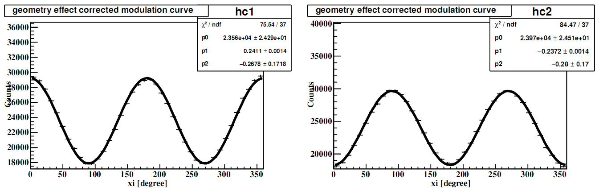
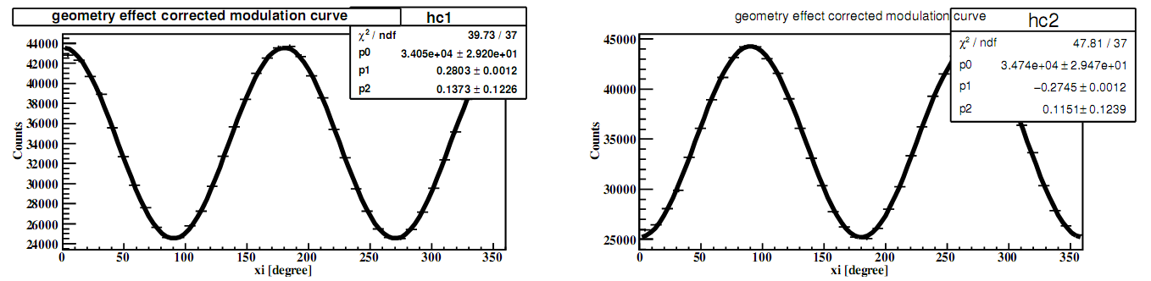
Data analysis and results – Modulation curve
Modulation curve, 110 keV
Modulation curve, 80 keV

Slide 22
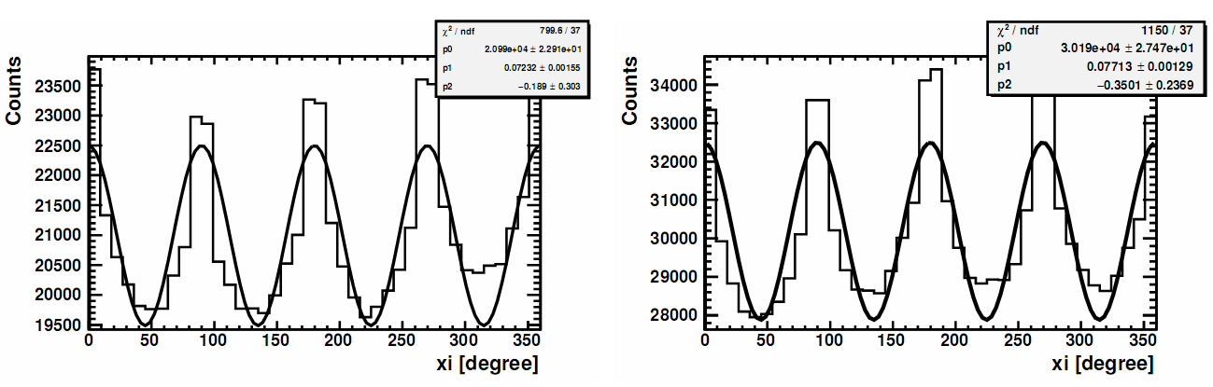
Data analysis and results – Modulation curve
Modulation curve (unpolarized)
Left: 110 keV, right: 80 keV

Slide 23
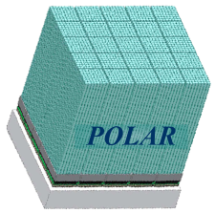
Summary for beam test
The preliminary results with beam test show that POLAR has good polarization measurement (modulation factor ~ 40% @140keV),
More deep data analysis is on going…..

Slide 24

Summary and outlook
POLAR is collaborated between China and Europe
POLAR is expected to give prominent observation results
Currently, the PSDC (POLAR Scientific Data Center) is under construction
“Tiangong”timetable
  2011.9.29，TG-1 launched
  2011.11， TG-1 docking with Shenzhou-8 (without astronaut)
  2012.6，TG-1 docking with Shenzhou-9 (with astronauts)
  2013 Summer，TG-1 docking with Shenzhou-10 (with astronauts)
  2016 Autumn, launch of TG-2
TG-1 launch
For more details, please refer to the following website or contact me.
http://polar.ihep.ac.cn
E-mail: wubb@ihep.ac.cn
Thanks for your attention！

Slide 25
Additional Slides
(Not shown)

Slide 26
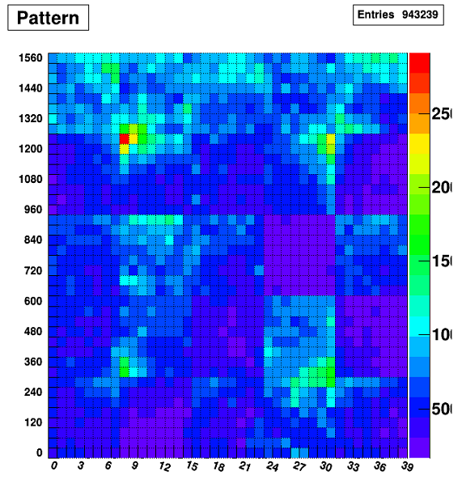
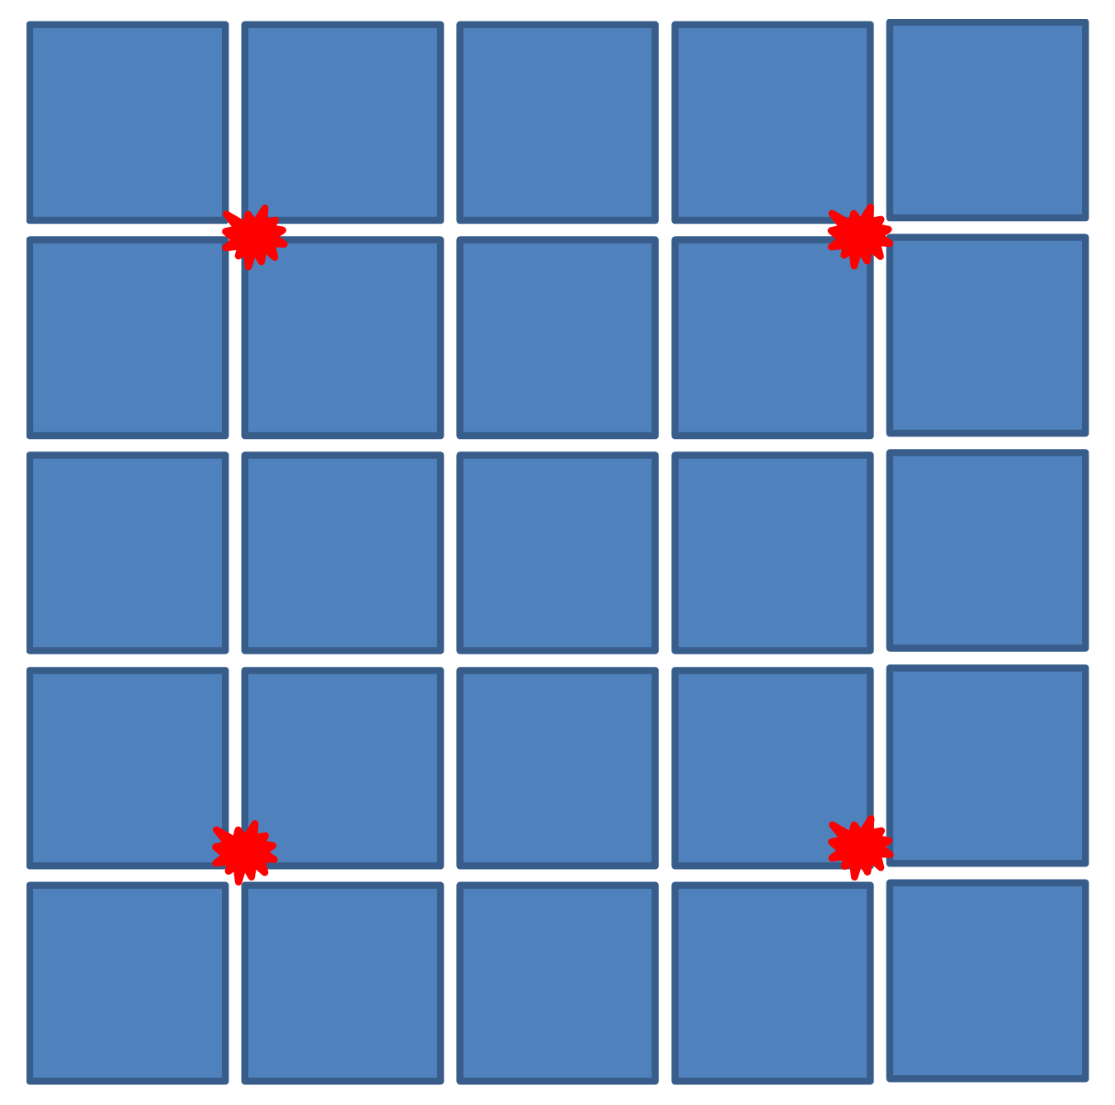
In orbit calibration
Top view of POLAR: 4 Na-22 sources (in red color) locations
Triggering pattern of the 1600 channels

Slide 27
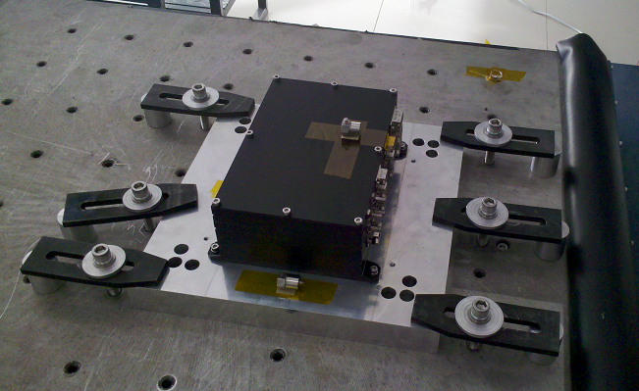
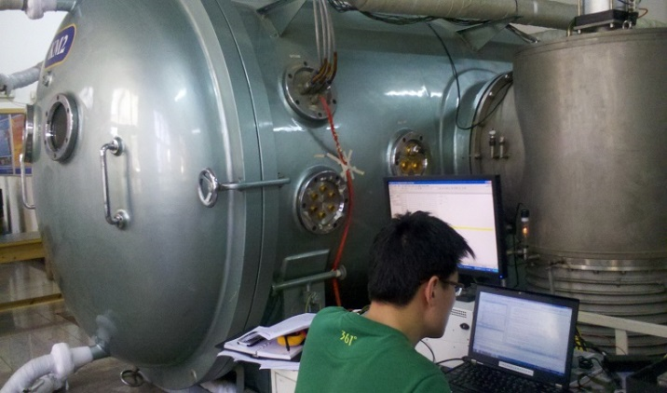
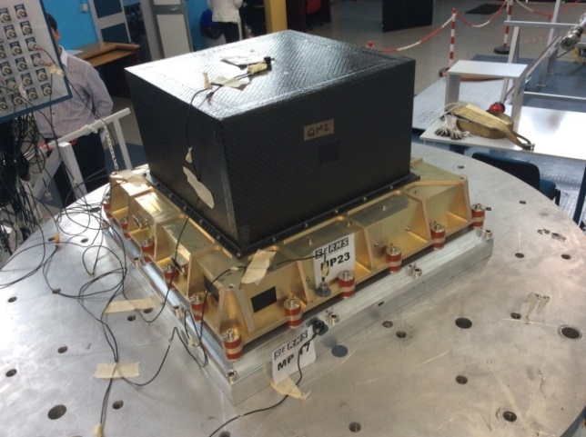
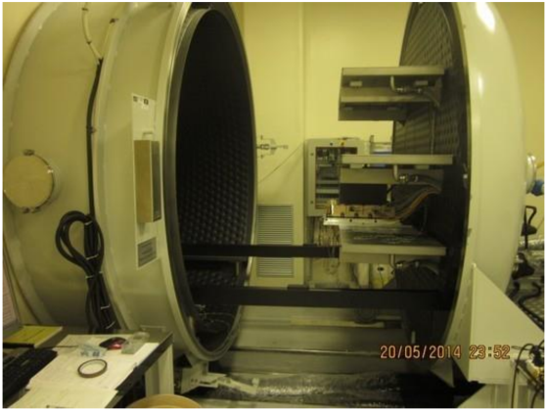
Space qualification tests
IBOX vibration test
IBOX thermal vacuum test
OBOX vibration test
OBOX thermal vacuum test

