Slide 1
CZT Imager of Astrosat
A R Rao
Tata Institute of Fundamental Research, India
(on behalf of CZTI team)
TIFR: Lead institute, overall instrument design & development
VSSC: Electronic design, assembly and testing
ISAC: Mechanical design, quality consultation & project management, science team
IUCAA: Coded Mask design, analysis algorithm, calibration & Payload Operations
PRL: Polarimetry algorithm & demonstration, calibration, response matrix
SAC: Analysis software
NCRA: Radio observations

Slide 2
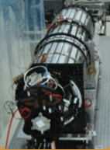
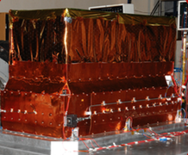
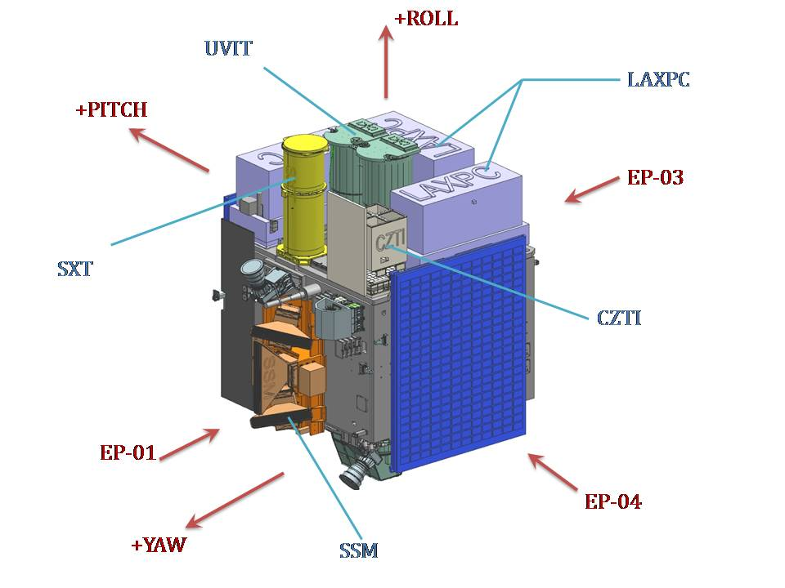
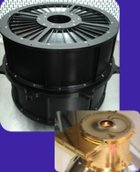
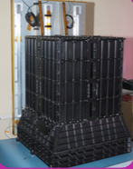
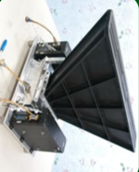
ASTROSAT

Slide 3
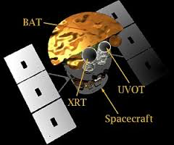
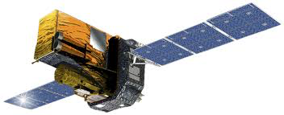
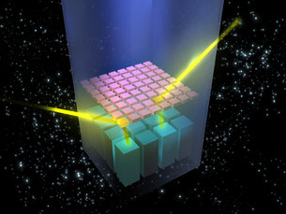
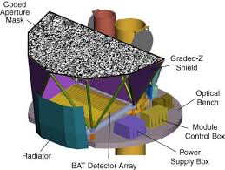
Integral
Swift
Above 80 keV:
HEAO A4 : 22 sources (2 years)
Swift/BAT : 86 sources (6 years)
Integral/IBIS : 132 sources (11 years)

Slide 4
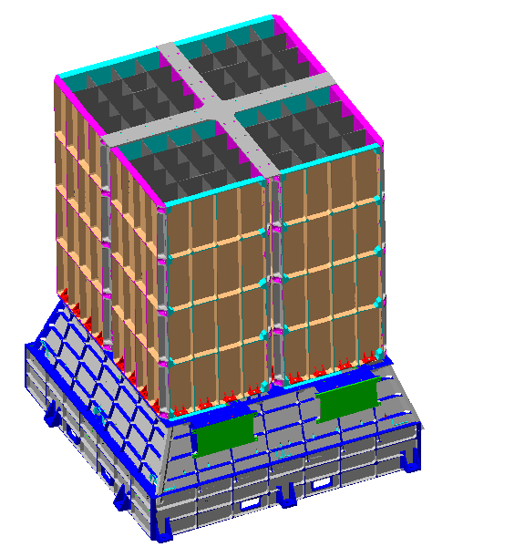
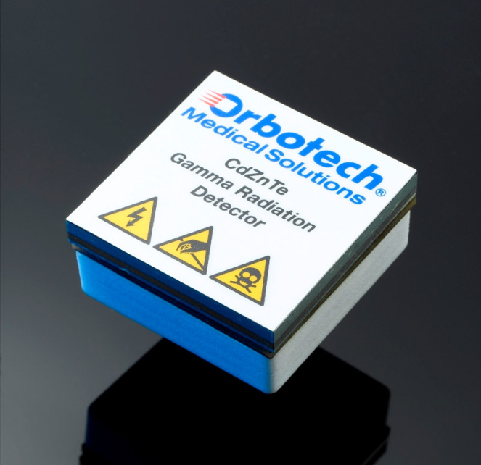
Four Independent Quadrants
Size - 484 x 484 x 600 mm
Power- 50 Watts
Weight - 50 kg
FOV – 4.8 x 4.8 Degree; 17 x 17 Degree; ~80 Degree
Shield Material – Tantalum + Aluminum (Passive shielding)

Slide 5
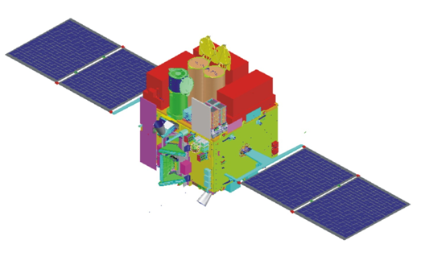
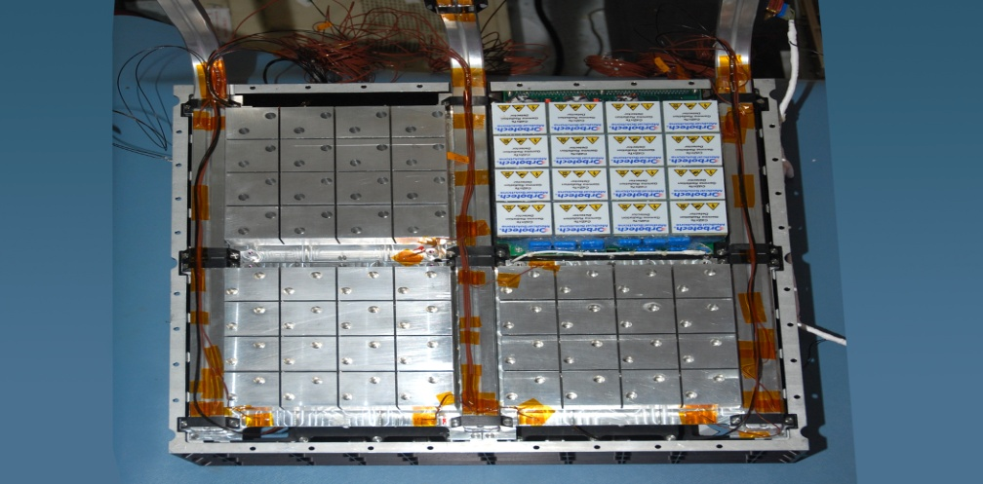
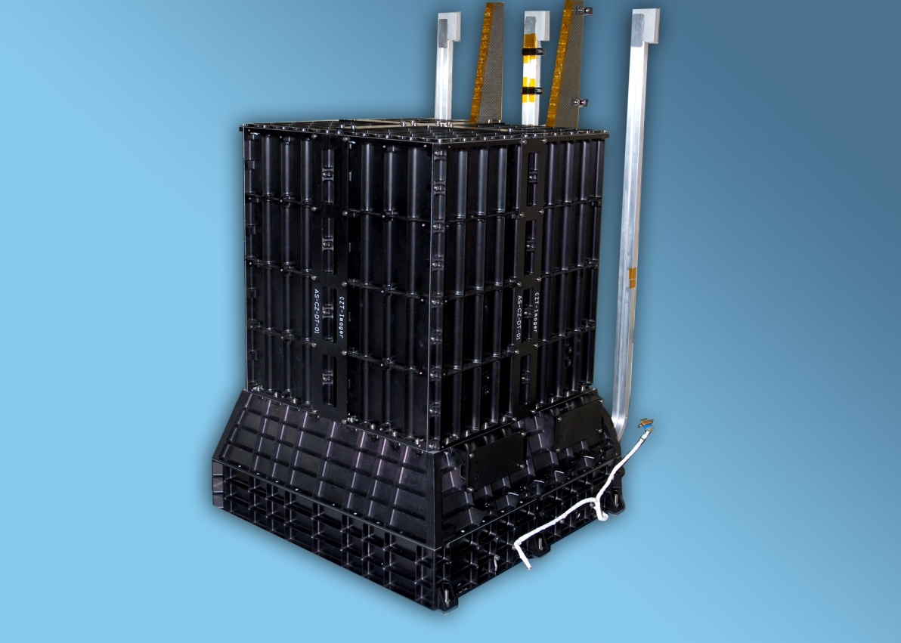
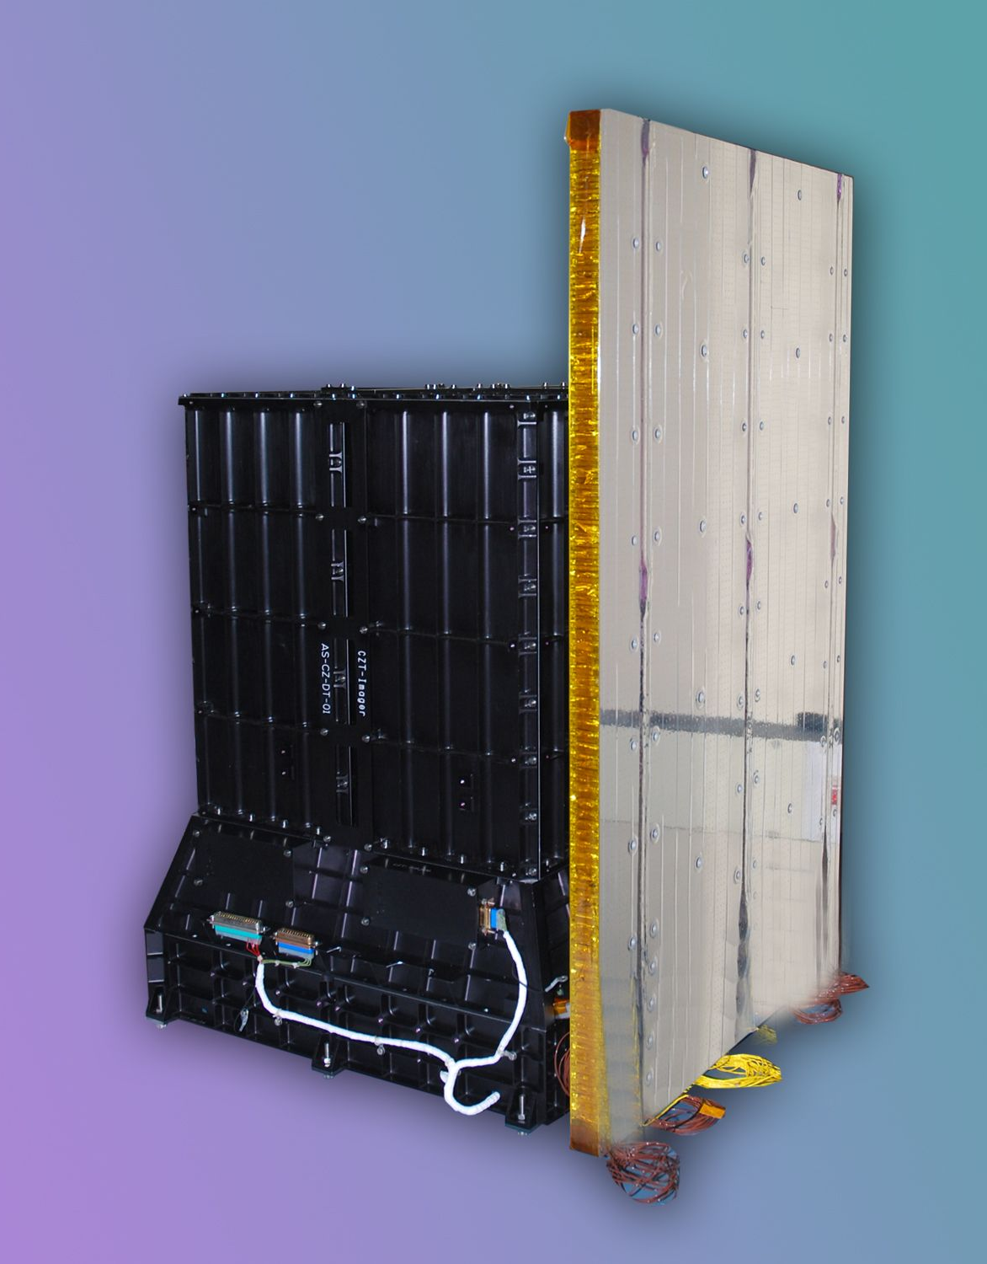
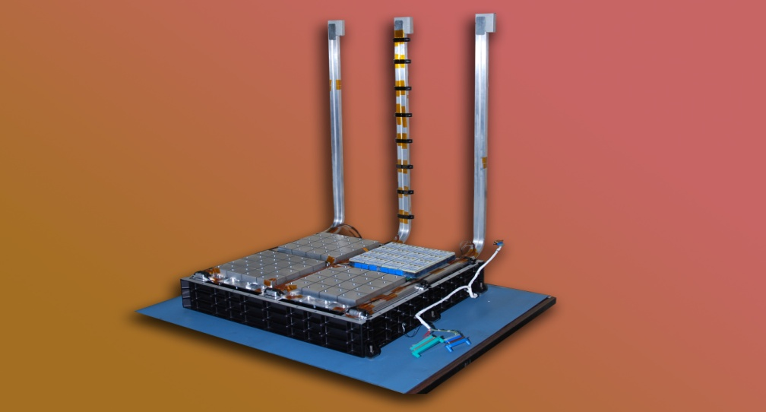

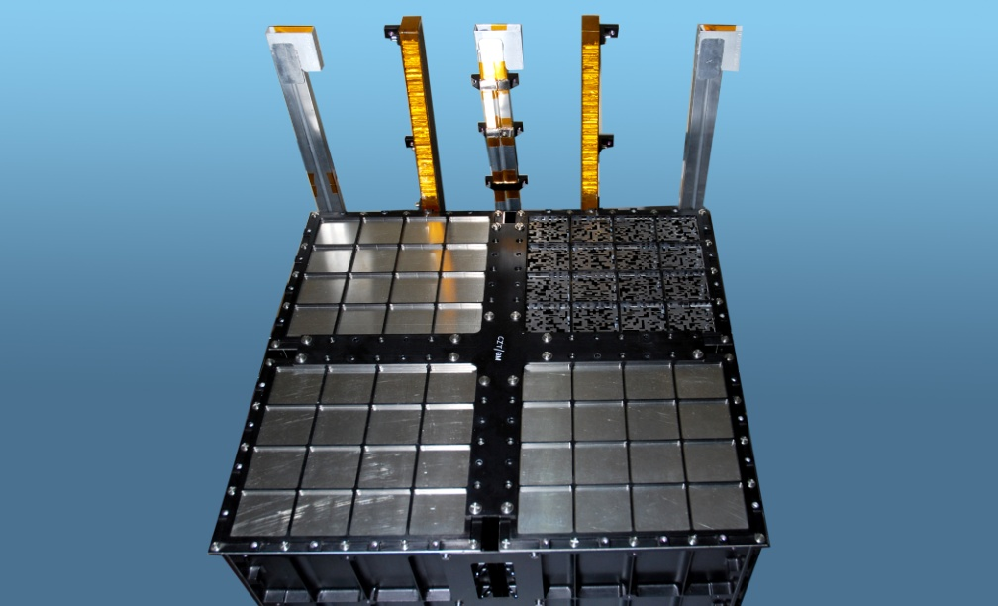
CZT-Imager
Weight - 50 kg
Size: 60 cm
Integral
(2000 kg; 500 cm; 25.6°)
Swift (1500 kg; 560 cm; 20°)
Low Inclination 6°
Continuous time-tagged individual photon data (20 micro-sec)
Hard X-ray monitoring
(above ~ 80 keV)
CAM
Radiator
Alpha tag

Slide 6
Individual photon data
CZT : Energy (pulse height), pixel address, Time of incidence (20 μs).
Veto : Energy (pulse height), time of incidence.
Alpha : time of incidence.
Simultaneity: Interaction : nano-sec.
Detectors : 1-2 μ s.
Electronics : 4-5 μ s.
Total : 20 μ s.
Chance : < 0.2 % (calculation).
Diffuse Cosmic background Calibration source | <10 <100
Crab Nebula | 100
Veto triggered events | ~ 250
Maximum expected event rate | 1000

Slide 7
Ground Calibration
Individual pixel calibration as X-ray detectors at multiple temperatures using radio-active sources : spectral calibration (gain, off-set; relative quantum efficiency).
Imaging test with sources at known distance (a couple of meters).
Individual photon data:
time calibration, alpha-calibration,
veto calibration: by analysis.

Slide 8
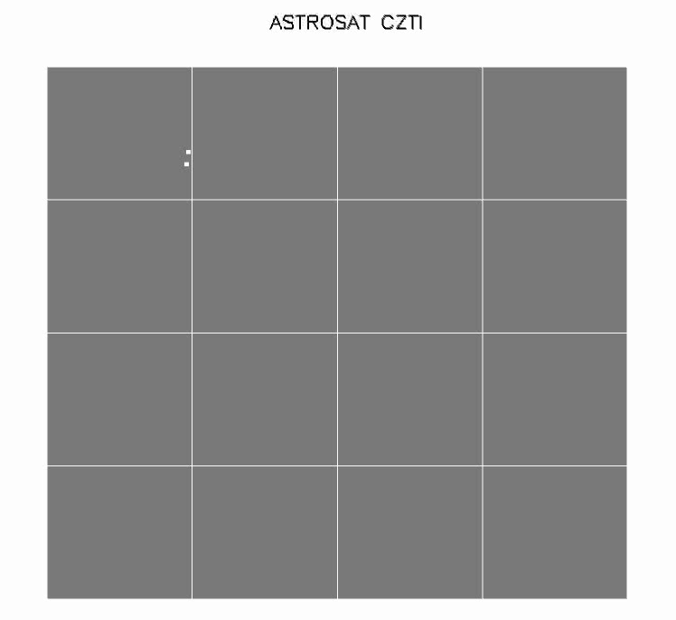

Slide 9
Onboard Testing
The CZT electronics is very sensitive: a Cosmic Ray interaction gives multiple events.
Observed counts: a couple of thousand per second per quadrant (against the expected ~ hundred)
Onboard software patch successfully implemented to digitally reject these events.
Effective data pipe line (`bunch cleaning’)

Slide 10
Posters
Spectral calibration of Astrosat-CZTI
- N P S Mithun
Astrosat CZTI Image calibration
- A Vibhute
CZTI Timing Calibration
- Rakesh Khanna
Polarisation measurement of Crab Nebula and GRB151006A & GRB160131A with Astrosat CZTI
- S. Vadawale and T. Chattopadhyay
Transients with Astrosat CZTI
- V Bhalerao
CZT Imager as a Compton Telescope
- S Chakraborty et al.

Slide 11
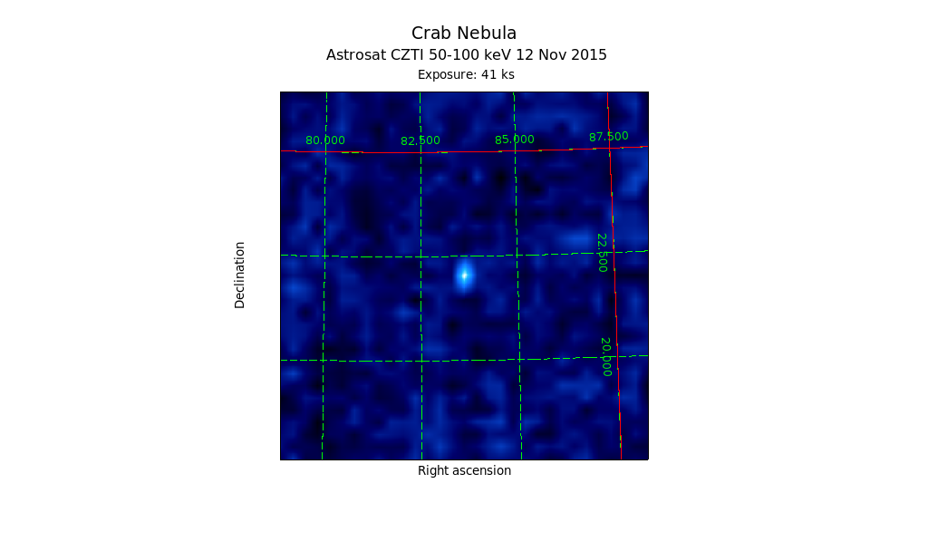
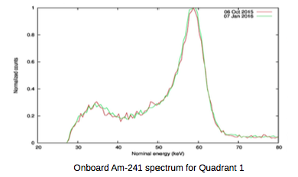
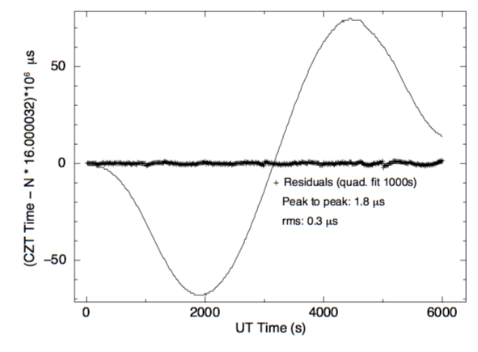
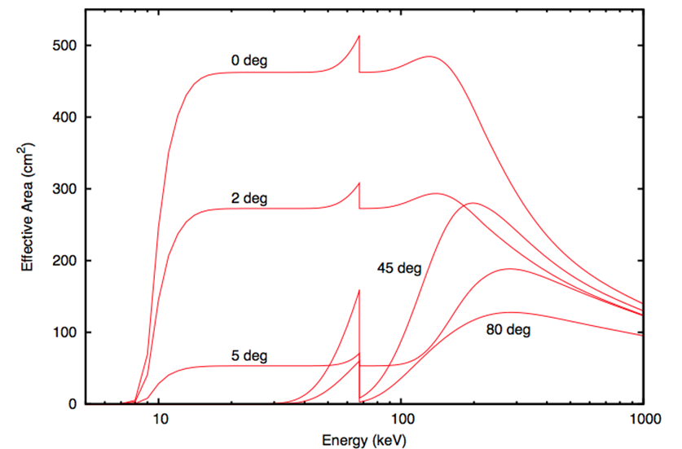
Image
Alpha tagged spectrum:
Resolution @60 keV : 8%
Spectra
Mithun
Dipankar/Santosh
Timing
Area
rms: 0.3 μs
Dipankar
Rakesh

Slide 12
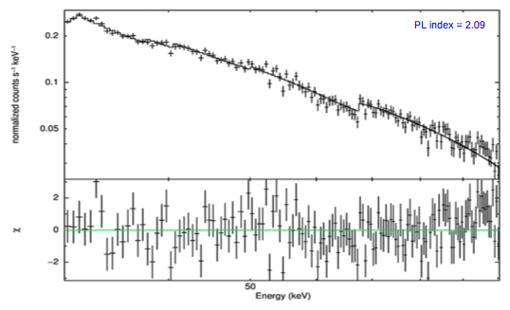
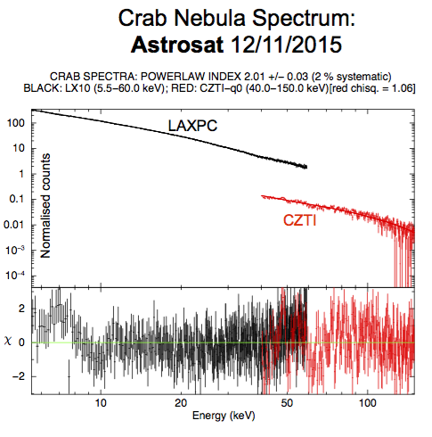
Norm free;
(yet to be finalized).
Index: 2.1
Good χ²
Energy range
^{e}
Mayukh Pahari/ J S Yadav/Mithun

Slide 13
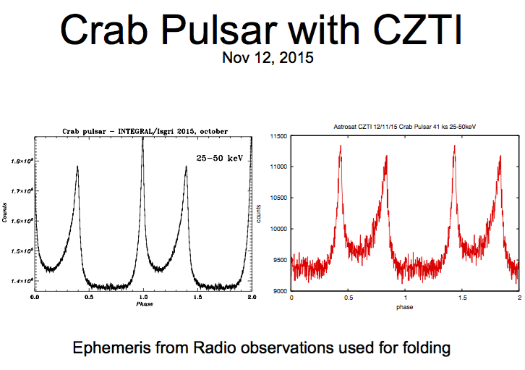
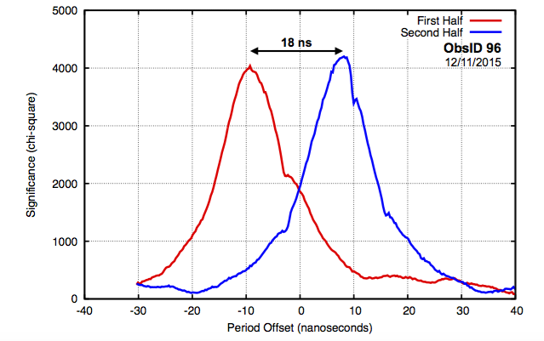
Dipankar

Slide 14
Core Science Areas
Galactic Black Hole Binaries: Spectro-temporal long term monitoring and understanding disk-jet connection with simultaneous multi-wavelength data like GMRT etc.
Pulsars: Search for hard X-ray counterparts for Fermi-LAT pulsars.
Gamma-ray bursts: Investigate hard X-ray spectro-polarimetric properties of very bright GRBs and make follow up studies using GMRT etc.
Bright nearby AGN: Make spectro-temporal long term monitoring to understand the emission mechanism.

Slide 15
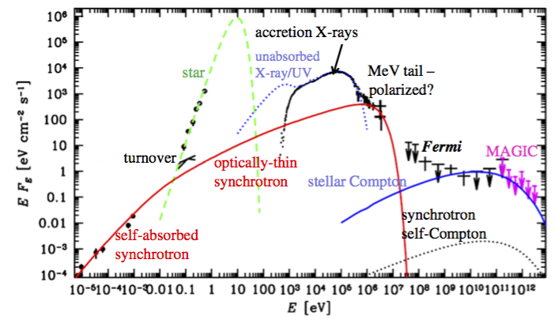
Astrosat science:
Cygnus X-1: black hole binary
Chandra
HST
Zdziarski+

Slide 16
SXT
UVIT
LAXPC
Mt Abu
HCT
TIRSPEC
CZTI
HAGAR
GMRT

Slide 17
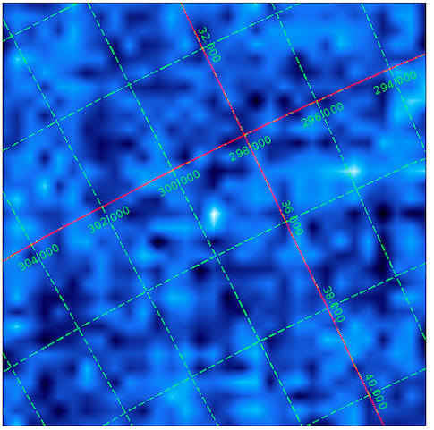
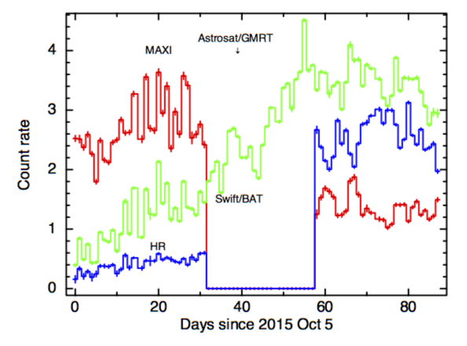
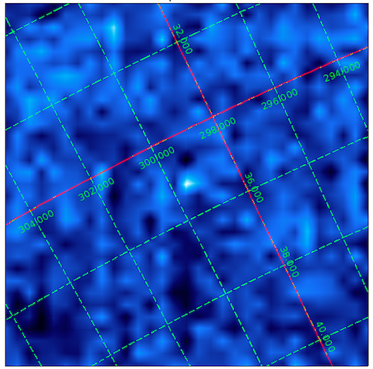
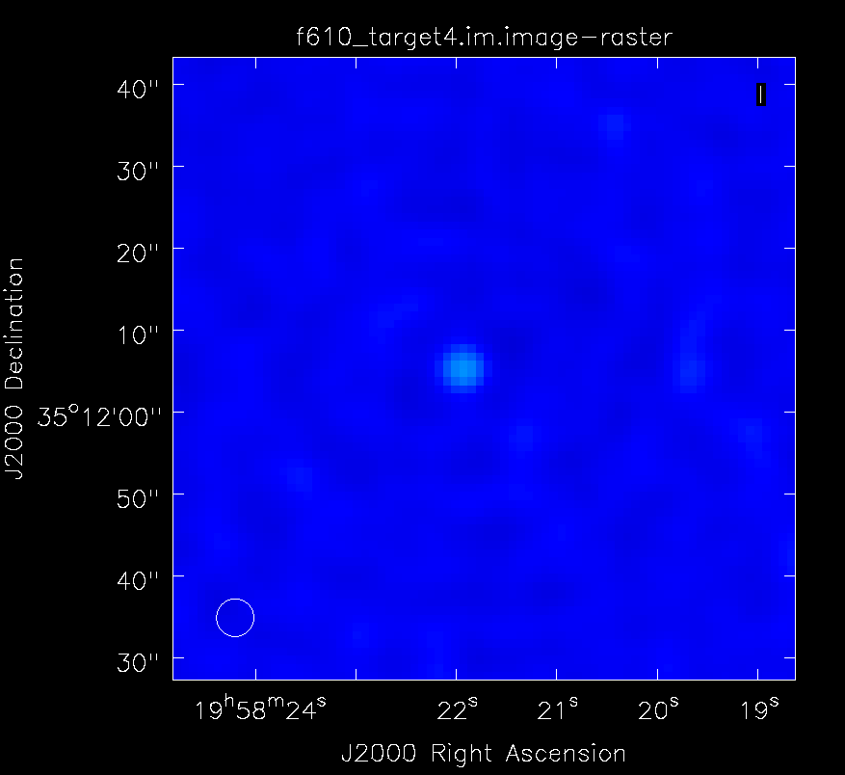
Black Hole Source: Cyg X-1
CZTI: Oct
Cyg X-1: CZTI, GMRT, and Mt Abu
9.07 + 0.25 mJy radio (612 MHz)
Mt Abu: Non-thermal tail
CZTI: Nov
GMRT: Nov
Yash/Mithun/Debdutta/Ishwara

Slide 18
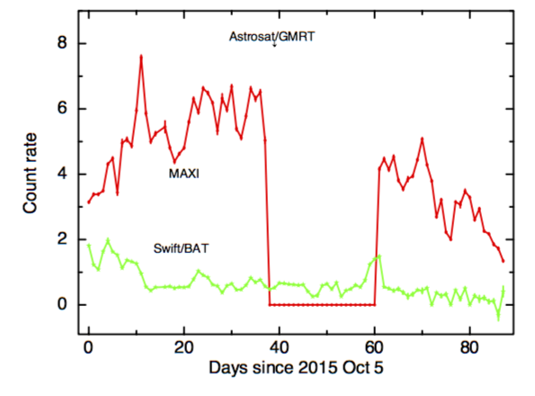
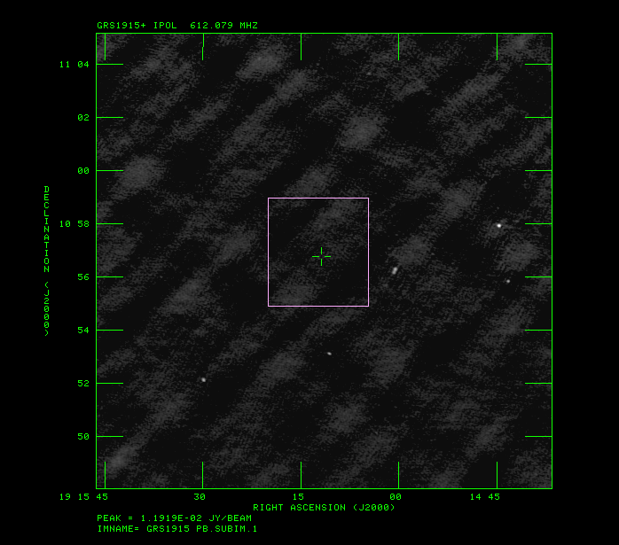
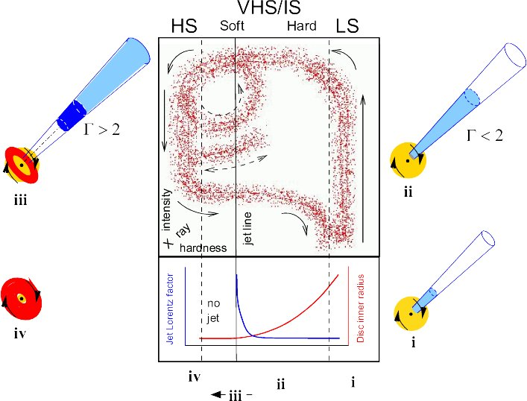
Black Hole Source:
GRS 1915+105
Flux density < 200 μJy
GMRT
Yash/ Vikas/Ishwara

Slide 19
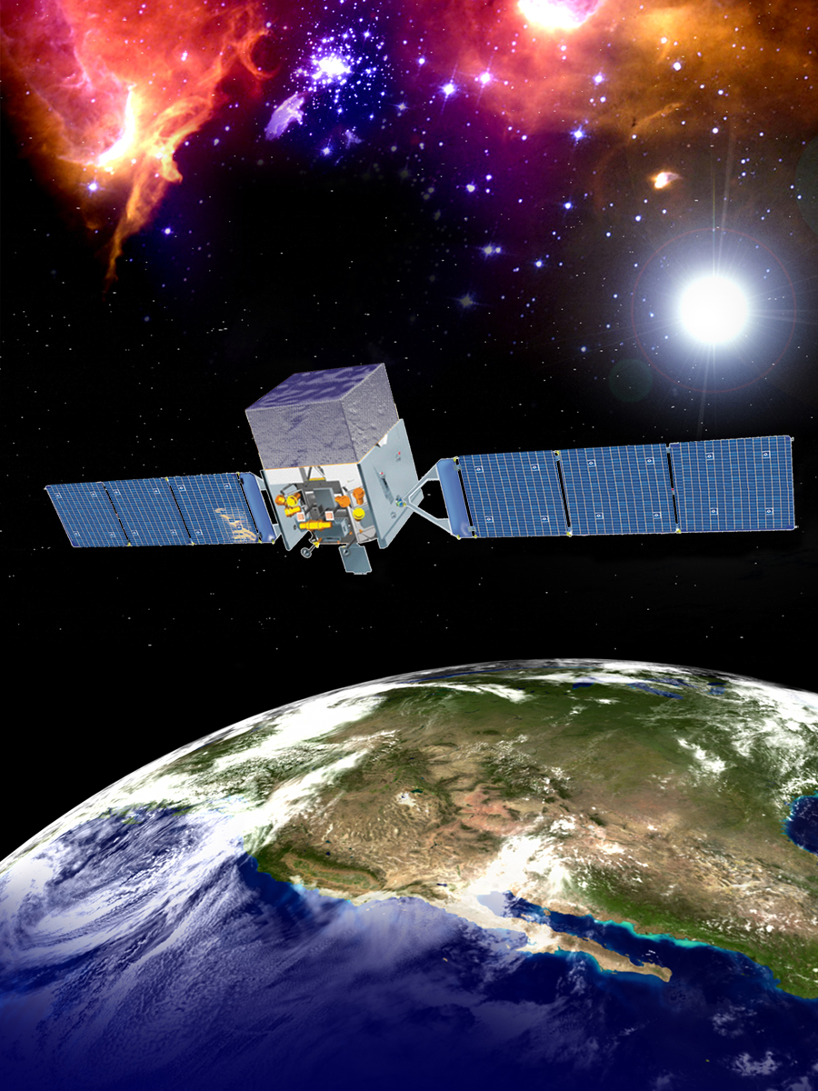
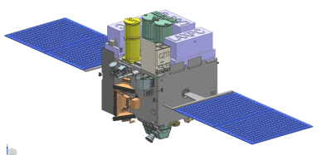
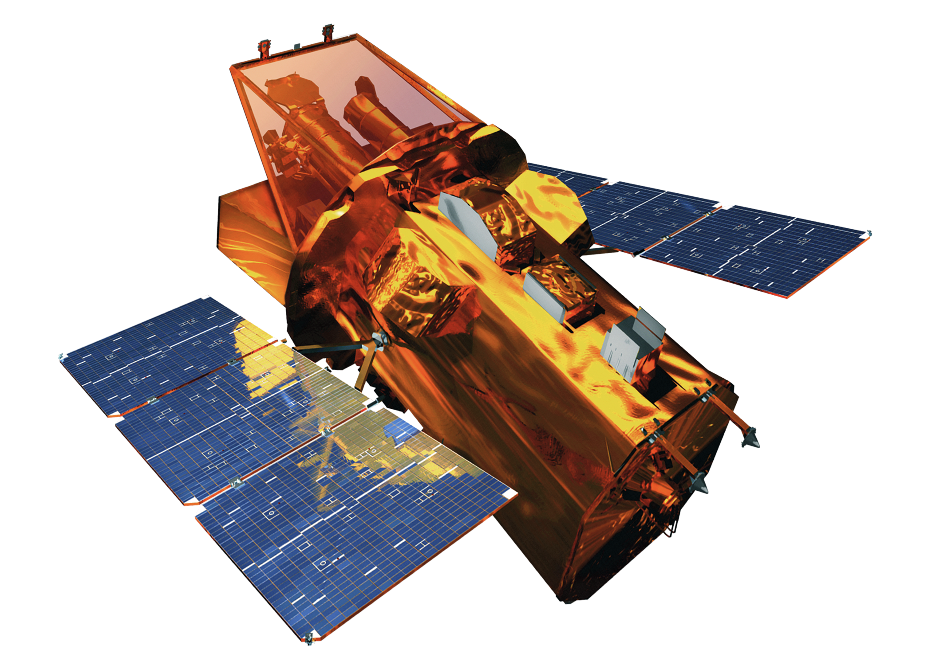
Gamma-ray Bursts
Astrosat: 650 km; 6° Fermi: 565 km 25°.6 Swift: 600 km 20°
Fermi
Swift
Astrosat

Slide 20
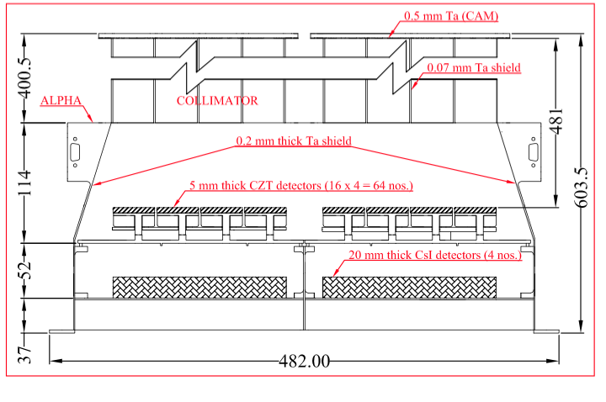
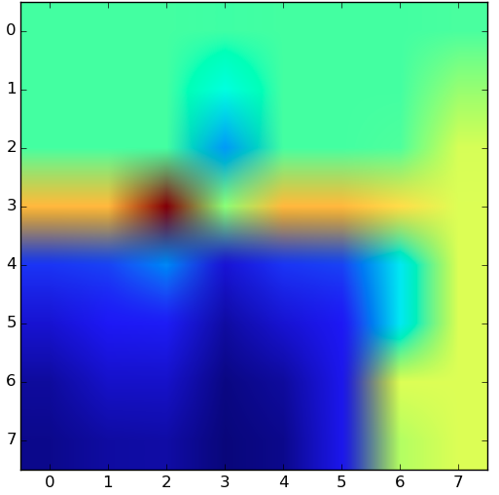
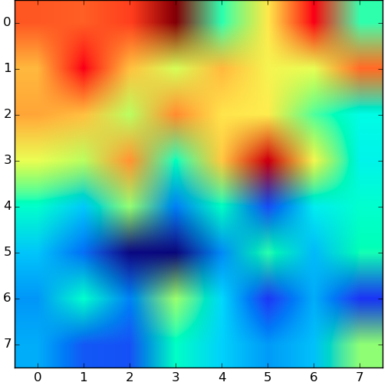
GRB151006A
Vikas/Kutty/Dipankar/Debdutta

Slide 21
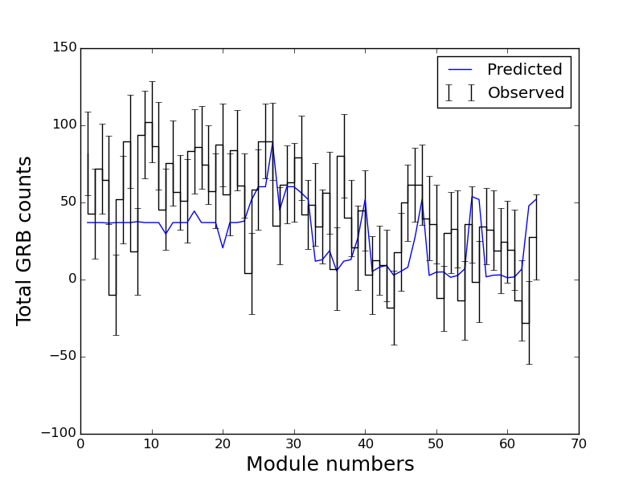
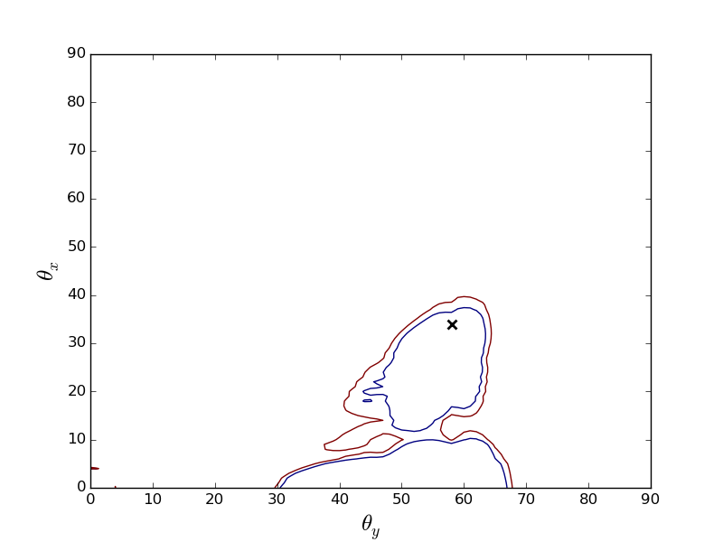
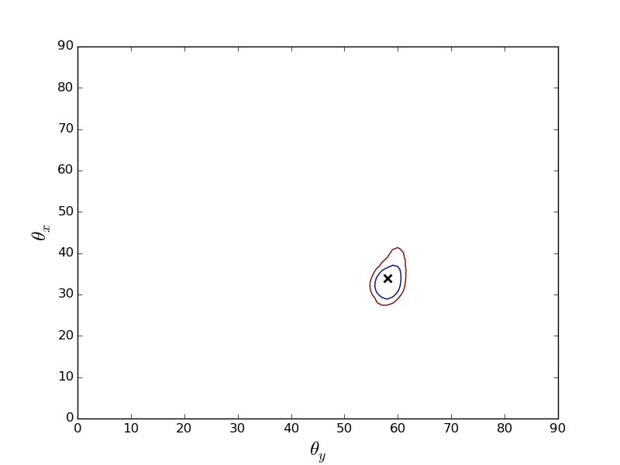
Observation
Localization: a few degrees
mass model to be refined. Need detailed mass model for polarization studies too.
Simulation

Slide 22
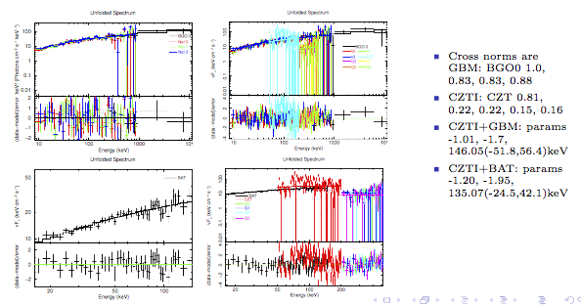
Vikas
Polarization: GRB151006A: marginal
GRB160131A: detected

Slide 23
Conclusions
Full commissioning completed (software patch; setting parameters and thresholds)
Pipe-line is operational and running.
More work needed on self consistent results on spectra, image.
Comparison with other instruments going on.

