Slide 1

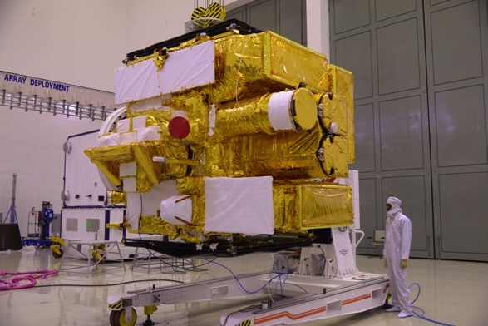
Performance of Soft X-ray Telescope onboard Astrosat
SXT
K. P . Singh (TIFR)

Slide 2
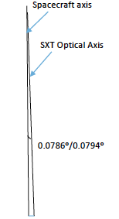
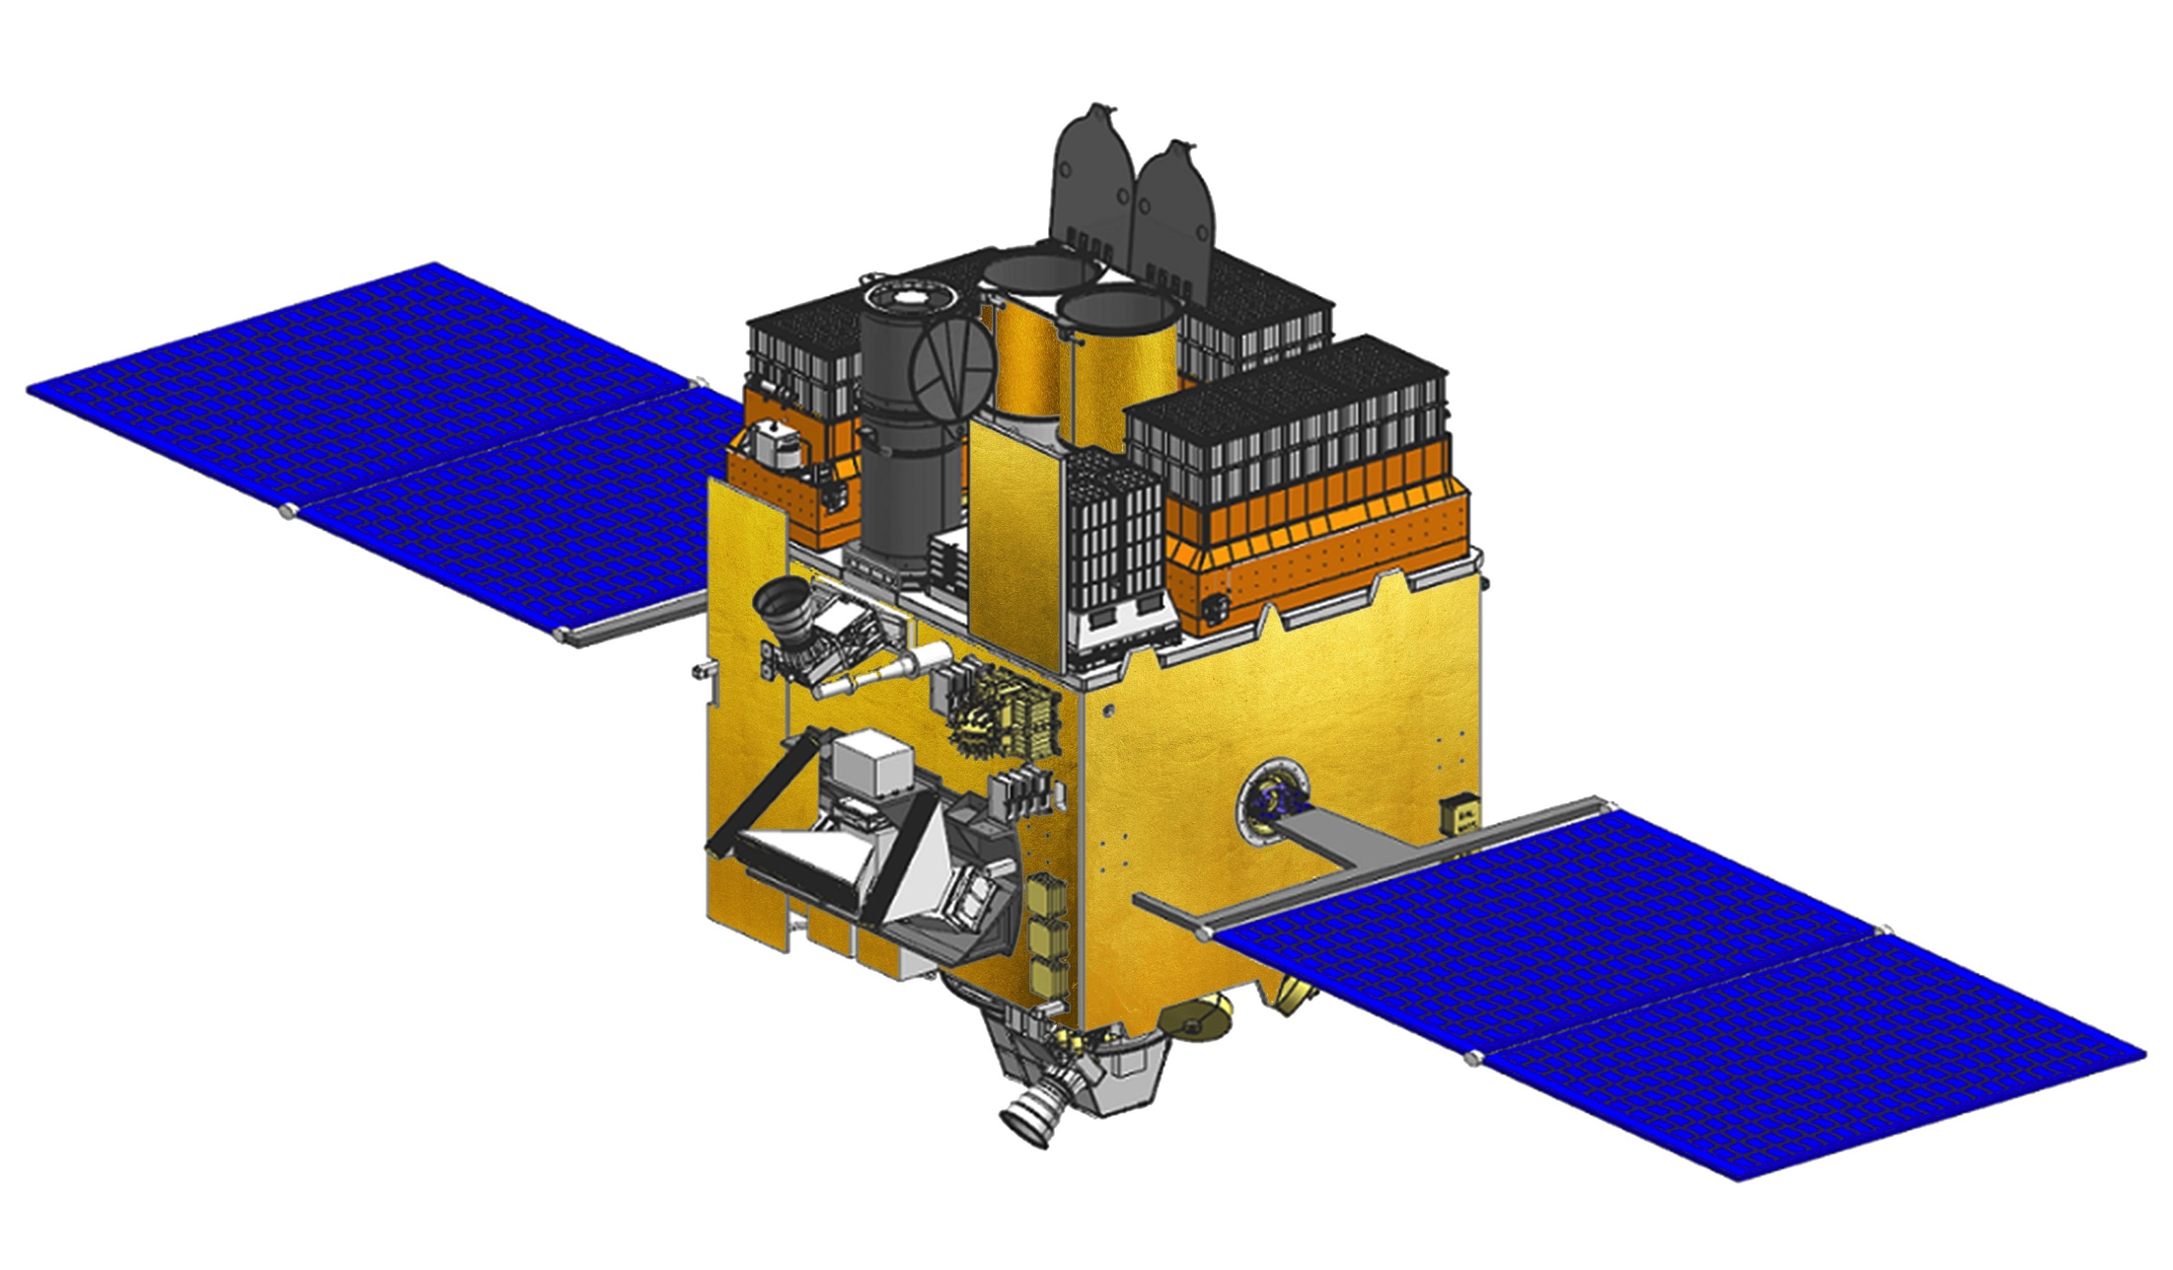
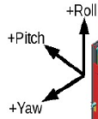
AstroSat: Co-aligned multi-wave instruments
UVIT (IIA+ISAC+CSA+IUCAA+TIFR)
SXT
(TIFR+UoL+ISAC+VSSC)
LAXPC (TIFR)
Pitch / Yaw
CZTI (TIFR+IUCAA+
VSSC)
SSM (ISAC+VSSC)
Cold Side with
Radiator plates
For CCD and
CZTI
Star Sensors (ISAC)
Website : astrosat.iucaa.in

Slide 3
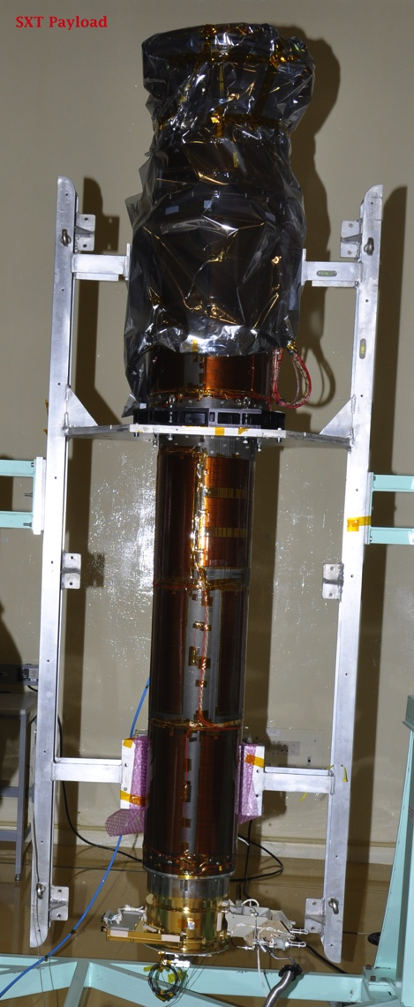
SXT
2 m focal length;
~2 arcmin HPD;
40 shells (130 – 260 mm dia);
Total Mass: 65 Kg.
Mass of the Optics Assembly: 12 Kg !

Slide 4
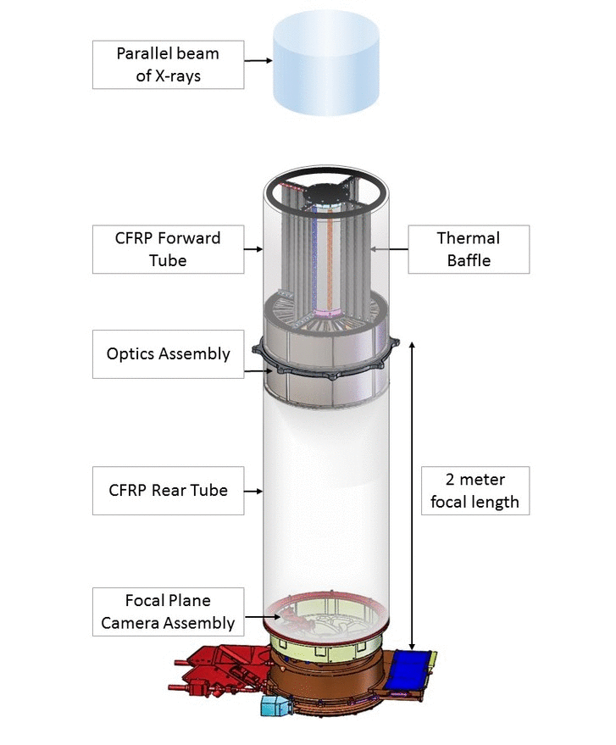
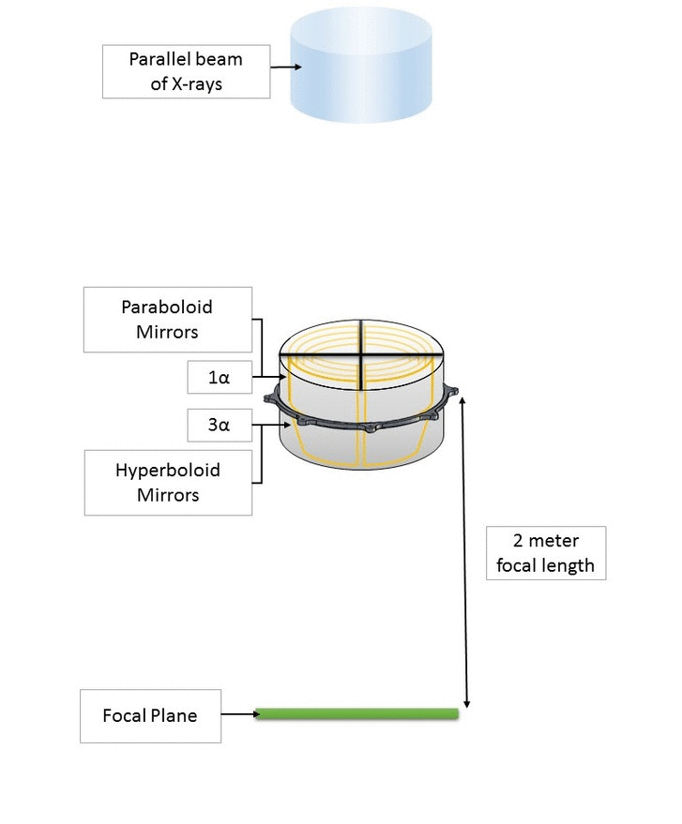
SXT

Slide 5
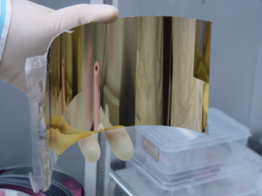
SXT: Optics – Replicated Thin foil mirrors made in TIFR (following Suzaku), assembled using custom made mechanical structure
Mirror roughness 7 – 10 Angstroms : Exp. Ast. (2011), 28,11

Slide 6
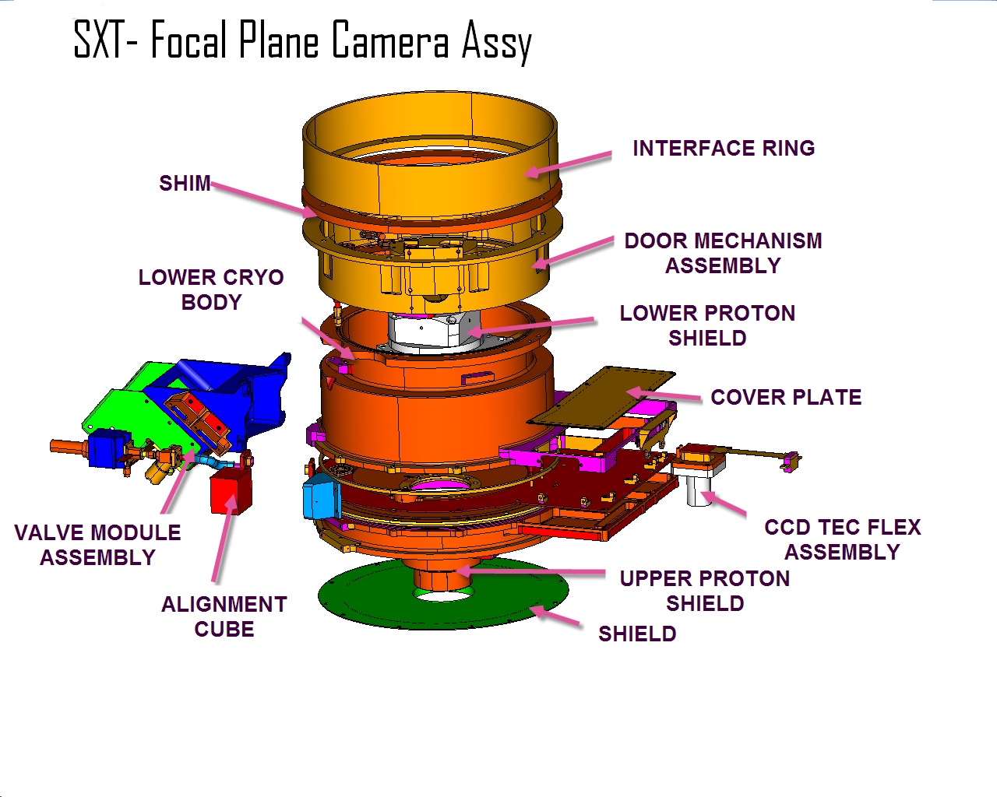
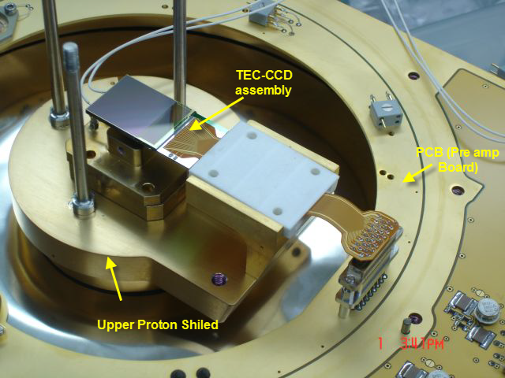
Modified from Swift; Using
spare MOS CCD22 from XMM:
600 x 600 pix, 40 microns
Four Fe-55 calibration (corner) sources
One Fe 55 calibration door source
Thin Optical Blocking Filter
CCD Assy. including TEC
PCB with front-end electronics

Slide 7
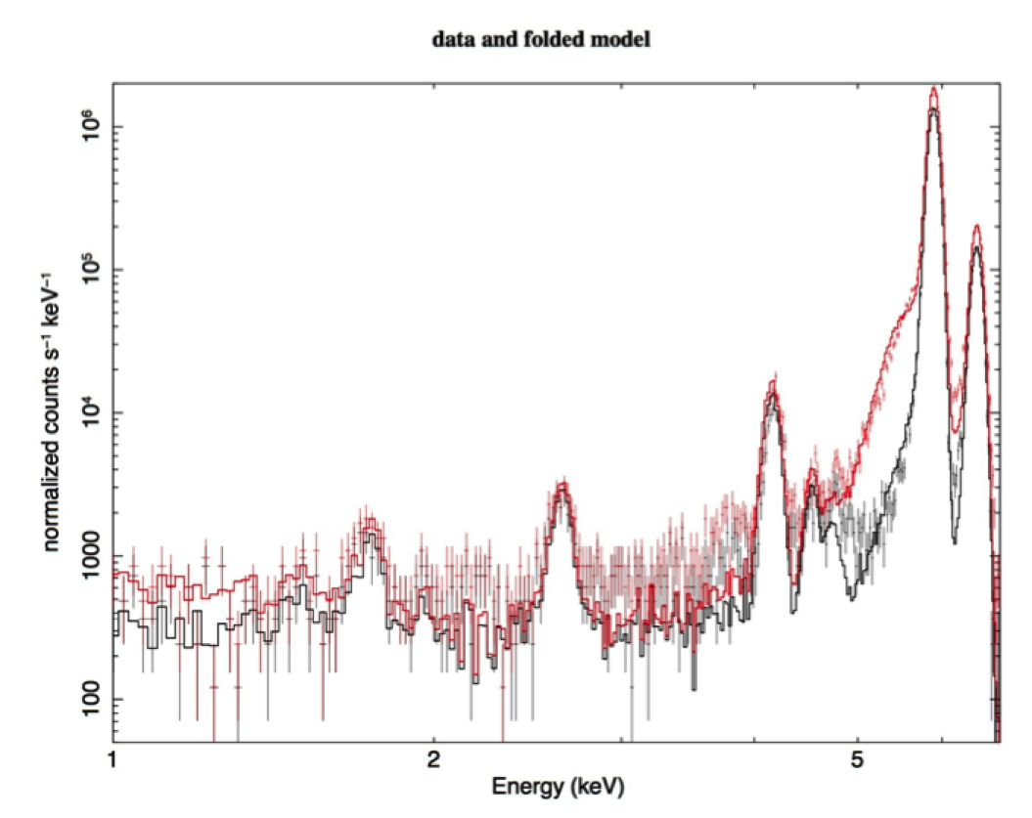
SXT FM: Electronics: NIM:A (2009), 604,747; Energy Calibration spectrum measured using internal sources: Single Pix events, all types of events. CCD @ -80 C
Fe-55 lines
Before Launch
4.5 keV
(Ti-F)
4.15, 4.75 keV Mn-K Esc
1.48 keV
(Al-F)
2.6 keV
(CL-F)
1.74 keV
(Si-K)

Slide 8
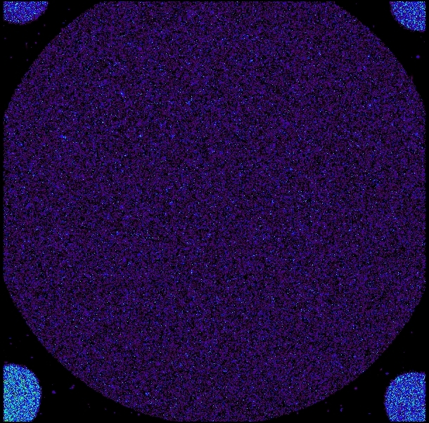
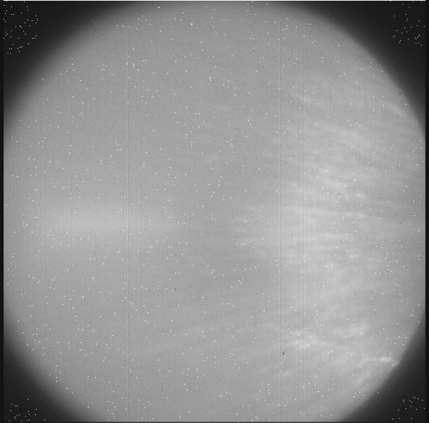
SXT CCD – Switch On: Camera venting – Daily Oct 1st - 26th
TEC ON for CCD - Oct 9th and the following images taken after launch in the first week of Oct. 2015
Door and Corner X-ray Calibration Sources
Optical LED Image

Slide 9
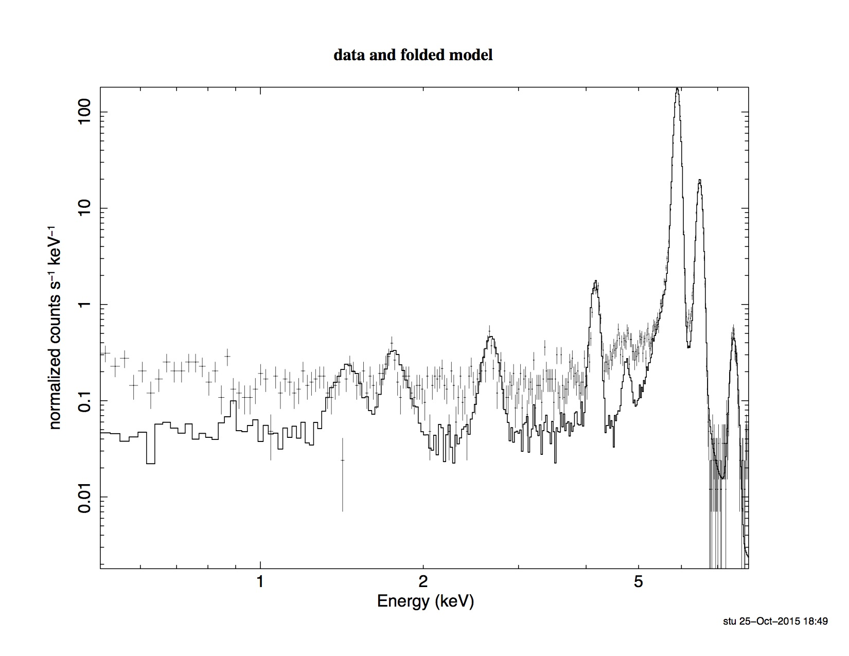
SXT Energy Calibration Spectrum measured after launch using internal sources: Single Pix events; CCD @ -82+/-2 C
Fe-55 lines
After Launch
October 12 &17, 2015
New Bgnd induced feature- Ni line?
4.5 keV
(Ti-F)
1.74 keV
(Si-K)
4.15, 4.75 keV Mn-K Esc
2.6 keV
(CL-F)
1.48 keV
(Al-F)

Slide 10
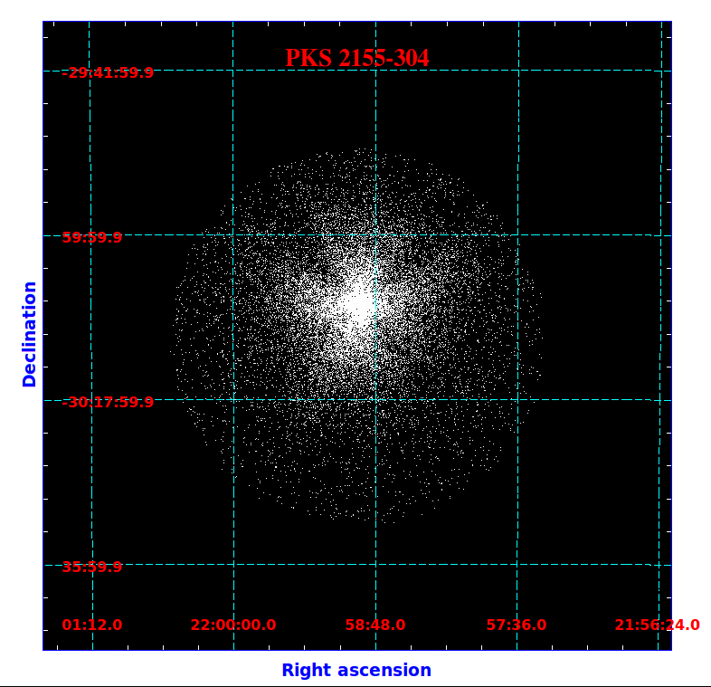
SXT Switch ON continued …. and FIRST LIGHT
Telescope (Optics) Door opening - Oct 15th
Camera Door Opening - Oct 26th @ 06:30 UT
First Light – Oct 26th
Pointed at and observed- PKS2155-304 (Quasar) at redshift of 0.116
(1.6 Billion LY away)

Slide 11
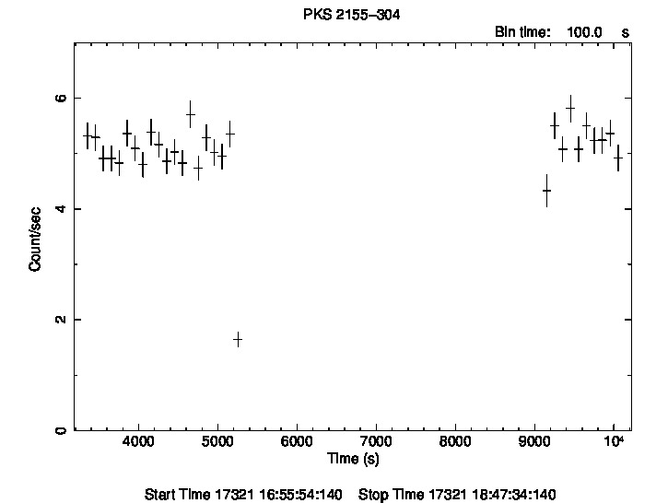
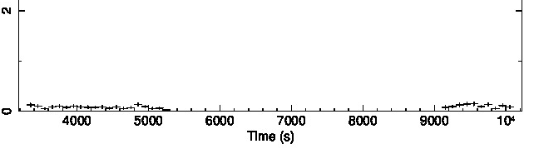
SXT X-ray Light Curve of PKS2155-305
At 1 mCrab level !!
Can go a hundred times fainter in 10000s
Background
SXT Software Team led by:
K. Mukerjee

Slide 12
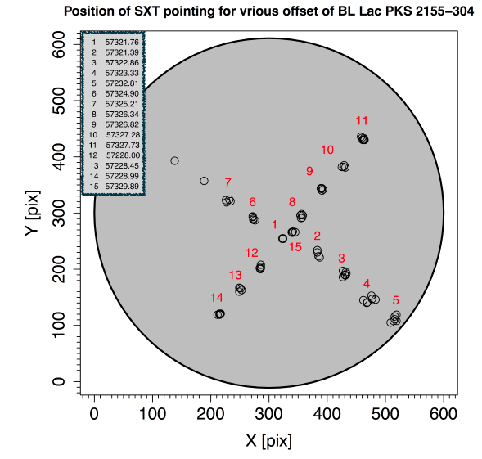
SXT Bore-site and off-axis effective area: foV = 42 arc min (dia); 1 pix = 4 arc sec
Courtesy: S. Chandra

Slide 13
SXT Bore-site and off-axis effective area using 2E01020-72
Courtesy: S. Chandra,
S. Bhattacharyya

Slide 14
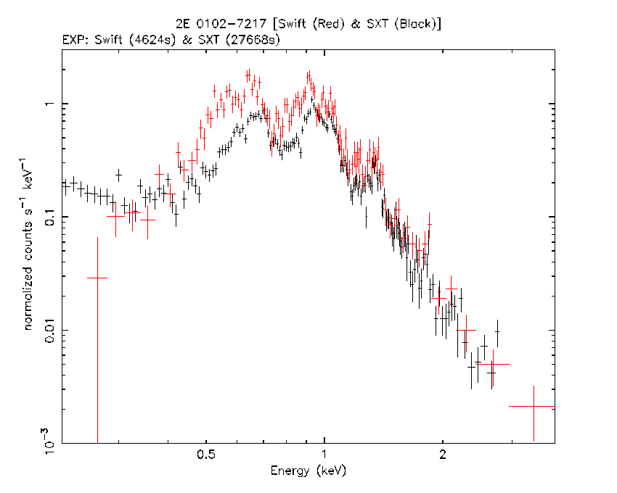
2E01020-72: Spectral Comparison with Swift
Courtesy:
S. Chandra

Slide 15
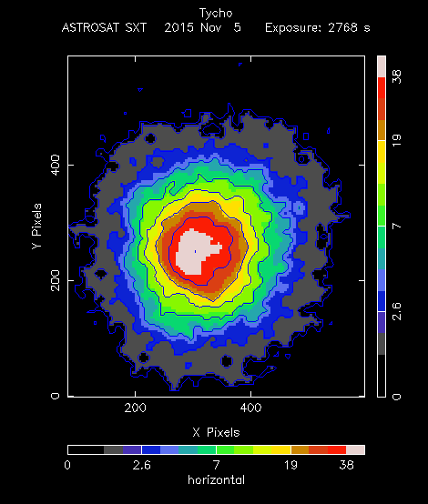
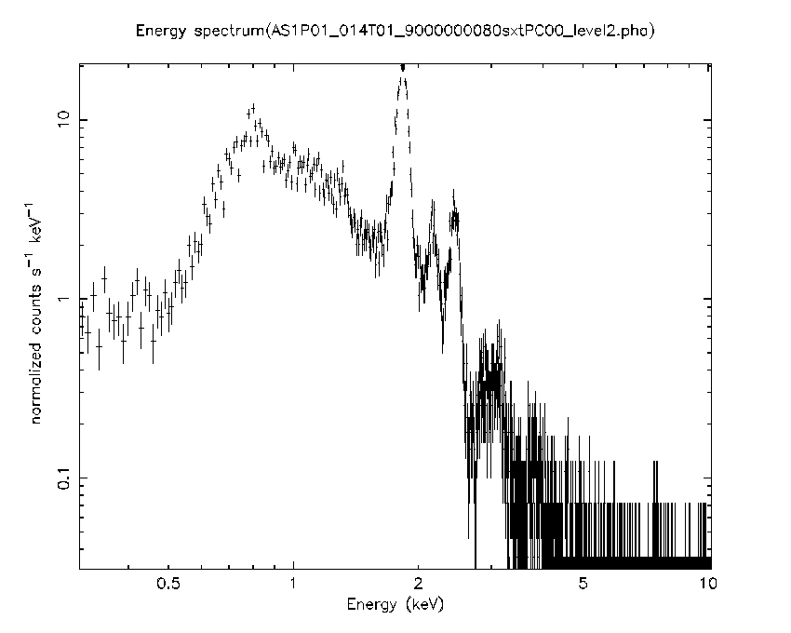
Tycho A: Supernova remnant (1572 AD) 8000 ly away (Astrosat SXT Exposure: 2700s) – 9’ dia
Emission lines from fully ionized Mg, Si, S, Ar, Ca
Observed on Nov 6, 2015: Background not subtracted
Courtesy: K. Mukerjee

Slide 16
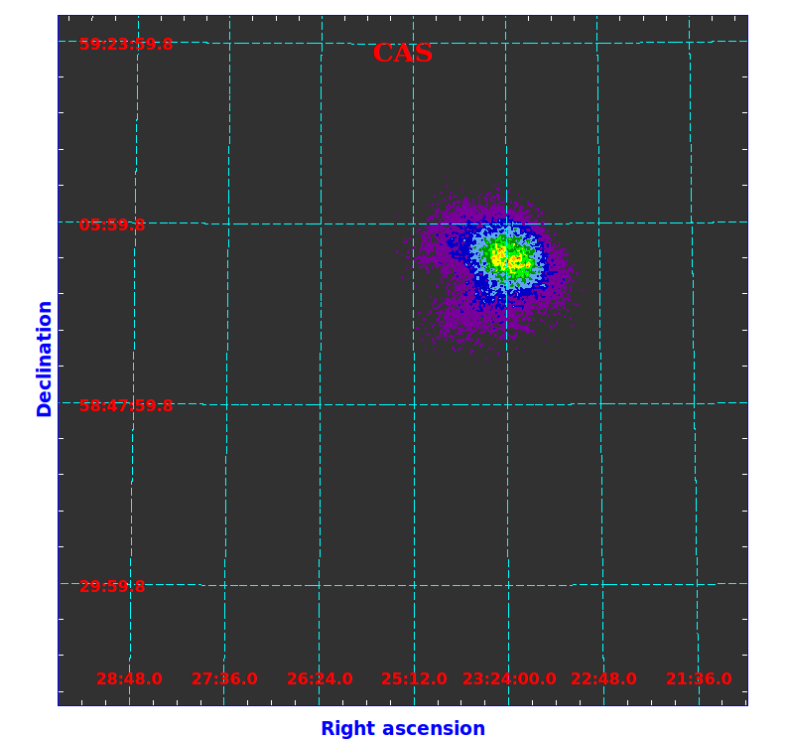
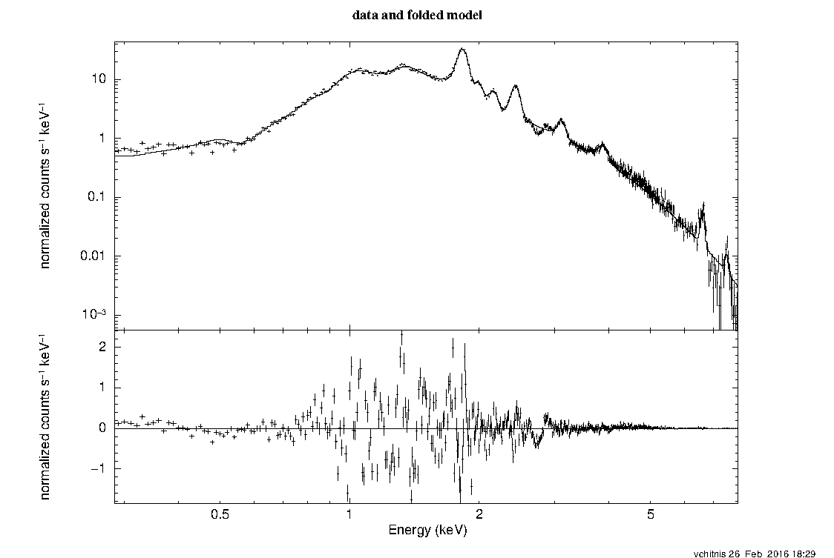
Cas A: Supernova Remnant (1680 AD) at D=11000 ly
~5’ diameter
LAXPC (UVIT?) pointing… on the edge of the SXT foV – poorer psf and area on the edge
SXT Spectrum
Courtesy: V. Chitnis

Slide 17
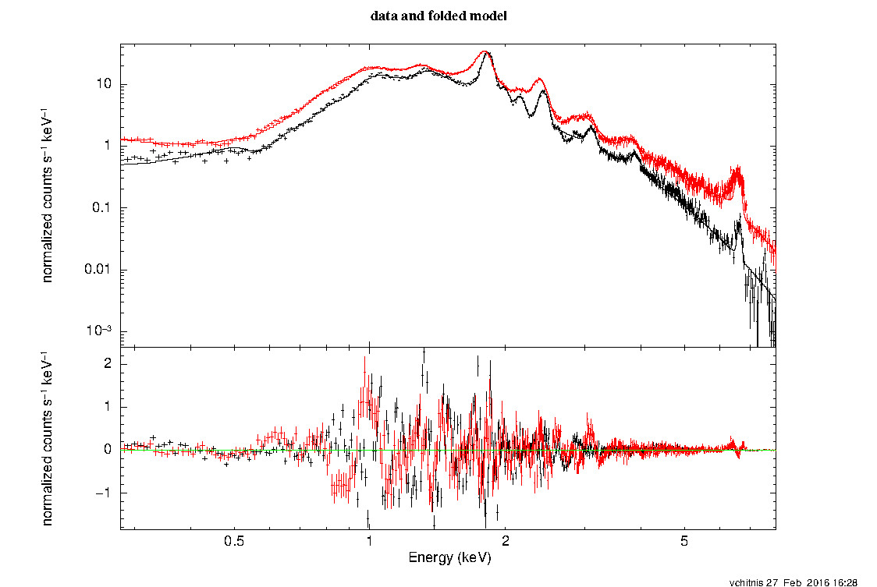
Cas A
SWIFT XRT (in Red) and SXT Spectrum comparison
Courtesy: V. Chitnis

Slide 18
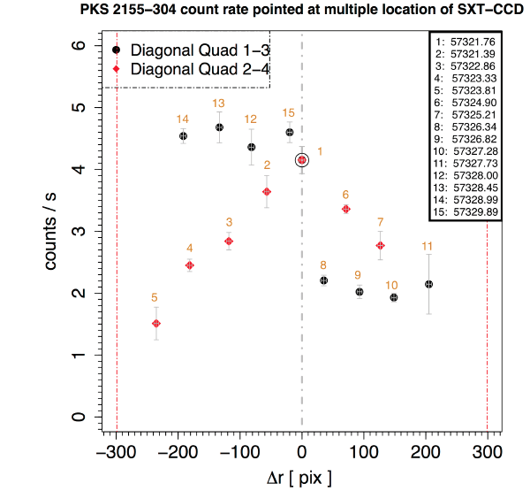
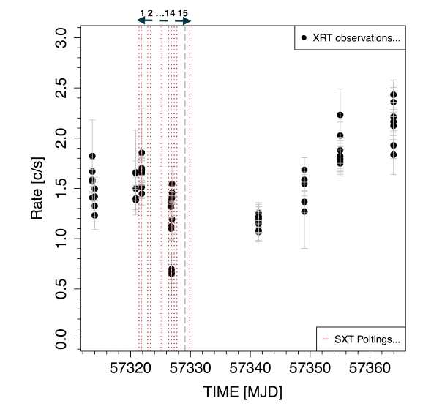
SXT Bore-site and off-axis effective area using PKS2155-304
Courtesy: S. Chandra

Slide 19
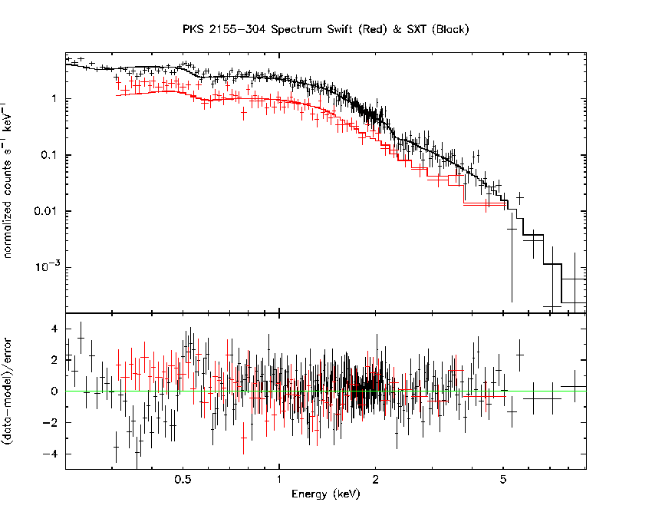
SXT & Swift XRT: Near Simultaneous Observations
Swift: Oct. 25, 20:40:40 (1466 s)
SXT: Oct 26, 18:20:10 (3571 s)
Model: wabs*bknpow + cons*wabs*bknpow
Astrosat SXT
Swift XRT
N_{H}= 1.41 x 10²⁰
PhIndex1=1.97 +/- 0.04
BreakE= 1.39 +/- 0.08
PhIndex2= 2.94 +/- 0.1
Const= 0.80 +/- 0.03
Courtesy:
S. Chandra
K. Mukerjee

Slide 20
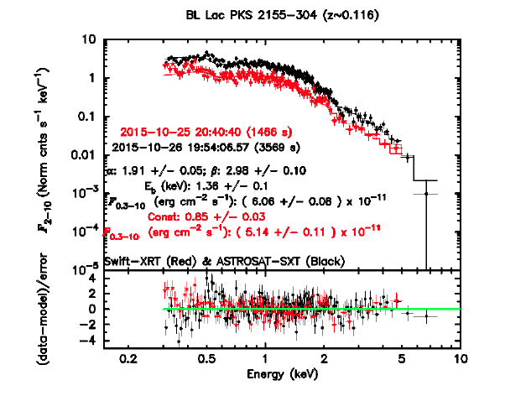
SXT & Swift XRT: Near Simultaneous Observations - another comparison
Swift: Oct. 25, 20:40:40 (1466 s)
SXT: Oct 26, 19:54:08.57 (3569 s)
Astrosat SXT
Swift XRT
Model: wabs*bknpow + cons*wabs*bknpow
Courtesy:
S. Chandra

Slide 21
1ES1959+650 (z~0.048):
Blazar – A target of opportunity
Comparison with the Swift XRT data (observed 4 days before & 4 days after SXT
SXT: 2015-11-20T05:28:58 & exp 2084s
XRT: 2015-11-16T23:25:37 & exp 990s
SXT: 2015-11-20T05:28:58 & exp 2084s
XRT: 2015-11-24T21:24:05 & exp 984s

Slide 22
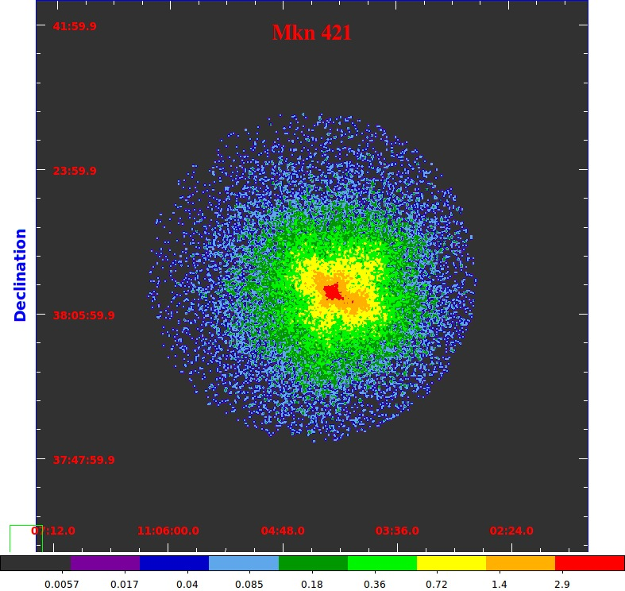
BL Lac: Mkn 421

Slide 23
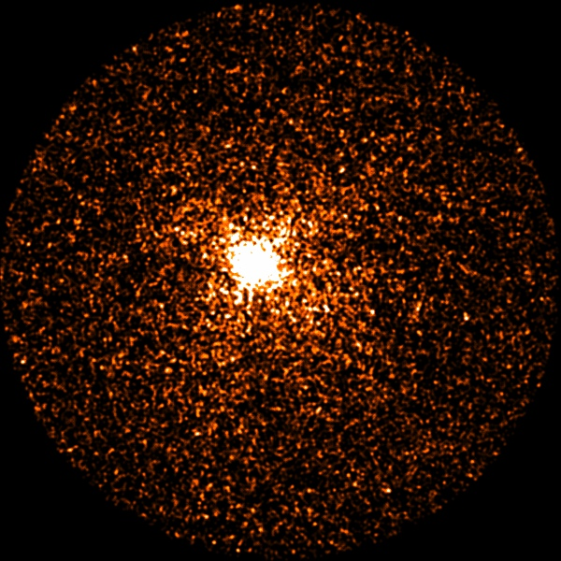
Swift 1854-78 (Seyfert Galaxy) 32179s exposure SXT image
ESO 25-2
z= 0.0293
A very weak soft X-ray source with count rate of ~0.2 – 0.4 per sec in SXT
Integral/IBIS Source
detected in 20-100 keV
Also in FIR Catalog
Observed along the UVIT axis by the UVIT Team
Courtesy: S. Kotak, N. Kamble

Slide 24
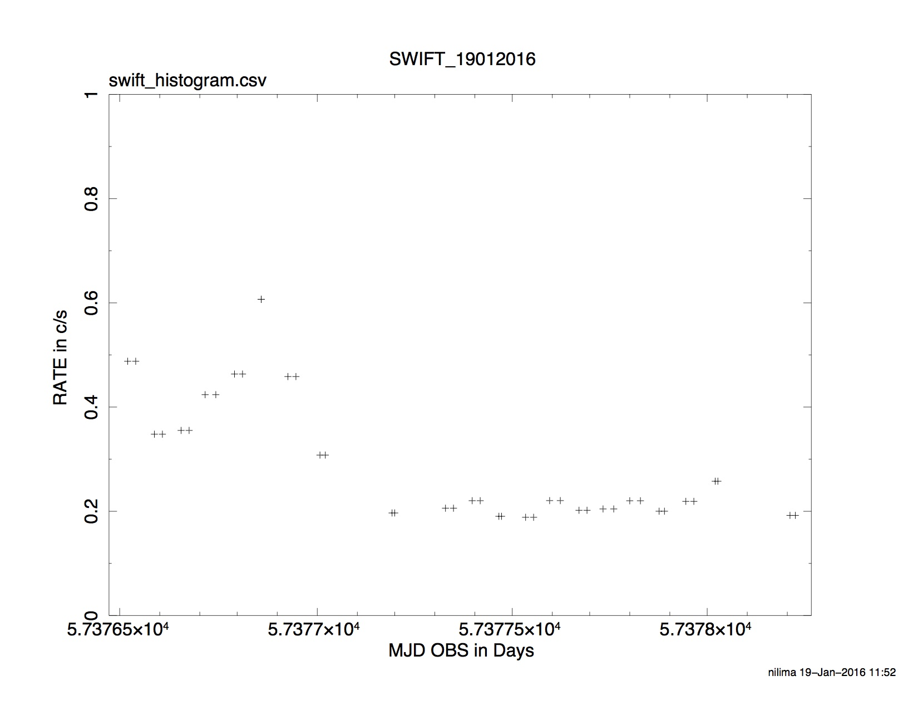
Swift 1854-785: SXT Light Curve

Slide 25
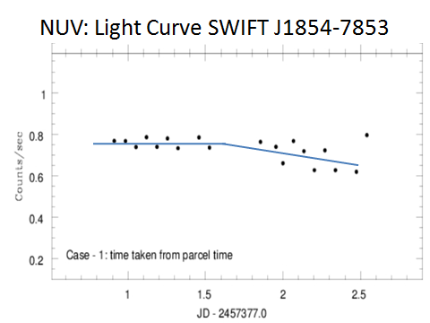
Swift 1854-7854 – AstroSat NUV Light Curve
Courtesy:
UVIT Team

Slide 26
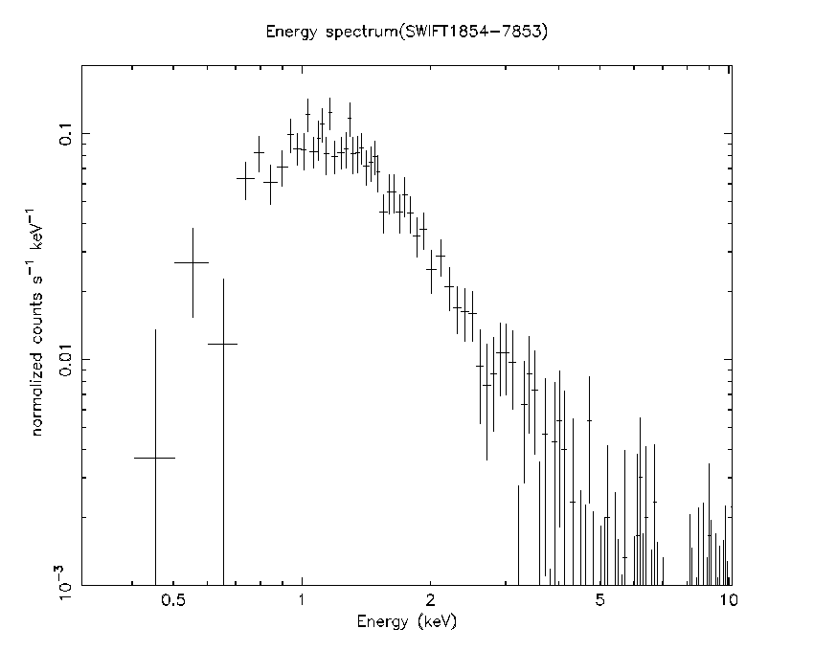
Swift 1854-78 (Seyfert Galaxy) 32179s exposure along with UVIT: z= 0.0293
Log N_{H} = 20.92
Without background subtraction

Slide 27
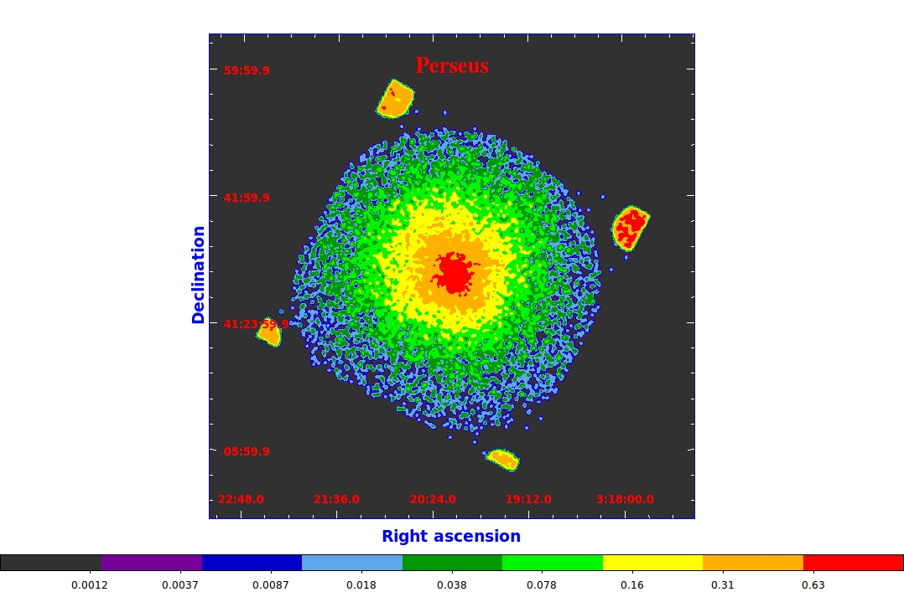
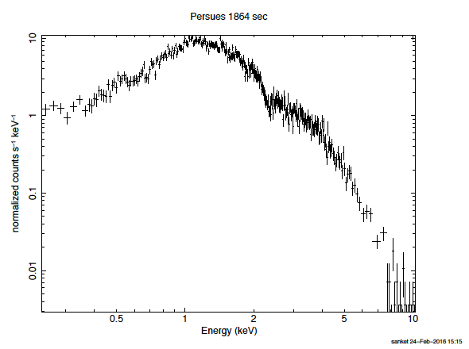
Clusters of galaxies with SXT: Perseus (1864 s from one orbit)
Other clusters observed as SXT targets:
  AWM7
  PKS0745-19
  A1795
  A496

Slide 28
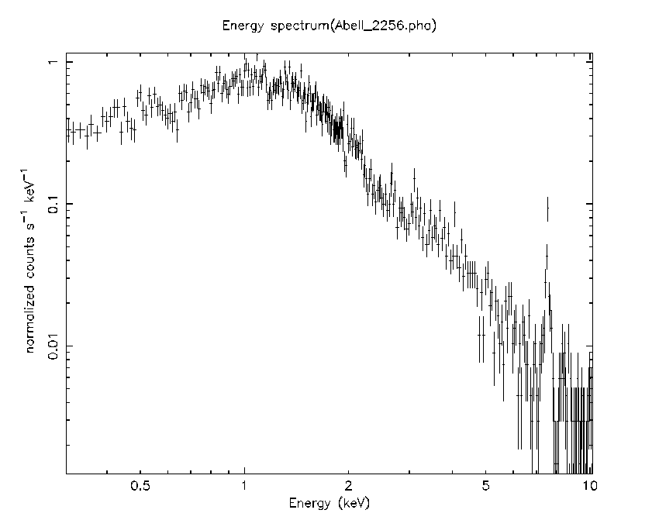
Clusters of galaxies: exposure time with SXT: 9000 s
LAXPC Target: Abell 2256
Z=0.058
250 Mpc
(800 M Ly)
Size ~ 25’
Hot (7 keV) plasma with only 0.2 solar
Abundance of elements
Background not subtracted
Line - seen post-launch;

Slide 29
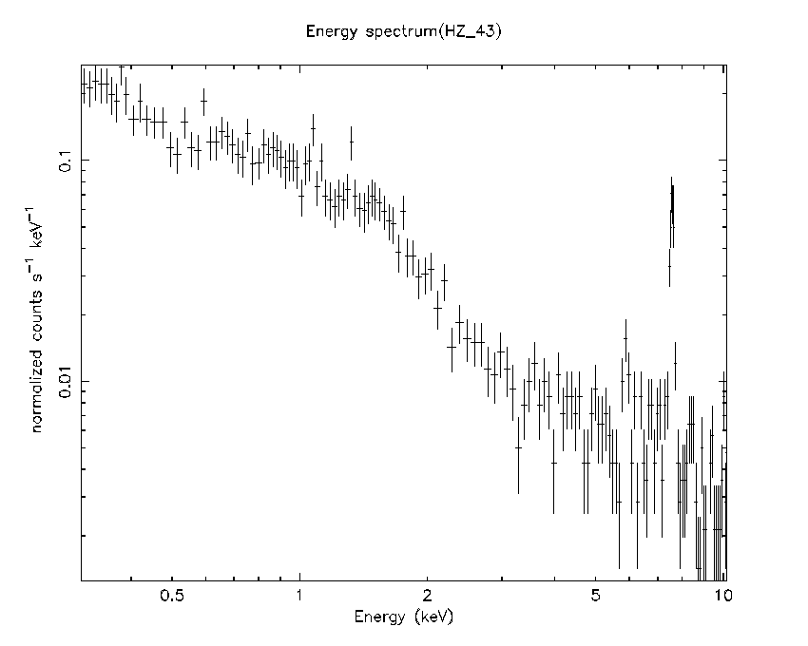
White Dwarf calibrator with SXT
HZ 43
SXT Target for 9 orbits: Cumulative spectrum
Also observed
But not detected
in SXT :
GD153
GD419 (UVIT)
Courtesy: S. Kotak

Slide 30
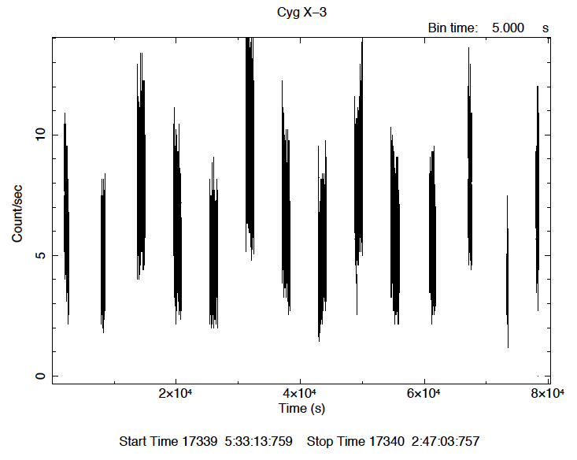
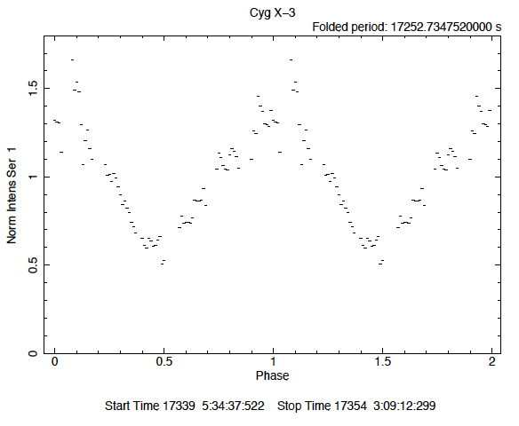
Cyg X-3: SXT Observation for the CZTI target
P= 4.79242631 hrs
or
0.19968443 d
Courtesy:
Y. Bhargava and AR Rao

Slide 31
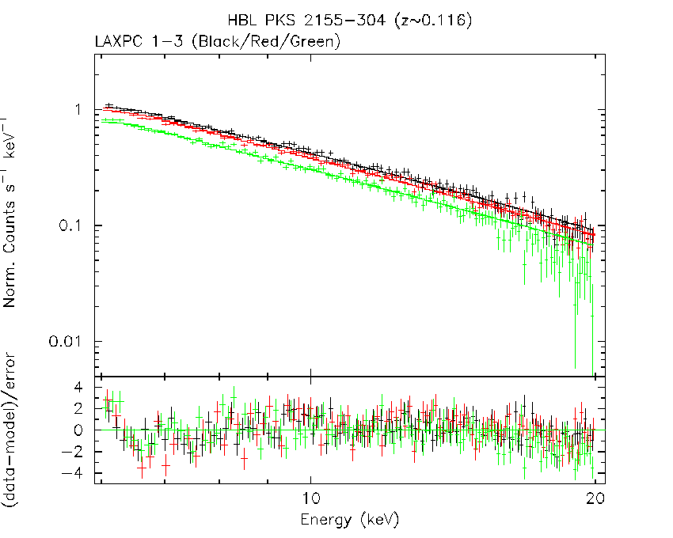
PKS 2155-304 (z~0.116) — LAXPC
with multiplication of variable constant
Model: C1*PL + C2*PL + C3*PL
Γ= 2.28+/- 0.015
C1= 1.0 fixed
C2= 0.9 +/- 0.009
C3= 0.74 +/- 0.008
χ²_{ν}=1.56
dof: 340
Courtesy:
LAXPC Team
V. Chitnis
S. Chandra

Slide 32
PKS 2155-304 (z~0.116) — LAXPC
Adding Bremss (40 keV) for CXB
Model: (PL+Br) + C1*(PL+Br) + C2*(PL+Br)
Γ= 2.9 (fixe)
C1= 1.0 fixed
C2= 0.9 +/- 0.009
C3= 0.74 +/- 0.008
χ²_{ν}=1.63
dof: 339
Courtesy:
LAXPC Team,
V. Chitnis, &
S. Chandra

Slide 33
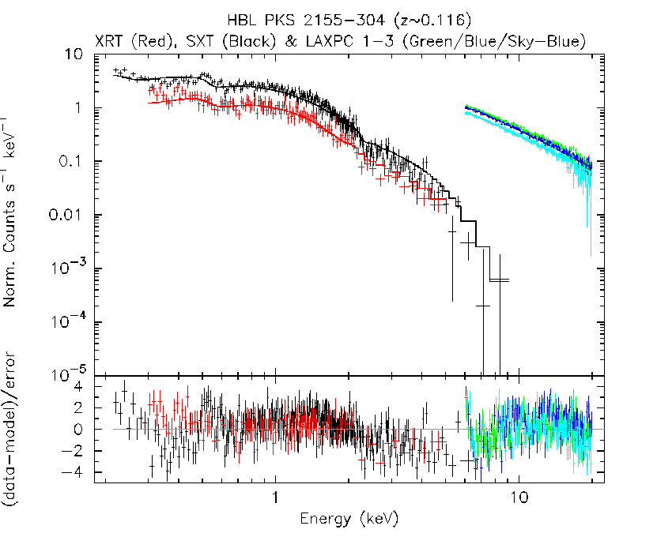
PKS 2155-304 (z~0.116)
Swift-SXT-LAXPC Combined Fit
Model: (SXT) bknpow
+ (XRT) c*(bknpow)
+(LAXPC) c*(bknpow)
Fitting LAXPC band 6 - 20 keV
N_{H}= 1.41x10²⁰ fixed
Γ1=1.93 +/- 0.07
BreakE= 0.81 +/- 0.09
Γ2= 2.33 +/- 0.01
(SXT) C1=1.0 fixed
(XRT) C2= 0.80 +/- 0.03
(LX1) C3=2.09 +/- 0.07
(LX2) C4=1.88 +/- 0.06
(LX3) C5=1.53 +/- 0.05
Χ²_{ν}=1.74; dof: 702
Courtesy:
LAXPC Team,
V. Chitnis, &
S. Chandra

Slide 34
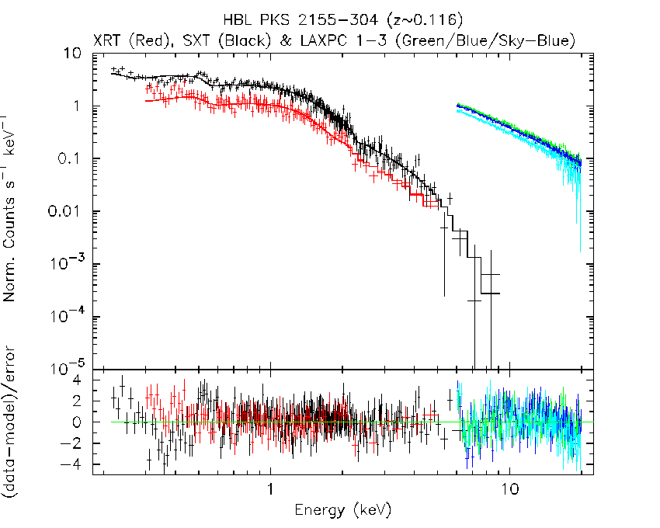
Model: (SXT) (bknpow + Bremss) +(XRT) cons*(bknpow+ Bremss)
+ (LAXPC) cons*(bknpow+ Bremss)
PKS 2155-304 (z~0.116)
Swift-SXT-LAXPC Combined Fit with 40 keV Bremss for CXB
Fitting LAXPC band 6 - 20 keV
N_{H}= 1.41X10²⁰ fixed
Γ1=1.96 +/- 0.07
BreakE= 1.32 +/- 0.1
Γ2= 2.82 +/- 0.08
Bremss Norm =
(1.19 +/- 0.08)x10⁻³ (LAXPC)
(SXT) C1=1.0 fixed
(XRT) C2= 0.80 +/- 0.03
(LX1) C3=2.64 +/- 0.17
(LX2) C4=2.38 +/- 0.15
(LX3) C5=1.94 +/- 0.14
Χ²_{ν}=1.48; dof: 701
Courtesy: LAXPC Team,
V. Chitnis & S. Chandra

Slide 35
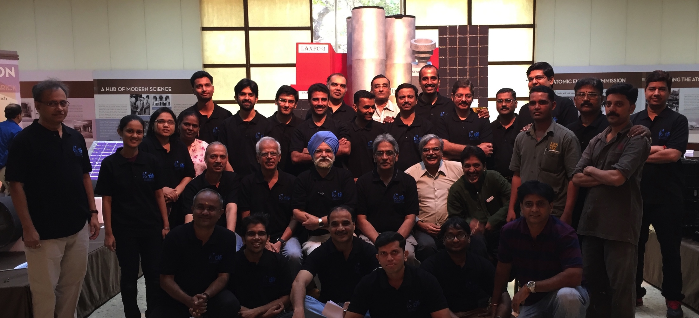
TIFR Team for X-ray instruments
Thanks !
Several colleagues at TIFR, Mumbai; IIA, Bangalore, IUCAA), Pune
Canadian Space Agency, University of Leicester, UK
ISRO Satellite Centre (ISAC), Bangalore,
Vikram Sarabhai Space Centre, Trivandrum,
Space Applications Centre, Ahmedabad
Raman Research Institute, Bangalore & Physical Research Laboratory, Ahmedabad

Slide 36
Readout Modes of the CCD
Photon Counting Mode (PC), [The Default Mode - includes the calibration sources]
Photon Counting Window Mode (PCW) – 5 pre-defined windows recommended
Fast/Timing Mode (FM),
Bias Map Mode (BM), and
Calibration Mode (CM).
X-ray spectral information available in all the modes.
Time resolution in the PC, PCW, CM modes is 2.4 s, and 0.278 s in the FM mode.
FM reads only the central 150 x 150 pixels of the CCD.
For observing very strong cosmic sources, the PCW mode should be used to avoid pile-up followed by the Calibration mode where four small windows (each of size=80 x 80 pixels) covering only the corners are used for the corner radioactive sources in the CM. ( A central 100x100 window is also used in the CM).

Slide 37
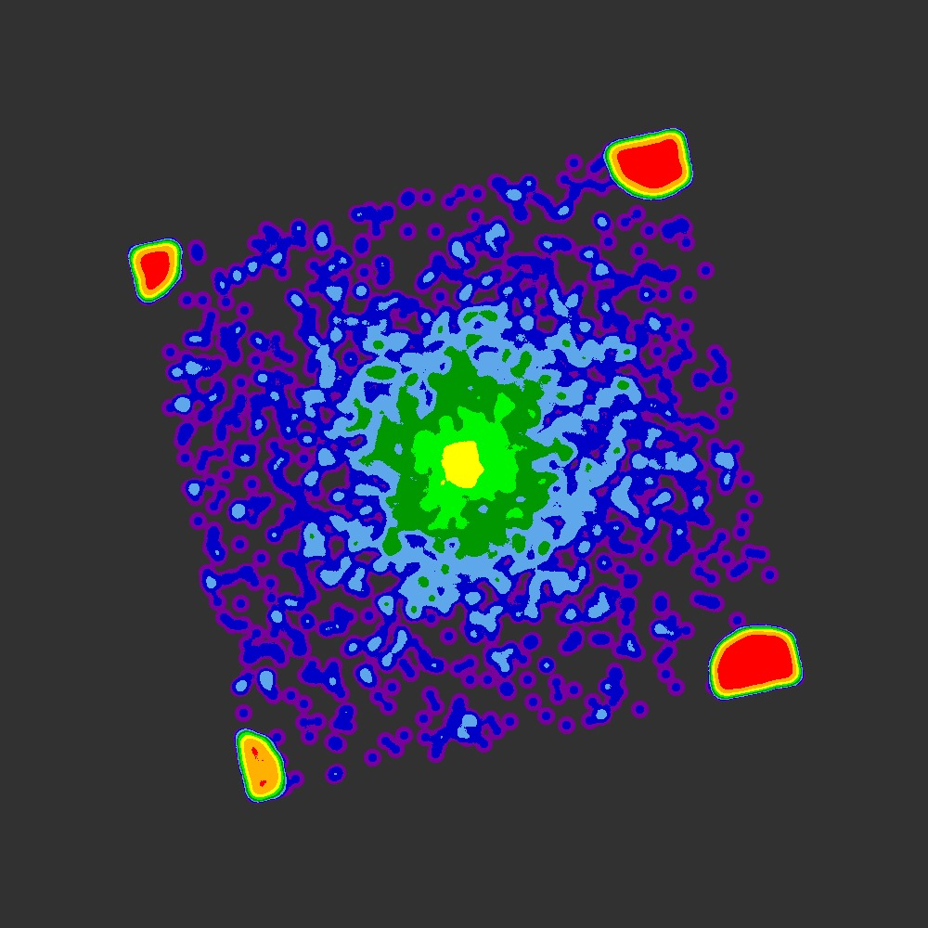
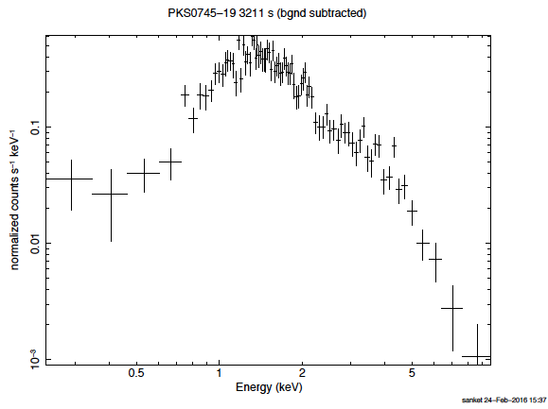
Clusters of galaxies with SXT: PKS0745-19 (3211 s)

Slide 38
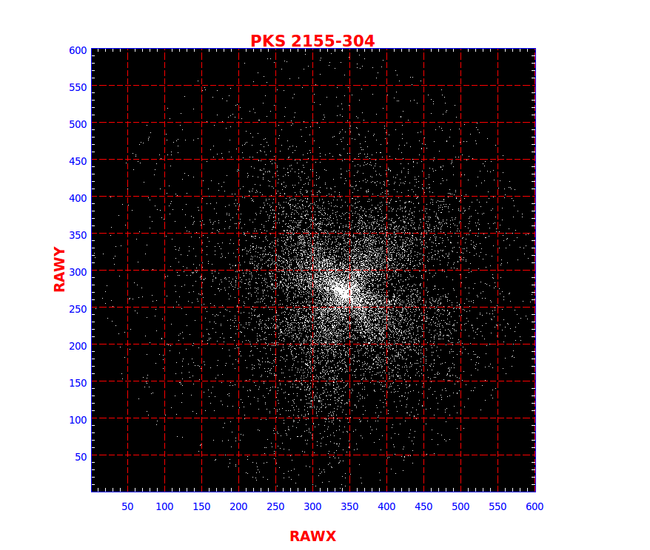
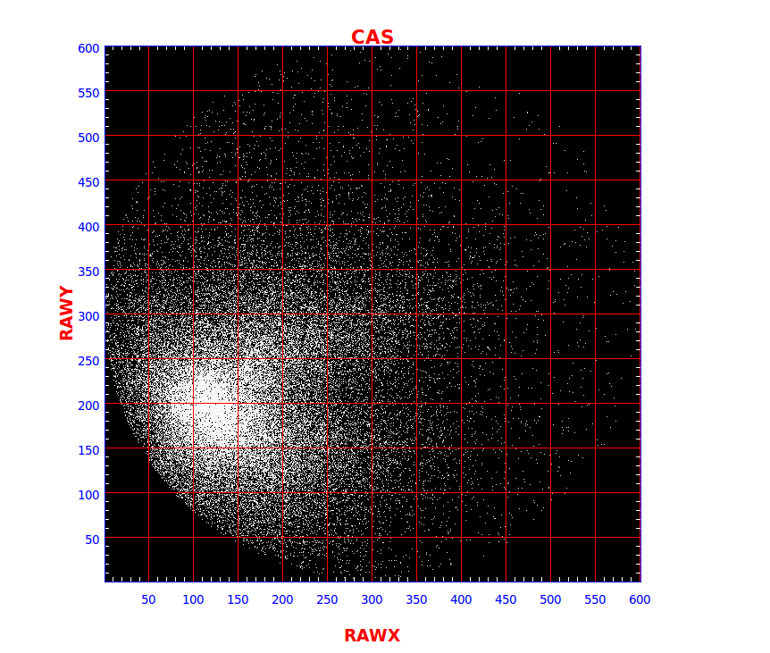
SXT vs LAXPC (UVIT?)
Measured Pointing diff of ~15 arcmins before UVIT ON (Nov.) and ~8 arcmins after (on Dec 29th) !

