Slide 1

Challenges for
High-Resolution Spectral Analysis
Randall Smith
Smithsonian Astrophysical Observatory

Slide 2
Whither XSPEC – Some slides from Keith Arnaud

Slide 3
Thoughts from Knox Long

Slide 4
Thoughts from Frits Paerels

Slide 5
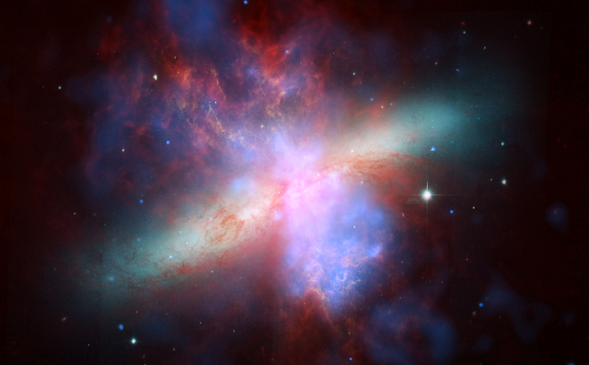
Spectral Analysis: A Use Case with XSPEC
M82 X-rays:
Pure winds?Charge Exchange? Recombination? something else?
Liu et al (2011) found that the RGS data shows odd Ne IX ratios.
What will the SXS say?

Slide 6
Spectral Analysis: A Use Case with XSPEC
A simulated spectrum fit with a single temperature thermal model; poor fit but why?
(10,000 count spectrum)
With two thermal components, no major complexes ‘missing’ but ratios are still all wrong.

Slide 7
Spectral Analysis: A Use Case with XSPEC
Zoom in to the OVII and O VIII bandpass and the problems with the 2-T fit are clear.
Issues:
Where is the continuum?
What lines are these?
Should I include the line at 0.7 keV?
Should I label the feature at 0.63 keV one line or a blend?

Slide 8
Spectral Analysis: A Use Case with XSPEC
We will be photon limited and line dominated.
  Continuum measurements are key
Line (& blend) ID is not a one-pass procedure.
  Must automate repeated analysis
  Most analysis will be on sub-ranges
Results must be confirmable with known tools.
Issues:
Where is the continuum?
What lines are these?
Should I include the line at 0.7 keV?
Should I label the feature at 0.63 keV one line or a blend?

Slide 9
Key Points for Analysis Software
Efficiency of analysis is essential
  Spectroscopy documentation needed, not sufficient.
  Analysis that can in theory be done is not enough
    It must be doable in finite time.
  Analysis should be straightforward for all users, beginner to expert
  Examples tools exist but no “silver bullets.”
Must build on existing tools (XSPEC/SPEX/ISIS/Sherpa)
  pyXSPEC works (and is very useful! Try it!)
  We’ll want to use parallelism…

Slide 10
Profit – an existence proof

Slide 11
Profit – What’s missing?
A ‘log’ of actions and results
  How did a given analysis session lead to a specific result?
Connections between fits & database
  If this line is Fe XVII, what else does that imply?
Limited built-in mathematical abilities
  Need existing fitting tools & models: XSPEC/Sherpa
Fixed capabilities
  Must be expandable – probably via python.
  Can leave complexity for future scripting
(and it’s a total disaster in choice of name)

Slide 12
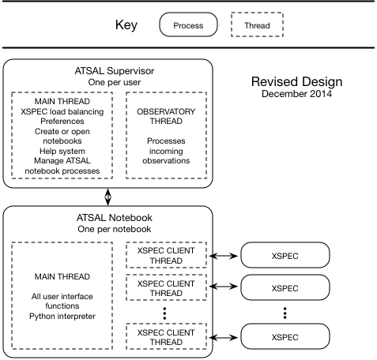
ATSAL: Attempt #2
ATSAL looks like a single ‘monolithic’ application to users, with an interface similar to that of IGOR or Mathematica, both in visual appearance and programmability.

Slide 13
Parallelism
Original plan was to allow modifications to user interface while XSPEC was busy, but this could lead to crashes, so executing notebooks cannot be edited
Multiple process approach means only executing notebooks are locked, so users are free to work on other notebooks
Multiple XSPECs may be busy at the same time, on the same or different notebooks

Slide 14
ATSAL in practice
Roll Tape
Notes:
Python code entered into a Python tool is executed during each refresh cycle. These tools might summarize results, perform custom fits, prompt for input, etc. Code in Python tools is usually short, but may access other Python components.

Slide 15
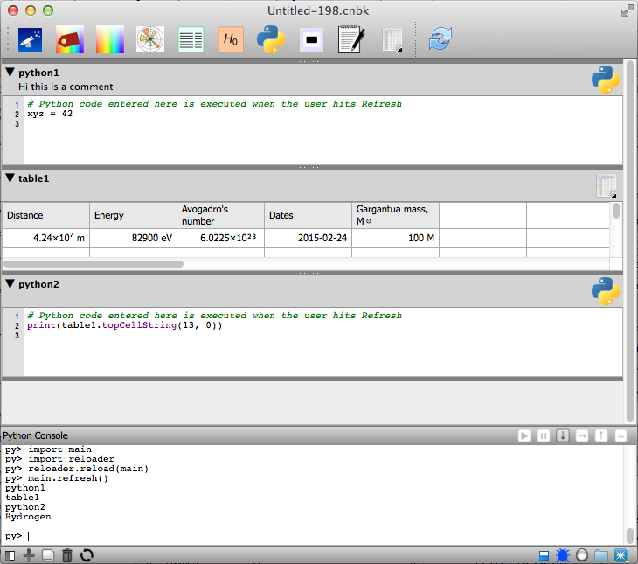
ATSAL & Python

Slide 16
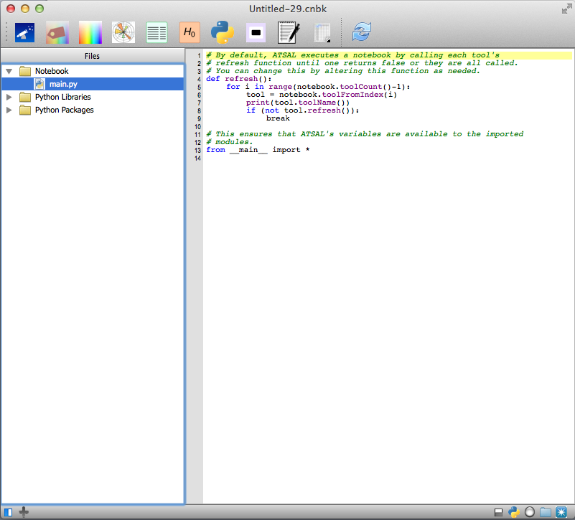
The Python Main
Notes:
The Refresh button causes a refresh message to be sent to each tool in succession. Main.py, created by ATSAL, loops through all the tools and calls each tool’s refresh(). Users can override this default by modifying this file. Users may also add files and folders to the notebook as needed. These files may be Python source code, docs, or other files that should be associated with the notebook.

Slide 17
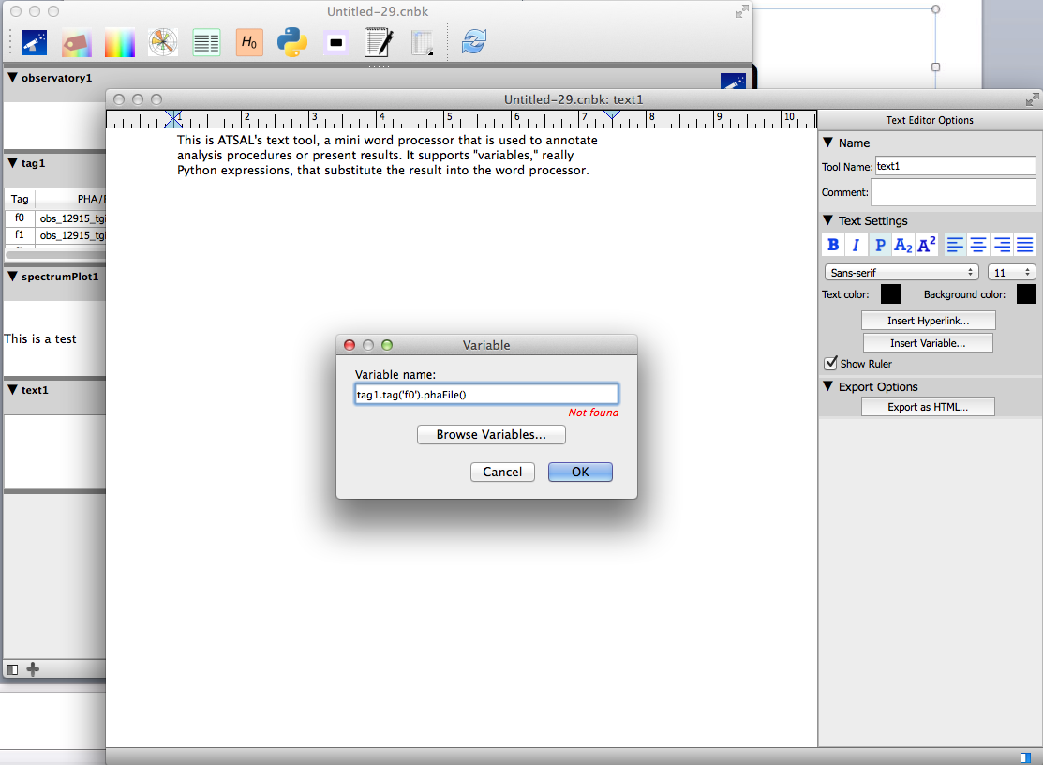
Variable Substitution
Notes:
Here, the user is substituting the name of the PHA file associated with tag “f0”. (It says “Not found” because the symbol is not yet present in the symbol table.)

Slide 18
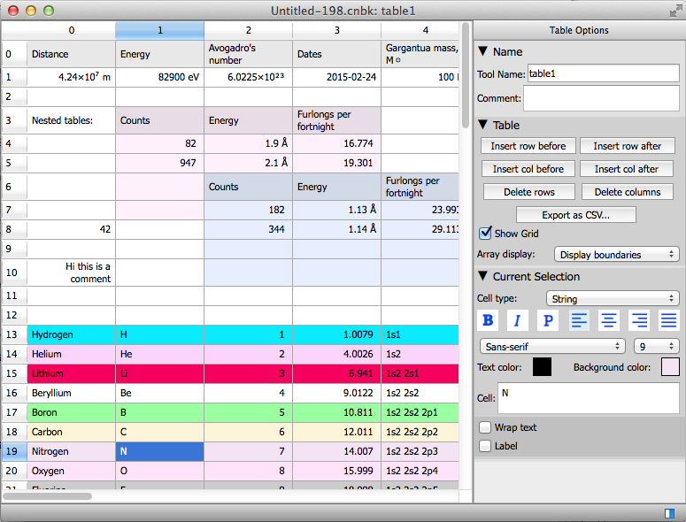
ATSAL & Table Display

Slide 19
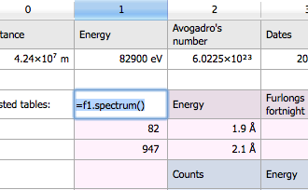
ATSAL & Tables w/Python

Slide 20
ATSAL is not
Just a fitting tool or math package. These exist (XSPEC, Sherpa, etc) and are reused.
Just a user-friendly UI front-end. The GUI is a necessary part of the larger integration.
A one-size-fits-all solution. ATSAL will provide a base that will be expanded by users via Python.

Slide 21
Python in ATSAL
Inconspicuous (but powerful)
  User-familiarity with Python is not required for ATSAL analysis
Basic spreadsheet-style functions
  Text and table tools can display Python variables and function results
The Python tool: supplies a bit of “glue” between tools
Python main: controls the refresh loop, can be changed as needed
  Add Python files to the notebook for notebook-specific extensions
  Create libraries that are shared across multiple notebooks
  Use packages like Matplotlib and Numpy, included with ATSAL
  Incorporate packages from the Python user community
Access Qt’s user interface, database, web, etc. to extend ATSAL
Can use XSPEC’s Python to access XSPEC directly

Slide 22
Conclusions (sort of)
We have many needs:
  More models, especially flexible ones
  Atomic data, especially in user- and computer-accessible formats
  A range of tools, from simple to complex, to manipulate observed spectra and make connections to models & atomic data
Addressing these will take time

Slide 23
Conclusions (sort of)
Fitting tools will still be XSPEC & SPEX, with some ISIS & Sherpa usage.
Python is the more-or-less accepted scripting language for astronomy & HEASARC
Choice of atomic database can be left to user decision; issue is access to models & data
ATSAL would enable complex fits & access to atomic data via scripting with XSPEC interface

Slide 24
Backup

Slide 25
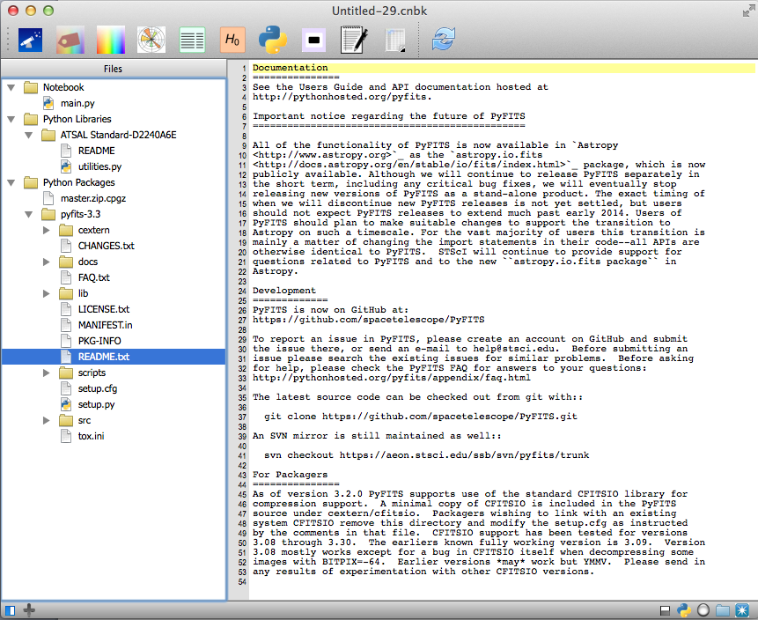
Python Packages
Notes:
Python packages are available from the PyPI site. When downloaded, they are installed into ATSAL’s sandboxed Python for readonly use. (Advanced users can copy a Python package into the library folder for customization, if needed.)

Slide 26
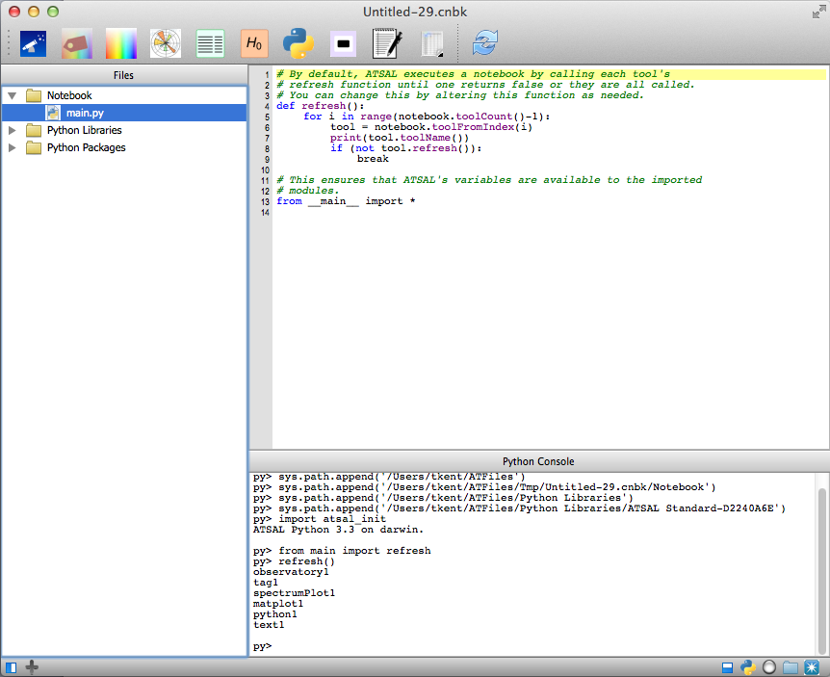
The Python Console
Notes:
This optional pane shows output from Python programs and errors. It is useful when debugging. In this example, the refresh loop prints the name of each tool as it calls its refresh function.

Slide 27
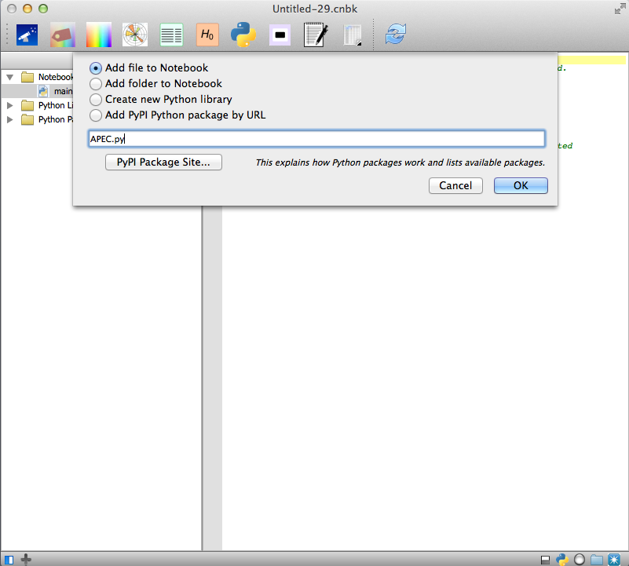
Adding Files
Notes:
Since files in this folder are stored inside the notebook, they are included when the notebook is given to another user.

Slide 28
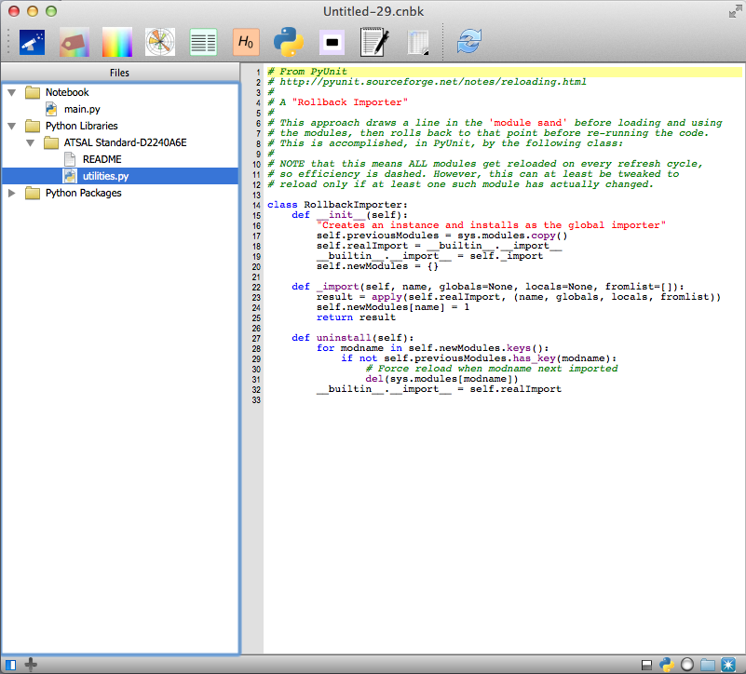
Python Libraries
Notes:
A library is defined here as a folder containing a group of related files. Each library has a UUID (universal unique identifier) to avoid conflicts. Libraries are shared, available to all notebooks. They are not saved with the notebook. However, when exporting an archive, they are included.

Slide 29
PythonQt
Chosen over PySide and PyQt
Allows access to Qt class library
  Comprehensive user interface tools
  3D and Postscript graphics
  Database
  Web browser
  Much more

Slide 30
XSPEC Python
ATSAL’s Python cannot directly access XSPEC, but XSPEC has its own Python
If you need access to XSPEC internals, use XSPEC’s Python instead

Slide 31
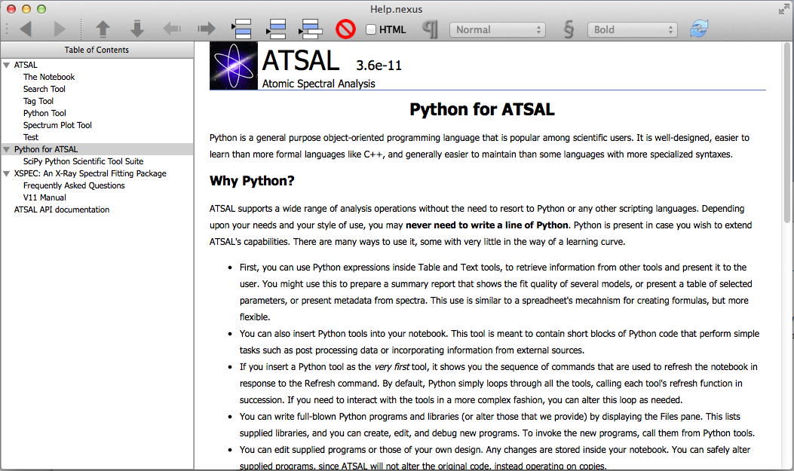
Help
Notes:
Online help is included with ATSAL. The help window is shown in the edit mode used to create the help. API documentation is generated by Doxygen.

