Slide 1
Absolute Crab Flux
Kristin K Madsen, IACHEC 2017

Slide 2
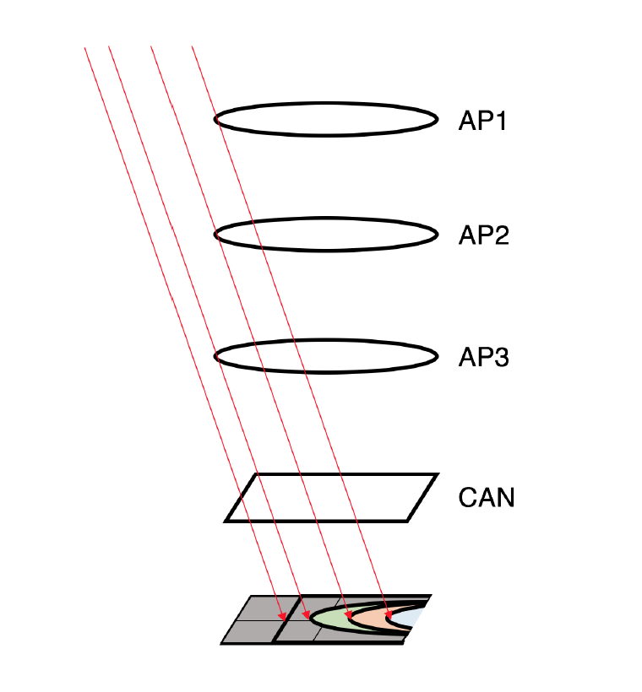
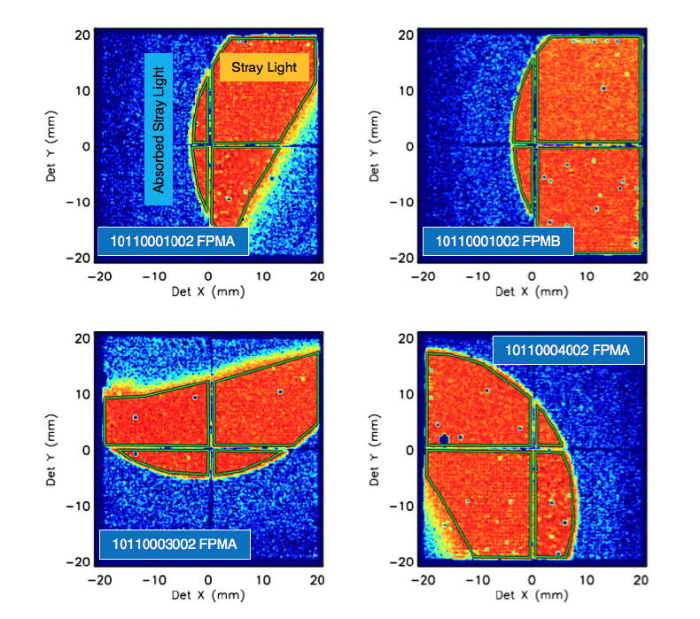
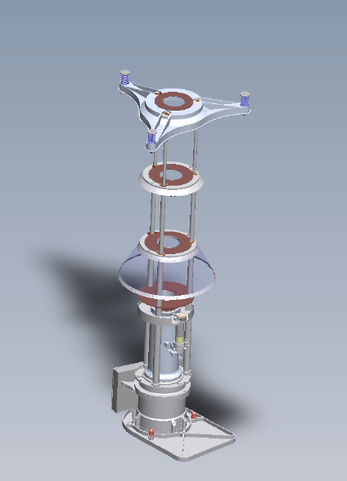
NuSTAR stray light observations
Paper submitted and accepted in ApJ.

Slide 3
Response
Area on detector (1%)
Be window (1%)
100 m with a throughput of 92% at 5 keV and 98% at 10 keV.
RMF (1%)
  98% between 4 - 40 keV and understood to < 1%

Slide 4
Spectrum
Nuabs * Tbabs * powerlaw
N_{H}=2.2 x 10²¹ cm⁻²
  At 4 keV the absorption of this column is 1% and if the column was increased to 4 x 10²¹ cm⁻² the absorption at 4 keV would be 2%.
  With the best fit detector absorption parameters frozen, N_{H} has for these observations a 90% confidence limit of 1.1 x 10²¹ cm⁻² .
Nuabs is fitted. It is somewhat degenerate with N_{H.}

Slide 5
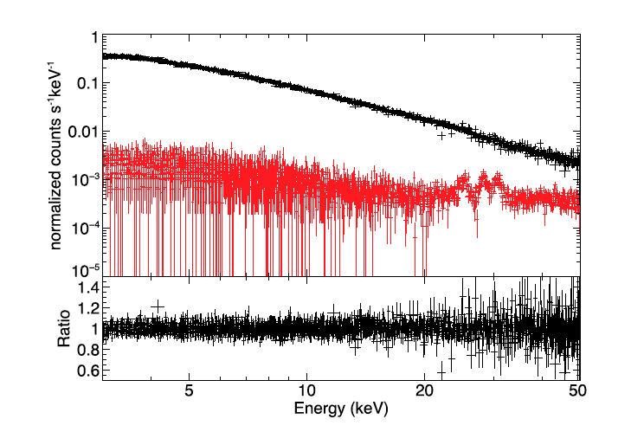
Stray light spectrum

Slide 6
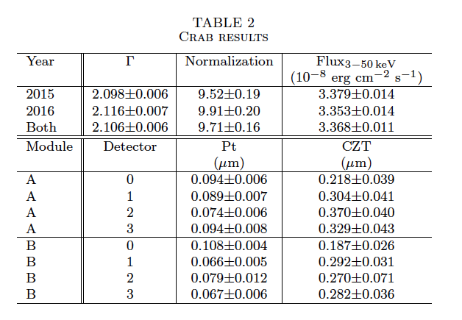
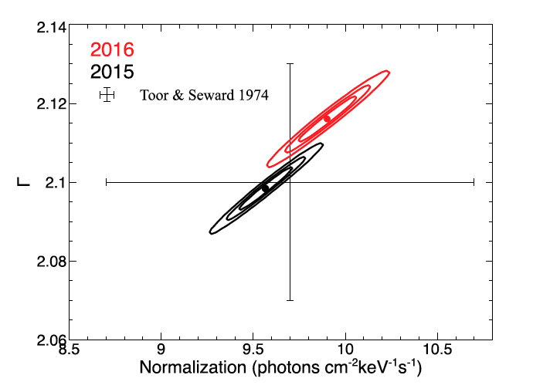
Results

Slide 7
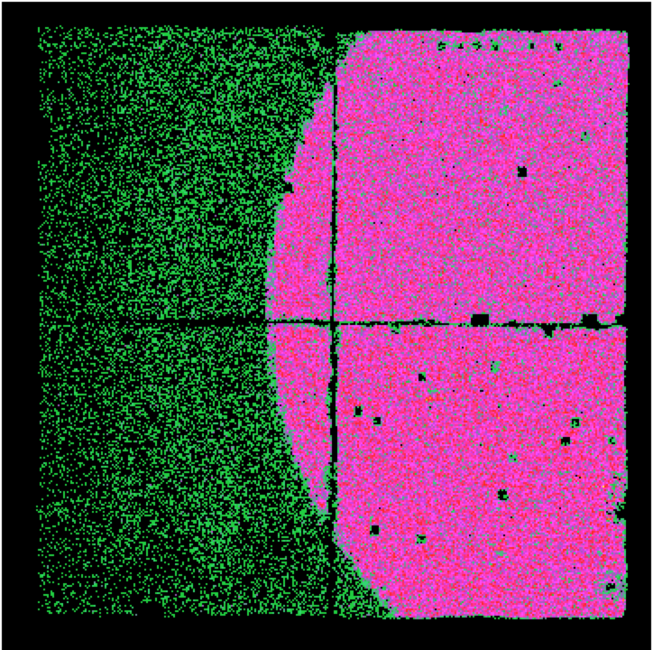
Proposal for monthly campaign
One observation a month for:
  20 ks SL observation (science, calibration)
  10-20 ks background observation
  10 ks focused observation (calibration)
Aim is to get:
  Measure 2% flux variations
  Get accurate snap shot spectra

Slide 8
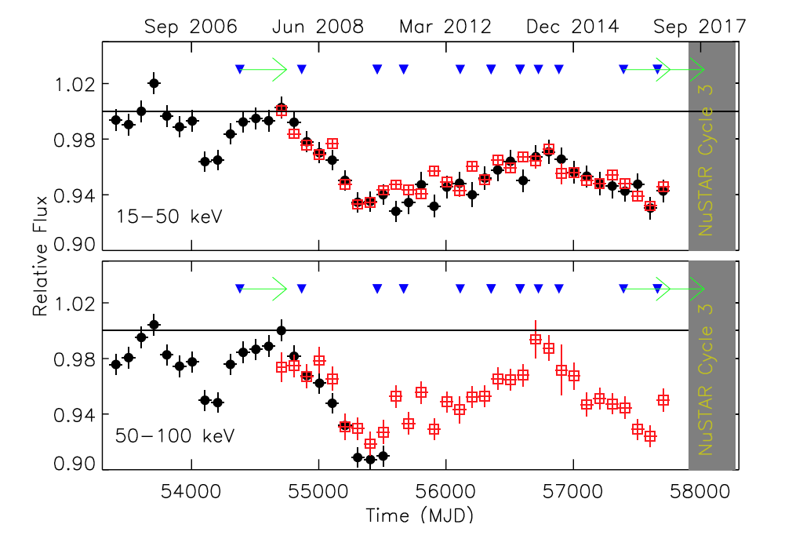
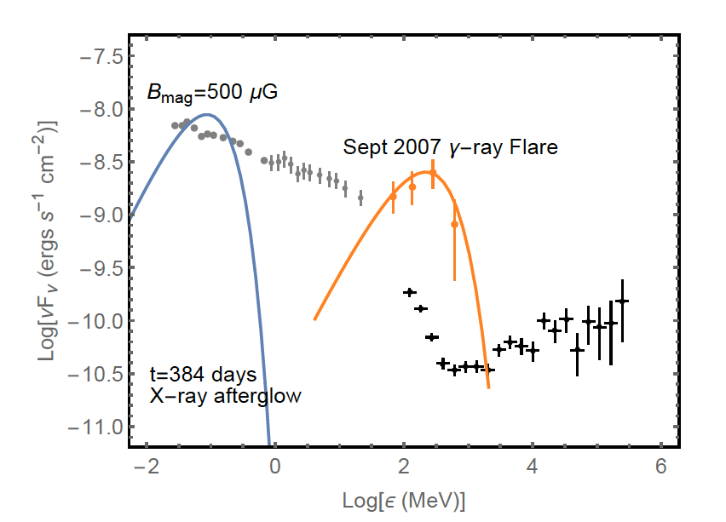
Scientific motivation

Slide 9
Predicted Spectrum

