Slide 1
Preliminary in-orbit observation results and calibration of POLAR
Jianchao SUN
Institute of High Energy Physics, CAS
On behalf of the POLAR collaboration

Slide 2
Outline
Overview of POLAR
Science of POLAR
Preliminary in-orbit calibrations
Preliminary in-orbit observation results
Summary and Outlook

Slide 3
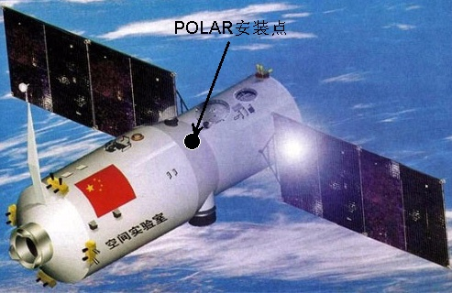
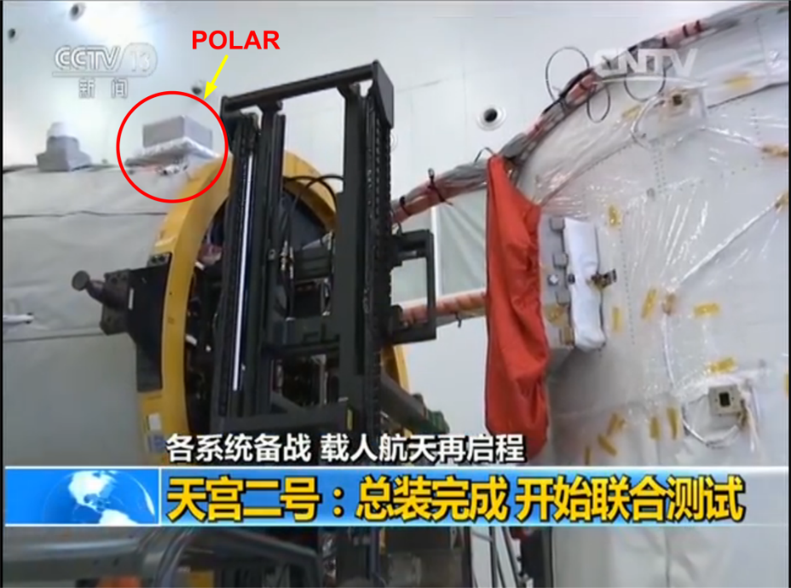
1. Overview of POLAR
Main scientific goals
  Measure the polarization of the GRB prompt emissions as well as Solar flare emissions, to confirm or restrict the radiation mechanism model
  In 2 years of flight lifetime, be able to measure ~ 100 GRBs, contributing to the largest GRB prompt emission polarization observation database
  For the GRBs with fluence higher than 3×10⁻⁵ erg cm⁻², the Minimum Detectable Polarization (MDP) of POLAR can be less than 10%
  Launched onboard Chinese Space-Lab “Tiangong-2”on 15th Sep, 2016
Imagined TG-2 model: installation position of POLAR

Slide 4
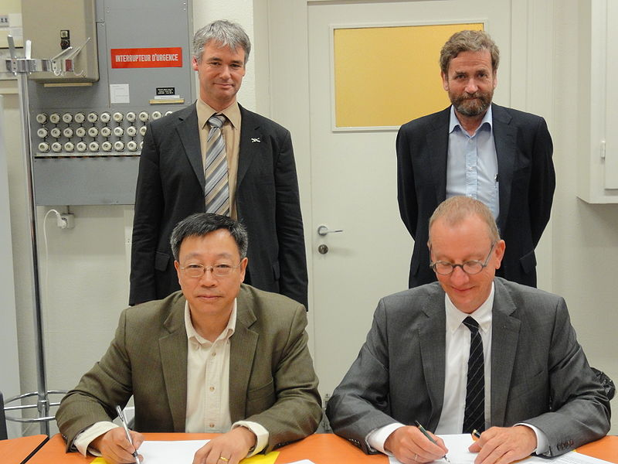









Collaborations of POLAR
Notes:
POLAR is mainly collaborated by China, Switzerland and Poland, the institution includes IHEP, UNIGE, ISDC, PSI, NCBJ, etc. Prof. Shuangnan Zhang (from IHEP) is the PI of China, while Prof. Martin Pohl (from UNIGE) is the PI of Europe.

Slide 5
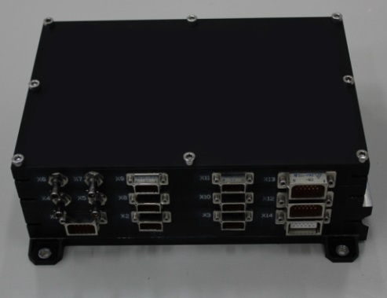
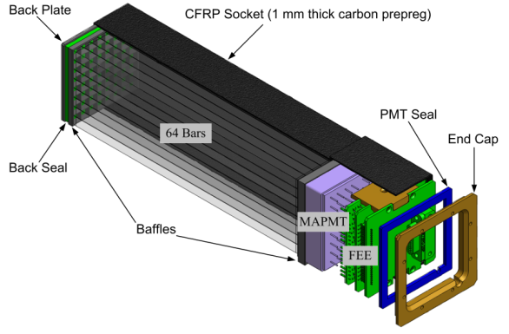
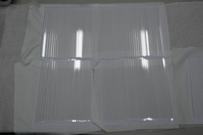
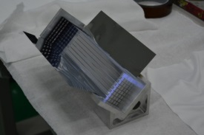
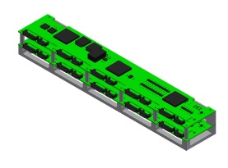
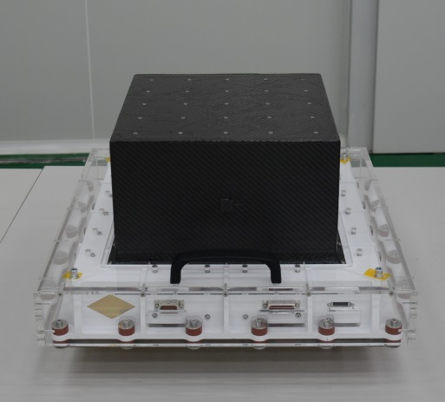
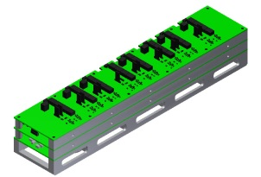
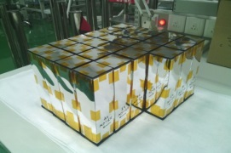
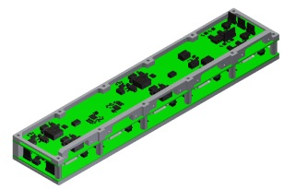
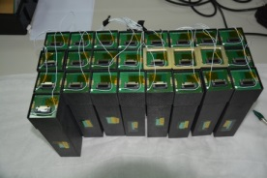
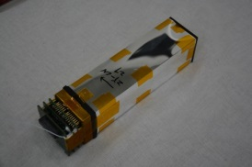
POLAR- detector composition and construction
Detector modular unit
Plastic scintillator bars
Electric cabinet—IBOX
POLAR
Assembly of the PS target
Central trigger
PS targets
Detector—OBOX
HVPS
LVPS
Assembled DMUs
Naked DMU
Notes:
POLAR is composed of IBOX and OBOX. OBOX consists of 25 detector modular units (DMU). Each DMU is composed of 64 plastic scintillator bars, one multi-anode photomultiplier (MAPMT) and one set of front-end electronics (FEE). Other parts of OBOX include the central trigger (CT), high voltage power supply (HVPS) and low voltage power supply (LVPS).

Slide 6
Physics principle
Plastic scintillators
(low Z material)
Notes:
For photons between 50 keV and 500 keV, they mainly interact with the plastic scintillators by Compton effect.

Slide 7
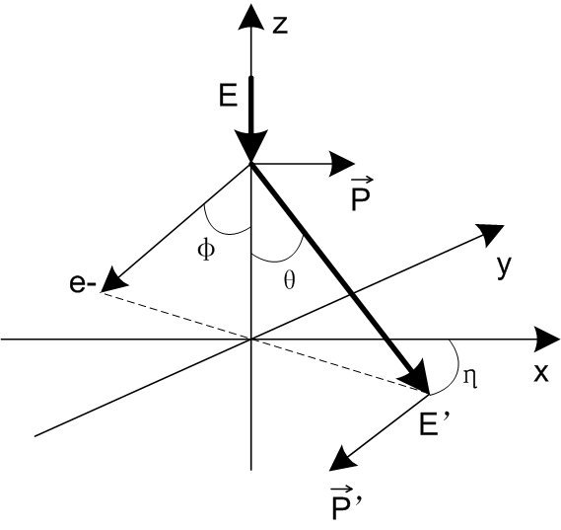
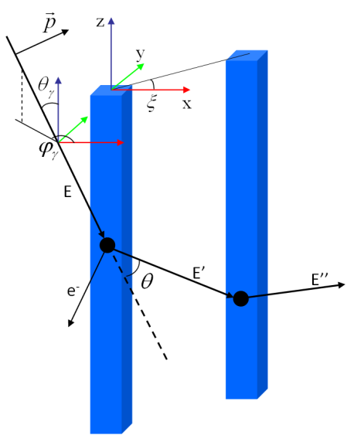
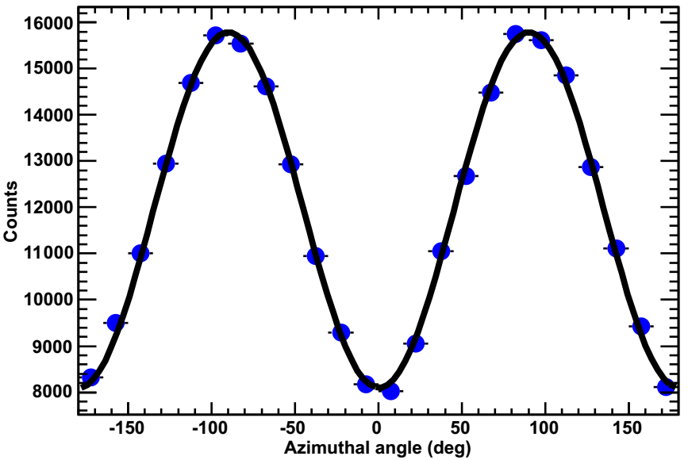
Detection principle of POLAR
Klein-Nishina equation:
Compton Scattering with polarization
Distribution function
Modulation factor
Polarization level
Detection principle of POLAR
Modulation curve
Notes:
The incoming photons will interact with the plastic scintillator bars in POLAR detector. The scattering azimuthal angle of the scattered photons is strongly dependent on the incoming photons’ polarization degree and angle. Therefore, if we can reconstruct the polarization information of the incident photons by measuring the scattering azimuthal angles of the scattered photons. The distribution of the scattering azimuthal angles is called modulation curve. While by fitting the modulation curve, we can get the modulation factor. The final polarization degree is dependent on the modulation factor.

Slide 8
Summary of designed technical performance
1 | Detector material | Plastic scintillator (EJ-248M)
2 | Yearly detectable GRBs | ~50 GRBs/year
3 | GRB localization accuracy | ≤5°(Fluence≥10⁻⁵ erg cm⁻²)
4 | Energy detection range | ～50－500 keV
5 | FOV | ±70°×±70°（~1/3 of the sky）
6 | Modulation factor | 40%@200 keV
7 | MDP | <10％ （Fluence_{total} ≥ 3×10⁻⁵ erg cm⁻²）
8 | Detector geometry area | ~570 cm² (on-axis view)
9 | Mass | OBOX: 27.6 kg, IBOX: 3.52 kg
10 | Dimensions | OBOX: 462×462×268.5 mm³ IBOX: 247×160×85 mm³
11 | Power consumption | ≤80 W
12 | Time accuracy(UTC) | ±1 ms
13 | Reliability | 0.90（in 2 years lifetime）

Slide 9
Mission History
  2006~2010, detector prototype construction phase
  In 2005, POLAR as a concept (N. Produit et al. 2005, NIMA)
  In 2006, POLAR was selected as one of the flight payload candidates of TG-2
  In 2008, POLAR passed the scheme and design review (S. Xiong et al. 2009, NIMA)
  In 2009, first polarization measurement with partially polarized radioactive source and 100% polarized synchrotron radiation (S. Orsi et al. 2011, NIMA; E. Suarez-Garcia, 2010, PhD thesis)
  2011~2013, qualification model construction phase
  Qualification tests (S. Orsi et al. 2014, Proc. of SPIE; J. Sun et al. 2011, Proc. of ICRC)
  In 2011, second polarization measurement with 100% polarized synchrotron radiation (J. Sun, 2012, PhD thesis)
  2013~2015, flight model construction phase
  Acceptance tests
  Performance and calibration tests (J. Sun et al. 2016, Proc. of SPIE)
  In 2015, finish the flight model phase and delivered
  In 2016, launched onboard TG-2 (M. Kole et al. 2016, Proc. of IEEE)

Slide 10
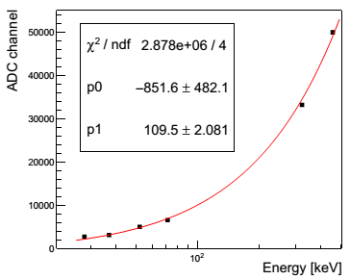
Performance and calibration tests before launch
E-C relation measurement and fitting results
X.F. Zhang, Ph.D. thesis, 2016
Notes:
This is the energy response calibration results on ground before launch with different sources. Where we can find the E-C relation for each channel of the detector.

Slide 11
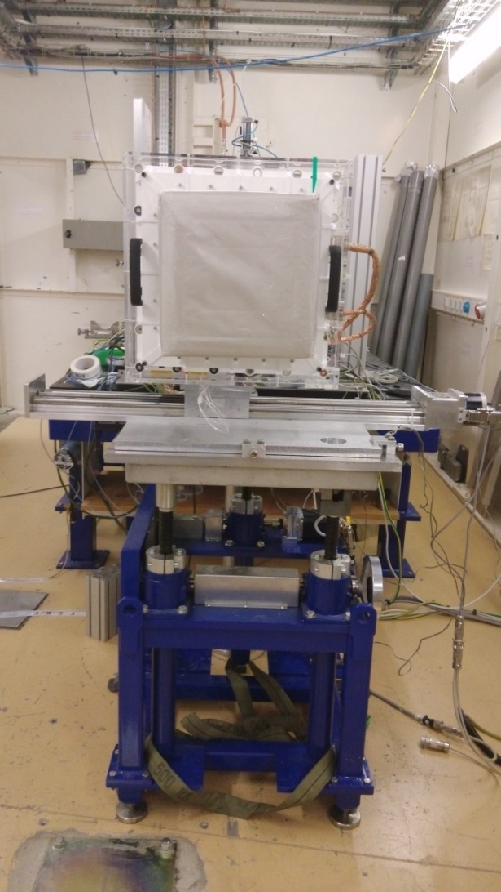
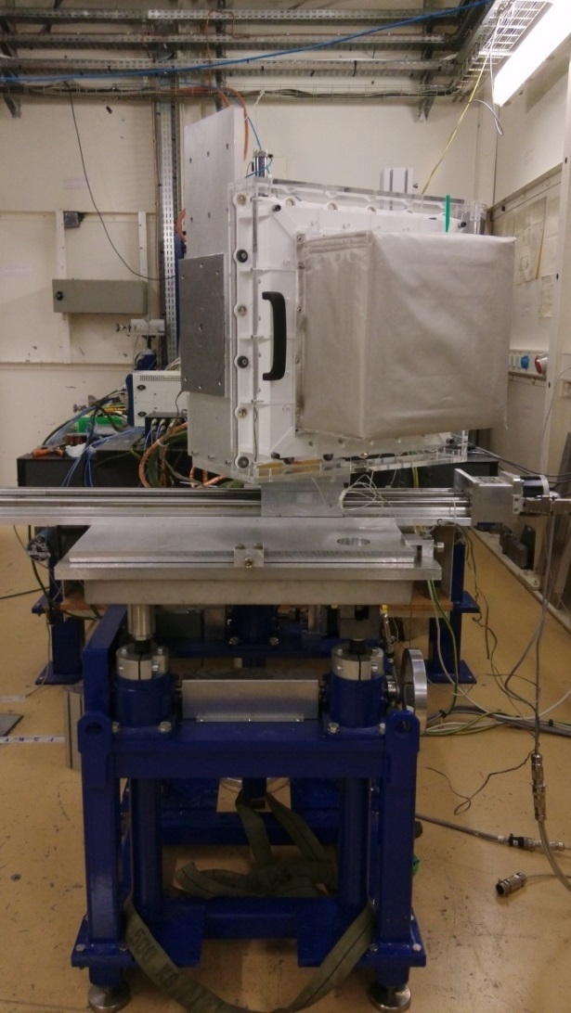
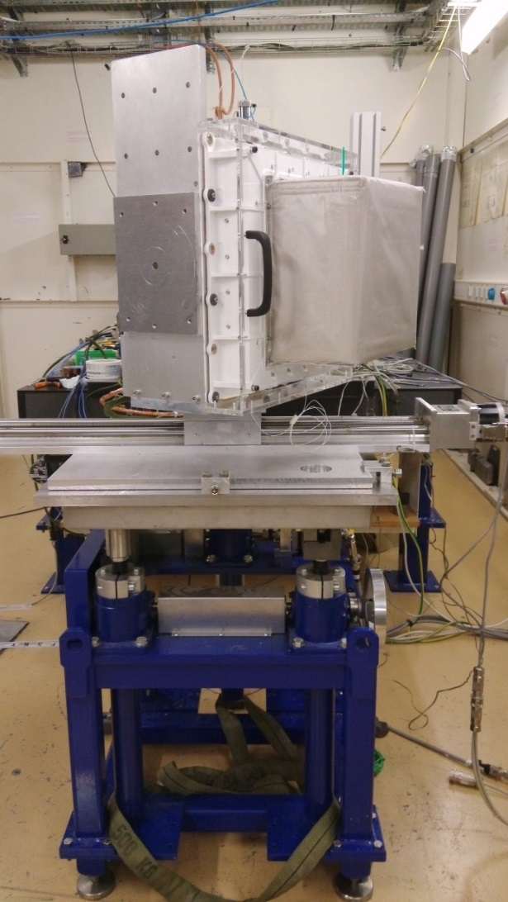
Performance and calibration tests before launch
ESRF 100% polarized beam test in 2015
On axis
30°off axis
60°off axis

Slide 12
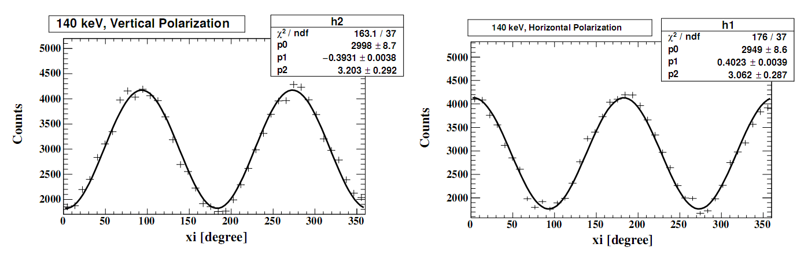
Performance and calibration tests before launch
ESRF beam test in 2015 - modulation factor calculation results
Modulation curve, 140 keV
0°polarized
90°polarized
  140 keV，on-axis measurement
  Modulation factor
      0°polarization：39.31%
      90°polarization：40.23%
      Simulated result: ~40%

Slide 13
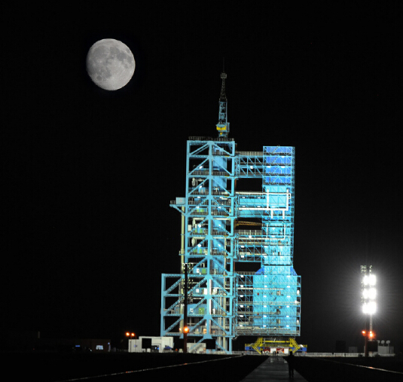
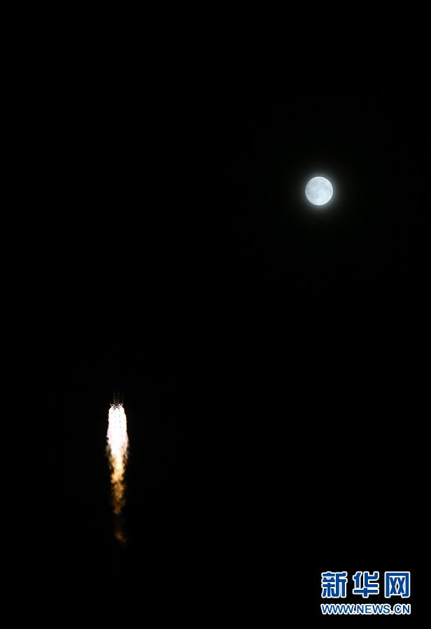
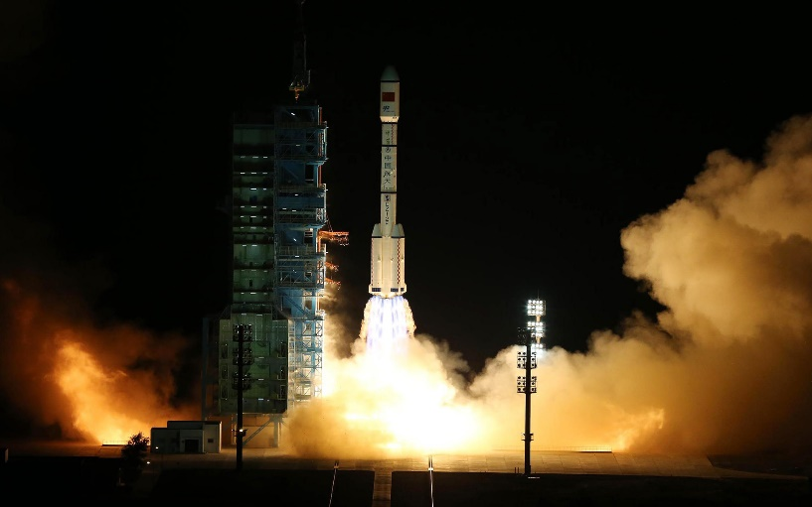
Mission Status
Ready to launch
Fly accompanied with moon
15th Sep, 2016 was the
Chinese Moon Festival
Launching
of TG2
Photos from internet

Slide 14
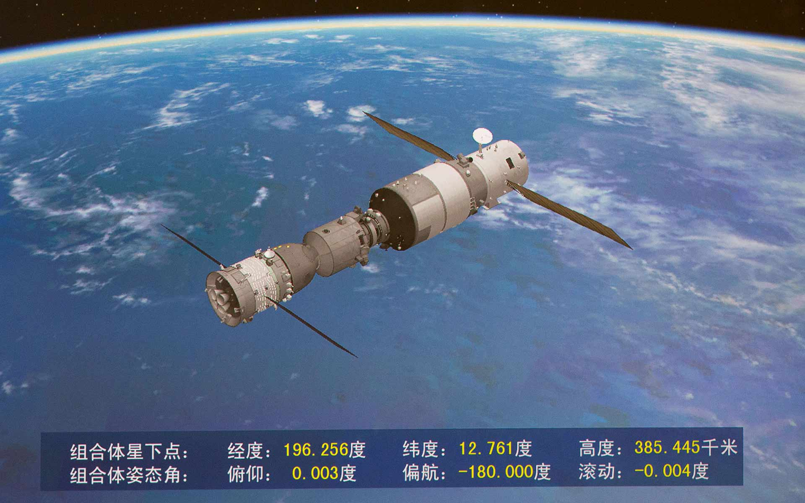

Mission Status
POLAR
TG-2
Shenzhou-11
with astronauts
Docking of TG-2 with Shenzhou-11 Shenzhou-11 launched on 17th Oct. 2016

Slide 15
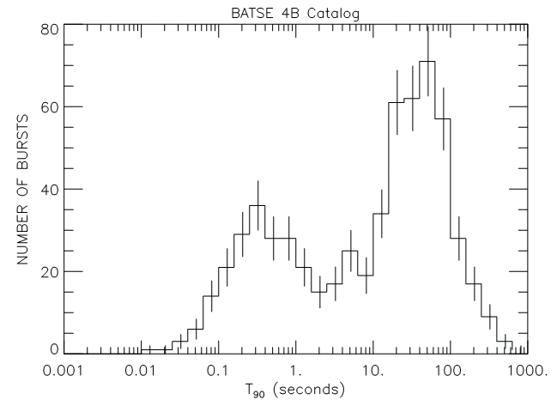
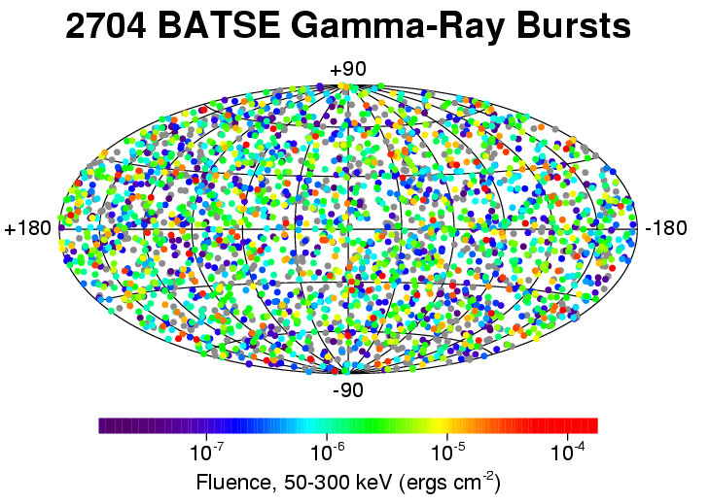
2. Science of POLAR
WHY Gamma-Ray bursts?
Flashes of gamma rays randomly distributed in the sky and in time
Brightest bursts in the universe since Big Bang; some release more energy in 10 seconds than what the Sun will emit in its entire 10 billion year lifetime!
Short duration: last from 10 milliseconds to several minutes, 20-40 s typically
About 1 GRB/day observed (~682 seen by Fermi/GBM in ~3 years)
2 seconds
Distribution and fluence of GRB samples
GRB classification: Bing Zhang et al., IJMPA 2004
Notes:
isotropically distributed in the sky
Light curve diversity: No two gamma-ray burst light curves are identical

Slide 16
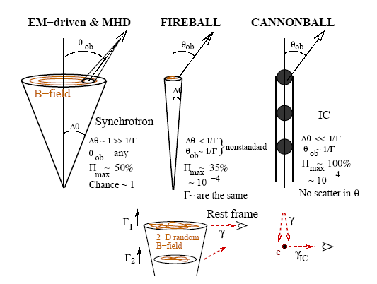
GRB Models and Polarization
Models | Prediction on GRBs polarization level of the prompt emission
EM-driven & MHD | <~ 50 %
Fireball | ~ 10 – 20 %
Cannonball | 0 – 100 %
From M. Lyutikov, 2003
GRB polarization can be produced by:
  Synchrotron radiation
  Cyclotron emission
  Bremsstrahlung
  Inverse Compton Scattering
  Magnetic photon splitting
  Strong interest in GRB polarization
Papers discussing GRB models:
  T. Piran, 2004
  M. Lyutikov, et al., 2003
  A. Dar, et al., 2004
  D.Lazzati & M. Begelman 2009
  …
Notes:
Polarization is a key factor to determine the radiation mechanism of GRB, so we have strong interest in GRB polarization measurement.

Slide 17
Summary of Current GRB Polarization Measurement
GRB | Instr. /Sat. | Pol degree (%) | Energy range (keV) | Comments
151006A | AstroSat | 32±22 | 100-300 | Low significance
110721A | GAP/IKAROS |  | 70-300 | @3.3σ，with constant pol direction
110301A | GAP/IKAROS | 70±22 | 70-300 | @3.7σ，with constant pol direction
100826A | GAP/IKAROS | 27±11 | 70-300 | @2.9σ，with inconstant pol direction
021206 | RHESSI | 80±20; | 150-2000 | With a very big systematic error
140206A | IBIS/INTEGRAL | >48 | 200-400 | Unable to restrict the GBR model
061122 | IBIS/INTEGRAL | >60; >65; >52 | 250-800; 250-350; 350-800 | Unable to restrict the GBR model
041219A | IBIS/INTEGRAL IBIS/INTEGRAL SPI/INTEGRAL | <4; 43±25; 98±33 | 200-800; 200-800; 100-350 | With inconstant pol direction
960924 | BATSE/CGRO | >50 | 20-1000 | Unable to restrict the GRB model
930131 | BATSE/CGRO | >35 | 20-1000 | Unable to restrict the GRB model
Notes:
The current GRB polarization measurement results are not enough to constrain the GRB radiation emission mechanism models.

Slide 18
3. Preliminary in-orbit calibrations
(1) In-orbit calibration requirement
Performance variation of the detector
  Gain variation due to the shipment, launch and environment temperature
    Gain of PMT
    Coupling status between PS bars and PMT
  Light output reduction of PS bars due to the irradiation in orbit
    ~ 5% reduction in 2 years for estimation
  Aging effect
    PS bars, PMT and electronics
Affection of the performance variation
  Direct affection
    Pedestal and noise, gain, crosstalk ratio, etc.
  Indirect affection
    Low threshold, modulation factor and even MDP
Therefore we need in-orbit calibration for POLAR!
Notes:
这一页为在轨标定的需求。

Slide 19
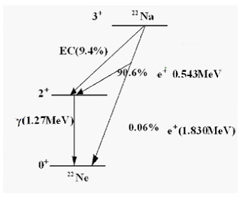
3. Preliminary in-orbit calibrations
(2) Scheme of POLAR in-orbit calibration
4 weak ²²Na nuclei devices (activity_{total}=~350 Bq)
Back-to-back 511 keV photons from the annihilation of the e⁺
The Compton edge of the 511 keV photons will be used for the calibration of the gain non-uniformity of all the channels, and the sources can also be used for calibrating the crosstalk of each module and other performances of POLAR in orbit
Notes:
POLAR in-orbit calibration strategy: use 4 weak 22Na sources (511 keV photons annihilated by e+ emitted from the nuclei) to calibrate the performance of POLAR in-orbit. 4枚22Na源总活度为~350 Bq。

Slide 20
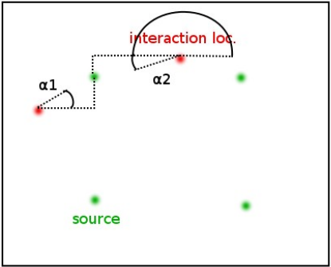
3. Preliminary in-orbit calibrations
(2) Scheme of POLAR in-orbit calibration
All events with > 1 trigger shall be selected
Two non-adjacent channels with highest energy depositions are selected
The location of the 4 internal sources are known
The angles of the two interacting bars with respect to the 4 sources, α1 and α2 are calculated
α2 - α1 is calculated for all the 4 sources
An event is selected if abs(α2-α1)-pi < 0.175 (10°, can be adjusted to improve the calibration result) as it implies it is likely to come from a source
Notes:
挑选在轨标定源事例的标准：两个相互作用点和22Na源在一条（或接近在一条）直线上的事例选为有效事例。

Slide 21
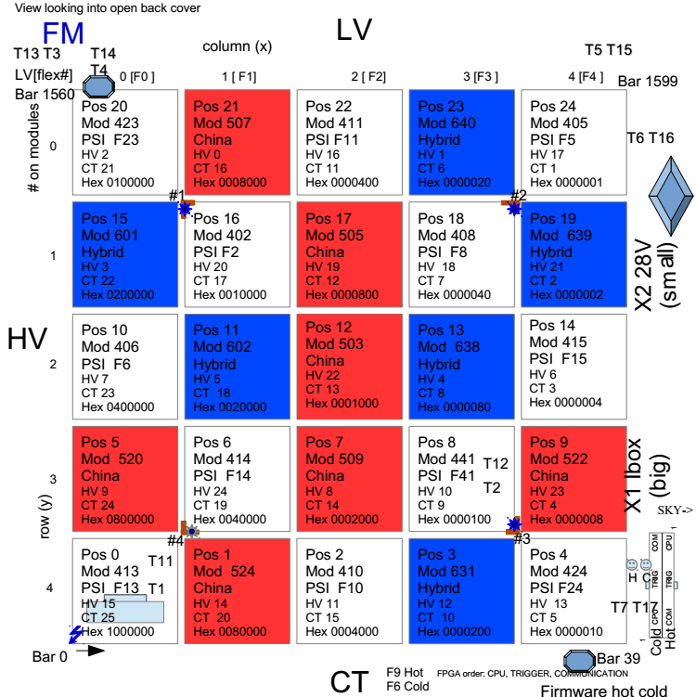
3. Preliminary in-orbit calibrations
(3) Locations of the in-orbit calibration sources
Notes:
图中4个*号位置为4枚22Na源的安装位置。

Slide 22
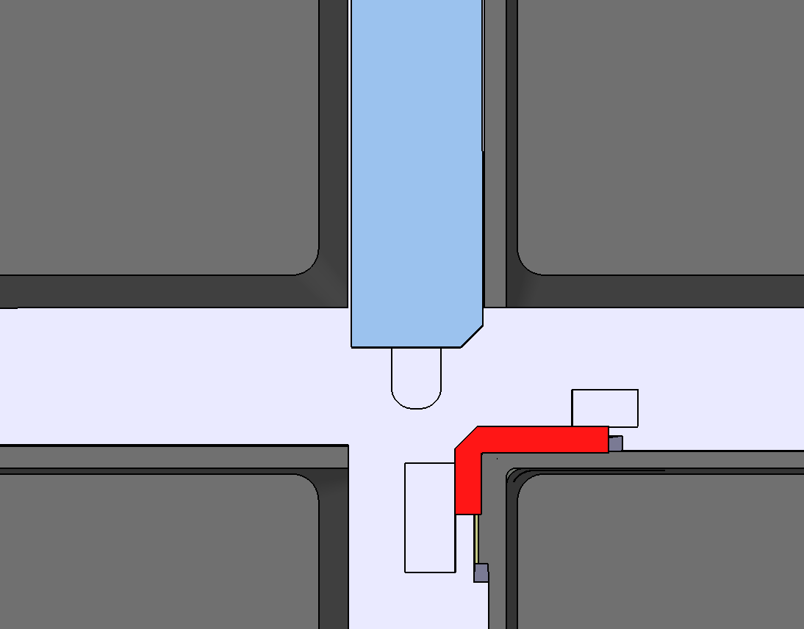
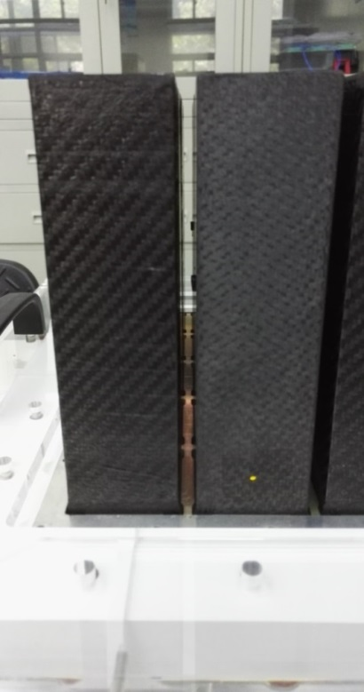
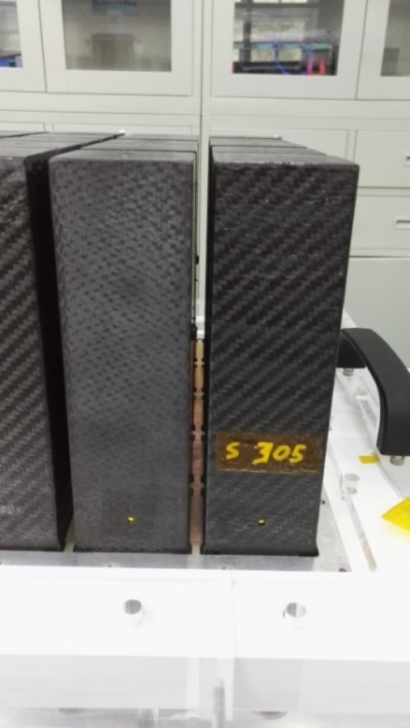
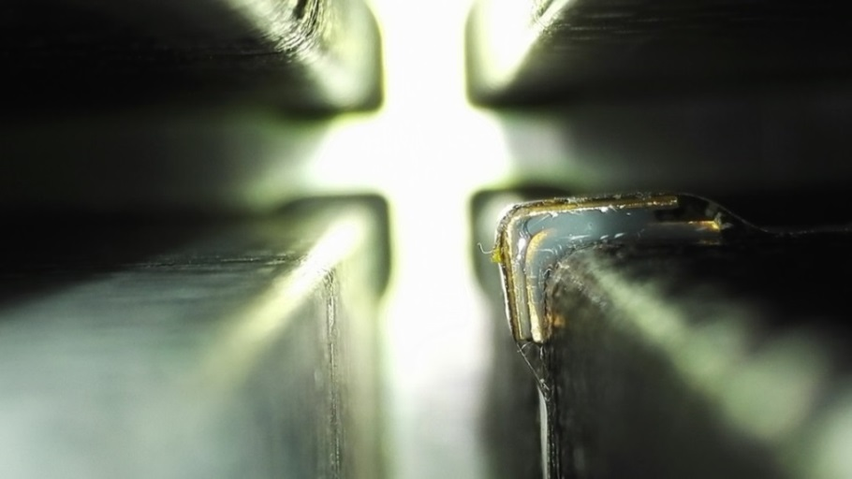
3. Preliminary in-orbit calibrations
(4) Installation of the in-orbit calibration sources
Notes:
22Na源安装实物照片。

Slide 23
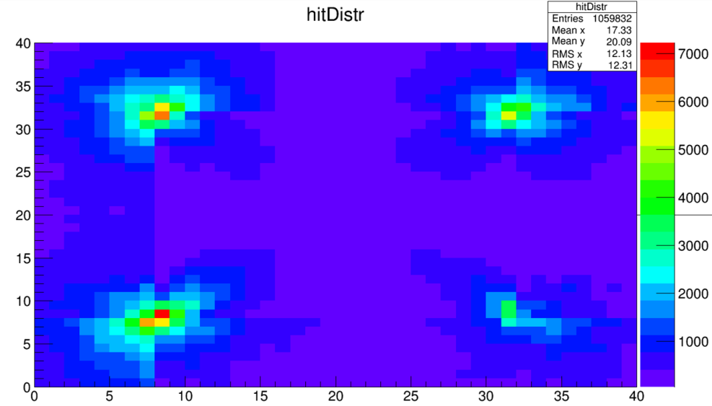
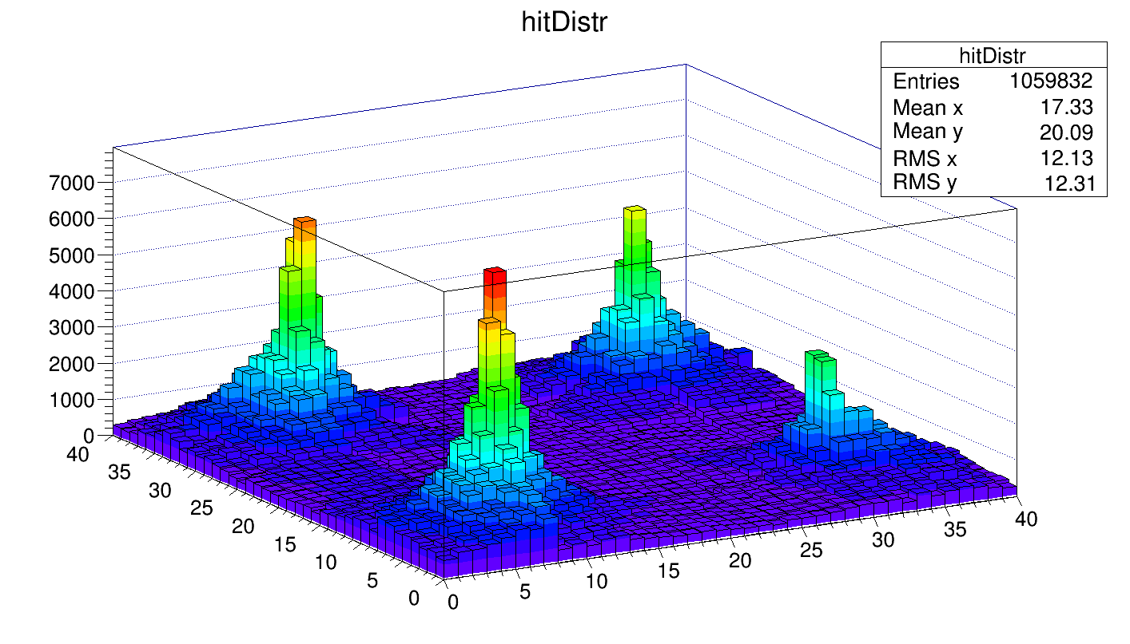
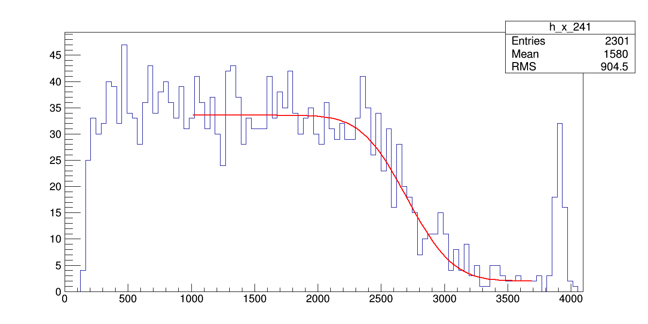
3. Preliminary in-orbit calibrations
(5) Test with the in-orbit calibration sources before launch
Notes:
22Na源地面测试结果。上面两幅图为4枚22Na源在1600个通道中的触发计数响应。下面的图为其中一个通道的Compton边位置拟合结果。

Slide 24
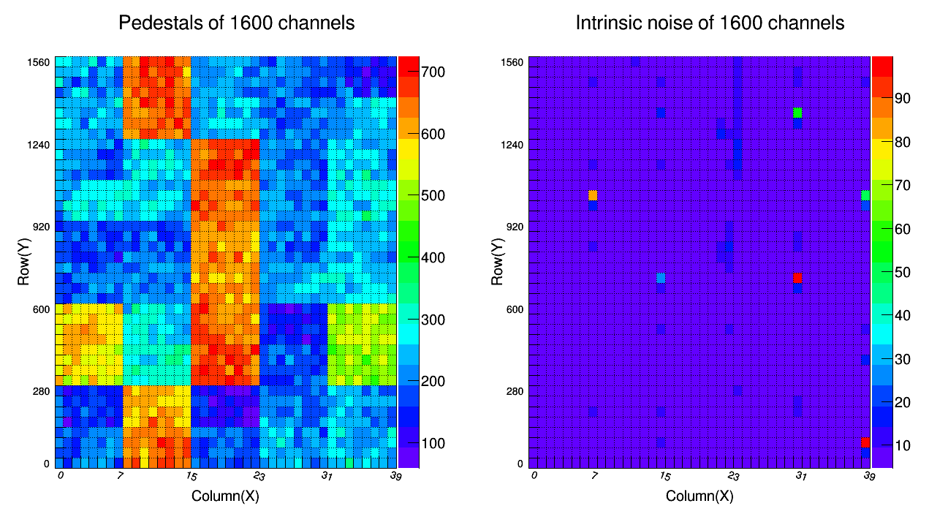
3. Preliminary in-orbit calibrations
(6) Preliminary in-orbit calibration results after launch
Left: pedestal; Right: noise
Notes:
在轨标定初步结果：左图为1600个通道的基线结果；右图为1600个通道的噪声分布。

Slide 25
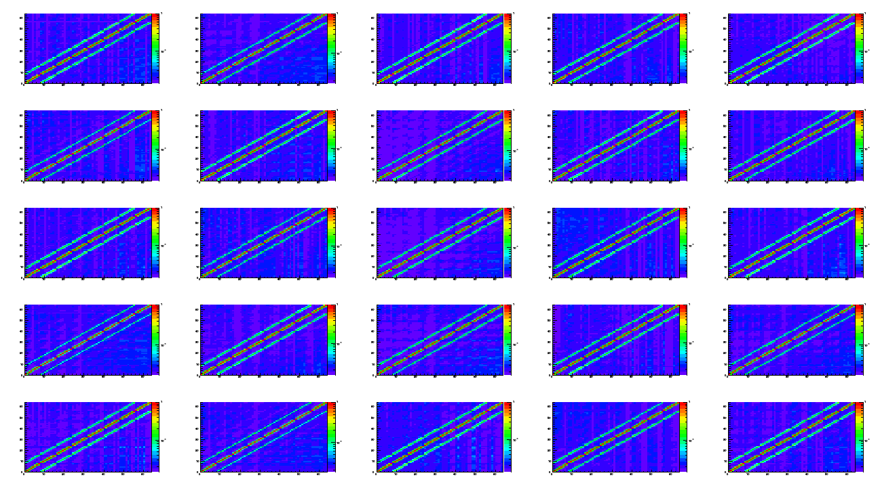
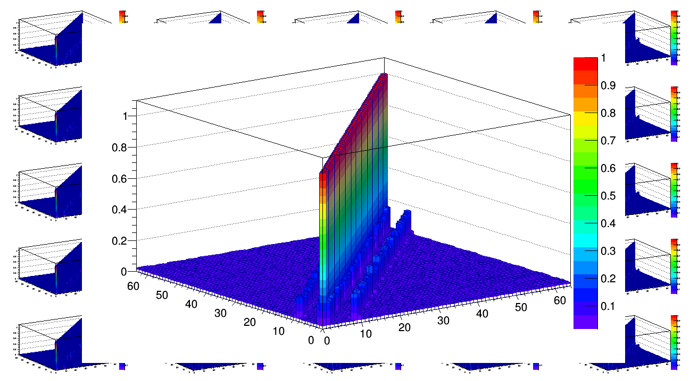
3. Preliminary in-orbit calibrations
(6) Preliminary in-orbit calibration results after launch
Left: Crosstalk matrix of 25 modules; Right: Zoom of crosstalk of one module
Notes:
在轨标定初步结果：左图为25套单体的串扰矩阵；右图为将其中一套单体的串扰矩阵放大后的结果。

Slide 26
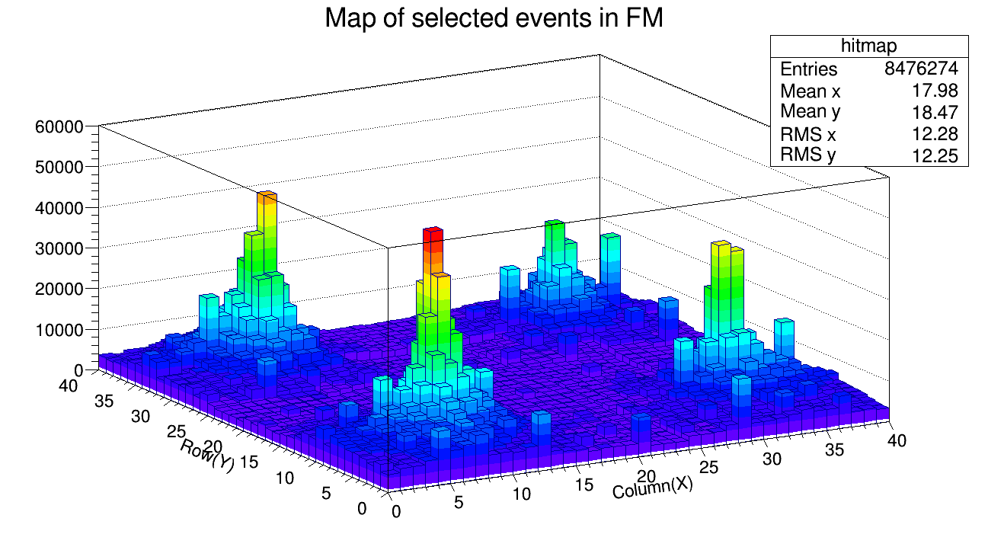
3. Preliminary in-orbit calibrations
(6) Preliminary in-orbit calibration results after launch
Triggering pattern of selected Na-22 sources events
Notes:
在轨标定初步结果：图中为在轨标定22Na源事例在1600个通道的触发计数响应情况。

Slide 27
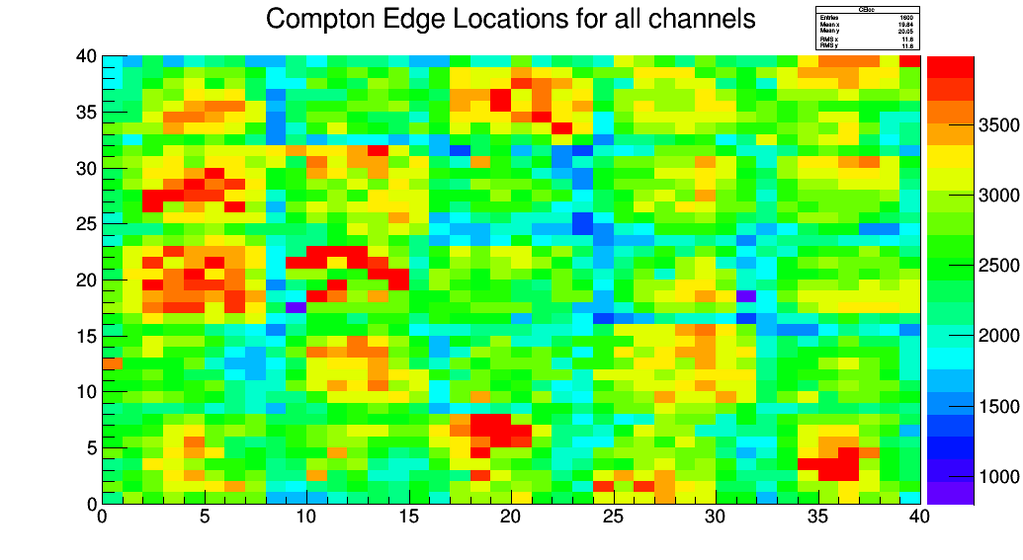
3. Preliminary in-orbit calibrations
(6) Preliminary in-orbit calibration results after launch
Compton edge positions of the 1600 channels in calibration working mode
Notes:
在轨标定初步结果：图中为1600个通道的22Na源Compton边位置拟合结果。

Slide 28
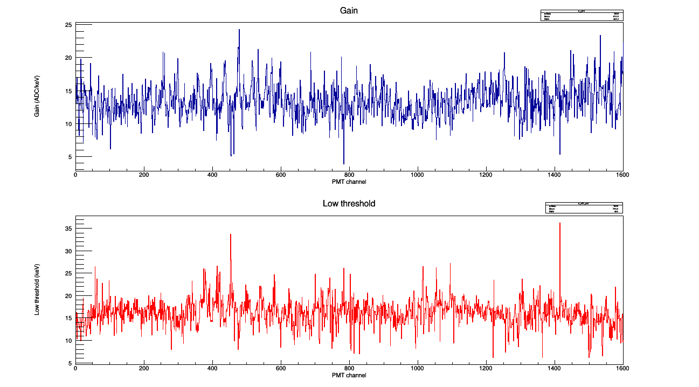
3. Preliminary in-orbit calibrations
(6) Preliminary in-orbit calibration results after launch
Gain and low threshold of 1600 channels in GRB observation mode
Top: gain in ADC/keV; Bottom: low threshold in keV
Notes:
在轨标定初步结果：图中为1600个通道的增益（上图）和低能阈值（下图）标定结果。

Slide 29
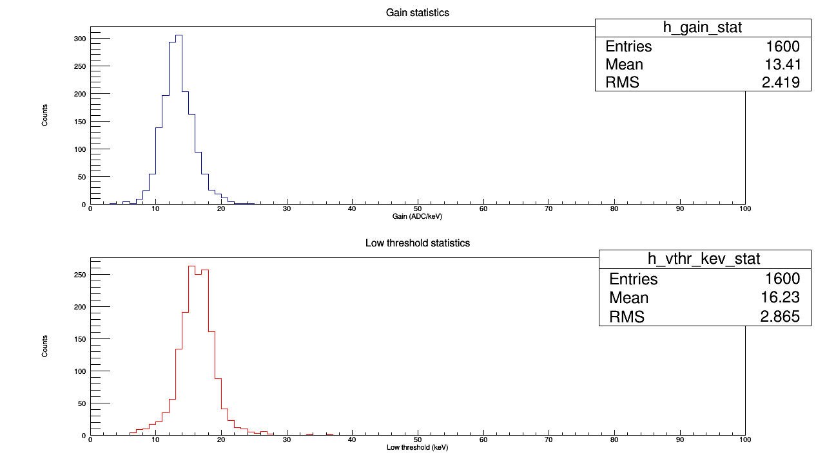
3. Preliminary in-orbit calibrations
(6) Preliminary in-orbit calibration results after launch
Mean gain of 1600 channels is ~ 13.41 ADC/keV
Mean threshold of 1600 channels is ~ 16.23 keV
Top: gain in ADC/keV; Bottom: low threshold in keV
Notes:
在轨标定初步结果：图中为1600个通道的增益（上图）和低能阈值（下图）标定结果统计分布。其中，增益的平均值为~13.41 ADC/keV，阈值的平均值为~16.23 keV。

Slide 30
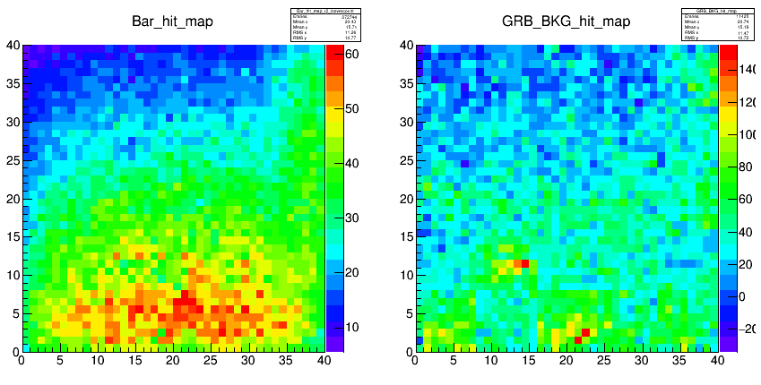
3. Preliminary in-orbit calibrations
(7) Preliminary in-orbit calibration results after launch
Detection efficiency calibration with GRB data. Left: MC simulation of the 1600 channels hitting response of GRB 161218B; Right: observation results of the 1600 channels hitting response of GRB 161218B
Notes:
在轨标定初步结果：尝试采用GRB测试数据以及模拟数据对1600个通道的探测效率进行相对标定。左图为模拟得到的1600个通道的触发计数响应分布；右图为实测结果。

Slide 31
3. Preliminary in-orbit calibrations
(8) Summary of the preliminary in-orbit calibration results
In-orbit calibration results are consistent with the ground test results
To measure photons with lower energies, we need to increase the HV (then we may lose some high energy events), lower the Vthr (perhaps we need to kill some hot channels, or further use the offset by adjusting this parameter)
Gain-HV-temperature calibration has been done and will be done periodically, further data analysis is on-going
Notes:
在轨初步标定结果总结。

Slide 32
4. Preliminary in-orbit observation results
POLAR has been running for ~ 5 months after launch, the detector is powered on for ~ 4 months due to the docking of TG-2 and Shenzhou-11
Raw scientific data: ~ 6 TBytes
POLAR has observed more than 50 GRBs which are confirmed by other satellites until now, and ~ 50 GCN circulars have been delivered. The related calibration and polarization analysis work are on-going
Besides, Crab and Solar Flare signals have also been detected by POLAR, data analysis is on-going
Notes:
在轨初步观测结果总结。

Slide 33
4. Preliminary in-orbit observation results
First GRB detected by POLAR
GRB 20160928A light curve. Top: POLAR data with Bkg; Middle: POLAR data with Bkg substracted; Bottom: Fermi/GBM data
Notes:
POLAR观测到的第一个GRB的光变曲线结果。

Slide 34
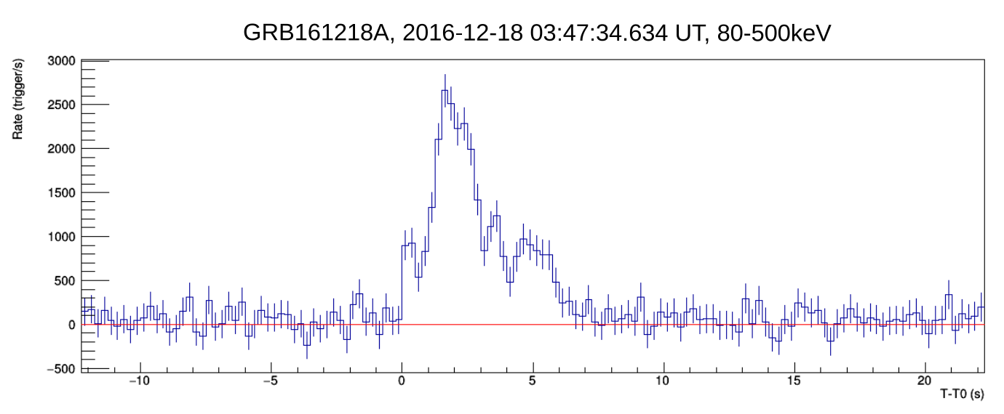
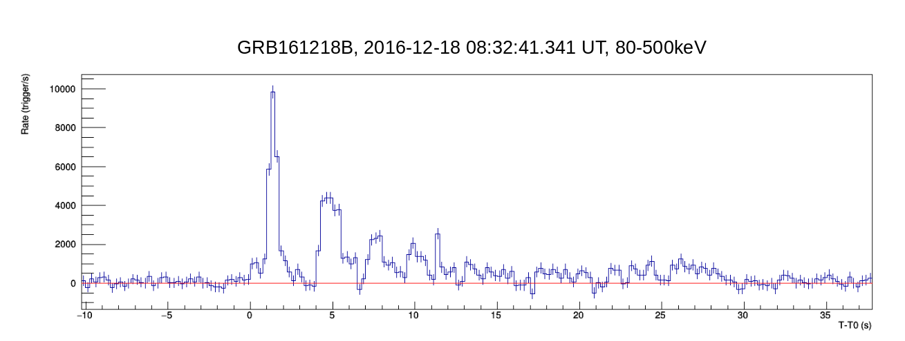
4. Preliminary in-orbit observation results
Bright GRBs detected by POLAR
POLAR observations. Top: light curve of GRB 20161218A (detected by Swift/BAT); Bottom: light curve of GRB 20161218B (detected by Fermi/GBM)
Notes:
POLAR观测到的两个亮暴的光变曲线结果。

Slide 35
5. Summary and outlook
Collaboration between China and Europe
POLAR has been launched on 15th Sep, 2016
Working for ~ 5 months properly, a series of tests have been performed
More than 50 GRBs have been detected by POLAR, data analysis work is on-going, polarization results coming later…
POLAR is expected to give prominent observation results on GRB and Solar flare polarization measurement
More collaborations on data analysis, calibration and polarization analysis are needed
For more details, please refer to the following website or contact us.
http://polar.ihep.ac.cn
E-mail: wubb@ihep.ac.cn, or sunjc@ihep.ac.cn

Slide 36
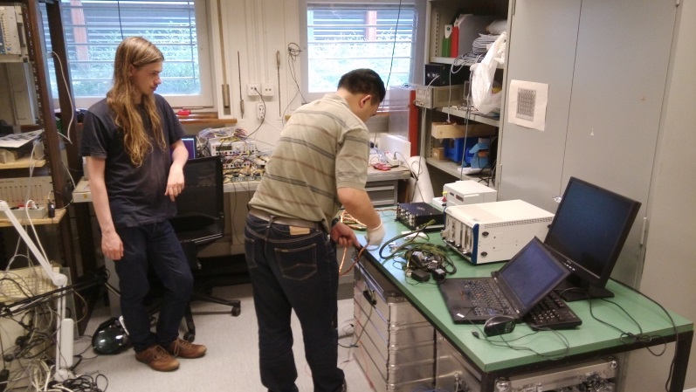








Working moments of POLARers

Slide 37
Thanks for your attention！

