Slide 1
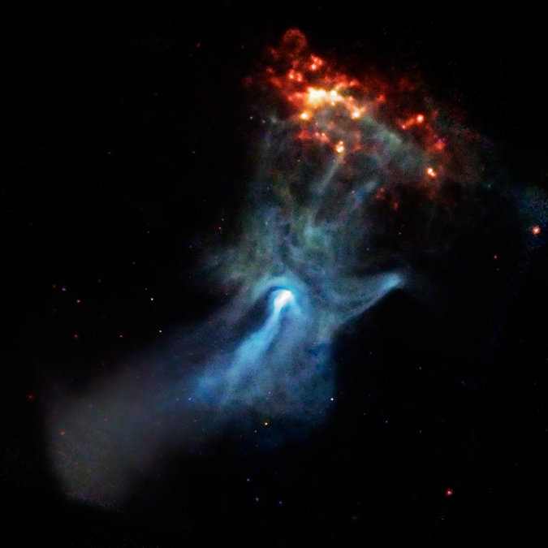
INTEGRAL/ISGRI Analysis of PSR B1509-58
James Rodi, Lorenzo Natalucci
INAF-IAPS Rome, Italy
IACHEC 2022 Spring Virtual Workshop
Image: https://chandra.harvard.edu/photo/2009/b1509/

Slide 2
PSR B1509-58 Details
Young radio Pulsar
Period of ~150 ms
Detected from radio to TeV
Observed by instruments from X-ray to gamma-ray
RXTE, XMM, HXMT, NuSTAR, INTEGRAL, Suzaku, and other missions
Potentially cross-calibration source for IACHEC

Slide 3
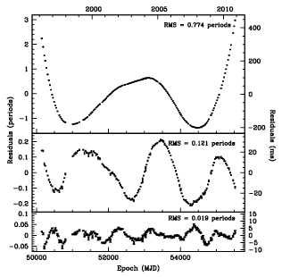
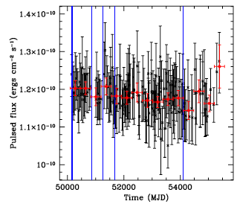
PSR B1509-58 Details
Difficult to use for timing analysis due to evolving period
RXTE timing analysis from Livingstone & Kaspi (2011) unable to describe timing behavior with 12 derivatives
But pulsed flux constant over time
~1.18 x 10⁻¹⁰ erg/cm²/s in 2-50 keV
Linear fit found Χ² =52.4 with dof = 150 so consistent with constant flux (Livingstone & Kaspi, 2011)
Livingstone & Kaspi (2011)

Slide 4
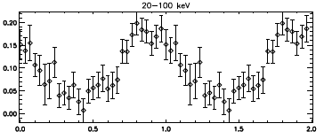
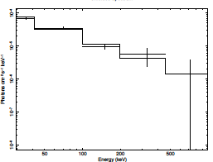
Initial INTEGRAL/ISGRI Analyses
INTEGRAL/ISGRI:
20-1000 keV range
61 microsec timing resolution
Forot et al (2006) ~ 1.3 Ms of ISGRI, but focused on unpulsed flux
Currently have ~13 Ms exp time
Early work with INTEGRAL/ISGRI using observations during MJD 53021-53086
spectrum of pulsed Flux in 30-900 keV range

Slide 5
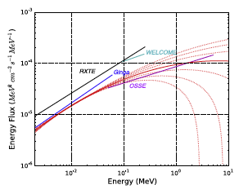
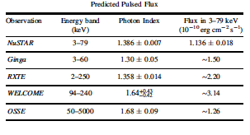
Comparison with Previous results
Compare with results in Chen et al (2016)
ISGRI
INTEGRAL/ISGRI 30-900 1.3 ± 0.1 ~1.9
2-50 keV flux ~ 1.14 (ISGRI) vs 1.18 (RXTE)
Chen et al (2016)

Slide 6
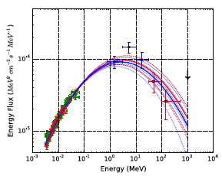
Future plans
Initial work using only ~77 ks / 13 Ms exp time
analyze all ISGRI data using recently released OSA v11.2
Look at pulsed spectrum
Study spectral variability with phase
Compare with other instruments, e.g. NuSTAR
Compare ISGRI results with broadband spectrum from Chen et al (2016)
ISGRI
Chen et al (2016)

