Slide 1


Current status of Insight-HXMT
2023 Seeblick Pelham
15th IACHEC meeting
Xiaobo Li (on behalf of HXMT mission)
2023-04-24

Slide 2
Outline
1
Introduction to the Insight-HXMT
2
Core Sciences
3
Current status of Insight-HXMT mission
4
Highlights of the scientific results
5
Summary

Slide 3

1. Hard X-ray Modulation Telescope (HXMT)
  China’s 1st X-ray astronomy satellite
  Selected in 2011
  Launched on June 15th, 2017
  Dubbed “Insight” after launch
  Working in-orbit: ~2100 days
    Designed lifetime : 4 years
    Total weight : ~2500 kg
    Cir. Orbit：550 km→540 km
    incl. ：43°
    Mode：Pointed, scanning and GRB modes
  Extended Operation phase
The overview of the HXMT mission and payloads are published in SCIENCE CHINA.
Zhang, S.-N. et al. Overview to the Hard X-ray Modulation Telescope (Insight-HXMT) Satellite
SCIENCE CHINA: Physics, Mechanics & Astronomy Vol. 63, No.4 , April 2020, 249502

Slide 4
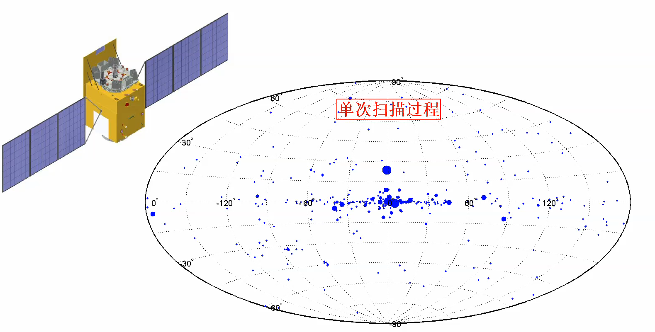
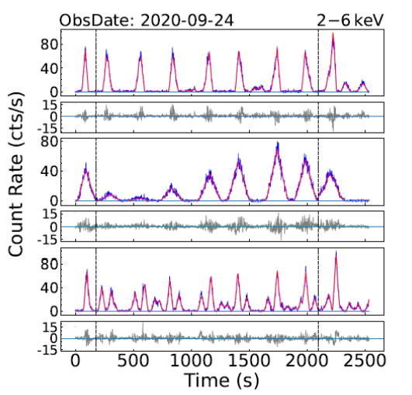
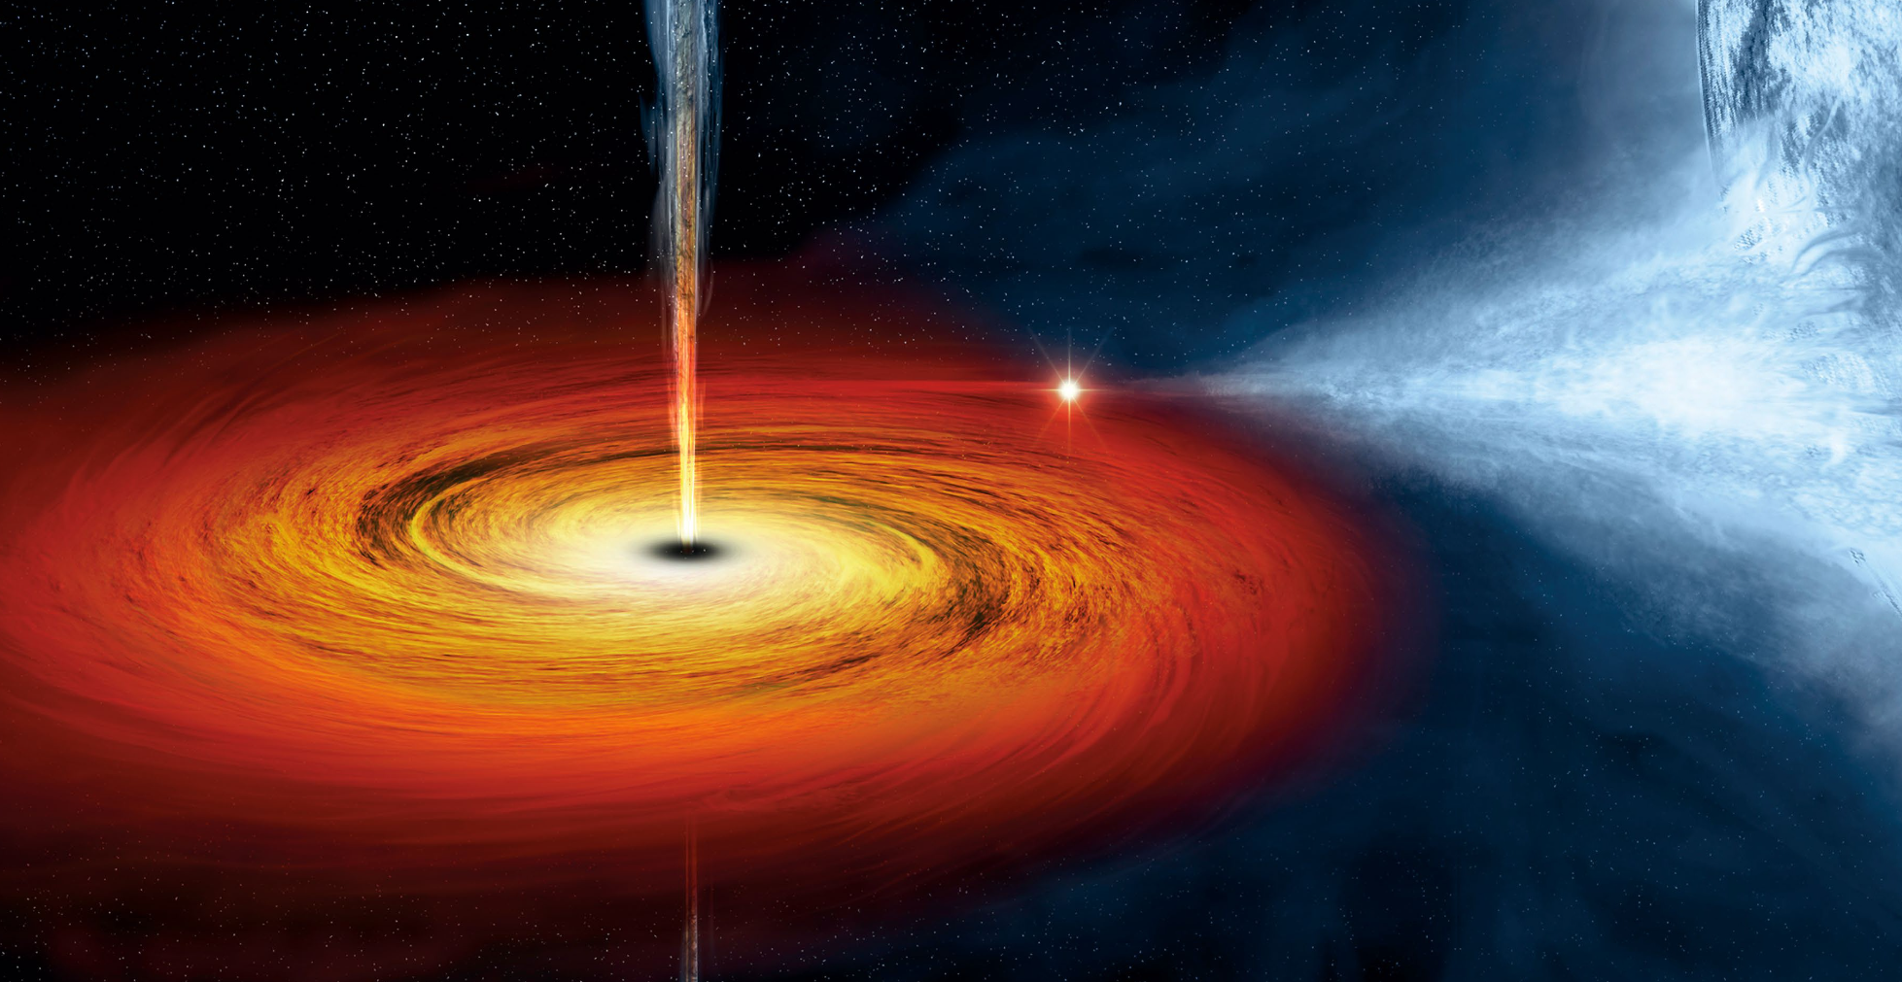
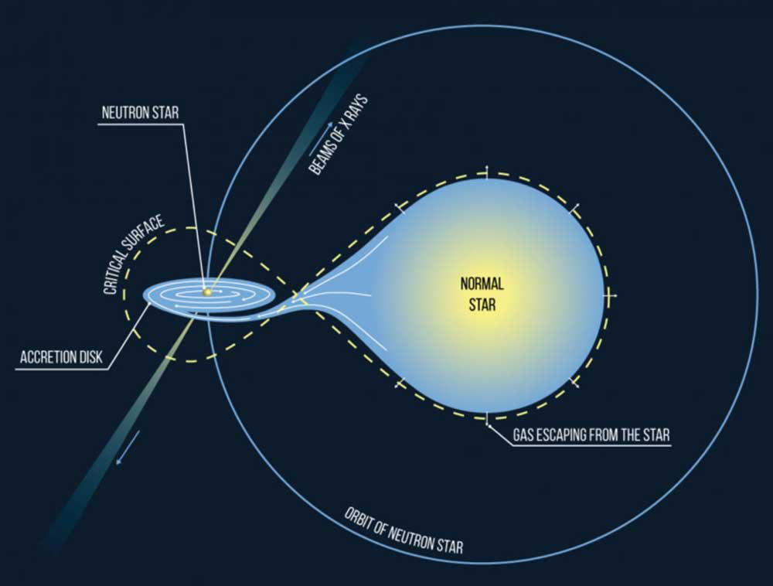
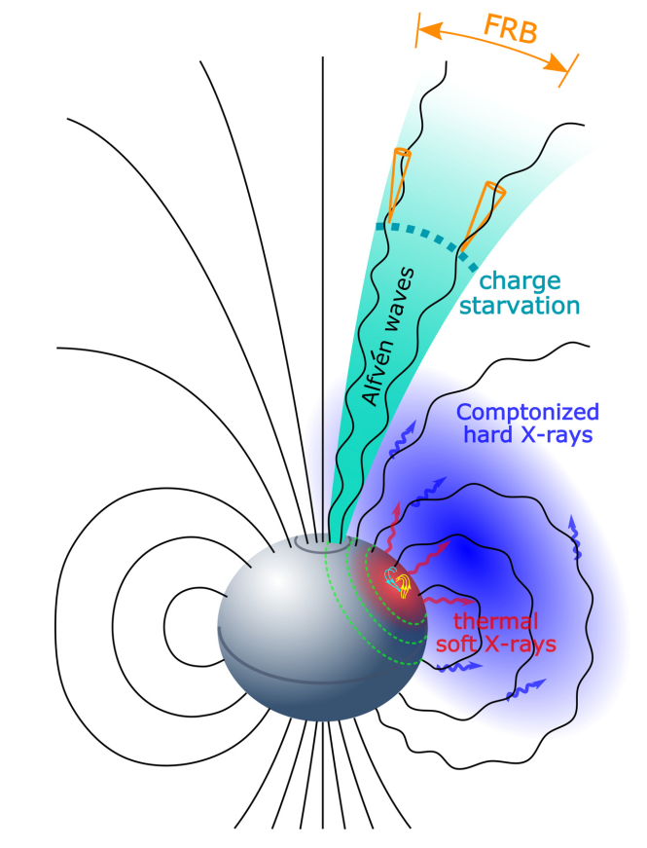
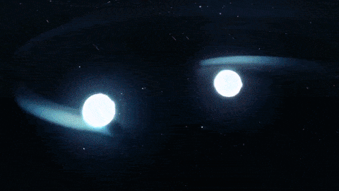
2.Core Sciences
Galactic plane scan
1.
Scan for new transient sources and monitor the known sources in very wide energy band (1-250 keV)
Pointed observations
2.
High statistics study of bright sources
and long-term high cadence monitoring of XRB outbursts.
High energy outbursts
3.
GRBs，especially associated with GW, FRB, HEN, etc.
Magnetar flares

Slide 5
3. Current status of HXMT mission
3.1
Proposals
3.2
Observation Schedule
3.3
Science Data Product
3.4
Data Analysis Software
3.5
Calibration

Slide 6
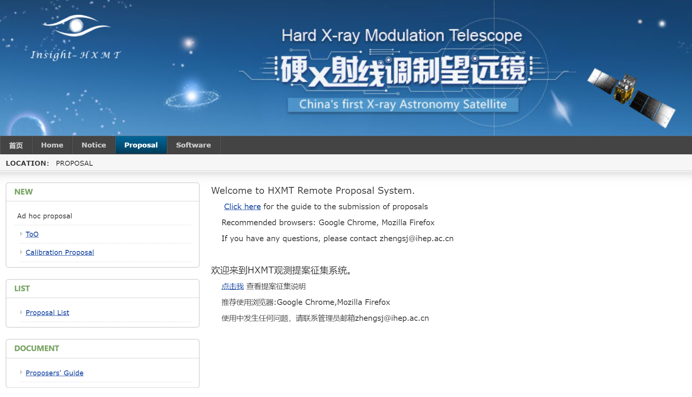
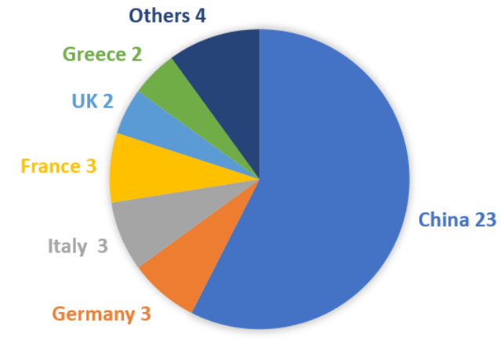
3.1 Proposals
Cycle | Submission Period | Proposals Amount | Observation Amount | Observation Period | ToO
AO01 | 2016.8-9 | 90 | 517 | 2017.11-2019.06 | 39
AO02 | 2019.1-2 | 35 | 349 | 2019.07-2020.07 | 26
AO03 | 2020.4-5 | 34 | 329 | 2020.08-2021.07 | 16
AO04 | 2021.4-5 | 33 | 333 | 2021.08-2022.08 | 30
AO05 | 2022.4-5 | 43 | 339 | 2022.09-2023.08 | /
Proposals from 40 Universities or Institutes：
http://proposal.ihep.ac.cn; AO06 is ongoing!

Slide 7
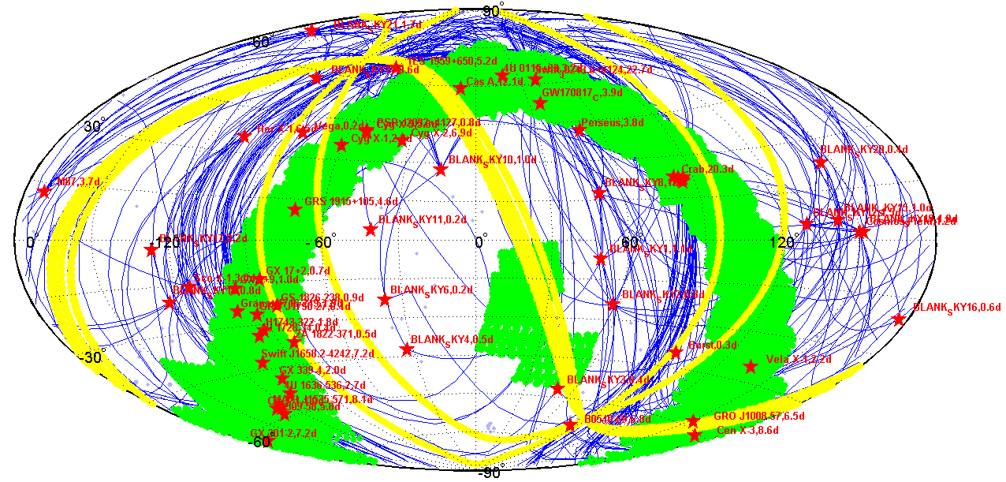
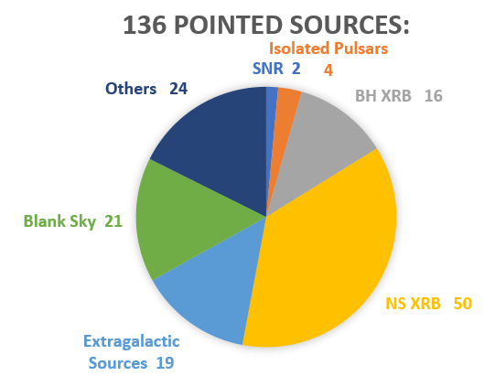
3.2 Observation Schedule
Short Term Schedule: http://www.hxmten.ihep.ac.cn/shortPlan.jhtml
Long Term Schedule:
http://www.hxmten.ihep.ac.cn/LongPlan.jhtml
Red stars: Pointed observations
Green regions: Small area scans
Blue lines: Tracks of slew
Yellow belts: All sky survey

Slide 8
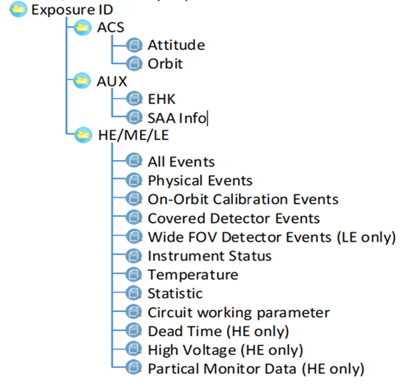
3.3 Science Data Product
Data Product
Data Structure
Level 1: published to users
Data format：FITS
Data release：Pointed Observations
Download: http://archive.hxmt.cn/proposal
Data Protected Period
Annual regular proposals (Core/Guest): 365 days
Pre-approved ToO proposals: 90 days
Temporary ToO proposals: 0 days

Slide 9
3.4 HXMT Data Analysis Software--HXMTDAS
HXMTDAS and CALDB
Data Processing
用户培训
HXMTDAS:
  Task Style: FTOOLs style (Compatible with HEASoft)
CALDB : HEASARC CALDB format
Input : Level 1 data product & CALDB
Output ：Response files，background files, event files, spectra, light-curves
Calibration: Calibrate the unfiltered event files;
Screening: filter the calibrated event files by GTI and other parameters;
Extraction: extract spectrum and LC.
2017
2018
2019
2020
2021
2022
2017.07：
hxmtsoftv1
CALDBv1
2017.12：
hxmtsoftv2
CALDBv2
2018.12：
hxmtsoftv2.00
CALDBv2.00
2020.05：
hxmtsoftv2.03
CALDBv2.03
2020.10：
CALDBv2.04
2020.11：
hxmtsoftv2.04
2022.02：
hxmtsoftV2.05
CALDBv2.06
2019. 06：
hxmtsoftv2.01
CALDBv2.01
2019.12：
hxmtsoftv2.02
CALDBv2.02
2021.03：
CALDBv2.05
Released versions of software and CALDB
http://hxmten.ihep.ac.cn/software.jhtml

Slide 10
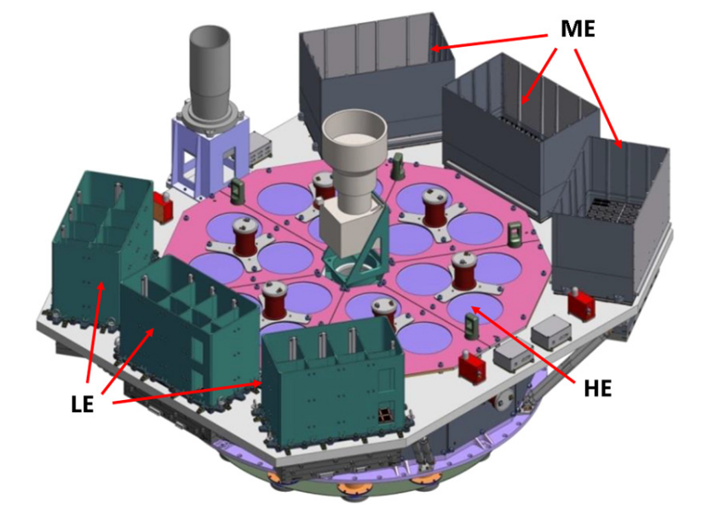
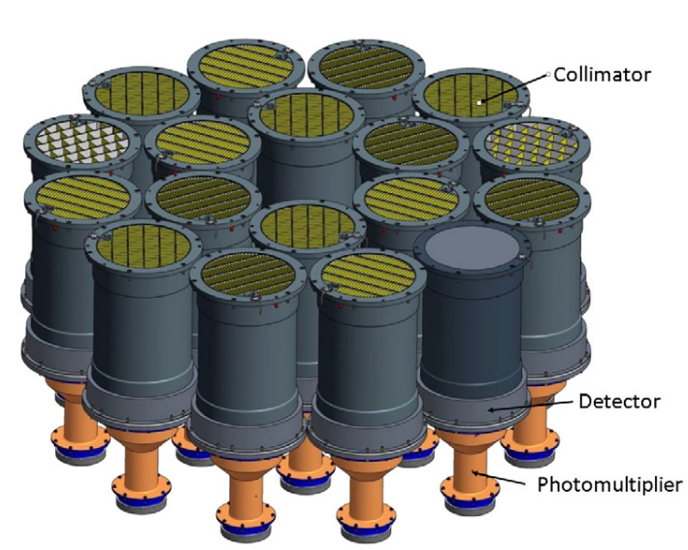
3.5 Calibration
Instruments:
  HE : 5000cm², 28-250 keV, 18 NaI/CsI phoswich
  ME: 952cm², 10-35 keV, 1728 Si-Pin
  LE : 384cm², 1-10 keV, 96 SCD
Advantages:
  Broad energy band: 1-250 keV
  Large areas at high energy
  High time resolution (HE: 2 µs, ME: 6 µs )
  Small dead time and no pipe up effect
  Unique ability to study bright sources.

Slide 11
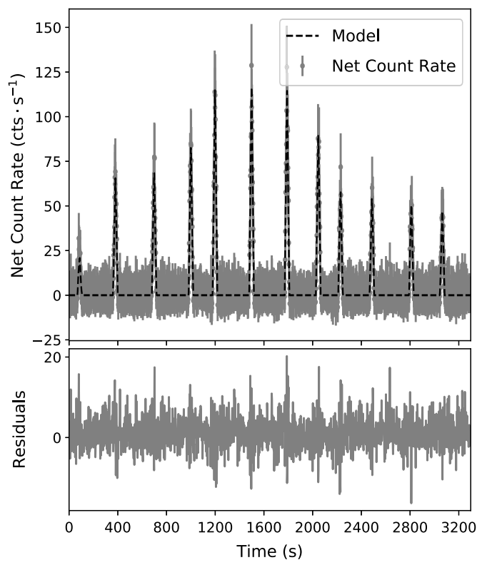
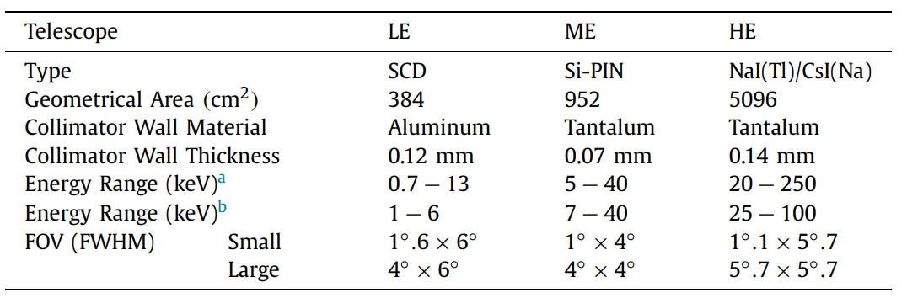
3.5 Calibration—Collimator Response
Small FoV:
Scan direction
Starting Point
LE
7°
HE
Crab
ME
Nang et al, 2020, JHEAp
The collimator response is calibrated by the scan of Crab area.

Slide 12
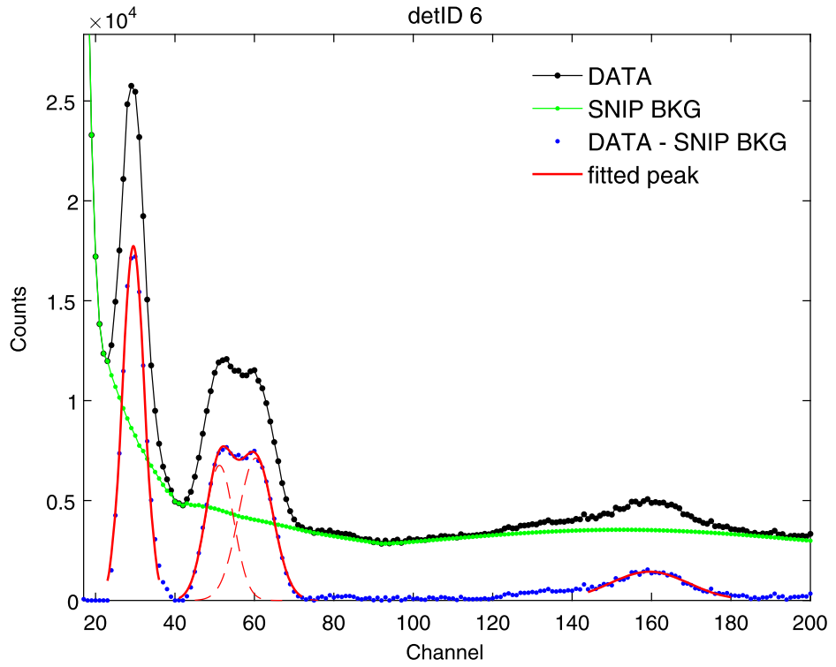
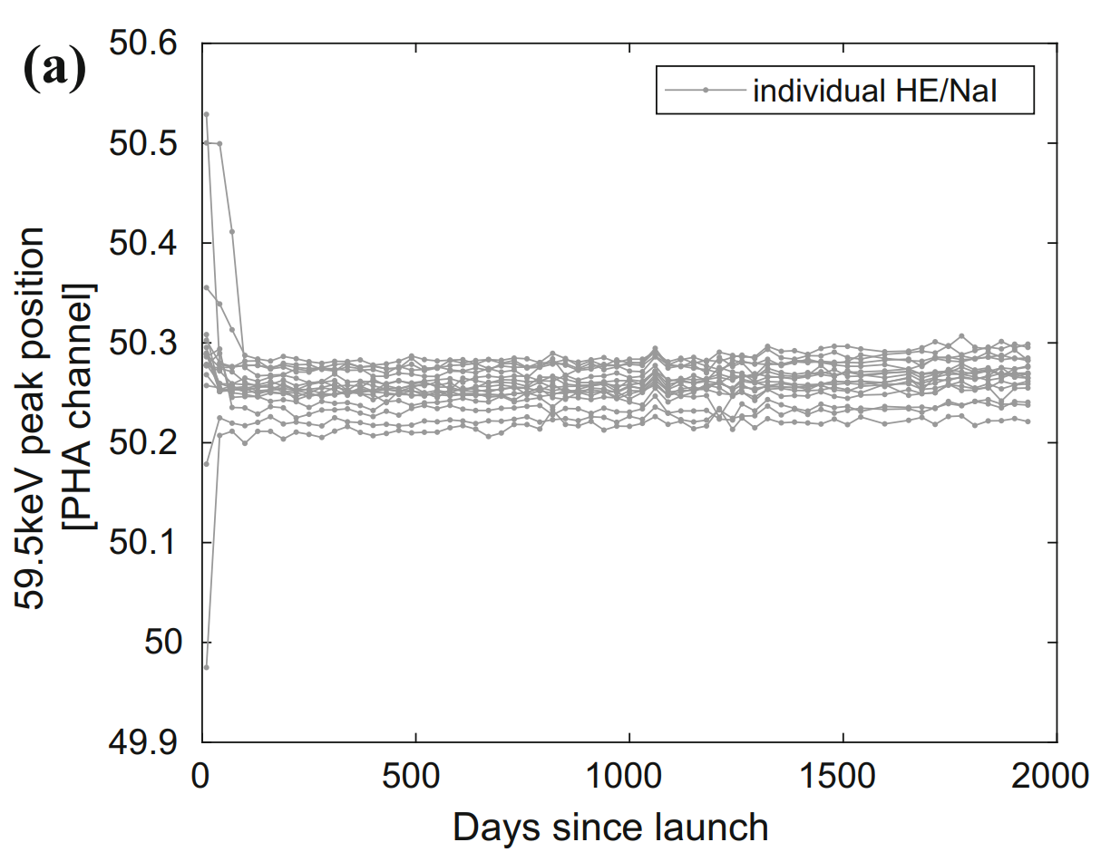
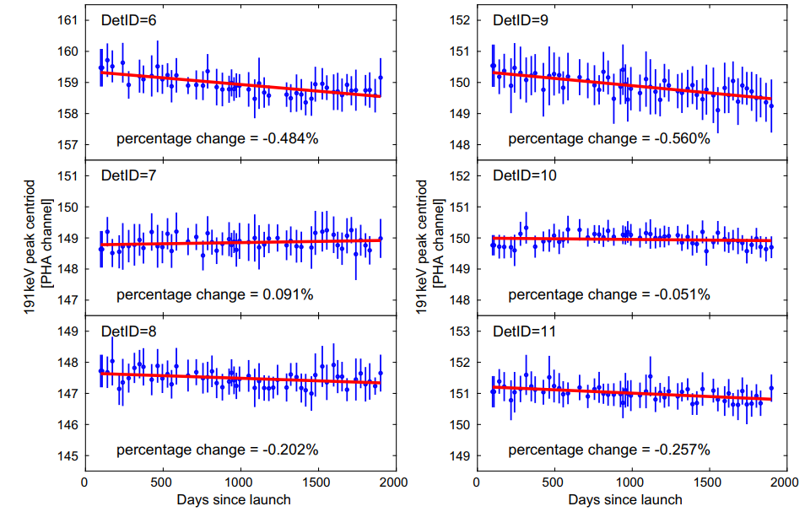
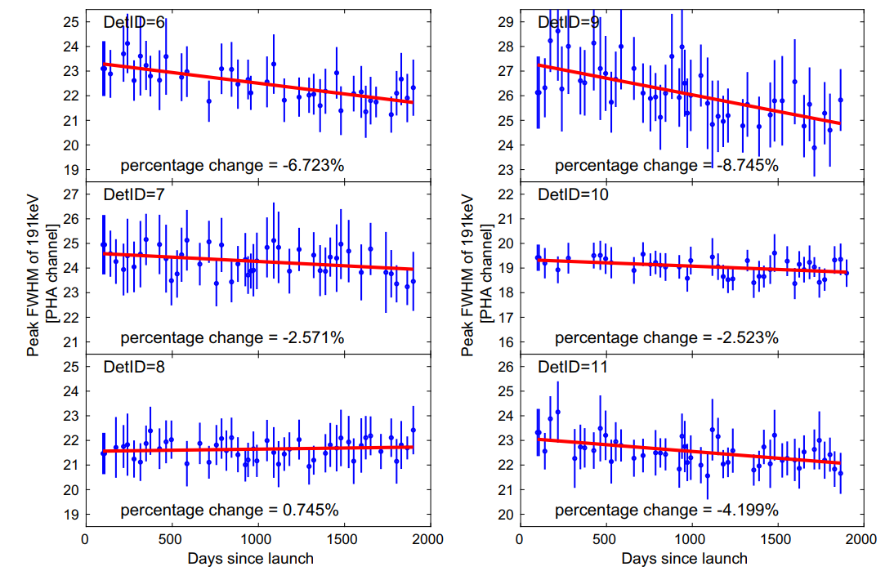
3.5 Calibration—HE
  Gain and Energy Resolution are calibrated by the background lines.
    HE: 31, 56, 67, 191 keV (activation of iodine)
  Automatic Gain Controller(AGC): Gain: <1%
  FWHM: slightly getting better
  Li et al. 2020, JHEAp, Li et al. 2023, RDTM.
HE: Gain vs Time
HE: FWHM vs Time
AGC

Slide 13
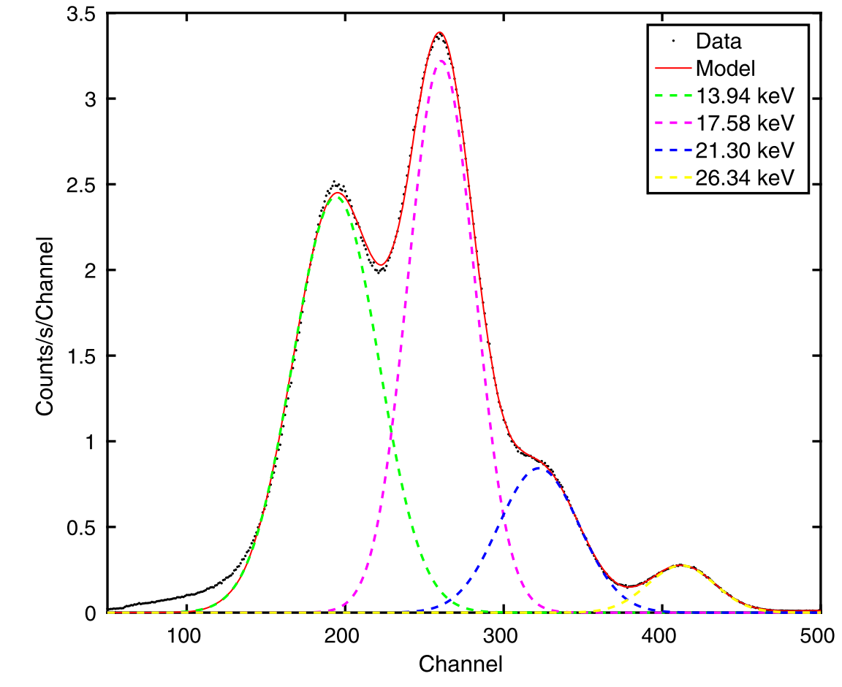
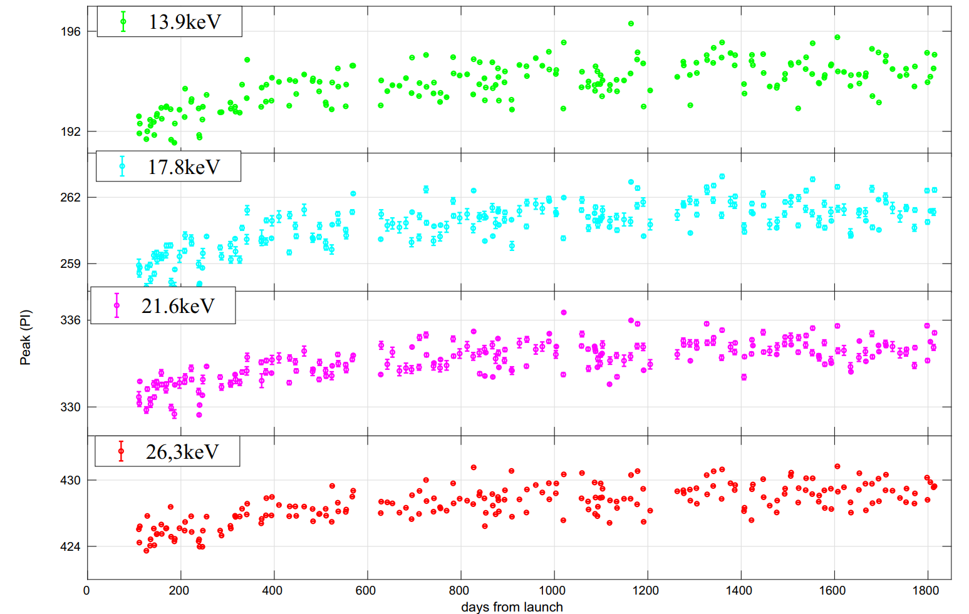
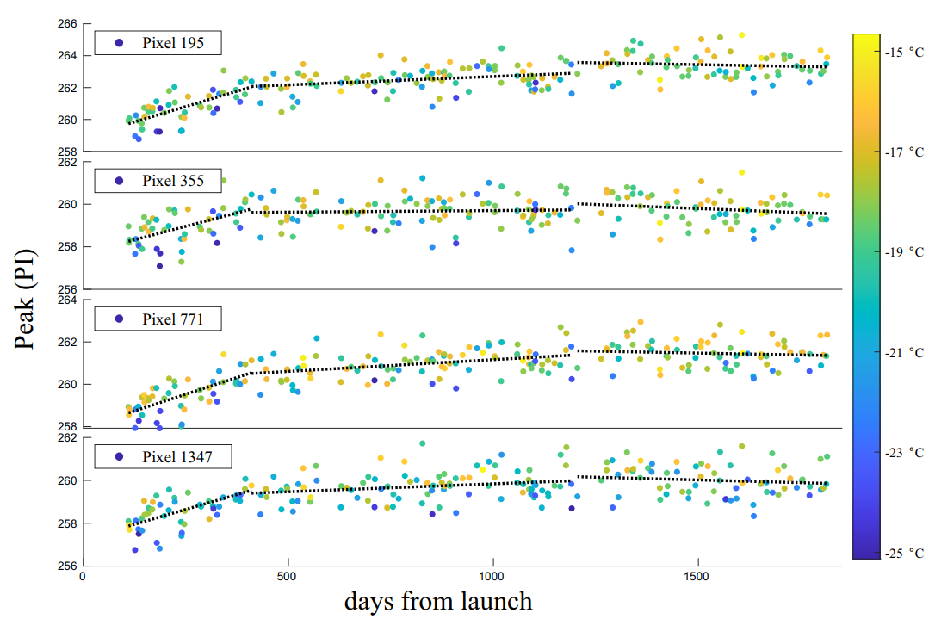
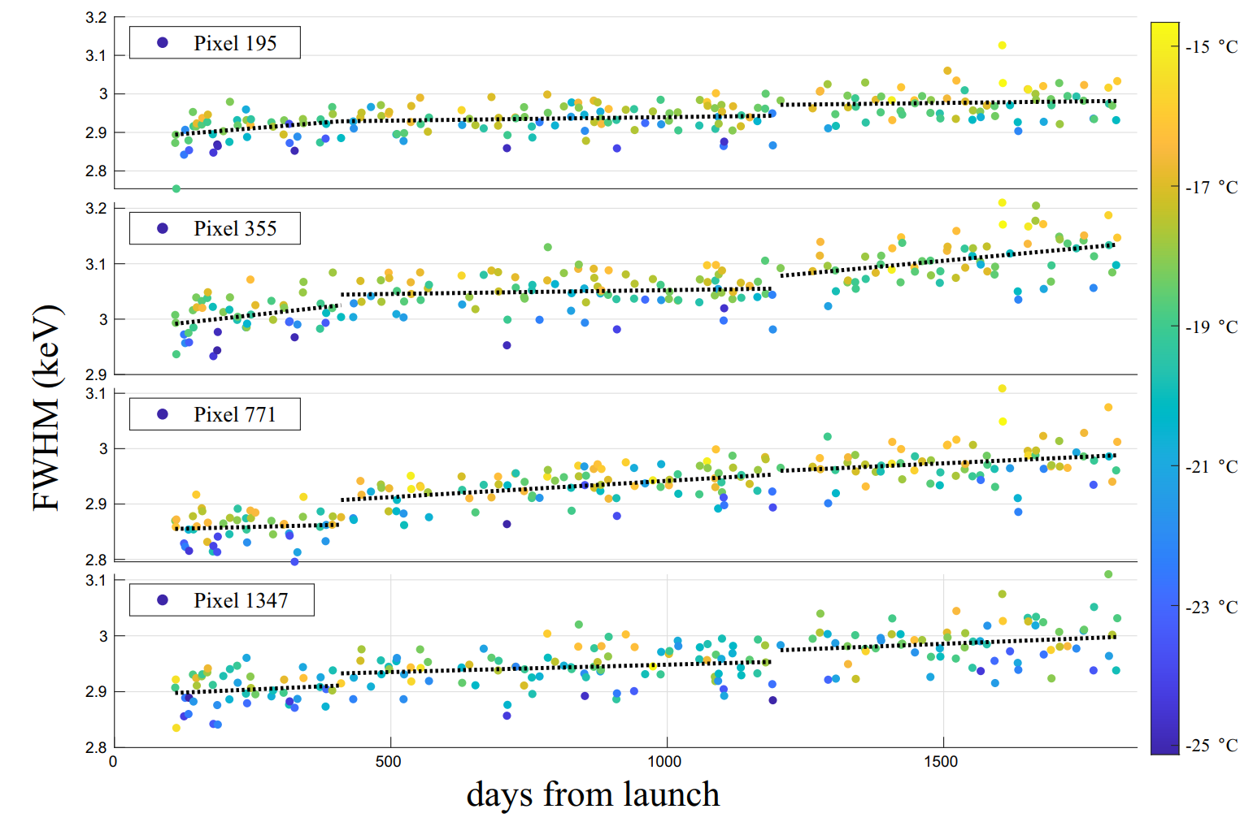
3.5 Calibration—ME
  Energy Gain and Resolution are calibrated by radioactive source and Ag line generated in the nearby material.
    ME: 13.9, 17.6, 21.3, 26.3 keV (radioactive source ²⁴¹Am) and 22.5 keV (Ag line)
    Variation of gain and resolution are less than 1% and 3%.
  Li et al. 2020, JHEAp, Tan et al. 2023, RDTM.
²⁴¹Am
spectrum
ME: Gain vs Time
ME: Energy Resolution vs Time

Slide 14
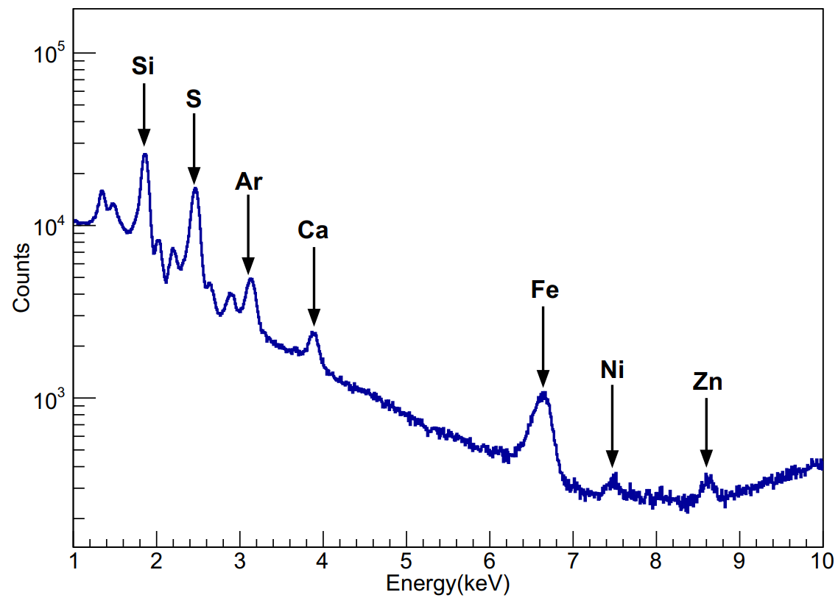
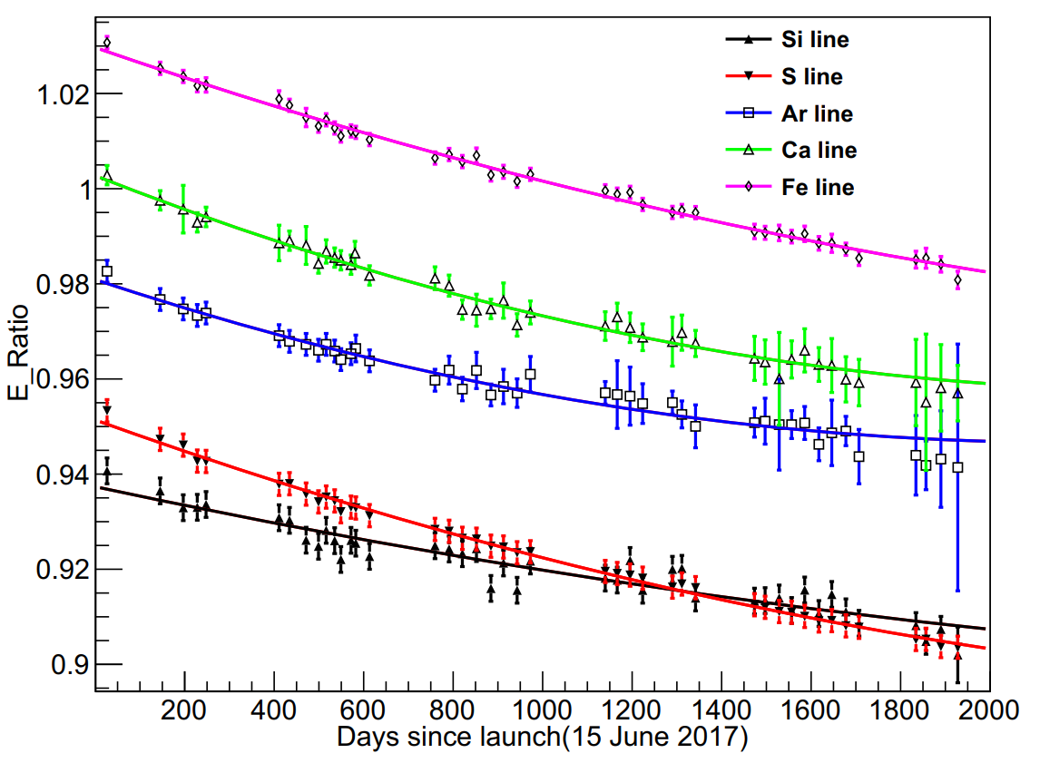
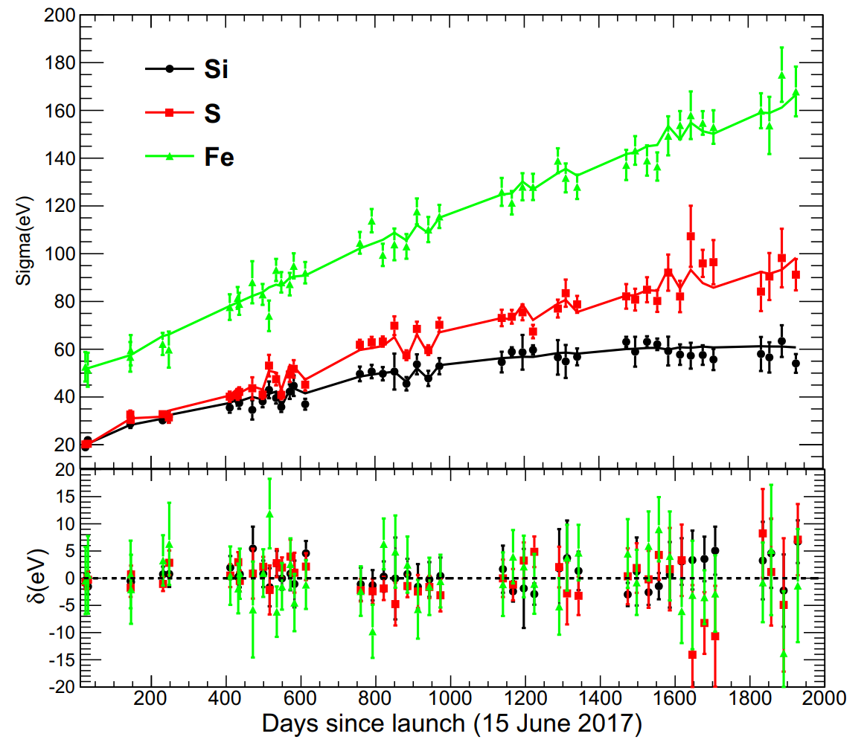
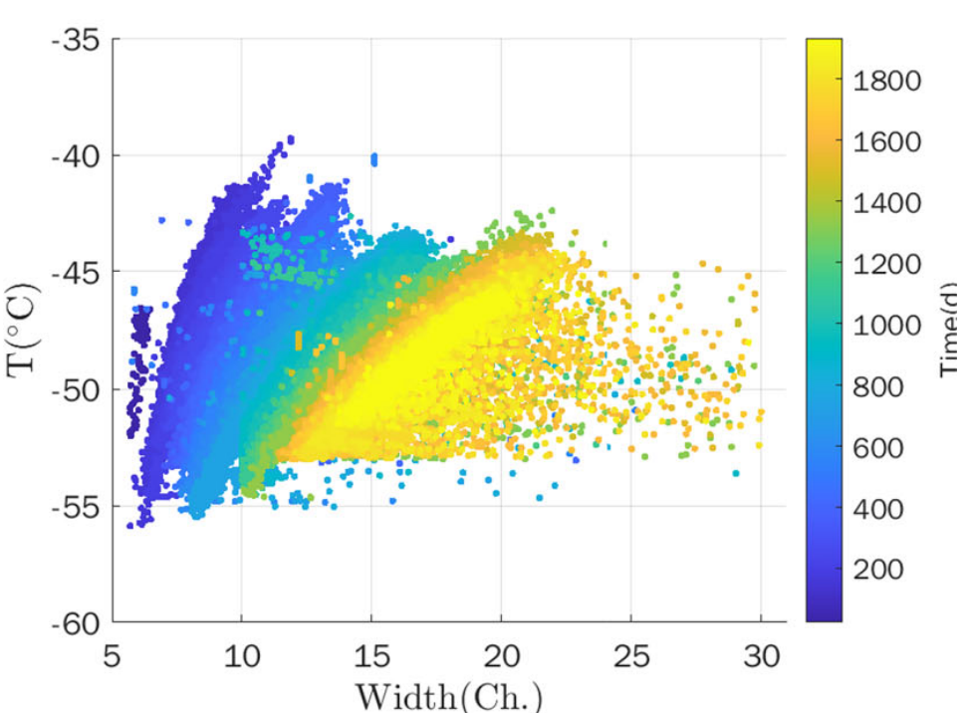
3.5 Calibration—LE
  Gain and Energy Resolution are calibrated by the observations of Cas A and background lines generated in the material near SCD.
    Cas A: 8 lines
    Background lines: 3 lines, Ni, Cu, Zn line
    Gain and resolution are decreasing
  Li et al. 2020, JHEAp, Li et al. 2023, RDTM.
Cas A spectrum
LE: Gain vs Time
LE: FWHM vs Time and temperature
Notes:
LE has the forced trigger events, which record the noise amplitude per 32 ms of each CCD

Slide 15
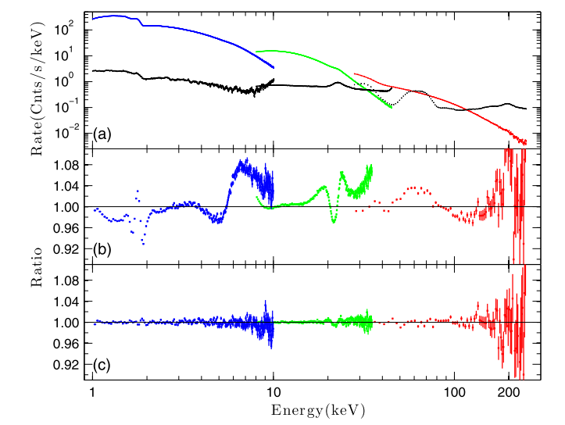
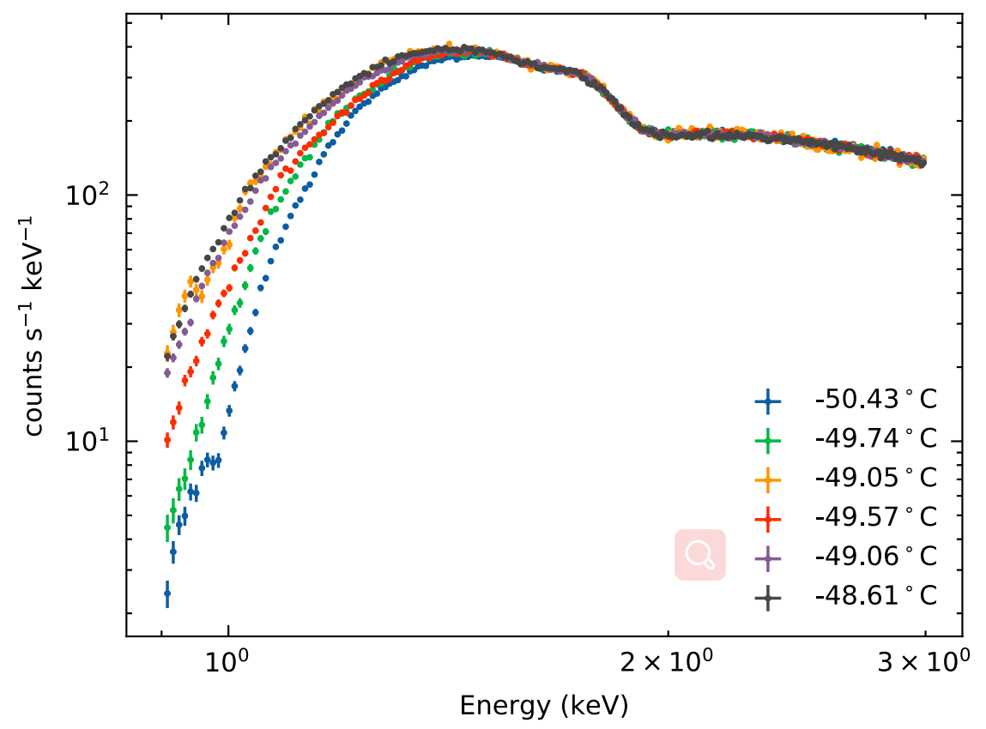
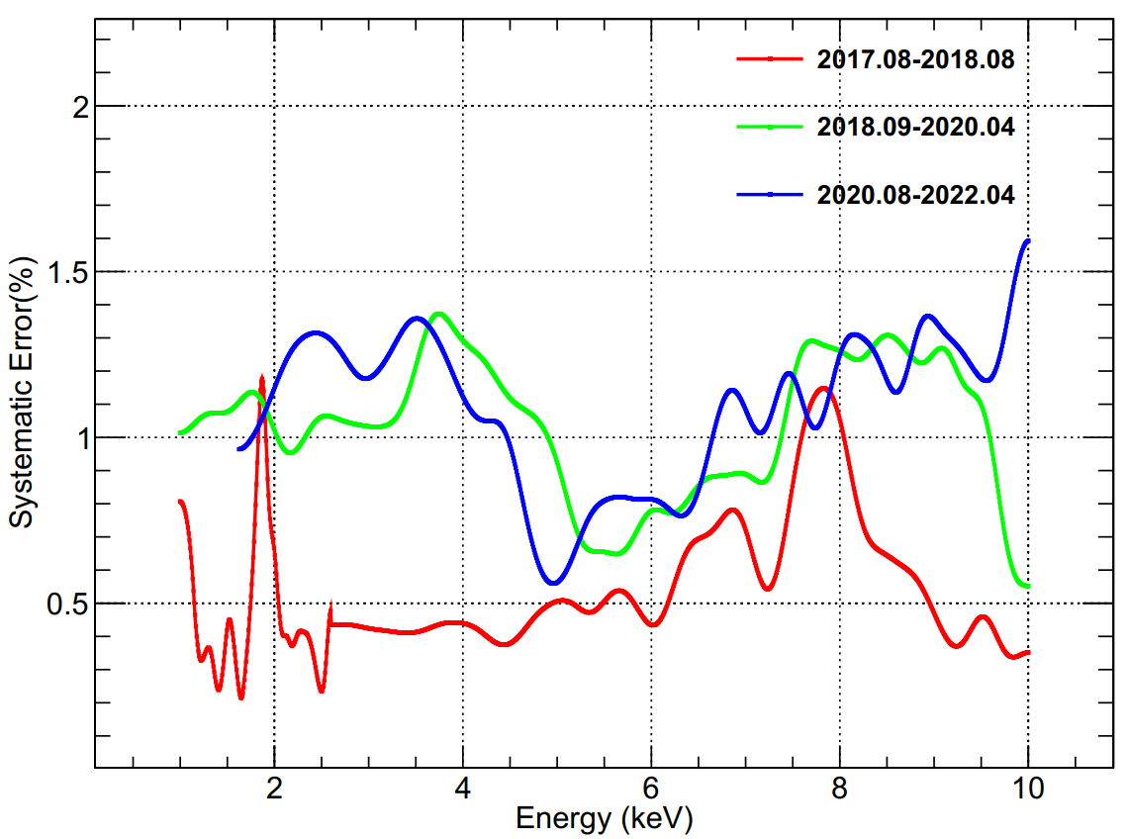
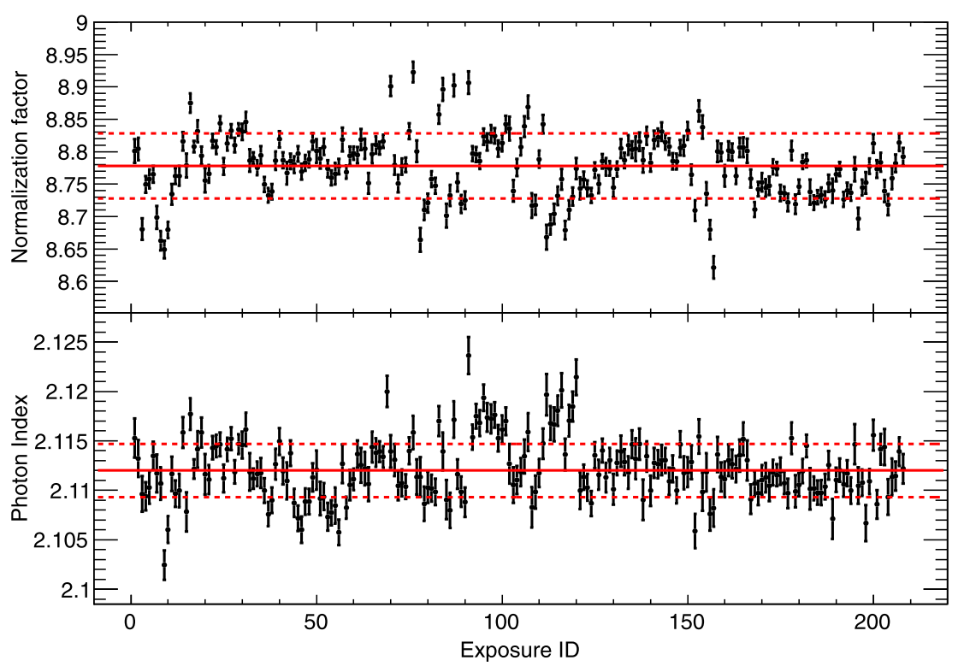
3.5 Calibration—Effective Areas
  The effective areas are calibrated by the pointed observations of Crab nebular.
  The systematic errors are:
    HE: 28—120 keV (<2%), 120—250 keV (2%—10%)
    ME: 10—35 keV (~ 1.5%)
    LE: 1—7 keV (1.5%), 7—10 keV (2%)
  Li et al. 2020, JHEAp, Li et al. 2023, RDTM
Crab nebular spectrum
Crab nebular spectrum by LE
Notes:
list

Slide 16
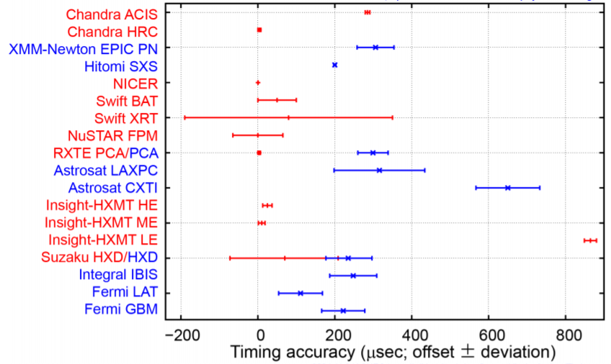
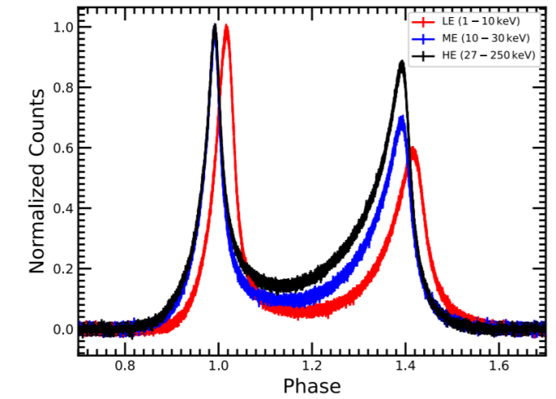
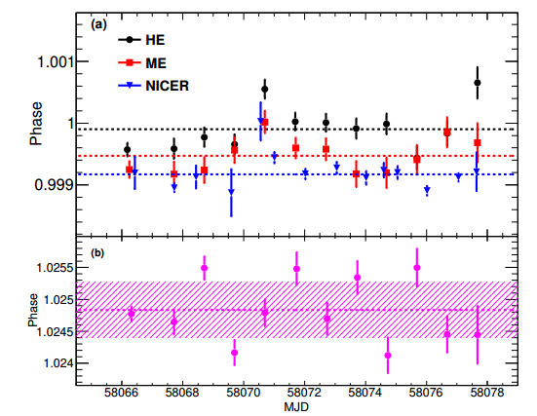
3.5 Calibration—Timing system
The timing offset is determined by the design of the electronics of the three instruments:
  HE：156 ns，ME：334 ns，LE：864 µs
The systematic errors of the timing systems is obtained by simultaneous observations of the Crab Nebula with NICER.；
  HE：12 µs， ME：9 µs， LE：16 µs
  https://wikis.mit.edu/confluence/display/iachec/Timing
Tuo et al, 2022, ApJS
Youli’s presentation
in timing WG.
Notes:
时间系统系统误差来源：
GPS晃动
载荷时间延迟
晶振精度
时间解算方法（截断误差）
Crab脉冲星的计时噪声

Slide 17
4. Highlights of the scientific results
4.1
Highest-E Neutron star cyclotron absorption line
Large Areas
Discovery of oscillations above 200 keV in a black hole X-ray binary MAXI J1820+070
Large Areas
Broad energy band
Timing
4.2
Identification of a non-thermal X-ray burst from SGR J1935+2154 and associated with FRB 200428
Broad energy band
Light Curve
Localization
4.3

Slide 18
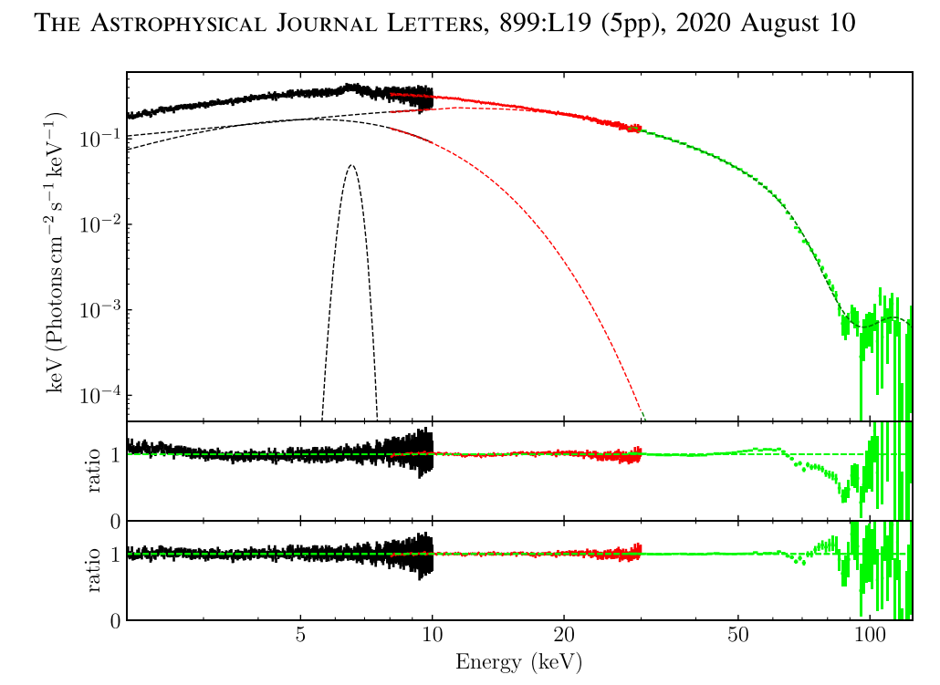

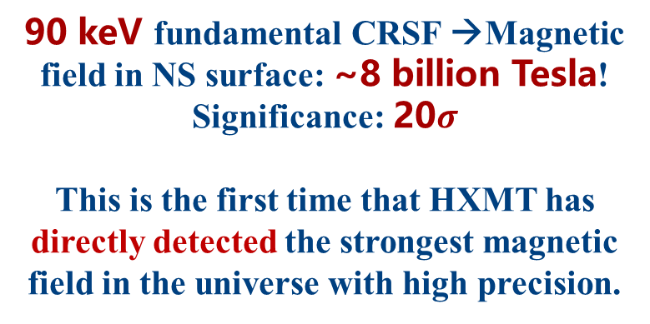
4.1 Strongest magnetic field in the universe
Insight-HXMT firstly directly detected the highest energy Fundamental Cyclotron Resonance Scattering Feature (CRSF).
Accreting Neutron Star: GRO J1008-57
90 keV
90 keV fundamental CRSF →Magnetic field in NS surface: ~8 billion Tesla!
Significance: 20$σ$
This is the first time that HXMT has directly detected the strongest magnetic field in the universe with high precision.
吸收深度随中子星转动的调制
Ge et al. 2020, ApJL
Notes:
HXMT directly detected the strongest magnetic field in the universe.
~90 keV Highest-E Neutron star cyclotron(/ˈsaɪklətrɑːn/ Resonance/ˈrezənəns/ Scattering Feature) absorption line

Slide 19
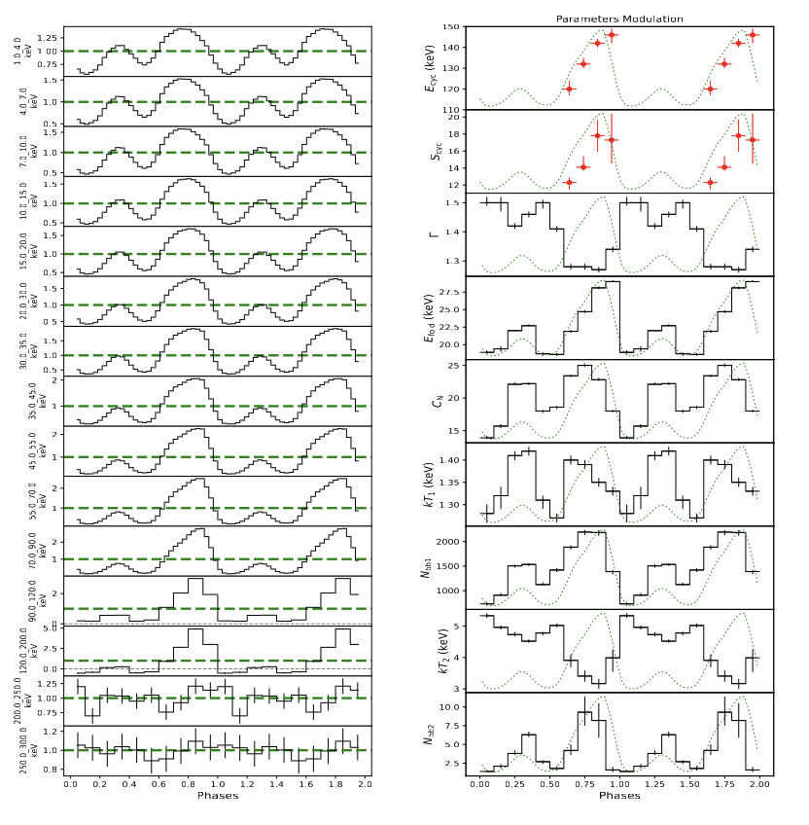
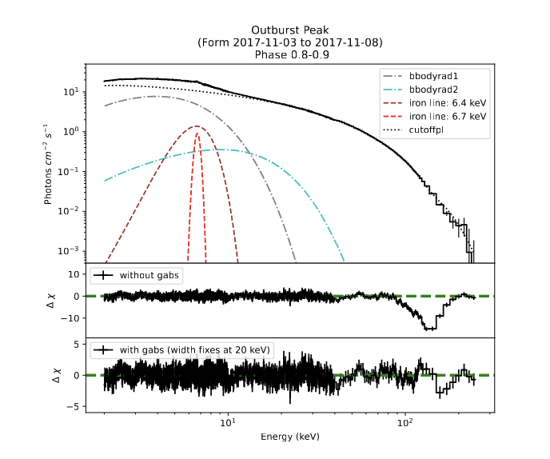

4.1 Strongest magnetic field in the universe
A new record for the energy of CRSF and the strongest direct measurement of the magnetic field in the universe.
Swift J0243.6+6124
Significance: 6-18 $σ$
fundamental CRSF 146 keV→16 billion Tesla
Kong et al. 2022, ApJL
Notes:
这是电子在磁场中回旋共振散射造成的，

Slide 20
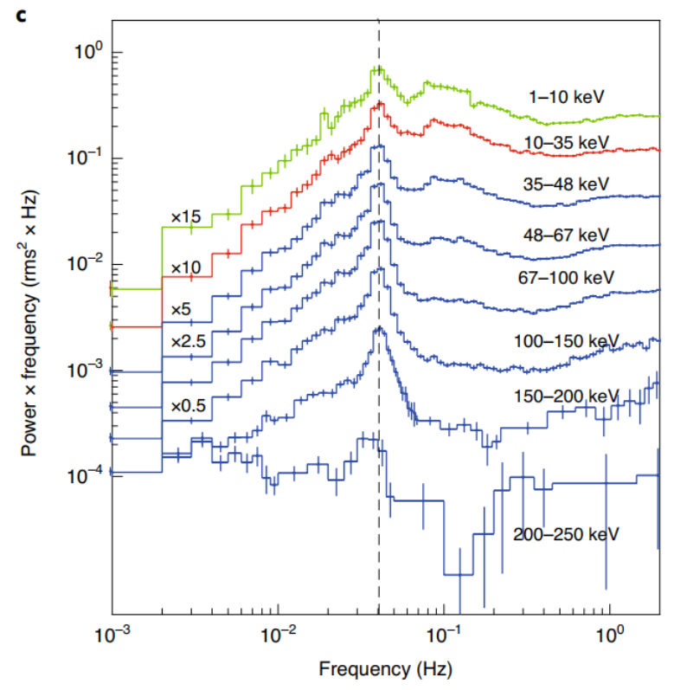
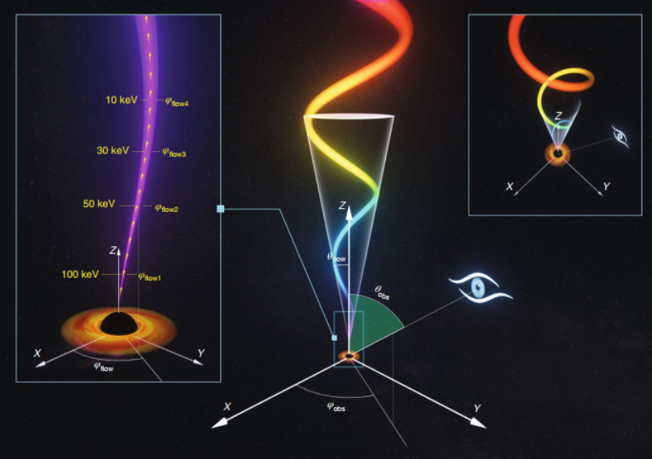
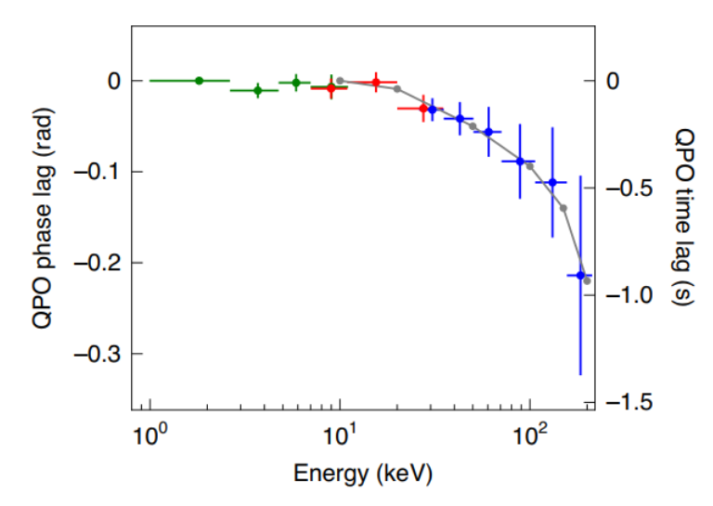
4.2 Discovery of QPO above 200 keV in MAXI J1820+070
QPOs of BH binaries: < 30 keV → >200 keV
Very large & soft lag:
not precession corona
New model of BH QPOs: L-T precession Jet
Ma et al, 2021, Nature Astronomy

Slide 21
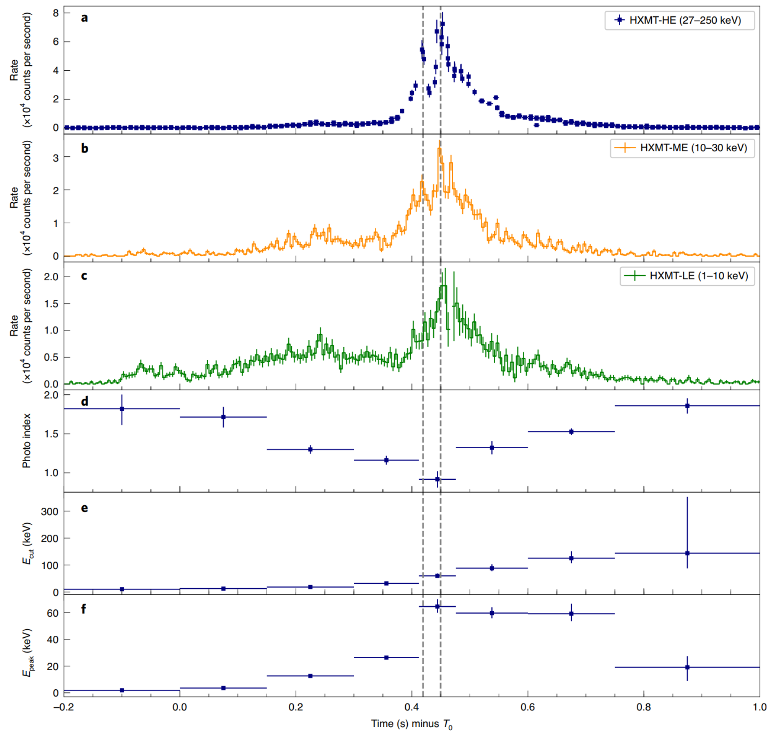
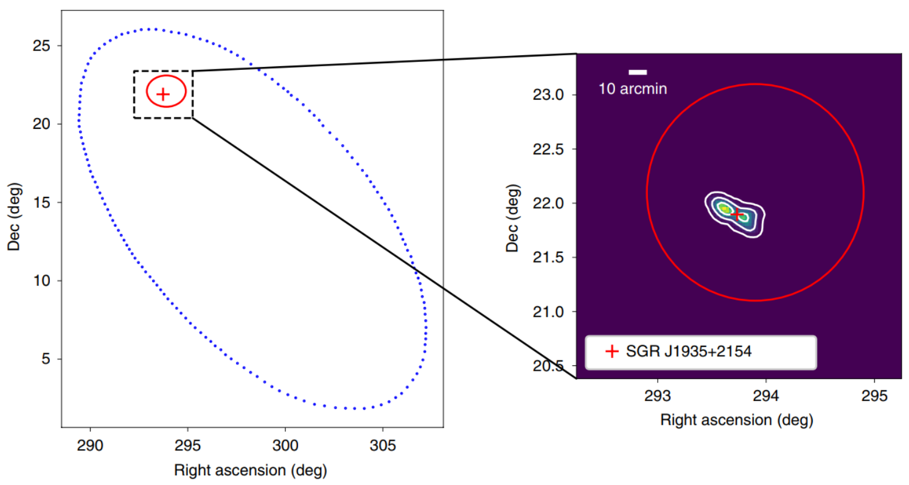
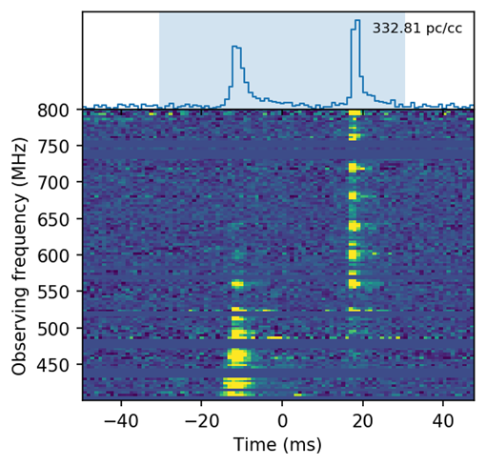
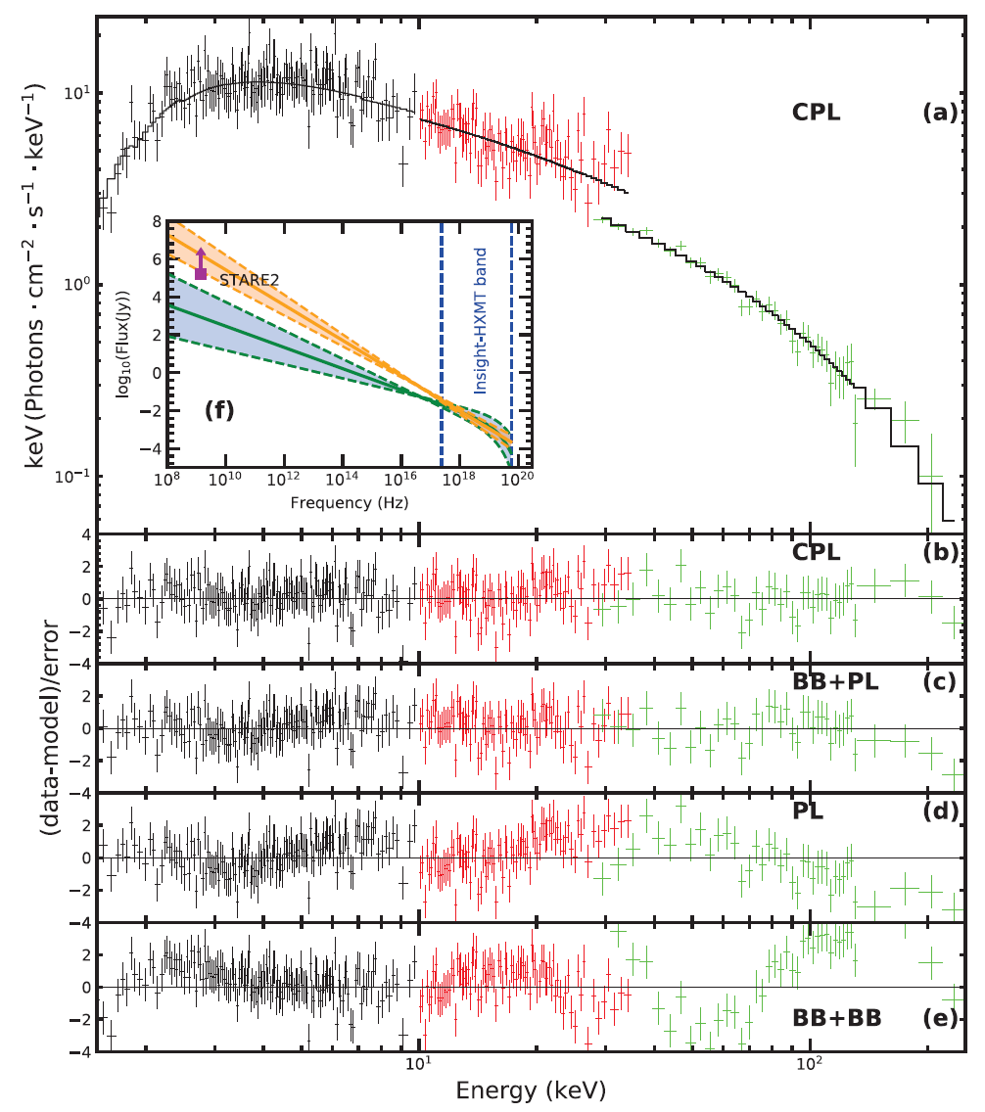
4.3 Identification of a non-thermal X-ray burst from SGR J1935+2154 associated with FRB 200428
Historic event on April 28th 2020
CHIME
Insight-HXMT Localization
Identification of the X-ray burst with SGR J1935+2154
Insight-HXMT
中子星（外星人无法生存）
Insight-HXMT broad band spectrum
CHIME/FRB Collaboration, 2020 Nature;
Insight-HXMT broad band light curves
Two narrow X-ray peaks coinciding the twin radio pulses (30 ms separation)
Identification of the X-ray burst with FRB 200428
CPL: photon index ~1.6,
Ecut~84 keV
BB+PL: Tbb~11 keV,
photon index ~1.9
Li et al, 2021, Nature Astronomy

Slide 22
5. Summary
Insight-HXMT has worked smoothly for ~2100 days, and all the instruments work well.
Five cycles of AO have been collected and the scientific observation targets of the five years have been successfully scheduled. AO06 is ongoing.
The pointed data have been released after the protection.
HXMTDAS , CALDB and background model are continuously updated.
With its combined advantages of large area, broad band, high timing and energy resolution, HXMT has opened a new window for the study of hard X-ray fast timing and energy spectra of black holes and neutron stars.
Homepage: http://hxmten.ihep.ac.cn
THANKS！

