Slide 1
Coordinated Observations Working Group
Report for 15th IACHEC meeting, Pelham am See, Germany
Karl Forster Apr 27th, 2023

Slide 2
Coordinated Observations Working Group
We live in exciting times
Report for 15th IACHEC meeting, Pelham am See, Germany
Karl Forster Apr 27th, 2023

Slide 3
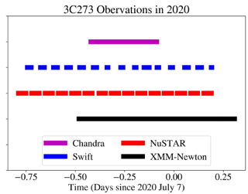
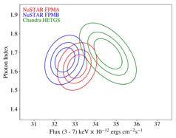
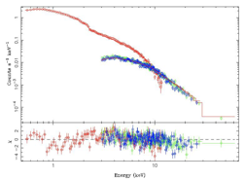
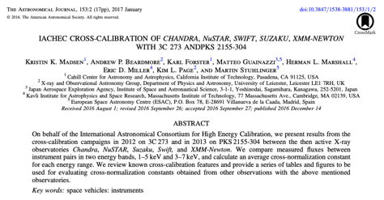
Scope of the Co-Obs Working Group
coordinate new observations jointly among different telescopes
analyze those observations
and publish the results.
Co-Obs report for IACHEC meeting, Pelham am See – April 27, 2023 Karl Forster

Slide 4
Activity in 2023
XRISM scheduling process – Chris Baluta
Weekly schedule upload to spacecraft
Posted online ~3 weeks in advance
Minimum 2 days response time for ToO’s
(3 days over weekends)
Contact information for scheduling teams
Routine calibration observations during mission
E0102 / Perseus cluster for low / high energy calibration and contamination monitoring
Plan to join annual IACHEC cross-calibration campaign on 3C 273
Working group virtual meeting
Feb 10th on zoom
18 working group members attended
XRISM calibration plans – Eric Miller
1-month of in-flight calibration
starting at launch +3 months
see "Planning in-flight calibration of XRISM" E.D. Miller et al. (2020) SPIE online paper
Calibration plans include requests for coordinated observations by
NuSTAR – on-axis Aeff, optical axis
Chandra – Resolve gain
XMM, Swift, NICER – off-axis PSF, timing
Calibration observations begin Sept 2023
Assuming late May Launch
Delay of 2023-June 3C 273 campaign
Chandra, XMM, Swift, NICER, INTEGRAL, NuSTAR
Discuss at IACHEC meeting a delay to early January to allow XRISM to join
Co-Obs report for IACHEC meeting, Pelham am See – April 27, 2023 Karl Forster

Slide 5
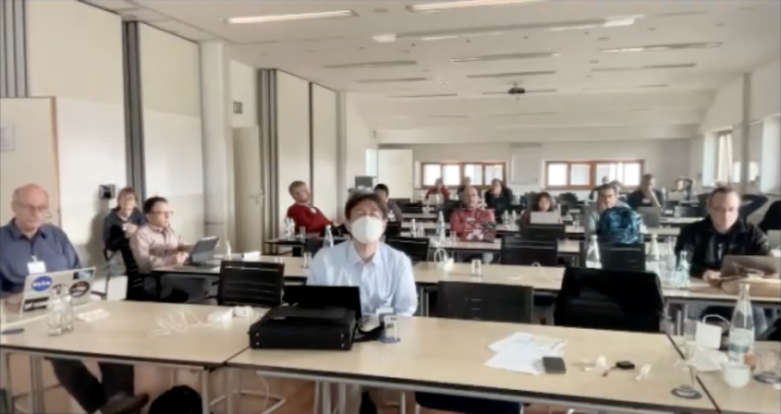
Working group session – April 27
18 attended in person
+7 on zoom
Agenda
XRISM in-flight calibration adjustment after launch delay
Possible support for Einstein Probe in-flight calibration
Delay of IACHEC 3C 273 coordinated cross-calibration observations to January 2024
Support for continuing coordinated calibration observations
Working group communications
Co-Obs report for IACHEC meeting, Pelham am See – April 27, 2023 Karl Forster

Slide 6
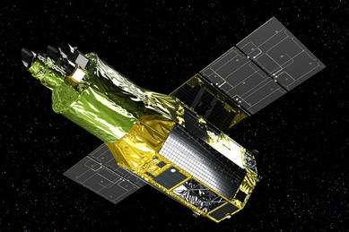
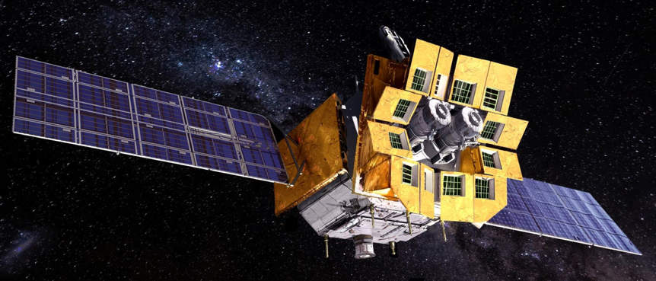
Support for in-flight calibration of new missions
XRISM
Launch no earlier than the end of August 2023
Calibration observations from 2023 December
Will continue during 6-month PV-phase
Launch date TBD
Coordinated calibration targets approved
NuSTAR and Chandra
XMM, Swift, & NICER obtained as DDT requests
Einstein Probe
Preliminary launch date early November 2023
Calibration observations begin late November
Launch date TBD
Will discuss possible coordinated observations
XRISM
Einstein Probe
Co-Obs report for IACHEC meeting, Pelham am See – April 27, 2023 Karl Forster

Slide 7
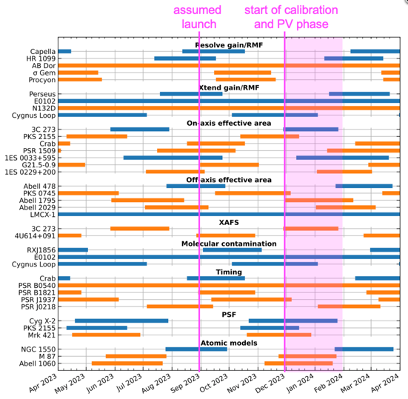
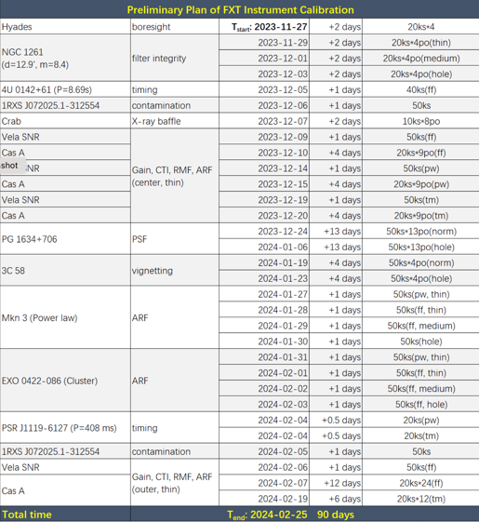
Support for in-flight calibration of new missions
XRISM CAL targets
EP-FXT CAL Plan
XRISM
Launch no earlier than the end of August 2023
Calibration observations from 2023 December
Will continue during 6-month PV-phase
Launch date TBD
Coordinated calibration targets approved
NuSTAR and Chandra
XMM, Swift, & NICER DDT requests
Einstein Probe
Preliminary launch date early November 2023
Calibration observations begin late November
Launch date TBD
Will discuss possible coordinated observations
courtesy of Eric Miller
Coordination/communication via ESA/MPE co-investigator teams
from Chengkui Li presentation
Co-Obs report for IACHEC meeting, Pelham am See – April 27, 2023 Karl Forster

Slide 8
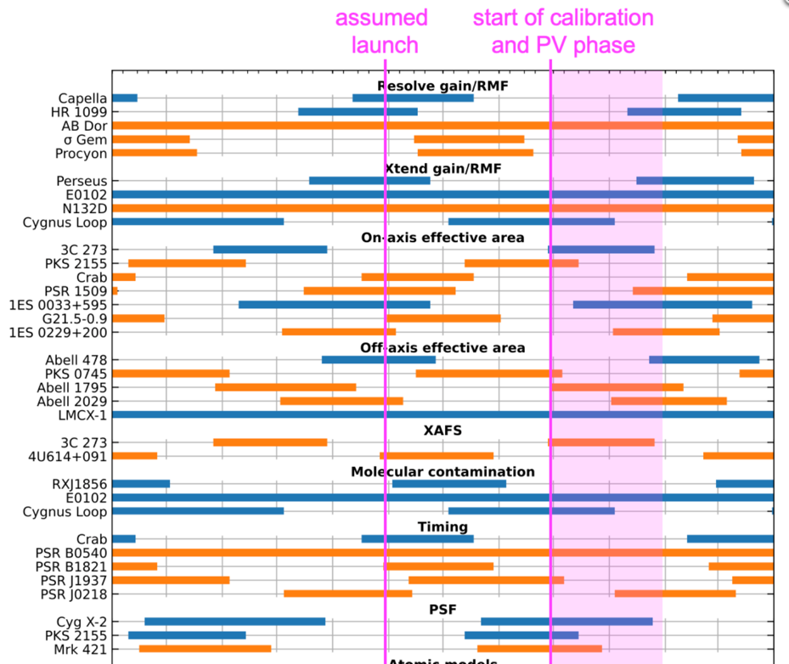
3C 273 cross calibration
XRISM CAL targets
Confirmed decision to delay observations to January 2024
Latest date January 14th due to XMM visibility
Einstein Probe (FXT) could join in campaign because Solar aspect angle is > 90 degrees starting 2023 December 27th
Not on FXT calibration target list
EP team will discuss
Co-Obs report for IACHEC meeting, Pelham am See – April 27, 2023 Karl Forster

Slide 9
XRISM Calibration coordinated observation targets
Coordinated Calibration Targets Eric Miller and Chris Baluta
NuSTAR observations approved
Including NuSTAR Crab stray light observation
Chandra observation of Capella approved
To obtain a baseline of binary system phase
IACHEC campaign simultaneous with XRISM open filter 3C 273 observation
Will hold a meeting after launch date has been determined
After a preliminary calibration schedule has been developed
Calibration implementation plan being developed
Target | NuSTAR | XMM | Chandra | Swift | NICER | Notes
1ES0033+595 | Y
3c273 (x3) | Y | Y | Y | Y | Y | IACHEC campaign
LMC X-1 | Y
Capella |  |  | Y |  |  | inc. raster scan
Crab | Y |  |  |  | (y) | NuSTAR stray light
Cyg X-2 |  | m |  | m | m
PKS 2155-304 |  | m |  | m | m
Other (not visible)
1ES 0033+595 | (y)
HR 1099 |  |  | (y)
Co-Obs report for IACHEC meeting, Pelham am See – April 27, 2023 Karl Forster

Slide 10
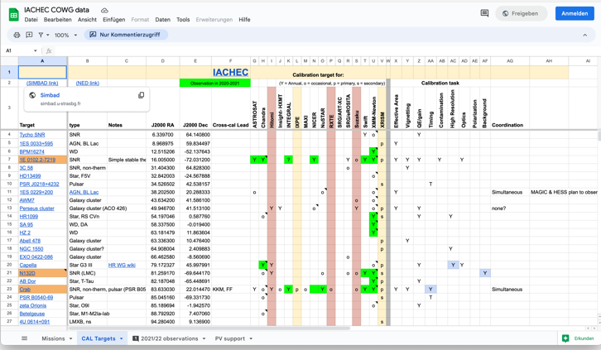
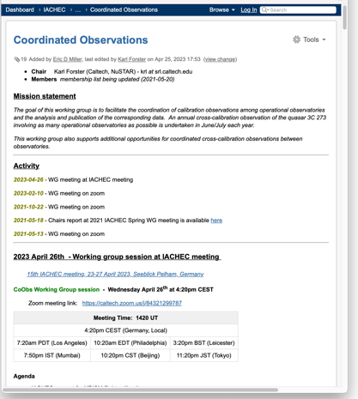
Working Group Communications
Mailing list
iachec-co-obs@lists.srl.caltech.edu
41 members
Slack Channel
On IACHEC slack site
#coordinated-obs
77 members
CoObs google sheets
CoObs WG wiki
Co-Obs report for IACHEC meeting, Pelham am See – April 27, 2023 Karl Forster

Slide 11
New 3C 273 cross-calibration paper
from Jeremy Hare presentation
Plans for new cross-calibration paper – Led by Jeremy Hare
Based on 2017 observations during 3C 273 IACHEC campaign
Including first NICER observation
Contacts for analysis check:
XMM – Felix Fuerst
NuSTAR – Kristin Madsen
Chandra – Herman Marshal
Swift – Andy Beardmore
Follow similar presentation to Madsen et al. 2017 paper
Possibly include analysis of cross-calibration using XRISM observation in 2024
Lots of plots!
Plans for data storage and sharing
IACHEC wiki webpage has enough space
Eventually transfer to HEASARC
Plan to start up discussions again
Also generate concordance format data
Fluxes in bands
Co-Obs report for IACHEC meeting, Pelham am See – April 27, 2023 Karl Forster

Slide 12
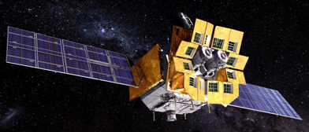
Coordinated Observations Working Group
We live in exciting times
...again!
Report for 15th IACHEC meeting, Pelham am See, Germany
Karl Forster Apr 27th, 2023

