Slide 1
IACHEC Concordance &
XMM Calibration Implications:
In-Flight Calibration of X-ray Telescopes
without Absolute References
Herman L. Marshall (MIT), Vinay Kashyap, Jeremy Drake, Pete Ratzlaff, Paul Plucinsky (SAO), Matteo Guainazzi (ESA)
Yang Chen (Harvard, UMich.), Xiao-Li Meng, Xufei Wang (Harvard), David van Dyk (ICL)
(Marshall+, 2021, AJ, 162, 254; see also IACHEC May 2022)

Slide 2
The Goal
The problems
Discrepant results from X-ray observatories in orbit
Cluster temperatures and fluxes
Blazar fluxes from simultaneous observations
SNR line fluxes
Imperfect ground cal, performance changes in flight
Instrument area priors $a_{i}$ differ from “true values” $A_{i}$
No absolute calibrators across all bands in flight: no “true” $F_{j}$
Specific task: derive $\overset{̂}{A_{i}}$ for optimal agreement
Let flux $f_{ij}=c_{ij}/T_{ij}/a_{i}$
where $a_{i}$ = prior on $A_{i}$
$c_{ij}$ = observed counts
$T_{ij}$ = known exposure time

Slide 3
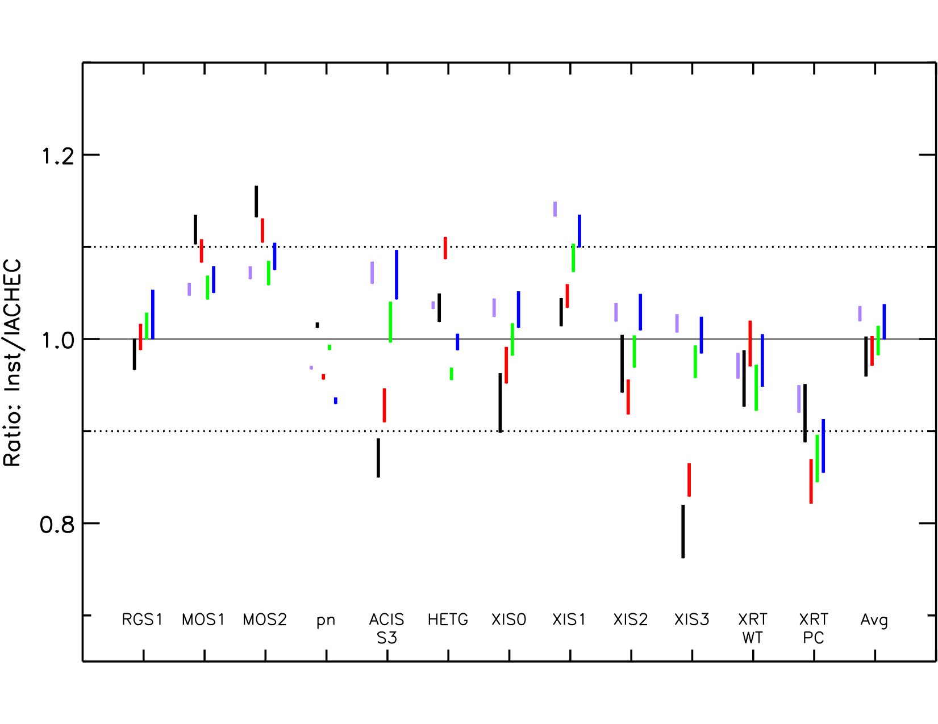
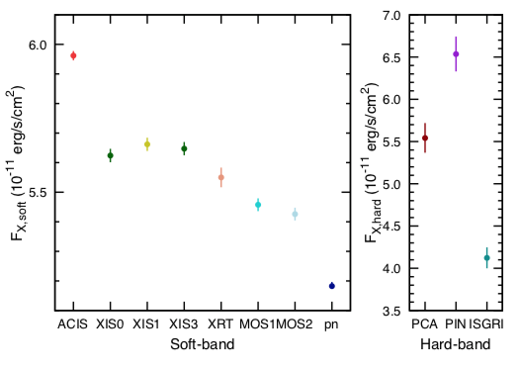
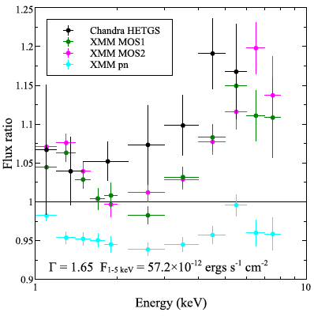
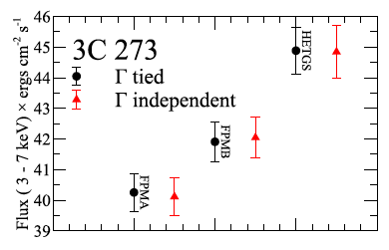
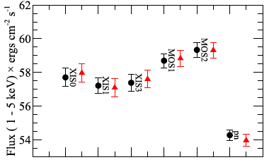
Some Previous Cross-Cal Work
1E0102 (Plucinsky+ ’17)
G21.5-0.9 (Tsujimoto + ’10)
3C 273 (Kruse Madsen + ’17)

Slide 4
The Problem, Graphically
Observed
Count Rate
a2
A2
A1
a1
C13/T13
a3 = A3
Estimated EA
Ideal EA
F1
F2
F3
Source Flux

Slide 5
Multiplicative Shrinkage (Chen+ ’19, JASA)
$$y_{ij}=B_{i}+G_{j}-\frac{σ_{i}^{2}}{2}+e_{ij},y_{ij}≡log(c_{ij}/T_{ij}),B_{i}≡logA_{i},G_{j}≡logF_{j}$$
$$\overset{̂}{B_{i}}=W_{i}({\overline{y}}_{i⋅}^{′}-{\overline{G}}_{i})+(1-W_{i})b_{i}\text{and}\overset{̂}{G_{j}}={\overline{y}}_{⋅j}^{′}-{\overline{B}}_{j}$$
$${\overset{˜}{y}}_{ij}^{′}={\overset{˜}{y}}_{ij}+0.5σ_{i}^{2},{\overline{y}}_{i⋅}^{′}=\frac{∑_{j=1}^{M}{\overset{˜}{y}}_{ij}^{′}σ_{i}^{-2}}{\sum_{j=1}^{M}{σ_{i}^{-2}}},{\overline{y}}_{⋅j}^{′}=\frac{∑_{i=1}^{N}{\overset{˜}{y}}_{ij}^{′}σ_{i}^{-2}}{\sum_{i=1}^{N}{σ_{i}^{-2}}},{\overline{G}}_{i}=\frac{∑_{j=1}^{M}\overset{̂}{G_{j}}σ_{i}^{-2}}{\sum_{j=1}^{M}{σ_{i}^{-2}}},{\overline{B}}_{j}=\frac{∑_{i=1}^{N}\overset{̂}{B_{i}}σ_{i}^{-2}}{\sum_{i∈I_{j}}{σ_{i}^{-2}}}$$
$$W_{i}=\frac{Mσ_{i}^{-2}}{τ_{i}^{-2}+Mσ_{i}^{-2}}$$
EA prior uncertainties
Data uncertainties

Slide 6
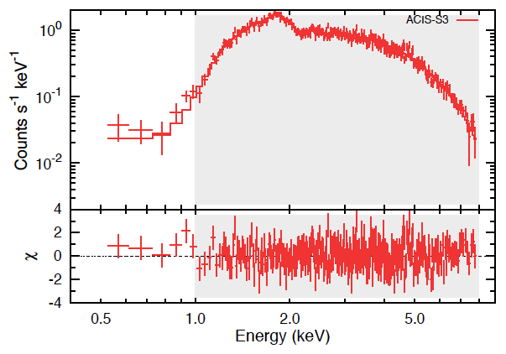
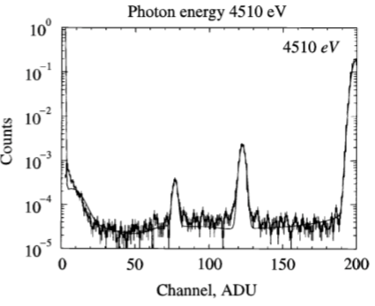
Complications I: Flux Measurements
Concordance: find $A_{i}$ where $C_{ij}=T_{ij}A_{i}F_{j},A(E)=A_{i}α_{i}(E)$
Fluxes in band $(E_{1},E_{2})$ derived by an inversion process
Input: observation $c_{ijk}$ for counts in channel k
Then fit to model $C_{ijk}^{′}=t_{ij}a_{i}f_{ij}\frac{∫_{E_{1}}^{E_{2}}α_{i}(E)q_{j}(E)Φ_{k}(E)dE}{∫_{E_{1}}^{E_{2}}q_{j}(E)dE}={\overset{˜}{T}}_{ijk}a_{i}f_{ij}$
where $f_{ij}=∫_{E_{1}}^{E_{2}}n_{E}(Θ_{ij})dE=n_{ij}∫_{E_{1}}^{E_{2}}q_{j}(E)dE$ and $\overset{˜}{A}(E)=a_{i}α_{i}(E)$ define shape functions $q_{j}(E)$ and $α_{i}(E)$, the detector response is $Φ_{k}(E)$, and $\underset{k}{∑}Φ_{k}(E)=1$
Now, $C_{ij}=\underset{k}{∑}C_{ijk},T_{ij}=\underset{k}{∑}{\overset{˜}{T}}_{ijk}$
G21.5-0.9 (Tsujimoto + ’10)
Bautz+ ‘99
ACIS RMF

Slide 7
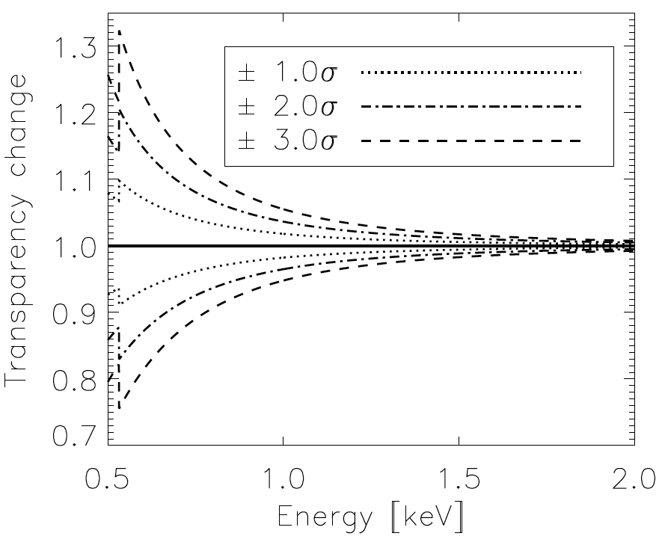
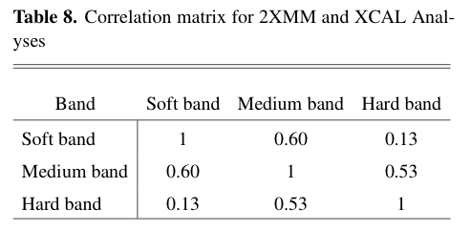
Complications II: Eff. Area Correlations
Assume we have EA parameters $\overset{⃗}{ξ}$ giving $log\overset{˜}{A}(E;\overset{⃗}{ξ})=\overset{˜}{B}(E;\overset{⃗}{ξ})$ with $p(\overset{⃗}{ξ})$
Then $\overset{̂}{B}(E)=∫\overset{˜}{B}(E;\overset{⃗}{ξ})p(\overset{⃗}{ξ})d\overset{⃗}{ξ}$ is the best (prior) estimate of B and $τ^{2}(E)=∫[\overset{˜}{B}(E;\overset{⃗}{ξ})-\overset{̂}{B}(E)]^{2}p(\overset{⃗}{ξ})d\overset{⃗}{ξ}$ should be the prior’s variance
Consider two energies, $E_{i}$ and $E_{i^{′}}$, then the correlation between these is $ρ_{i,i^{′}}=\frac{1}{\sqrt{τ(E_{i})τ(E_{i^{′}})}}∫[\overset{˜}{B}(E_{i};\overset{⃗}{ξ})-\overset{̂}{B}(E_{i})][\overset{˜}{B}(E_{i^{′}};\overset{⃗}{ξ})-\overset{̂}{B}(E_{i^{′}})]p(\overset{⃗}{ξ})d\overset{⃗}{ξ}$
In reality, a Monte Carlo method is used to compute the correlations…

Slide 8
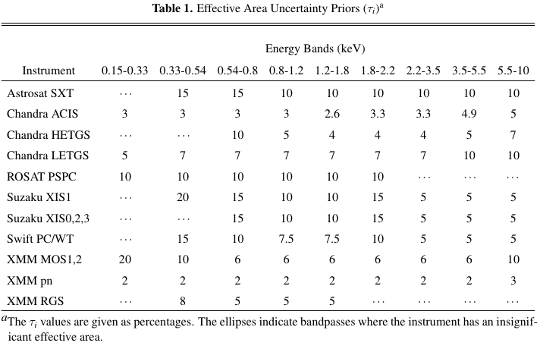
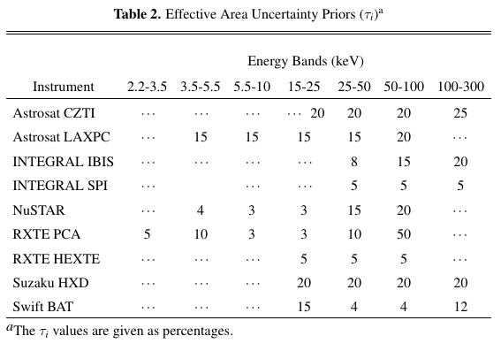
Assessing Priors
Collecting prior (fractional) uncertainties on effective areas
Cal scientists assessed their instruments

Slide 9
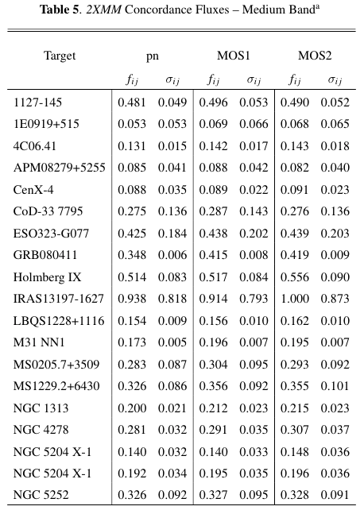
Input Data
Paper I (Chen+, 2019, JASA)
1E0102 with 13 instruments (N=13), O & Ne (M=2)
2XMM catalog targets, N=3, M=41; soft, medium, hard
XCAL bright targets, N=3, M=94-108; soft, medium, hard
Paper 2 (Marshall+, 2021, AJ, 162, 254)
Same 3 sets as in Paper I
Also Capella with Chandra gratings, N=8, M=15
Added correlations of XMM hard, medium, soft
Added corrlations of O, Ne fluxes of 1E0102
Used heterogeneous tau values
Sample Data (Marshall+ 2021)

Slide 10
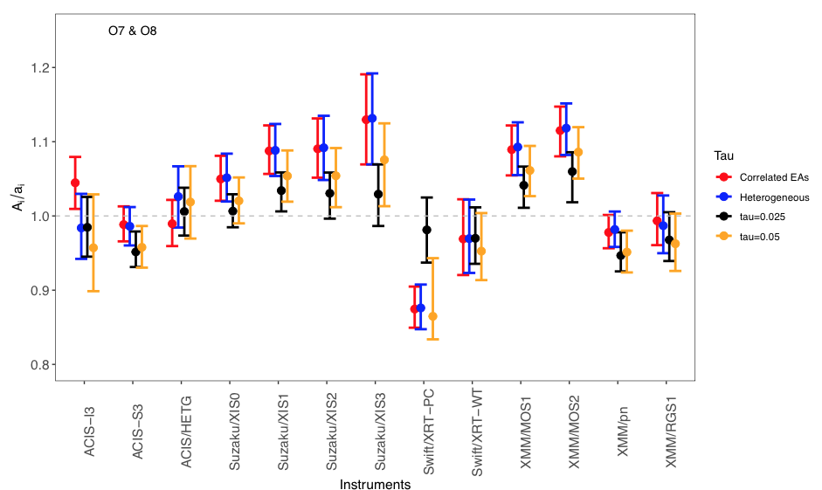
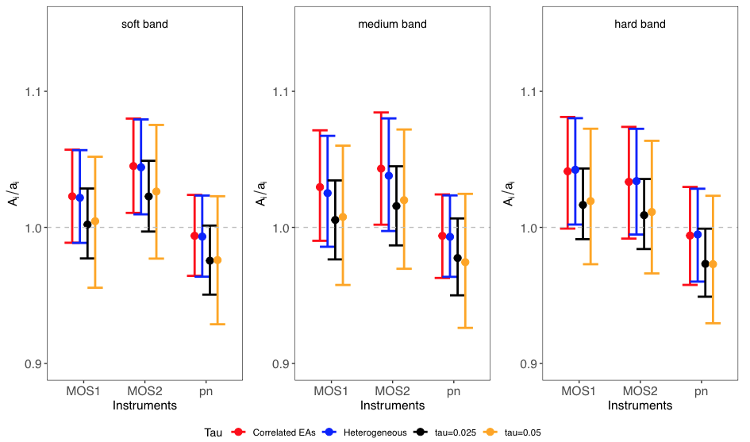
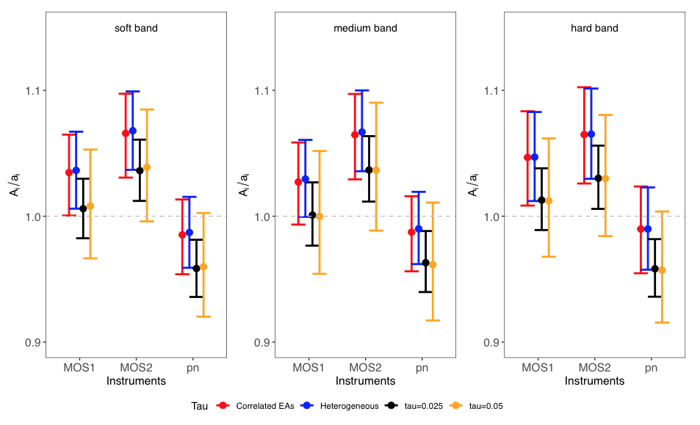
Concordance Results
SNR 1E0102: Correlations change results, tau values matter
2XMM sample: slight changes when taus are assigned
XCAL: same as 2XMM
Capella, Chandra TGs: ±1 orders agree, LETG is low of HETG

Slide 11
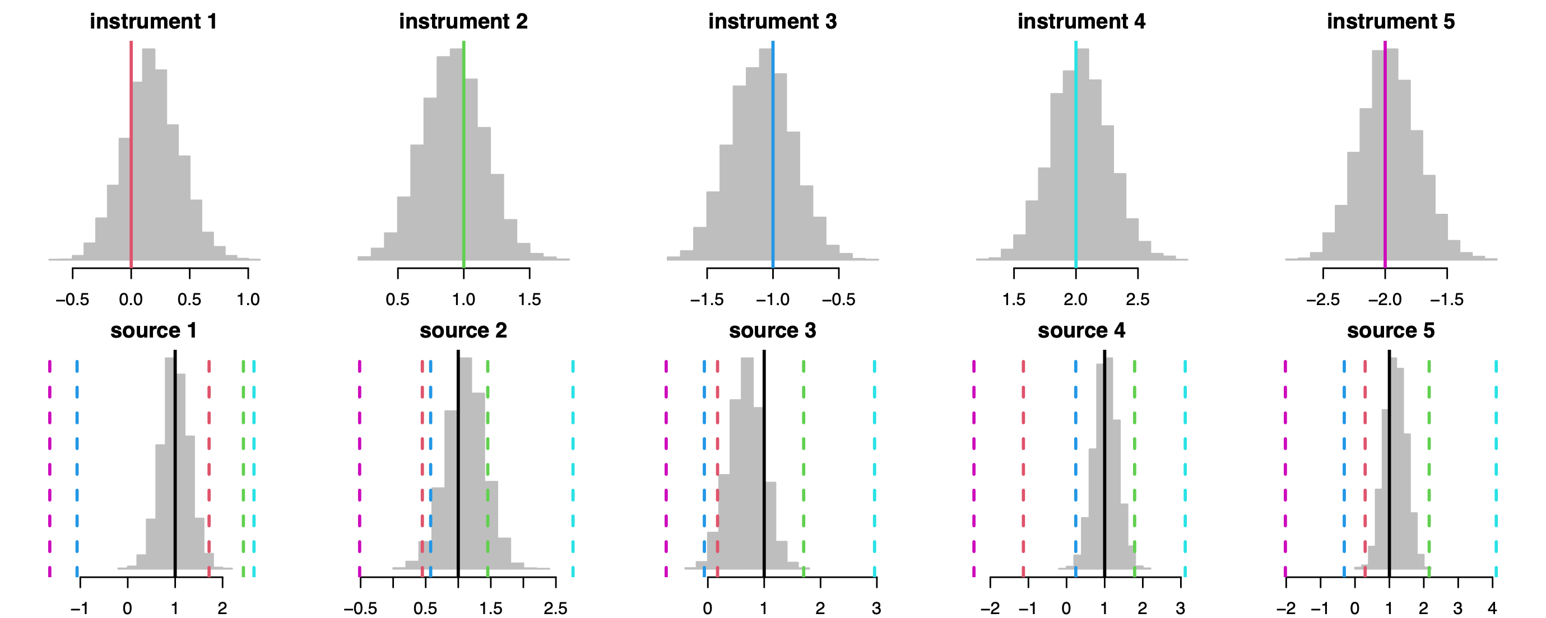
Validation Simulation 1
5 Instruments, $logA_{i}/a_{i}$ = [0, 1, -1, 2, -2], t=1
40 sources, $σ_{i}=[0.5,0.5,0.5,0.5,0.1]$ (on $logf_{ij}$)
Concordance: unbiased $A$ posteriors, good $F$ posteriors
Ratio estimates: wide flux ranges

Slide 12
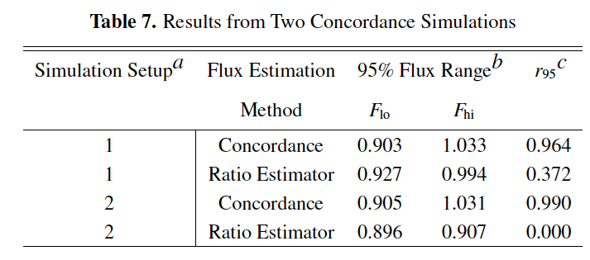
Validation Simulation 2
3 instruments, 20 sources, 3% stats, ${A_{i}}/{a_{i}}$ = [1.0,1.0,0.9]
Sim 1: poor flux error range coverage but good with Concordance
Sim 2: same setup but 0.3% stats for $i=3$
Concordance is still good
Ratio estimator ranges don’t cover true fluxes

Slide 13
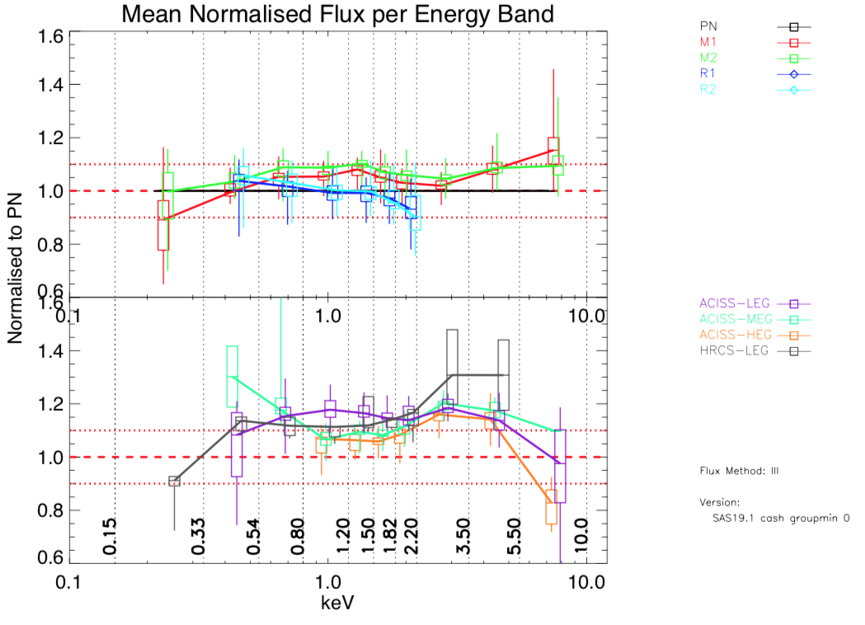
Next: XMM/Chandra XCAL

Slide 14
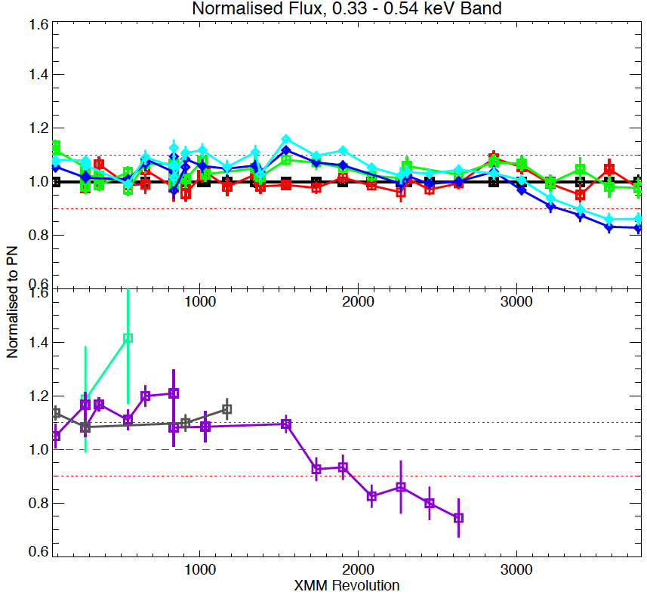
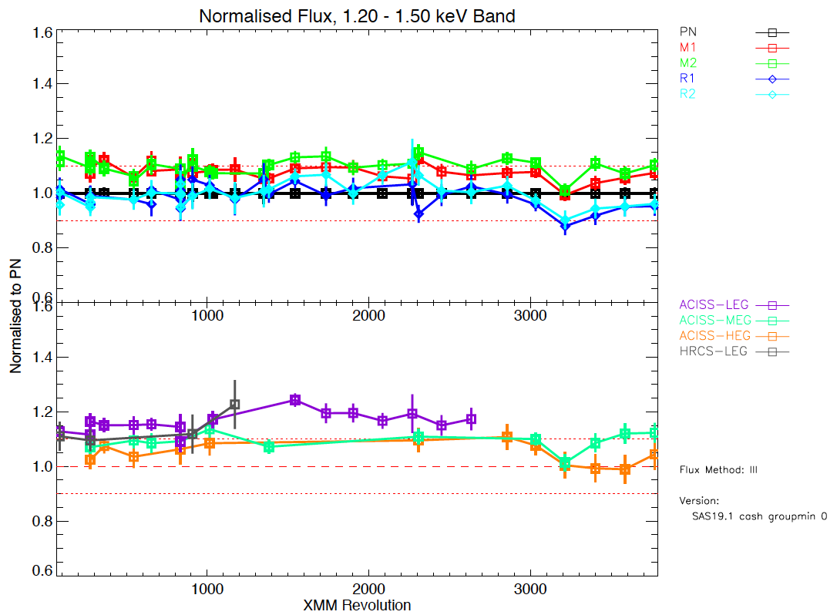
XCAL Time-Dependence

Slide 15
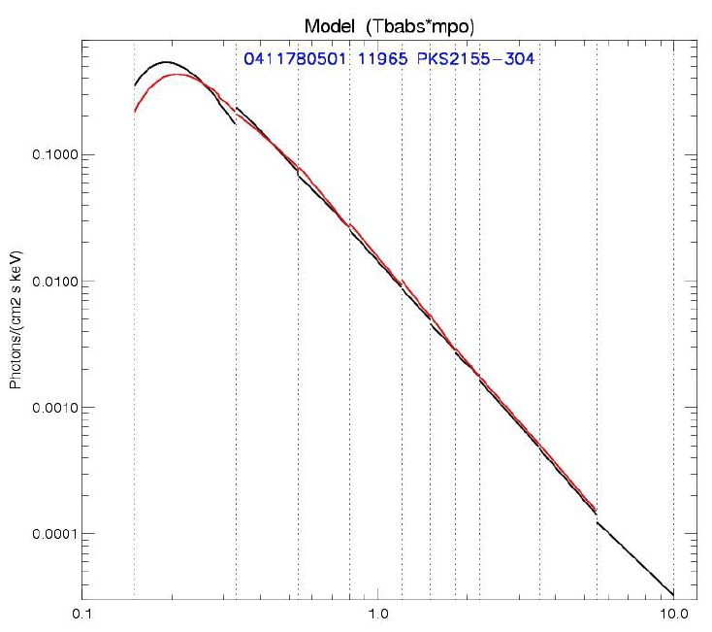
Conclusions
Concordance is “operational”
Simple situations an simulations give reasonable answers
Possible improvements
Outliers handled with t distribution
Fluxes in bands are related globally, not independent
Instrument areas are time-dependent
Upcoming: XMM/Chandra cross-cal

