Slide 1
Contamination Working Group:
Status & Plans
Herman L. Marshall
April 27, 2023

Slide 2
Goals and Status
Goals
Update and compare contamination models
Generate a white paper on mitigation and analysis
Updates since WG meeting of Nov. 2021
Chandra ACIS (H. Marshall, A. Bogdan)
contamination is still growing
model was updated in late 2022
the model is still good!
No progress on white paper after WG meeting

Slide 3
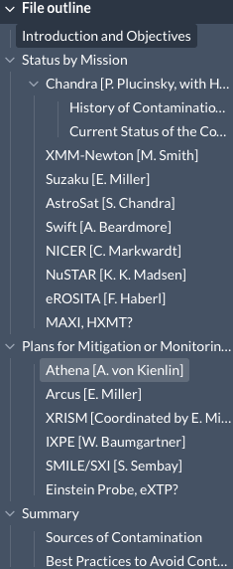
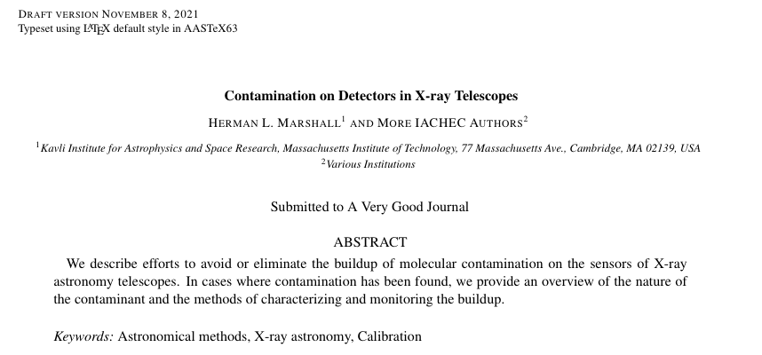
White Paper Plan
Develop on overleaf, link to edit was distributed
Review progress monthly
Target completion by next IACHEC Plenary
Initiate as white paper, decide on journal later

Slide 4
What ChatGPT can do
Response to Vinay’s prompt: ”A chorus about Chandra Optics"
With mirrors coated oh so fine
Chandra's optics capture every line
X-rays focussed with unparalleled care
Revealing details beyond compare

Slide 5
What Humans can do!
A Few of our Favorite Things
ChatGPT, Herman Marshall, and Bev LaMarr
(apologies to Rodgers and Hammerstein)
Polishing mirrors was done so precisely
Chandra finds sources so very concisely.
X-rays are focused with unparalled care
Finding fine details beyond all compare.
Trap maps and gain curves and in-flight cal sources,
Cross-calibration and statistics courses,
New background models in processing strings,
These are a few of our favorite things!
When the sun flares,
when the gain drifts
when the temps get hot;
You simply remember your favorite things
and then you can fix your plot!
While Insight and Swift, eROSITA exposing,
World-wide scientists; all are proposing.
At low E there's NICER with count rates galore,
Use NuSTAR if high E you want to explore.
With XMM, IXPE, and Integral flying,
These are the good times for us -- no denying.
Athena and XRISM are part of our hopes,
These will be two of our favorite ‘scopes!
SNRs, nebulae, all matched with Hubble,
A galaxy cluster with inflated bubble;
Praises for X-rays now everyone sings,
These are a few of our favorite things!
When the source fades,
if high background,
when your fit is bad;
You simply remember your favorite things
And then you don't feel so sad.

