Slide 1
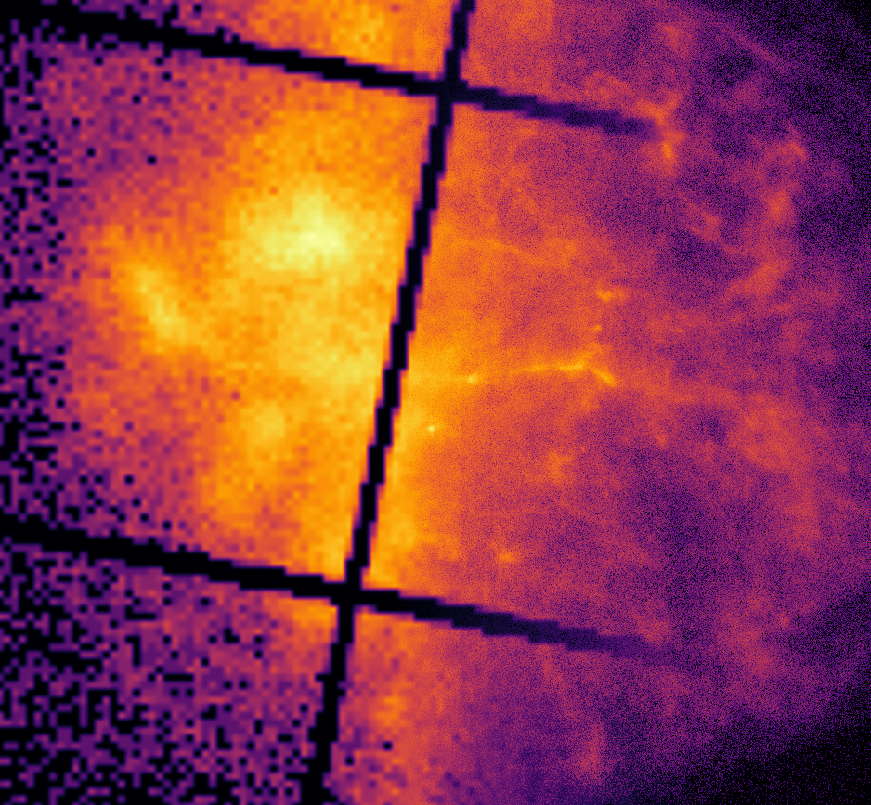
Deep Learning-Based Super-Resolution and De-Noising for XMM-Newton Images
Ivan Valtchanov, XMM SOC
Sam Sweere, Maggie Lieu, Eva Verdugo, Antónia Vojtekova, Maria Santos-Lleo, Florian Pacaud, Alexia Briassouli and Daniel Cámpora Pérez
MNRAS 2022, arXiv:2205.01152
IACHEC 2023, Pelham, Germany

Slide 2
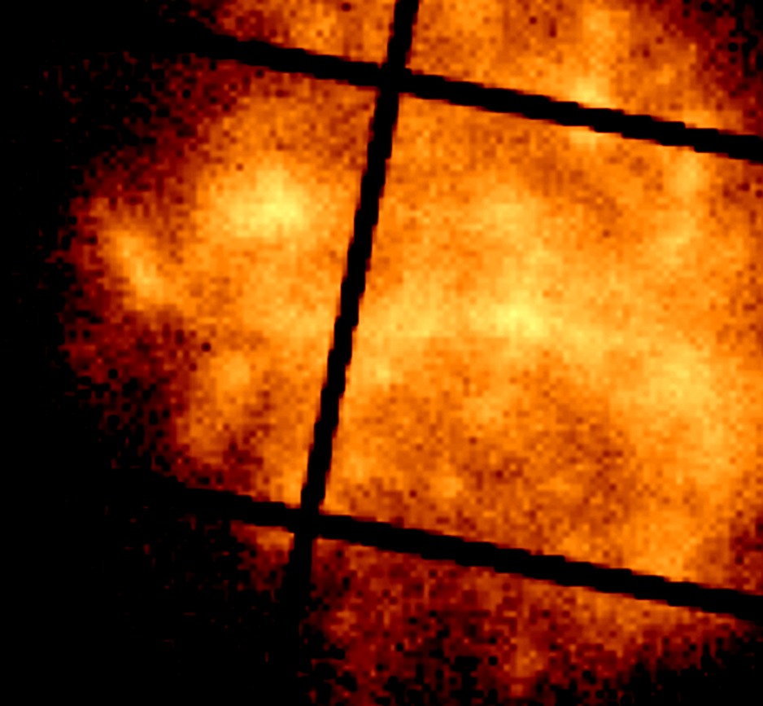
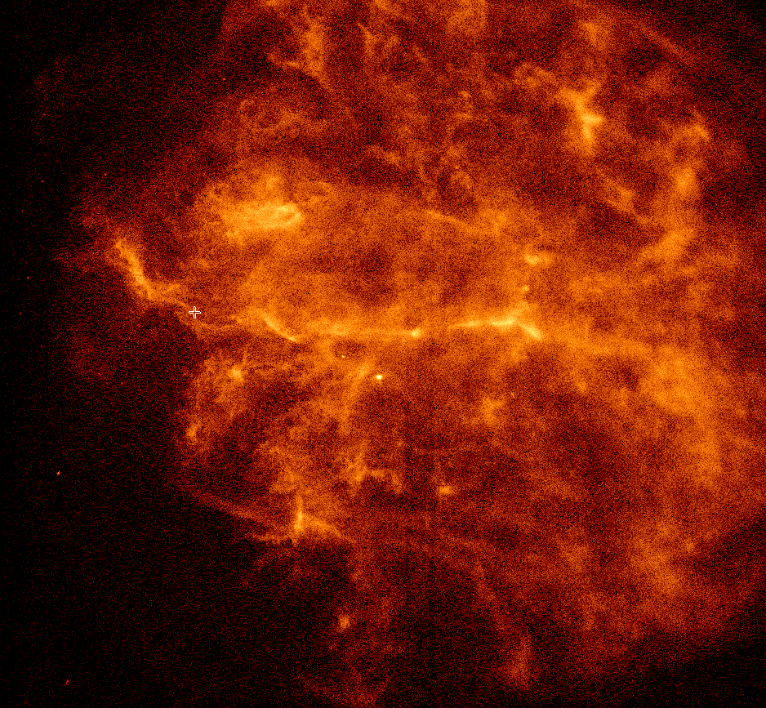
The idea
Increase the scientific exploratory value of XMM-Newton data
Improve spatial resolution (super-resolution)
Decrease noise (de-noising)
XMM-Newton
(6`` FWHM PSF)
Chandra
(0.5`` FWHM PSF)
Source ID: SNR 292.0+01.8

Slide 3
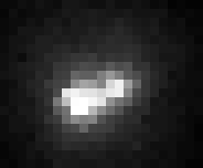
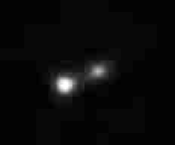
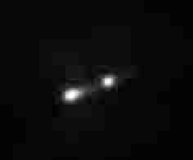
Traditional Approach for Super-Resolution
Direct Demodulation (DD) or Deconvolution
Difficult for XMM-Newton because of changing PSF
Needs high S/N and to be hand tuned
➔ Machine Learning
XMM-Newton
(2.5`` pixel size)
XMM-Newton DD
(0.5`` pixel size)
Chandra
(1.2`` pixel size)
Source: Improving the spatial resolution of xmm-newton epic images by direct demodulation technique; H. Feng, et. al.
Notes:
DD not applicable to xmm because of a non constant psf
Maggie showed an example of classical

Slide 4
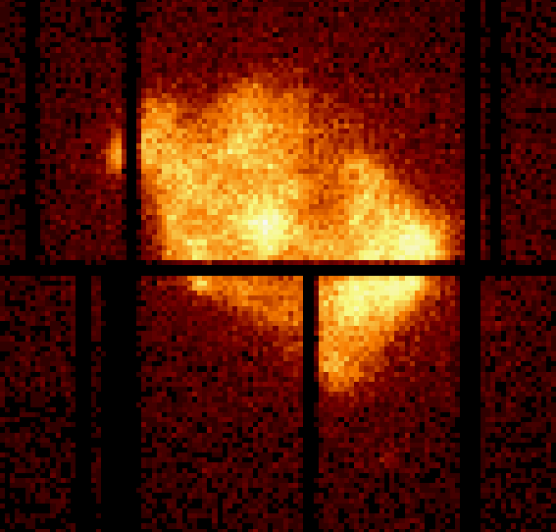
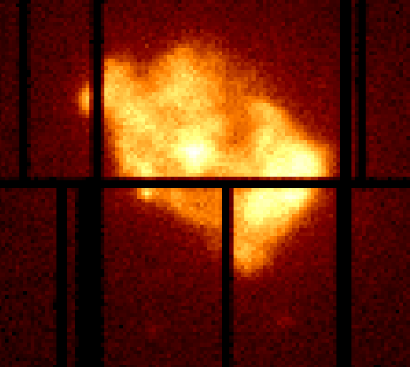
XMM-Newton Super-Resolution and De-Noising
Super-
Resolution
Model
XMM-Newton
Chandra
De-Noising Model
XMM-Newton
20ks exposure
XMM-Newton
100ks exposure
Source ID: SNR 292.0+01.8 and 3x397

Slide 5
RRDB Super-Resolution and De-Noise Models
Super-Resolution Model
De-Noise Model
Notes:
500 000 paramters

Slide 6
Residual in Residual Dense Block (RRDB)
Adapted from: ESRGAN: Enhanced Super-Resolution Generative Adversarial Networks, Xintao Wang et. al.
Notes:
Easier to learn.

Slide 7
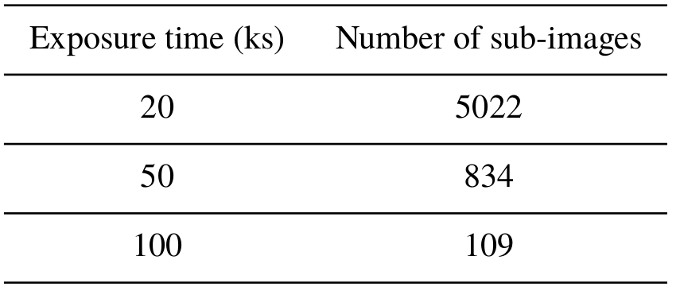
Training Data for De-Noising
De-noising, no resolution increase
Training on real data with higher exposure time
Limited number of long exposure images
Notes:
834 real images, 583 training images

Slide 8
Training Data for Super-Resolution
XMM-Newton cannot zoom
Chandra telescope has a higher spatial resolution, however:
Different image characteristics
Only a few hundred good pairs
XMM-Newton
(6`` FWHM PSF)
Chandra
(0.5`` FWHM PSF)
Source ID: SNR 292.0+01.8

Slide 9
XMM-Newton Simulation
Create training pairs with improved PSF and spatial resolution
Enhance interesting extended features
SIXTE X-ray simulation software (Bamberg University)
IllustrisTNG simulation input
Notes:
The IllustrisTNG suite consists of a series of large, state-of-the-art cosmological magnetohydrodynamical simulations of galaxy formation. They simulate a mock Universe starting from soon after the Big Bang until the present day, taking into account a large range of physical processes that drive galaxy formation.
Sixte was made for athena
TNG300-1 has [100] snapshots available, with 201.5 TB total data volume.
Over all snapshots, have 1,696,057,751 FoF groups, 1,478,735,255 Subfind groups, and 3,092,931,362,649 particles.
Agn log n log s, random, absorption
Training numbers
30000 images
25000 agn + background
10^13 possible unique simulated XMM observations
6000 cpu hours to simulate

Slide 10
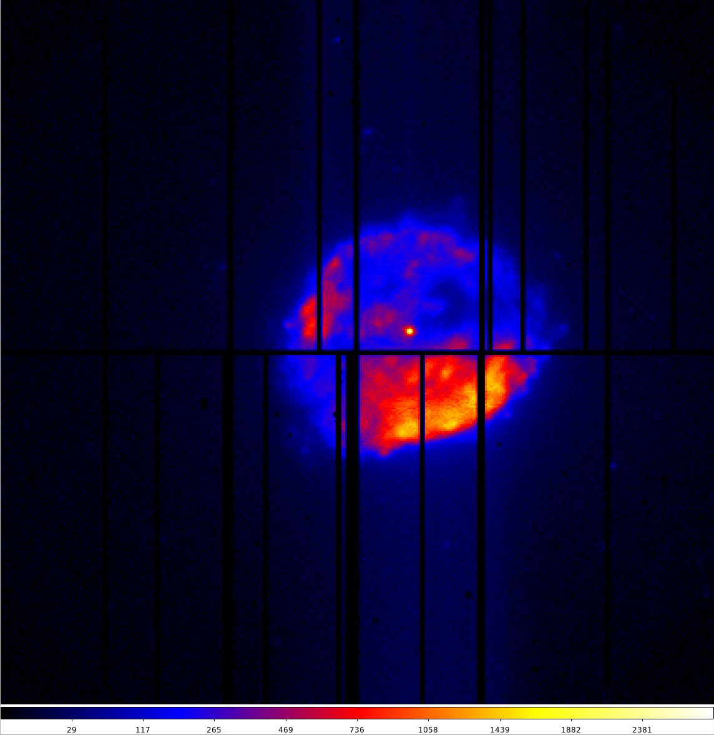
Training Challenges: High Dynamic Range
Source ID: 1E 1613-5055
Notes:
Note challenges, cross through solved challenges

Slide 11
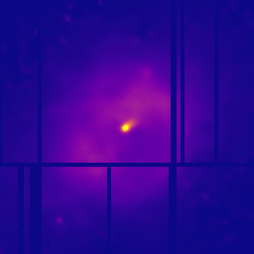
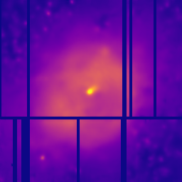
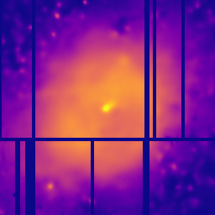
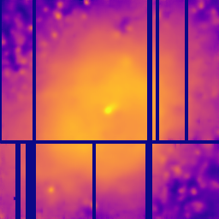
Training Challenges: Faint Artifacts
Trained on linearly scaled data
Linear
Square root
Asinh
Logarithm
Notes:
High dynamic range
Clipping
Mention loss function
This is the output
Linear data scale vs sqrt data scale
PSNR combined with MS\_SSIM: Best performing run based on the PSNR and Poisson metrics, visually more similar to the label image.

Slide 12
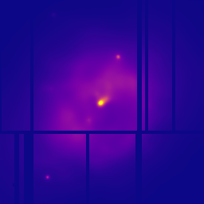
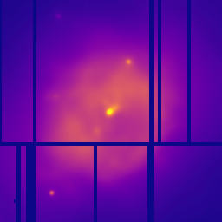
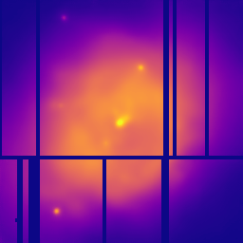
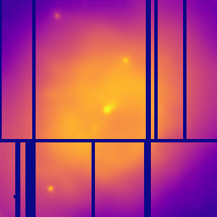
Training Challenges: Artifacts in Faint Areas
Trained on linearly scaled data
Trained on square root scaled data
Linear
Square root
Asinh
Logarithm
Notes:
High dynamic range
Clipping
Mention loss function
This is the output
Linear data scale vs sqrt data scale
PSNR combined with MS\_SSIM: Best performing run based on the PSNR and Poisson metrics, visually more similar to the label image.

Slide 13
Final Models
Data scaling: SQRT
Loss function: PSNR combined with MS_SSIM
De-noising model (XMM-DeNoise):
Pre-trained on simulated data, fine-tuned on real data
Input: 20ks exposure
Target: 50ks exposure
Super-resolution model (XMM-SuperRes):
Trained on simulated data
Input: 20ks exposure
Target: 100ks exposure, no background, double spatial resolution
Notes:
Mention Hyper-Paramter Tuning
Fine-tuning
Best possible image, i.e. 100ks exposure, no background, twice spatial resolution

Slide 14
Results De-Noising Model
XMM-DeNoise

Slide 15
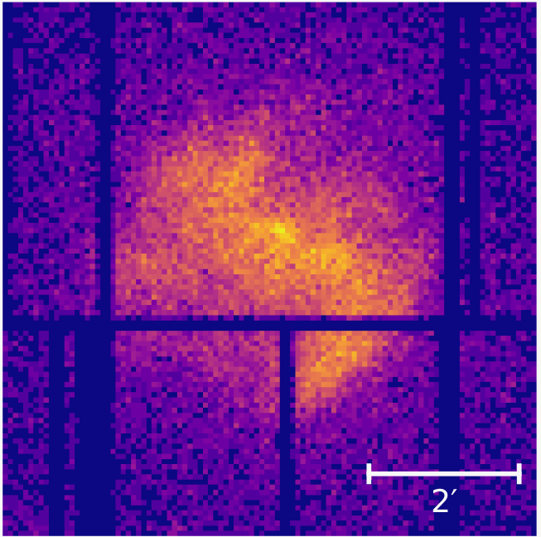
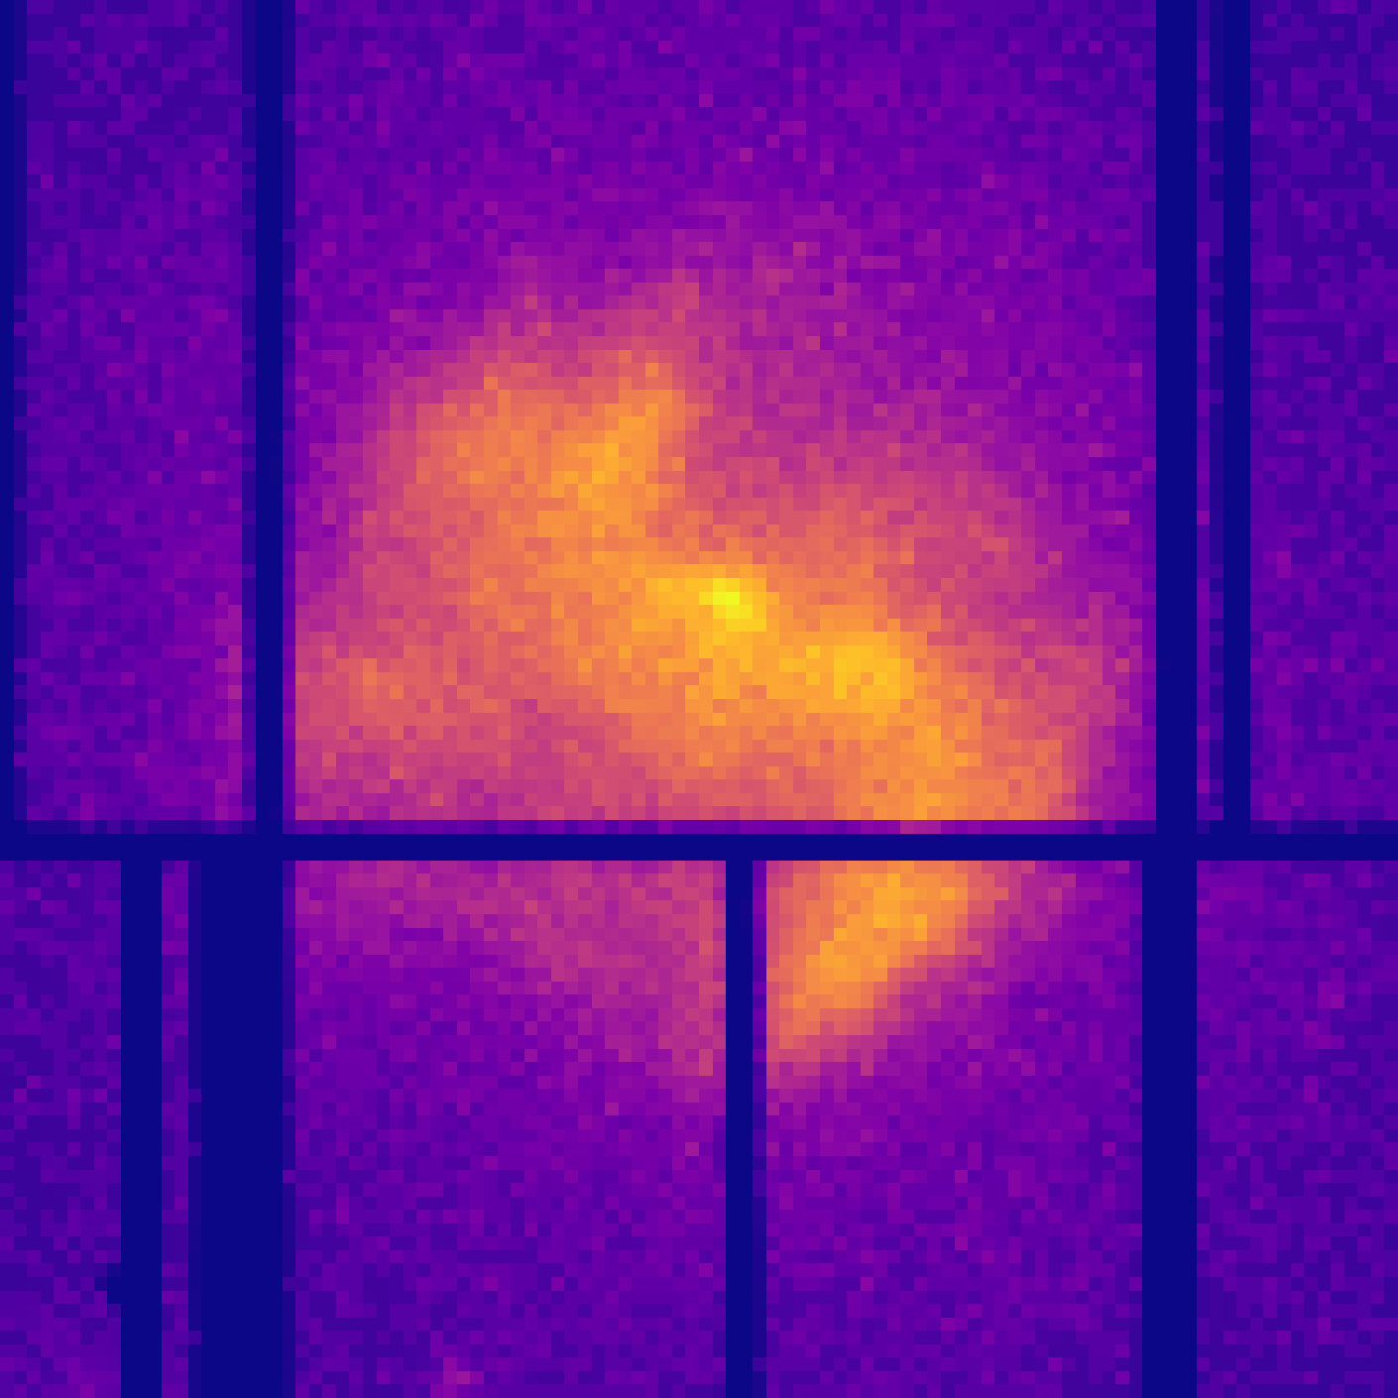
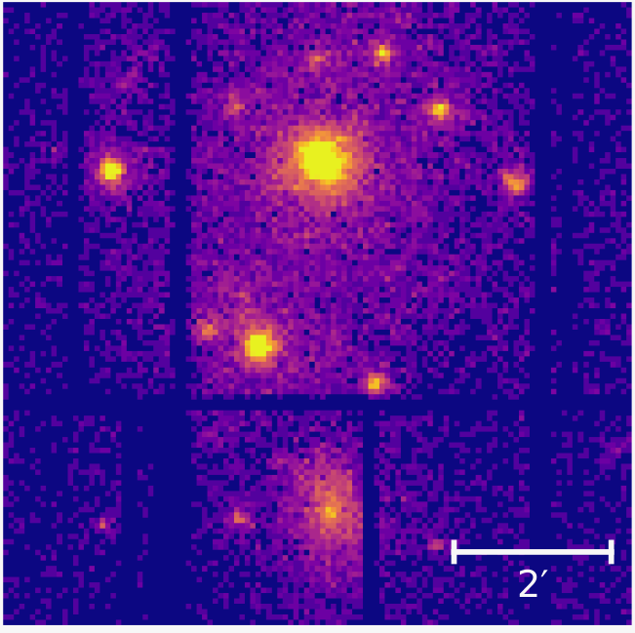
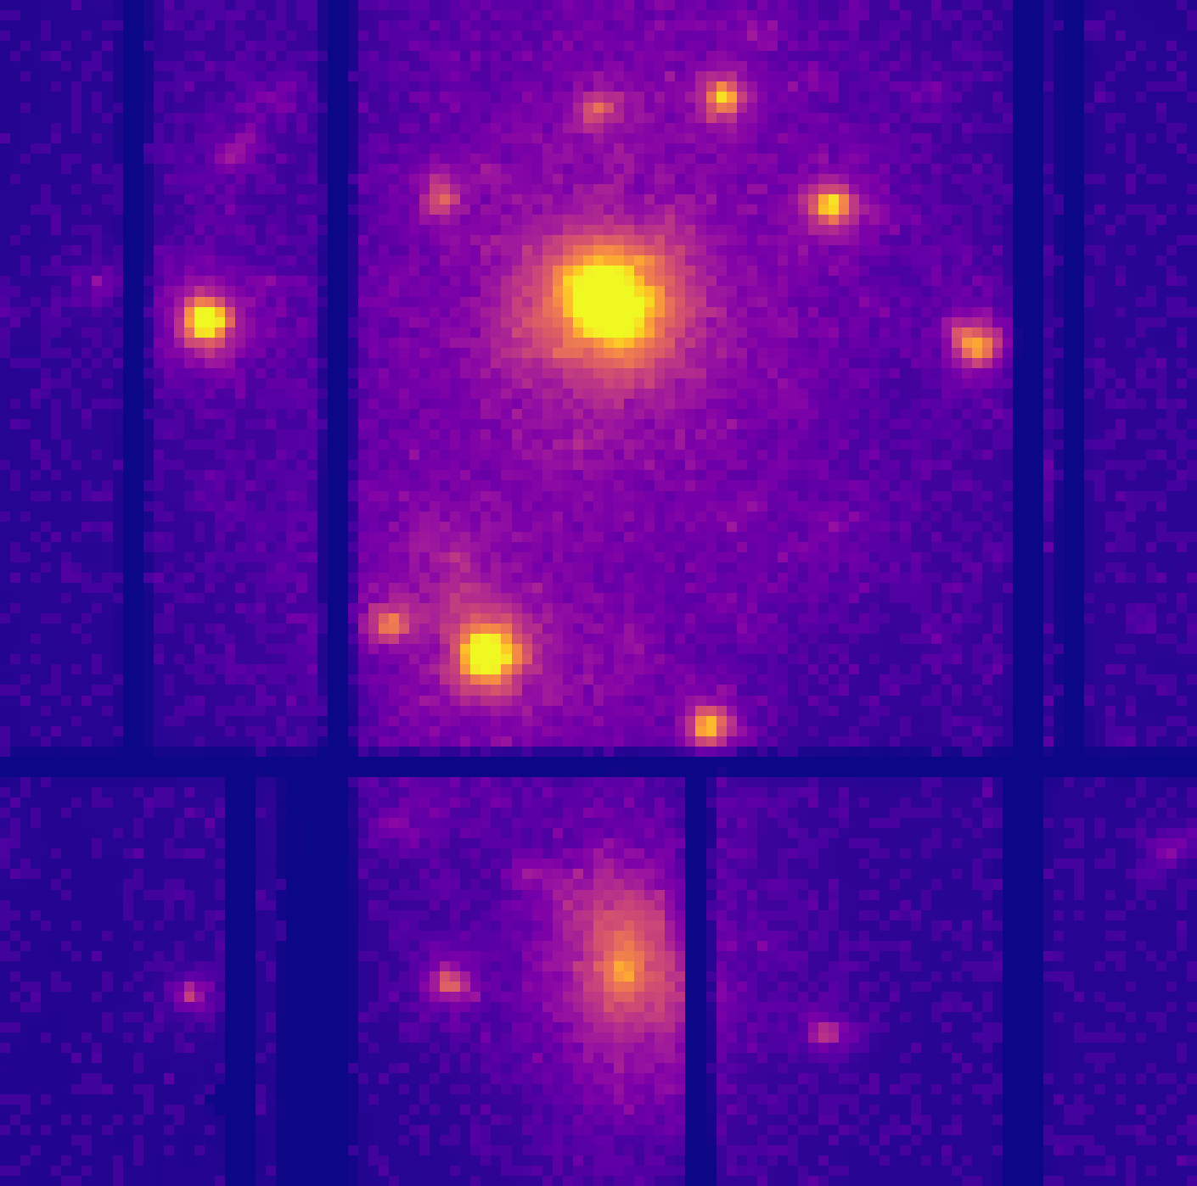
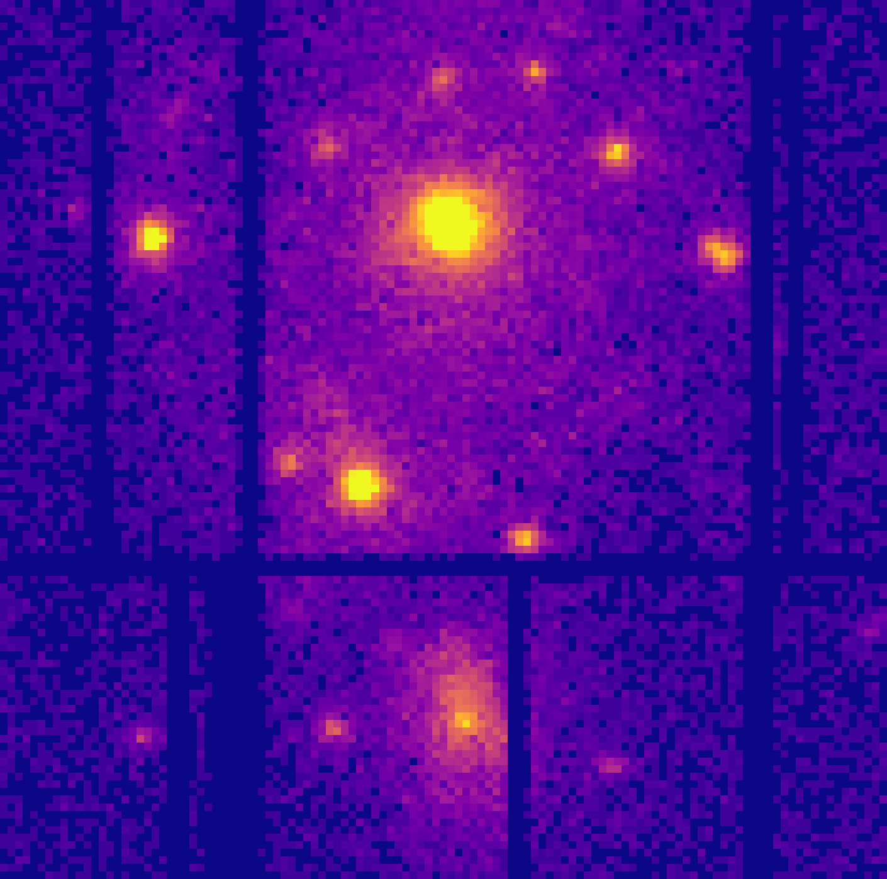
XMM-DeNoise on Real Data
Input
20ks exposure
Predicted
50ks exposure
Target
50ks exposure
Notes:
Fine-tuning worked best
Supernova Remnant W49B
M51 galaxy cluster
PSNR by 8.2% and reduced the L1 by 38%

Slide 16
Results Super-Resolution Model XMM-SuperRes
Notes:
27.5 min in

Slide 17
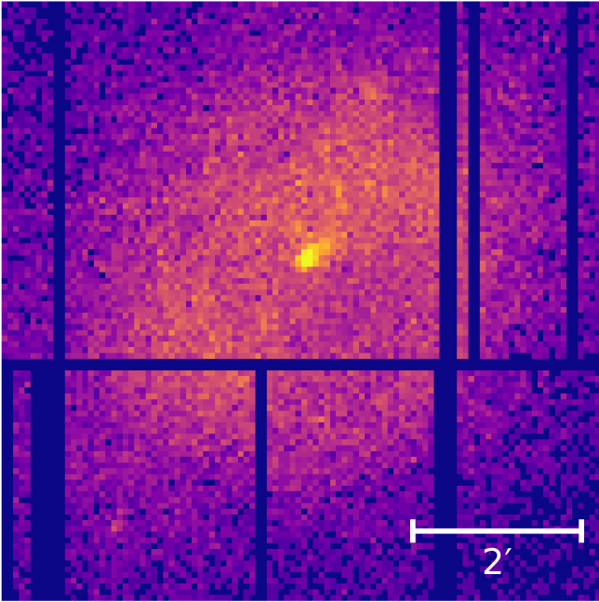
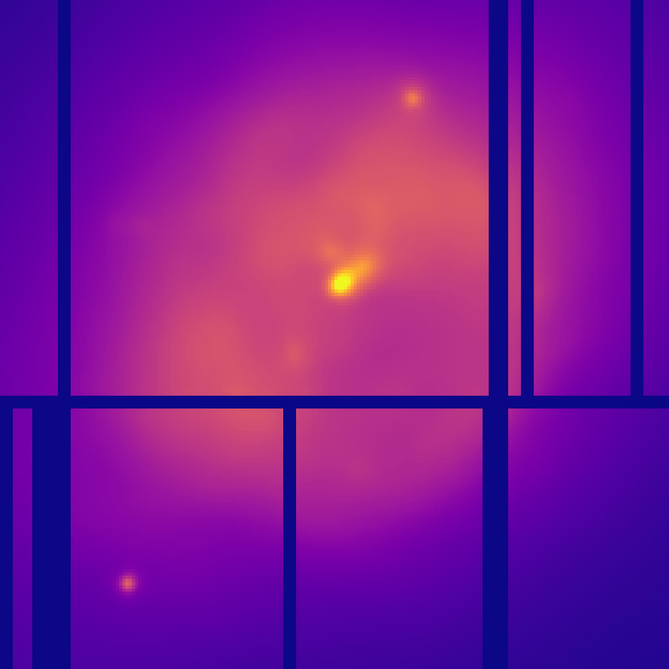
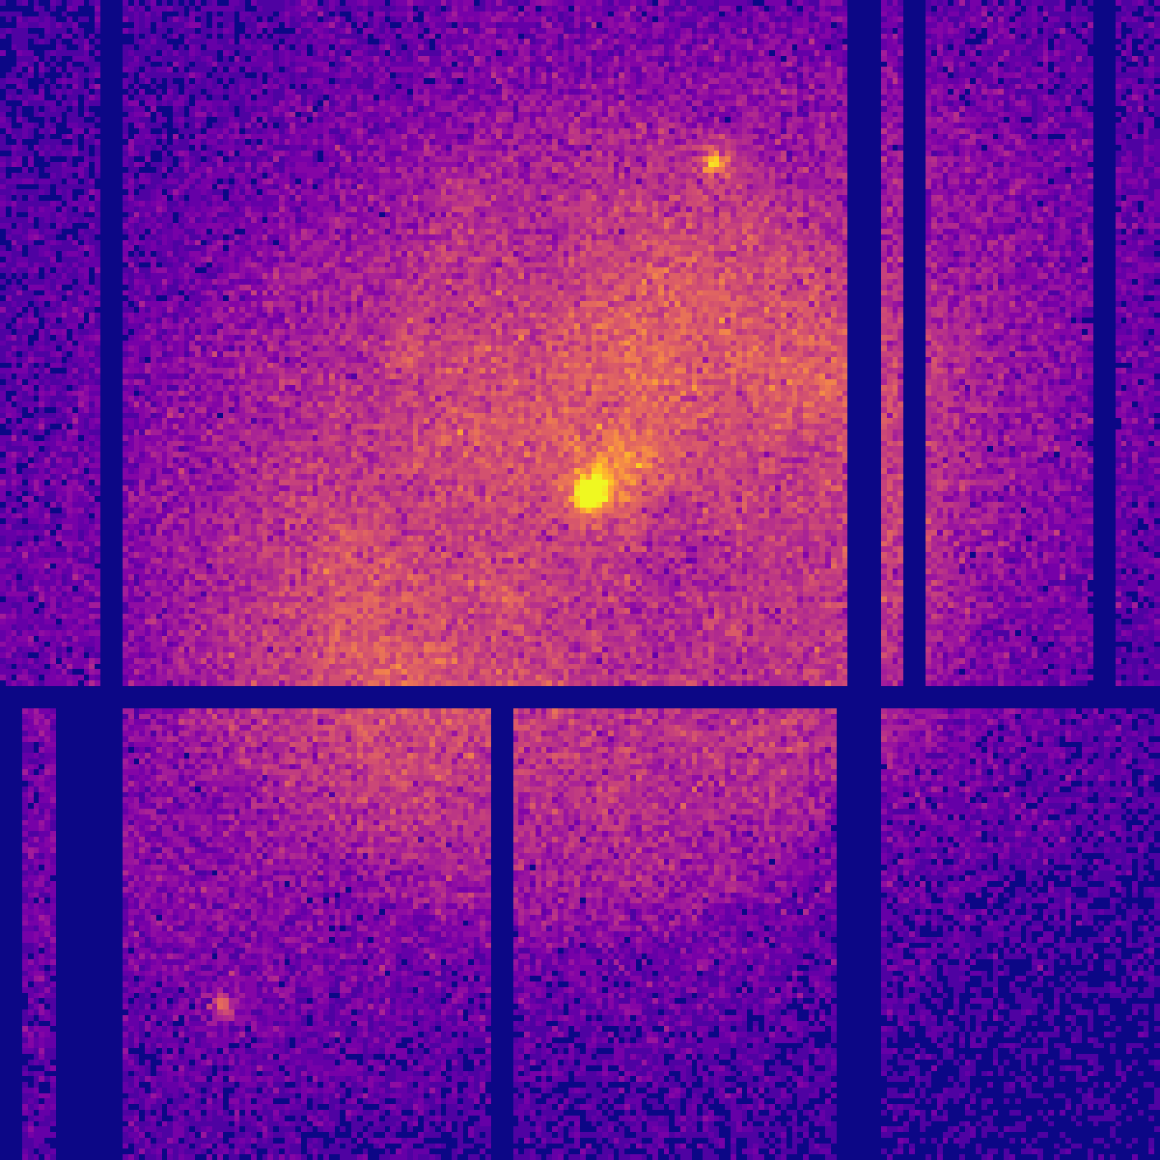
XMM-SuperRes on Simulated Data
Input
1x resolution
20ks exposure
Predicted
2x resolution
100ks exposure
Target
2x resolution
100ks exposure

Slide 18
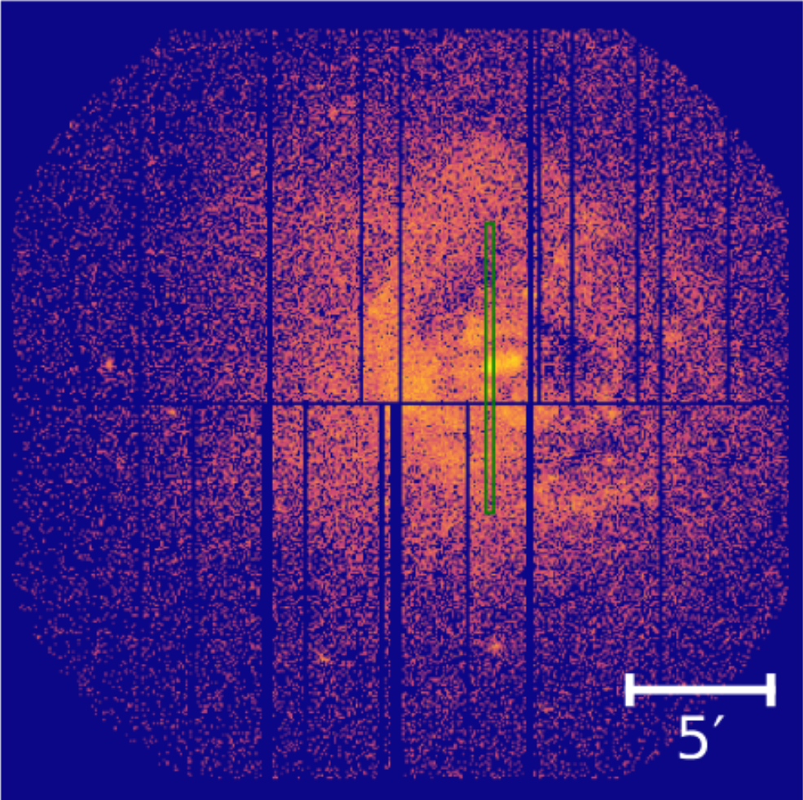
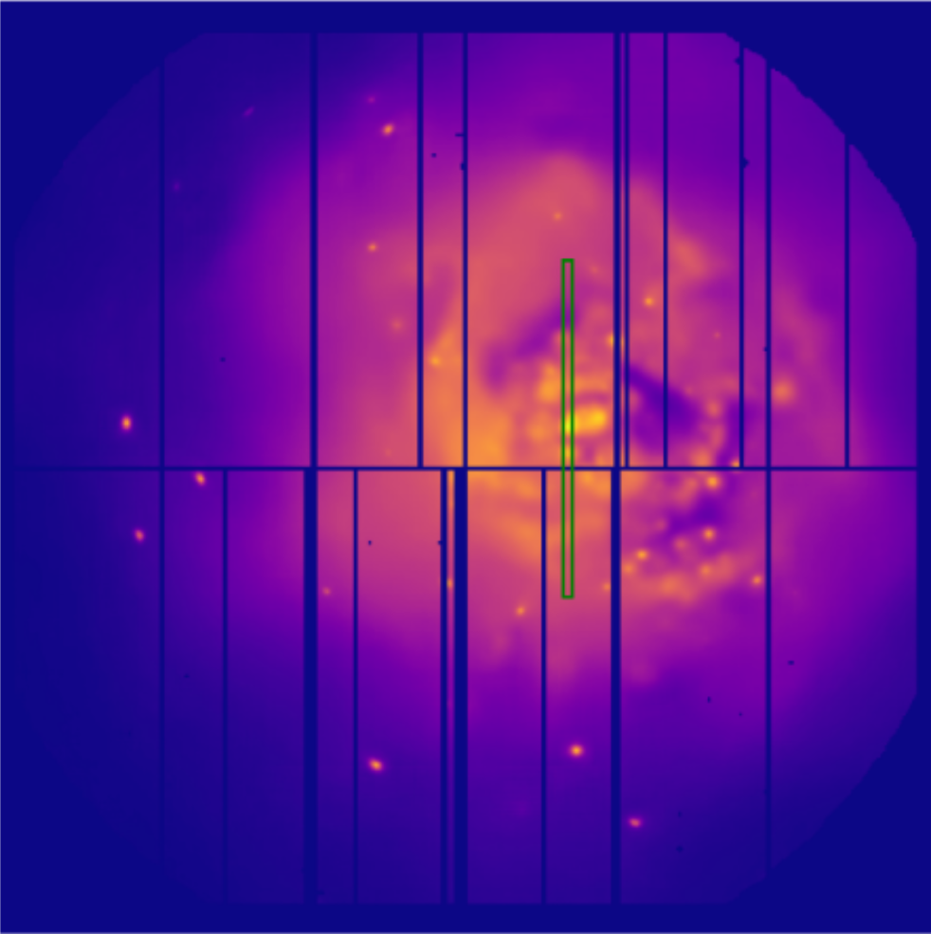
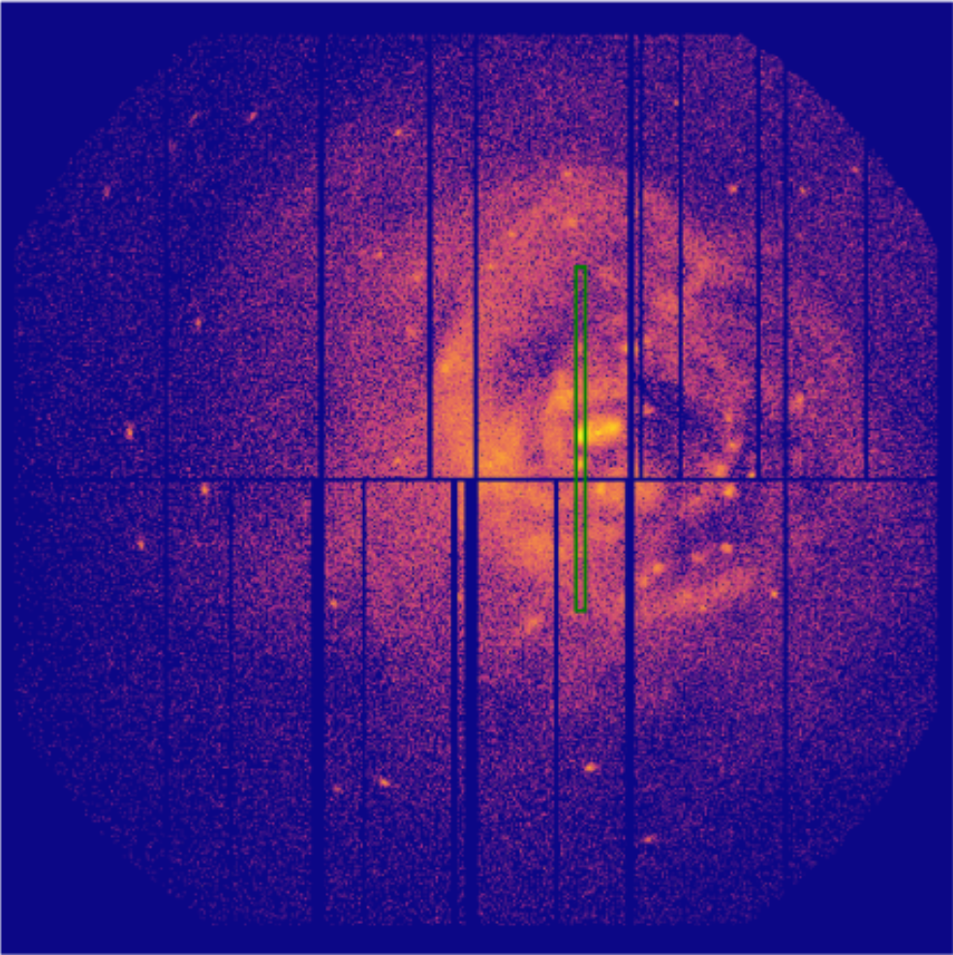
Strip Plot on Simulated Data
Input
1x resolution
20ks exposure
Predicted
2x resolution
100ks exposure
Target
2x resolution
100ks exposure

Slide 19
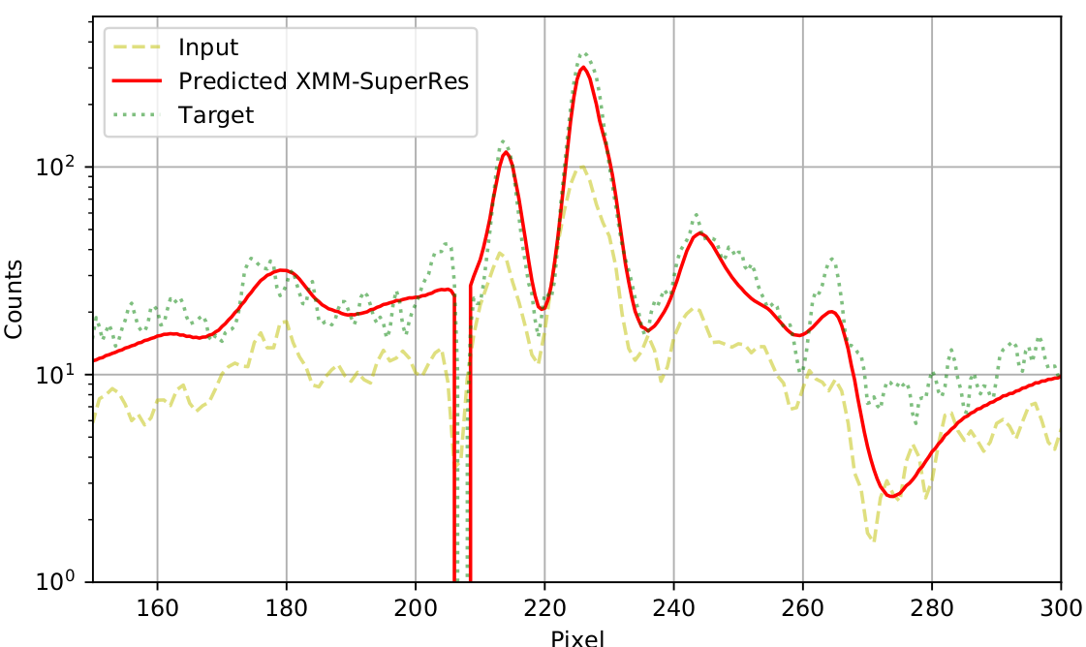
Strip Plot on Simulated Data
Notes:
The generated images are smoother than the input and target images; therefore, we smooth the input and target images using 1d convolution with a Gaussian kernel of size 5 and 𝜎 = 1.0 for a fairer comparison.
The predicted XMM-SuperRes image
(red) bares better resemblance to the target brightness in comparison
to the input image.

Slide 20
Chandra Comparison: Bullet Cluster
Input
1x resolution
20ks exposure
Predicted
2x resolution
100ks exposure
Reference
Chandra
12x resolution
88ks exposure
Notes:
Our first case study is the Bullet cluster (Figure 11) a well know
system of two interacting galaxy clusters. The cavity between the
two X-ray components is enhanced in both the Chandra and the
generated SR image in comparison to the input XMM-Newton image.
Looking at the real XMM-Newton image and the SR-generated one,
with white contours from Chandra overlayed, we can see that the
cavity between the two clusters is much better defined in the SR
and DN image compared to the original XMM-Newton image, the
Chandra image also clearly contains this feature.

Slide 21
Chandra Comparison: Galaxy Group M51
Input
1x resolution
20ks exposure
Predicted
2x resolution
100ks exposure
Reference
Chandra
12x resolution
190ks exposure
Notes:
Messier 51 (M5̇1) is an interacting spiral galaxy with an active
galactic nuclei, and it is another useful case study to see how the
network performs (Figure 13). In this example we see that the gener-
ated image has point sources that are better defined compared to the
real XMM-Newton image. For example, the faint source at the bot-
tom left of the centre is clearly visible in the SR and Chandra image
but are barely in the real XMM-Newton image. Looking at the real
XMM-Newton image and generated SR XMM-Newton with in white
the contours of Chandra overlayed. We can also see that in the top
left of the SR image an extended feature is visible that matches with
the contours of Chandra, this extended feature is harder to be seen
in the real XMM-Newton image. However, the SR image also does
sometimes mis-predict features, for example on the right side the is
a circular blob visible in the Chandra contours. In the real XMM-
Newton image it is hard to tell if there is anything present. However,
the SR model predicted almost no counts in that area.

Slide 22
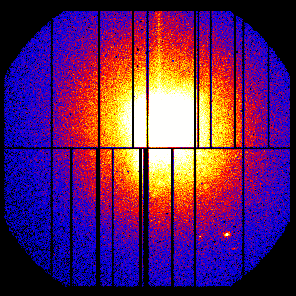
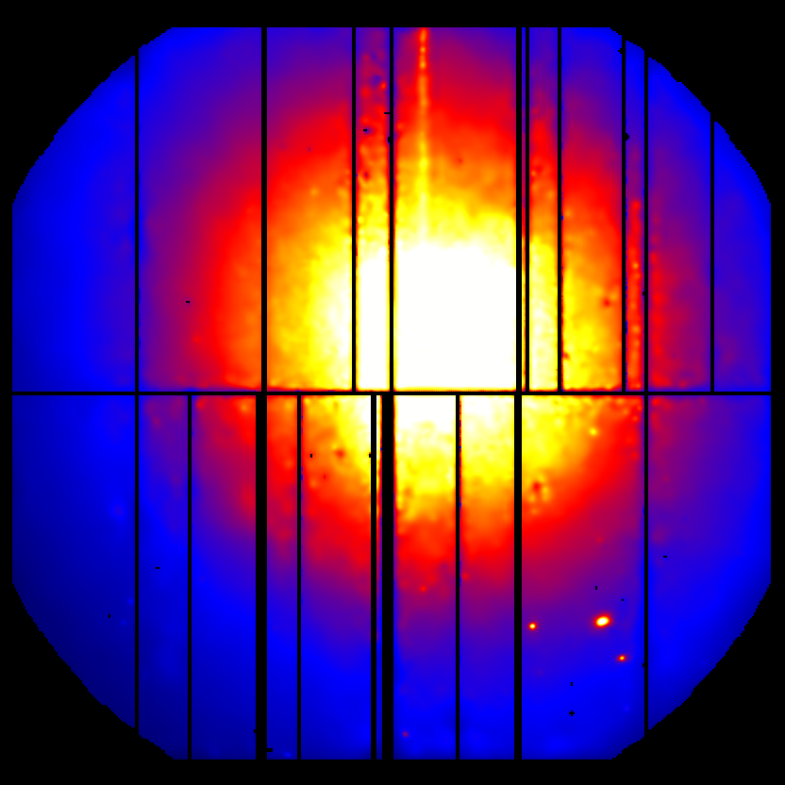
Limitations
Super-resolution and de-noising are ill-posed problems
Clipping limits method to faint sources
Super-resolution bound by the quality of the simulations
Input
1x resolution
20ks exposure
Predicted
2x resolution
100ks exposure
Source ID: M87

Slide 23
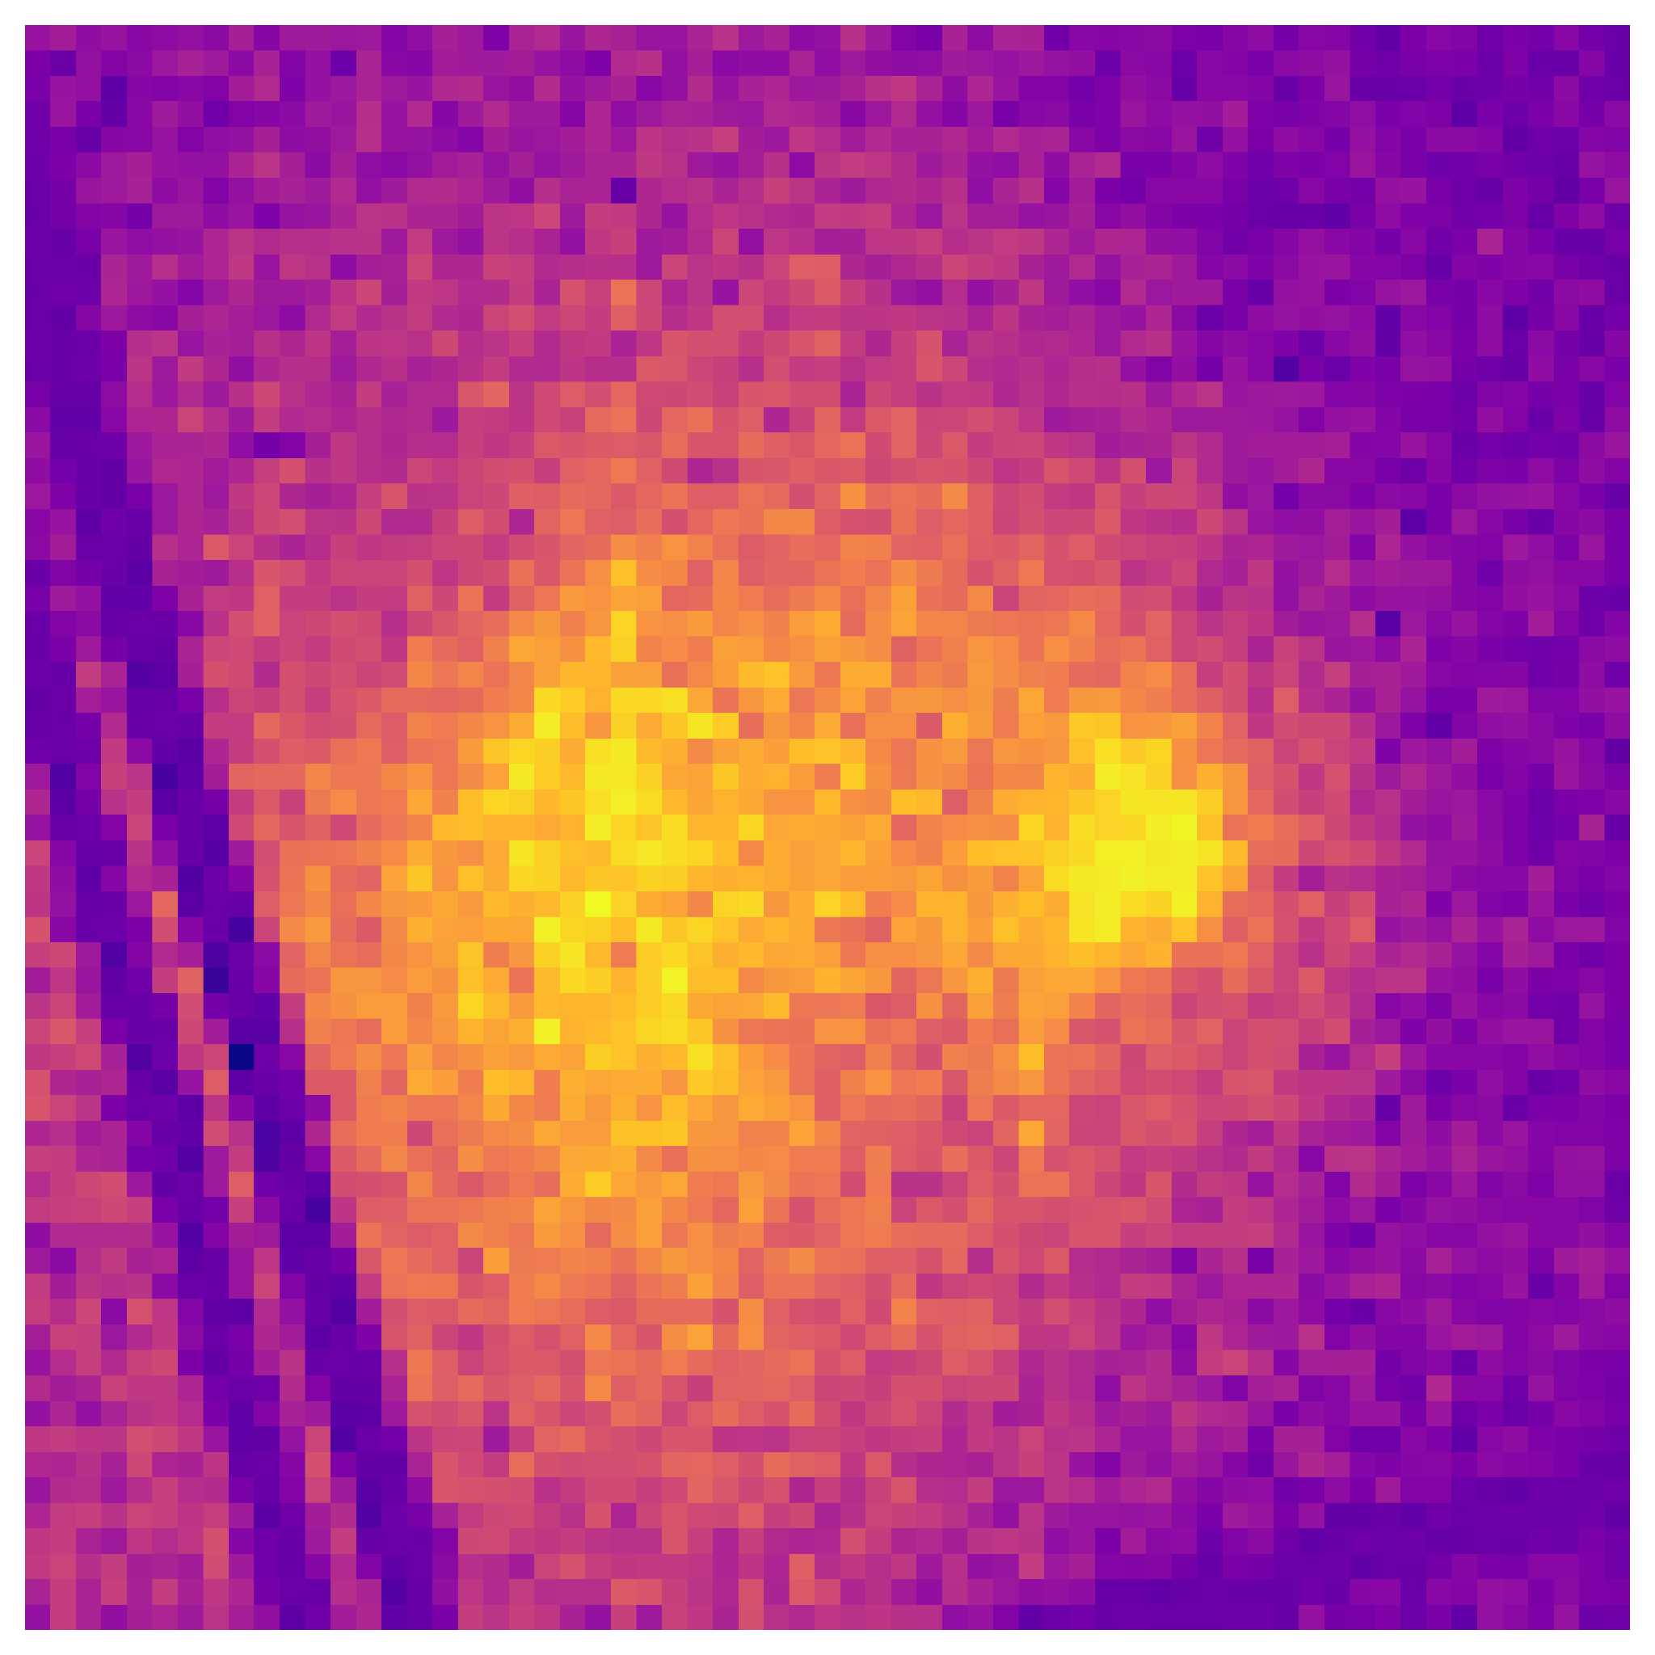
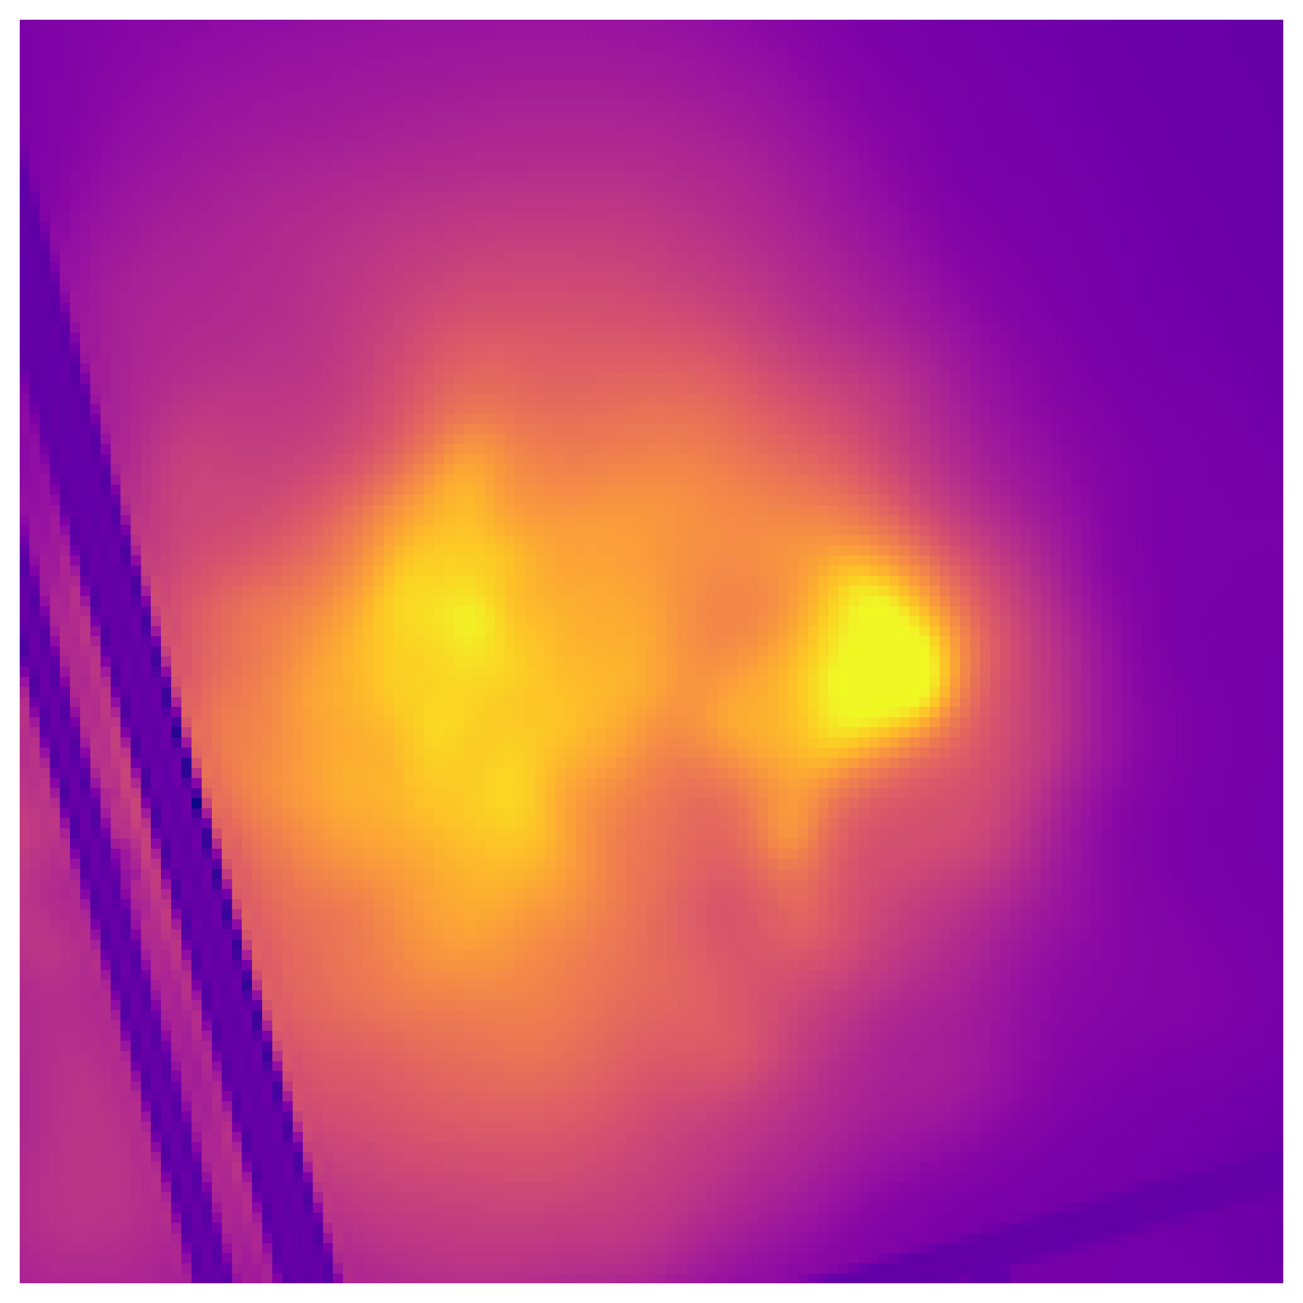
Conclusion
XMM-SuperRes and XMM-DeNoise models:
Improved visual clarity and noise properties
Proof-of-concept for more elaborated methods
Follow-up observations/further analysis
Input
Predicted
Source ID: Bullet cluster
Notes:
In conclusion, we have demonstrated the feasibility of using deep-
learning models to improve the spatial resolution and denoising of
XMM-Newton EPIC-pn X-ray astronomy images to increase their
scientific value. The XMM-SuperRes and XMM-DeNoise models de-
veloped in this paper could be used as a proof-of-concept to create
more elaborated methods. Such as creating a model that can output
a range of possible SR and DN images to more directly tackle the ill-
posed nature of the problem. In the future, the training of the models
could be extended to more instruments, more X-ray telescopes, and
incorporating more energy ranges and exposure times.
We increase the resolution of the observations and de-noise to improve the noise properties and enhance features that are challenging to locate in the original XMM-Newton images.
influence of the model architecture parameters, data pre-processing, and loss functions
data scaling
combined loss function consisting of both PSRN and MS SSIM
PSNR by 8.2% and reduced the L1 by 38%

Slide 24
Code availability
Inference code is available in ESA GitLab (not public yet)
Full code + training/validation/testing datasets:
available in GitHub
data sharing (~300-400 GB) not solved yet.
(stay tuned for ESA Datalabs)

Slide 25
The end

Slide 26
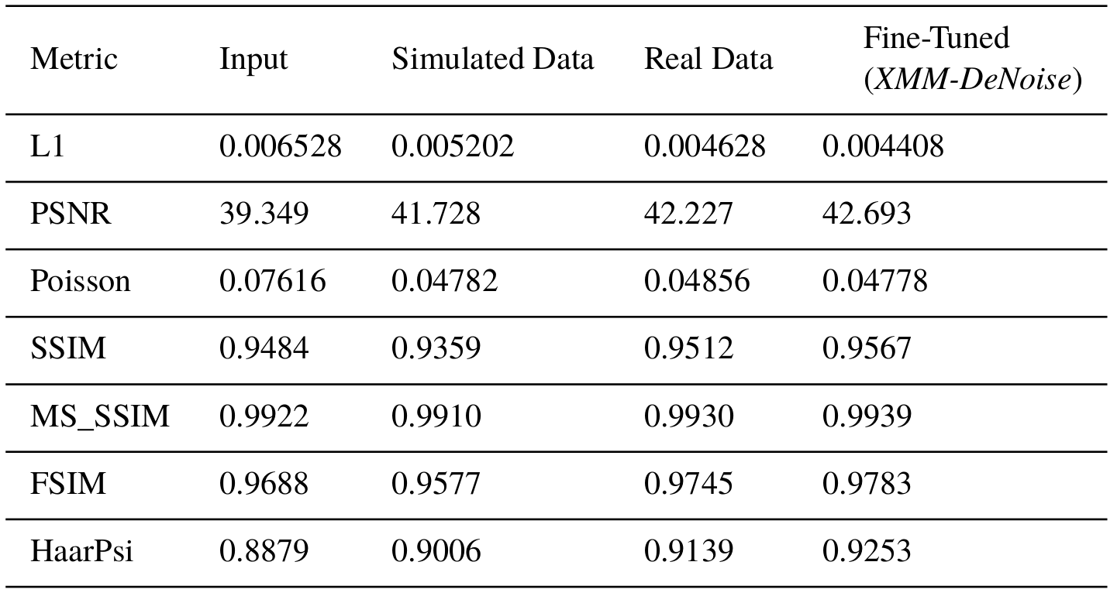
De-Noising Performance on Real Data
Notes:
PSNR by 8.2% and reduced the L1 by 38%

Slide 27
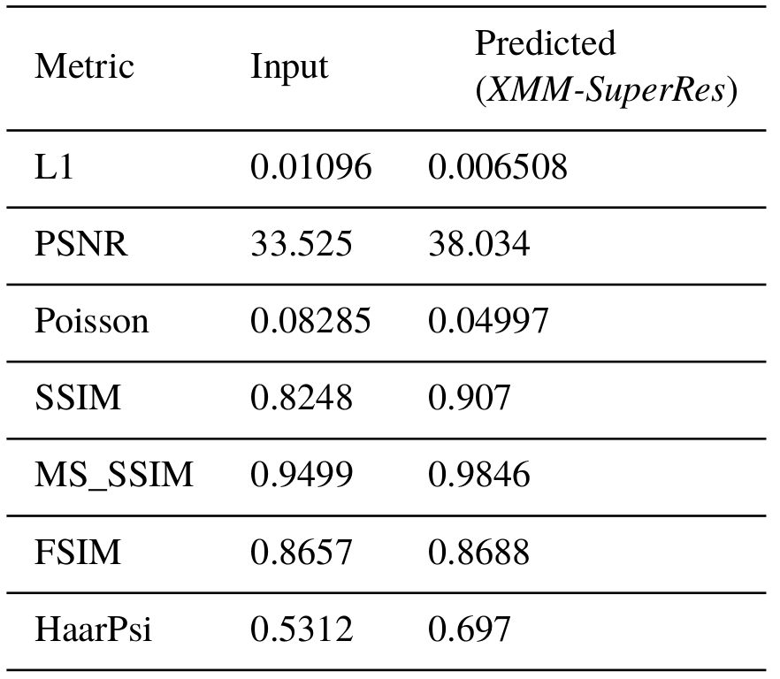
Super-Resolution Performance on Simulated Data

Slide 28
L1 Loss vs Adversarial Loss
L1 Loss:
L1 + Adversarial Loss:
Input
1x resolution
Predicted
2x resolution
Target
2x resolution
Notes:
XXX Find better example

Slide 29
Image Quality Metrics and Loss Functions
L1: Mean absolute difference
PSNR: Peak-Signal-to-Noise-Ratio
Poisson: Likelihood assuming Poisson distribution
SSIM: Structural Similarity Index
MS_SSIM: Multi Scale Structural Similarity Index
FSIM: Feature Similarity Index
HaarPSI: Haar wavelet-based Perceptual Similarity Index
Final loss function: PSNR combined with MS_SSIM
Notes:
No metric corresponded perfectly with visual

Slide 30
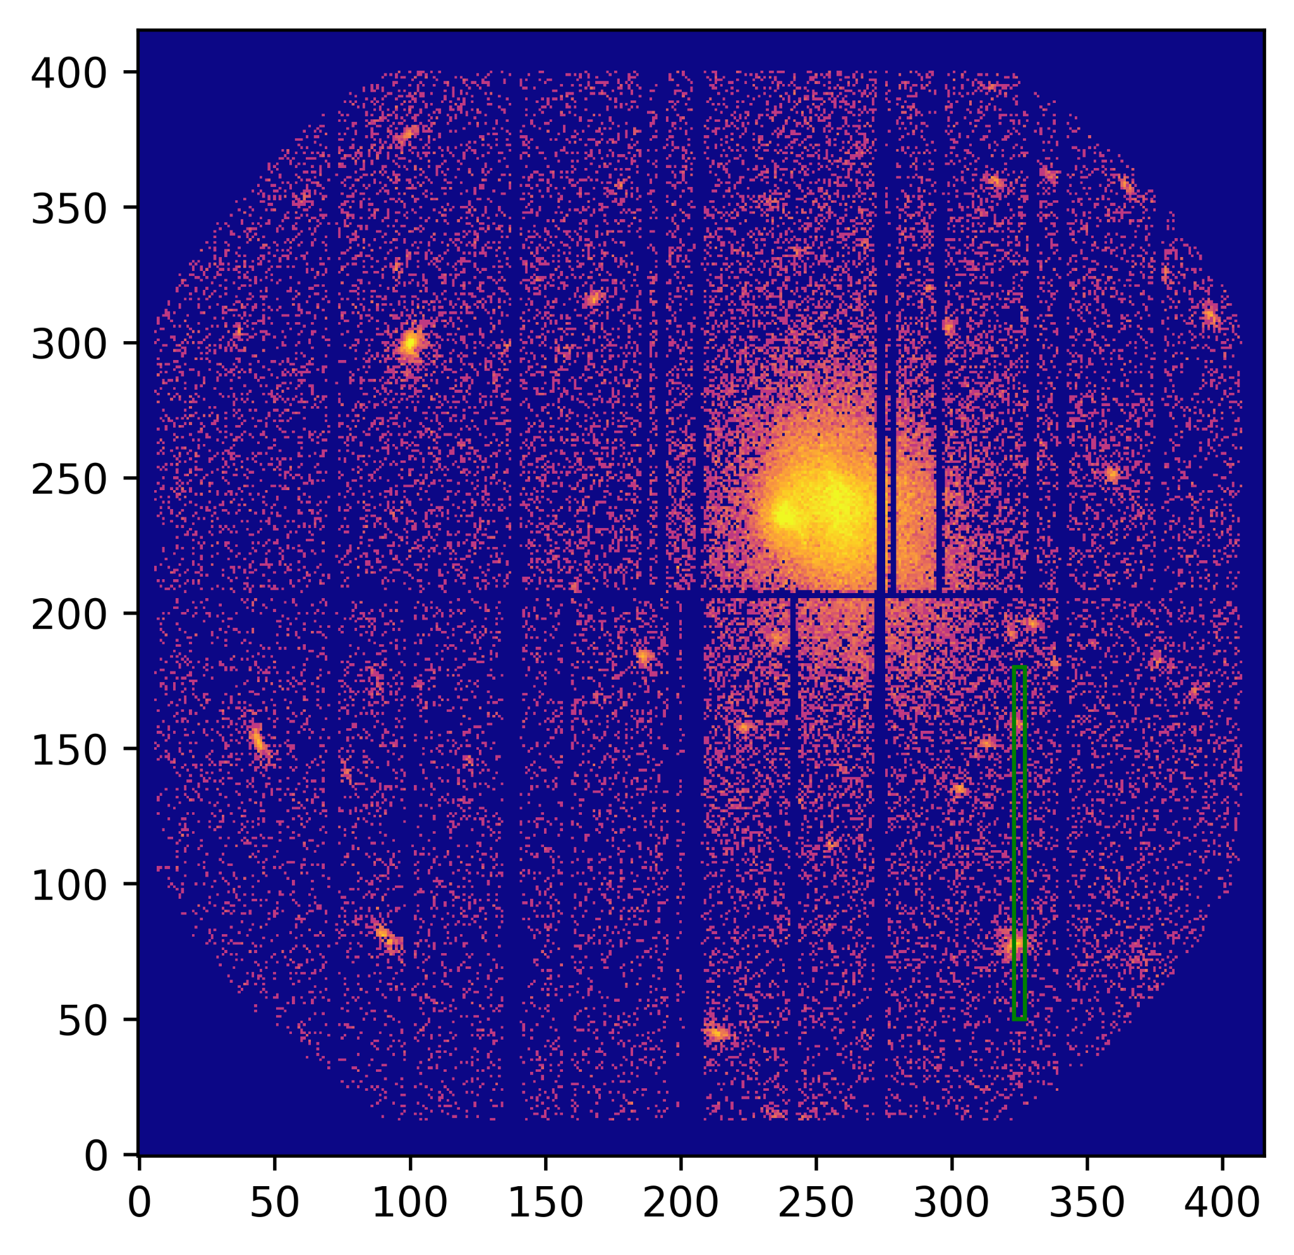
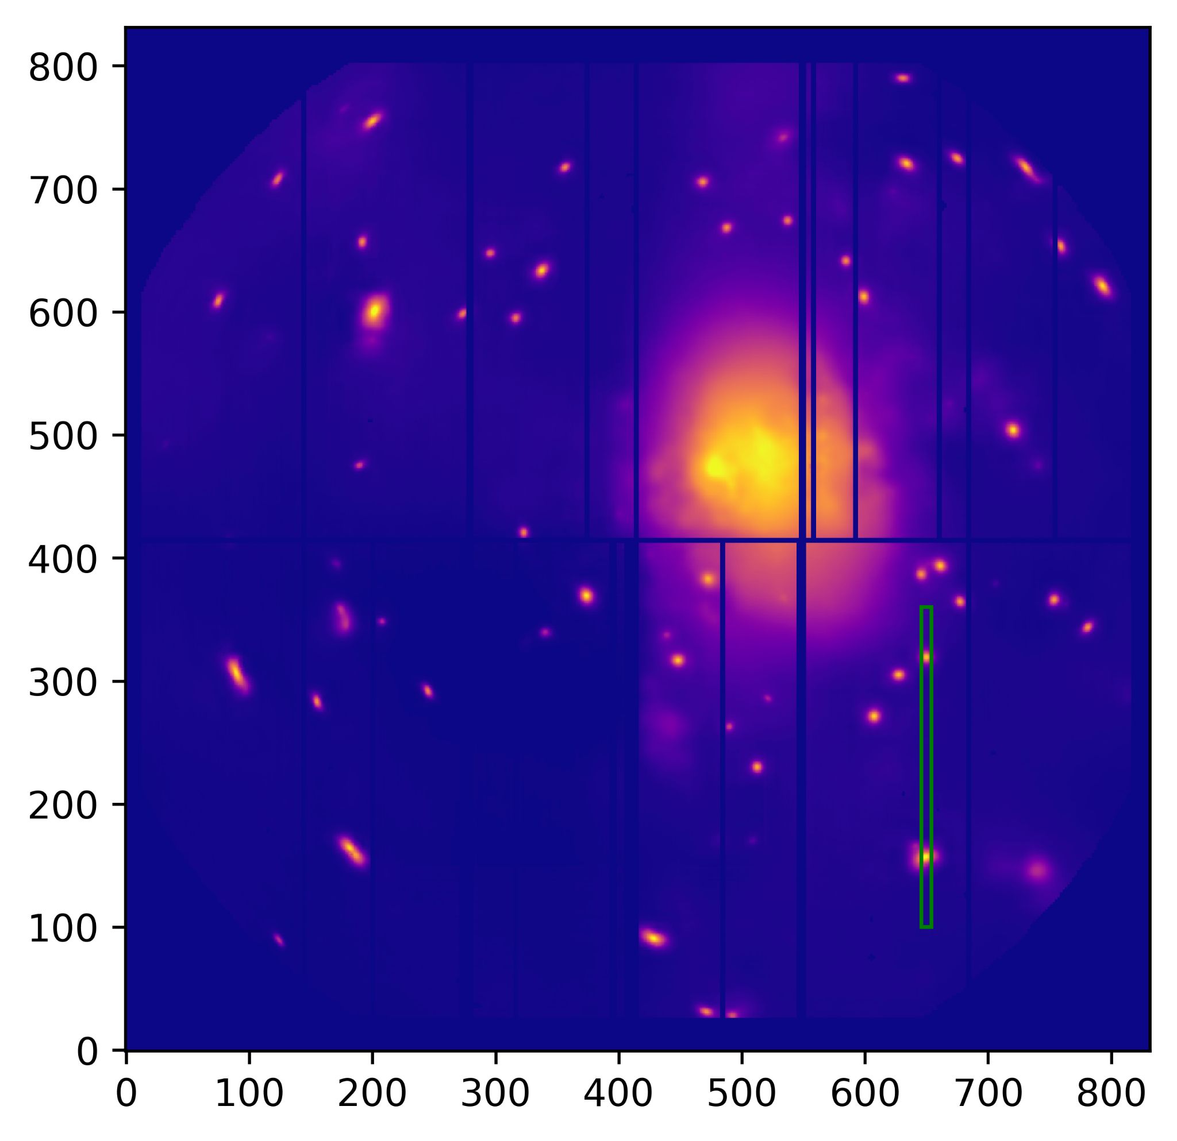
Strip Plot on Real Data
Input
1x resolution
20ks exposure
Predicted
2x resolution
100ks exposure
Notes:
Bullet Cluster

Slide 31
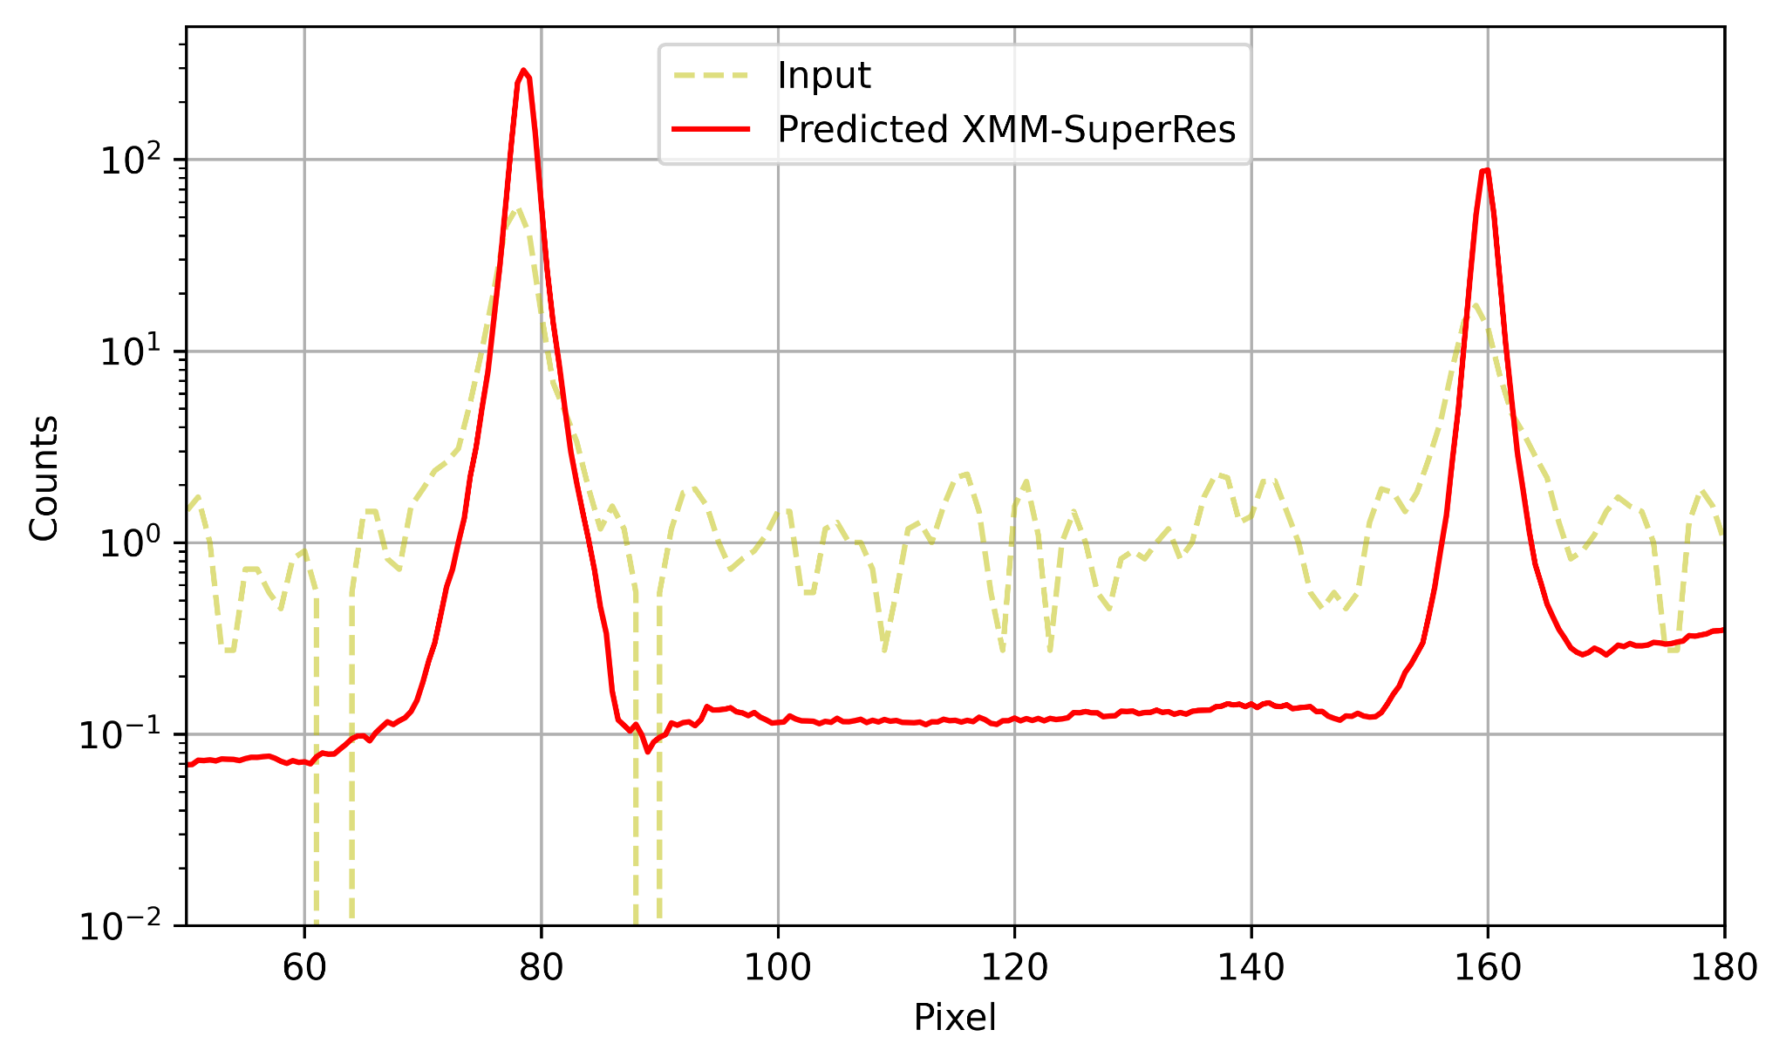
Strip Plot on Real Data
Notes:
Remember, no target. Sharper peaks, lower noise

Slide 32
Chandra Comparison: Supernova Remnant W49B
Input
1x resolution
20ks exposure
Predicted
2x resolution
100ks exposure
Reference
Chandra
12x resolution
158ks exposure

Slide 33
Traditional Approaches for De-Noising
Gaussian blurring
Wavelet transform
Input
20ks exposure
Gaussian Blurred
Wavelet Transformed
Reference
119ks exposure
Notes:
Send to Maggie

Slide 34
PSNR combined with MS_SSIM Loss

Slide 35
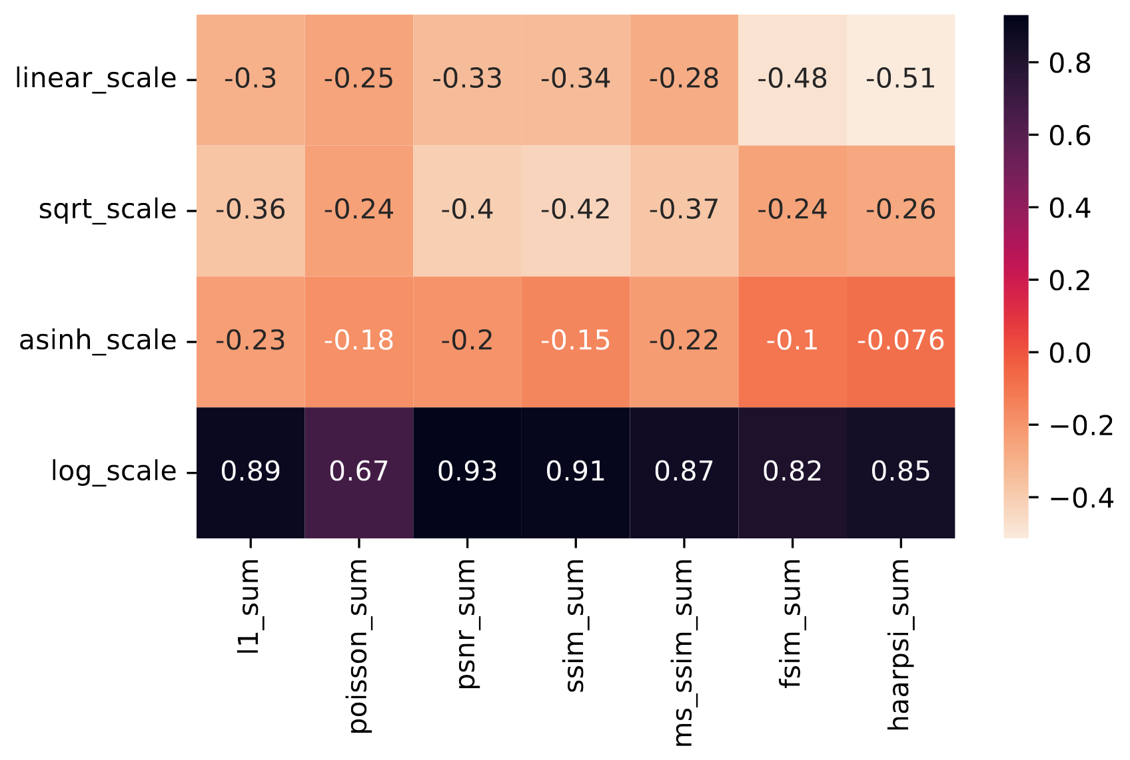
Data Scaling Correlations

Slide 36
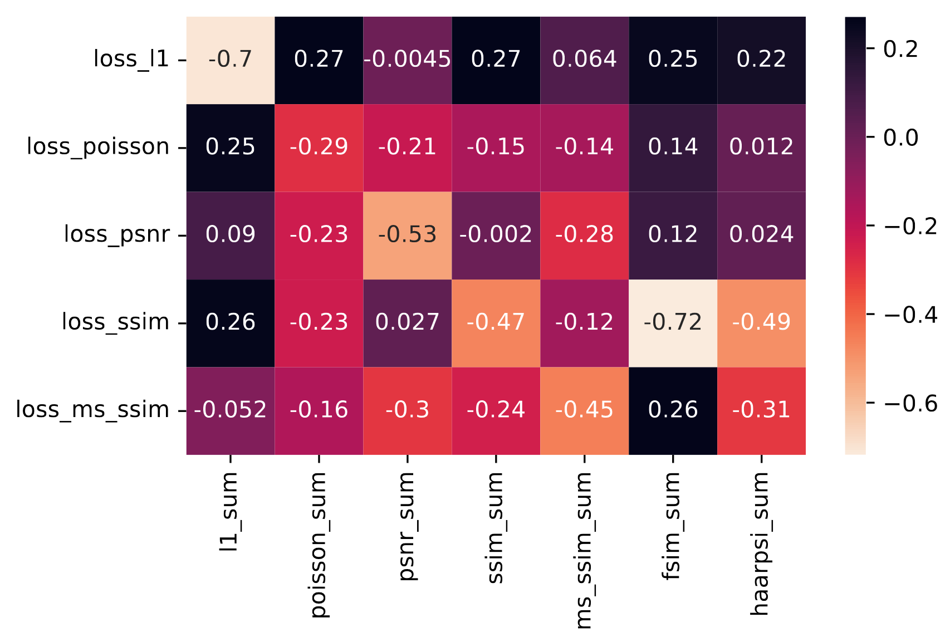
Loss Function Correlation

