Slide 1


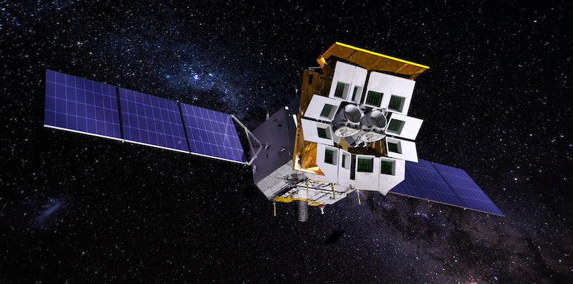

Einstein Probe mission &
EP-WXT pathfinder LEIA
Zhixing Ling (NAOC)
Instr. scientist of WXT
PI of LEIA
On behalf of EP consortium
2023 April 15th IACHEC meeting

Slide 2
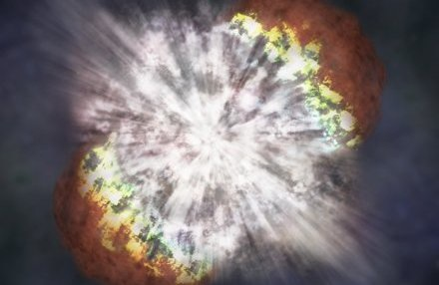

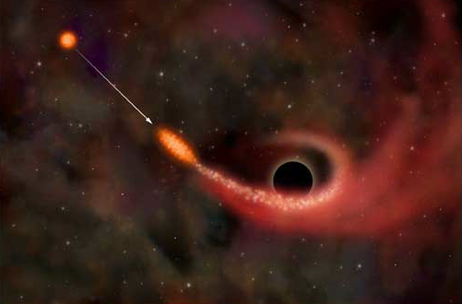
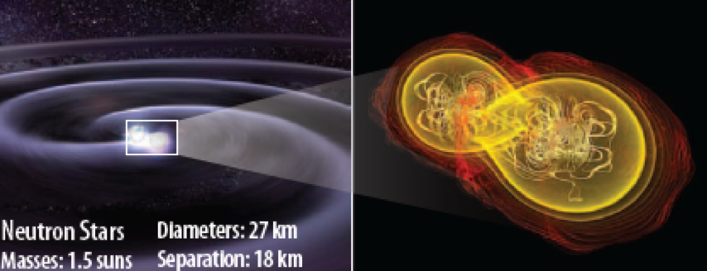
Main science objectives
Systematic survey of soft X-ray transients and variability of X-ray sources with unprecedented combination of sensitivity and cadence
Discover otherwise quiescent black holes at almost all astrophysical mass scales and other compact objects by capturing their transient X-ray flares
Detect and localize the electromagnetic-wave sources of gravitational-wave events by synergy with gravitational-wave detectors

Slide 3

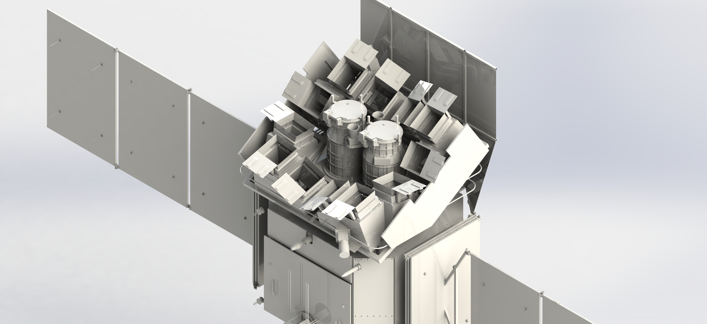

Instruments & spacecraft
Orbit: 600 km
Inclination: < 30°
Life : 3 + 2 years
Weight: 1.3 ton
PI : Prof. Weimin Yuan
Wide-field X-ray Telescope
WXT (12 modules)
Follow-up X-ray Telescope
FXT (2 units)
Optics: lobster-eye MPO
Detectors: CMOS
FoV: 3,600 sq deg (1.1 sr)
Band: 0.5 – 4 keV
Spatial resolution: ~ 5’ (FWHM)
Effective area : 2 - 3 cm² @1keV
Optics: Wolter-1
Detectors: pn-CCD
FoV: ~1 deg
Band: 0.3 -10keV
spatial resolution: <30” (HPD, on-axis)
Effective area: 300 cm² @1keV (x 2 units)

Slide 4
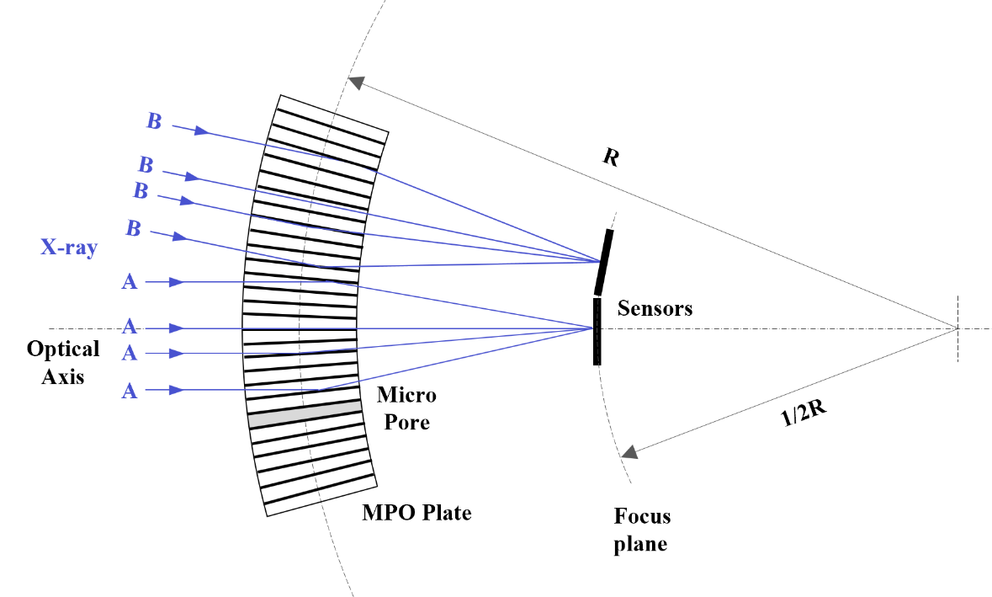
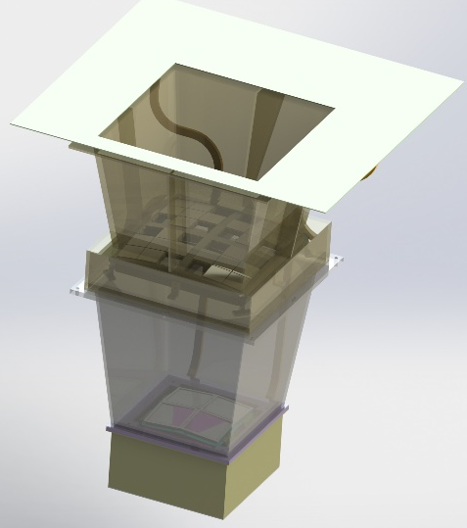
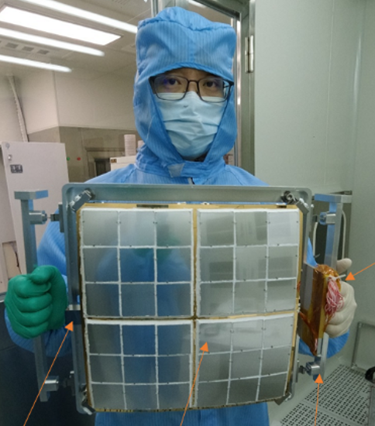

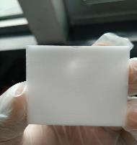
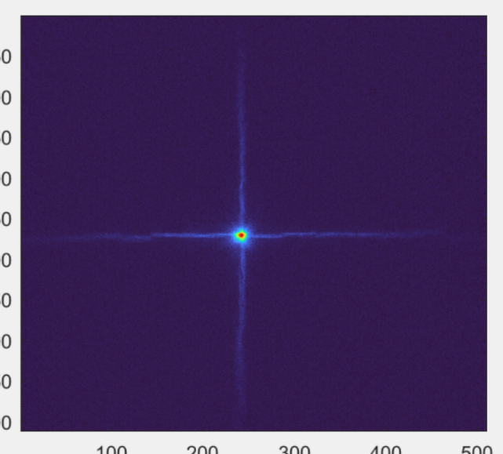
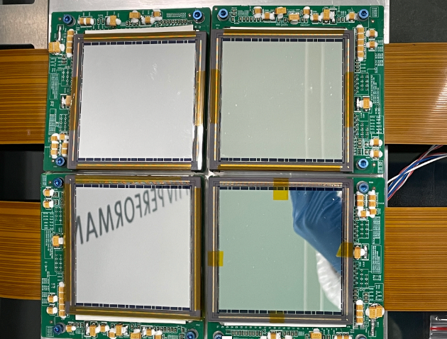
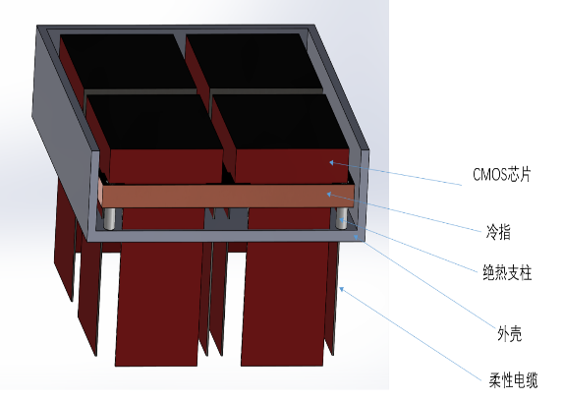
Wide-field X-ray Telescope (WXT)
Focal length: 375mm
eff. area: ~3 cm² @1keV (PSF centre)
Proposed by Angle 1979
One of 12 WXT modules
radiator
36 MPO plates
4 BI CMOS
6cm x 6cm each
single reflection
Measured PSF
@ NAOC/CAS
double reflection

Slide 5
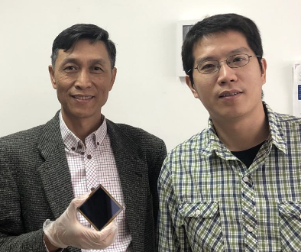
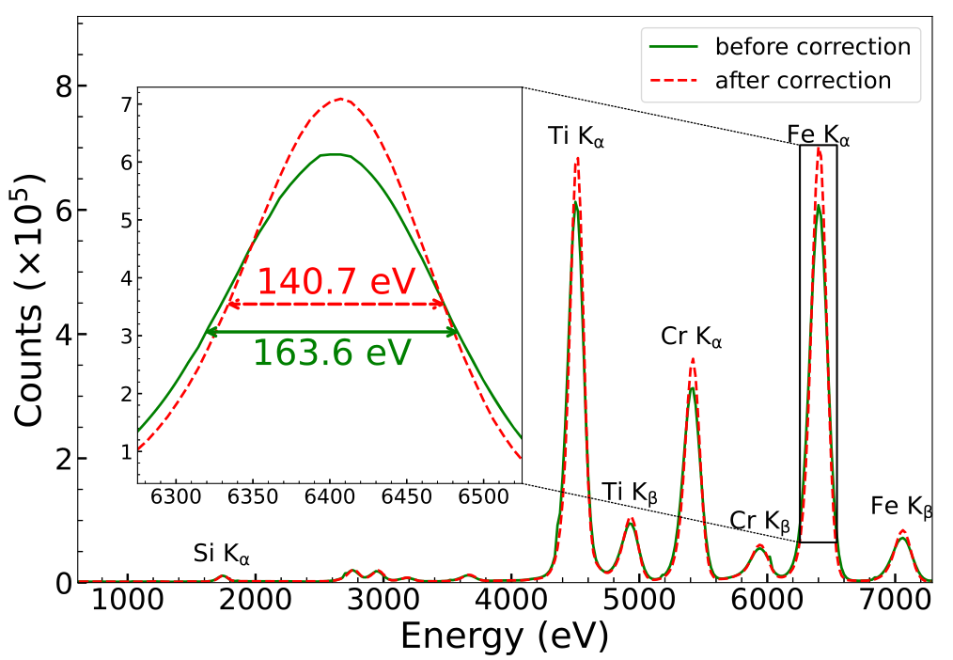
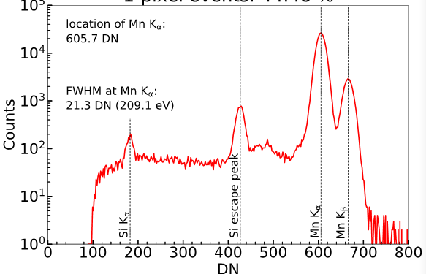
X-ray CMOS detector
We customized a large-format CMOS sensor for EP-WXT.
From 2015-2020. More than 100 chips are fabricated.
specification:
Size: 6.1 cm × 6.1 cm
Array: 4096 × 4096 pixels
FWHM: ~200 eV @5.9 keV (140 eV@20℃，after gain correction)
Frame rate: 20Hz （boost to 100 Hz）
Feature:
  Fast readout
  radiation harden (No CTI)
  higher temperature (-30℃ is Ok)
  On-chip analog/digital electronics
  Low cost (1/3 of CCD)
To our knowledge:
                This is first time the CMOS sensor used in X-ray astronomy.
            One of the largest Si image sensor in space. WXT will use 48 sensors (1700 cm² total).
Wu et al 2022, 2023

Slide 6

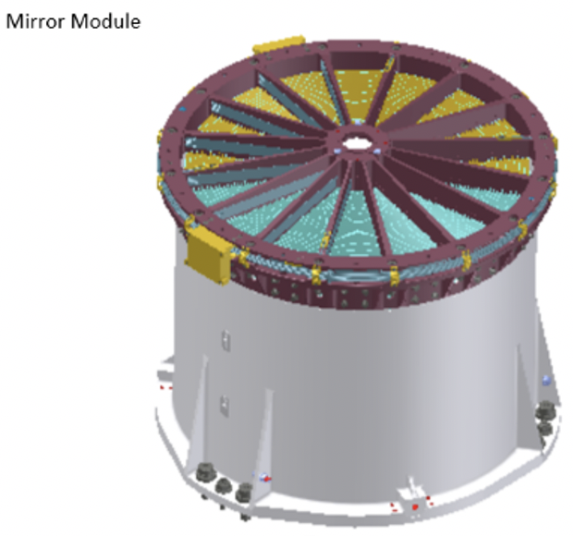
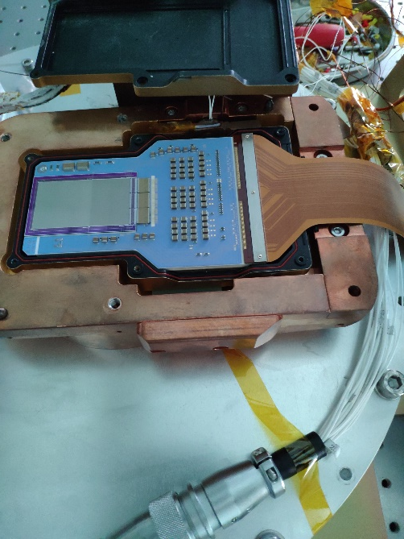
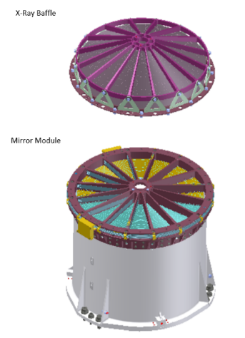
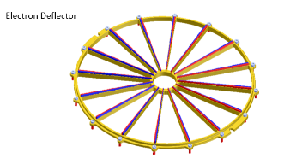

Follow-up X-ray Telescope (FXT)
Joint developed by IHEP/CAS, ESA and MPE
X-ray optic systems
  ESA + MPE
  eROSITA design
X-ray cameras
  PN-CCD module (MPE)
MM-B
MPE
(eROSITA FS)
ESA/MPE
MM-A
ESA/
MediaLario
ESA/MPE
For more details. Please refer to Juan and Chengkui’s talk.

Slide 7
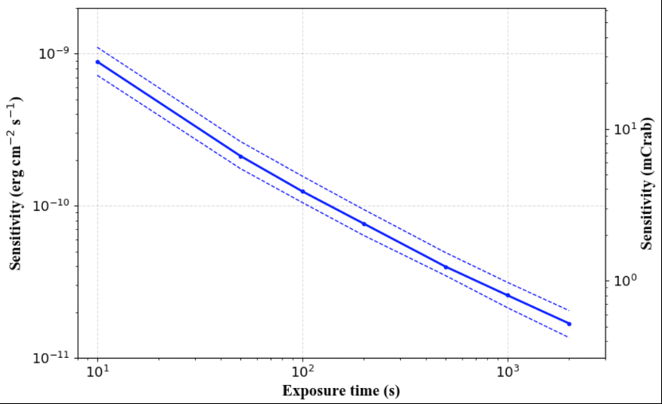
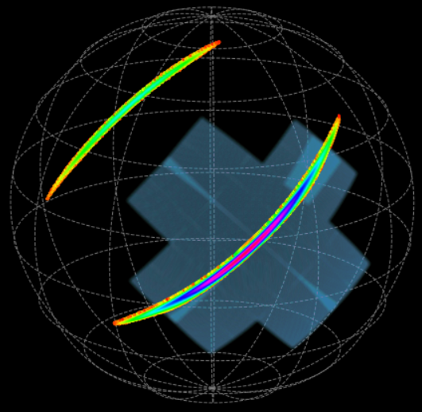
WXT sensitivity & FoV
FoV size compared with typical GW source locus
~ 3 x10⁻¹¹ erg/s/cm² @1ks
LEIA in-orbit observation.
# transients per week
EP: >10
Swift: 2.5
MAXI: 0.8
WXT will search the transient onboard in real time and publish the information by internet. FXT will slew to the transient in 3 minutes.
Positioning accuracy : < 2 arcmin mostly, ~ 1 arcmin for bright sources (90% error)

Slide 8
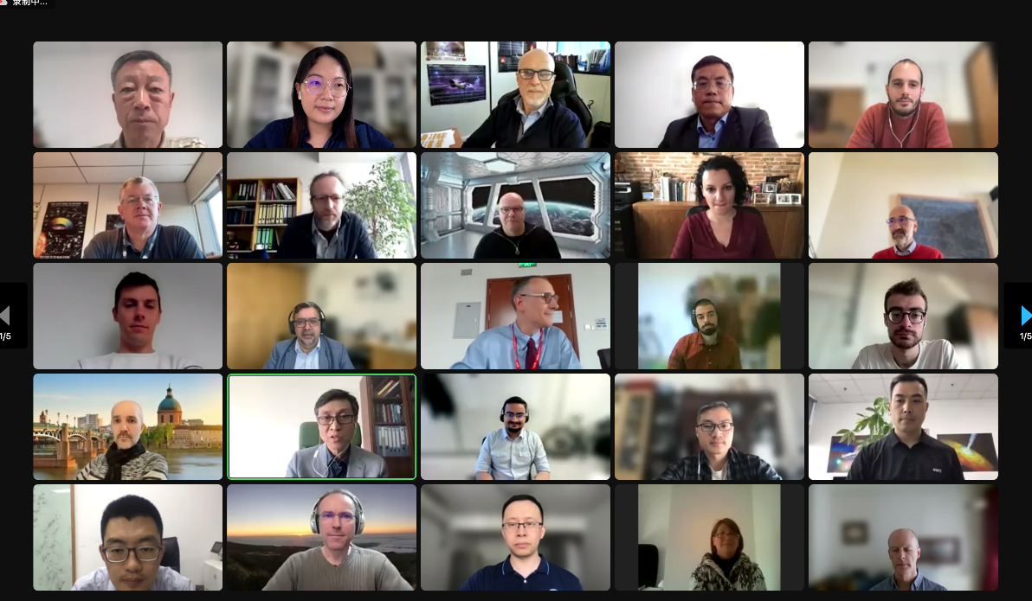
Science team and data policy
We have built the STP team recently, total 100 scientists.
China : 75
  ESA : 10
  MPE: 10
  CNES: 5
  The data will only accessible to team members within a proprietary period (6 month/ 1 year).
  For more details, please refer to http://ep.bao.ac.cn.
Executive Committee
Erik Kuulkers | ESA
Kirpal Nandra | MPE
Weimin Yuan (Chair) | CAS
Shuang-Nan Zhang | CAS

Slide 9
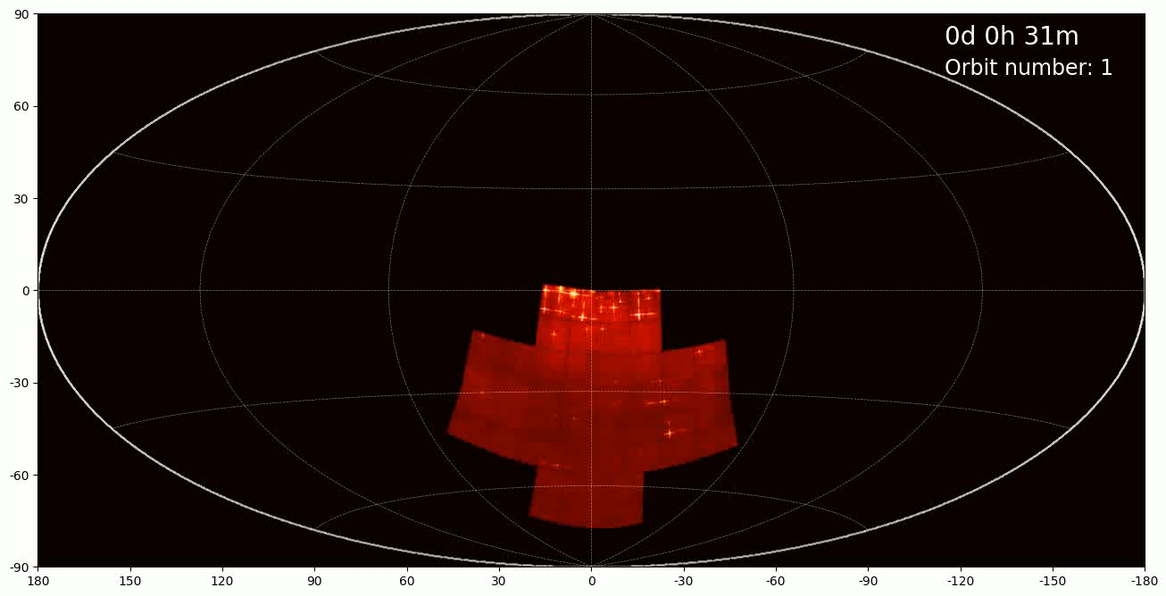
Simulation of 1 day survey by WXT
1 day sky coverage
Galactic coordinates
In 3 orbits (~ 5hr) WXT covers once the night sky; cover the whole sky in half a year

Slide 10
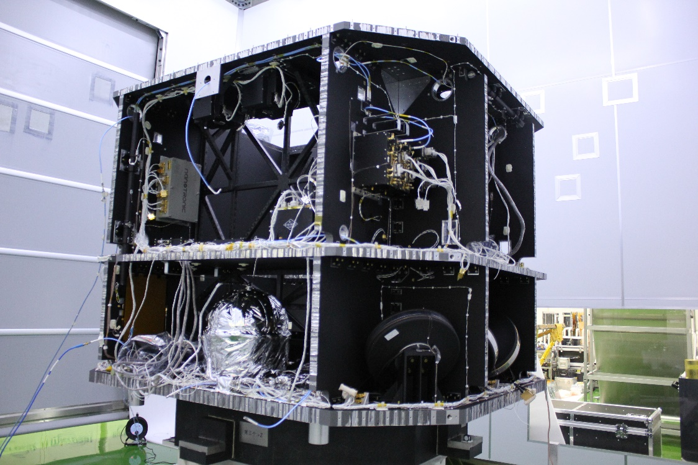
Phase D Schedule
We are here.
2022.3
2022.5~11
2022.10~12
2023.4
2023.5
2023.3~5
SC PFM FM Units Ready
FM Electrical Interfaces and Functions Test
FXT FM ready
Satellite Assembly and E2E Test
CDR
12 WXT FM ready
2023.11
2023.10
2023.8
2023.7
2023.6
Launch campaign
Flight acceptance review
（FAR）
Vibration test
Electro magnetic compatibility（EMC ）test
Magnetic test
Thermal Test
SIRR
（S/C Integration Readiness Review ）
Launch

Slide 11
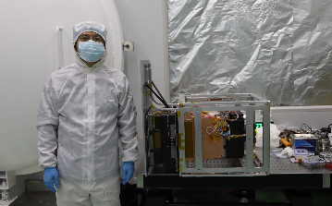
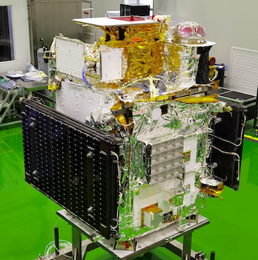
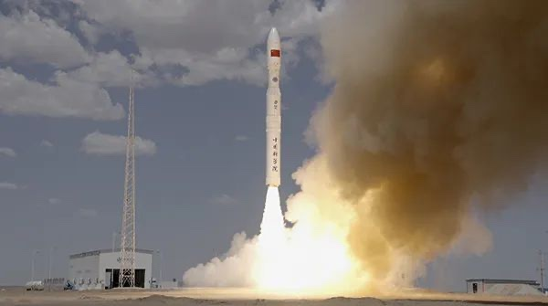
WXT pathfinder: Lobster Eye Imager for Astronomy (LEIA)
Pathfinder: one WXT test module aboard CAS’s SATech-01
Proposed in 2019.
600 km SSO orbit.
95 minute period
26 + 27kg, 85 W
1 pointing per orbit
(10 – 15 minutes).
10 orbit per day.
launched 2022 July 27
CAS’s SATech-01 credit: MicroSAT

Slide 12
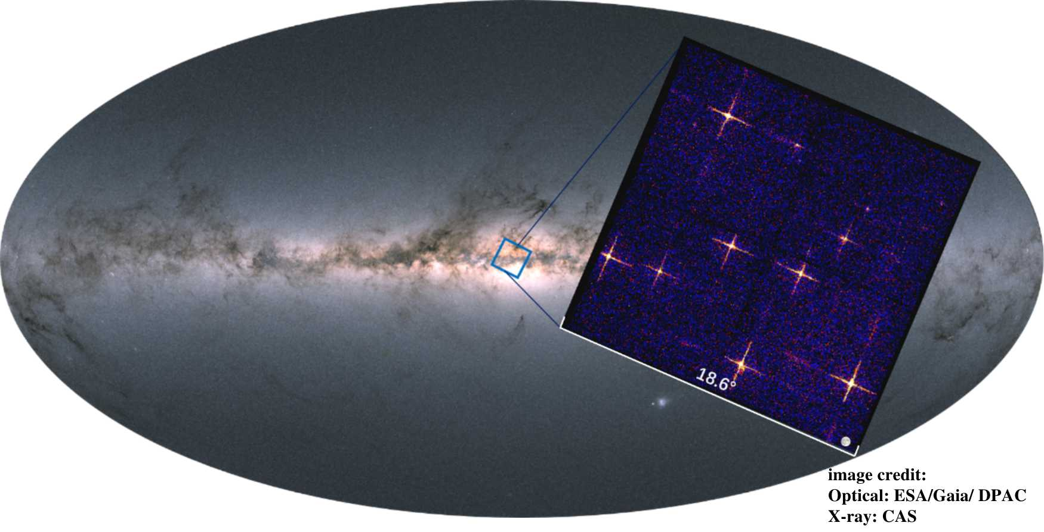
LEIA first light: Galactic Centre
FoV 340 deg²
~800s exposure
Size of full Moon
Instrument test observations: August 8-10, 2022

Slide 13
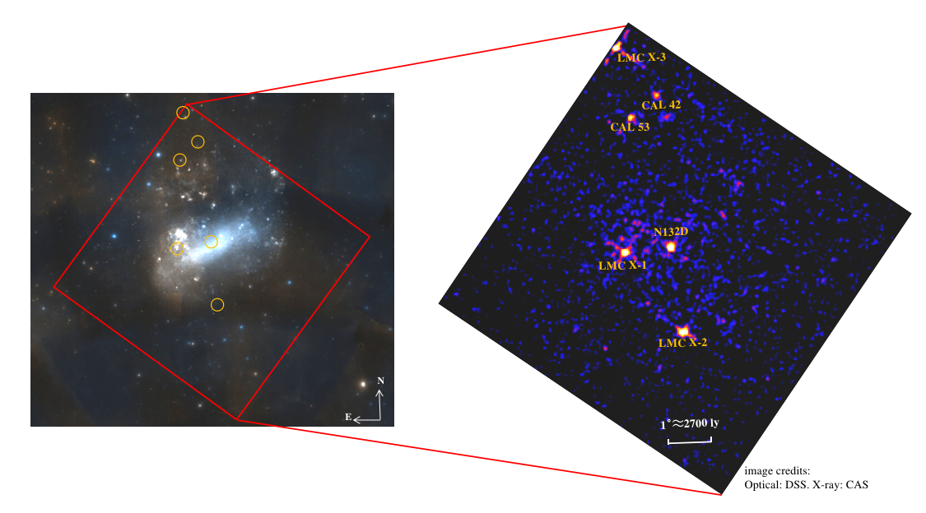
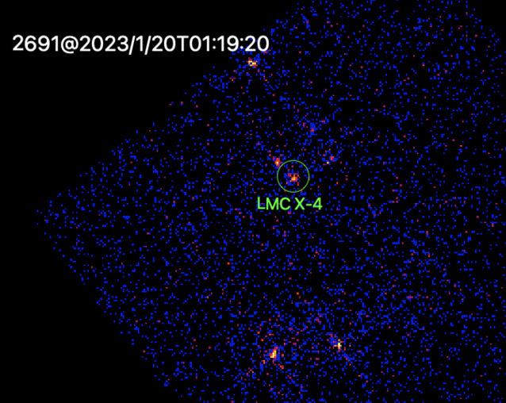
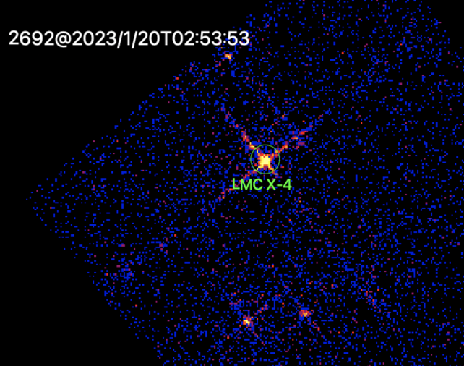
LMC monitoring
700s observation
1 CMOS image (1/4 FoV of module)

Slide 14
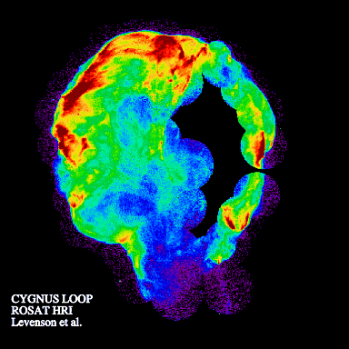
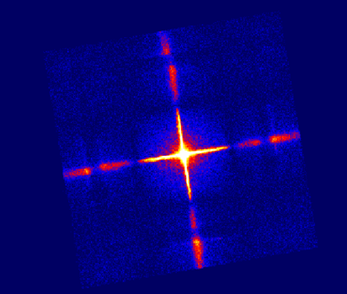
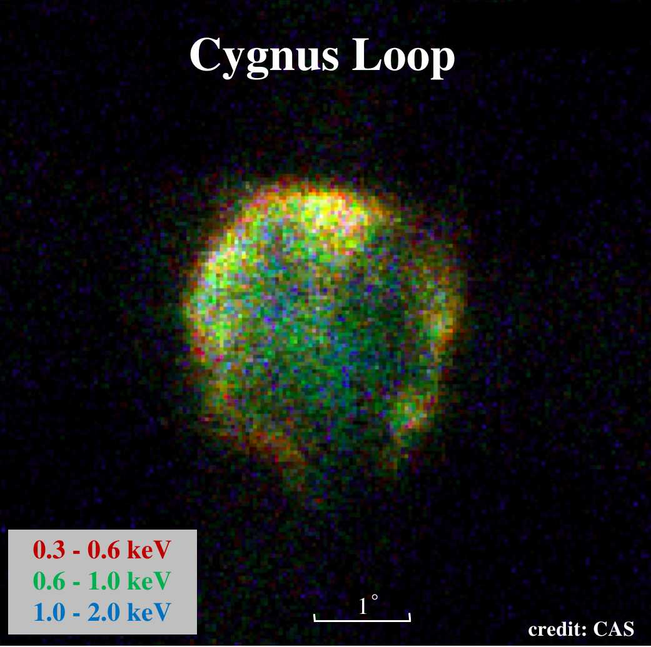
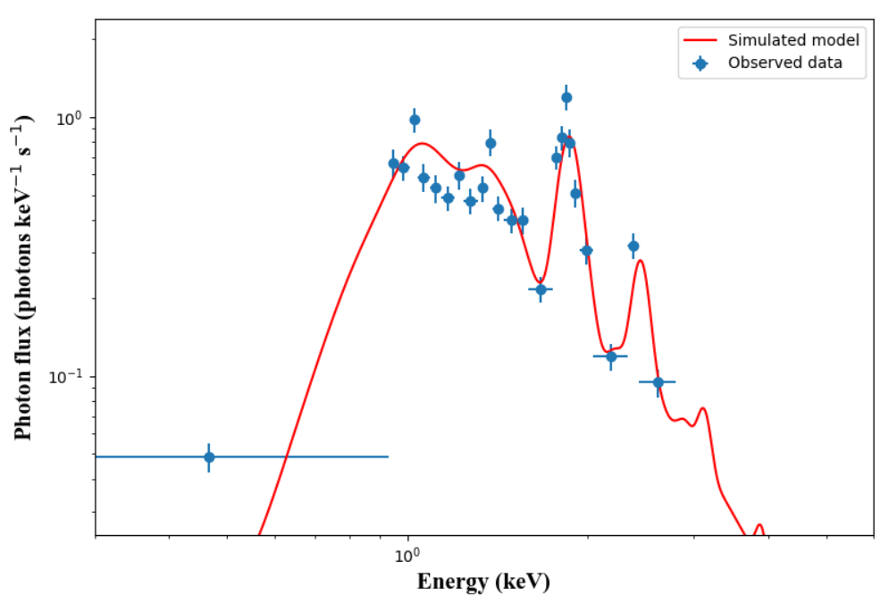
Image and spectrum
Sco X– 1
Cas A (SNR)
Cygnus loop

Slide 15

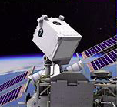
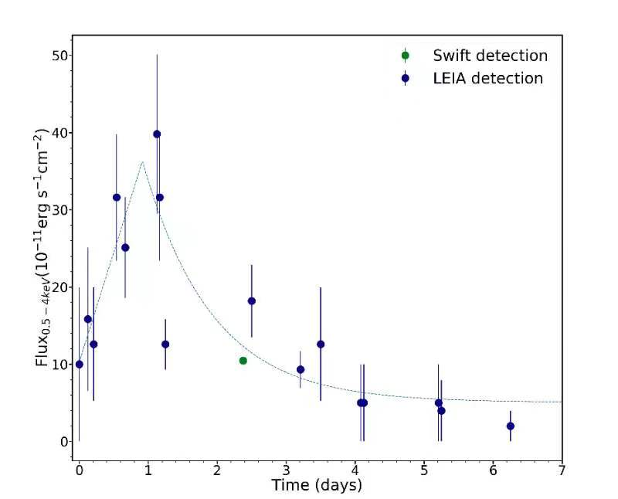
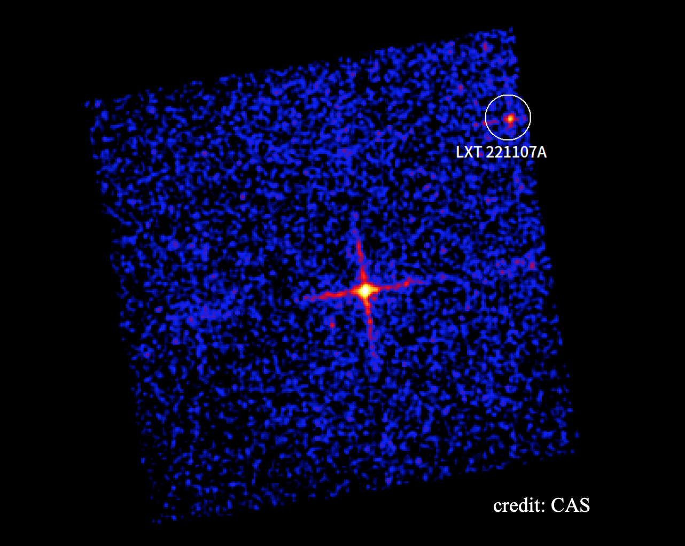
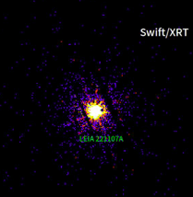
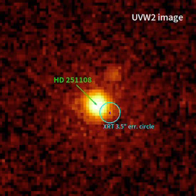
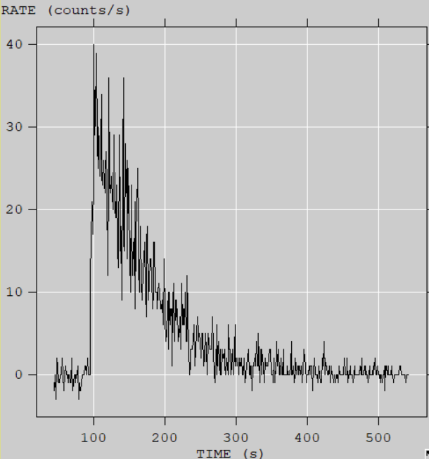
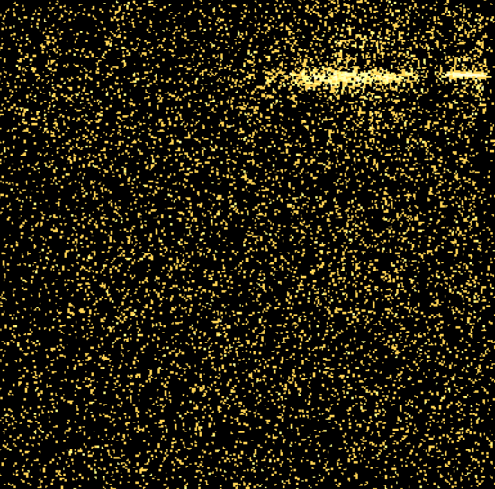
LEIA’s transient: stellar flares and GRBs
Followed up by :
LXT 221107A super flare
Swift
NICER
LXT221107A
LEIA X-ray Lightcurve
last about 1 week.
Transient rate: 1 per (1 - 2) weeks.
EP will be 30-40 times of LEIA .
GRB230307A

Slide 16
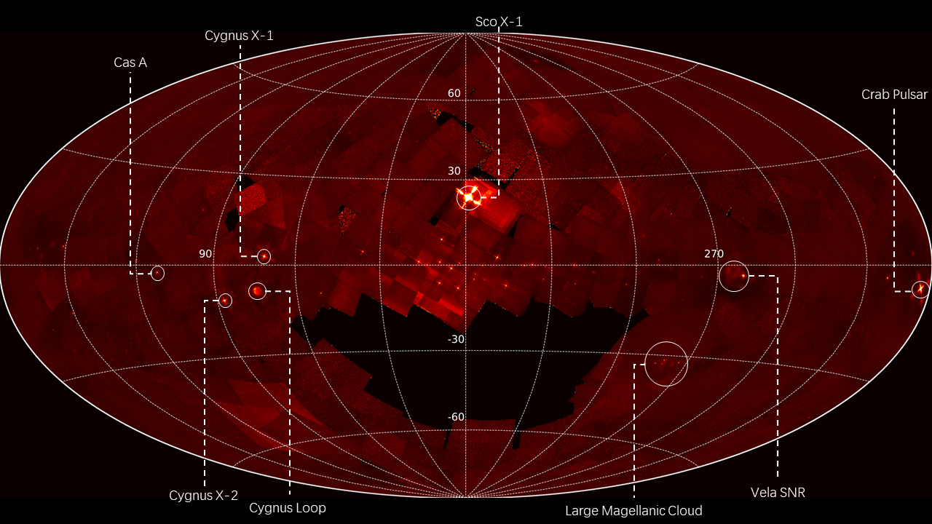
LEIA’s all sky survey
Finished 90% of whole sky over last 5 months

Slide 17

Summary
Einstein Probe will be a powerful mission. It will be launched in 2023.
    3600 deg² Fov for WXT(find the transient), 600 cm² effective area of FXT (follow up automatically)
    Two new technology are used: MPO optics and CMOS sensor.
All of the instrument (2 FXT, 12 WXT) have been finished and will be calibrated recently.
For future, Synergy and follow up with/by other in-orbit/ground facilities offers great science opportunities.
lingzhixing@nao.cas.cn http://ep.bao.ac.cn

