Slide 1
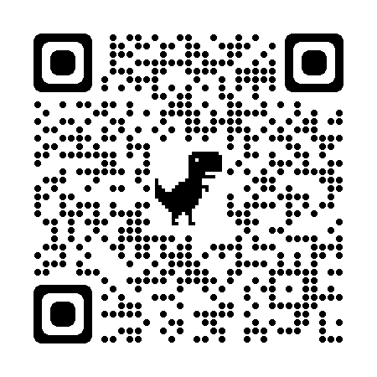
Towards precision particle background estimation for future X-ray missions:
correlated variability between
Chandra ACIS and AMS
Catherine Grant et al. 2022,
Proceedings of SPIE vol. 12181, arXiv:2208.01130
Presented at SPIE Astronomical Telescopes + Instrumentation
SPIE paper

Slide 2
Credits
Undergraduates: Brian Avendano (MIT), Alexander Yu (Oberlin)
US WFI team:
Eric Miller, Mark Bautz, Arnab Sarkar, Ben Schneider, Rick Foster (MIT)
Gerrit Schellenberger, Ralph Kraft, Paul Nulsen (SAO)
Dan Wilkins, Steven Allen (Stanford)
David Burrows, Abe Falcone (PSU)
Athena WFI Background Working Group:
Silvano Molendi, Fabio Gastaldello (INAF)
Tanja Eraerds, Andreas von Kienlin, Arne Rau (MPE)
Michael Hubbard, Jonathan Keelan, David Hall (Open University)
And many more

Slide 3
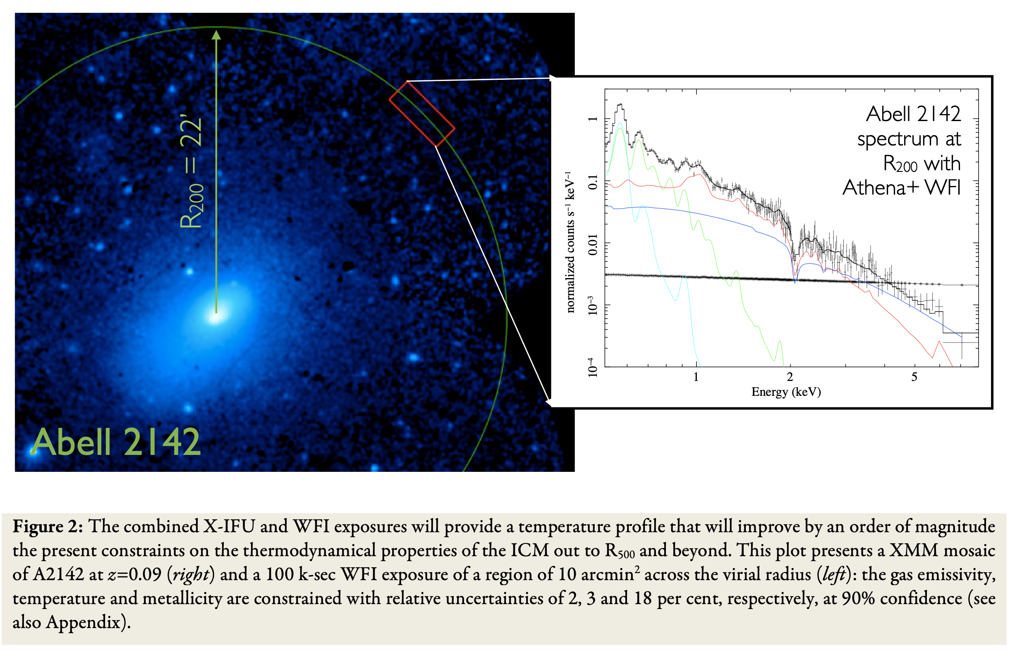
Why does the background matter?
Future X-ray observatories, like Lynx, Athena, and AXIS have ambitious science goals
Finding first groups and clusters
Mapping cosmic structure thru time
Aligns with Astro2020 “Cosmic Ecosystems” theme
Deep observations of faint diffuse objects
Background adds statistical and systematic uncertainty to results
Observations of low surface brightness sources often currently limited by systematic uncertainty in background level
Meeting these science goals requires both reducing the background and improving knowledge of the residual background
Ettori+ 2013, arXiv:1306.2322, Athena WP
“The Hot and Energetic Universe:
The astrophysics of galaxy groups and clusters”

Slide 4
Components of Background in the X-ray band
Focused X-rays vs everything else
Diffuse XRB + unresolved point sources
Below 1-2 keV, XRB dominates the background
Particle background
Galactic cosmic rays, solar energetic protons, Earth’s trapped radiation
Temporally variable, depends on orbit
Unfocused cosmic hard X-ray background
Constant in time
Eric Miller, MIT
Background simulation for AXIS

Slide 5
Types of Orbits
Low-Earth Orbit (LEO) – Suzaku/Hitomi/XRISM, Swift, NuSTAR
Exposure to trapped radiation (South Atlantic Anomaly and high latitudes) depends on orbit inclination
Geomagnetic shielding of solar/Galactic particles, depends on orbit inclination
Background varies with orbit, geomagnetic shielding
Earth-Sun L1/L2 (eROSITA, Athena), Lunar resonance (TESS)
No exposure to Earth’s trapped radiation except low-density magnetotail
No geomagnetic shielding, quiescent particle background is higher
High-Earth Orbit (HEO) – Chandra, XMM
Transit thru trapped radiation belts at perigee while instruments are off
During science observations, environment should be similar to L1/L2
Possible exception – low energy proton flares?

Slide 6
X-ray Background: Current State of the Art
Standard event selection and grade/pattern filtering
Specialized modes, (ACIS Very Faint, WFI SAC) allow for additional filtering and reduction of background by examining neighbor pixels
Better statistical treatment of background, modeling not subtracting
For example, Eric Miller’s IACHEC talk, a case study for Suzaku and N132D
https://iachec.org/2020-iachec-online-meeting-date/
More recently, particle simulation tools (Geant4) used pre-launch
Can inform instrument design choices to reduce background
May be outweighed by other needs – thermal, outgassing, radiation shielding

Slide 7
Can we do better?
Substantial effort by ESA in support of Athena on understanding and reducing all background components
Focus has been on reducing background, lowers statistical error; better knowledge of background lowers systematic error
The US participation in the WFI background WG:
Develop methods to identify unrejected background events using correlations between unrejected background and particle tracks
Examine full frame data from Chandra ACIS and XMM EPIC
Refine/validate background reduction algorithms using Geant4 simulations of Athena WFI
Better understand systematic background errors and strategies to reduce them
Variability studies of on-orbit X-ray background data
Comparison to dedicated particle measurements
Establish best practices for background normalization
Work in progress!

Slide 8
Can we do better?
Substantial effort by ESA in support of Athena on understanding and reducing all background components
Focus has been on reducing background, lowers statistical error; better knowledge of background lowers systematic error
The US participation in the WFI background WG:
Develop methods to identify unrejected background events using correlations between unrejected background and particle tracks
Examine full frame data from Chandra ACIS and XMM EPIC
Refine/validate background reduction algorithms using Geant4 simulations of Athena WFI
Better understand systematic background errors and strategies to reduce them
Variability studies of on-orbit X-ray background data
Comparison to dedicated particle measurements
Establish best practices for background normalization
Work in progress!

Slide 9
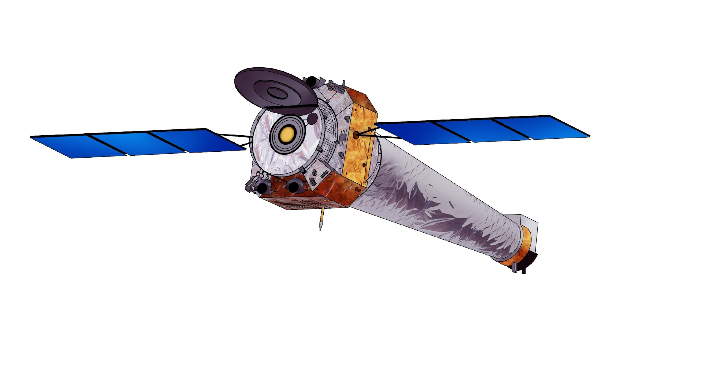
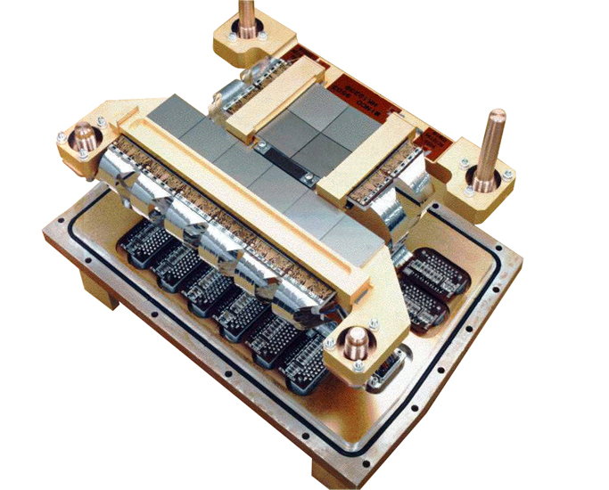
Chandra ACIS
Chandra X-ray Observatory launched into 2.6-day highly elliptical orbit in 1999
Samples a variety of radiation environments
Science observing time is always outside radiation belts
Unfocused background should be similar to that at L1/L2 or lunar-resonance orbit
Advanced CCD Imaging Spectrometer (ACIS)
10 frame transfer CCDs
1024x1024 24-µm pixels
ACIS-S3 BI CCD, 45 µm thick, fully depleted
Closest analog of future detectors
Stowed calibration data, only unfocused bkg

Slide 10
CCD Event Detection
Sample ACIS-S3 raw data frames
Back-illuminated CCD; 3.3 sec frame time
Nearly everything in these images is particle background
Telemetry limitations require discarding most pixels on-board
On-board processing identifies potential X-ray event candidates, telemeters subset most likely to be X-rays and not particles
Saves a counter of number of discarded events: ”High energy reject rate”, good bkg proxy

Slide 11
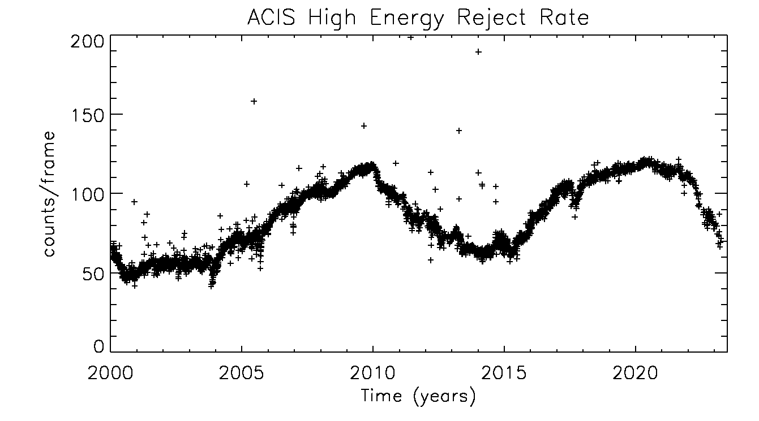
ACIS Background Variability
~2x solar cycle variation
23+ year baseline
Primarily GCR protons
Modulated by heliomagnetic field → solar activity
Higher rates during solar storms
Many timescales of variability
Solar cycle, ~2x over 11 years
Individual solar storms, ~10% over weeks-months
“Bubbling”, ~5% over days-weeks
Solar min
Solar max

Slide 12
ACIS Background: short timescale variability
Solar max
Solar min
~5% over days
No significant solar activity
~10% over weeks-months

Slide 13
Alpha Magnetic Spectrometer on the ISS
Precision general purpose particle instrument
Sensitive to a wide range of particle types and energies
Time-resolved GCR proton spectra reconstructed by filtering on cut-off rigidity
http://ams02.space for more on AMS with references and links to calibrated data

Slide 14
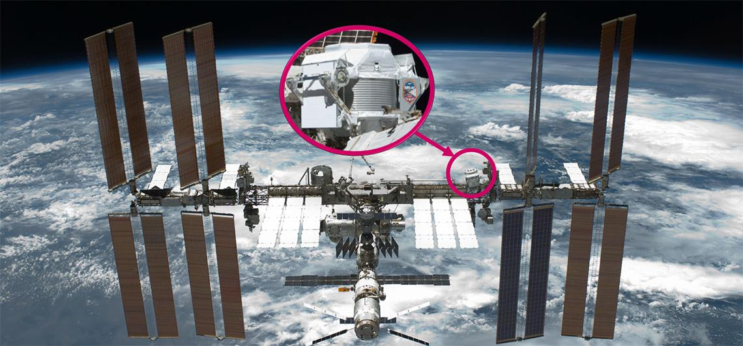

Slide 15
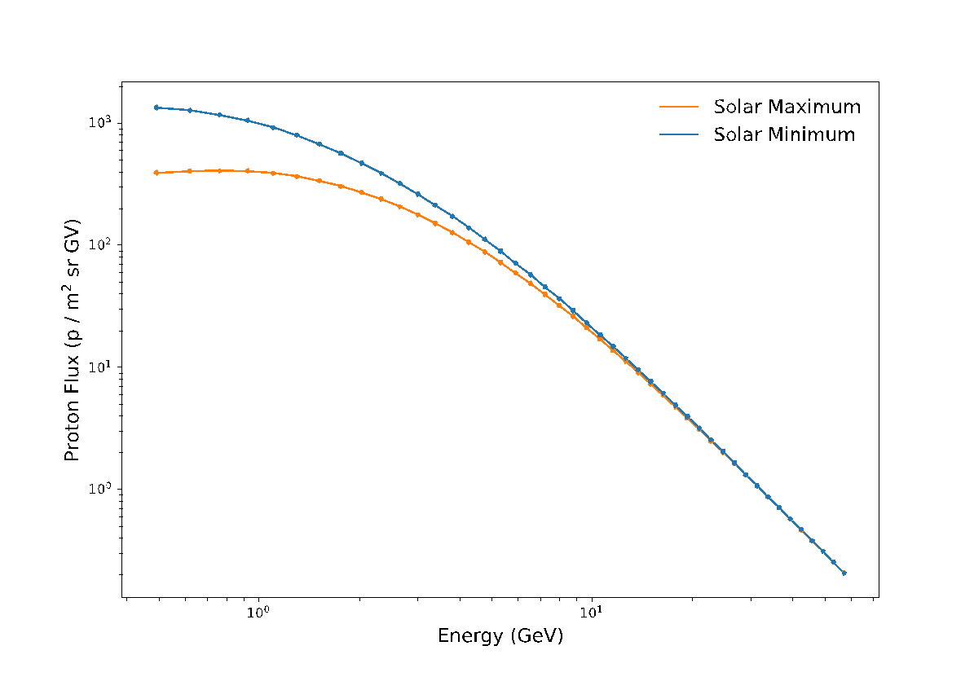
AMS GCR proton spectra
GCR proton spectra, as seen outside geomagnetic shielding
Low energy turn-over due to heliosphere magnetic shielding
Overall flux higher at solar min, reduced magnetic shielding
Flux is suppressed at lower energies at solar maximum
Statistical + systematic errors are shown, high precision data

Slide 16
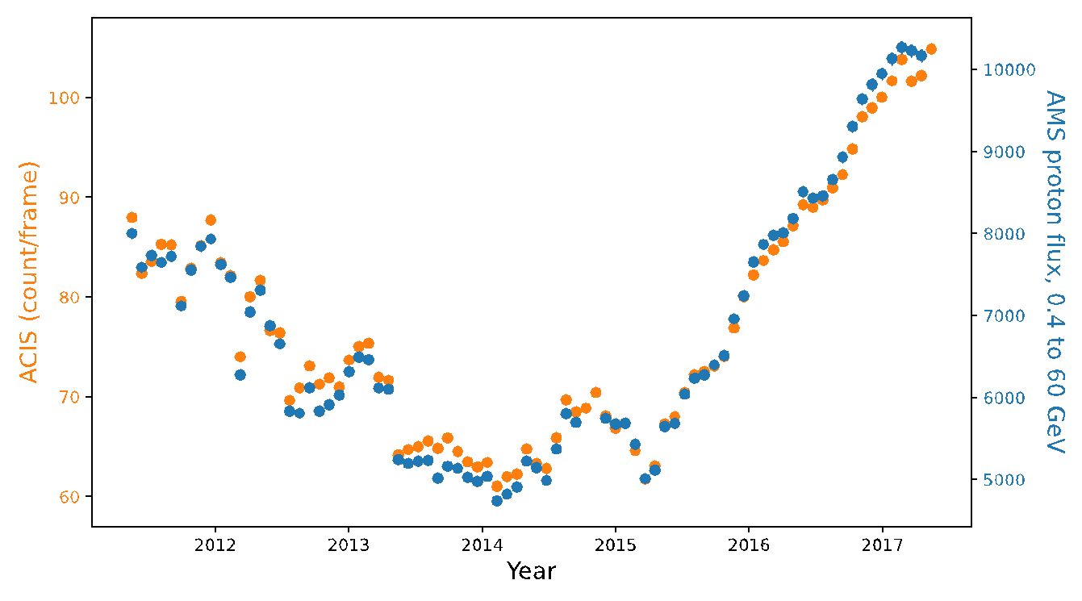
AMS / ACIS Comparison: Binned Data
ACIS (orange)
AMS (blue)
Bartels rotation bins, 27 day ∼solar rotation
Not a fit! Y-axes are scaled
Good correspondence of features on many timescales

Slide 17
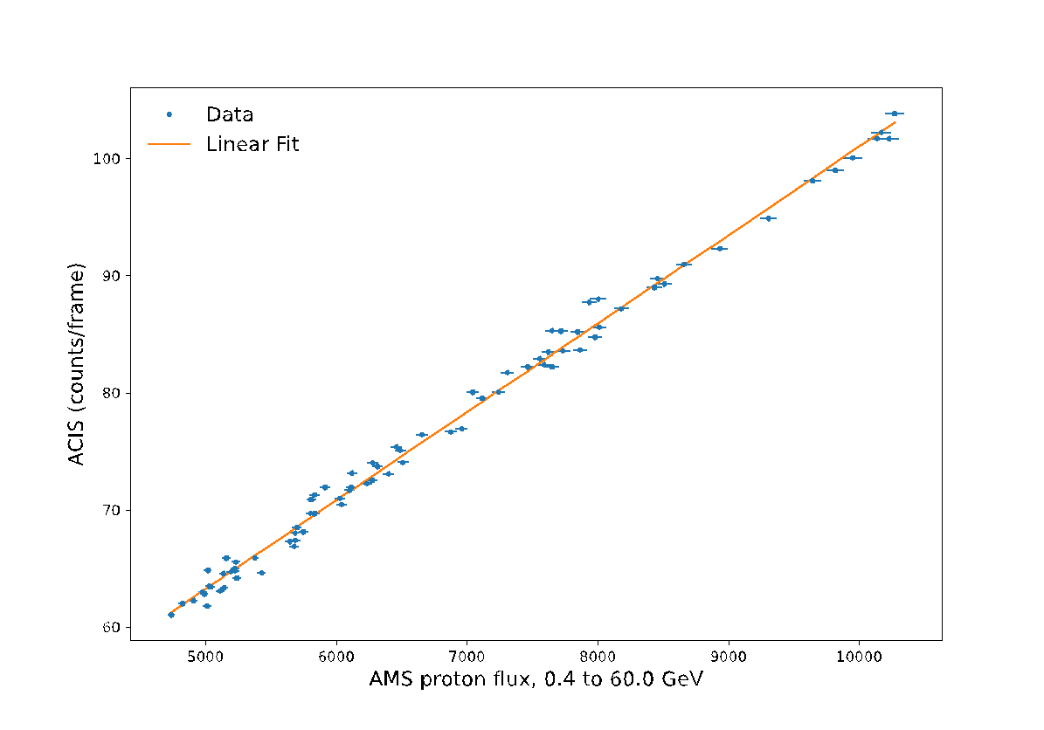
AMS / ACIS Comparison: Binned Data
Data are well correlated
Fit has high significance
Scatter possibly due to
Uneven sampling of ACIS data within each bin
Variation of ACIS data within each bin
Fit extrapolates to non-zero ACIS rate; likely HXB

Slide 18
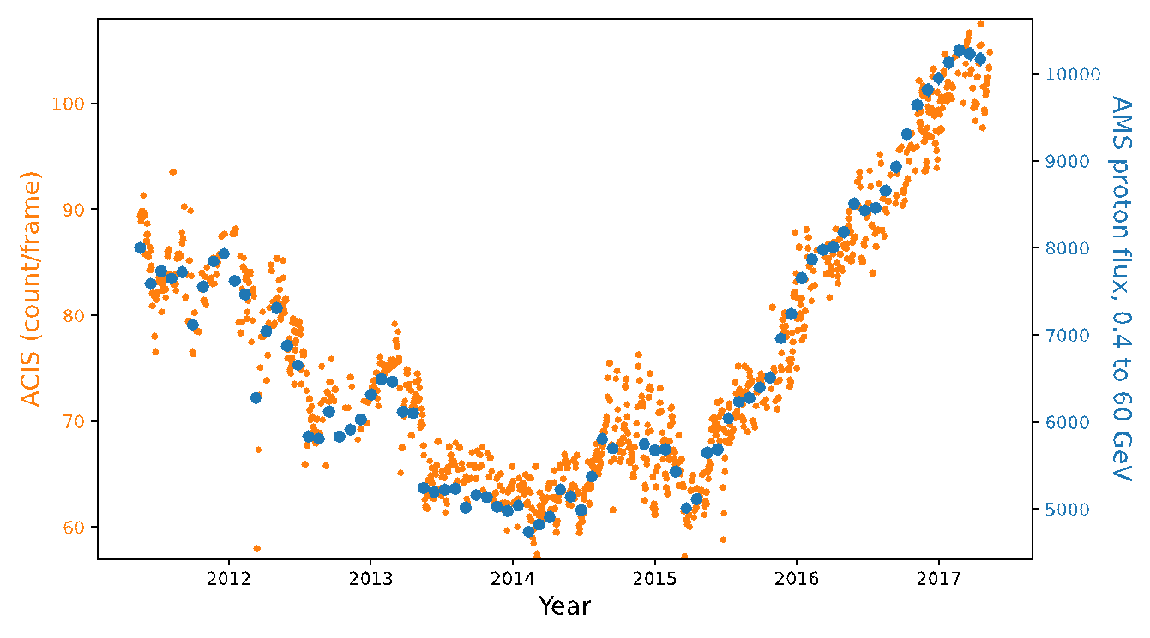
AMS / ACIS Comparison: Binned Data
ACIS (orange)
AMS (blue)
Unbinned ACIS data
Substantial variation within each 27-day Bartels rotation

Slide 19
To LEO or not to LEO
Orbit choice has major ramifications for normalization and variability of particle background
In LEO, modulation of the particle background by geomagnetic shielding can be accurately modelled, e.g. Suzaku XIS (Tawa+ 2008)
In HEO/L1/L2, normalization of the background ~5x higher then LEO, variability is driven by solar activity and solar cycle
Cannot be simply or accurately predicted, requires nearly simultaneous measurement
Detector area outside FOV, on-board particle monitor, ???

Slide 20
Summary
Observations of low surface brightness sources often currently limited by uncertainty due to the background
Background is variable on many timescales, better understanding of that variability can reduce systematic errors
ACIS background proxy is well correlated with AMS GCR proton flux on timescales of the 27-day solar rotation cycle
Substantial variation of ACIS data on smaller timescales
Future work:
Adding ACIS science data to increase the time coverage on short timescales
Exploring the ACIS/AMS correlation with 1-day binning
Does the correlation continue at shorter timescales? Can we see real differences between the environment at AMS and ACIS?
For future missions, do you need an on-board particle monitor? Detector area outside of FOV? How well can you substitute non-local particle measurements?

Slide 21
For more information…
MIT analysis of simulated WFI bkg data: Miller+ 2021, JATIS 8 (1)
ACIS full frame data: Grant+ 2018, Proc. SPIE 10699
XMM Small Window Mode data: Bulbul+ 2020, ApJ 891 Schellenberger+ 2023, in prep
Gratefully acknowledge support by NASA grant NNX17AB07G and contracts NAS 8-37716 and NAS 8-38252
ML approach to background reduction: Wilkins+ 2022, SPIE 12181-155
MPE WFI team background simulations: Eraerds+ 2021, JATIS 7 (3)
And many other publications related to Athena and AREMBES

Slide 22
Backup Slides

Slide 23
Outline
Why does the background matter?
Brief introduction to
Components of background, orbits, and particle radiation sources
CCD event detection and background discrimination
Current state of the art for background removal/modeling
Can we do better?
Better understanding of background variability -> reduction of systematic errors
Variability of the particle background seen by Chandra ACIS
Comparison to AMS on the ISS

Slide 24
Can we do better?
Substantial effort by ESA in support of Athena on understanding and reducing all background components
ATHENA Radiation Environment Models and X-ray Background Effects Simulators (AREMBES)
Systematic analysis of in situ X-ray background data, primarily XMM
Characterization of particle environment in L1/L2 (particles, normalization, variability)
Optimization/validation of simulation tools (space physics list, mass models)
Many resulting publications
WFI and X-IFU Background Working Groups
Geant4 simulations informing instrument design decisions, flight and ground software
Studies of stray-light, CXB modeling, magnetic diverter to prevent soft proton flares
Self anti-coincidence was proposed as a method to reduce the background on the WFI and meet the challenging science requirement (Meidinger+ 2016)

Slide 25
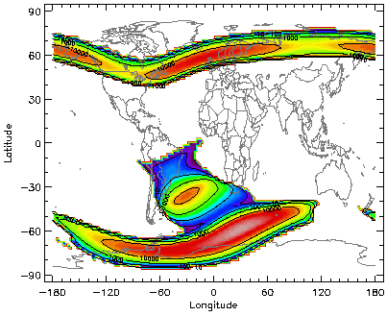
Particle Radiation Sources
Trapped protons and electrons in Earth’s radiation belts
Primary particle source in LEO
High radiation levels during SAA and auroral region passages
Less important for HEO, not a factor for L1/L2
Flux of trapped electrons (>1 MeV) at 500 km altitude using NASA AE-8 model. Image from SPENVIS manual

Slide 26
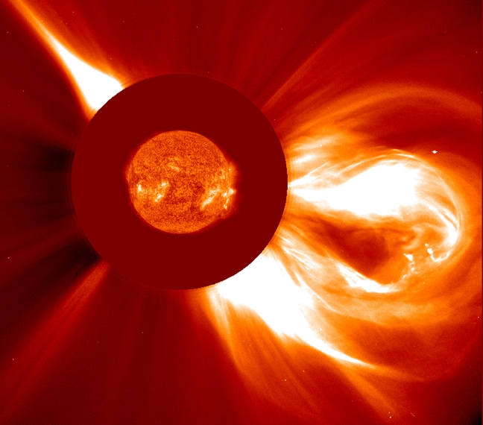
Particle Radiation Sources
Solar proton events: flares and coronal mass ejections
LEO is shielded from direct impact; can energize radiation belts
More frequent near solar maximum (2023-2026)
Large distribution in duration and particle spectrum
SOHO (ESA & NASA)

