Slide 1



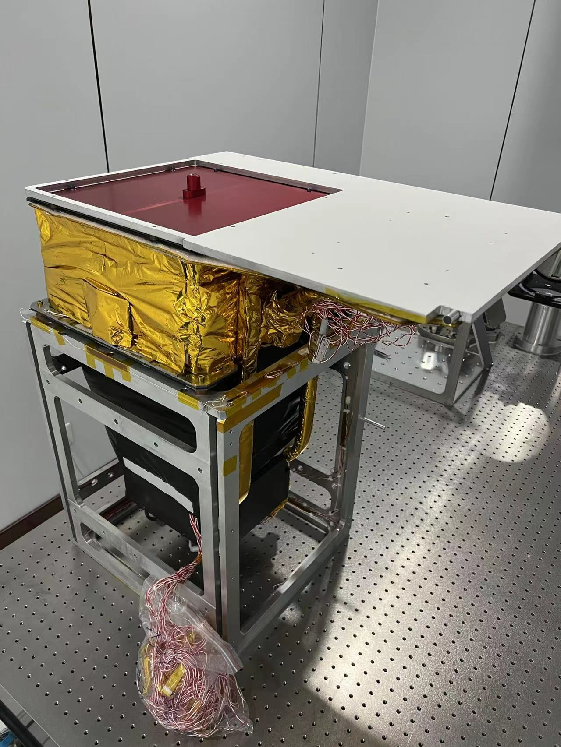
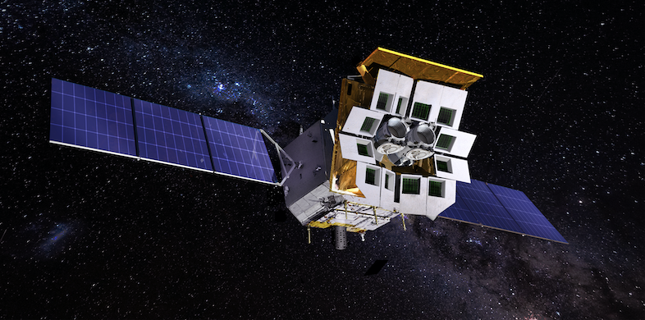
On-ground calibration for LEIA and EP-WXT Flight Models
Huaqing Cheng
National Astronomical Observatories, Chinese Academy of Sciences
On behalf of the EP-WXT calibration team
15th IACHEC workshop, Seeblick Pelham, Munich, April 2023
Notes:
Hello every, I am Huaqing Cheng from NAOC, and I am very happy to be here and show me some on-ground calibration results of LEIA, also as known as EP-pathfinder, as well as the EP-WXT flying modules.

Slide 2
Outline
Context
Ground calibration for LEIA
On-going ground calibration for EP-WXT FM
Summary
Notes:
This is the outline of my talk, including four parts, since this is the first talk about Einstein Probe. I will give a short introduction to the EP mission as well as LEIA. Then I will show you the on-ground calibration results of LEIA before its launch, mainly carried out in the past two years. I will also introduce some preliminary results on the on-ground ground calibration of EP-WXT Flying modules. Finally I will give a summary.

Slide 3
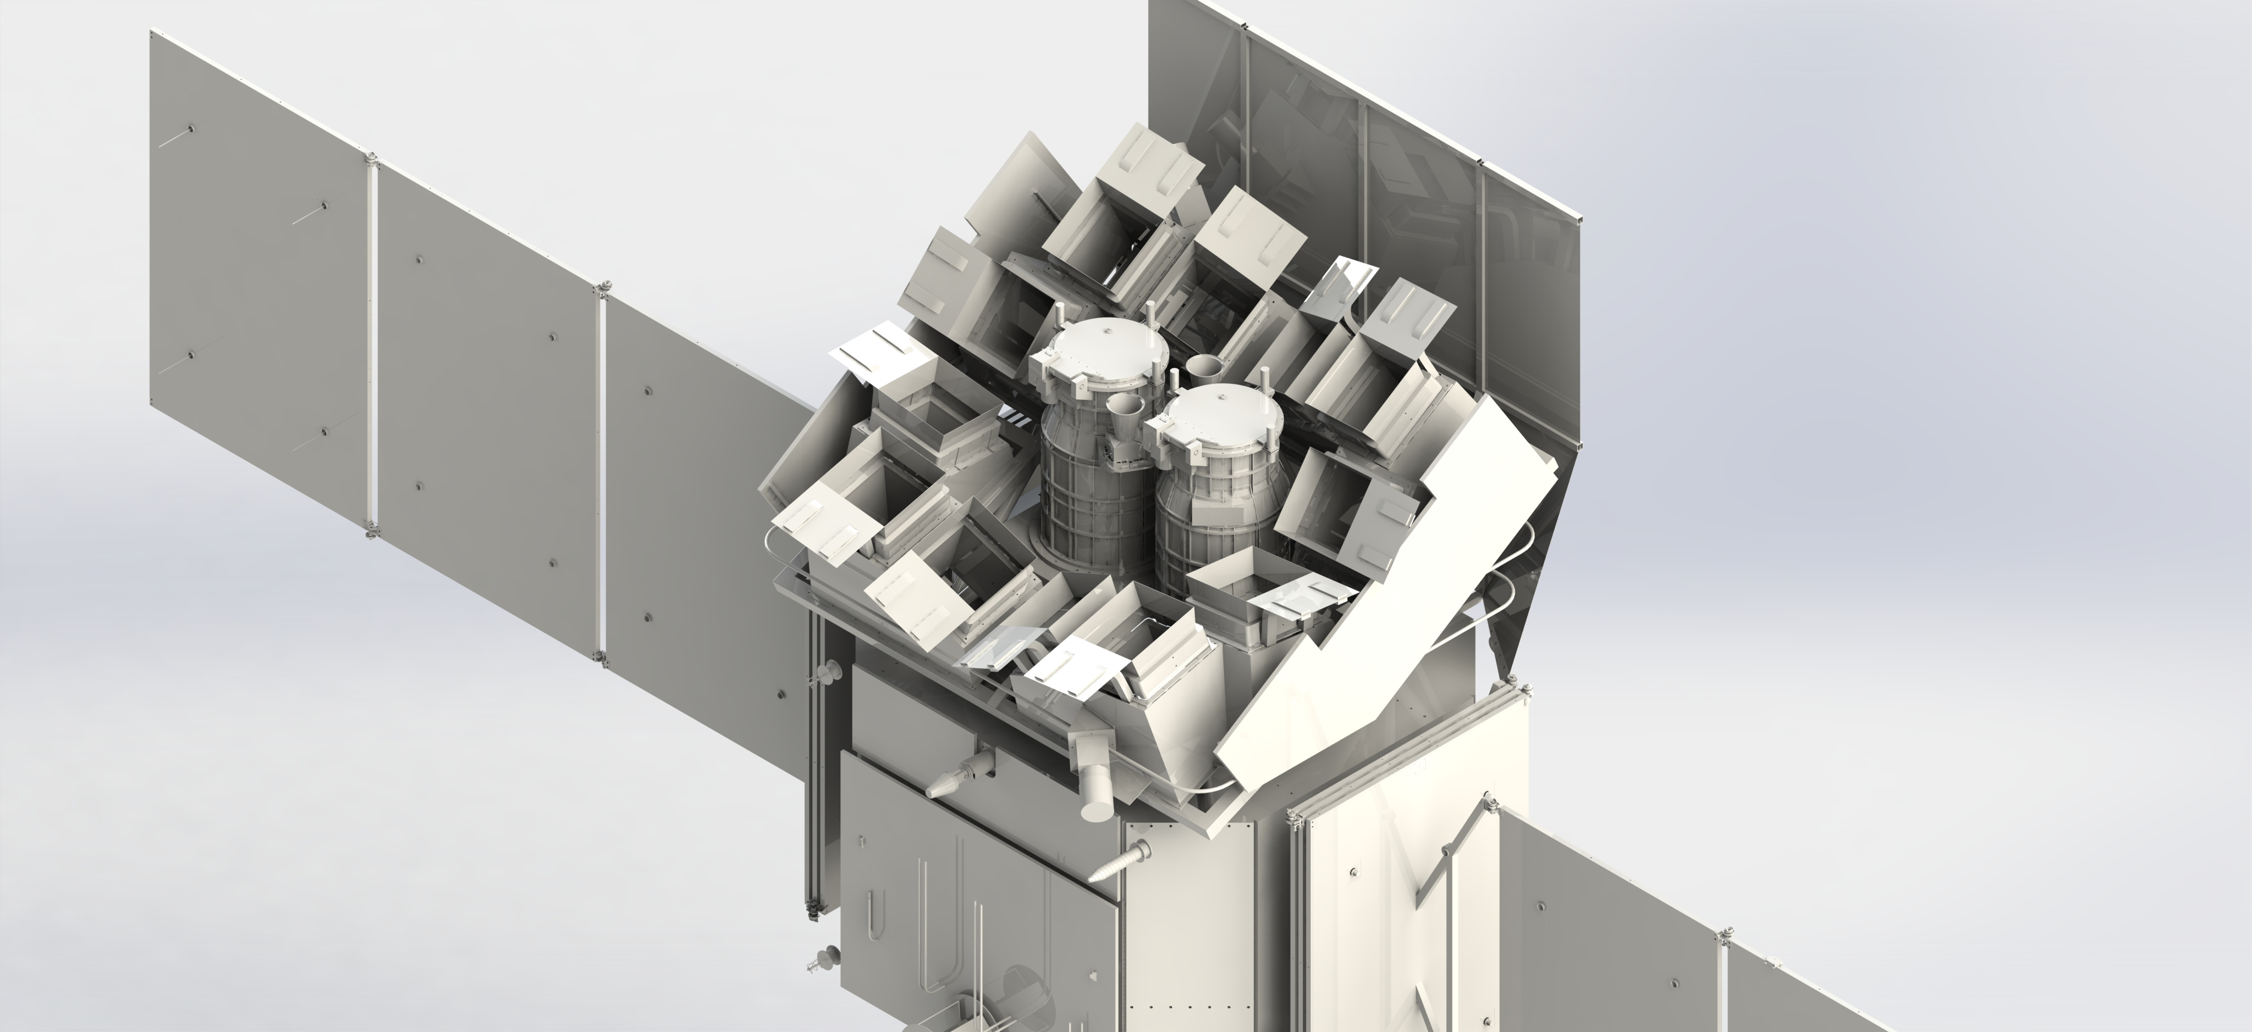


Einstein Probe (EP) mission
A space mission for all-sky monitoring dedicated to discover & characterise high- energy transients and monitor source variability in X-rays
To be launched in Nov. 2023
spacecraft
On-board data processing
Autonomous X-ray follow-up observation ~within 3min
Fast alert data downlink and uplink (ToO)
WXT (12 modules)
Wide-field X-ray Telescope
FXT (2 modules)
Follow-up X-ray Telescope
lobster-eye MPO + CMOS
FoV: 3600 sq deg (1.1 sr)
band: 0.5 – 4 keV
eff. area: ~3 cm² @1keV
resolution: ~ 5’ (fwhm)
Positioning accuracy: <1’
Wolter-1 type + CCD
FoV: ~ 1 deg
band: 0.3-10keV
eff. area: 2x 300cm² @1keV
resolution: 30” (HPD)
Notes:
So the EP mission, in abbreviate for Einstein Probe, Einstein Probe mission, js a space misson for all-sky soft X-ray monitoring dedicated to discover and characterize high-energy transients, including Gamma-ray burst, X-ray novae, supernova breakouts. Also, EP will monitor the X-ray variability for known sources. The EP satellite is now scheduled to be launched in November this year. There are two main payloads on EP satellite. The wide-field X-ray telescope (WXT), equipped with the lobster-eye MPO and CMOS detector, will monitor the sky in soft X-ray band. Specifically, the field of view of WXT is about 3600 square degree, the angular resolution is about 5 arcmin and the positioning accuracy is about 1 arcmin. The other payload is the follow-up X-ray telescope (FXT). Just as its name, FXT is used to do follow-up observations once a transient is discoved. EP will also have on-board data processing and quick data delivery.

Slide 4
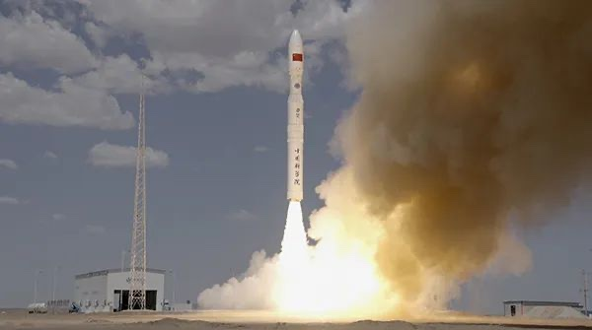
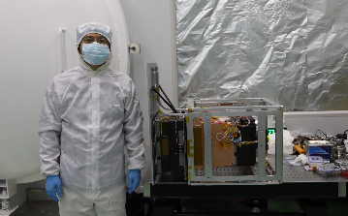
Lobster Eye Imager for Astronomy (LEIA)
LEIA/EP-Pathfinder
  Mission led by CAS
  Launched by SY01 @Jiuquan center 2022.7.27
  A qualification model for EP-WXT
  1/12 of EP FoV ~ 300 sq. deg
Goals:
  Verify MPO and CMOS technologies
  Investigate in-orbit performance of MPO and CMOS
  Test in-orbit calibration procedure for LE telescope (refer to Haiwu’s talk)
Launch of LEIA on 2022/7/27
For more detailed description on EP and LEIA please refer to Zhixing’s talk.
LEIA after module calibration (PI: Dr. Zhixing Ling)
Notes:
The lobster eye imager for Astronomy, also known as EP-pathfinder, is one of the three qualification modules of EP-WXT payload. It was launched successfully in Jiuquan launch center on July 27th, last year.
With LEIA, we can verify the two state-of-the-art technologies utilized on EP, MPO and CMOS. Also, we can investigate their in-orbit performance. And finally, we can make some rehearsals and tests for the in-orbit calibration procedure for Lobster-eye telescope, which, to my knowledge, has never been done before. For the last part, you may refer to my colleague Haiwu’s talk for more detailes.
This talk will focus on the ground calibrations.

Slide 5
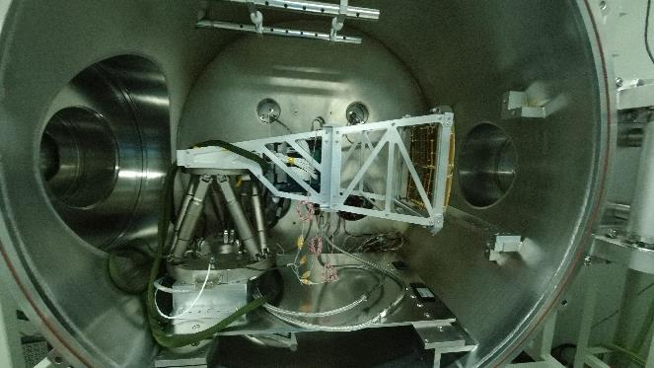
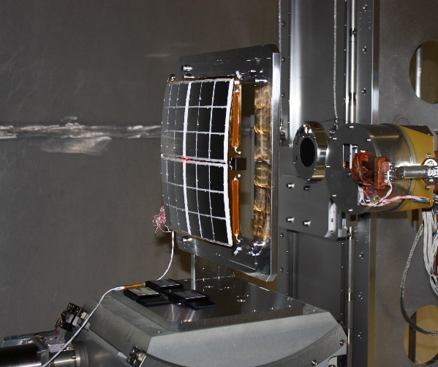
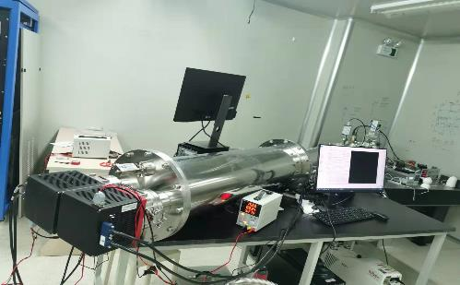
Calibration schedule of LEIA
A series of tests and calibrations were performed before its launch to fully characterize its performance at NAOC, MPE/Panter and IHEP
Calibration schedule
  2021.4-5 MPE/Panter, MA
  2021.8 NAOC, MA
  2021.9 NAOC, MA after vibration
  2021. NAOC, CMOS detector
  2021.11 IHEP, complete module
Mirror assembly test at NAOC XIB
Mirror assembly test at MPE/Panter
CMOS test at NAOC
Notes:
So, before the launch of LEIA, a series of tests and calibrations on different levels were performed at different facilities. First, the mirror assembly was tested at Panter facility for its optical performance, including the focal length, PSF and effective area. After shipping back to China, it was tested twice before and after vibration. In the meantime, the four CMOS detectors onboard LEIA were tested on a multi-target X-ray beam. Finally, after the integration, the complete module of LEIA was tested on the 100m facility of the Institute of High Energy Physics of CAS.

Slide 6
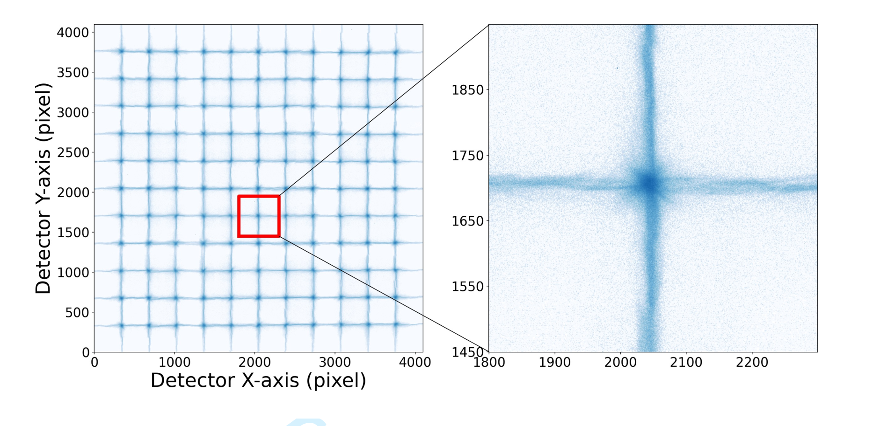
Calibration of LEIA before integration
The mirror assembly of LEIA has been calibrated for
  the point spread function (PSF) within the FoV
  the effective area within the effective energy band (~0.5 – 4keV)
The measured PSF within ¼ of FoV at NAOC 2021-8
Effective area @MPE/Panter 2021-04
Credit: Vadim
Notes:
Here are some calibration results of mirror assembly before its integration. The left figure is the obtained PSF within one quarter of the FoV, as you can see, we use an 11x11 scan mode, in total of 121 points, to perform the focal plane mapping measurement. The zoom-in figure here shows the typical shape of the lobster eye optics PSF, including a focal spot and two cruciform arms contributed by photons undergoing odd reflections within the microchannel. The Gaussian fit to the 1-dimensional PSF shows the positioning accuracy around 1 arcmin. Also the measured effective area obtained at Panter facility (right figure) is generally consistent with Monte Carlo simulations.

Slide 7
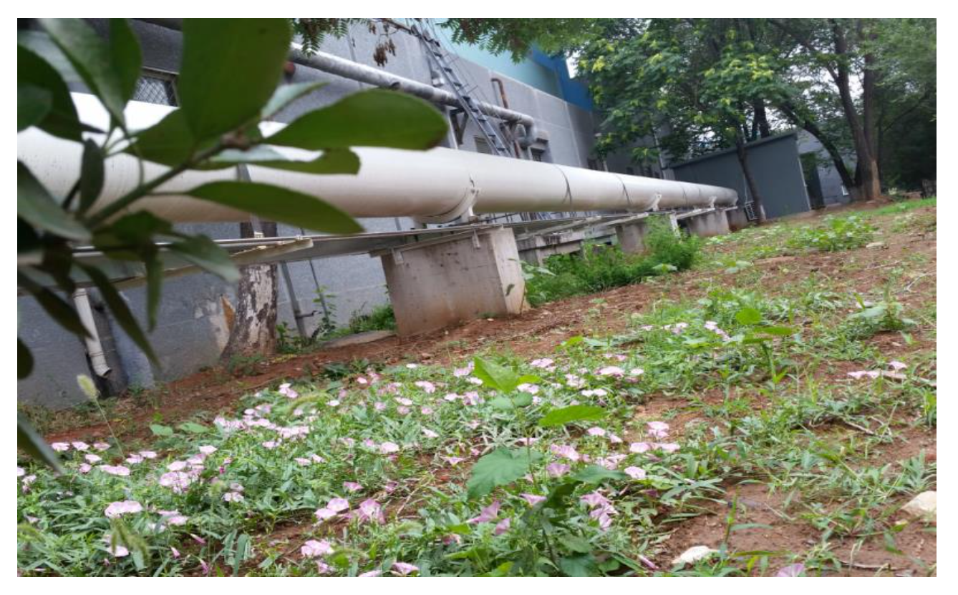
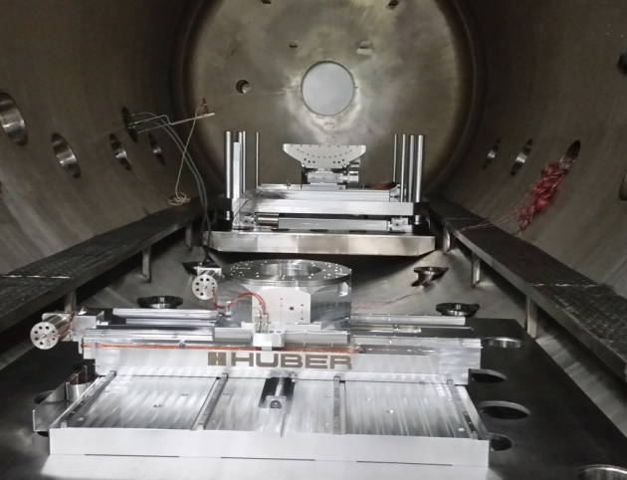
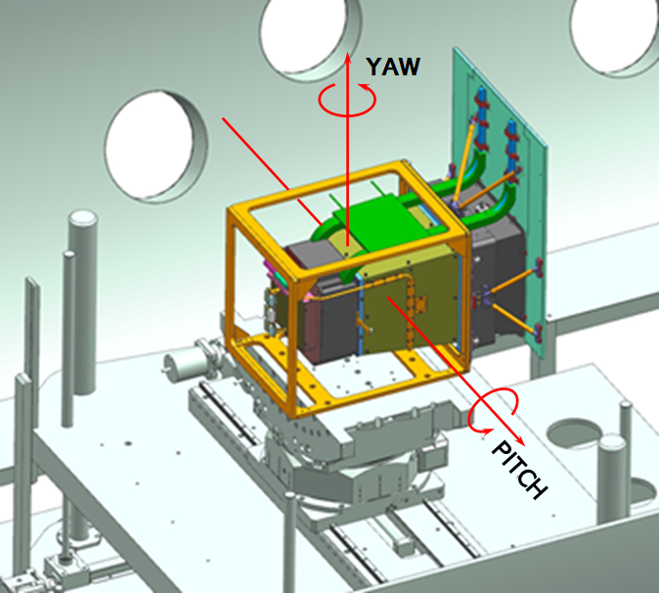
LEIA calibration in IHEP: setup and calibration items
The complete module of LEIA was calibrated at the 100-m facility at IHEP in Nov. 2021
The calibration items mainly covers
  PSF
  Effective area
  Positioning accuracy
  Energy response
  Gain, energy resolution
  Defects
  …
100m X-ray facility of IHEP
Turntable in the vacuum tank
Diagram for LEIA on the turntable
Notes:
After the integration, the complete module of LEIA was calibrated at the 100m facility of IHEP in Nov.2021. The calibration campaign is lasted for two to three weeks, and there are plenty of items involved during the calibration, including the PSF. Effective area, as well as the energy response, etc..

Slide 8
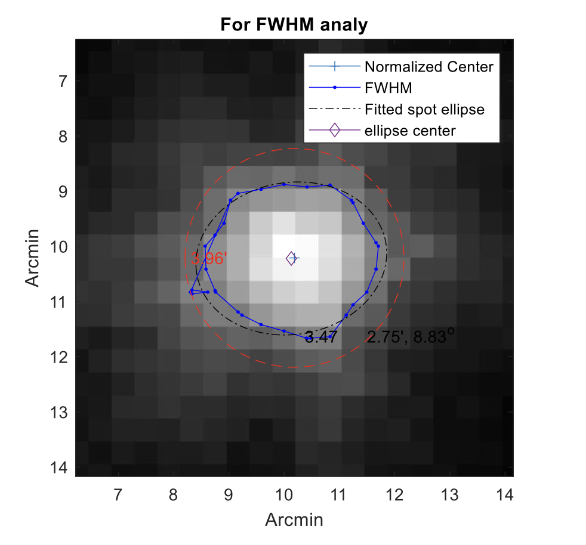
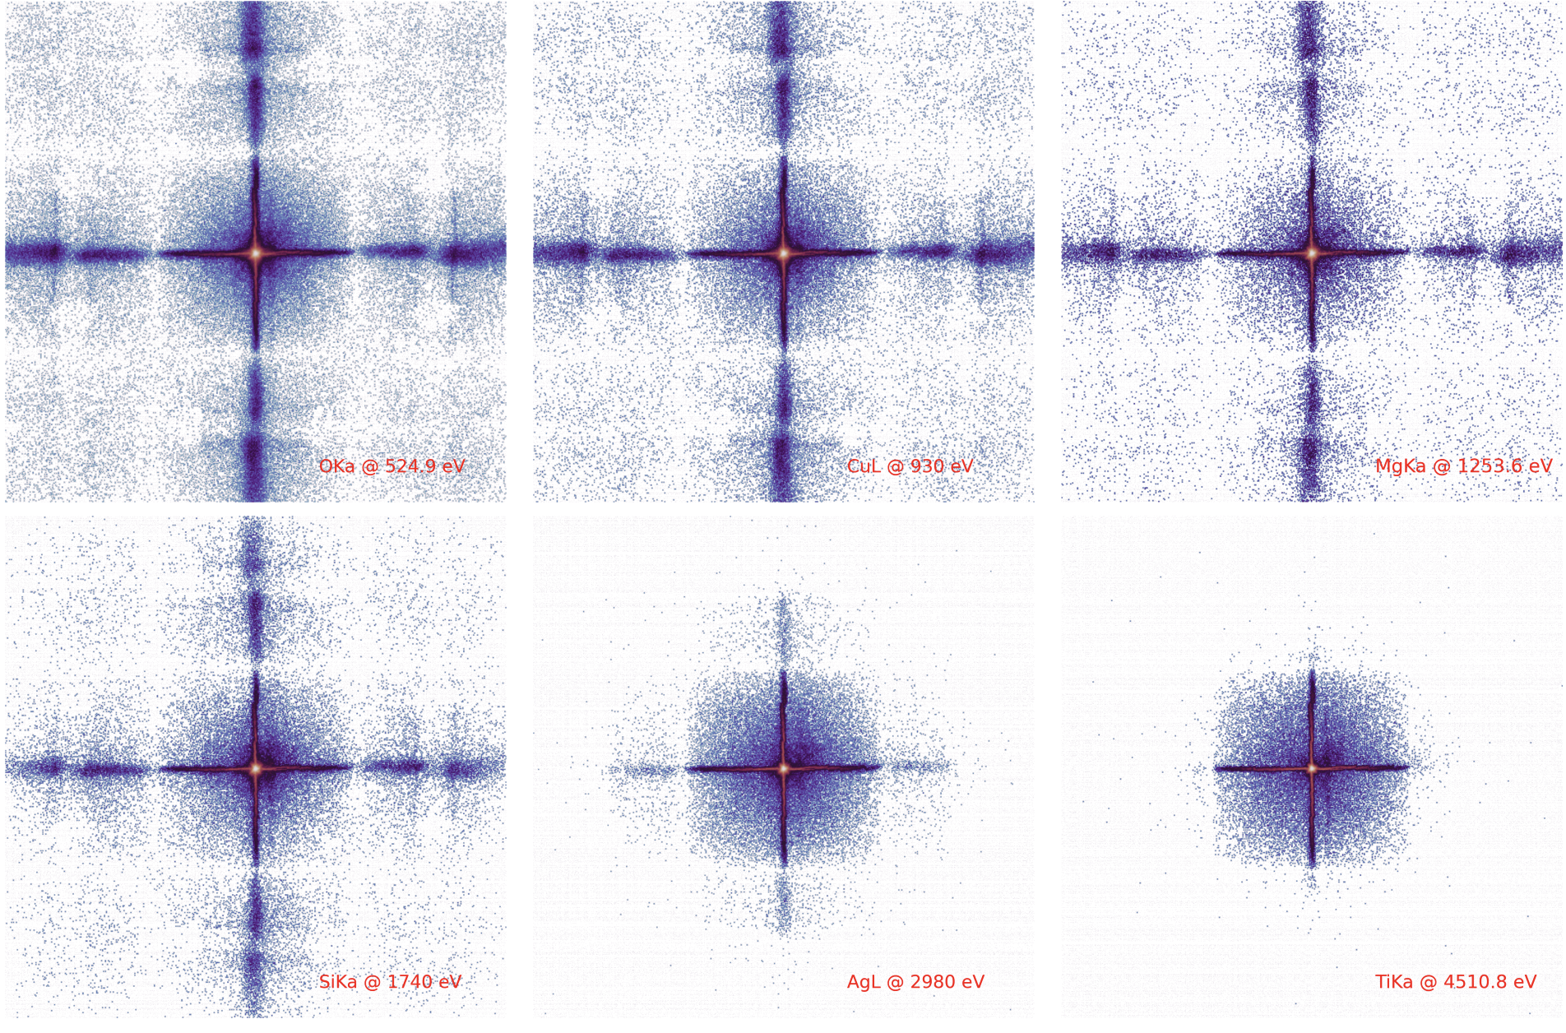
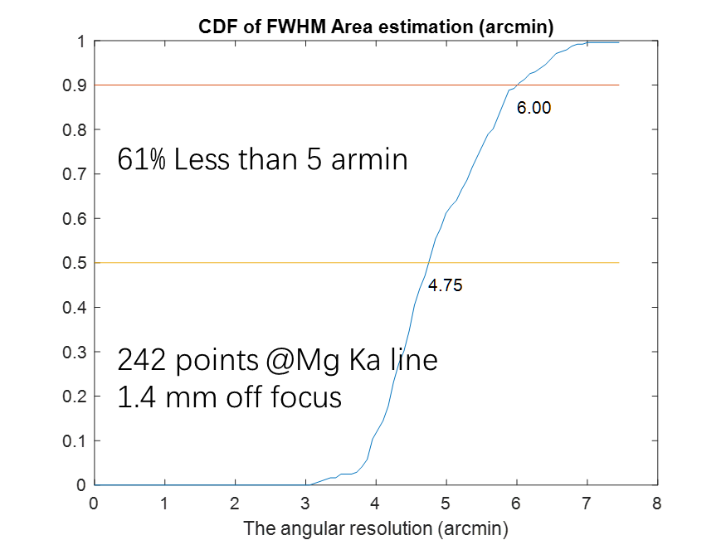
LEIA calibration in IHEP: PSF
PSF analysis
The measured PSF and spatial resolution
On-axis PSF at tested energies
FWHM/Spatial resolution ~ 4-8 arcmin
Notes:
This slide shows the measured PSF of the complete module. The left figure shows the on-axis PSF at different tested energies, including the Oxygen Ka, Copper L, magnesium Ka, Silicon Ka, Silver L, and Titanium Ka. We can see that with the increasing energy the strength of the cruciform arms are diminishing. This is because the mirror is more sensitive to low-energy photons. The upper right figure shows the zoom-in focal spot analyzed with an elliptical function to obtain its Full Width Half Maximum, which is employed to quantify the spatial resolution. We find that the FWHM is around 4-8 arcmin for the majority of the sampled PSF.

Slide 9
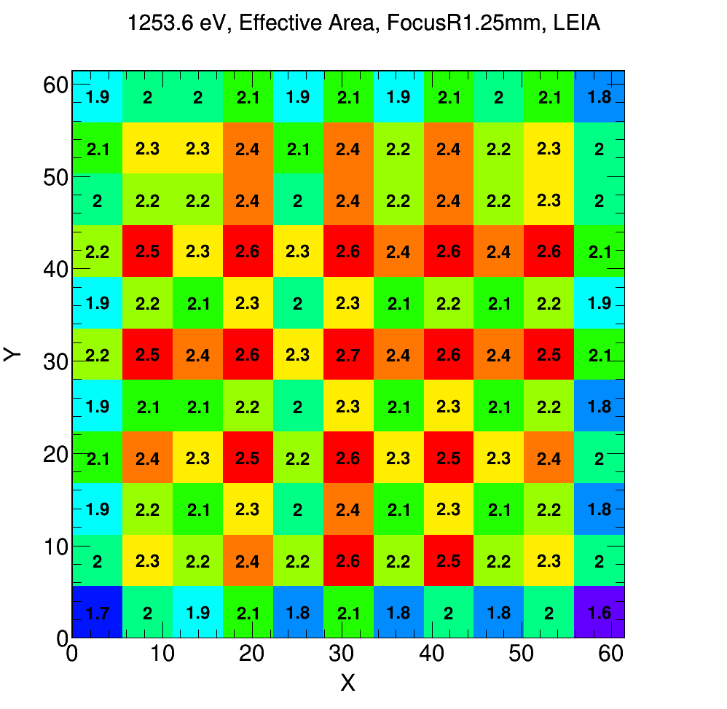
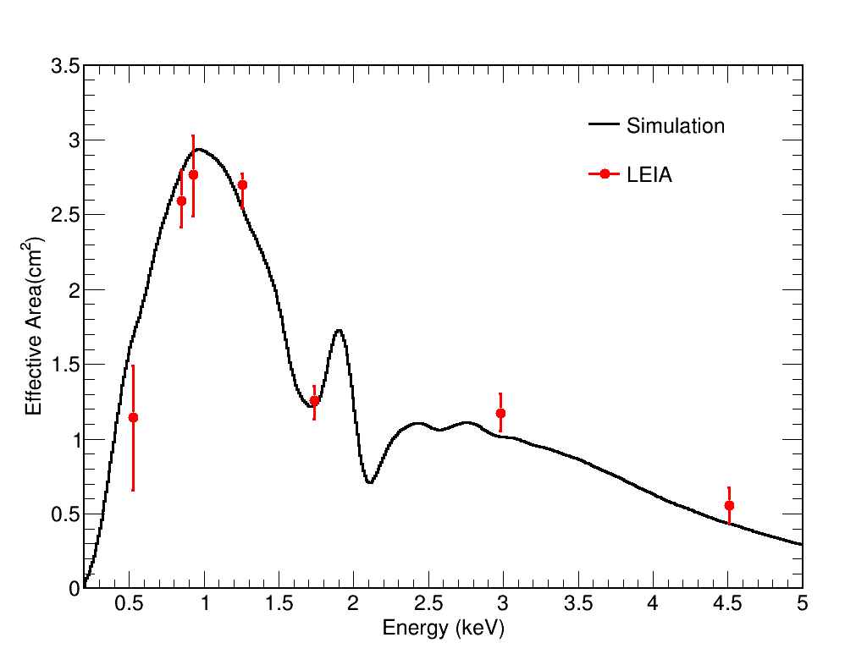
LEIA calibration in IHEP: effective area
On-axis effective area compared with MC simulations
Effective area at different incident angles (vignetting & mirror bracket shield)
Notes:
This slide shows the effective area. The left figure shows the on-axis effective area of the focal spot measured at different tested energies, together with the Monte-Carlo simulated curve. We can see the the data and model are generally consistent. The right figure shows the distribution of the effective area of the focal spot within a quarter of FoV at 1.25 keV. The distribution of the effective area is not the same with that of the Wolter-I type X-ray telescope. In addition to the common-known vignetting effect,

Slide 10
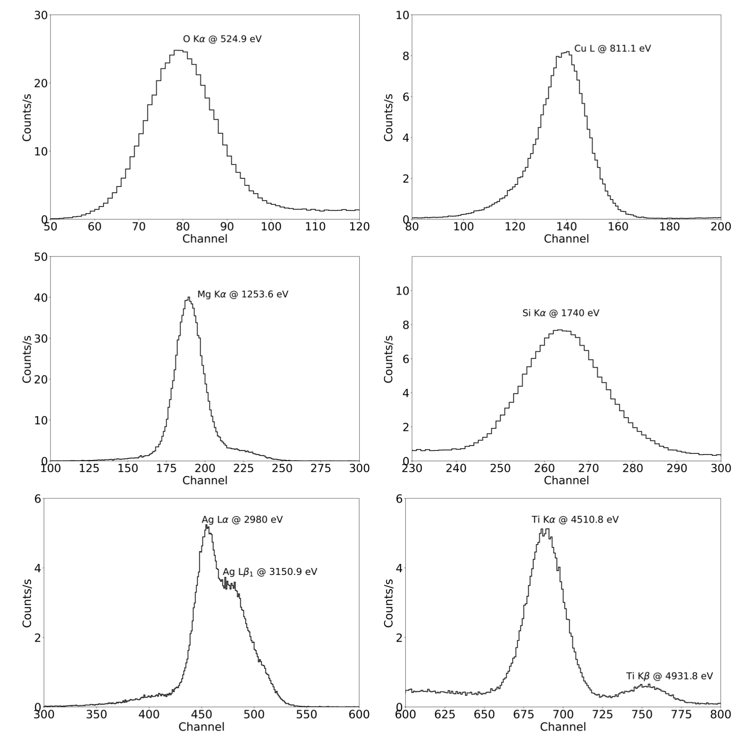
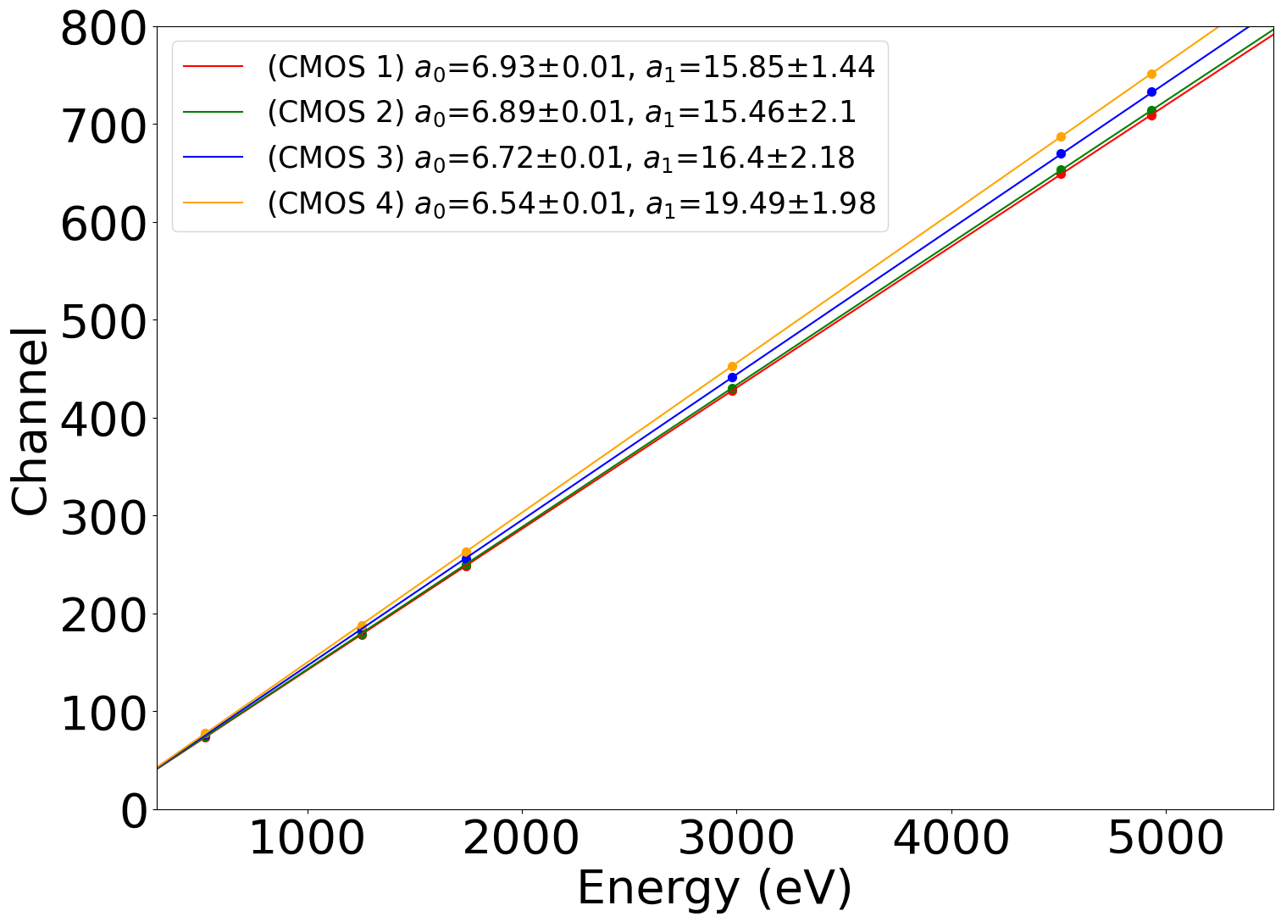
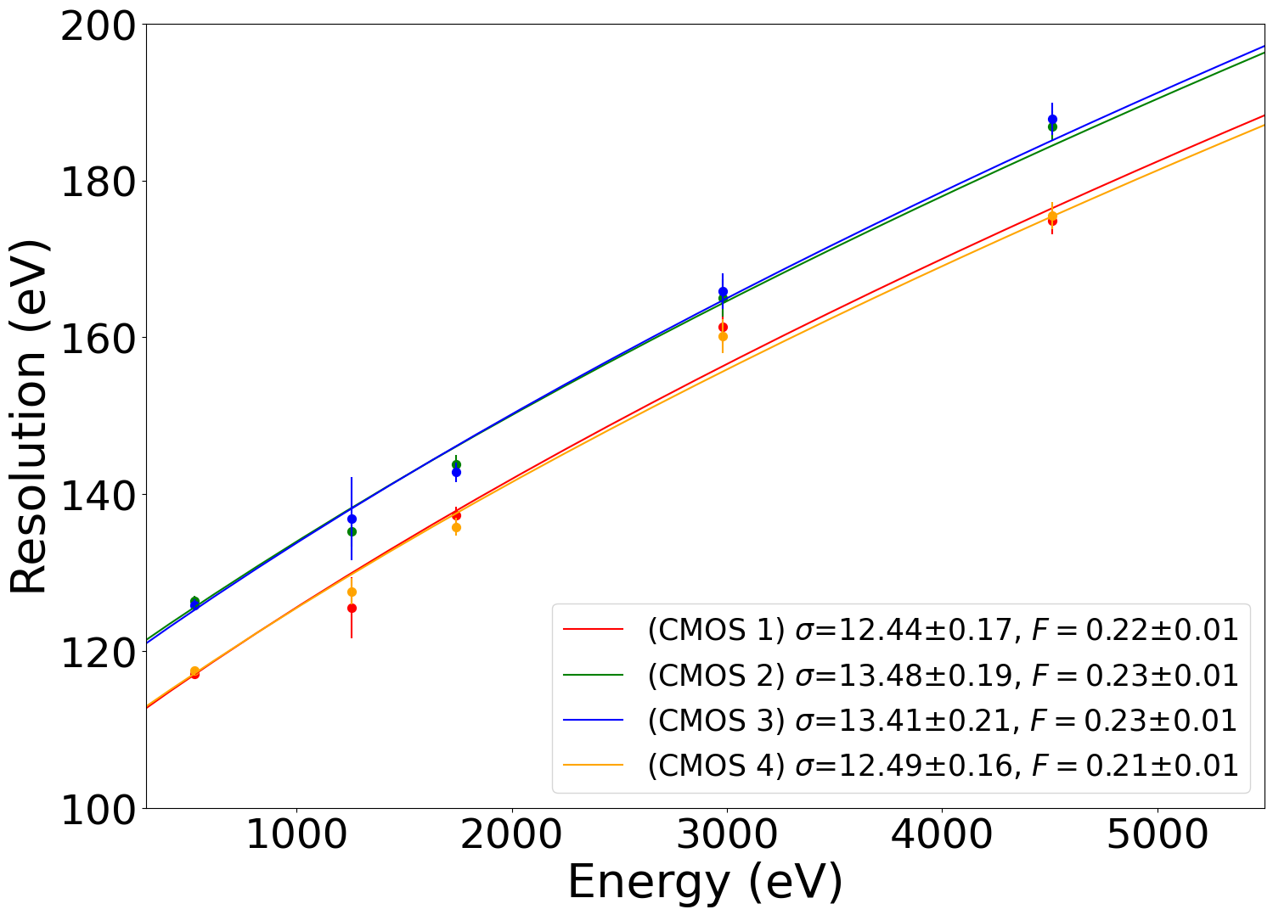
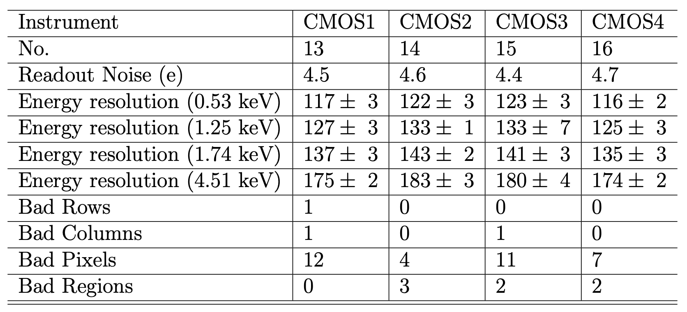
LEIA calibration in IHEP: energy response of CMOS
Resolution
GAIN
CMOS spectra at different X-ray emission lines
CMOS specifications onboard LEIA
Notes:
This slide shows the energy response of the four CMOS detectors obtained from module calibration. The left figure shows the responsed CMOS spectra at different tested energies, including the Oxygen Ka, Copper L, magnesium Ka, Silicon Ka, Silver L, and Titanium K. On the right we may see the energy-channel relation, as well the parabolic relation between the energy resolution and energy. This table summarizes the specifications of four CMOS detectors, including the energy resolution as well as the number of bad pixels, column, and regions, etc.

Slide 11
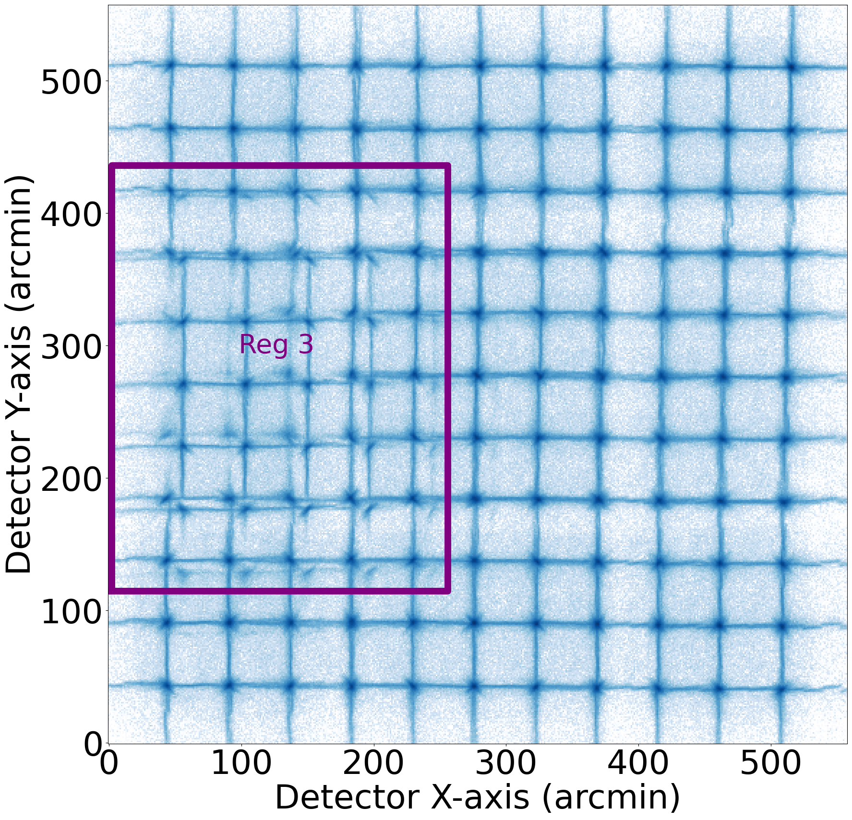
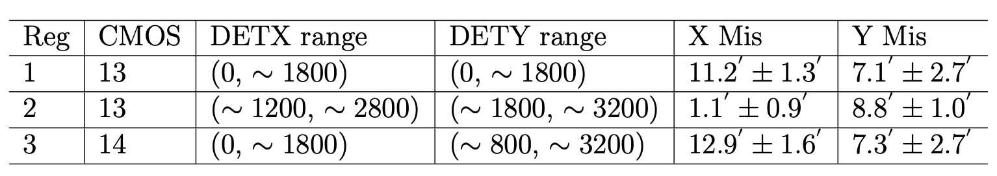
LEIA calibration in IHEP: misalignments of PSF
PSF misalignment on CMOS14
The ‘split’ focal spot resulted from PSF alignment
Incorrect parameter provided before MPO installation, only appear on LEIA.
EP do not have this problem.
Notes:
Some defects of LEIA are also noticed during the calibration procedure. In addition to the CMOS defects shown in the last slide, there is a PSF misalignment issue associated with imperfect MPO installation. We find that in three regions of two CMOS detectors, the PSFs have offsets on average of 10-20 arcmin, as summarized in this table. The PSF misalignment leads to a characteristic phenomenon, the split of the focal spot, as shown in this zoom-in figure, because the focus of the adjacent MPO chips do not overlap after installation. This is a result of incorrect parameter provided before the MPO installation, and only appears on LEIA. So EP do not have this problem.

Slide 12
On-going ground calibration for EP-WXT FM
Optical Assembly
  All 12 assemblies have been calibrated at NAOC before the integration
  One assembly (FM5) has been calibrated at MPE-Panter in Nov. 2022
CMOS Assembly
  All single chips have been calibrated at NAOC at both room and working temperature before integration
  The chips have been tested again at SITP after integration to assemblies at room temperature
Complete Module
  FM1 has been successfully calibrated at IHEP in Aug. 2022
  Two FMs will be calibrated at IHEP next month
Other tests
  Thermal, vibration tests are ongoing…
Refer to Yanfeng’s talk for details…
To be launched in Nov. 2023
Notes:
The above are the calibration of LEIA. This year is the launch year of EP satellite, and there is a tight ground calibration schedule for the WXT payload. As you can see here, there are a lot of tests and calibrations been done, be doing and to be carried out soon.

Slide 13
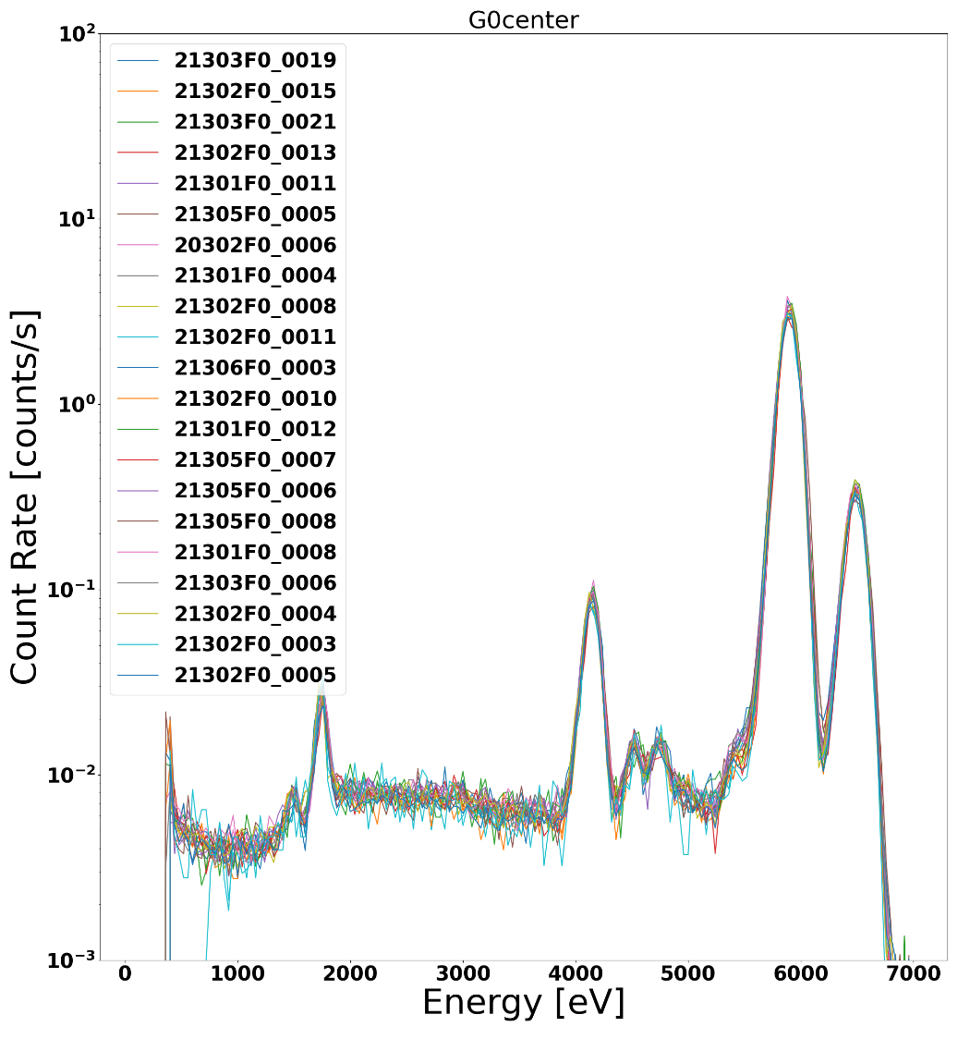
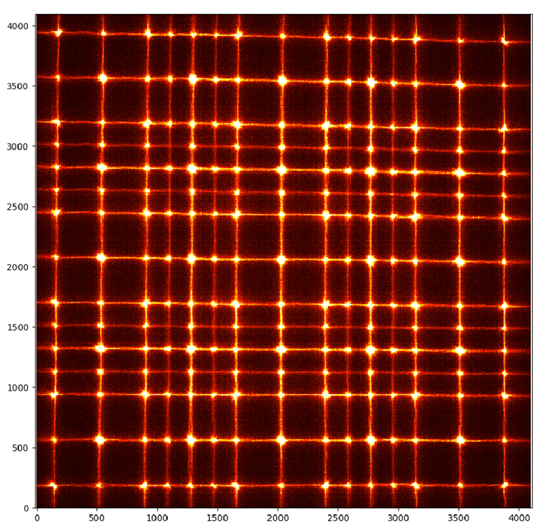
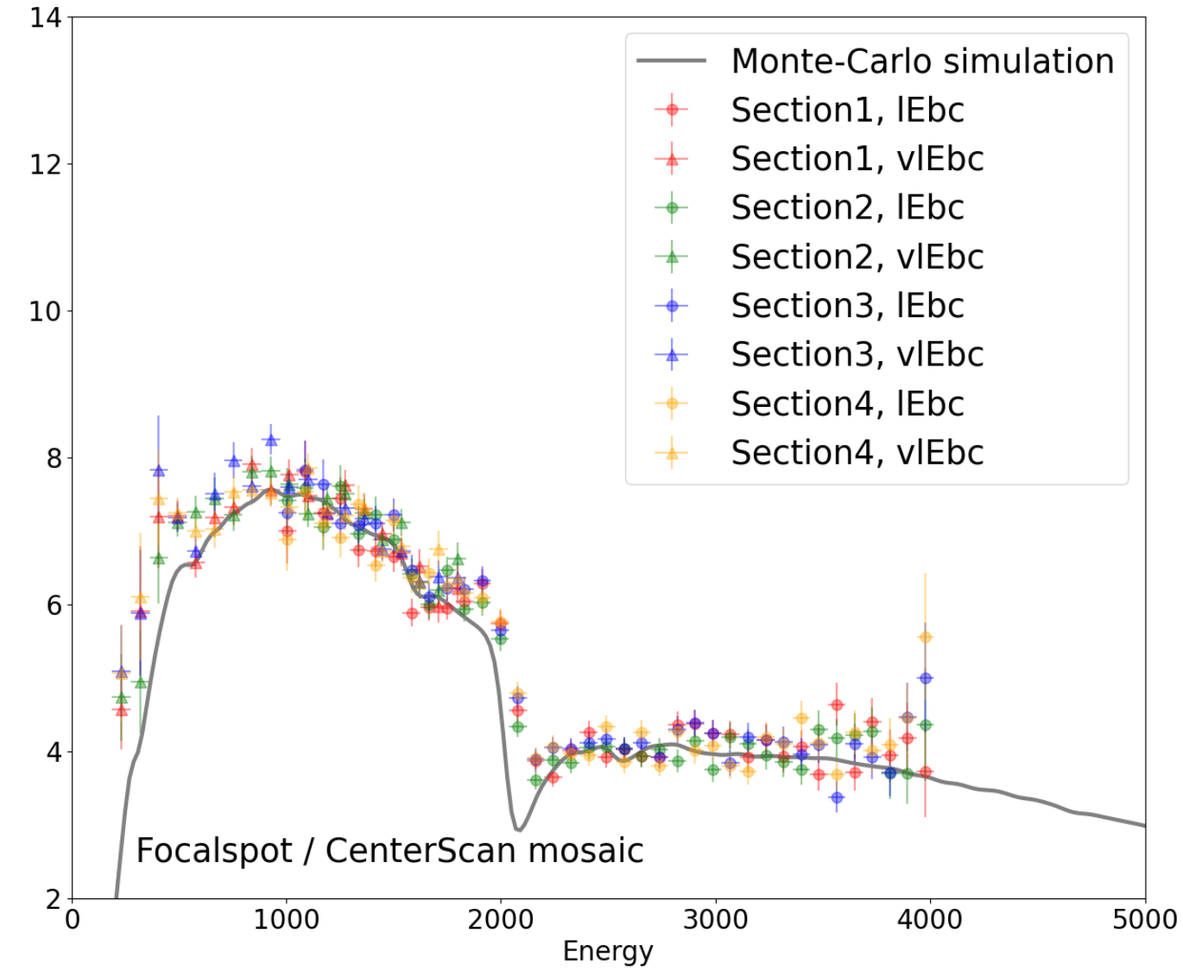
Ground calibration of EP-WXT FM assemblies
The PSF, effective area and energy response for each FM module have been tested before integration.
Mn Ka
Mn Kb
Si Ka
FM MA Focal plane mapping/PSF scan (121 pnts → 209 pnts)
Effective area of FM5 @Panter in Nov. 2023
Fe55-illuminated spectra for CMOS chips
Notes:
This slide shows some calibration results for the flying model. This is the scanned PSF of the mirror assembly at NAOC. You can see that compared to the qualification model, we use a finer scan mode, in total of 209 points to assess the distribution of PSF within ¼ of FoV. The second figure shows the measured effective area of FM5 at Panter in last November. And the third figure shows the spectra for 21 CMOS detectors illuminated with an Fe-55 source. We can see a very very good uniformity of the FM chips.

Slide 14
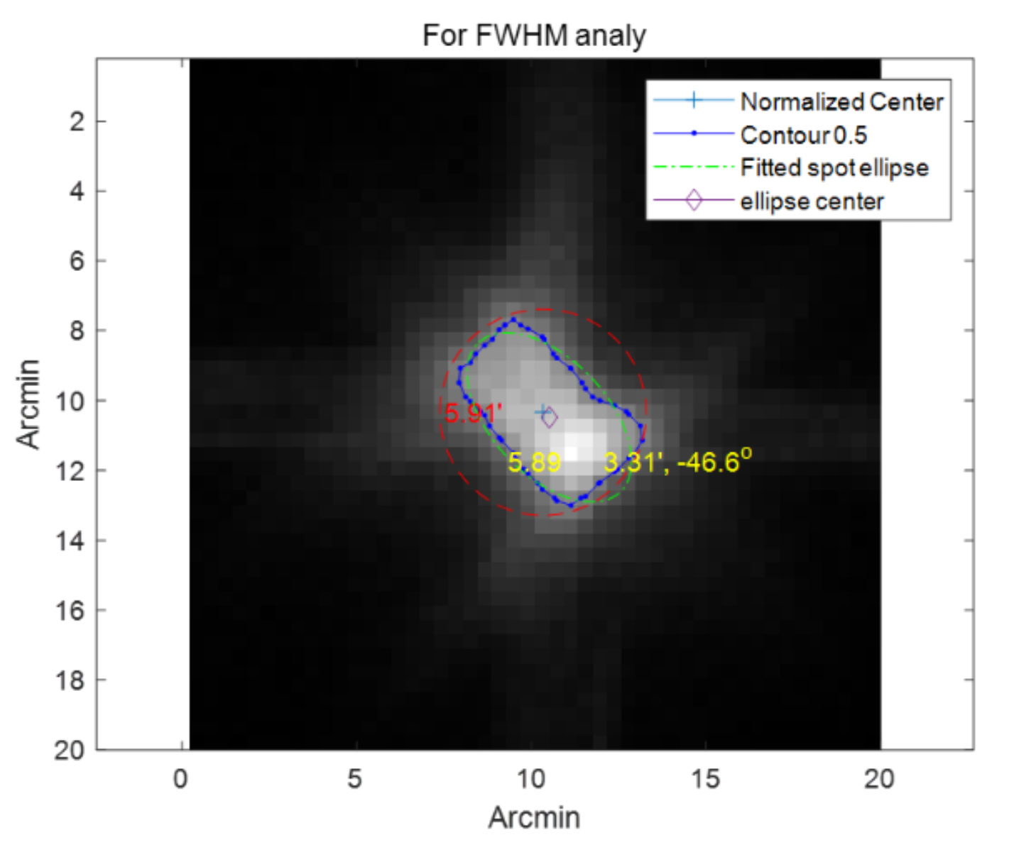
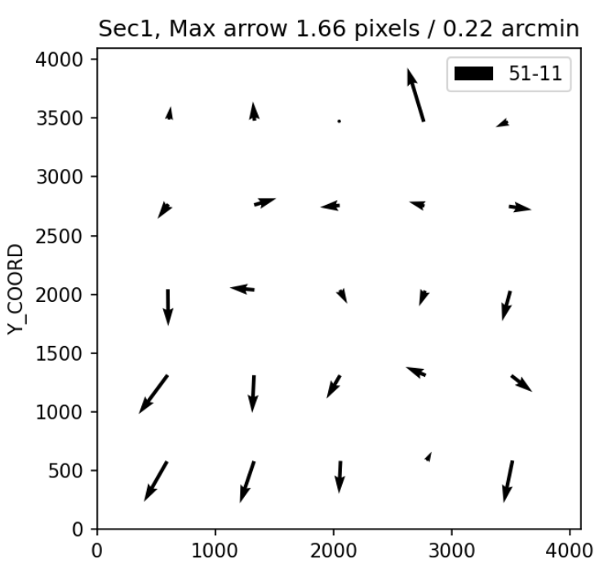
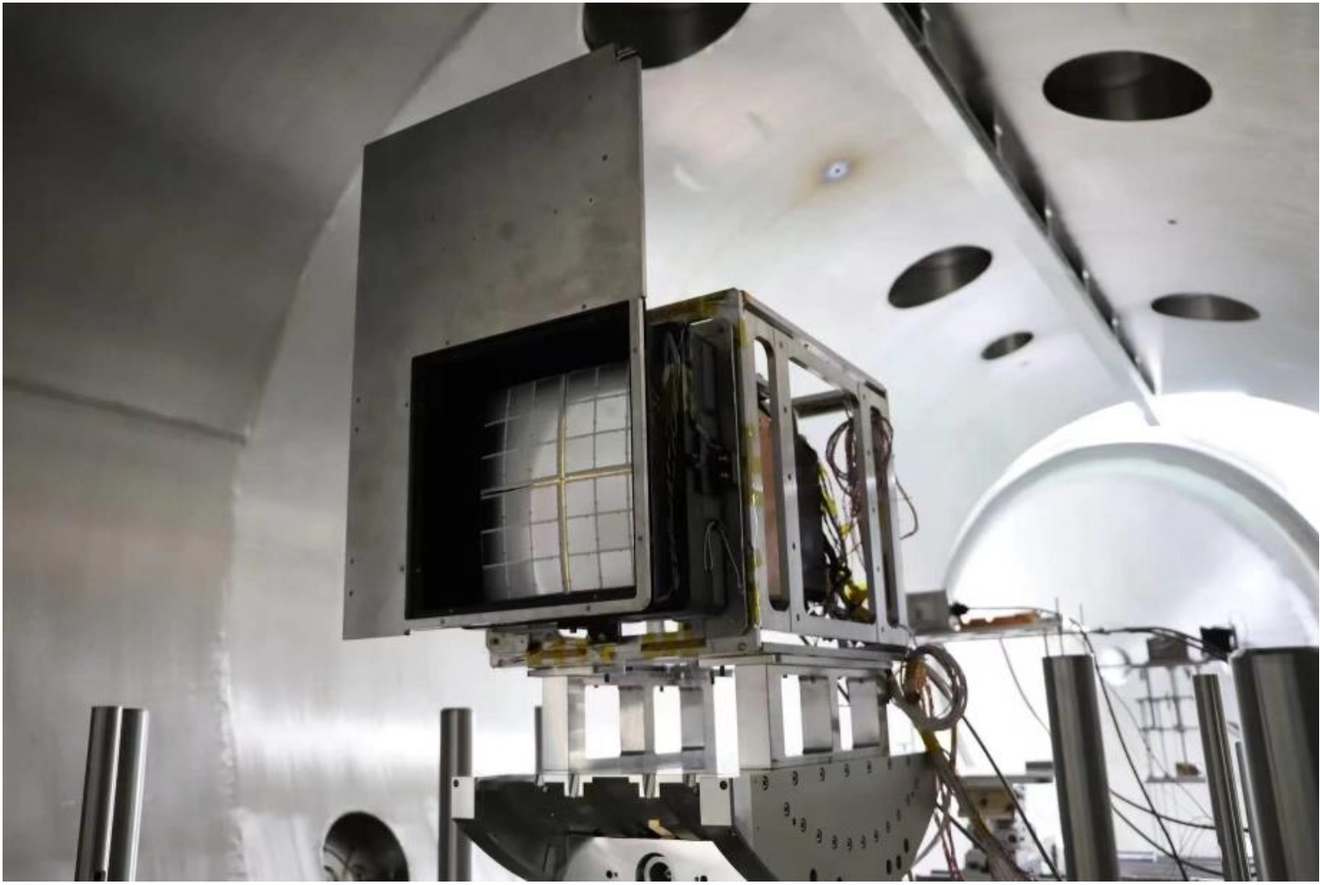
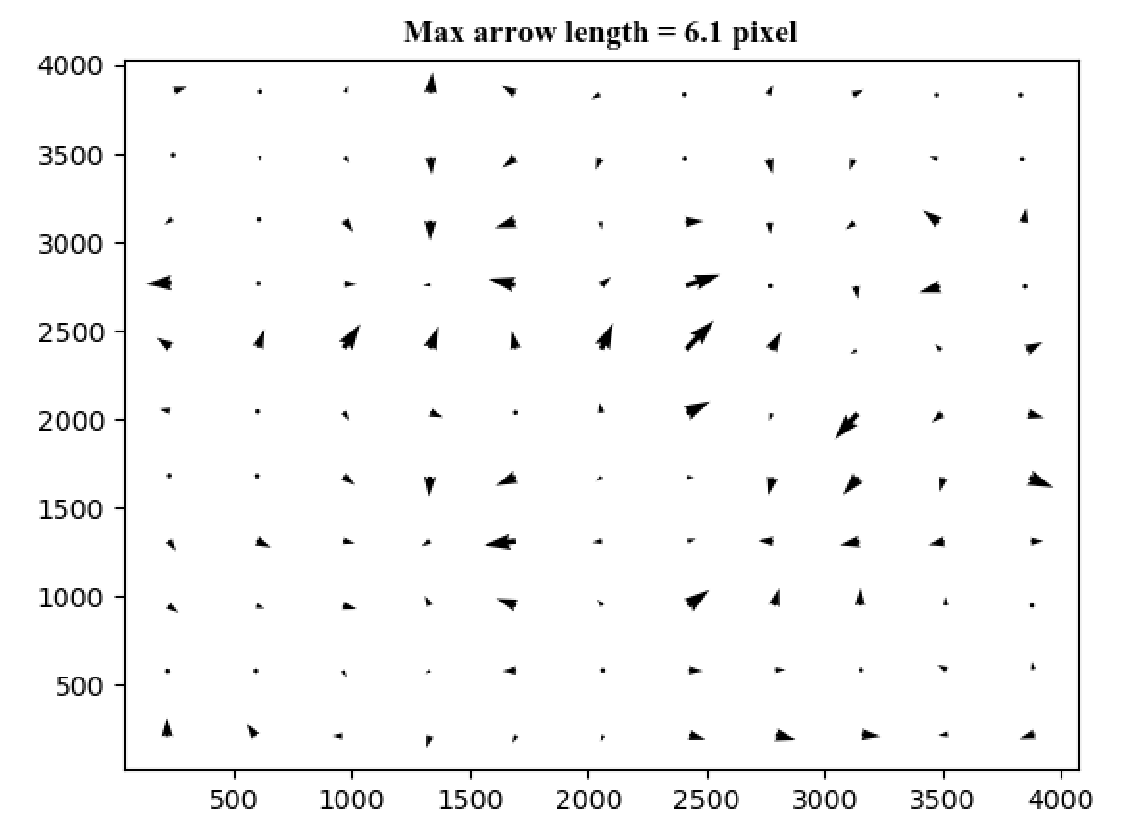
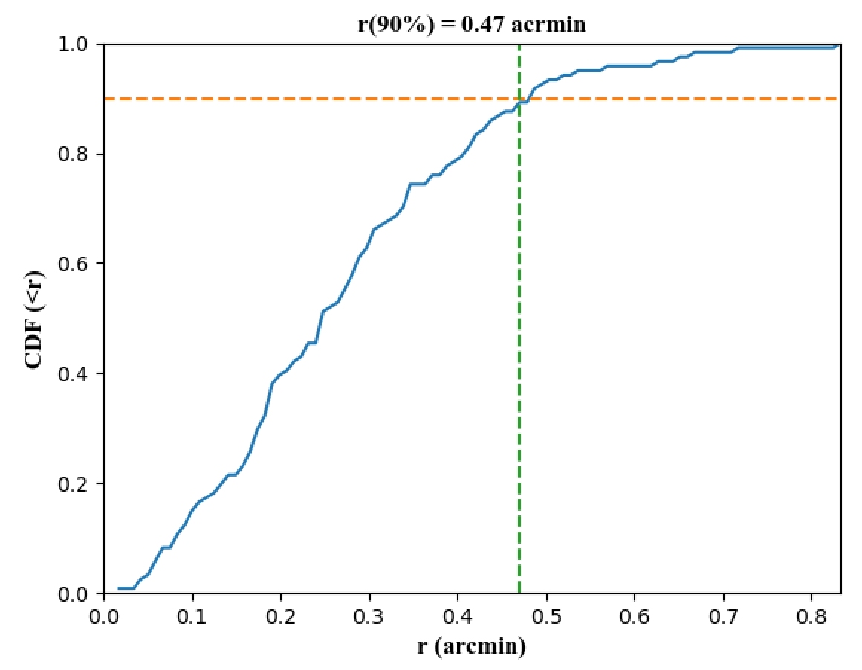
Ground calibration of first complete module (FM1) at IHEP
PSF, FWHM~3-4’
PSF offset ~0.2’ for temp. change
FM1@IHEP 100m facility, 2023.8
FMs show generally better performance than QM.
Refer to Yanfeng’s talk for summaries…
Positioning Accuracy ~0.5’ (~1’ for LEIA)
Notes:
The first complete flying model module, FM1, was calibrated at IHEP in August last year. The calibration items are nearly the same compared with LEIA. We find that the flying models have better optical performance than qualification models including the spatial resolution as well as the positioning accuracy. This is attributed to the improvement in both manufacturing and installation of the MPO chips. We also performed a thermal test by heating the mirror assembly to a higher temperature. The offset of the focal spot is very small.

Slide 15
Summary
A series of tests and calibrations were implemented before the launch of LEIA.
Experience and lessons are accumulated from the calibration of LEIA, and applied in the development and tests of WXT FM.
The calibration of EP-WXT FM is underway. The FMs show generally better performance than LEIA.
We are looking forward to the calibration of two FMs to be carried out in IHEP next month.
hqcheng@nao.cas.cn

