Slide 1
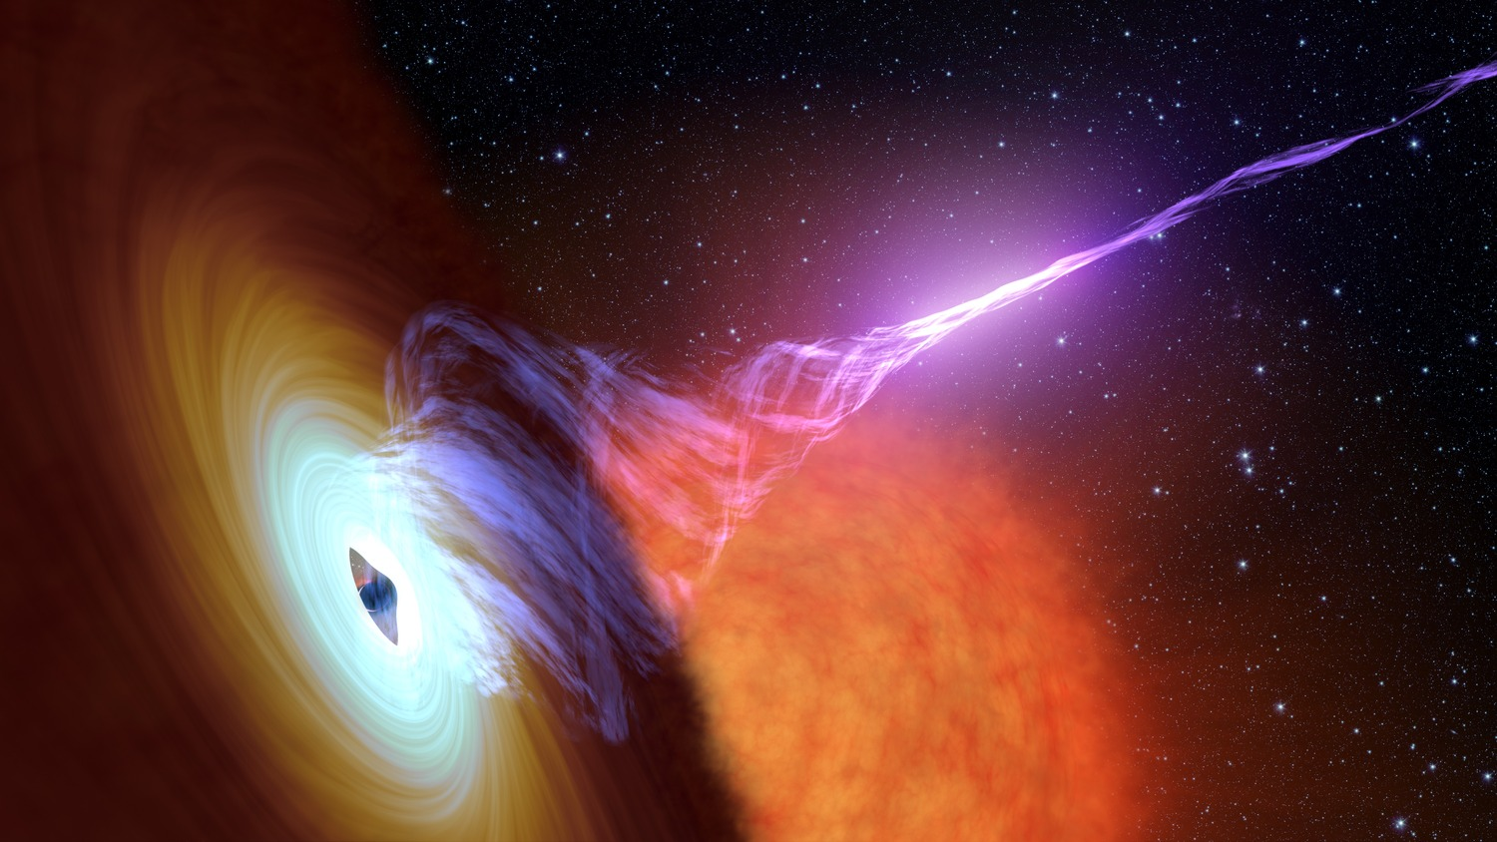
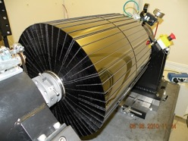
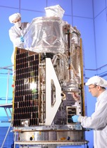
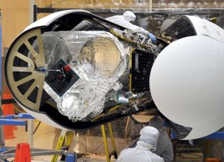
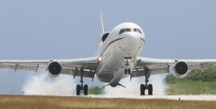
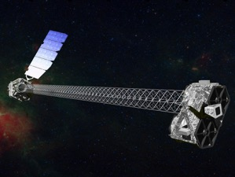
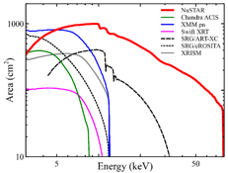
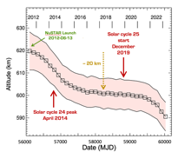
NuSTAR Observatory Status
15th IACHEC meeting
Pelham, Bavaria, Germany
April 24 - 27, 2023
Karl Forster, NuSTAR SOC

Slide 2
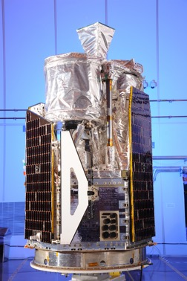
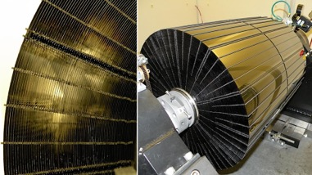
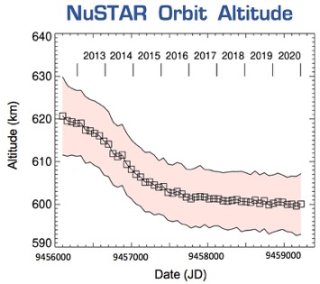
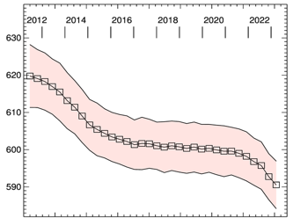
NuSTAR Observatory
NASA small explorer astrophysics mission
PI Fiona Harrison (Caltech)
Partners: ASI, SSDC, DTK, HEASARC, UCB-SSL
Launched on June 13th, 2012, 620 km, 6° orbit
Northrop Grumman LeoStar-2 spacecraft bus
Science Operations at Caltech
Mission Operations at UCB-SSL
NASA approved funding to 2025 (3-year renewal)
2 Optics Modules
Conical Wolter-I approximation
133 shells (43 W/Si, 90 Pt/C)
HPD = 1 arcminute
FOV = 12’ x 12'
10.14m focal length
deployed Mast
CdZnTe detectors
4x(32x32 pixels)
Resolution:
400 eV @ 6 keV
900 eV @ 60 keV
2 ms time resolution
60 $μ$s with clock correction
No consumables
Single string
> 20 year orbit lifetime
NuSTAR status – IACHEC, Pelham, April 2023 – Karl Forster

Slide 3
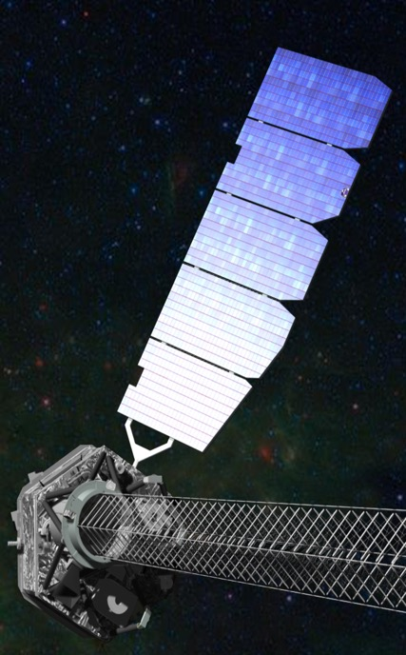
NuSTAR Observatory
Subsystem Status
Nominal
NuSTAR status – IACHEC, Pelham, April 2023 – Karl Forster

Slide 4
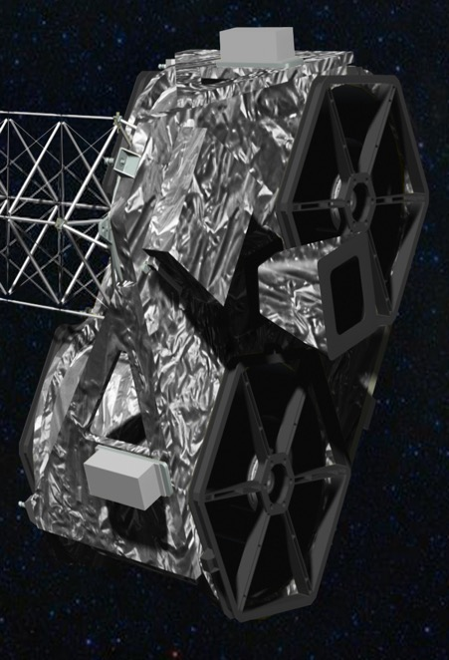
NuSTAR Observatory
Subsystem Status
Nominal
LeoSTAR-2 spacecraft bus has no consumables
Solar Array and SADA, EPS | No concerns
Attitude Control System IRU*, Star trackers*, TAM, MTB, CSS, Reaction Wheels | No concerns
RF Communications | No concerns
Thermal control | No concerns
Electronics CEU, APE* | No concerns
Battery Evaluation of end of discharge voltage shows normal ageing >20 years before any concerns | No concerns
*rare resets occur as expected
NuSTAR status – IACHEC, Pelham, April 2023 – Karl Forster

Slide 5
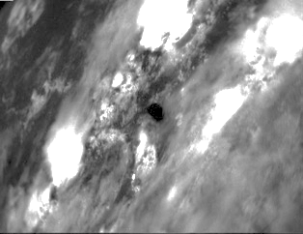
NuSTAR Observatory
Optics
Tear in MLI on rear of Optic-0 | Observe at SAA < 130º where possible
Higher Optic-0 temperature for SAA > 145º FPMA temperature dependent ARF available | Minor scheduling constraint
Astrometry Star Tracker (CHU4)
Low gain area in central 1º of 20º field of view | Only Solar observations at SAA < 20º | Solar observations only at SAA < 20º
Caused by repeated Solar observations Star Tracker performance remains nominal | Observations of bright point sources allowed* for 20º < SAA < 43º | Observations of bright point sources allowed* 20º < SAA < 43º
*Optimal astronomy solution is for Solar Aspect Angle (SAA) > 43º
CHU4 image taken during Earth occultation of science target
(cities beneath clouds)
NuSTAR status – IACHEC, Pelham, April 2023 – Karl Forster

Slide 6
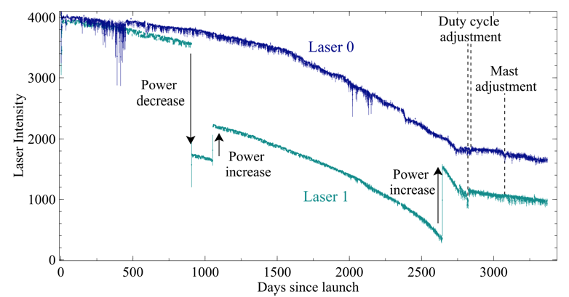
NuSTAR Observatory
Laser Metrology System
stabilized
Implemented an adjustment of the operating duty cycle of the lasers in 2020 Produced significant improvement in rate of decline of laser intensity
Indicates that, with no further changes, the metrology system should remain nominal for another 9 years
Additional adjustments can be made to extend laser lifetime
Laser Metrology System tracks the relative motion of optics with respect to CZT X-ray detectors (10m mast!)
Metrology data is used by ground processing software to reconstruct:
Location of optical axes
With star tracker camera on optics bench the sky position of events recorded in CZT
NuSTAR status – IACHEC, Pelham, April 2023 – Karl Forster

Slide 7
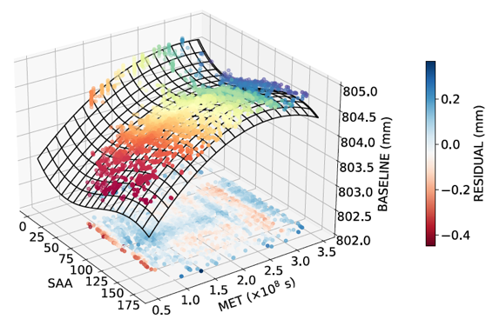
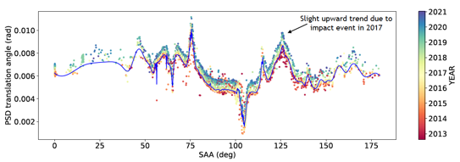
NuSTAR Observatory
Laser Metrology System
stabilized
Development of a predictive model of mast motion was completed in 2021 Earnshaw et al. 2021 JATIS 8.1.014009
The algorithm estimates position of a non-functioning laser spot based on historical data
Will be implemented in NuSTARDAS if one laser fails (development is underway at SSDC)
Adjustments to model will be made as mast behavior evolves
The parameters required to estimate the distance between the laser spots (Z) are the time (X) and the Solar Aspect Angle (Y). The underlying model uses a third-order 2D polynomial fitted to the archival observations to predict the laser position in case of the loss of one
NuSTAR status – IACHEC, Pelham, April 2023 – Karl Forster

Slide 8
NuSTAR Orbit Altitude
NuSTAR status – IACHEC, Pelham, April 2023 – Karl Forster

Slide 9
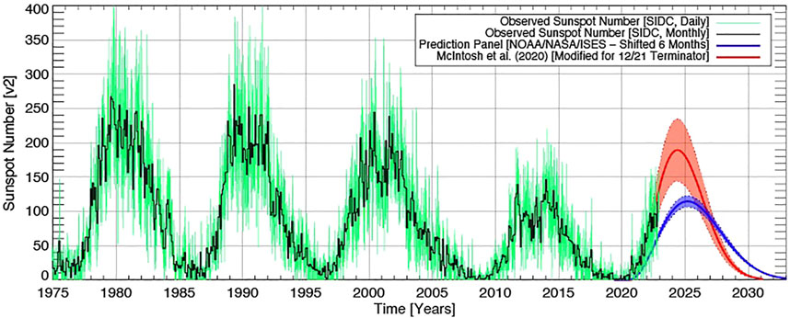
NuSTAR Orbit Altitude
NuSTAR momentum control likely to remain nominal down to 550 km altitude
past this solar maximum into cycle 26
2023 Updated Solar Activity Prediction
McIntosh et al. (2023) “Frontiers in Astronomy and Space Physics
NuSTAR status – IACHEC, Pelham, April 2023 – Karl Forster

Slide 10
NuSTAR Synergies
Energy Range: 3 – 78 keV
Stray light
~100 keV
NuSTAR status – IACHEC, Pelham, April 2023 – Karl Forster

Slide 11
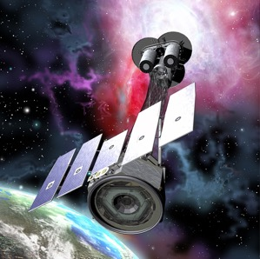
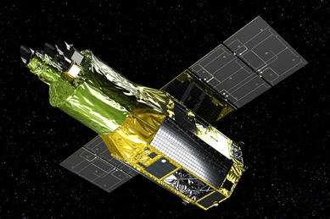
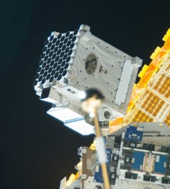
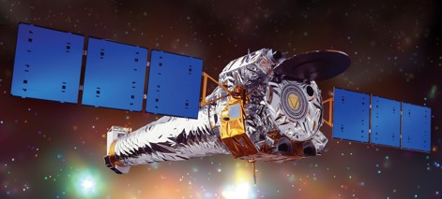
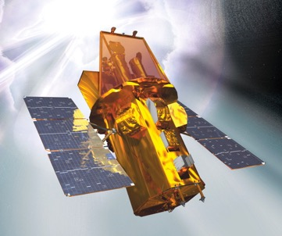
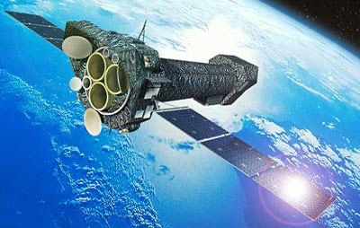
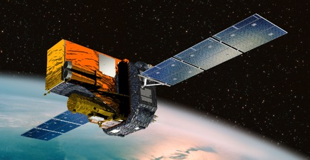
NuSTAR Synergies
Joint Observing Programs
Coordinated cross-calibration observations
XRISM
IXPE
Chandra
NICER
INTEGRAL
XMM-Newton
Gehrels-Swift
NuSTAR status – IACHEC, Pelham, April 2023 – Karl Forster

Slide 12
NuSTAR Synergies
CoObs WG session
Wed 26th, 4:20pm
Joint Observing Programs
Coordinated cross-calibration observations
XRISM
IXPE
Chandra
NICER
INTEGRAL
XMM-Newton
Gehrels-Swift
NuSTAR status – IACHEC, Pelham, April 2023 – Karl Forster

Slide 13
NuSTAR calibration history
https://nustarsoc.caltech.edu/NuSTAR_Public/NuSTAROperationSite/software_calibration.php#CALDB
Details on NuSTAR SOC website: https://nustarsoc.caltech.edu/NuSTAR_Public/NuSTAROperationSite/software_calibration.php#CALDB
Date | Description
2013-08-14 | Initial CALDB public release
2013-11-25 | ARF adjustment (-15% NuSTAR flux)
2014-01-17 | VIGN adjustment
2014-07-01 | Gain calibration improvement
2015-03-20 | Full mission Gain adjustment
2016-06-06 | Update gain, effective area, line of sight absorption
2019-12-13/19 | Update long term gain tracking
2020-05-06 | High resolution clock correction
2020-08-13 | Temperature-dependent ARF implemented
2021-02-23 | Observatory alignment update
2021-10-26 | Observatory calibration update based on 9-years of crab observations
2022-05-10 | FPMA DET2 long term gain adjustment
1 year after start of science operations
Based on IACHEC cross-calibration to better match
XMM/Swift/Chandra measurements
allows 100 microsecond accuracy for some observations
NuSTAR status – IACHEC, Pelham, April 2023 – Karl Forster

Slide 14
NuSTAR calibration history
https://nustarsoc.caltech.edu/NuSTAR_Public/NuSTAROperationSite/software_calibration.php#CALDB
Details on NuSTAR SOC website: https://nustarsoc.caltech.edu/NuSTAR_Public/NuSTAROperationSite/software_calibration.php#CALDB
Date | Description
2013-08-14 | Initial CALDB public release
2013-11-25 | ARF adjustment (-15% NuSTAR flux)
2014-01-17 | VIGN adjustment
2014-07-01 | Gain calibration improvement
2015-03-20 | Full mission Gain adjustment
2016-06-06 | Update gain, effective area, line of sight absorption
2019-12-13/19 | Update long term gain tracking
2020-05-06 | High resolution clock correction
2020-08-13 | Temperature-dependent ARF implemented
2021-02-23 | Observatory alignment update
2021-10-26 | Observatory calibration update based on 9-years of crab observations
2022-05-10 | FPMA DET2 long term gain adjustment
Calibration update 2021-10-26 (CALDB v20211020)
Based on detailed analysis of more than nine years of observations of the Crab, utilizing both focused and stray light measurements.
For details see Madsen et al. (2021) JATIS (on arXiv) and the SOC website.
The overall changes between to previous calibration are primarily off-axis dependent.
Users of the updated calibration may see the following changes compared to previous analysis:
A flux increase of ~5% | ~10% | ~15% for sources < 1' | 1' to 2' | > 4' off-axis
Slopes of power law model components may change by ~0.04 depending on off-axis angle
More accurate high-energy and high off-axis angle corrections
A better agreement in the FPMA and FPMB flux measurements
Little or no practical change expected in interpretation of results for most observations, especially for analysis of low signal-to-noise spectra.
This CALDB release also contained an update to the tracking of detector gain.
Details are available in the calibration memo Grefenstette et al. (2021)
1 year after start of science operations
Based on IACHEC cross-calibration to better match
XMM/Swift/Chandra measurements
allows 100 microsecond accuracy for some observations
NuSTAR status – IACHEC, Pelham, April 2023 – Karl Forster

Slide 15
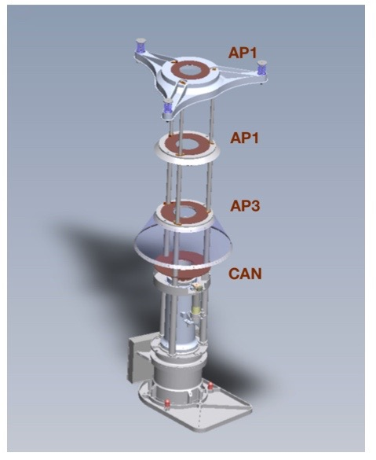
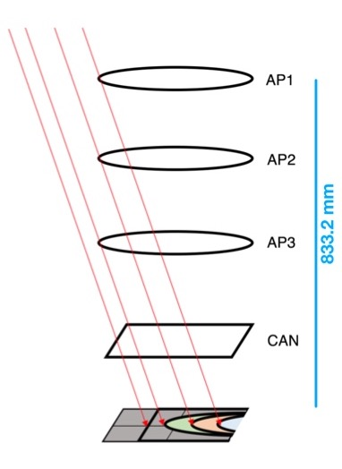
NuSTAR Stray light calibration
10.14 m
Schematic of the path of stray light photons. (Left) Observatory schematic illustrating how off-axis sources can directly illuminate the aperture stops and detectors. (Center) CAD rendering of the focal plane and the aperture stop assembly. (Right) Red traces show the stray light paths that survive to the focal plane after passing around the aperture stop rings (AP1, AP2, and AP3) and the “can” housing the detectors. Wik et al. (2014) ApJ 792,48 and Madsen et al. (2017a) JATIS 3, 044003.
NuSTAR status – IACHEC, Pelham, April 2023 – Karl Forster

Slide 16
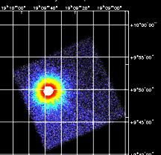
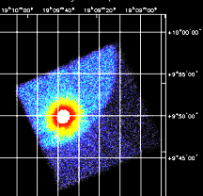
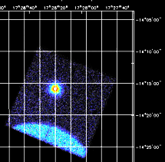
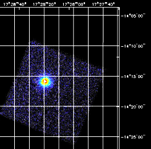
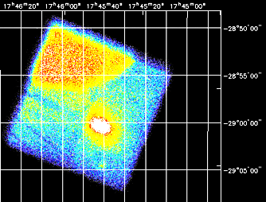
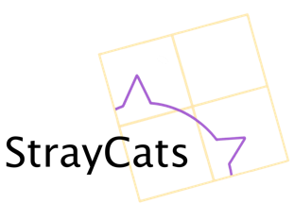
NuSTAR Stray light calibration
FPMA
FPMB
Stray light observations may extend NuSTAR science reach past 100 keV
High energy limit of 79 keV determined by optics response
Annual Stray light observations of the Crab used for calibration
Bypasses optics, based on well understood detector response
Accurate measurement of Crab flux allows absolute calibration to 4% precision
Measurement of the Absolute Crab Flux with NuSTAR, Madsen et al. (2017)
Adjustment to cross calibration with other observatories
(XMM-pn calibration update)
Originally a nuisance, now stray light observations are used to:
Harvest transient light curves and spectra from Galactic center region
Minimize data loss during observations of bright sources
Allowing uninterrupted observations – avoiding overwrite of on-board storage buffer
StrayCats on github
Grefenstette et al. (2021) ApJ 909, 30 and Ludlam et al (2022) ApJ 934 59
https://nustarstraycats.github.io/straycats/
Extended SMC X-1 spin and orbit analysis
Brumback et al. (2022) ApJ 296, 187
4U 1907+09
PDS 456
Sgr A* 2019-03-29 150 ks (FPMA)
NuSTAR status – IACHEC, Pelham, April 2023 – Karl Forster

Slide 17
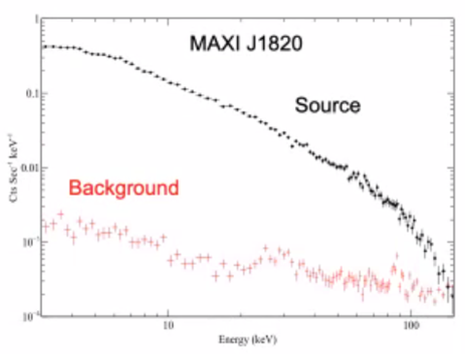
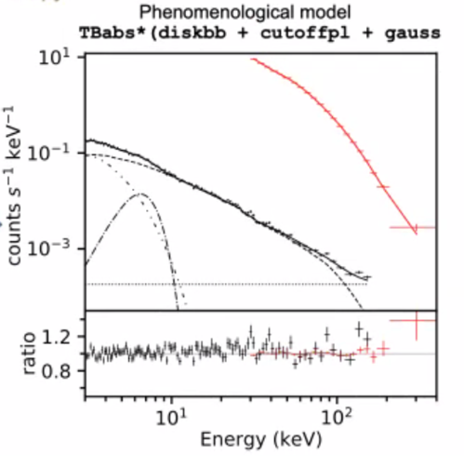
NuSTAR Stray light calibration
From AAS-HEAD meeting poster: Gullo Mastroserio
Extend Stray light calibration above 100 keV
NuSTAR detectors do not saturate until ~250 keV
Data for bright (> 0.1 Crab) sources are already present well above the 79 keV optics cutoff
Effective area is mostly the “geometric” detector area
> 300 cm² focused
< 8 cm² stray light
Updated calibration will allow simultaneous modelling with INTEGRAL-IBIS
Models must now work:
over multiple decades in energy
with very different statistics
may need more sophisticated background model
See: Mastroserio, G. et al. (2022) ApJ 941, 35
INTEGRAL
Cyg X-1
NuSTAR
NuSTAR status – IACHEC, Pelham, April 2023 – Karl Forster

Slide 18
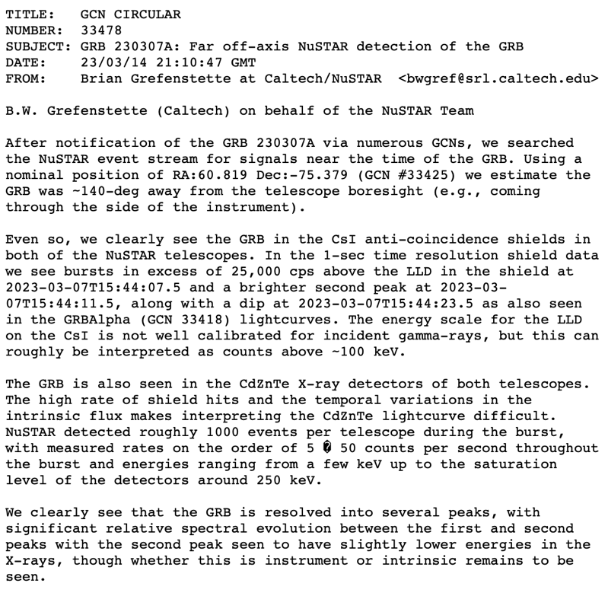
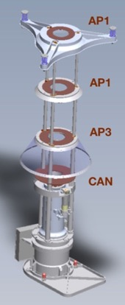
NuSTAR - Gamma-ray Burst Detector?
GCN circular 33478 – Brian Grefenstette 2023-03-14
The BOAT
CsI
Shield
NuSTAR status – IACHEC, Pelham, April 2023 – Karl Forster

