Slide 1
In-flight calibration for LEIA
Haiwu Pan
National Astronomical Observatories, Chinese Academy of Sciences
panhaiwu@bao.ac.cn
On behalf of EP WXT calibration team

Slide 2
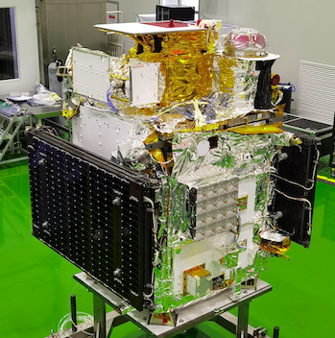
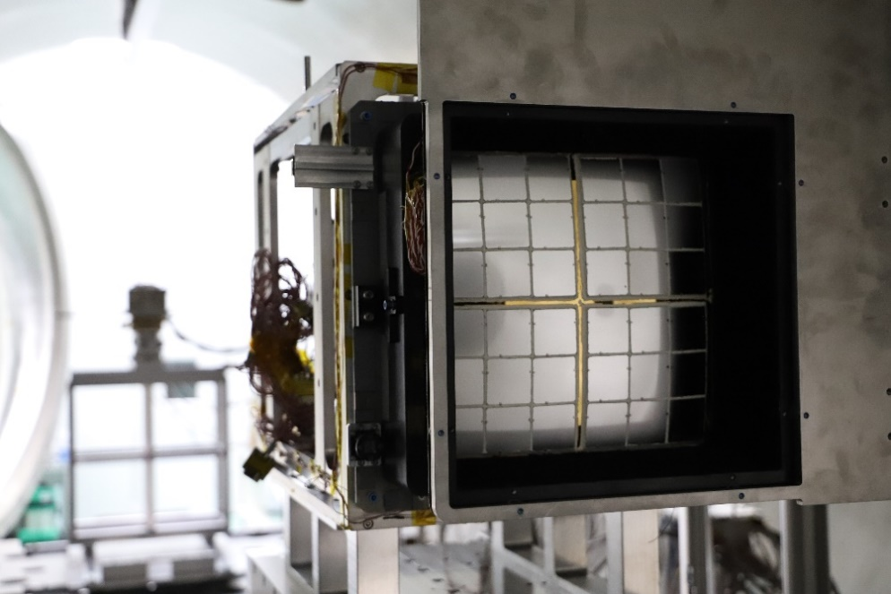
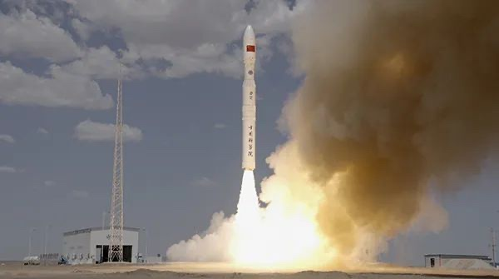
EP-WXT pathfinder
Lobster Eye Imager for Astronomy (LEIA)
LEIA
CAS’s experimental satellite SATech-01
More details in Zhixing’s talk!
Successfully launched 2022 July 27, @Jiuquan

Slide 3
In-flight calibration
Gain: Cas A
Background: blank sky
Effective area: Crab
Positioning: Crab

Slide 4
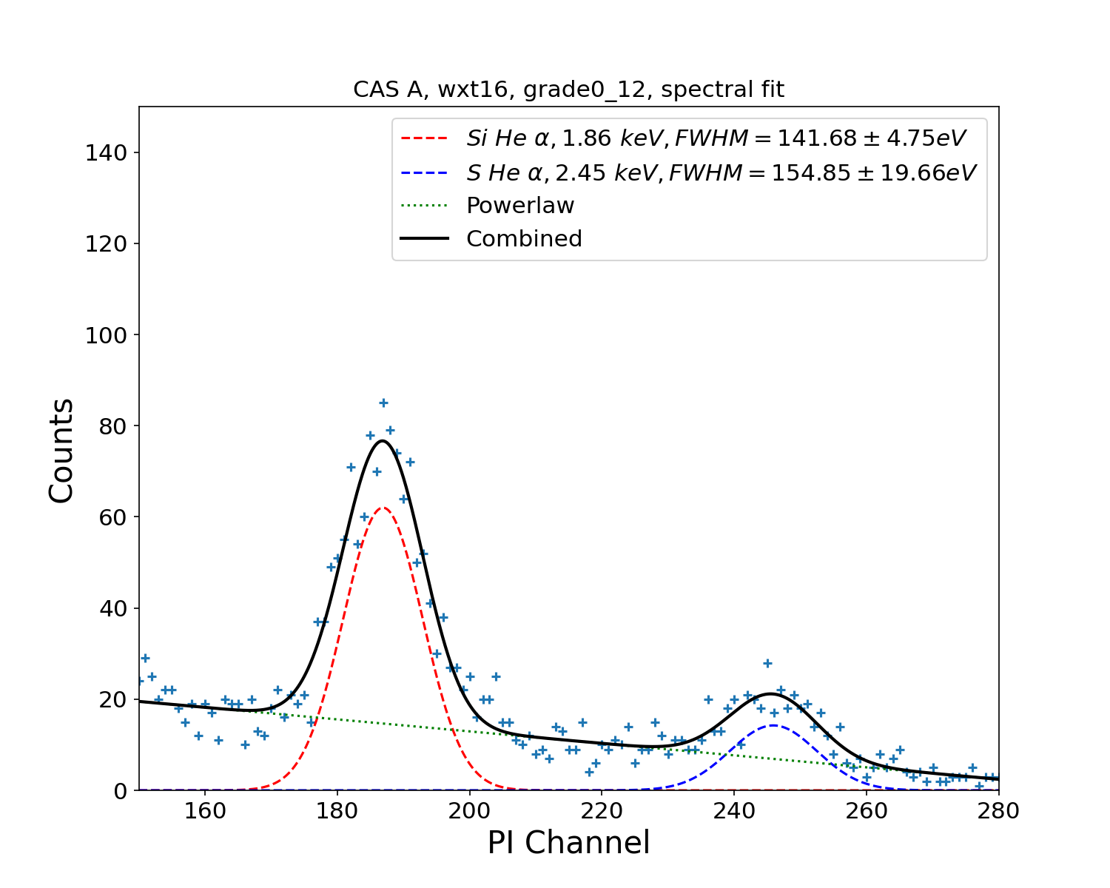
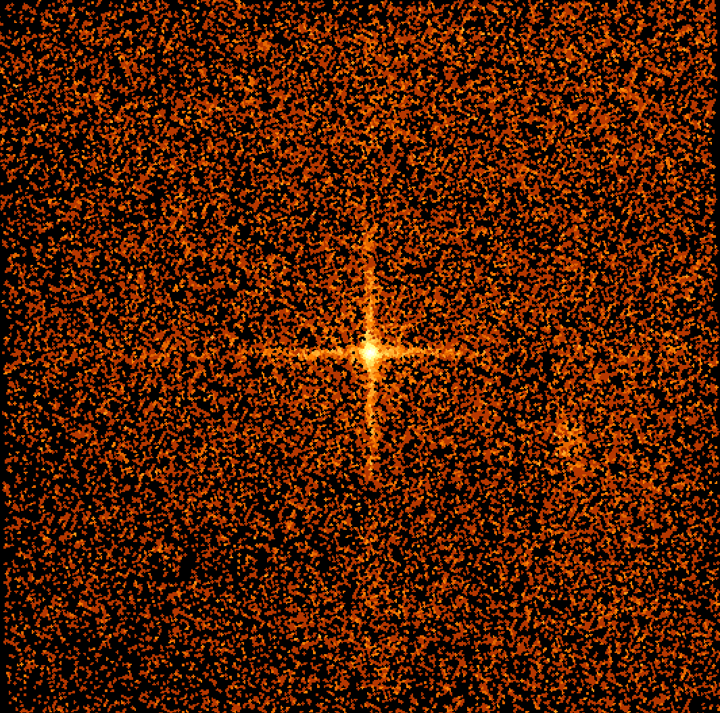
Gain: Cas A
PI(PH) = (PHA*GC0+GC3) / G
Gain values (GC0, GC3) from on-ground calibration
Nominal gain (G) is set to be 10

Slide 5
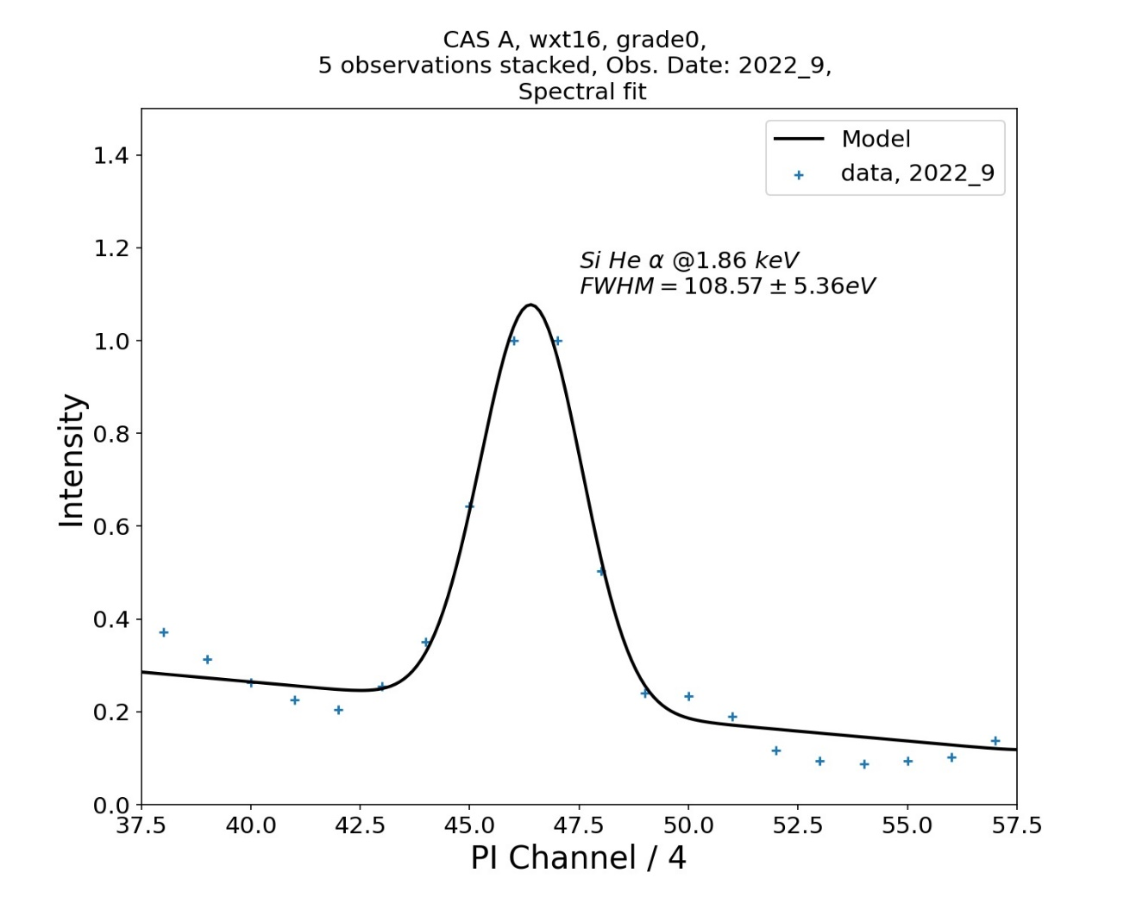
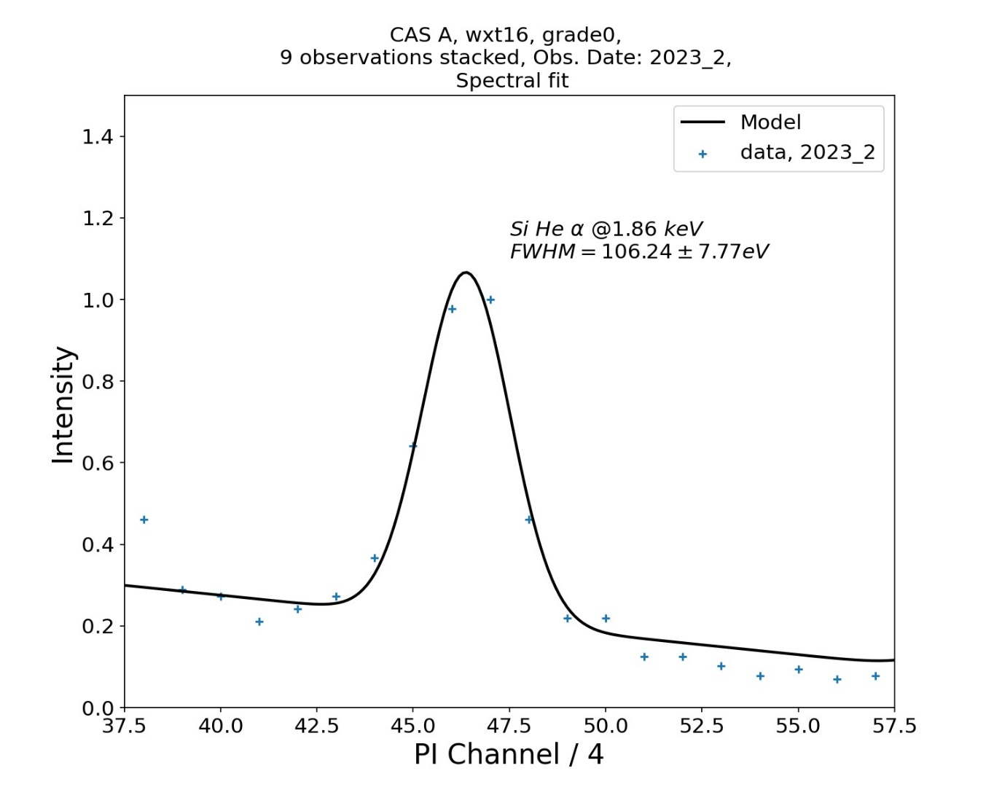
Gain and Energy resolution: variation?

Slide 6
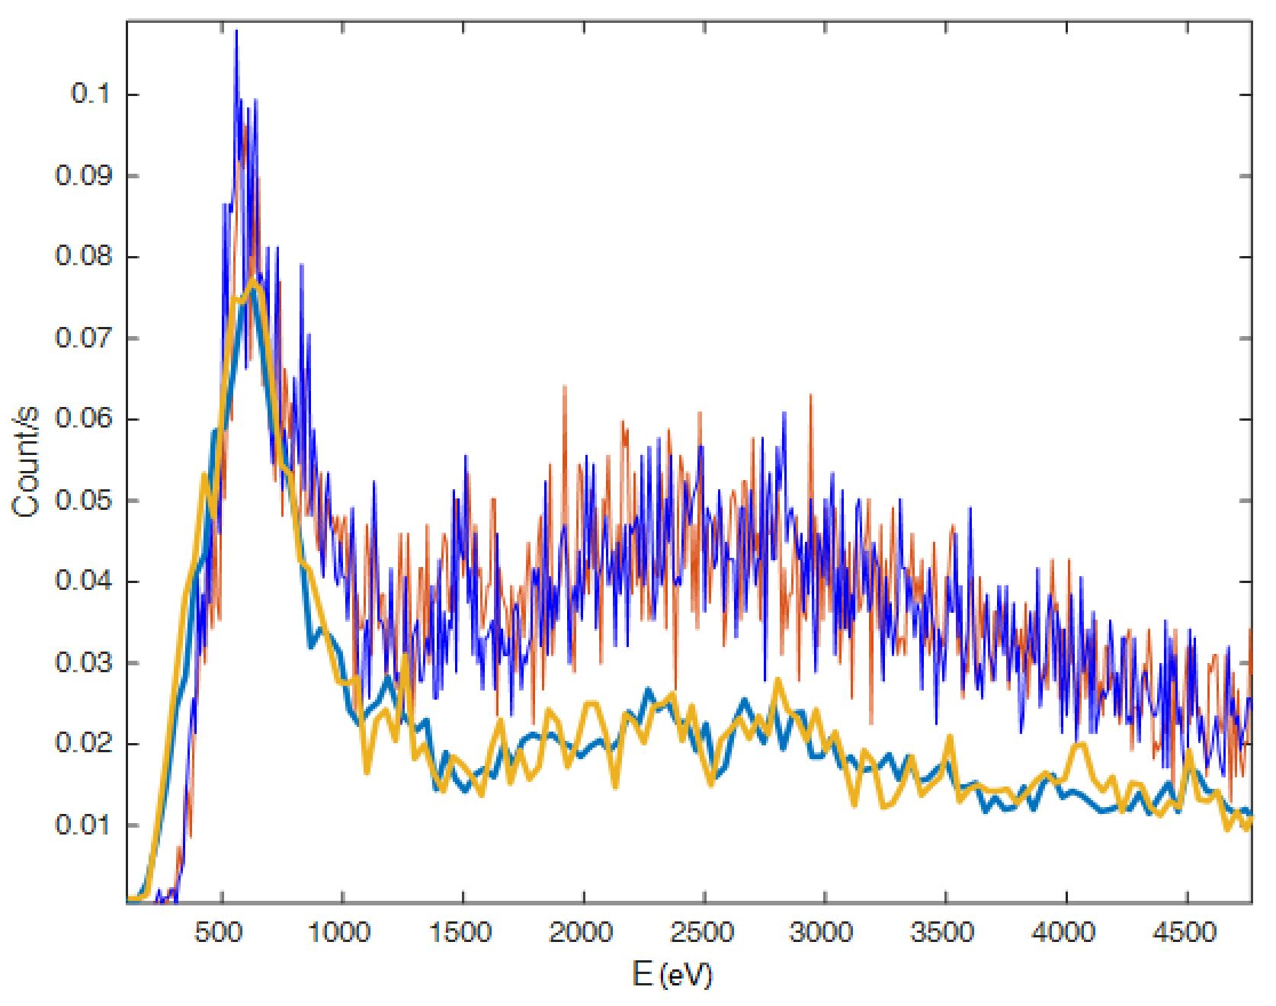
Background: blank sky
X-ray emission
The particle background is higher than expected.
LEIA operates in a sun-synchronous near-Earth circular orbit; high particle background at high geo-latitude regions.
Particle
Observed
Simulated
Spectra of blank sky observed with LEIA

Slide 7
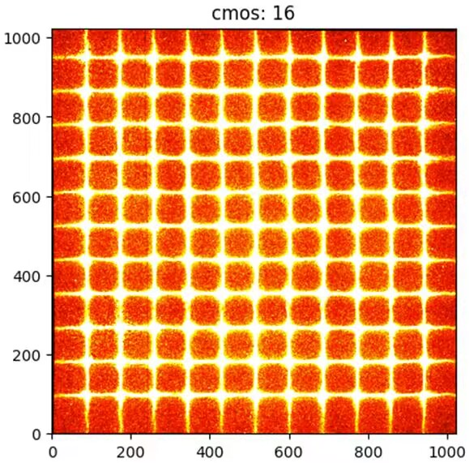
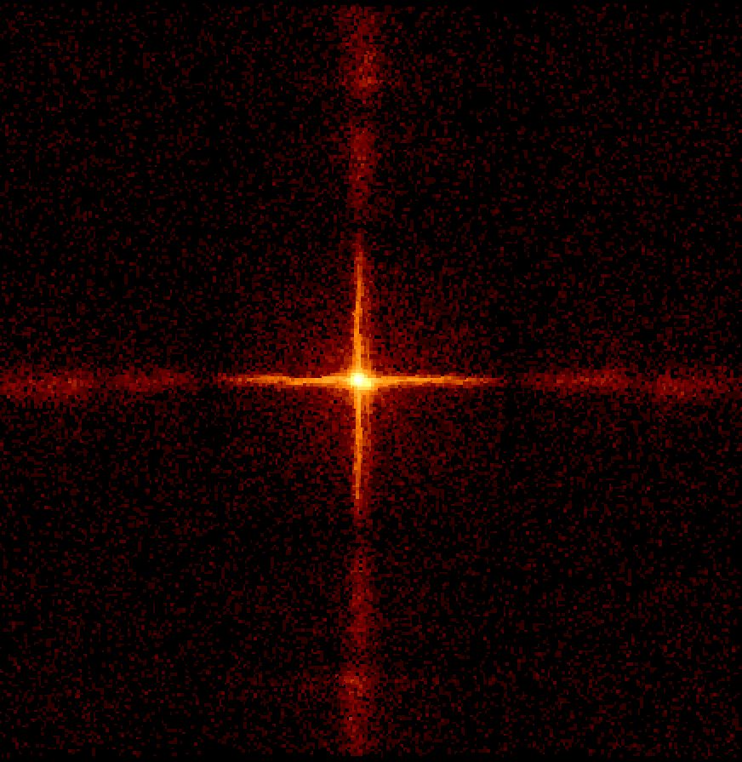
Effective area: Crab

Slide 8
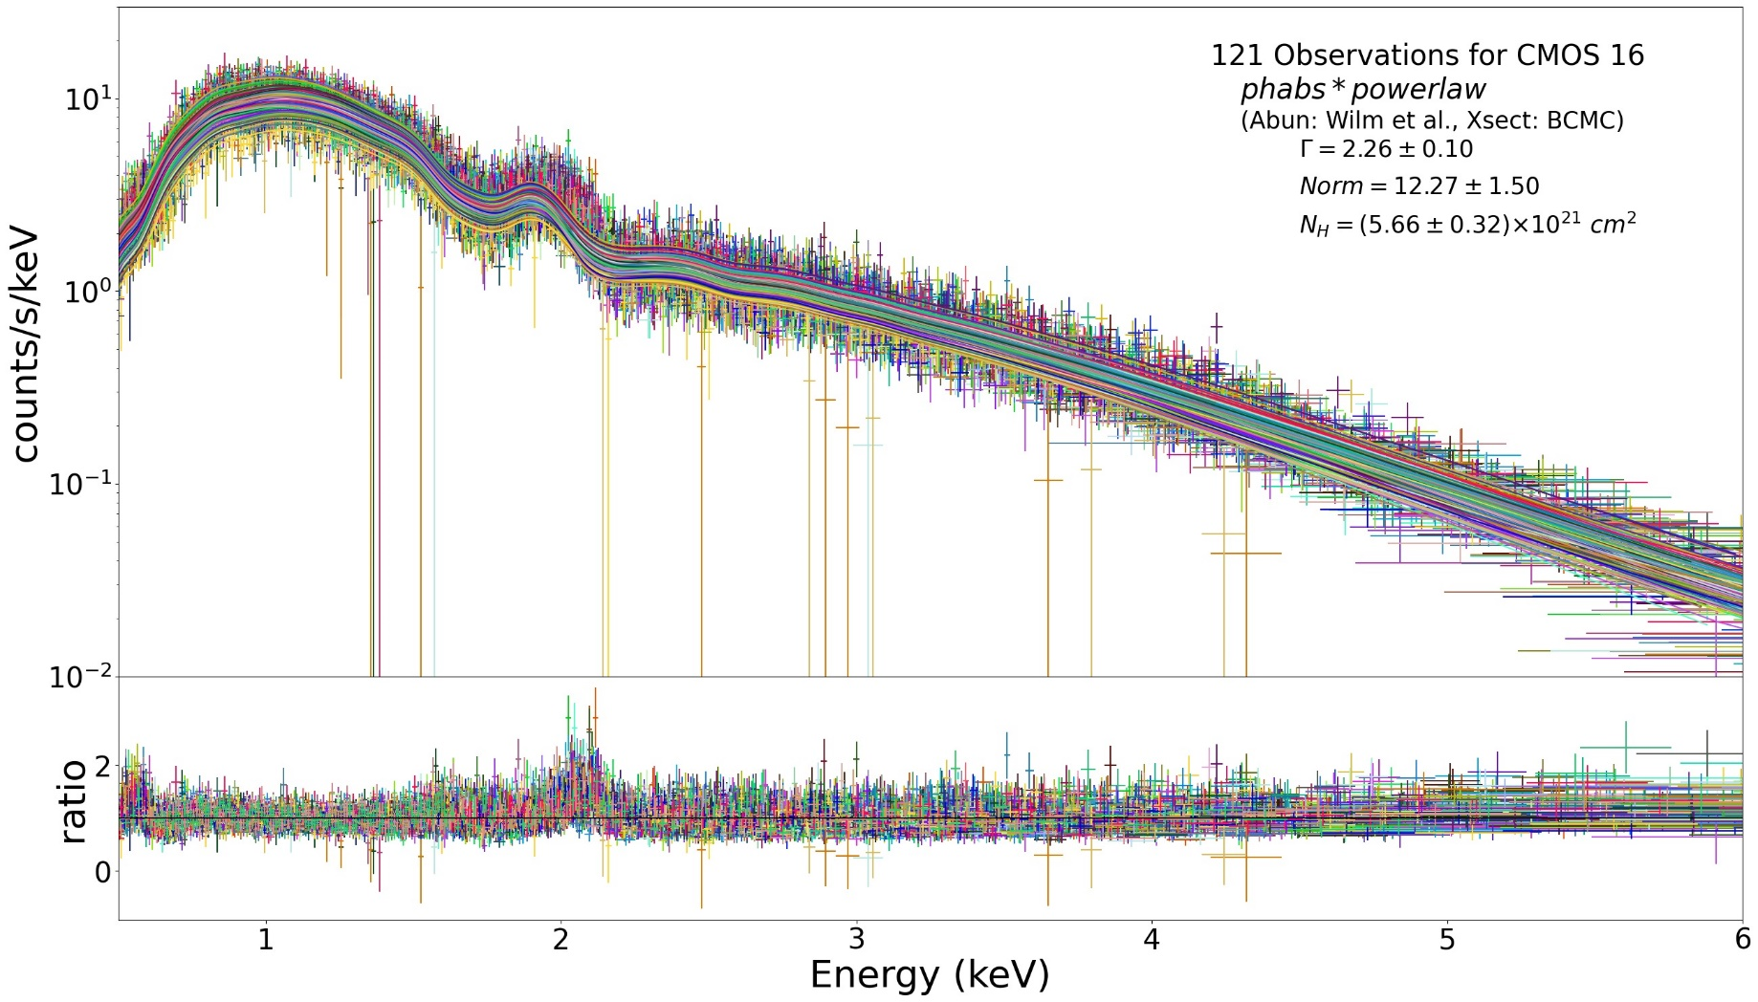
Effective area: Crab
? Not understood

Slide 9
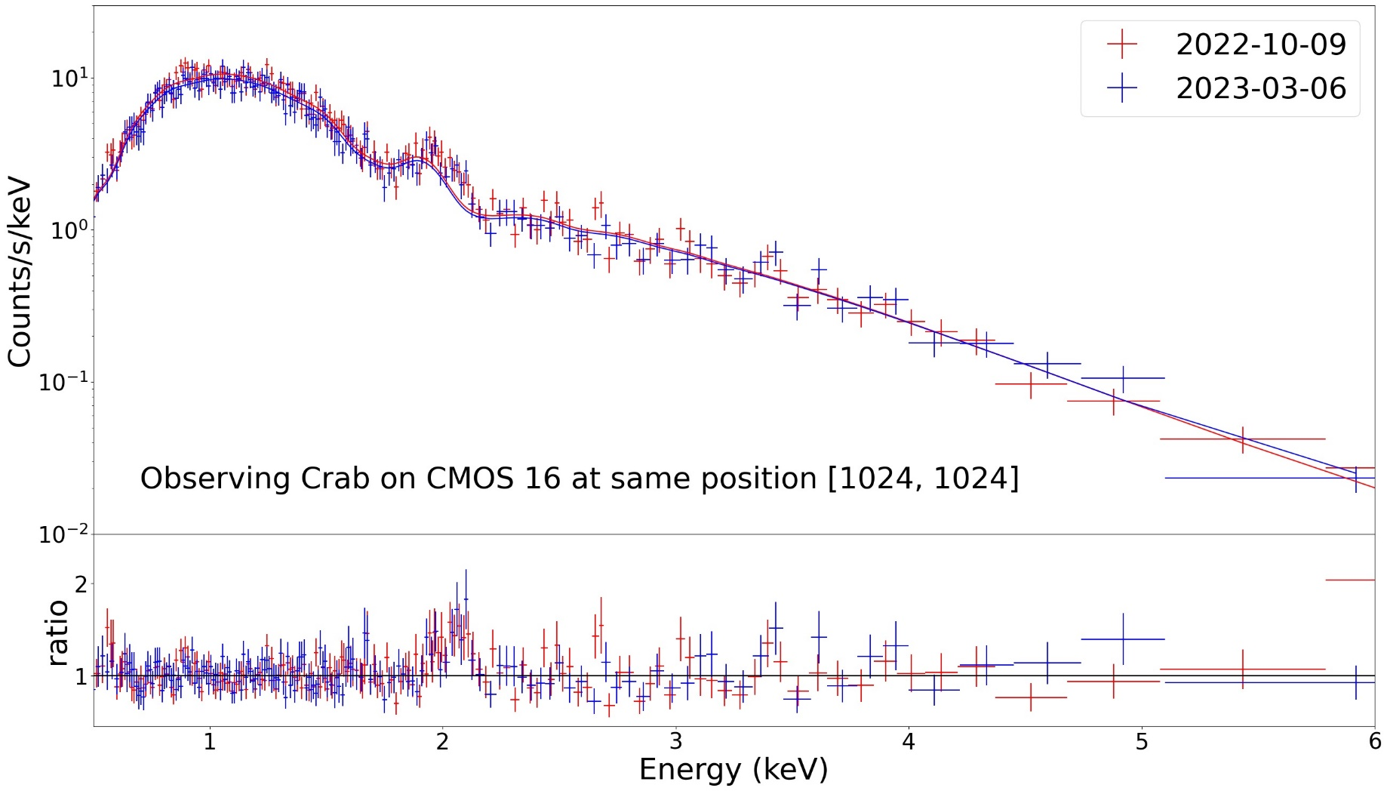
Effective area: variation?

Slide 10
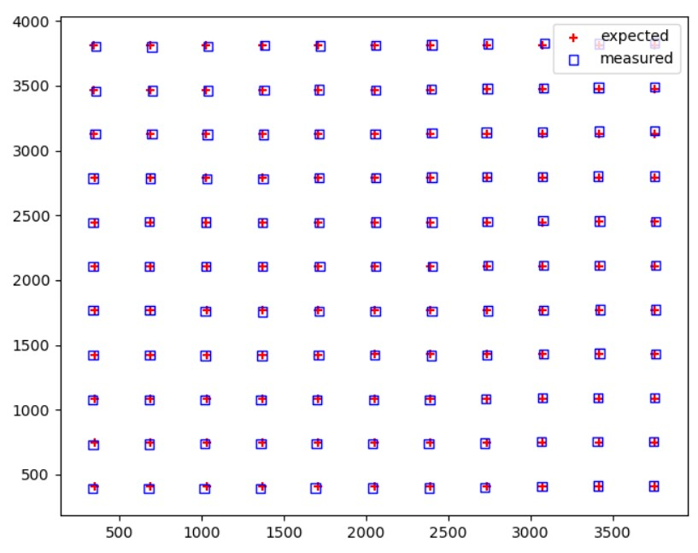
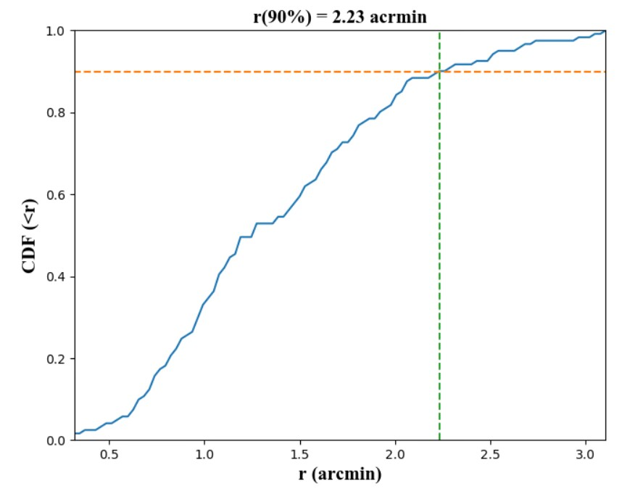
Positioning: Crab
Rotation Matrix corrected

Slide 11
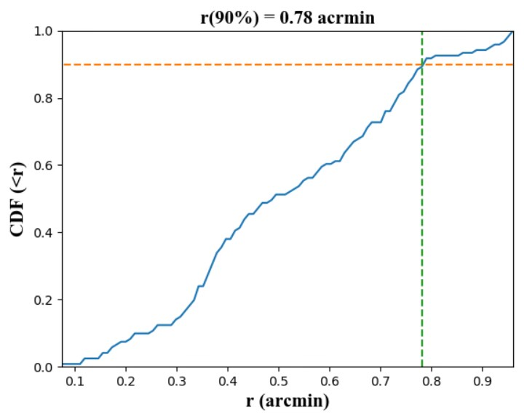
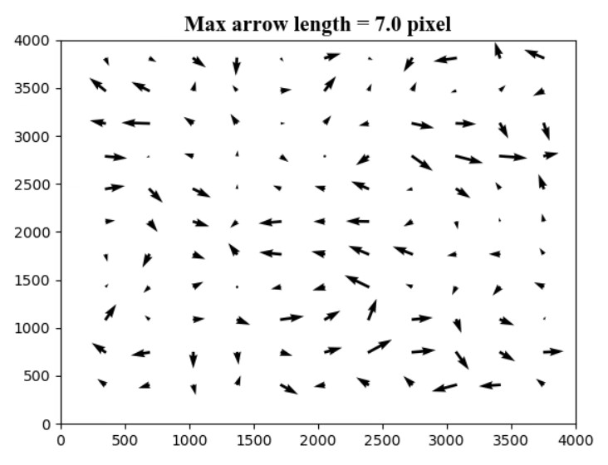
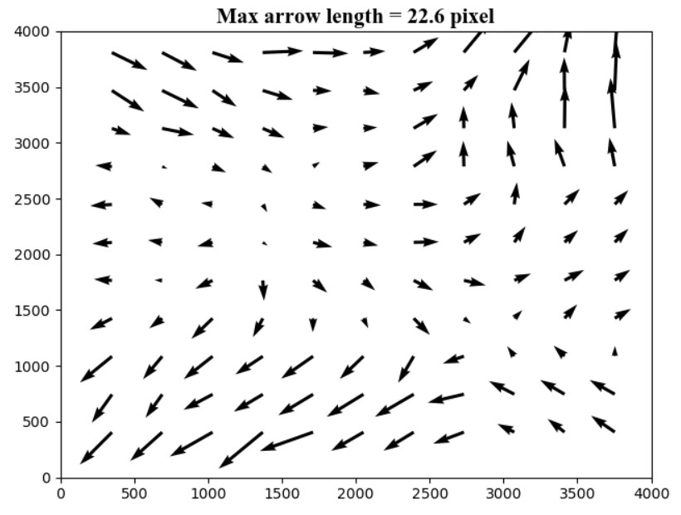
Positioning: off-set correction
Cubic polynomial

Slide 12
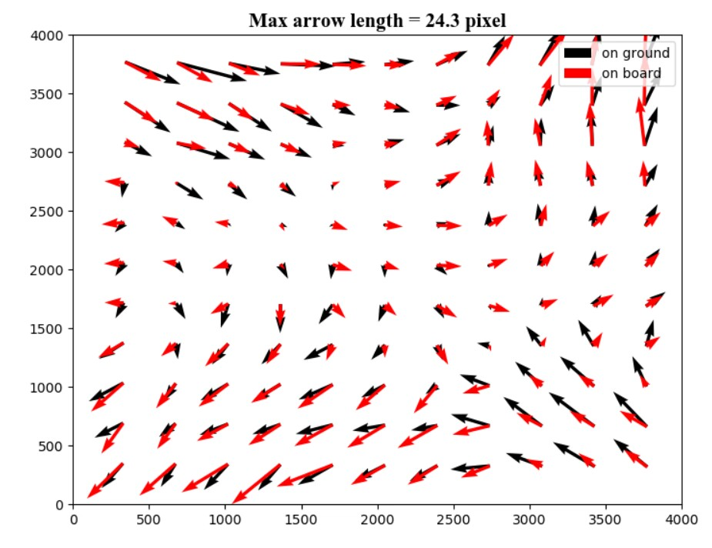
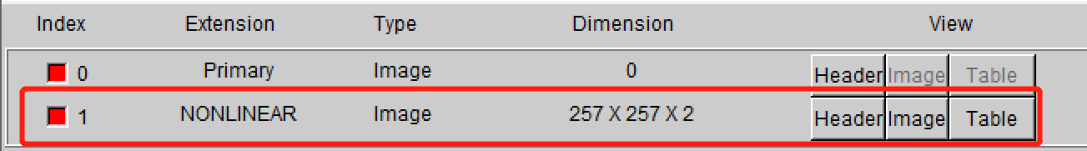
Positioning: off-set correction
Telescope definition file
Thin-plate spline interpolation

Slide 13
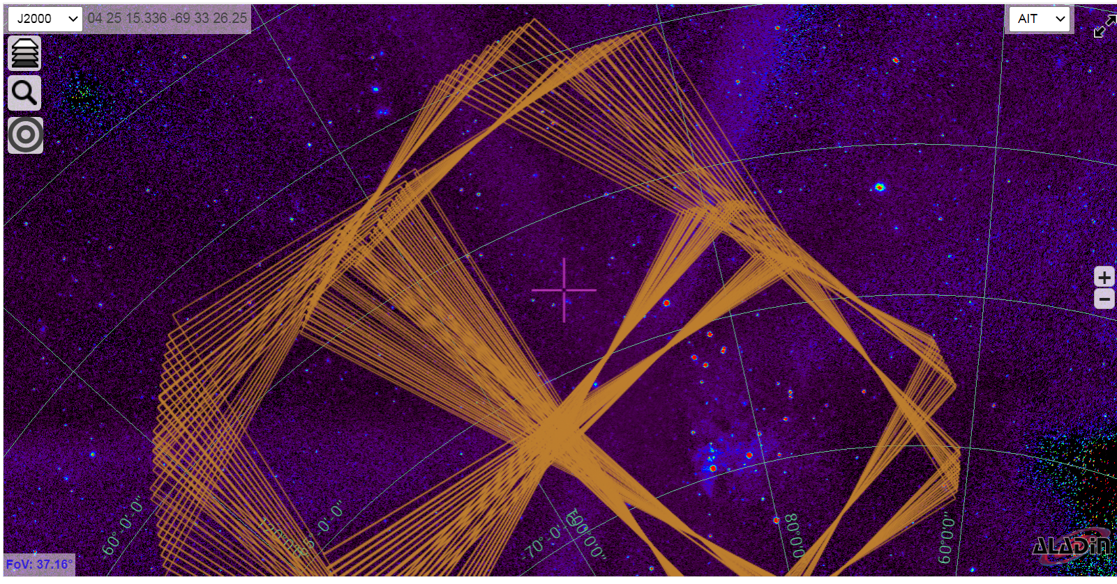
Positioning accuracy
LMC X-3
Observed by CMOS15, 16
2023.1.1-1.31, observations of LMC

Slide 14
Positioning accuracy
Square: off-set correction not considered
Triangle: off-set correction considered
Positioning accuracy of LEIA can reach ~2 arcmin

Slide 15
EP-WXT in-flight calibration strategy
Targets: Cas A, Crab
12 modules (48 sections); No enough time!
4 scanning points of Cas A for each section
7×7 scanning points of Crab for each section
Other bright sources (like GC sources) will be used to calibrate the positioning

Slide 16
Observations of Crab and Cas A during all-sky survey
The observation positions of Crab
The observation positions of Cas A

Slide 17
Conclusion
The gain and energy resolution of LEIA in-flight are consistent with the result from on-ground calibration.
The X-ray emission background is similar with the simulated result, while the particle background is somewhat higher, due to LEIA’s orbit .
The effective areas of LEIA are consistent with the result from on-ground calibration.
The positioning accuracy of LEIA can reach ~2 arcmin.
Thank you

