Slide 1
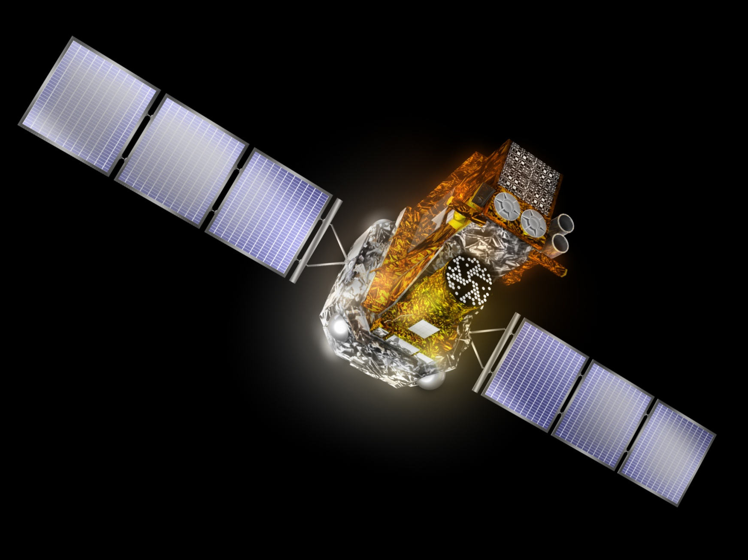
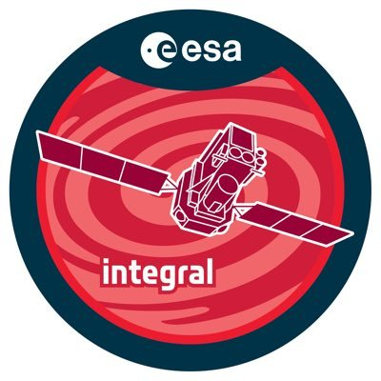
INTEGRAL Observatory Update
Seeking out the extremes of the Universe
Presenter: L. Natalucci
Main Contributors:
E. Kuulkers, A.Bazzano, P.Ubertini
15th IACHEC Meeting, 23-27 April 2023

Slide 2
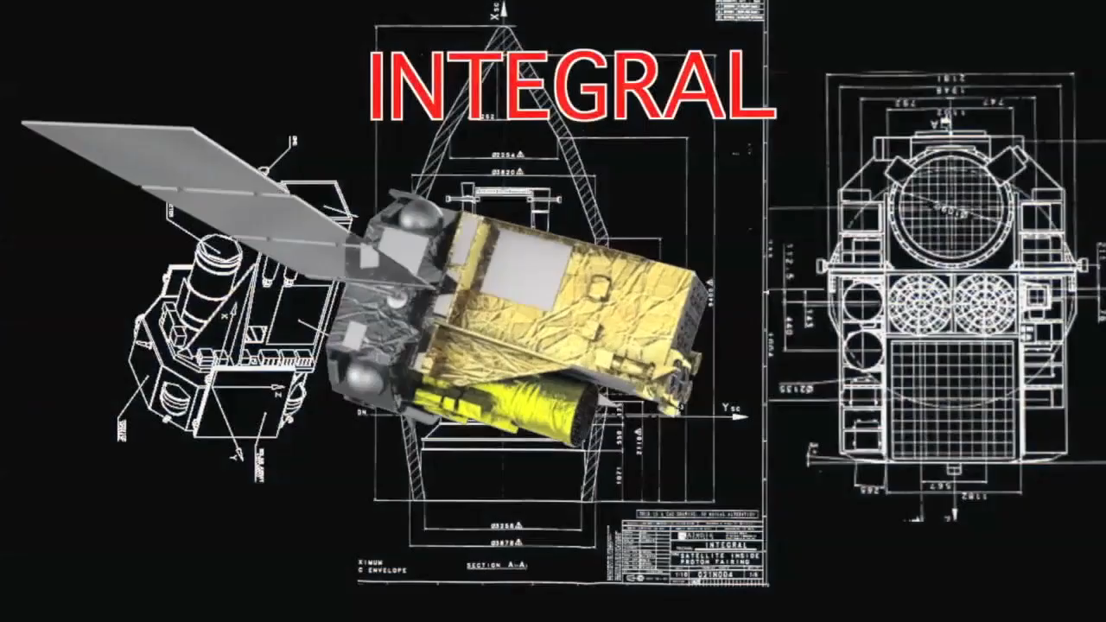
INTEGRAL main features
Key for GW prompt and afterglow science!
INTEGRAL is the ESA M2 mission of the Horizon 2000 program, launched 2002. It has:
3 keV-10 MeV energy range with unprecedented sensitivity
Wide FoV: ≈ 100-1000 deg² plus..
All-sky monitor capability in
the range 80 keV - 2.5 MeV
High time resolution: <120 μs absolute
Arc min angular and keV energy resolution and
Unique High Energy polarimetry capability
Very elliptical orbit with duty cycle >85% and all-sky coverage
Long uninterrupted observations 2.7days 6 h perigee passage
INTEGRAL is the link between the soft X-ray and high energy γ-ray universe

Slide 3
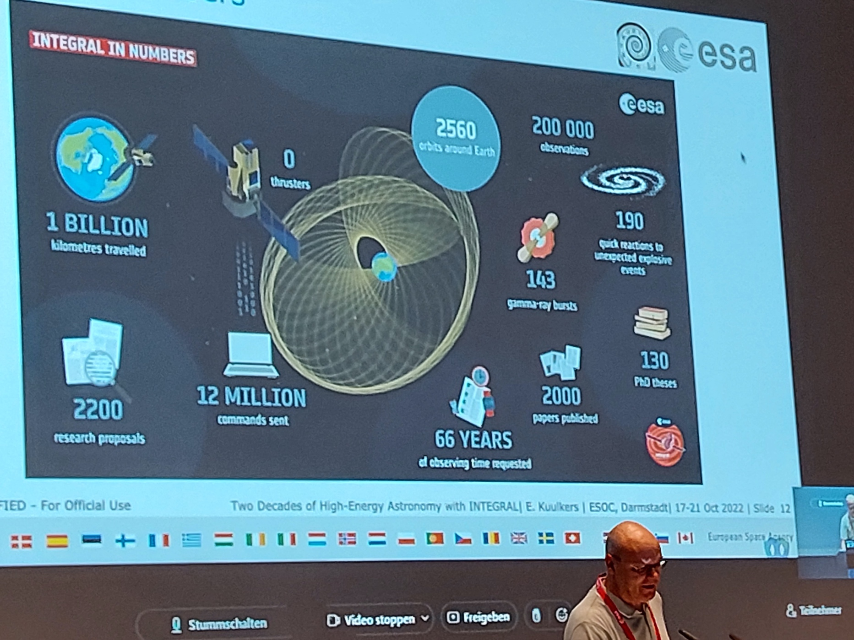
INTEGRAL in Numbers today

Slide 4

INTEGRAL Confirmation & Extension
INTEGRAL continues to address key questions from ESA’s Cosmic Vision 2015-2025 plan: ‘What are the fundamental physical laws of the Universe?’ and ‘How did the Universe originate and what is it made of?’
On March 8th, 2023 the ESA Science Program Committee approved INTEGRAL’s operations until the end of 2024
SPC recommendation:
Science Operation are extended enabling support of the fourth international campaign of joint observations of gravitational waves by the network of instruments LIGO, Virgo, and KAGRA. This will be followed by two years of post-operations and monitoring of the spacecraft until re-entry in February 2029.

Slide 5
INTEGRAL uniqueness
The exceptionally robust and versatile design of the INTEGRAL mission has allowed researchers to exploit data collected not only with the pointed instruments, but also with the active cosmic-ray shields of the main instruments to detect impulses of gamma-rays in coincidence with unpredictable phenomena.
The full-sky coverage, mostly unocculted by the Earth, the large effective area, the stable background, and the high duty cycle (85%) put INTEGRAL in a privileged position to give a major contribution to multi-messenger astronomy.
INTEGRAL has recently provided:
Stringent upper limits on the gamma-ray emission from BH binary mergers, detected a short gamma-ray burst in coincidence with a binary neutron star merger,
contributed to define the spectral energy distribution of a blazar associated with a neutrino event,
upper limits on impulsive and steady gamma-ray emission from cosmological FRBs, and detected a magnetar flare associated with fast radio bursting emission.

Slide 6

15 Review papers on New Astronomy Reviews
INTEGRAL Re-Loaded
Integral Multi-Messenger Astrophysics
INTEGRAL surveys
Review on pulsating sources
Review of INTEGRAL Extragalactic Sky
INTEGRAL view on black hole X-ray binaries
INTEGRAL serendipitous observations of solar and terrestrial X-rays and gamma rays
Steady-state nucleosynthesis throughout the Galaxy
Synthesis of radioactive elements in novae and supernovae and their use as a dignostic tool
INTEGRAL results on the electron-positron annihilation radiation and X-ray \& Gamma-ray diffuse emission of the Milky Way
INTEGRAL view on Cataclysmic Variables and Symbiotic Binaries
The INTEGRAL view of the pulsating hard X-ray sky: from accreting and transitional millisecond pulsars to rotation-powered pulsars and magnetars
SS433: a massive X-ray binary in an advanced evolutionary stage
INTEGRAL Results on Gamma-Ray Bursts and Polarization of Hard X-ray Sources
The Galactic LMXB Population and the Galactic Centre Region

Slide 7
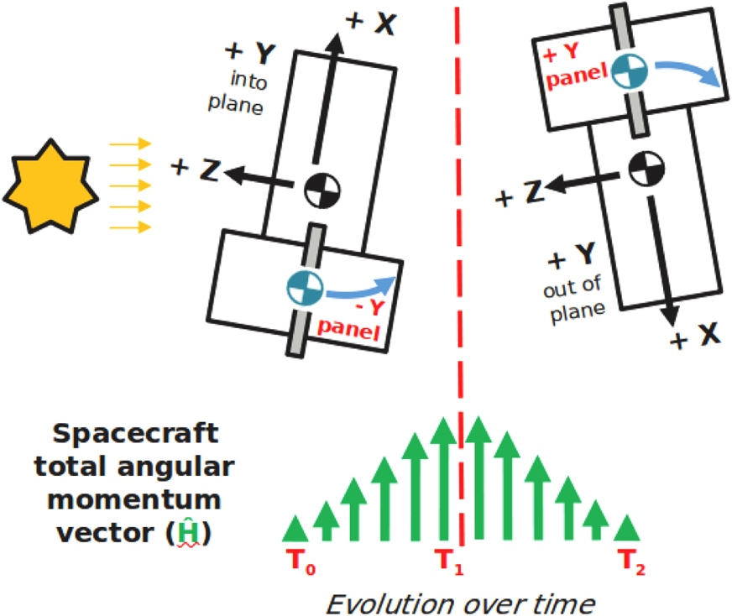
INTEGRAL “Reloaded”
After all these years in orbit, INTEGRAL remains in excellent health with only minor degradation. The lifetime-limiting resources should allow science operations to continue until shortly before satellite re- entry in 2029 . There are no permanent failures at unit level and relatively few component failures:
4 of the original 19 SPI Germanium detectors and two sets of the SPI FEE. Internal redundancy in the instrument means that this has no impact.
a number of Remote Terminal Unit (RTU) digital acquisition channels have been lost.
Running out of hydrazine availability in April 2020.
A new pointing strategy: the Z-flip
Kuulkers et al. 2023
10.1016/j.newar.2021.101629
Notes:
the accumulated angular momentum is redistributed between the reaction wheels by “flipping” INTEGRAL by 180 around its Z-axis (hence ’Z-flip’) using reaction wheels. In this way, the total angular momentum accumulation rate changes sign leading to a net balance over a suitable time interval

Slide 8
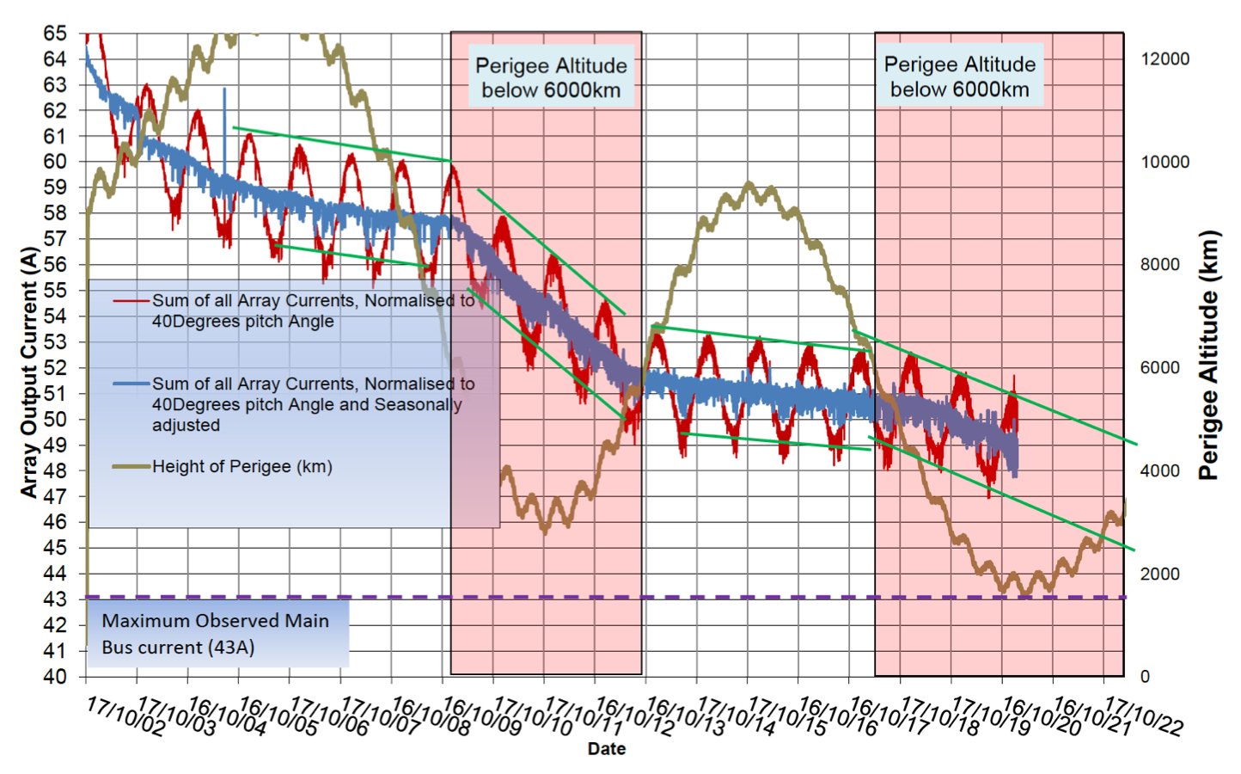
Kuulkers et al. 2023
10.1016/j.newar.2021.101629

Slide 9
INTEGRAL legacy
discovery of currently more than 600 new high-energy sources
the first-ever direct detection of 56Ni and 56Co radio-active decay lines from a Type Ia supernova;
spectroscopy of isotopes from galactic nucleo-synthesis sources;
new insights on enigmatic positron annihilation in the Galactic bulge and disk;
pioneering gamma-ray polarization studies;
detection of the first prompt electromagnetic radiation in coincidence with a binary neutron star merger.

Slide 10
INTEGRAL as a Transient Discovery Machine
Prioritise science goals - “keep an eye on the X/gamma-ray sky”
Focus on Galactic plane scans & bulge to maximise discovery chances
Trigger on (extragalactic) Target-of-Opportunities – kilonovae, fast radio bursts, GW events, ...
Monitor brightest sources
Maintain unique capability for Galactic supernova observations
Participation in key multi-wavelength programmes
Maximise scientific advantage gained from new operating procedures (such as modified slewing algorithm) being implemented since ESAM#8
Perform ultra-fast ToOs (2 hours or better)

Slide 11
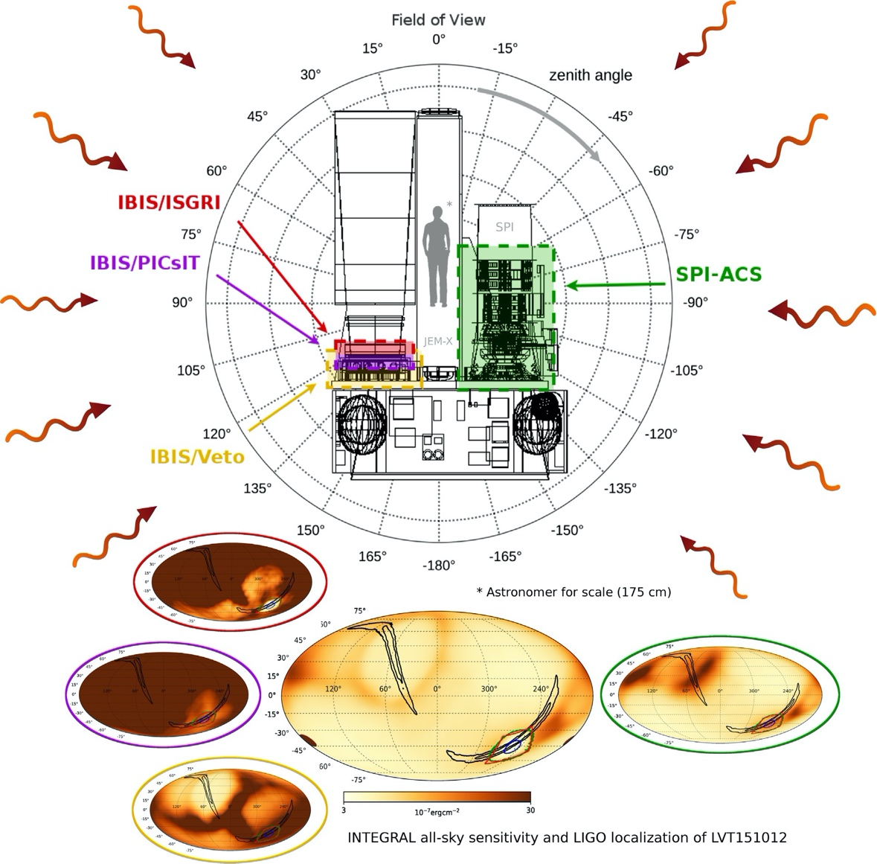
Multi-Messenger Astronomy with INTEGRAL
Targeted searches:
gravitational waves (GW)
high-energy neutrinos
Fast Radio Bursts (FRBs)
Identification and Follow-up strategies:
automated procedures for analysis
Ferrigno et al. 2023
10.1016/j.newar.2020.101595

Slide 12
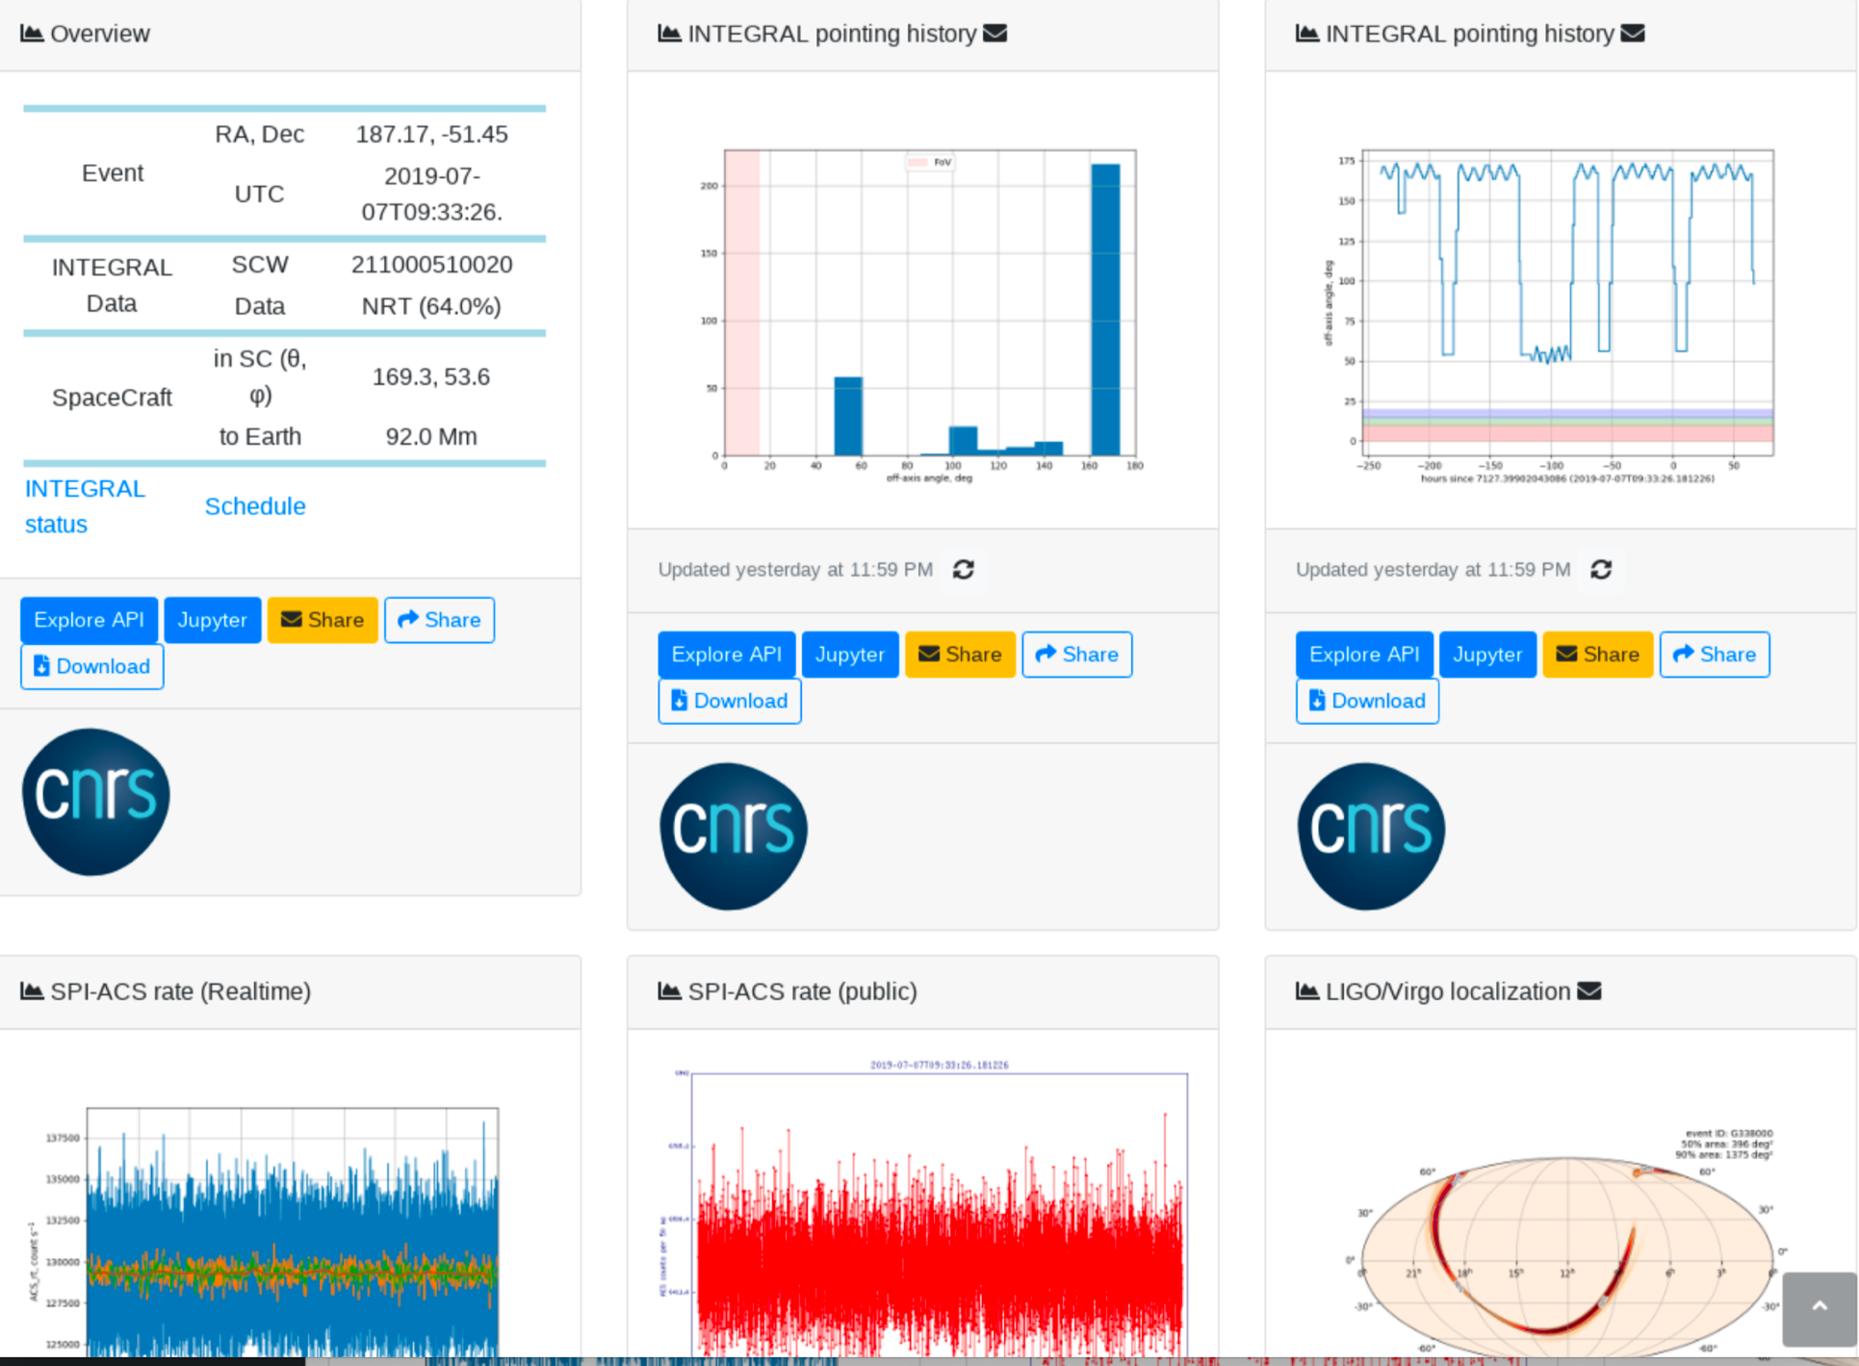
INTEGRAL Dashboard for MM

Slide 13
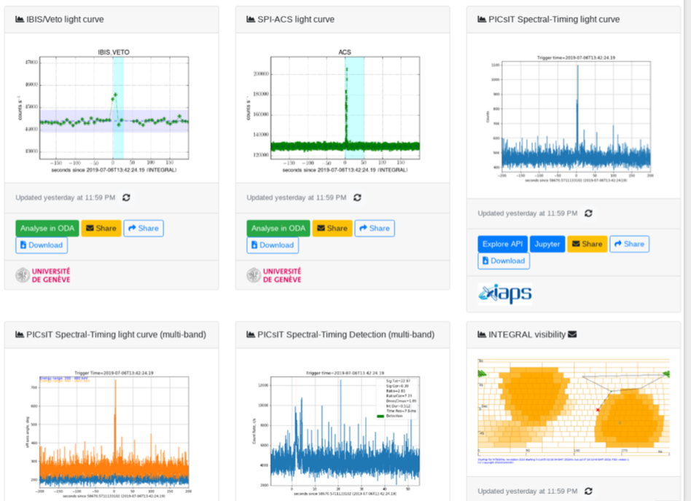

Slide 14
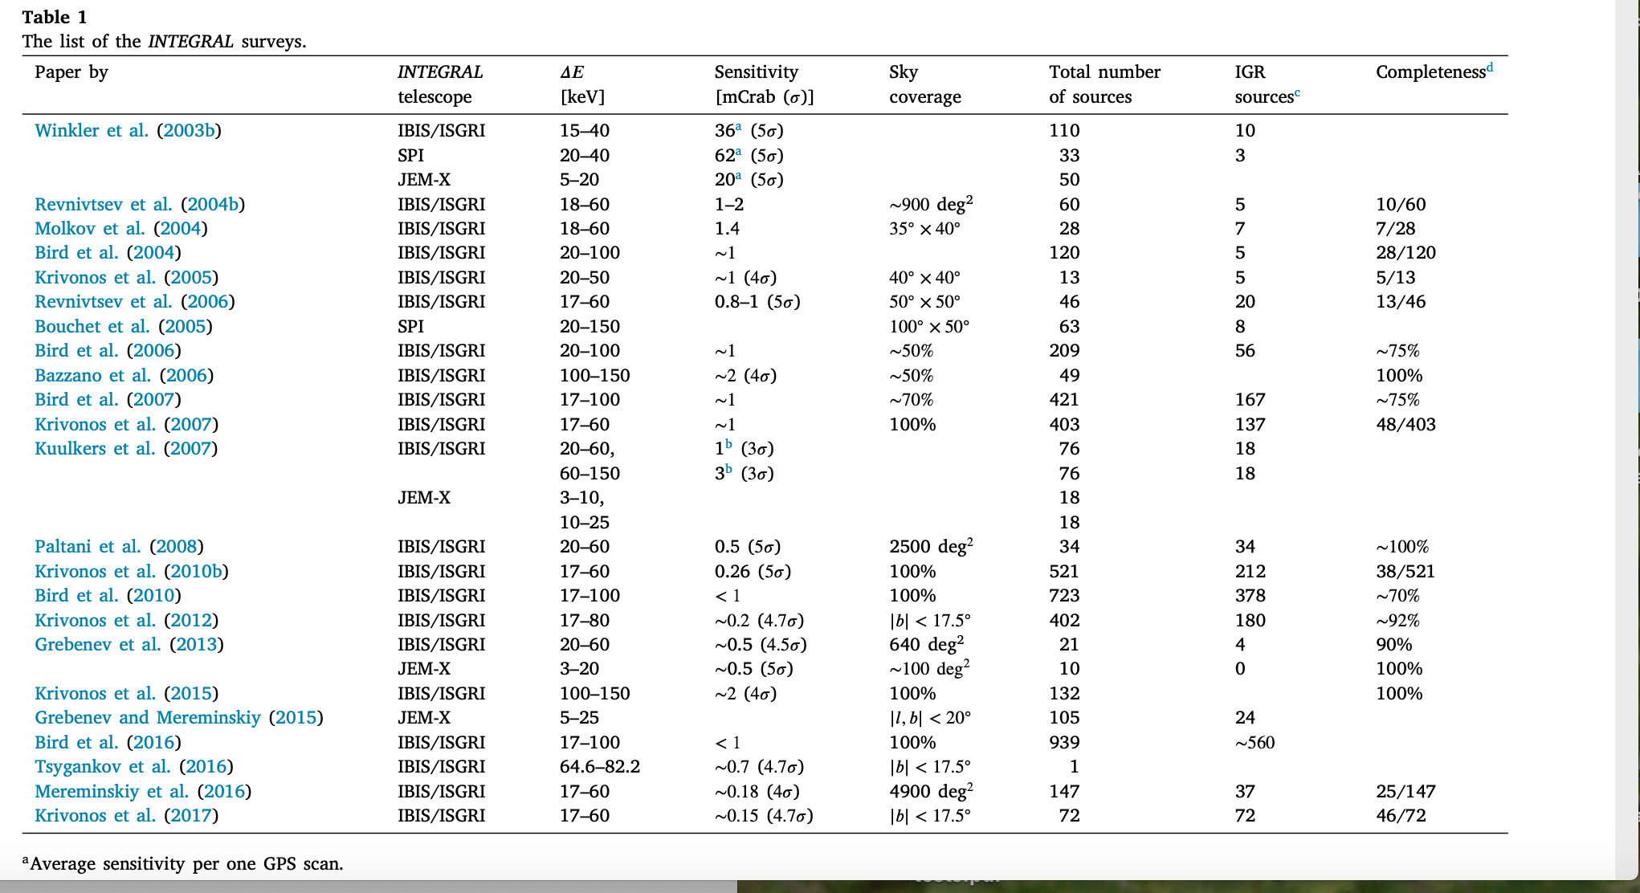
15 years of Galactic Surveys & Hard X-Ray Background Measurements
Krivonos et al. 2023
10.1016/j.newar.2021.101612

Slide 15
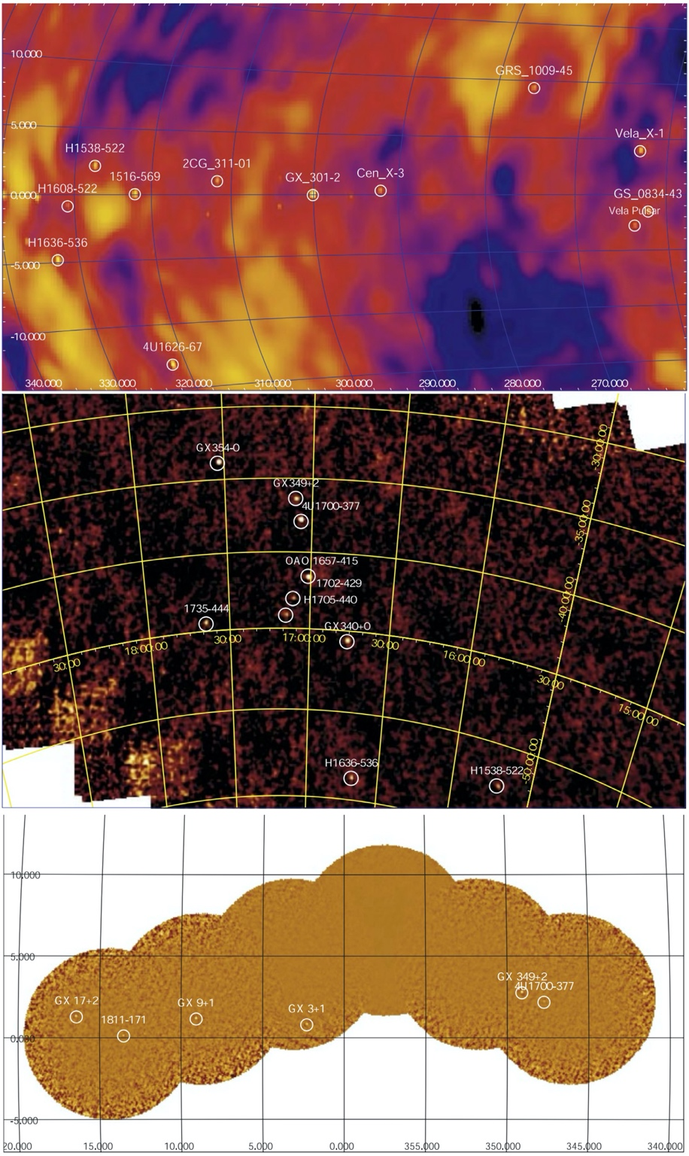
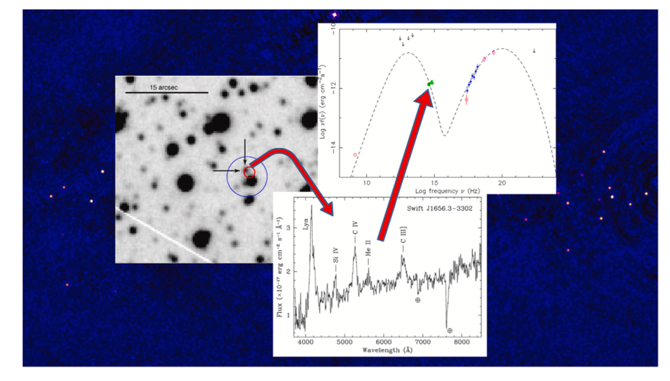
Examples of Galactic sky maps obtained during the GPS observations. Top panel: SPI significance 20–40 keV sky map in galactic coordinates (December 2002–March 2003). Middle panel: 15–30 keV IBIS/ISGRI skymap in equatorial J2000 coordinates (12 March 2003). Bottom panel: 3–15 keV JEM-X sky map close to the Galactic Centre
Graphic representation of the follow-up process going from the accurate positioning through soft X-ray observations, to the optical spectroscopy allowing the identification of the nature and main features of the source, and ending with its multiwavelength characterization thanks to the building of a spectral energy distribution for the object.

Slide 16
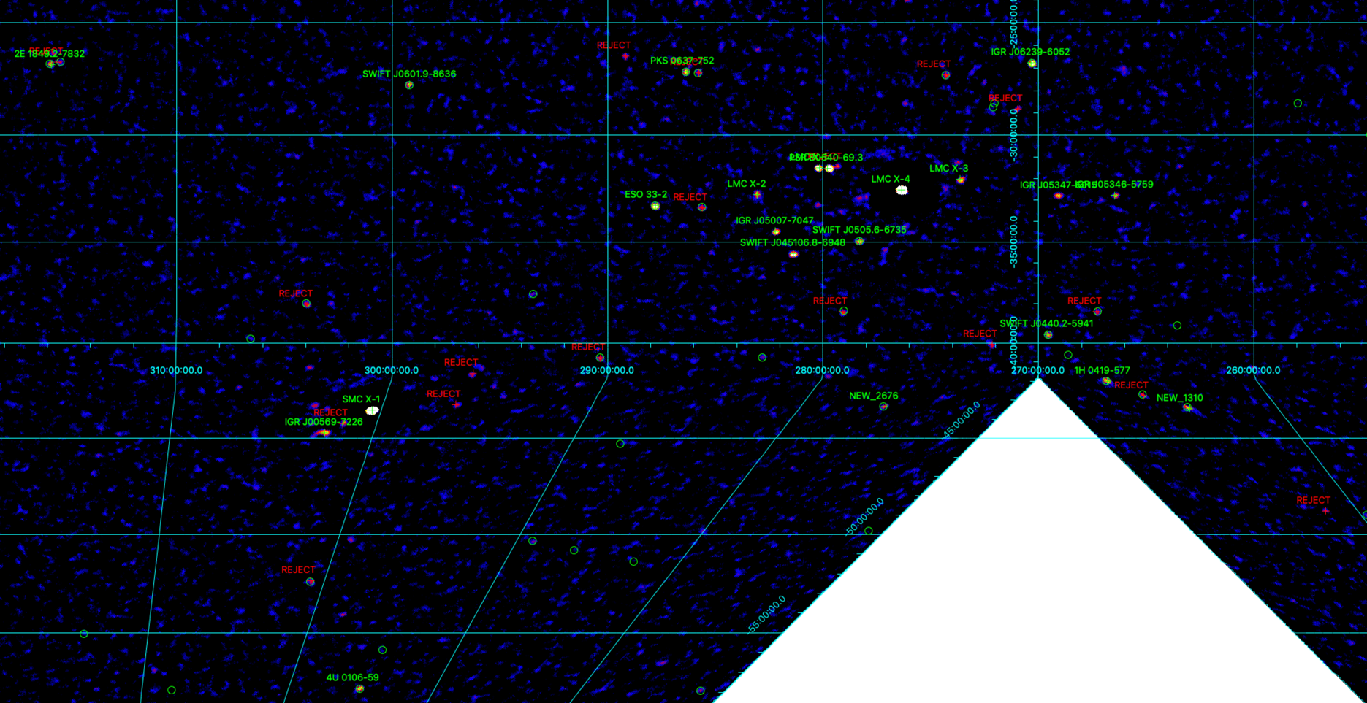
IBIS new survey
A new Survey using OSA11.2 and 2000 orbits
A zoom of the first map in the 18-60 keV band is shown below

Slide 17
New Software release OSA 11.2 ready for use by the community
On April 2022 a new OSA version (11.2) was released by the ISDC.
While the software itself contains minor updates, the most significant changes are related to the IBIS/ISGRI calibration which has now been standardised across the entire mission.
This update was possible thanks to the work of Volodymyr Savchenko at ISDC, with support provided by ISOC, IBIS and SPI instrument teams.
It provides a substantial improvement to the IBIS/ISGRI energy reconstruction, efficiency, and spectral response. The software and calibration files can be downloaded from the ISDC.

Slide 18
Future Prospects
After 20+ years in operation the science return is continuing at a high level and addresses a broad variety of astrophysical themes in view of its uniqueness + complementarity
No mission in operation or planned for next years offer the same unique capabilities of INTEGRAL for Multi-Messenger Astrophysics
INTEGRAL plays a key role as link between electromagnetic channel and the New Astronomies and between X-ray and VHE (Fermi, HESS, MAGIC….) at a level of 1% of the MISSION cost at CAC (20 years ago)

Slide 19
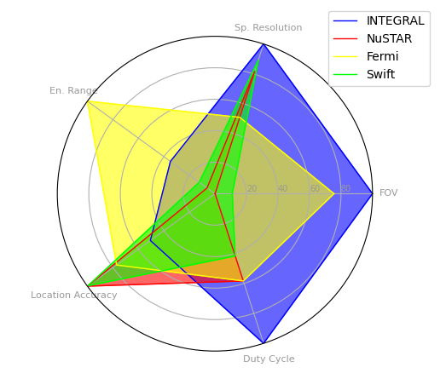
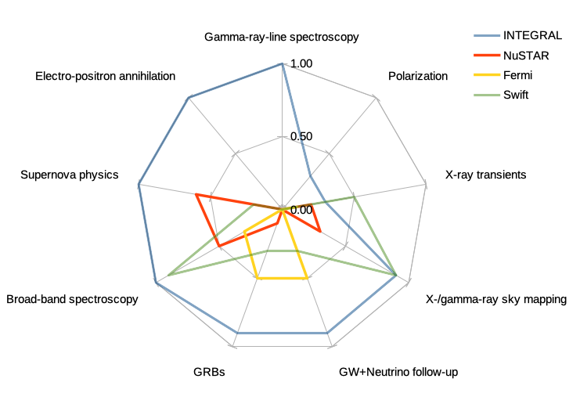
INTEGRAL versus current Missions
INTEGRAL is the only mission providing high-resolution gamma-ray spectroscopy
INTEGRAL: combination of high spectral resolution and fine imaging over a wide field-of-view with high observing efficiency;
The AC shields around SPI and IBIS and the PiCSIT subsystem provide access to the whole sky.

Slide 20
Backup slides

Slide 21
New release of the Multi-Messenger Online
Data Analysis system
On November 2021 ISDC, University of Geneva, EPFL, and APC Paris have developed the Multi-Messenger Online Data Analysis (MMODA) to obtain high-level science products from the instruments: INTEGRAL (IBIS/ISGRI, JEM-X, SPI- ACS), Antares, and Polar.
Highlights of this release:
specify number of science windows within a given time interval and access to
private data
added banner with news and issues, personalized feedback on jobs, expanded help pages, and visualisation with js9
expanded python API supporting asynchronous requests, new Kubenetees cluster for faster request processing, access to powerful HPC cluster for large jobs
Know limitations include:
max of 50 requests per hour resulting in 100 emails
OSA11 ISGRI analysis still restricted to revolution 1626 and beyond but OSA 11.2
release is imminent.
Complete details: https://www.aanda.org/articles/aa/abs/2021/07/aa37850-20/aa37850-20.html

