Slide 1
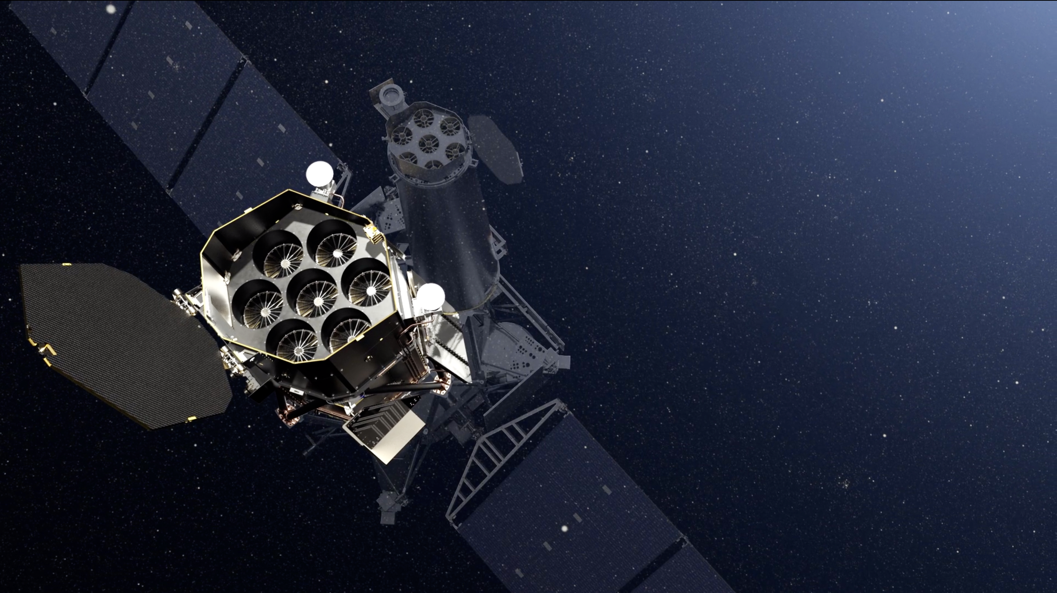
eROSITA instrument: performance and status
Miriam E. Ramos Ceja
15th IACHEC meeting
Seeblick Pelham, April 2023
Image credit: DLR

Slide 2

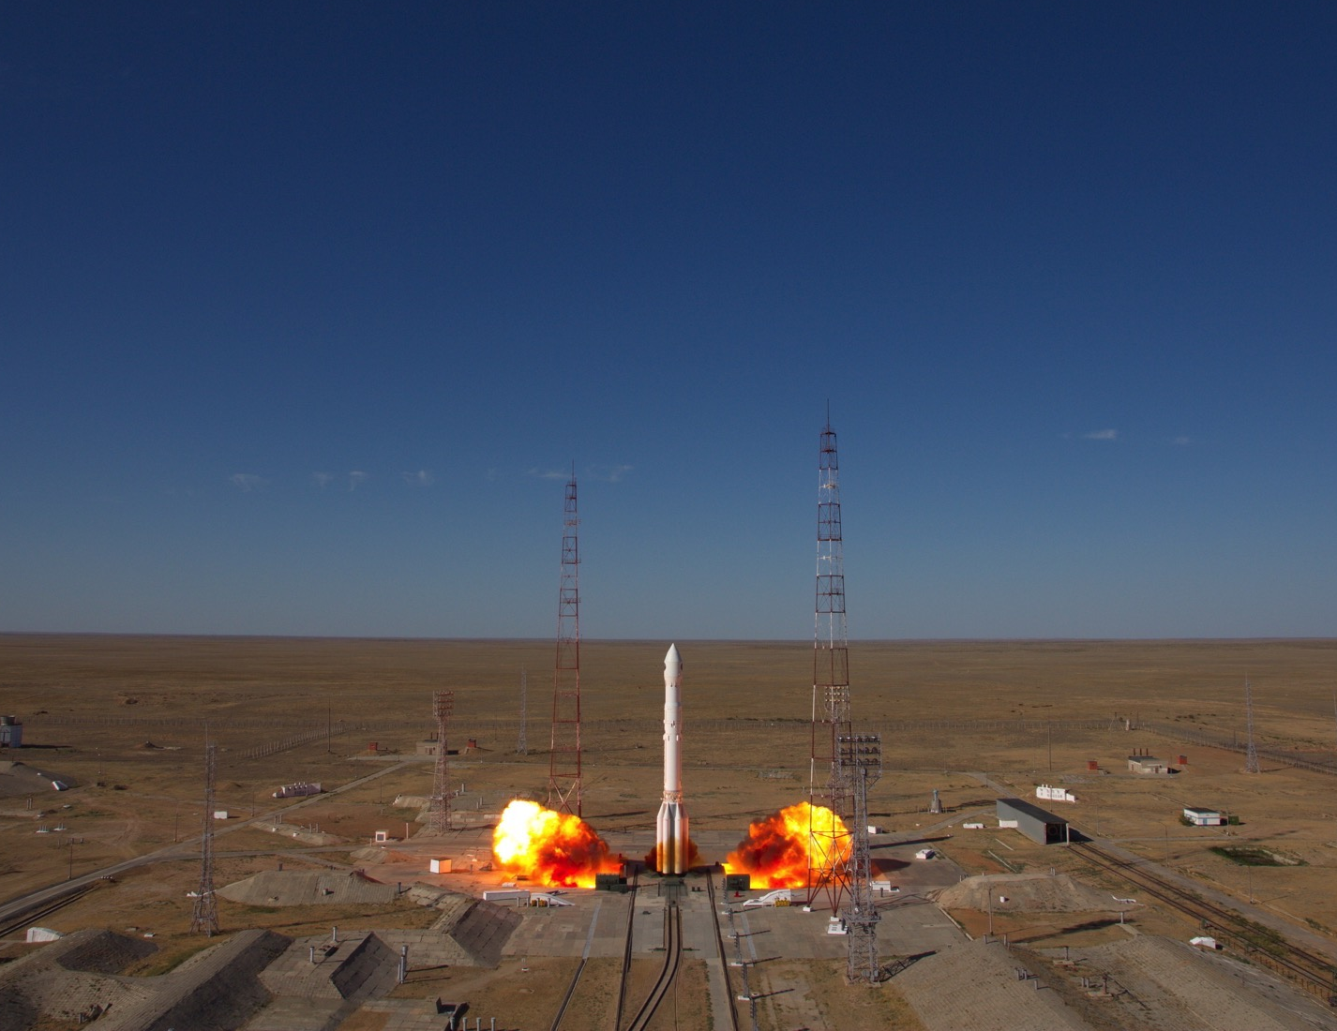
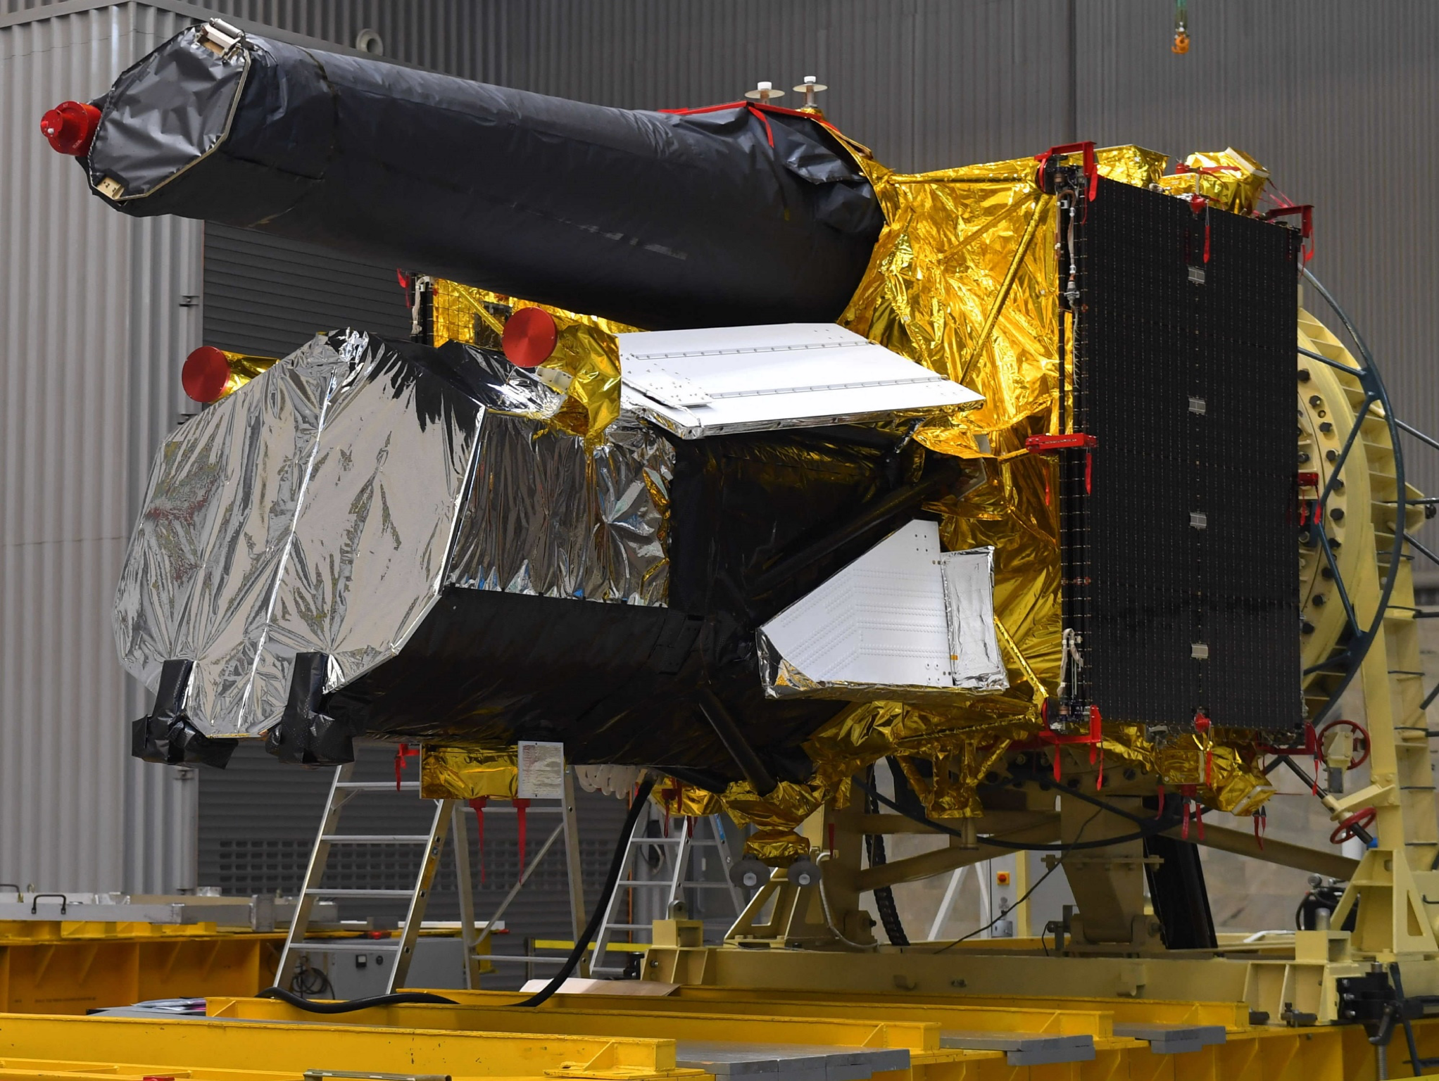


eROSITA X-ray telescope on SRG
extended ROentgen Survey with an Imaging Telescope Array.
Spectrum-Roentgen-Gamma (SRG) observatory.
Launch: July 13 2019, from Baikonur cosmodrome.
Russian-German collaboration.
Destination: Lagrange 2 (L2) point.
ART-XC
ART-XC
Navigator
eROSITA
Image credit: MPE
Image credit: ROSCOSMOS

Slide 3
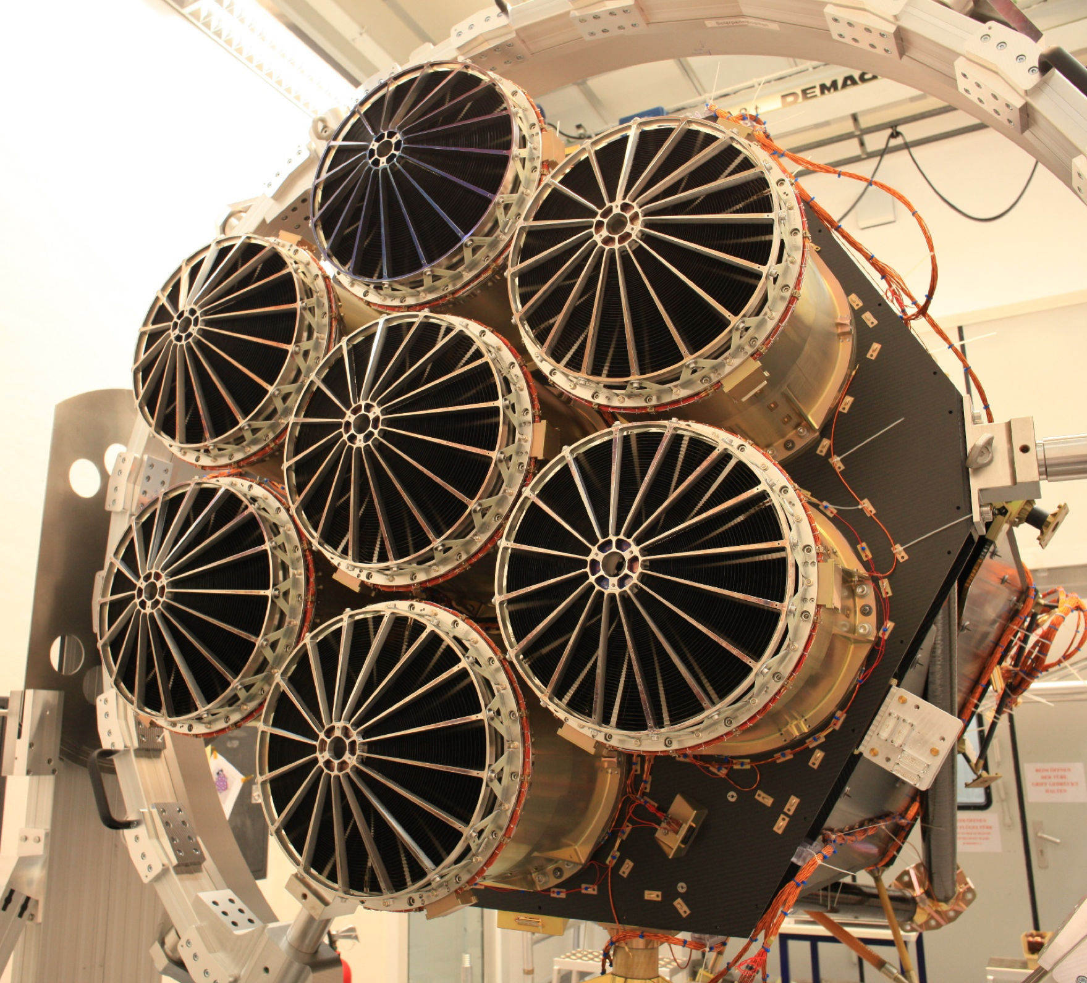
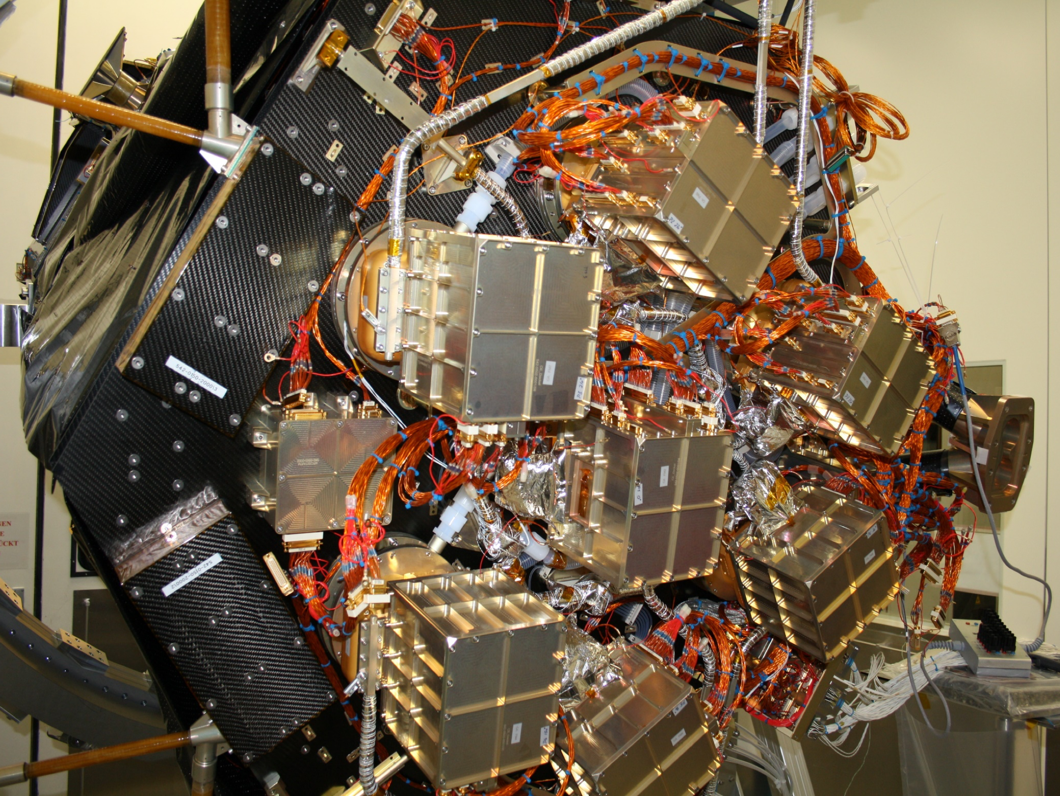
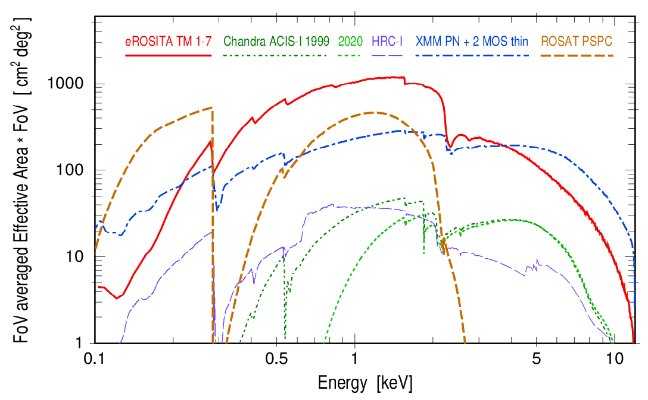
eROSITA in numbers
7 Wolter-I telescopes.
Each with 54 nested mirror shells.
⌽ outer mirror: 35.8 cm.
Focal length: 1.6 m.
Energy range: 0.1 – 10 keV.
Field of view: ~ 1 degree.
Effective area: 1237 cm² @ 1keV, 139 cm² @ 5 keV.
Half-Energy width (HEW): ~18” (on-axis, pointed), ~26” (FoV averaged, survey).
Expected lifetime: 7.5 years.
Predehl+2021

Slide 4
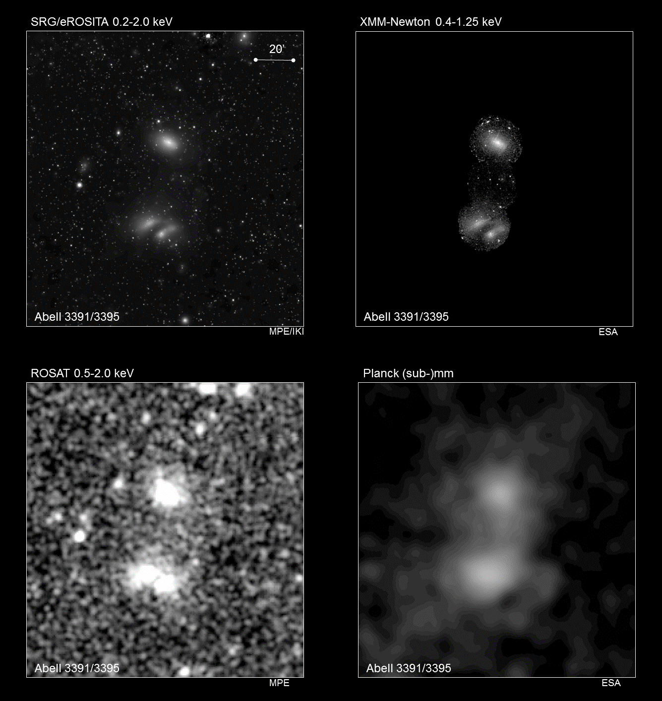
Comparison with previous/current X-ray telescopes
Interacting galaxy clusters A3391 and A3395
Reiprich+2021
ART-XC

Slide 5
eROSITA in numbers (as today)
Days in space | 1382 days
Days in fully operating mode | 872 days
eRASS1 survey percentage | 100% (184 days)
eRASS2 survey percentage | 100% (188 days)
eRASS3 survey percentage | 100% (184 days)
eRASS4 survey percentage | 100% (187 days)
eRASS5 survey percentage | 38% (69 days)
Days in safe mode I (26.02-16.11 2022) | 263 days
Days in stand-by mode (16.11.2022-25.03.2023) | 110 days
Days in safe mode II (since 25.03.2023) | 31 days
Data downloaded | ~ 375 Gb
eRASS = eROSITA All-Sky Survey

Slide 6
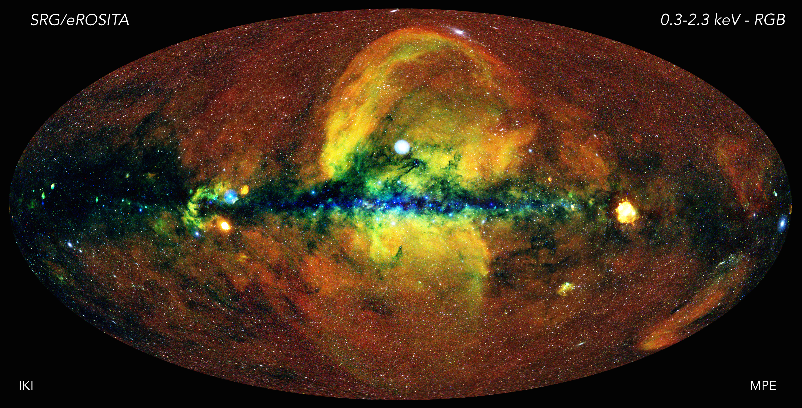
First eROSITA all-sky survey (eRASS1)
ART-XC

Slide 7
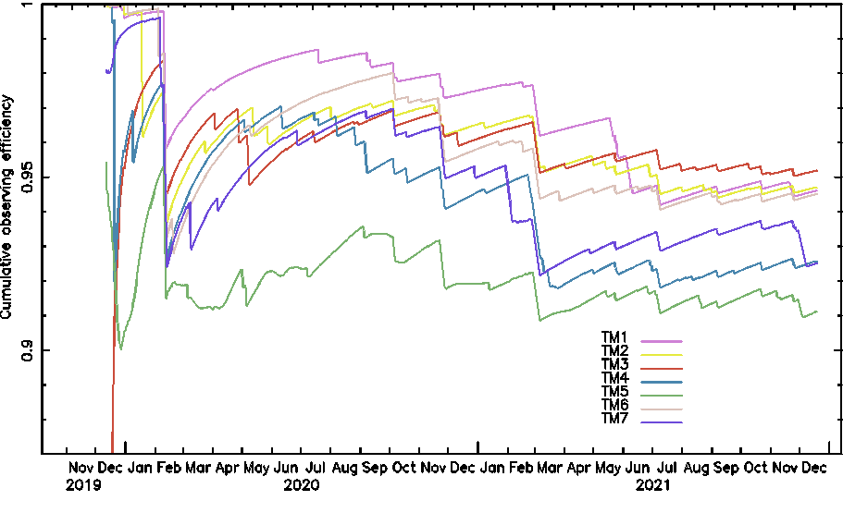
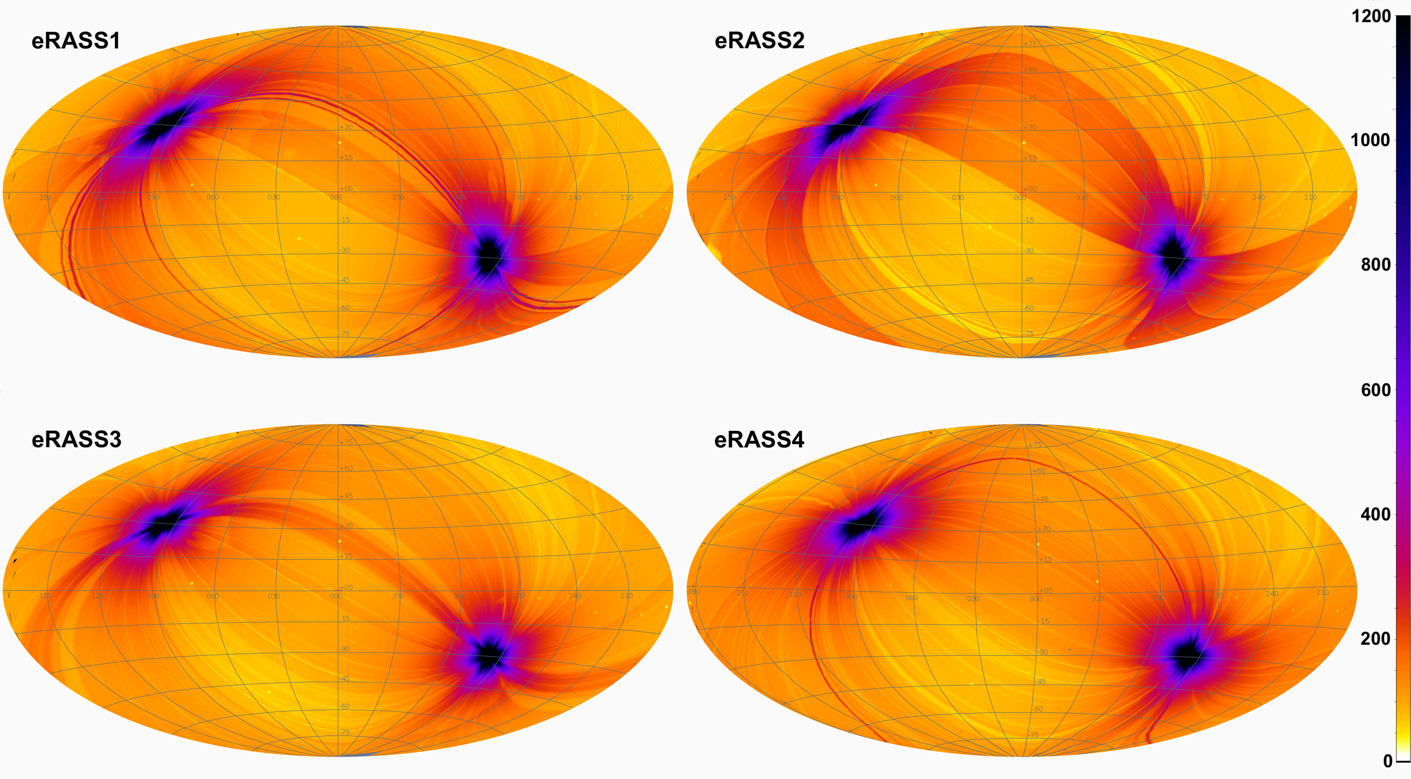
eROSITA observation efficiency
94% in two years
Vignetted exposure time in the 0.6–2.3 keV energy band
Camera electronics and Interface and Thermal Controller anomalies.
Orbit corrections.
Light leak in telescope modules 5 and 7.
Coutinho, Ramos-Ceja+2022

Slide 8
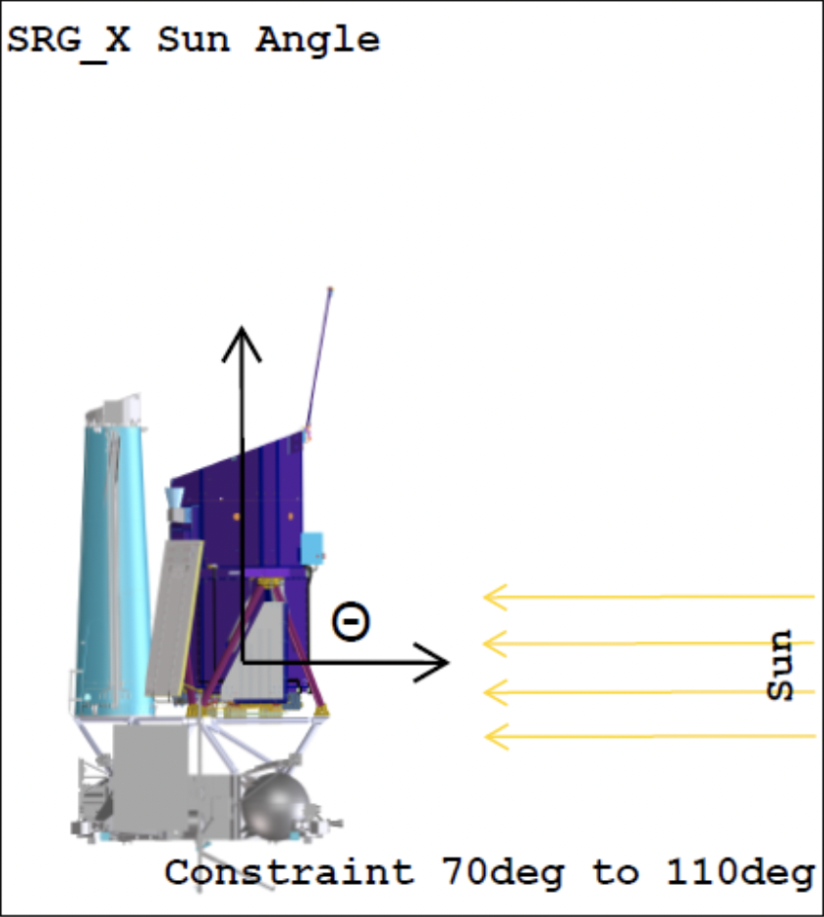
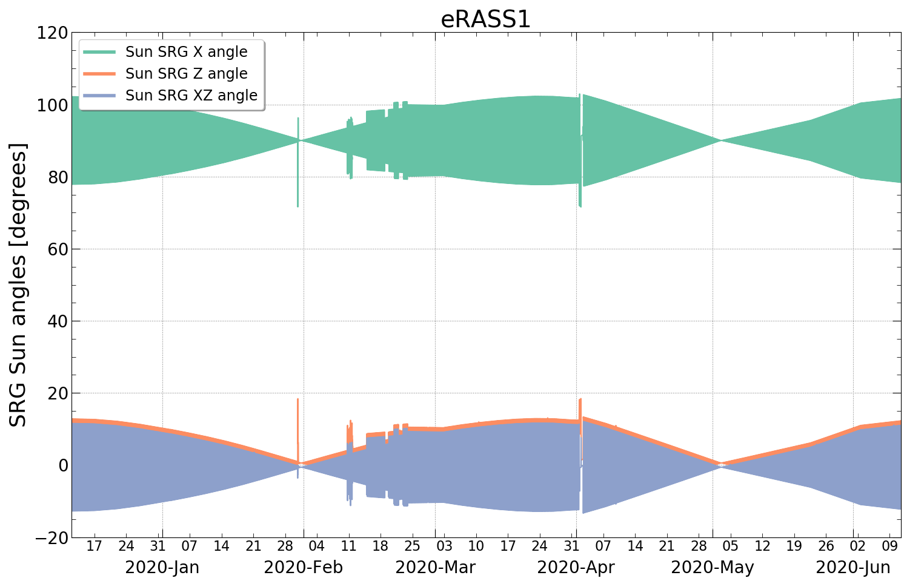
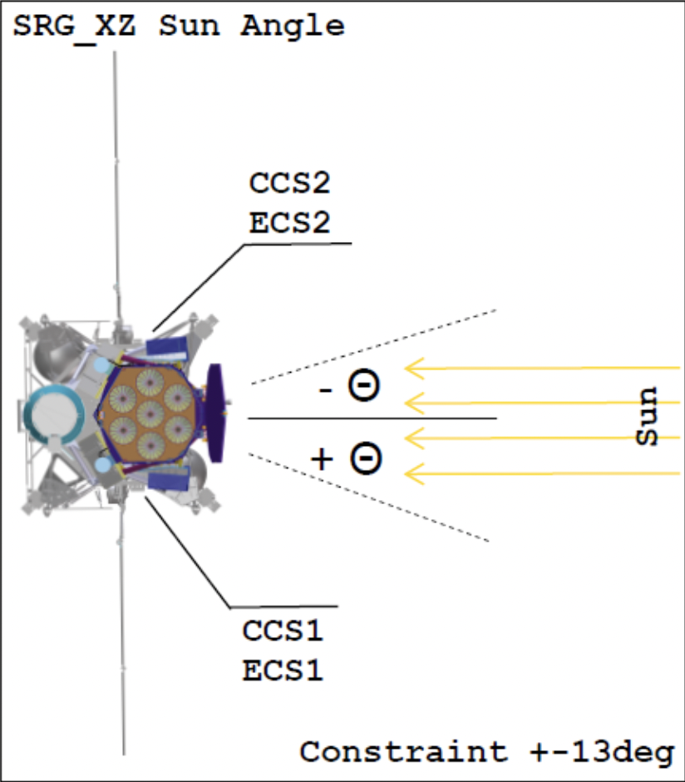
eROSITA health and status
All eROSITA system are still fully operational,
  No sub-system has permanent malfunction.
  Degradation as expected due to external environmental effects in L2.
Power consumption and operating temperatures dependent on the incident Sun angle.
Parameter | Value
Maximum power cosumption | 340 W < P < 360 W
Electronics control temperatures | -16 C < T < 10 C
Mirror control temperatures | 19 C < T < 21 C
CCD temperatures | -86 C < T < -79 C
CE and ITC internal temperatures | T < 27 C
Average camera availability | 90 – 95 %
Coutinho, Ramos-Ceja+2022

Slide 9
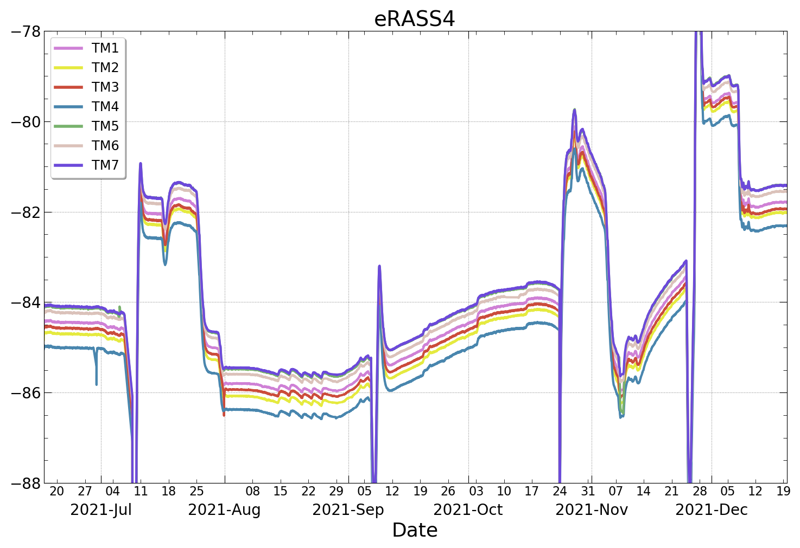
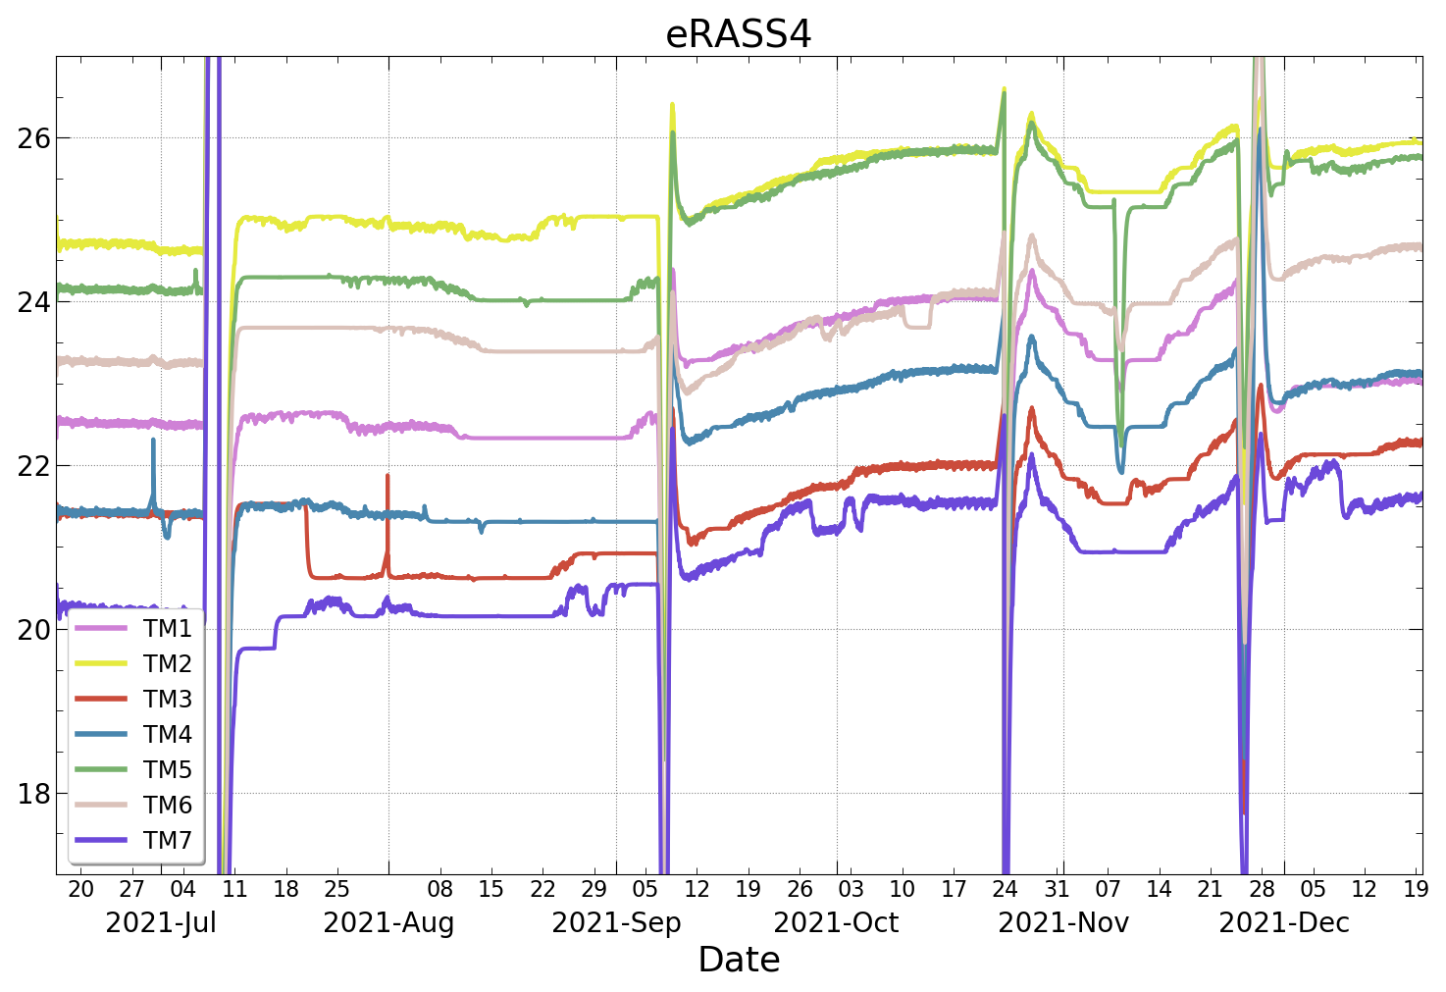
eROSITA cameras and electronics
The seven CCD cameras and electronics operated continuously for 2.5 years.
No visible degradation in the functionality of the cameras – onboard source calibration campaigns every 6 months.
  Increment of the charge transfer inefficiency as expected.
CCD temperatures
Electronic temperatures
Coutinho, Ramos-Ceja+2022

Slide 10
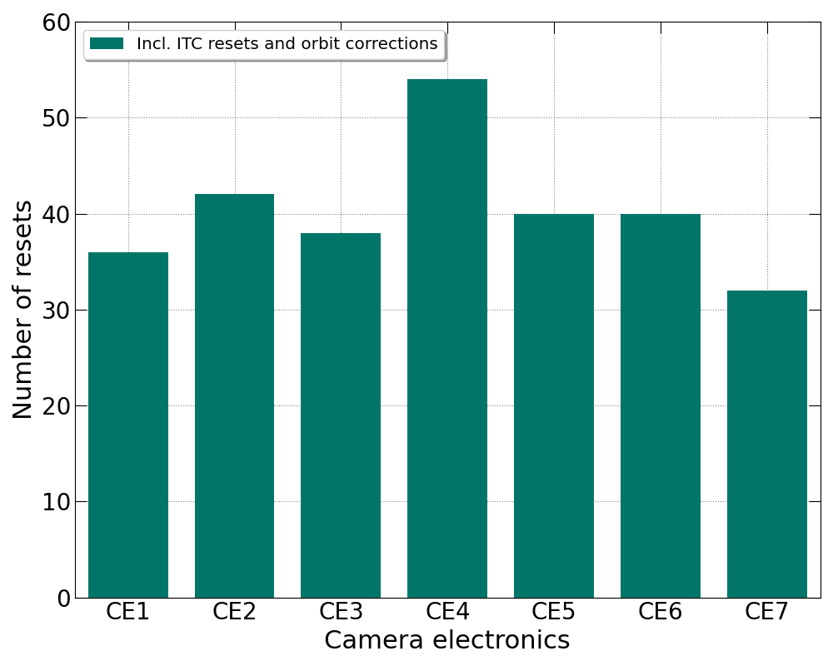
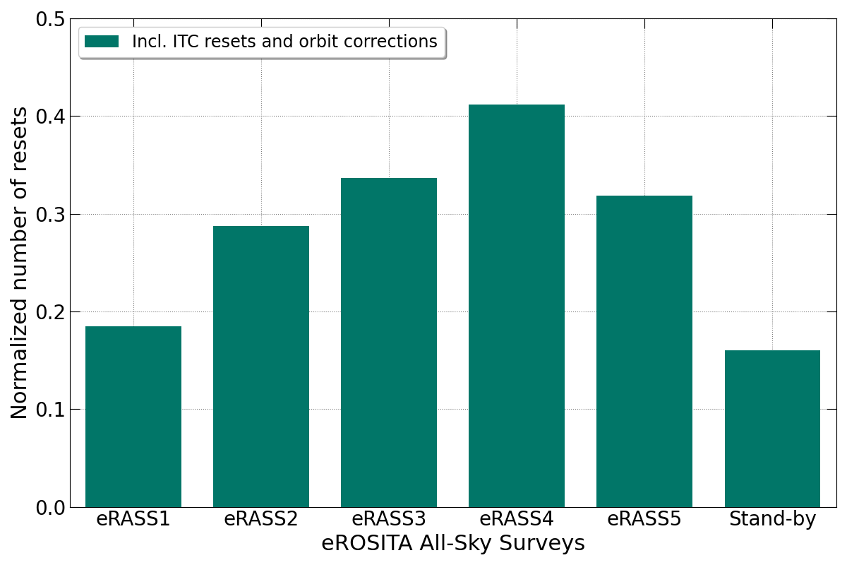
L2 enviromental effects
Anomalies – camera and camera electronics (CEs)
  CEs suffer from radiation-induced Single Event Upsets (SEU) - digital anomalies.
  Occur independently per camera.
  283 anomalies since start of mission,
    Solved by a CE reset (100% of the cases).
  Main concerns:
    Could damage the camera if voltages are randomly changed during anomaly.
    Loss of exposure time due to a camera being offline during the time of the anomaly.
  Impact on operations and on duration of ground session.
Number of resets per day

Slide 11
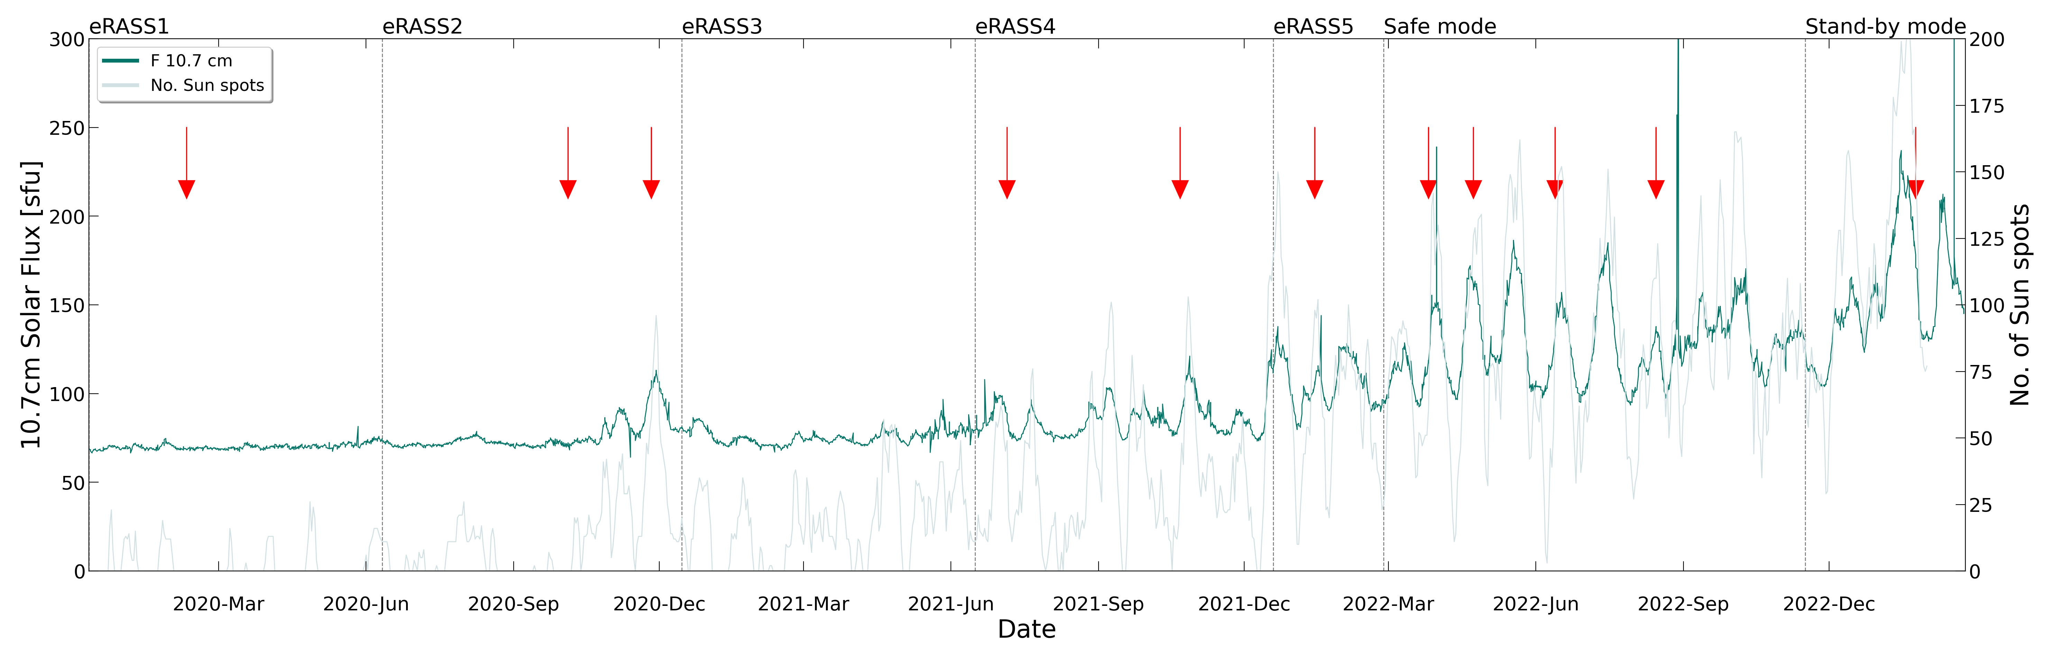
L2 enviromental effects
Anomalies – Interface and Thermal Controller (ITC)
  During ITC anomalies, eROSITA enters into survival mode.
  Possible correlation with solar activity.
  These anomalies change the thermal control functionality.
  11 anomalies during since the beginning of the survey.

Slide 12
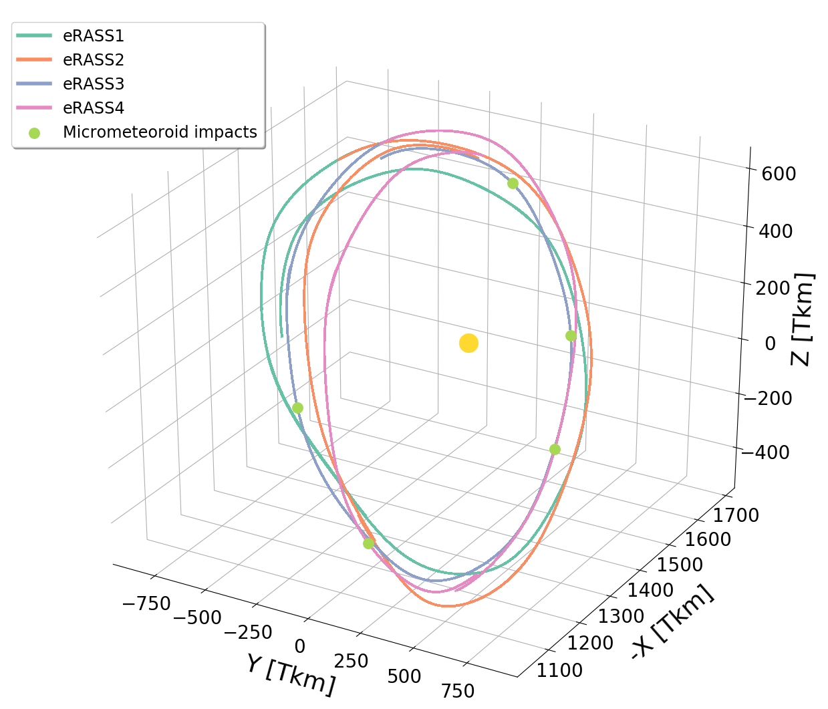
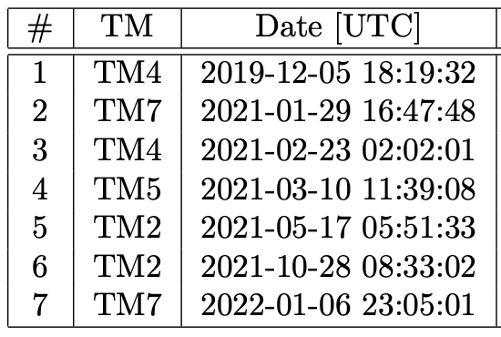
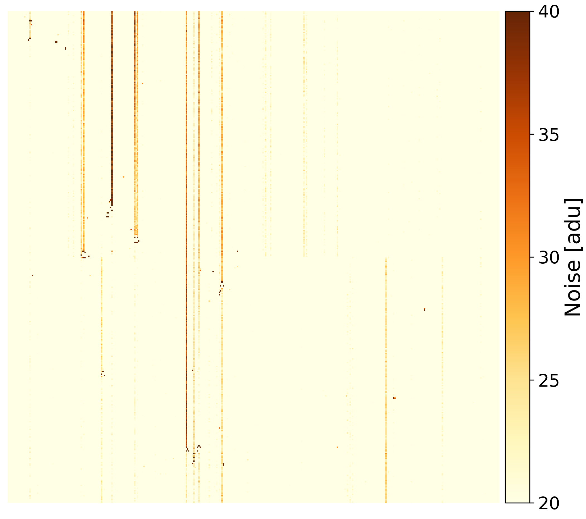
L2 enviromental effects
Micrometeoroid hits
  Mostly minor damage.
  TM4 hit > 6000 affected pixels.
Freyberg+2022
Coutinho, Ramos-Ceja+2022

Slide 13
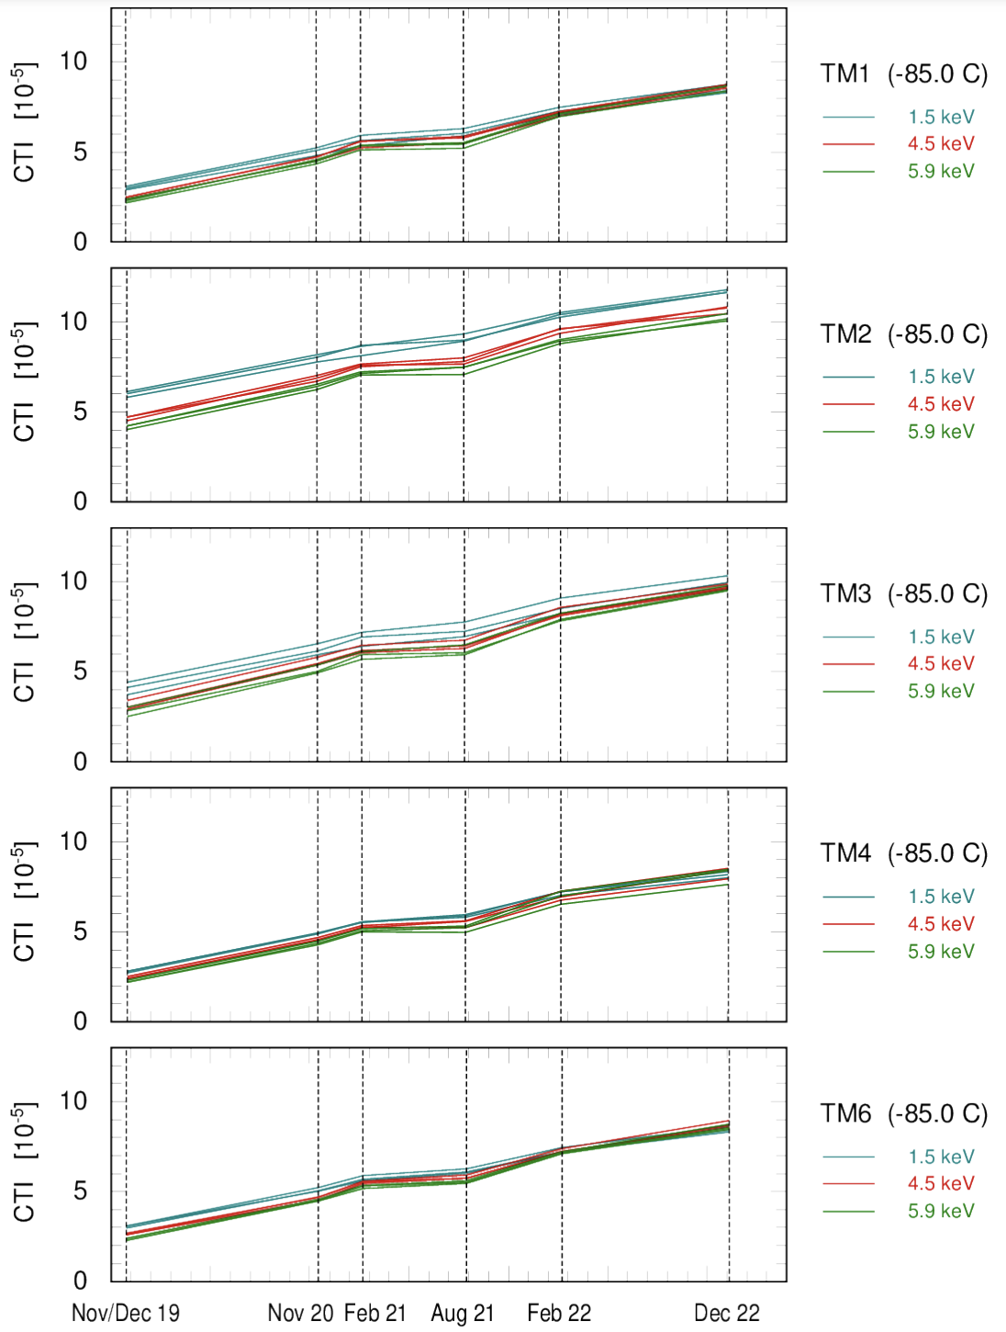
L2 enviromental effects
Camera radiation damage
  In-flight camera calibration measurements with the onboard Fe⁵⁵ source.
  CTI degradation as expected according to ground testing and analysis.
  Even after Safe mode I, the CTI follows the same trend as before:
    No unexpected degradation due to safe mode.
Coutinho, Ramos-Ceja+2022, K. Dennerl 2023

Slide 14
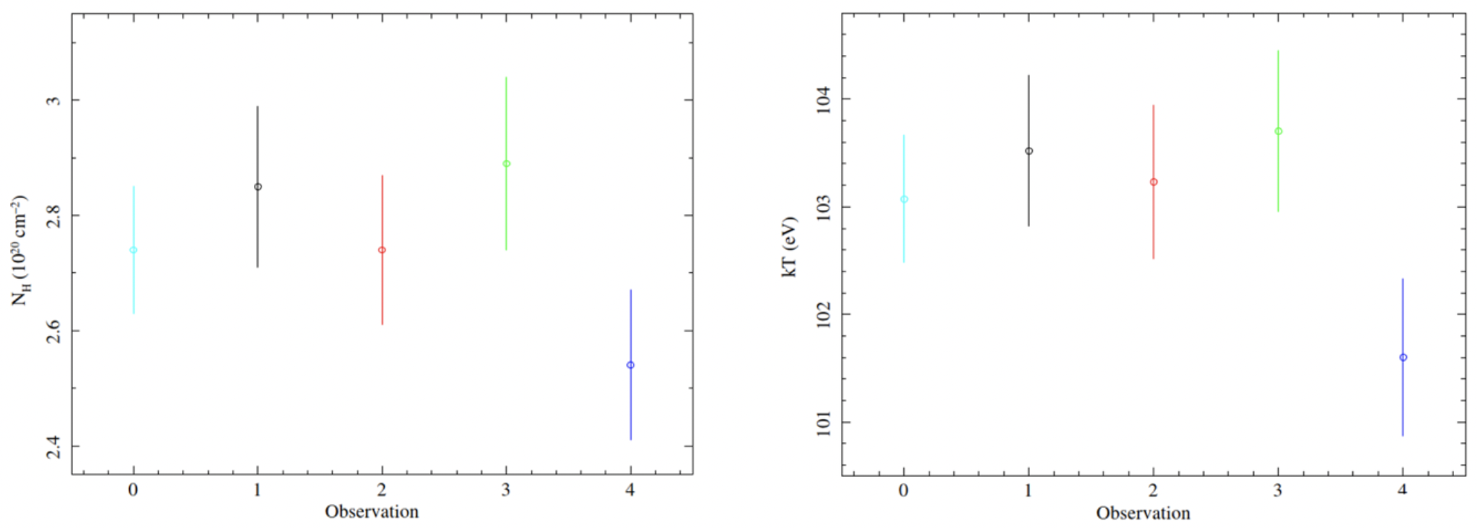
L2 enviromental effects
Mirror contamination monitoring
  After major orbit corrections, due to expelled propellant.
  Pointed observations after orbit corrections (isolated neutron stars).
  Spectral analysis show no significant change in the spectra of the calibration sources below 500 eV.
1RXS J214303.7+065419
Coutinho, Ramos-Ceja+2022

Slide 15
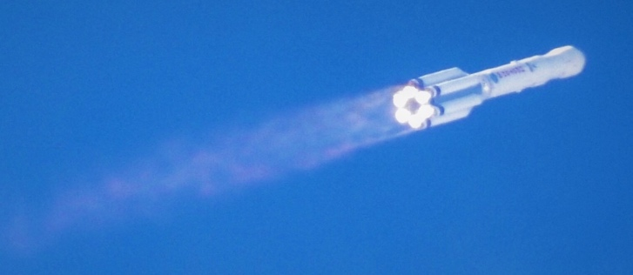
eROSITA programmatics
Cal-PV:
Calibration and
Performance Verification
26.2.2022
eROSITA in safe mode
eRASS8
All-sky survey
eRASS1
eRASS3
eRASS2
eRASS4
eRASS5
eRASS6
eRASS7
2.5-years pointed observations
GTO/GO phase
2019
2020
2021
2022
2023
2024
2025
2026
Launch
July 1st 2021: EDR
Cal-PV data
and associated papers
DR1
eRASS1
Q3 2023
DR2
eRASS:3
Q4 2024
TBC
DR3
All-sky survey
Q1 2026
TBC
Early Data Release (EDR) in 2021: several fields, including eFEDS mini-survey
Ongoing preparation for Data Release 1 (DR1) in Fall 2023 – eRASS1.

Slide 16
Summary
eROSITA has successfully completed 50% of its mission.
  With an observation efficiency of over 90%.
All eROSITA systems are fully operational.
  Despite the inactivity of the cameras and filter wheels during safe mode, a technical exercise allowed us to confirm health of the instrument.
The evolution of the camera's transfer charge inefficiency in space follows the same trend as before eROSITA was put into safe mode.

Slide 17








www.mpe.mpg.de/eROSITA
Follow us on Twitter:
@eROSITA_SRG
YouTube:
eROSITA SRG
Thanks for your attention!
(Credit: DLR)

