Slide 1
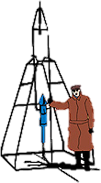
IACHEC Apr 2023
NICER Calibration Status Craig Markwardt (NASA/GSFC) on behalf of NICER Team
GSFC

Slide 2
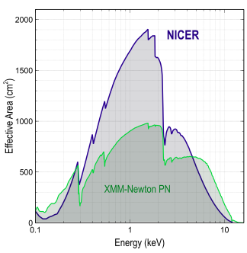
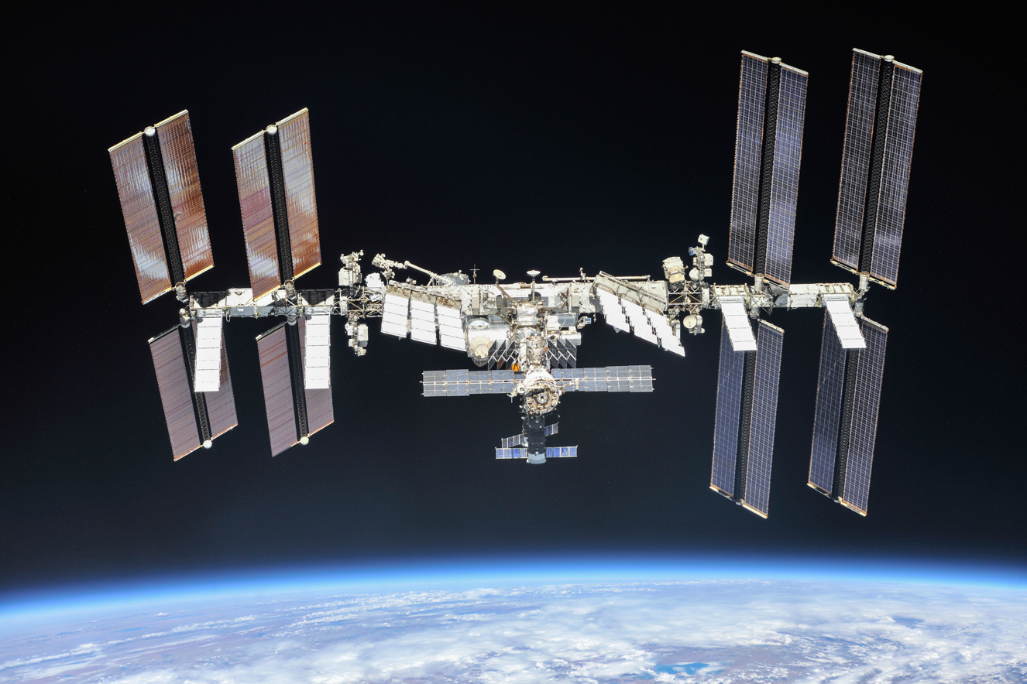
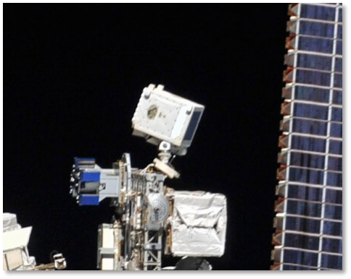
NICER’s Unique Capabilities
Launched June 2017 to International Space Station
Spectral band: 0.2–12 keV
52 operating single-pixel silicon detectors
Energy resolution: < 150 eV @ 6 keV
Comparable to X-ray CCDs
Timing resolution:
100 nsec RMS absolute
Non-imaging field of view
6 arcmin diam. (half-max)
High throughput (3.5 Crabs with no pileup)

Slide 3
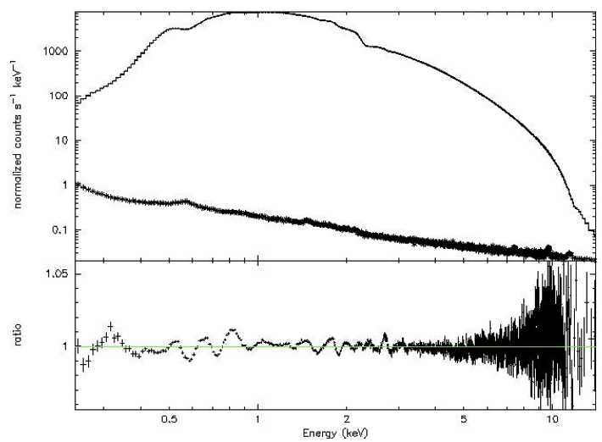
NICER Calibration Status
NICER calibration remains very stable
NICER energy scale
After calibrations, all event files have “PI” column with common energy scale
1 PI = 10 eV
Estimated error ~5-10 eV (0.25-10 keV)
NICER response
NICER calibrated against Crab nebula as a “smooth” continuum
Systematic errors <1.5% (0.4-10 keV)
Total effective area and slope comparable to Madsen et al. 2017 NuSTAR
NICER Crab

Slide 4
Overview of Recent Changes
Calibration updates
Jeremy Hare joins NICER team as calibration scientist
Multi-mission cross-calibration (3C 273)
Crab pulsed spectrum
Energy scale improved > 8 keV
ARF & RMF calculators customize to observation
Three background models publicly available
Overall streamlining and simplification of software and calibration and experience for NICER users

Slide 5
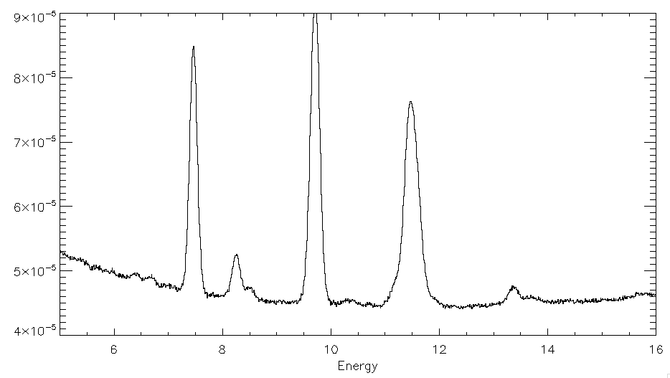
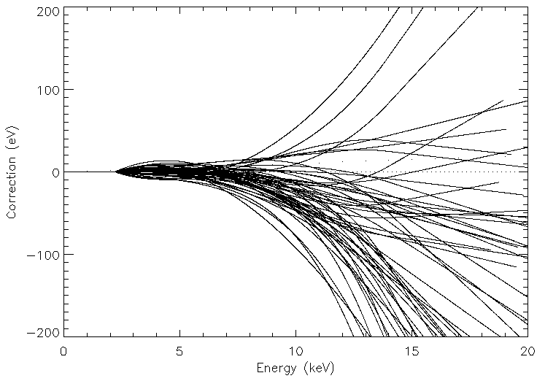
Energy Scale Improved > 8 keV
NICER SAA Spectrum (52 Detector Sum)
Use of lines detected during SAA passes
Au L & Ni K complexes
Si K & Al K at lower energies
“optmv13” solution
Shifts ~10 eV (2-7 keV); up to 300 eV at high energies
No correction (by construction) below 2.2 keV
Ni K⍺
Au L⍺
Au Lβ
Ni Kβ
Fe K
Au Lη
Au Lɣ
Au Lɣ
“Prime Science” Band
52 Detectors
Shift
Energy (keV)

Slide 6
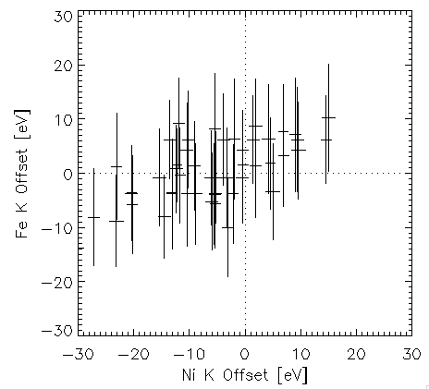
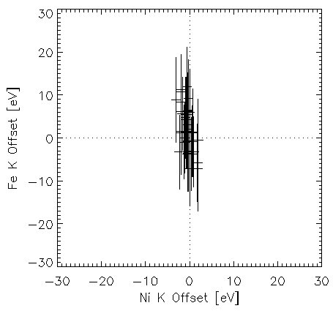
Post-optmv13 Improvements
OLD
optmv12
NEW
optmv13
Fe K Offset (6.4 keV)
Ni K Offset (7.5 keV)
Ni K Offset (7.5 keV)
Old Gain: Fe K (σ = 5.41 eV); Ni K (σ = 11.00 eV)
New Gain: Fe K (σ = 4.65 eV); Ni K (σ = 0.98 eV)
RMS improvements: Fe K (2.75 eV); Ni K (10.95 eV)
Fe K is near statistical limit

Slide 7
Response Calculators
Before July 2020, responses were pre-calculated and not adjustable
After July 2020 both ARF and RMF calculator tools are provided which are adjustable based on
Off-axis position of target (ARF vignetting & scattering)
Target surface brightness profile (point-like, gaussian, flat sky, user-provided profile)
Dark current / noise which affects RMF resolution

Slide 8
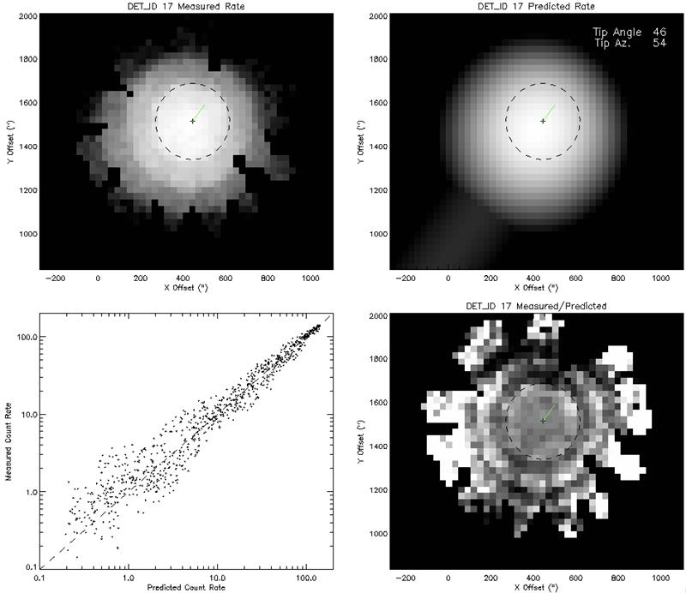
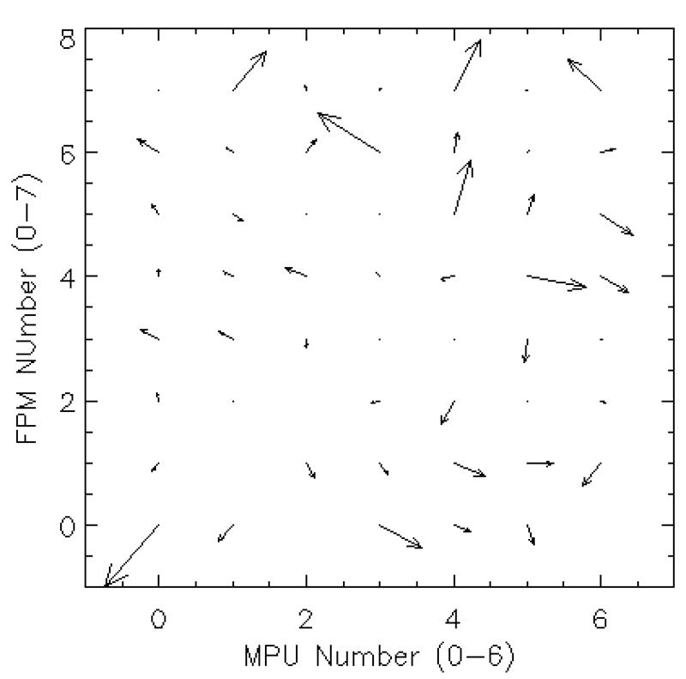
Off-Axis ARF Calculator
Full raytrace of grid of off-axis angles
Fitted to Crab raster scans
Estimation of boresight and tip-tilt of each of 52 optics
Calculator tool to apply these effects
Example Tip/Tilt Fit
Estimated Tip/Tilt

Slide 9
New: Background Models
Background models are now included in NICERDAS
SCORPEON (New)
3C50
Space Weather

Slide 10
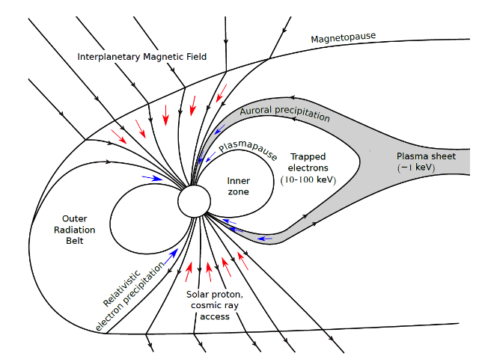
SCORPEON Background Modeling
SCORPEON Model
Major goals
Break down background into physically-motivated components
Assume simple spectral shapes
Use HK to estimate norms
Model is adjustable in XSPEC
Thorne et al 1980 Tyssoy presentation

Slide 11
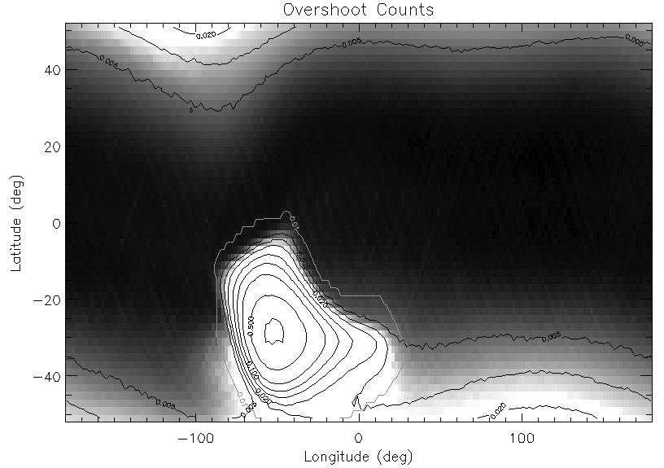
Geographic Overview of Dominant NICER Background Contributors
Trapped Electrons
(TREL)
Cosmic Rays (COR)
SAA
Precipitating Electrons (PREL)

Slide 12
SCORPEON Background Components
CON
Const: CXB, Sky, Noise
SAA Trapped Protons
COR Cosmic Ray
Hadron-Dominated
TREL
Trapped Electrons
PREL Precipitating Electrons
LEEL Low-Energy Electrons
Electron-Dominated

Slide 13
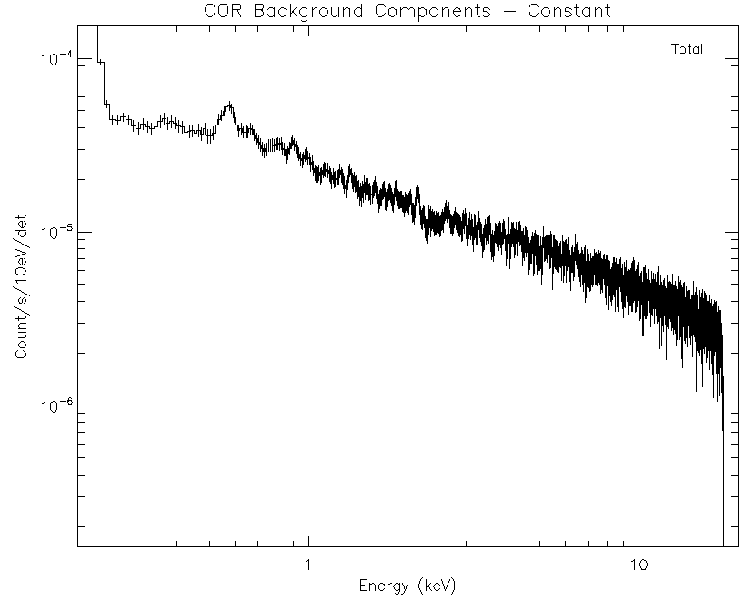
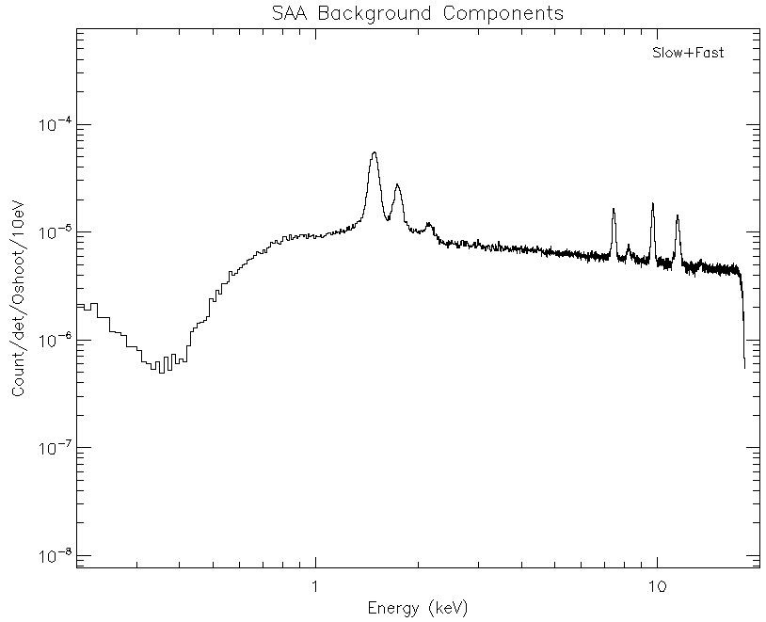
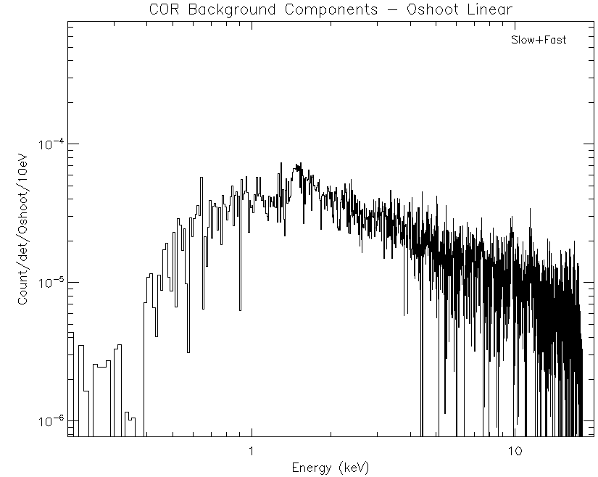
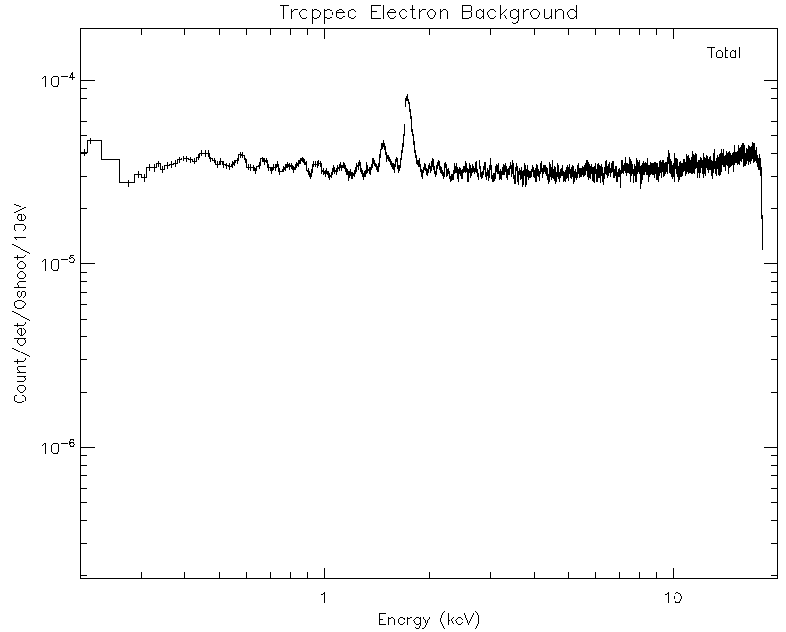
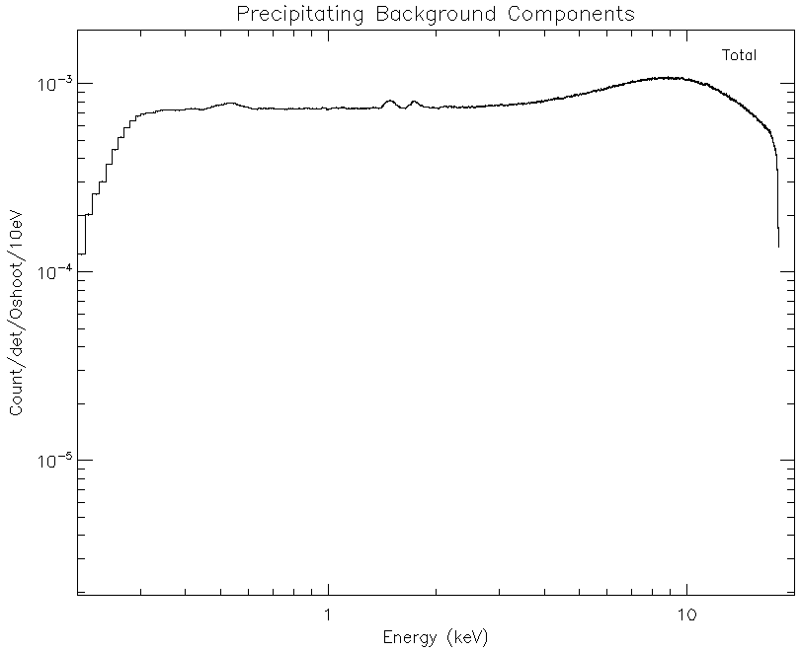
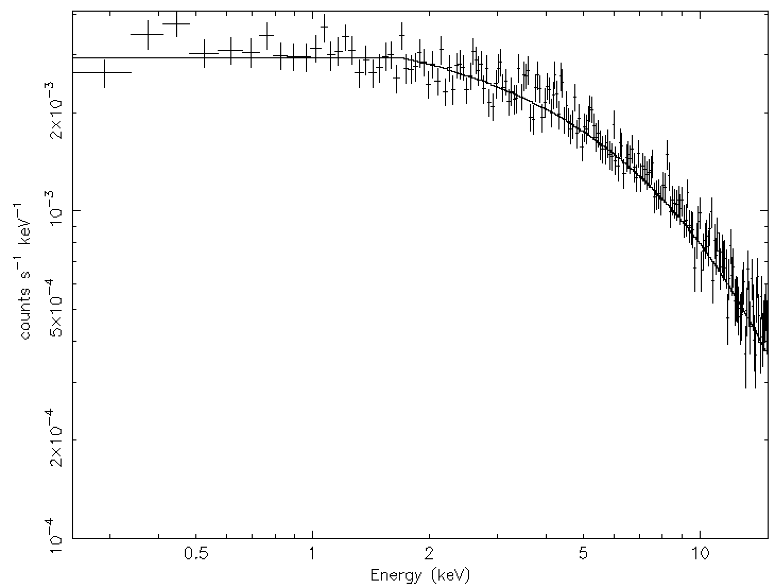
SCORPEON Background Components
CON Constant NXB, Sky
SAA Trapped Protons
COR Cosmic Ray
Hadron-Dominated
TREL
Trapped Electrons
PREL Precipitating Electrons
LEEL Low-Energy Electrons
Electron-Dominated

Slide 14
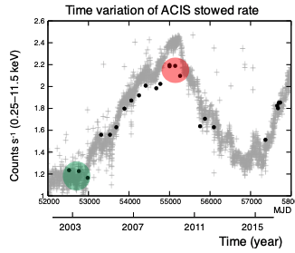
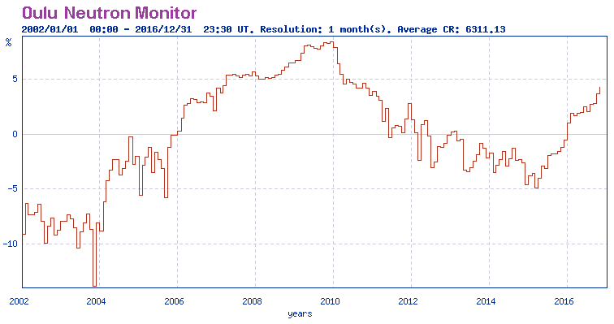
Cosmic Ray Modulations
COR (Cosmic Ray) component depends on geomagnetic cutoff, but also solar modulation
“SOLAR_PHI”
NICER SCORPEON is using Oulu neutron observatory data to estimate SOLAR_PHI, and apply to background estimate
Chandra ACIS Stowed Rate
Oulu Neutron Monitor

Slide 15
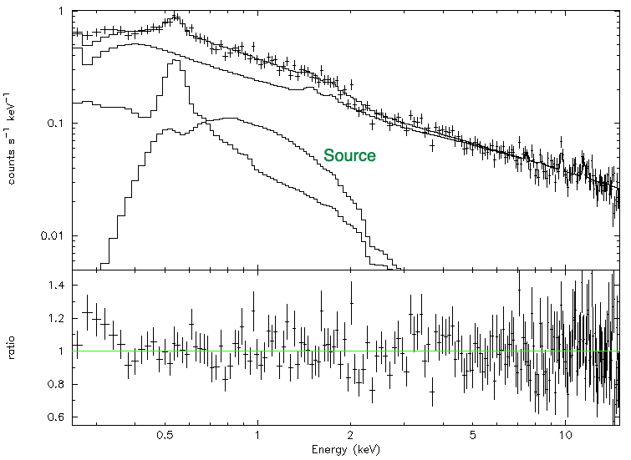
Faint Source with SCORPEON
Flux 1-sigma range is 0.87 – 1.15 x 10⁻¹³ erg/s/cm² (~5-6 sigma)

Slide 16
Summary
NICER calibration is stable
Jeremy Hare addition to the team
Still significant new developments / improvements to workflow

Slide 17
BACKUP SLIDES

Slide 18
Detector / Calibration Trending
Overall, the NICER calibration is extremely steady
Higher leakage currents experienced by some detectors lead to more dark current and noise, but these are calibrated
Electronic noise increasing at <0.1 eV/year!
Some small long-term energy scale drifts which team is monitoring (eV level)
Team has monitored soft sources for evidence of contamination build-up – none detected to date

Slide 19
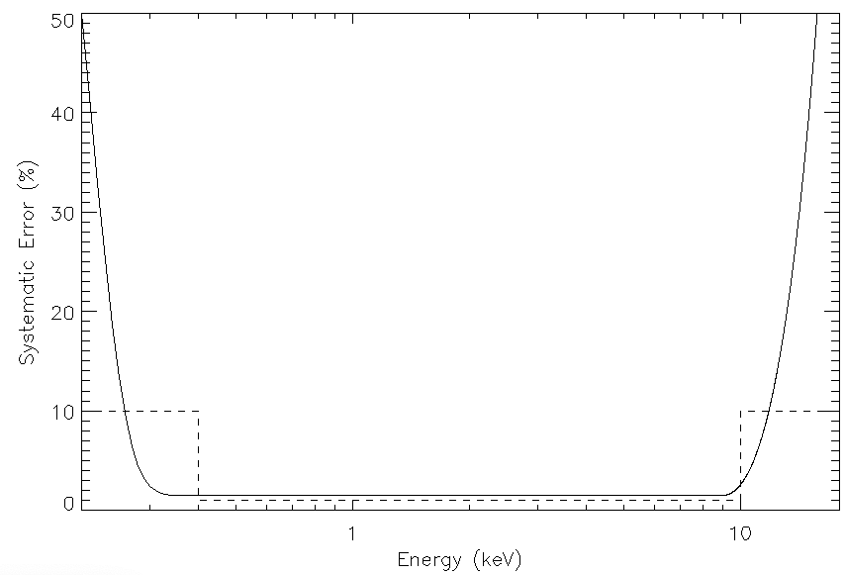
New: Systematic Error Vector
Uncertainty in threshold
Uncertainty in high energy response
Previous Release Guidance
New Release
Recommended systematic error vector
Applied automatically by new pipeline tools
Intended to de-weight high-statistics portions of spectrum

Slide 20
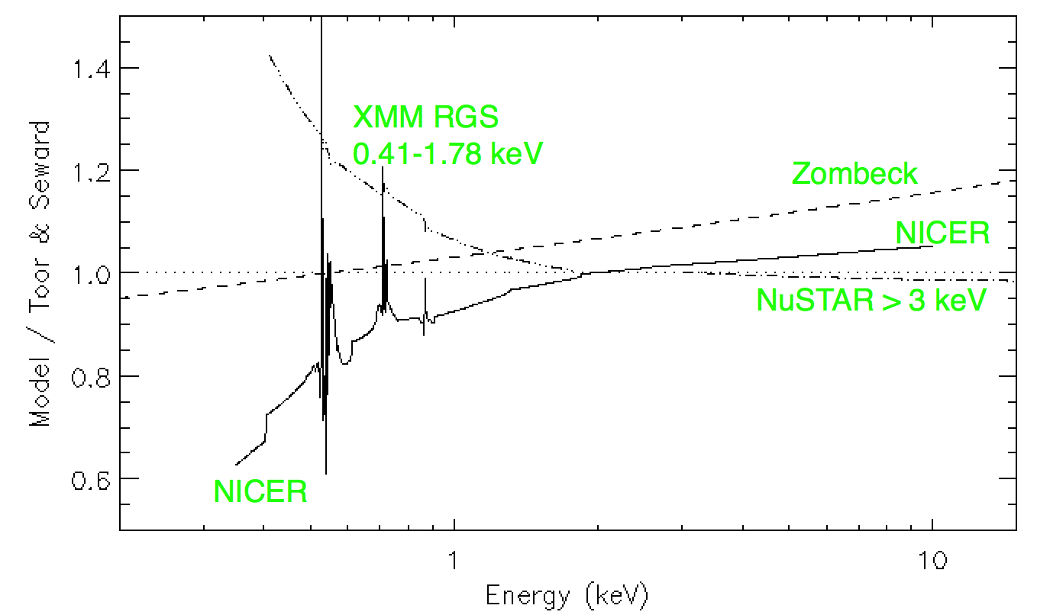
NICER To-Do: Spectral Mismatches
Absorbed Crab Spectrum
Basis of comparison is Toor & Seward (1978) result, extended to lower energies
NICER agrees with NuSTAR to with ~5% above 2 keV
Very significant differences between XMM RGS (Kaastra et al. 2009) and NICER
These are primarily driven by minor differences in absorption and dust scattering which led to large apparent differences in flux

Slide 21
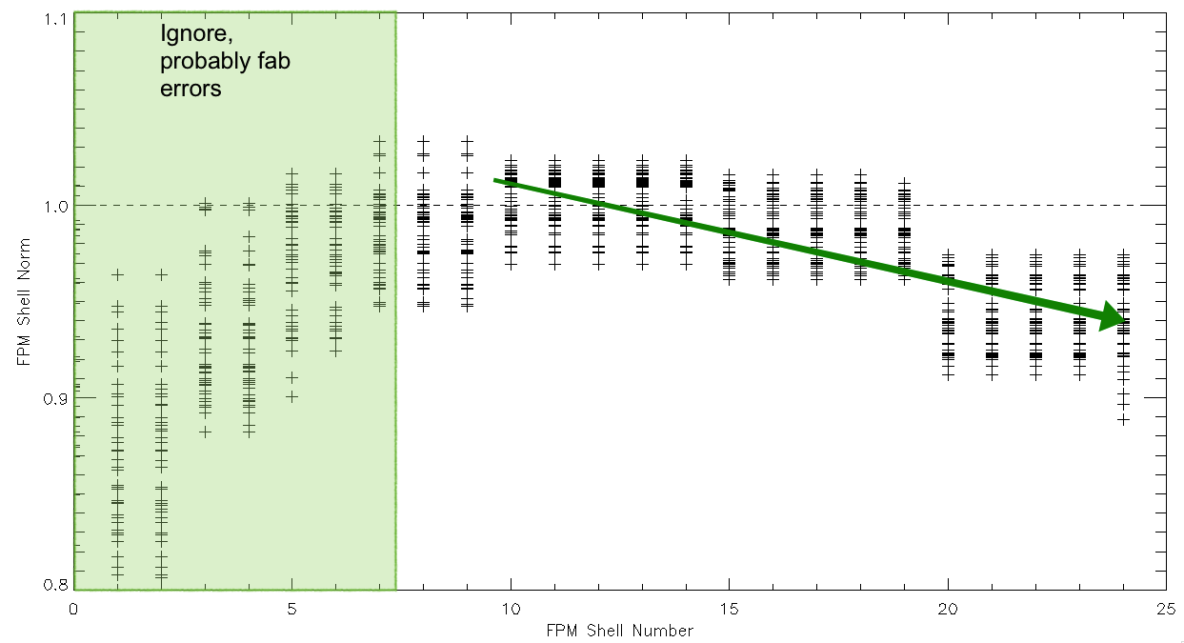
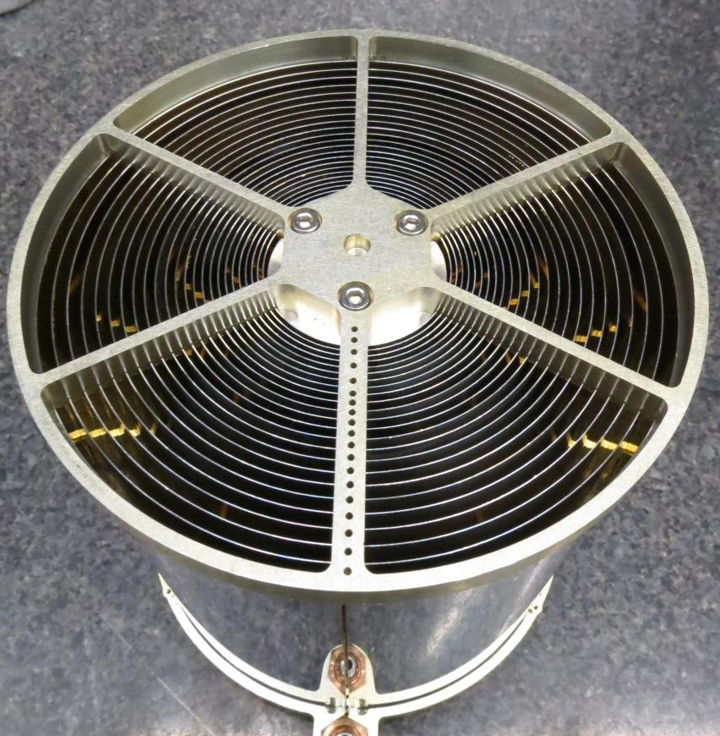
Possible Explanation in ARF Construction
Harder Energies
Softer Energies
Fitted / Geometric Area Ratio
Per-shell norms show unphysical trend, too high in middle shells, too low at outer shells
May be that Craig assumed the wrong “reference” spectrum for Crab in 2018
Shift in power law index of ~0.05 could resolve this

