Slide 1
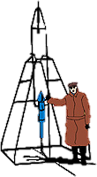
Working Groups
SCORPEON for Modeling NICER Background Craig Markwardt (NASA/GSFC) on behalf of NICER Team
GSFC

Slide 2
Summary Up Front
To some extent the background is predictable a priori
The power of SCORPEON is that the a priori norms can be adjusted by fitting to data while simultaneously fitting to your source data
Better fit
Better capture of covariance between background uncertainty and science model parameter uncertainty

Slide 3
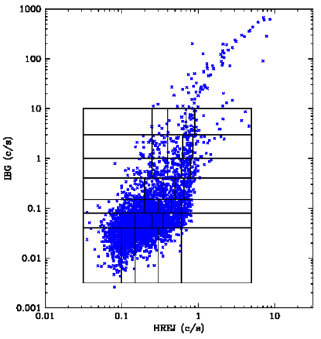
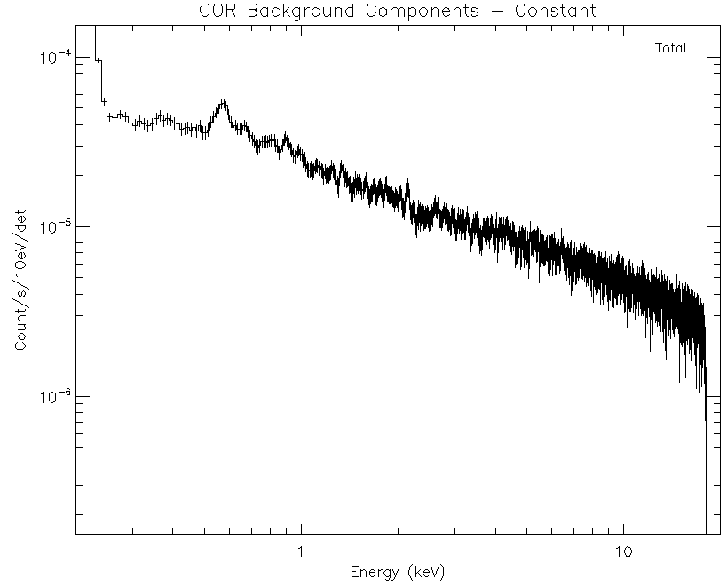
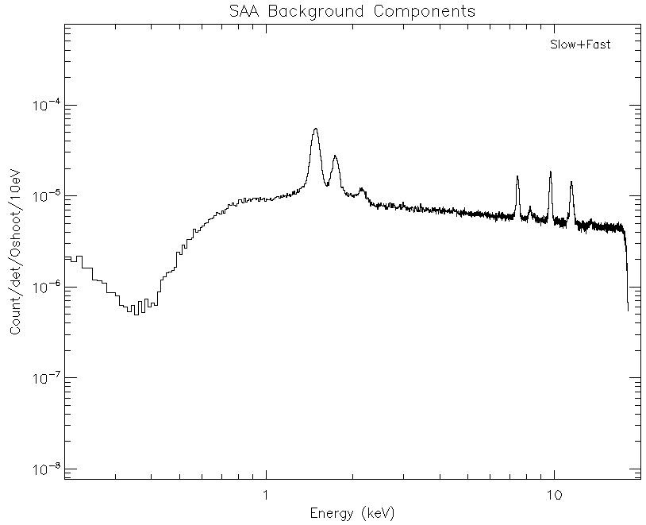
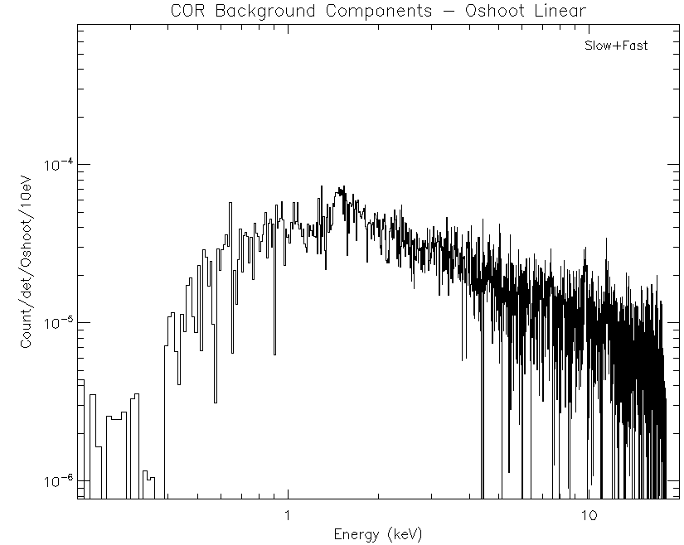
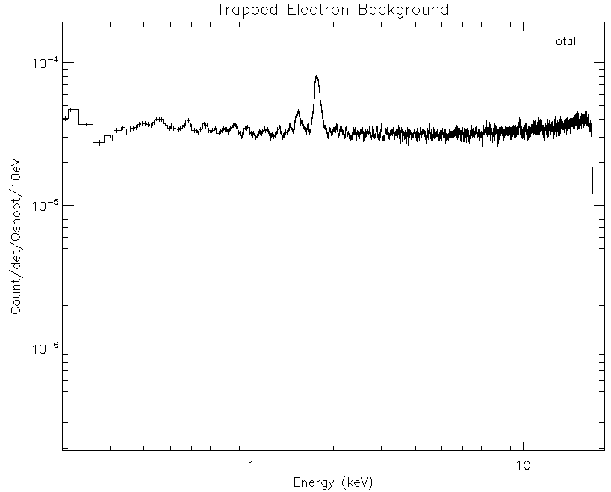
Library Models vs Template Models
Library Model: 3C50
Template Model: SCORPEON
IBG: 15-17 keV Events
HREJ: PI Ratio-Rejected Events
Measure ”basis vector” of each unique component
Make smoothed version of template as XSPEC model
Normalized based on known telemetry (overshoots, etc)
Application: predict norms from telemetry & load into XSPEC
Break parameter space into cells, measure background in each shell (library of spectra)
Application: calculate exposure in each shell, make weighted sum of library spectra

Slide 4
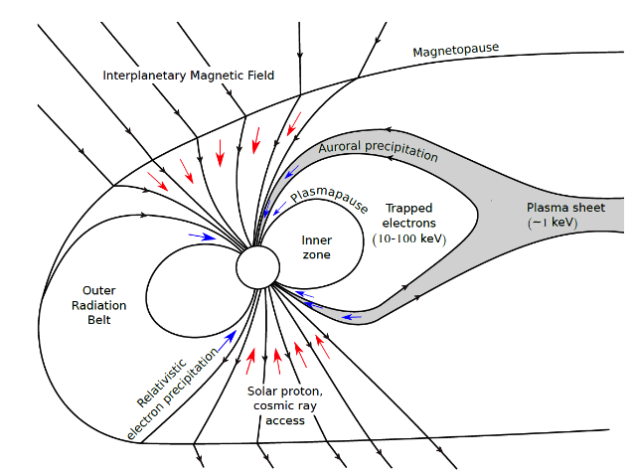
SCORPEON Background Modeling
SCORPEON Model
Major goals
Break down background into physically-motivated components
Assume that these components can be modeled with simple spectral models so they are easy to implement
Thorne et al 1980 Tyssoy presentation

Slide 5
SCORPEON Name
S COR PE O N
S = SAA
COR = COsmic-Ray (COR_SAX)
PE = Precipitating & trapped Electrons
Precipitating electron population (PREL)
Trapped electron population (TREL)
Low energy electrons (LEEL) – solar storms
O = cOnstant
Astrophysical: CXB + Halo + LHB + SWCX
Non-varying Non-X-ray background
N = Noise peak (not dealt with here)

Slide 6
SCORPEON Background Components
CON Constant NXB, Sky
SAA Trapped Protons
COR Cosmic Ray
Hadron-Dominated
TREL
Trapped Electrons
PREL Precipitating Electrons
LEEL Low-Energy Electrons
Electron-Dominated

Slide 7
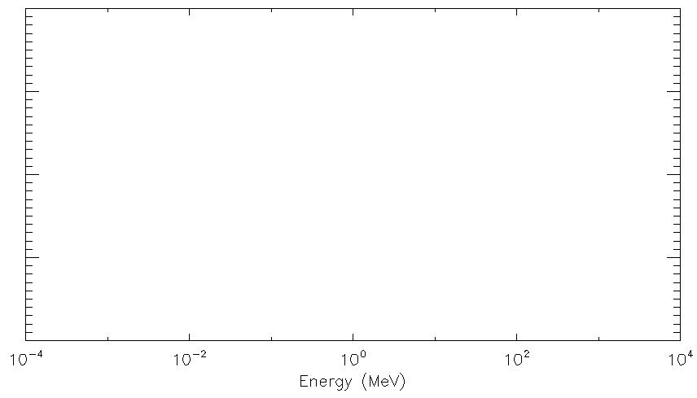
Energy Ranges of Components
NICER Band → Overshoots
Penetrate NICER Shielding → Trumpet-rejected (HREJ)
LEEL
PREL
Trapped Electrons (TREL)
SAA
Minimum Ionizing
Cosmic Rays (COR)
TLM
TLM

Slide 8
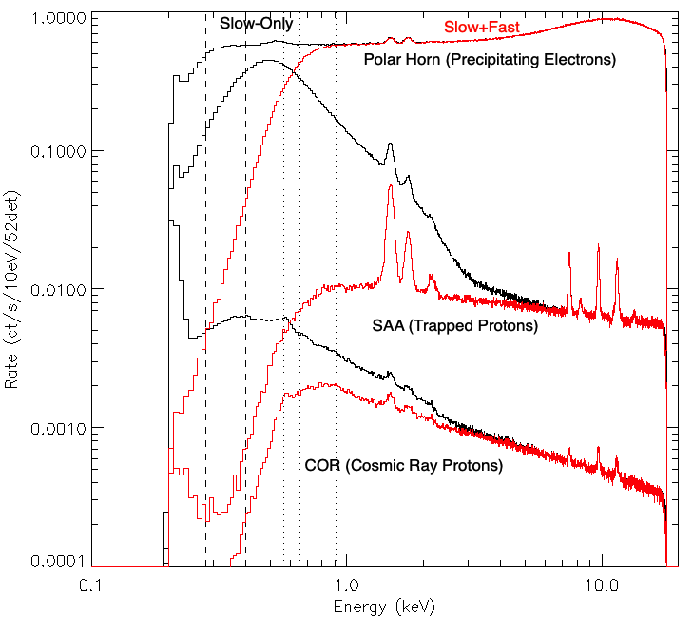
Early Work (Three Components)

Slide 9
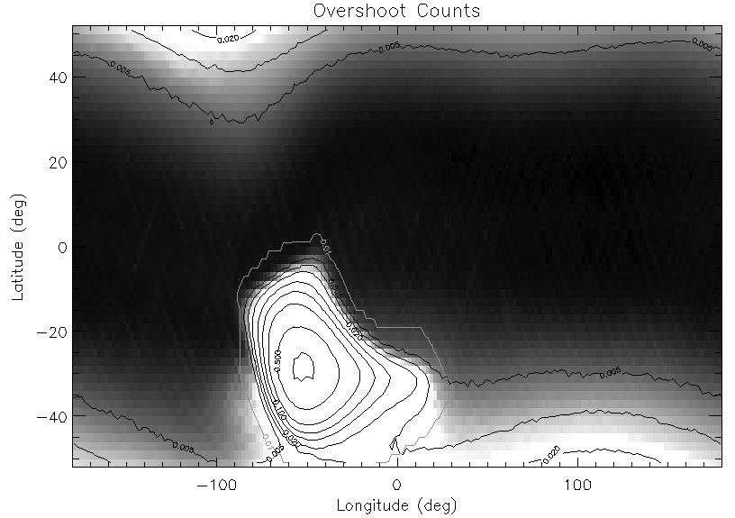
Geographic View of Overshoots
Cosmic Ray
SAA
“Polar Horns”
2017-2019 Overshoots

Slide 10
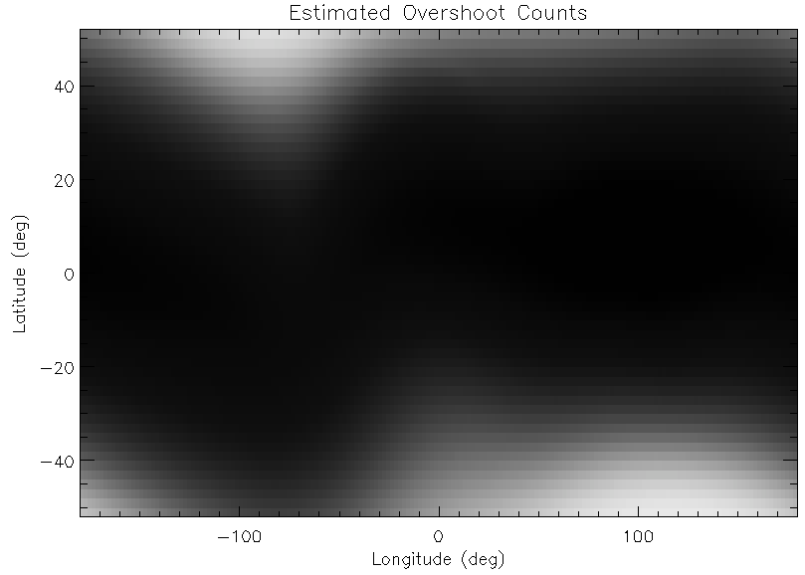
The Cosmic Ray Component is Predictable
Predictions based upon “COR_SAX” (Cutoff rigidity)

Slide 11
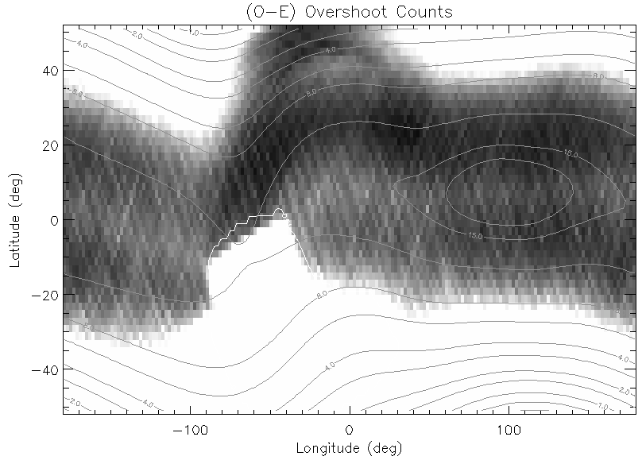
Residuals After Subtracting COR
Trapped Electrons
Cosmic Ray
SAA
Trapped Electrons
Contours: COR_SAX

Slide 12
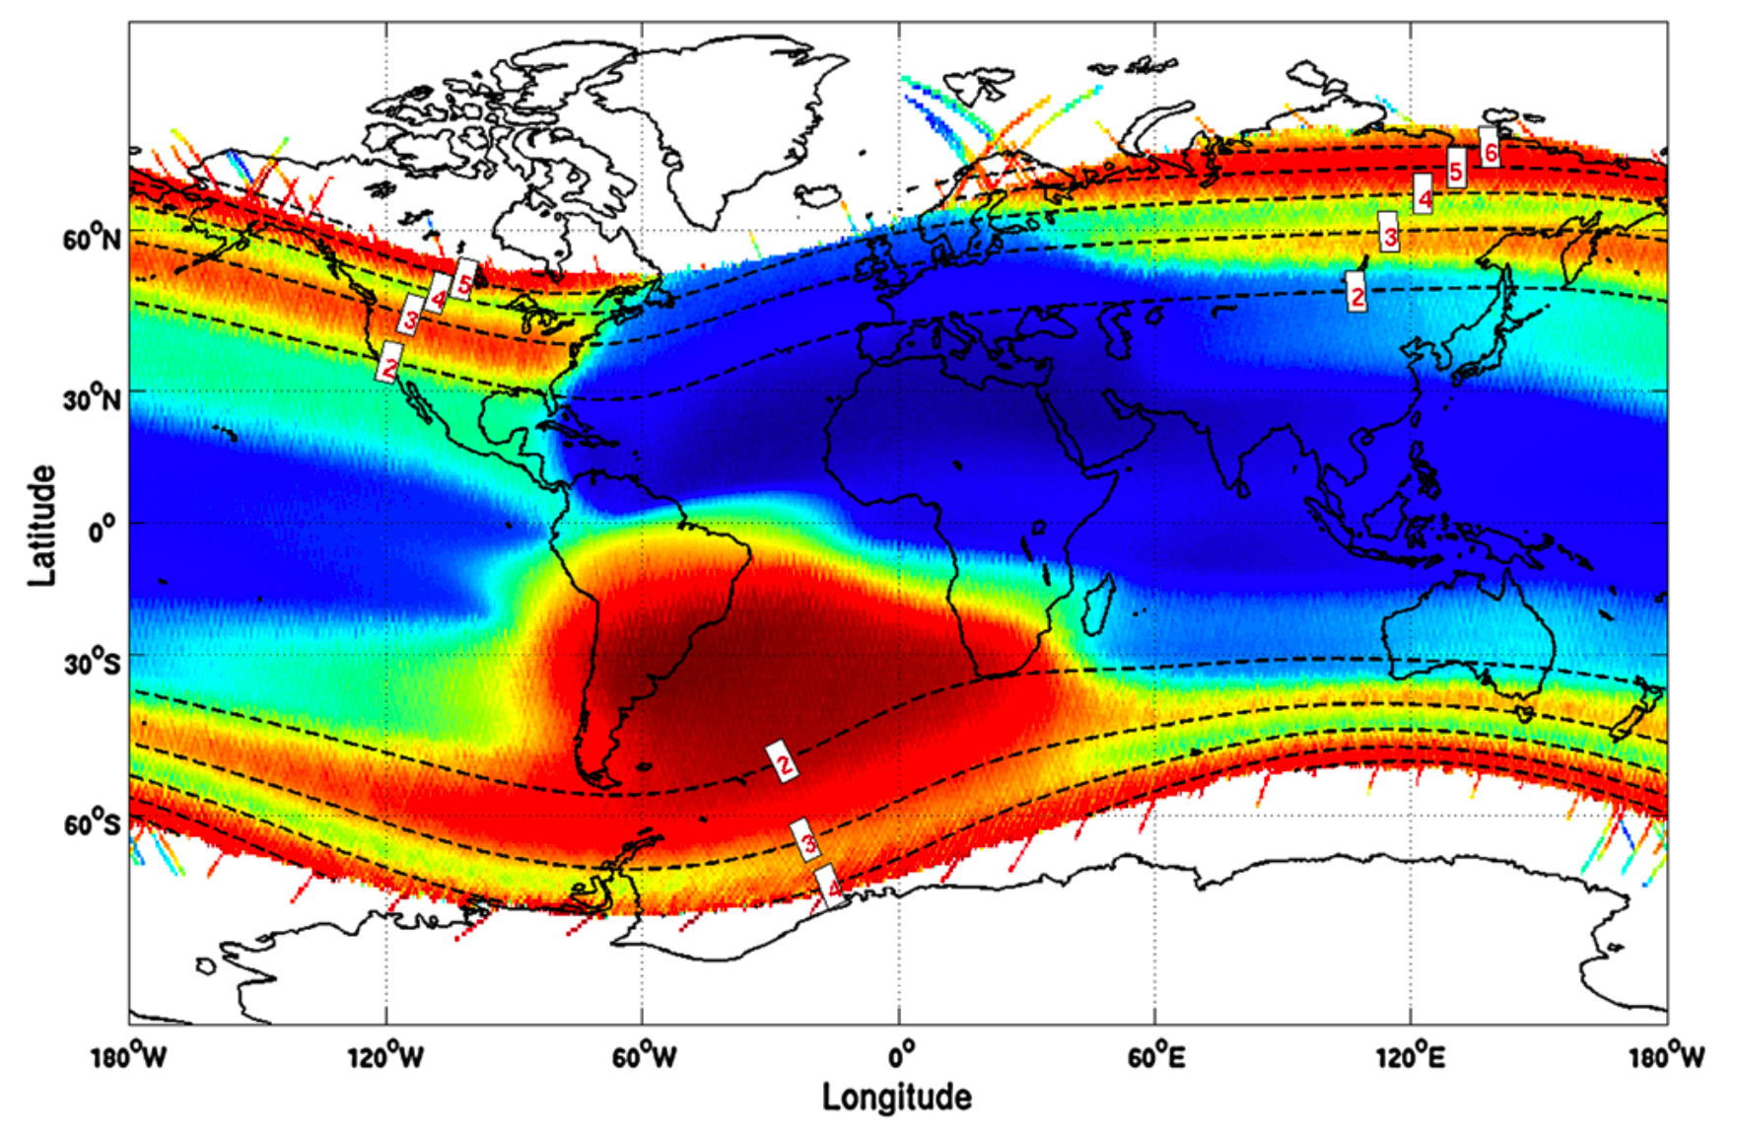
Trapped Electron Population
DEMETER IDP Instrument Electron Map, Whittaker et al 2013

Slide 13
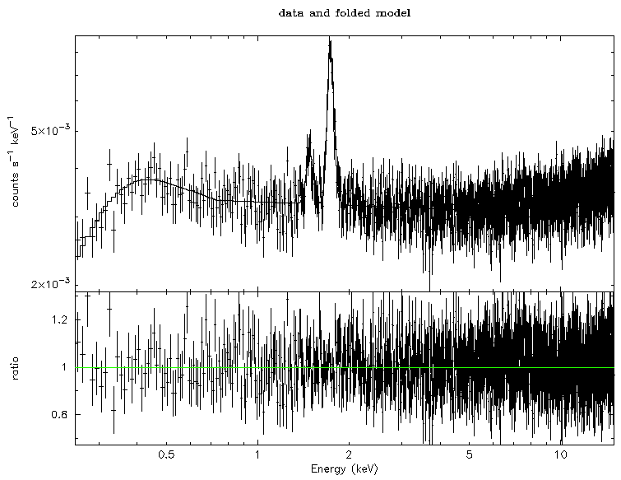
Example: Trapped Electron

Slide 14
Vision for SCORPEON Usage
SCORPEON design is that scientist could…
get a priori estimate of background parameters and fit in XSPEC to get refined background fit
Pretty good ✅
get a priori estimate of background parameters to generate fixed bkg.pha
About the same as 3C50 model 🤔
get a priori estimate of time-dependent background parameters to generate estimated background light curve
Needs work ❌ (June 2023)

Slide 15
SCORPEON is a Series of XSPEC Models
mdefine scorpeon (scorpeon_conv(0.0)*_con_corr + scorpeon_cor_sfv(_sigma,_alk_corr,_sik_corr,_aum_corr,_nik_corr,_aula_corr,_aulb_corr,_aulg_corr)*_cor_norm*1.0e5 + _cor_norm*1.0e5*_cor_so_corr*(scorpeon_cor_so1v(_b1fract) + scorpeon_cor_so2v(1.0-_b1fract)) + scorpeon_trelv(_sigma,_alk_corr,_sik_corr,_aula_corr,_aulb_corr,_aulg_corr)*_trel_norm*1.0e5)

Slide 16
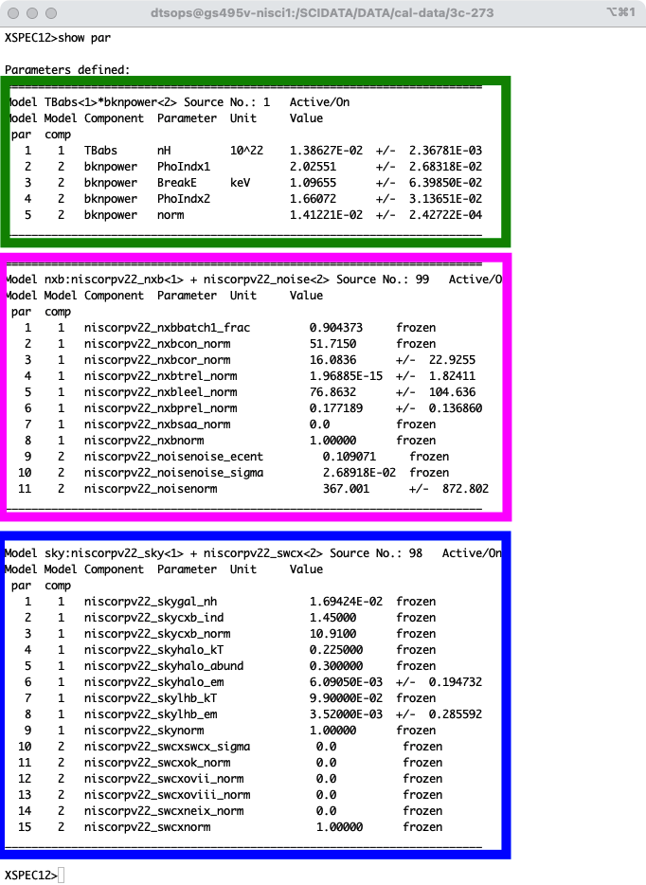
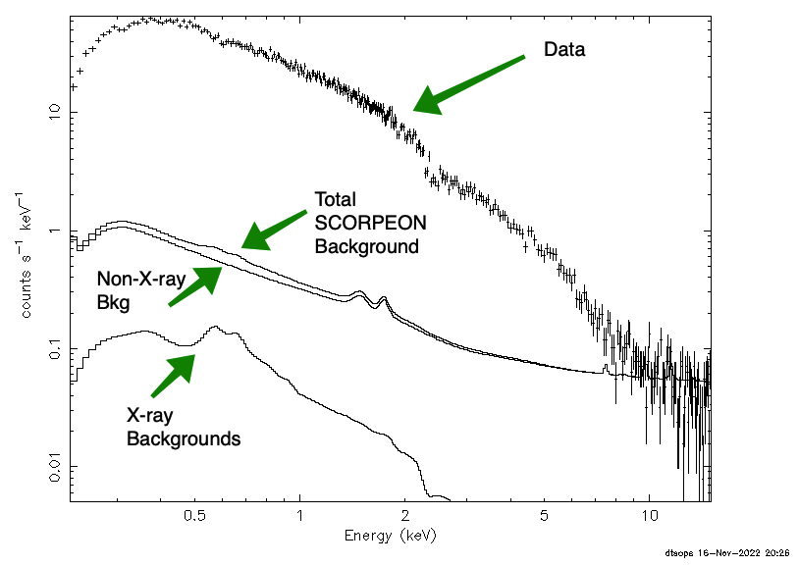
XSPEC Fitting Example

Slide 17
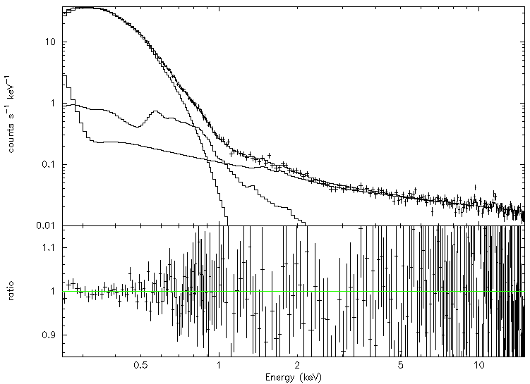
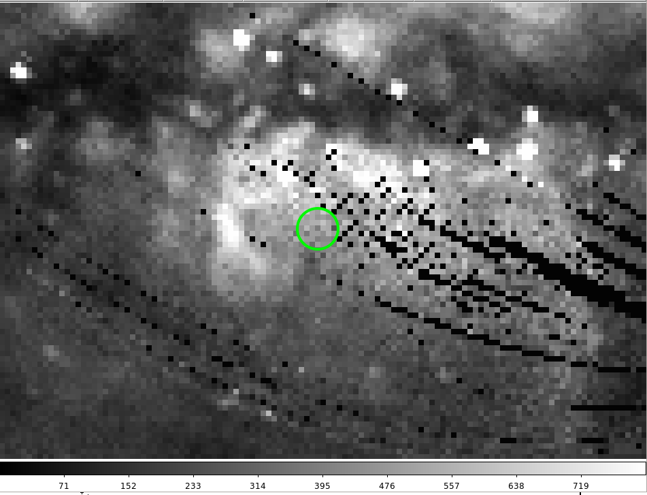
NICER Modeling of RX J1856
J1856
1BB Fit - NICER
nH = 11.9(1.3) x 10⁻¹⁹ cm⁻²
kT = 63.48(65) eV Norm = 0.89(7) x Chandra
J1856 Embedded in Bulge Diffuse Emission
Diffuse
NXB
ROSAT PSPC ¾ keV Survey
NICER consists of 52 non-imaging X-ray modules with nearly 2x effective area as EPIC-pn @ 1keV and ~3’ radius FOV
New analysis of existing J1856 data with in-development cal products
Includes 1BB for J1856 and Galactic Bulge, CXB, Local Hot Bubble, Galactic Halo, and other NXB components
NICER statistical error bars are ~1%
J1856 parameters are coupled with background parameters but are reasonable overall; no evidence of ~1 keV excess

Slide 18
BACKUP SLIDES

Slide 19
How Well Does SCORPEON Do?
I have 2017 through 2019 background data reduced
Estimate component norms a priori (pre-fit)
Fit norms in XSPEC (post-fit)
Compare pre-fit and post-fit results
There are over 800 data sets, so let’s look at a subset

Slide 20
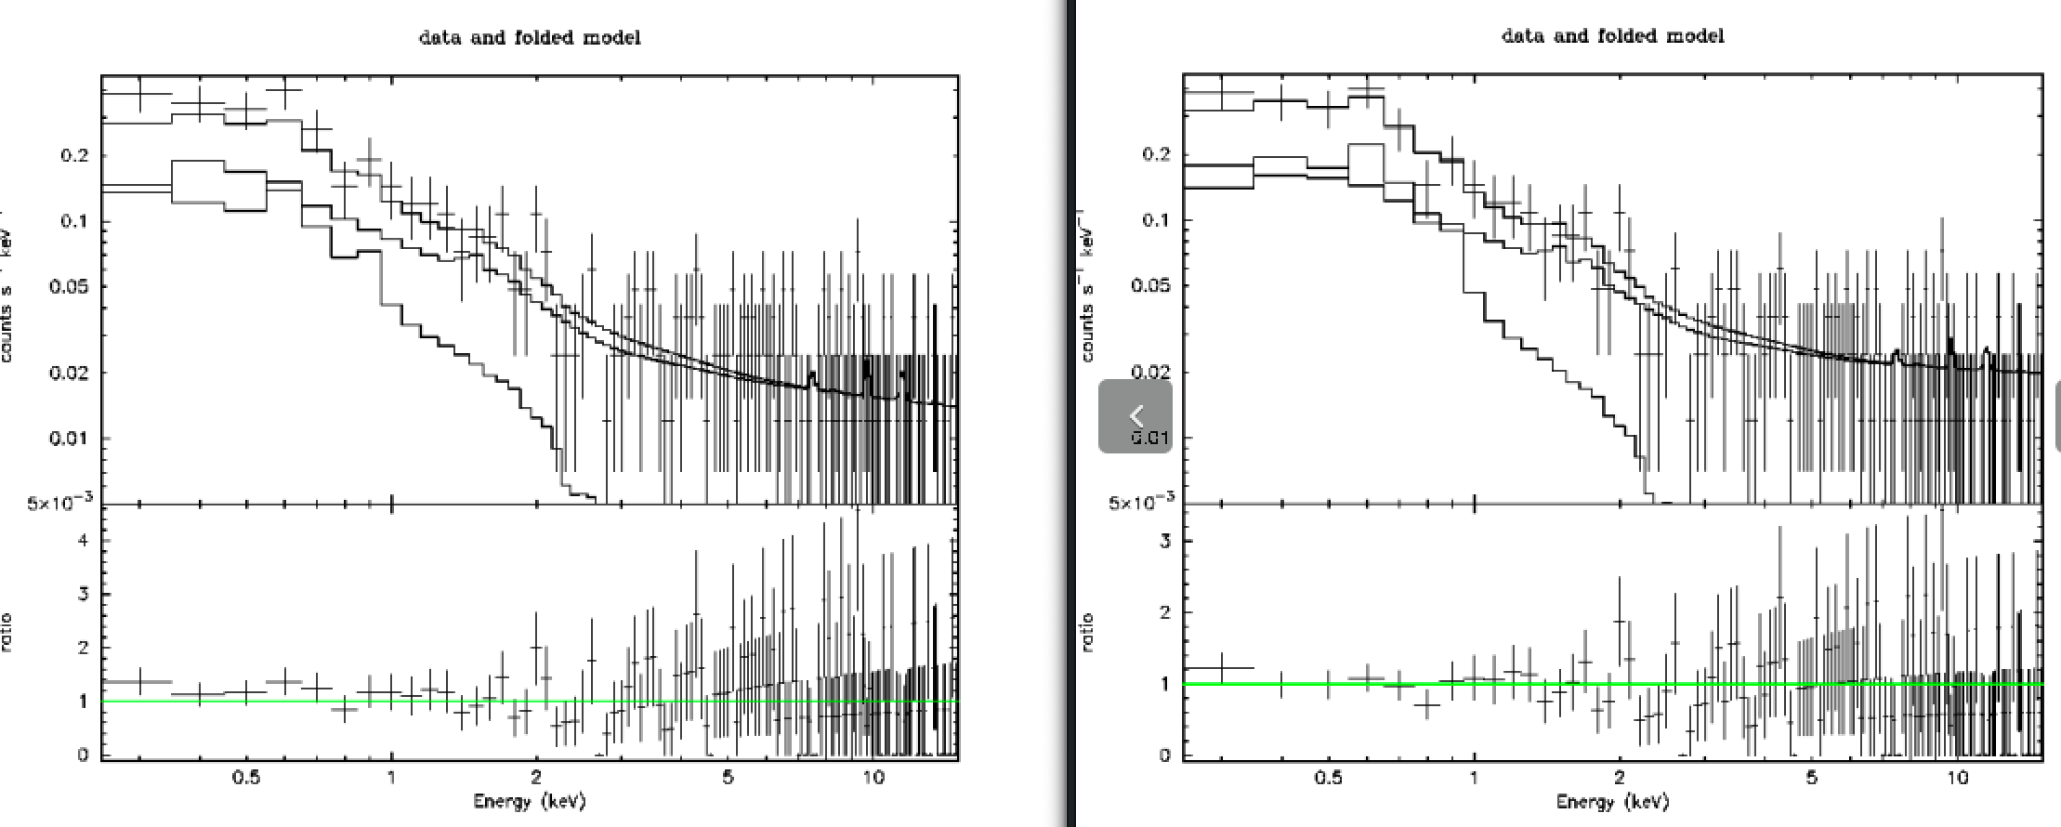
0012010103
A Priori (PRE-FIT)
POST-FIT
Prefit does a pretty good job (no LEEL)

Slide 21
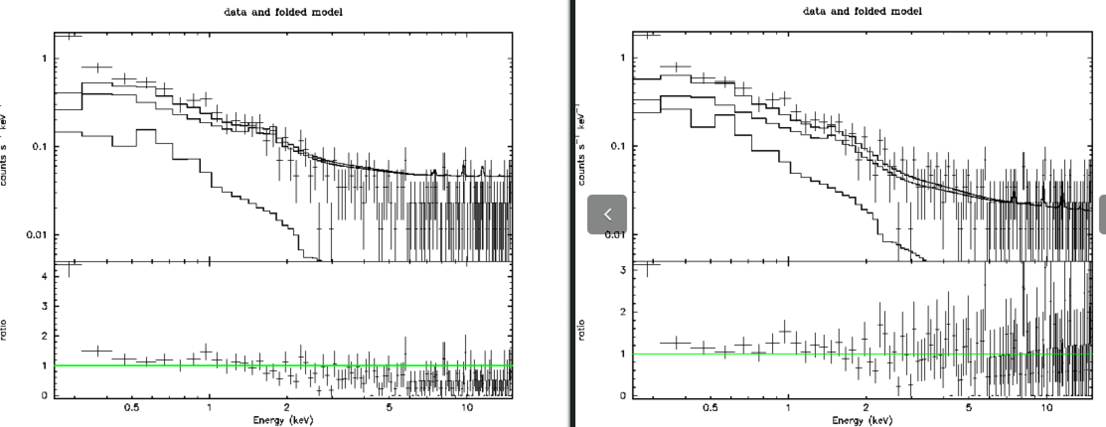
0012040102
A Priori (PRE-FIT)
POST-FIT
Prefit overestimates TREL

Slide 22
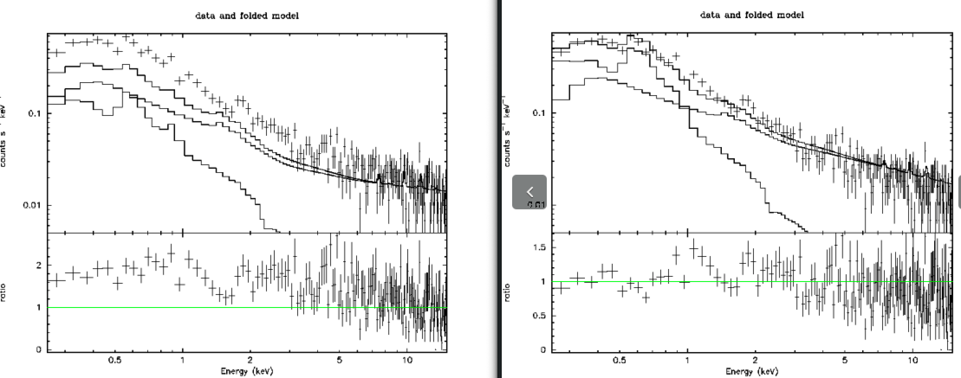
0012050102
A Priori (PRE-FIT)
POST-FIT
Background pointing #5 may have higher local hot bubble and halo emission

Slide 23
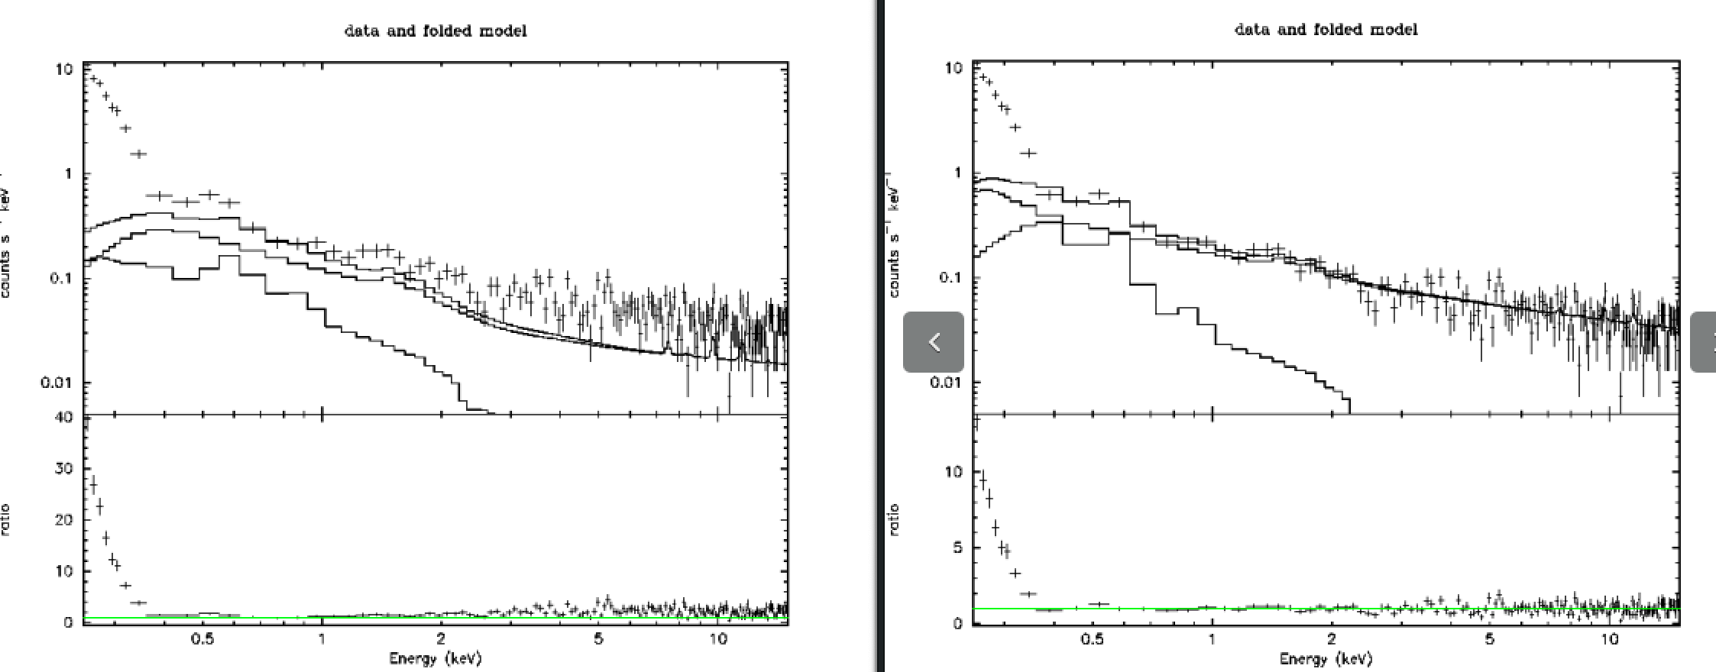
0012060103
A Priori (PRE-FIT)
POST-FIT
Prefit does OK but doesn’t get the tail right, low energy noise peak is very strong

Slide 24
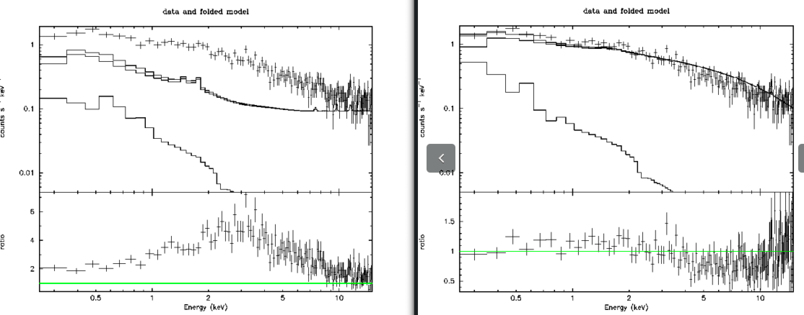
1012010193
A Priori (PRE-FIT)
POST-FIT
Prefit doesn’t know about LEEL so assigns it to TREL instead

Slide 25
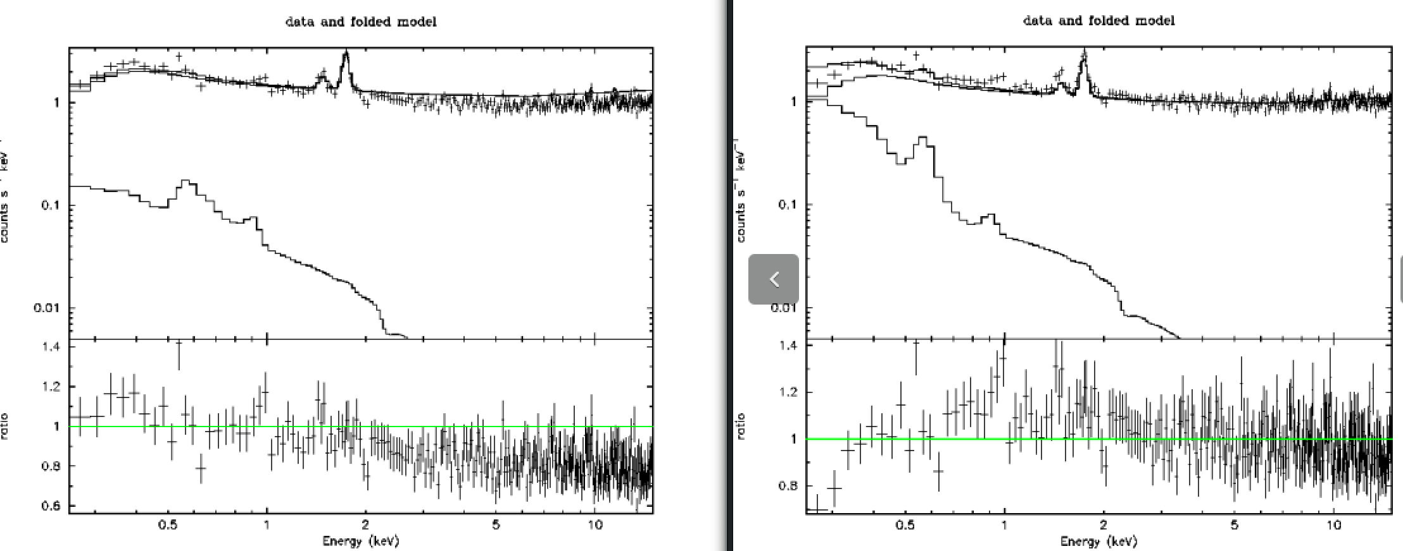
1012010112
A Priori (PRE-FIT)
POST-FIT
Prefit does pretty good! (strong TREL)

