Slide 1
NuSTAR Calibration Update
Kristin K. Madsen & Brian Grefenstette
And the NuSTAR SoC

Slide 2
Date | Description
2013-08-14 | Initial CALDB public release
2013-11-25 | ARF adjustment (-15% NuSTAR flux)
2014-01-17 | VIGN adjustment
2014-07-01 | Gain calibration improvement
2015-03-20 | Full mission Gain adjustment
2016-06-06 | Update gain, effective area, line of sight absorption
2019-12-13/19 | Update long term gain tracking
2020-05-06 | High resolution clock correction
2020-08-13 | Temperature-dependent ARF implemented
2021-02-23 | Observatory alignment update
2021-10-26 | Observatory calibration update based on 9-years of crab observations
2022-05-10 | FPMA DET2 long term gain adjustment

Slide 3
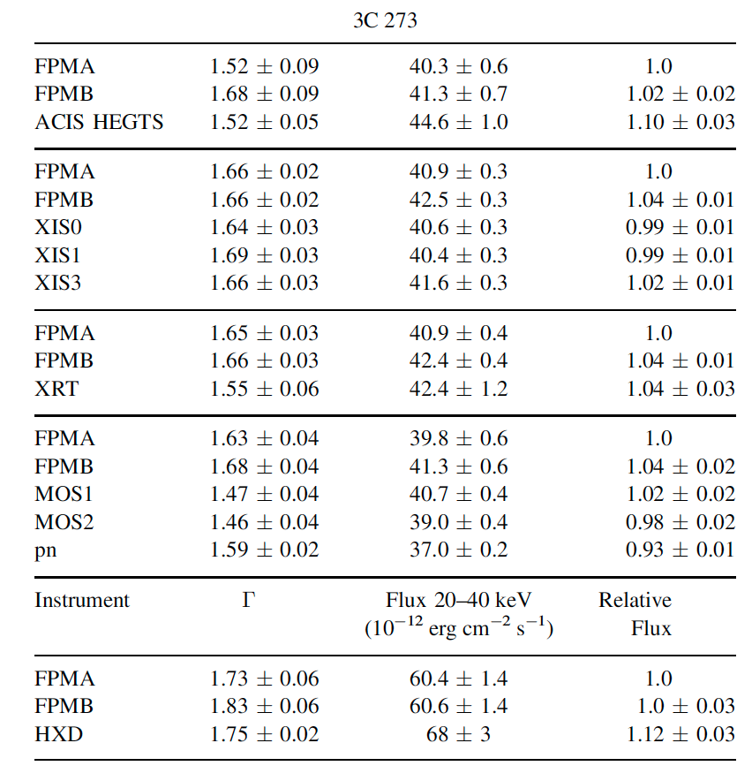
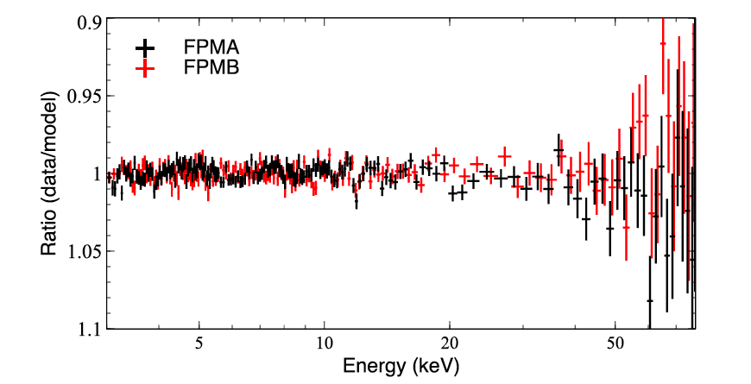
2012 In-flight Calibration
Implemented a 15% increase in effective area to decrease the flux
Focused Crab model:
Gamma = 2.1
N = 8.5

Slide 4
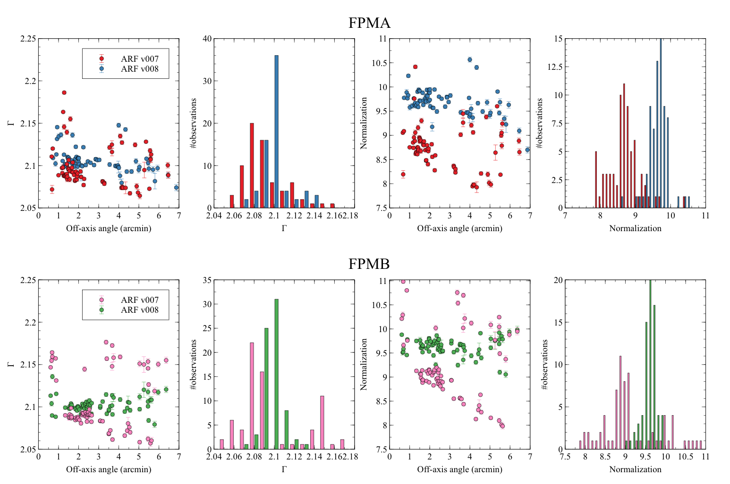
71 focused
Crab observations

Slide 5
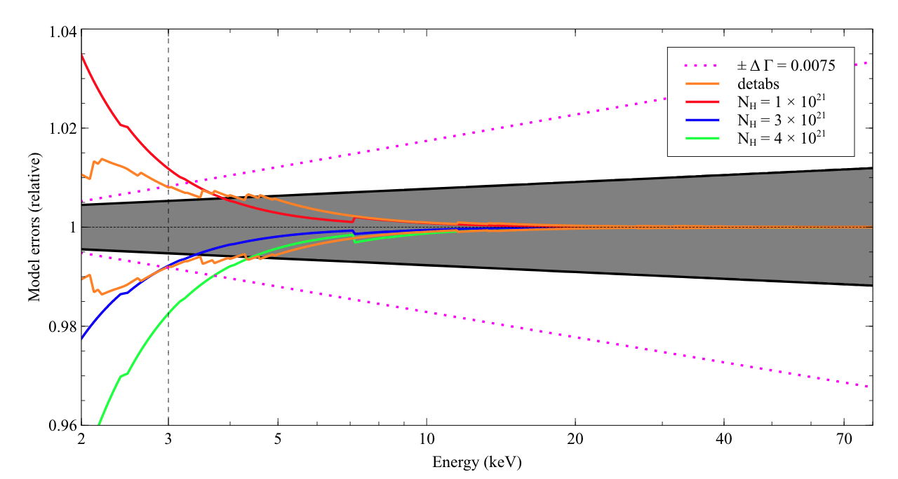
Relative model components

Slide 6
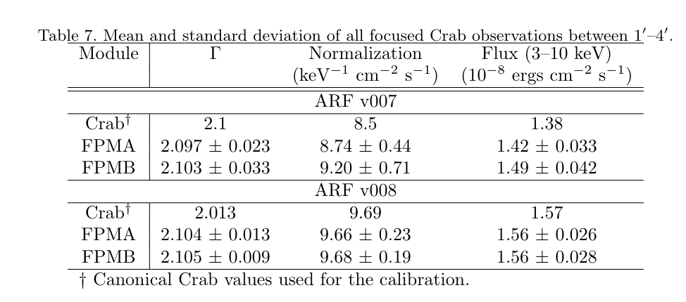
2021-10-26
2.13

