Slide 1
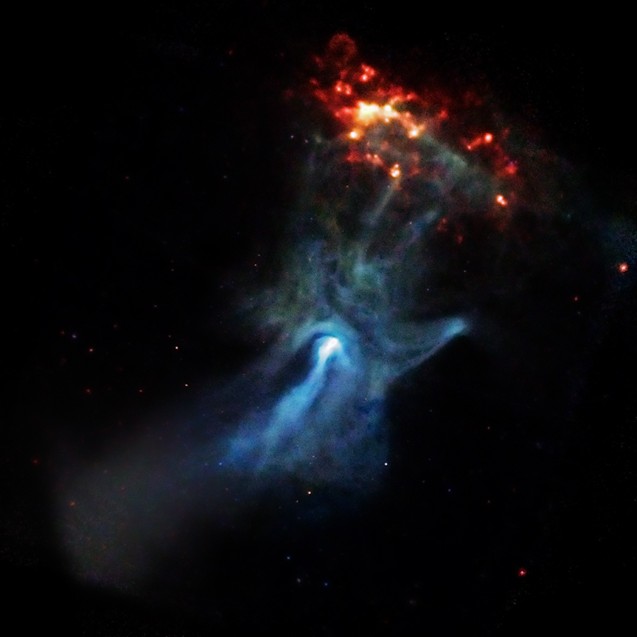
INTEGRAL/ISGRI Analysis of PSR B1509-58
James Rodi, Lorenzo Natalucci
INAF-IAPS Rome, Italy
15th IACHEC Workshop
Pelham, Germany 23-27 April, 2023
Image: https://chandra.harvard.edu/photo/2009/b1509/

Slide 2
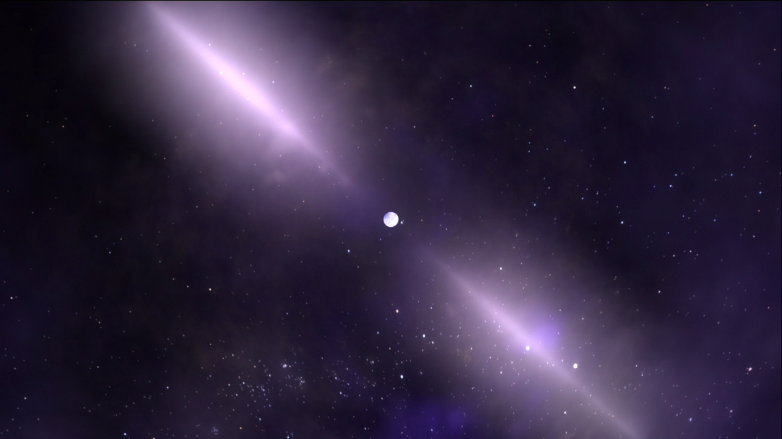
PSR B1509-58 Details
Young radio Pulsar
Period of ~150 ms
Detected from radio to TeV
Observed by instruments from X-ray to gamma-ray
RXTE, XMM, HXMT, NuSTAR, INTEGRAL,
Suzaku, and other missions
Potentially cross-calibration source for IACHEC
Credit:https://www.nasa.gov/feature/goddard/2017/nasa-continues-to-study-pulsars-50-years-after-their-chance-discovery

Slide 3
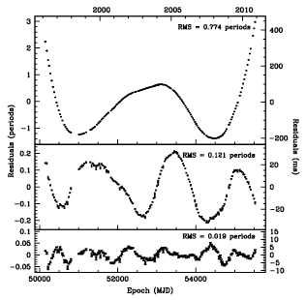
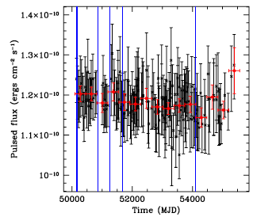
PSR B1509-58 Details
Difficult to use for timing analysis due to evolving period
RXTE timing analysis from Livingstone & Kaspi (2011) unable to describe timing behavior with 12 derivatives
But pulsed flux constant over time
~1.18 x 10⁻¹⁰ erg/cm²/s in 2-50 keV
Linear fit found Χ² =52.4 with dof = 150 so consistent with constant flux (Livingstone & Kaspi, 2011)

Slide 4
Initial INTEGRAL/ISGRI Analyses
INTEGRAL/ISGRI:
20-1000 keV range
61 microsec timing resolution
Forot et al (2006) ~ 1.3 Ms of ISGRI, but focused on unpulsed flux
ISGRI has ~13 Ms exp time
Early work with INTEGRAL/ISGRI using observations during MJD 53021-53086
Exp time of ~77 ks
30 phase bins (~5 ms)
Used ephemeris of Livingstone & Kaspi (2011)

Slide 5
Initial INTEGRAL/ISGRI Analyses
phase resolved spectra between OSA 10.2 and OSA 11
similar 𝚪, but different
Running unpulsed phases still
Chen show 𝚪 drops in pulse; increases unpulsed
Need to confirm trend
Chen et al (2016)

Slide 6
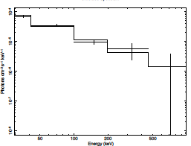
Initial INTEGRAL/ISGRI Analyses
Comparison of pulsed spectra OSA 10.2 and OSA 11
similar fluxes (~2.7 vs ~3.1)
𝚪’s sig different (1.3 vs 1.6)
Possibly due to new E calibration
Need to Double check phases in 10.2 analysis first
OSA 10.2
OSA 11
𝚪= 1.6 +/- 0.1
3-79 keV flux: ~3.1 x10⁻¹⁰ erg/cm²/s
𝚪= 1.3 +/- 0.1
3-79 keV flux: ~2.7 x 10⁻¹⁰ erg/cm²/s

Slide 7
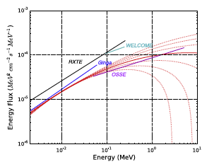
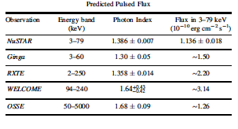
Comparison with Previous results
Compare with results in Chen et al (2016)
ISGRI similar to Welcome values
ISGRI
INTEGRAL/ISGRI 30-900 1.3 ± 0.1 ~2.7 OSA 10.2
INTEGRAL/ISGRI 30-900 1.6 ± 0.1 ~3.1 OSA 11
2-50 keV flux ~ 1.7 (ISGRI) vs 1.18 (RXTE)
Chen et al (2016)

Slide 8
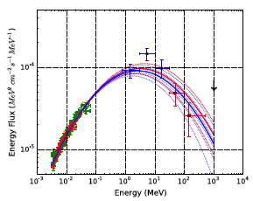
Future Work
Initial work using only ~77 ks / 13 Ms exp time
Finish current 6 band analysis and understand 10.2/12 differences
analyze all ISGRI data with OSA v11.2 at higher E res
Look at pulsed spectrum
Study spectral variability with phase
Compare with other instruments, e.g. NuSTAR (Chen
et al. (2016) in similar energy range
Expand results with broadband spectrum
ISGRI
Chen et al (2016)

