Slide 1
Towards an Absolute Flux Calibration of RXTE PCA
Craig Markwardt
RXTE / PCA Team

Slide 2
Overview
What is RXTE PCA?
Two absolute geometric area estimates
Application to Crab & Cas A
Flux offset of 5.6%
Crab as a flux transfer standard

Slide 3
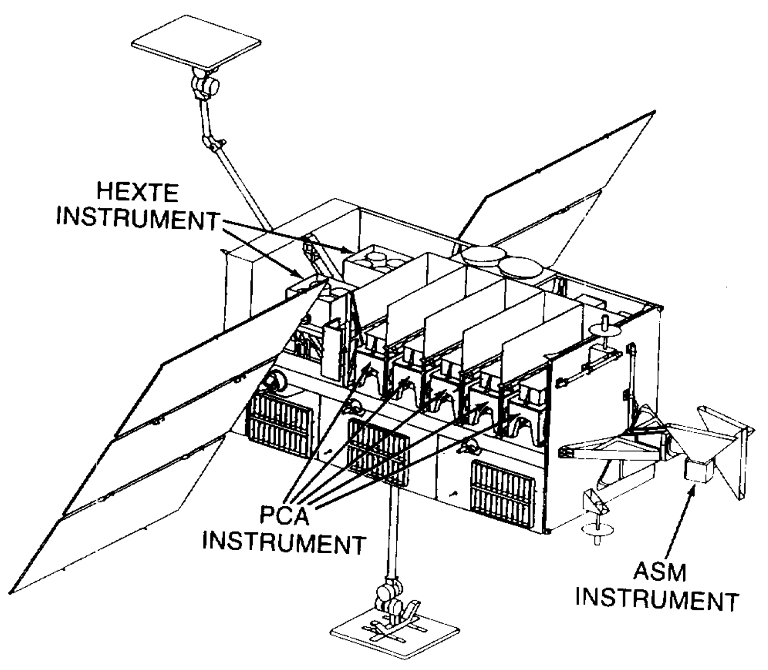
Rossi X-ray Timing Explorer
Launched December 1995
Terminated January 2012
All-Sky Monitor (ASM)
High-Energy X-ray Timing Experiment (HEXTE)
Proportional Counter Array (PCA)
5 “identical” collimated Xenon-filled proportional counter units (PCUs)
2-60 keV

Slide 4
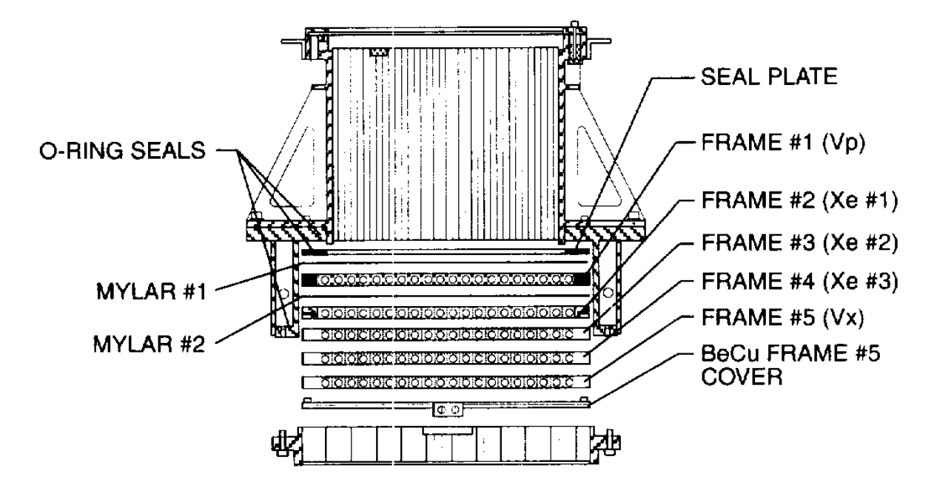
Proportional Counter Array (PCA)
Each unit is a collimated proportional counter
5 collimator modules
3-layer Xenon active volume
Propane and side Xenon veto layers
COLLIMATOR

Slide 5
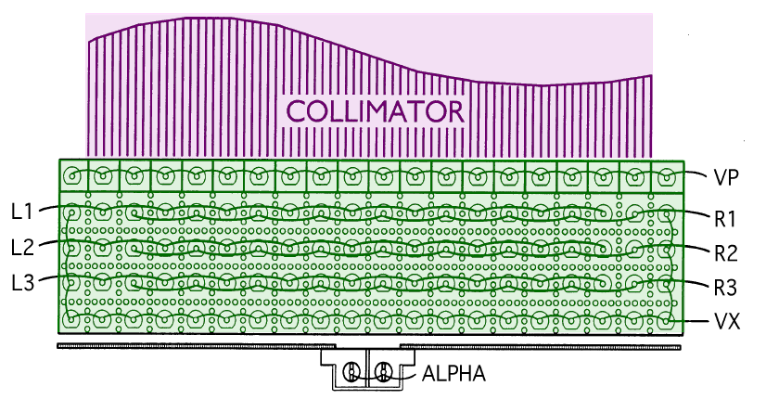
RXTE PCA Layer Highlight
WINDOWS
PROPANE VETO
XENON (3-layers)
REAR/SIDE VETO
Note: discovered that Xenon diffuses into the propane layer over time

Slide 6
What Started This
A colleague walked into my office with old PCA flight hardware, offered it to me
Collimators & PCU mechanical housing / aperture
Can use to measure geometric area?
Two estimation methodologies
“First Principles” from my measurements
Pre-launch optical throughput measurements
Later information that ground-measured PCA geometric area was not used in flux calibration
Zombeck spectrum / flux normalization was simply assumed!

Slide 7
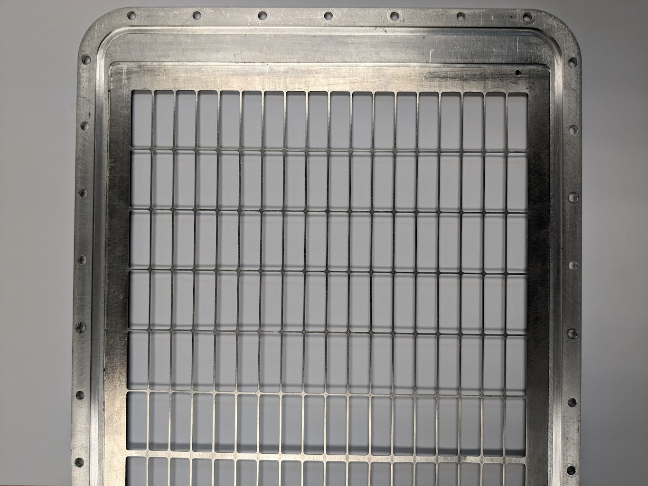
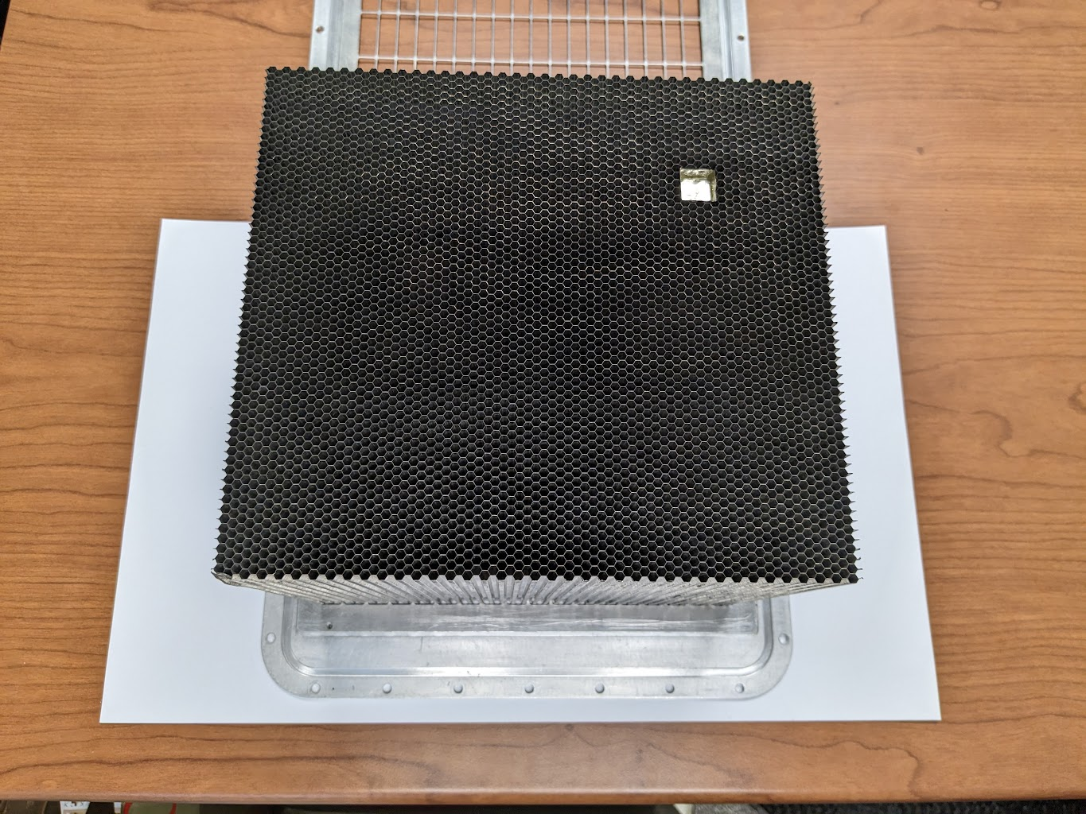
Method 1: ”First Principles” Measure Flight-like Hardware
PCU Aperture “Shoe”
PCU Collimator Module
Need to build a realistic model of geometric area / blockages

Slide 8
Outer Epoxy and Outer Walls
Measured dimension of two existing flight-like collimator modules
Epoxy filling of outer exposed hexagonal cells
Collimator open fraction due to cell walls

Slide 9
Reference Mirror
0.5” x 0.5” reference flat used for module alignment

Slide 10
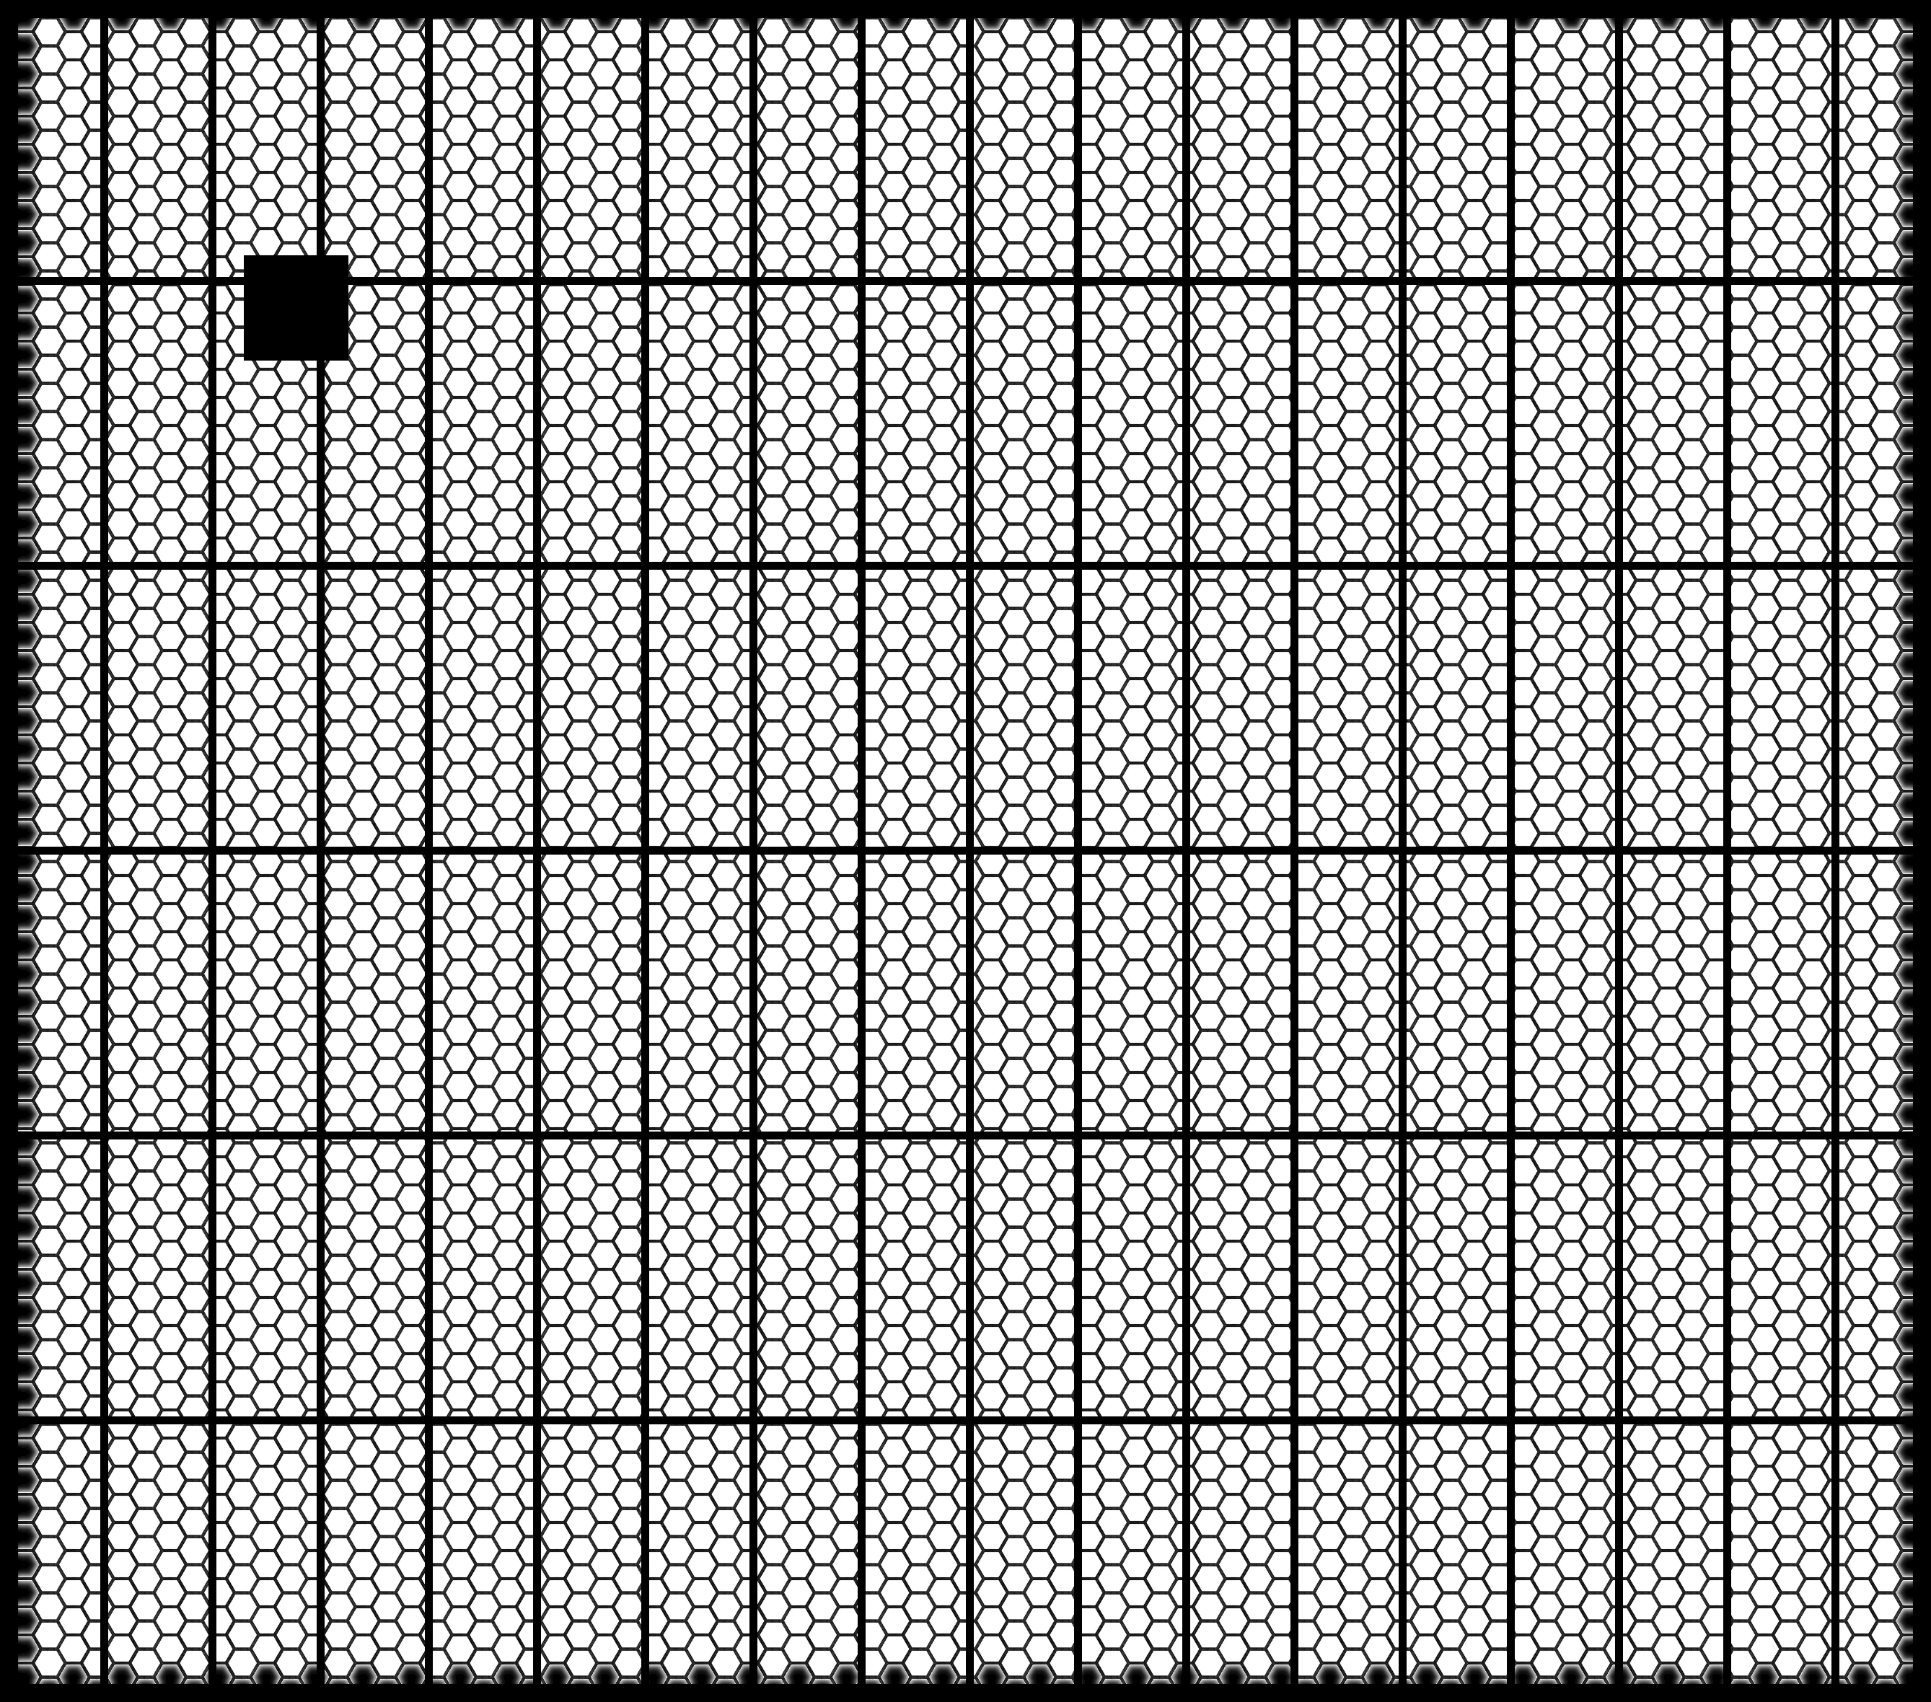
Shoe Support Structure
Measured dimensions from existing flight-like PCU shoe

Slide 11
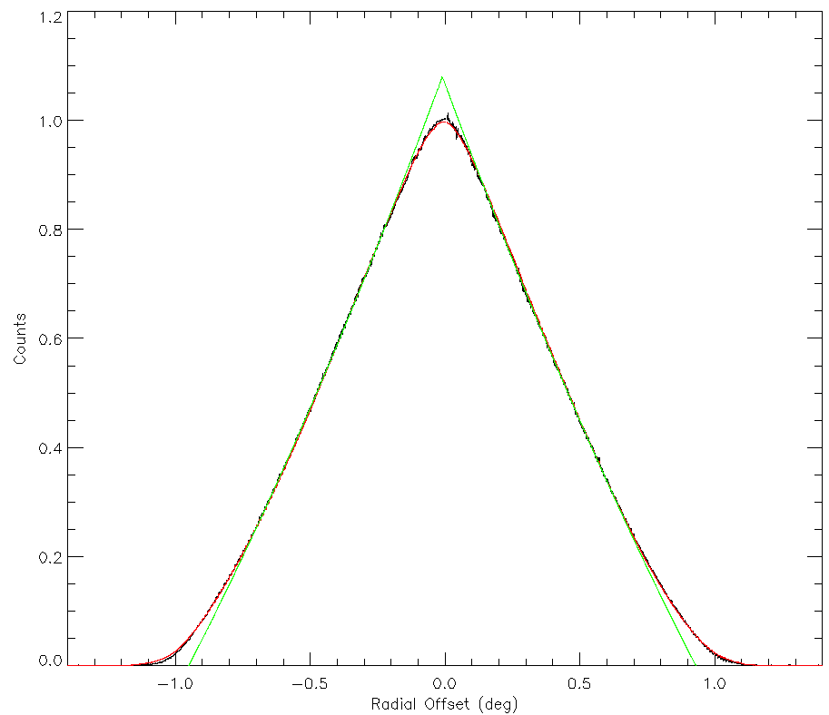
X-ray On-Axis Throughput Loss
RXTE PCA Crab Scans
In-flight Crab scan measurements
Collimator model (red)
Fit using same formula as ground-based optical measurements (green)
Total decrement 8% due to random misalignment of collimator cells
Ideal
Realistic
8%
Off-Axis Angle

Slide 12
Method 2: Pre-Launch Optical Throughput Measurements
Measurements provided by colleague as a spreadsheet + additional notes
Measure a collimator unit as-built
Placed on an optical table
Tip-tilt to achieve max throughput
With-without collimator to measure total on-axis throughput

Slide 13
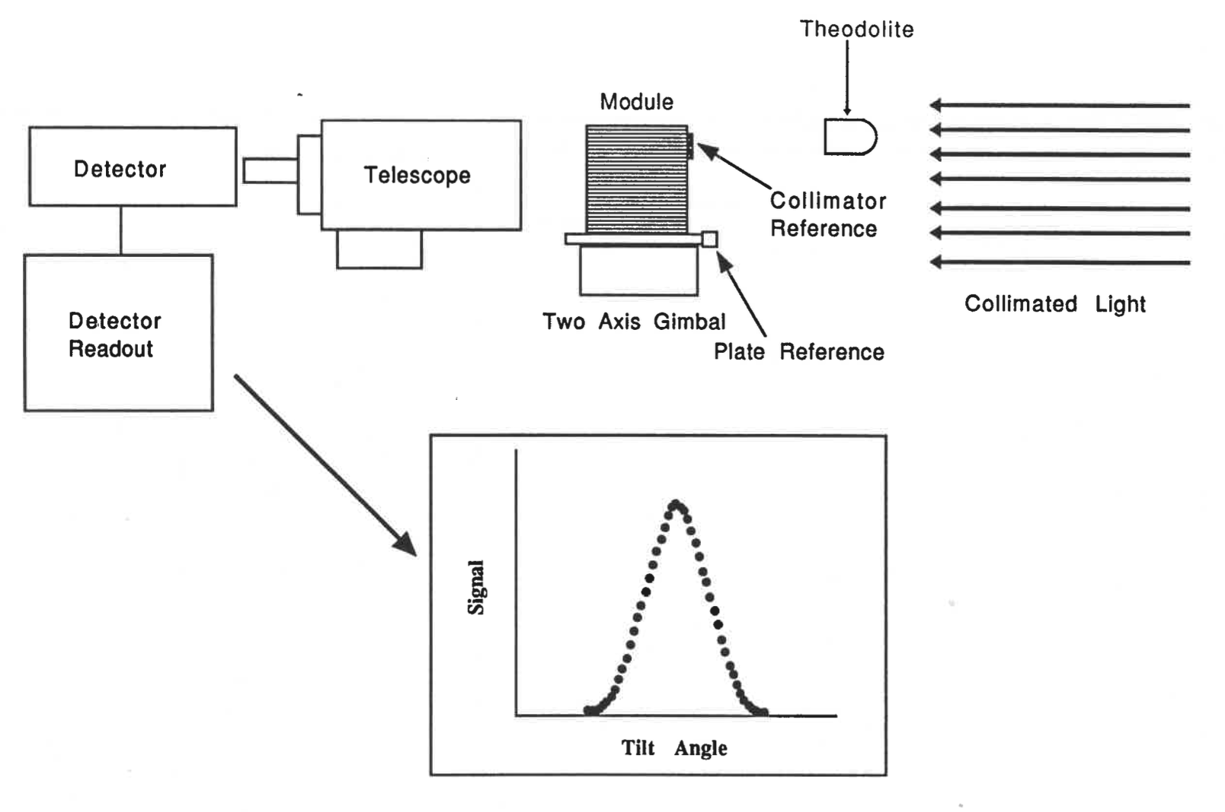
Pre-Launch Throughput Measurements
Optical throughput measurements on tip/tilt stage
Also no-optic measurement
Measurements yield
Module alignment
Total throughput
Random collimator cell misalignments
PCA CDR (1991)

Slide 14
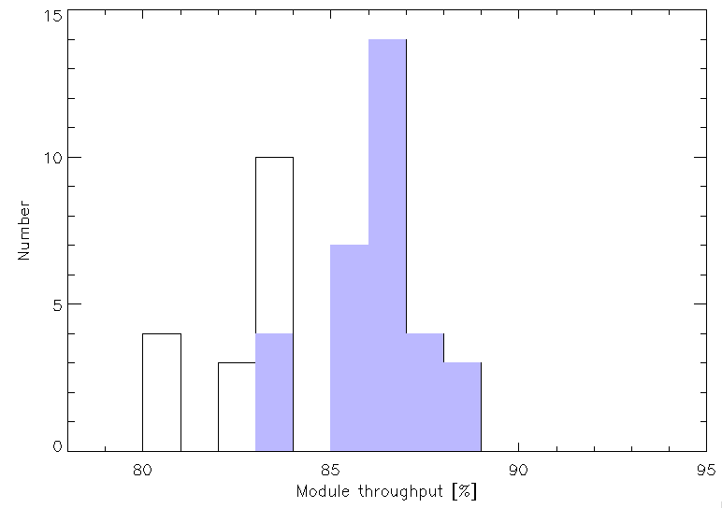
Optical Throughput Numbers
A total of 45 collimator module measurements are documented
Only 25 actually flew
But we don’t know which modules flew or on which PCUs!
We know that as-built all units had very similar open area and alignment
Use top 66% (32 measurements) as indicator of the flight quality units

Slide 15
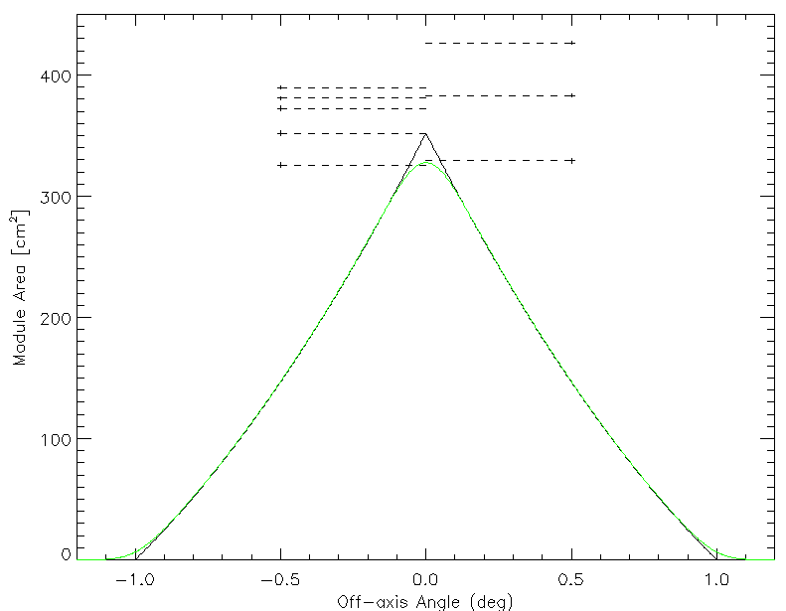
Summary
“First Principles”
Optical Throughput
Collim Aperture
Shoe Aperture
Shoe Aperture
Collim Aperture
Edge Epoxy
Accounting of both methodologies
“First Principles”
“Optical Throughput”
Nearly, but not entirely independent
Answer very similar!
Collim Walls
On-axis Loss
Optical Throughput

Slide 16
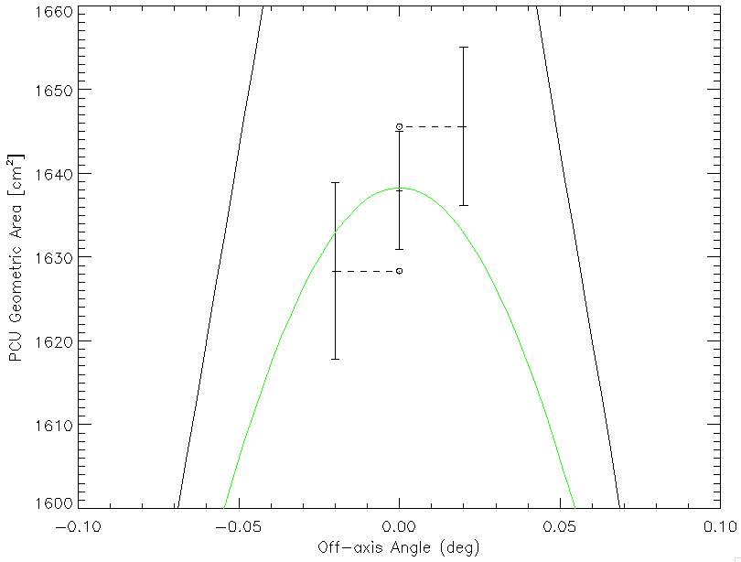
PCU Geometric Area
Two separate measurements
FP = 1628 ± 11 cm²
Opt = 1646 ± 9 cm²
Weighted mean
1638.15 ± 7.1 cm²
Optical Throughput
First Principles

Slide 17
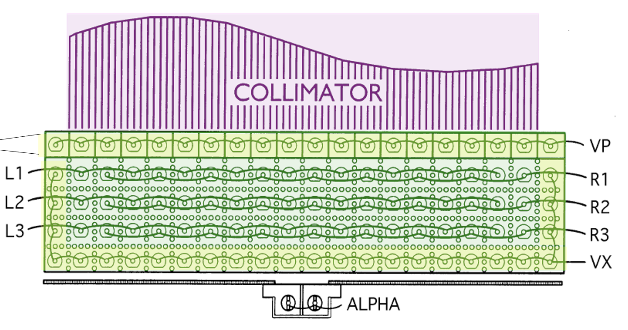
Problem: Entangled Parameters
I can’t just “use” these geometric area values in response calculator since geometric area was optimized along with other parameters in 2012
Geometric area is correlated / entangled with other important parameters
Xenon density
Propane density
Xenon leakage rate
Detector escape model
Necessitates re-fitting response from scratch
Use newly (re)discovered knowledge!
Fitting process for Crab data
Remember there are 5 PCU detectors x 3 layers = 15 spectra per observation!
Include 2.2 – 3 keV as a bonus!
Used 20 Crab observations spaced over time
Crab model: tbabs*pow (index free, norm varies with time)

Slide 18
Fit Residuals: 20 Observations
Layer 1
Layer 2
Layer 3
PCU 0
PCU 1
PCU 2
PCU 3
PCU 4
Energy (2-60 keV)

Slide 19
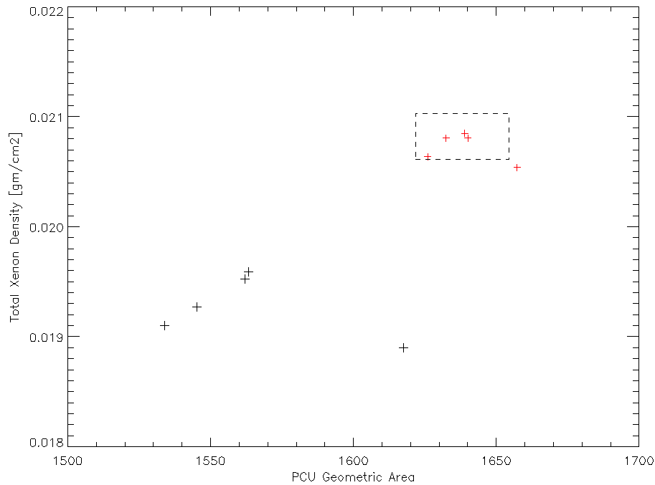
Comparing Old versus New Response
Old parameters highly correlated, unphysical
New fitted parameters comply with expected geometric area and Xenon densities
Previous results (Shaposhnikov et al 2012) appear to have been numerically trapped in shallow minimum in chi-square space
New Parameters
Total Xenon Density
A Priori Expectation
Old Parameters
Geometric Area

Slide 20
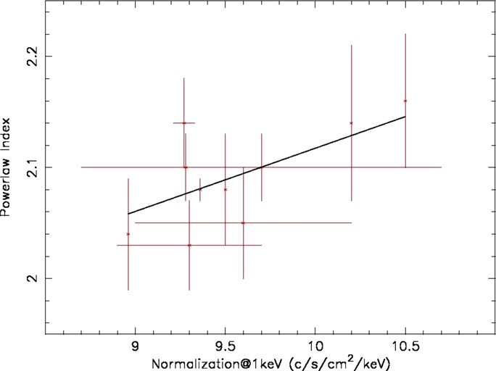
Crab Fit Results
Flux smaller by 5.6%
Comparison to Weisskopf et al 2010
Measurements from 1974-1992
New result more consistent with historical
Power law index 2.111
Compare 2.106 (Madsen et al 2017)
Weisskopf et al 2010

Slide 21
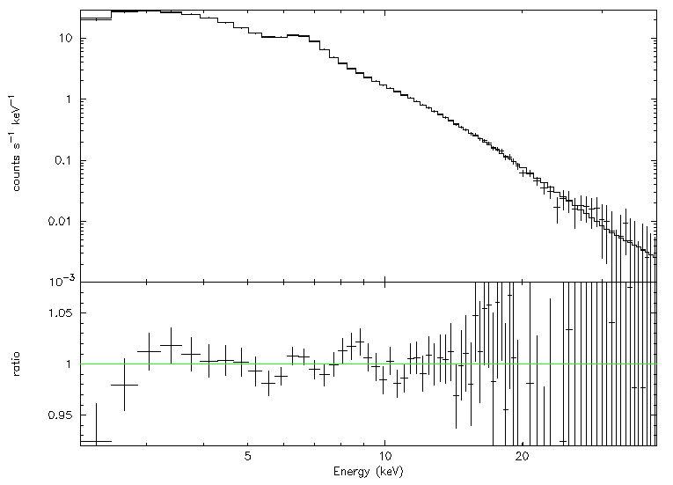
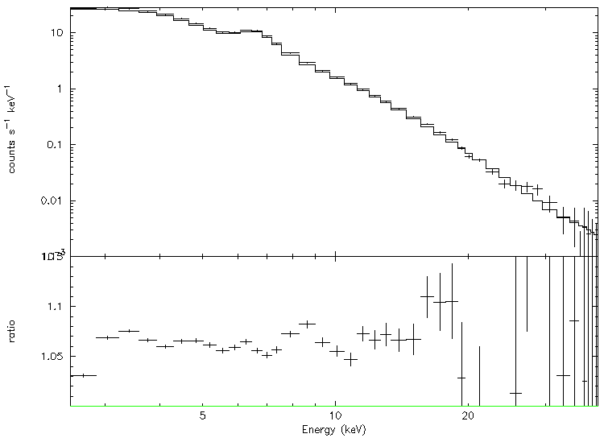
Cassiopeia A Results
New Model New Response
New Model Old Response
6%
Cas A: very different spectrum compared to Crab (Therm + PL ind ~3)
Flux offset 6%, no spectral shape changes, as desired

Slide 22
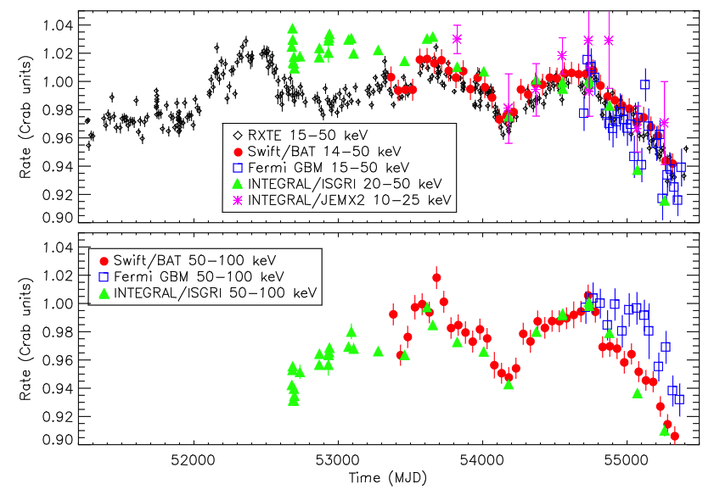
Crab as a Flux Transfer Standard
We now know that Crab is not constant (Wilson-Hodge et al 2010), BUT
Use absolute flux measurements (PCA & NuSTAR) to anchor flux scale
Fermi GBM, Swift BAT, and RXTE ASM long-term light curves to extend flux scale over ~27 years
Tie to other observatories
Need to consider that Crab pulsar flux decreases ~0.2% per year due to spindown
Still needs work!
PCA
NuSTAR
Wilson-Hodge et al 2010

Slide 23
Summary
New RXTE PCA absolute effective area calibration to ~1%
Fluxes are 5.6% smaller compared to previous release in 2012
No apparent spectral shape differences
Planned release this Summer

