Slide 1
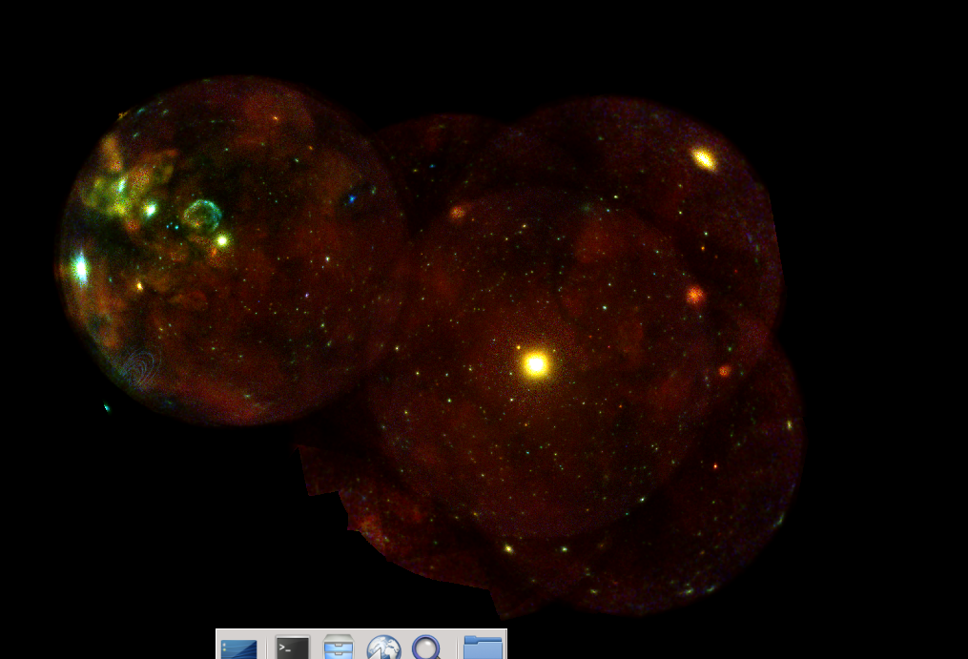
Monitoring the evolution of SN1987A, a comparison between eROSITA and XMM-Newton EPIC-pn observations:
Chandreyee Maitra
Max Planck Institute for Extraterrestrial Physics
April 24, 2023
IACHEC meeting

Slide 2
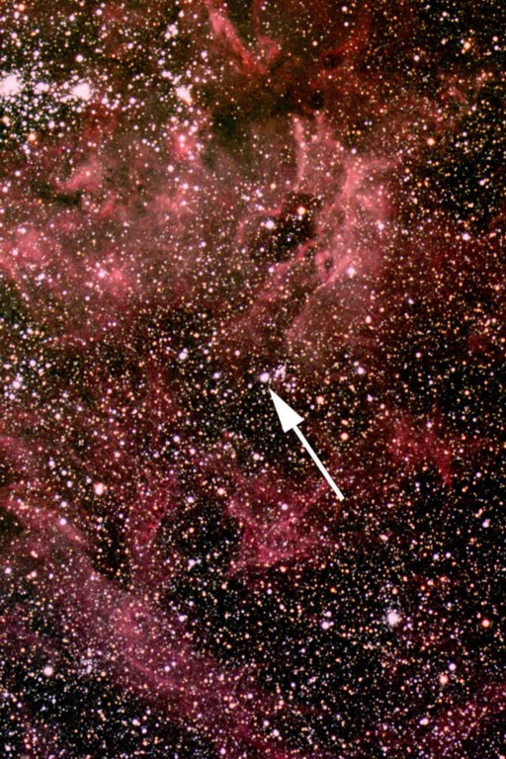
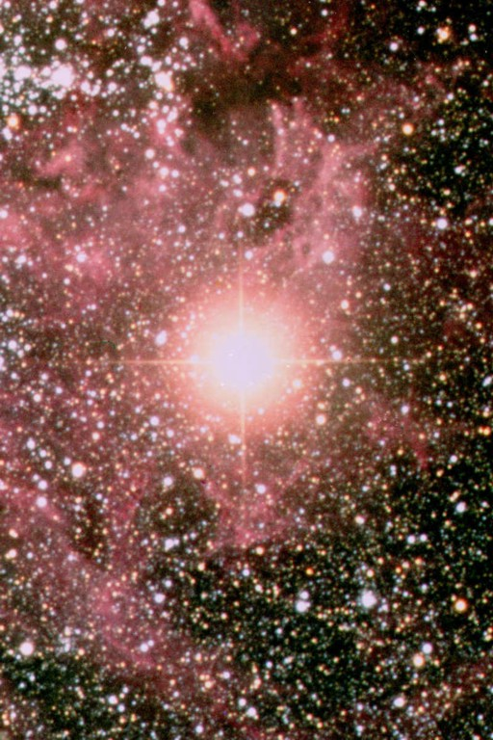
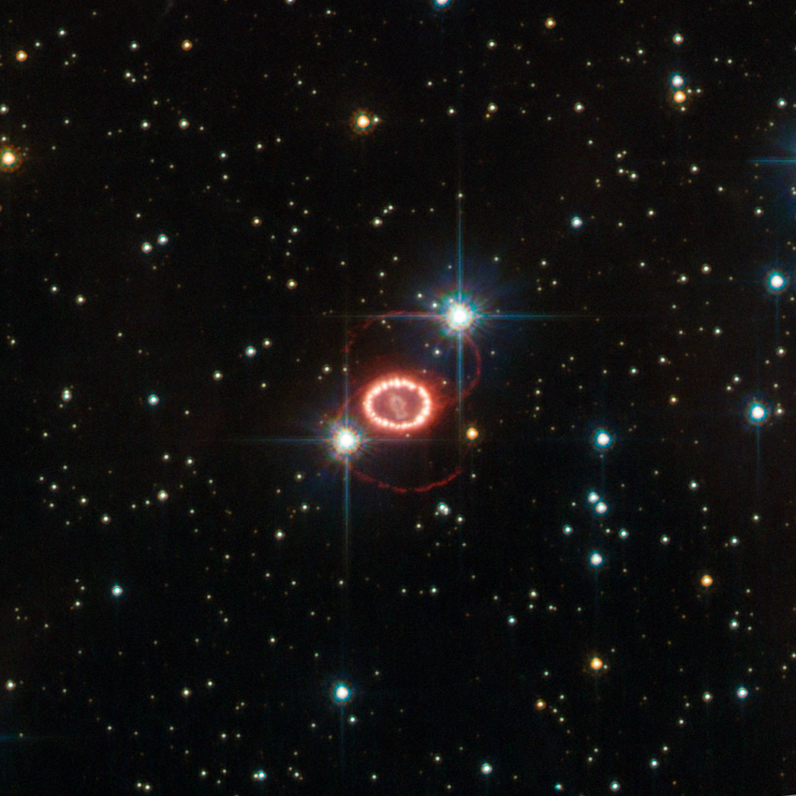
SN 1987A: A template to link supernovae to their remnants
Large Magellanic cloud at a distance of 51.4 ±1.2 kpc (Panagia 1999)
Core collapse origin; progenitor was identified as Sanduleak -69 202, a blue supergiant.
Subject of intense monitoring at all wavelengths, one of the most well-studied objects in astronomy
Monitored in X-rays with Rosat, XMM, Chandra, Suzaku (recently eROSITA & NuSTAR)
Sanduleak −69 202
Supernova 1987A
Australian Astronomical observatory
SN 1987A in 2011. Credit: ESA/Hubble & NASA

Slide 3
SN 1987A: A template to link supernovae to their remnants
Large Magellanic cloud at a distance of 51.4 ±1.2 kpc (Panagia 1999)
Core collapse origin; progenitor was identified as Sanduleak -69 202, a blue supergiant.
Subject of intense monitoring at all wavelengths, one of the most well-studied objects in astronomy
Monitored in X-rays with Rosat, XMM, Chandra, Suzaku (recently eROSITA & NuSTAR)
Sanduleak −69 202
Supernova 1987A
Australian Astronomical observatory
Frank et al.2016
SN 1987A in 2011. Credit: ESA/Hubble & NASA
SN 1987A in 2011. Credit: ESA/Hubble & NASA

Slide 4
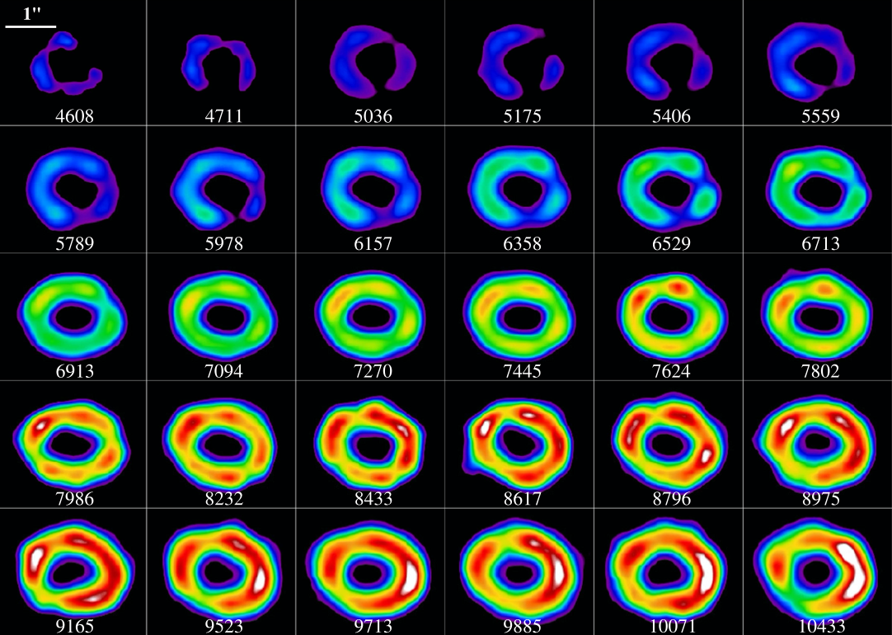
Monitoring of SN 1987A
X-rays Insights into physics of the shock emitting plasma and its interaction with the CSM structures, SN ejecta & progenitor
X-ray monitoring
First detected with ROSAT (Beuermann+94, Hasinger+96)
Steep increase in X-ray flux at ~ 4500 d after explosion. Intense monitoring by XMM-Newton, Chandra (Park+2005,Haberl+2006, Maggi+2012,Frank+2016, Maitra+22)
XMM/EPIC-pn monitoring 2007-2023 traces the flux (& spectral) evolution
Near-simultaneous pointed observation with eROSITA in Sept. 2019, also eRASS surveys (2020-2021)

Slide 5
SN 1987A: X-ray emission model
High resolution X-ray spectroscopy was used to model the X-ray emission (Zhekov+2010, Dewey+2012) : 3 plane parallel shock components (vpshock)
Material in the dense equatorial ring heated by a slow shock (including inter-clump gas)
Shock heated CSM (HII region) located above and below the ring
Reflected shock heated gas, also in recent years shock heated ejecta
kT2 fixed to 1.15 keV & ionisation timescales cover a factor of 2

Slide 6
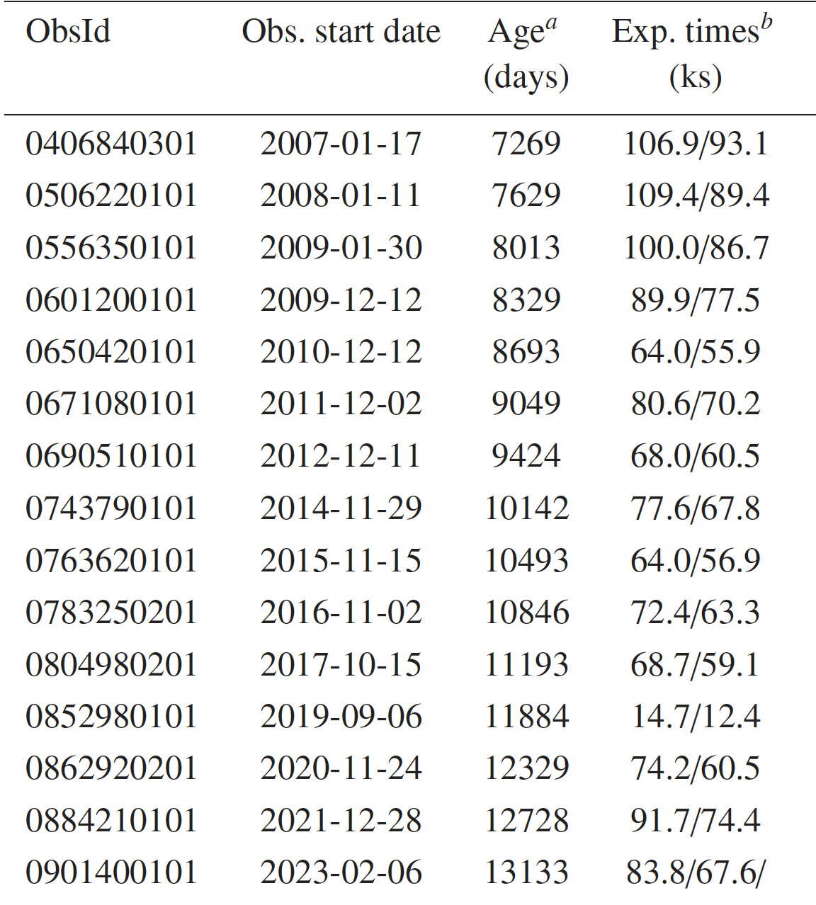
35 years of monitoring of SN 1987A with EPIC-pn

Slide 7
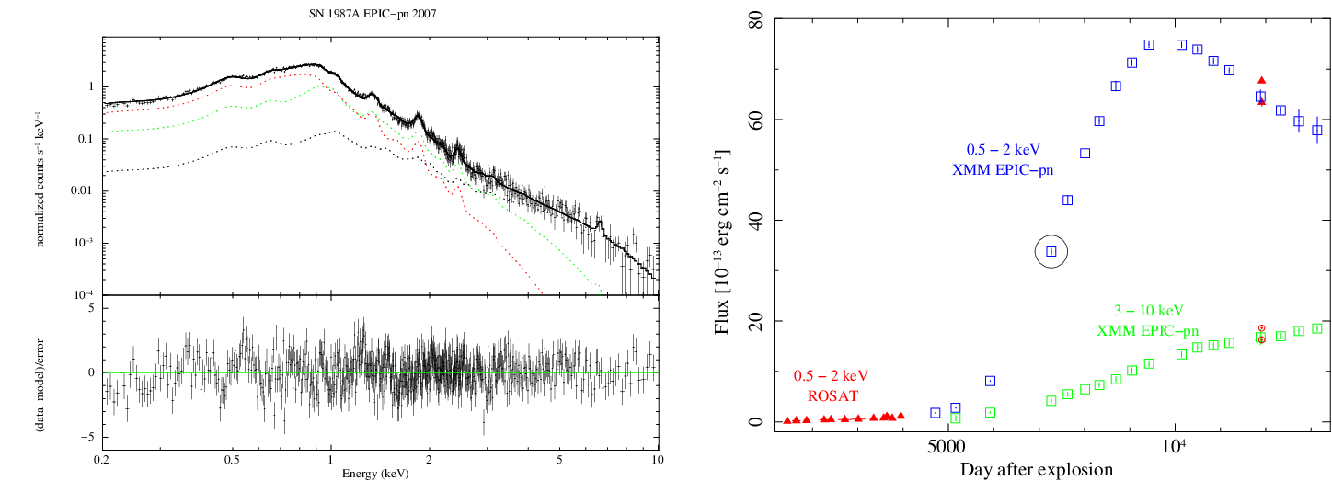
Monitoring the flux evolution of SN 1987A with EPIC-pn
Consistent monitoring with EPIC-pn FF and medium filter, single-pixel events
Flux in the soft band dropped by 23% of the peak value (0.5-2 keV)
Hard band (0.3-10) sloped changed from 2.5E-3/day to 1.8E-3/day
EPIC-pn monitoring from day 4712 to 13133 after explosion - Now entry into ejecta dominated phase !

Slide 8
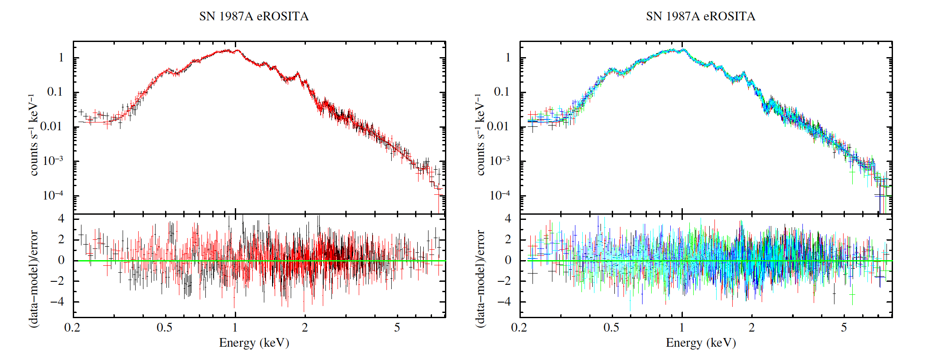
Monitoring of SN 1987A with SRG/eROSITA
However early pointed observations with an older event processing mode (PMWORK)
Survey data is shallower..

Slide 9
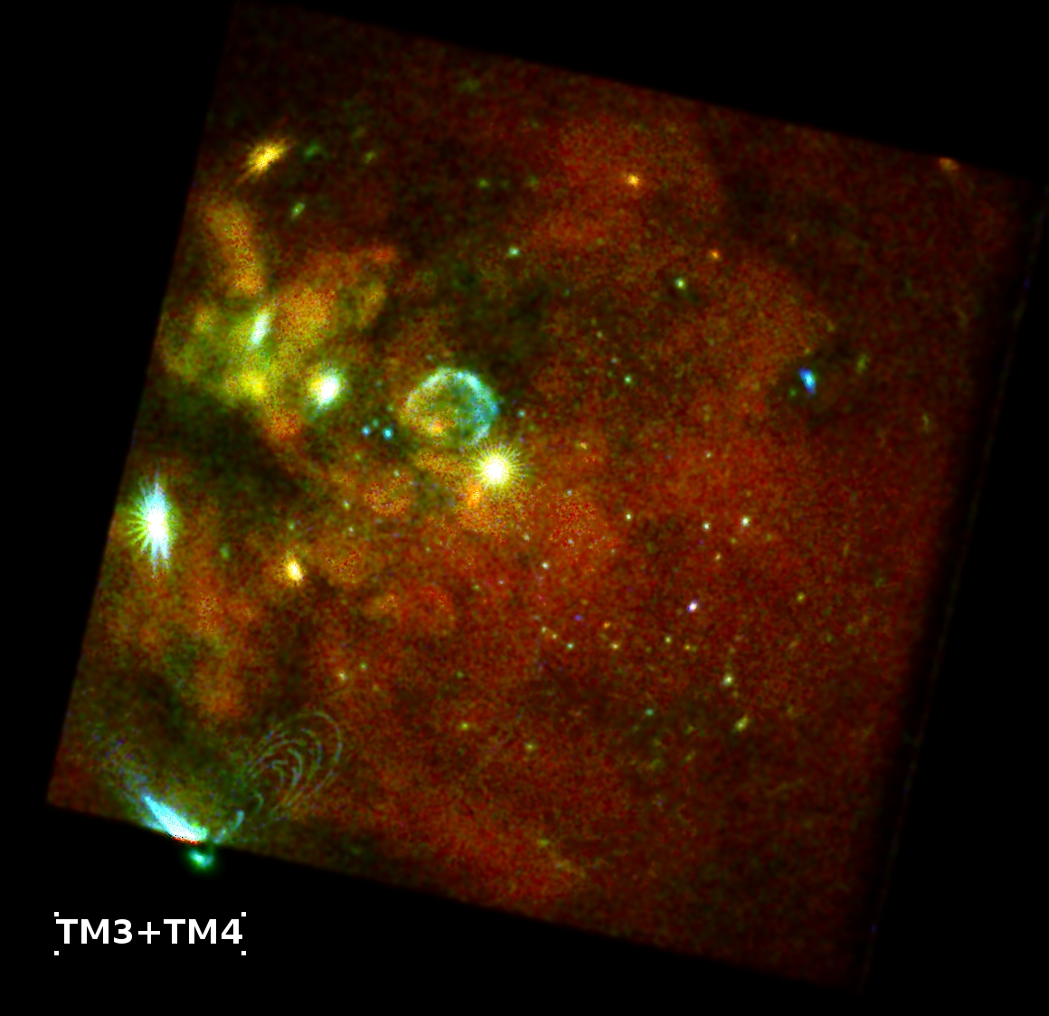
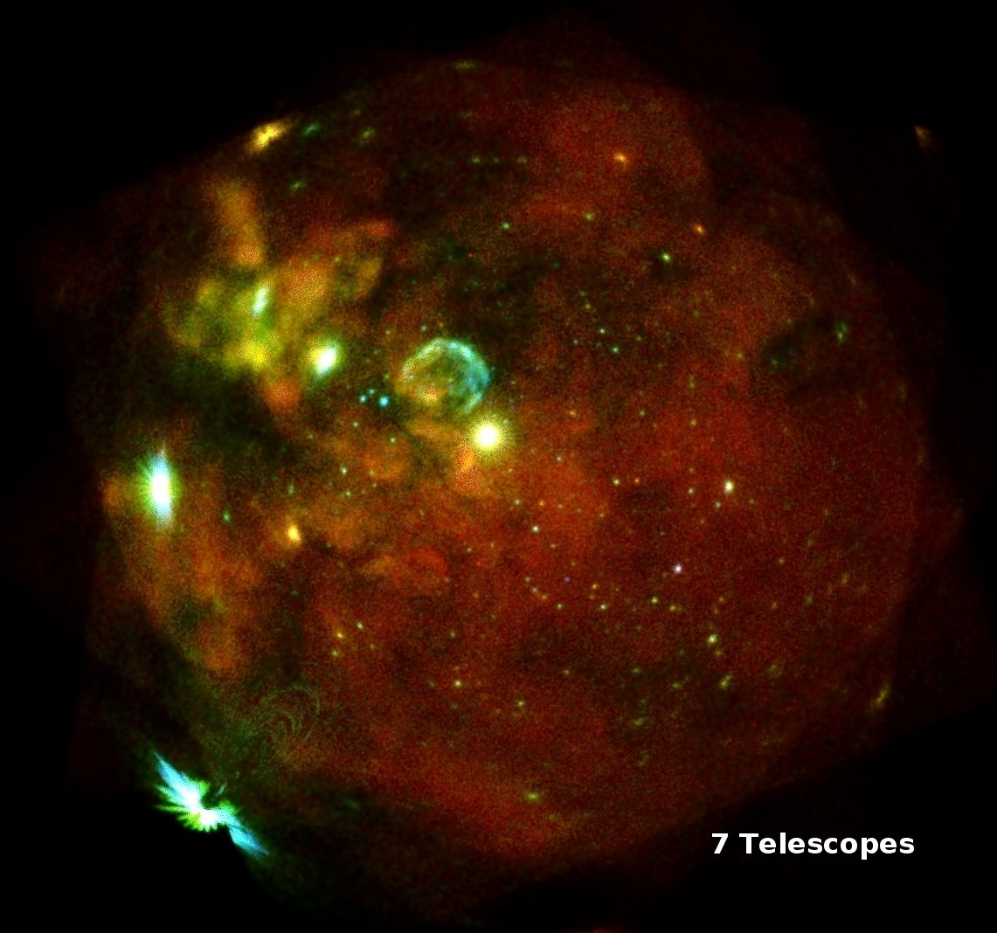
eROSITA observations of SN 1987A
2019-09-15 Commissioning phase observation ~100 ks
Quasi-simultaneously with XMM-Newton
2019-10-18 First light observation ~70 ks

Slide 10
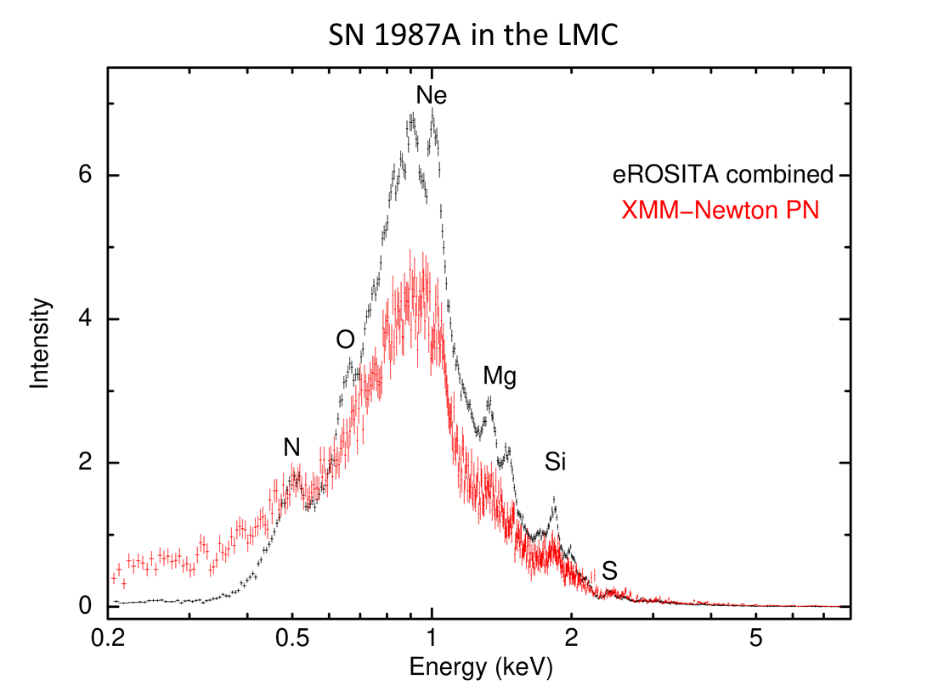
eROSITA observations of SN 1987A
Comparison of XMM Newton EPIC-pn spectrum from with eROSITA Cal. observation:
Note the much stronger re-distribution in the EPIC-pn spectrum at low energies.

Slide 11
eROSITA Comm. Spectrum
Obtained by fitting best-fit spectrum for EPIC-pn
PATTERN 1
TM3, TM4
Fluxes agree within < 1% for PAT 15
PAT 1 fluxes lower by ~ 2%
Energy keV | TM3 Flux (10⁻¹³ erg/cm²/s) | TM4 Flux (10⁻¹³ erg/cm²/s)
0.5-2.0 | 69.5^{+1.8} -1.9 | 69.2^{+1.6} -1.9
3-10.0 | 20.3^{+1.1} -0.8 | 20.2^{+1.1} -0.9
PATTERN 15
TM3, TM4

Slide 12
eROSITA FL. Spectrum
Fluxes agree within < 4% for PAT. 15
PAT 1 fluxes lower by ~ 5-7%
PATTERN 1
TM 1, 2,3,4,6
TM1 Flux (10⁻¹³ erg/cm²/s) | TM2 Flux (10⁻¹³ erg/cm²/s) | TM3 Flux (10⁻¹³ erg/cm²/s) | TM4 Flux (10⁻¹³ erg/cm²/s) | TM6 Flux (10⁻¹³ erg/cm²/s)
69.7±1.2 | 68.9±1.0 | 68.2±1.0 | 69.4±1.1 | 67.1±1.0
19.2±0.8 | 19.0±0.7 | 18.8±0.7 | 19.1±0.8 | 18.5±0.7
PATTERN 15
TM 1, 2,3,4,6
PATTERN 1

Slide 13
Simultaneous fit of eROSITA+EPIC-pn 2019
eROSITA & EPIC-pn fluxes agree within 5% and 2% for all valid and single pixel events in 0.5-2 keV; & 10% and 3% in 3-10 keV.
Lower post-shock temperature kT3 in eROSITA spectrum
Slightly elevated abundance measured for Ne, Si and S compared to EPIC-pn 2019
Parameters in broad agreement with EPIC-pn

Slide 14
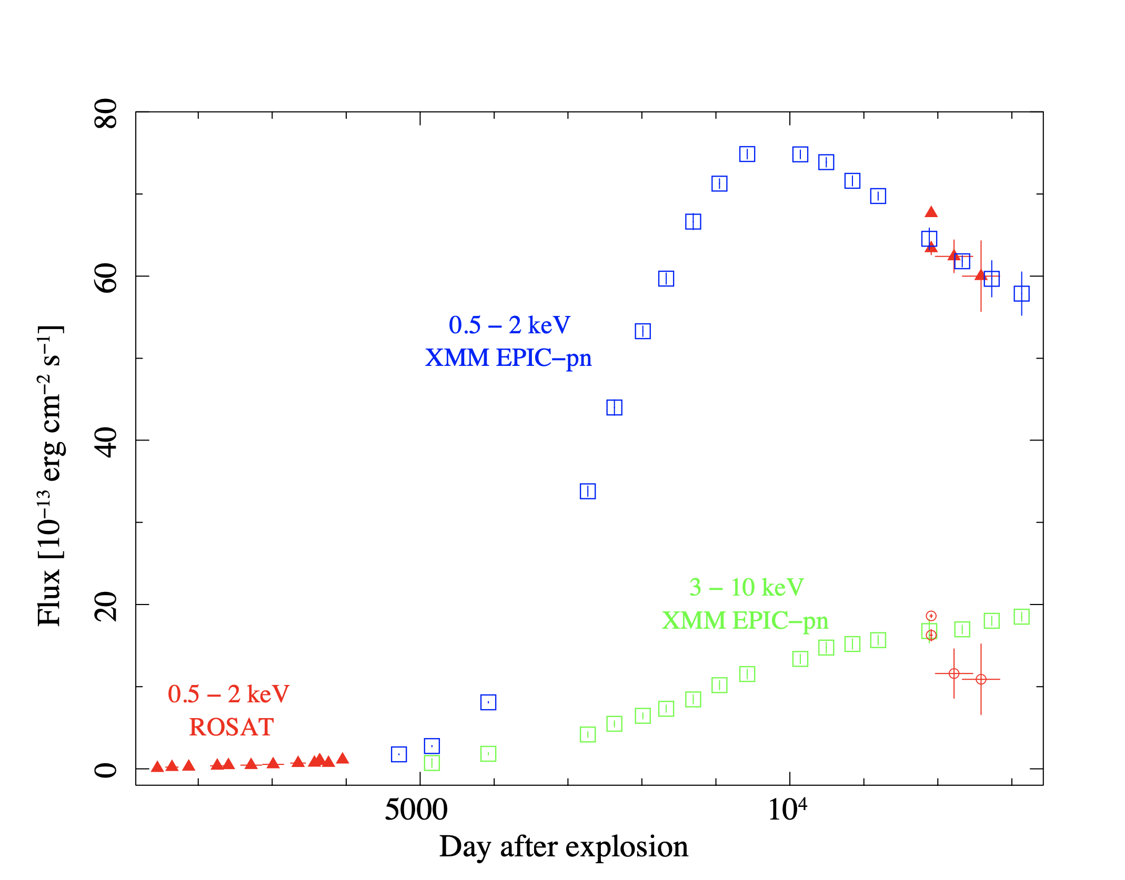
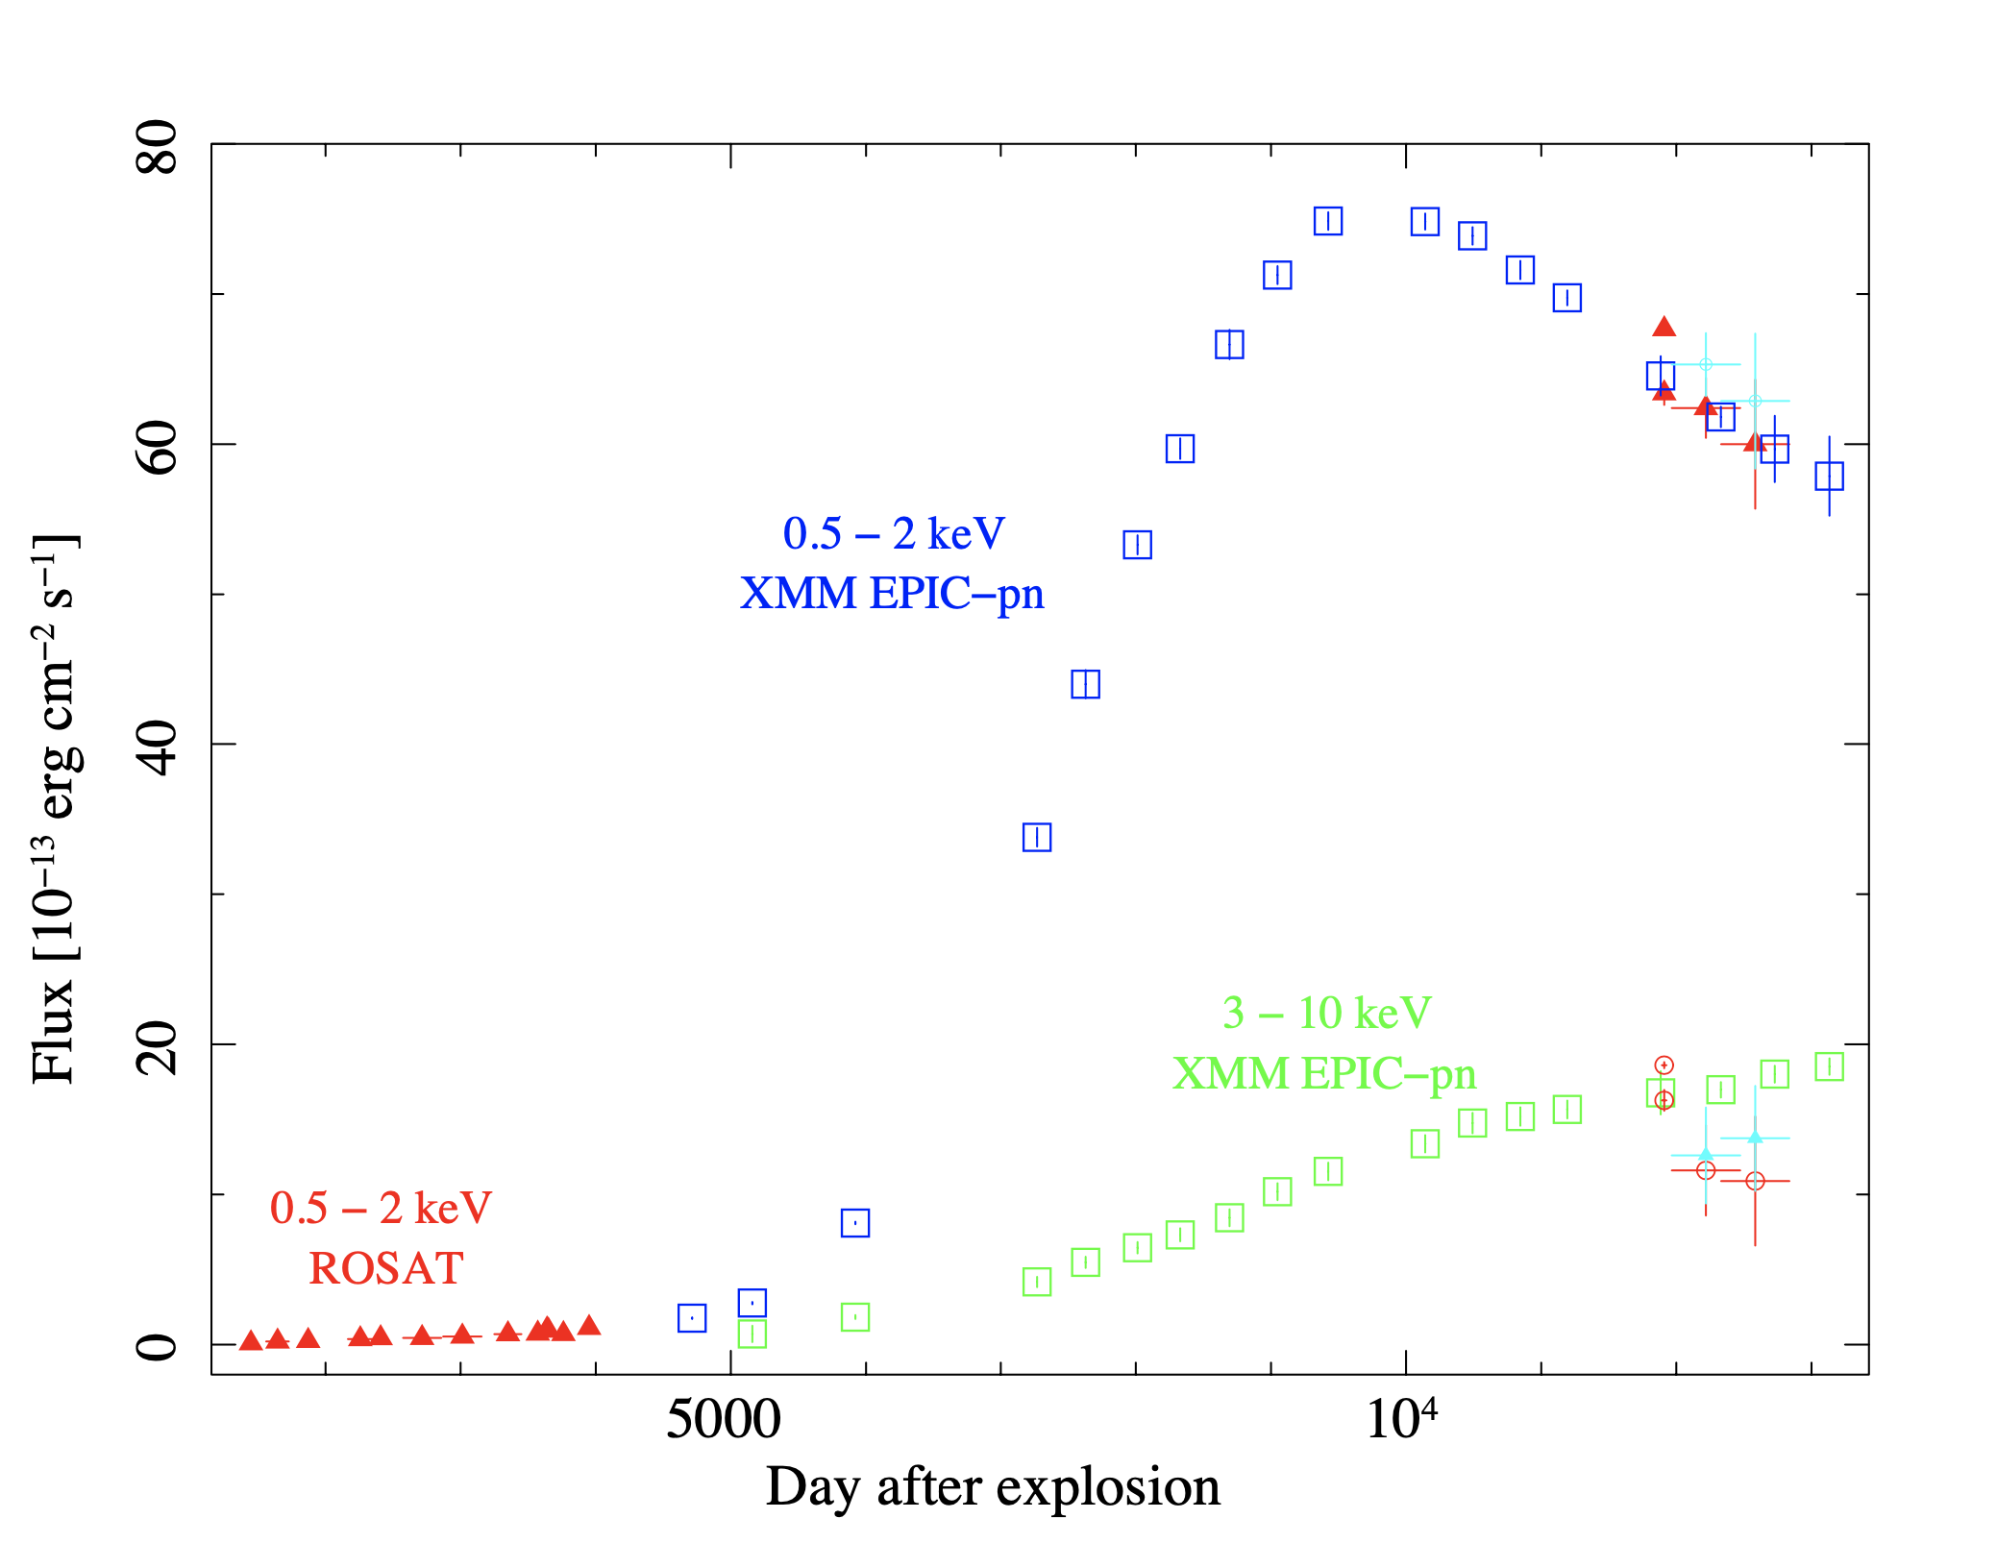
Comparing the flux evolution of SN 1987A
PATTERN 15
PATTERN 15
PATTERN 1
PATTERN 1
Survey data
Survey data
Survey data
Improved threshold for pattern recognition and energy calibration
EPIC-pn monitoring from day 4712 to 13133 after explosion - Now entry into ejecta dominated phase !

Slide 15
Comparing the flux evolution of SN 1987A
PATTERN 15
PATTERN 15
PATTERN 1
PATTERN 1
Survey data
Survey data
Survey data
eROSITA survey data (eRASS1-2 & eRASS3-4) compared before and after improved thresholds for pattern recognition & energy calibration (K. Dennerl)
Fluxes agree within 8% for TMs for valid patterns in 0.5-2 keV & 3-10 keV
Fluxes increase by 6-8 % after applying improved pattern & energy calibration
eRASS fluxes in 3-10 keV band lower by ~21% than EPIC-pn (large errors dominate)

Slide 16
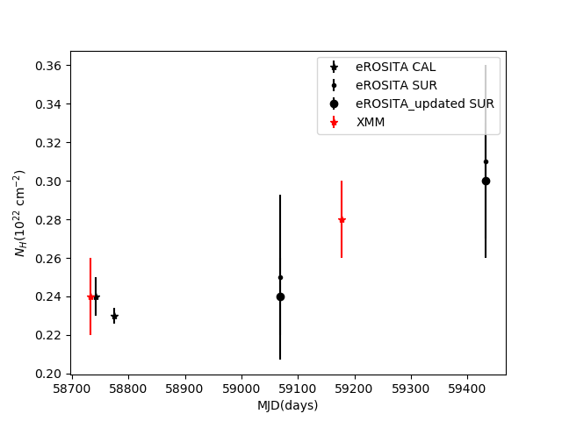
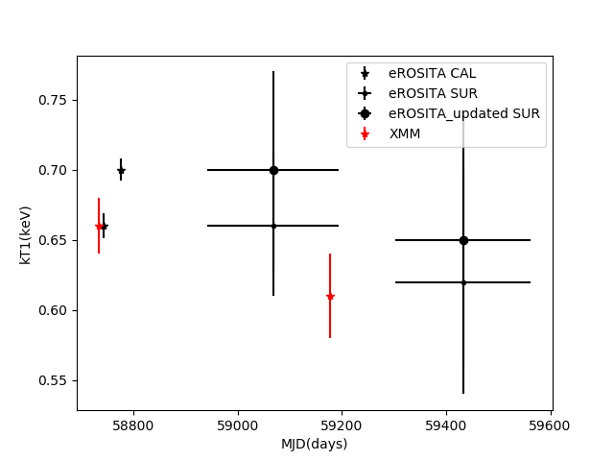
Comparison of continuum parameters
2019
2020-2021
The 2 groups broadly consistent within each other
eROSITA survey data (eRASS1-2 & eRASS3-4) have higher errors, but centroid values seem to have shifted with improved energy & pattern calibration
The hot plasma component is very unconstrained in eRASS data

Slide 17
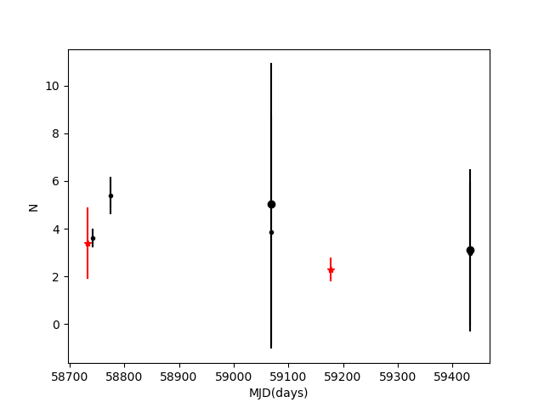
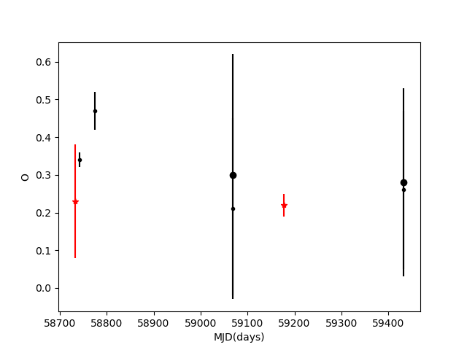
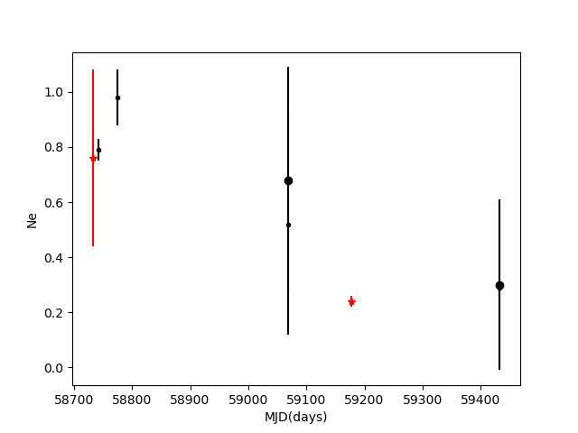
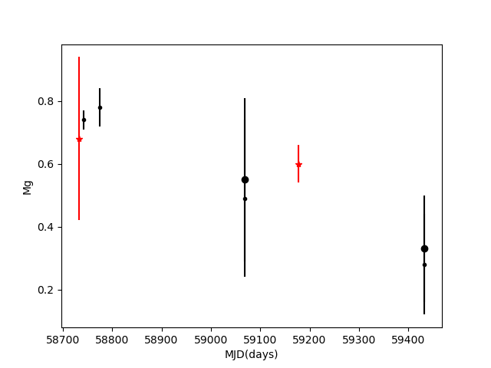
Comparison of Elemental abundances
2019
2020-2021
2019
2020-2021
2019
2020-2021
2019
2020-2021

Slide 18
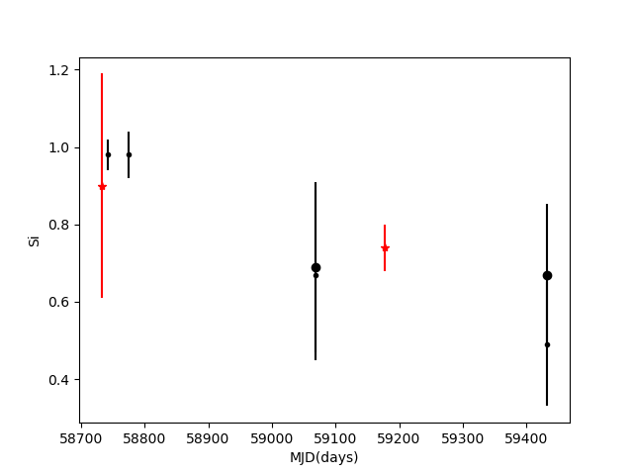
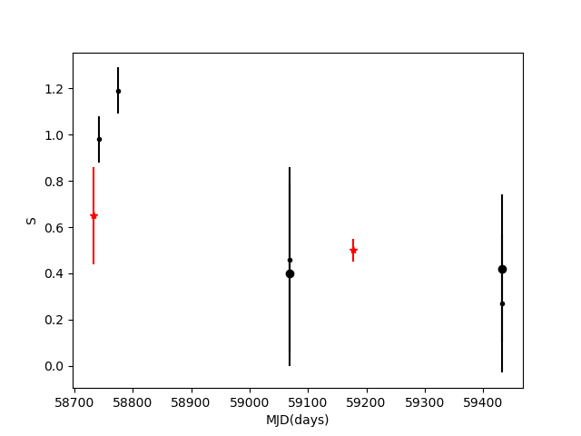
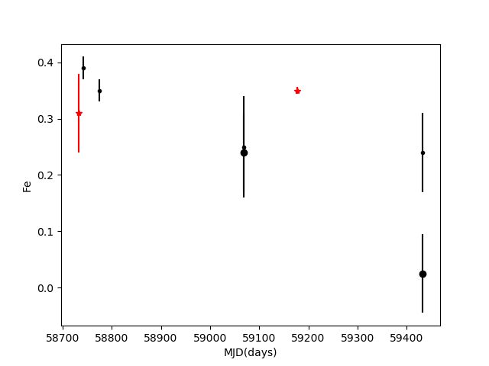
Comparison of Elemental abundances
2019
2020-2021
2019
2020-2021
2019
2020-2021

Slide 19
Caution on elemental abundances
Chemical composition from EPIC-pn is averaged over plasma components which is evolving
Comparison between different missions require one consistent model, e.g Chandra HETG/LETG and XMM/RGS use 2 kT models.
Chemical composition of the cooler+warm emission components is consistent with recent analysis of grating spectra (HETG/RGS,Bray+2020, Sun+21)
EPIC-pn and eROSITA abundances and broadly consistent within errors.

Slide 20
Summary
Flux evolution of SN 1987A (2007-2023) obtained in the X-ray band with EPIC-pn indicates a drop in peak flux by 23% in the soft band and a flatter slope in the hard band.
eROSITA fluxes are higher than EPIC-pn in 2019 with valid-patterns (PAT=15 )and slightly lower with single-pixel events (PAT=1). Spectral parameters in broad agreement. However eROSITA CalPV obs were in old processing mode (PMWORK)
eRASS data is limited by exposure time
eRASS fluxes in 3-10 keV band lower by ~21% than EPIC-pn (large errors dominate)
eRASS fluxes increase by 6-8 % after applying improved pattern & energy calibration in all bands
Elemental abundances & continuum parameters between eROSITA and EPIC-pn (2019-2021) broadly consistent
C. Maitra, F. Haberl, M. Sasaki, P. Maggi, K. Dennerl, M. Freyberg, E. Gatuzz, P. Gawade

Slide 21
Chandra view of Evolution of SN 1987A
Similarities between the radio and the hard X-ray band (2-10 keV) suggest that the emission arises from the same region

Slide 22
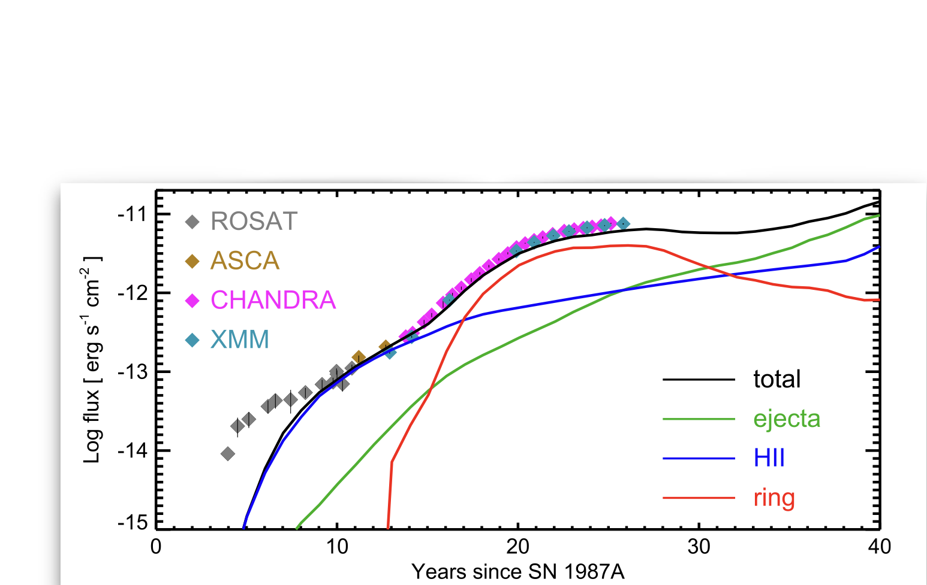
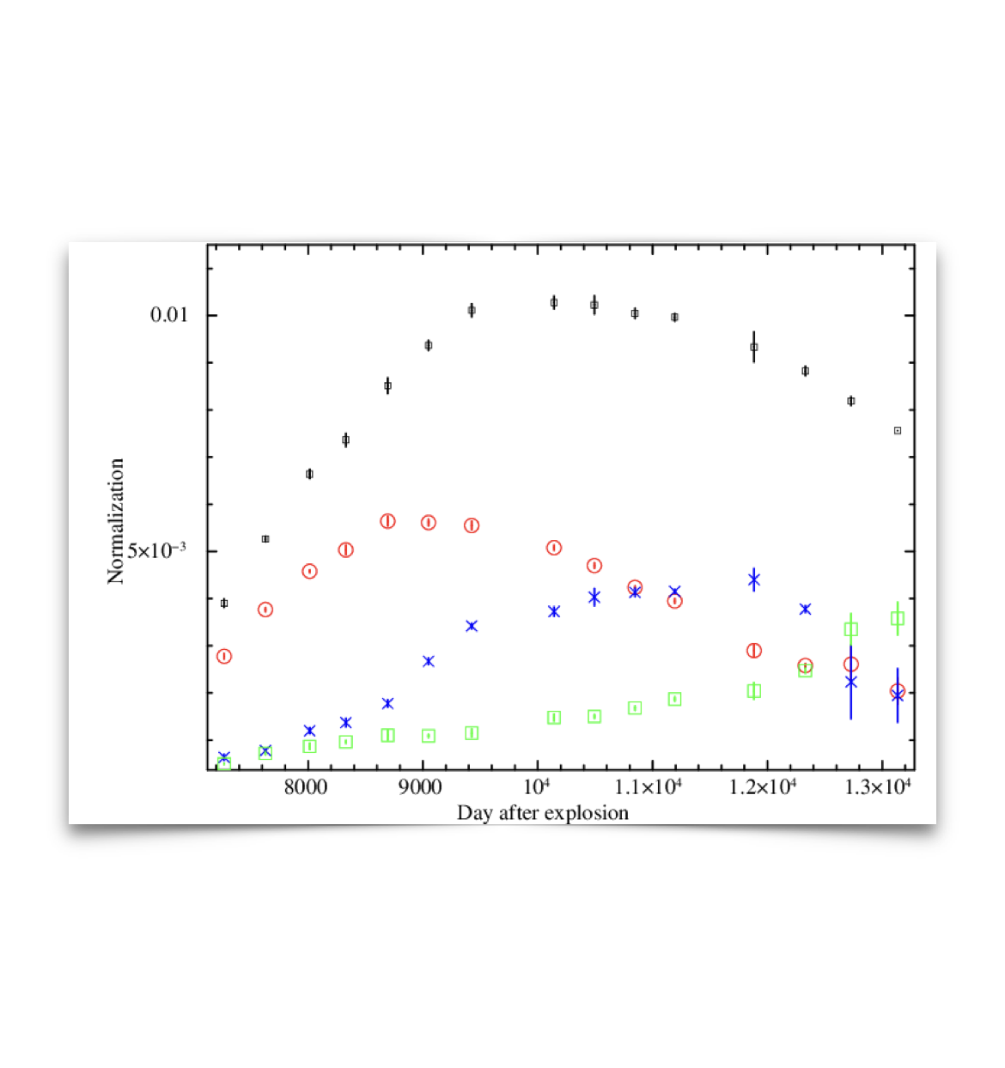
Flux evolution of SN 1987A: A new evolutionary phase
latest EPIC-pn fluxes unto 13133 d confirms the blast wave has passed over the ER
Elemental abundance of O, Ne, Mg have increased with time.
Properties of ejecta will begin to dominate the X-ray emission

Slide 23
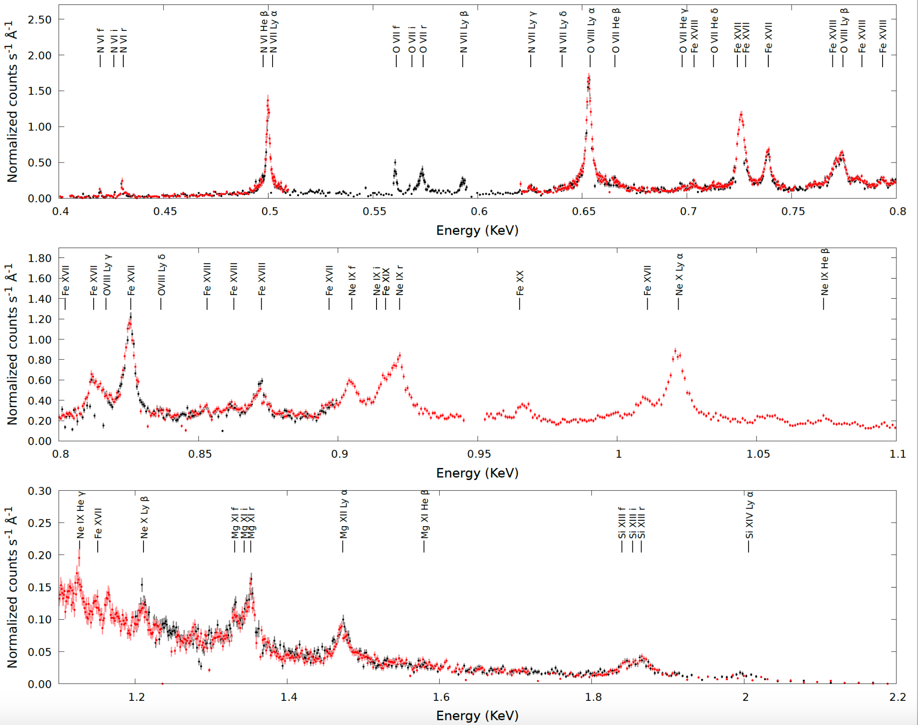
EPIC RGS observation of SN 1987A
1.32 Ms co-added spectrum (2007-2020)

