Slide 1
Preparing SPEX for the next generation of high-resolution spectrometers
Jelle de Plaa
The SPEX team: Jelle Kaastra,
Liyi Gu, Christina Dwiriyanti

Slide 2
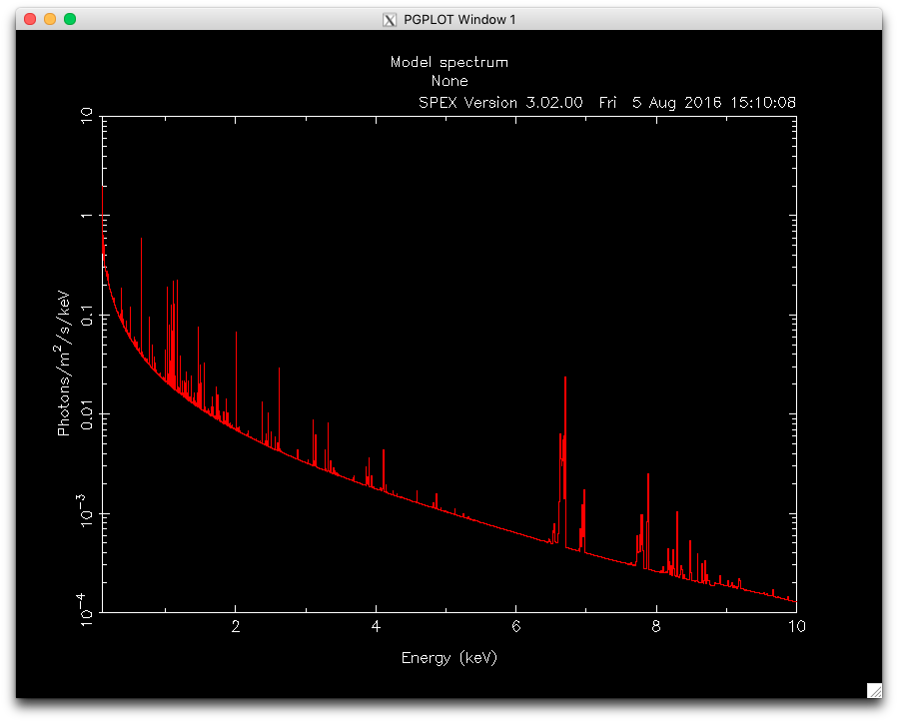
SPEX standard interface
Command-line interface
PGPLOT figures
Access to plasma parameters and line properties derived from the models

Slide 3
Improvements in recent years (software side)
Usability:
Python interface (also returns data to Python)
Easier installation (Anaconda)
Documentation:
Searchable HTML documentation on Github
Analysis threads and exercises to learn SPEX
Help function on SPEX> prompt
Transparency:
Source code available on Zenodo (GPL license)
Issue tracker on Github

Slide 4
SPEX manual and tutorials
https://spex-xray.github.io/spex-help/index.html

Slide 5
SPEX python interface

Slide 6
New and improved models
Improved atomic database (order 10⁶ lines)
Thermal CIE model
Photoionisation model (emission and absorption)
Time-dependent photo-ionisation model
Atomic data error command
For calibration:
Gain model
Model gain using Chebychev polynomials
Applicable to micro-calorimeter data (XRISM)
Correct energy scale also in between MXS lines

Slide 7
Chandra grating spectrum of Capella (CIE test)
Red:
Gaussians
Blue:
SPEX model
Gu et al. (2022)

Slide 8
SPEX software challenges
Involving the community in SPEX development:
Modularity and interfacing:
How to run (parts of) SPEX in external programs
How to run external programs in SPEX
Expand source code documentation
Expand online collaboration (for example, Github)
Prepare for new instruments:
Preparing for high-performance computing
Optimizing calculation speeds
Preparing for new data structures
Exploring instrument modeling

Slide 9
SPEX next steps
Development for SPEX v4
Create modules & interfaces
Expand atomic database
Improve spectral models
This is currently being done by
programmer.
Fitting module (variables & subroutines)
Data module
(variables & subroutines)
User interface
Model module (variables & subroutines)
Atomic data module

Slide 10
Some advertisements
AHEAD2020 funding for visits (to SRON and others)
See AHEAD2020: https://ahead.iaps.inaf.it
Visitor program: https://ahead2020.le.ac.uk/
HEACIT initiative
The “IACHEC” for high-energy analysis software
HEACIT information:
https://heasarc.gsfc.nasa.gov/docs/heacit/
HEACIT Open Astronomy forum:
https://community.openastronomy.org/c/heacit/20

Slide 11
Conclusions
SPEX is continuously evolving and improving
Regarding its software aspect:
SPEX team is expanding the user interface options step by step
SPEX team is improving its documentation and usability
SPEX will be more modular
Regarding atomic data:
SPEX team continues to improve atomic data (with XRISM help)
Develop new models (time-dependent photo-ionisation, etc.)
Preparing the software for a new era of X-ray spectroscopy.

