Slide 1



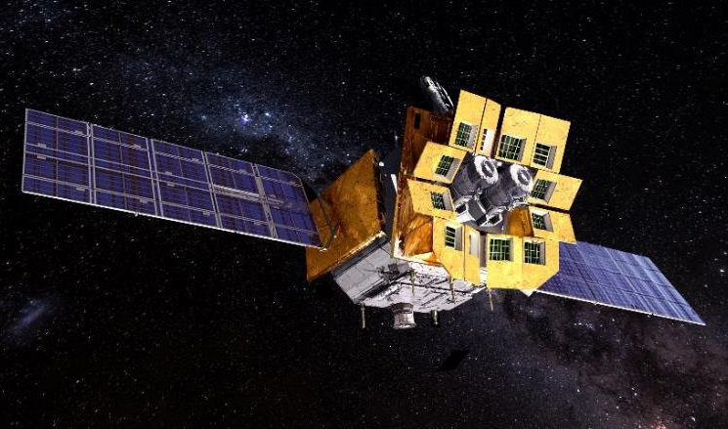
Ground Calibration Processes and Status of EP-WXT
Yanfeng Dai
X-ray Imaging Laboratory
National Astronomical Observatories, CAS.
April 25,2023
International Astronomical Consortium for High-Energy Calibration
@Seeblick Pelham (Germany)

Slide 2
Contents
Einstein Probe(EP)
Wide-field X-ray Telescope(WXT)
WXT Team
Ground Calibration Processes
MPO Plates Status
Optics Assemblies Status
Ground Calibration Status
Summary

Slide 3
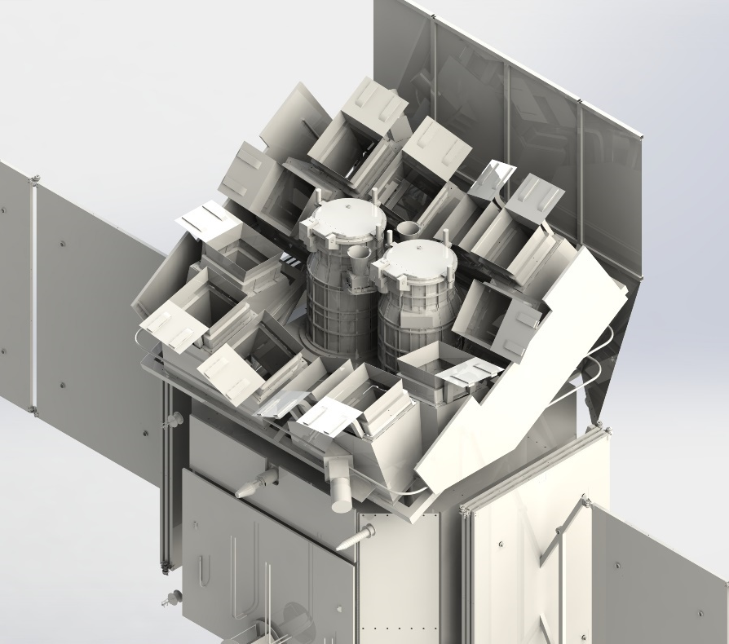
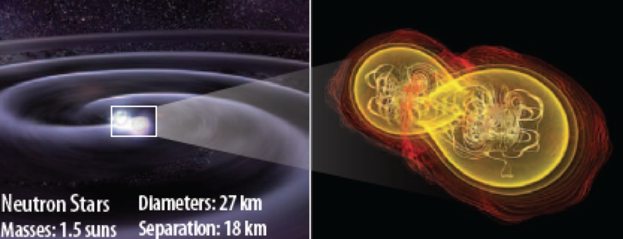
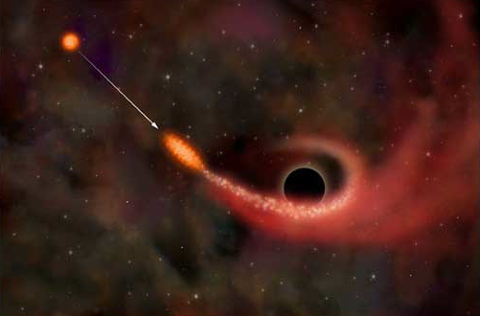



Einstein Probe
EP mission: CAS、ESA、MPE、CNES
time-domain high-energy astrophysics
Primary Goals: discover high-energy transients and monitor variable objects;
FOV: 3600 square degrees
Spatial Resolution: FWHM ~5 arcmin
Instruments: Wide-field X-ray Telescope (WXT)
Follow-up X-ray Telescope (FXT)
Weight: ～1400 kg
Average Power: ～1212 W in total
Launch Time: the end of 2023
Lifetime: 3 years (5 years as a goal)
Now: Phase D

Slide 4
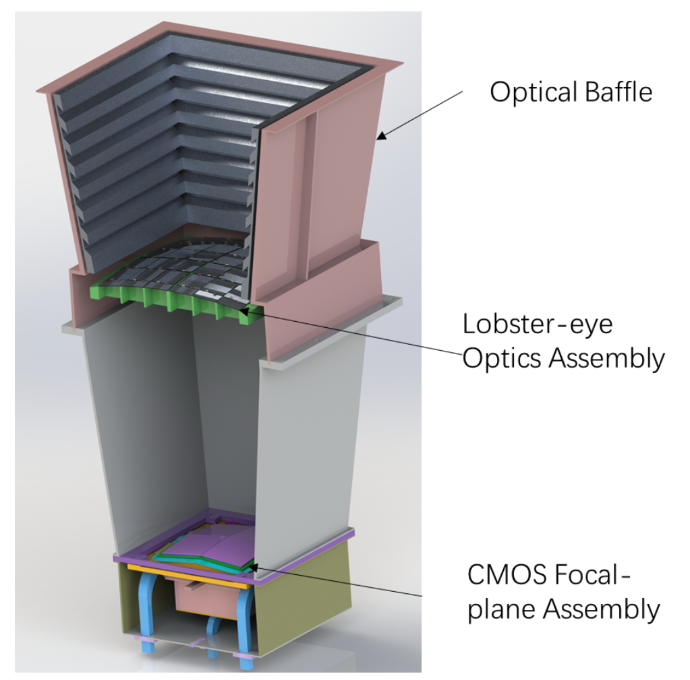
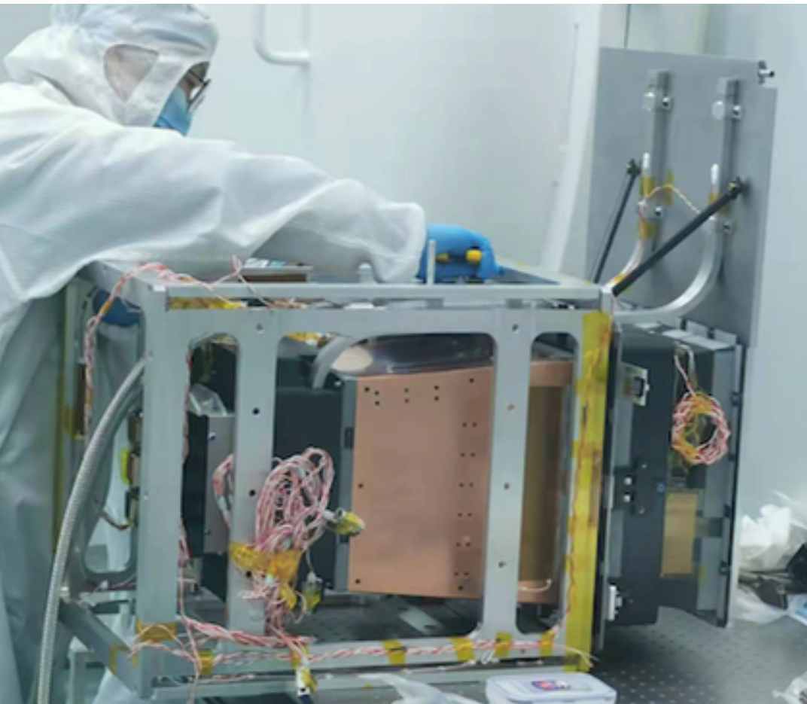
Wide X-ray Telescope(WXT)
Parameter | Specification
Focal Length | 375mm±2%
FOV | ≥ 3600 square degrees
Modules | 12
Effective Area | ≥2.7cm²@1keV
Angular Resolution | ≤5′ @1keV
Energy Resolution | ≤170 eV@ 1.25 keV
Energy Range | 0.5~4.0 keV
Location Accuracy | <1′
Time Resolution | ≤0.05 s
WXT module in Phase C

Slide 5
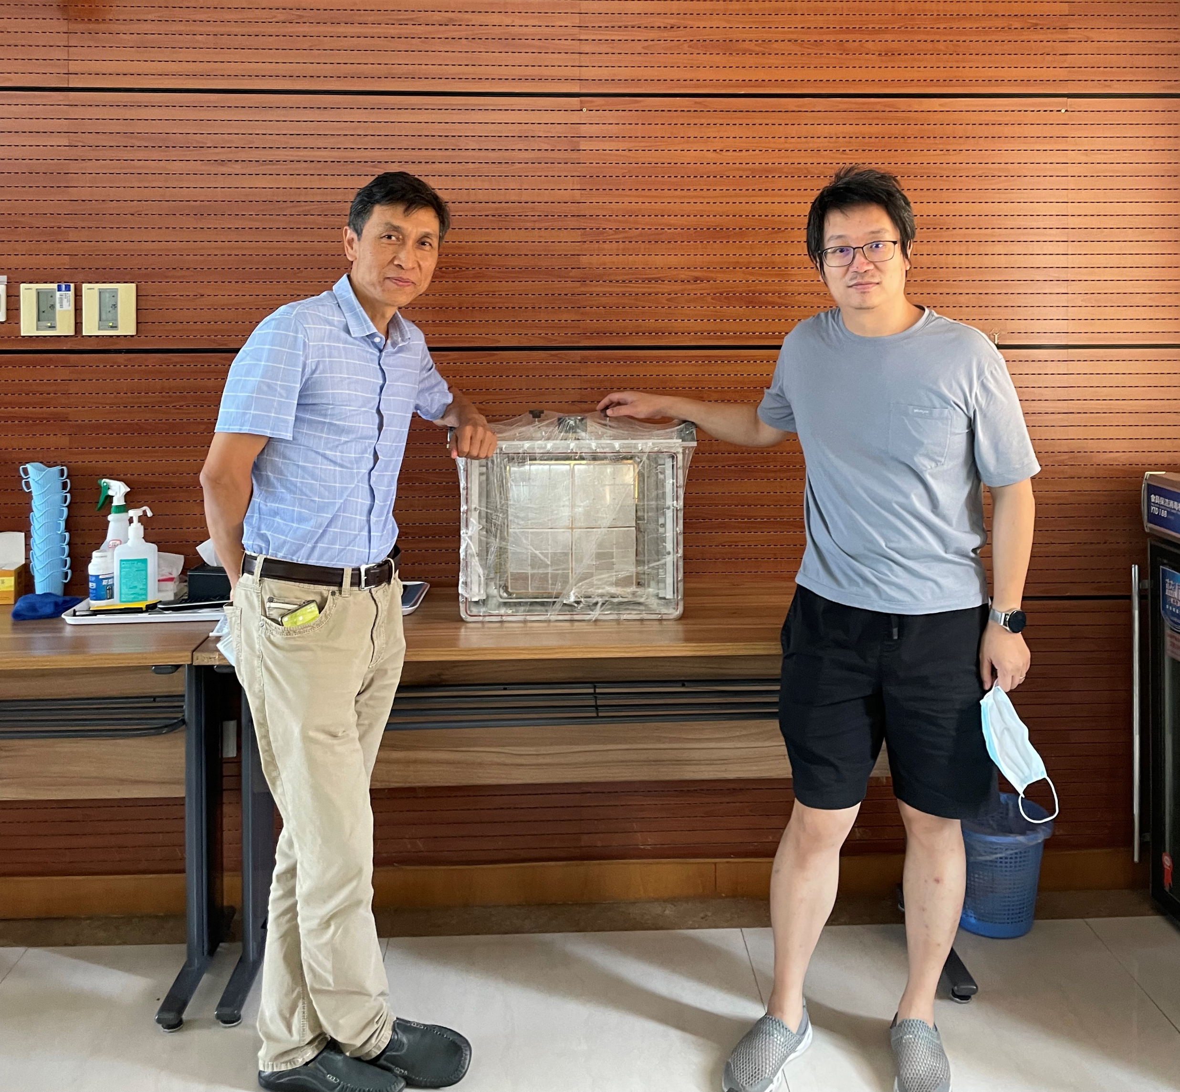
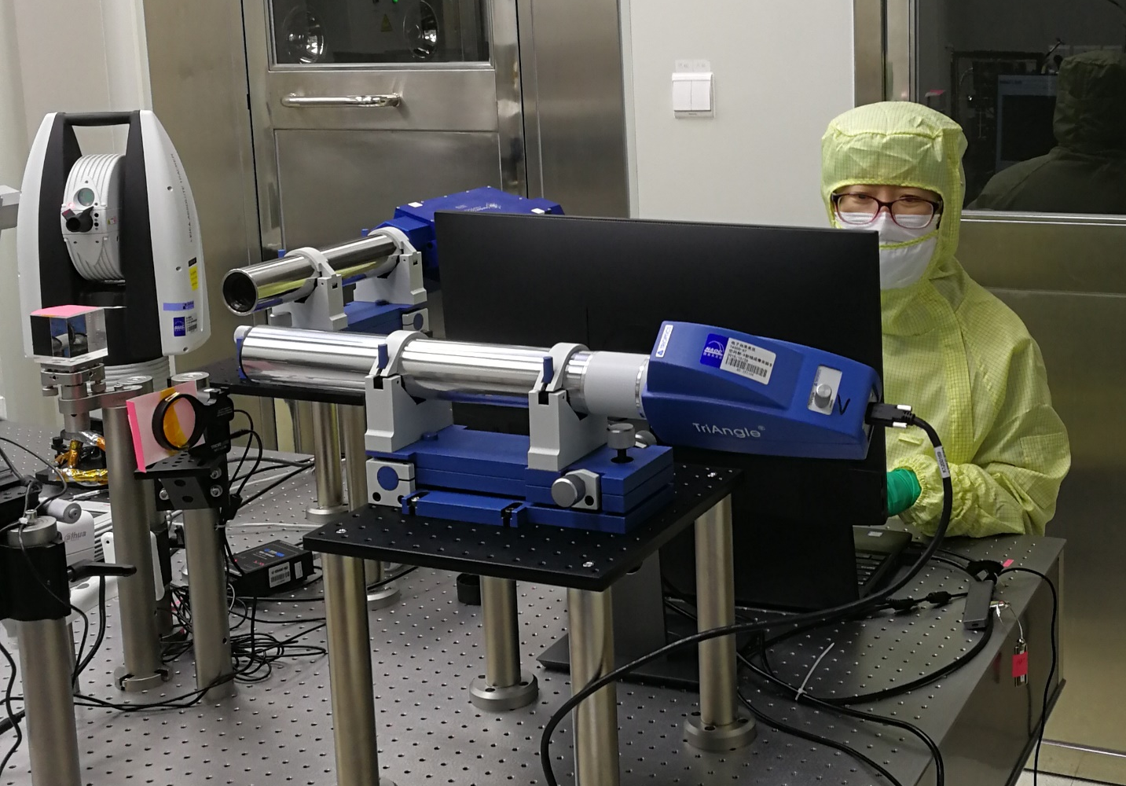
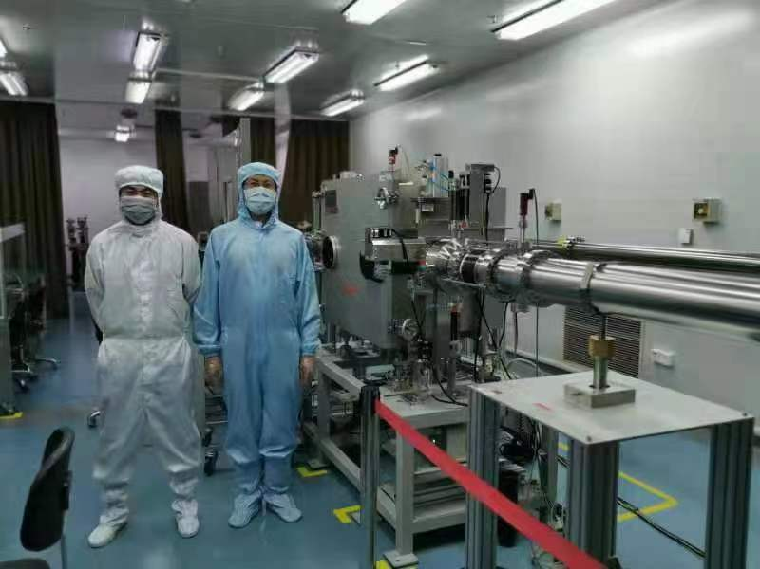
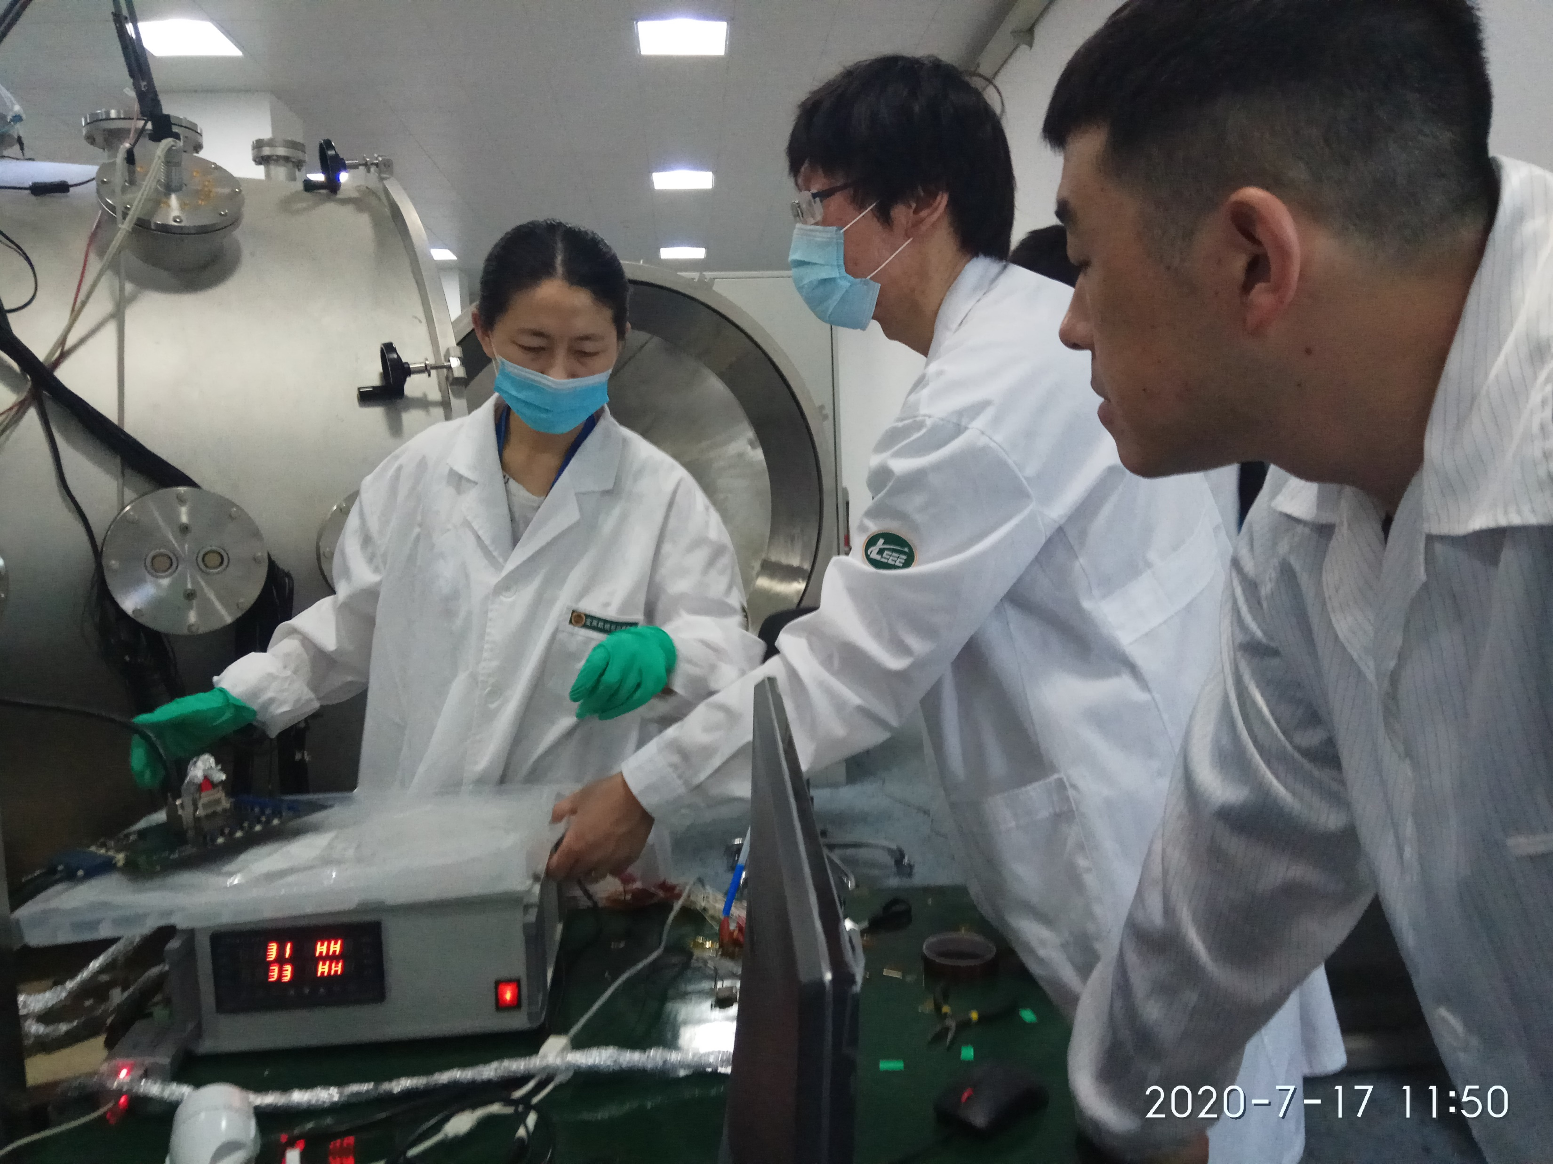
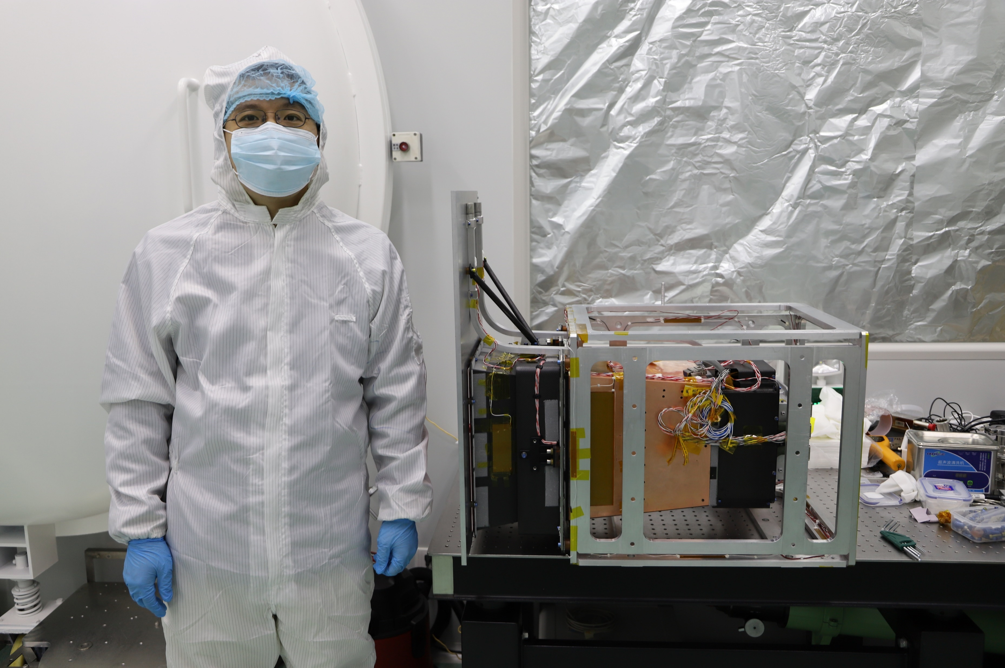
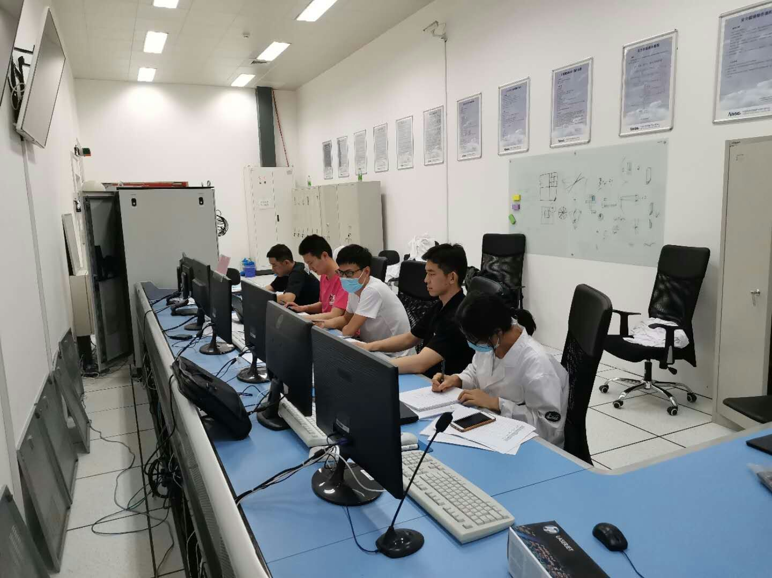
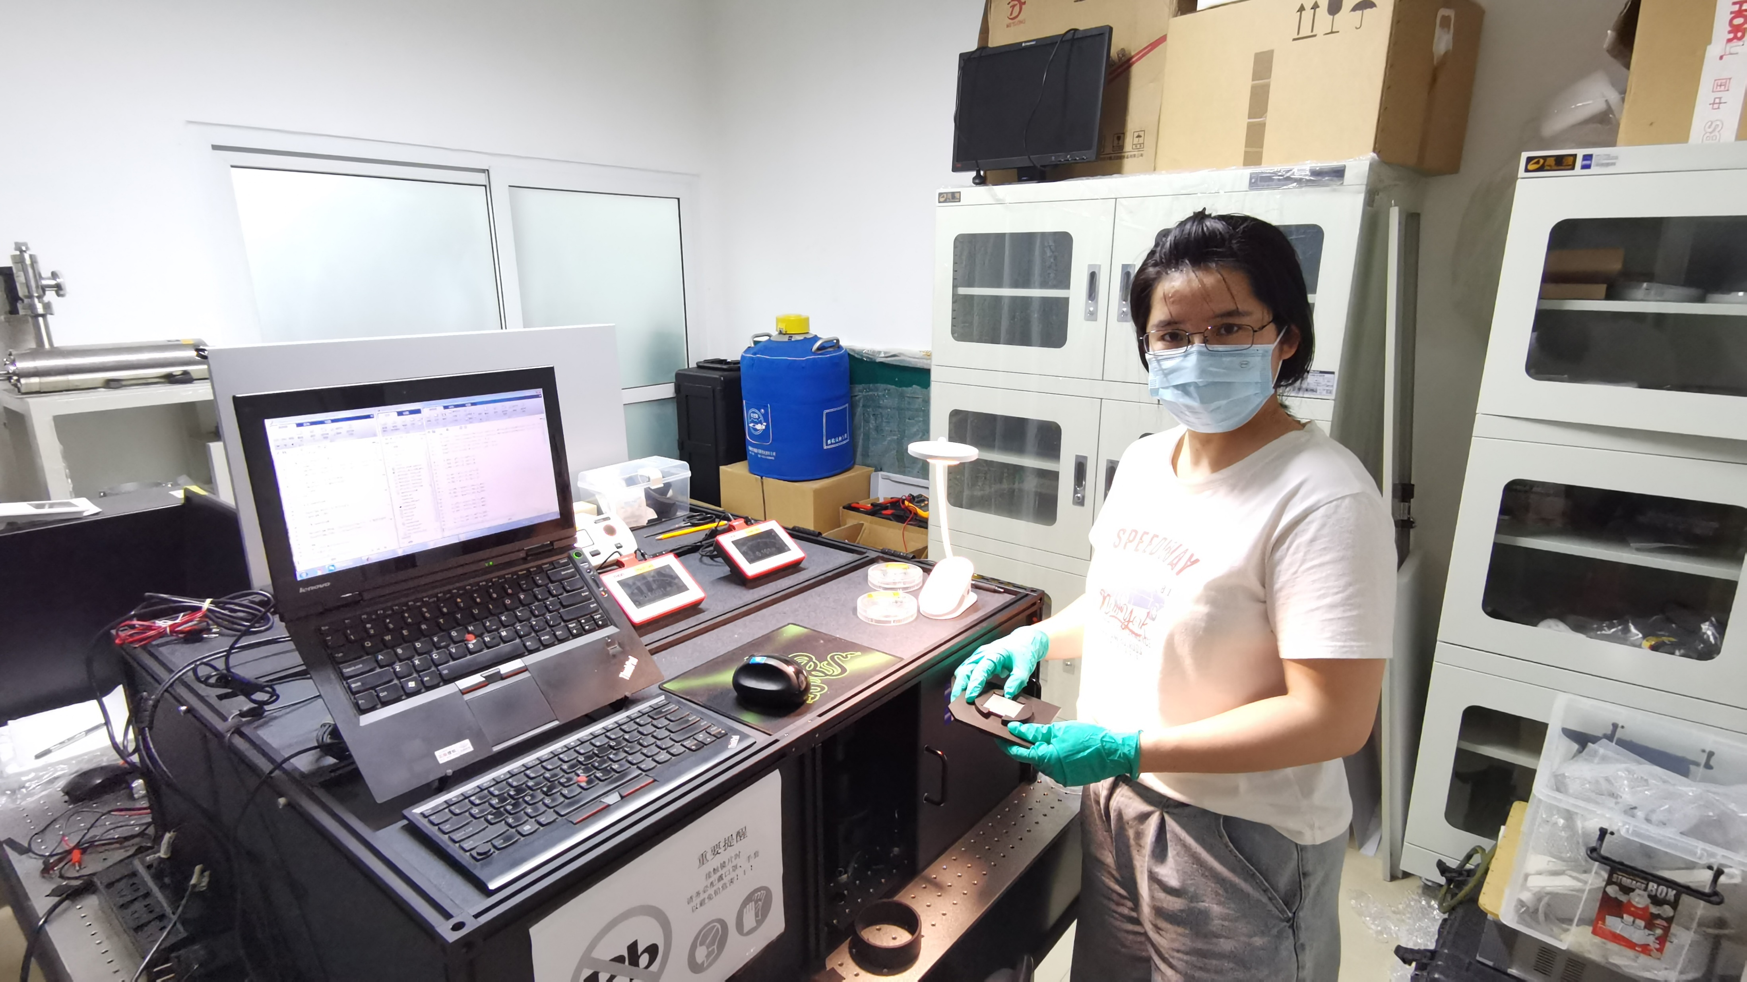
WXT Team
National Astronomical Observatories, CAS (NAOC)
North Night Vision Technology Co.,LTD(NNVT)
Shanghai Institute of Technical Physics, CAS (SITP)
Innovation Academy for Microsatellites, CAS (IAM)
University of Leicester (LU)
Max Planck Institute for Extraterrestrial Physics (MPE)

Slide 6
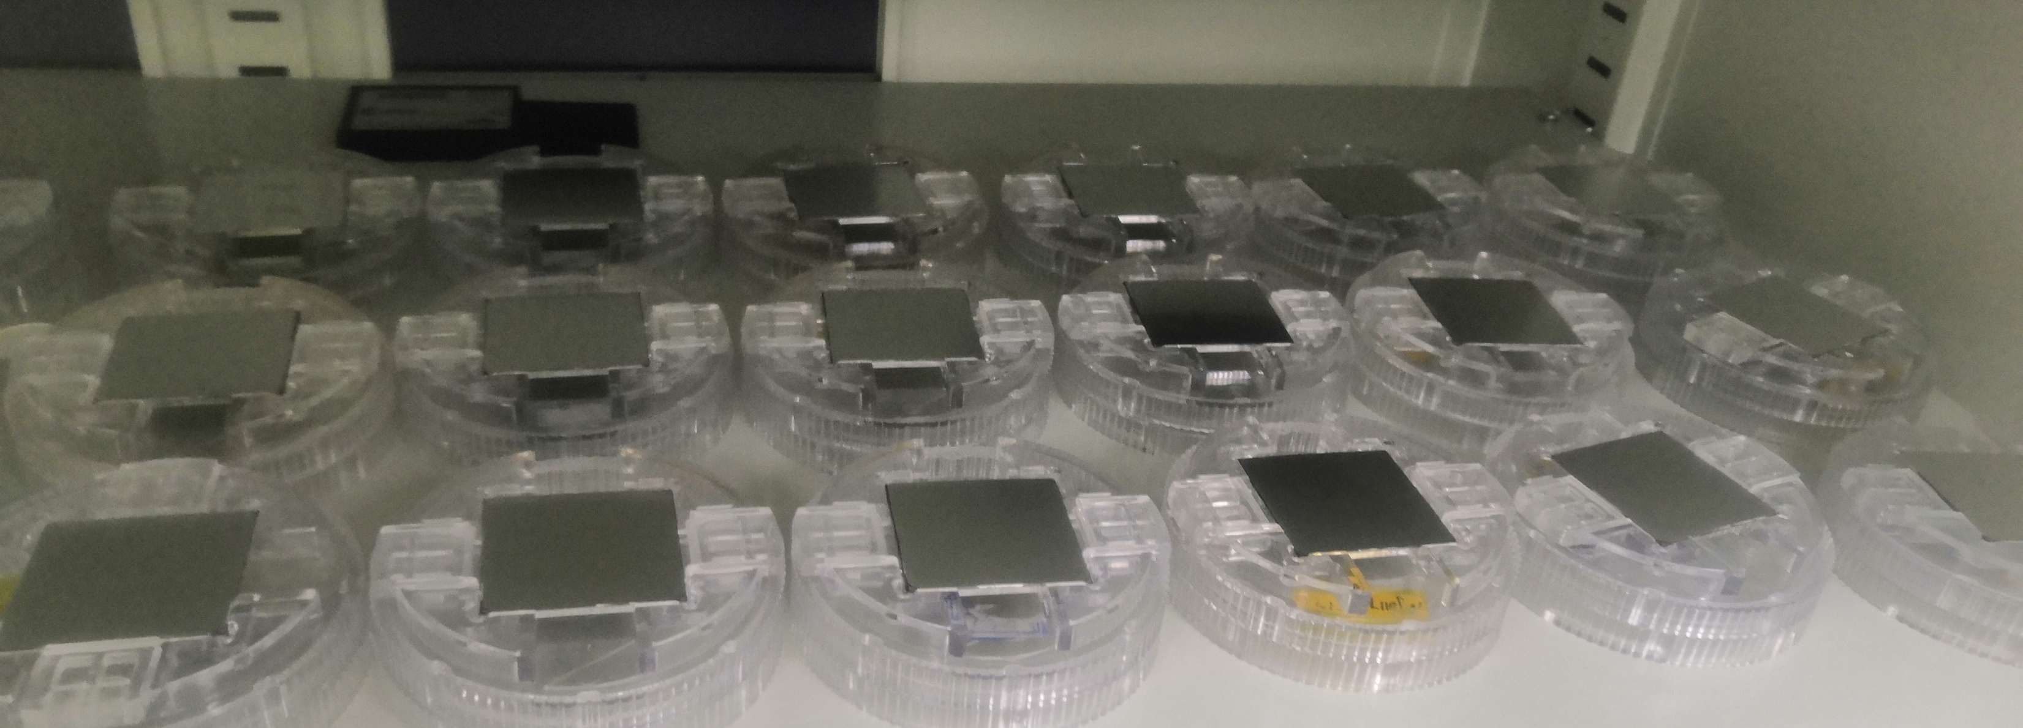
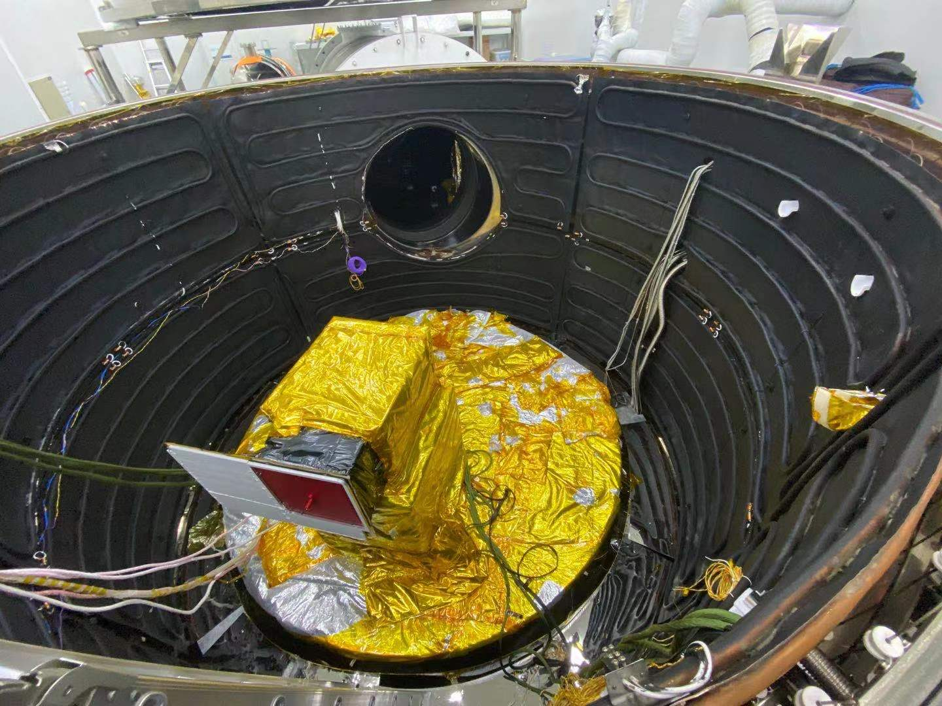
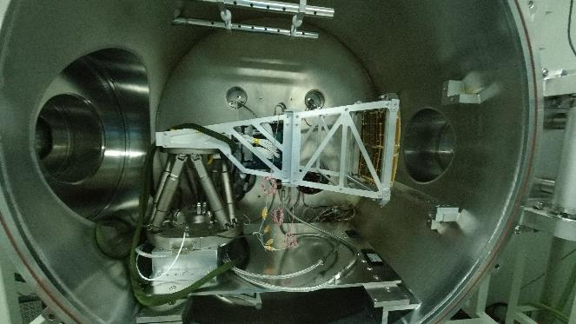
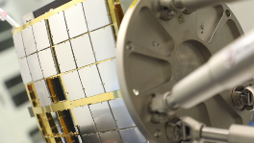
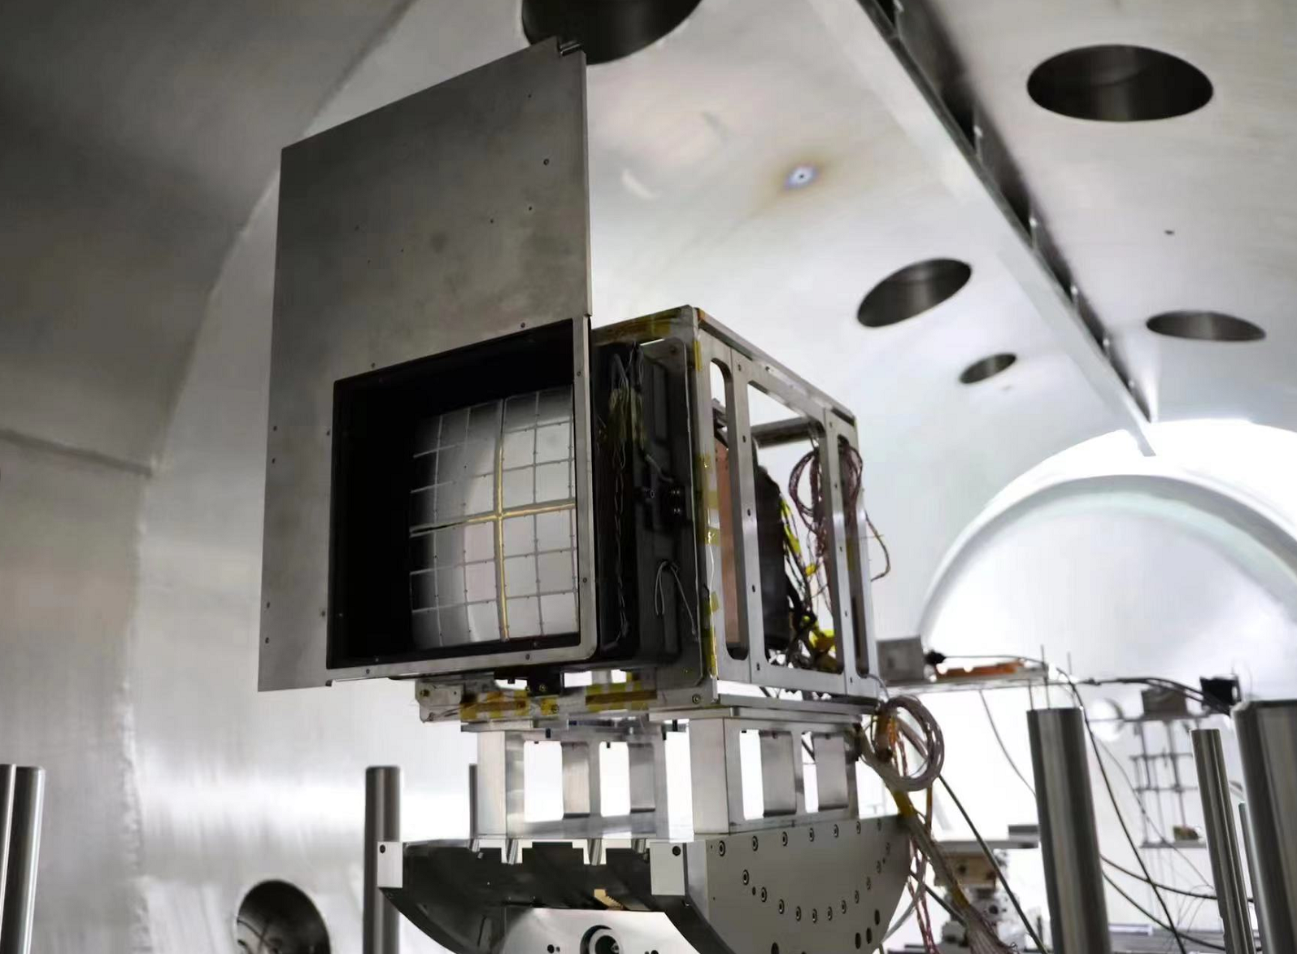
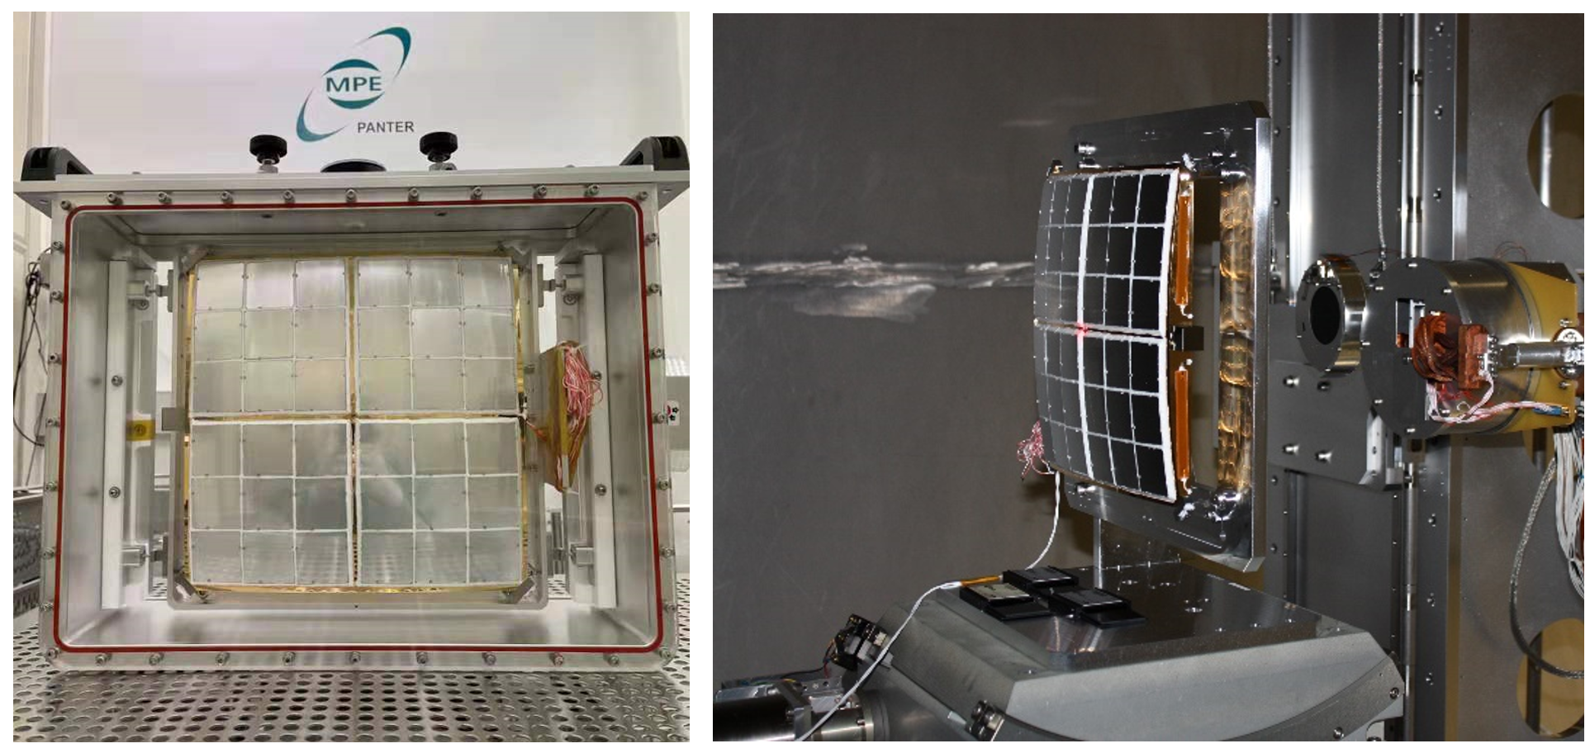
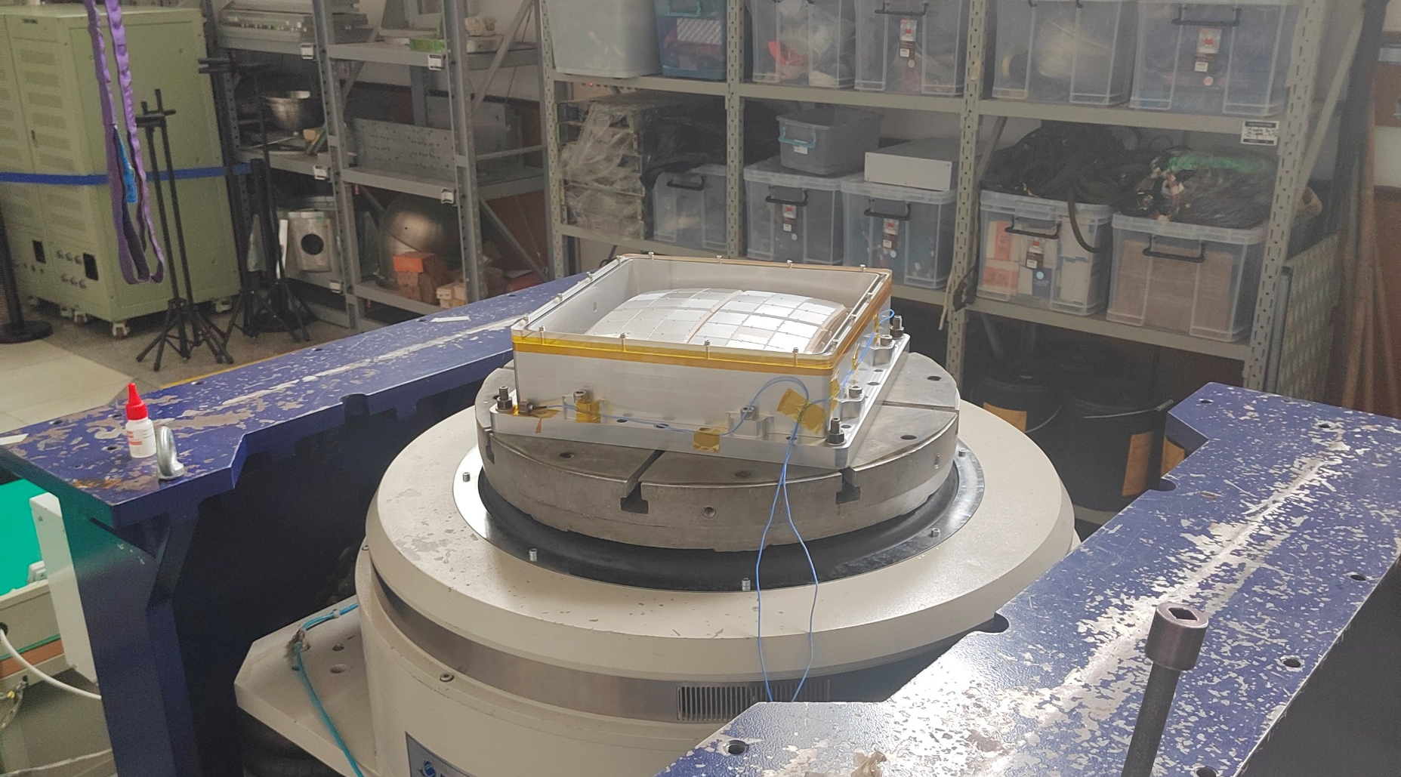
Ground Calibration Processes
MPO Plate@NNVT(~600 Plates)
WXT Module Thermal Balance Test @SITP
Optics Assembly Calibration @NAOC(3 QMs, 12FMs)
Optics Assemblies@NAOC (3 QMs, 12FMs)
Optics Assembly Calibration @PANTER(OQM3, OFM5)
Vibration@NAOC
WXT Module Calibration@IHEP

Slide 7
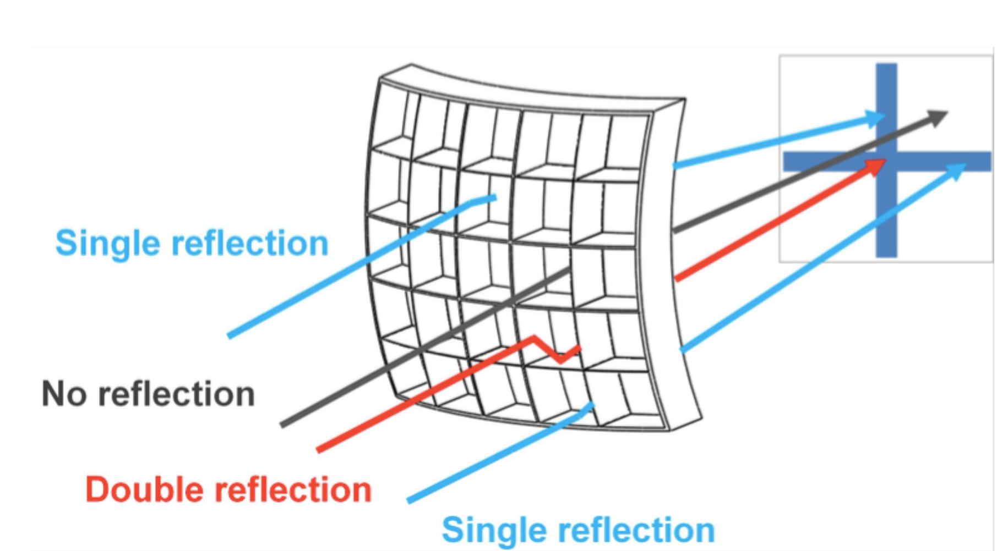
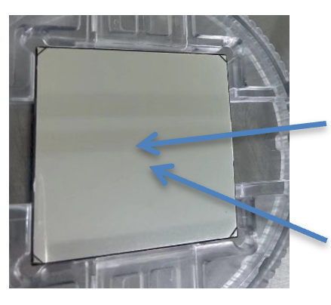
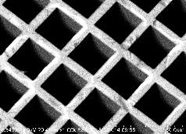
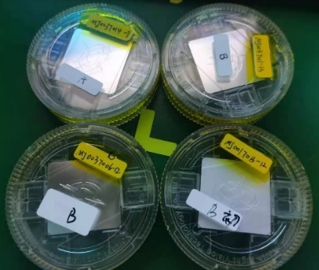
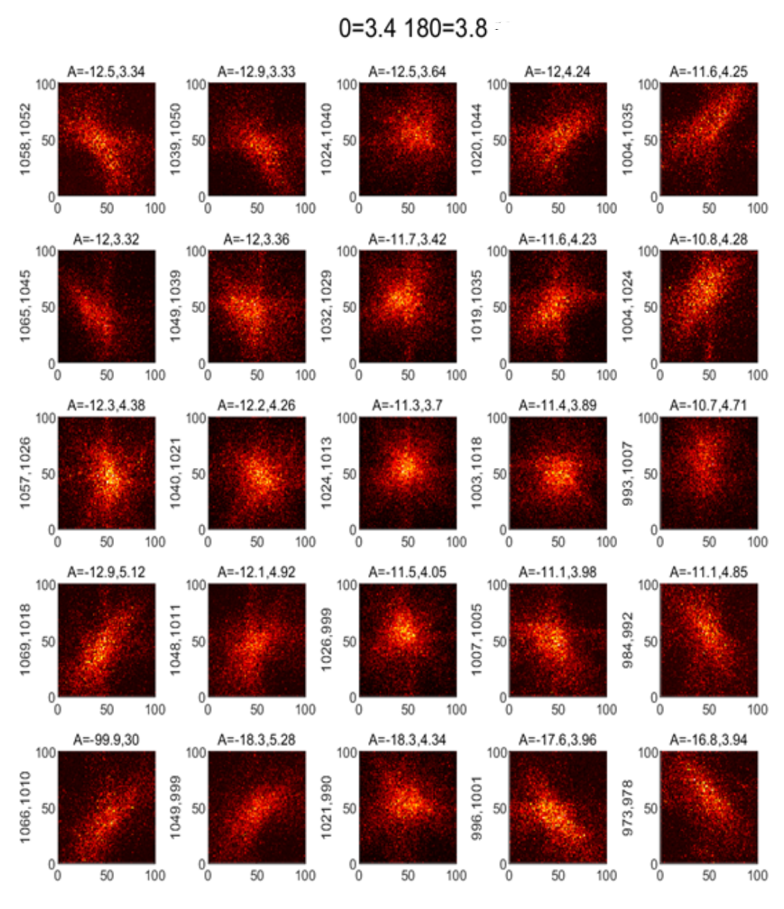
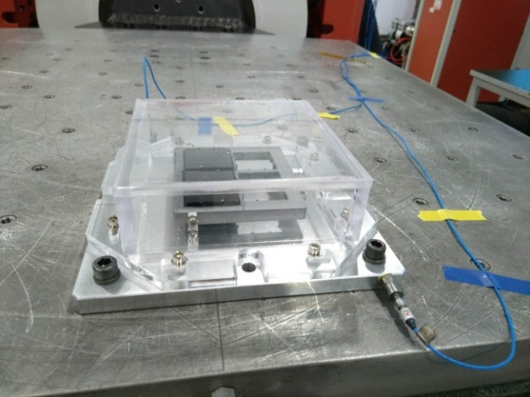
MPO Plates Status
Shock and Vibration
5×5 X-ray Scan

Slide 8
MPO Plates Test
Performance statistics
Angular Resolution | WXT Phase C |  | WXT Phase D
 | Num. | Percent | Num. | Percent
<3.5′ | 0 | 0.00% | 7 | 3.07%
3.5′ -4′ | 32 | 28.07% | 109 | 47.81%
4′-4.5′ | 35 | 30.70% | 112 | 49.12%
4.5′-5.0′ | 47 | 41.23% | 0 | 0
Total | 114 | 100% | 228 | 100%
MC9047006-14 in NAOC
MC9047006-14 in LU
Effective Area | WXT Phase C |  | WXT Phase D
 | Num. | Percent | Num. | Percent
95%-100% | 4 | 10.53% | 28 | 12.28%
90%-95% | 12 | 31.58% | 60 | 26.32%
85%-90% | 22 | 57.89% | 140 | 61.40%
Total | 38 | 100% | 228 | 100%
Comparative test in LU&NAOC：
Sep. 2019, Phase C ;
3 MPO plates:
1 poor ;1 Good; 1 Avg.
Results were in good agreement.

Slide 9
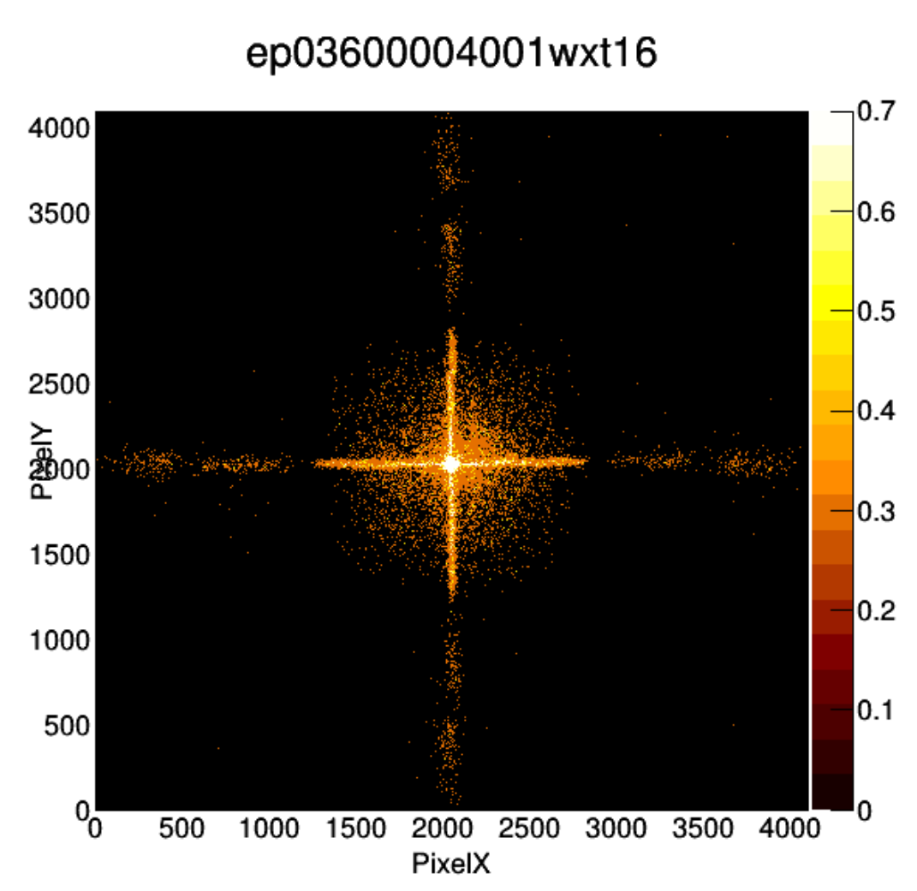
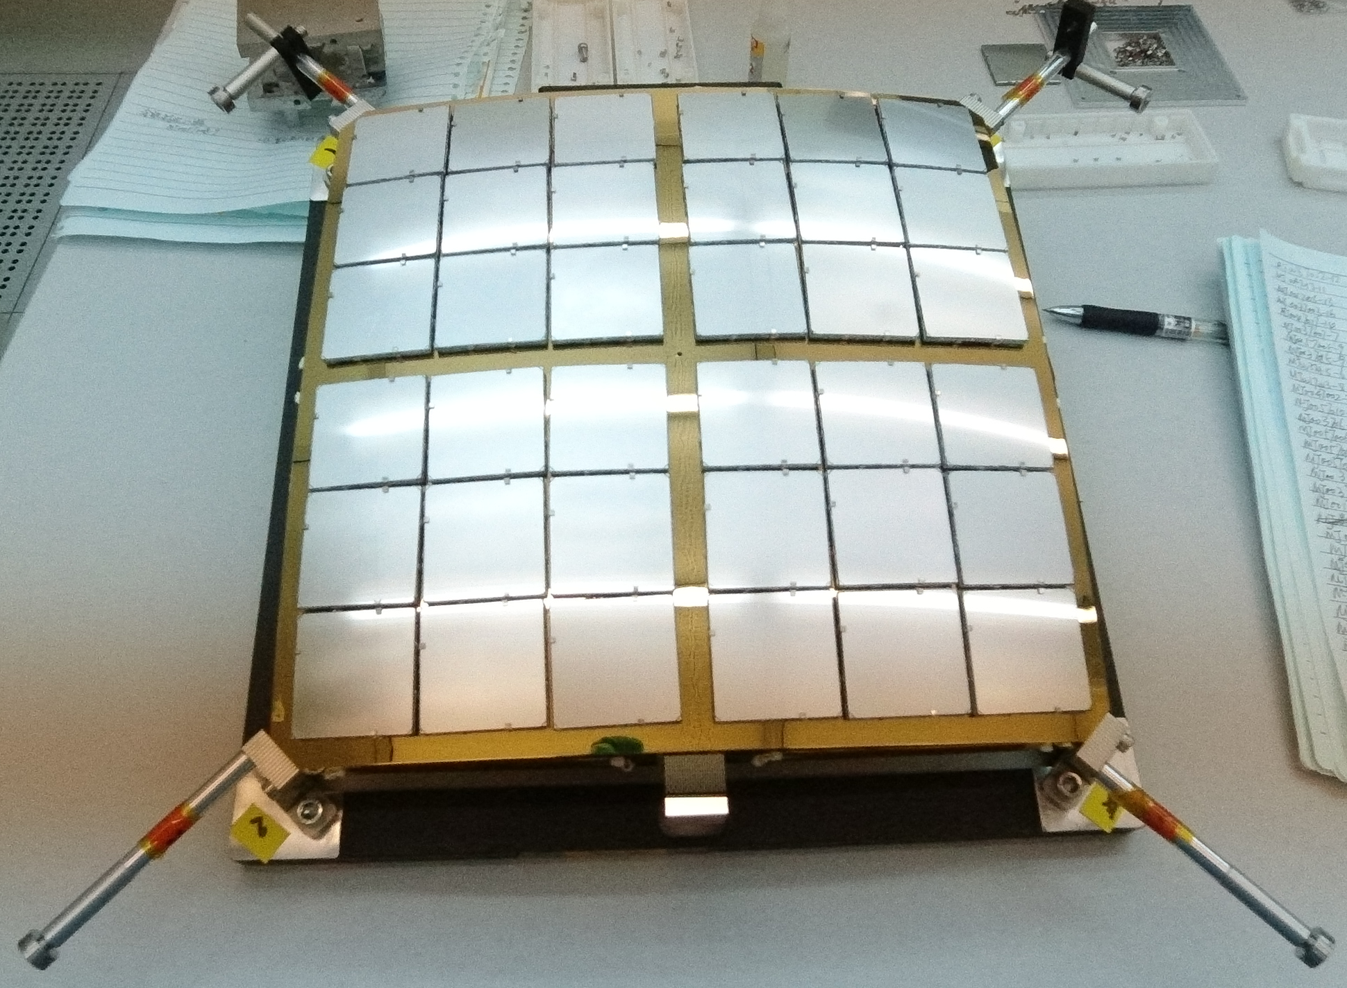
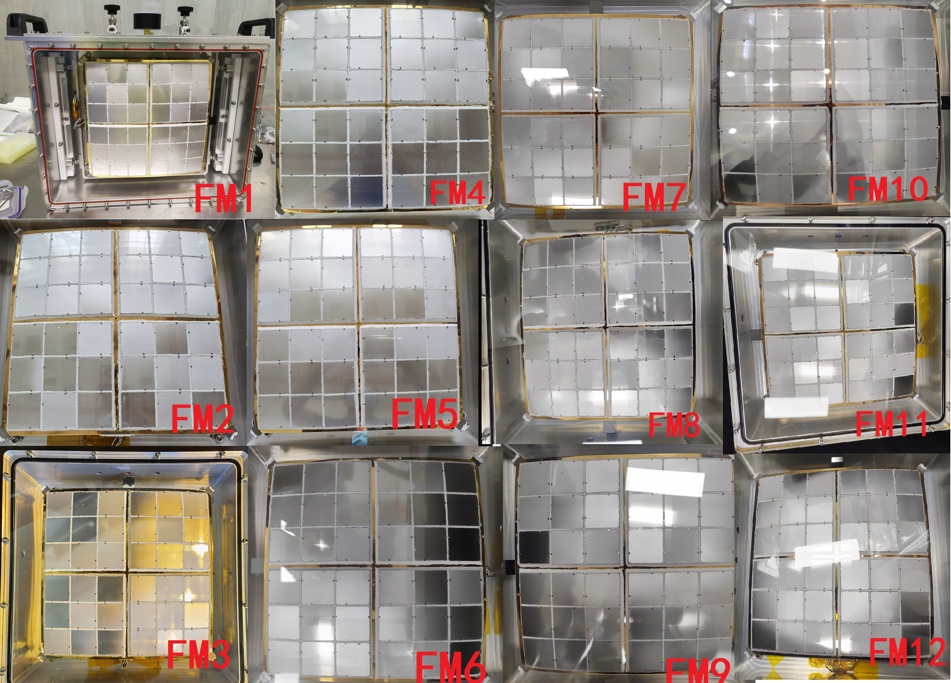
Optics Assemblies Status
2020
OQM3(2021.1) OQM3 point error (arcsec)
OQM3 PSF@Panter
Point Error (arcsec) after Mounting MPO Plates of All FMs

Slide 10
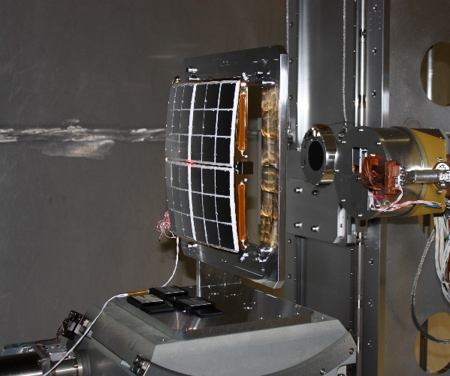
Ground Calibration Status(Phase D)
Effective Area, PSF
Source Positioning Accuracy
Effective Area, Focus Search
Focal Plane Mapping
Effective Area, PSF
Source Positioning Accuracy
2020
12 assemblies calibration
@NAOC Done
Data analysis is carrying on.
1 assembly calibration
@Panter Done
3 modules calibration
@IHEP
1 done, 2 going on

Slide 11
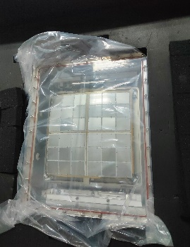
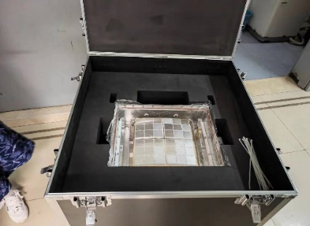
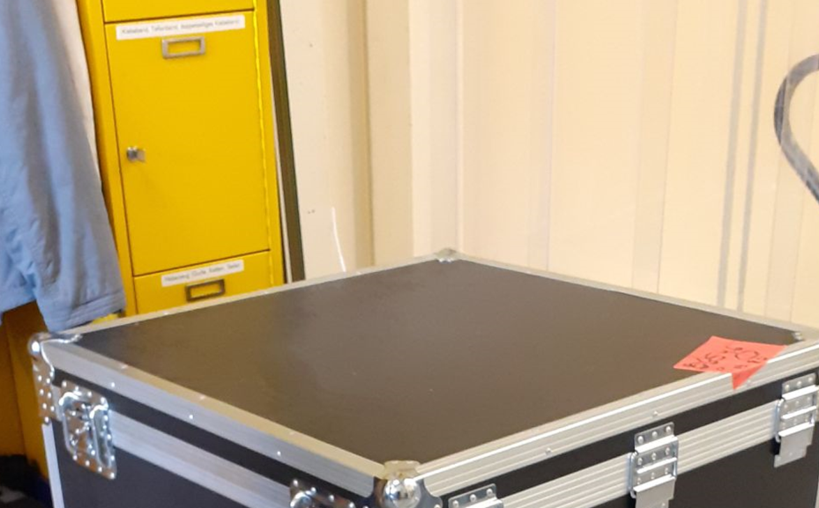
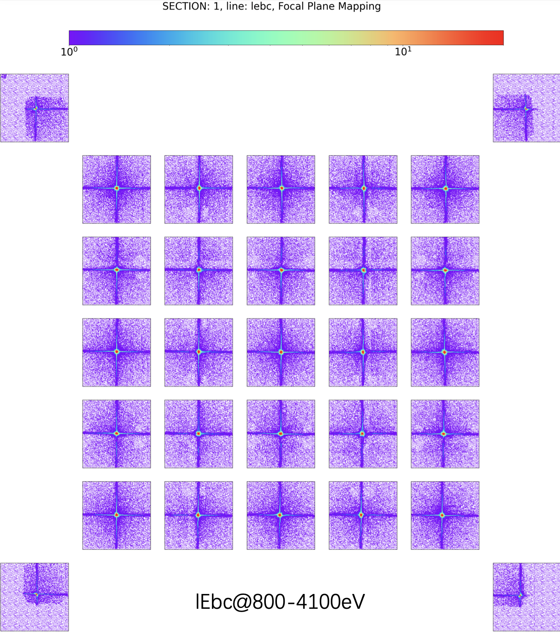
Calibration@PANTER
Sep. 5 2022 OFM5@NAOC
Sep. 20 2023@MPE
OFM5@PANTER
Dec. 29 2022 Back to NAOC
Optics Assembly Calibration@Panter
 | LEIA(OQM3) | EP OFM5
Focal Length | 375mm | 375mm
FOV | >18*18 | >18*18
Angular Resolution | Best 4′ Arg<5′ | Best 3′，Arg<4.5′
Effective Area | >95% | >95%
Panter Results

Slide 12
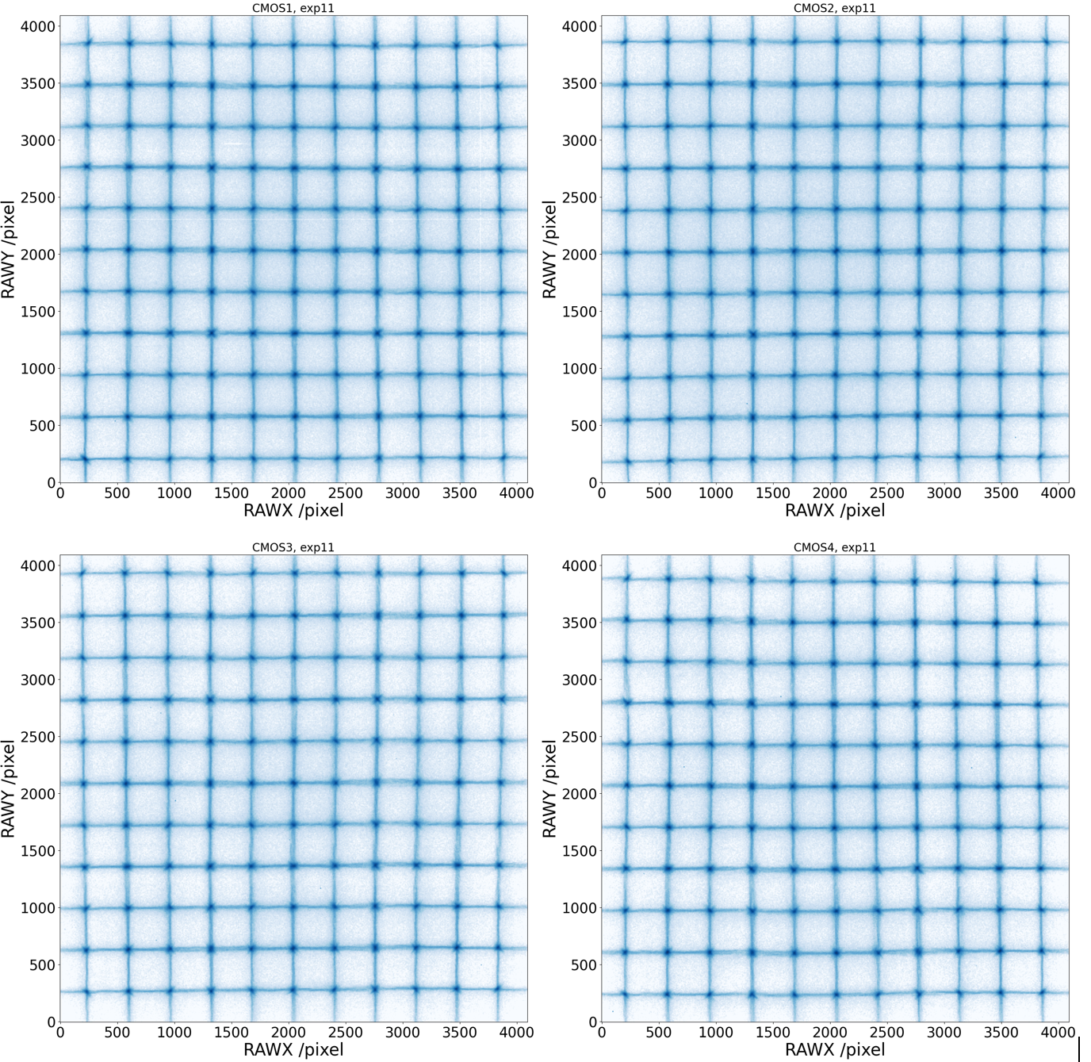
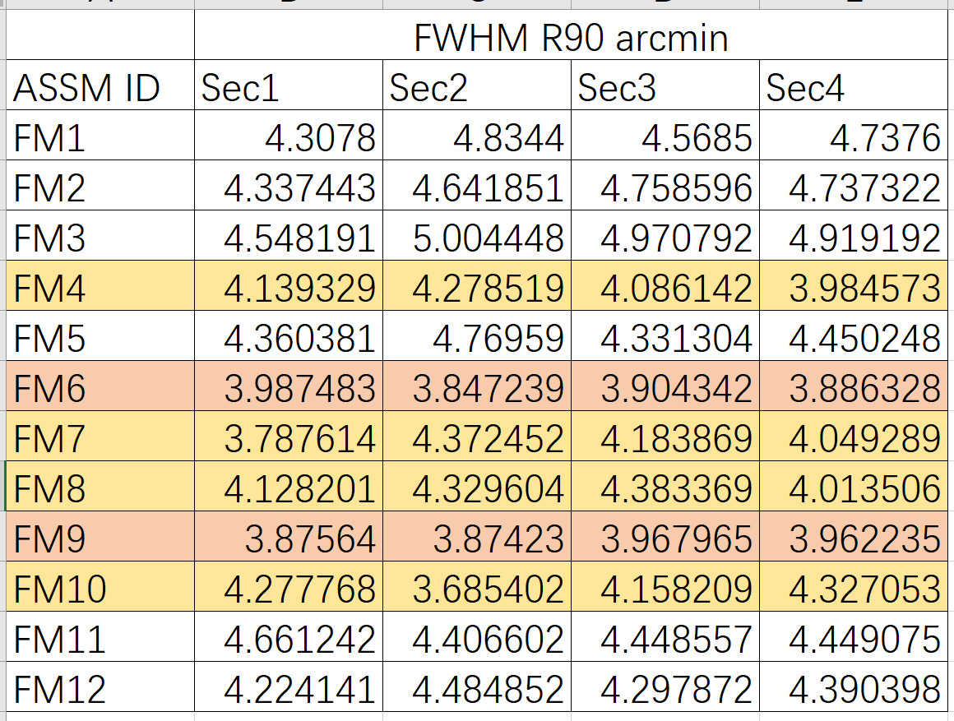
Calibration @ NAOC IHEP
Optics Assemblies FMs Calibration @NAOC
No misalignment
WXT FM1 Calibration @IHEP

Slide 13
Summary
MPO plates are the key
    Comparative test- done, all parameters - provided.
    Best chip: 3’, Avg : <4.5’。
Optics assemblies status
    Optics assemblies -finished (2023.3).
    No misalignment. Hard work.
    The data analysis - in progress, preliminary results - further update
    WXT Modules status
    12 EP-WXT Flight Modules :OK
    1 Module- On-ground calibration OK(2022.8)；
    1 Module(OFM5@Panter) and 1 Module(Good) – calibration going on(2023.5)
    EP, Good luck! Email: yanfeng.dai@bao.ac.cn Tel. +8613621030075
2020

