Slide 1
XMM-Newton Calibration Updates
Michael Smith, ESAC
(Ivan Valtchanov, XMM Cal team)
15th IACHEC Meeting, 24 April 2023

Slide 2
XMM-Newton calibration releases over 2022/23
Astrometry: Time variable boresight - 2023 update XMM-CCF-REL-394
RGS: Update of the correction to the RGS Effective Area XMM-CCF-REL-395
EPIC-pn: Spatial CTI correction and energy scale in [6,9] keV for XMM-Newton
EPIC-pn in Full Frame and Extended Full Frame modes XMM-CCF-REL-391
Dedicated talk by I. Valtchanov in Detectors and Background WG session
EPIC-MOS: EPIC MOS contamination XMM-CCF-REL-390
EPIC MOS response XMM-CCF-REL-396
EPIC pn & MOS: Empirical correction of the EPIC effective area XMM-CCF-REL-388
Dedicated talk by Felix Fürst (later today)
Notes:
Astrometry and RGS eff area: annual/periodic updates using data up to the end of 2022.

Slide 3
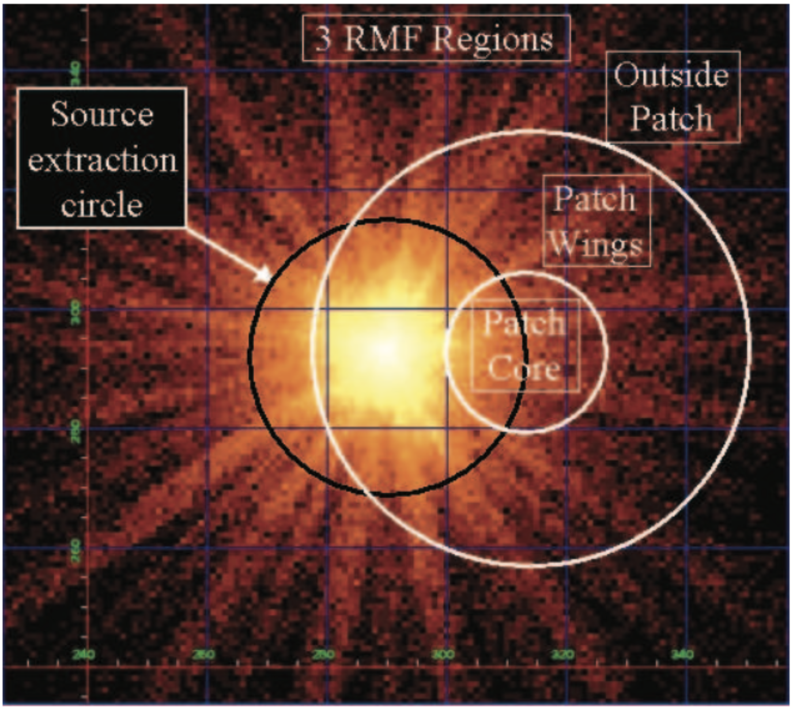
EPIC-MOS: contamination and redistribution
MOS cameras show time dependent changes in response due to
contamination (A_{eff} change < ~ 1 keV)
spatially dependent redistribution
patch core: r<14”
patch wings: 14<r<36”
off-patch: r> 40”
where main photo peak “shoulder” flattens into a “shelf” in patch
Are corrected for in calibration (contaminant model; epochal & spatially dependent RMFs) but need periodic updates. Previous major updates were in 2013.
Degeneracy: a given RMF solution is dependent on the A_{eff}.
Current methodology:
Update contaminant model (off-patch data from SNR 1E 0102)
Update RMF based on new A_{eff} estimate
Notes:
How the new Aeff is estimated? 1: contamination updates Aeff and then with the Aeff the RMF si updated.

Slide 4
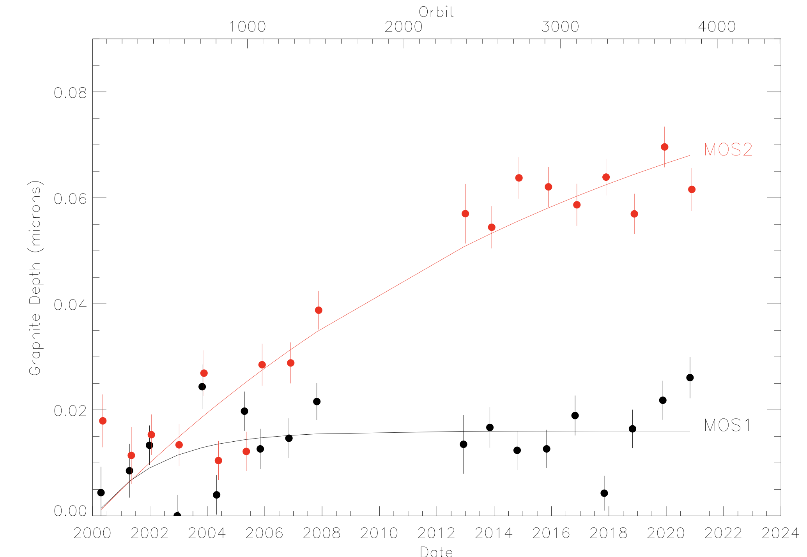
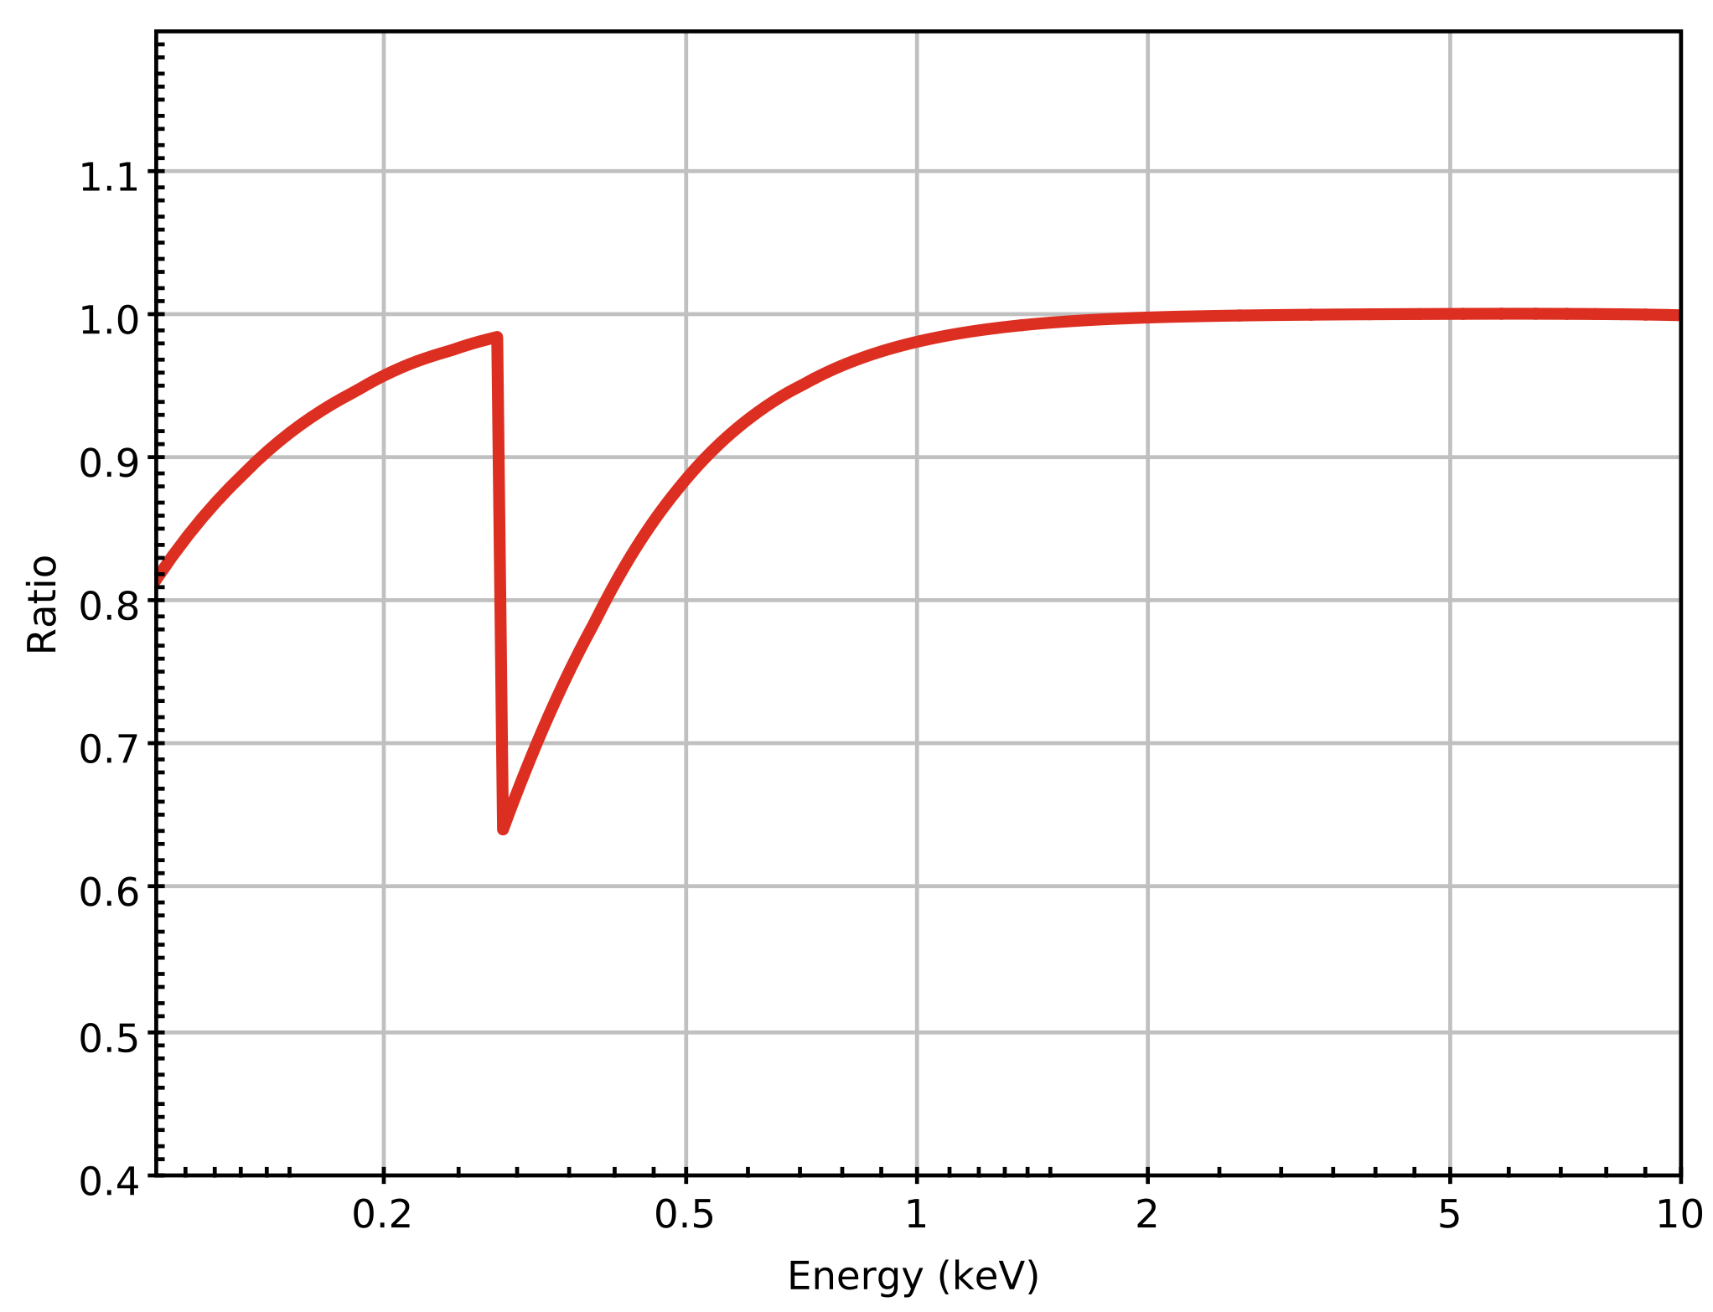
EPIC-MOS: contamination
Measurement of contaminant based on off-patch observations of SNR 1E0102-7219
Modelled as pure C
Depth determined by the ratio of observed count rates in 0.1 - 0.75 keV and 0.98 - 3.0 keV bands
Depth as function of time modelled by an exponential (MOS2)
Ratio of the MOS2 effective area curves from
revolutions 3652 (~2019) and 1082 (~2005)
S.Rosen
Notes:
Why there is a gap from 2008 to 2013? To ask Simon/Jari

Slide 5
EPIC-MOS: redistribution
Redistribution:
Last significant update was in 2013
New release is a substantial extension of the time-base: 5 new epochs of 300 revs each, from 2013 onwards
Built upon the latest update of MOS time-dependent contamination
Based on iterative adjustment of empirical RMF model, given data and assumed spectral models of
1E 0102-7219
Zeta Puppis
RX J1856.5-3754
Sources are observed on- and off-patch to allow
RMFs to be produced for on-patch, patch wings and off-patch regions

Slide 6
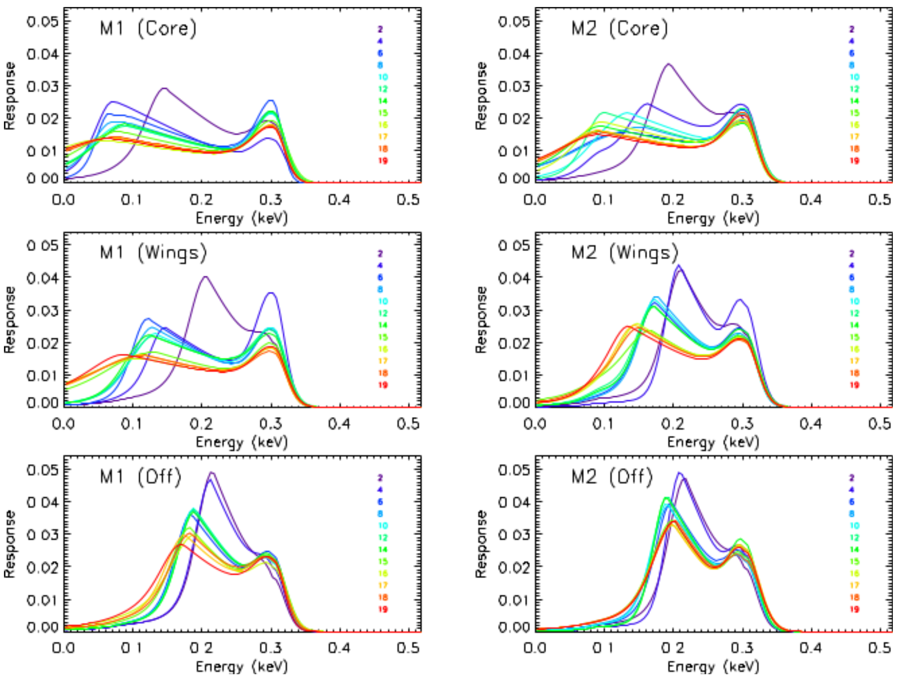
EPIC-MOS: redistribution
Epochal evolution of redistribution functions @ 300 eV
Previous broad temporal behaviour continues
Especially for the core and wings regions:
Drift to lower energies of the peak of the low-energy shoulder component
Broadening of its low energy wing
S.Rosen
Notes:
Colour coded are the epochs. More important for core and wings and less so for off patch

Slide 7
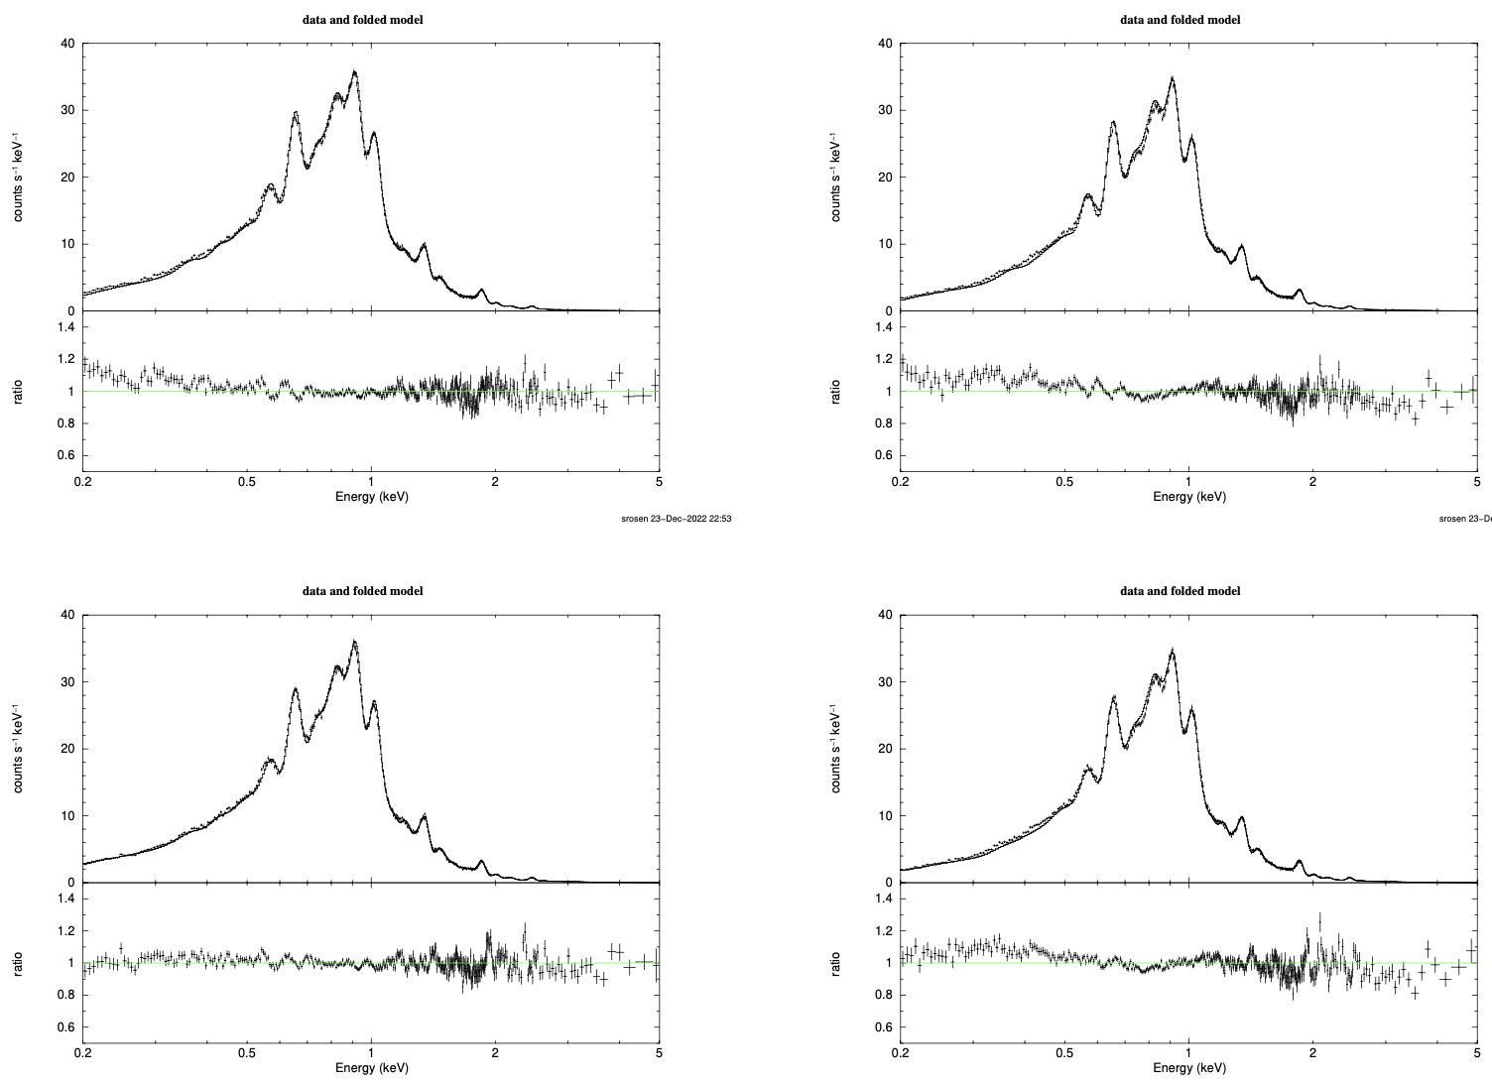
EPIC-MOS: contamination and redistribution
MOS1
N 132D
MOS2
Results tested on:
RX J1856 and N 132D: spectral fits (using IACHEC models, free overall normalisation) show significant improvement in fit quality.
RX J1856: temporal flux stability (in 0.2-0.5 keV band) is maintained.
RX J0720.4-3125: (NS, observed in rev 3636) is a case showing worsening results – could be due to uncertainties in the model used.
old calibration
new calibration
S.Rosen
Notes:
Temporal flux stability: is this something to check on my side for the SNR flux stability issues?

Slide 8
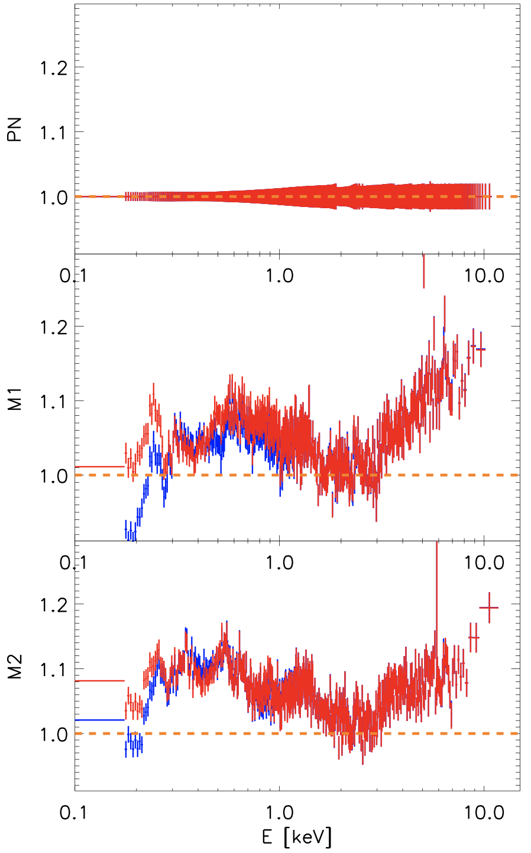
EPIC-MOS: contamination and redistribution
Stacked data/model, normalised to PN
Results tested on:
RX J1856 and N 132D: spectral fits (using IACHEC models, free overall normalisation) show significant improvement in fit quality.
RX J1856: temporal flux stability (in 0.2-0.5 keV band) is maintained.
RX J0720.4-3125: (NS, observed in rev 36363) is a case showing worsening results – could be due to uncertainties in the model used.
Sample of 37 sources: stacked data/model ratios used to evaluate MOS-to-PN cross calibration; improved consistency between MOS1 and PN at lowest energies.
old calibration
new calibration

Slide 9
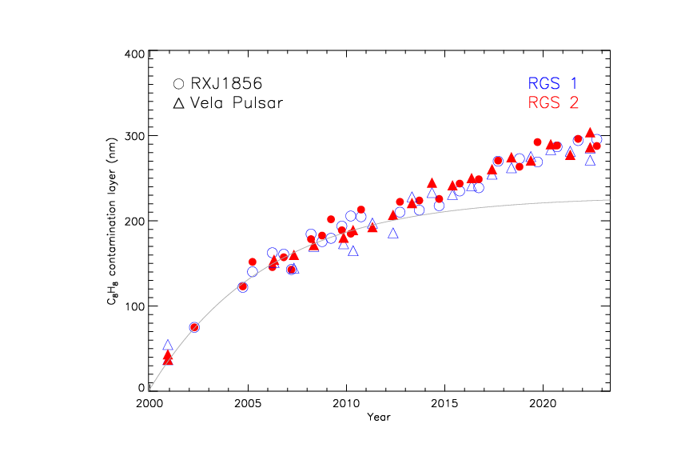
RGS: contamination and effective area
Extra contamination of
undetermined origin
Contamination estimated from the flux of the Isolated Neutron Star RX J1856-357 at long wavelengths.
Observed flux decrease not explained by C₈H₈ contamination.
Empirical corrections in place – latest update covers data taken until end of 2022.
R. González-Riestra
Notes:
The curve is the previous model?

Slide 10
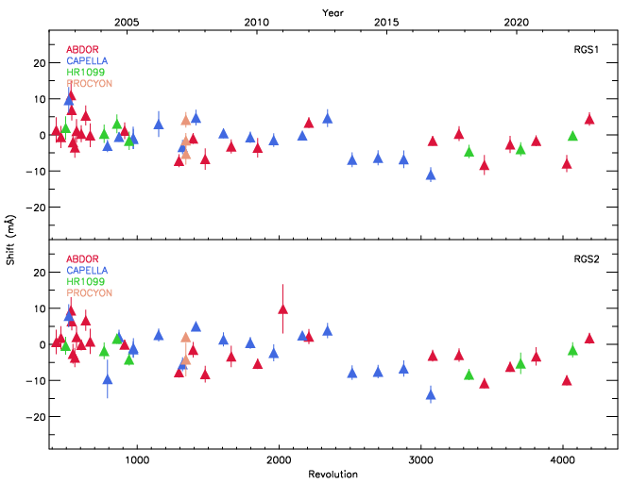
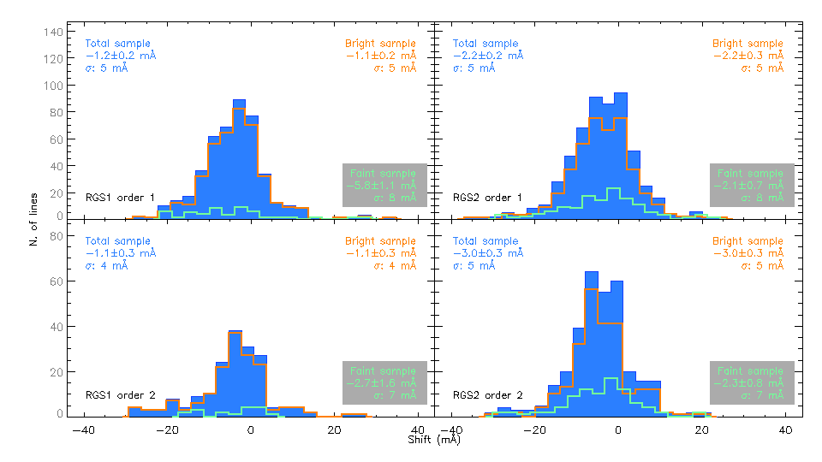
RGS: wavelength scale
Average wavelength shift of spectra of spectra of bright stars:
Measured shifts of emission lines in two samples of stars: “Bright” (orange) and “Faint” (cyan):
R. González-Riestra
Notes:
So, what’s the conclusion? No problems here? Within 5 mA

Slide 11
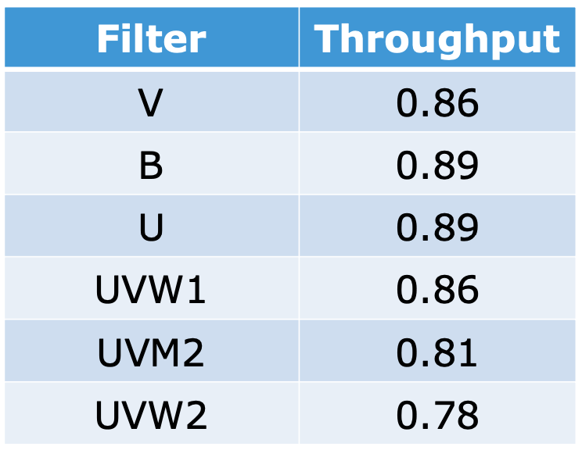
OM: time-dependent sensitivity degradation
OM throughput estimate for 2030:
Time-dependent degradation continues to be monitored, and is corrected in the SAS
S.Rosen
Notes:
Degradation to what? To magnitudes/flux, sensitivity, throughput?

Slide 12
The end

