Slide 1
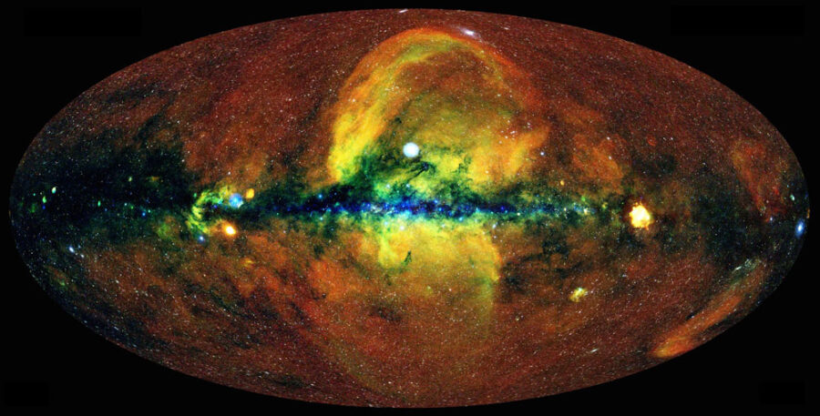
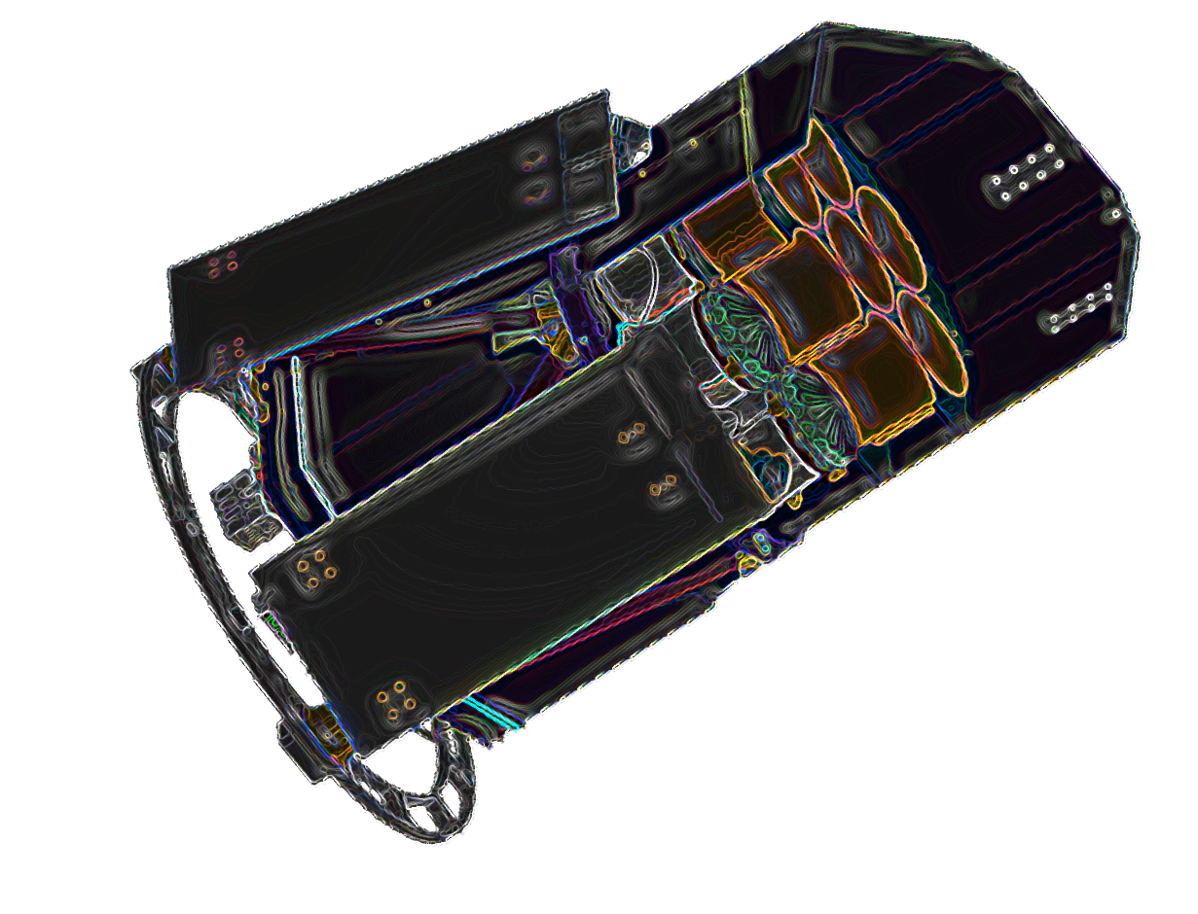
The energy calibration of eROSITA
Pelham, Germany
IACHEC, 2023 April 25
Konrad Dennerl, MPE

Slide 2
Energy Calibration: some eROSITA Specialties
onboard:
use of precomputed threshold maps for optimizing telemetry
compression mode ‚PMENV2‘ for scientific data
compression mode ‚PMALLSINGLES‘ for ⁵⁵Fe data
ground processing:
utilization of subpixel resolution
fast PSF focal plane mapping at high count rates
use of constant energy thresholds (in eV)
improved noise suppression for >1 pixel patterns
floating point PI values
RMFs and ARFs with non-constant bin sizes
CTI and gain adjustments to varying CCD temperatures
automatic refinement of RMFs and ARFs
efficiency:
only ~5 days needed for initial energy calibration on ground
only ~2 days per year needed for energy calibration in space

Slide 3
Energy Calibration: some eROSITA Specialties
onboard:
use of precomputed threshold maps for optimizing telemetry
compression mode ‚PMENV2‘ for scientific data
compression mode ‚PMALLSINGLES‘ for ⁵⁵Fe data
ground processing:
utilization of subpixel resolution
fast PSF focal plane mapping at high count rates
use of constant energy thresholds (in eV)
improved noise suppression for >1 pixel patterns
floating point PI values
RMFs and ARFs with non-constant bin sizes
CTI and gain adjustments to varying CCD temperatures
automatic refinement of RMFs and ARFs
efficiency:
only ~5 days needed for initial energy calibration on ground
only ~2 days per year needed for energy calibration in space

Slide 4
eROSITA Specialties

Slide 5
Energy Calibration: some eROSITA Specialties
onboard:
use of precomputed threshold maps for optimizing telemetry
compression mode ‚PMENV2‘ for scientific data
compression mode ‚PMALLSINGLES‘ for ⁵⁵Fe data
ground processing:
utilization of subpixel resolution
fast PSF focal plane mapping at high count rates
use of constant energy thresholds (in eV)
improved noise suppression for >1 pixel patterns
floating point PI values
RMFs and ARFs with non-constant bin sizes
CTI and gain adjustments to varying CCD temperatures
automatic refinement of RMFs and ARFs
efficiency:
only ~5 days needed for initial energy calibration on ground
only ~2 days per year needed for energy calibration in space

Slide 6
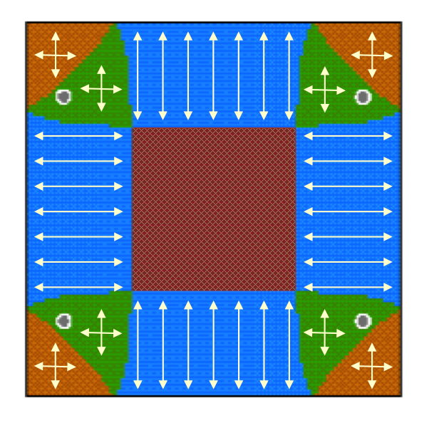
eROSITA Specialties
utilizing subpixel resolution for the mirror calibration
without subpixel resolution
from IACHEC 2011
with subpixel resolution

Slide 7
eROSITA Specialties
fast PSF Focal Plane Mapping at high count rates

Slide 8
Energy Calibration: some eROSITA Specialties
onboard:
use of precomputed threshold maps for optimizing telemetry
compression mode ‚PMENV2‘ for scientific data
compression mode ‚PMALLSINGLES‘ for ⁵⁵Fe data
ground processing:
utilization of subpixel resolution
fast PSF focal plane mapping at high count rates
use of constant energy thresholds (in eV)
improved noise suppression for >1 pixel patterns
floating point PI values
RMFs and ARFs with non-constant bin sizes
CTI and gain adjustments to varying CCD temperatures
automatic refinement of RMFs and ARFs
efficiency:
only ~5 days needed for initial energy calibration on ground
only ~2 days per year needed for energy calibration in space

Slide 9
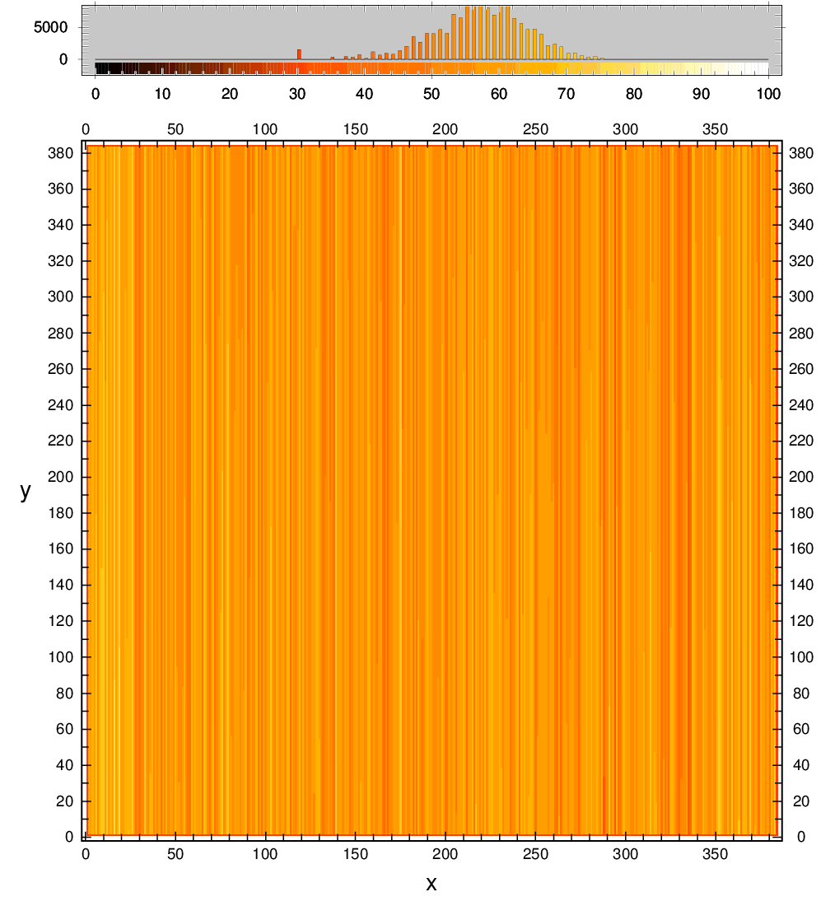
eROSITA Specialties
pattern recognition with constant energy thresholds in eV
the charge cloud..
..as it is created
..as it appears (gain & CTI)
released charge cloud in eV
released charge cloud in adu
TM4, Fe-K
split thresholds for TM4 in adu, computed for 65 eV

Slide 10
Energy Calibration: some eROSITA Specialties
onboard:
use of precomputed threshold maps for optimizing telemetry
compression mode ‚PMENV2‘ for scientific data
compression mode ‚PMALLSINGLES‘ for ⁵⁵Fe data
ground processing:
utilization of subpixel resolution
fast PSF focal plane mapping at high count rates
use of constant energy thresholds (in eV)
improved noise suppression for >1 pixel patterns
floating point PI values
RMFs and ARFs with non-constant bin sizes
CTI and gain adjustments to varying CCD temperatures
automatic refinement of RMFs and ARFs
efficiency:
only ~5 days needed for initial energy calibration on ground
only ~2 days per year needed for energy calibration in space

Slide 11
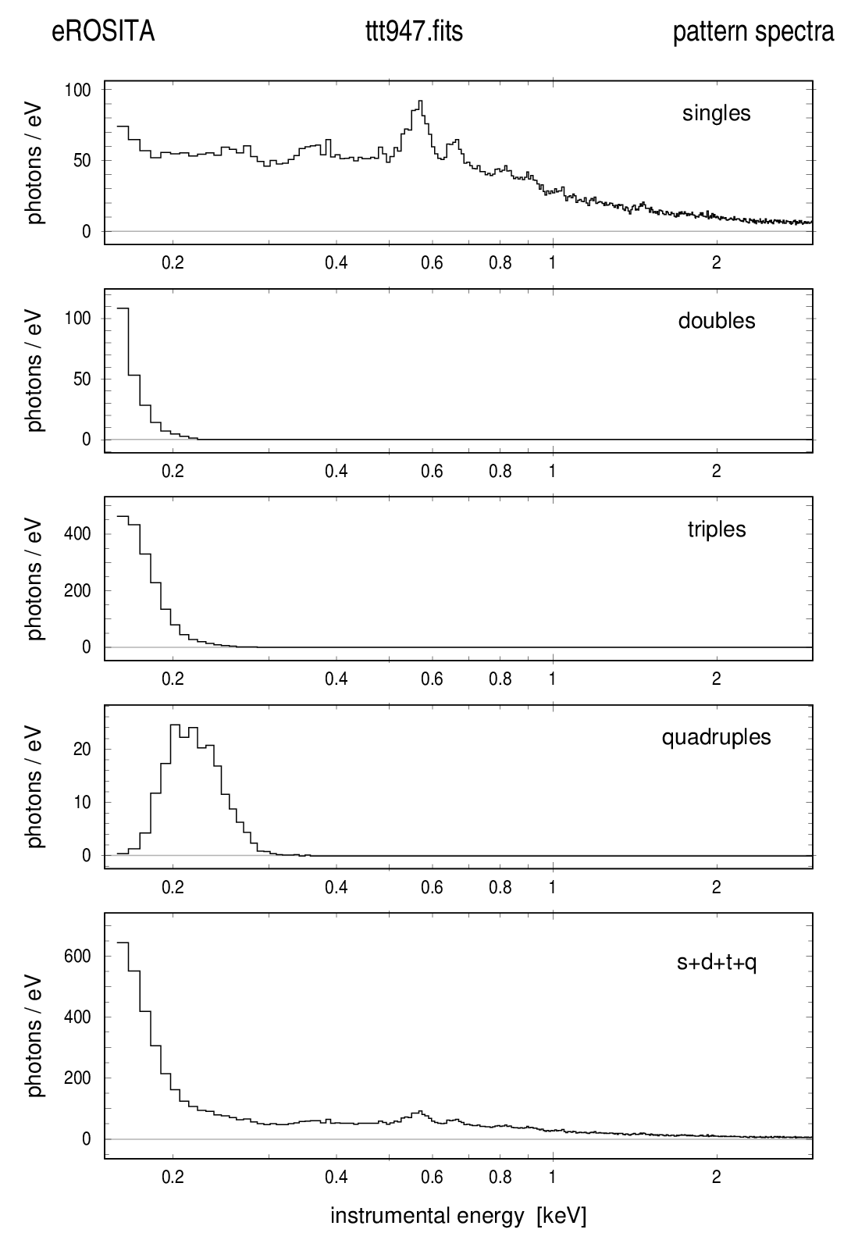
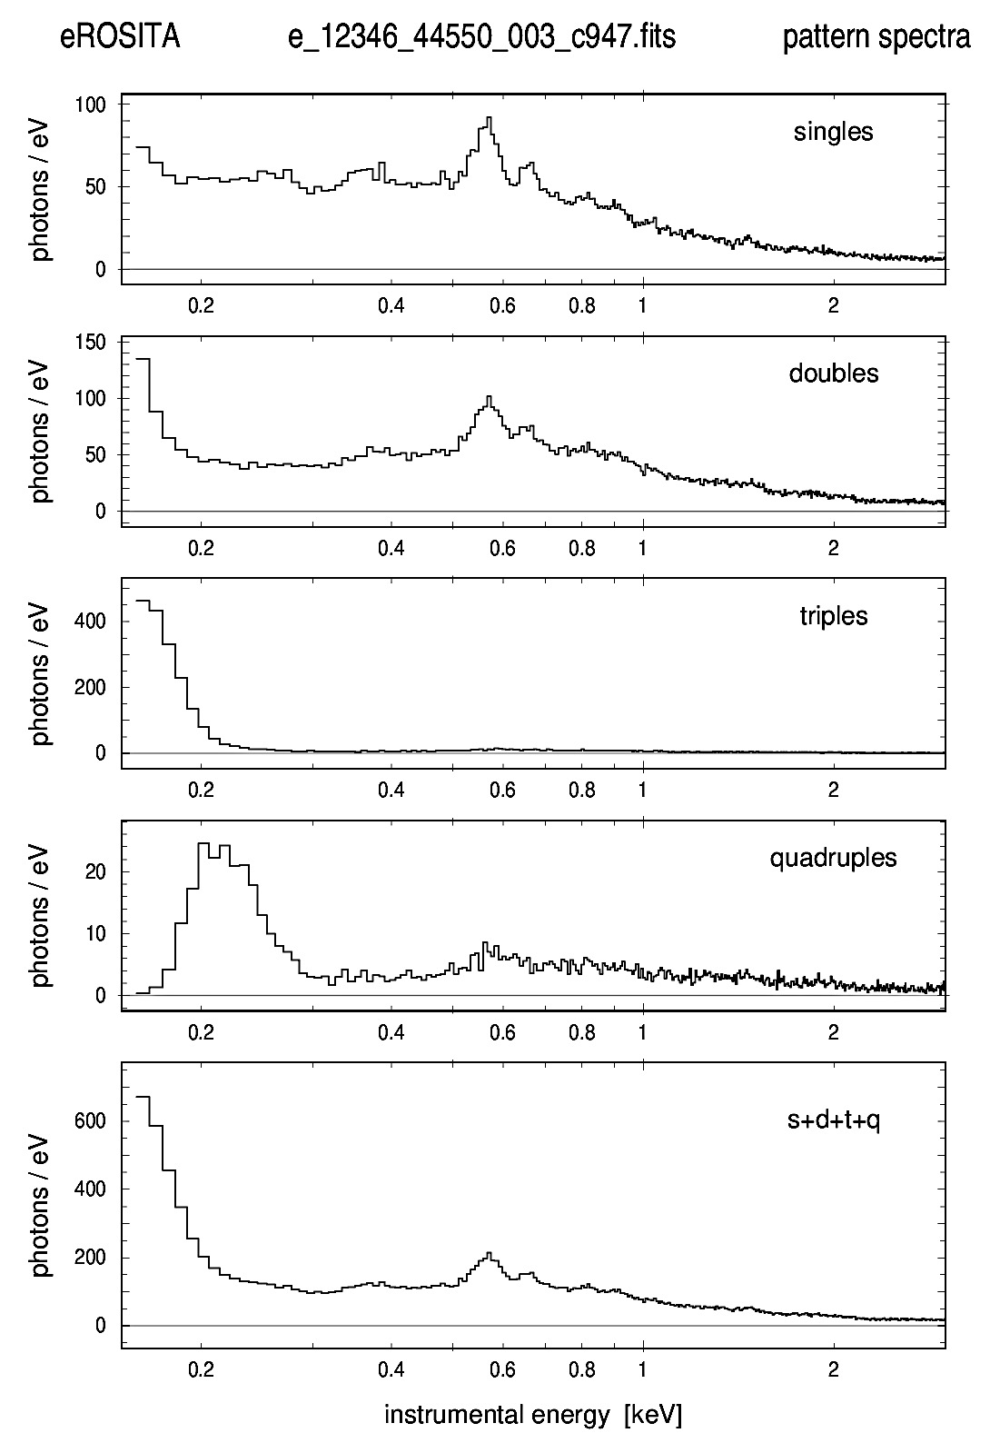
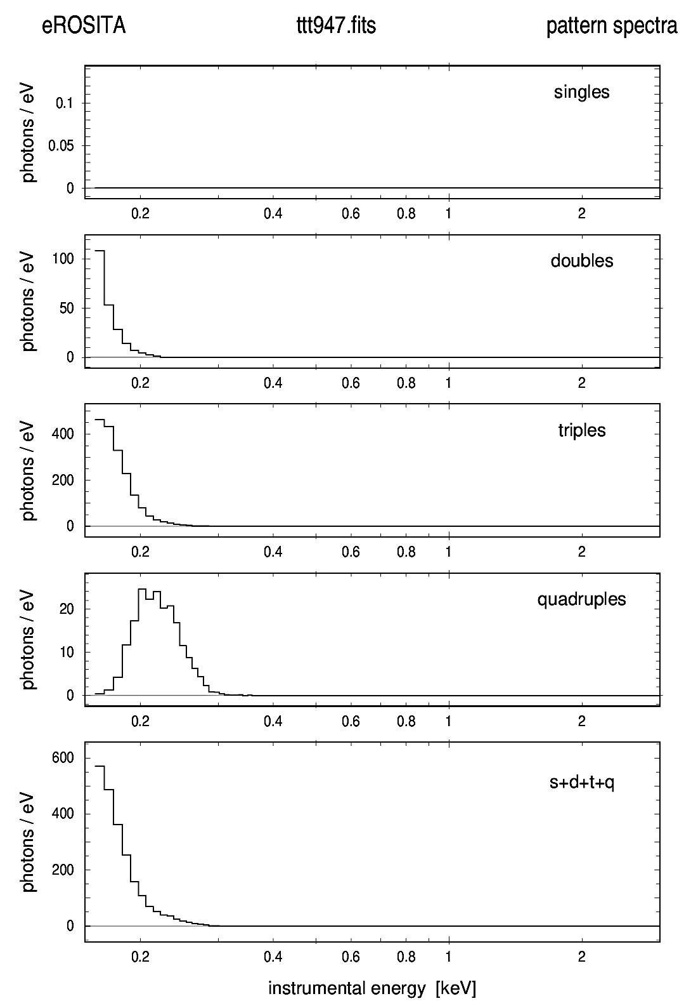
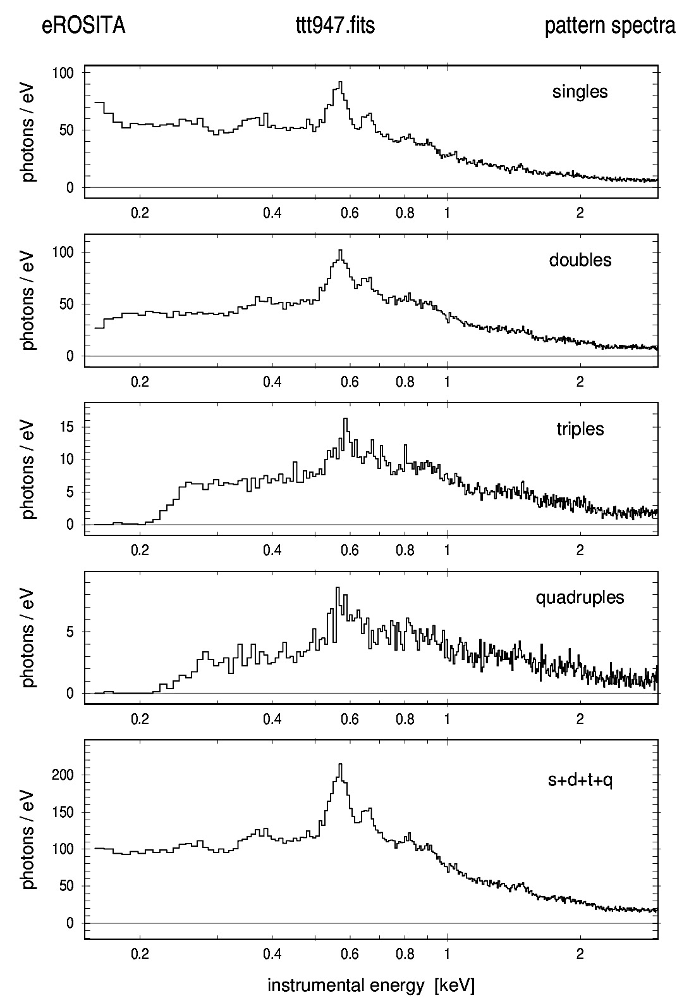
eROSITA Specialties
novel method for suppressing low energy detector noise
-
=
150 eV (!)
original patterns
-
rejected patterns
=
accepted patterns

Slide 12
Energy Calibration: some eROSITA Specialties
onboard:
use of precomputed threshold maps for optimizing telemetry
compression mode ‚PMENV2‘ for scientific data
compression mode ‚PMALLSINGLES‘ for ⁵⁵Fe data
ground processing:
utilization of subpixel resolution
fast PSF focal plane mapping at high count rates
use of constant energy thresholds (in eV)
improved noise suppression for >1 pixel patterns
floating point PI values
RMFs and ARFs with non-constant bin sizes
CTI and gain adjustments to varying CCD temperatures
automatic refinement of RMFs and ARFs
efficiency:
only ~5 days needed for initial energy calibration on ground
only ~2 days per year needed for energy calibration in space

Slide 13
eROSITA Specialties
floating point PI values, binning of ARFs and RMFs
computation of floating point PI values to avoid unneccessary binning artefacts
usage of ARFs and RMFs with non-constant bin sizes to avoid overhead in storage and to increase the performance in spectral fits
physical energy axis:
< 8 keV: small bins near lines and absorption edges
≥ 8 keV: large bins at high energies
instrumental energy channel axis:
< 8 keV: bin size matches energy resolution
≥ 8 keV: large bins
https://wiki.mpe.mpg.de/eRosita/erocalib_calibration

Slide 14
Energy Calibration: some eROSITA Specialties
onboard:
use of precomputed threshold maps for optimizing telemetry
compression mode ‚PMENV2‘ for scientific data
compression mode ‚PMALLSINGLES‘ for ⁵⁵Fe data
ground processing:
utilization of subpixel resolution
fast PSF focal plane mapping at high count rates
use of constant energy thresholds (in eV)
improved noise suppression for >1 pixel patterns
floating point PI values
RMFs and ARFs with non-constant bin sizes
CTI and gain adjustments to varying CCD temperatures
automatic refinement of RMFs and ARFs
efficiency:
only ~5 days needed for initial energy calibration on ground
only ~2 days per year needed for energy calibration in space

Slide 15
Energy Calibration: some eROSITA Specialties
onboard:
use of precomputed threshold maps for optimizing telemetry
compression mode ‚PMENV2‘ for scientific data
compression mode ‚PMALLSINGLES‘ for ⁵⁵Fe data
ground processing:
utilization of subpixel resolution
fast PSF focal plane mapping at high count rates
use of constant energy thresholds (in eV)
improved noise suppression for >1 pixel patterns
floating point PI values
RMFs and ARFs with non-constant bin sizes
CTI and gain adjustments to varying CCD temperatures
automatic refinement of RMFs and ARFs
efficiency:
only ~5 days needed for initial energy calibration on ground
only ~2 days per year needed for energy calibration in space

Slide 16
Energy ground calibration in 2016
TM7 (FM1): Jan 18-22
TM2 (FM2): Feb 17-26
TM1 (FM3): Mar 15-22
TM4 (FM4): Apr 07-14
TM5 (FM5): Apr 25-28
TM3 (FM7): Jun 09-13
TM6 (FM6): Jun 27-30
mainly long flatfield exposures
energies: C-K, O-K, Cu-L, Al-K, Ti-K, Cu-K, Ge-K
CCD temperature: -95°C
event rate: ~2100 events/s
TM7
TM2
TM1
TM4 TM5
TM3 TM6

Slide 17
eROSITA Energy Calibration:
Ground

Slide 18
Reconstructing the spectral distribution requires
pattern recognition
correction for gain variations between CCD channels
correction for charge transfer loss (CTI)
gain determination
example: Fe-K, measured with FM4

Slide 19
CTI determination
Reconstructing the spectral distribution requires
pattern recognition
correction for gain variations between CCD channels
correction for charge transfer loss (CTI)
CCD column 240 (arbitrary choice)
CTI = 2.1 x 10⁻⁵
emission line determined in 130 (adaptively computed) macro pixels containing a minimum of 30 first singles around the line
→ CTI = 2.1×10⁻⁵

Slide 20
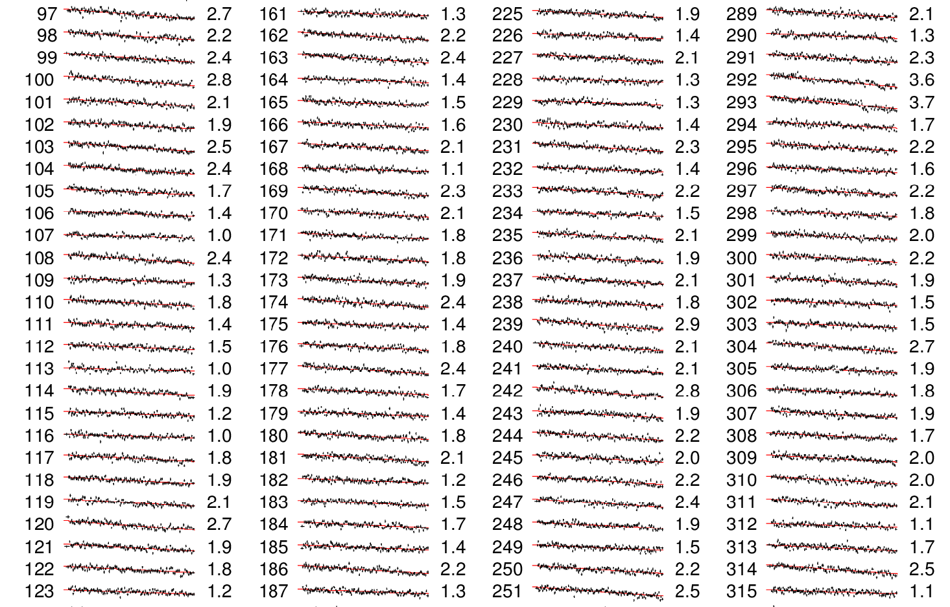
CTI determination

Slide 21
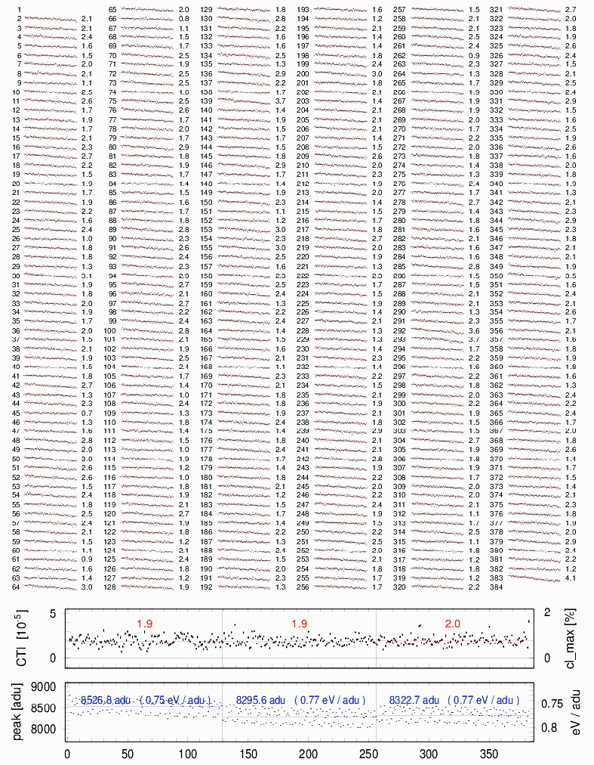
CTI determination
example: Fe-K, measured with FM4
plot contains 47 267 data points
each data point is the result of several iterative template fits

Slide 22
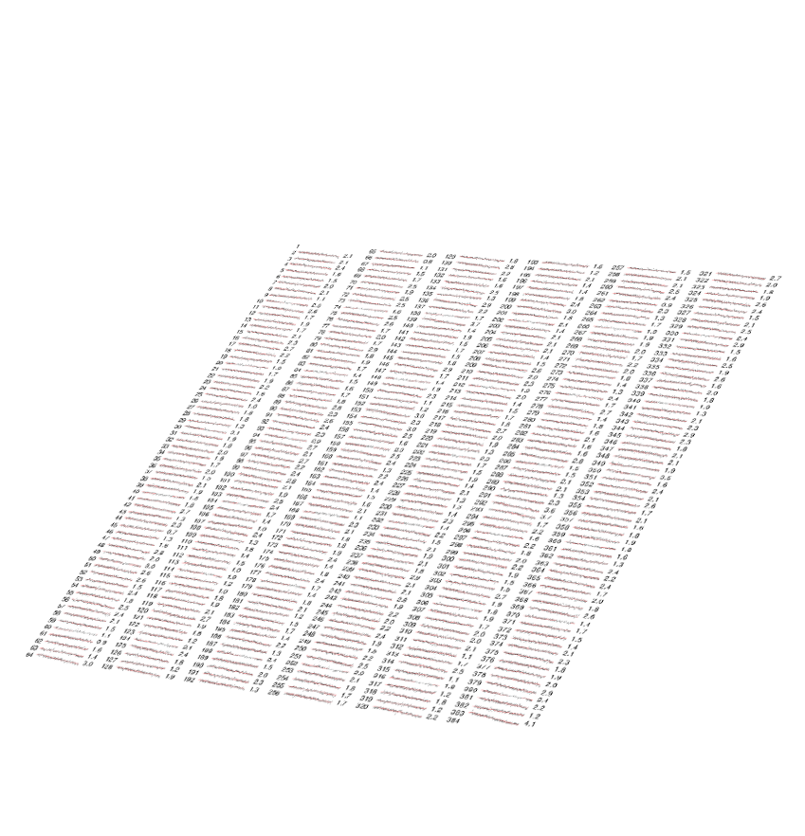
CTI determination
8 calibration energies

Slide 23
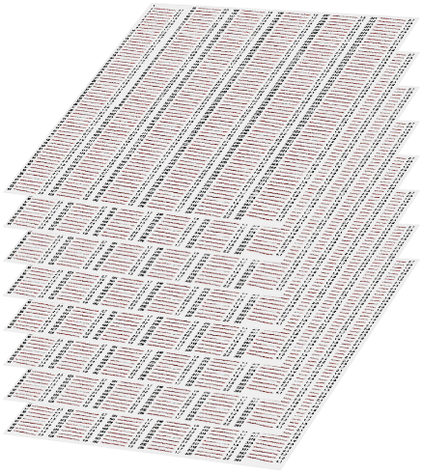
8 energies
7 CCDs
all 7 CCDs calibrated with 3.3 billion events

Slide 24
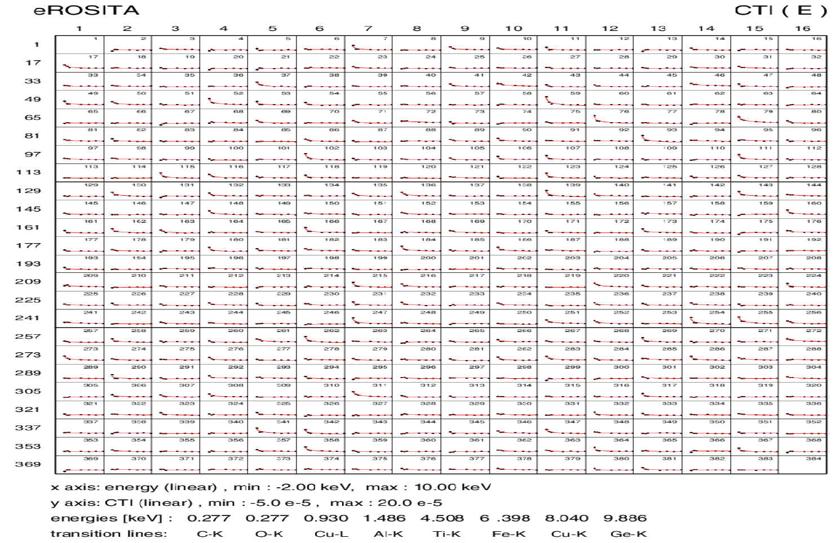
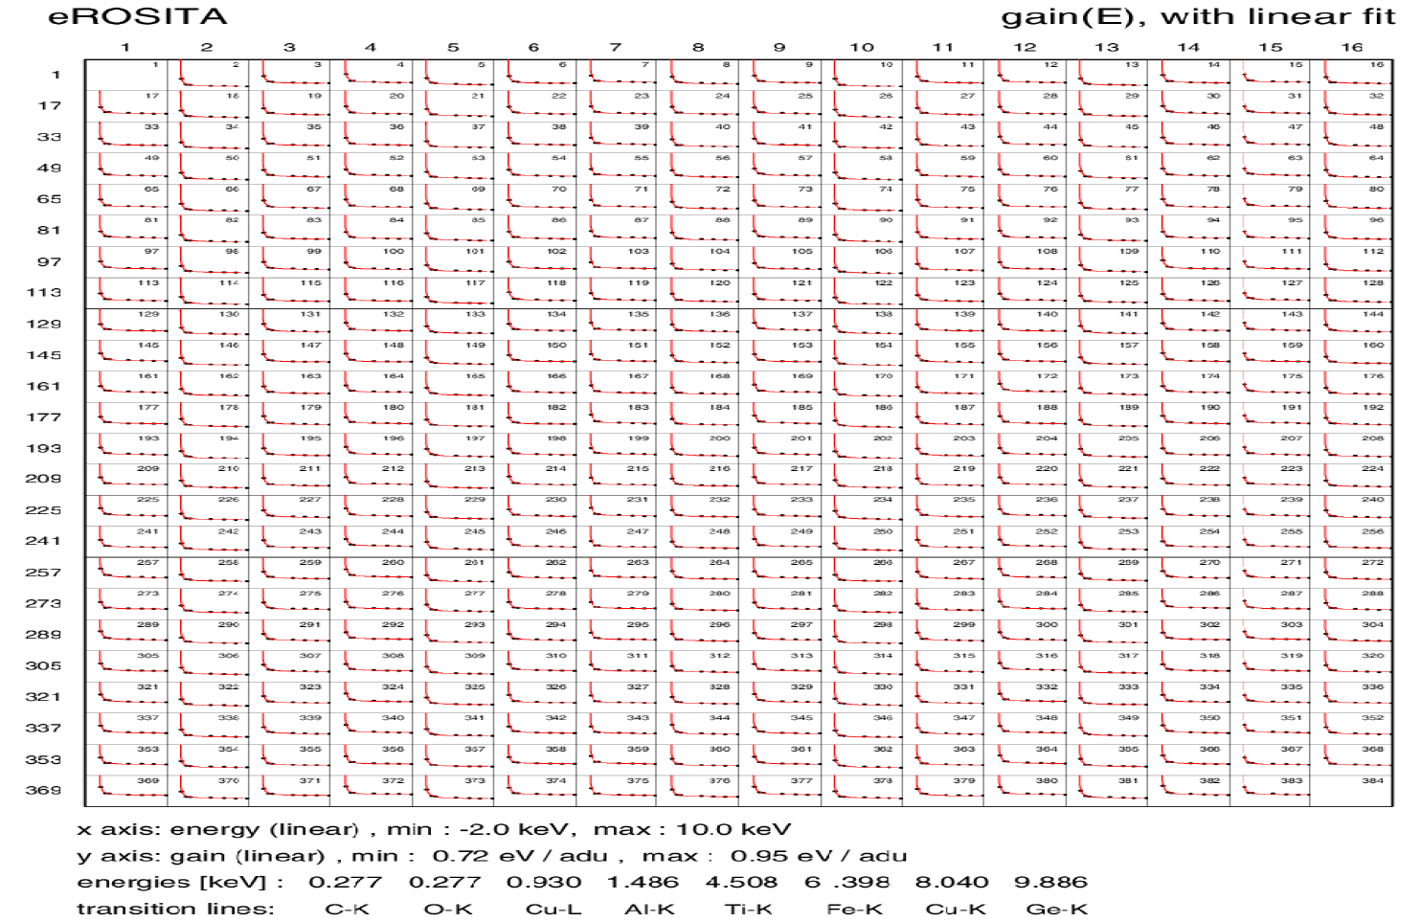
individually for each CCD column
CTI
Energy interpolation of the CTI and gain
gain

Slide 25
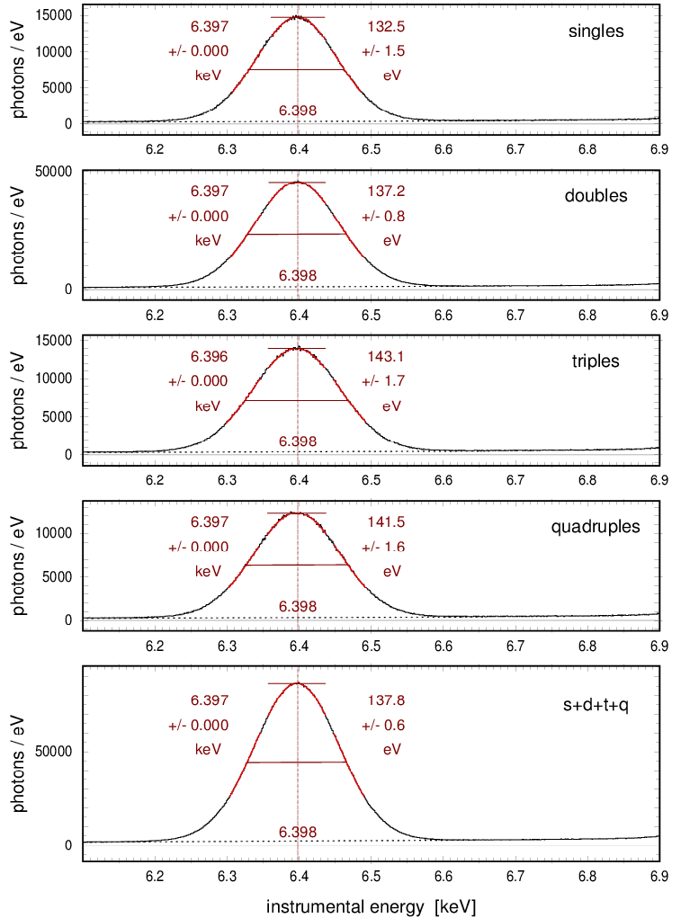
Reconstructing the spectral distribution requires
pattern recognition
correction for gain variations between CCD channels
correction for charge transfer loss (CTI)
singles
doubles
triples
example: Fe-K, measured with FM4
raw data
quadruples
all valid patterns
FWHM = 132.5 – 143.1 eV, all photons: FWHM = 137.8 eV
accuracy of absolute energy scale: ± 2 eV (± 0.03%)
reconstructed spectral distribution

Slide 26
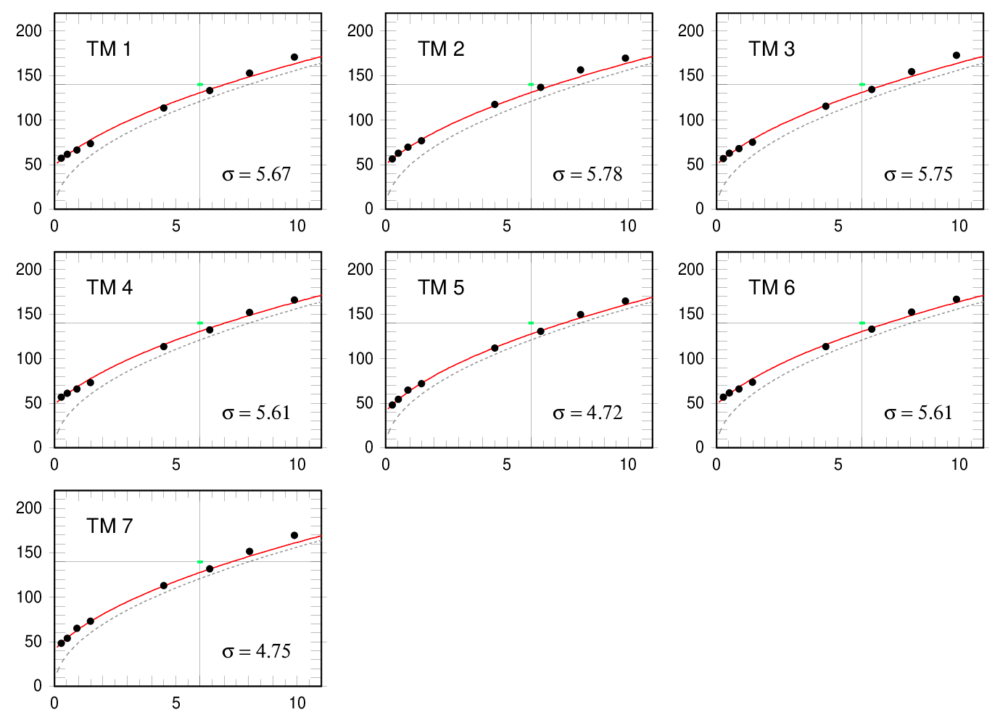
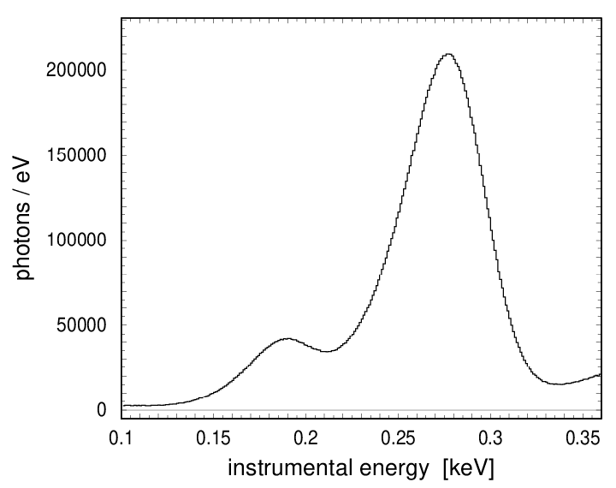
Spectrum of Boron and Carbon emission lines
FWHM [eV]
FWHM ~ 49 eV
FWHM [eV]
energy [keV]
energy [keV]
Energy resolution obtained for
single pixel events in comparison
with theoretical limit (dashed curve)
FWHM [eV]
energy [keV]

Slide 27
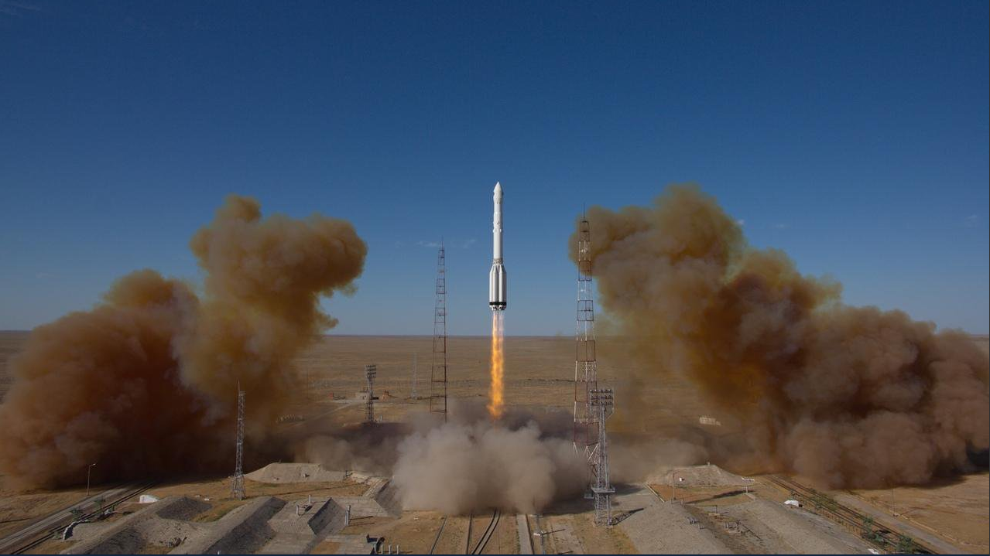
Baikonur, Kazakhstan, 2019 July 13

Slide 28
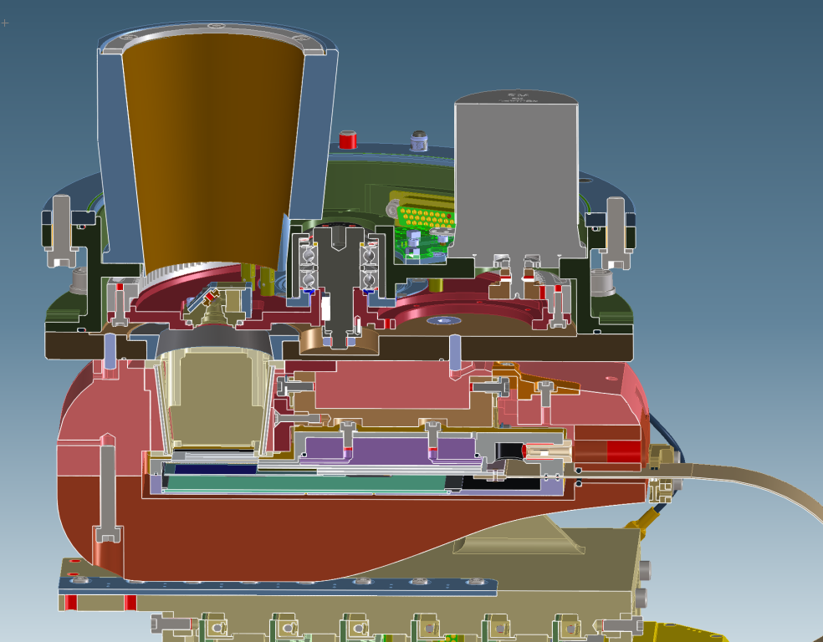
Energy calibration with the internal ⁵⁵Fe source
Mn-K
Al-K Ti-K

Slide 29
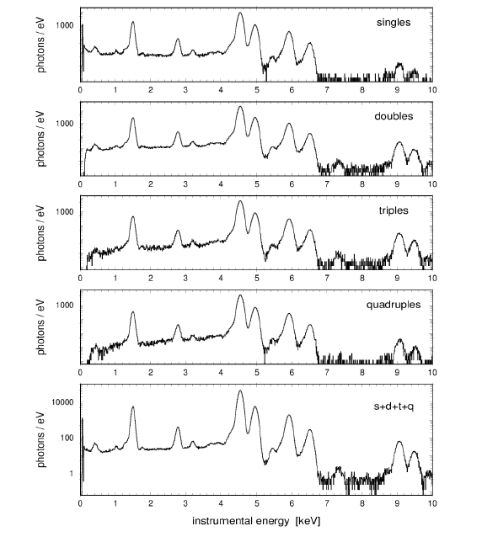
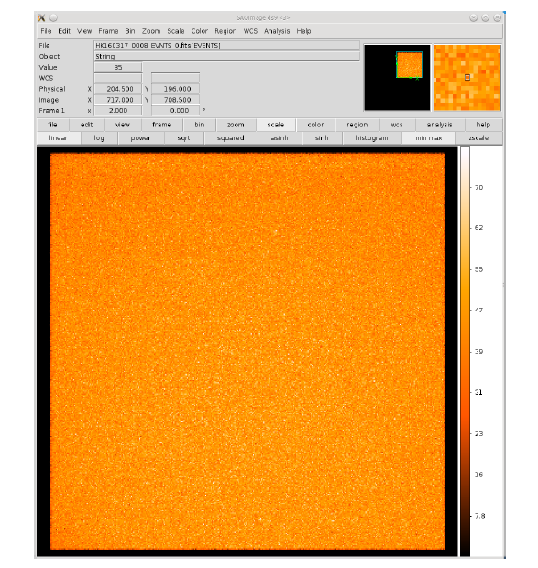
Energy Calibration: internal calibration source

Slide 30
Gain: TM 4, Al-K
ground calibration

Slide 31
Gain: TM 4, Al-K
in-orbit calibration

Slide 32
CTI: TM 4, Al-K
ground calibration

Slide 33
CTI: TM 4, Al-K
in-orbit calibration

Slide 34
eROSITA Energy Calibration:
Space

Slide 35
Energy calibration in space
Light leak in TM5 and TM7
CCD temperatures 10°-15°C higher
two unexpected effects

Slide 36
Energy calibration in space
Light leak in TM5 and TM7
CCD temperatures 10°-15°C higher
two unexpected effects
CTI increase due to radiation damage
also „gain“ decrease due to CTI increase in the framestore region
one expected effect

Slide 37
Energy calibration in space
Light leak in TM5 and TM7
CCD temperatures 10°-15°C higher
two unexpected effects
CTI increase due to radiation damage
also „gain“ decrease due to CTI increase in the framestore region
one expected effect
and one ‚missing‘ effect
no signs for any contamination (!)

Slide 38
Energy calibration in space
Light leak in TM5 and TM7
CCD temperatures 10°-15°C higher
two unexpected effects
CTI increase due to radiation damage
also „gain“ decrease due to CTI increase in the framestore region
one expected effect
and one ‚missing‘ effect
no signs for any contamination (!)

Slide 39
Challenges for the energy calibration:
1) CCD temperatures (Sep 2019 – Feb 2022)
first ⁵⁵Fe measurements after launch
ground calibration at -95°C

Slide 40
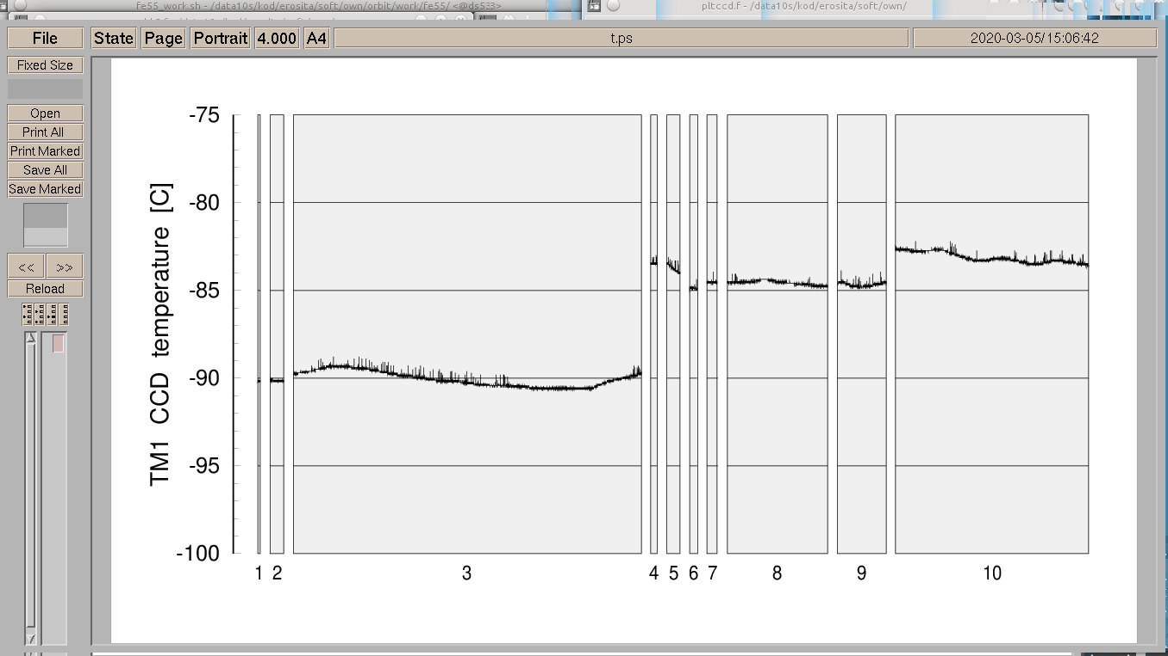
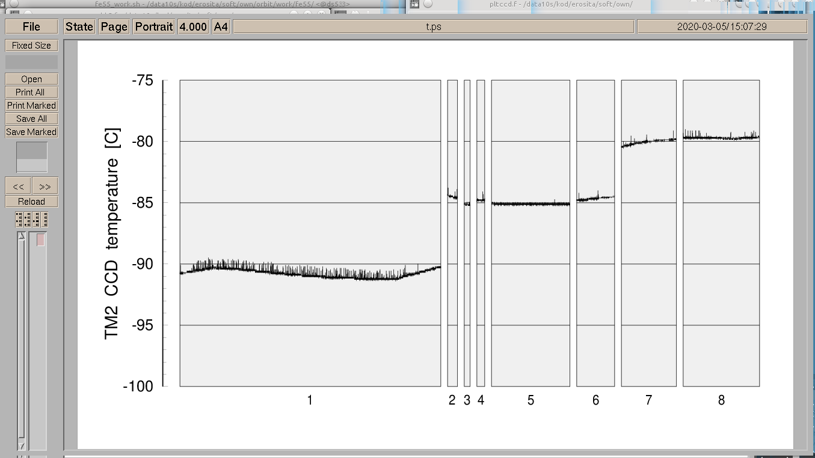
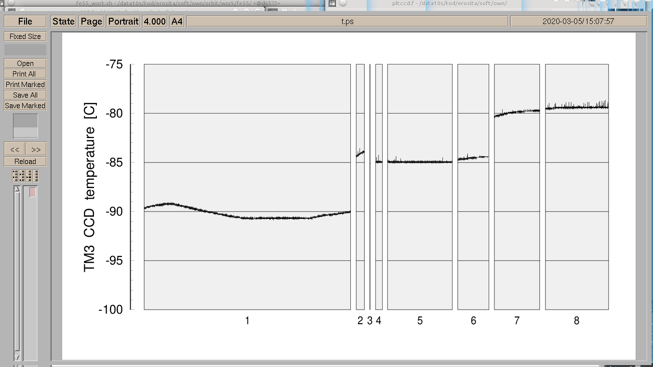
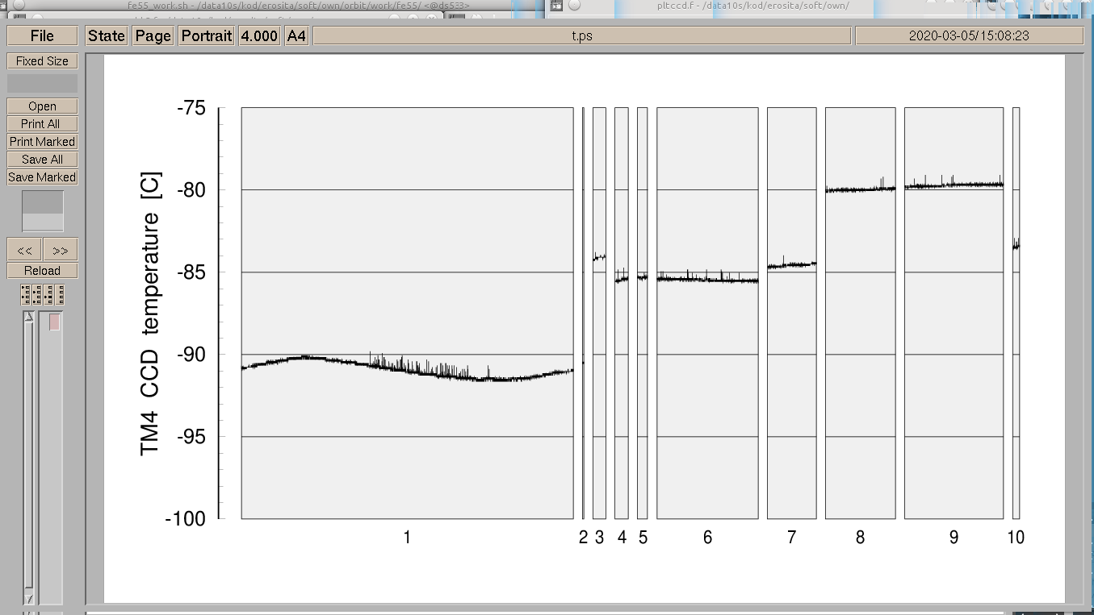
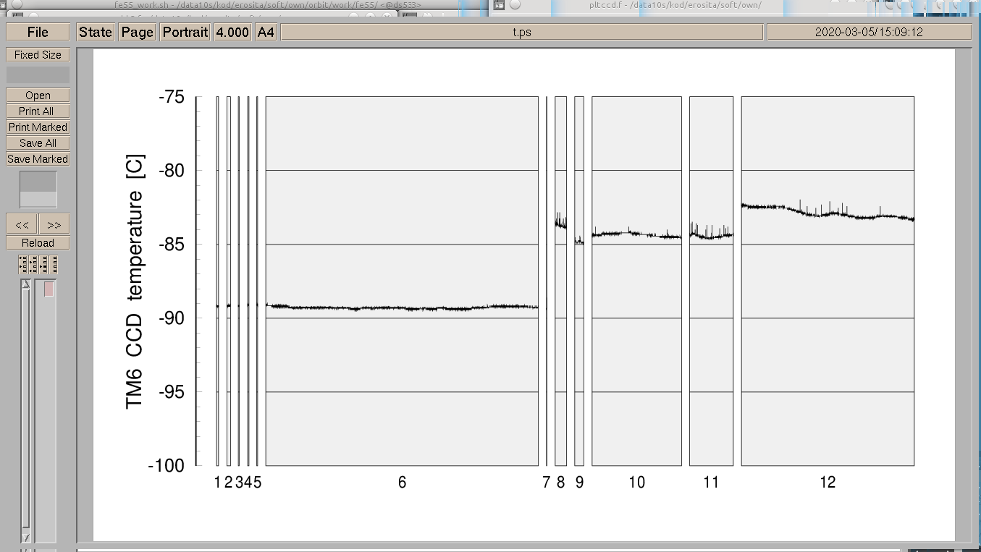
CCD temperatures during the first ⁵⁵Fe measurements after launch
(major) challenge:
develop a temperature
model for gain and CTI

Slide 41
Challenges for the energy calibration:
2) CTI increase due to radiation damage
1
2
3
4
5
ground calibration at -95°C

Slide 42
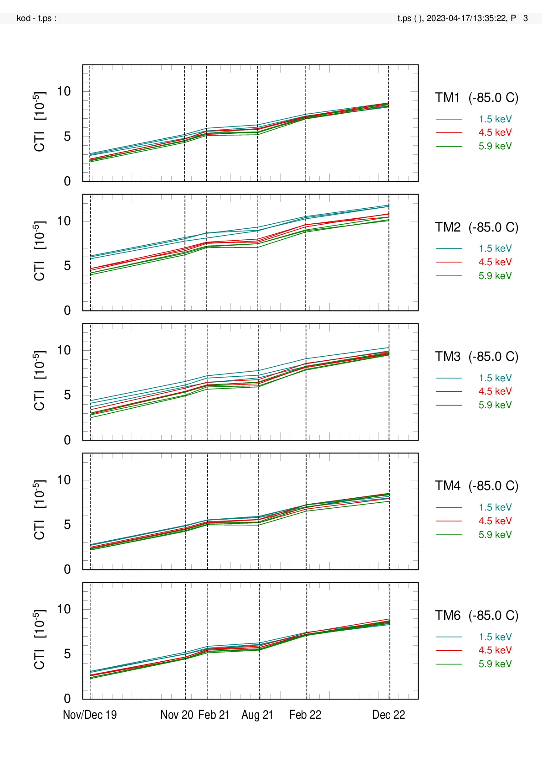
Challenges for the energy calibration:
2) CTI increase due to radiation damage

Slide 43
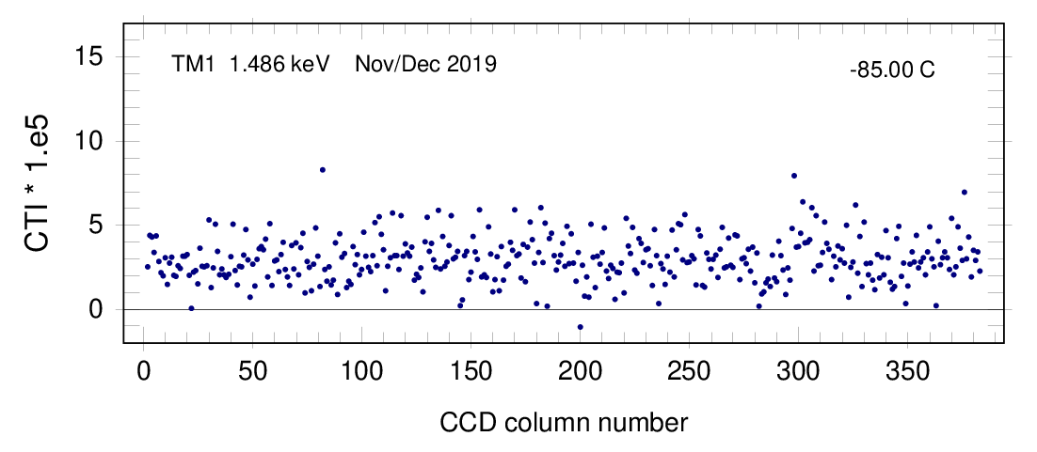
CCD column specific CTI evolution
TM1, Al-K
1
Feb 2022
Aug 2021
Feb 2021
Nov 2020
Nov/Dec 2019

Slide 44
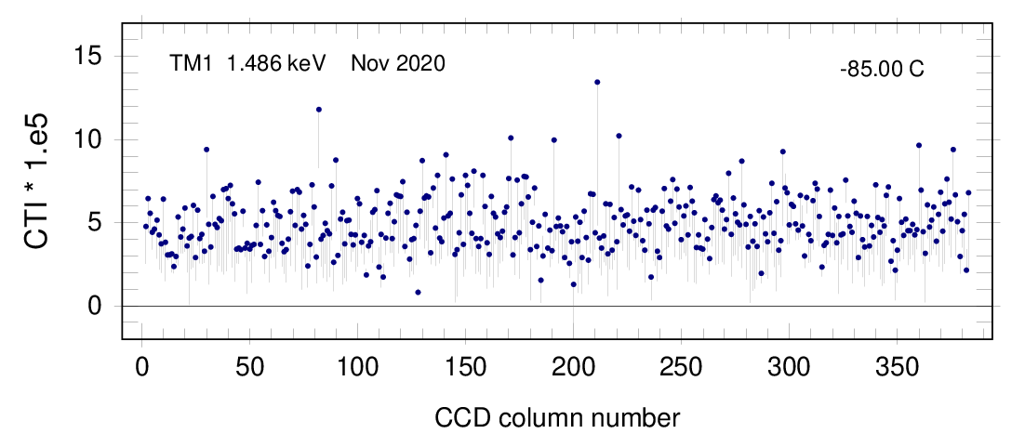
CCD column specific CTI evolution
TM1, Al-K
2
Feb 2022
Aug 2021
Feb 2021
Nov 2020
Nov/Dec 2019

Slide 45
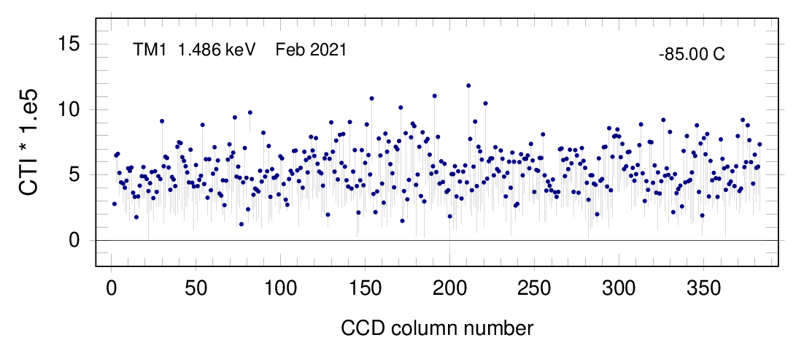
CCD column specific CTI evolution
TM1, Al-K
3
Feb 2022
Aug 2021
Feb 2021
Nov 2020
Nov/Dec 2019

Slide 46
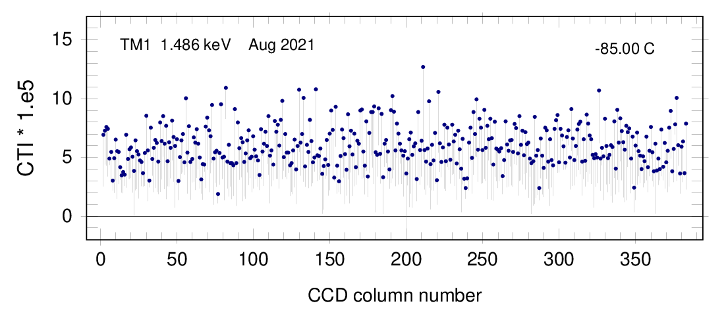
CCD column specific CTI evolution
TM1, Al-K
4
Feb 2022
Aug 2021
Feb 2021
Nov 2020
Nov/Dec 2019

Slide 47
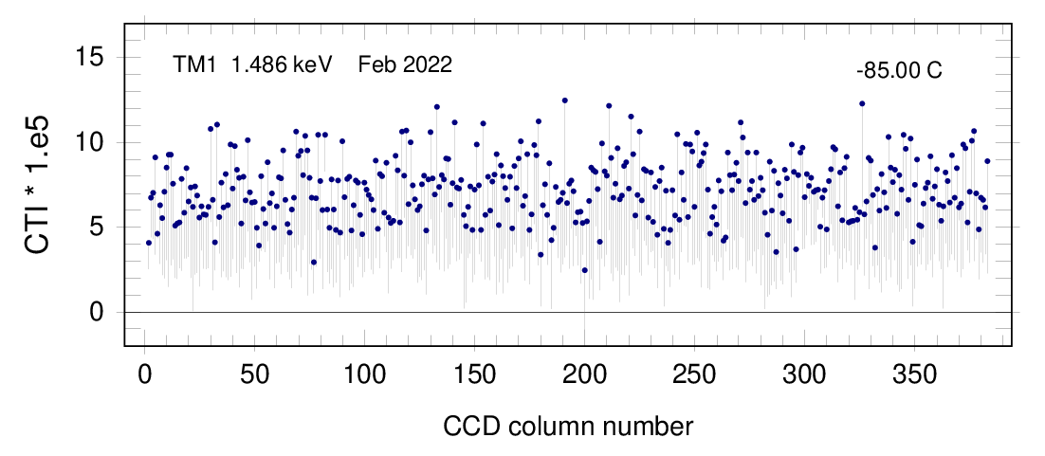
CCD column specific CTI evolution
TM1, Al-K
5
Feb 2022
Aug 2021
Feb 2021
Nov 2020
Nov/Dec 2019

Slide 48
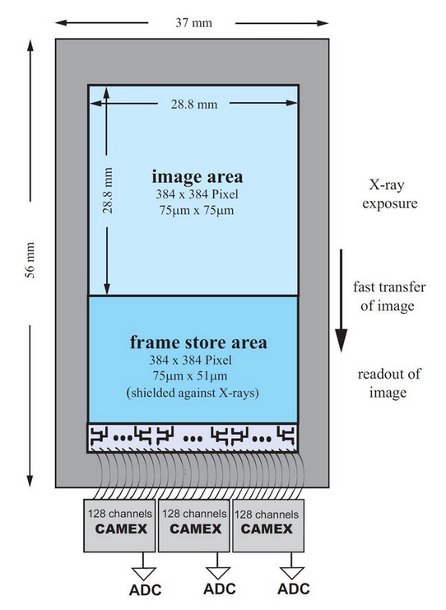
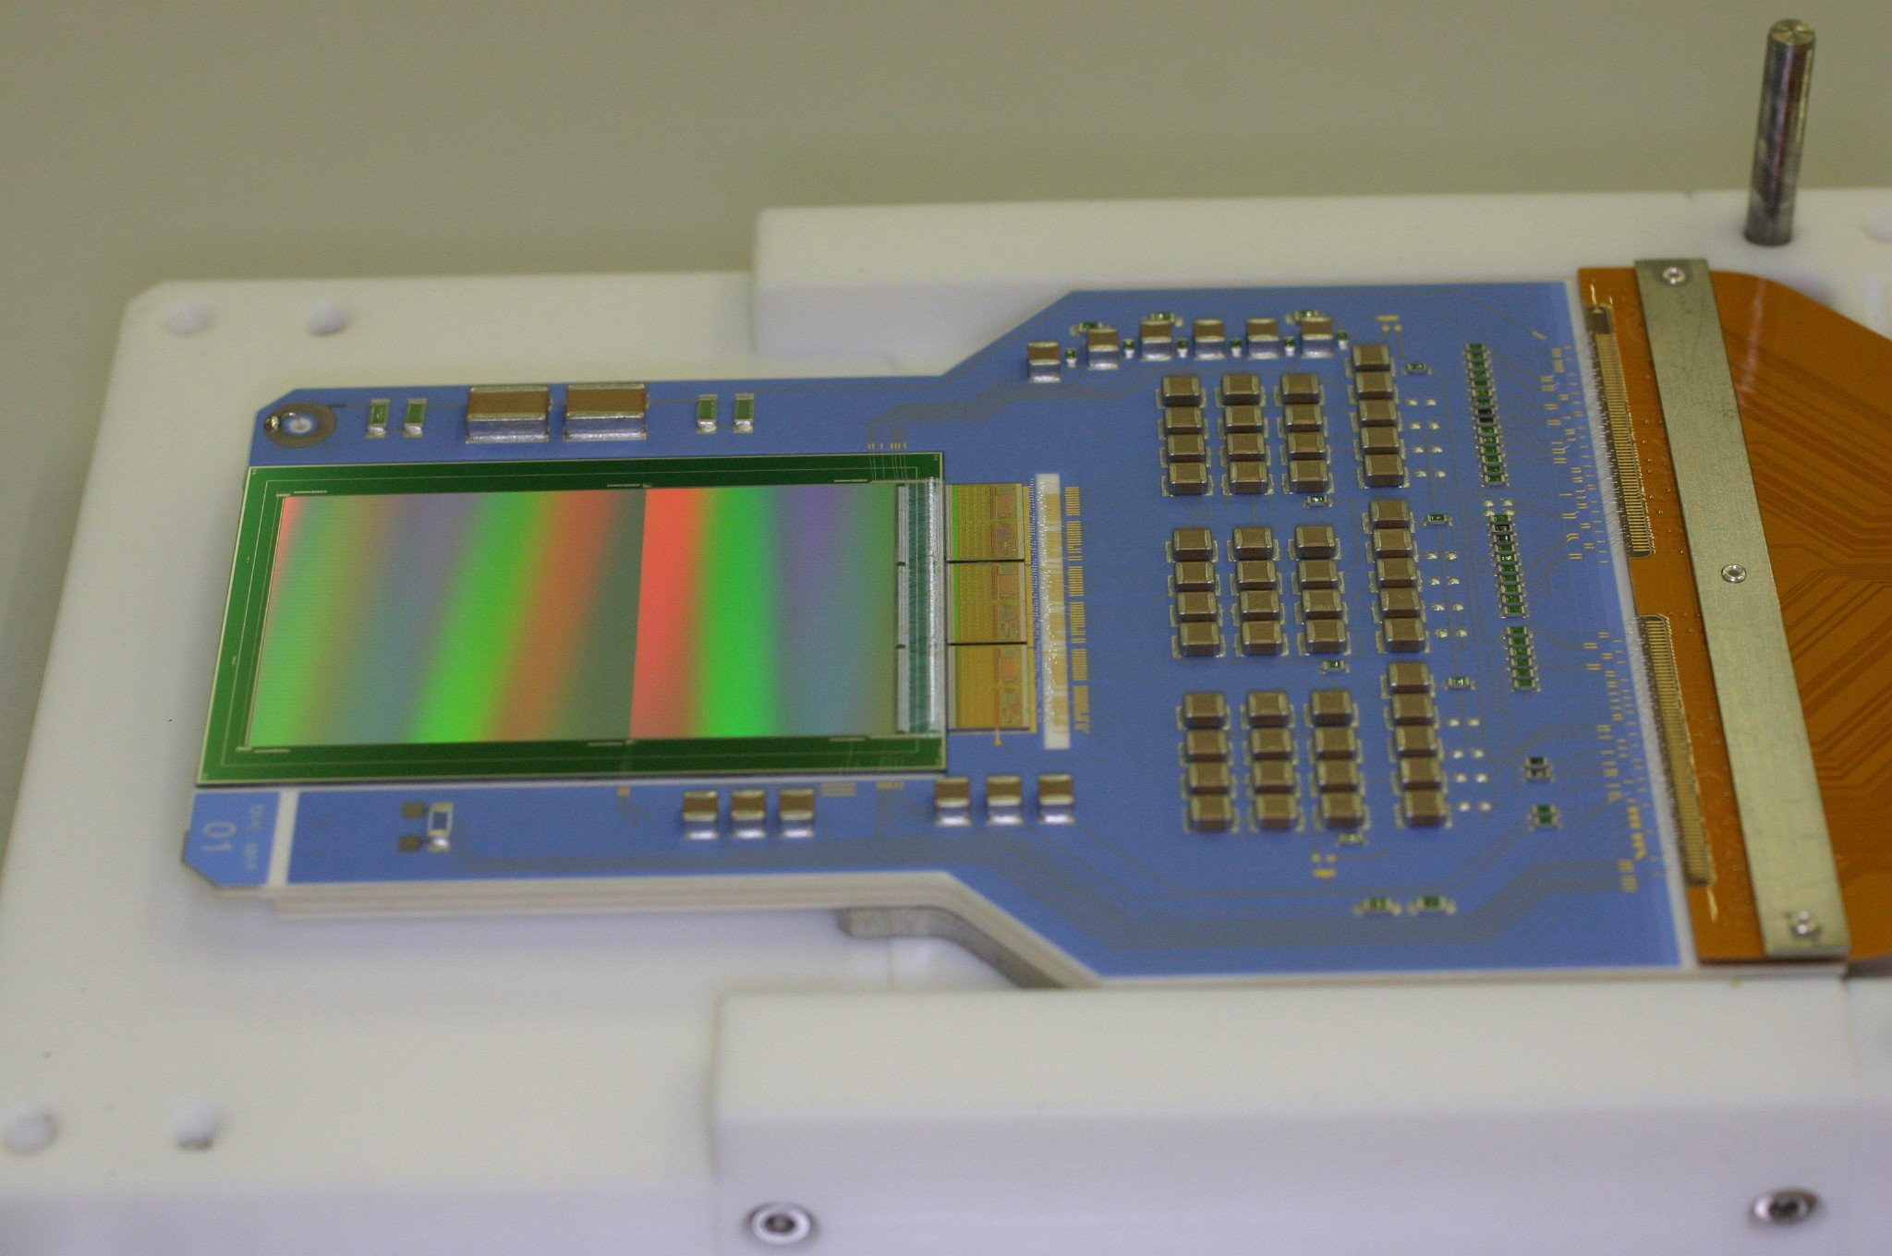
eROSITA CCD
CTI increase in frame store area appears as gain [adu/eV] decrease

Slide 49
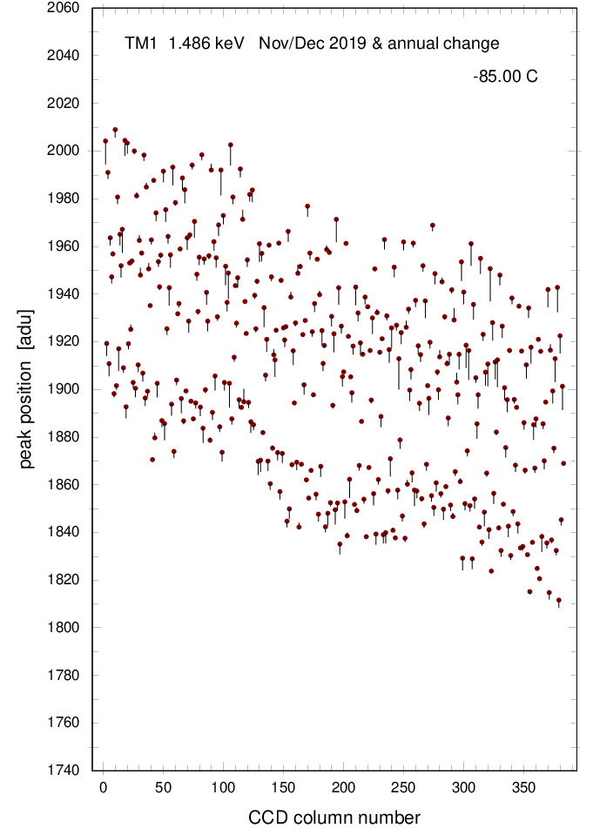
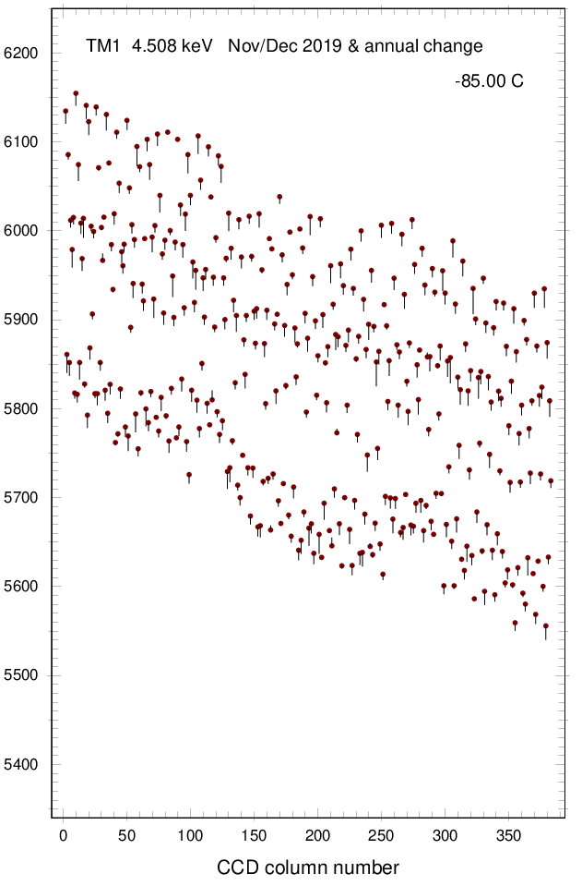
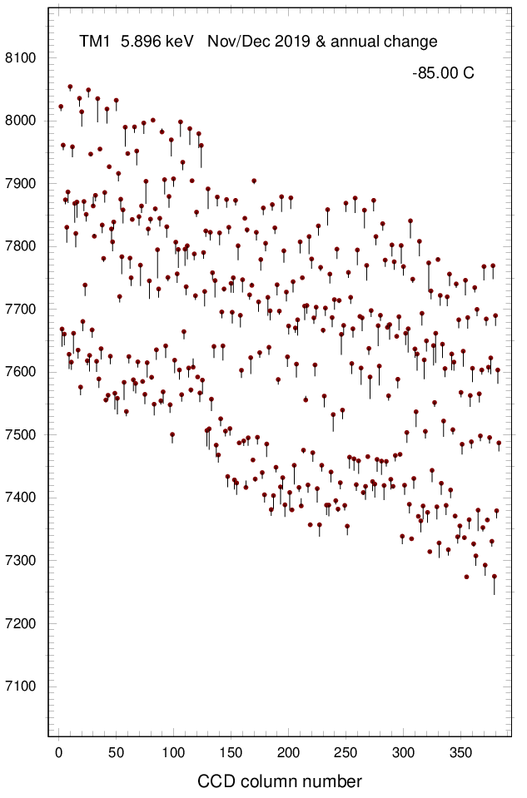
CCD column specific ‚gain‘ evolution
peak position [adu]
TM1, Al-K
TM1, Ti-K
TM1, Mn-K
CCD column number
CCD column number
CCD column number

Slide 50
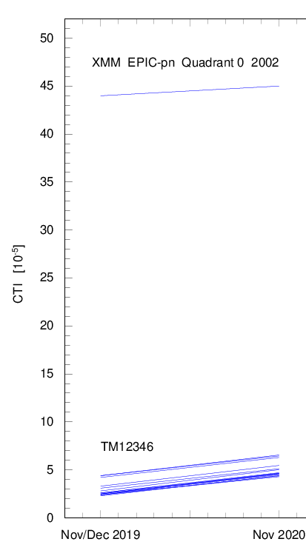
Expected CTI increase @ 5.9 keV
XMM / EPIC-pn
eROSITA
2020
2021
2022
2023
2024
2025

Slide 51
Energy calibration: results 1) ⁵⁵Fe calibration data

Slide 52
Testing the energy calibration
1) internal calibration source
1
2
3
4
5
ground calibration at -95°C

Slide 53
Nov 2020
Feb 2021
Aug 2021
Feb 2022
2
3
4
5
TM1
TM1
TM1
TM1
TM2
TM2
TM2
TM2
TM3
TM3
TM3
TM3
TM4
TM4
TM4
TM4
TM6
TM6
TM6
TM6

Slide 54
Nov 2020
Feb 2021
Aug 2021
Feb 2022
2
3
4
5
TM1
TM1
TM1
TM1
TM2
TM2
TM2
TM2
Al-K: absolute energy scale accurate to ± 1 eV (despite CCD temperature changes and CTI increase)
TM3
TM3
TM3
TM3
TM4
TM4
TM4
TM4
TM6
TM6
TM6
TM6

Slide 55
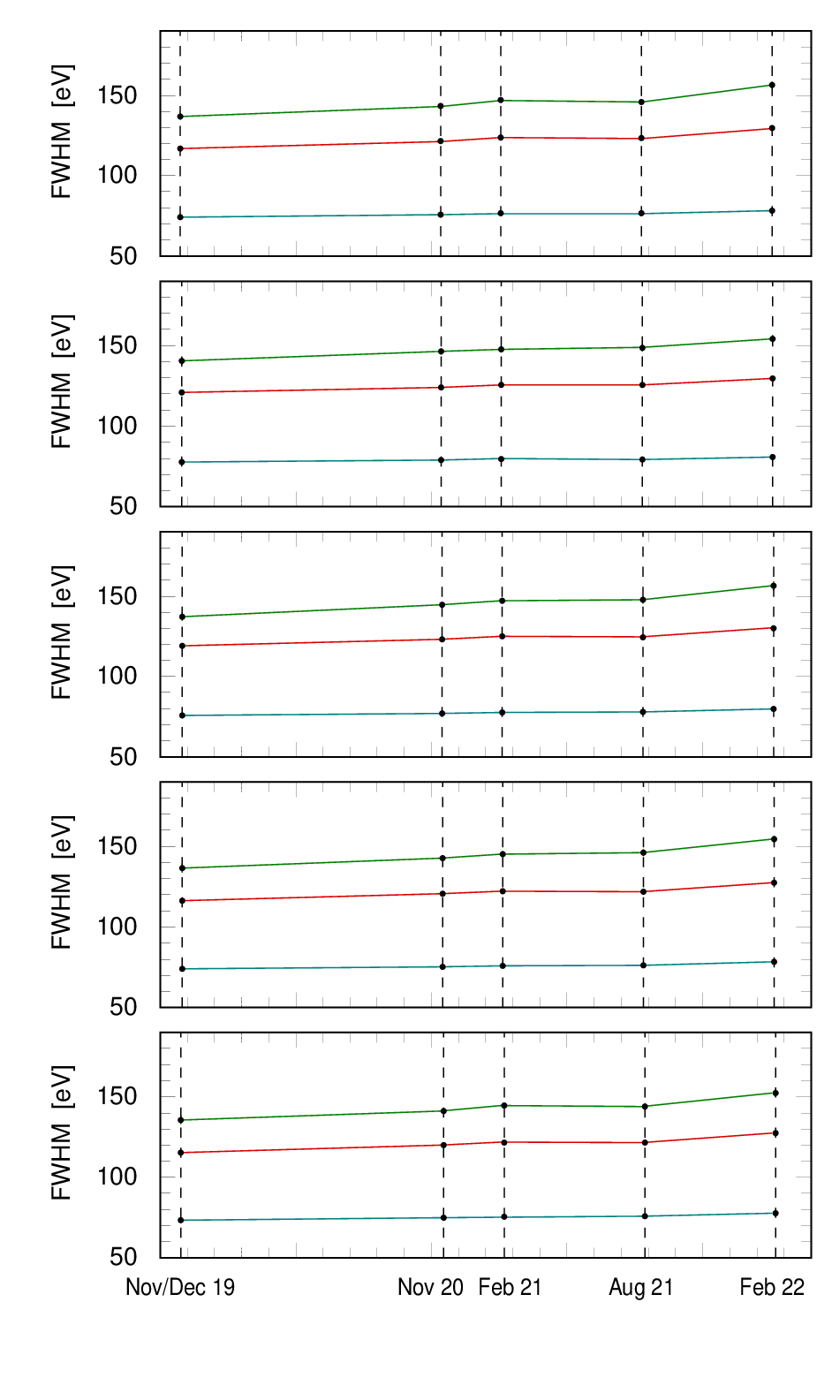
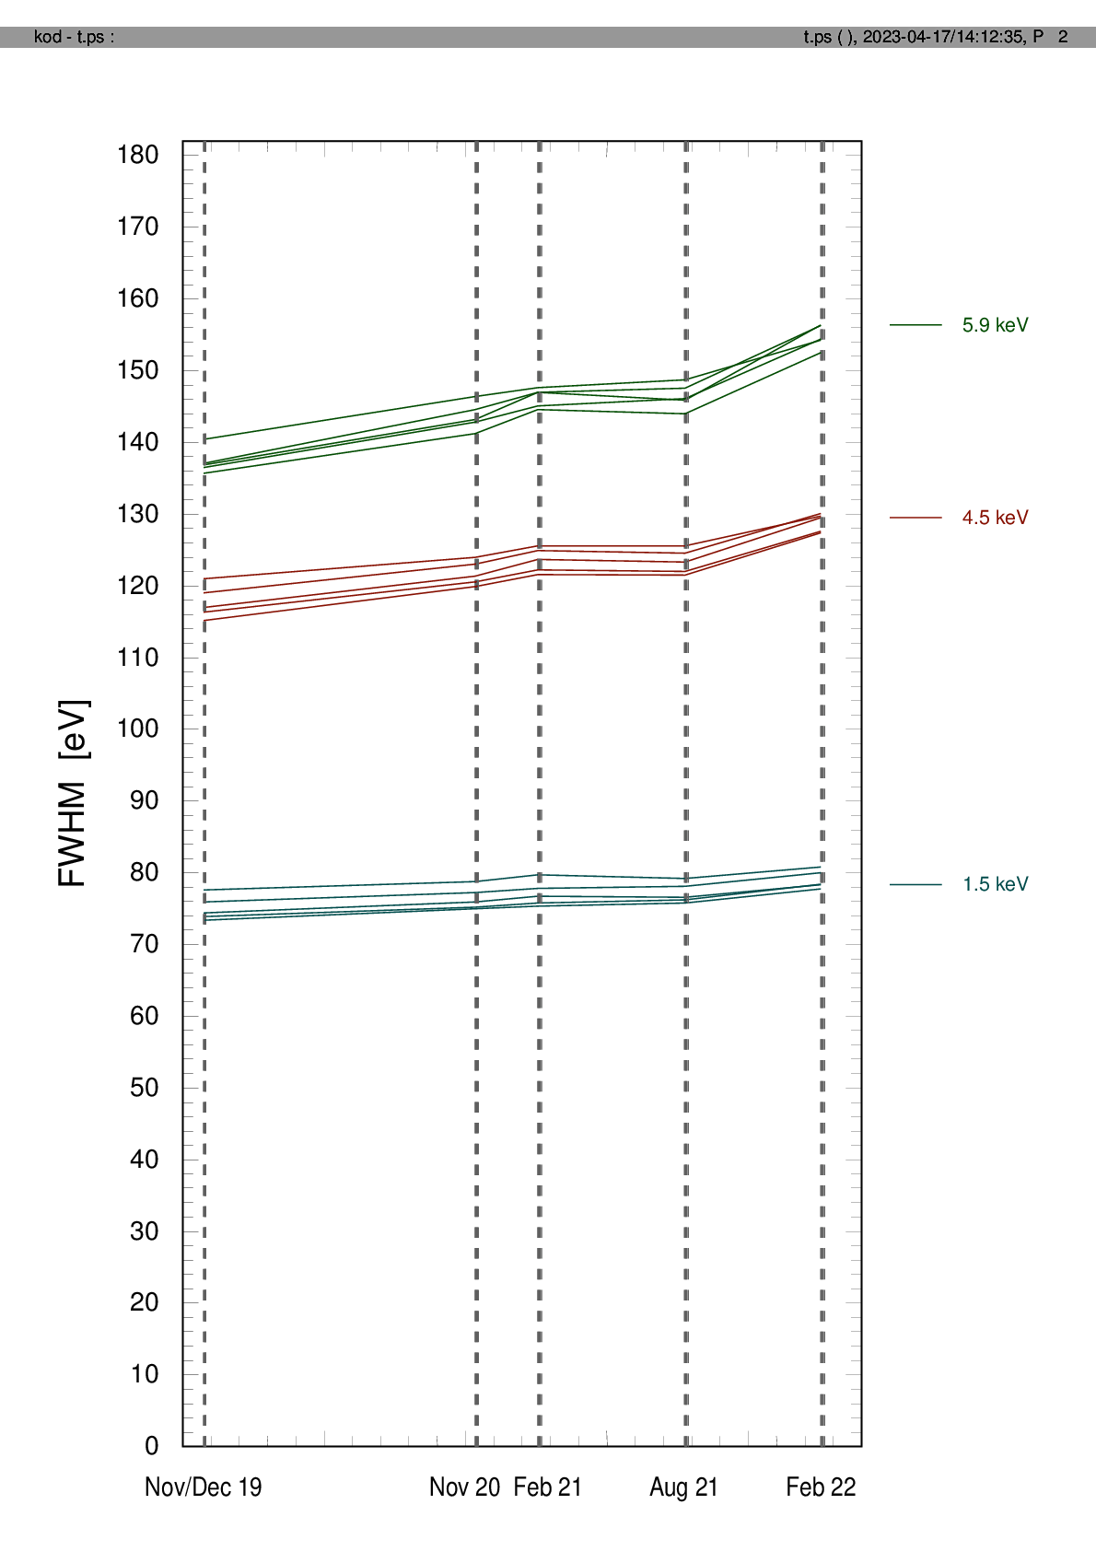
Energy calibration: CTI and spectral resolution
TM1
5.9 keV
TM2
4.5 keV
TM3
1.5 keV
TM4
TM6
CTI
FWHM (singles)

Slide 56
Energy calibration: results 2) diffuse X-ray sky

Slide 57
Testing the energy calibration
2) diffuse X-ray sky
input: eROdays 43850 .. 48550, in steps of 100 eROdays (except 44850), for TM12346
covering the whole survey period (so far): Dec 2019 – Feb 2022 (with 16.7 day sampling)

Slide 58
Testing the energy calibration
2) diffuse X-ray sky
TM12346 @ eRASS:5
(sampled in steps of 100 eROdays)
CCD temperature: -86 .. -79 C
threshold: „PMENV2“
O VII: He-like triplet:
560.9 - 568.5 - 574.0 eV
O VII
E = 568 eV, FHWM = 66.8 ± 0.8 eV

Slide 59
Comparison with ground calibration
TM1 (FM3)
( TM12346, all valid patterns )
ground calibration (2016)
CCD temperature: -95.8 .. -94.2 C
threshold: 46 adu, E = 527 eV
TM2 (FM2)
FWHM = 64.0 ± 0.1 eV
TM3 (FM7)
diffuse X-ray sky (2019-2022)
eRASS:5 (2019-2022)
CCD temperature: -65 .. -79 C
threshold: „PMENV2“, E = 568 eV
FWHM = 66.8 ± 0.8 eV
TM4 (FM4)
TM6 (FM6)

Slide 60
Comparison with ground calibration
TM1 (FM3)
( TM12346, all valid patterns )
ground calibration (2016)
CCD temperature: -95.8 .. -94.2 C
threshold: 46 adu, E = 527 eV
TM2 (FM2)
FWHM = 64.0 ± 0.1 eV
Similar energy resolution (O VII) in space as on ground (O-K), despite:
O VII emission intrinsically broadened
561.0 eV (f)
568.7 eV (i)
574.0 eV (r)
mean energy higher than 537 eV (O-K)
CCD temperature 10-15°C higher and variable
CTI increase
TM3 (FM7)
diffuse X-ray sky (2019-2022)
eRASS:5 (2019-2022)
CCD temperature: -65 .. -79 C
threshold: „PMENV2“, E = 568 eV
FWHM = 66.8 ± 0.8 eV
TM4 (FM4)
TM6 (FM6)

Slide 61
Energy calibration: results 3) RXJ1856 and 1E0102

Slide 62
Testing the energy calibration
3) RXJ1856 and 1E0102
requirements:
‚correct‘ physical model
‚correct‘ RMFs and ARFs

Slide 63
General properties of the ARF and RMF
ARF: „Ancillary Response File“, RMF: „Redistribution Matrix File“
observed pulse height distribution
RMF
spectral model
ARF
known
known

Slide 64
General properties of the ARF and RMF
ARF: „Ancillary Response File“, RMF: „Redistribution Matrix File“
observed pulse height distribution
RMF
spectral model
ARF
known
known

Slide 65
General properties of the ARF and RMF
ARF: „Ancillary Response File“, RMF: „Redistribution Matrix File“
observed pulse height distribution
RMF
spectral model
ARF
known
known
typically ~1000 elements (comparatively trivial)
typically several million elements
→ HUGE parameter space!

Slide 66
General properties of the ARF and RMF
ARF: „Ancillary Response File“, RMF: „Redistribution Matrix File“
normalization
observed spectrum of RXJ1856
spectral model of RXJ1856
RX J1856-3754
RMF
ARF
spectral model of 1E0102
observed spectrum of 1E0102
1E 0102.2-7219
gain
normalization
ARF: 4 free parameters
RMF: 25 free parameters

Slide 67
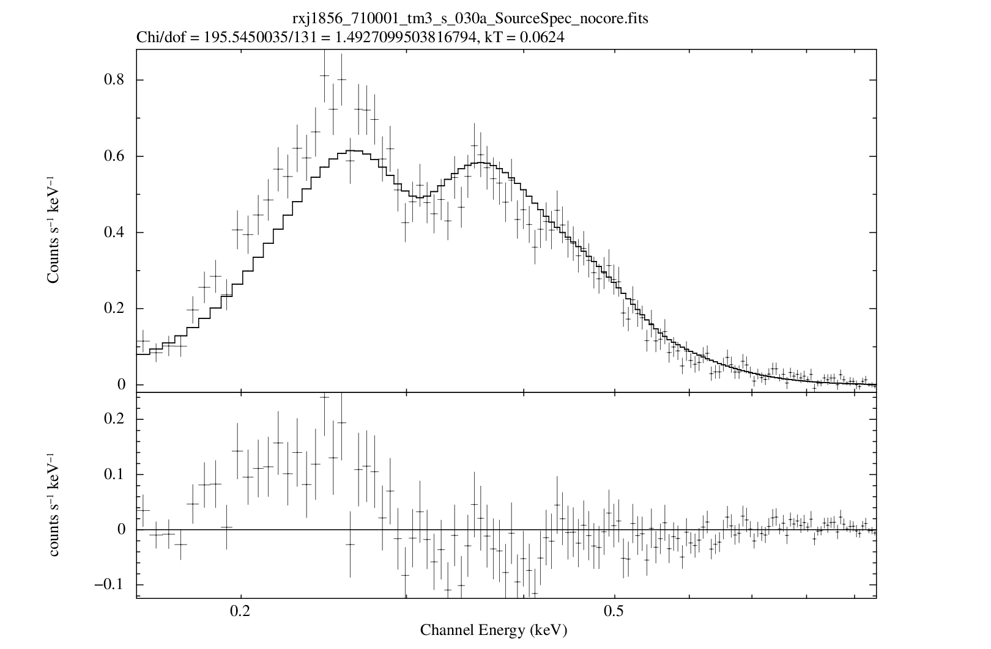
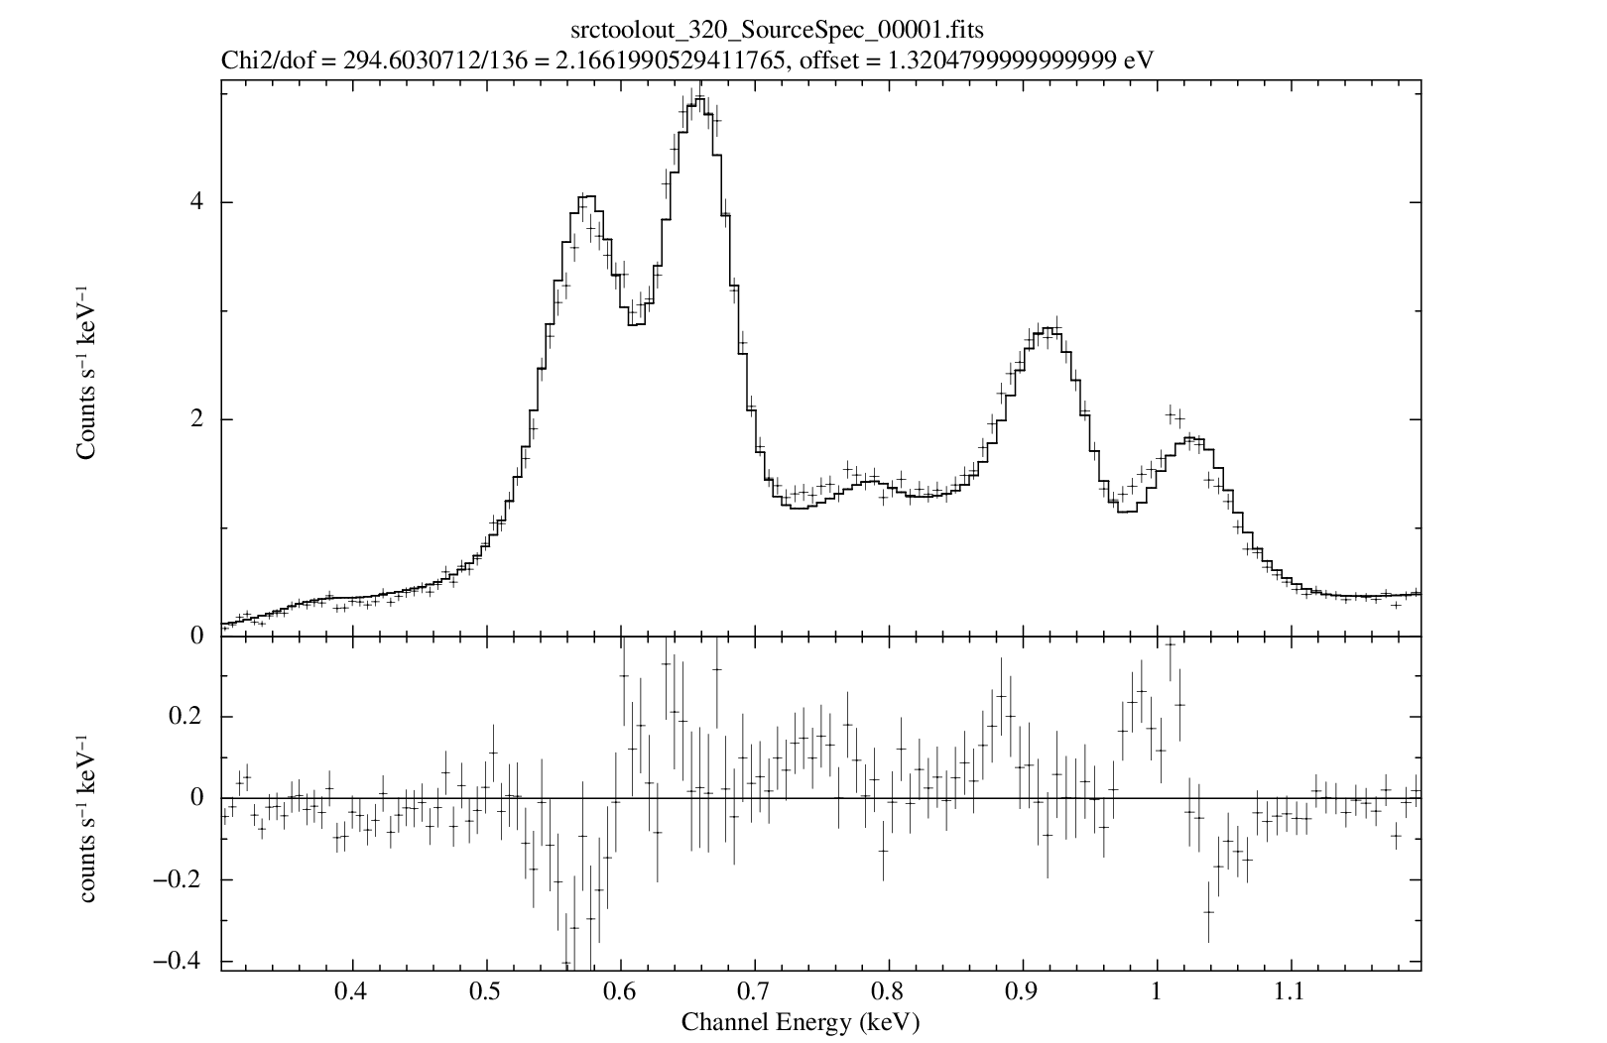
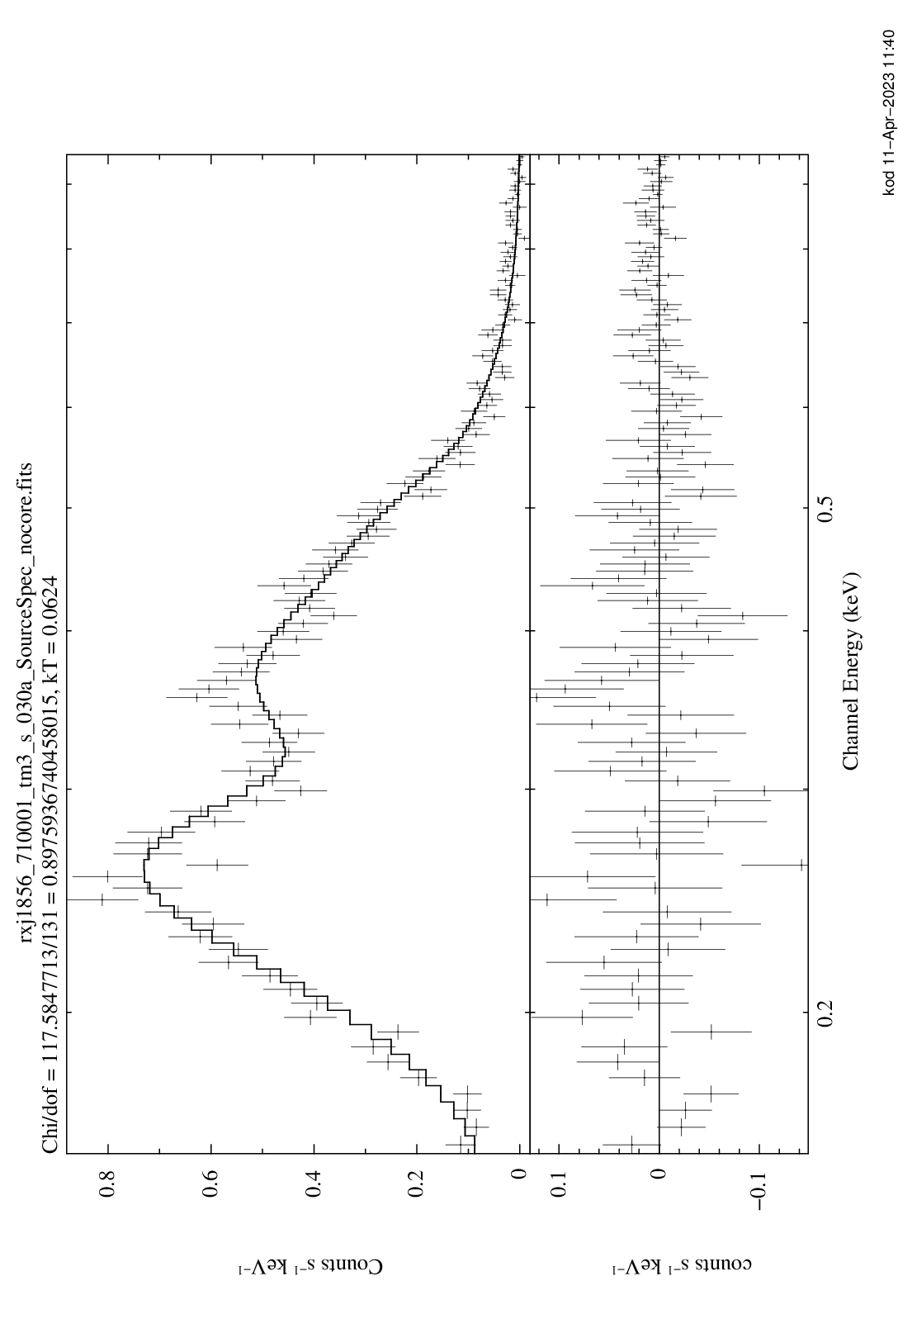
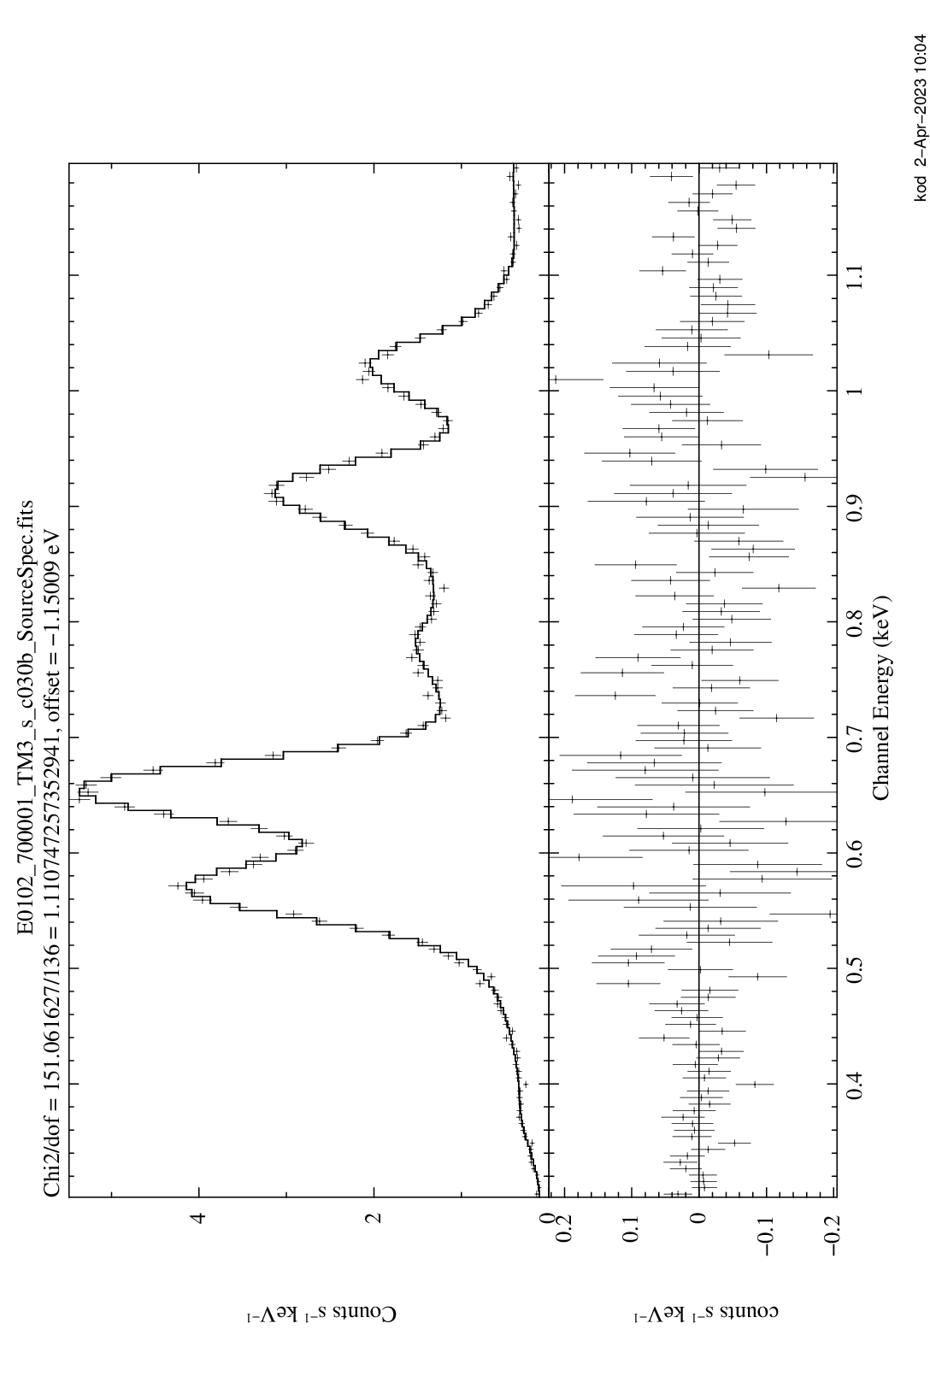
TM 3
χ_{ν}² = 2.2
TM 3
„Fitting“ the RMF and ARF
χ_{ν}² = 1.5
offset = +1 eV
Method:
consider two sources with „reliable“ spectral models simultaneously:
RX J1856-3754
& 1E 0102.2-7219
RX J1856-3754
1E 0102.2-7219
TM 3
χ_{ν}² = 1.1
TM 3
χ_{ν}² = 0.9
offset = -1 eV

Slide 68
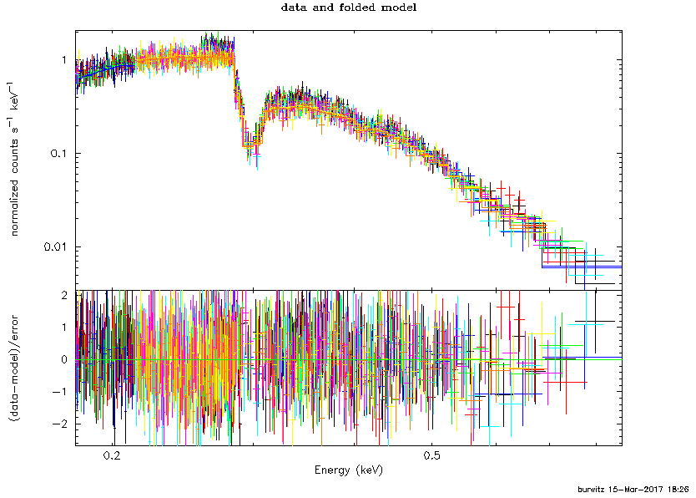
RX J1856-3754: Chandra LETG
RXJ 1856
Chandra LETG
Χ² = 694, ndof = 1251
V. Burwitz
nH = (7.2 +/- 0.3) × 10¹⁹ cm⁻², kT = 62.4 +/- 0.4 eV, norm = (1.58 +/- 0.06) x 10⁵ [tbabs * bbodyrad]

Slide 69
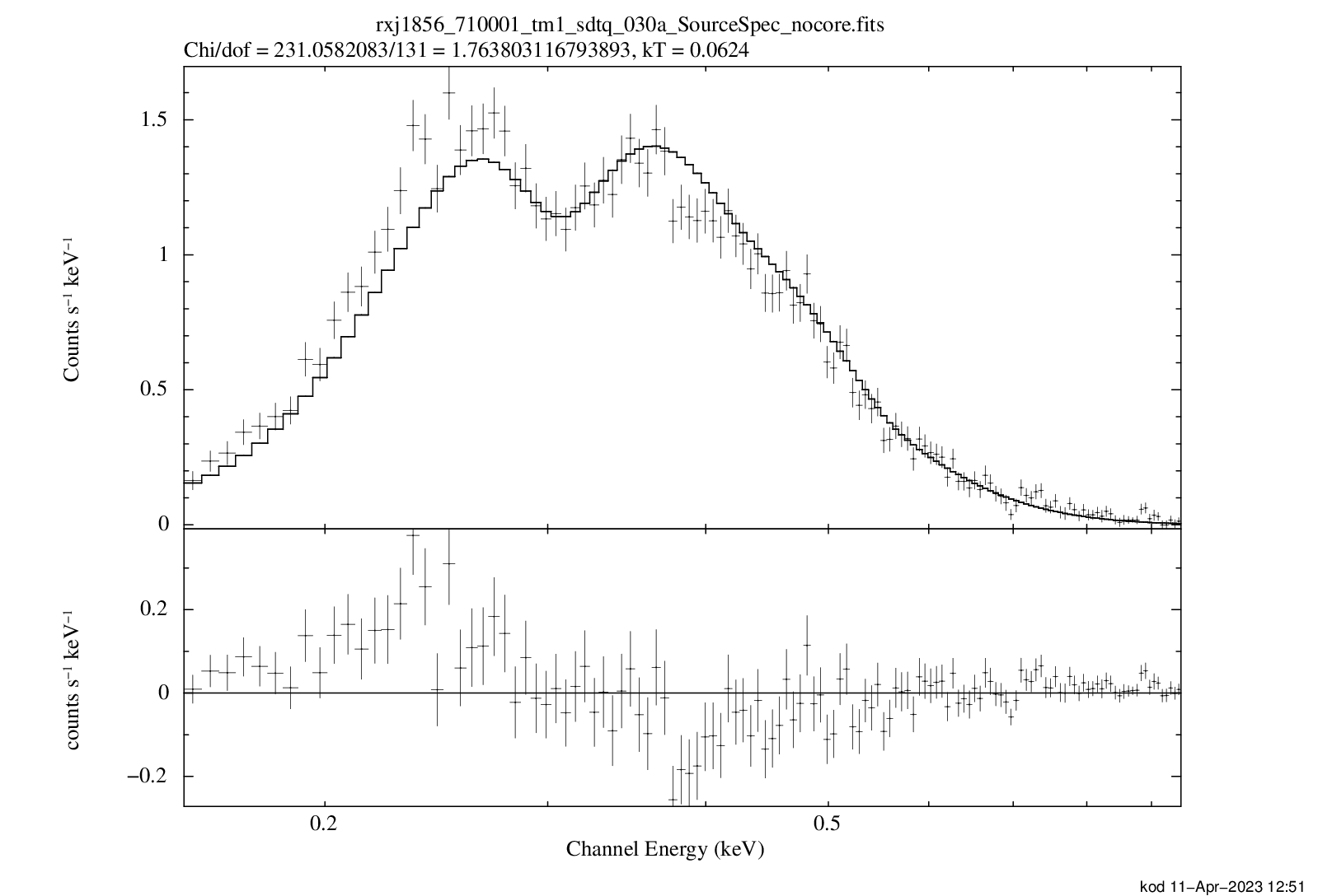
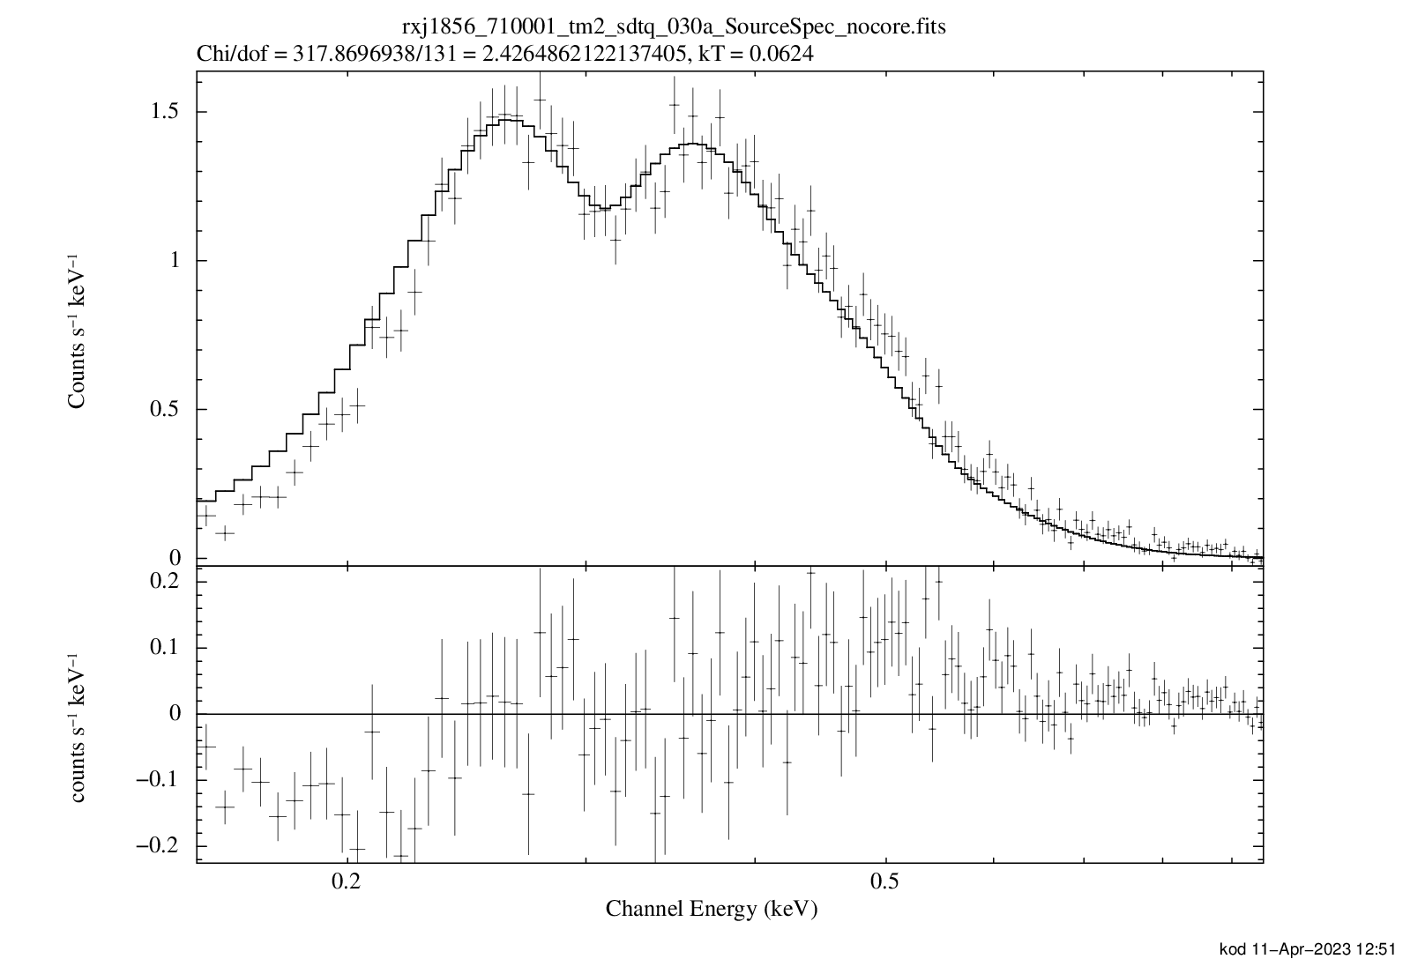
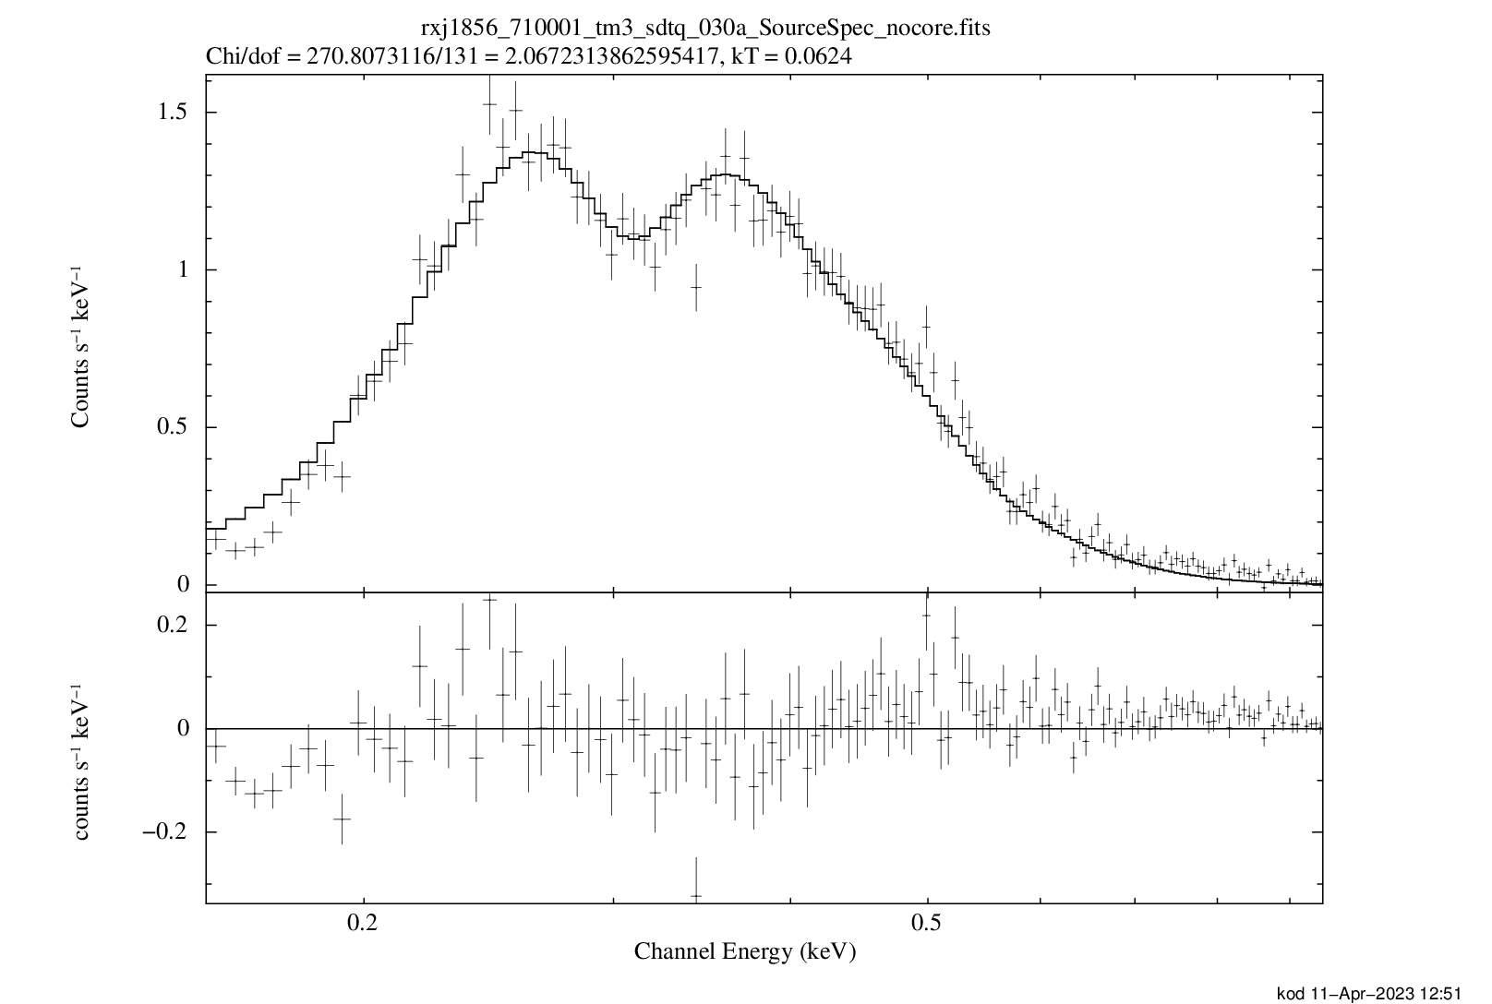
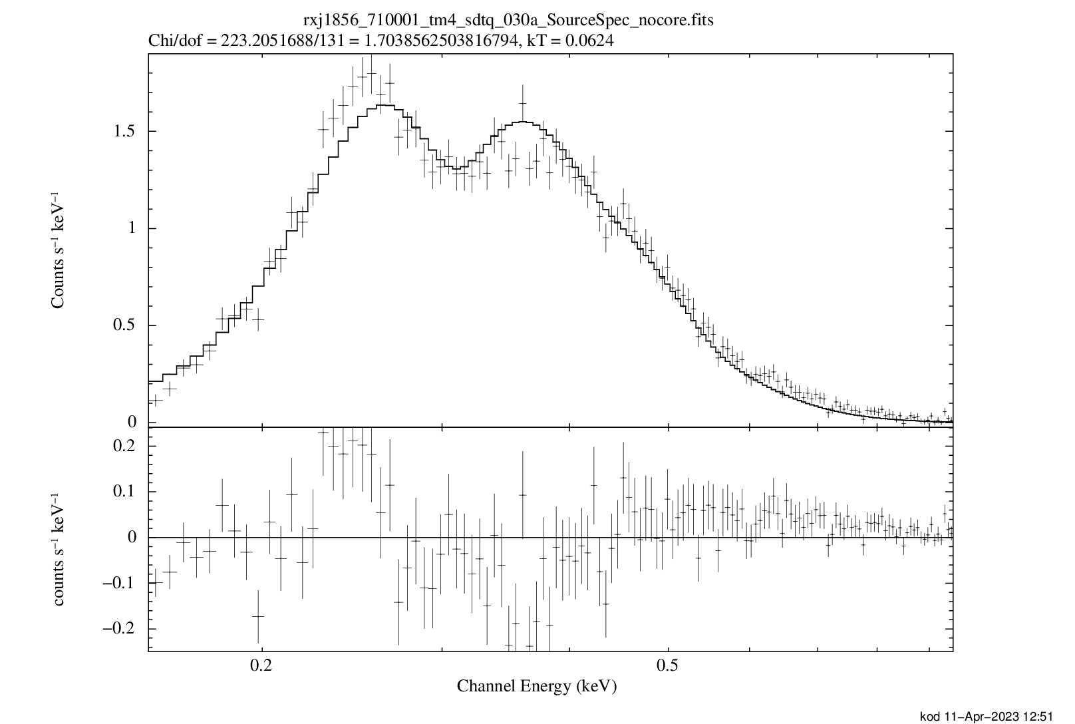
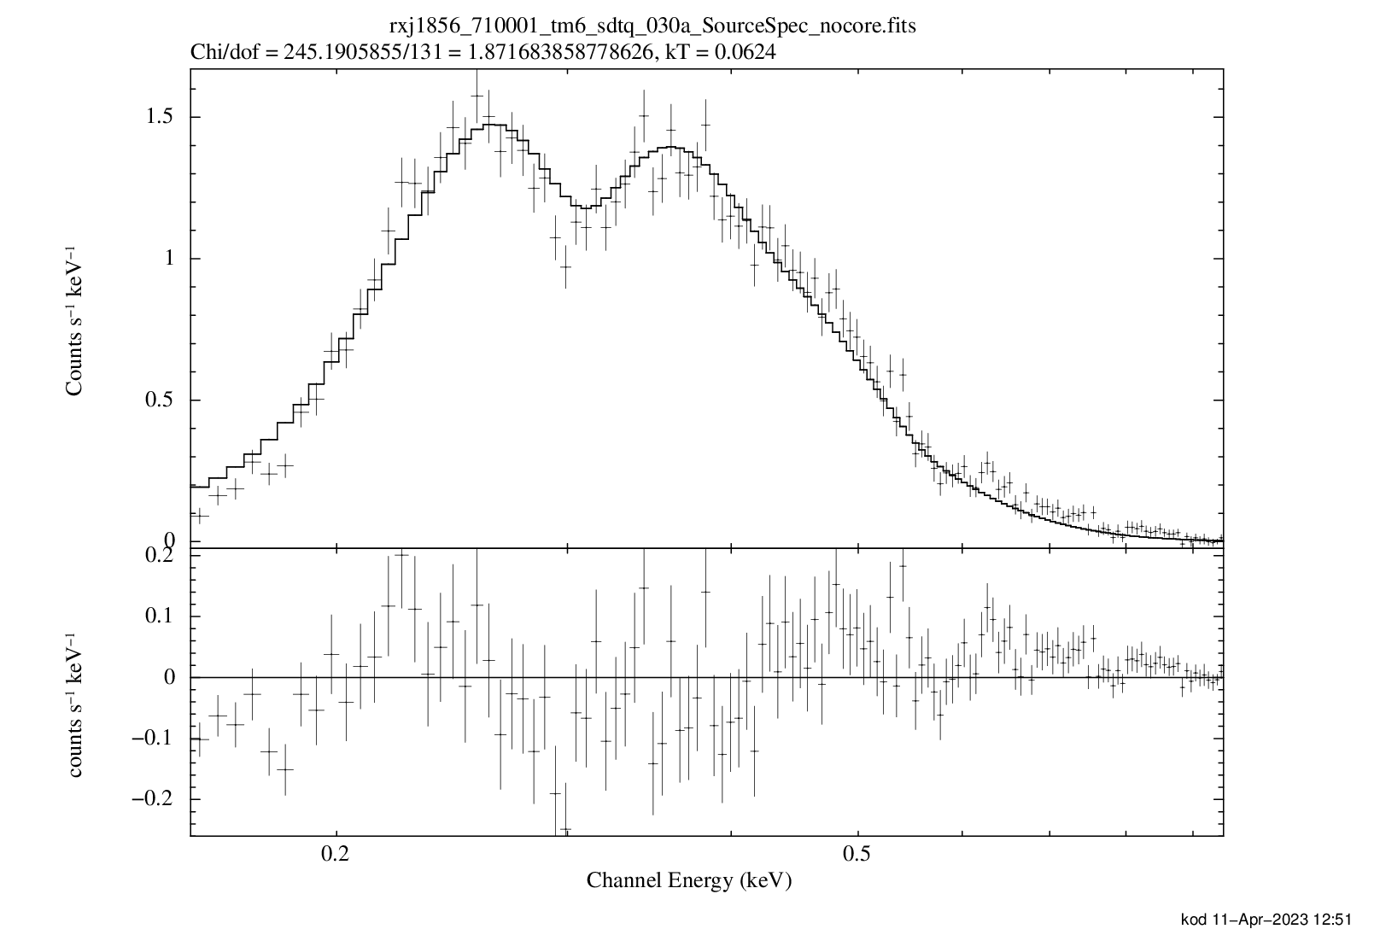
„before“
RX J1856-3754
2020 Apr 01-02
all valid patterns
TM 1
TM 2
χ_{ν}² = 1.8
χ_{ν}² = 2.4
only 1 free parameter:
normalization
(4 central pixels ignored)
nH = 7.25 × 10¹⁹ cm⁻²
kT = 62.4 eV
(Chandra LETG)
TM 3
TM 4
TM 6
χ_{ν}² = 2.1
χ_{ν}² = 1.7
χ_{ν}² = 1.9

Slide 70
„after“
RX J1856-3754
2020 Apr 01-02
all valid patterns
TM 1
TM 2
χ_{ν}² = 1.2
χ_{ν}² = 1.1
only 1 free parameter:
normalization
(4 central pixels ignored)
nH = 7.25 × 10¹⁹ cm⁻²
kT = 62.4 eV
(Chandra LETG)
TM 3
TM 4
TM 6
χ_{ν}² = 1.3
χ_{ν}² = 1.1
χ_{ν}² = 1.3

Slide 71
„after“
RX J1856-3754
2020 Apr 01-02
single pixel events
TM 1
TM 2
χ_{ν}² = 1.1
χ_{ν}² = 1.0
only 1 free parameter:
normalization
(4 central pixels ignored)
nH = 7.25 × 10¹⁹ cm⁻²
kT = 62.4 eV
(Chandra LETG)
TM 3
TM 4
TM 6
χ_{ν}² = 0.9
χ_{ν}² = 1.1
χ_{ν}² = 1.1

Slide 72
1E 0102.2-7219: IACHEC !

Slide 73
eROSITA calibration observations of 1E 0102.2-7219
3 long (30-60 ks)
pointed eROSITA observations
2019 - 2021
Chandra ACIS
1
2019 Nov 07-08
2
2020 Jun 18-19
8 C
3
2021 Nov 26-27

Slide 74
1E 0102.2-7219
2019 Nov 07-08
all valid patterns
1
χ_{ν}² = 1.7
TM 1
χ_{ν}² = 1.4
TM 2
offset = -2 eV
offset = -3 eV
original IACHEC model used
only 2 free parameters:
offset and normalization
χ_{ν}² = 1.4
TM 3
χ_{ν}² = 1.9
TM 4
χ_{ν}² = 1.0
TM 6
offset = -2 eV
offset = -2 eV
offset = +2 eV

Slide 75
1E 0102.2-7219
2020 Jun 18-19
all valid patterns
2
χ_{ν}² = 1.2
TM 1
χ_{ν}² = 1.1
TM 2
offset = -3 eV
offset = -5 eV
original IACHEC model used
only 2 free parameters:
offset and normalization
χ_{ν}² = 1.6
TM 3
χ_{ν}² = 1.6
TM 4
χ_{ν}² = 1.3
TM 6
offset = +3 eV
offset = -3 eV
offset = -1 eV

Slide 76
1E 0102.2-7219
2021 Nov 26-27
all valid patterns
3
χ_{ν}² = 1.7
TM 1
χ_{ν}² = 1.7
TM 2
offset = -4 eV
offset = +1 eV
original IACHEC model used
only 2 free parameters:
offset and normalization
χ_{ν}² = 1.4
TM 3
χ_{ν}² = 1.1
TM 4
χ_{ν}² = 1.5
TM 6
offset = +2 eV
offset = -2 eV
offset = +2 eV

Slide 77
1E 0102.2-7219
2020 Jun 18-19
single pixel events
1
χ_{ν}² = 1.7
TM 1
χ_{ν}² = 1.2
TM 2
offset = -3 eV
offset = -2 eV
original IACHEC model used
only 2 free parameters:
offset and normalization
χ_{ν}² = 1.1
TM 3
χ_{ν}² = 1.2
TM 4
χ_{ν}² = 0.9
TM 6
offset = -1 eV
offset = -3 eV
offset = +4 eV

Slide 78
1E 0102.2-7219
2020 Jun 18-19
single pixel events
2
χ_{ν}² = 1.1
TM 1
χ_{ν}² = 1.2
TM 2
offset = -3 eV
offset = -1 eV
original IACHEC model used
only 2 free parameters:
offset and normalization
χ_{ν}² = 1.2
TM 3
χ_{ν}² = 1.1
TM 4
χ_{ν}² = 1.0
TM 6
offset = +2 eV
offset = -3 eV
offset = -1 eV

Slide 79
1E 0102.2-7219
2021 Nov 26-27
single pixel events
3
χ_{ν}² = 1.2
TM 1
χ_{ν}² = 1.2
TM 2
1E0102 is an ideal source for benchmark tests of the energy calibration accuracy
the eROSITA results are consistent with the IACHEC model
despite (sometimes very large) changes
in the CCD temperature, the absolute energy scale can be reconstructed to an
accuracy of ≈ 3 eV
independent of the pattern size
over a time span of 2 years
offset = -1 eV
offset = +4 eV
original IACHEC model used
only 2 free parameters:
offset and normalization
χ_{ν}² = 1.2
TM 3
χ_{ν}² = 1.0
TM 4
χ_{ν}² = 1.2
TM 6
offset = +1 eV
offset = -1 eV
offset = +1 eV

Slide 80
The energy calibration of eROSITA
Pelham, Germany
IACHEC, 2023 April 25
Konrad Dennerl, MPE

