Slide 1
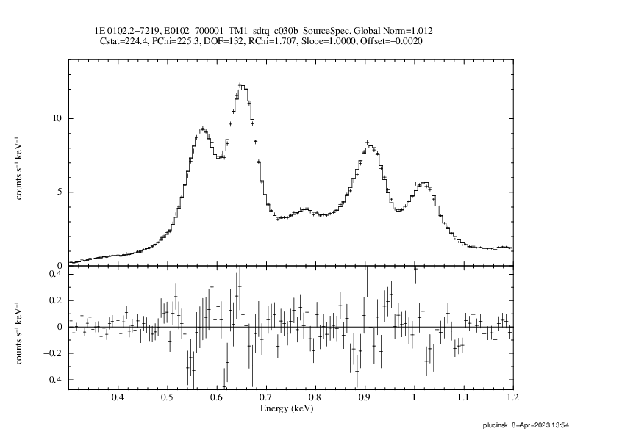
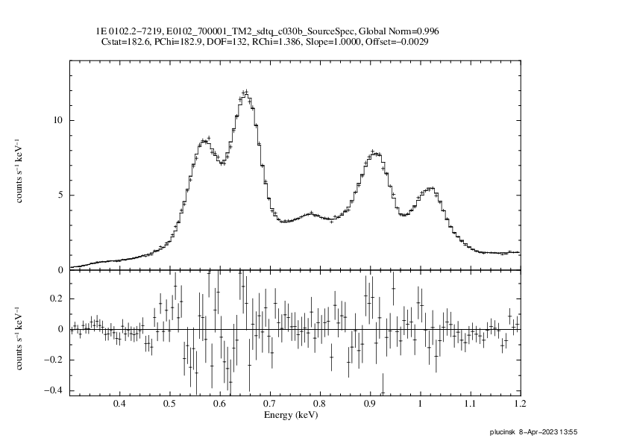
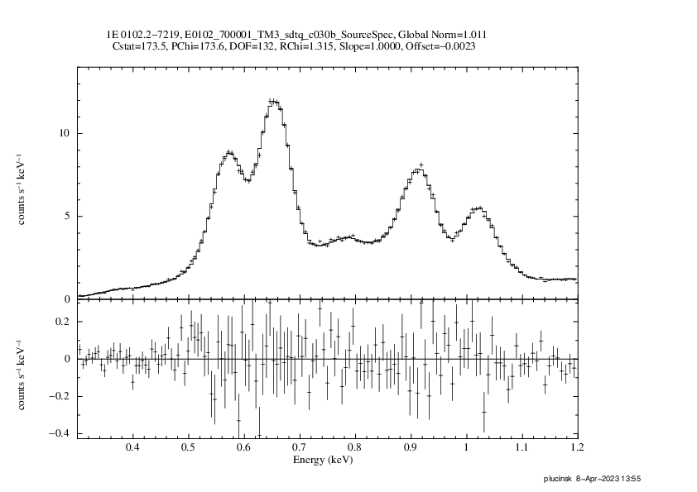
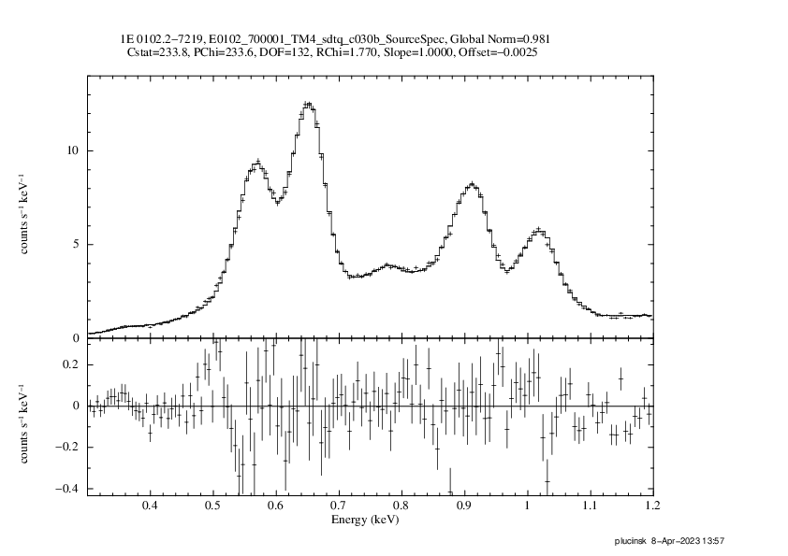
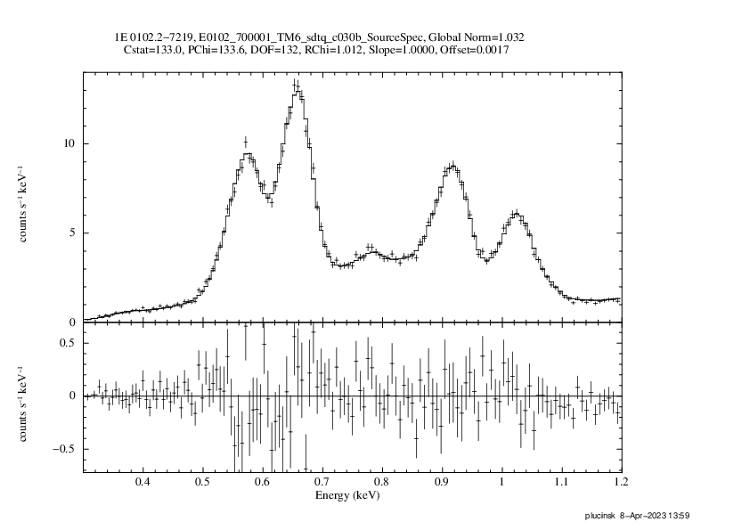
χ_{ν}² = 1.7
TM 1
χ_{ν}² = 1.4
TM 2
1E 0102.2-7219
2019 Nov 07-08
all valid patterns
×1.012
×0.996
offset = -2 eV
offset = -3 eV
χ_{ν}² = 1.3
TM 3
χ_{ν}² = 1.8
TM 4
χ_{ν}² = 1.0
TM 6
×1.011
×0.981
×1.032
offset = -2 eV
offset = -3 eV
offset = +2 eV

Slide 2
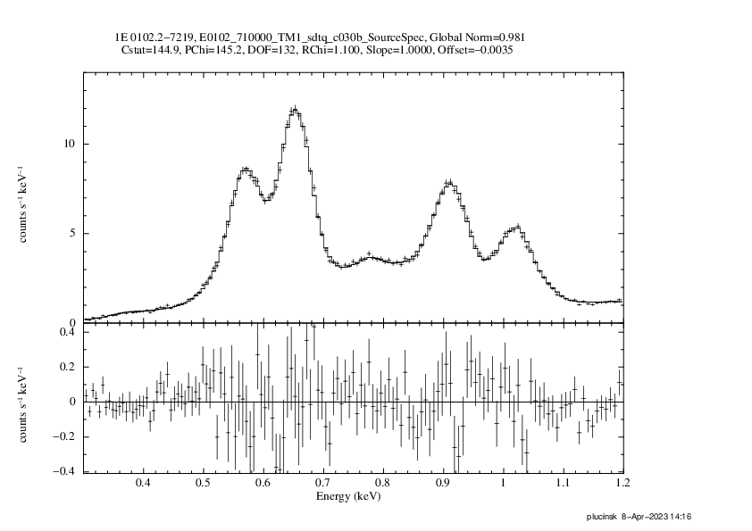
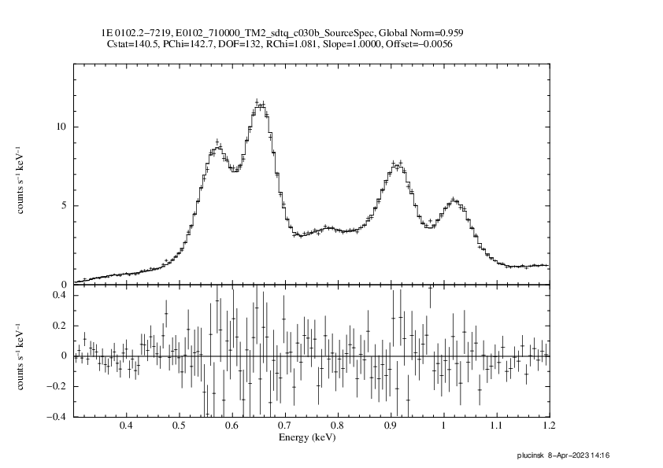
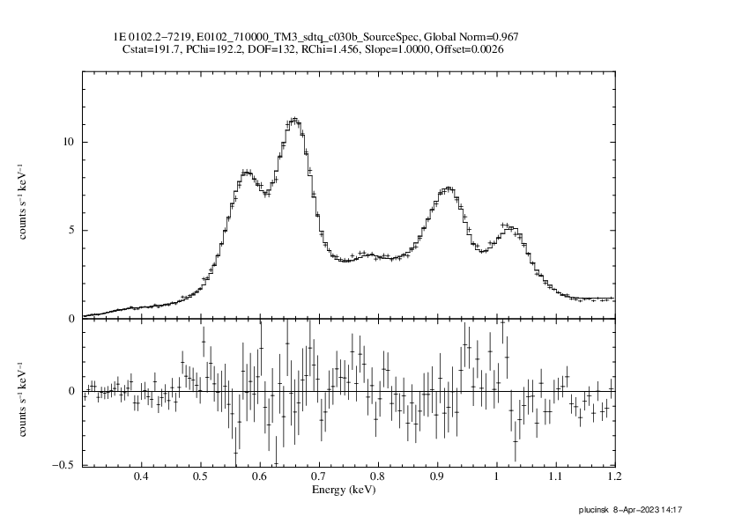
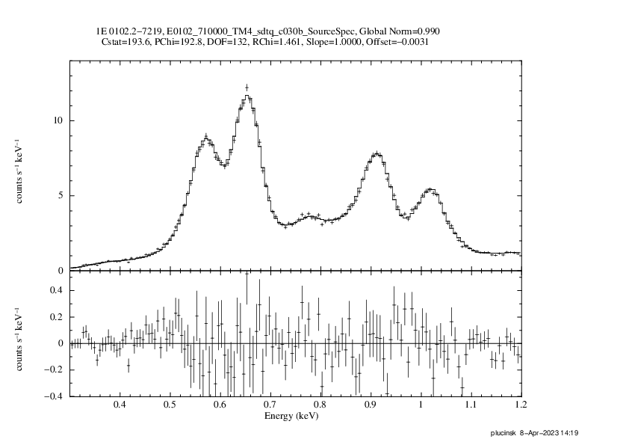
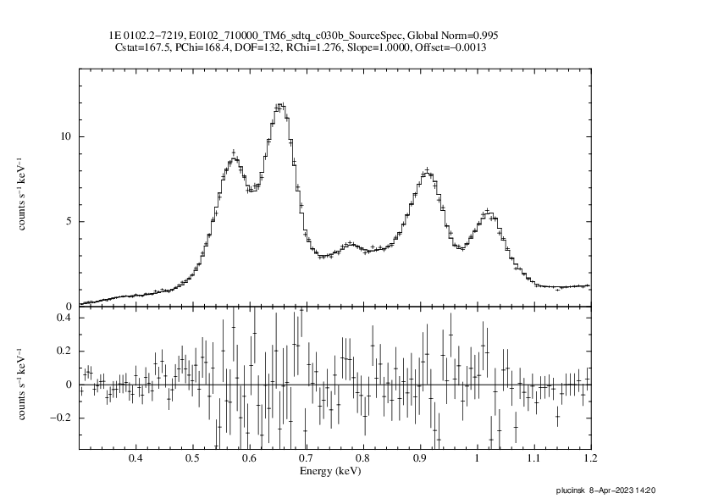
χ_{ν}² = 1.1
TM 1
χ_{ν}² = 1.1
TM 2
1E 0102.2-7219
2020 Jun 18-19
all valid patterns
×0.981
×0.959
offset = -4 eV
offset = -6 eV
χ_{ν}² = 1.5
TM 3
χ_{ν}² = 1.5
TM 4
χ_{ν}² = 1.3
TM 6
×0.967
×0.990
×0.995
offset = +3 eV
offset = -3 eV
offset = +1 eV

Slide 3
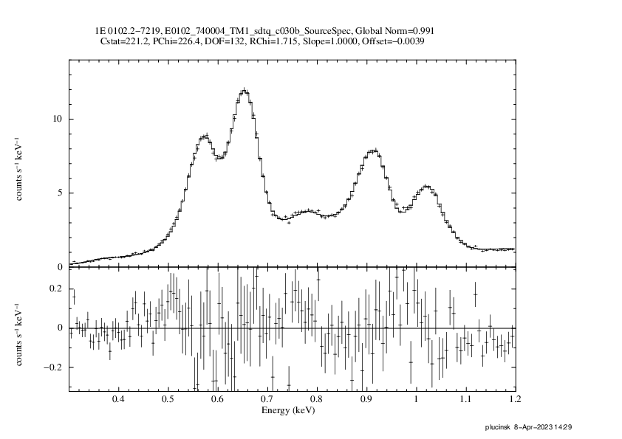
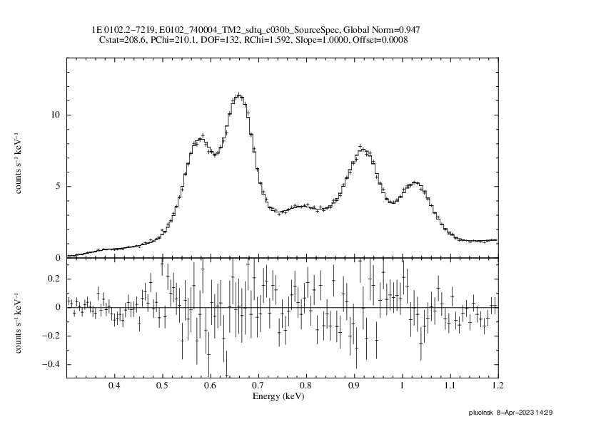
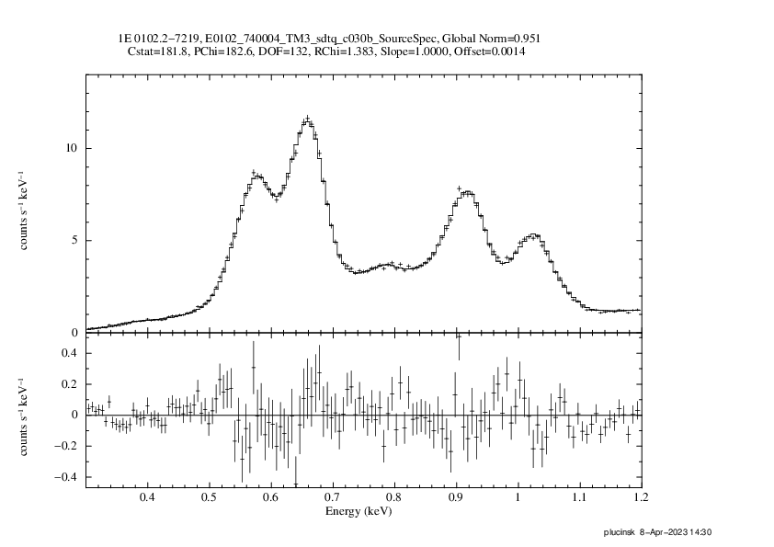
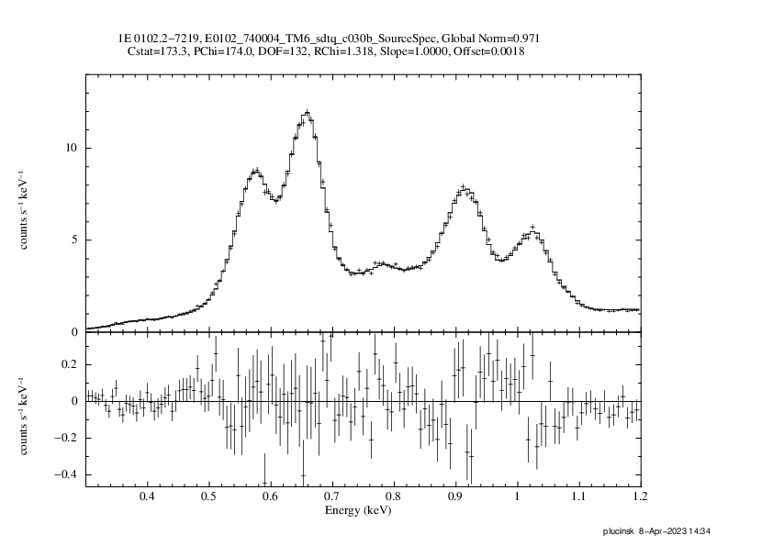
χ_{ν}² = 1.7
TM 1
χ_{ν}² = 1.6
TM 2
1E 0102.2-7219
2021 Nov 26-27
all valid patterns
×0.991
×0.947
offset = -4 eV
offset = +1 eV
χ_{ν}² = 1.4
TM 3
χ_{ν}² = 1.1
TM 4
χ_{ν}² = 1.3
TM 6
×0.951
×0.914
×0.971
offset = +1 eV
offset = -2 eV
offset = +2 eV

Slide 4
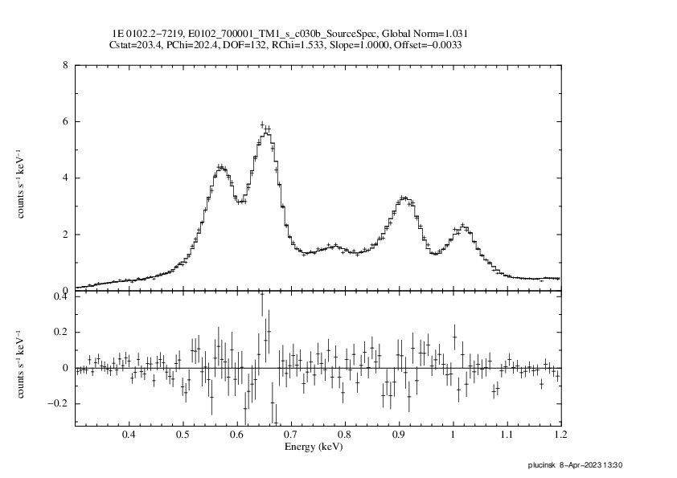
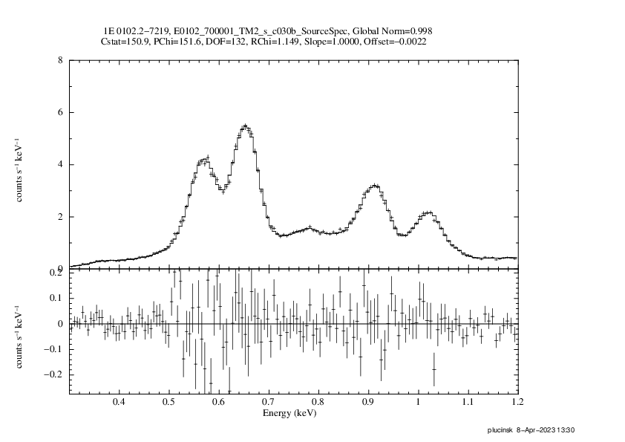
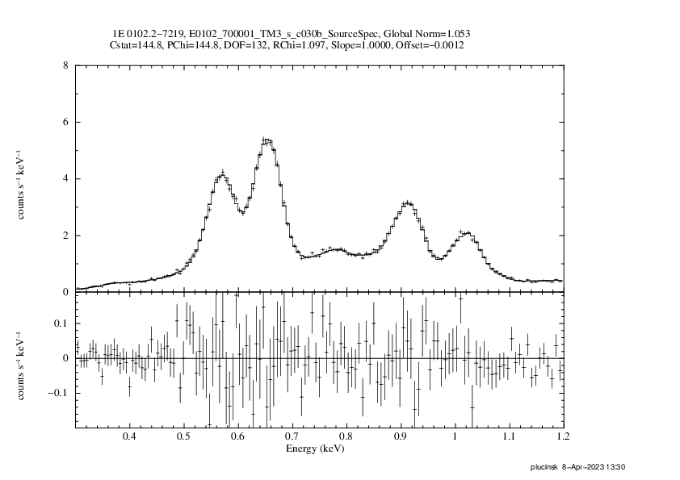
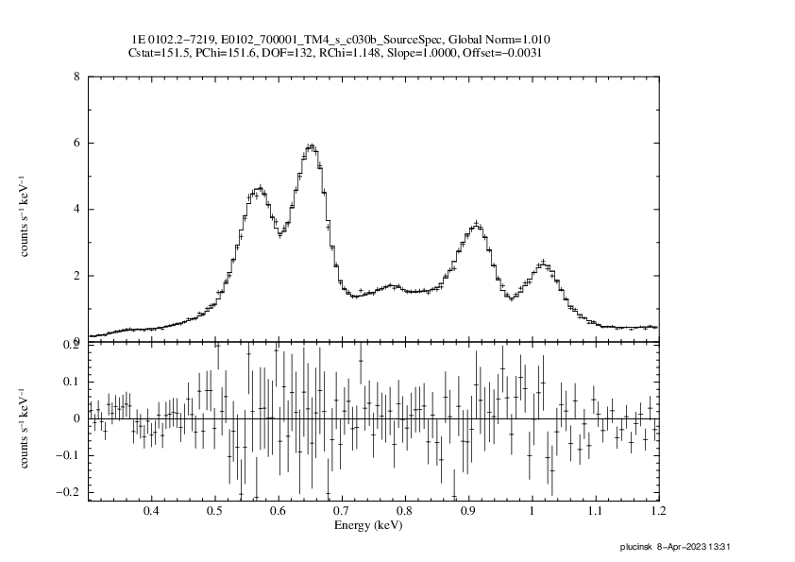
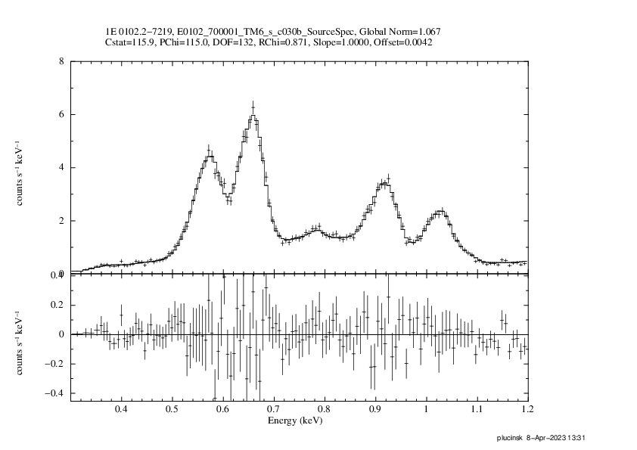
χ_{ν}² = 1.5
TM 1
χ_{ν}² = 1.1
TM 2
1E 0102.2-7219
2019 Nov 07-08
single pixel events
×1.031
×0.998
offset = -3 eV
offset = -2 eV
χ_{ν}² = 1.1
TM 3
χ_{ν}² = 1.1
TM 4
χ_{ν}² = 0.9
TM 6
×1.053
×1.010
×1.067
offset = -1 eV
offset = -3 eV
offset = +4 eV

Slide 5
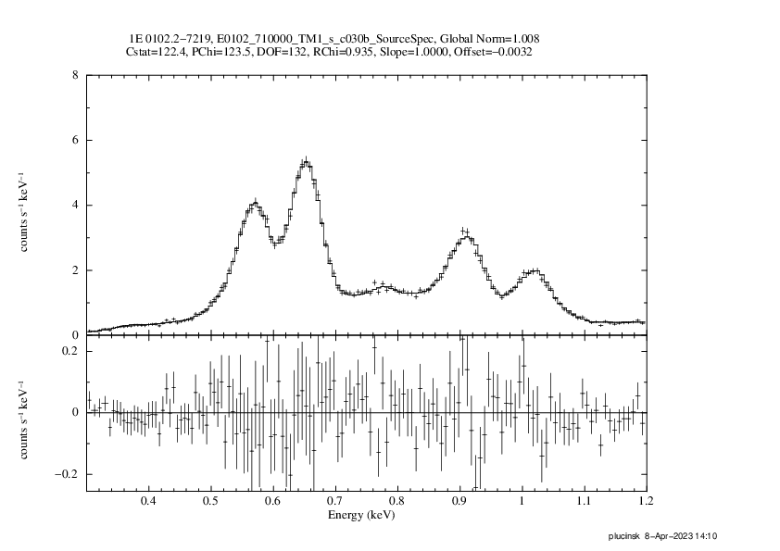
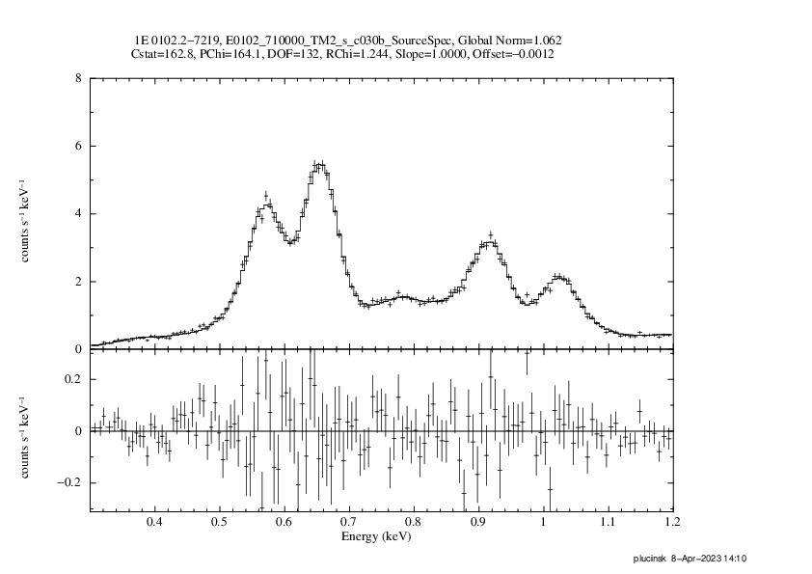
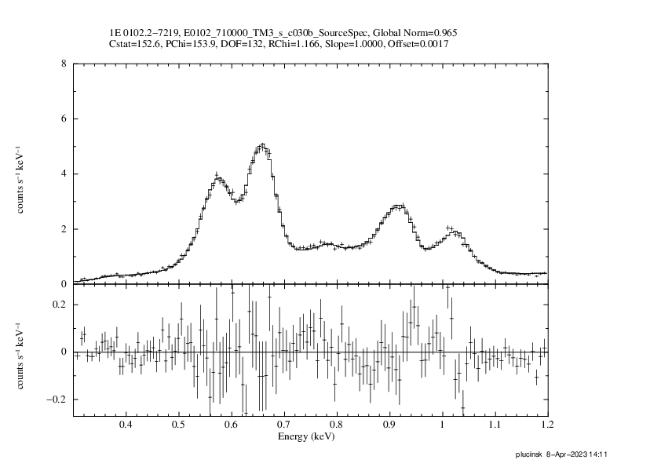
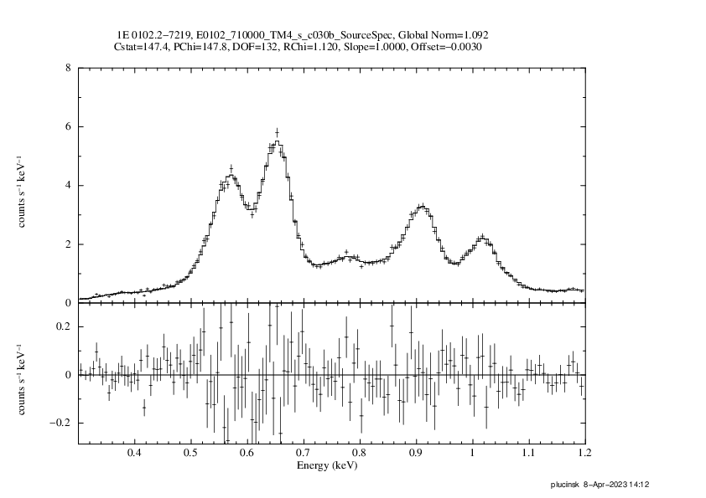
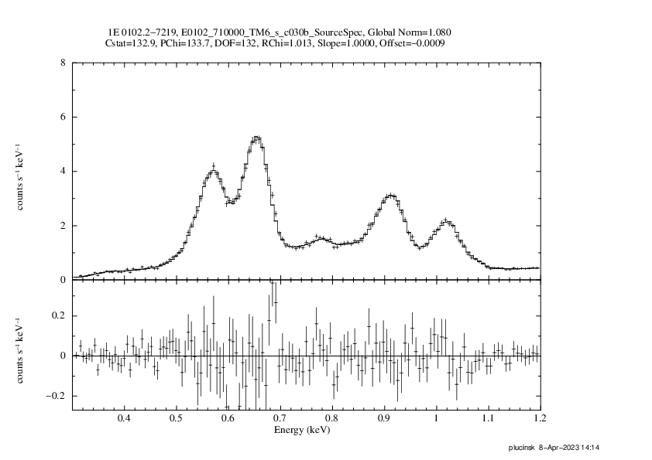
χ_{ν}² = 0.9
TM 1
χ_{ν}² = 1.2
TM 2
1E 0102.2-7219
2020 Jun 18-19
single pixel events
×1.008
×1.062
offset = -3 eV
offset = -1 eV
χ_{ν}² = 1.2
TM 3
χ_{ν}² = 1.1
TM 4
χ_{ν}² = 1.0
TM 6
×0.965
×1.092
×1.080
offset = +1 eV
offset = -3 eV
offset = -1 eV

Slide 6
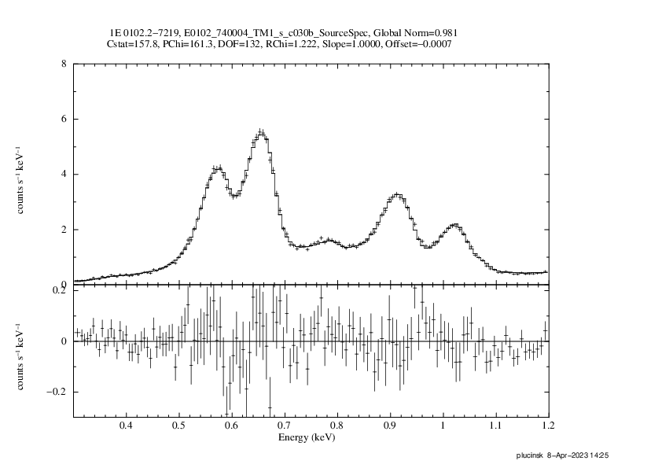
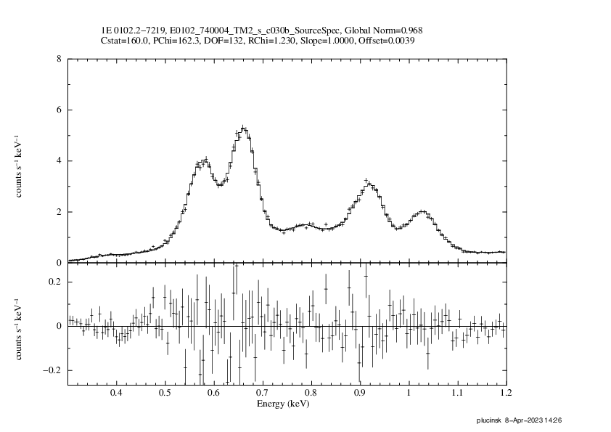
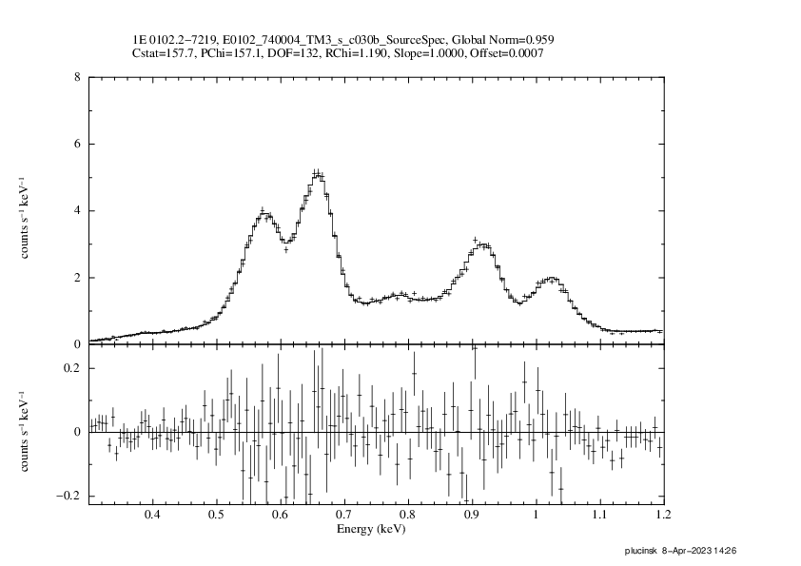
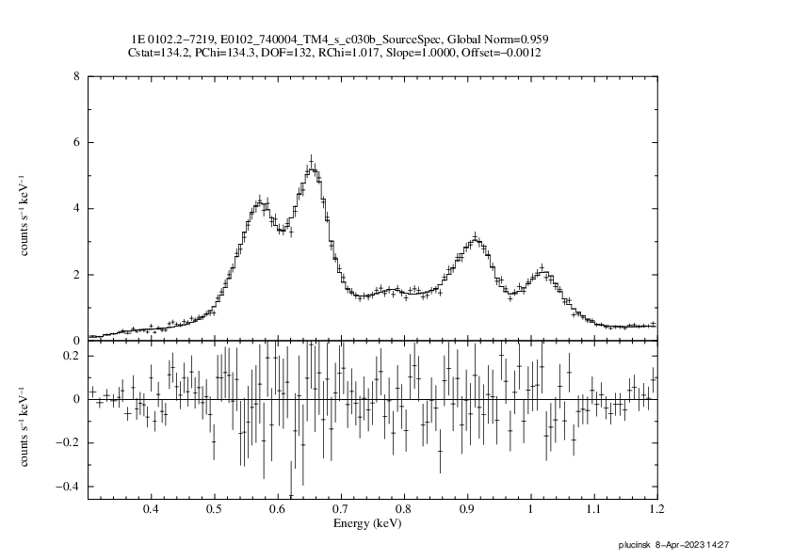
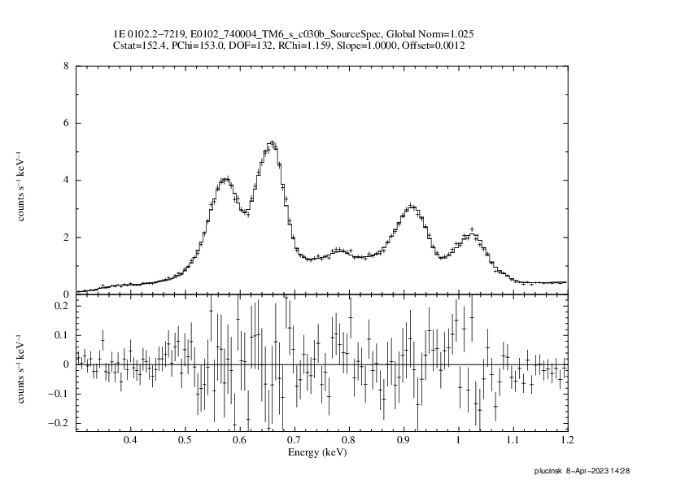
χ_{ν}² = 1.2
TM 1
χ_{ν}² = 1.2
TM 2
1E 0102.2-7219
2021 Nov 26-27
single pixel events
×0.981
×0.968
offset = -1 eV
offset = +4 eV
χ_{ν}² = 1.2
TM 3
χ_{ν}² = 1.0
TM 4
χ_{ν}² = 1.2
TM 6
×0.959
×0.959
×1.03
offset = +1 eV
offset = -1 eV
offset = +1 eV

