Slide 1
LEXI Calibration
The LEXI Team
The PANTER Calibration Team
The Marshall SLTF Team

Slide 2
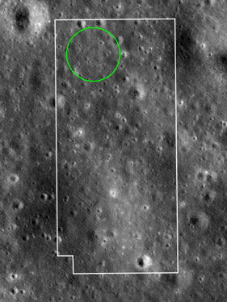
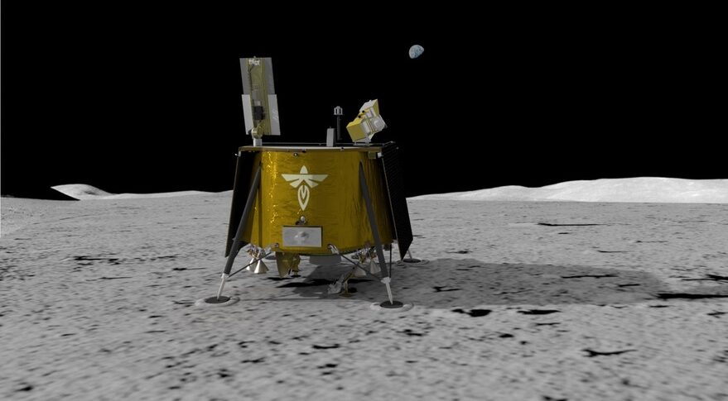
Lunar Environment heliospheric X-ray Imager
Small, self-contained, wide-field X-ray telescope
Sensitive to energies from 0.1 to 2.0 keV
9º×9º FOV and a PSF ~15´
Utilizes a 3×3 mosaic of slumped micropore optics (SMPO) or lobster-eye optics
Will operate on the lunar surface (launch in 2024)
Observations will last 8 days
Observations made from Mare Crisium
Will observe X-ray emission from the Earth’s magnetosheath

Slide 3
Lunar Environment heliospheric X-ray Imager
Originally launched as a sounding rocket payload.
Launched 12/12/12
Launched as tech demo piggybacked on DXL
Proposal requirement
Instrument effectively built pre-proposal
→ Minimal Funding for construction
So no coatings on the optics - just bare glass.
Pathfinder for other magnetospheric observers!

Slide 4
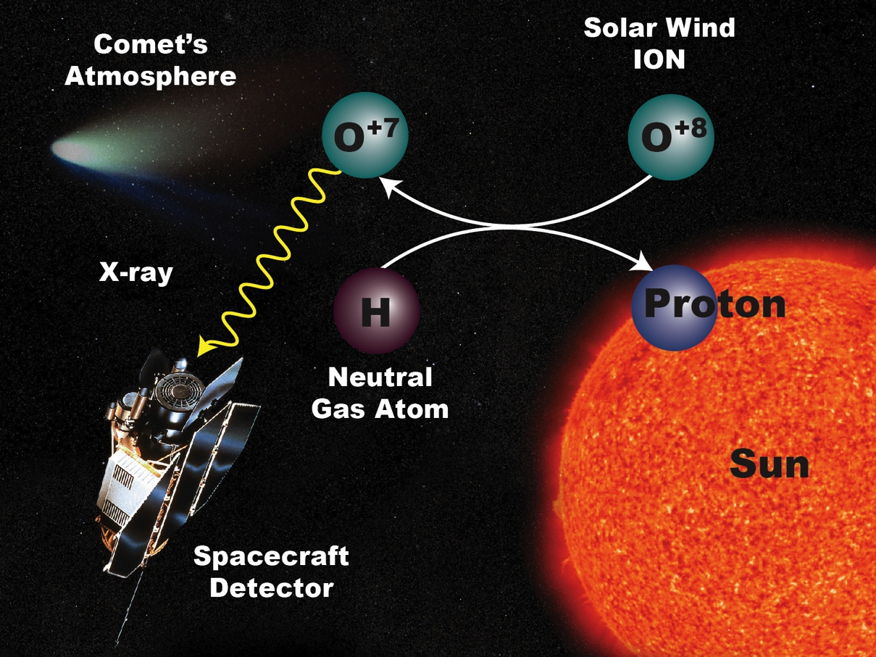
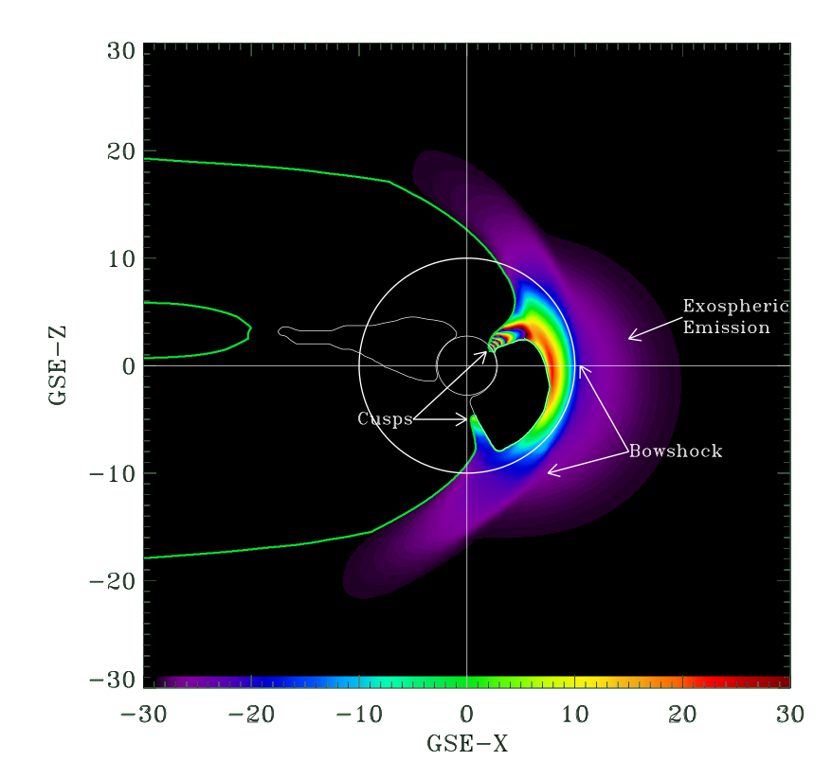
LEXI Science
Solar Wind Charge eXchange (SWCX) emission:
- Occurs when high state ions in the solar wind charge-exchange with neutral atoms, producing FUV/low energy X-rays.
- Is particularly strong in the Earth’s magnetosheath where the solar wind is shocked and compressed.
Magnetospheric SWCX allows:
- Imaging of the magnetosheath
- Measurement of the location of the magnetopause over an extended region
No other method allows measurement of the global shape of the magnetopause!
Such measurements are crucial to understand magnetic reconnection in the magnetosheath.

Slide 5
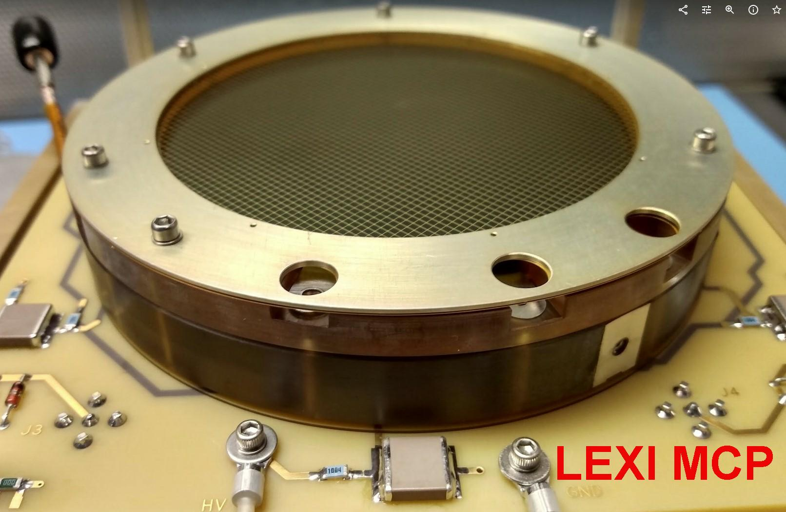
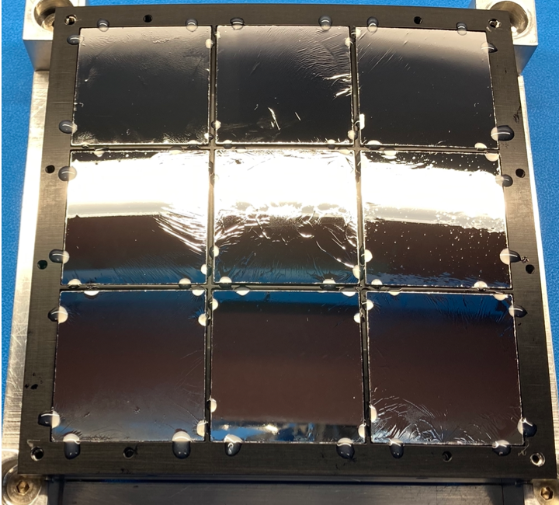
LEXI Mechanical Description
Electronics box
Electrical connectors
MCP detector
Internal baffles
Sweeping magnets
Optics holder
Vents
Sunshade
Mounting feet
Puller pin
Deployer door
Fins
LEXI consists of
- Sunshade
- 3×3 mosaic of bare-glass SMPO supporting
- Al-polyimide optical blocking filters
- MCP detector

Slide 6
LEXI consists of
- Sunshade
- 3×3 mosaic of bare-glass SMPO supporting
- Al-polyimide optical blocking filters
- MCP detector
}
“Outline”
Measurement of facet Rc
- GSFC test stand
- Calibration of optic+OBF
- PANTER
- Calibration of optic+OBF+MCP
- Marshall SLTF
- Work is still ongoing
- Calibration of optic+OBF+MCP+Sunshade
- Discuss the sunshade only

Slide 7
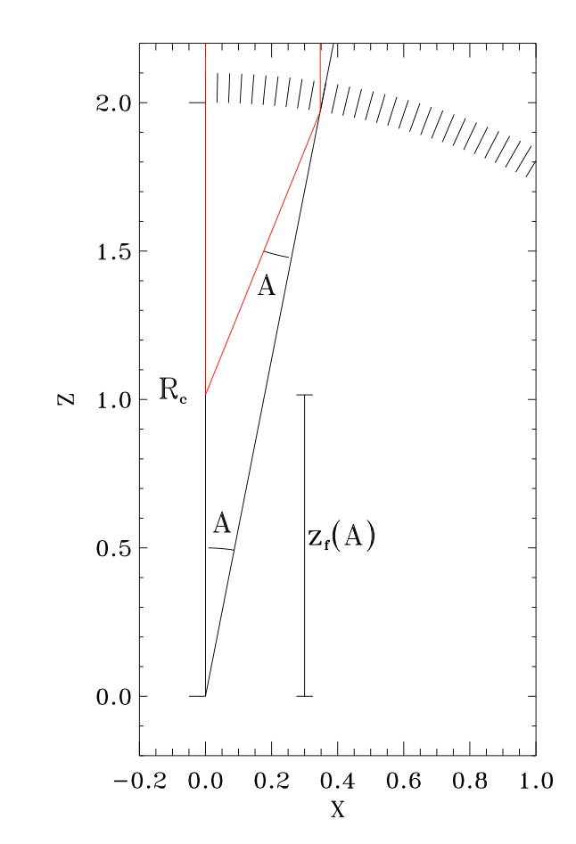
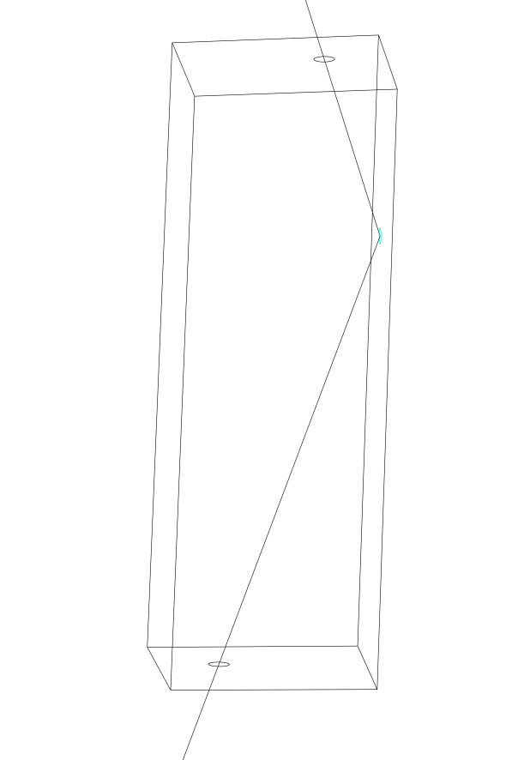
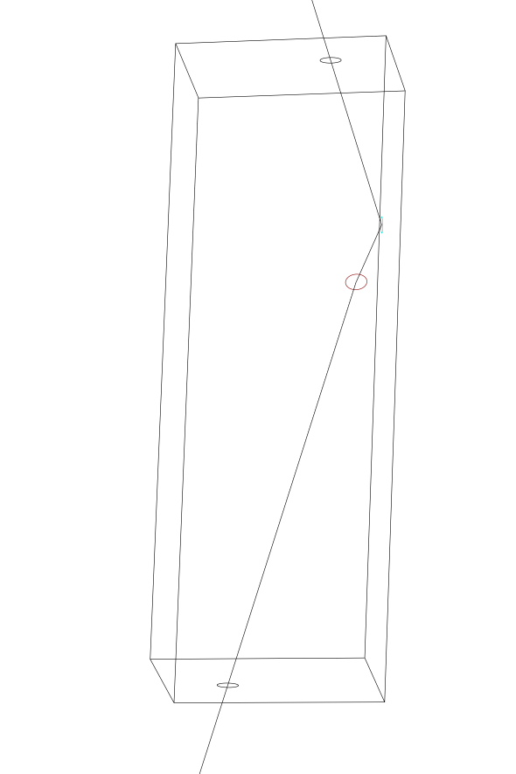
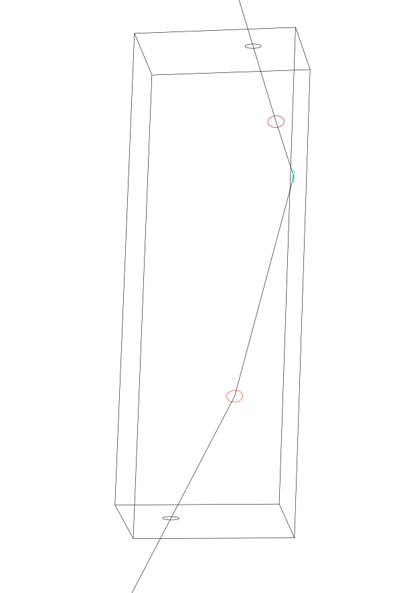
Slumped Micro-Pore Optics
SMPO focus X-rays using grazing incidence reflection,
with an array of flat plates perpendicular to the surface of a sphere
(which allows focussing in one direction)
and with an array of flat planes ⟂ to that array and the sphere
(which allows focussing in a second direction)
Photons must reflect from two ⟂ walls for focussing

Slide 8
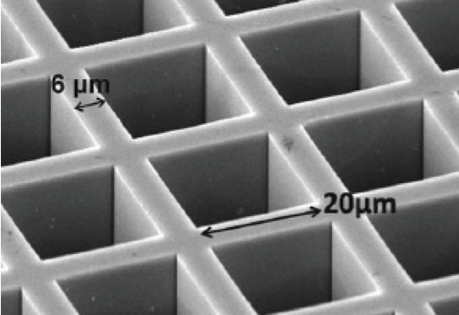
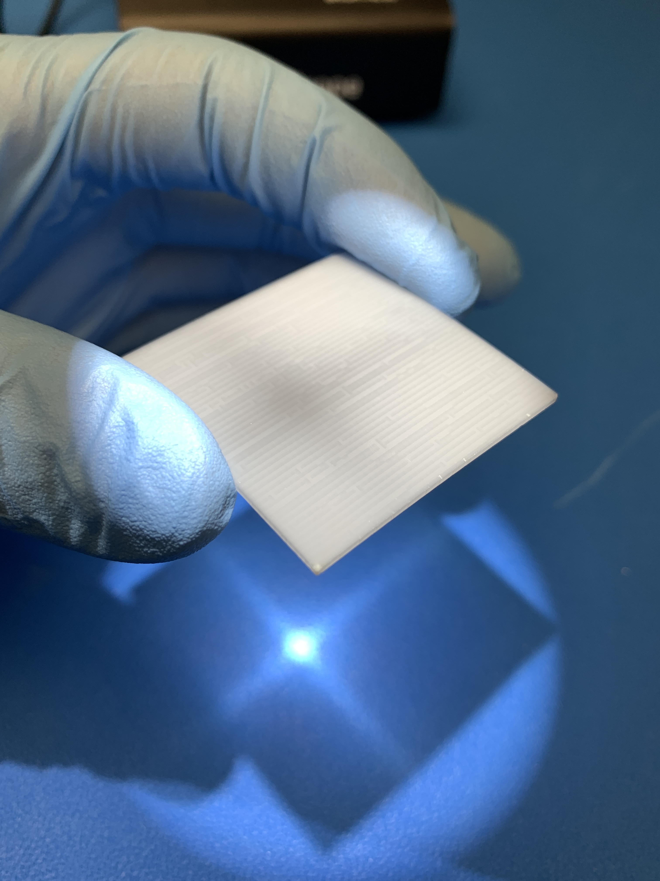
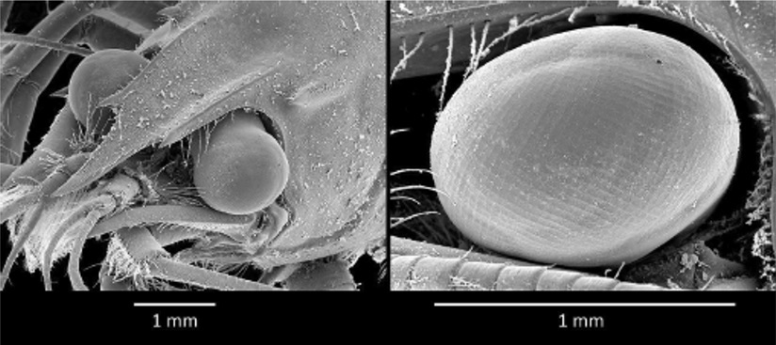
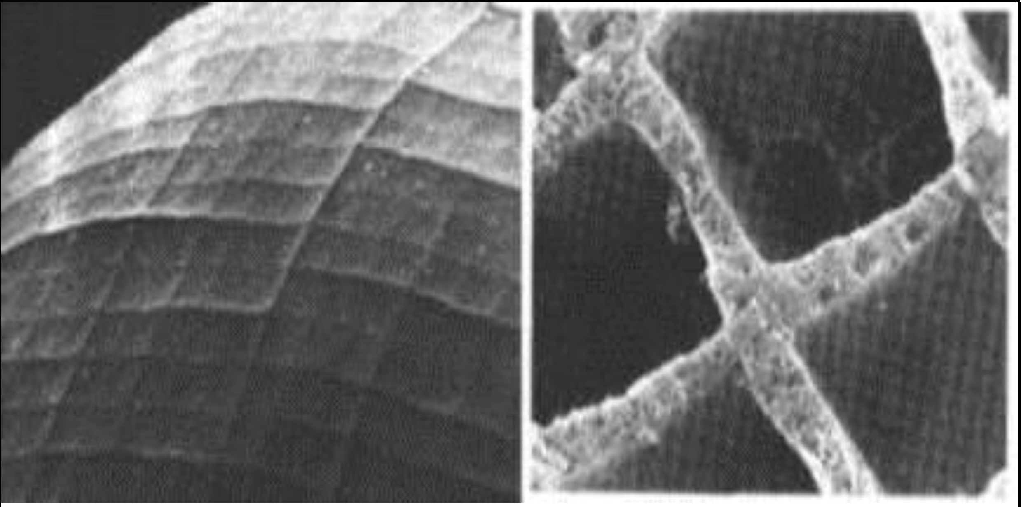
Slumped Micro-Pore Optics
SMPO focus by grazing incidence reflection from two set of mirrors ⟂ to each other and ⟂ to the surface of a sphere.
Working SMPO can be created from slumped square-pore micro-channel plates, which are similar to the structure of lobster eyes!

Slide 9
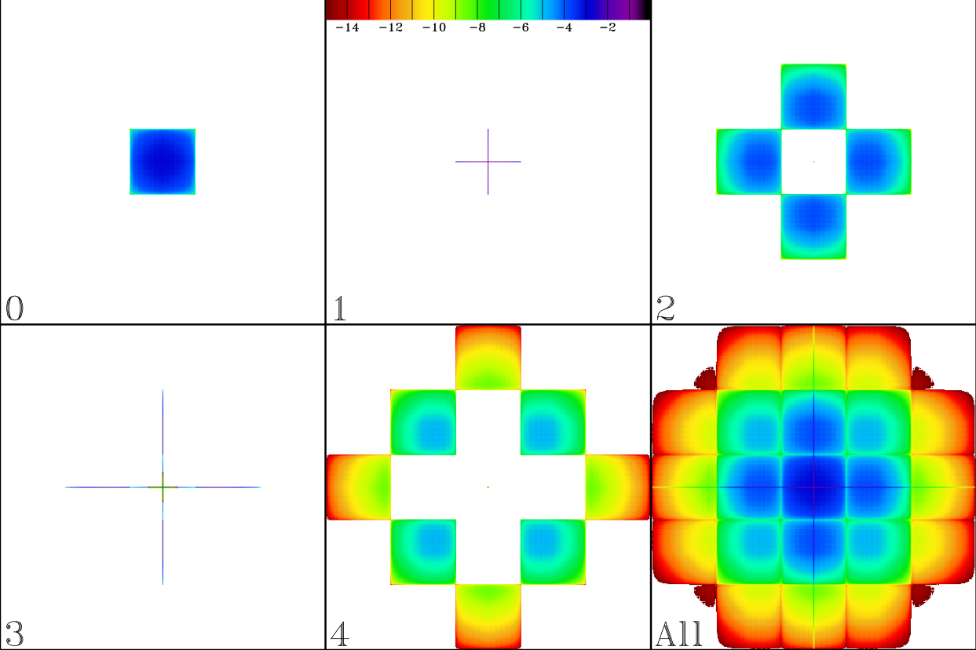
Slumped Micro-Pore Optics
SMPO optics have unique PSF structure:
- photons not reflecting from any wall are merely collimated
- photons have an odd number of reflections in a given direction are focussed in that direction
- photons having an even number of reflections in a given direction are not focussed in that direction
The components of the PSF as a function of the total number of reflections:

Slide 10
PBP
Simulations produced by Pore-By-Pore code
- NOT a Monte Carlo method
- Most definitely a work in progress!
- Each pore handled as a fully filled aperture
- Designed to handle
- MPO deformation if required
- Pore misalignment (but not yet implemented)
- Pore deformation (partially implemented)
- Different mosaicking strategies
- Various other facet errors
- Described in https://pages.jh.edu/kuntz1/vade_mecum.pdf

Slide 11
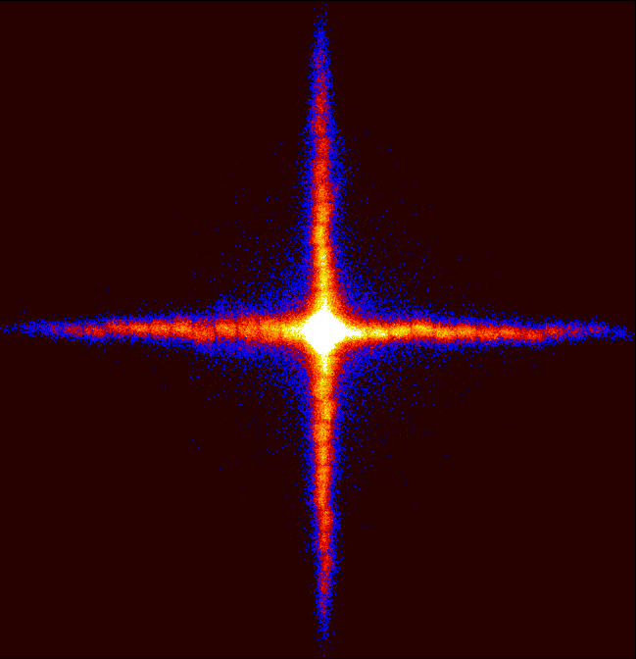
Slumped Micro-Pore Optics
SMPO optics have unique PSF structure:
~25% in the core
(fully focussed)
~50% in the arms
(partially focussed)
~25% in the background
(totally unfocussed)

Slide 12
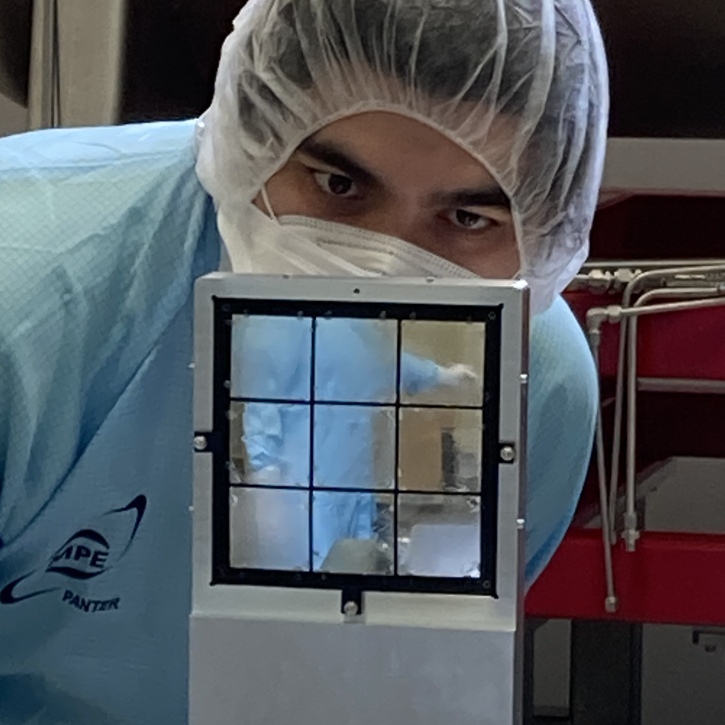
Slumped Micro-Pore Optics
Nota Bene:
Of the photons parallel to the optical axis, only those striking within an angle of acceptance Γ of the optical axis will be focussed;
photons from further away from the optical axis are reflected too many times within the pores and are absorbed.
Therefore: making the optic bigger does not increase the effective area
Making the optic bigger does increase the FOV.

Slide 13
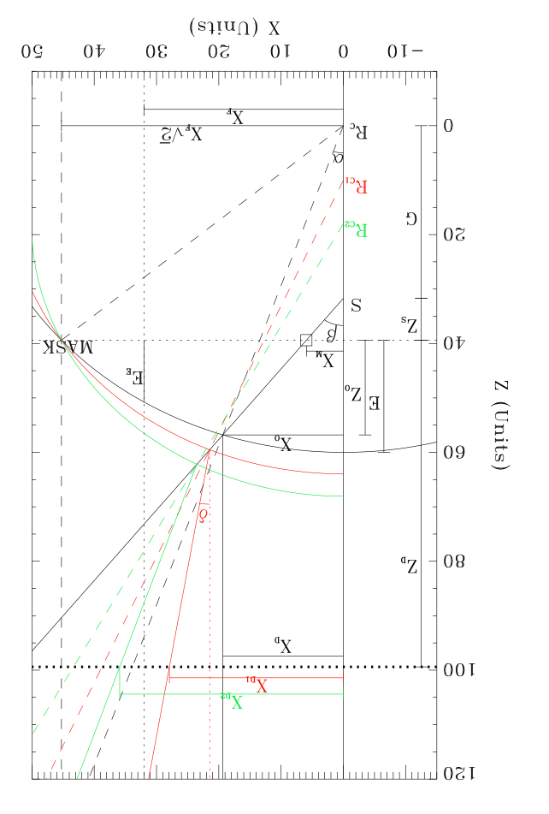
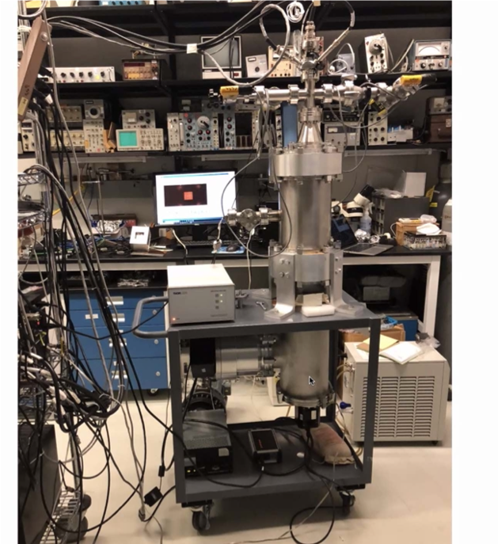
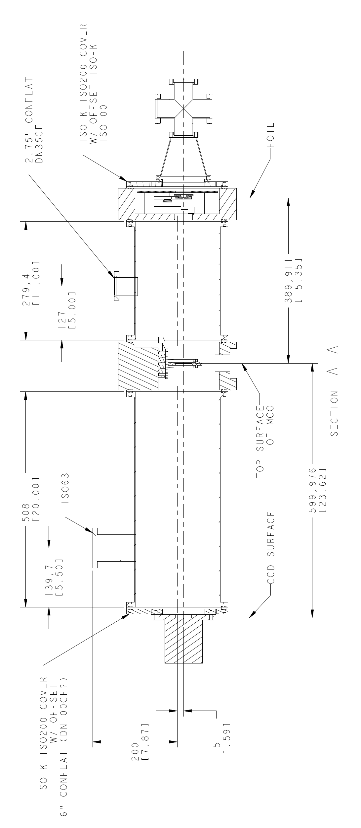
Facet Characterization
LEXI required 9 facets, but we acquired 18 to choose “best” half
- installation in optic frame is “irreversible”
- characterization required before installation → before beamline
Used specially designed test chamber at GSFC (by N. Thomas)
- measures Rc efficiently (and now we know it does it well!)
- currently difficult to measure throughput
- Rc smaller than expected

Slide 14
Characterization Goals
The characterization of the LEXI optic
(9 SMPO facets + optical blocking filters)
was performed at PANTER.
The characterization goals:
- measure the focal length of each SMPO facet (did not entirely trust TS)
- measure the PSF size of each SMPO facet
- measure the effective area as a function of energy
Source
Chamber

Slide 15
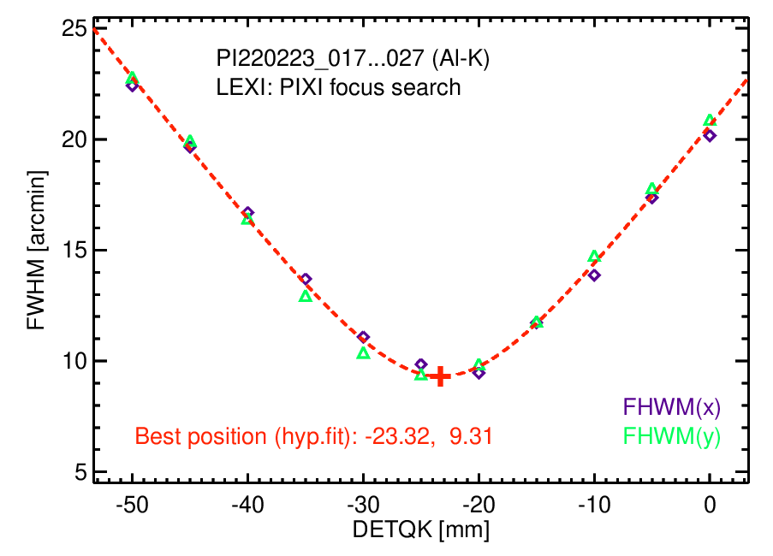
Focus
The facet specification: RC=750 mm (“the design focal length”)
This radius of curvature produces a focal length of 375 mm.
Frame holding facets precisely machined to this RC.
Focal length measured by masking off all but facet of interest and
adjusting distance to detector to minimize PSF size.
The facets have a mean RC=725 mm while in a frame with RC=750mm!

Slide 16
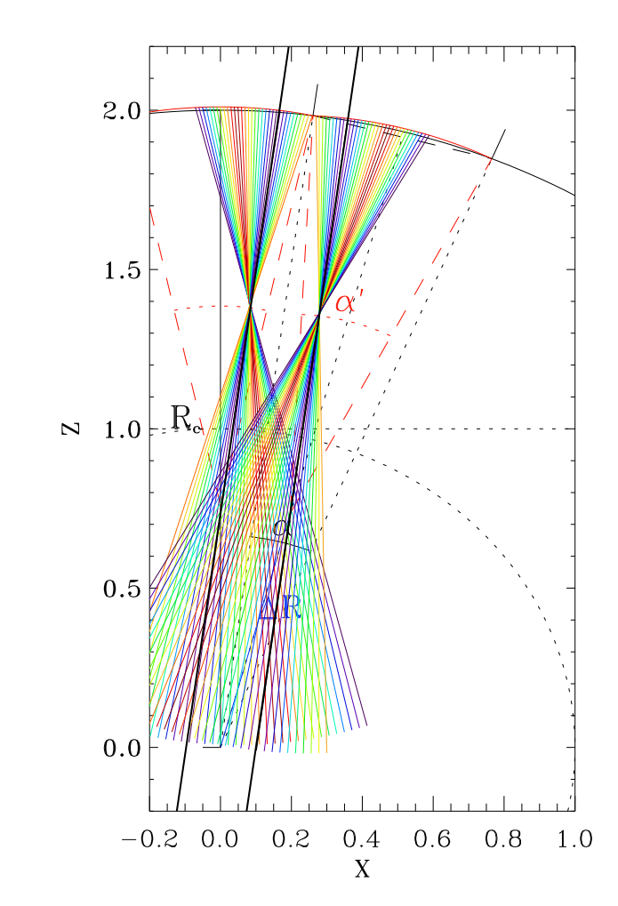
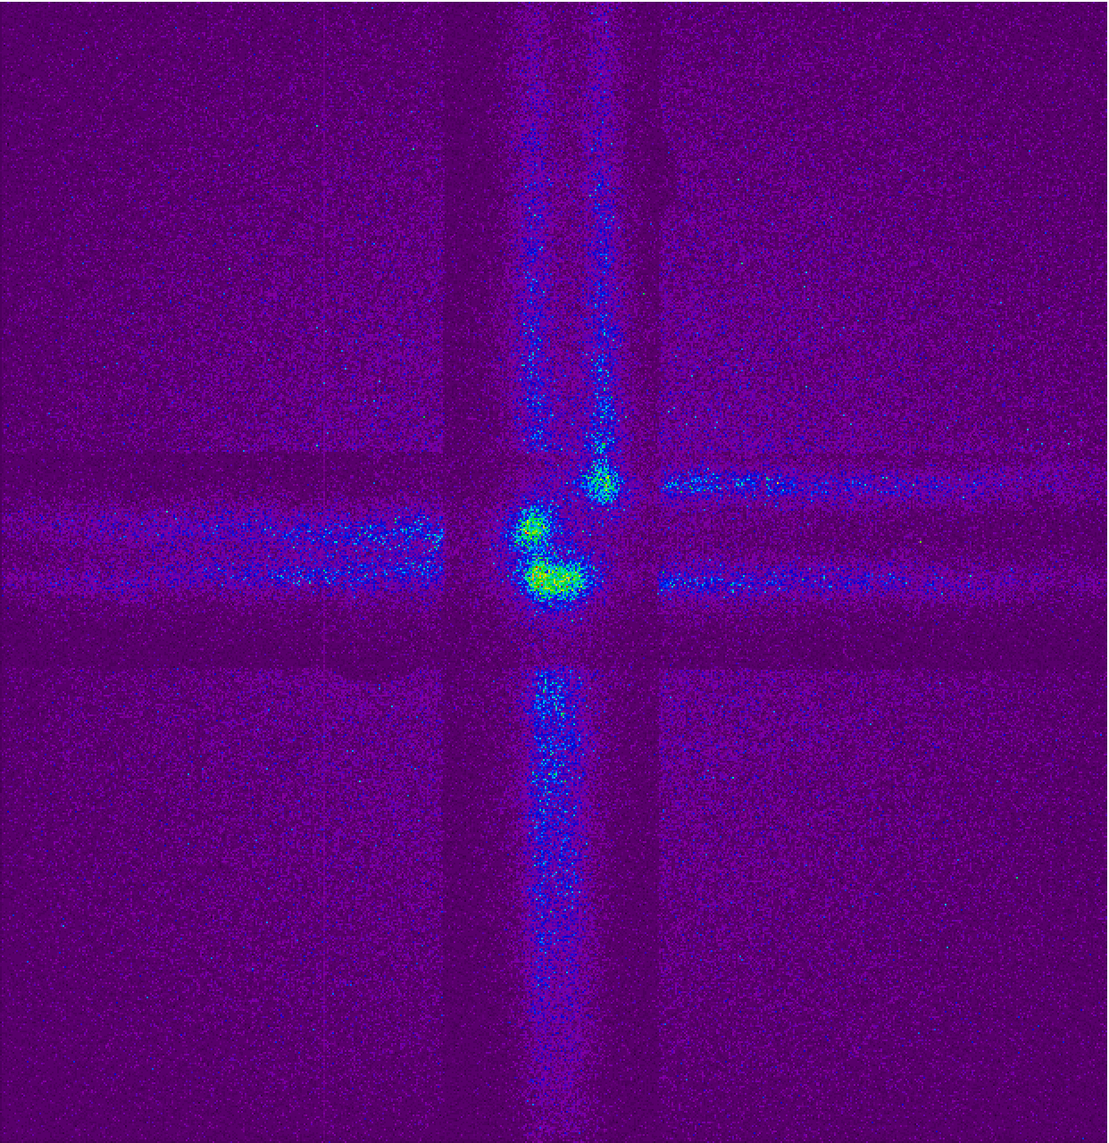
Focus
The mismatch between the facet RC and the RC of the frame that holds them means that
sources that are focussed by multiple facets
produce multiple images.
Ray-tracing suggested that the “best” PSF would be obtained at focal lengths slightly longer than the design focal length.

Slide 17
Focus
The mismatch between the facet RC and the RC of the frame that holds them means that
sources that are focussed by multiple facets
produce multiple images.
Ray-tracing suggested that the “best” PSF would be obtained at focal lengths slightly longer than the design focal length.
Focal searches at the corners of the central facet (where the source is imaged by four facets) find the best PSFs at 12.88, 4.76, 7.26, and 12.42 mm longer than the design focus.
To provide the greatest uniformity of image over the FOV, the design focus was used to characterize the effective area.

Slide 18
PSF
The FWHM of the PSFs were measured at both the “best” focus and at the design focus.
Thus, the individual SMPO facets have intrinsic PSFs with FWHM<15′.
There is some significant astigmatism.
Best Focus
Design Focus
11.36′×12.37′ | 11.89′×11.77′ | 10.92′×10.31′
10.44′×12.92′ | 9.52′×9.26′ | 11.62′×10.23′
14.91′×13.95′ | 10.50′×10.10′ | 14.60′×12.64′
15.72′×17.28′ | 17.35′×16.52′ | 13.60′×14.46′
15.43′×19.53′ | 12.43′×12.92′ | 10.74′×10.57′
20.42′×19.89′ | 12.76′×13.62′ | 11.31′×12.07′

Slide 19
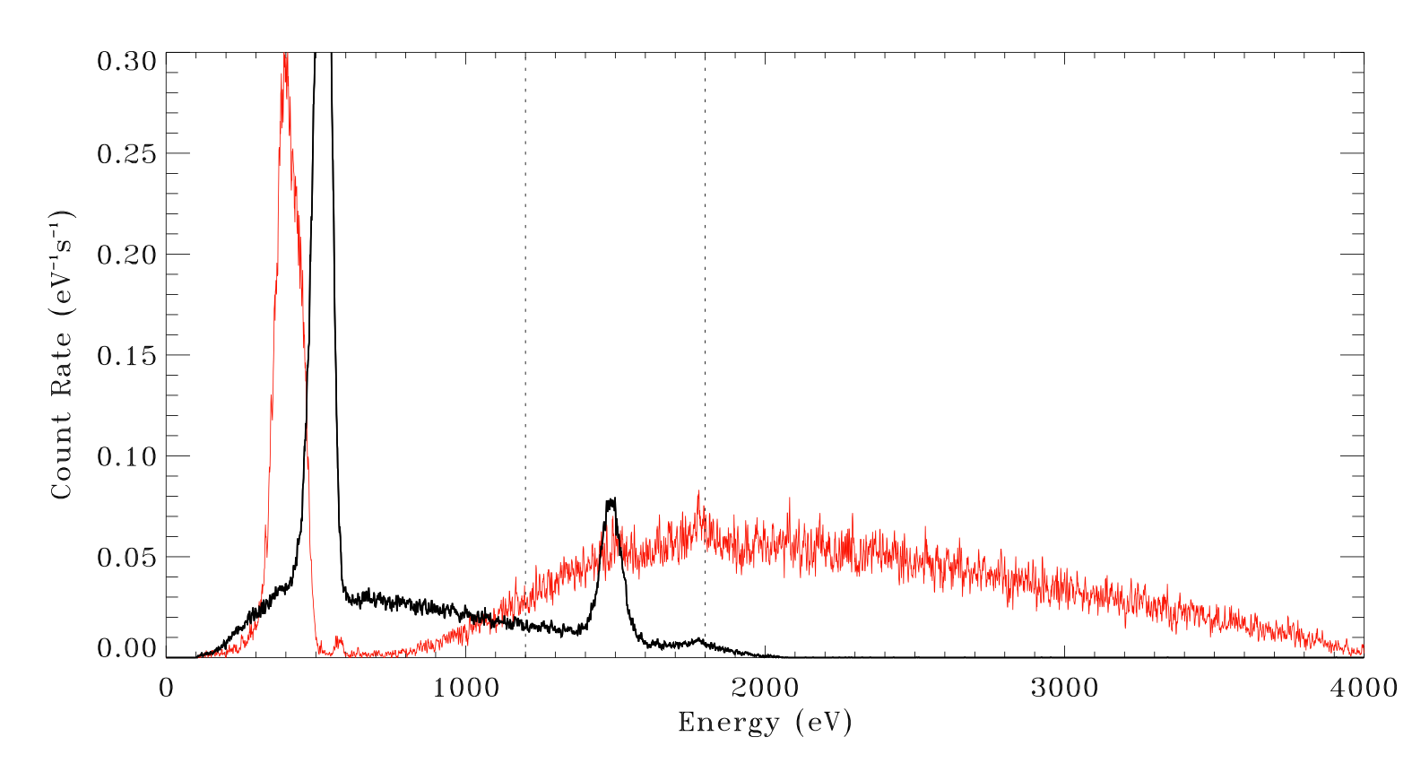
Effective Area
Compare count rates with and without the optic occulting the detector:
Effective Area measurements traditionally used line emission
- allowed use of detectors with limited energy resolution
- provided effective area only at a few energies
Using continuum sources and higher-energy-resolution detectors
- allows measurement at all energies (limited by detector to E>~100 eV)
- use continuum from Al target for 100-1800 eV
- use continuum from Ti target for 1200-3800 eV

Slide 20
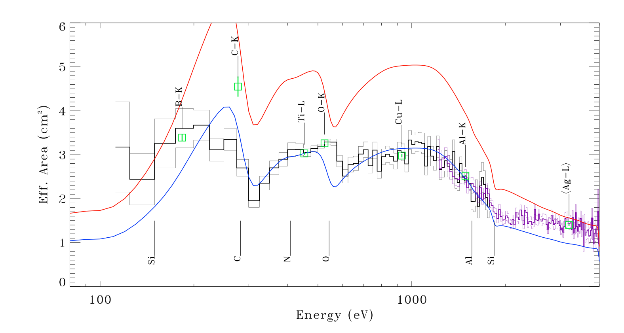
Comparison to Theory: Effective Area
Theoretical Effective Area:
Pore-By-Pore (PBP) ray-tracing (see pages.jh.edu/kkuntz1)
Assumed SiO2 reflectivity w/o surface roughness
(Since Ir coated optics show 85%-95% expected reflectivity, not a bad assumption)
Trace ingredients in glass expected only to introduce small edges
Modified by the optical blocking filter transmission
Introduces or increases edges at Al, C, N, and O
Modified by the detector line-spread function
Model
Model/1.6
Confirming
Line→
Measures
Edges→
A “grey” reduction does not fit the effective area curve.

Slide 21
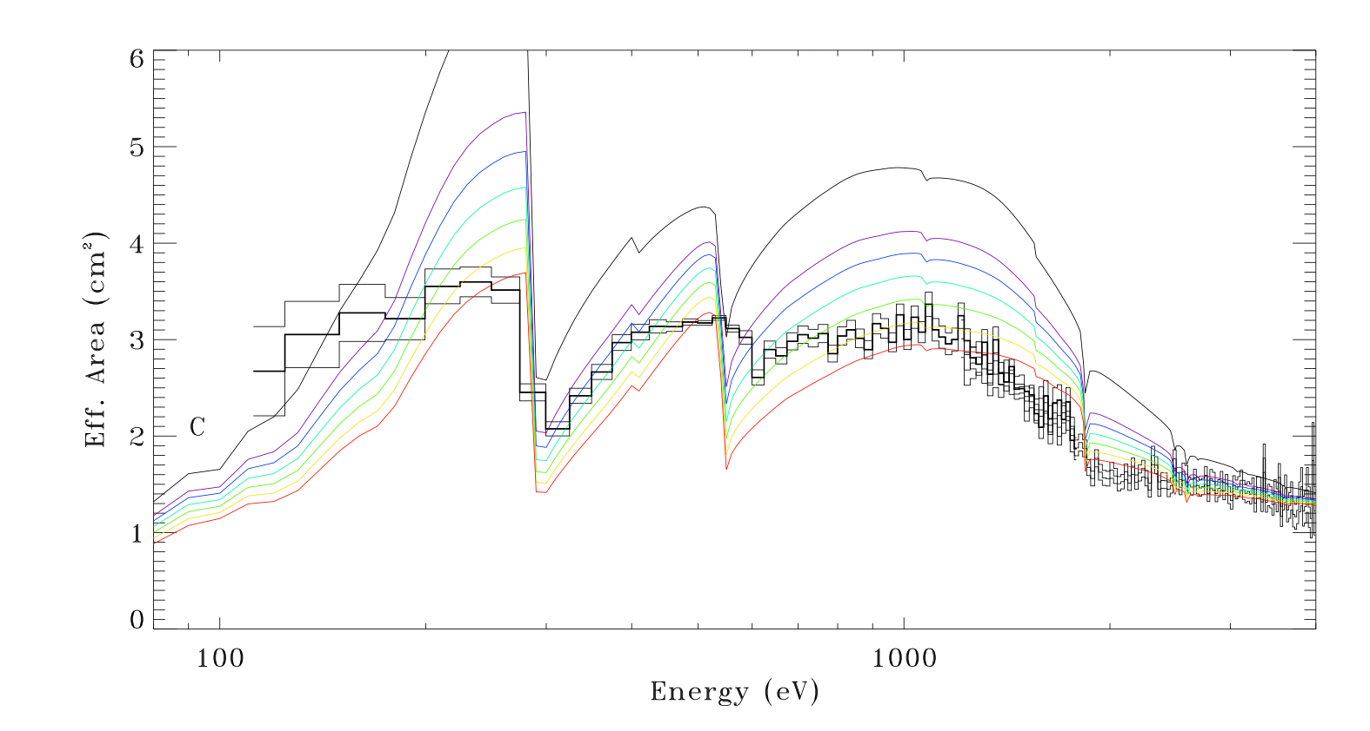
Are We Missing Something in the Glass?
We started out with a much more complicated glass model
- Included trace amounts Pb, K, Na, Bi as might be expected
- Trace amounts mostly contribute to edges in this model
→ Glass composition unlikely to be the culprit.

Slide 22
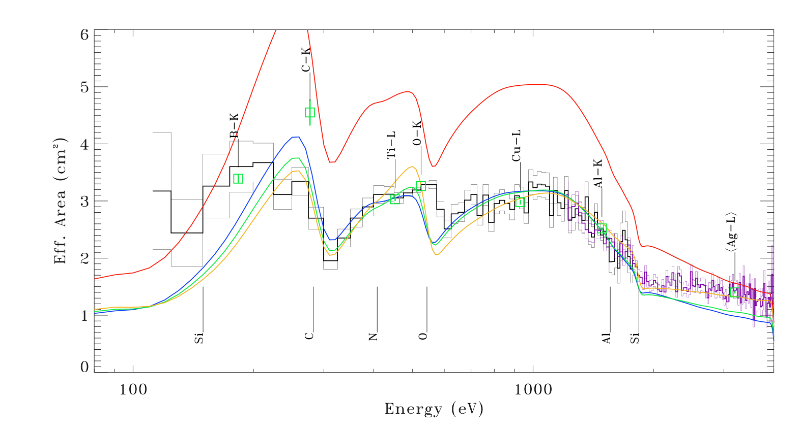
Comparison to Theory: Effective Area
Since a “grey” reduction does not match the effective area curve shape, apply surface roughness model.
Use the Nevot-Croce approximation from henke.lbl.gov and scaling
A 10nm roughness fits at high energies with scaling of unity
- does not fit at E<1000 eV
- is an order of magnitude larger than expected roughness
- nothing quite fits the O edge
Model
0nm*0.63
5nm*0.73
10nm*1.0
Confirming
Line→
Measures
Edges→

Slide 23
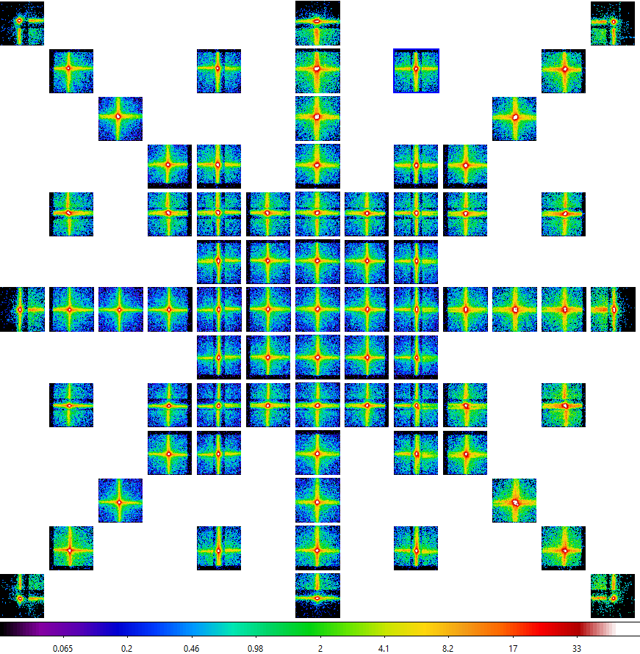
Vignetting
The effective area
(as well as the PSF)
was measured for a grid of locations across the FOV, at 0.76º or ¼ facet spacing.
Shown: O-K line and the
very low energy continuum.
Facet boundaries visible!

Slide 24
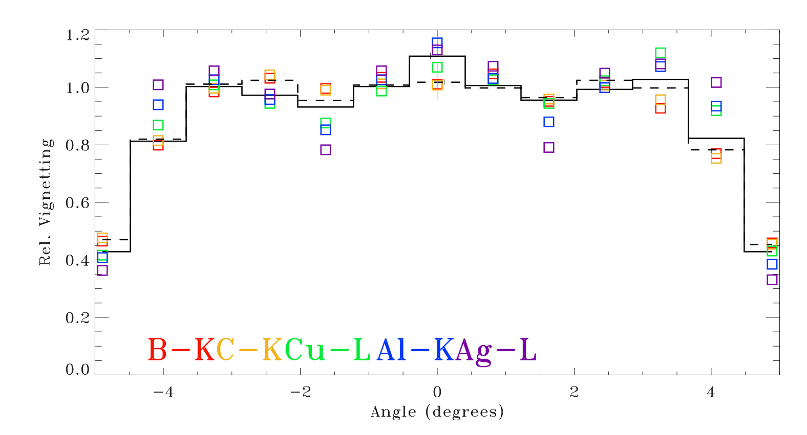
Comparison to Theory: Vignetting
Ray-tracing demonstrates that:
- vignetting is stronger at lower energies
(The effective acceptance area increases at energy decreases → vignetting starts further from the edge of the FOV)
- shadowing by the support structure stronger at higher energies
(At higher energies less of the flux is focussed and more of the flux is collimated)
Both demonstrated by the measured vignetting function

Slide 25
MCP Calibration
In Progress

Slide 26
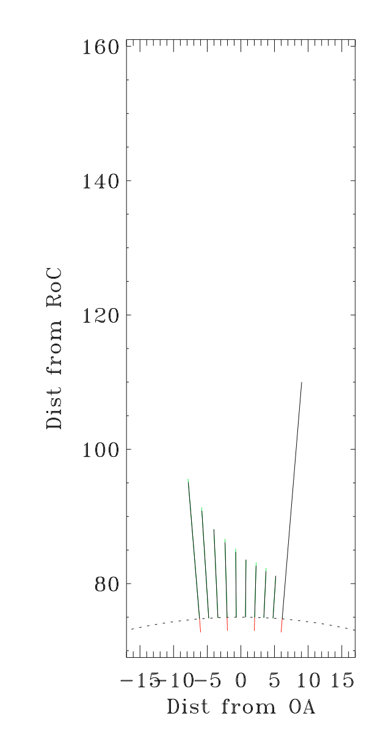
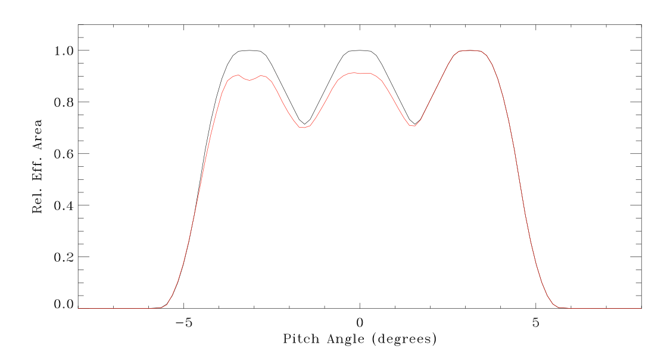
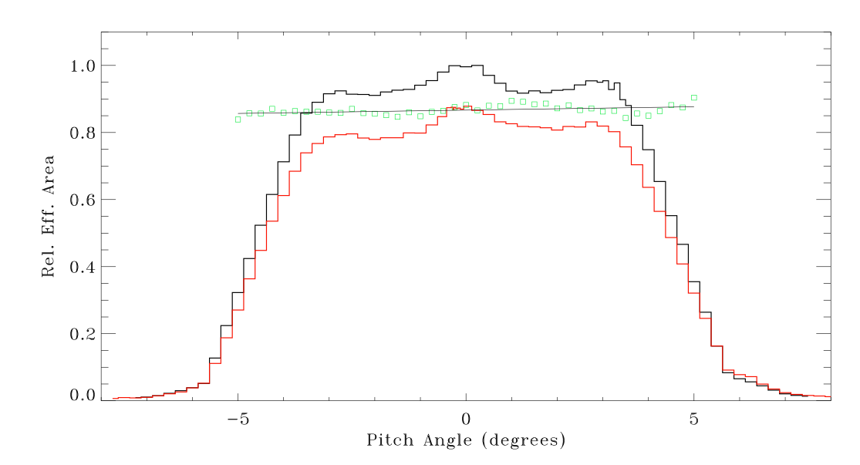
Sunshade
LEXI observes from the Moon the region between the Earth & the Sun
→ Earth shade & Sun shade necessary not to swamp the instrument
→ Interior baffles required to allow sunshade to be short
Simulation for an ideal device at Al-K
Requires more scattering than measured PSF
Lacking a treatment of “Willingale spread”
Surface roughness
Pore misalignment
Other effects
Building these into our simulator

Slide 27
Summary
LEXI optic has been characterized at GSFC, PANTER & MSLTF:
- identified and quantified the effects of the facet/frame RC mismatch
Simulations agree with measured best focal length at facet boundaries
- measured/characterized the PSFs for each facet
Measurements as a function of energy made at many positions
- measured the effective area and vignetting function across the FOV
Simulations do not agree with measured effective area
Different solutions suggested by different energy ranges
Perhaps due to surface roughness modifications to reflectivity
Other methods exist and are being explored
- measured data to characterize “Willingale spread”
- PBP simulator up and working, is being modified for the “spread”

Slide 28
Future
Charge Exchange Meeting being organized for summer 2024 - Greece?
If interested contact Dimitra Koutroumpa (or me).

