Slide 1
Flux comparisons between eROSITA and Chandra for SPT-selected galaxy clusters
Jeremy Sanders
MPE
Thanks to the eROSITA cluster working group (including Ang Liu, Emre Bahar, Xiaoyuan Zhang, Esra Bulbul, Vittorio Ghirardini) and Konrad Dennerl

Slide 2
Using clusters for X-ray flux comparisons
Positives
Constant flux (except for embedded point sources)
Relatively simple spectrum (though there can be temperature variation)
Not piled up
Negatives
Background can be important
Morphology can be complex (though not as much as SNR)

Slide 3
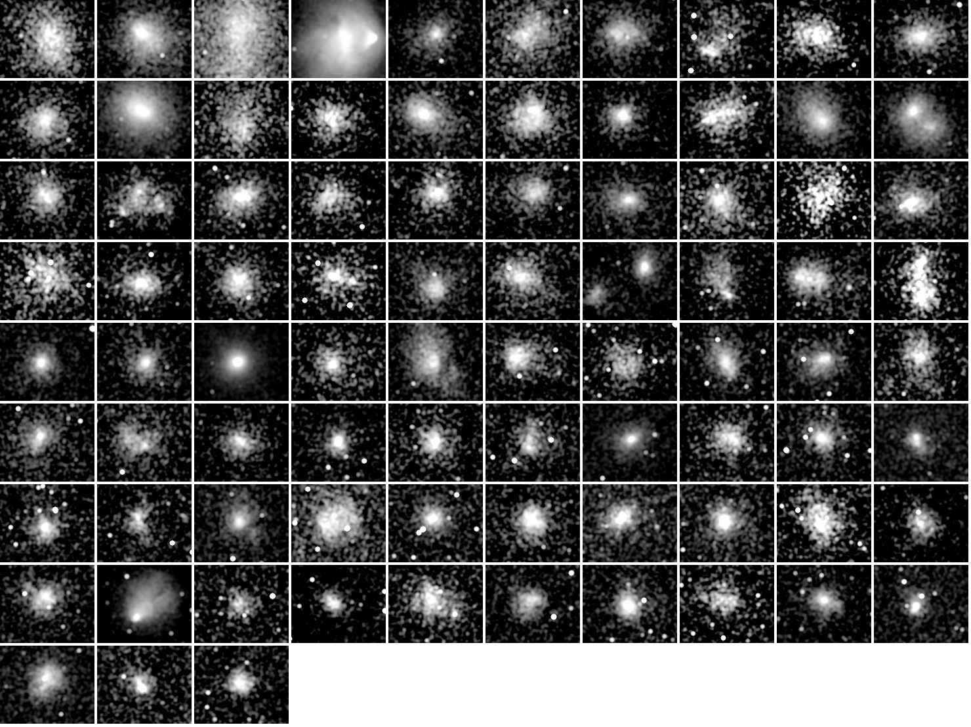
Sample is a set of 83 clusters selected by the SPT telescope using SZ effect, and observed by Chandra.
See:
Sanders+18
McDonald+13
Redshift order (0.28 to 1.2, median ∼0.6), 4.5x3.5 arcmin regions

Slide 4
Modelling software: MBProj2D
MBProj2D (MultiBand Projector in Two Dimensions) is a forward modelling package for galaxy clusters, where parametrized 3D models are fitted to 2D X-ray images in multiple energy bands
Previous codes fitted surface brightness profiles (MBProj2, Sanders+2018; MBProj, Sanders+2014)
Multiple bands provides low resolution spectroscopy, allowing temperatures, etc, to be measured
Good agreement between spectroscopic and fitted temperatures in tests
Code used for eROSITA eRASS1 cluster analysis
https://github.com/jeremysanders/mbproj2d

Slide 5
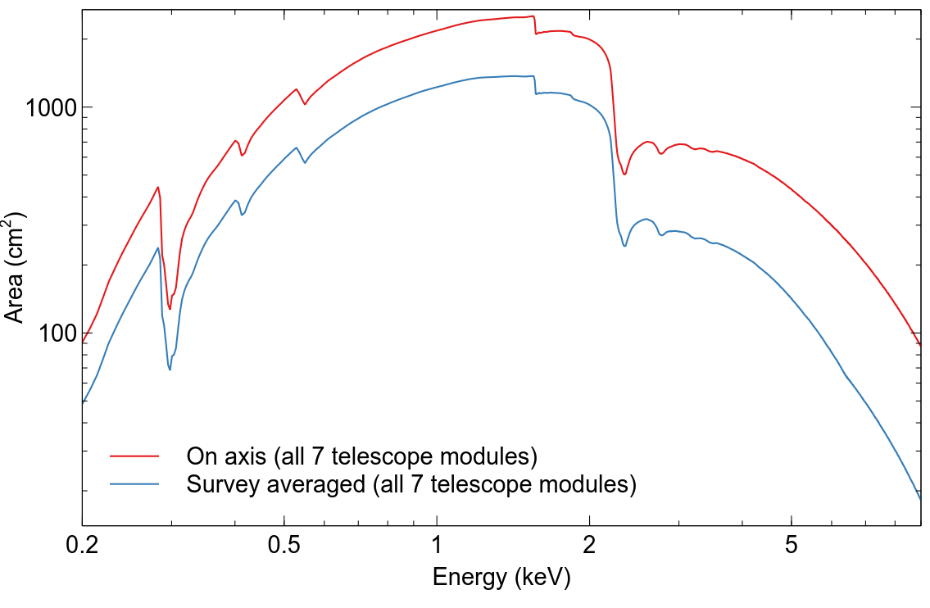
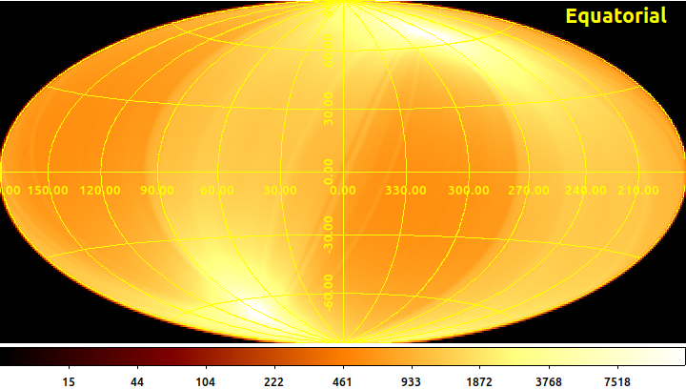
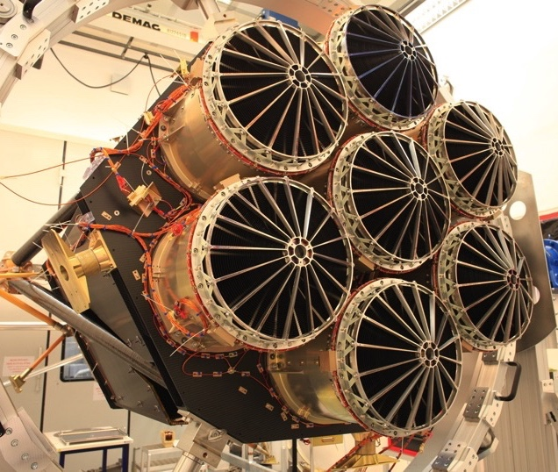
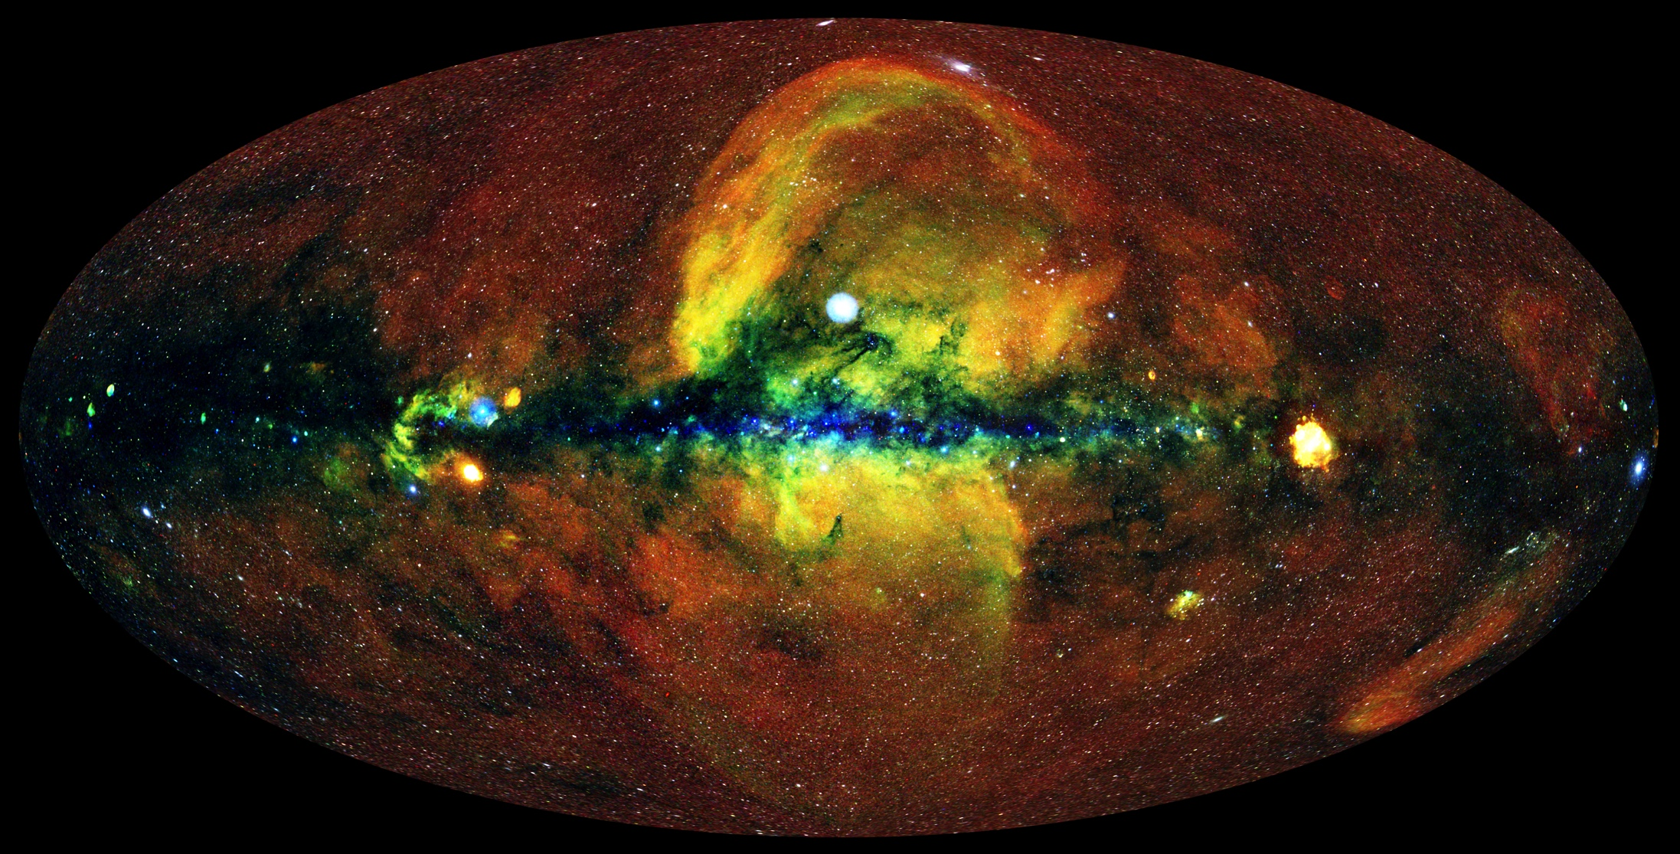
eROSITA survey
Effective area
eROSITA combined exposure over sky (s)
eROSITA on SRG consists of 7 telescope modules (TMs), which scanned sky every six months
Over four surveys taken (eRASS1-4)
FoV of each TM is around 1° diameter
Two of the TMs do not have an on-chip filter, and suffer from a light leak problem (TM5+7)
Survey averaged PSF ∼ 30ʺ HEW
eRASS1 (Galactic)

Slide 6
Data being fitted
Chandra:
Images in 10 bands (0.50-0.75, 0.75-1.00, 1.00-1.25, 1.25-1.50, 1.5-2.0, 2-3, 3-4, 4-5, 5-6, 6-7 keV)
eROSITA
Images taken from eRASS:4 survey (2 years of observations), using 020/948 processing version (similar to be released eRASS1 survey)
Single band 0.3-2.3 keV images
Use 5 non-light-leak cameras
All event patterns

Slide 7
Data treatment
For consistency, apply Chandra exposure mask to eROSITA data to use same field of view
Take Chandra point source catalogue, and mask to 0.35 arcmin radius in both datasets
Mask out everything beyond 5 Mpc cluster radius
Background
Chandra: Take smoothed blank sky dataset images with fitted scaling factor in each band
eROSITA: Assume flat vignetted sky distribution, with fitted scaling factor

Slide 8
Modelling
Cluster temperature
Chandra: fit temperature
eROSITA: use log-Gaussian temperature prior based on Chandra fits
Cluster density profile – Vikhlinin et al. – beta model with powerlaw core and outer profile break
Assume 0.3 solar metallicity (lodd abundances)
Same redshift (taken from SPT catalogue)
Same Galactic absorption (HI4PI value)

Slide 9
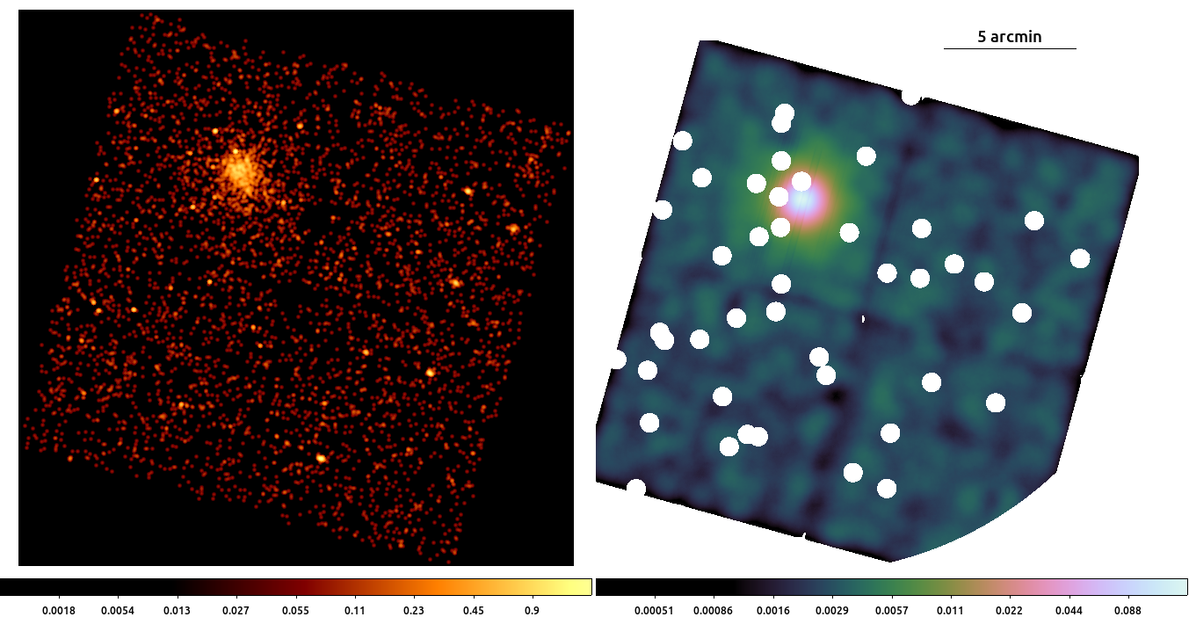
Example fit: SPT-CLJ0200-4852
Chandra
Data 0.5-2.0 keV, 2 arcsec bins
(around 25ks exposure)
Best fitting model image 1.00-1.25 keV,
showing mask

Slide 10
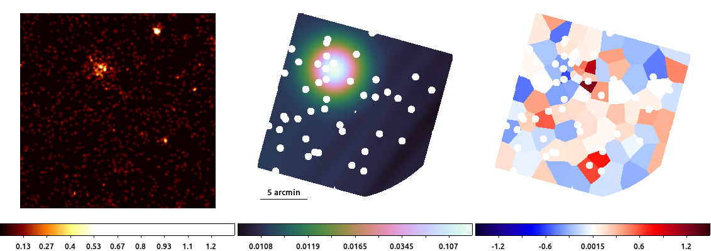
Example fit: SPT-CLJ0200-4852
eROSITA
Data 0.3-2.3 keV
(around 490s exposure)
Best fitting model image,
showing mask
Voronoi-binned residuals

Slide 11
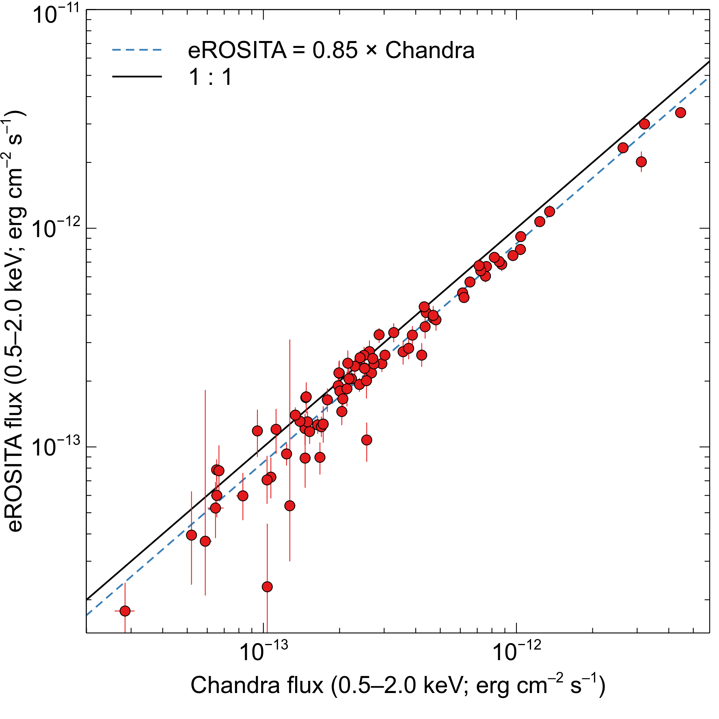
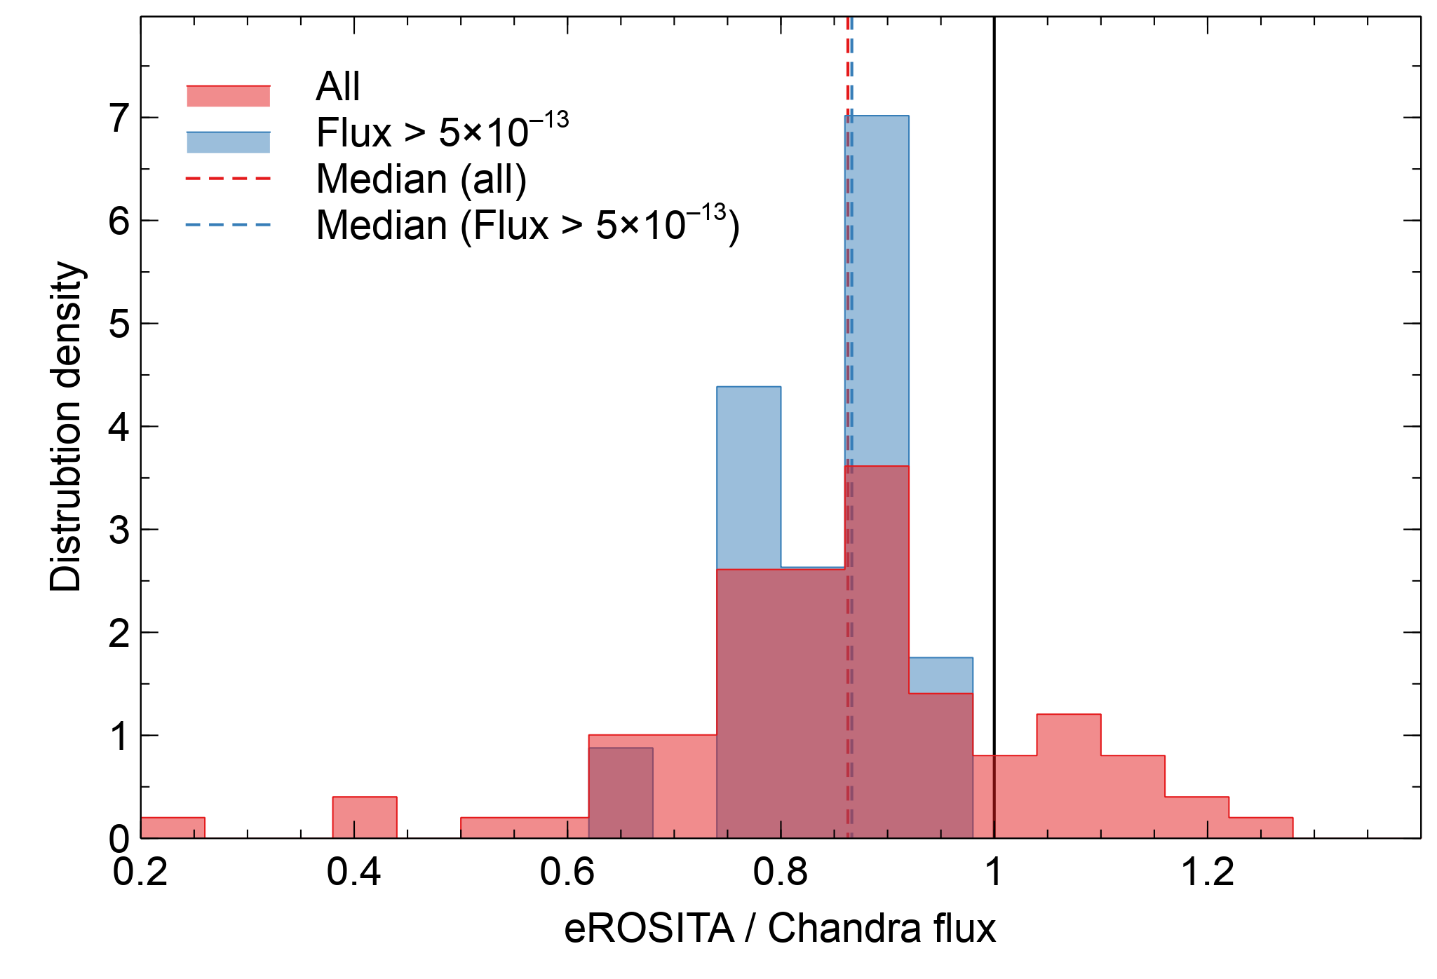
Flux comparison
Model flux inside a 2 arcmin radius aperture
Distribution of eROSITA/Chandra (median ∼0.86)

Slide 12
More advanced analysis
Joint fit between Chandra and eROSITA data
Apply a variable scaling parameter to eROSITA source model
Point sources:
Fit point sources for eROSITA, for those within 3 arcmin radius from cluster
However, continue to mask them for Chandra (masked regions small)
Outside 3 arcmin radius, mask to 0.5 arcmin radius
Exclude two clusters where point source model breaks

Slide 13
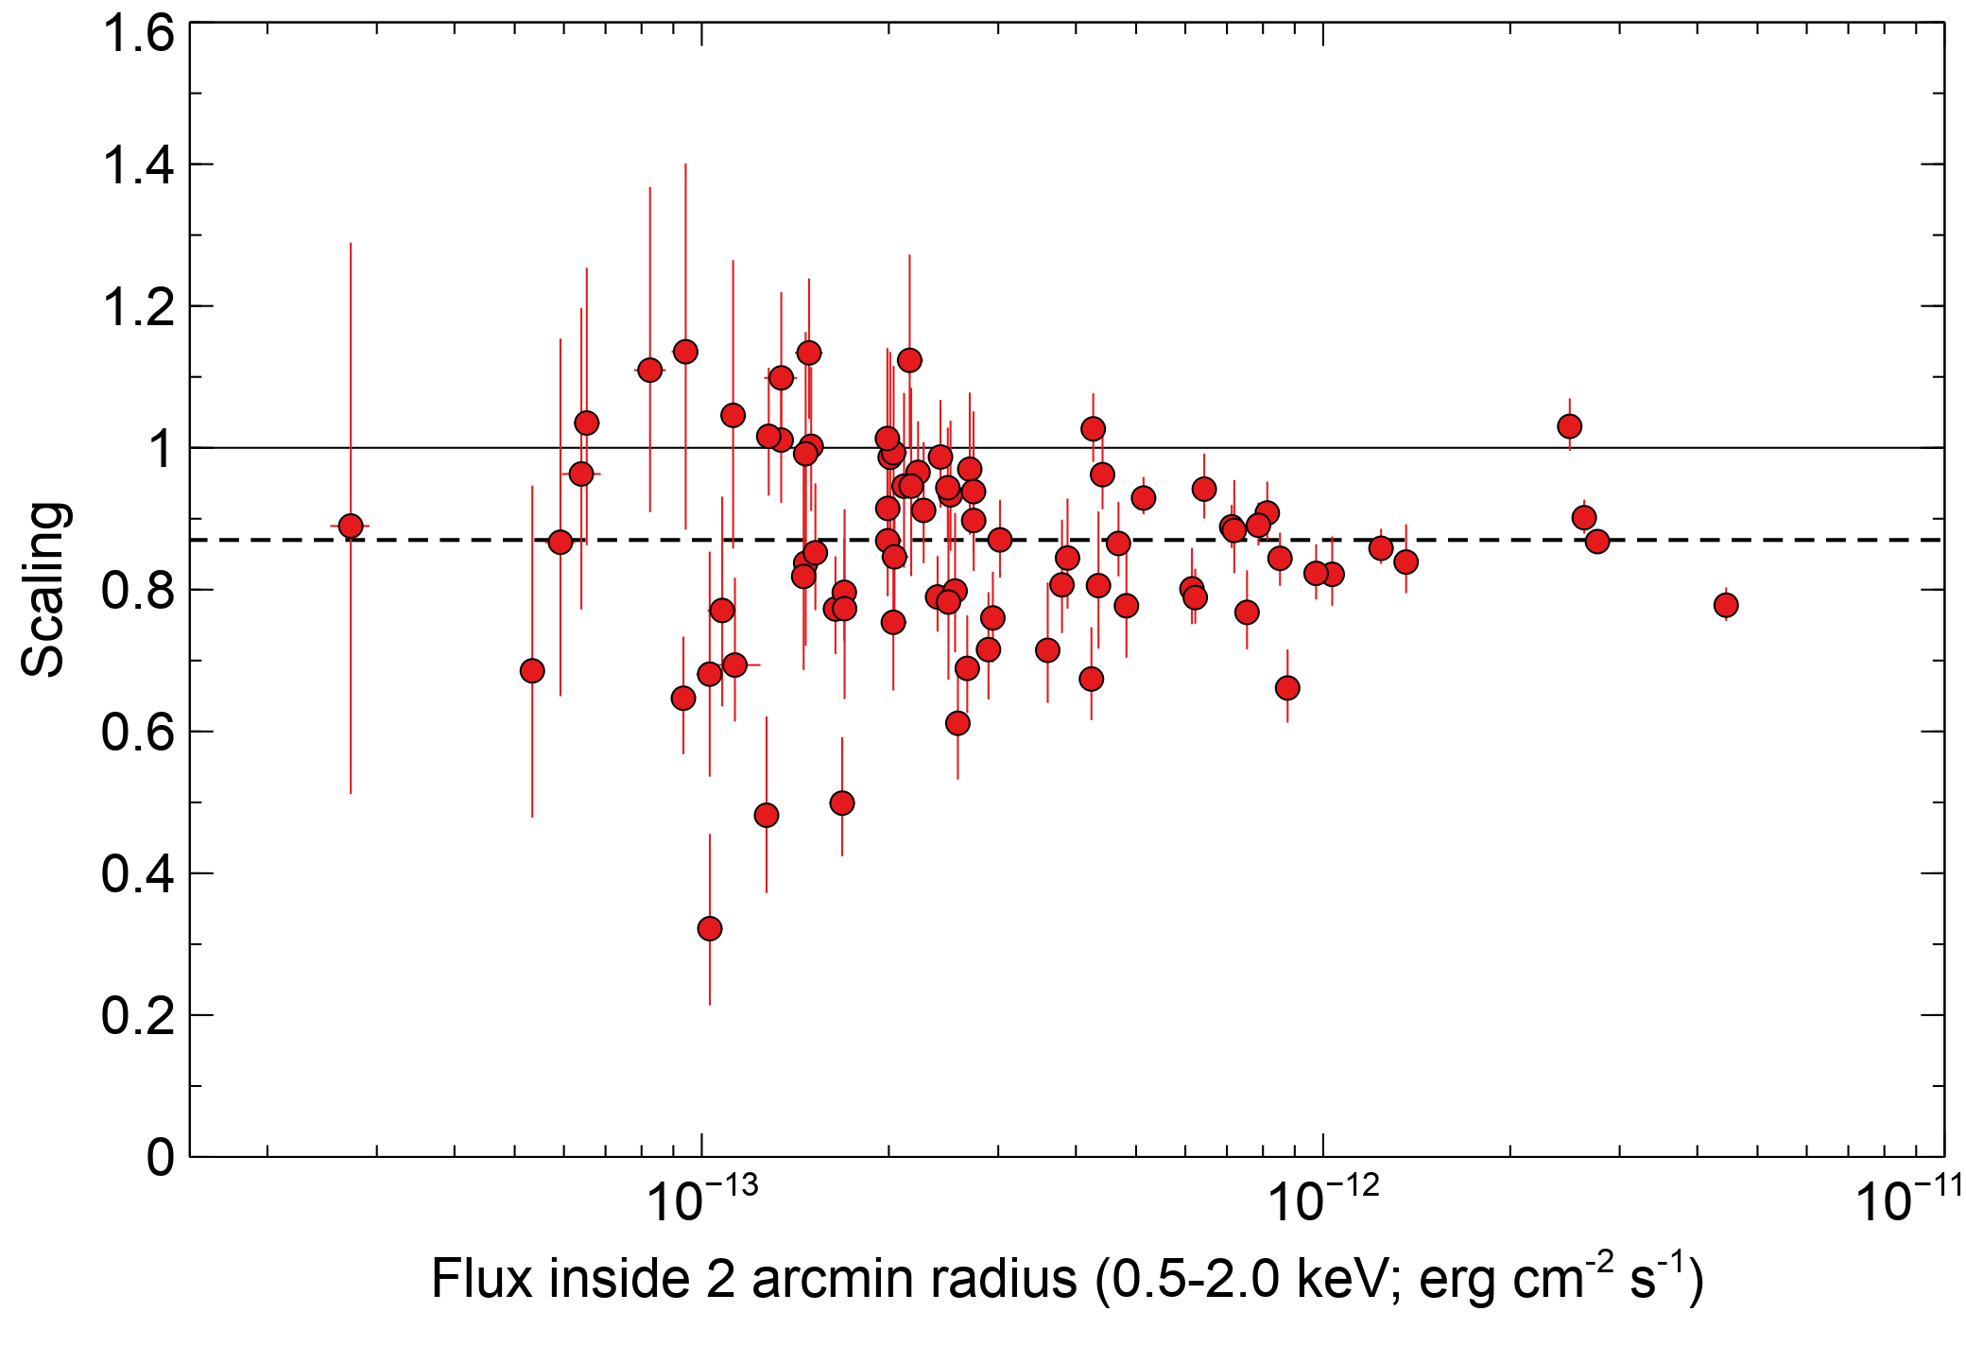
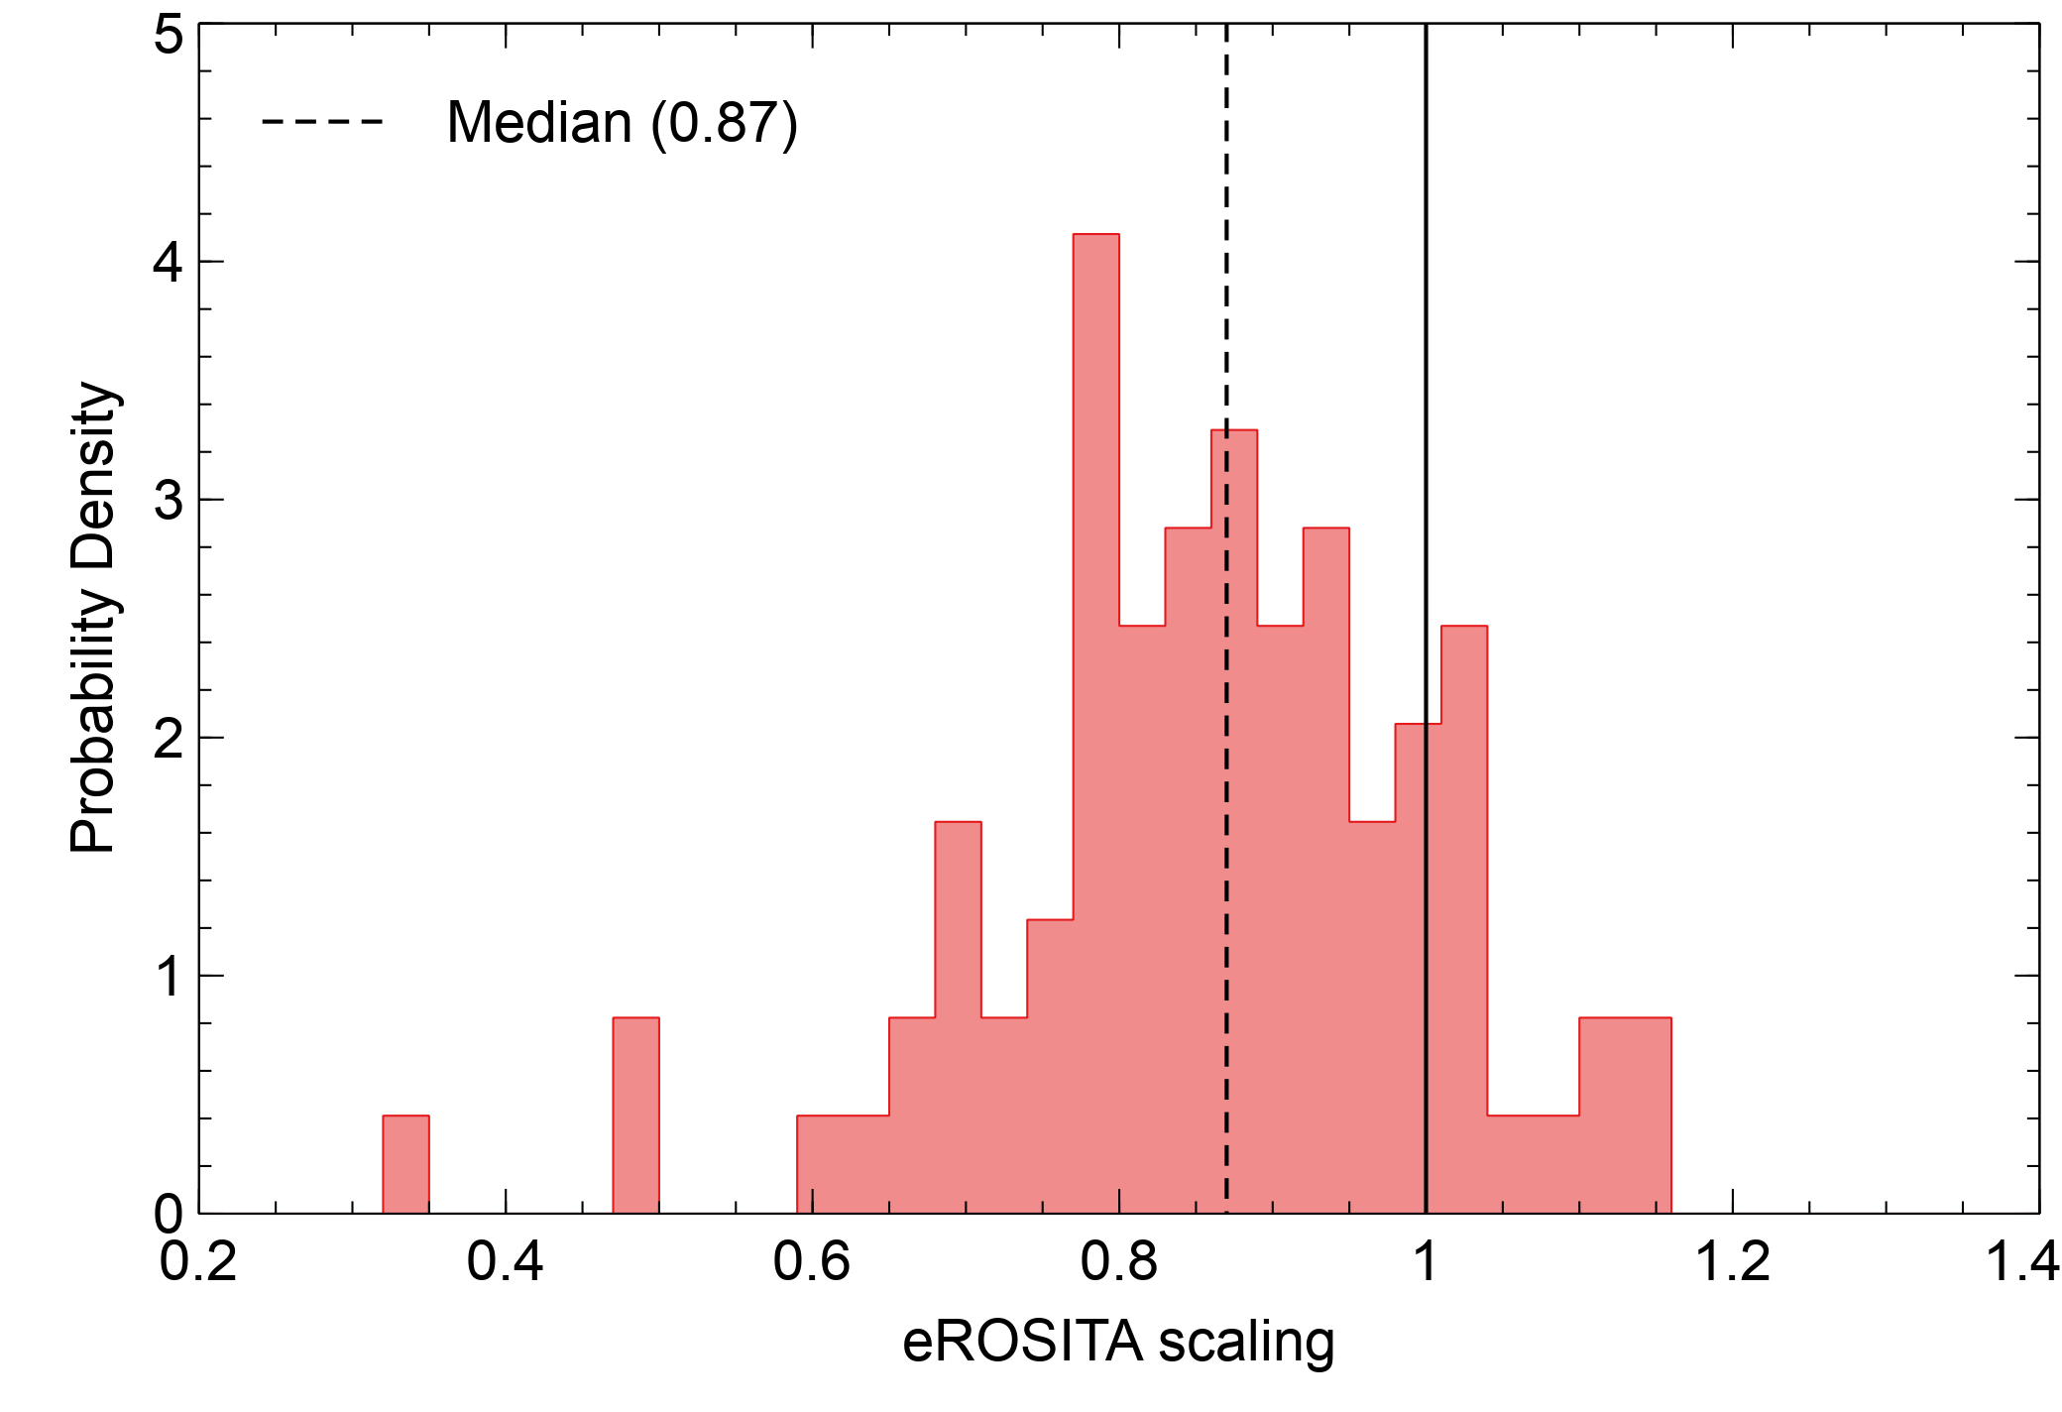
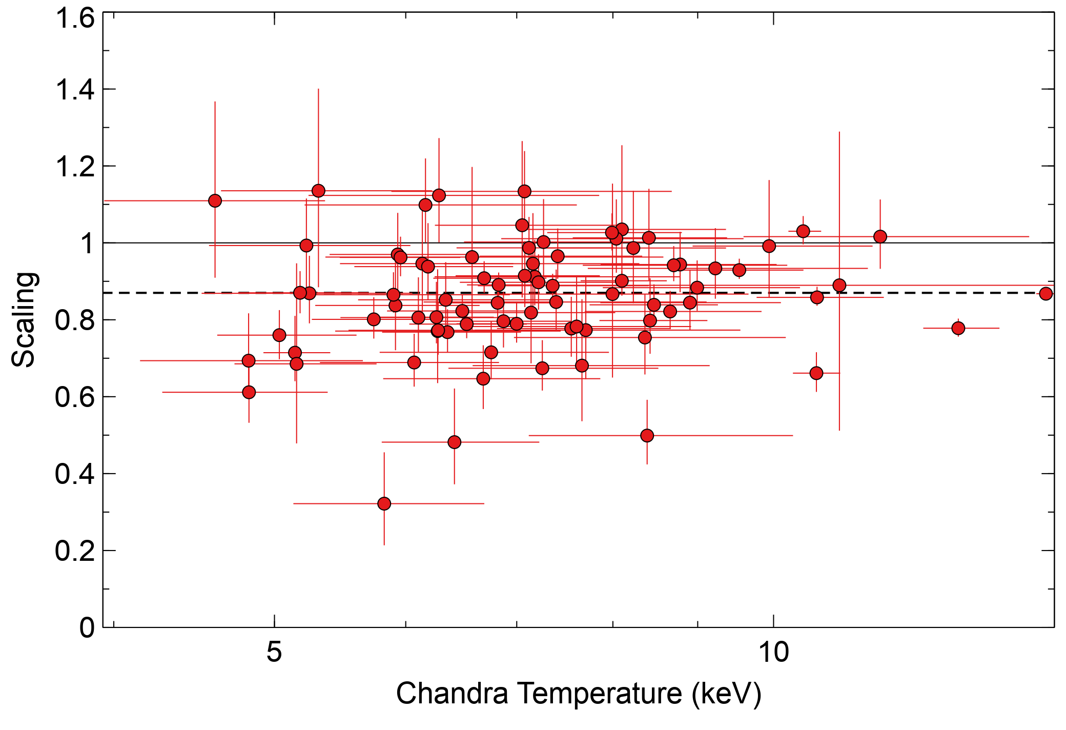
Joint eROSITA-Chandra fits
Same median scaling factor between eROSITA and Chandra as previous analysis
Independent image fitting code of Emre Bahar finds similar results for a different cluster sample

Slide 14
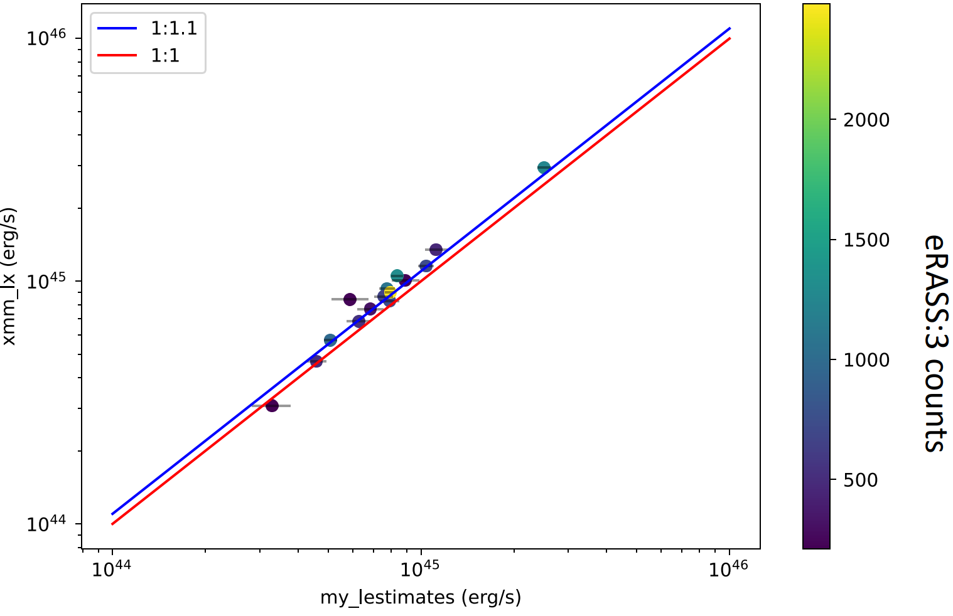
XMM-eROSITA comparison
Sample of bright Planck clusters
XMM results: Xiaoyuan Zhang
eROSITA results: Emre Bahar
Spectral fitting within R₅₀₀
Point sources same as eRASS1
Absorption, redshift and metallicity the same
Local background used
XMM luminosity (erg s⁻¹)
eROSITA luminosity (erg s⁻¹)

Slide 15
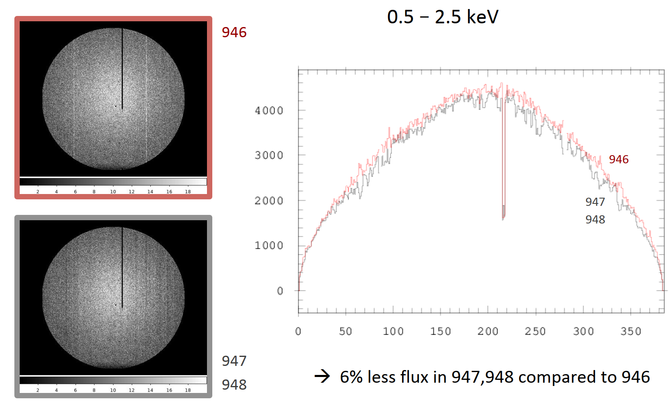
Issue with threshold in recent processing
TM2, 0.5-2.5 keV, all valid patterns, eROdays 48144–48199
CCD threshold issue in recent data processing (947/010 and 948/020) leads to a loss of around 6% of counts in soft band.
(old processing)
946: previous processing version
947/010: DR1 processing version
948/020: processing version used here
=> Significant, but not enough for what is seen here
Note: readout shadow not accounted for, but effect is <1%
Konrad Dennerl

Slide 16
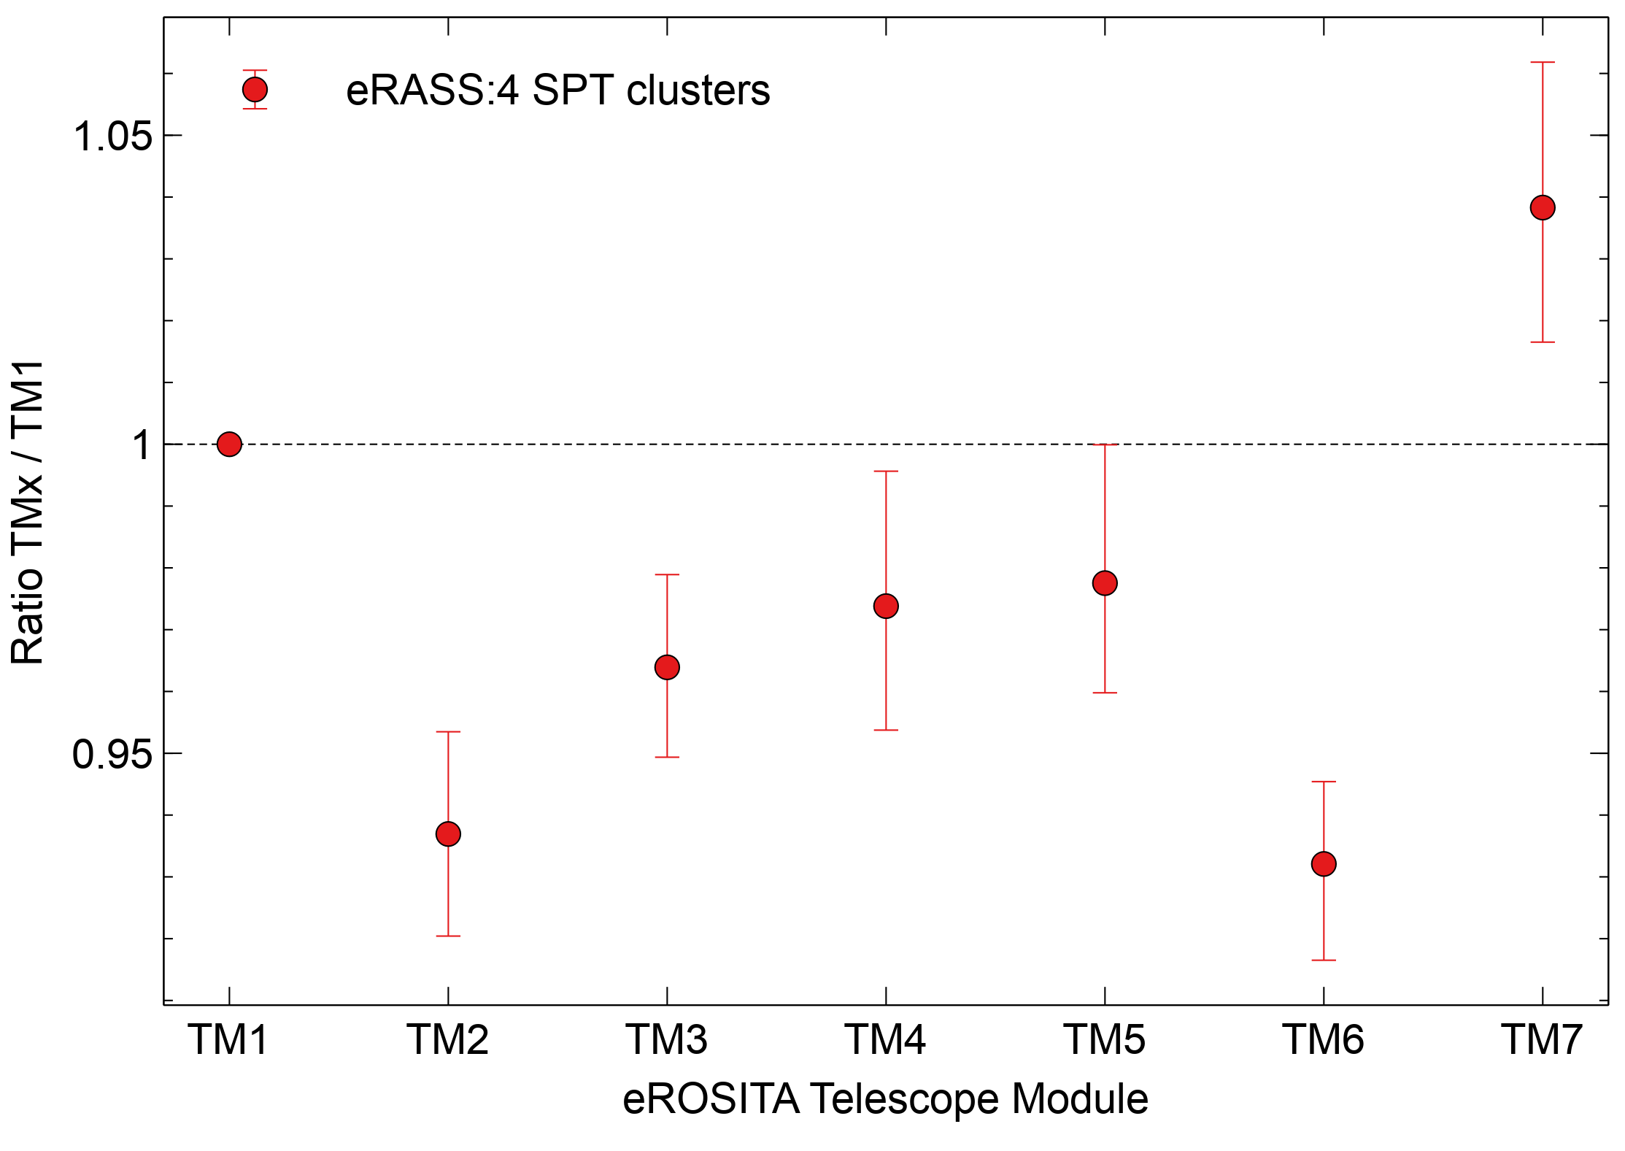
Examining differences between eROSITA TMs
Can include variable scaling parameters to cluster model for each input dataset.
Here all TMs for eROSITA can vary, except for TM1, fitting the data simultaneously. Backgrounds can vary for each TM.
Plot shows the average scaling factor for the cluster sample.
Variations between TMs of a similar size have also been found by K. Dennerl for 1E 0102.2-7219.

Slide 17
Conclusions
Current eROSITA processing has an issue of ∼6% lower fluxes caused by threshold levels
However, still remaining ∼9% lower fluxes in eROSITA than Chandra, when doing cluster analysis
eROSITA also around 10% lower than XMM (though before above 6% correction)
Unclear what the origin of the remaining differences is
In future
Separate out vignetting and effective area
Looking at bright extended sources in narrow energy bands in different telescopes may be very helpful to compare fluxes.
Currently doing stacked source analysis for vignetting and PSF
XMM comparison

Slide 18
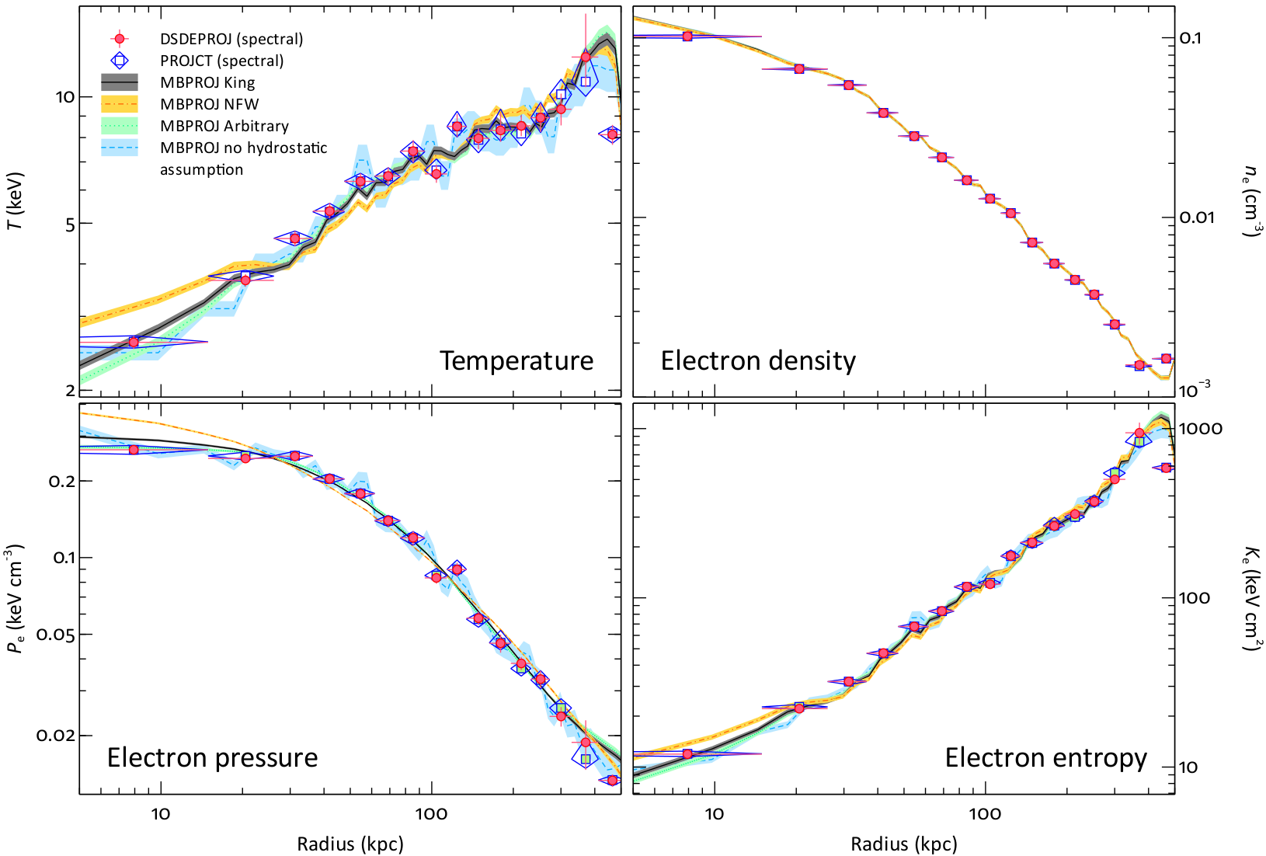
Multi band projection comparison
Sanders+2014
MBProj comparison for PKS 0745-191 cluster, showing excellent agreement between Chandra spectroscopic and imaging results (in deprojected profiles).
Just using three bands here (0.5-1.2, 1.2-2.5 and 2.5-6.0 keV).

Slide 19
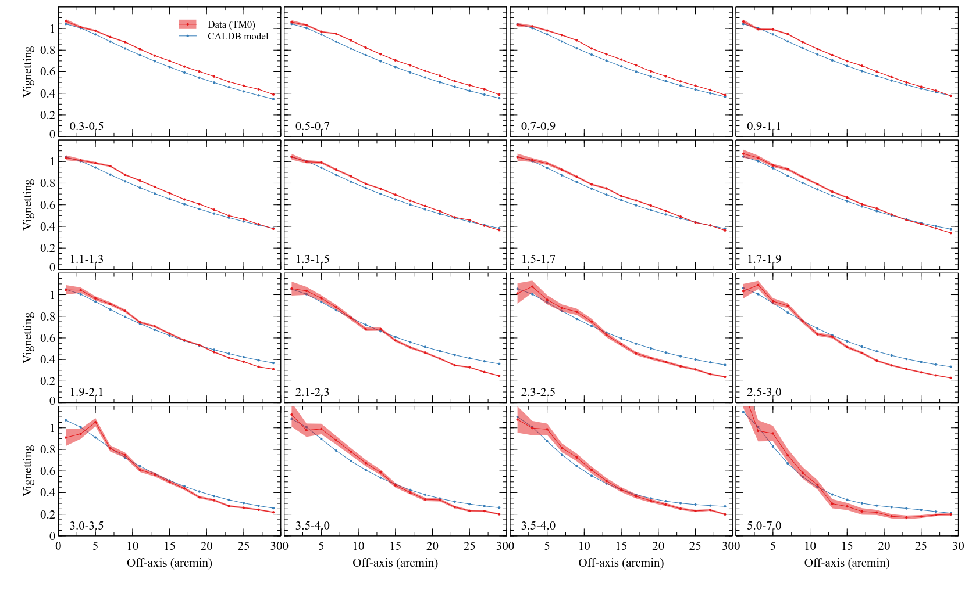
Results from source stacking approach and PSF modelling
Does not account for bad pixels
Normalised in centre, where most uncertain in survey
IN PROGRESS!

Slide 20
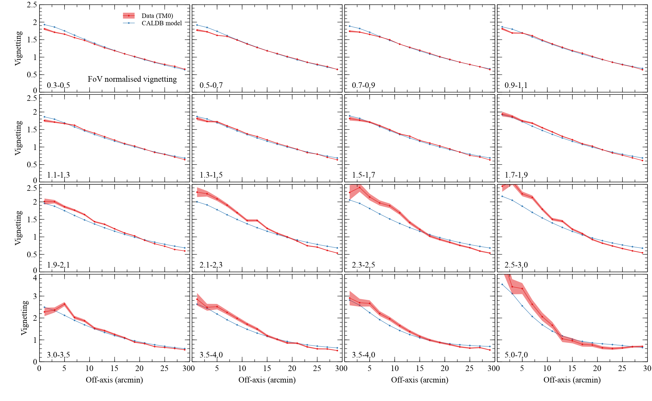
Results from source stacking approach and PSF modelling
Does not account for bad pixels
Detector area weighting normalisation to give average of 1
IN PROGRESS!

Slide 21
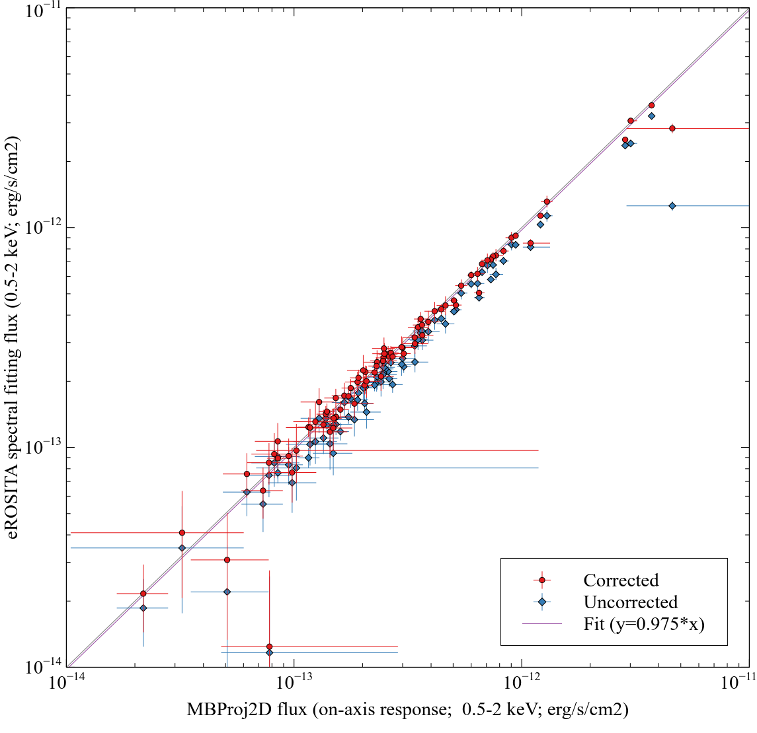
eROSITA: MBProj2D vs spectral fitting
Comparison of fluxes in a 2 arcmin radius aperture.
Temperatures fixed to Chandra values.
Only fit between 0.3 and 2.3 keV.
Local background spectra extracted from 4-6 arcmin radius (compared to 2 arcmin for source).
Corrections to account for point source regions and PSF computed from MBProj2D best fitting model.
On-axis response (with standard exposure map).

Slide 22
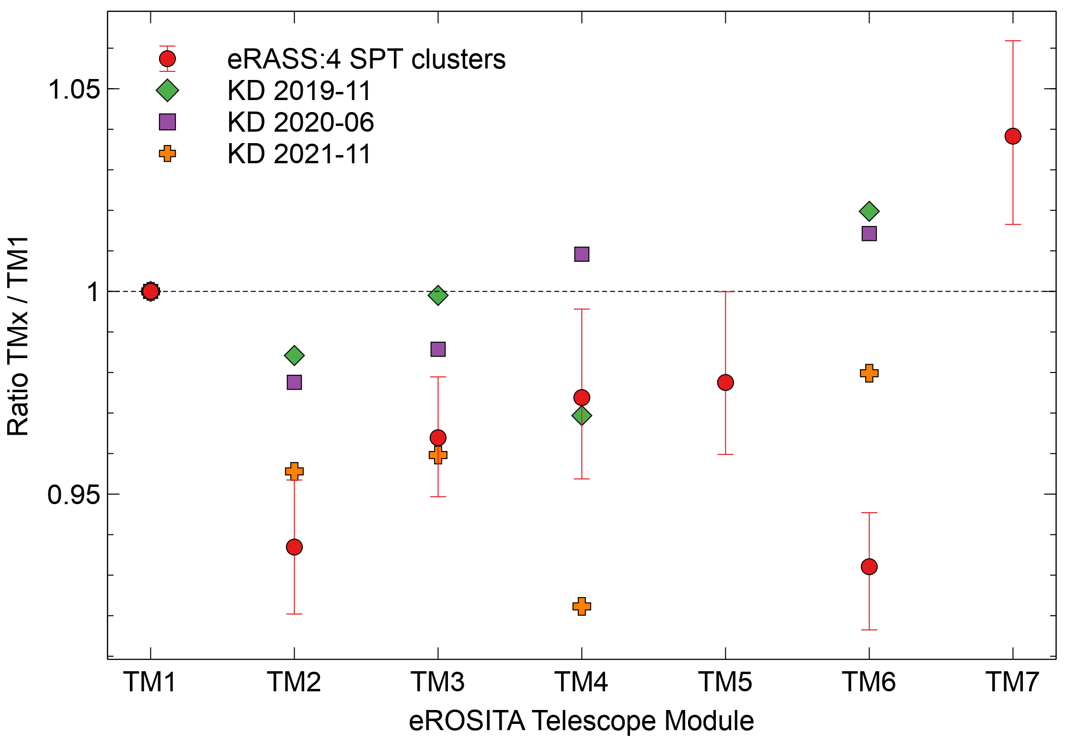
Konrad Dennerl results for 1E 0102.2-7219

Slide 23
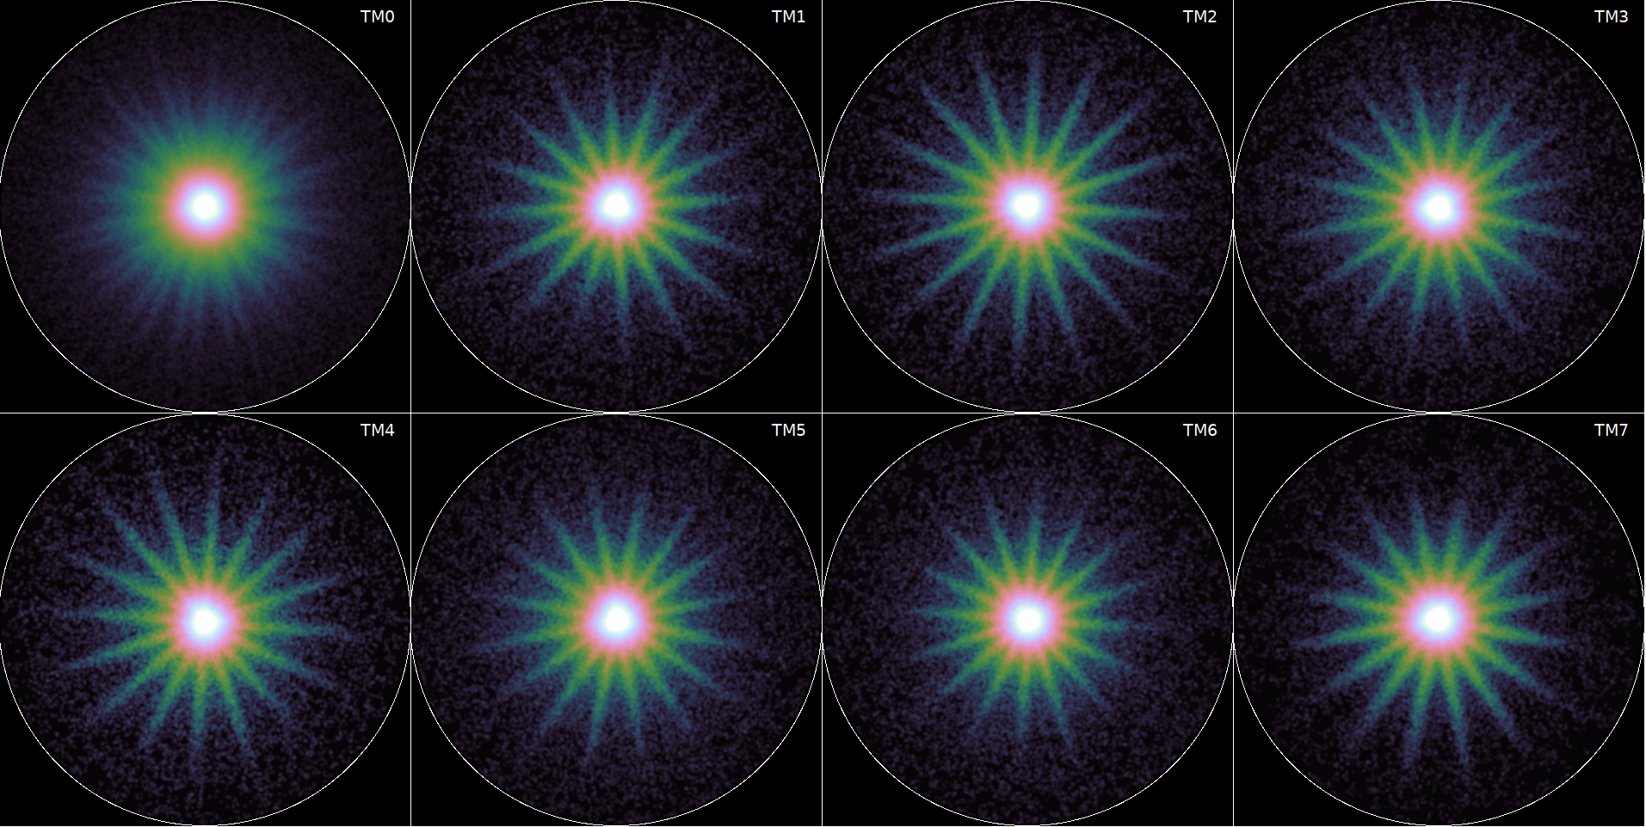
Once we have relative normalisations and background, we can stack normalised counts in annular regions.
0.3-2.3 keV stacked PSFs. Aperture is 4 arcmin radius. In detector-like coordinates (sky rotated by –ROLL). Smoothed.
IN PROGRESS!

Slide 24
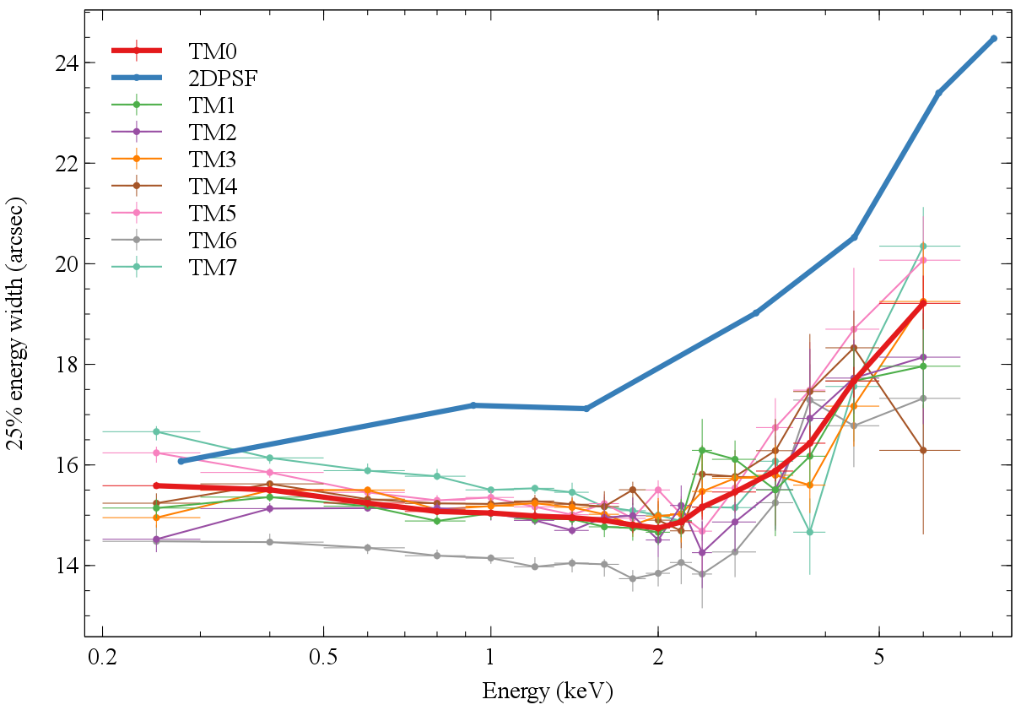
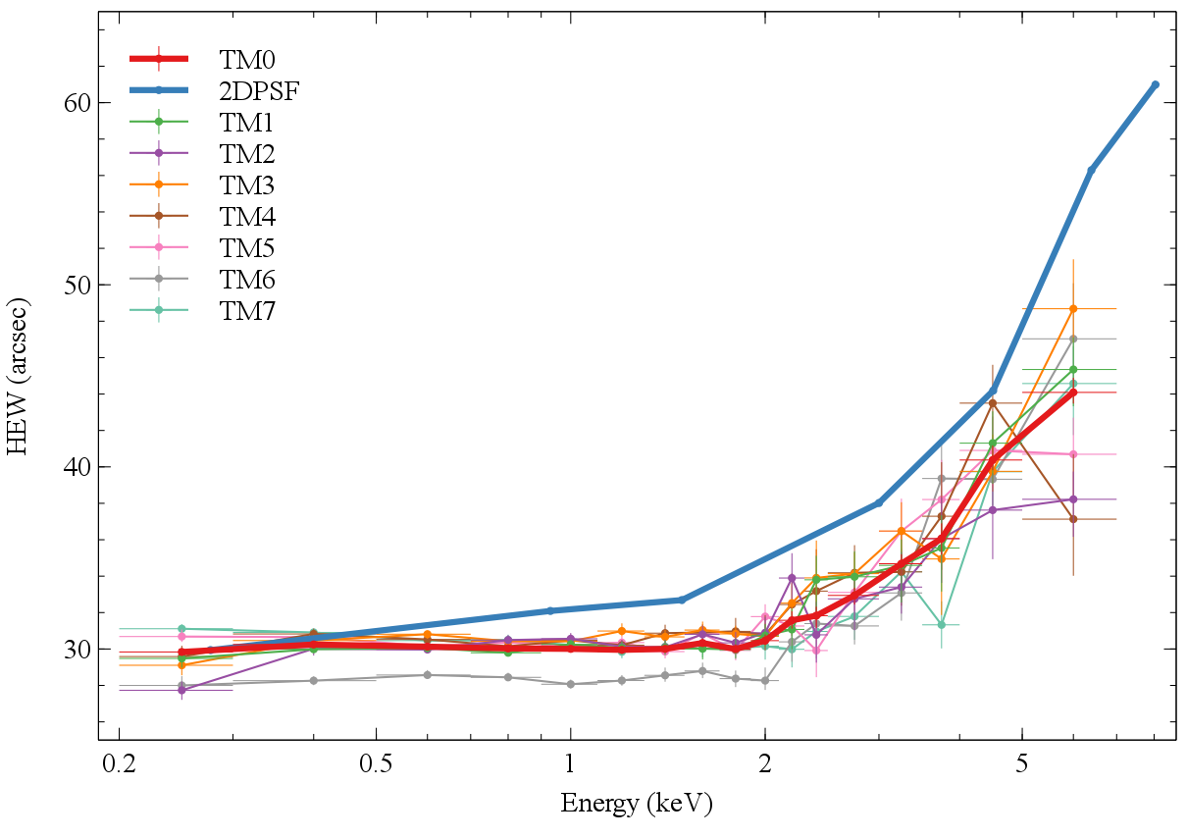
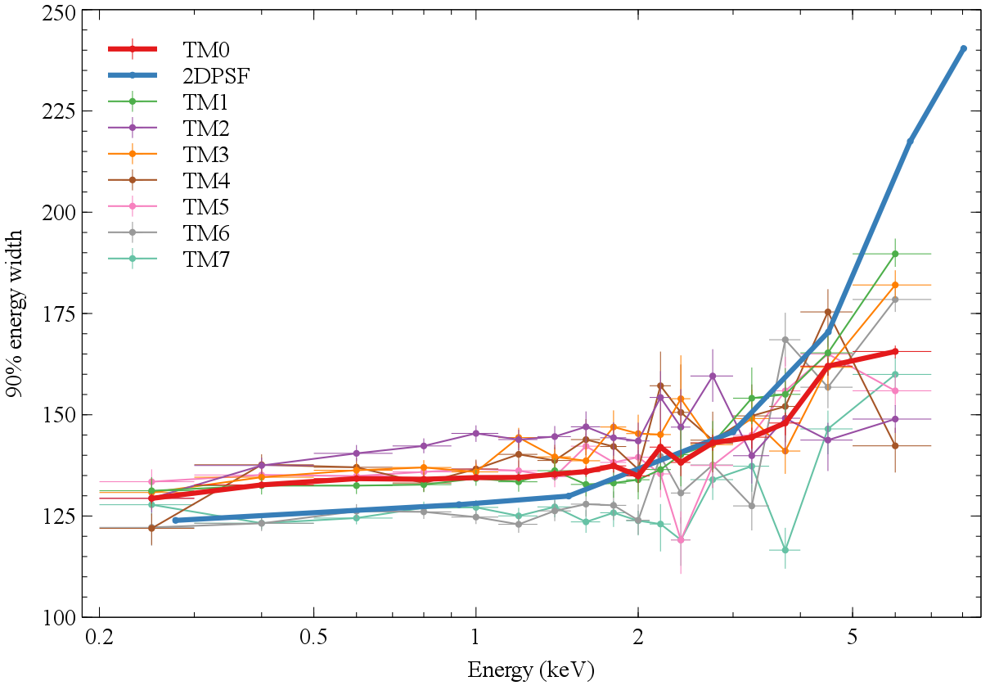
Survey average HEW
25% EW
HEW
90% EW
IN PROGRESS!

Slide 25
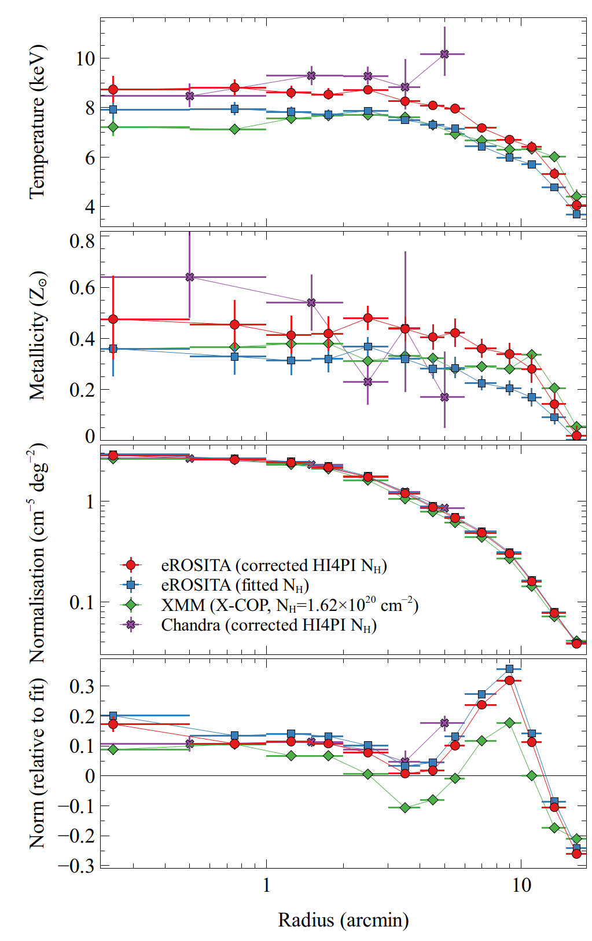
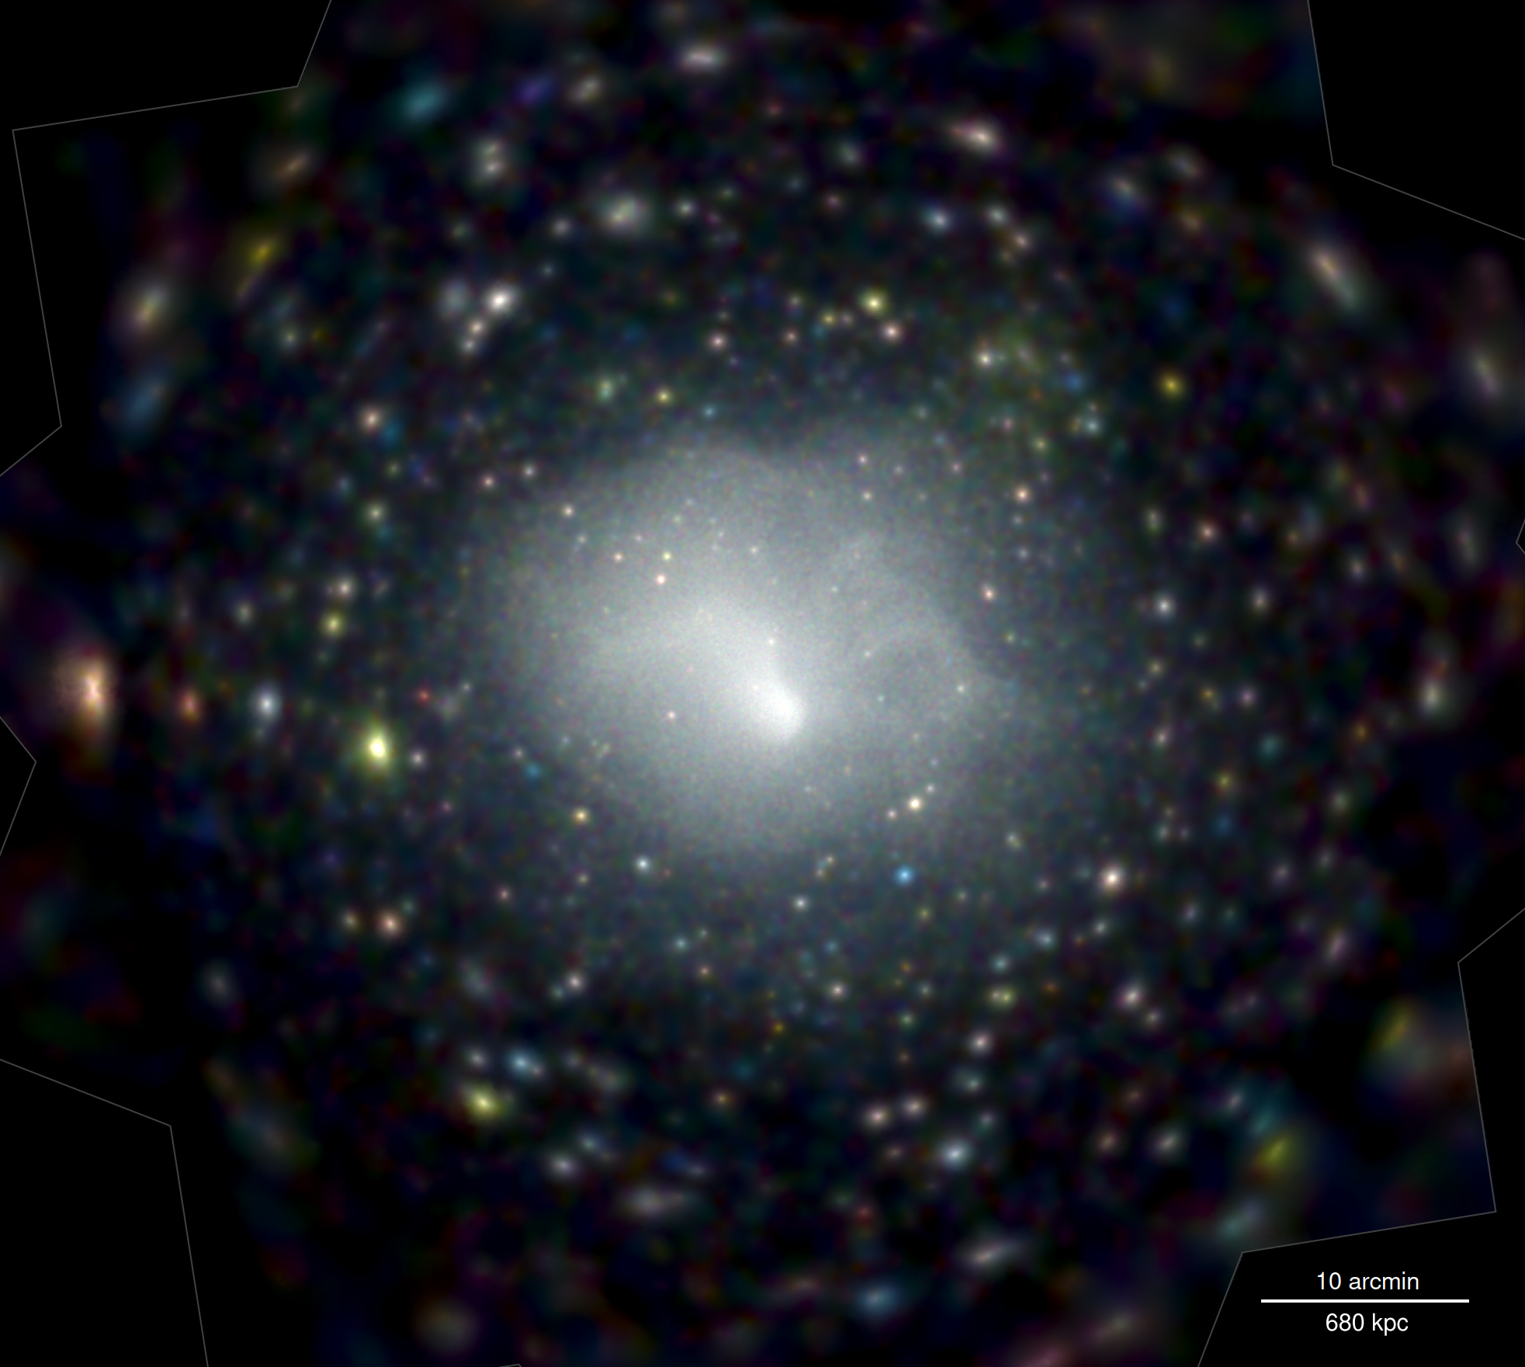
Abell 3266 pointed observation (Sanders+22)

