Slide 1
XMM EPIC-pn: spatial CTI correction using Cu K𝛂 and Mn K𝛂 (update from IACHEC 22)
Ivan Valtchanov, XMM SOC
IACHEC, Pelham, Germany, 24-27 Apr 2023

Slide 2
Spatial CTI offsets
Following Sanders, Dennerl et al. (2020), used in Gatuzz et al, (2022a, 2022b):
Apply the derived per-CCD long-term CTI correction for Cu K⍺ @8 keV
Stack event lists in bins of 500 revolutions, with step 250 (overlap)
For each stacked table, extract spectra for each CCD (12), read-out column RAWX (64) and bin by 20 pixels on RAWY (9).
Fit the Cu K⍺ line and derive the residual ➔ the spatial offsets as function of epoch, CCDNR, RAWX, RAWY.
➔ Spatial offset table dimensions: mode(2),epoch(8),CCDNR(12),RAWX(64),RAWY(200)

Slide 3
Example for modelling the LTC, CCD02
Q(t) = E_{obs}/8.04 keV
Cyan curve: [(1-TCOEF(t))/(1-a)]^{190}
Using <RAWY> for all observations

Slide 4
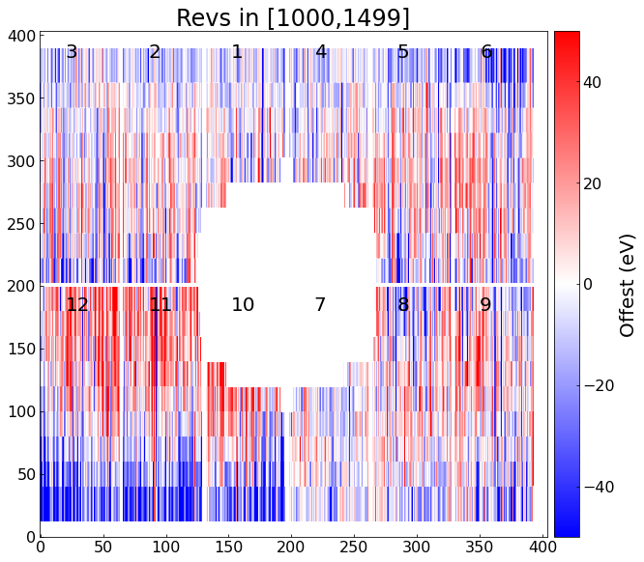
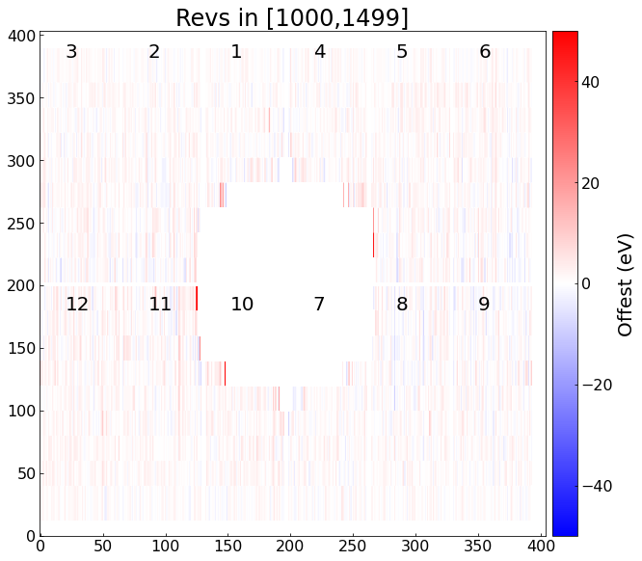
Cu K⍺ before and after
Offsets in eV applied at event list level

Slide 5
Example, correction
Procedure:
Apply derived offsets to the stacked event list
PI ➔ PI_CORR for all events
Fit Cu Ka using PI_CORR
Overall: going down from ~30 eV to ~3 eV
Taking the rms as redshift and then c*z
➔ Improvement in velocity space:
~1120 km/s (30 eV) to
~112 km/s (3 eV)

Slide 6
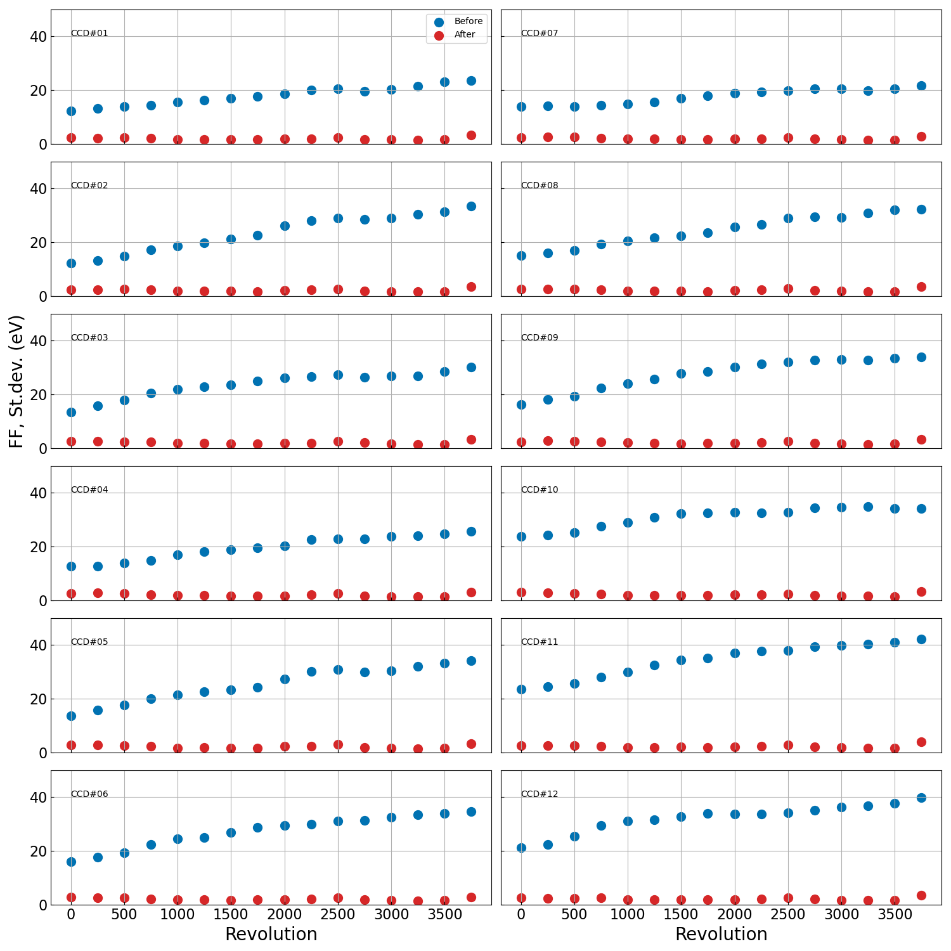
Full Frame Mode CU for Cu K⍺
Before, st.dev.
After, st.dev.

Slide 7
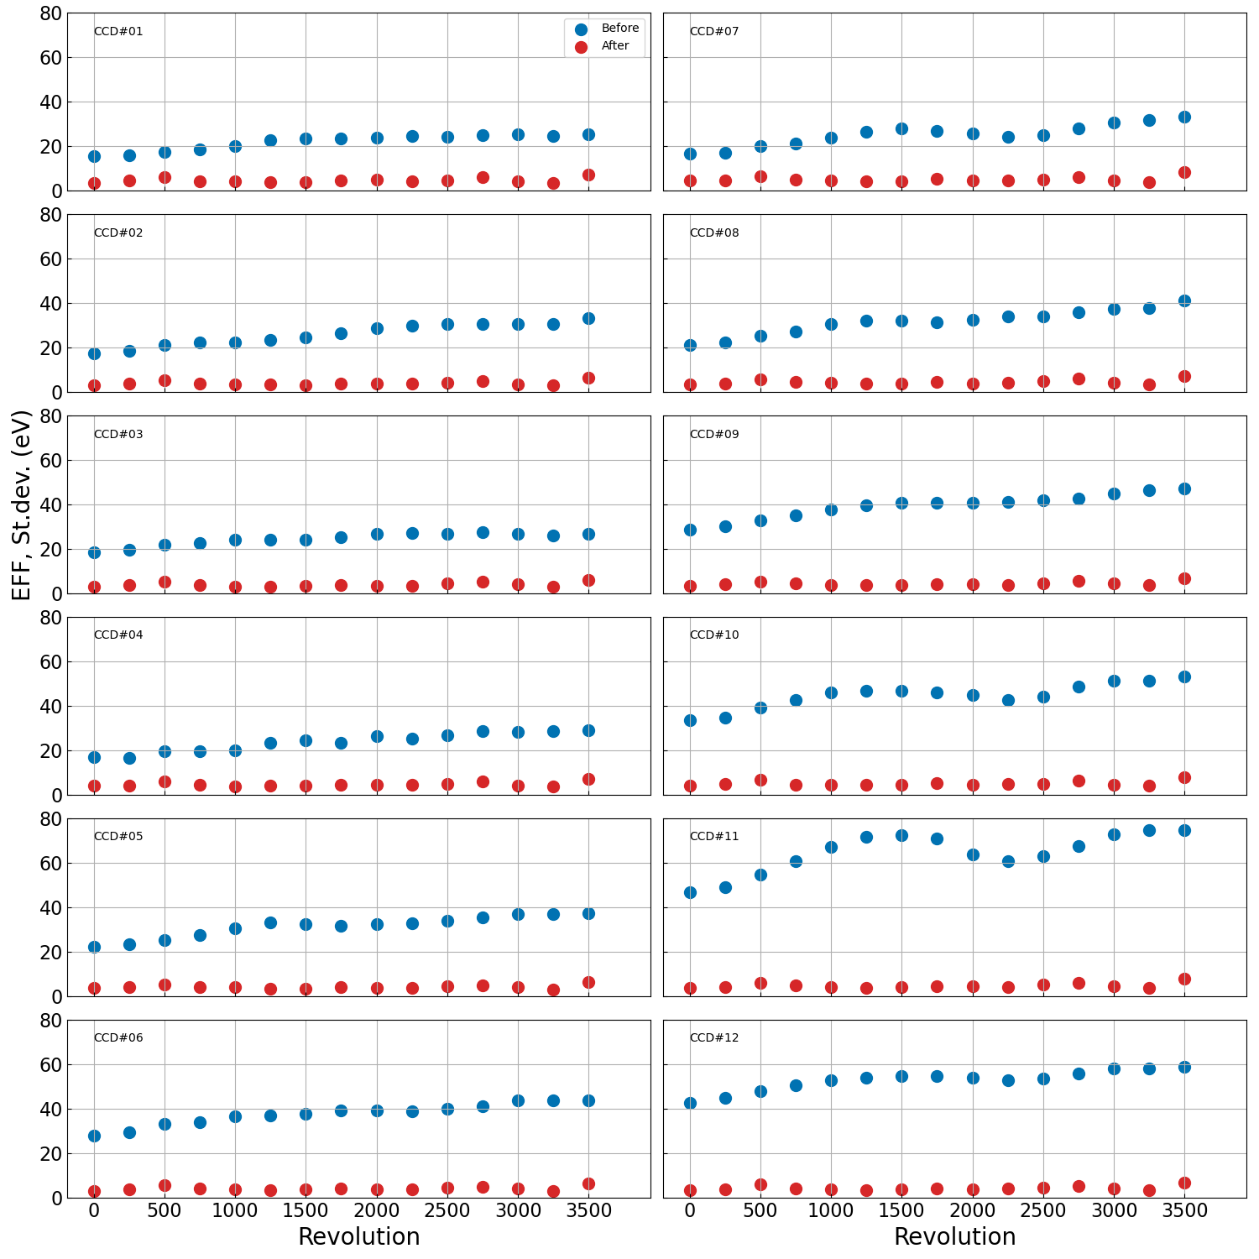
Extended Full Frame Mode CU
Before
After
Significant improvement in this quandrant!

Slide 8
Applying the spatial offsets to other energies?
In Sanders et al. (2020) the derived offsets are applied to energies down to ~ 6 keV, i.e. for the iron complex at ~6.5 keV (galaxy clusters)
To validate, we apply the Cu-derived offsets to the Mn K⍺ line at ~6 keV, internal calibration source
Source is faint after rev. 2000 ➔ no results in most of the spatial bins
Check at rev. < 2000 for validation

Slide 9
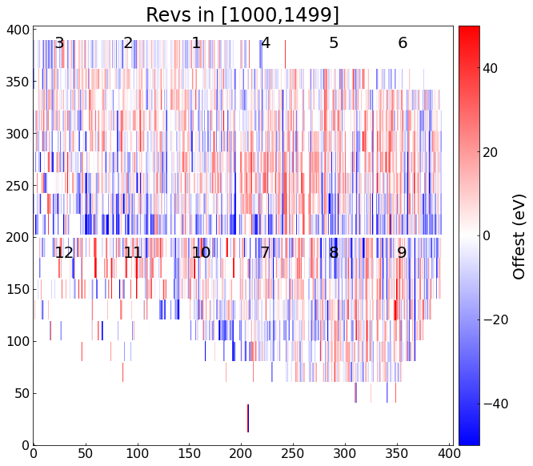
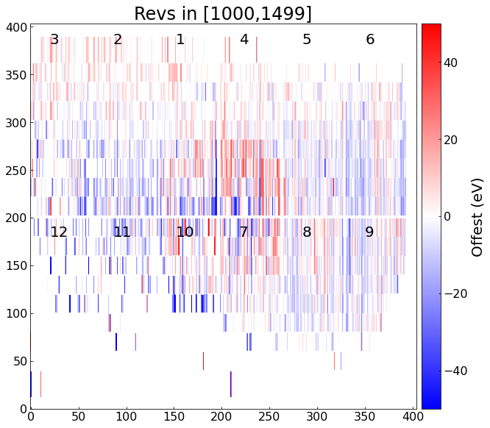
Mn K⍺ before and after CU correction

Slide 10
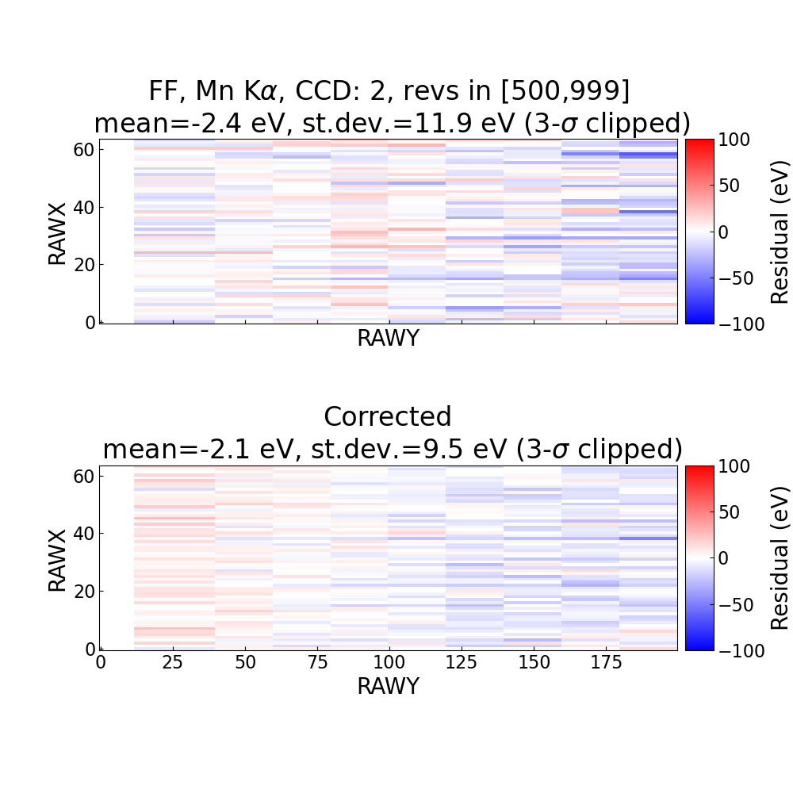
Marginal improvement

Slide 11
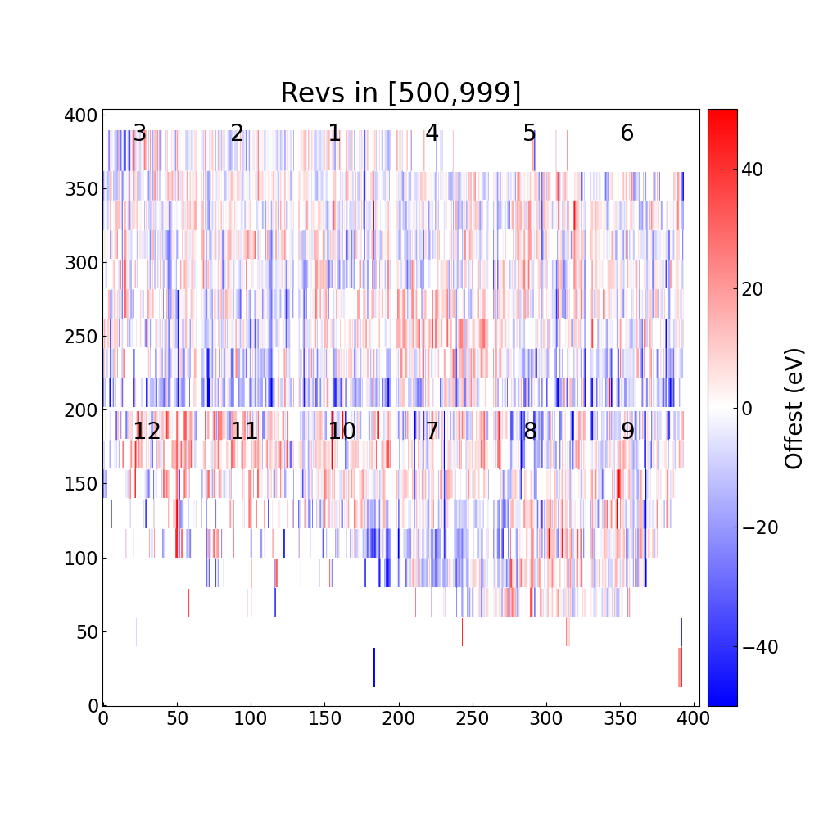
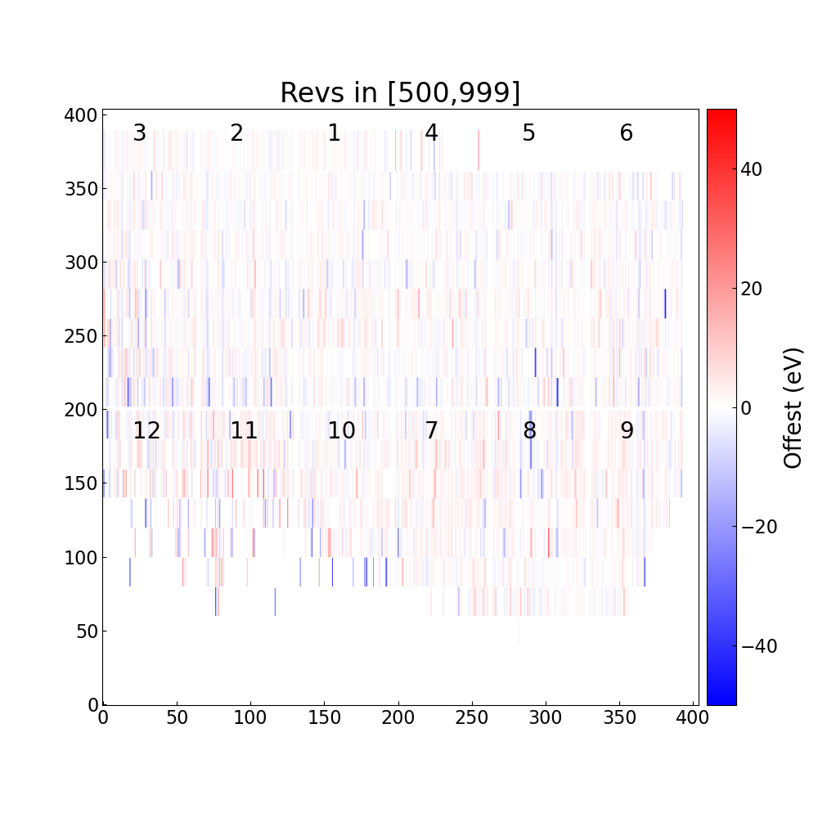
Mn K⍺ before and after MN correction

Slide 12
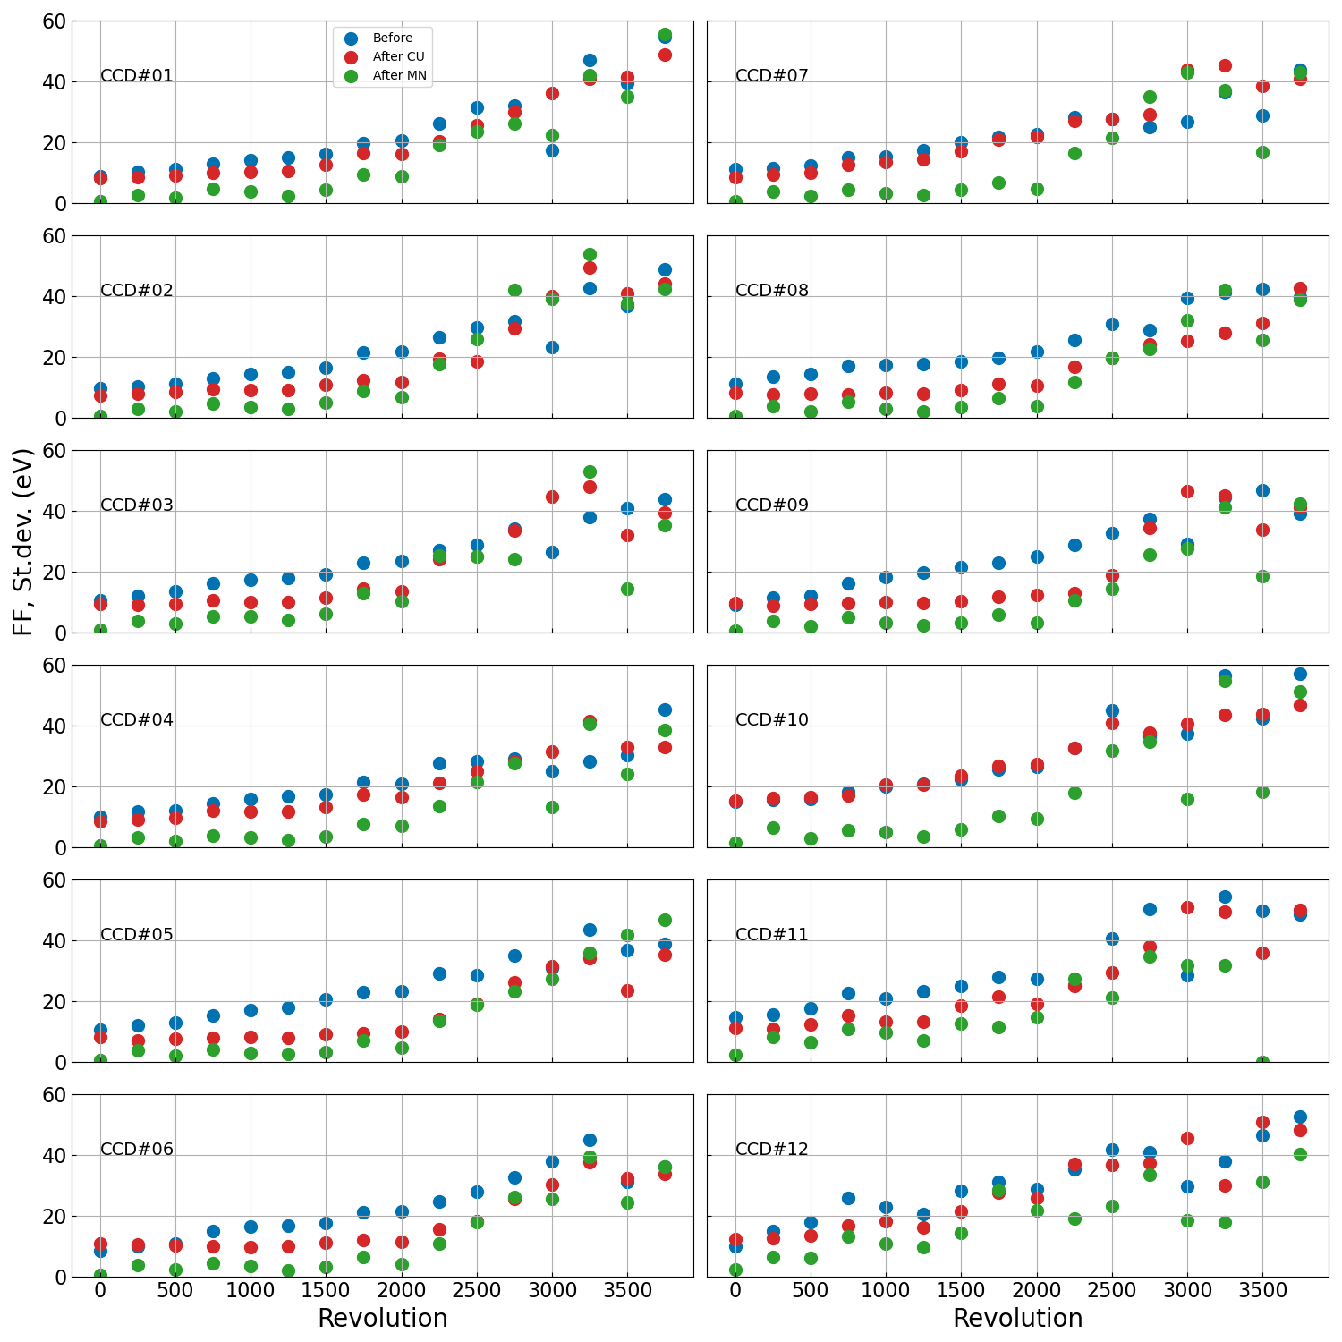
Mn K⍺ before and after CU and MN corrections
Only FF mode

Slide 13
Energy scale in [6,9] keV

Slide 14
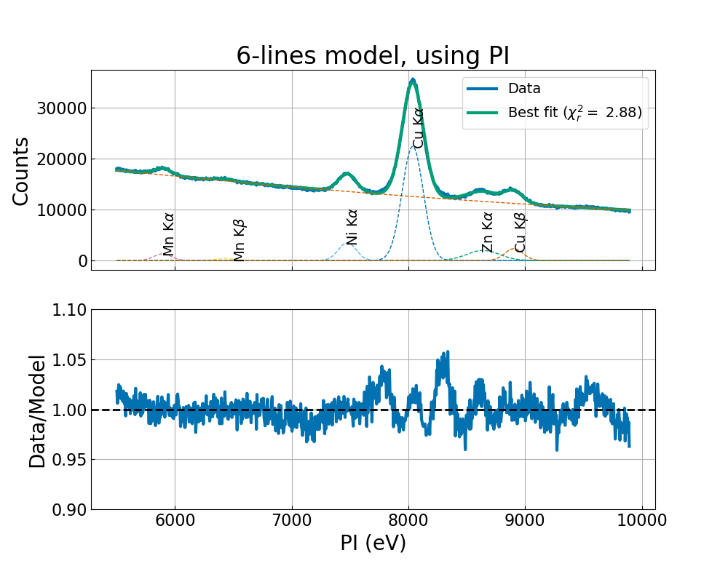
6-lines model examples, full CCD areas
Rev in [500,999]
Rev in [2500,2999]

Slide 15
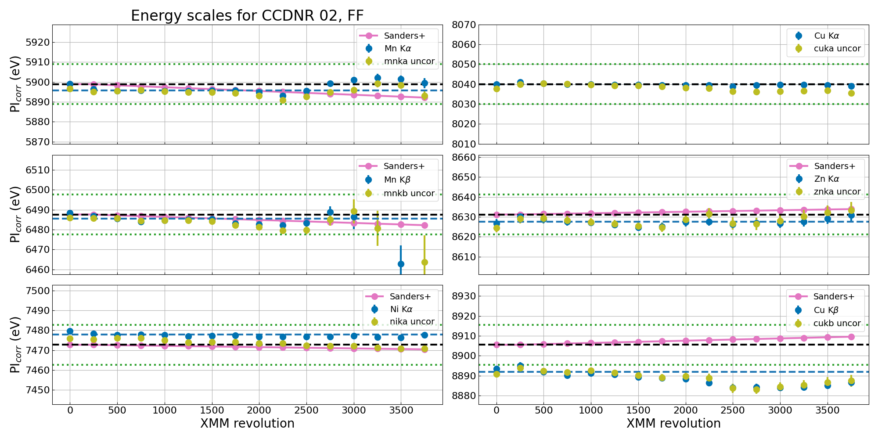

Slide 16
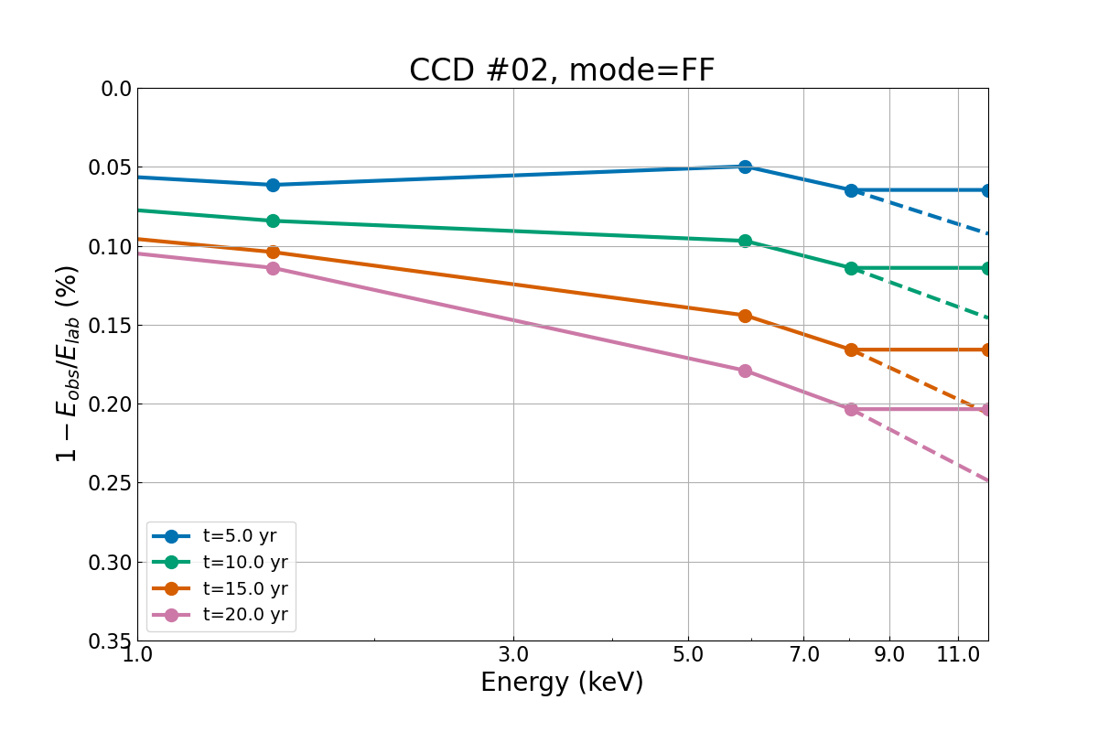
Energy dependence of the long-term CTI
Al K⍺
Cu K⍺
Mn K⍺

Slide 17
Summary
Spatial residuals derived using the fluorescent Cu K⍺ line at 8 keV
Spatial residuals derived using the cal source Mn K⍺ line at 6 keV
Both incorporated in EPN_SPATIALCTI_0001.CCF
(Both with caveats)
XMM-SAS task epspatialcti modified to use the new CCF with option SD20mode=yes (set as default)
One can choose either to apply the Cu K⍺ or Mn K⍺ with element=CU or element=MN
Inconclusive analysis of the energy scale compression in 6 to 9 keV ➔ not implemented.
Release note: https://xmmweb.esac.esa.int/docs/documents/CAL-SRN-0391-1-3.pdf

Slide 18
The end

