Slide 1
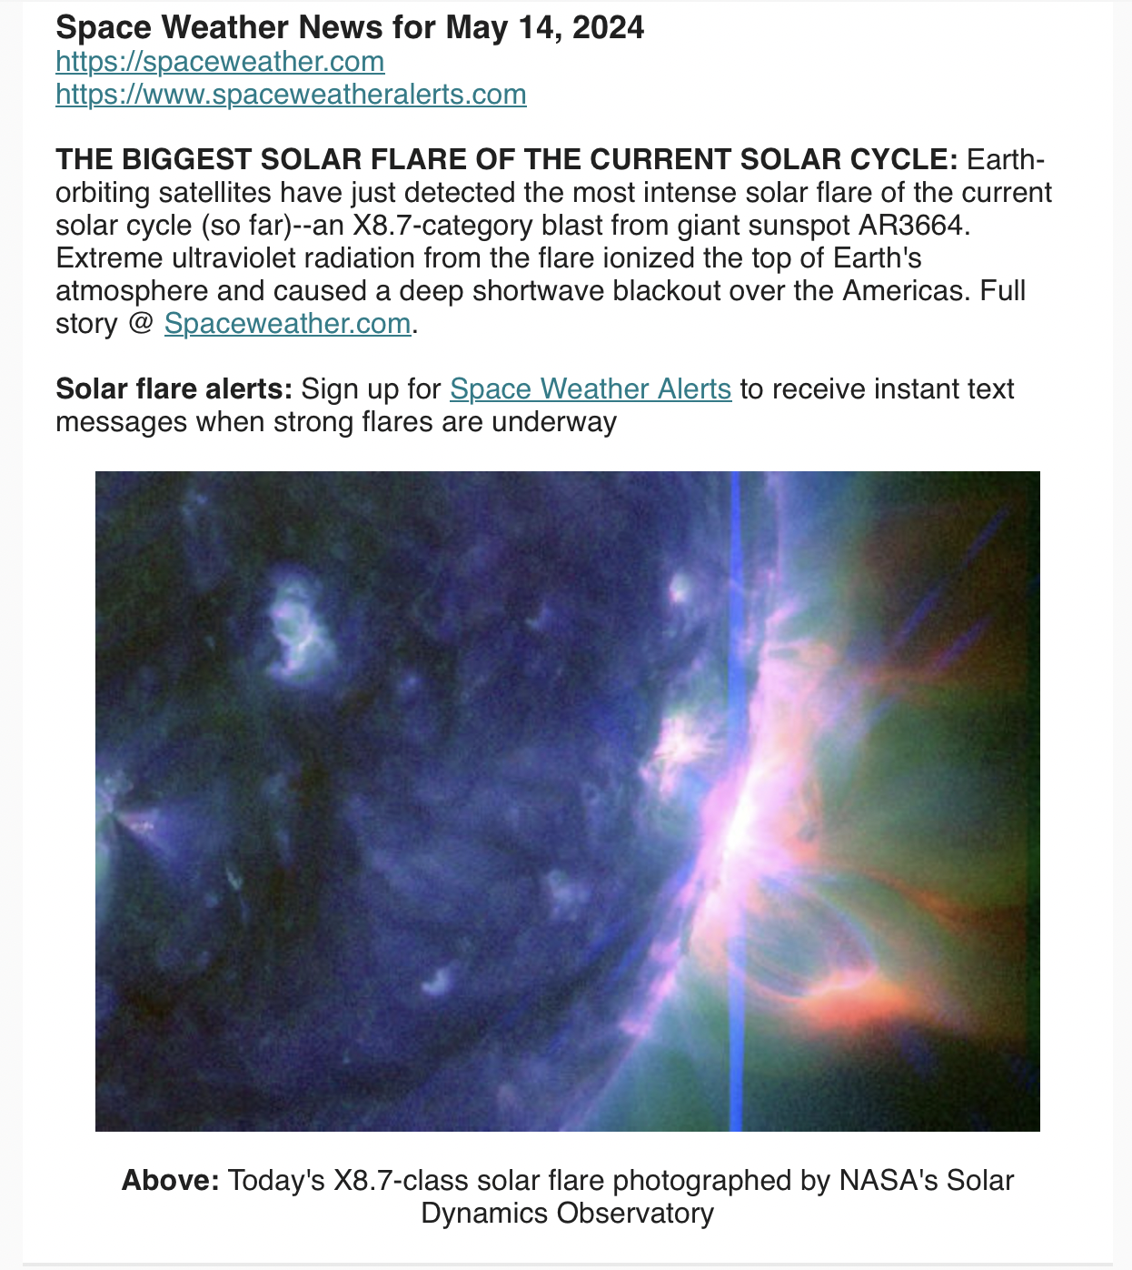
IACHEC Coordinated Observations Working Group
Summary
Karl Forster
Parador de La Granja, Spain May 16th, 2024
NASA/SDO AR3664 X8.7 flare 2024-05-14

Slide 2


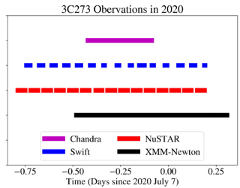
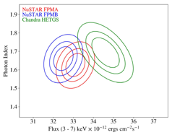
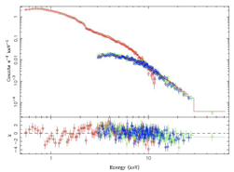
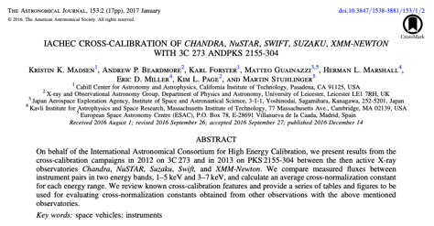
Scope of the Co-Obs Working Group
coordinate new observations jointly among different telescopes
analyze those observations
and publish the results.
IACHEC Co-Obs WG report, Parador de la Granja – may 16, 2024 Karl Forster

Slide 3

First... a quiz!
Q: The XRISM team can neither confirm nor deny...
  Simultaneous observations by XRISM and NuSTAR of 3C 273 were performed in January 2024
    (also coordinated with XMM-Newton, Chandra, and INTEGRAL)
  The measured spectral slope of 3C 273 agrees very well with NuSTAR
  The Resolve 3C 273 flux appeared 5% higher than measurements by NuSTAR and Xtend
  All of the above
IACHEC
IACHEC
IACHEC
IACHEC
IACHEC
IACHEC
IACHEC
IACHEC
IACHEC
IACHEC
IACHEC
IACHEC
IACHEC
IACHEC
IACHEC
IACHEC
IACHEC
IACHEC
IACHEC Co-Obs WG report, Parador de la Granja – may 16, 2024 Karl Forster

Slide 4
First... a quiz!
Q: The XRISM team can neither confirm nor deny...
  Simultaneous observations by XRISM and NuSTAR of 3C 273 were performed in January 2024
    (also coordinated with XMM-Newton, Chandra, and INTEGRAL)
  The measured spectral slope of 3C 273 agrees very well with NuSTAR
  The Resolve 3C 273 flux appeared 5% higher than measurements by NuSTAR and Xtend
  All of the above
IACHEC
IACHEC
IACHEC
IACHEC
IACHEC
IACHEC
IACHEC
IACHEC
IACHEC
IACHEC
IACHEC
IACHEC
IACHEC
IACHEC
IACHEC
IACHEC
IACHEC
IACHEC
IACHEC Co-Obs WG report, Parador de la Granja – may 16, 2024 Karl Forster

Slide 5
First... a quiz!
Q: The XRISM team can neither confirm nor deny...
  Simultaneous observations by XRISM and NuSTAR of 3C 273 were performed in January 2024
    (also coordinated with XMM-Newton, Chandra, and INTEGRAL)
  The measured spectral slope of 3C 273 agrees very well with NuSTAR
  The Resolve 3C 273 flux appeared 5% higher than measurements by NuSTAR and Xtend
  All of the above
IACHEC
IACHEC
IACHEC
IACHEC
IACHEC
IACHEC
IACHEC
IACHEC
IACHEC
IACHEC
IACHEC
IACHEC
IACHEC
IACHEC
IACHEC
IACHEC
IACHEC
IACHEC
IACHEC Co-Obs WG report, Parador de la Granja – may 16, 2024 Karl Forster

Slide 6
First... a quiz!
Q: The XRISM team can neither confirm nor deny...
  Simultaneous observations by XRISM and NuSTAR of 3C 273 were performed in January 2024
    (also coordinated with XMM-Newton, Chandra, and INTEGRAL)
  The measured spectral slope of 3C 273 agrees very well with NuSTAR
  The Resolve 3C 273 flux appeared 5% higher than measurements by NuSTAR and Xtend
  All of the above
IACHEC
IACHEC
IACHEC
IACHEC
IACHEC
IACHEC
IACHEC
IACHEC
IACHEC
IACHEC
IACHEC
IACHEC
IACHEC
IACHEC
IACHEC
IACHEC
IACHEC
IACHEC
IACHEC Co-Obs WG report, Parador de la Granja – may 16, 2024 Karl Forster

Slide 7
First... a quiz!
Q: The XRISM team can neither confirm nor deny...
  Simultaneous observations by XRISM and NuSTAR of 3C 273 were performed in January 2024
    (also coordinated with XMM-Newton, Chandra, and INTEGRAL)
  The measured spectral slope of 3C 273 agrees very well with NuSTAR
  The Resolve 3C 273 flux appeared 5% higher than measurements by NuSTAR and Xtend
  All of the above
IACHEC
IACHEC
IACHEC
IACHEC
IACHEC
IACHEC
IACHEC
IACHEC
IACHEC
IACHEC
IACHEC
IACHEC
IACHEC
IACHEC
IACHEC
IACHEC
IACHEC
IACHEC
IACHEC Co-Obs WG report, Parador de la Granja – may 16, 2024 Karl Forster

Slide 8
First... a quiz!
Q: The XRISM team can neither confirm nor deny...
  Simultaneous observations by XRISM and NuSTAR of 3C 273 were performed in January 2024
    (also coordinated with XMM-Newton, Chandra, and INTEGRAL)
  The measured spectral slope of 3C 273 agrees very well with NuSTAR
  The Resolve 3C 273 flux appeared 5% higher than measurements by NuSTAR and Xtend
  All of the above
IACHEC
IACHEC
IACHEC
IACHEC
IACHEC
IACHEC
IACHEC
IACHEC
IACHEC
IACHEC
IACHEC
IACHEC
IACHEC
IACHEC
IACHEC
IACHEC
IACHEC
IACHEC
IACHEC Co-Obs WG report, Parador de la Granja – may 16, 2024 Karl Forster

Slide 9
First... a quiz!
Q: The XRISM team can neither confirm nor deny...
  Simultaneous observations by XRISM and NuSTAR of 3C 273 were performed in January 2024
    (also coordinated with XMM-Newton, Chandra, and INTEGRAL)
  The measured spectral slope of 3C 273 agrees very well with NuSTAR
  The Resolve 3C 273 flux appeared 5% higher than measurements by NuSTAR and Xtend
  All of the above
IACHEC
IACHEC
IACHEC
IACHEC
IACHEC
IACHEC
IACHEC
IACHEC
IACHEC
IACHEC
IACHEC
IACHEC
IACHEC
IACHEC
IACHEC
IACHEC
IACHEC
IACHEC
IACHEC Co-Obs WG report, Parador de la Granja – may 16, 2024 Karl Forster

Slide 10
Activity in 2023 - 2024
Coordinated XRISM calibration observations
Adjusted for changes to the in-flight calibration plans
  PKS 2155-304 – NuSTAR, NICER – for off-axis PSF
  3C 273 – NuSTAR, XMM, Chandra, INTEGRAL, Swift – for on-axis effective area
  Crab – NuSTAR, NICER – for timing / bright source
  Cyg X-2 - NuSTAR – for off-axis PSF
  HR 1099 – Chandra/HETG – for Resolve gain
...delayed annual cross-cal campaign
(usually in June)
Additional campaigns
Crab – XMM, INTEGRAL, NuSTAR
IACHEC Co-Obs WG report, Parador de la Granja – may 16, 2024 Karl Forster

Slide 11
Working group session – May 14
Everyone in person!
+9 on zoom from EU and USA
Agenda
A NICER Look at Cross-calibration using 3C 273 – Jeremy Hare
XRISM on-axis effective area and comparison with other satellites – Eric Miller & Takayuki Hayashi
NASA’s Astrophysics Cross-Observatory Science Support (ACROSS) Initiative – Jamie Kenna (remotely)
Coordinated calibration plans for 2024-2025
Working group communications
IACHEC Co-Obs WG report, Parador de la Granja – may 16, 2024 Karl Forster

Slide 12

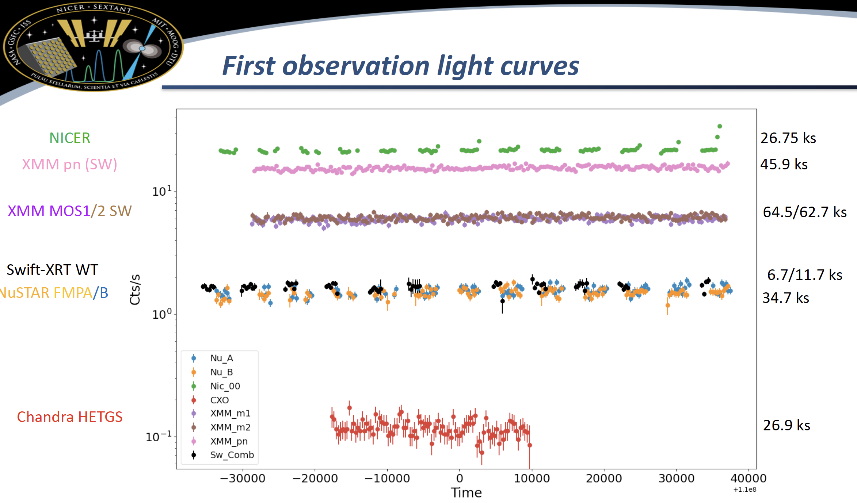
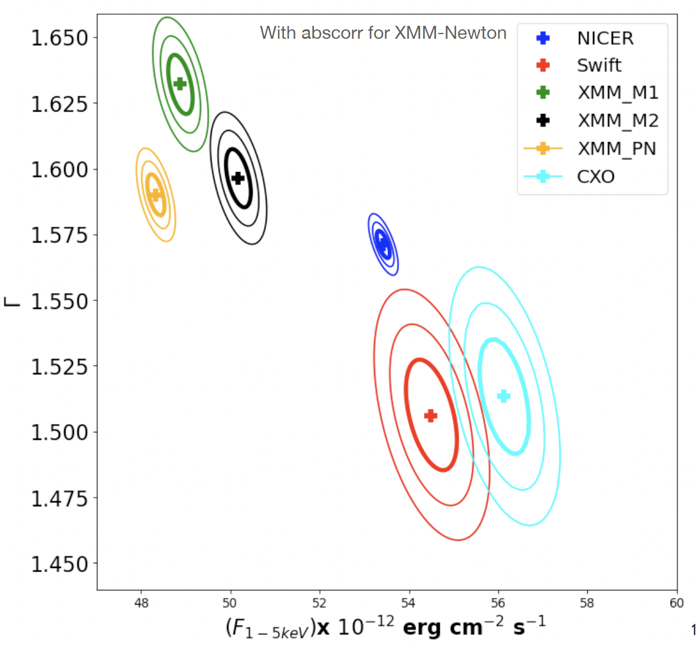
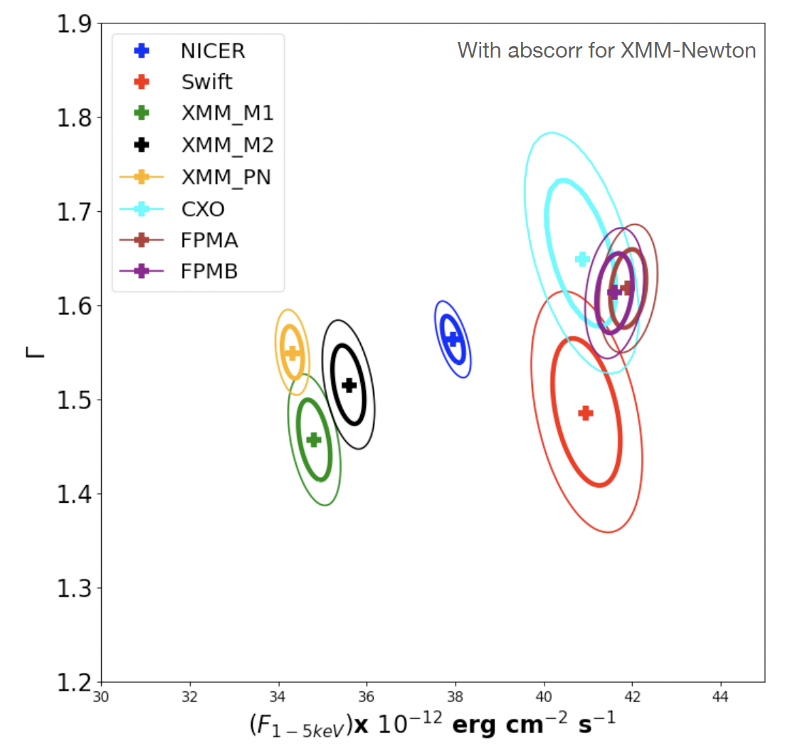
A NICER Look at Cross-calibration using 3C 273
Jeremy Hare (NASA/GSFC)
Followed Madsen et al. (2017)
Updated Swift-XRT analysis, using fluxcorr and caladjustment for XMM-newton
Merged both NICER and Swift observations
3C 273 IACHEC observations webpage
Felix Fuerst (ESAC)
Provides common GTI’s and spectra from each instrument team
Python notebooks provided, eventually including analysis scripts
Pipeline analysis scripts can be run (Swift API, CIAO, heasoftpy, SAS notebooks)
In part is similar to the goals of the heritage working group
Will continue updated analysis – starting with latest campaign including XRISM observation
1-5 keV
3-7 keV
with abscorr
IACHEC Co-Obs WG report, Parador de la Granja – may 16, 2024 Karl Forster

Slide 13
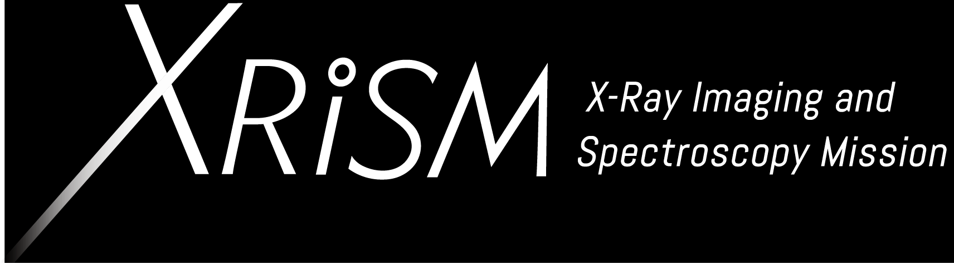
XRISM / Resolve on-axis effective area
Resolve vs NuSTAR 3C 273
Coordinated observation Jan 7-8th , 2024
Analysis by Aysegul Tumer of overlapping GTI
  Same TSTART and TSTOP
Resolve broad-band flux is 5% higher than NuSTAR
  cf XMM-PN is 18% lower than NuSTAR
Resolve 2-10 keV, 103 ks
NuSTAR FPMA 3-80 keV, 39 ks
2024-01-06
3-7 keV
3-12 keV
Eric Miller (MIT)
IACHEC Co-Obs WG report, Parador de la Granja – may 16, 2024 Karl Forster

Slide 14
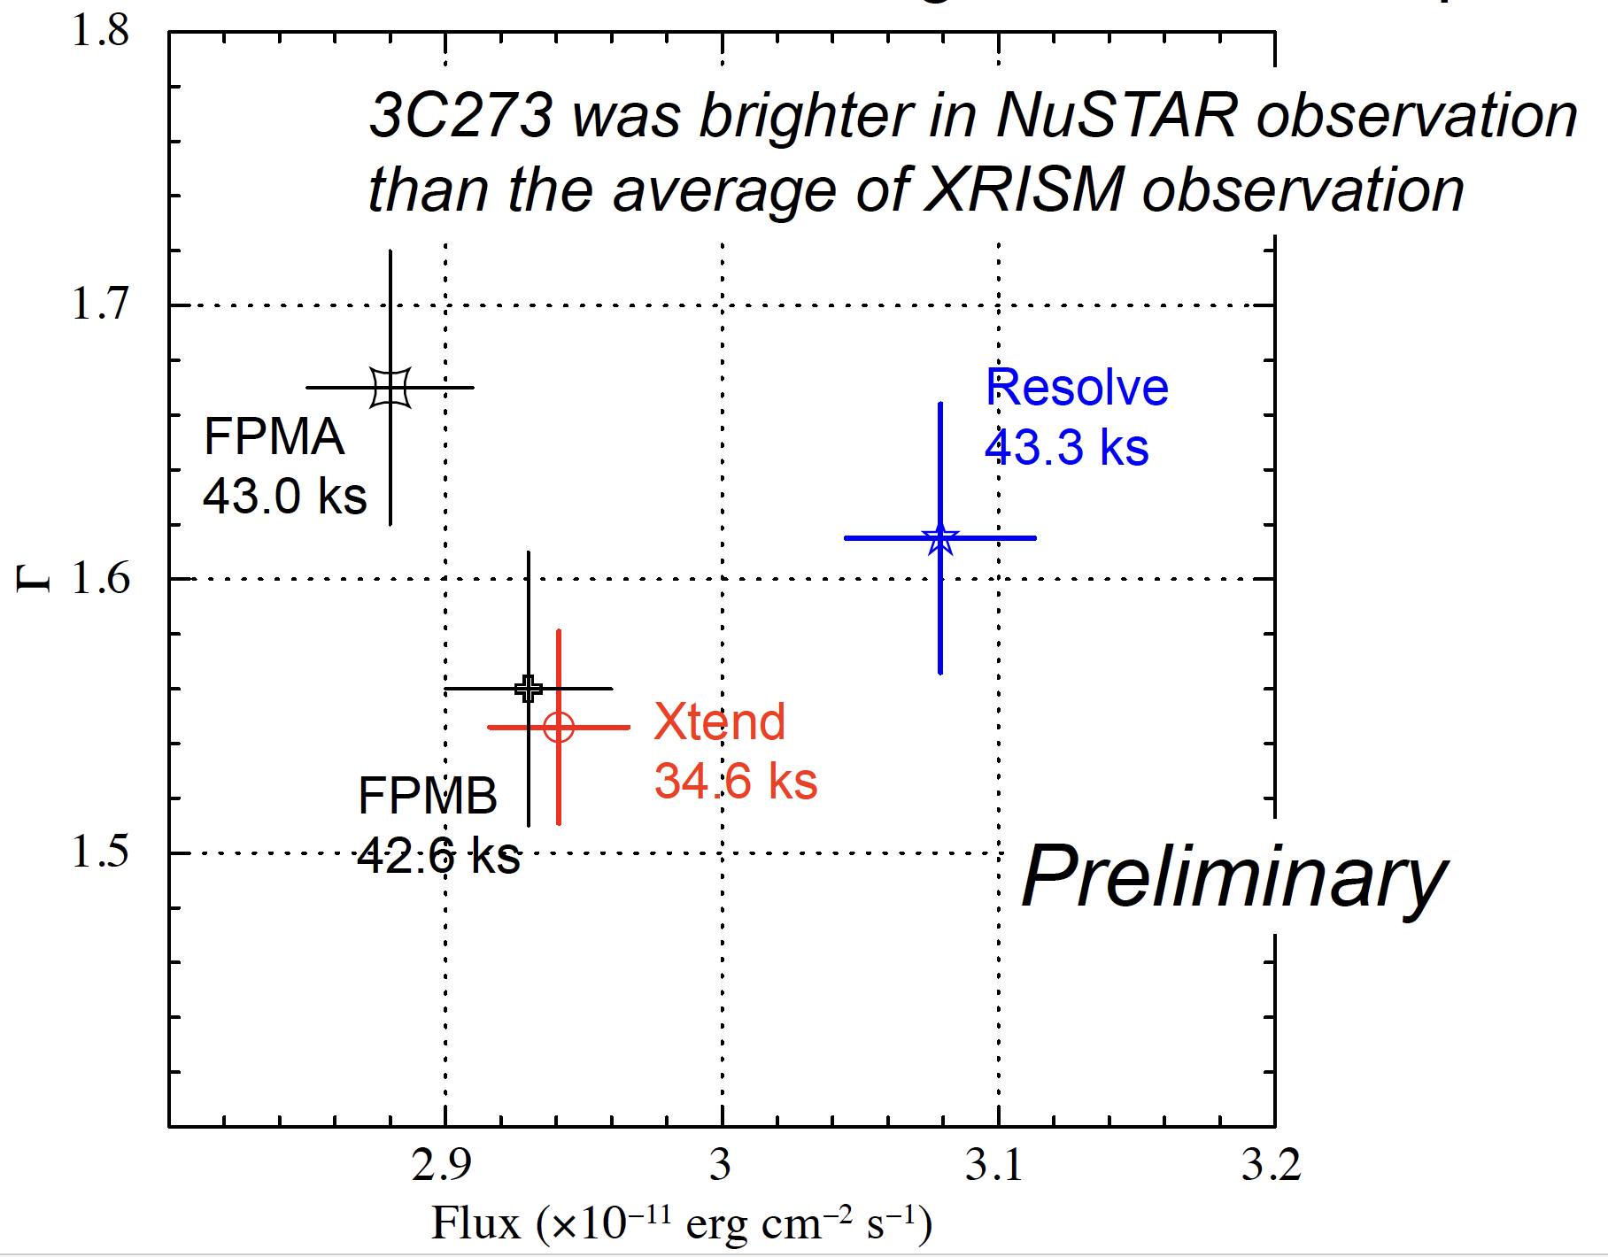
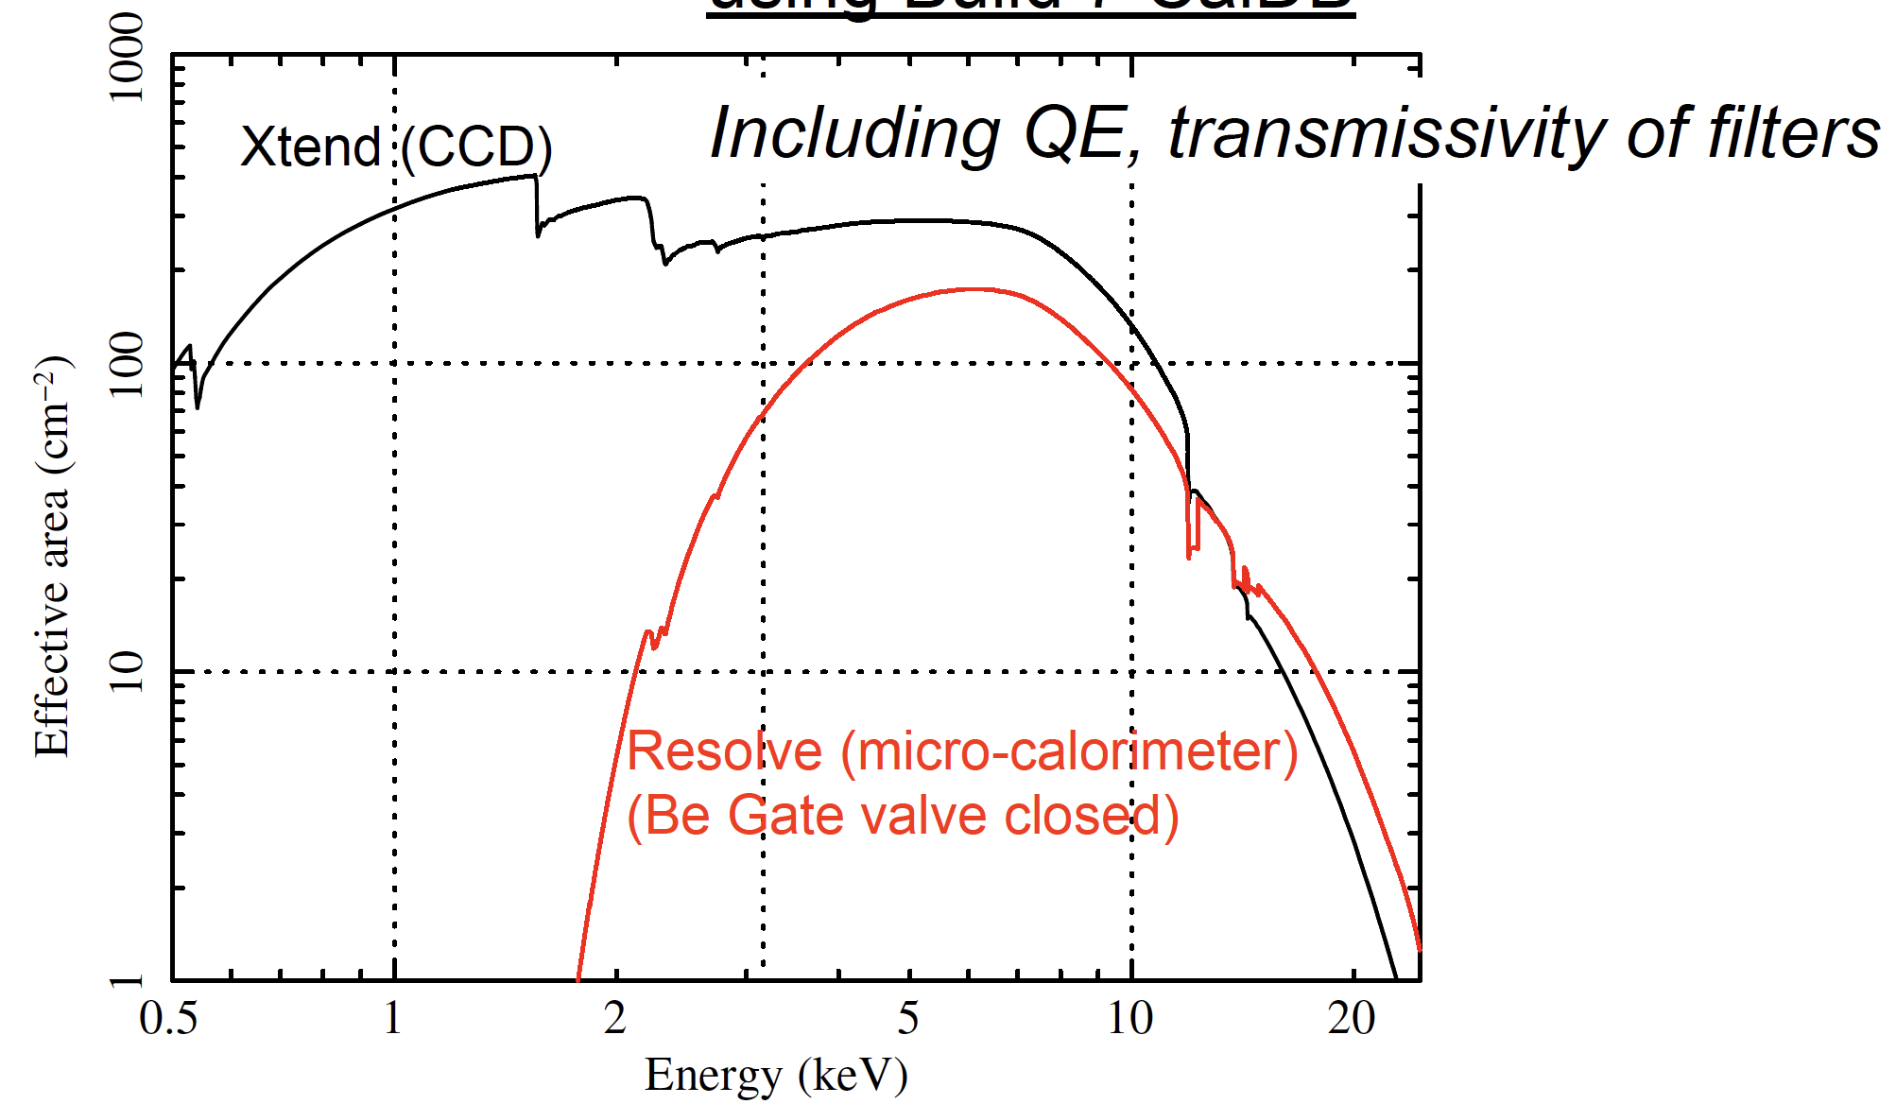
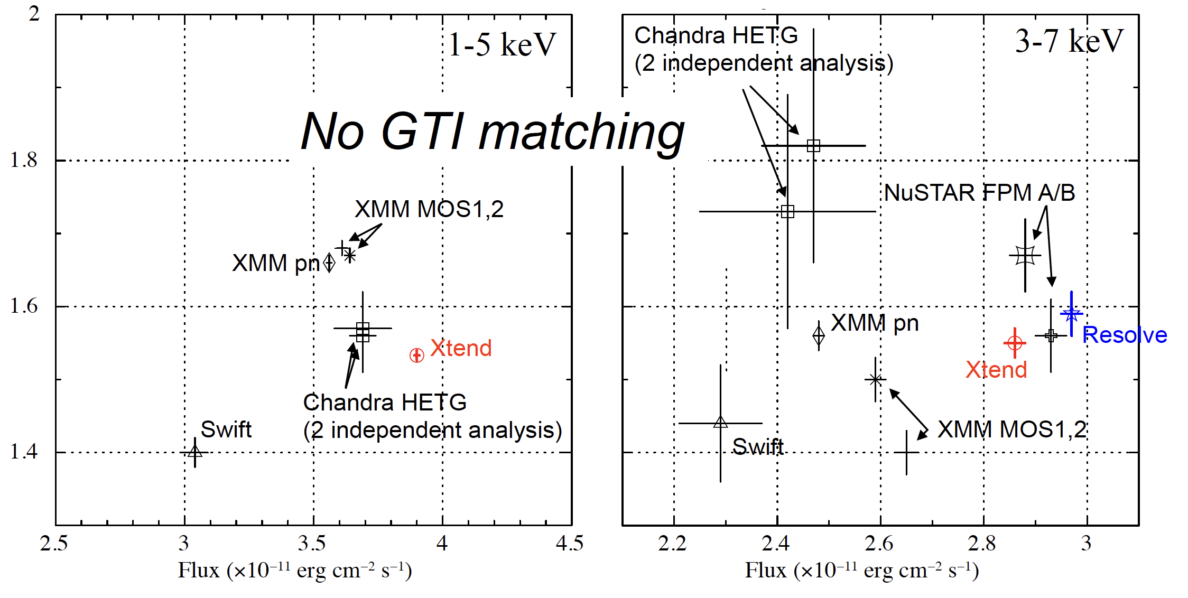
XRISM on-orbit Effective Area and Comparison with Other Satellites
Takayuki Hayashi (GSFC/UMBC)
On-axis effective area
Resolve-XMA on-axis effective area within 6% of simulation (1.8 – 17 keV)
Gate valve not yet open
  ~no effective area below 1.8 keV
3C 273 modeling
TBabs * Powerlaw (N_{H}, Z from Madsen et al)
  Soft excess (BBB) in Xtend spectrum?
Xtend and Resolve measurements are within range of measurements from other missions
  Xtend closer to NuSTAR flux than Resolve
IACHEC Co-Obs WG report, Parador de la Granja – may 16, 2024 Karl Forster

Slide 15

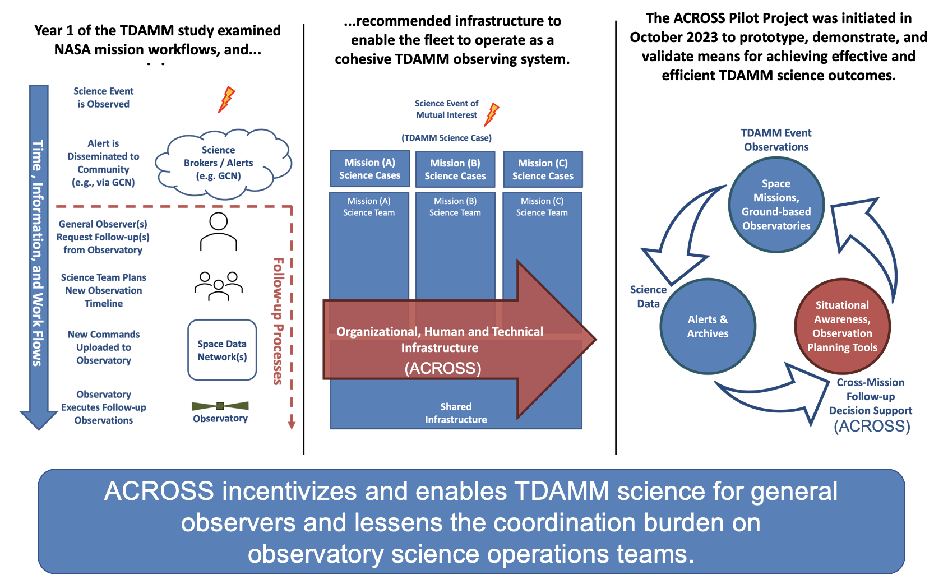
NASA’s Astrophysics Cross-Observatory Science Support (ACROSS) Initiative
TDAMM GOF
2024-25 Two-year pilot phase
  Investigation of coordination of NASA space-based missions
  Coordination with ground-based facilities
  (with possible expansion to international coordination)
2026 Research grant call for proposals
  TDAMM cross-observatory science cases
  To obtain a baseline of binary system phase
Interfaces established with BURSTCUBE & NuSTAR
  Value-added interfaces
Builds on IVOA protocols developed at ESAC
Where does IACHEC fit in?
Jamie Kennea (Penn State)
IACHEC Co-Obs WG report, Parador de la Granja – may 16, 2024 Karl Forster

Slide 16



Missed opportunities?
Multiple high-energy missions launched in 2023-2024
IACHEC CoObs WG support for organizing cross-cal observations is available
  Need better communication channels
Some contemporaneous observations were performed (e.g. 3C 273 EP-FXT)
Crab calibration campaigns in 2024 March
  NuSTAR + XMM + INTEGRAL (1st)
  XRISM + NuSTAR (18th-19th)
  EP-FXT (8th)
  HXMT (19th)
  NINJASAT (Feb 10-11th)
Initial cross calibration
Don’t be shy in requesting calibration support
IACHEC Co-Obs WG report, Parador de la Granja – may 16, 2024 Karl Forster

Slide 17



2024 - 2025 opportunities?
New instruments planned to launch
SVOM – MXT (0.2-10 keV)
LEXI – X-ray imaging from the Moon!
SMILE – soft X-ray imager (0.2–2.5 keV)
  Timing of transits of (bright?) sources in the FOV
3C 273 IACHEC campaign 2025
Sun angle > 95 deg on Jan 1st
  2024 campaign was on Jan 7th
Continued calibration support
XRISM, EP-FXT, XRISM + grating & ??
Don’t be shy in requesting calibration support
IACHEC Co-Obs WG report, Parador de la Granja – may 16, 2024 Karl Forster

Slide 18
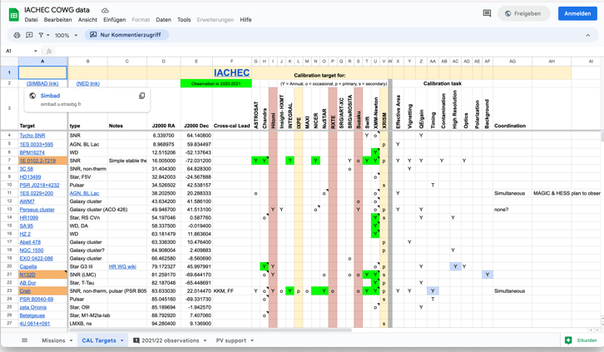
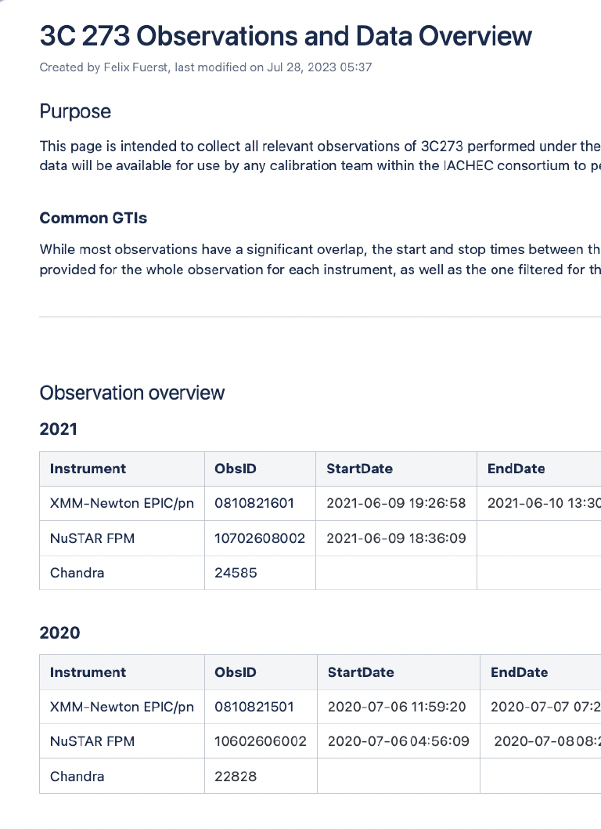
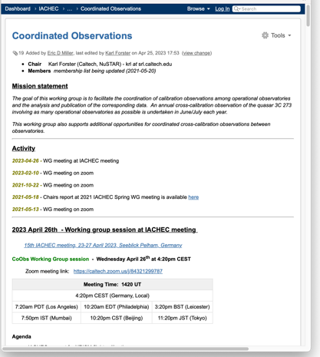
Working Group Communications
Mailing list
iachec-co-obs@lists.srl.caltech.edu
41 members
CoObs google sheets
Slack Channel
On IACHEC slack site
#coordinated-obs
  77 members
2024-25 activities
Jeremy Hare – organize telecons to discuss 3C 273 analysis
  Support from WG for completing cross-cal paper
James Rodi - Hosting mission data
Karl Forster – improve communications!
  Possible WG telecon in November
3C273 wiki
CoObs WG wiki
IACHEC Co-Obs WG report, Parador de la Granja – may 16, 2024 Karl Forster

