Slide 1
XMM-Newton EPIC-pn
Updates to the Long-Term CTI corrections
IACHEC #16, La Granja, Spain
Ivan Valtchanov

Slide 2
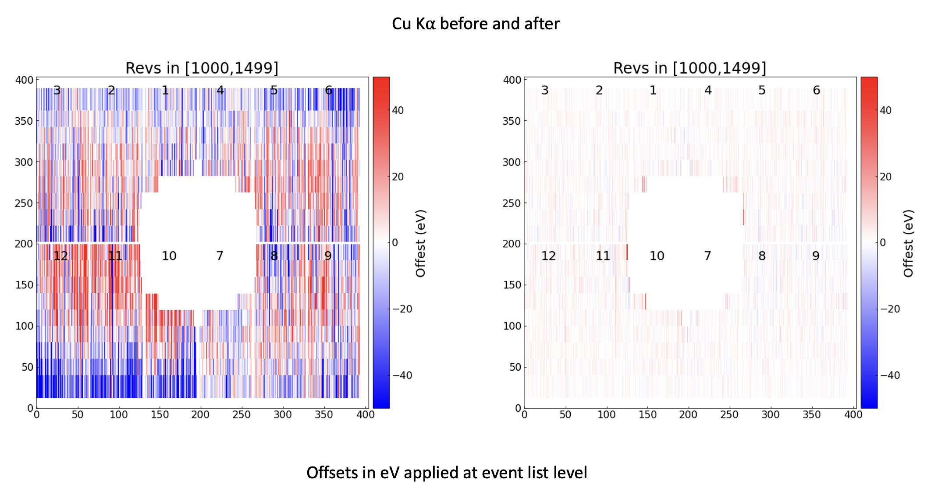
At previous IACHEC in Pelham:
  Spatial CTI for XMM EPIC-pn in Full Frame and Extended Full Frame modes (Sanders, Dennerl et al.)
  From ~ 30 eV rms to 3 eV at Cu K⍺ (8 keV)
  From 1000 km/s rms to 100 km/s

Slide 3
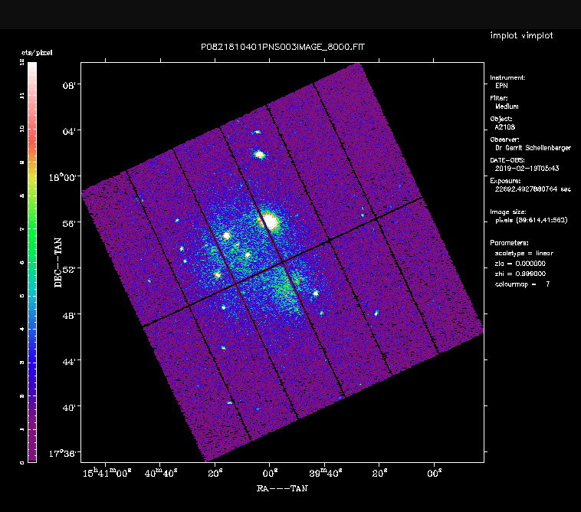
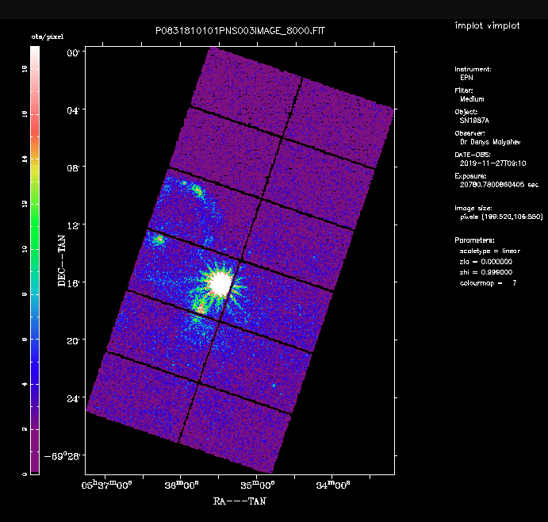
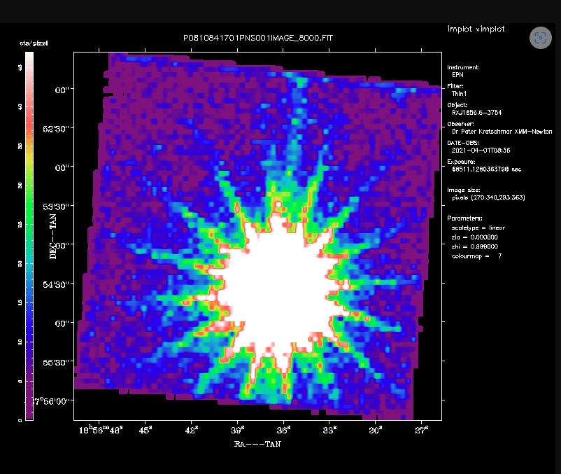
CCF Release note XMM-SOC-CAL-SRN-0407
  CCF file EPN_CTI_0058 already available
Full Frame and extended
Large Window
Small Window
+ Timing and Burst modes

Slide 4
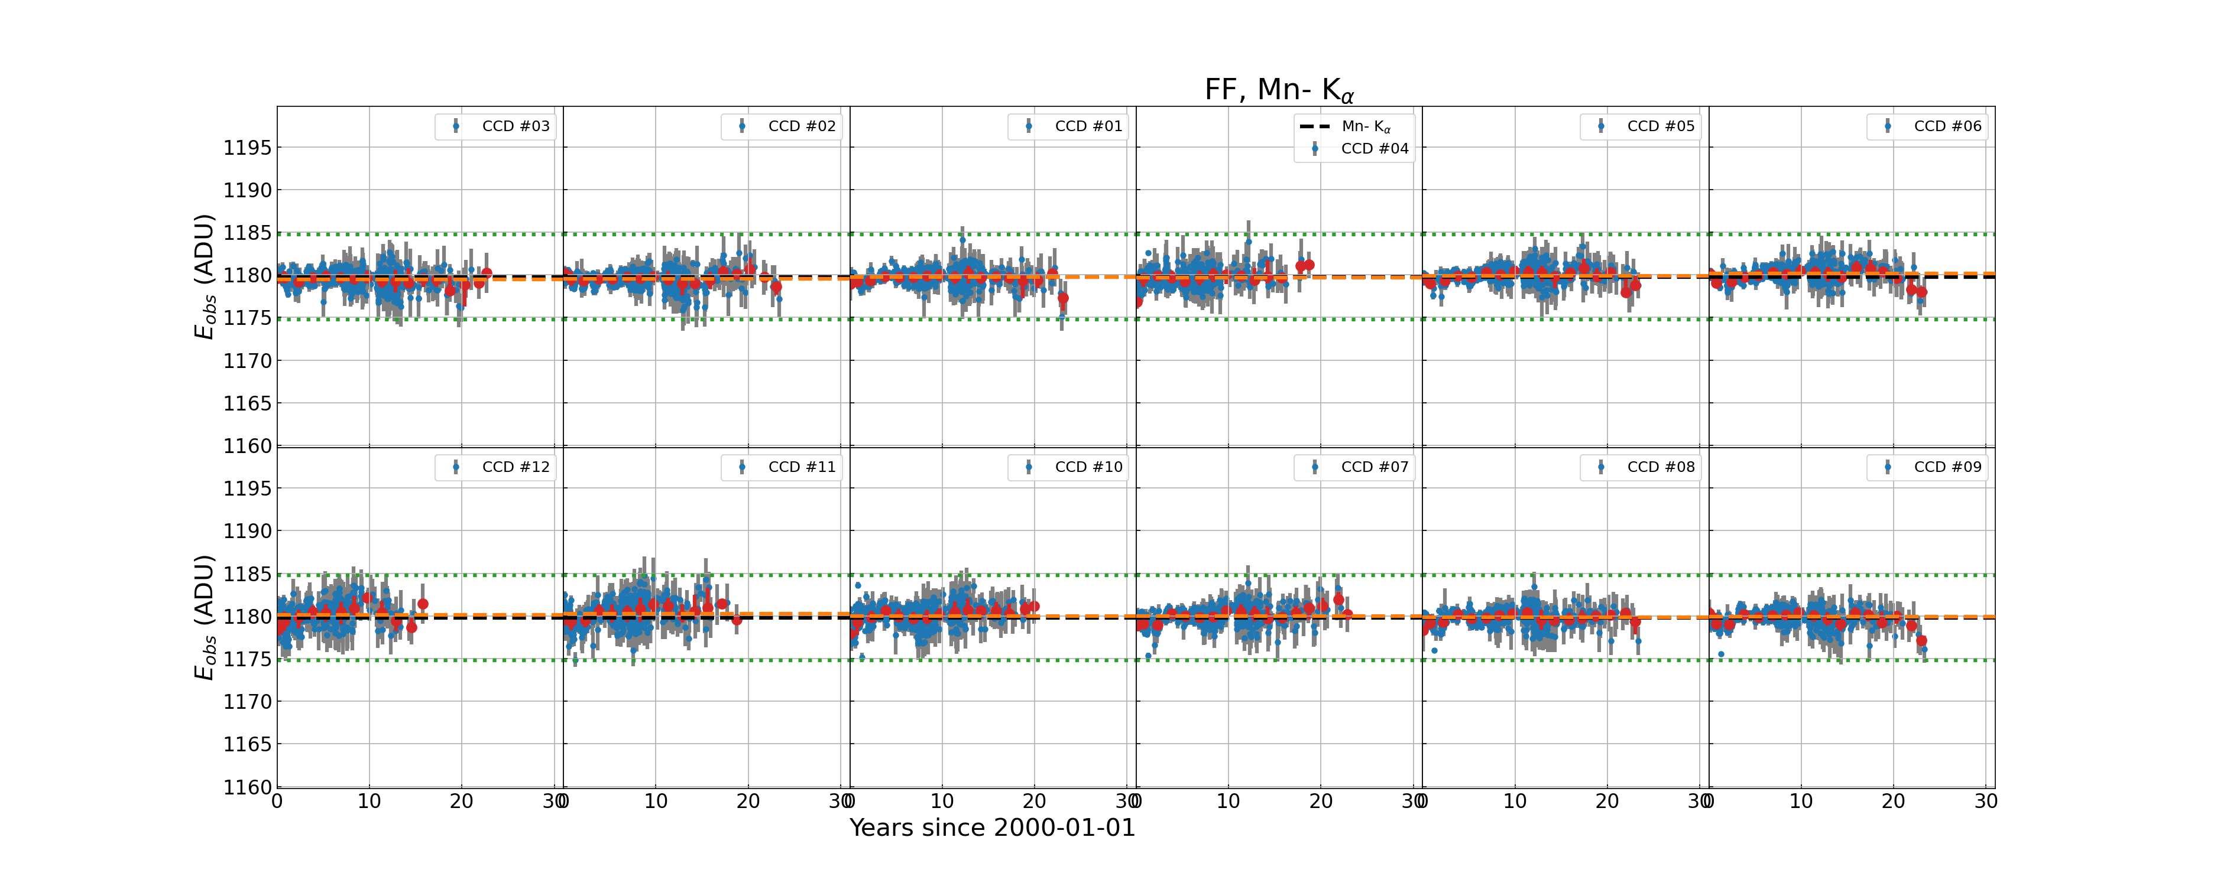
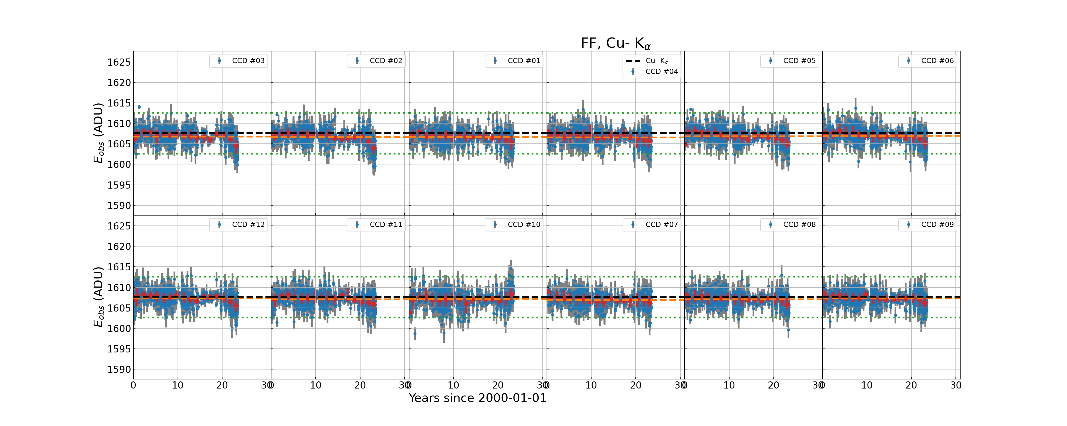
Need of an update
FF, Mn K⍺
FF, Cu K⍺, CalClosed only
0056 correction curves used data up to t=18 yr
➔ Obvious under-correction at t > 21 yr.

Slide 5
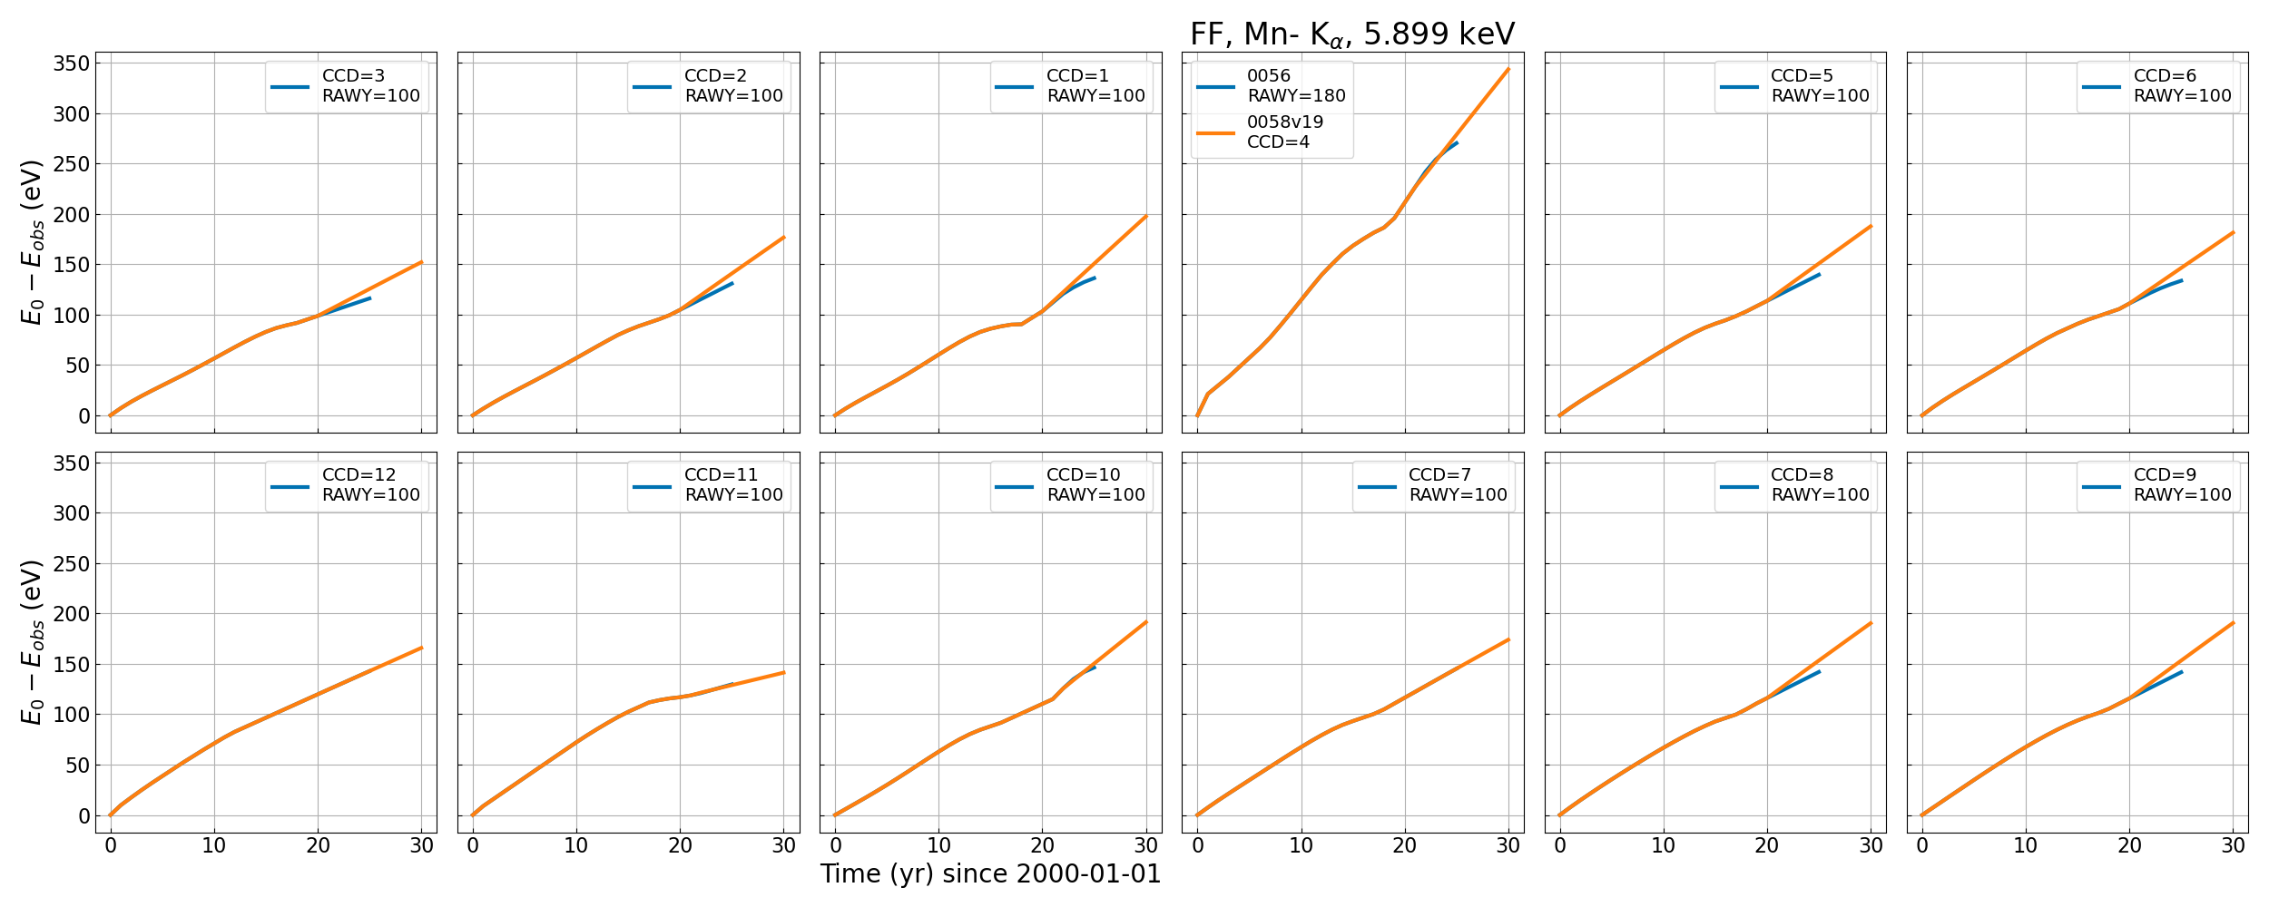
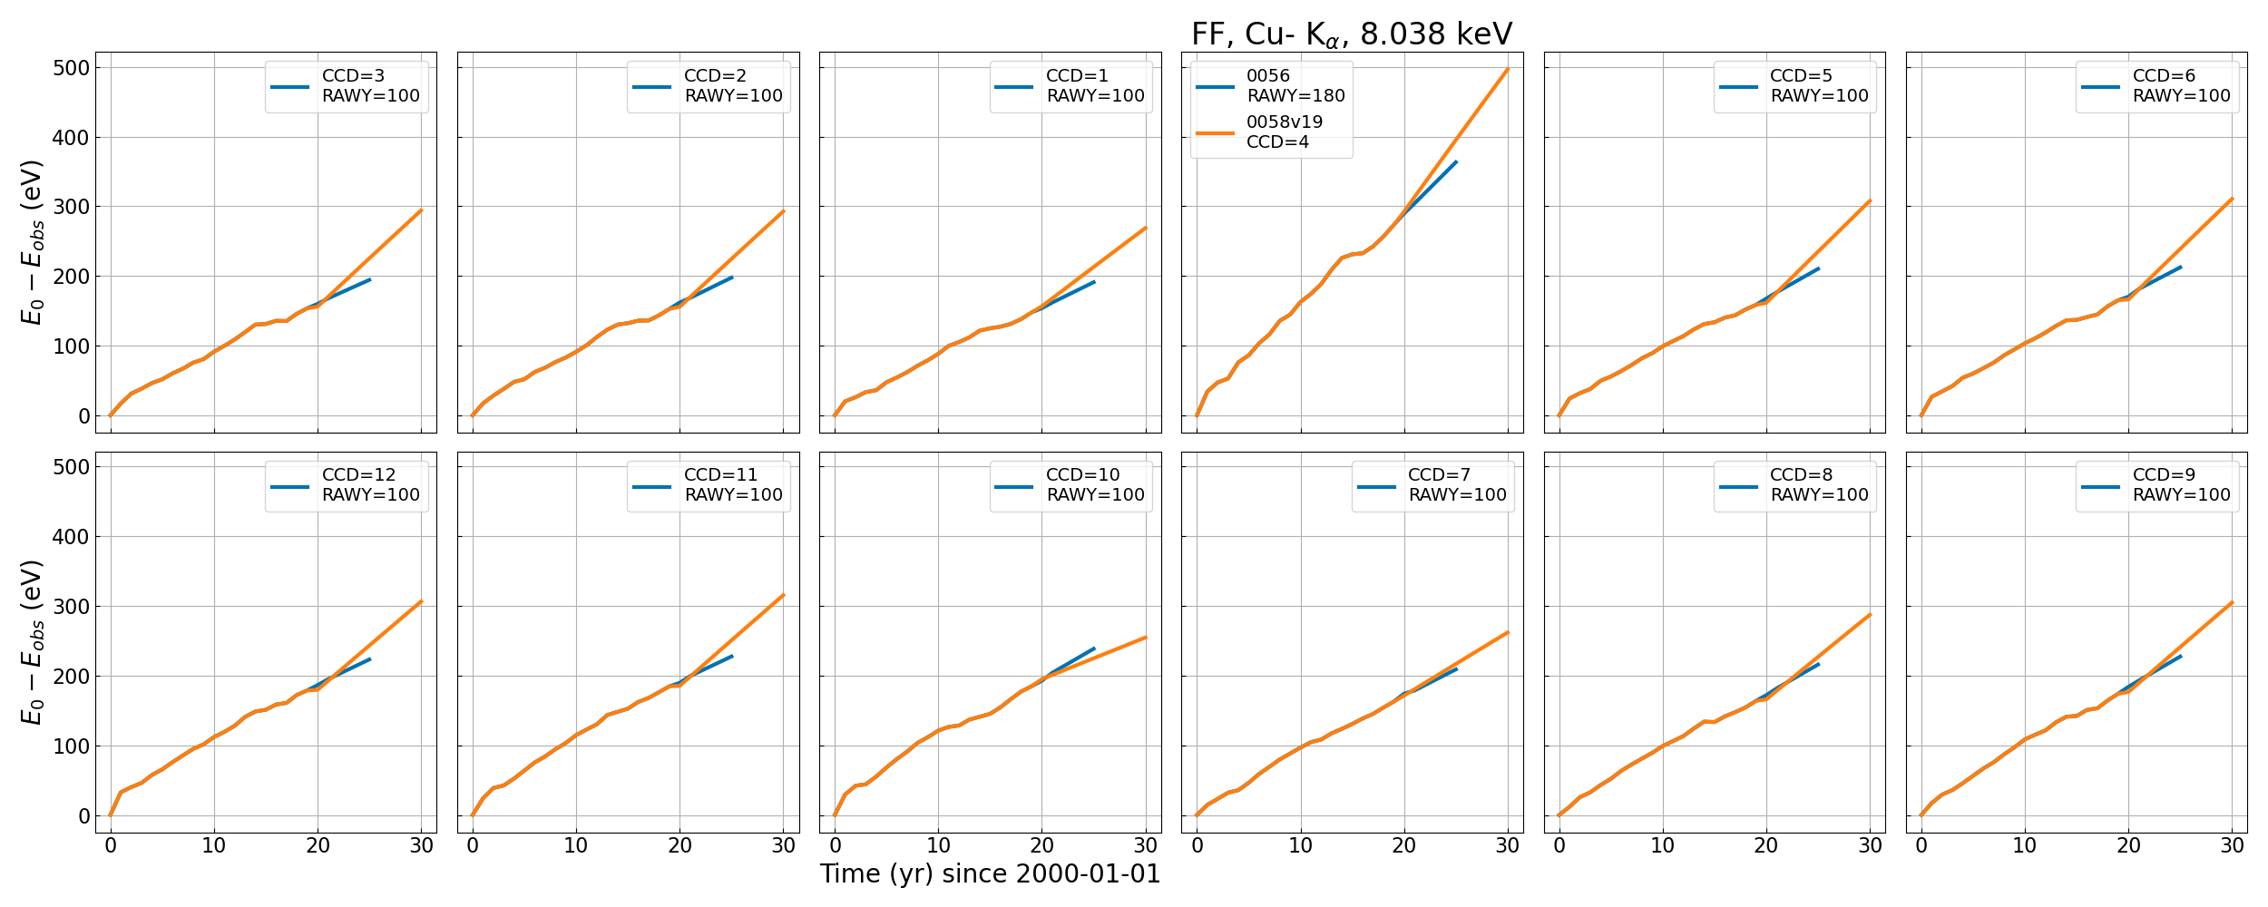
Empirical updates for t>18 yr, FF mode
FF, Mn K⍺
FF, Cu K⍺

Slide 6
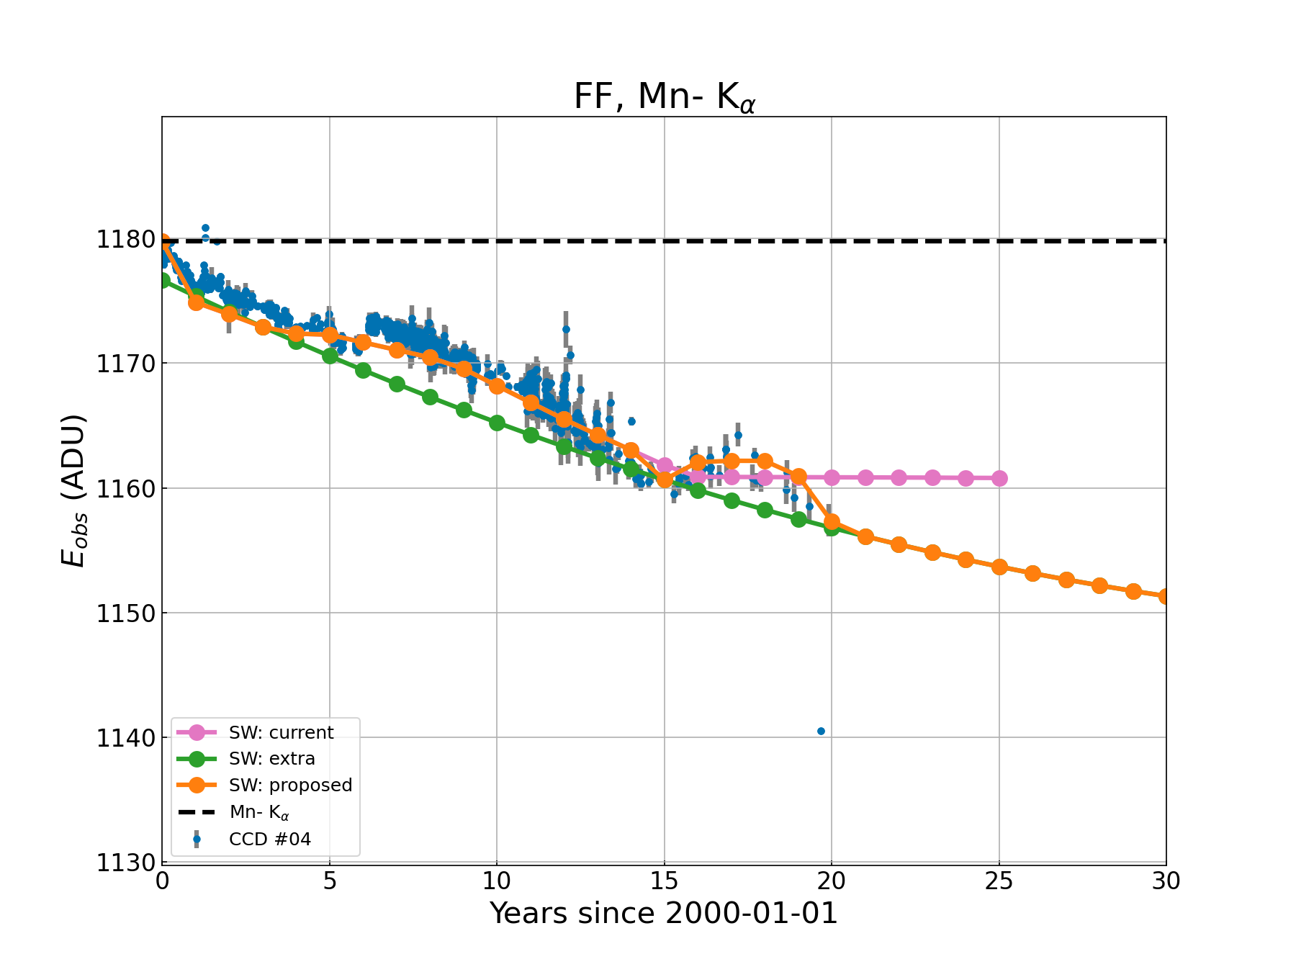
For SW and LW mode
No QPB correction available in LW and SW mode
Using FF CalClosed with no LTCTI and no QPB
Poly(2) on solar minima
Residual as smooth spline
Keep the residual for each CCD and line
Will use the residual shape for LW and SW mode
Applicable to Al K⍺, Mn K⍺ and Cu K⍺
Update for t>18 yr (in general)

Slide 7
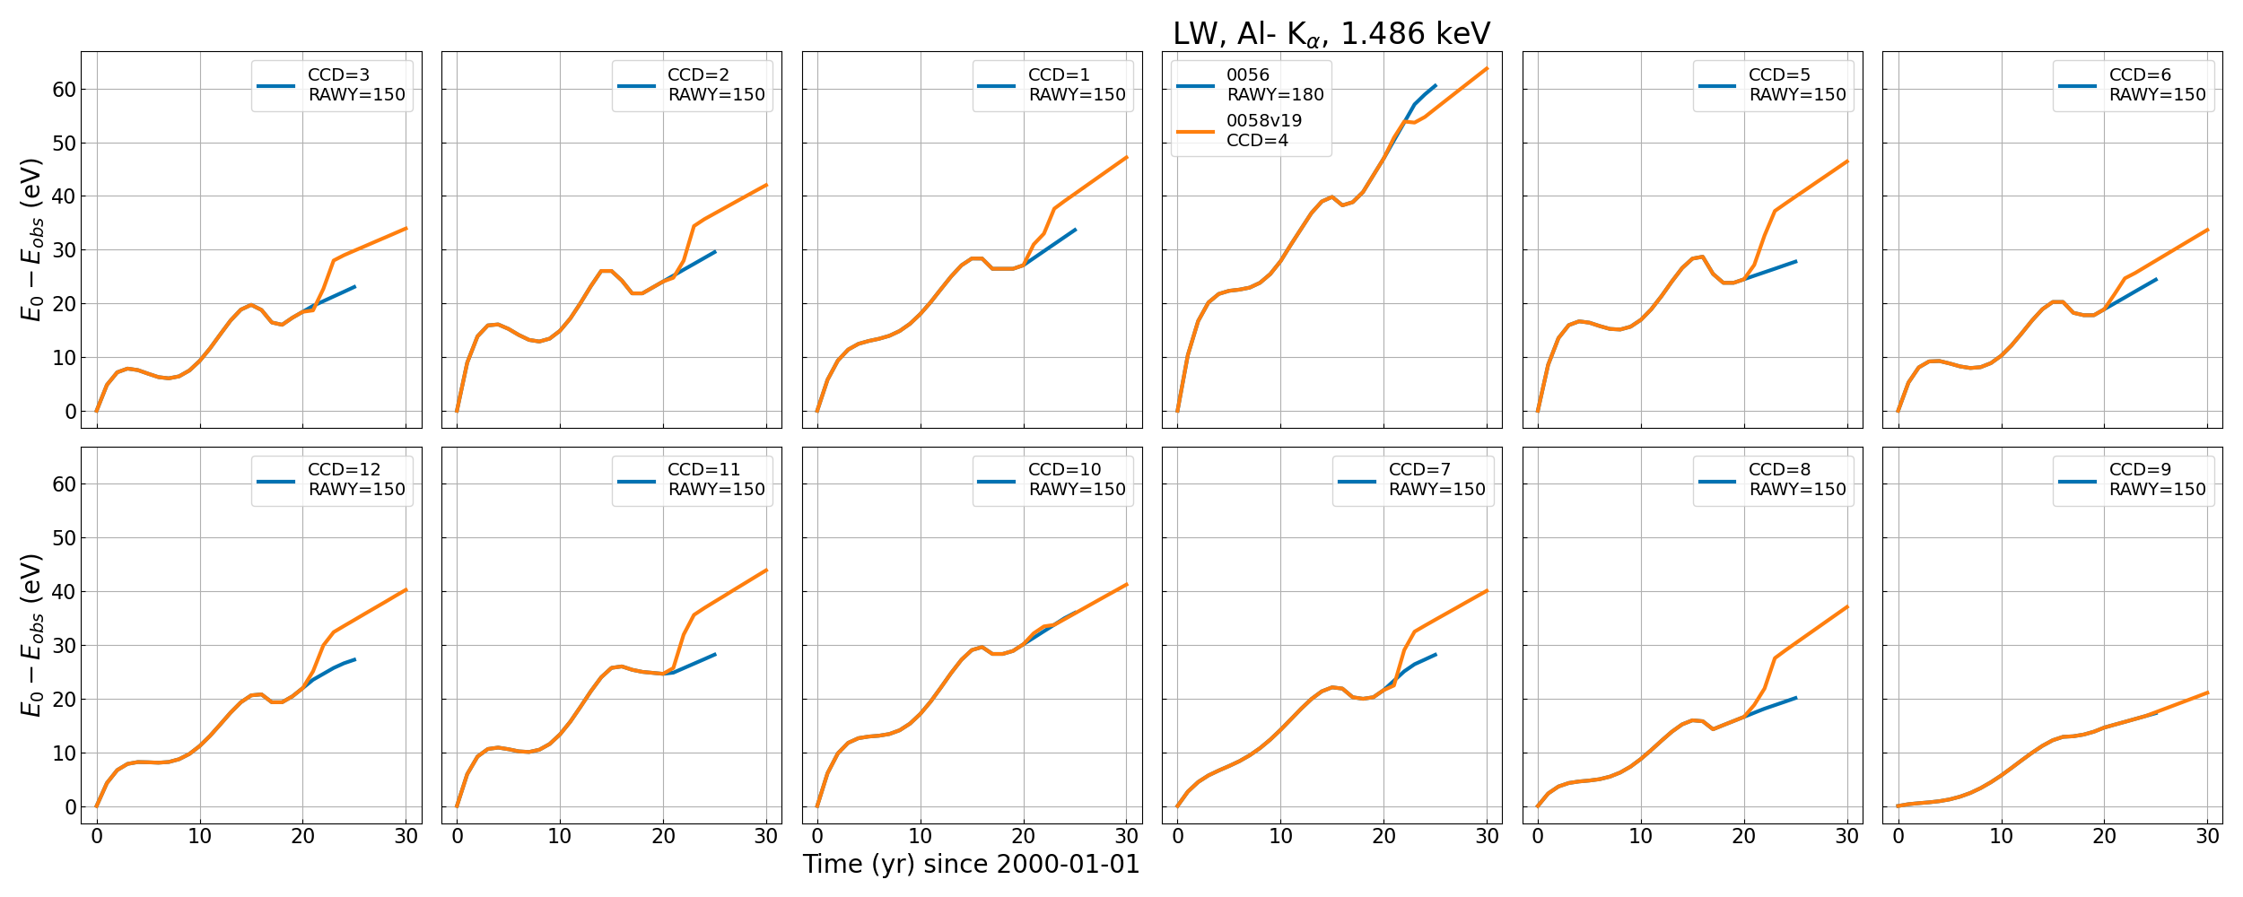
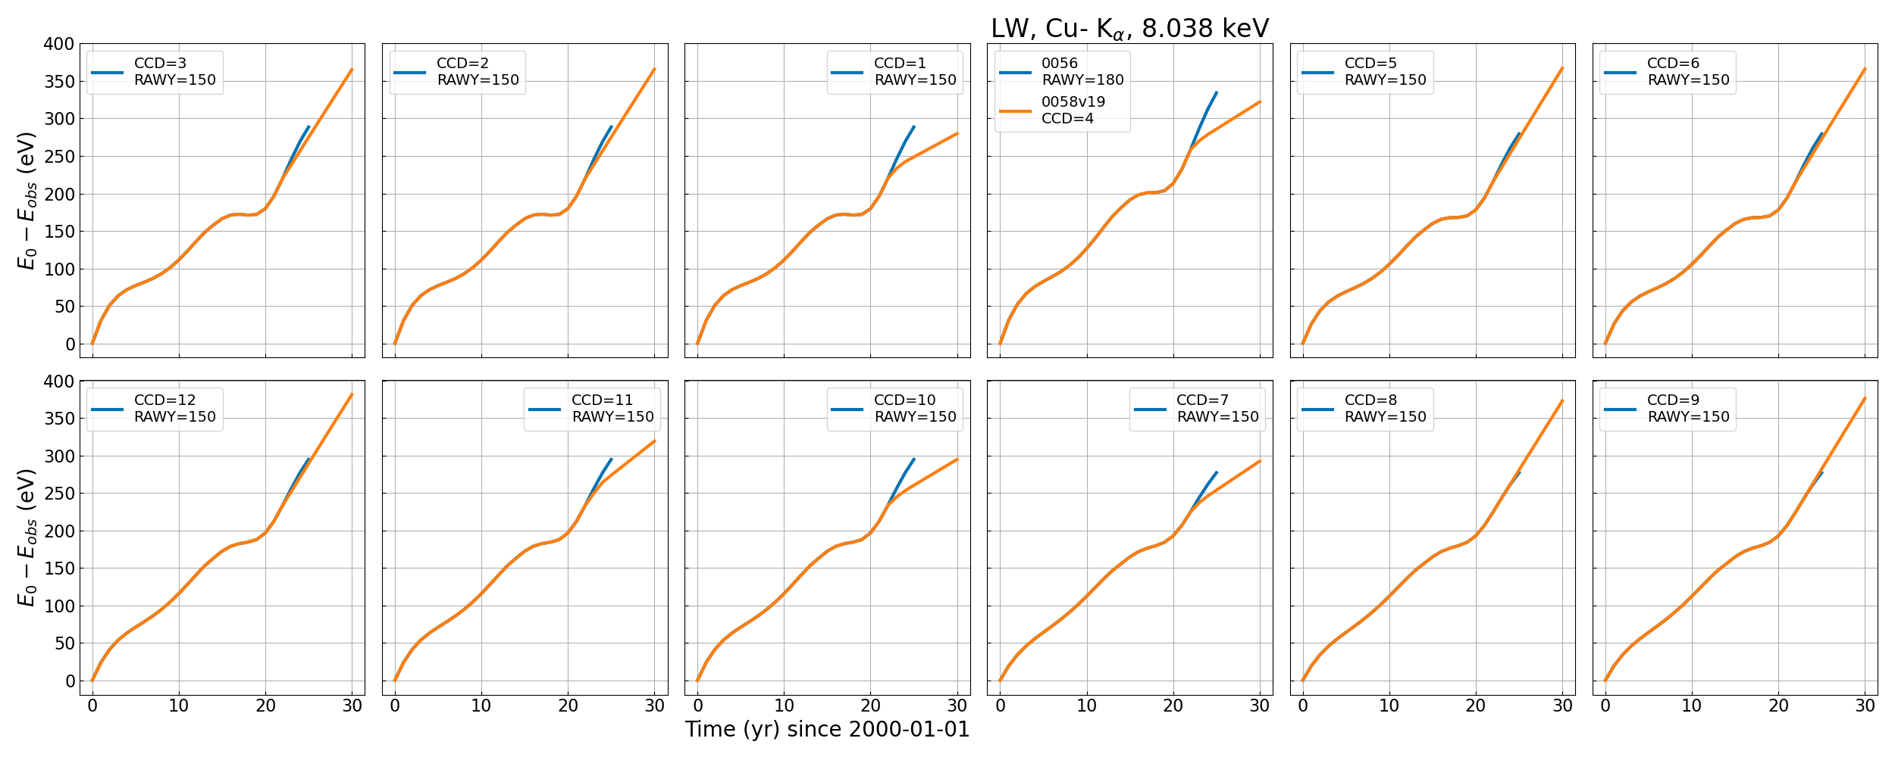
Updated curves for LW mode
LW, Al K⍺
LW, Cu K⍺

Slide 8
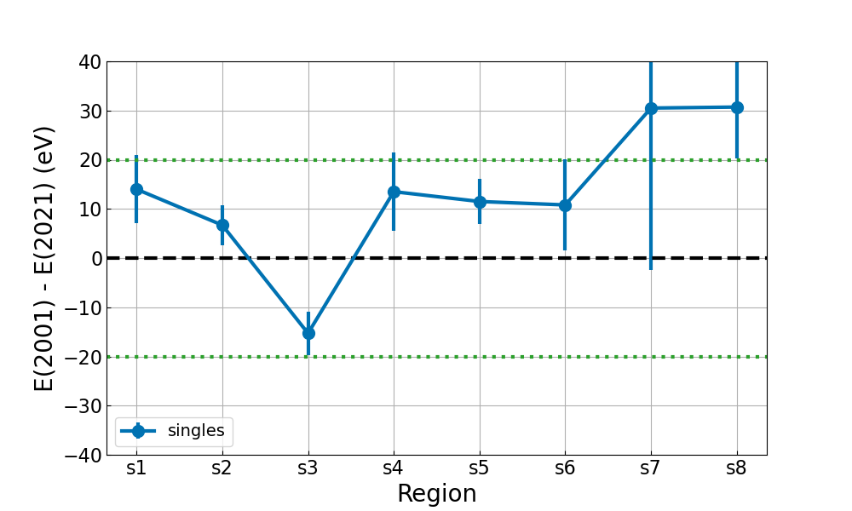
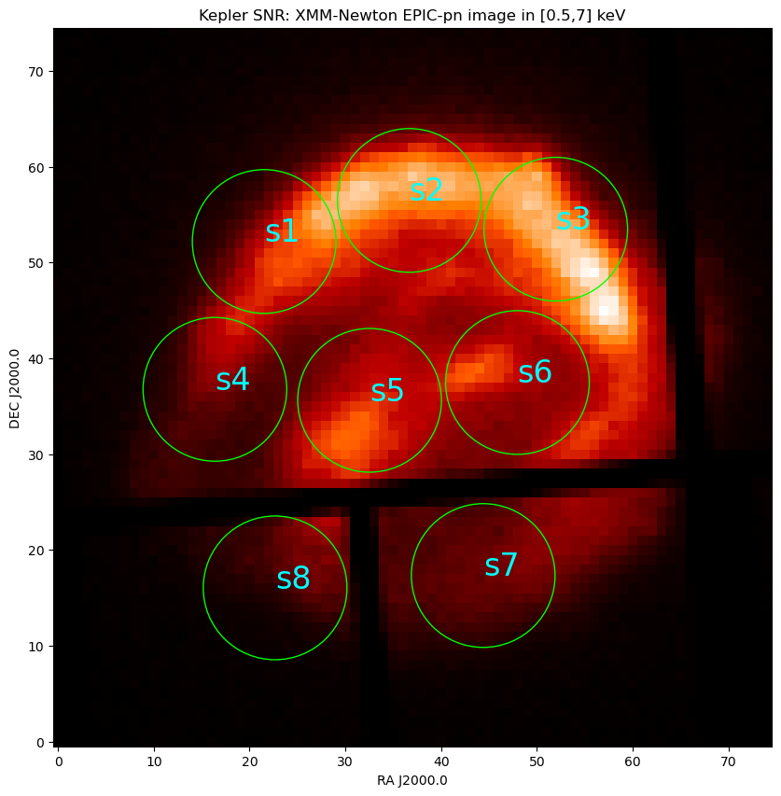
Validate LW at 6.4 keV with Kepler SNR
Fe K⍺ line, per region
Notes:
In terms of percentage: +/- 20 eV at 6400 eV is +/- 0.3%

Slide 9
Small Window (SW) change of strategy

Slide 10
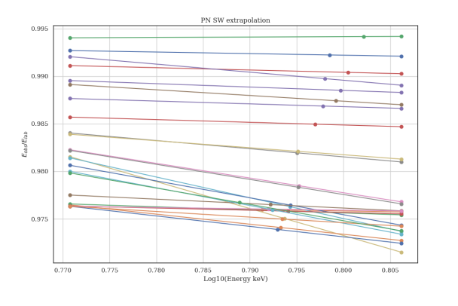
Previously, using ~10 AGNs with narrow Fe K⍺ lines
  Extrapolation to a common reference energy 6.4 keV, sources at different redshifts ➔ lines at different energies
Mn K⍺
Redshifted Fe K⍺ lines
6 keV
6.4 keV

Slide 11
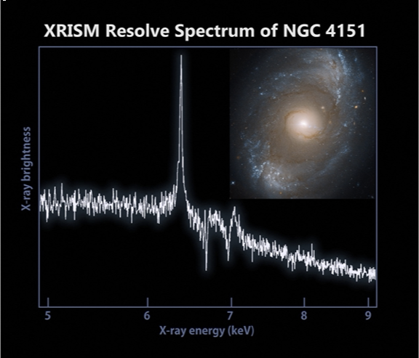
SW at 6.4 keV, using NGC 4151
In this update: using only NGC4151, to avoid extrapolation
  Several observations, most recent one at t=22.96 yr
  + some with Chandra HETG (XRISM too)
  Reference energy = best-fit line centroid from HETG at t=0.1 yr,
  ➔ E = 6.3752 keV
Using the Mn K⍺, SW curve and adjust to NGC4151 data
Validate with other AGN sources: NGC3516, MCG05-23-16,…

Slide 12
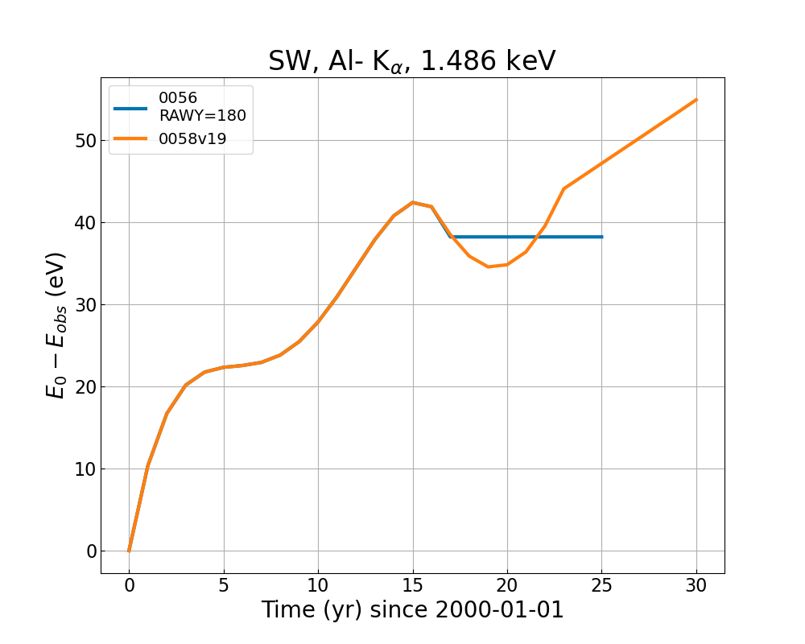
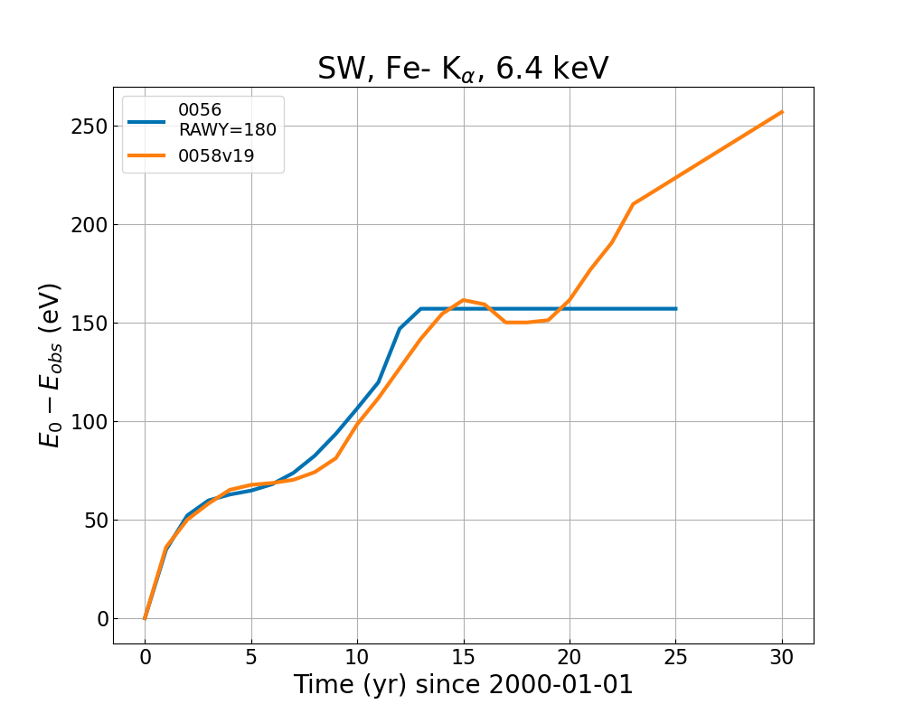
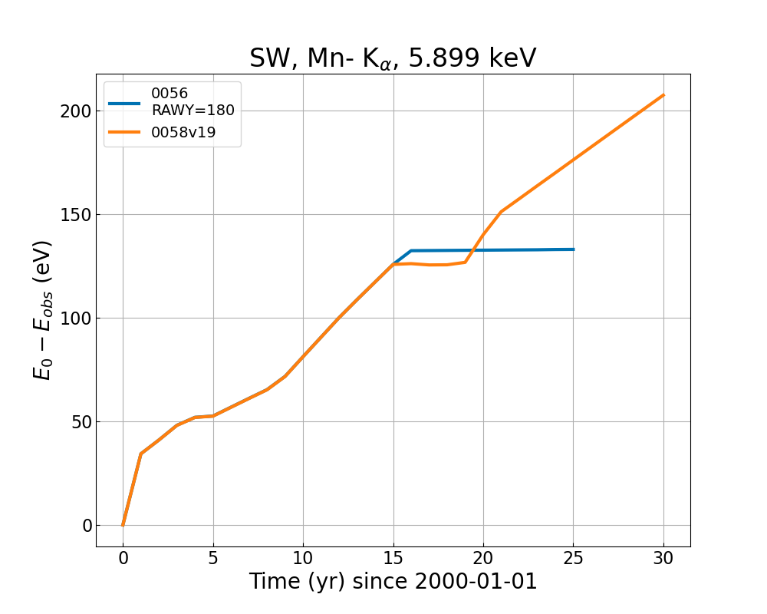
SW curve at 6.4 keV

Slide 13
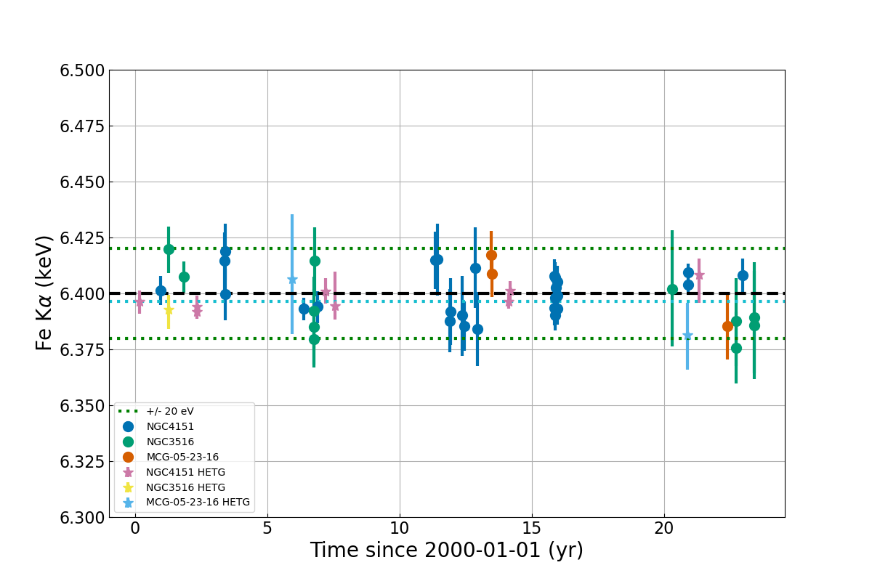
Best-fit Fe K⍺ lines for AGN sources
EPIC-pn in SW and Chandra HETG

Slide 14
Conclusions
Incremental update to all EPIC-pn modes (including TI + BU)
  Extrapolation to t=30 yr
  Change in SW modelling (only NGC4151)
  Will be used in the upcoming bulk reprocessing of the XMM archive!
Work in progress

Slide 15
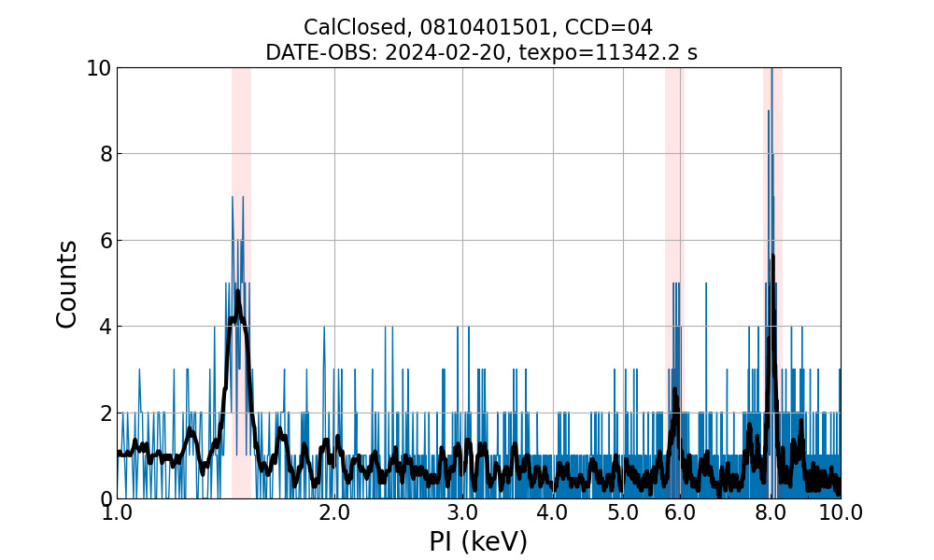
Future work
Proposal to stop serendipitous CalClosed (CC) observations (to save filter wheel movements)
➔ challenging for energy scale calibration
➔ + the weaker Fe-55 source
➔ planning of cal observation with long CCs once or twice per year? Under analysis.
Simultaneous QPB & LTCTI correction for future updates
  Using the number of discarded lines as proxy for QPB (will be available for window modes)
  Using Cu K⍺ to predict Al K⍺ and Mn K⍺ (low S/N for Cal source)
Update the spatial CTI ?

Slide 16
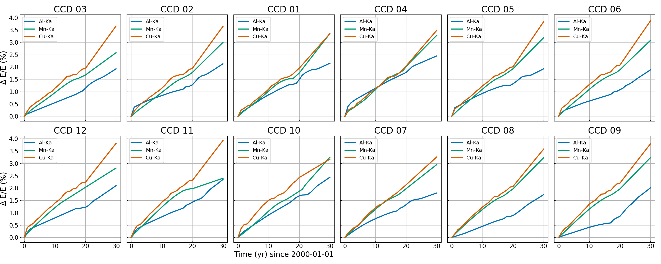
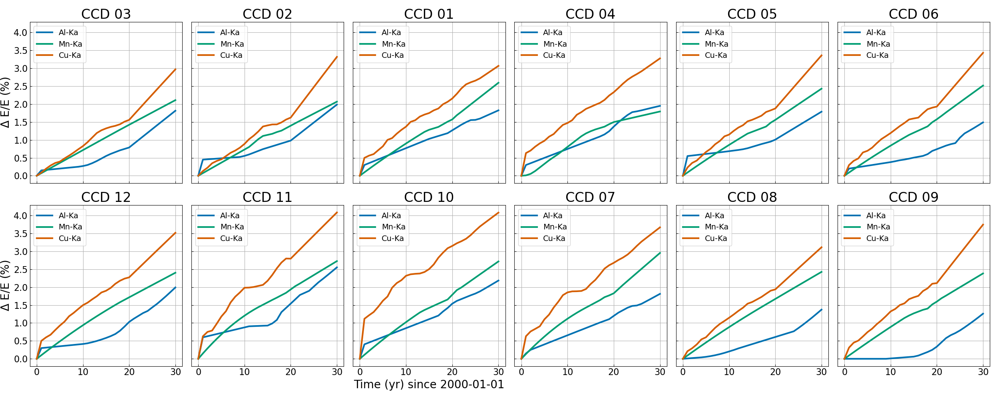
Predicted LTCTI 𝝙E/E in %
FF mode
EFF mode

Slide 17
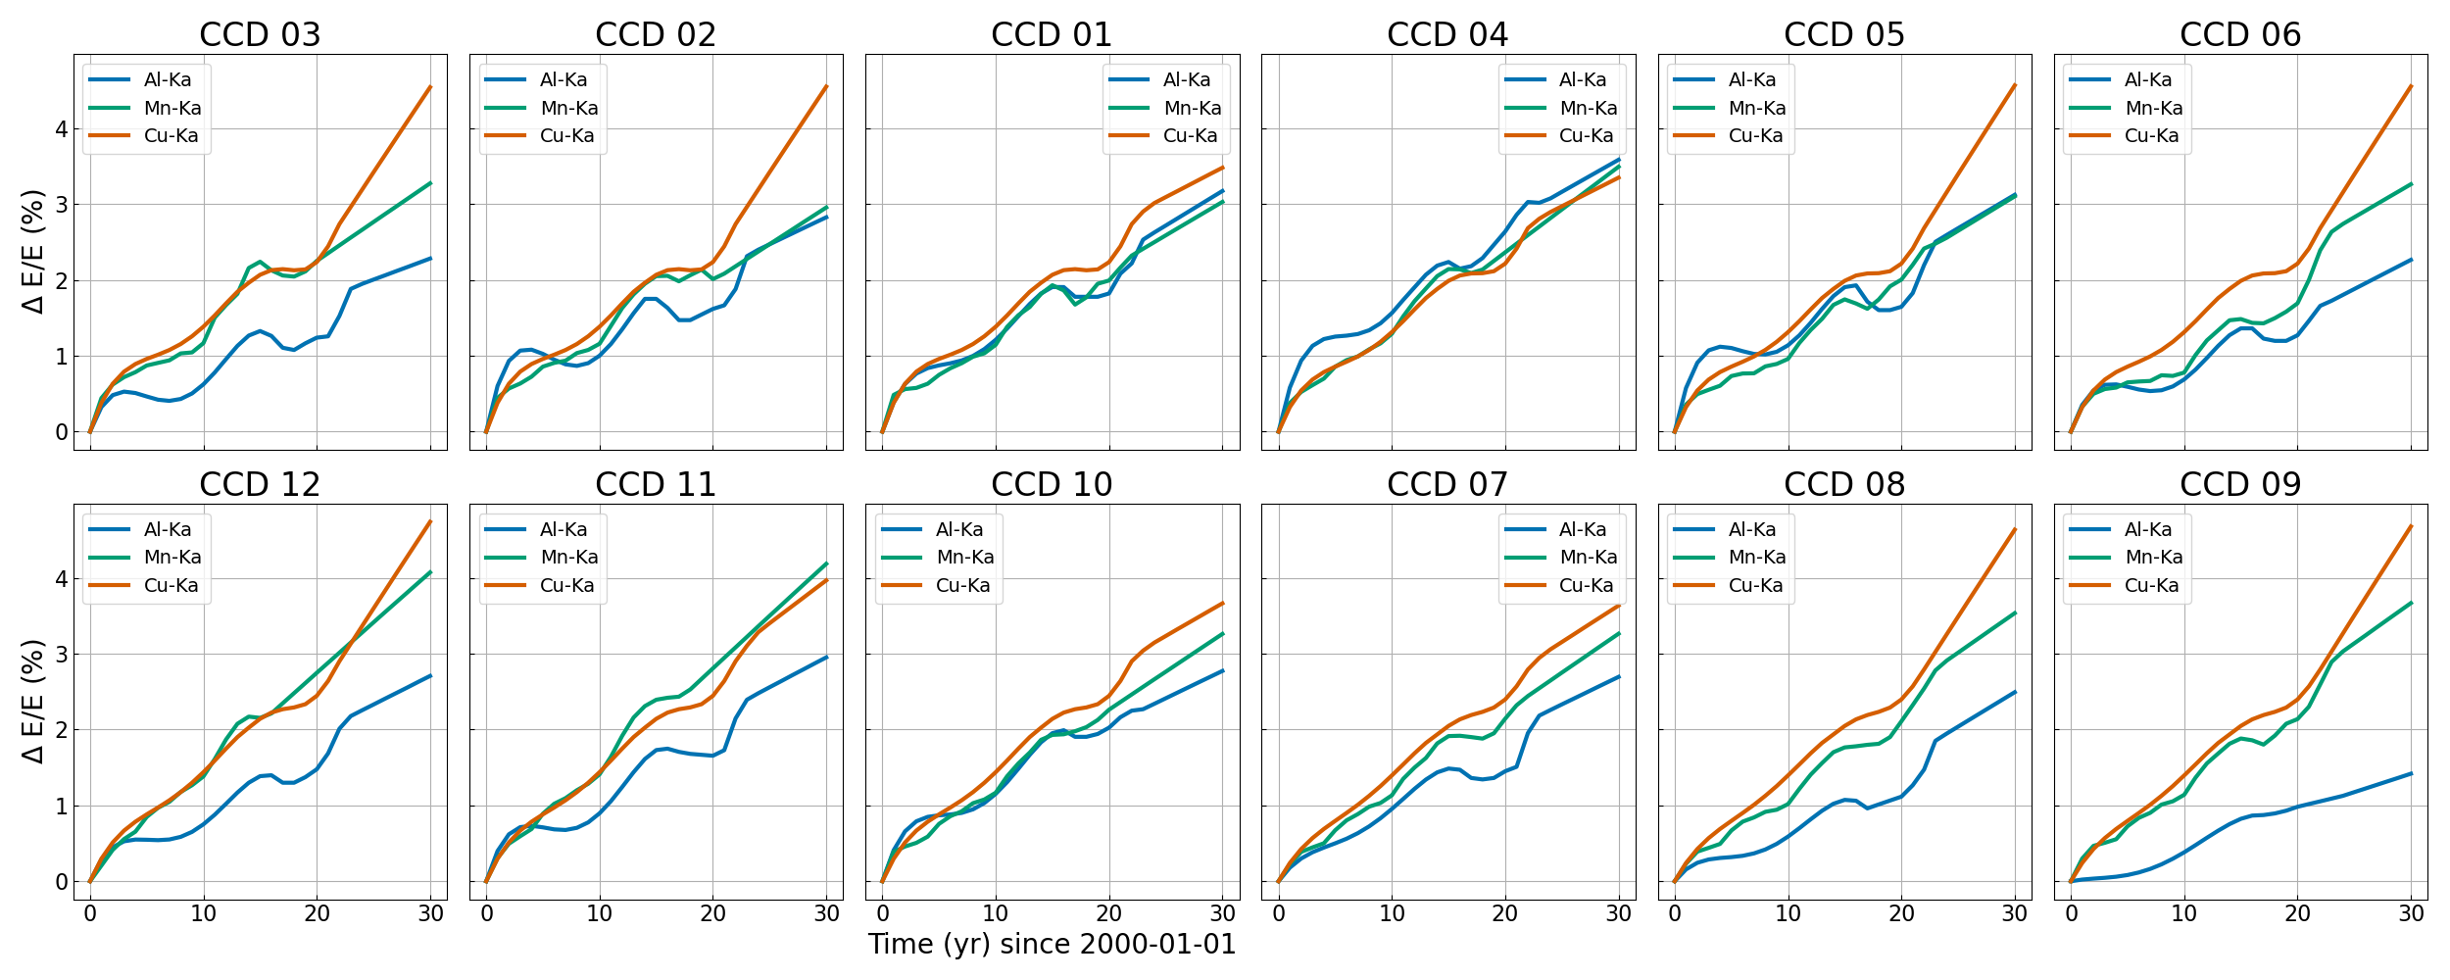
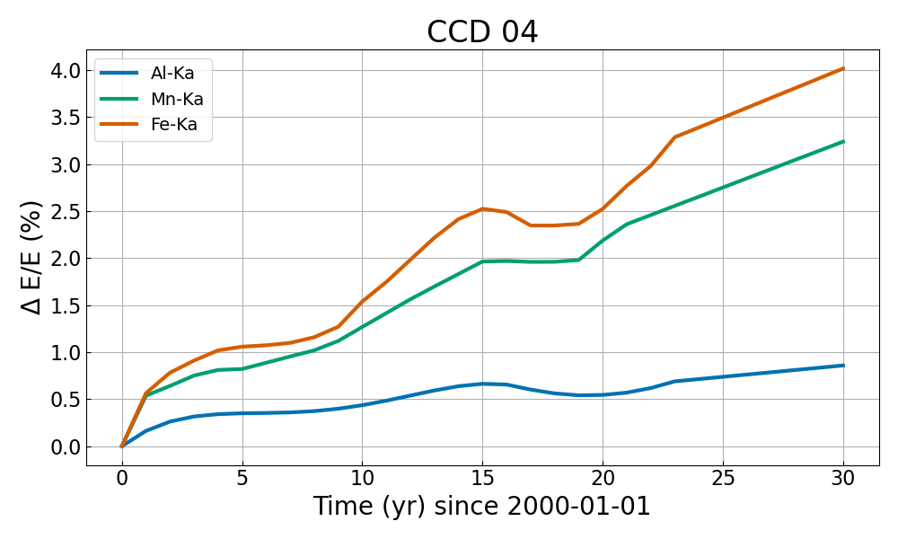
LW mode
SW mode

Slide 18
The End

Slide 19
Comparing the curves
E₀ is the correct line energy,
g(t) is the T_COEFF curve in CCF,
a₀=T_COEFF(0),
y= Distance from read-out node in RAWY in pixels.

Slide 20
Discussion
Incremental update: CCF needed for bulk reprocessing
Modelling E_{obs}/E₀ and using median RAWY in line core ➔😟
Modelling T_COEFF (median RAWY per observation) ➔ 😟
Need to understand why:
  Median RAWY in line core (±1σ) as function of time
  Normalisation a₀ ➔ in some cases it needs changing
Work in progress + simultaneous QPB & LTCTI correction
for future updates

Slide 21
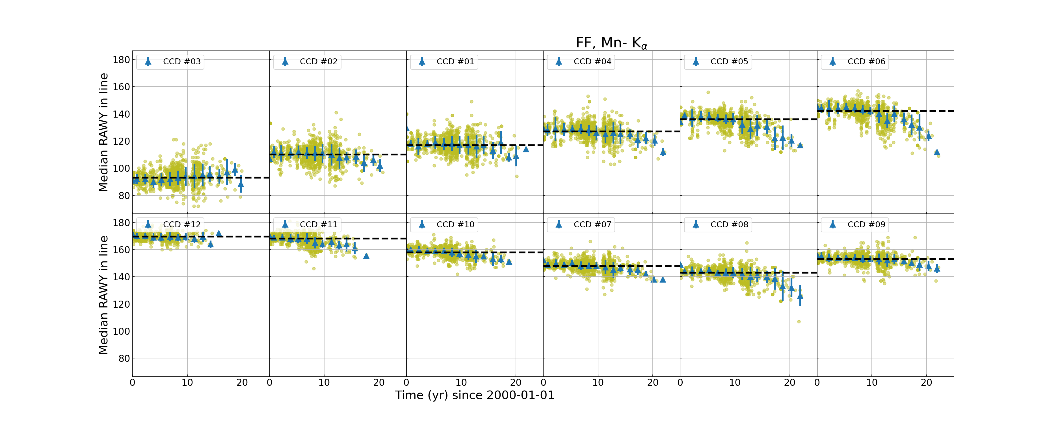
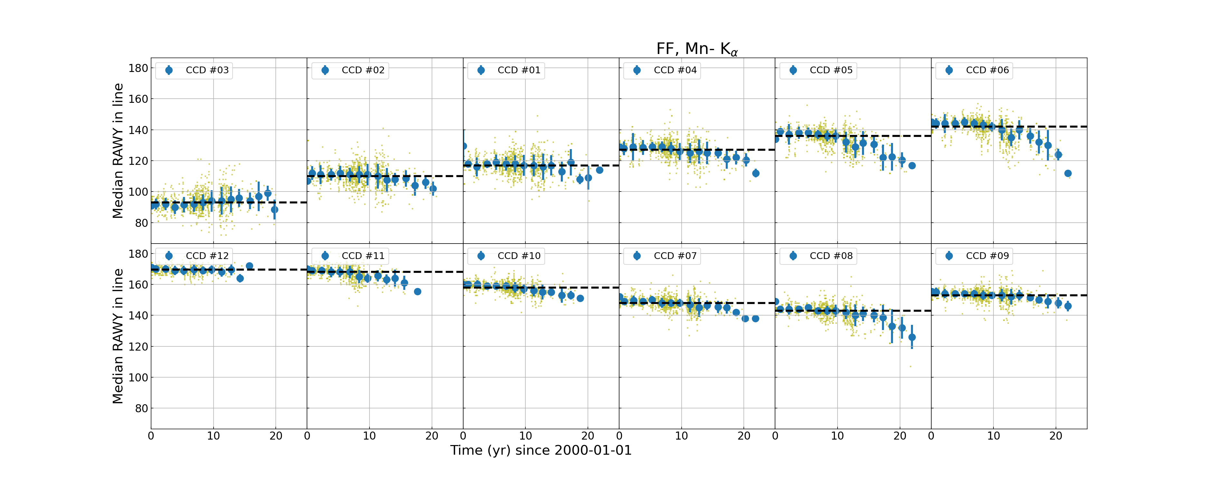
Median RAWY evolution
Time dependence
Exponential function on RAWY !
Linked to decreasing S/N?

