Slide 1
Apollo 15 (&16) X-ray instrument small step for a (wo)man…, but a giant leap for a scientist
IACHEC #16,
La Granja, Spain
Erik Kuulkers
ESTEC - European Space Agency
Notes:
In this presentation I will show you how I got involved in the Apollo project. It is about an instrument which was onboard the Apollo 15 (and 16).
Apollo 15 was launched on 26 July 1971.

Slide 2
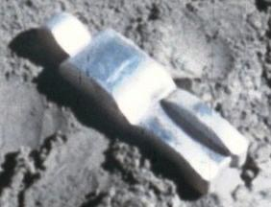
Apollo 15 highlights
First scientific ‘J’ mission (greater focus on science)
First Lunar Rover
First spacewalk (EVA) outside of Earth orbit
Hammer & Feather experiment
First work of art on the Moon
Launch: 26 July 1971
Lunar landing: 30 July 1971
Lunar lift-off: 2 August 1971
Splash-down: 7 August 1971
Notes:
Here are some highlights of the mission. It was the first scientific mission, so-called “J” mission. For the first time there was a greater focus on science to be done. Launch was 26 July 1971; the lunar landing was on 30 July, lunar lift-off on 2 August; they were back on Earth on 7 August.
It also had the first lunar rover onboard. They drove in total about 28 km on the Moon.
Al Worden performed the first spacewalk outside of the Earth orbit, on their way back from the Moon.
Dave Scott tested out Galileo Galilei’s couple of hundred years old theory that all objects in vacuum fall at the same speed, by dropping a hammer and a feather on the Moon.
It was also the first time a piece of art was put on the Moon.

Slide 3
X-rays from the Moon
Schmitt et al. 1991, Nature 349, 583
Notes:
Here is how the Moon emits X-rays. The Moon has no atmosphere, so when the X-rays from the Sun bombard the Moon, they interact with the Moon’s surface. Part of the Sun’s X-rays are reflected back, but another part is emitted at specific wavelengths by distinct material / elements near the surface; the latter is called fluorescent emission. With a spacecraft above the surface you can then map the X-ray emission. Here I show you how the Moon looks like in X-rays, taken by an X-ray imager onboard the German satellite ROSAT.

Slide 4
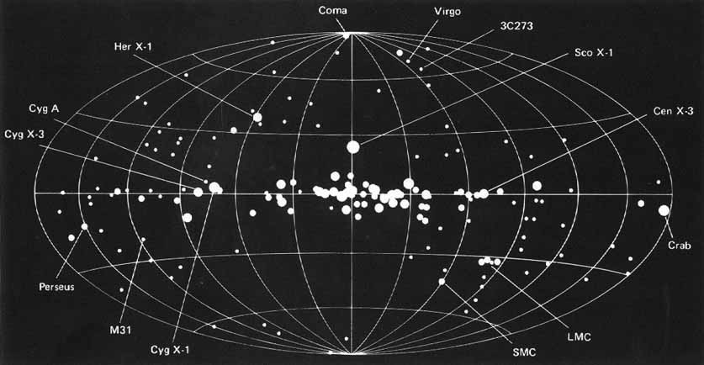
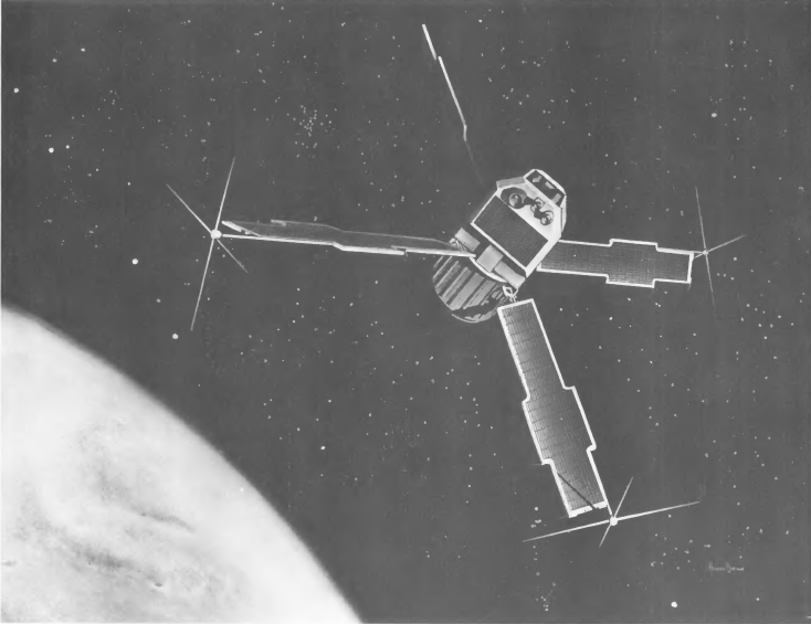
X-rays from space
Forman et al. (1978)
Notes:
This is a map of the X-ray universe and shows all the X-ray sources detected by UHURU.
So, by early 1971 many X-ray stars were known. An X-ray instrument in space was thus ideal to study the Moon AND the X-ray universe.

Slide 5
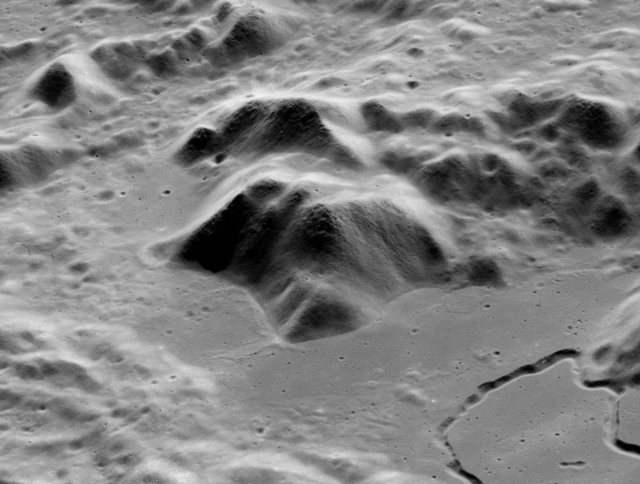
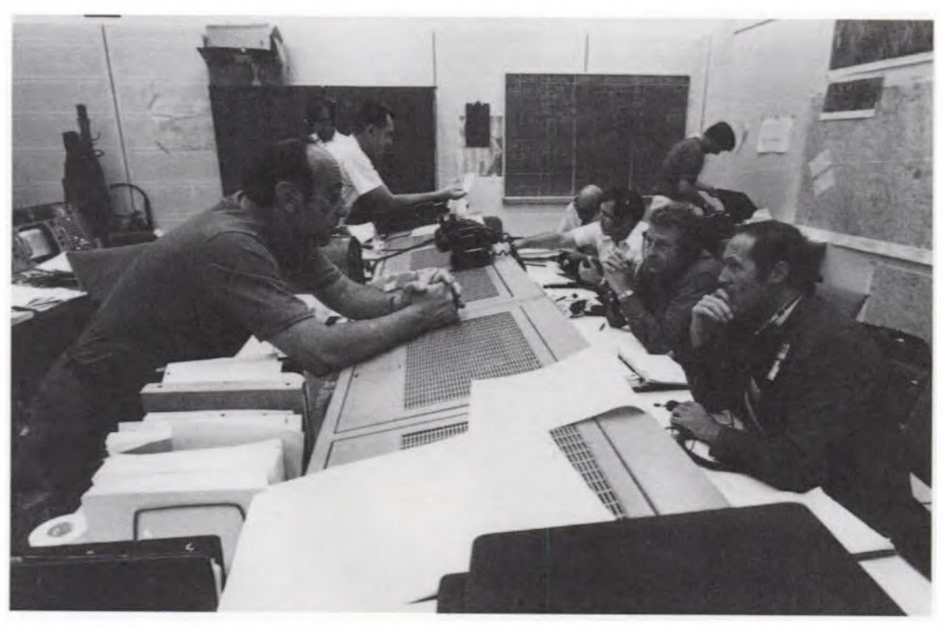
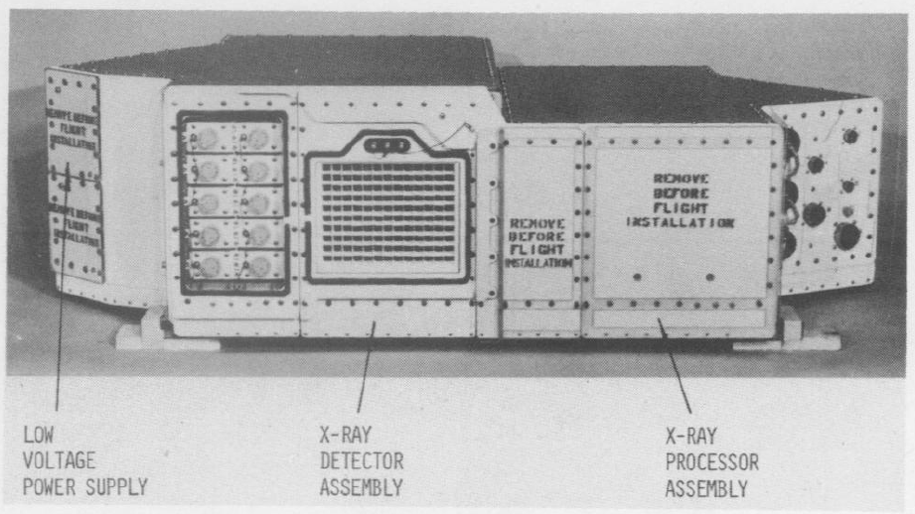
X-ray Fluorescence Spectrometer
Build by American Space and Engineering (AS&E), Cambridge, MA. Principal investigator: Isidore Adler (NASA/GSFC)
Isidore Adler
X-ray Fluorescence Spectrometer flight assembly
Mission Operations Orbital Science Support Room
Jagoda, N., et al. 1974
D.A. Beattie, “Taking Science To The Moon”, 2001
NASA S71-43255
Notes:
The X-ray instrument selected was the X-ray Fluoresence Spectrometer. It was build by American Science and Engenieering (by the same group who discovered the first extra-Solar X-ray source). The principal investigator was Isadore Adler from NASA’s Goddard Space Flight Center. Isadore passed away in 1990.

Slide 6
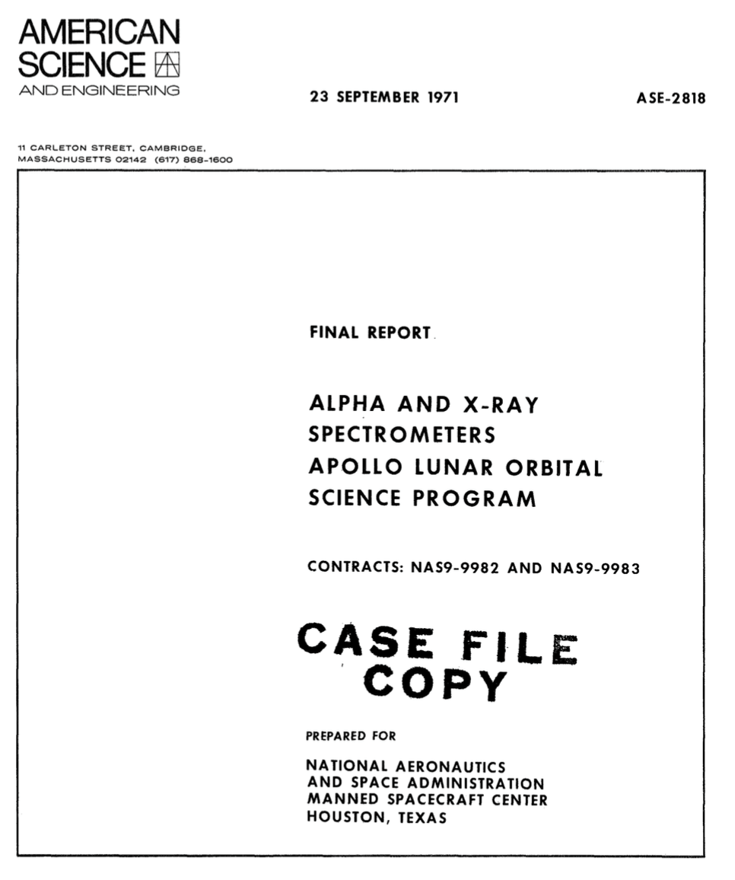
X-ray Fluorescence Spectrometer
6 units were manufactured by AS&E:
Flight Units #1 and #2 were send to KSC for integration into the SIM-bay of Apollo 15 & 16.
Nr. | Unit | delivered
1 | Mockup | November 1969
2 | Mass Mockup | February 1970
3 | Prototype Unit | June 1970
4 | Flight Unit #1 | Dec 1970-Apr 1971
5 | Flight Unit #2 | Jan-May 1971
6 | Qualification Unit | November 1970
Total costs (Nov 1969 -- May 1972): $5.5 M
Notes:
Within 2 years after selection, 6 units were manufactured. A mockup, a mass mockup, a prototype unit, 2 flight units which were used onboard Apollo 15 and 16, and a qualification unit.
The total cost of the project was 5.5 Million dollars.

Slide 7
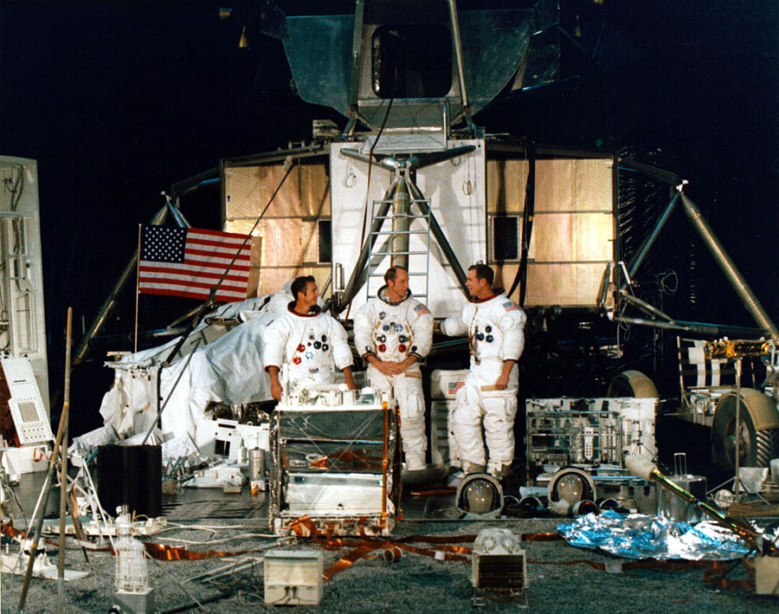
“Where is Waldo?”
ap15-S71-21324
Notes:
Here is a picture before launch of the Apollo 15 crew with all the equipment used. Spot the X-ray spectrometer!
It is loosely stand at the left…

Slide 8
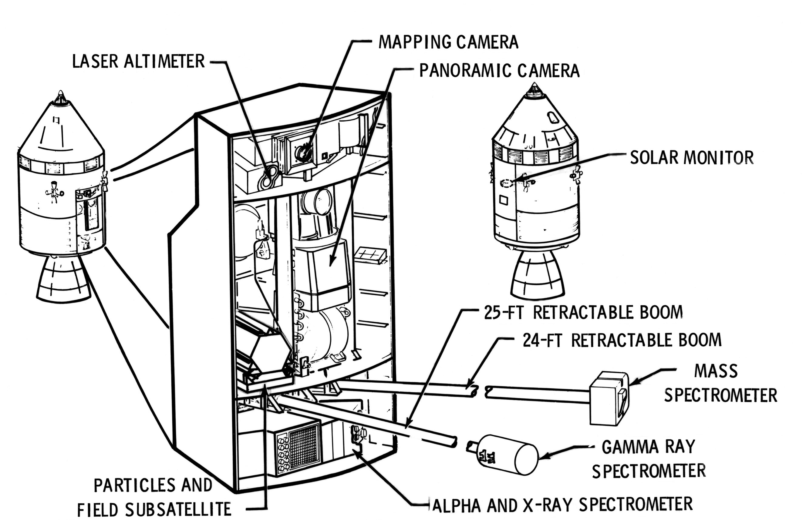
CSM - Scientific Instrument Module – SIM-bay
Geochemistry package:
Mass spectrometer
Gamma-ray Spectrometer
Alpha-particle Spectrometer
X-ray Fluorescence Spectrometer
+ Solar Monitor
Notes:
The X-ray spectrometer was part of the so-called geochemistry package. That package was put within the Scientific Instrument Bay on one side of the Command Service Module. At the opposite side was also a Solar X-ray Monitor. So, when the X-ray spectrometer was observing the Moon, the Solar Monitor was recording the Sun’s X-rays.
Note that there were also optical camera’s in the bay which took high-resolution pictures of the Moon, as well as a laser altimeter.

Slide 9
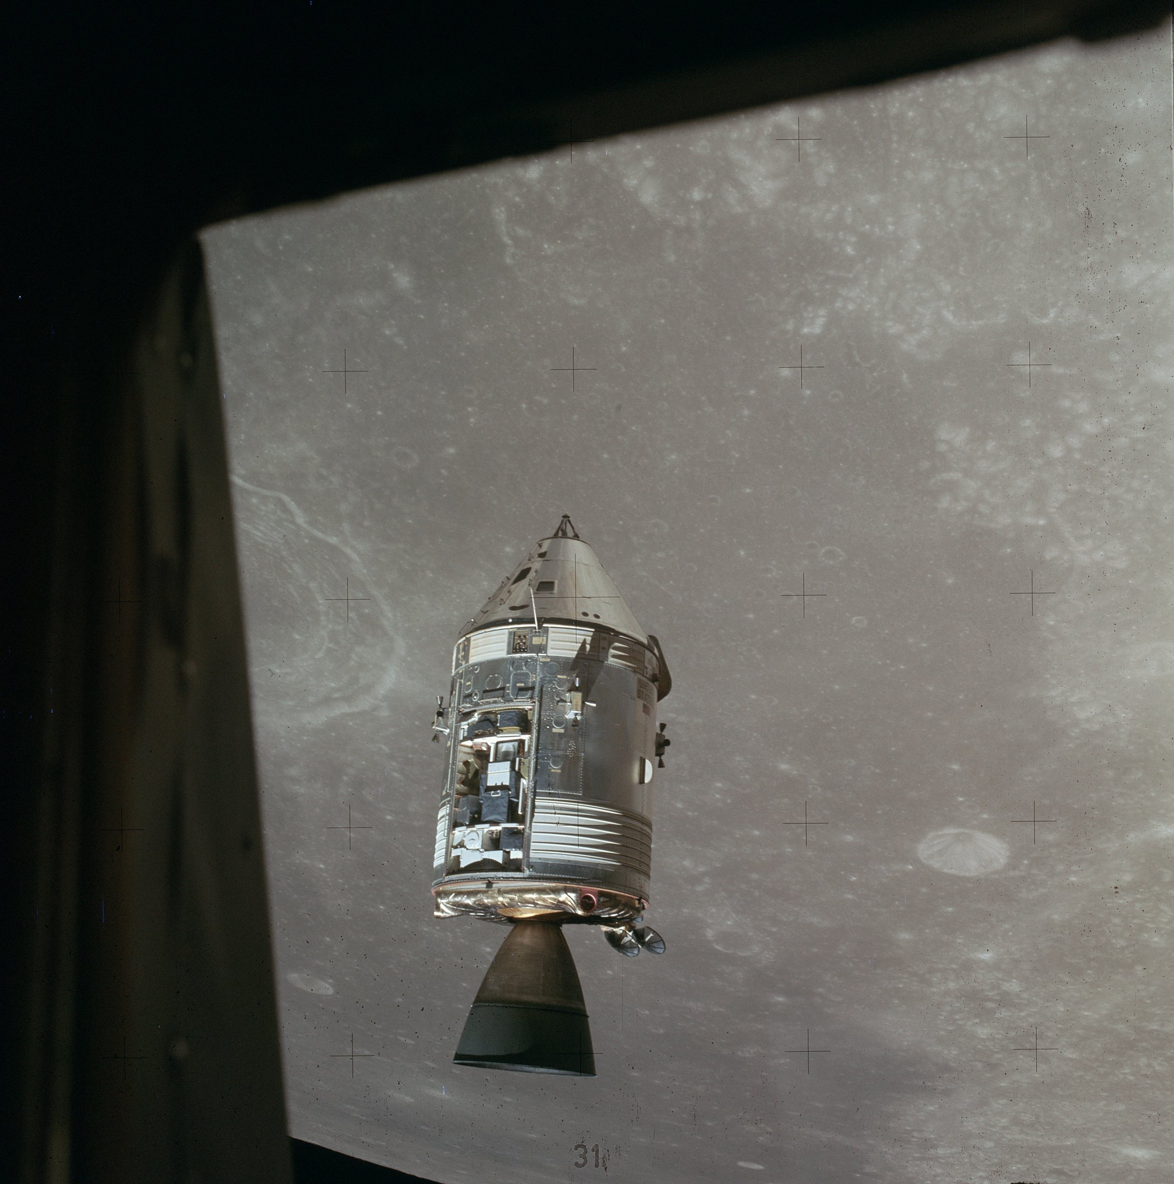
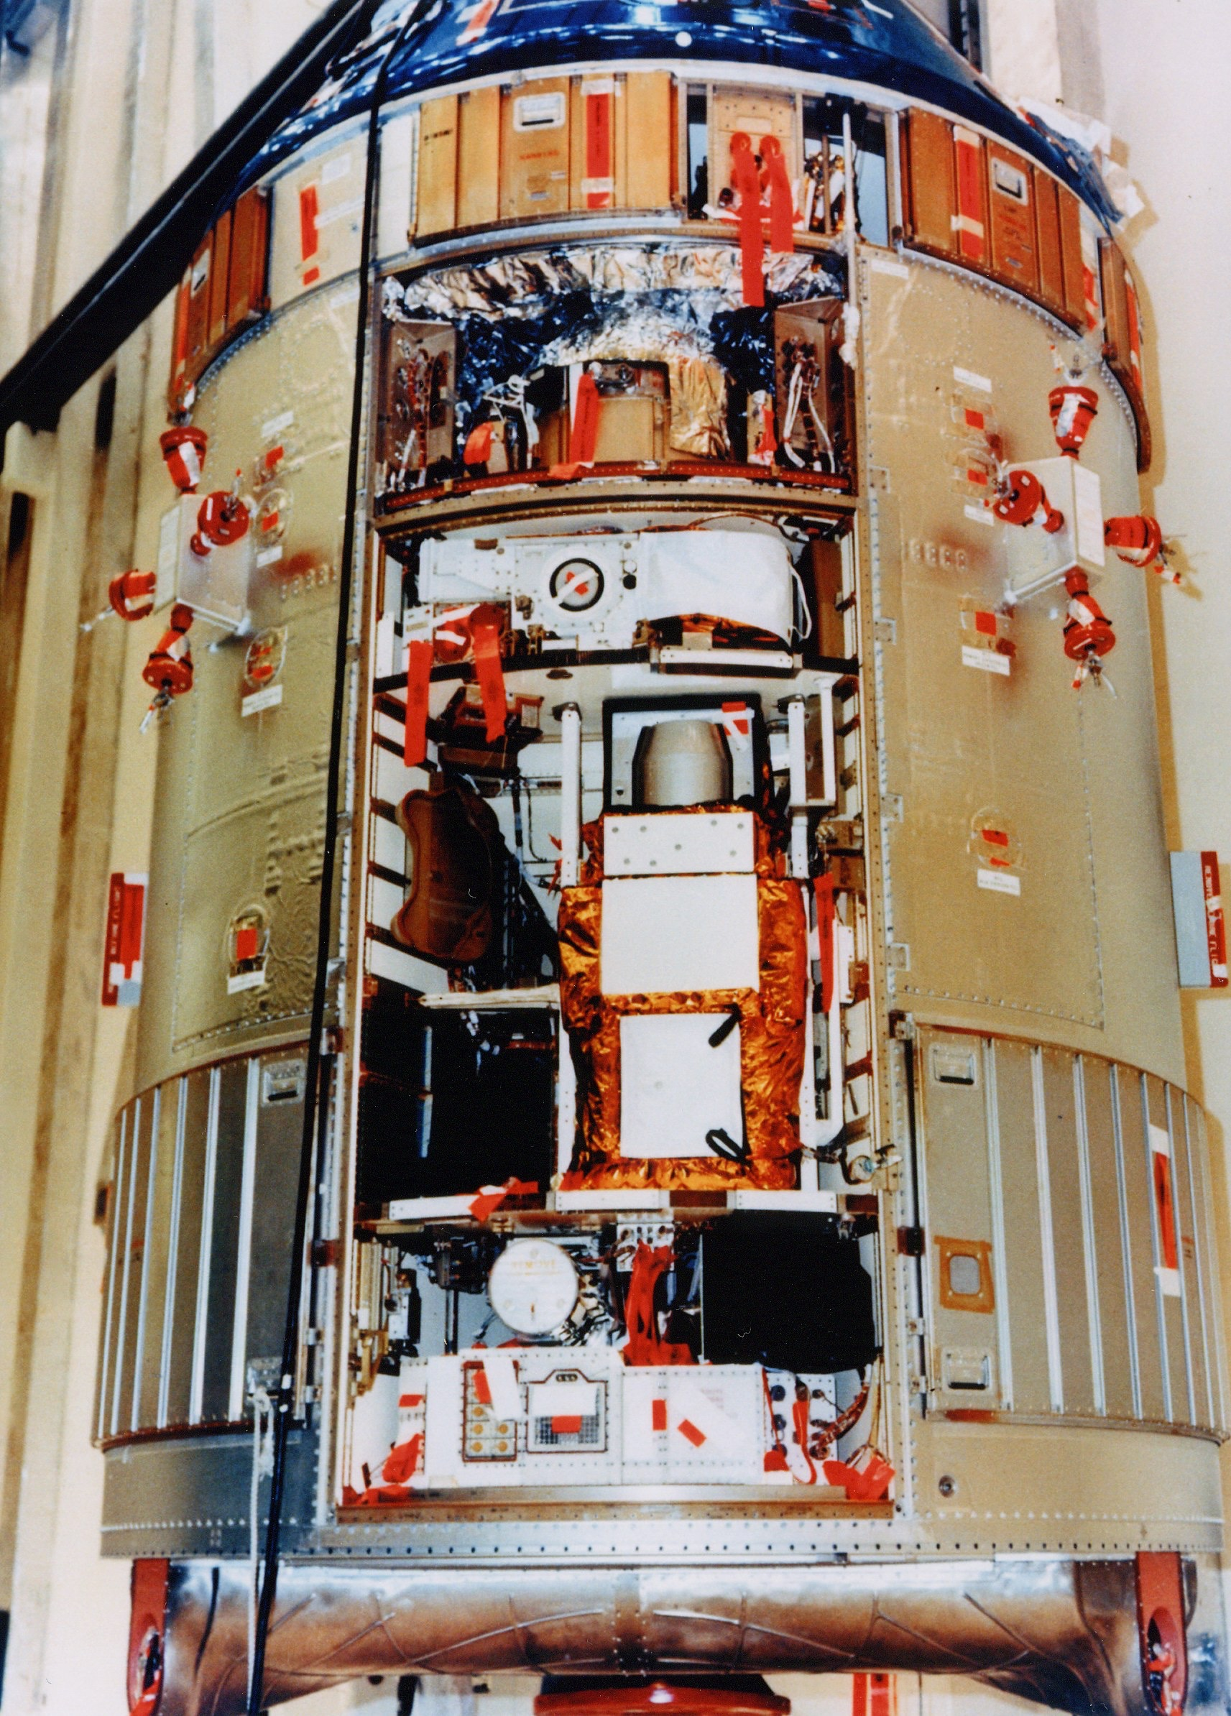
ap15-S71-2250
30 July 1971
crater Taruntius
AS15-88-11971
Notes:
Here is the SIM-Bay with all the scientific instruments integrated, at the Kennedy Space Center, before launch.
At right you see the Command Service Module at the time the Lunar Module was going to the Moon’s surface. The SIM-bay doors has been removed, and you can see the white covers on the geochemistry package.

Slide 10
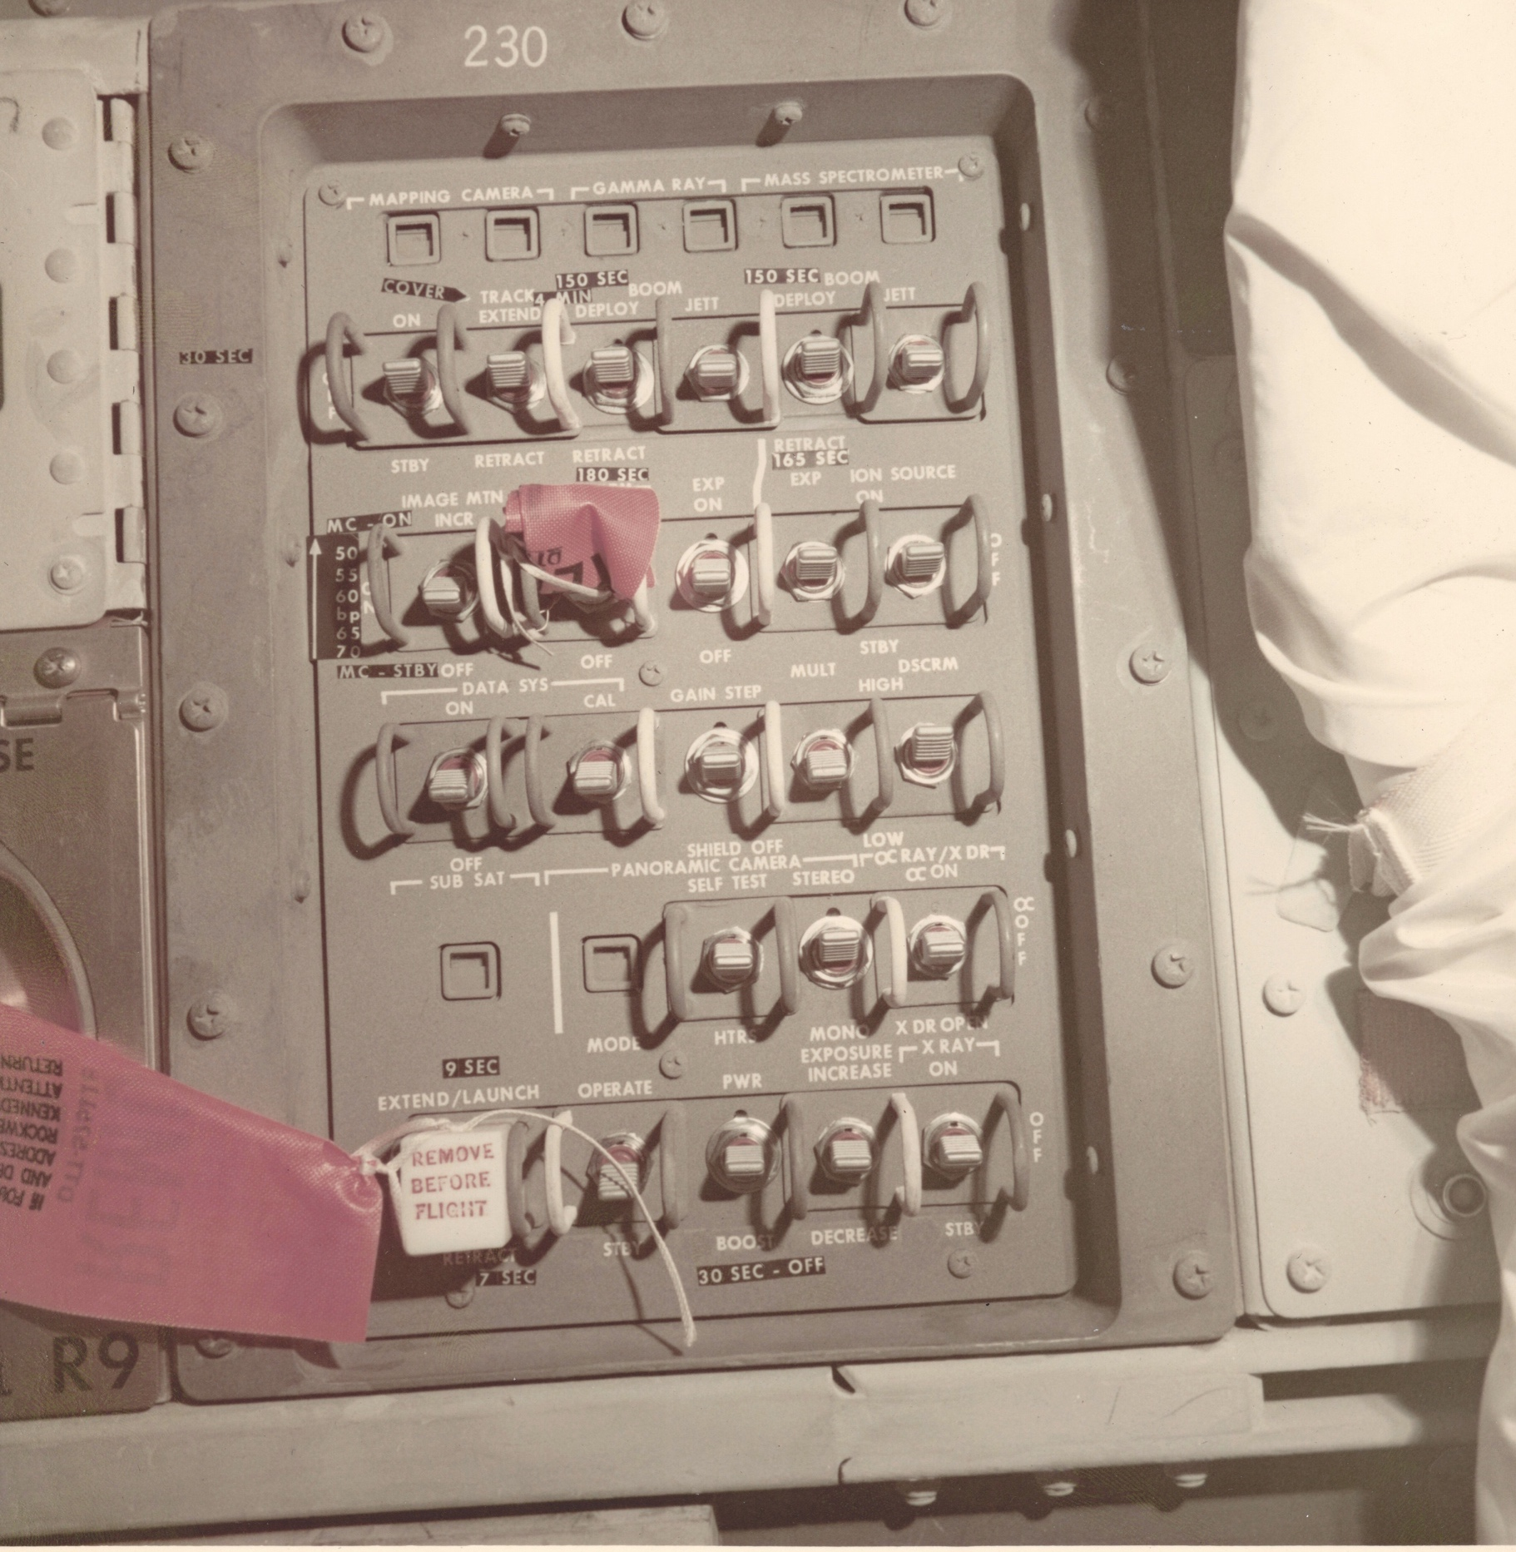
SIM-bay control panel 230
(lower instrument bay of CSM)
credit: Mike Acs
Notes:
The X-ray Spectrometer was easy to operate. Al Worden had to turn it either ”on”, “off” or “stand-by” at planned times.

Slide 11
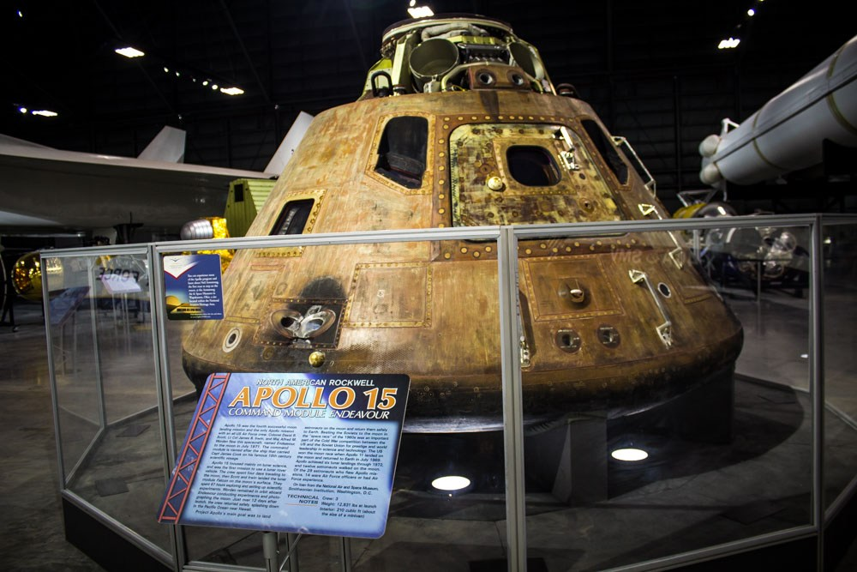
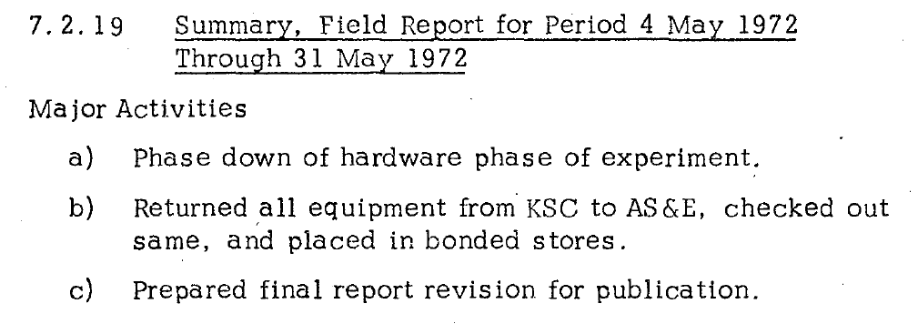
X-ray Fluorescence Spectrometer hardware
1973+: Giacconi and AS&E scientists move to Harvard-Smithsonian Center for Astrophysics (CfA). XRFS comes later, put in storage.
Command Module "Endeavor"
USAF Museum, Wright-Patterson Air Force Base, Dayton, Ohio, USA
Notes:
After Apollo 16, all equipment was returned by the end of May 1972 from Kennedy Space Center to AS&E, and reports were written. From 1973 onwards Giacconi and colleages from AS&E moved to Harvard-Smithsonian Center for Astrophysics in Cambridge, Massachusetts. The X-ray spectrometer came little later and was put in storage.
The Apollo 15 Command Module is on display in the USAF museum in Dayton, Ohio.

Slide 12
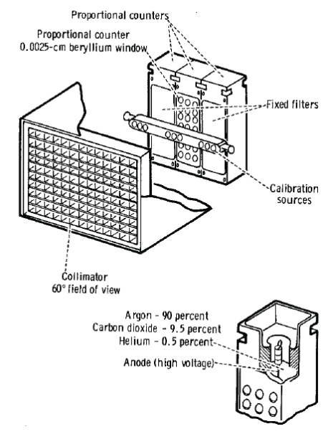
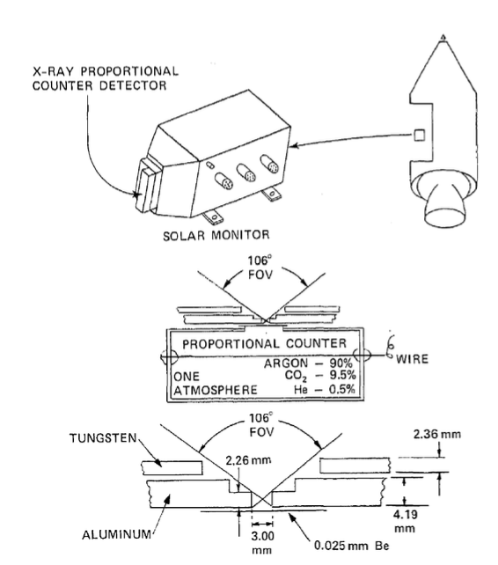
X-ray Fluorescence Spectrometer experiment - I
Adler, I., et al. 1975
From: Apollo 15 & 16 Preliminary Science Reports, 1972

Slide 13
X-ray Fluorescence Spectrometer experiment - II
X-ray detector – design same used for UHURU
Main aim: characterize Mg @1.25 keV, Si @1.5 keV & Al @1.75 keV at Moon surface & X-ray astronomy during journey Moon-Earth (”trans-Earth coast”, TEC)
Proportional counters + collimator limiting field-of-view (FOV) to ~60◦
Each counter: 25 cm^{2;} Be window; filled with 90% Ar, 9.5% CO₂, 0.5% He
In-flight calibration sources: Mn K_{α} @ 1.25 keV and Fe⁵⁵ @ 5.9 keV; rotated into FOV every 16 min for 64 sec
8-sec time resolution
7 channels covering 0.7-3 keV (every 8 hours: doubled for 2 hours)
Element lines not resolvable (~35% @ 2 keV; 18% @ 5.9 keV)
→ 3 detectors:1 with Al filter, 1 with Mg filter, 1 with no filter → energy dependent transmission characteristics allow flux ratios for Al/Si and Mg/Si
+ Solar monitor to determine incident Solar flux

Slide 14
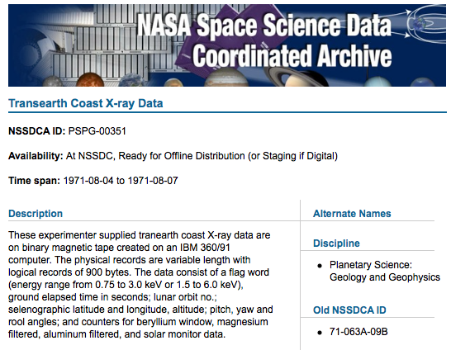
X-ray Fluorescence Spectrometer data - III
XRFS
Lunar orbit data: ASCII files @ National Space Science Data Center (NSSDC)
Count rates + Position @ 8-sec time resolution
Trans-Earth Coast (TEC) data: binary 9-track tape created on an IBM 360/91 computer at NSSDC
Count rates @ 8-sec time resolution
CSM orientation + telemetry (temperatures, voltages, etc.)
GET 222-238: time resolution is 60 sec. After that it is 600 sec…
Received June 2008

Slide 15
X-ray Fluorescence Spectrometer data - III
XRFS
Lunar orbit data: ASCII files @ National Space Science Data Center (NSSDC)
Count rates + Position @ 8-sec time resolution
Trans-Earth Coast (TEC) data: binary 9-track tape created on an IBM 360/91 computer at NSSDC
Count rates @ 8-sec time resolution
CSM orientation + telemetry (temperatures, voltages, etc.)
GET 222-238: time resolution is 60 sec. After that it is 600 sec…
Gamma-ray spectrometer:
binary tapedump at NSSDC for lunar orbit + TEC
GRS Count rates + CSM orientation + telemetry (temperatures, voltages, etc.) @ 3-sec resolution

Slide 16
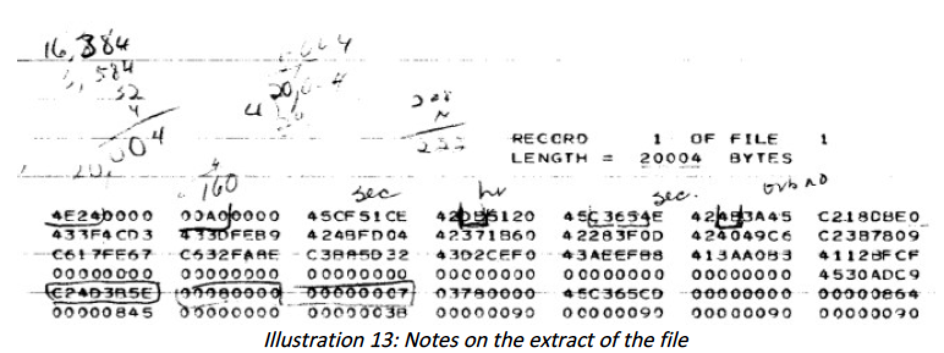
X-ray Fluorescence Spectrometer data - IV
Yoan Mollard:
2011-2012: 3-month intern @ ESAC – XRFS data
2015: Faculty visit to ESAC: GRS data
IBM 360/370 data structure

Slide 17
X-ray Fluorescence Spectrometer data
Lunar orbit
Trans-Earth Coast
29 July
7 Aug
Lunar X-ray observations
X-ray astronomy
“BBQ”
or PTC
GET = Ground Elapsed Time from launch
(26 July 1971; 13:34:00.6 UTC)
All X-ray data for Apollo 15: bare detector (except calibration periods)
Black = 0.7-3 keV; Red = 1.4-6 keV
PTC = Passive Thermal Control
Notes:
This graph show all the X-ray observations obtained by Apollo 15, during the lunar orbits, as well as during the journey home, from the Moon to the Earth, called trans-Earth coast. At the left you can see the peaks when the X-ray spectrometer was looking at the Moon with the Sun shining at the back. During the trans-Earth coast the X-ray spectrometer was looking at 7 locations in the sky. These were the first long X-ray observations at one location! The last half-a-day the X-ray spectrometer was left on. Since the Command Service Module was nominally in the so-called barbeque mode, in order to dissipate the heat from the Sun, when you turn the instrument around you basically get an all-sky view of the X-ray sky, including the Sun.

Slide 18
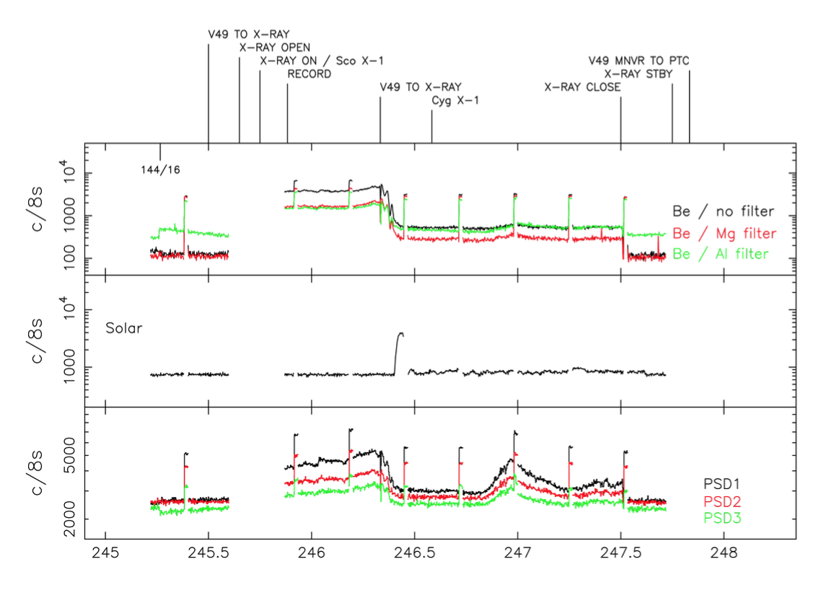
X-ray Fluorescence Spectrometer data - VI
First long (30-60 min) pointed X-ray observations!

Slide 19
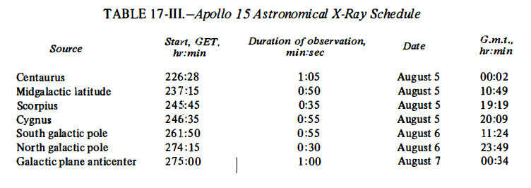
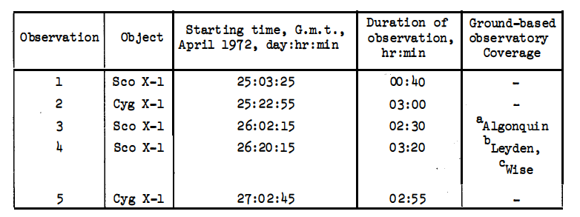
Apollo 15 & 16 pointing schedule
Apollo 15
Adler, I., et al. 1972, Apollo 15 Preliminary Science Report, NASA SP-289, p. 17-1
Apollo 16
Mission Evaluation Team 1972, Apollo 16 Mission Report, NASA MSC-07230

Slide 20
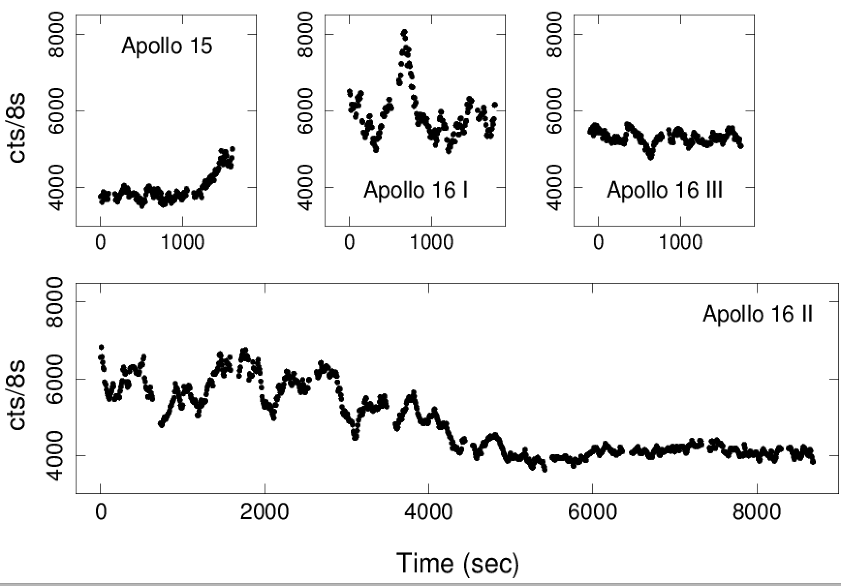
Scorpius X-1 X-ray observations
0.7->3 keV
26 Apr 1972
5 Aug 1971
25 Apr 1972
26 Apr 1972

Slide 21
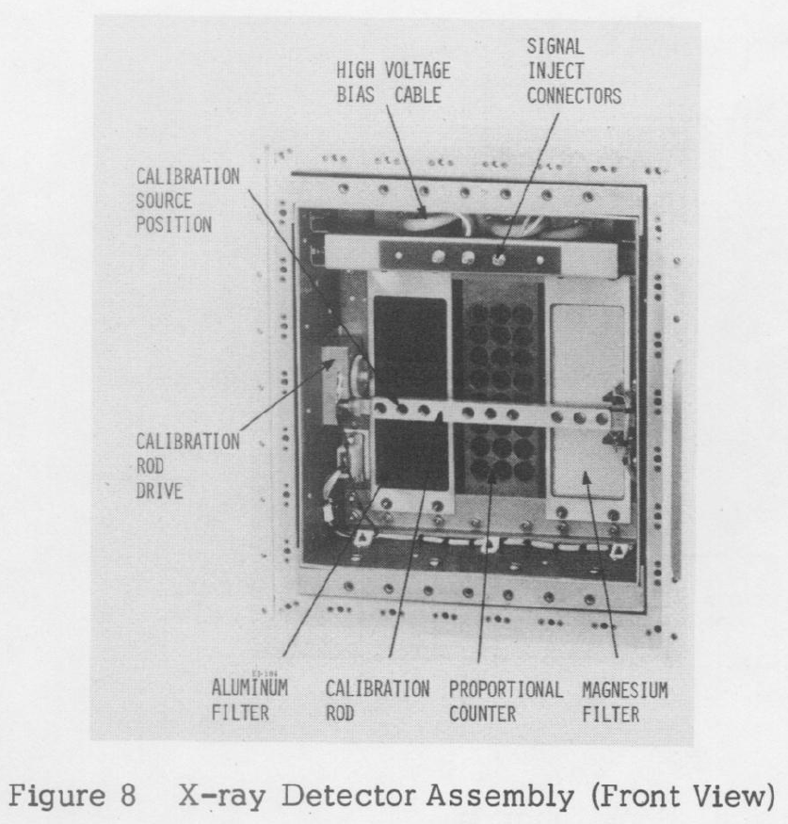
X-ray Fluorescence Spectrometer experiment - III
Jagoda, N., et al. 1974
Description of the detector, circuit functions, on-board data processing techniques and some flight results available – but no detailed calibration documents!

Slide 22
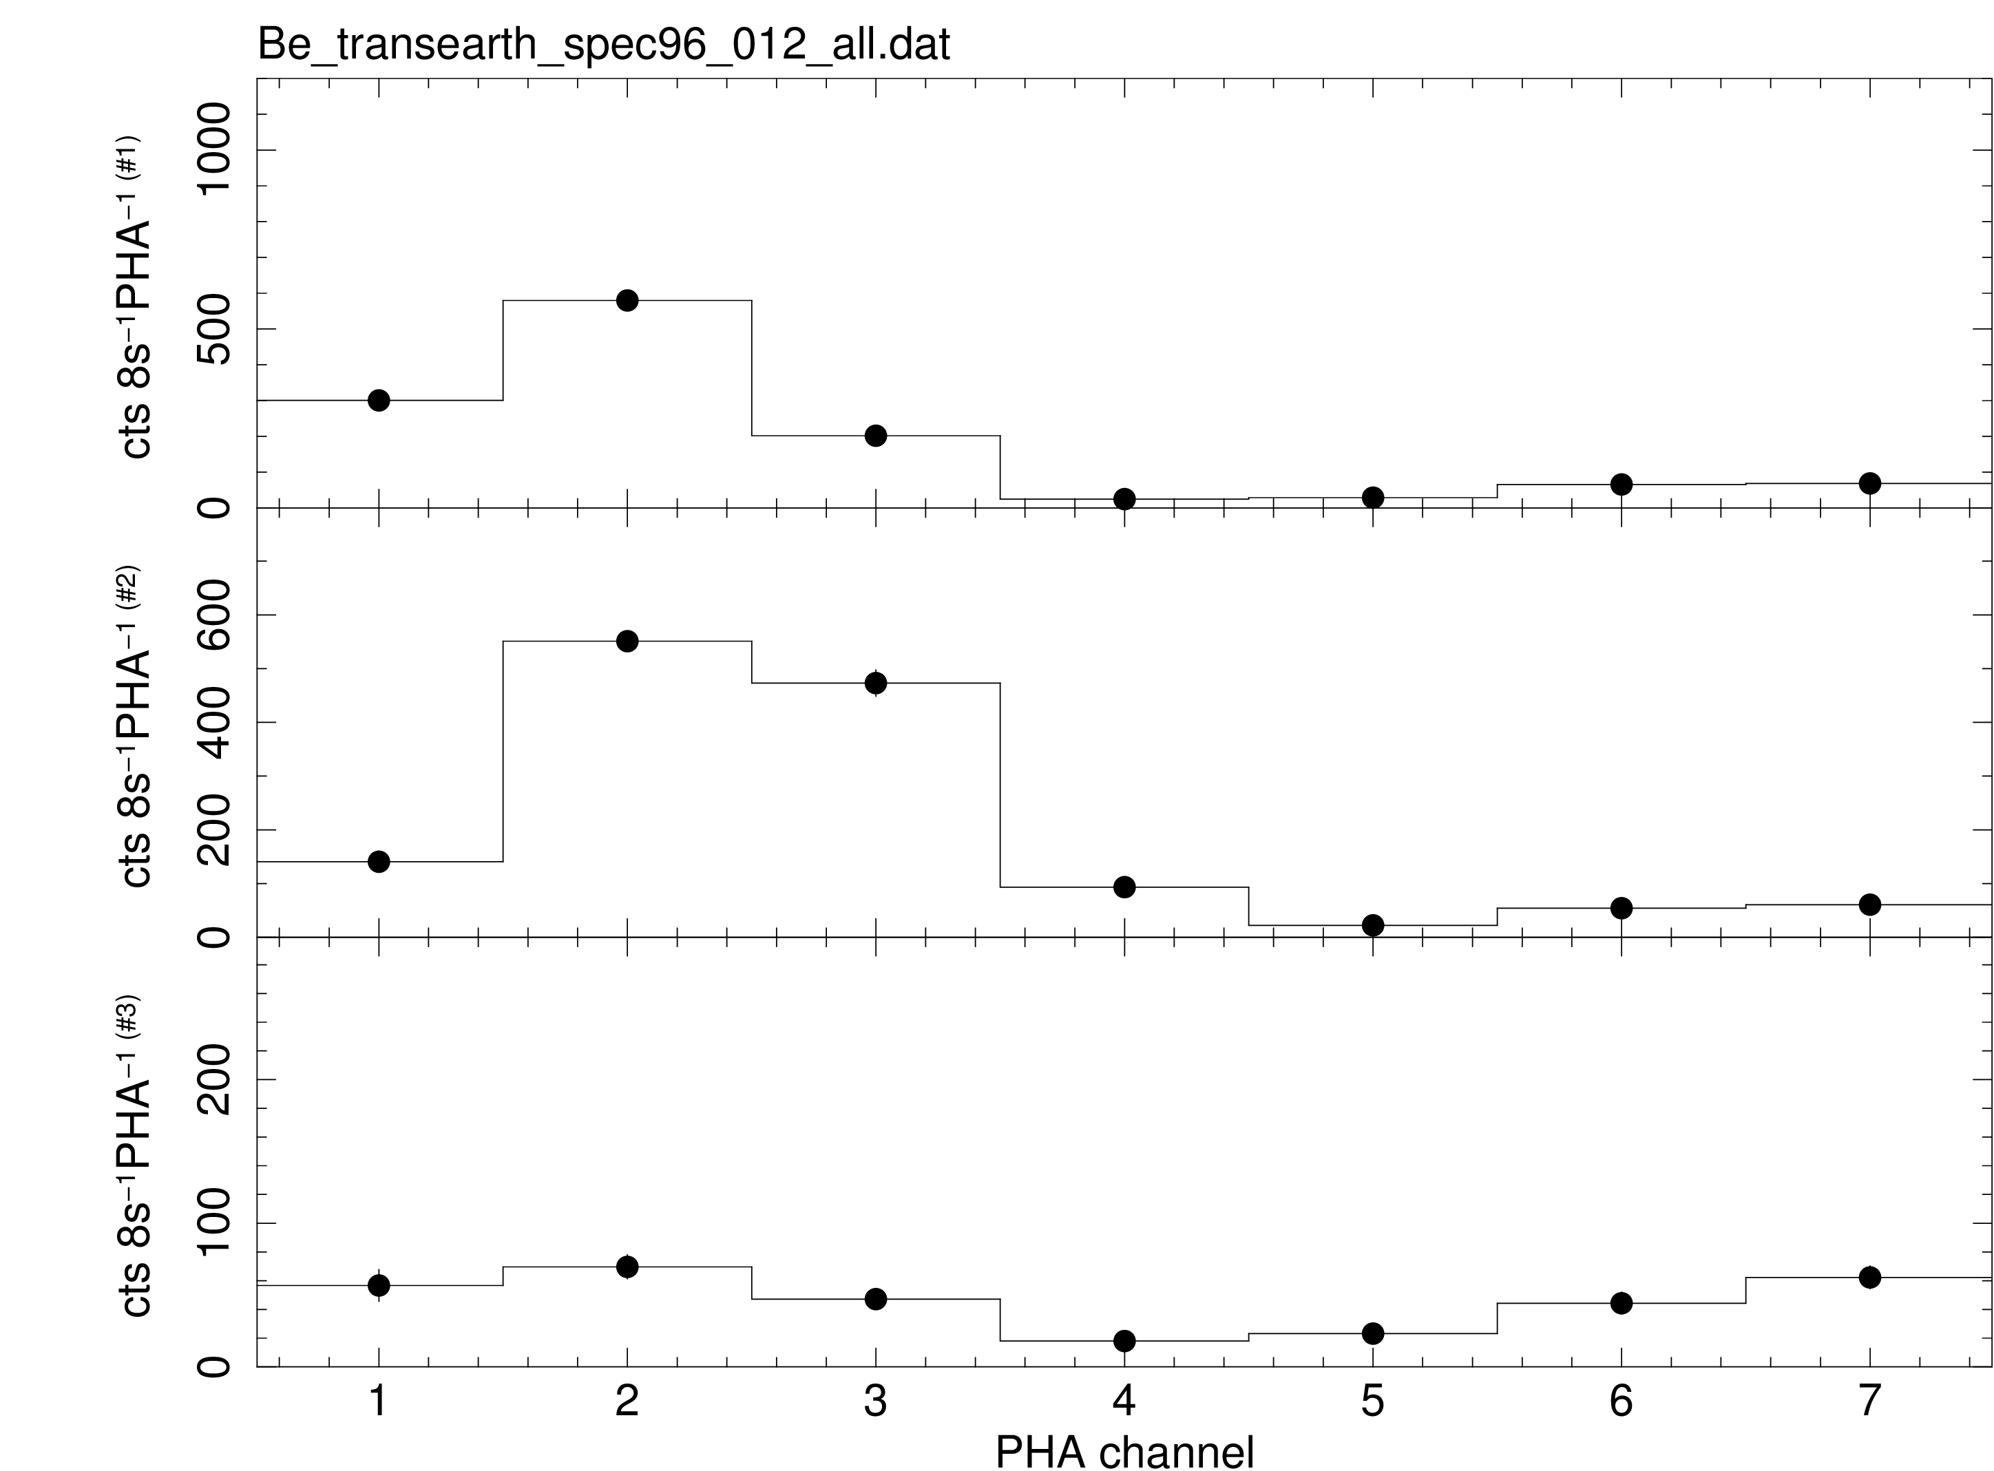
Energy calibration - 1
Mg K_{α} @ 1.25 KeV
Typical calibration spectra for detectors #1 (top), #2(middle) and #3 (bottom) taken during the trans-Earth coast with the X-ray cover closed, near GET 245.4

Slide 23
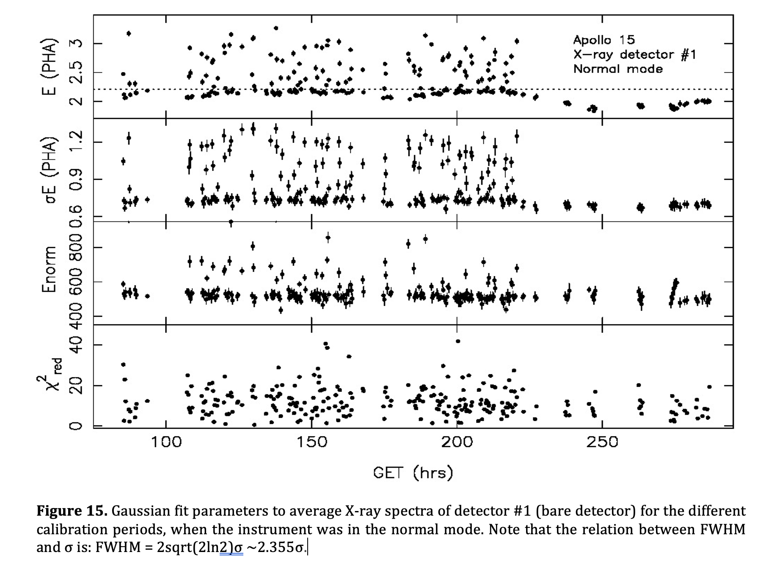
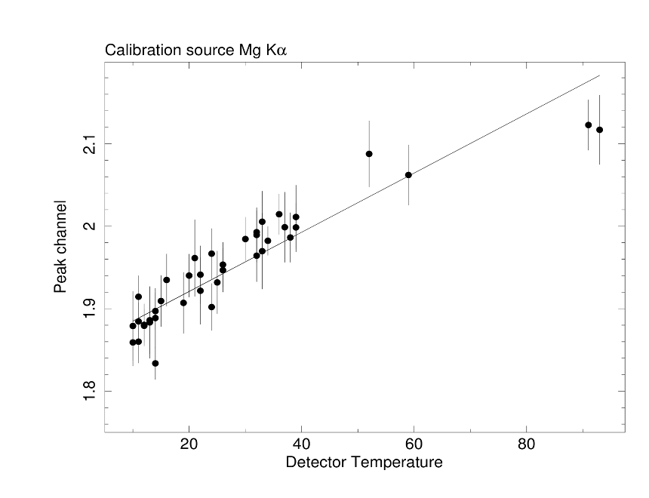
Energy calibration - 2
Literature value (Jagoda et al. 1974)

Slide 24
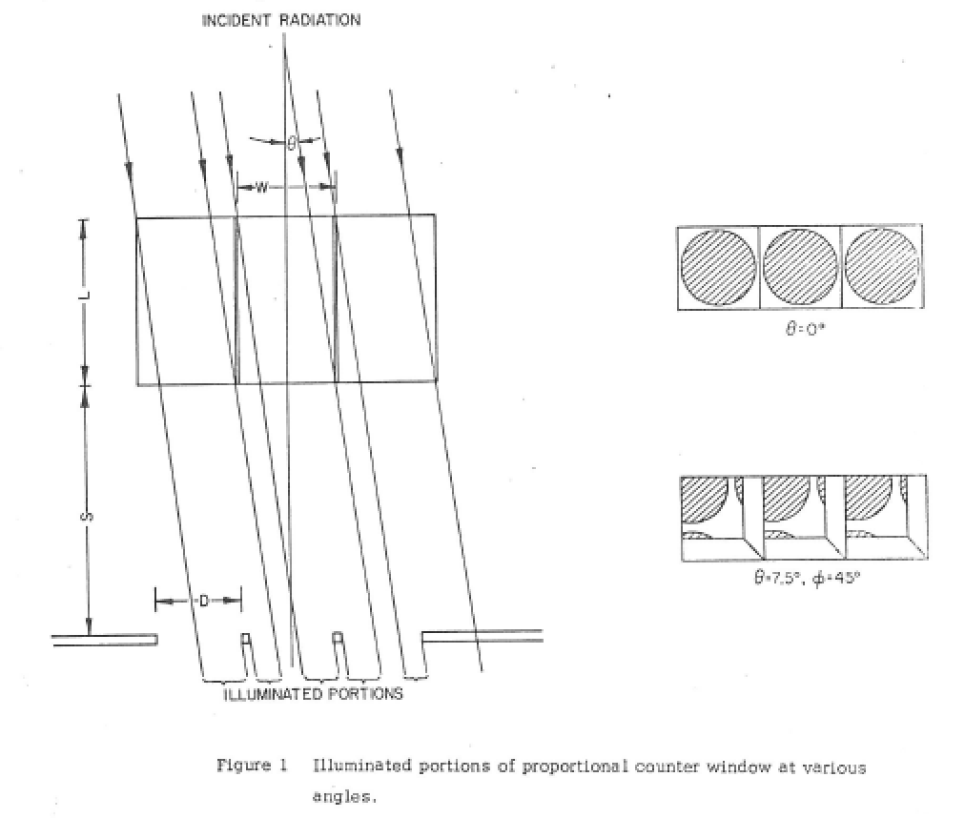
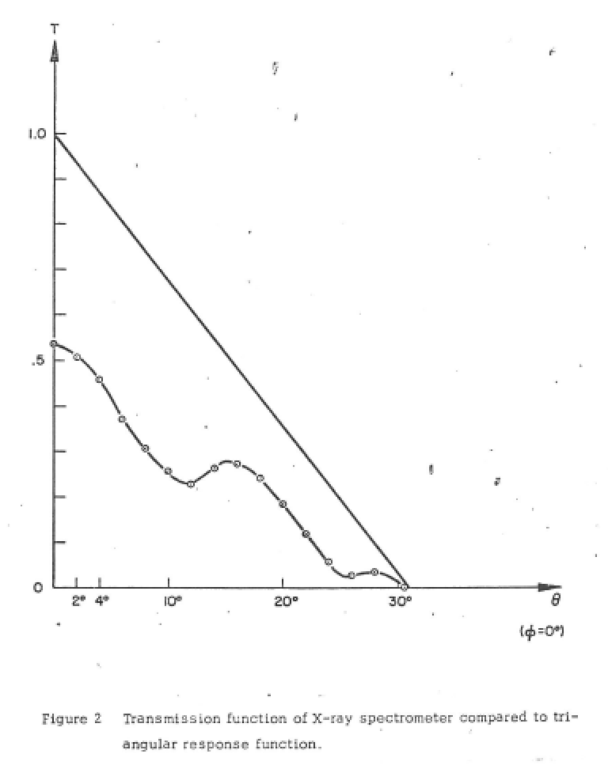
X-ray Fluorescence Spectrometer FOV - I
July 2012
Golub, I., et al. 1972, ASE-3067: Field of view of the Apollo 15/16 X-ray Fluorescence Spectrometer
[Referenced in Adler et al. 1975]

Slide 25
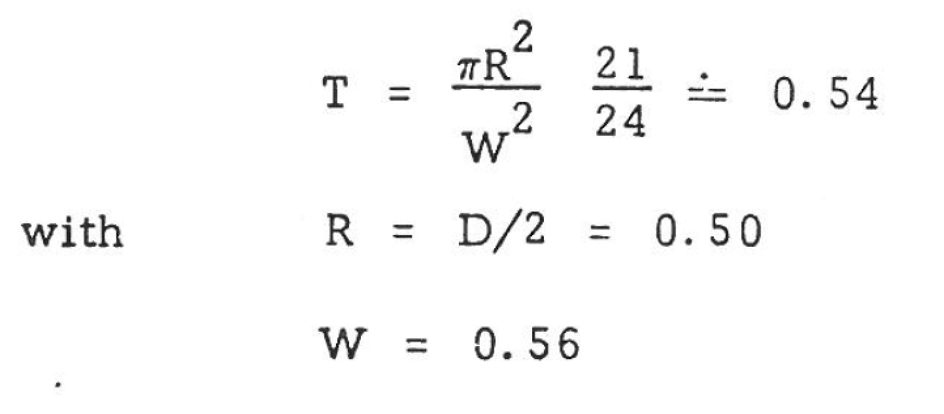
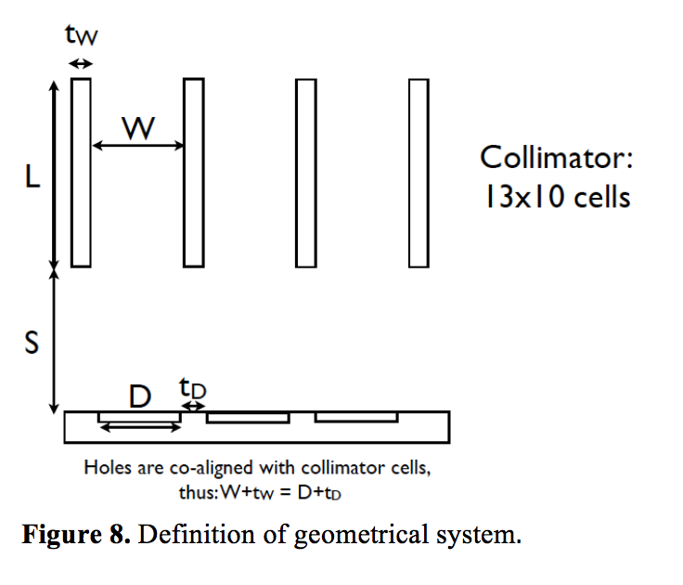
X-ray Fluorescence Spectrometer FOV - II
Golub, I., et al. 1972, ASE-3067: Field of view of the Apollo 15/16 X-ray Fluoresence Spectrometer
0.25
By re-engineering values from Golub-report:
L=0.97, S=1.42, D+t_D=W+t_W
They assumed t_W<<W, so W~W+t_W
All dimensions in inch!

Slide 26
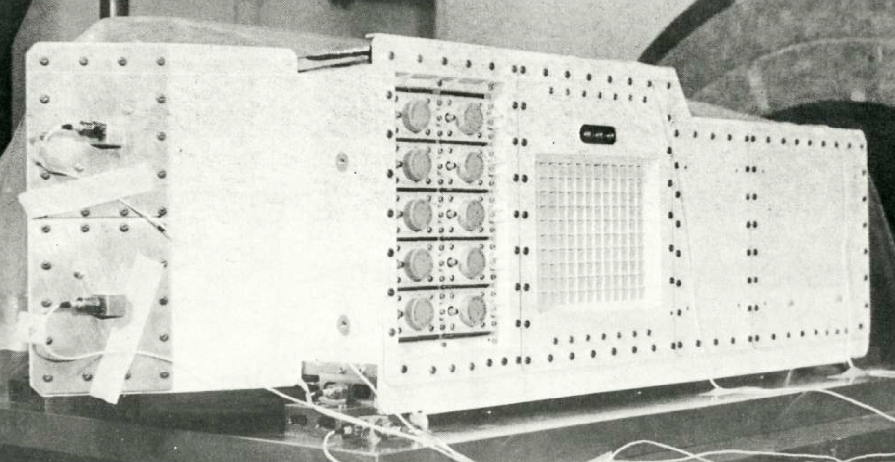
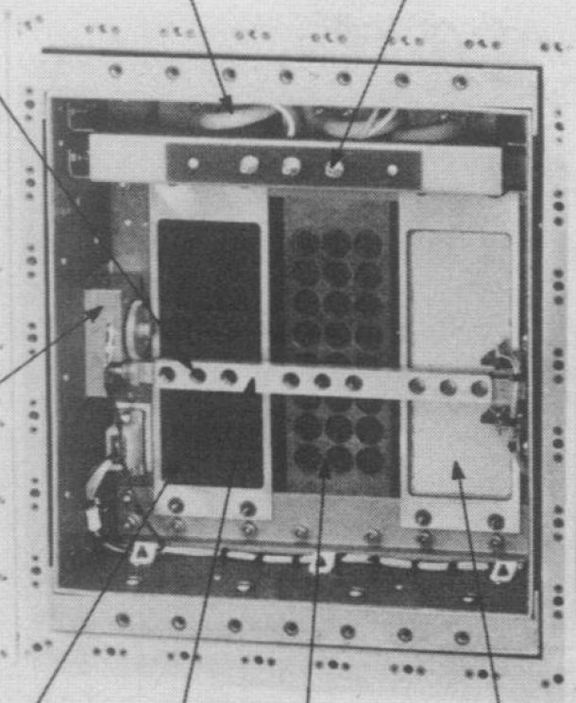
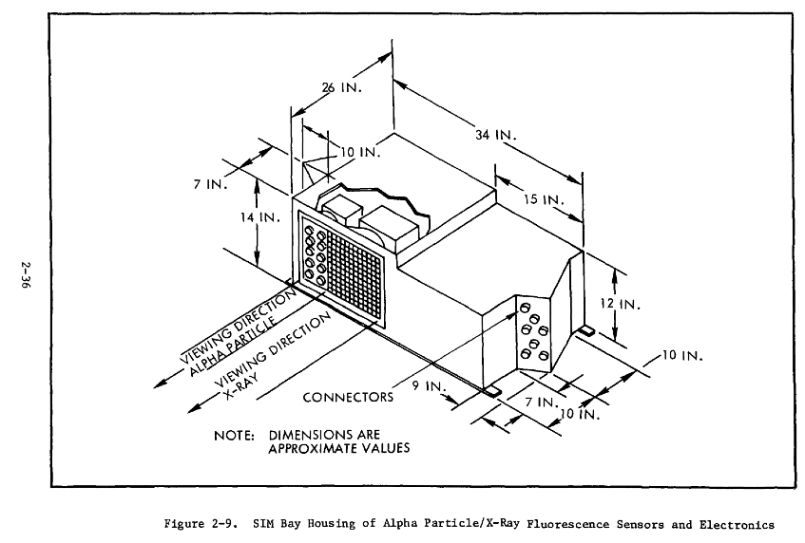
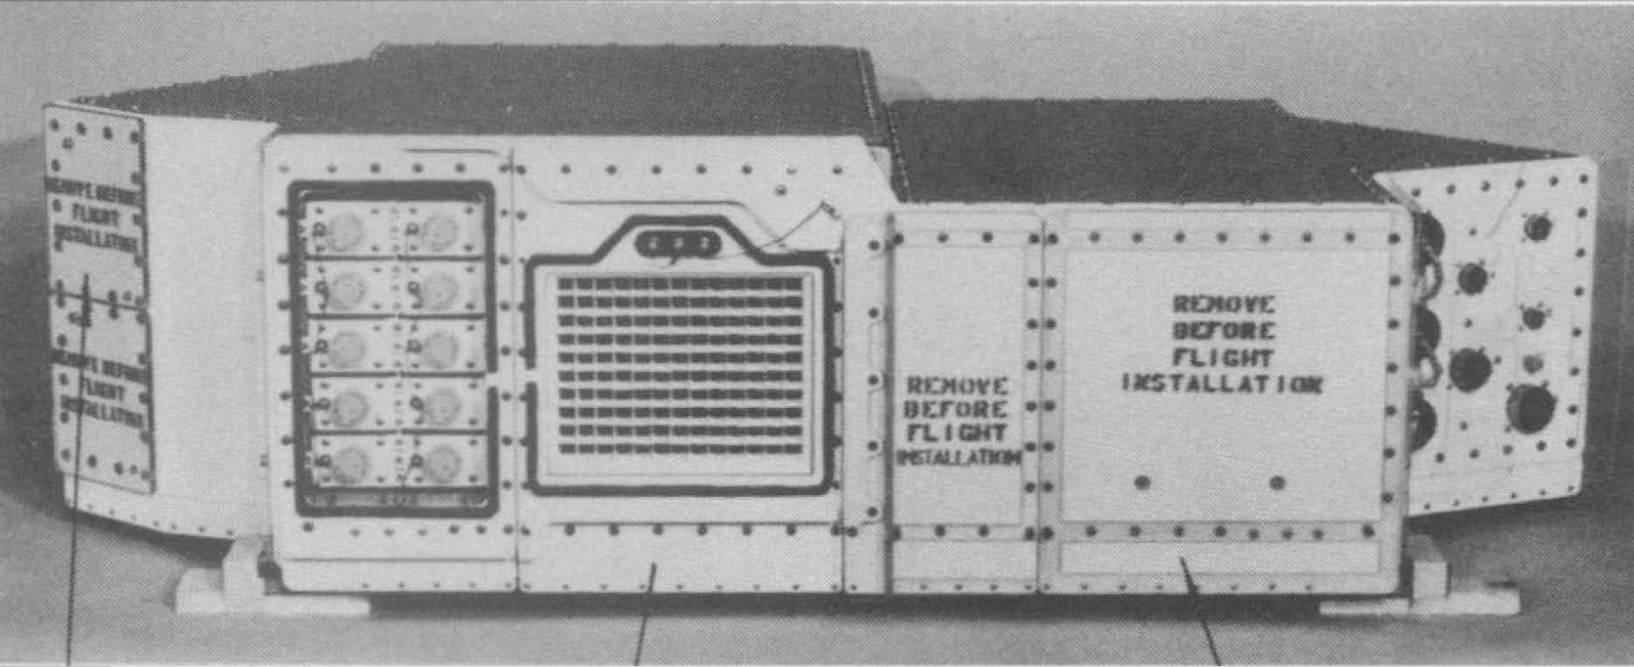
X-ray Fluorescence Spectrometer FOV - III
Digitizing photos: verified W+t_W~0.56 inch and D~0.50 inch
Mission Science Requirements J-1 Type Mission (Apollo 15), Preliminary. 1970, MSC-02536

Slide 27
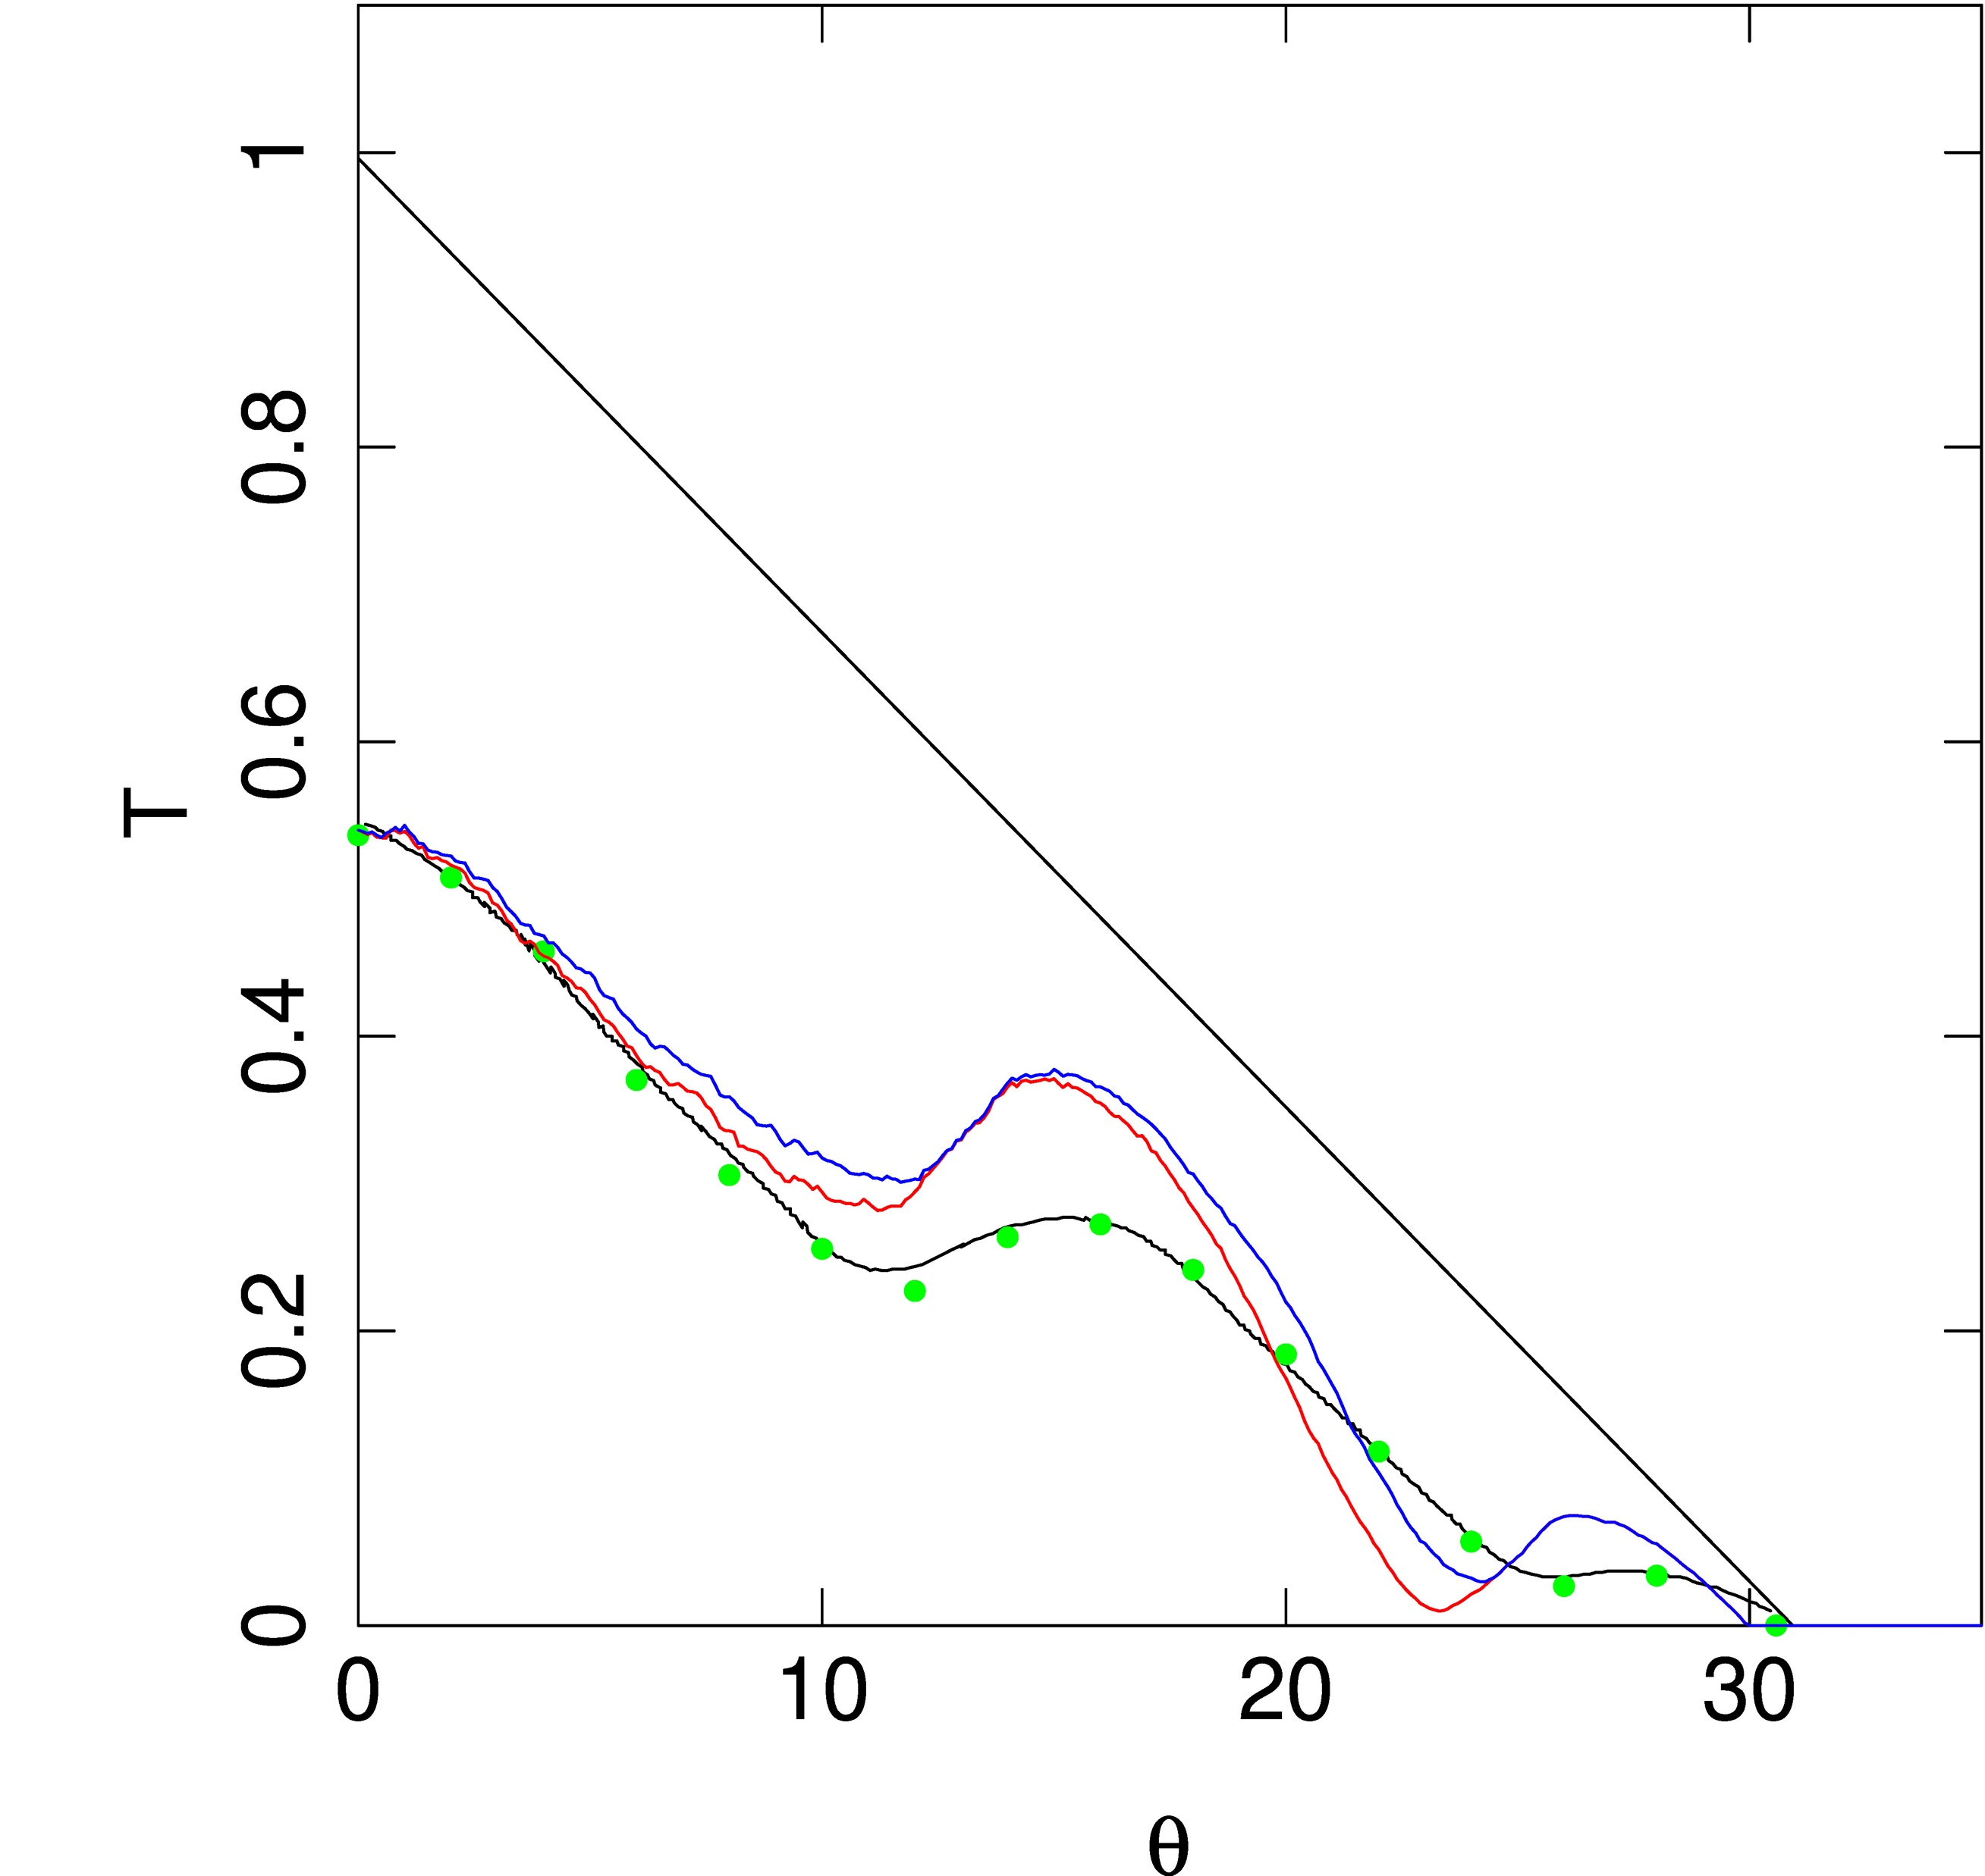
X-ray Fluorescence Spectrometer FOV - IV
Φ = 0
W=0.56, t_W~0, D=0.50, L=0.97, S=1.42
Golub/Adler
☞ Φ $≠$ 0 or used wrong values?
Golub, I., et al. 1972

Slide 28
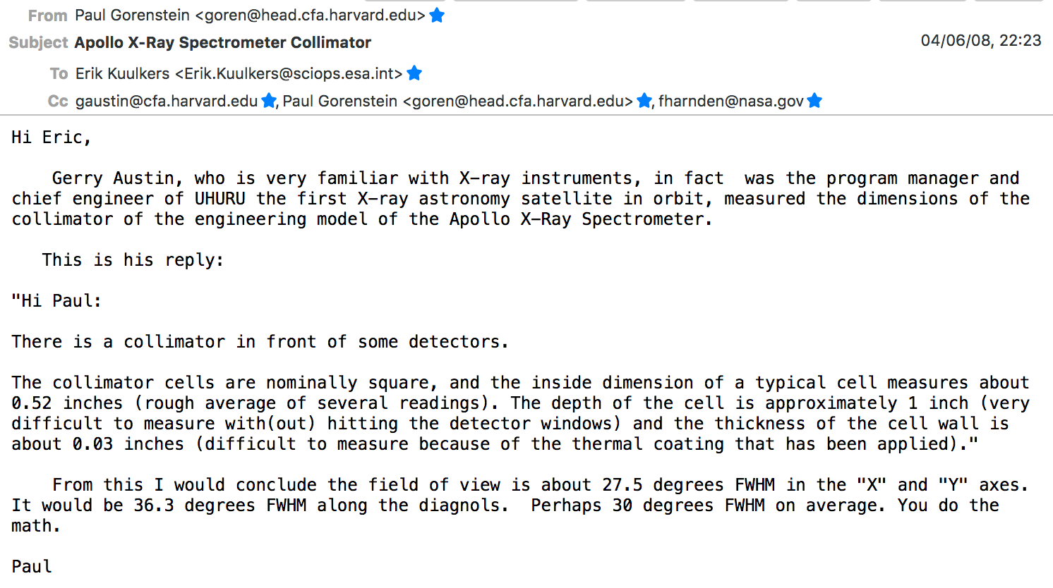
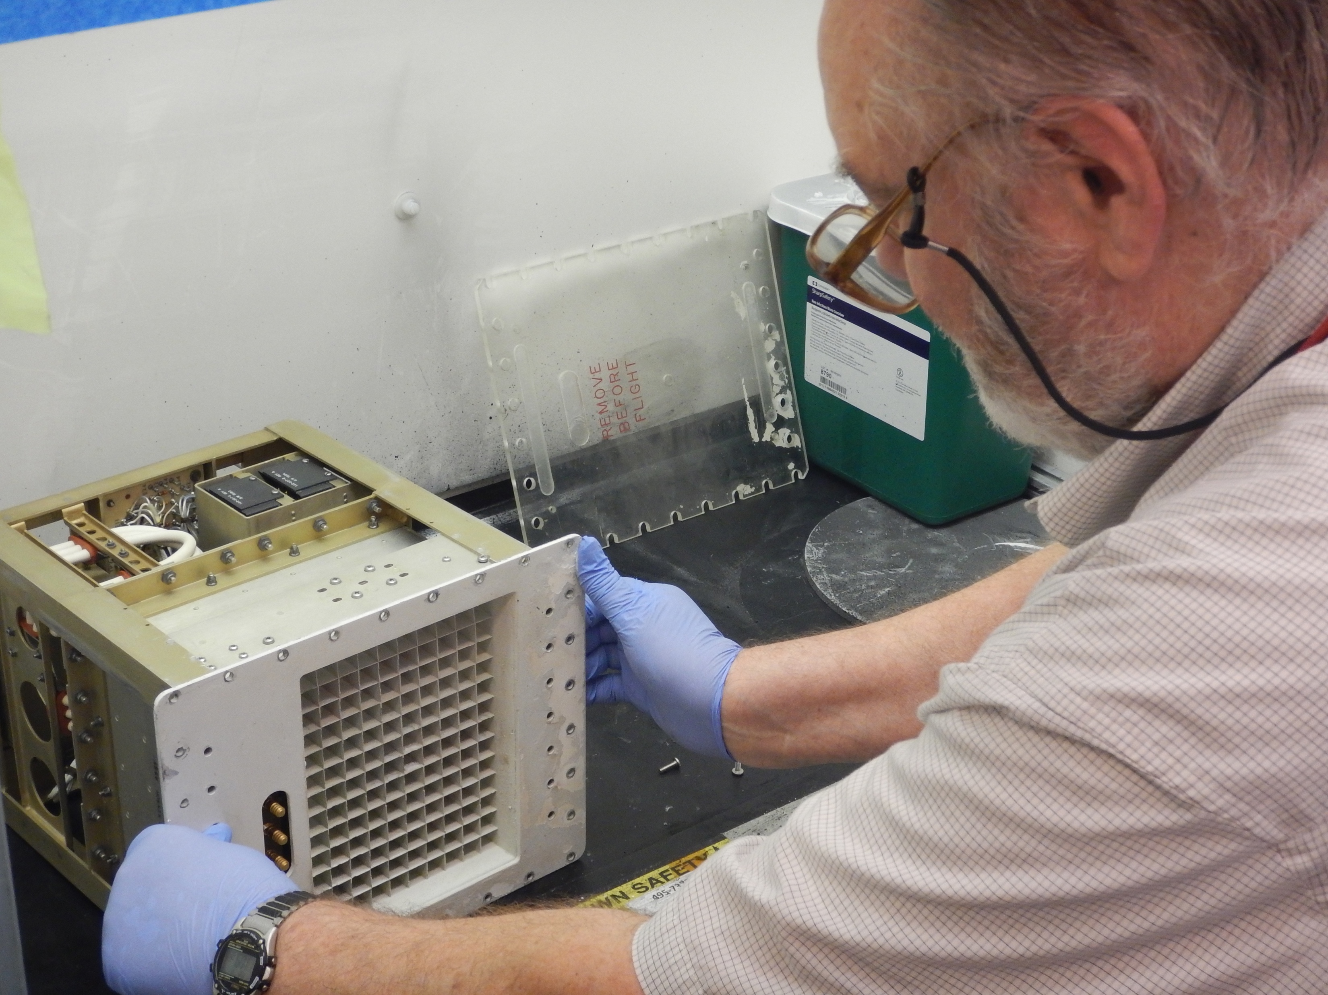
X-ray Fluorescence Spectrometer hardware
June 2008
Gerry Austin with X-ray detector assembly
August 2017
@CfA
Photo: Jörn Wilms
Notes:
So, I decided to contact in June 2008 the author of the paper Paul Gorenstein, retired at CfA. He told me that there was still an engineering model of the X-ray spectrometer available. A colleague of him, Gerry Austin (who was the program manager of UHURU!) measured the dimensions of the X-ray spectrometer, which I needed for my research.

Slide 29
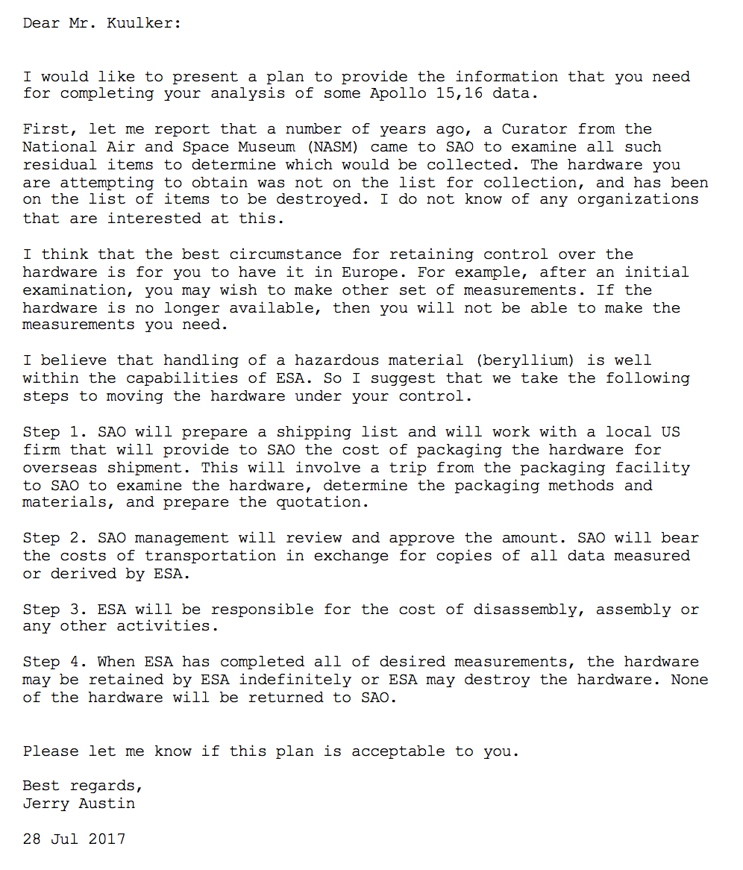
X-ray Fluorescence Spectrometer hardware
July 2017
Notes:
Over the years, I frequently communicated with Paul and Gerry, asking various questions about the X-ray spectrometer.
Suddenly, more than 2 years ago I got an e-mail from Gerry saying that somebody from the National Air and Space Museum had looked at the equipment of AS&E. The X-ray spectrometer was not on their list for collection and was on the list of items to be destroyed. Gerry thus asked if I was still interested in the instrument. They would send it to me for free and it would be mine afterwards! Ofcourse, I said yes…

Slide 30
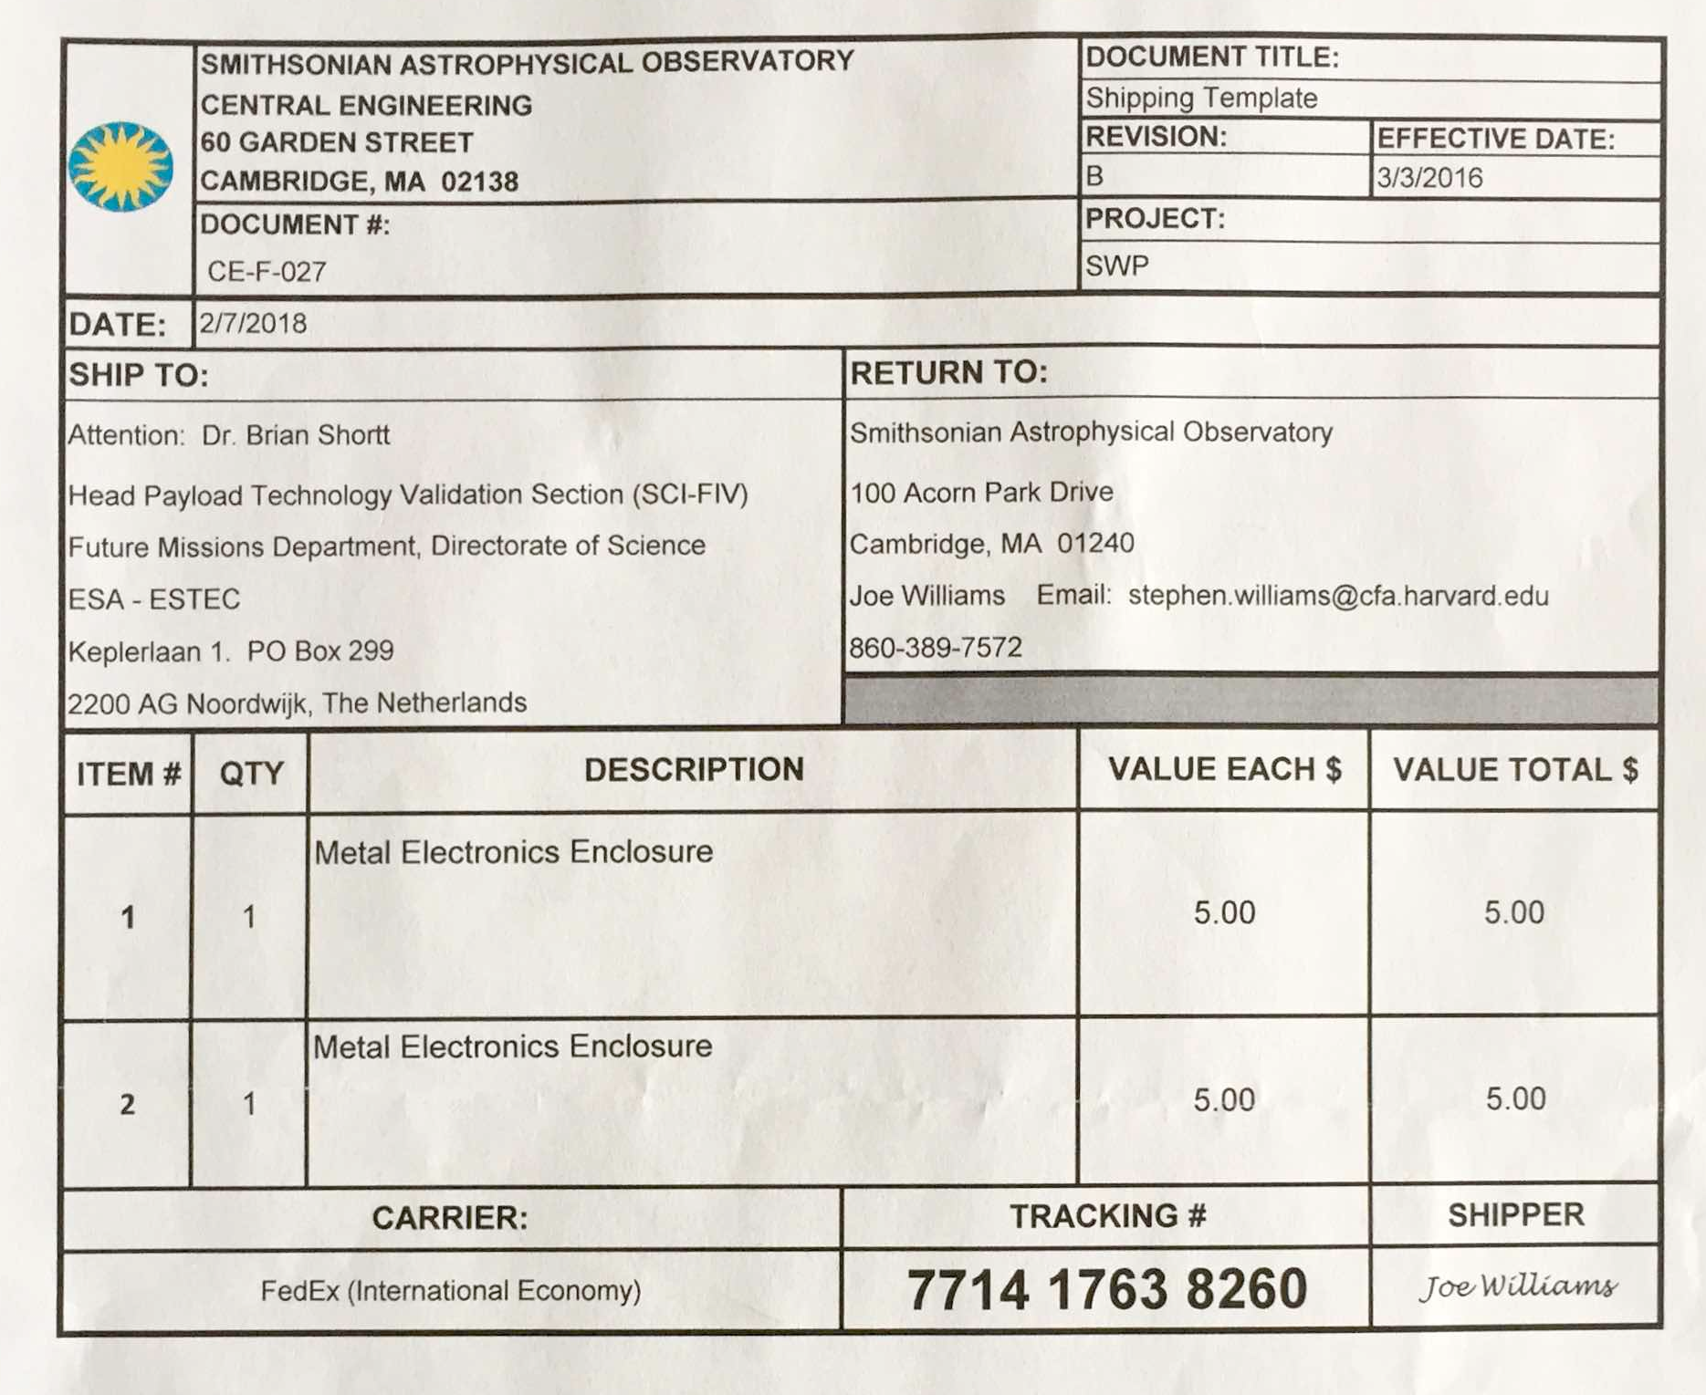
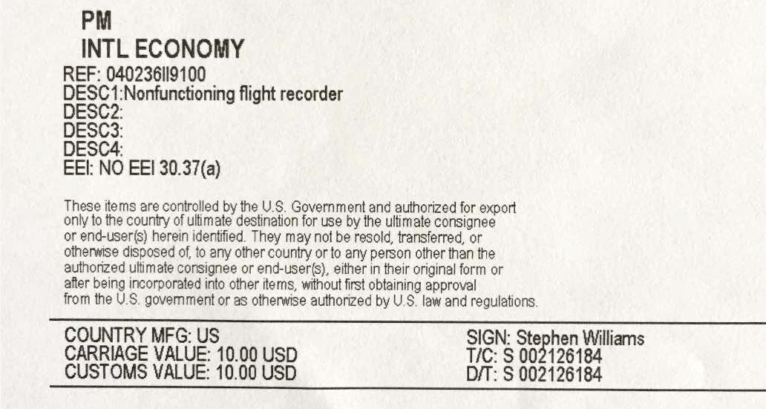
X-ray Fluorescence Spectrometer hardware
Value 2018: $10... ($320 loss per day)
Notes:
In the beginning of 2018 it was sent to the ESTEC labs, as a non-functioning flight recorder, with a value of 10 US dollar.
This means the X-ray spectrometer lost value of about 320 dollar per day from 1972 up to 2018…

Slide 31
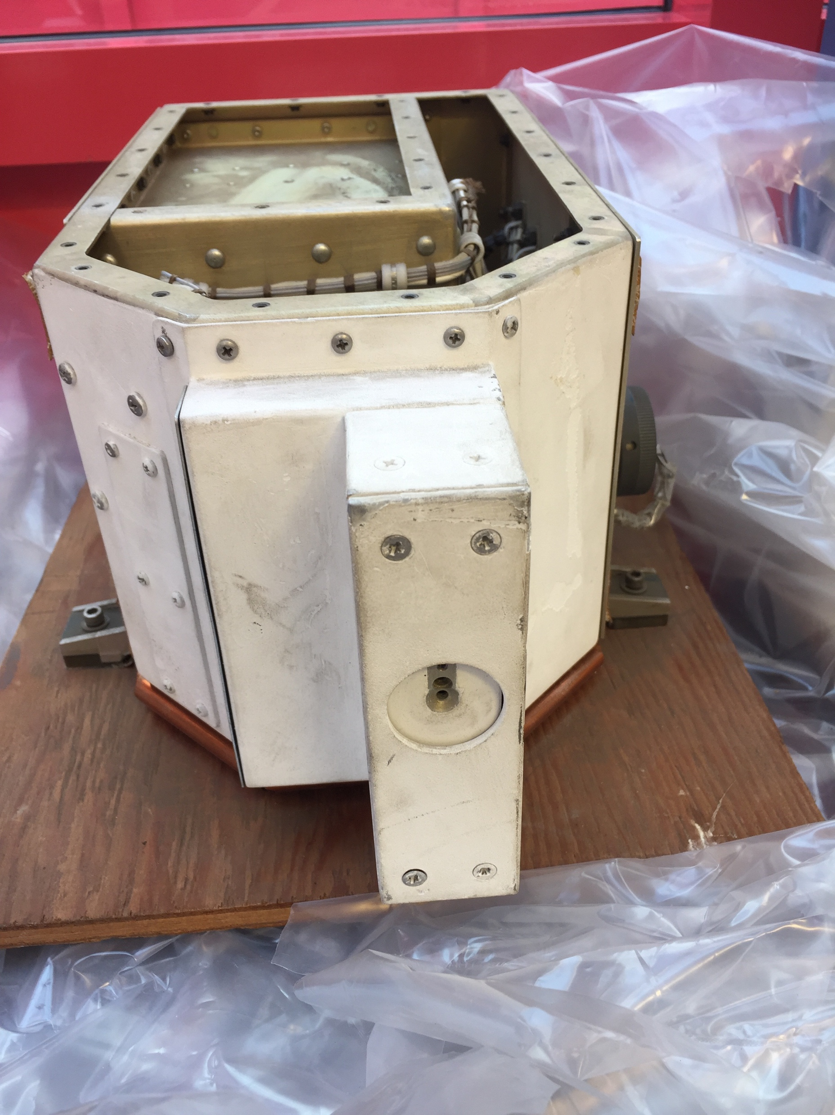
Feb 2018
@ESTEC!
X-ray detector Assembly
Solar Monitor Assembly
Notes:
In February last year it finally arrived at ESTEC and we opened the package. See here the X-ray spectrometer at the left, and the Solar X-ray Monitor at the right.

Slide 32
X-ray Fluorescence Spectrometer hardware
Nr. | Unit | delivered
1 | Mockup | November 1969
2 | Mass Mockup | February 1970
3 | Prototype Unit | June 1970
4 | Flight Unit #1 | Dec 1970-Apr 1971
5 | Flight Unit #2 | Jan-May 1971
6 | Qualification Unit | November 1970
Plate on Solar Monitor assembly
Notes:
This is the plate on the Solar Monitor. As you can see it was made by AS&E and the acceptance date is June 1970.
Here’s the table with the 6 units made by AS&E. As you can see, the X-ray spectrometer and Solar Monitor belong to the prototype unit.

Slide 33
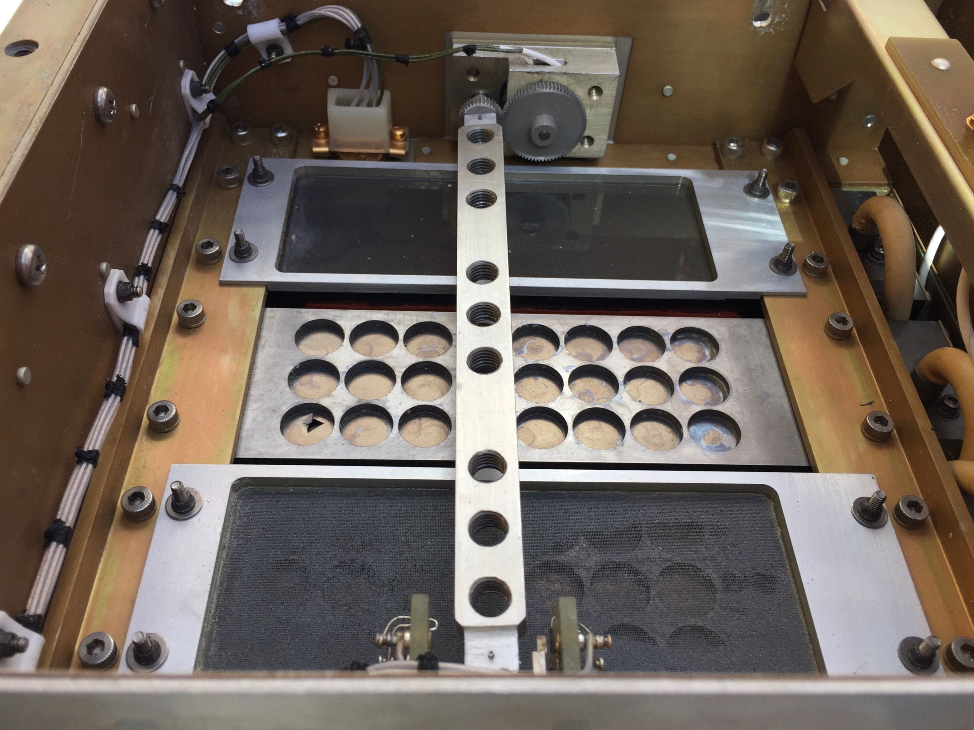
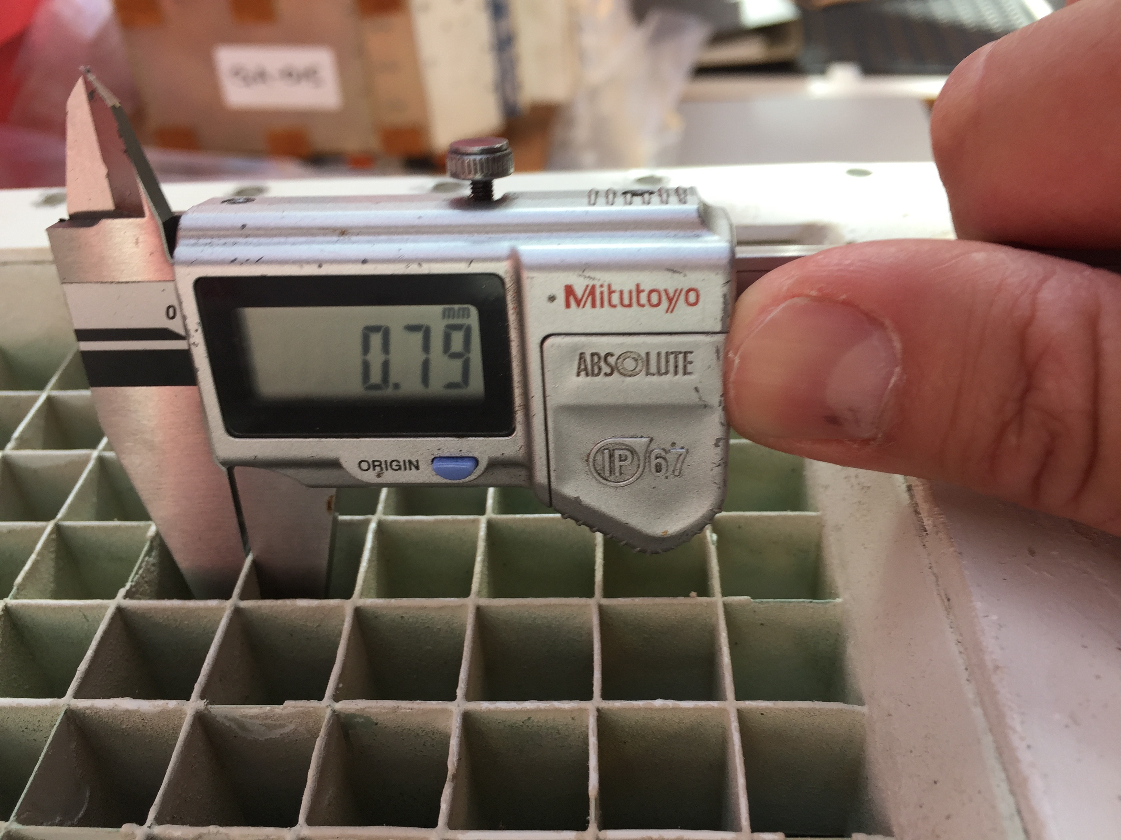
X-ray Fluorescence Spectrometer hardware
X-ray detector assembly
Measurements:
W=0.538, t_W=0.025, L=0.97, S=1.57, D=0.500, D+t_D=W+t_W, depth cell = 0.122. All dimensions in inch.
Notes:
We then started to open the spectrometer and did all the calibration measurements we wanted to do and determined the materials used. We even accidentally damaged one of the entrance of one the detectors, but this enabled us to do investigate the detector itself as well.

Slide 34
X-ray Fluorescence Spectrometer FOV - V
Source | W | t_W | D | L | S
Golub et al. | 0.56 | $≪W$~0 | 0.50
Re-engineering | 0.561 | $$≪W\text{\sim 0}$$ | 0.497 | 0.969 | 1.431
G. Austin | 0.52 | 0.03 |  | 1.0
ESTEC | 0.538 | 0.025 | 0.500 | 0.97 | 1.57
All dimensions in inch
All dimensions in inch
Golub et al. did not use Flight Unit?

Slide 35
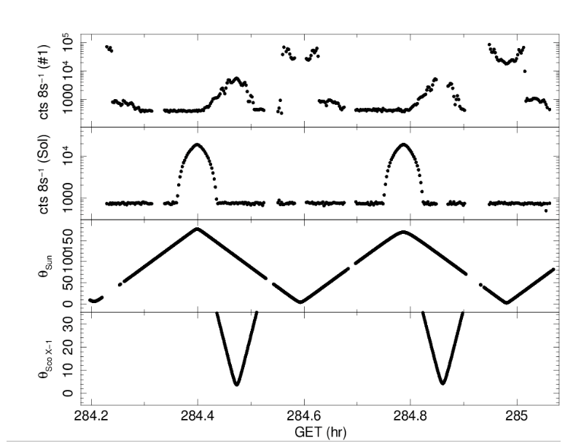
X-ray Fluorescence Spectrometer FOV - VI
Sco X-1
“Sky”
Example data during TEC/”BBQ”
Use Sco X-1 as in-flight calibration source!
Sun

Slide 36
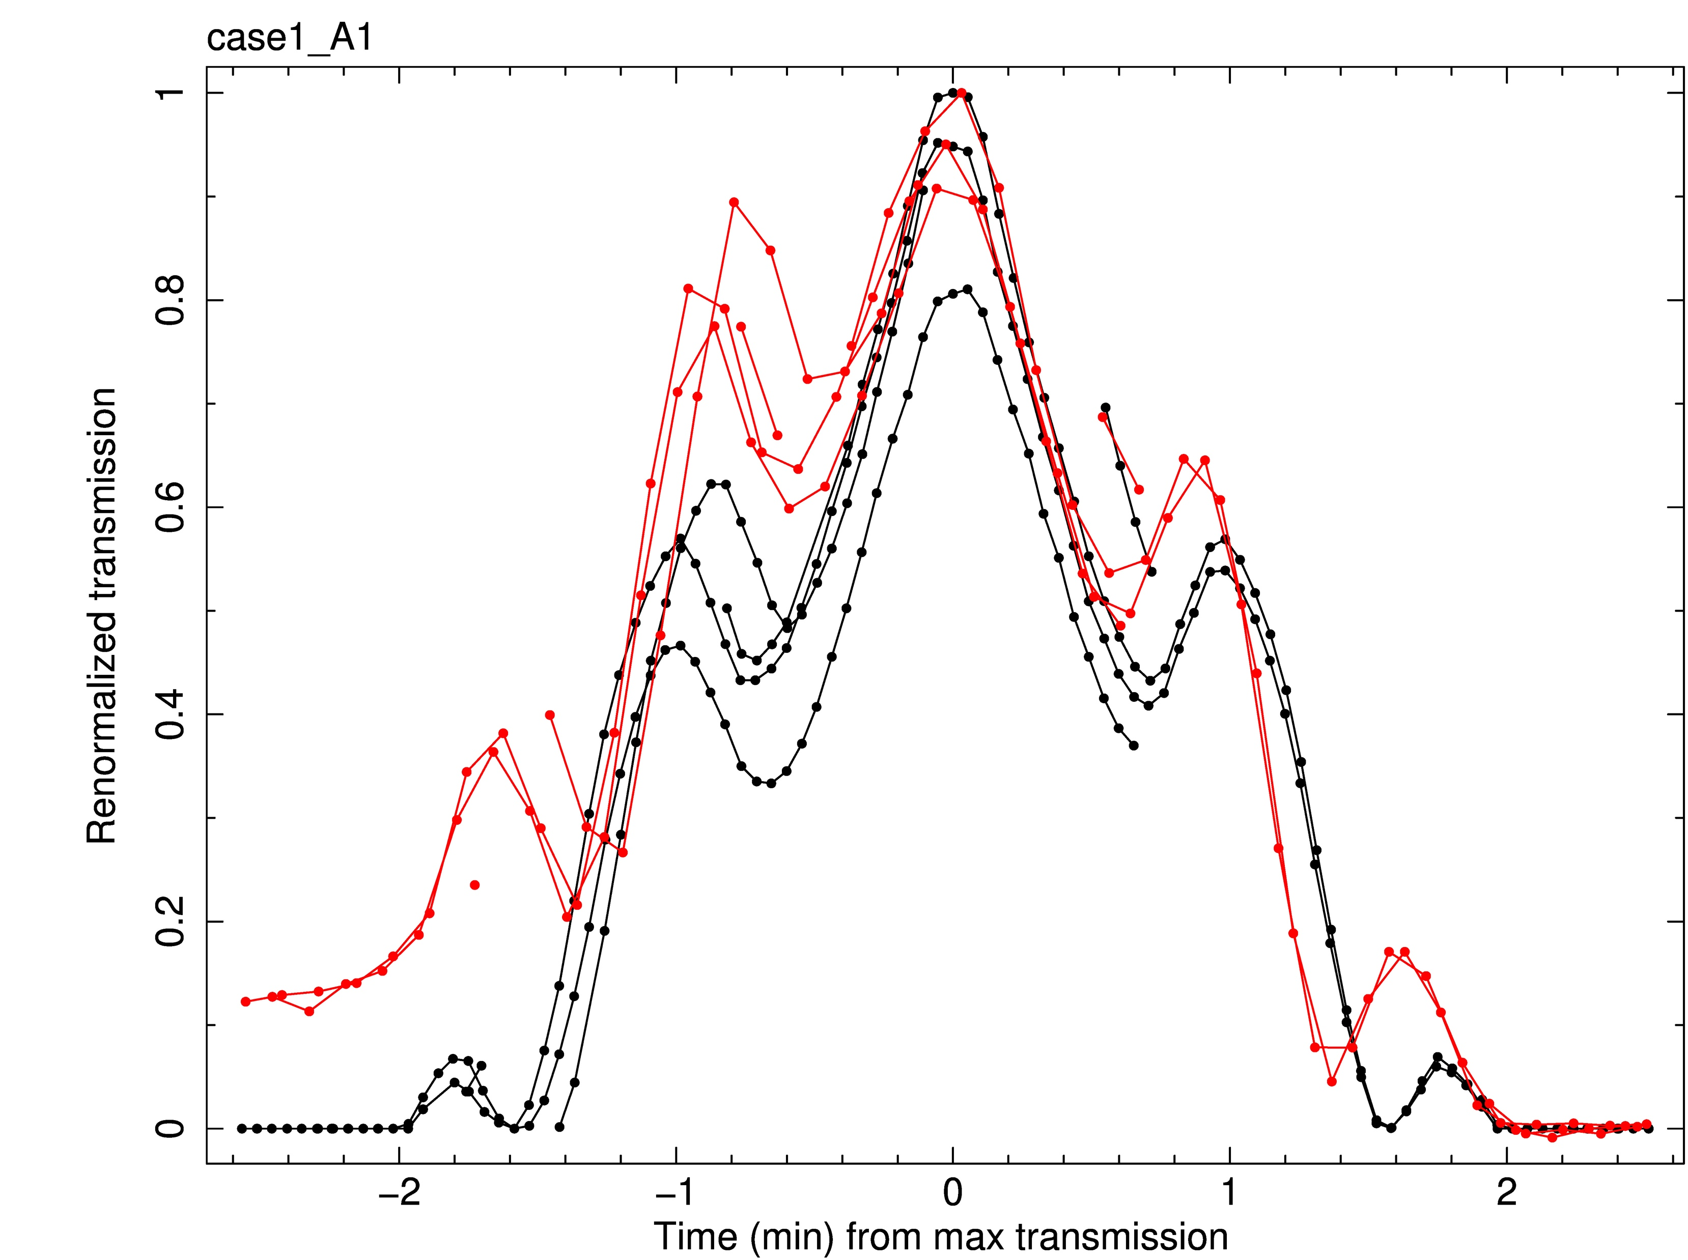
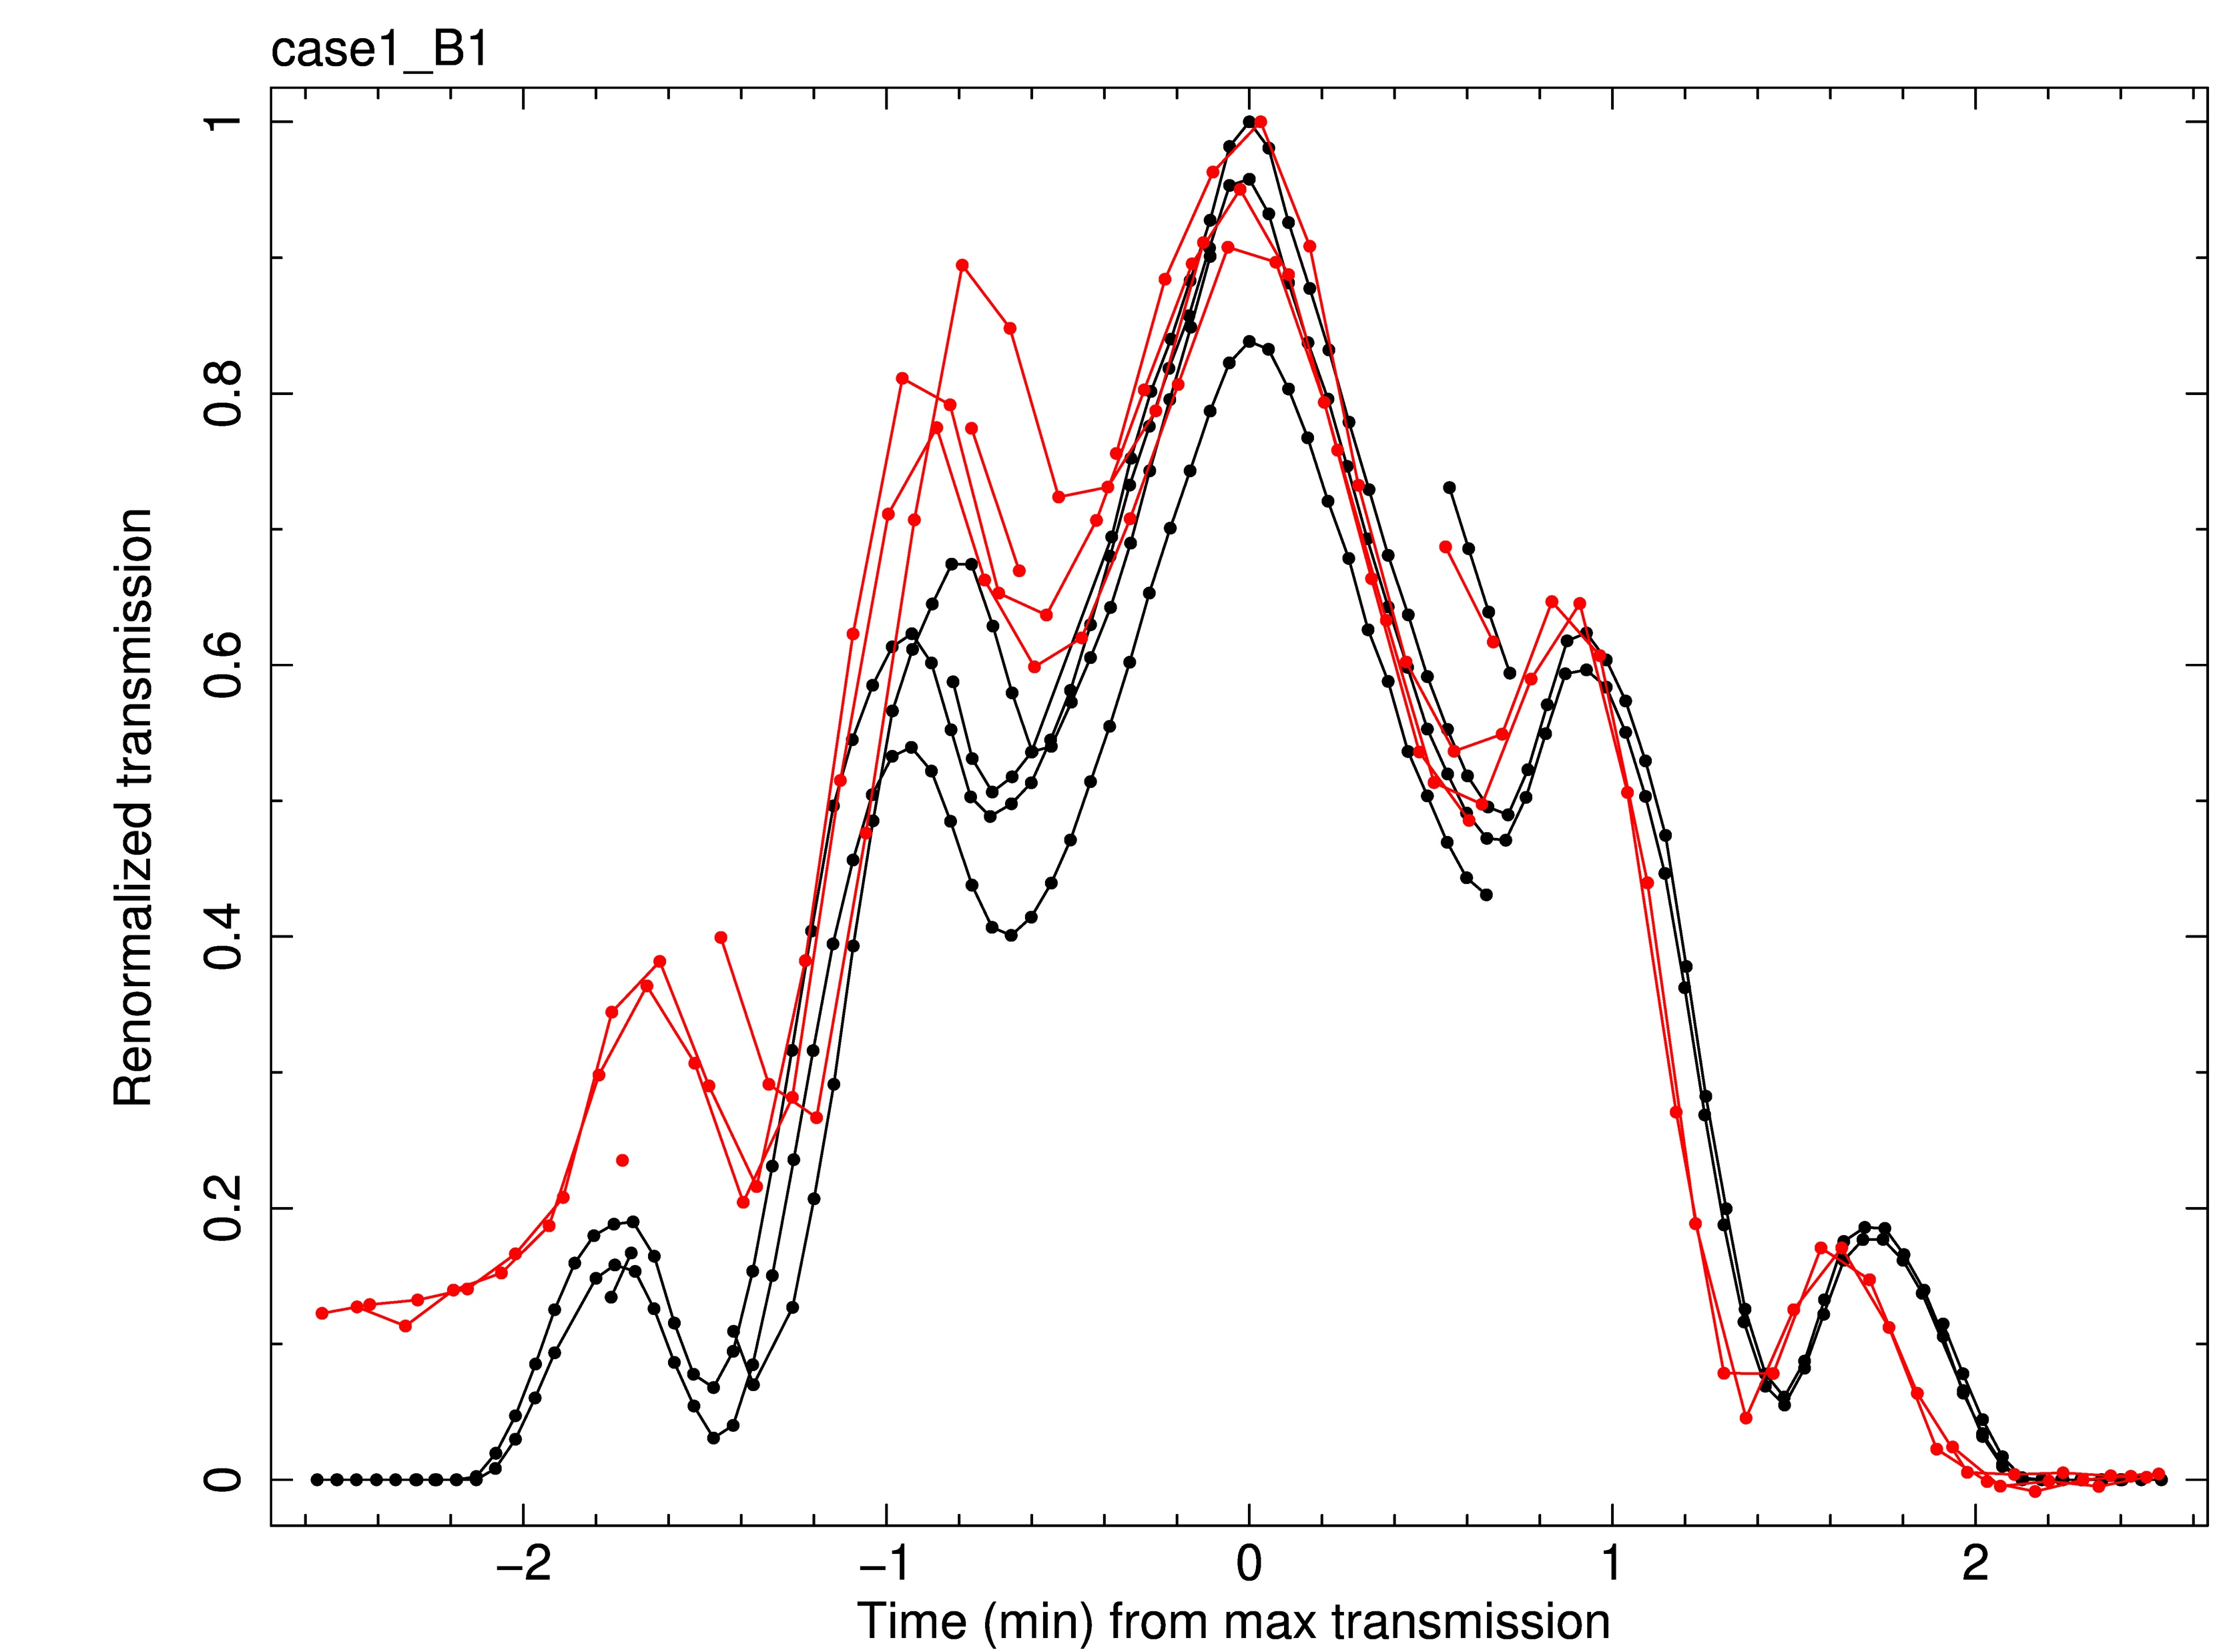
X-ray Fluorescence Spectrometer experiment - VII
Red = Sco X-1, Black = ray-tracing/GEANT (Riccardo Campana, INAF-OAS, Bologna)
S=1.43
S=1.57

Slide 37
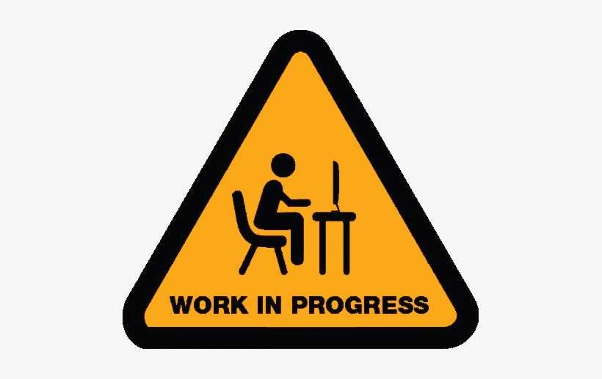
To be continued… [in my spare time]

Slide 38
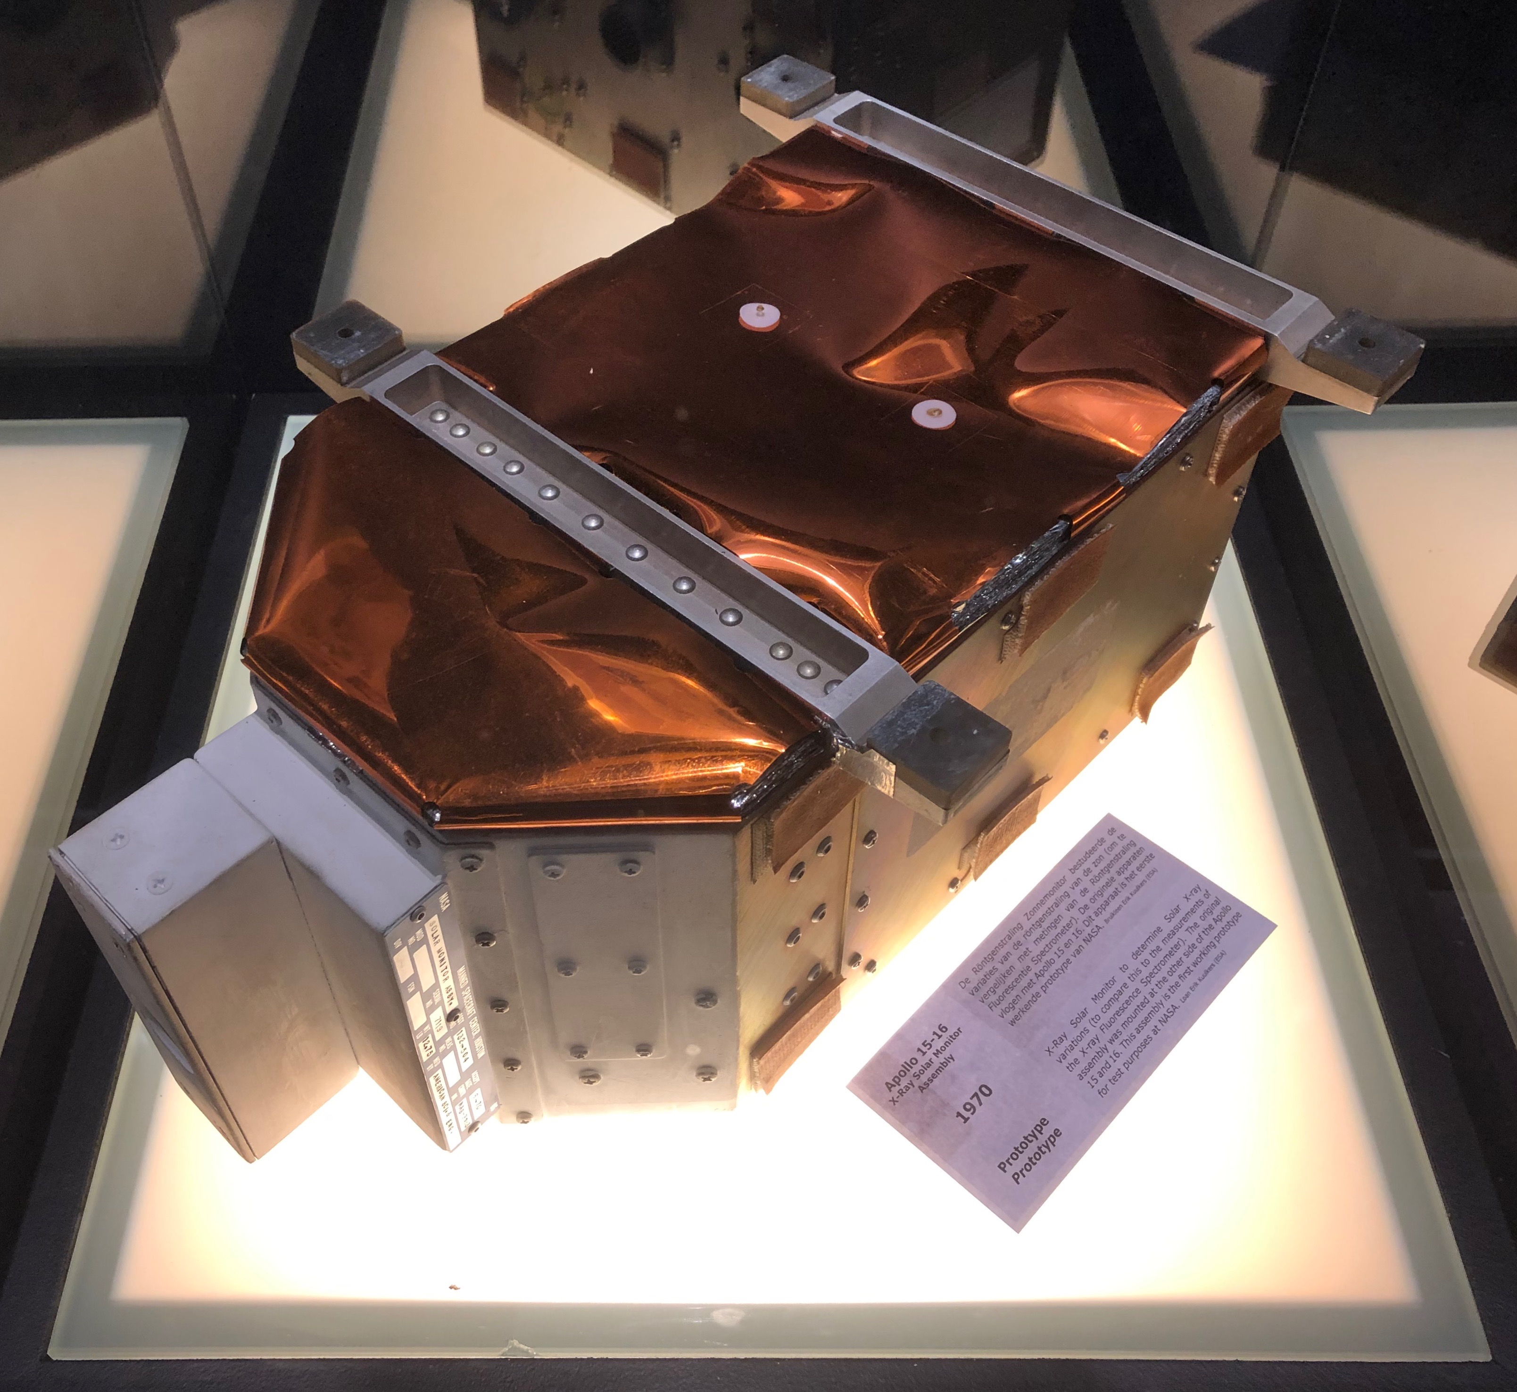
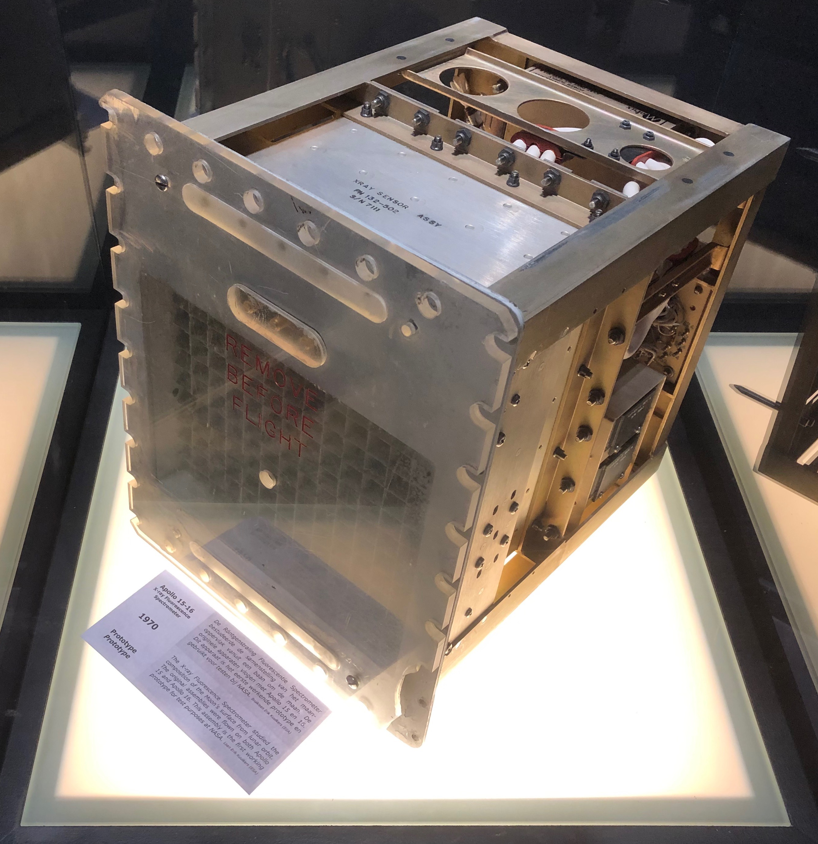
XRFS @ Space Expo in Noordwijk, The Netherlands
Notes:
..., and enjoy the X-ray instruments, for which you know know the history.

Slide 39
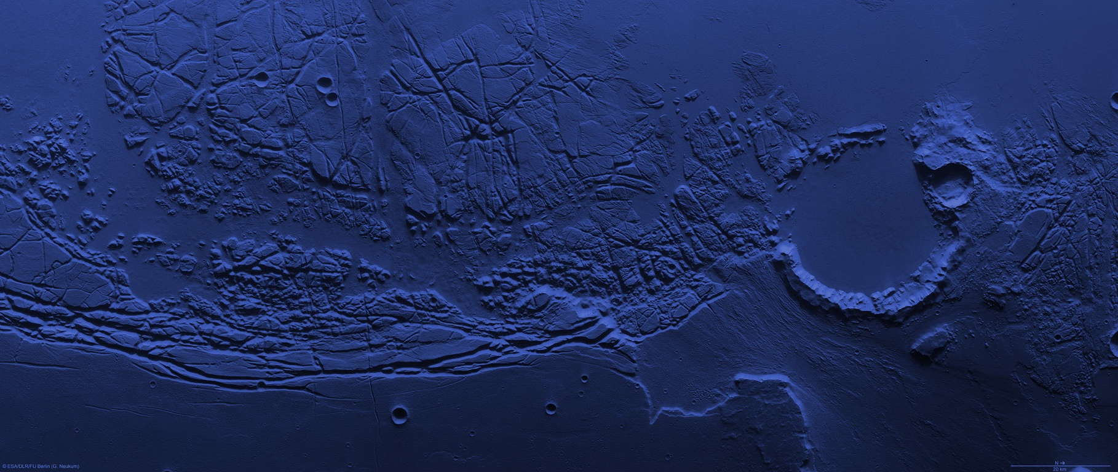
Thank you
www.esa.int sci.esa.int @ekuulkers
Notes:
Thank you for your attention.

