Slide 1
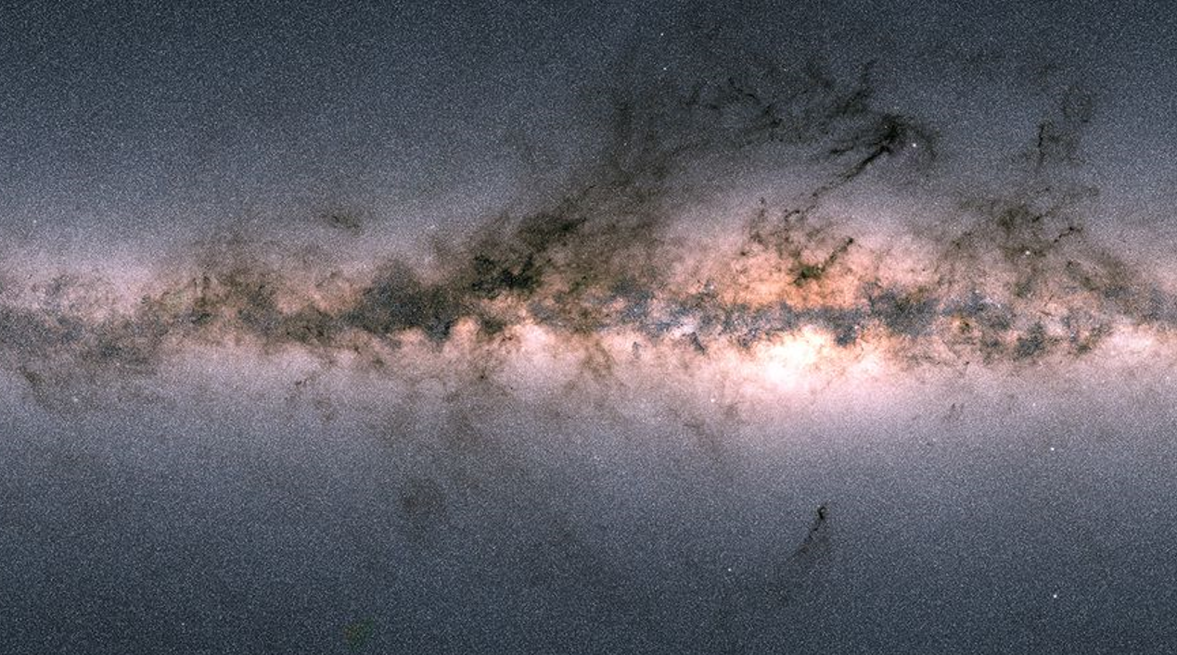
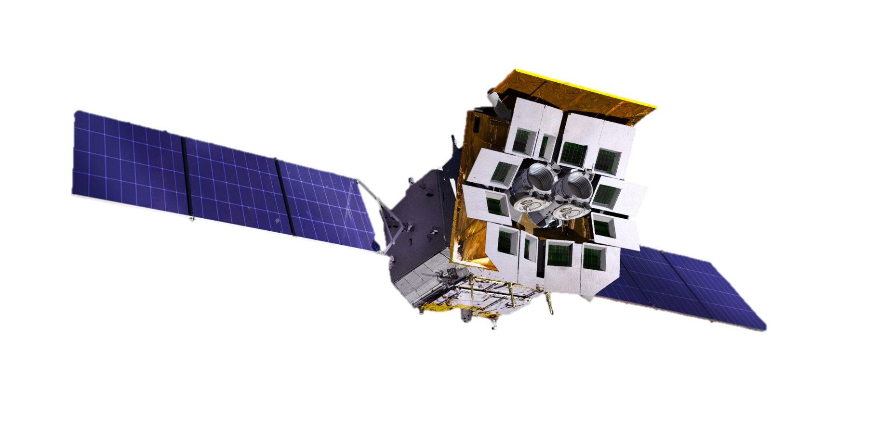

Introduction to Einstein Probe Science Center
Helen (Congying) Bao
EPSC, National Astro. Observatories, Chinese Academy of Sciences

Slide 2
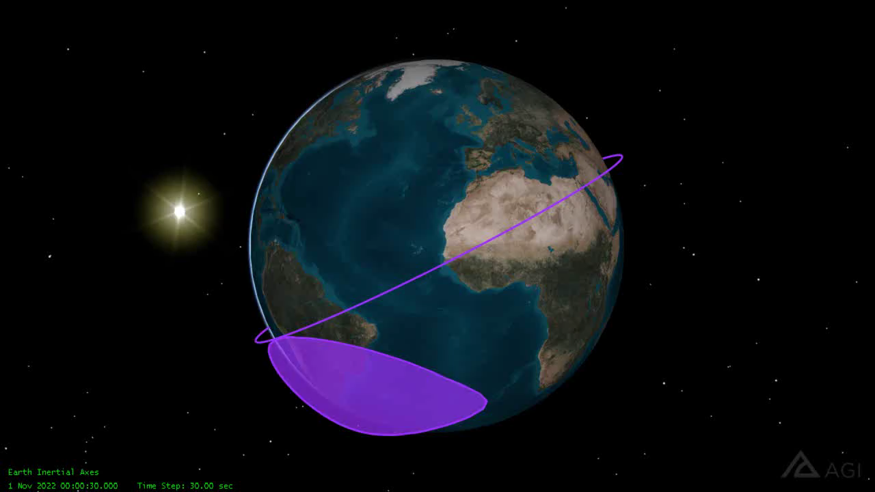

Observation modes
Circular orbit
  Height 592km, period 96min
  inclination angle 29 deg.
Observation modes
  Survey (primarily WXT)
  Autonomous follow-up (FXT)
  ToO (FXT, WXT)
  Calibration
WXT survey mode
  Pointing to night sky
  3 pointings/orbit, ~20min each
  ~ 1/2 sky covered in 3 orbits (~ 5 hr)
  Whole sky coverage in ½ year
  FXT pointed to pre-selected targets
Equatorial coordinates
Notes:
~ 45 snapshots per day
uniformity
FXT survey target observation (FSTO)

Slide 3
Alerts of transients, ToO & data
Transient alerts
  Onboard transient search and trigger unit
  Alert information quick downlink： minutes
    BD system (China)
    VHF (CNES/France)
  Alert information: release immediately to the community
    source position, flux, time, spectral parameter
ToO command uplink
  Normal (S-band): < 1 day
  Time critical (BD): < 10 min
Science data downlink
  X-band : it takes about a few hours to reach EPSC
  Will be made public (community outside EPST) after proprietary periods
  Non-ToO data: one year
  ToO by EP science team: 6 months
  ToO by guest observers: released immediately

Slide 4
EP data/information flow and where EPSC fits in
Data/info downlink
    X Band
    S Band
    Beidou
    VHF
Scientific Center
Control Center
ESA X Band Stations
    Kourou
    KSATlite Singapore
    KSATlite Western Australia
Science Community
EPSC

Slide 5
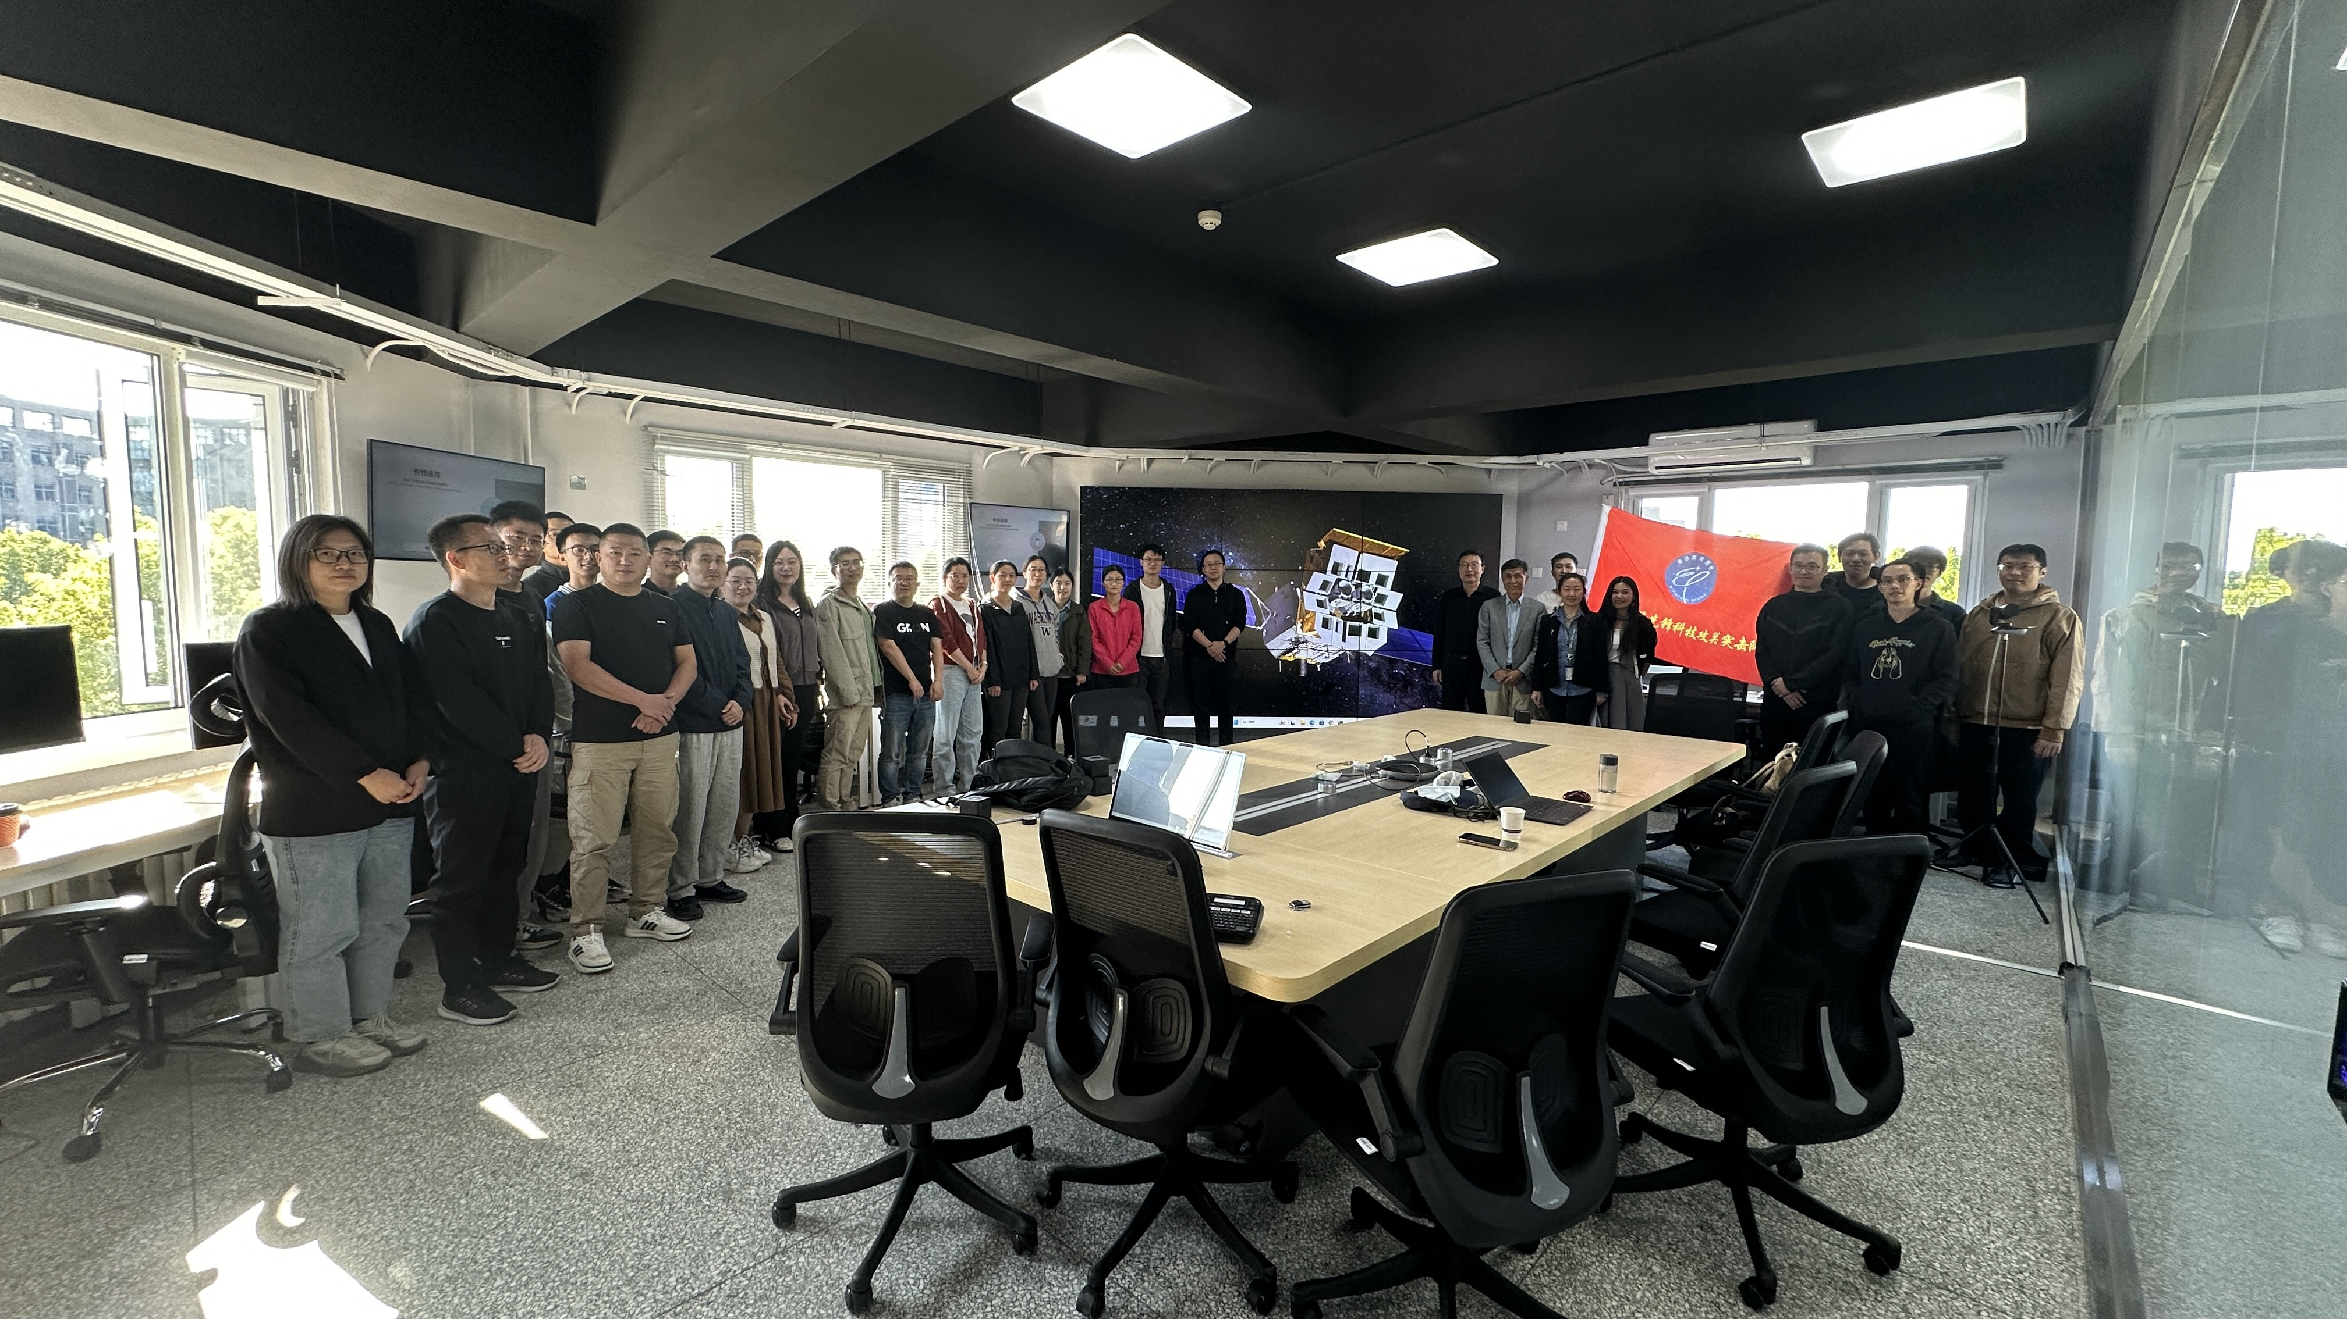
Tasks of the EP Science Center
Development of software of data processing pipeline and analysis tools
Developing EP simulator (WXT and FXT)
Studying and designing the survey plan
Instrument (in-orbit) calibration (Huaqing, Heyang, Chengkui, Yusa)
EP science operations
Support to the management of observing proposals
User and community support
Support to EP science team management
Training transient advocates (TA)
Public outreach and media support

Slide 6
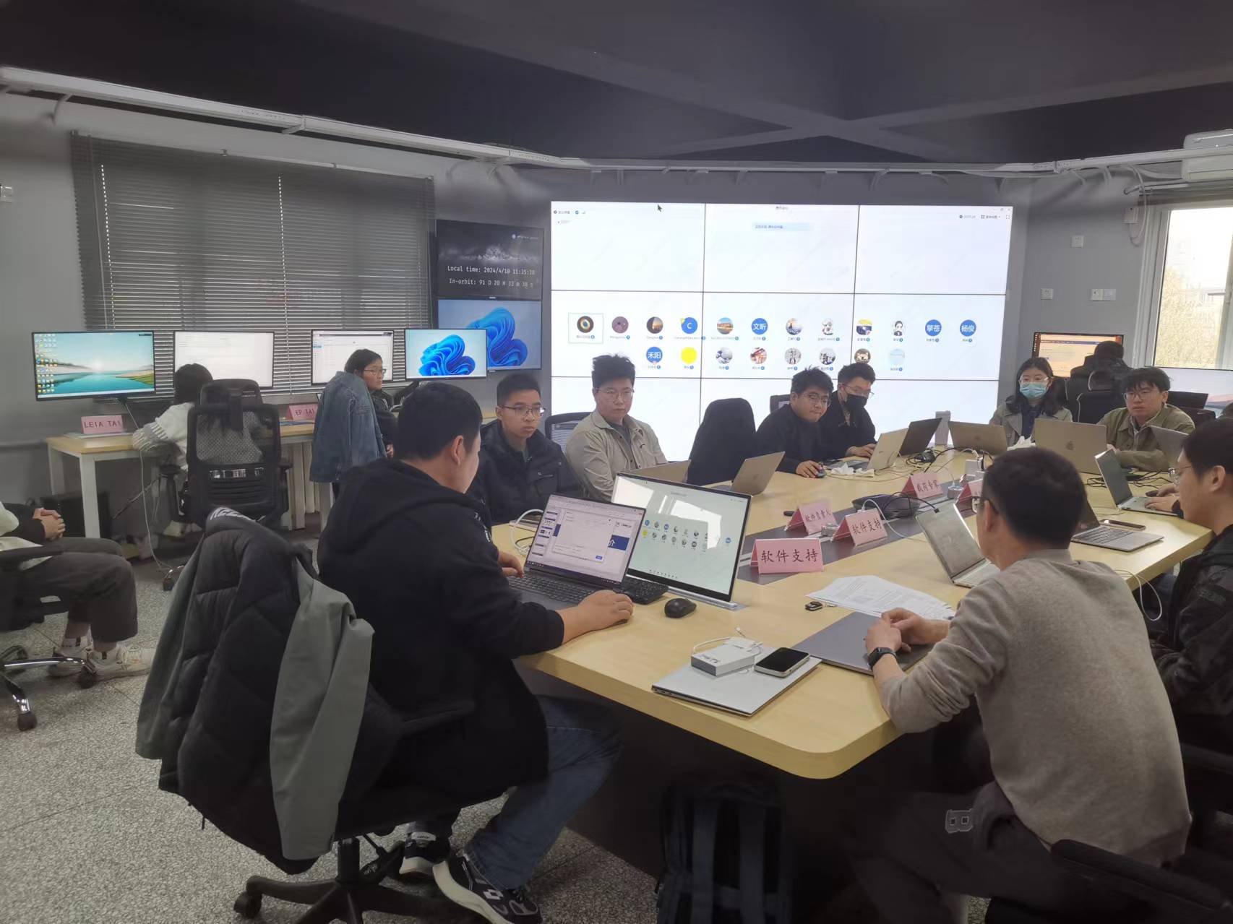
EP science operations
Monitoring the status of the spacecraft and payloads
Data processing, quick-look data analysis
Source identification and transient search
  Onboard search (automated)
  On-ground search
Issuing transient alerts (by GCN & Atel)
Notifying EP science team and whole community
Perform follow-up and ToO observations with FXT or proposal to other telescopes (e.g. SWIFT, NICER)
  Decision making (mission PI or duty scientists)
  Creating uplink commands
Data archiving and distribution within EPST

Slide 7
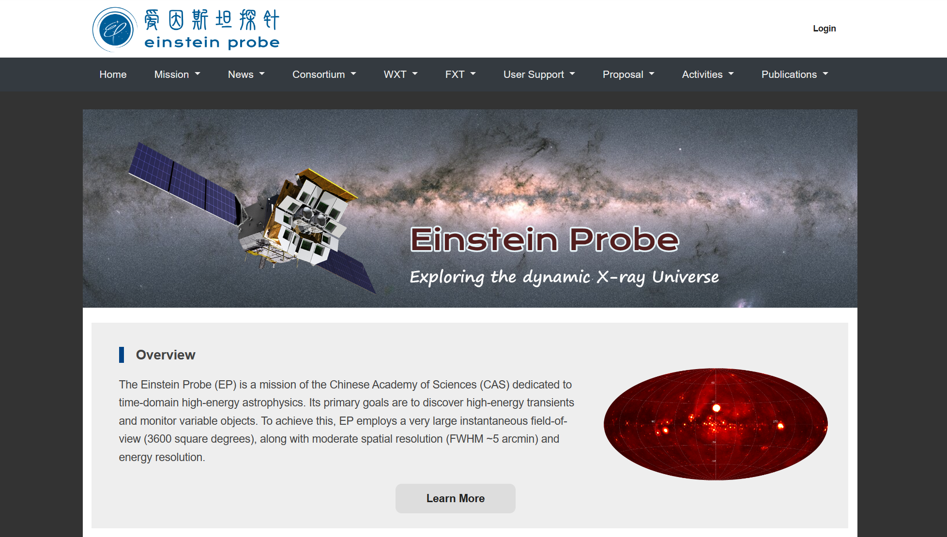
EP main web page at NAOC
https://ep.bao.ac.cn/ep/

Slide 8
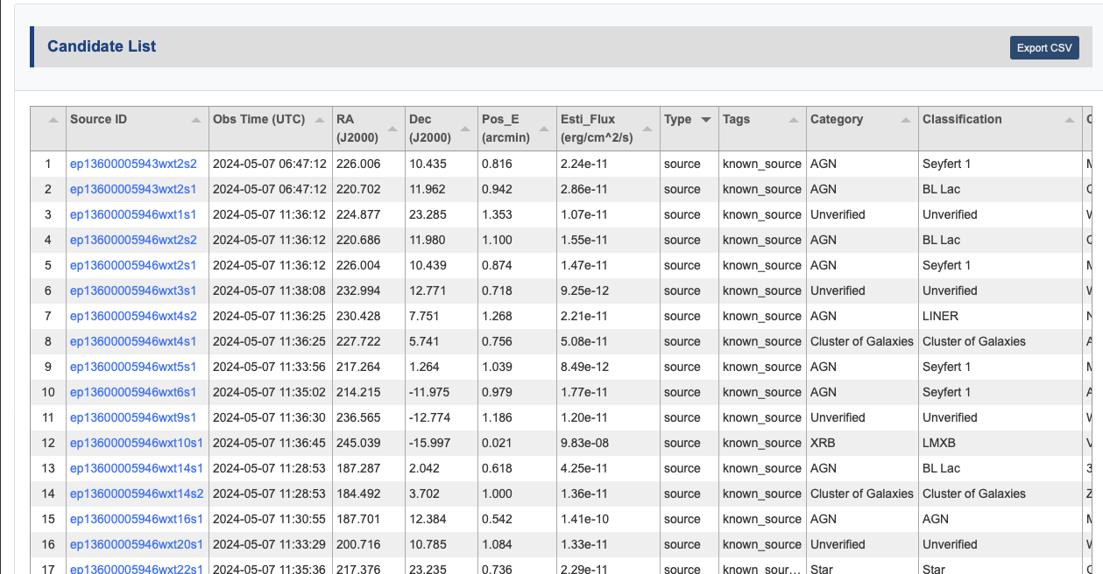
List of sources detected by WXT
Known sources: ~2000, transients: ~20

Slide 9
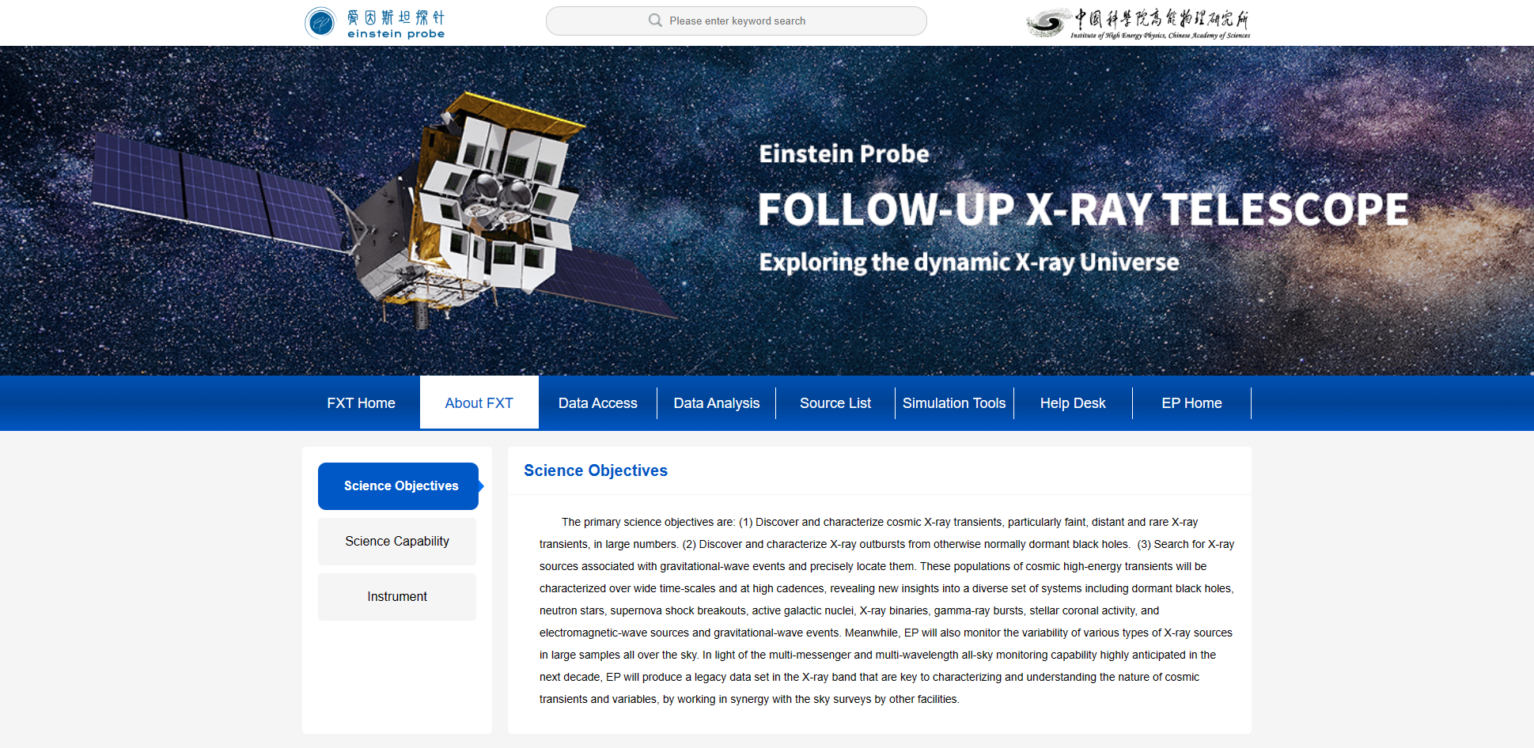
EP-FXT web at IHEP
http://epfxt.ihep.ac.cn/

Slide 10
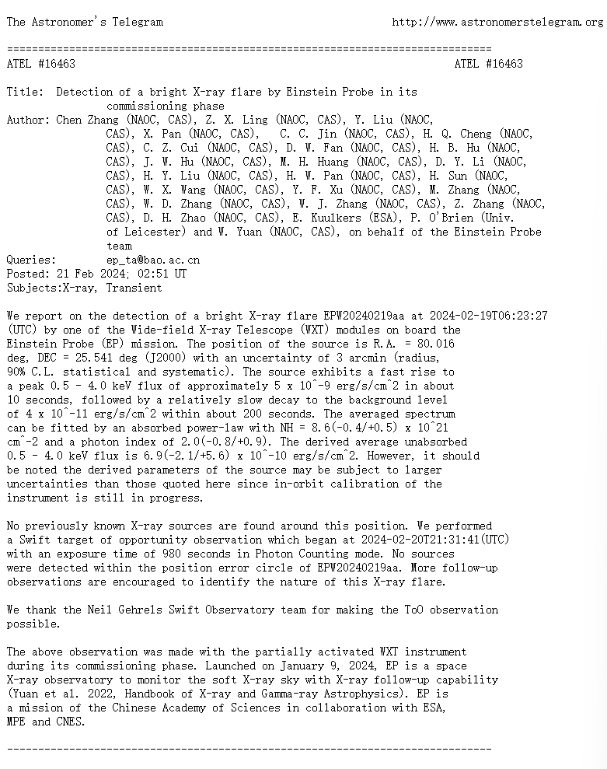

Examples of EP Atel and GCN
EP240219a
EP240315a

Slide 11
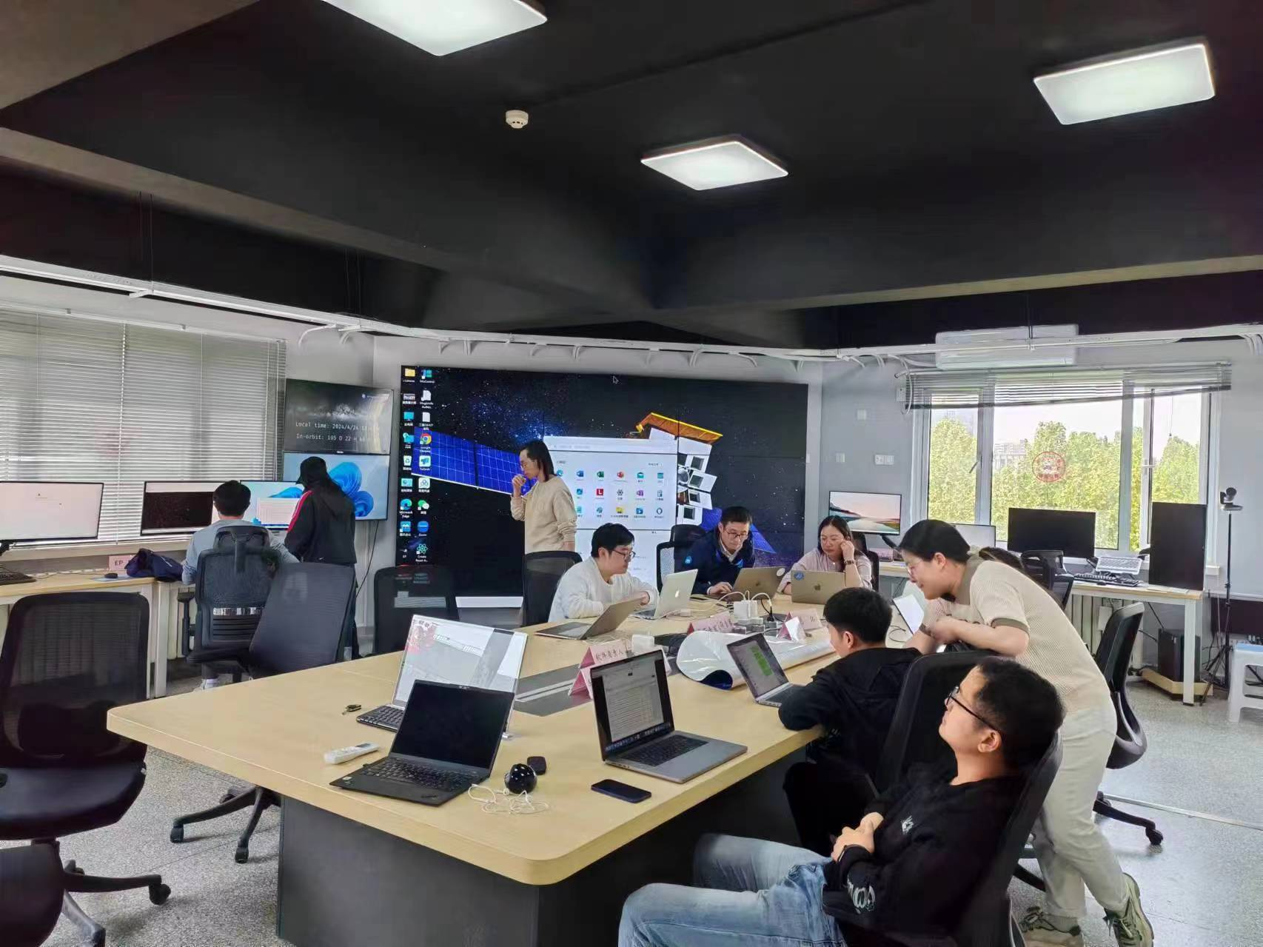
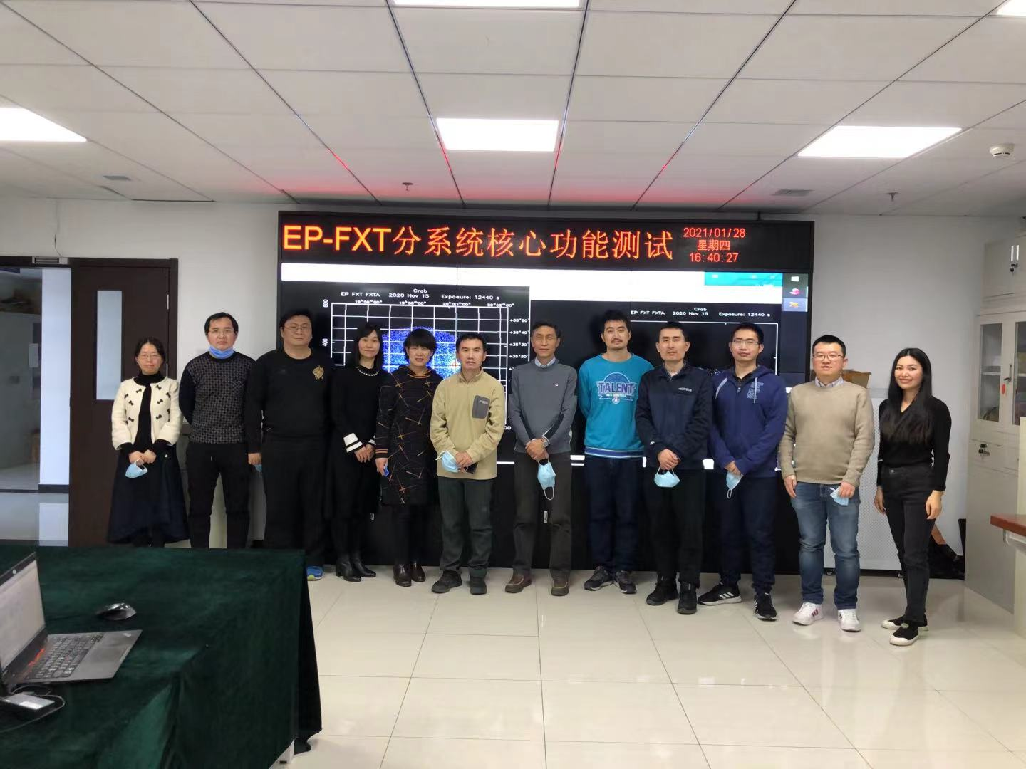
Who are we？
  NAOC: overall EPSC tasks and WXT data processing
  IHEP: FXT data processing
  32 members (17 staffs, 7 postdocs, 8 students)
  14 external TA from other institutions
EPSC operation room at IHEP
EPSC operation room at NAOC

Slide 12

Summary
EPSC has started to operate formally since EP launch on January 9, 2024
EPSC has supported the payload tests and calibration in the commissioning phase
EPSC has achieved its basic tasks as planned, and keeps improving its performance to a full scale when EP starts normal operations (expected June)
So far, X-ray sources have been detected and monitored
  Known sources: ~2000
  Stellar flares: >200
  Transients: ~20
EPSC has issued a number of transient alerts
  GCN: 18 Atel: 8
Thank you!
EPSC can fully support the EP science operation in the future!
https://ep.bao.ac.cn/ep/

